Slide 1

INTERACTIVE HIGH-FI PROTOTYPE
Sofia Kim, Sheng Moua, and Jennifer Quach

Slide 2




WHO WE ARE
SOFIA KIM
SHENG MOUA
JENNIFER QUACH
‘25
Symbolic Systems
Santa Cruz, Bolivia
‘25
Computer Science
Eau Claire, WI
‘25
Symbolic Systems
Lincoln, NE
Notes:
As a reminder of who we are..team consists of -> read names

Slide 3
1
HE RESULTS
2
REVISED DESIGN
AGENDA
3
PROTOTYPE IMPLEMENTATION
4
DEMO
5
SUMMARY

Slide 4
1
HE RESULTS
2
REVISED DESIGN
AGENDA
3
PROTOTYPE IMPLEMENTATION
4
DEMO
5
SUMMARY

Slide 5
55 TOTAL VIOLATIONS
HEURISTIC EVALUATION BREAKDOWN
HE Results
1
Severity 4 Issue
13
Severity 3 Issues
28
Severity 2 Issues
13
Severity 1 Issues

Slide 6
MOST VIOLATED HEURISTICS:
H4: Consistency & Standards (9)
H11: Accessible (9)
HE Results

Slide 7
MOST VIOLATED HEURISTICS:
H4: Consistency & Standards (9)
H11: Accessible (9)
HE Results
Inconsistencies in language and wording that don’t align within the platform as well across industry standards

Slide 8
MOST VIOLATED HEURISTICS:
H4: Consistency & Standards (9)
H11: Accessible (9)
HE Results
Content is hard to see: font size is too small and color pairings don’t allow for enough contrast

Slide 9

Revised Design
RECAP OF TASKS
SIMPLE
MODERATE
COMPLEX
Group challenge–-users join or create a group to complete community tasks (i.e. create a totem for your group, coordinate outfits)
Complete an individual challenge—users view and complete individual festival tasks
Add a friend and connect with others in the community

Slide 10
Revised Design
SIMPLE TASK REVISION OVERVIEW
View and complete individual festival tasks
20 TOTAL VIOLATIONS
11 VIOLATIONS ADDRESSED
2 Severity 3 & 4
10 Severity 1 & 2

Slide 11
Revised Design
SIMPLE TASK REVISION OVERVIEW
View and complete individual festival tasks
20 TOTAL VIOLATIONS
9 Revisions Made
1 major revision
8 minor revisions
11 VIOLATIONS ADDRESSED
2 Severity 3 & 4
10 Severity 1 & 2

Slide 12
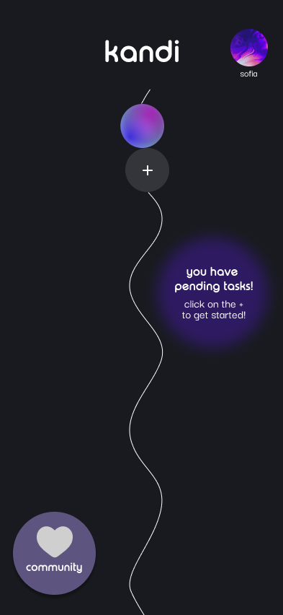
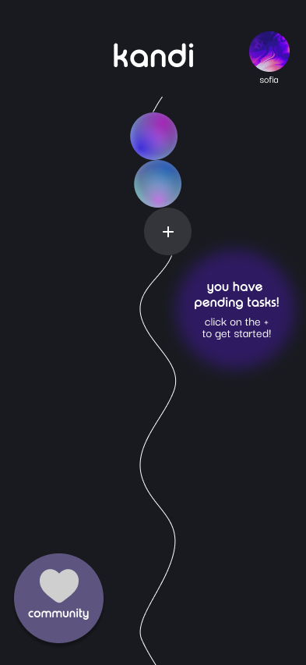
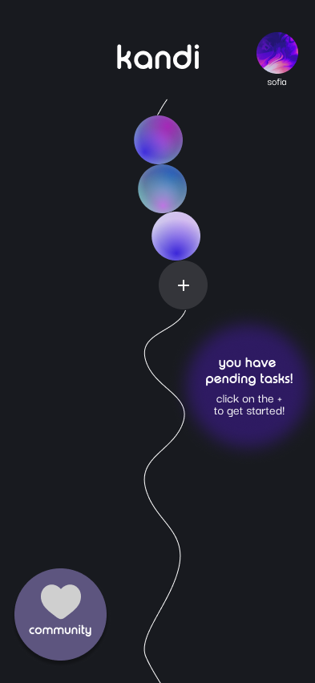
Revised Design - Simple Task
MAJOR REVISION 1
Persisting “Pending Tasks” Notification
H1: Visibility of System Status — Severity 3
ISSUE:
The “you have pending tasks” notification is not shown despite still having tasks to complete

Slide 13
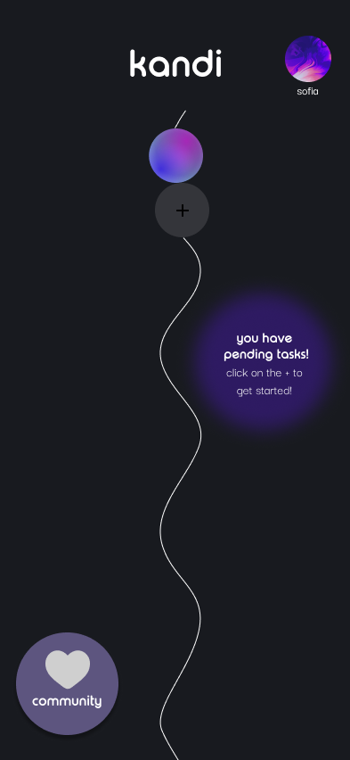
Revised Design - Simple Task
MINOR REVISIONS: Homepage
Minor Revision 1: H11
Changed color of + button
Minor Revision 2: H5, H11
Changed font size

Slide 14
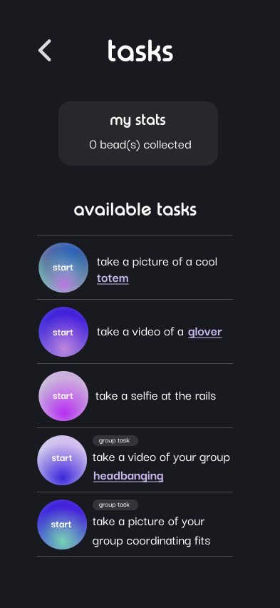
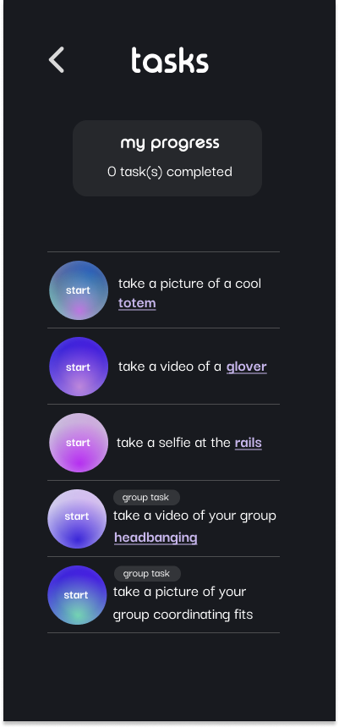
Revised Design - Simple Task
MINOR REVISIONS: Task Page
Minor Revision 3: H8
Changed to more accurate wording
Minor Revision 4: H8
Changed to more accurate wording
Minor Revision 5: H8
Removed redundant header
Minor Revision 6: H2
Added definition for “rails”
Minor Revision 7: H11
Increased font size

Slide 15
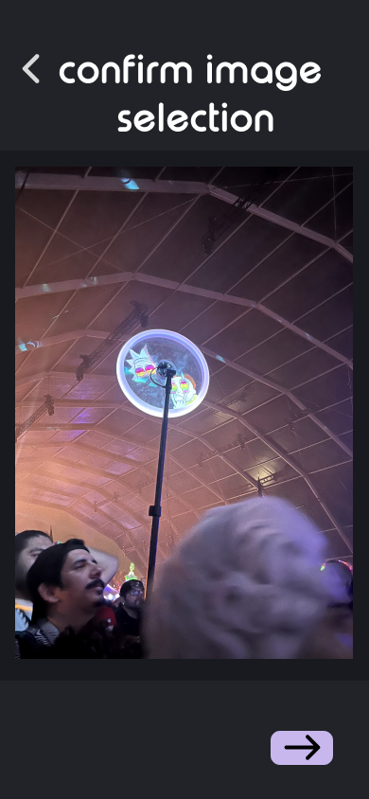
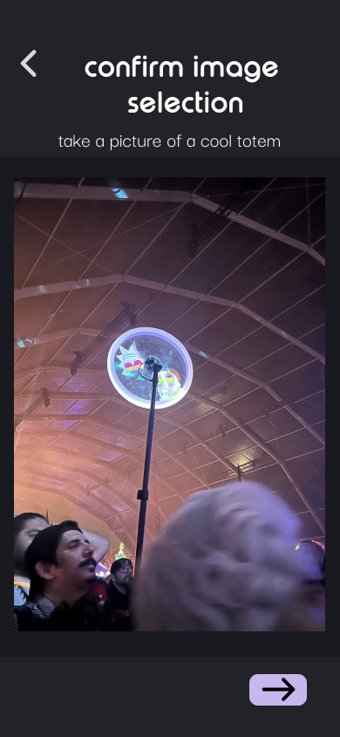
Revised Design - Simple Task
MINOR REVISIONS: Image Selection Page
Minor Revision 8: H6
Added reminder of current task

Slide 16
Revised Design
MODERATE TASK REVISION OVERVIEW
Add a friend and connect with others in the community
13 TOTAL VIOLATIONS
12 VIOLATIONS ADDRESSED
4 Severity 3 & 4
8 Severity 1 & 2

Slide 17
Revised Design
MODERATE TASK REVISION OVERVIEW
Add a friend and connect with others in the community
13 TOTAL VIOLATIONS
10 Revisions Made
3 major revisions
7 minor revisions
12 VIOLATIONS ADDRESSED
4 Severity 3 & 4
8 Severity 1 & 2

Slide 18
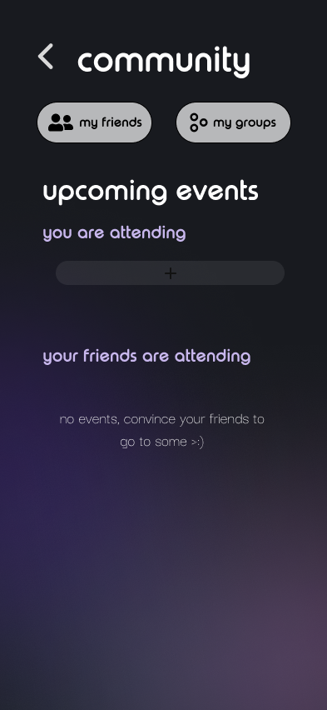
Revised Design - Moderate Task
MAJOR REVISION 2
Additional Ways to Create Group
H6: Recognition rather than Recall, H7: Flexibility and Efficiency of Use— Severity 3
ISSUE:
The only way to create a group is by starting a group task. Users will have to remember this.
Added “my groups” tab in the Community page

Slide 19
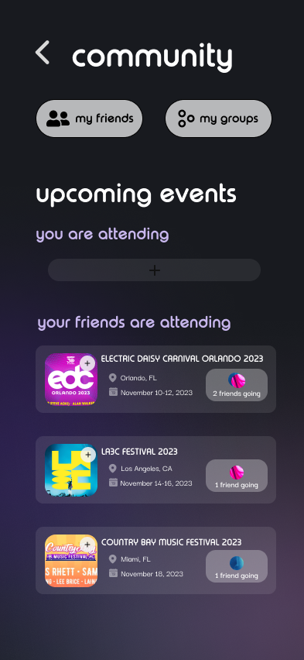
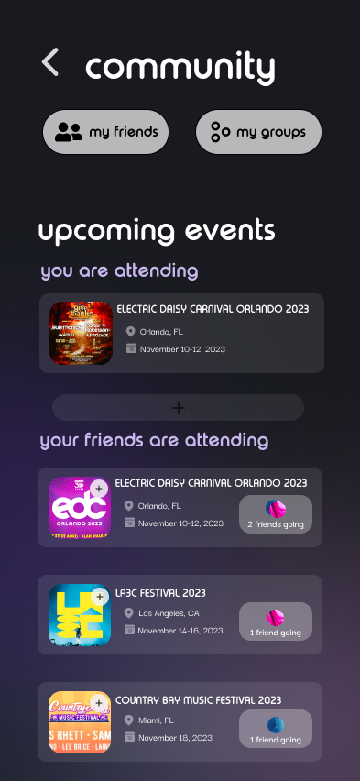
Revised Design - Moderate Task
MAJOR REVISION 3
Redesigned Events Tab
H7: Flexibility & Efficiency of Use— Severity 3
H3: User Control & Freedom, H7: Flexibility & Efficiency of Use, H5: Error Prevention —Severity 2
ISSUES:
Can’t see own events in “upcoming events”
Can’t directly add events friends are going to
No escape hatch from “add event”
Can only discover new events through “my events” back to community

Slide 20
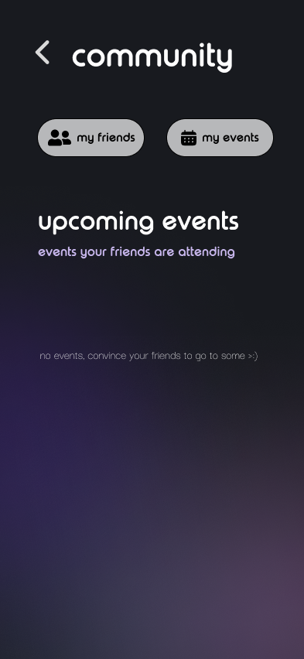
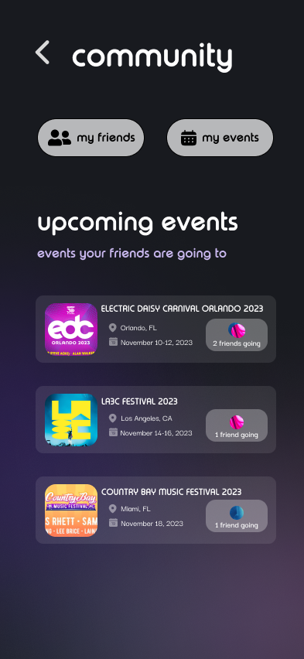
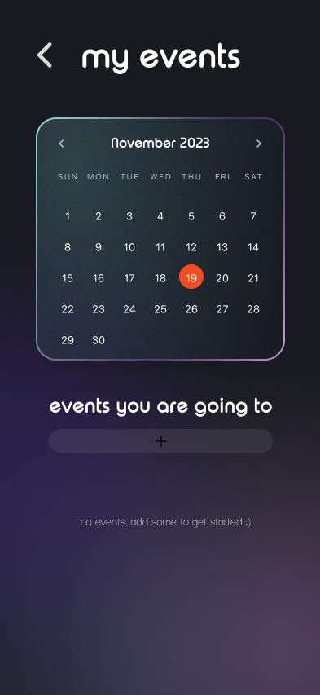
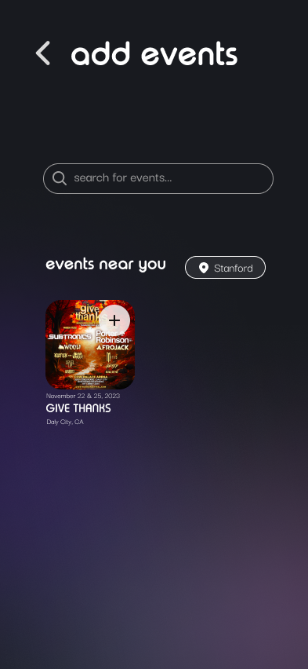
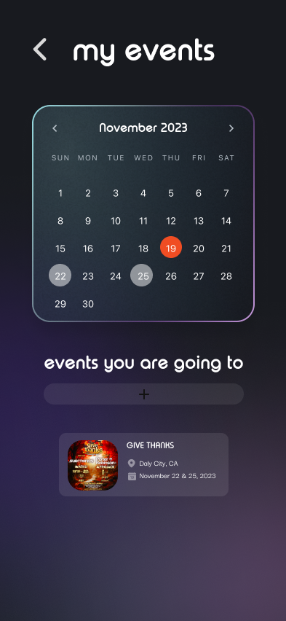
Revised Design - Moderate Task
MAJOR REVISION 3
Events Tab Before
No escape hatch to community page
Can’t see own events in “upcoming events”
Can only discover new events through “add events”
Can’t directly add events friends are going to

Slide 21
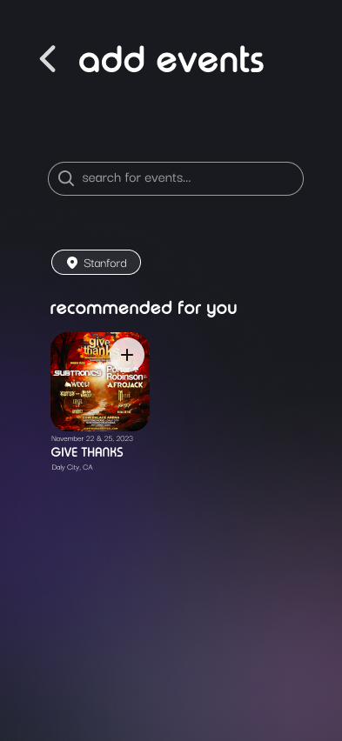
Revised Design - Moderate Task
MAJOR REVISION 3
Events Tab After
Direct escape from “add events” to community
Removed “my events” tab altogether
Can see own events directly
Can add events friends are attending

Slide 22
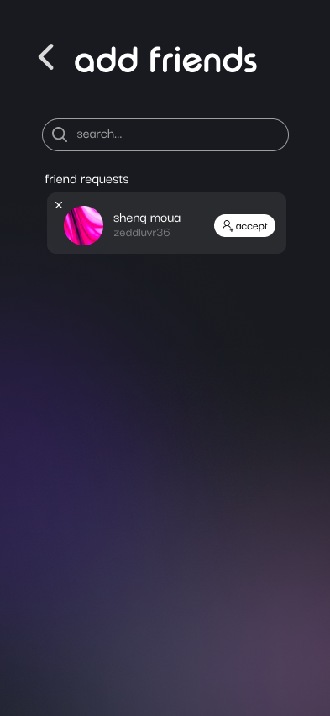
Revised Design - Moderate Task
MAJOR REVISION 4
Friend Request Decline Option
H4: Consistency & Standards— Severity 3
ISSUE:
Can’t decline friend requests
Added way to decline friend requests

Slide 23
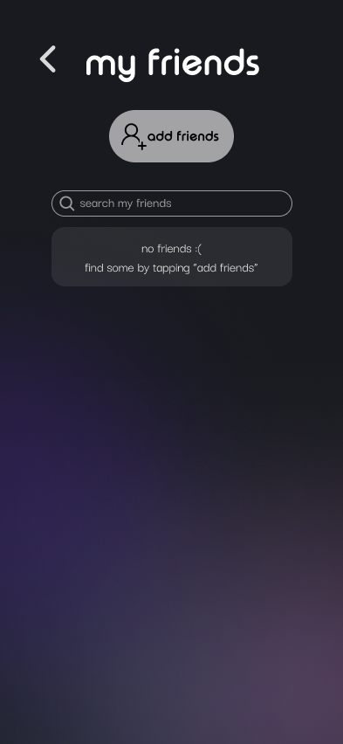
Revised Design - Moderate Task
MINOR REVISIONS: Friends Feature
Minor Revision 9: H4
Changed title to “friend requests instead of “added me”
Minor Revision 10: H4
More specific search bar
Minor Revision 11: H9
More descriptive error message

Slide 24
Revised Design - Moderate Task
MINOR REVISIONS: Community Tab
Minor Revision 12: H11
Increased font size

Slide 25
Revised Design
COMPLEX TASK REVISION OVERVIEW
Join or create a group to complete community tasks
7 TOTAL VIOLATIONS
6 VIOLATIONS ADDRESSED
2 Severity 3 & 4
4 Severity 1 & 2

Slide 26
Revised Design
COMPLEX TASK REVISION OVERVIEW
Join or create a group to complete community tasks
7 TOTAL VIOLATIONS
4 Revisions Made
1 major revision
3 minor revisions
6 VIOLATIONS ADDRESSED
2 Severity 3 & 4
4 Severity 1 & 2

Slide 27
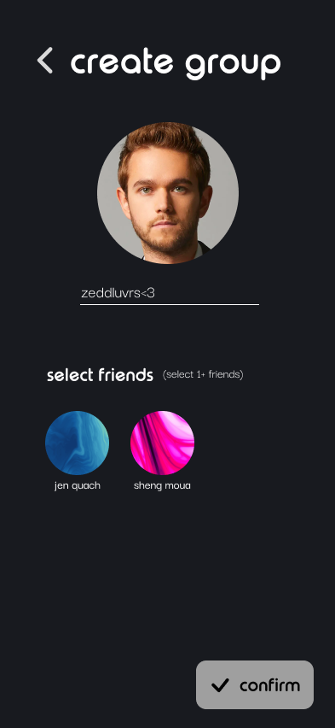
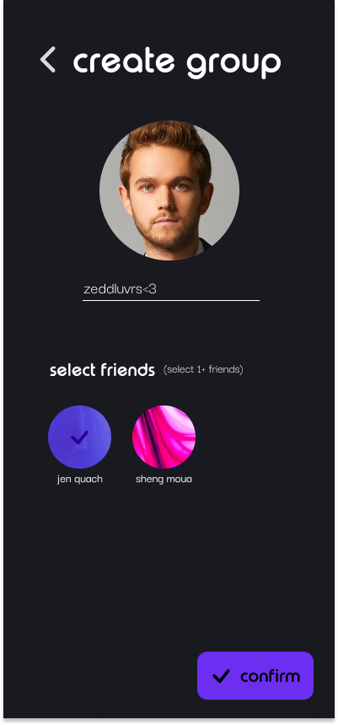
Revised Design - Complex Task
MAJOR REVISION 5
Group Sizing
H12: Inclusion — Severity 3
ISSUE:
Can only complete tasks in a group of 3+ which may make users feel excluded
Descriptive text changed
Confirm button can be clicked after selecting 1 friend

Slide 28
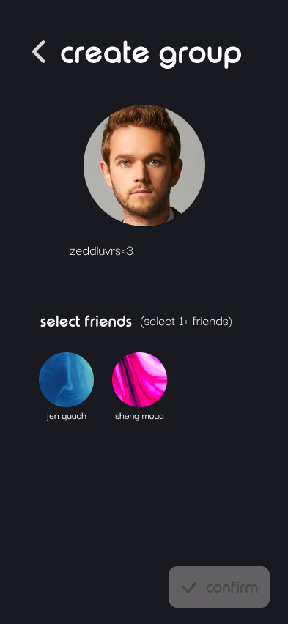
Revised Design - Complex Task
MINOR REVISIONS: Create group
Minor Revision 13: H11
Made font size bigger
Minor Revision 14: H9
Greyed out confirm button to show it isn’t clickable yet

Slide 29
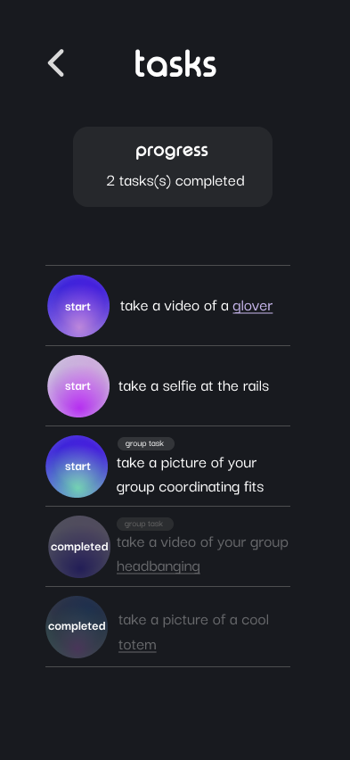
Revised Design - Complex Task
MINOR REVISIONS: Task Page
Minor Revision 15 : H8
Removed confusing header

Slide 30
23 TOTAL REVISIONS
Revised Design
REVISION SUMMARY
T
5 Major Revisions
15 Minor Revisions
3 Additional Revisions
(View in Appendix)
*33 Heuristic Violations Addressed*

Slide 31
27 TOTAL REVISIONS
Revised Design
REVISION SUMMARY
T
OUR REVISION RATIONALE
5 Major Revisions
Does this align with our values? (inclusivity, community, efficiency, joy of use)
Is this a feature essential to our main tasks?
Can we program this given our timeframe?
15 Minor Revisions
3 Additional Revisions
(View in Appendix)
*37 Heuristic Violations Addressed*

Slide 32
1
HE RESULTS
2
REVISED DESIGN
AGENDA
3
PROTOTYPE IMPLEMENTATION
4
DEMO
5
SUMMARY

Slide 33




Prototype Implementation
TOOLS USED
EXPO GO
Application framework
REACT NATIVE
Software development kit
VSCODE
Integrated development environment
FIGMA
Design components

Slide 34
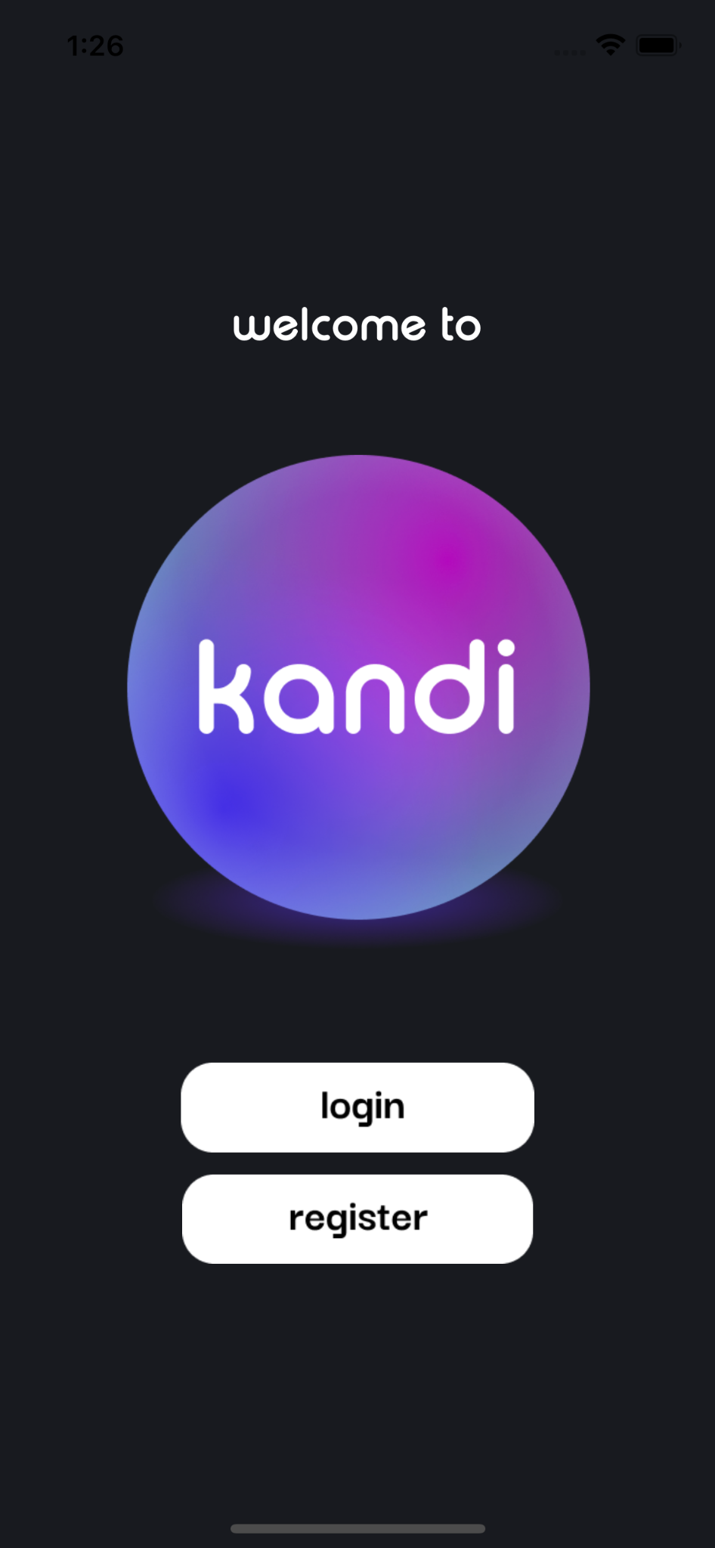
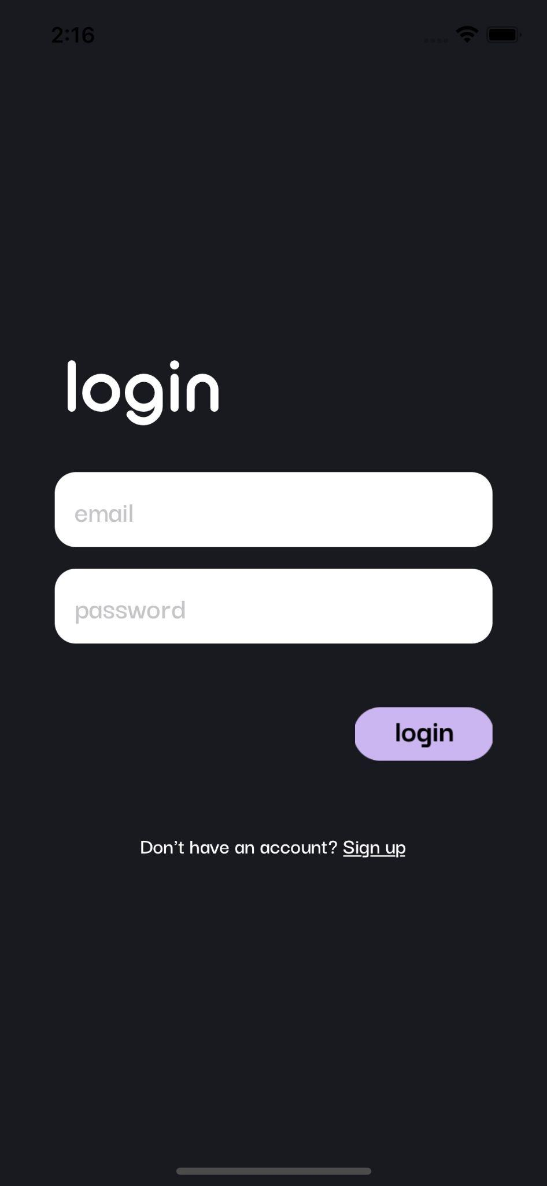
IMPLEMENTED FEATURES
Onboarding: User logs into existing account ✅
Users begin with entering their
information to login or sign up for
an account (second option
in progress)

Slide 35
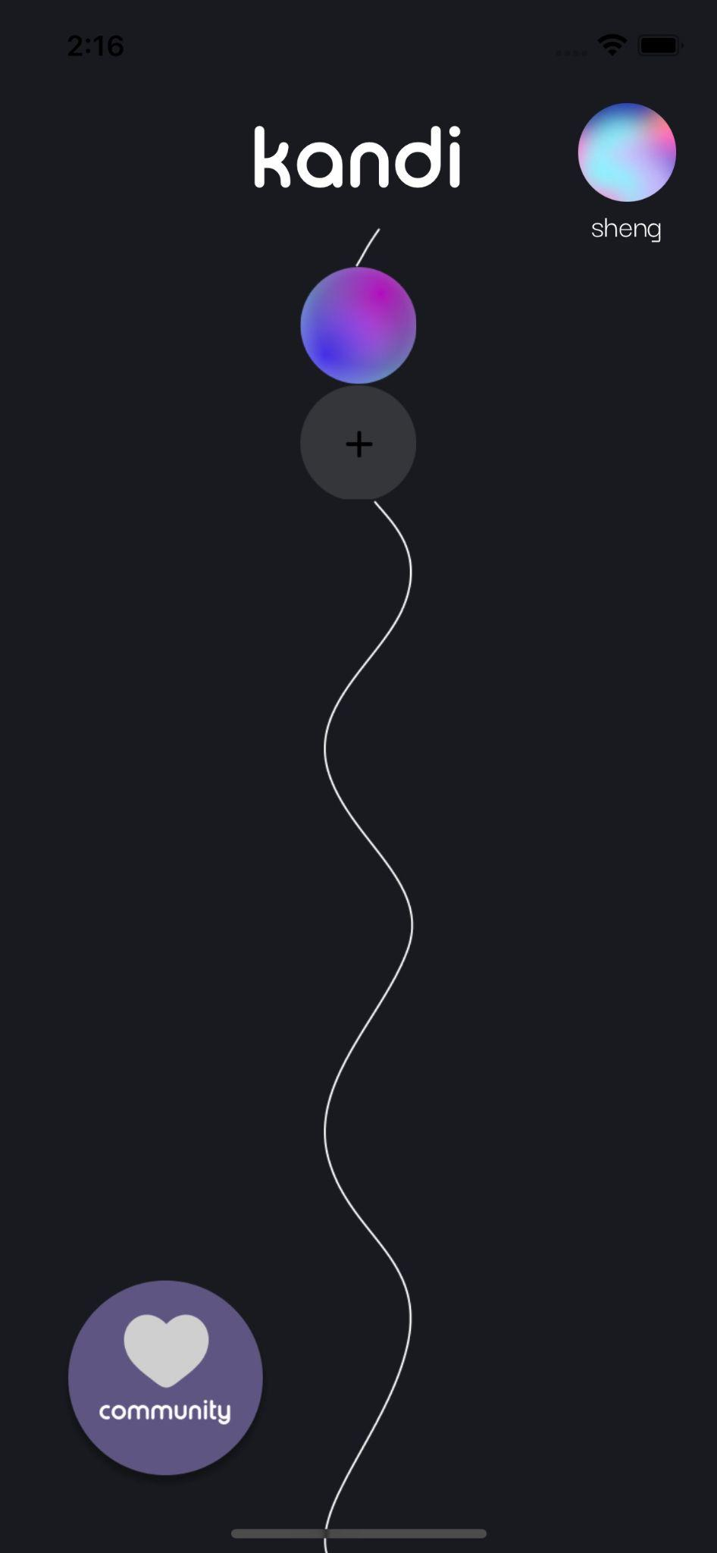
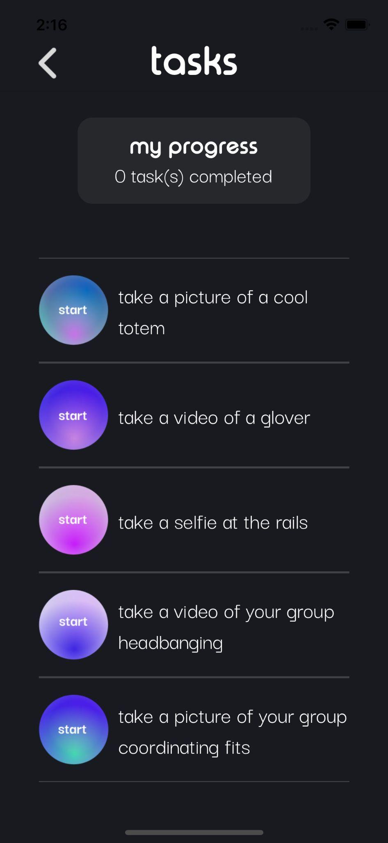
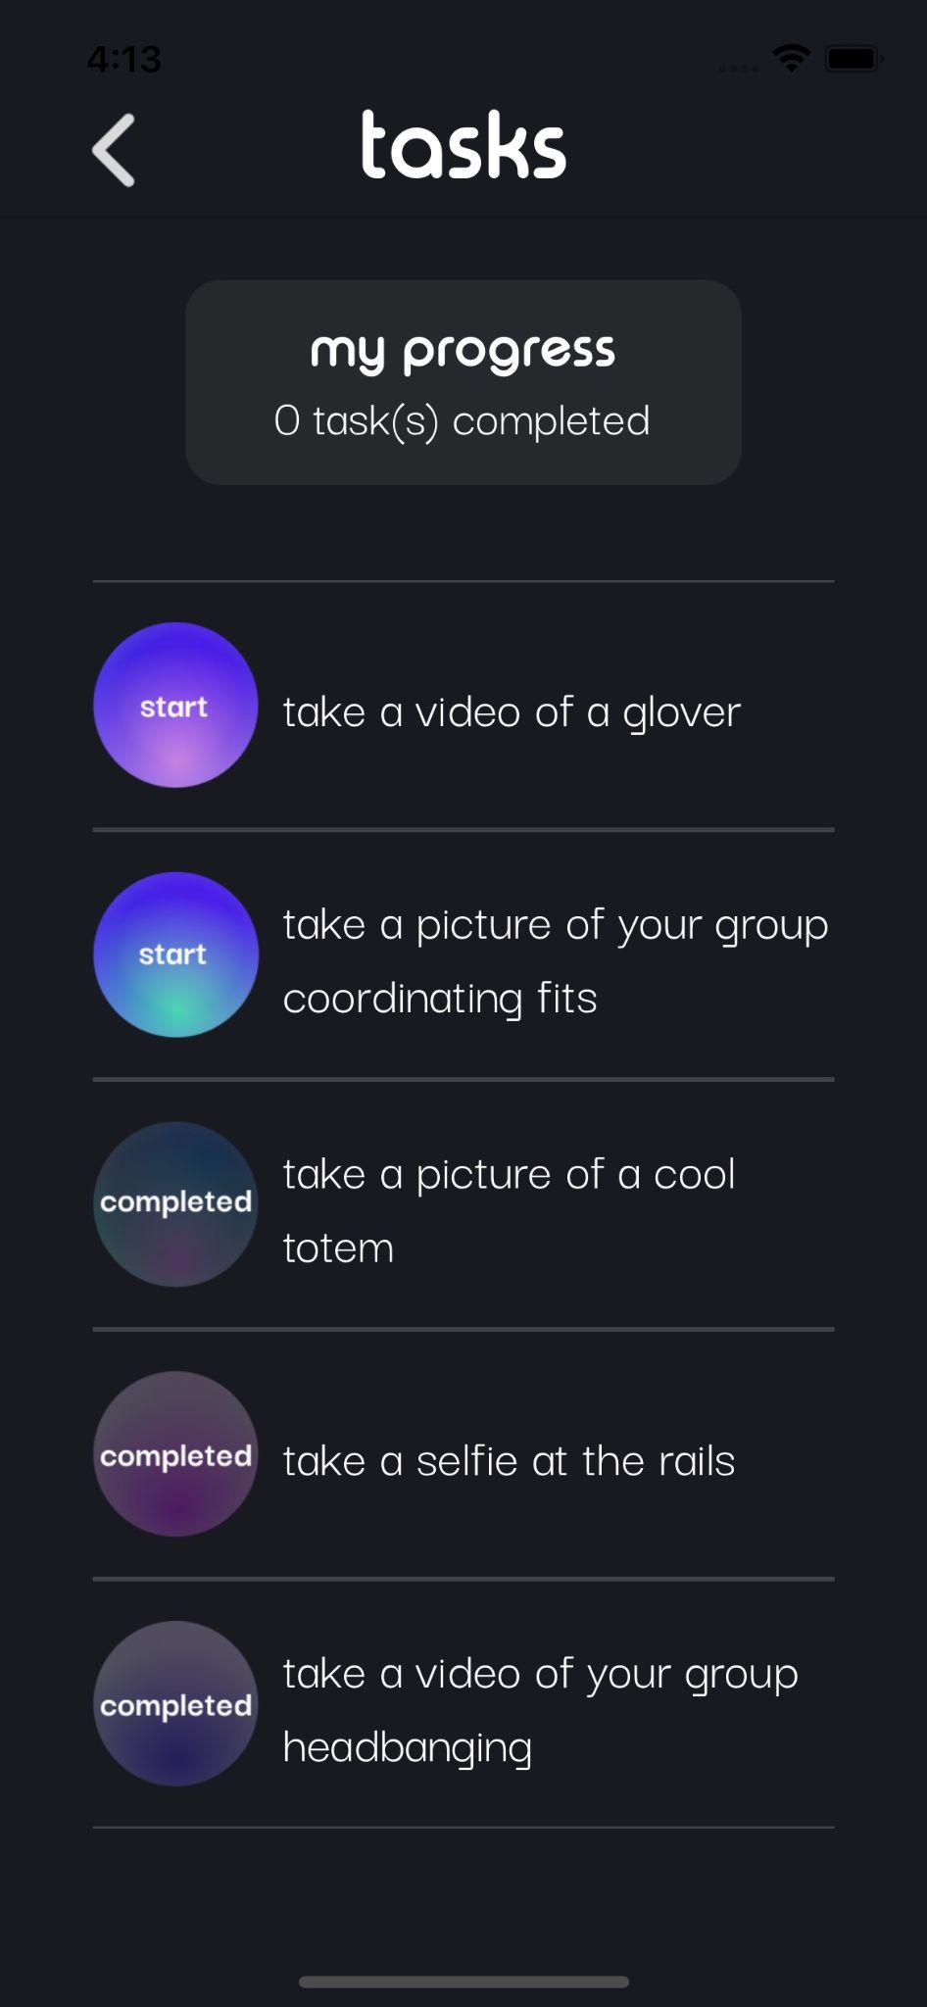
IMPLEMENTED FEATURES
Simple Task: View and complete individual festival tasks ✅
Homepage and tasks page
are now functional in code
Tasks page is accessible from
the home page, users can
now follow the process to
complete an individual task
with their own phone camera

Slide 36
UNIMPLEMENTED FEATURES
Our intended features
Adding a new friend
Completing a group task (and creating a group)
Communities tab with a personalized festival list
Account creation & onboarding screens

Slide 37
UNIMPLEMENTED FEATURES
Our plans to implement intended features
Integrate database to save users’ data & transfer information between screens
Aesthetic improvements for a dynamic user experience (motion graphics, sounds, and animations)
Access a festival database (Ticketmaster’s) for scheduling feature

Slide 38
WIZARD OF OZ TECHNIQUES
Adding a friend – we will be managing the profile and “adding” back the user
Image verification for task completion – pictures are automatically verified and authenticated regardless of image uploaded

Slide 39
HARDCODED ASPECTS
Users log into a hard coded account with name and profile picture automatically filled (temporary)
Task generation

Slide 40
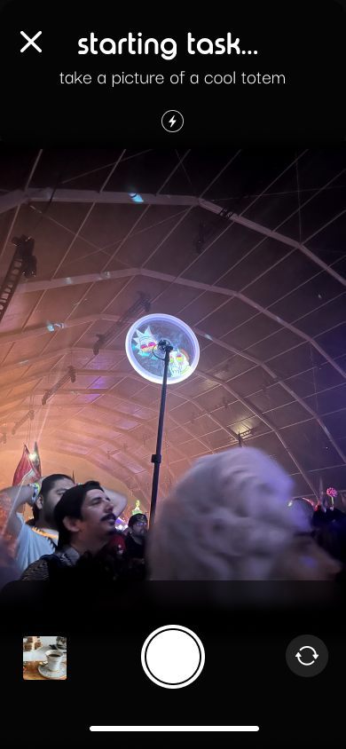
ISSUES/QUESTIONS
We need to address how to customize the camera and camera roll interfaces within our app, as shown below.
Our current tool, Expo Image Picker, offers a basic camera layout which doesn't align with our desired aesthetic or functionality. The challenge is to enhance this feature to display task progress visually while staying within the Expo framework.

Slide 41
1
HE RESULTS
2
REVISED DESIGN
AGENDA
3
PROTOTYPE IMPLEMENTATION
4
DEMO
5
SUMMARY

Slide 42
1
HE RESULTS
2
REVISED DESIGN
AGENDA
3
PROTOTYPE IMPLEMENTATION
4
DEMO
5
SUMMARY

Slide 43
SUMMARY
23 total revisions based on heuristic evaluations
Tasks 2 & 3 need to be fully implemented into hi-fi prototype
Temporary hard coded items will be replaced with more functional features
All final touches will be completed by the deadline

Slide 44
THANKS!
Questions?
Contact us!
sofiakim@stanford.edu
smoua@stanford.edu
tmquach@stanford.edu

Slide 45
HE Revisions Appendix
link

Slide 46
LINK TO FIGMA PROTOTYPE
https://www.figma.com/proto/uNvzGnBBYrtMgi6hSX6bYu/kandi-CS147-AU23?type=design&node-id=303-964&t=JqOvmkCQDaeFfddT-0&scaling=min-zoom&page-id=303%3A498

