Slide 1

J.A.C.K.
A1 Needfinding
Alyssa Frederick, Kabir Jolly,
Caleb Liu, Jasmine Vonk

Slide 2
01
The Team

Slide 3


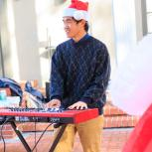
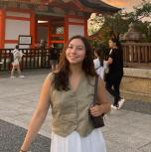
Team Members
Alyssa
Kabir
Caleb
Jasmine
Senior
Product Design, CS
Los Angeles, CA
Senior
CS
Houston, TX
Junior
CS, Music
Marin, CA
Senior
Psychology, CS
Houston, TX

Slide 4
Domain Selection
CAPTURING PERSONAL HISTORY
Is it interesting to us?
Mental Health
Relevant to preserving the past?

Slide 5
02
Methodology

Slide 6
Finding Participants
Beyond Stanford
Journaling / Time Capsule Experience
3 out of 4 of our participants were non-Stanford students
Diverse Backgrounds
Previous experience storing memories (journaling, time capsule, scrapbooks, etc. )
Participants came from a wide range of upbringings around the world
Notes:
We were hoping for gender parity but these are the people that were available to talk this week. We do have interviews scheduled next week with women where we can further test some of the insights that came out of this week’s interviews.
Methodology for finding users included cold emailing people who had participated in time capsules via names in newspaper articles, asking friends if they knew any people who journaled or took lots of photos, and reaching out to founders who had created startups in this space.

Slide 7
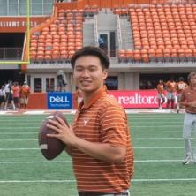
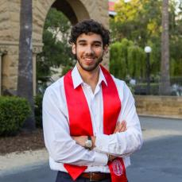
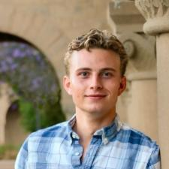
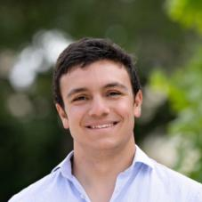
Our Participants
Michael
Asher
Matthew
Zane
UT Student
Part time musician
Stanford Student
Aspiring Physician
Candid Founder
Former Economics Student
Candid Founder
Former C.S. Student
Notes:
Have women in line to interview later, but their schedules didn’t work out for this week.

Slide 8
Guiding Topics
Background
Memories
Tell us about yourself
How do you think your past has informed you/your values today?
What are some ways you like to store memories?
Heirlooms / Traditions
What are some traditions or heirlooms your family passes down?
User-Specific
Domain experts

Slide 9
03
Interviews

Slide 10
Michael
over Zoom
extreme user
Memories and their importance fuel you to create more.
Notes:
Extreme user: Chosen because he captures memories on the extreme end
-Grew up taking lots of photos with his family and uses it as a form of staying close to friends/family
-Always taking photos of himself and his friends on both his phone and his digital camera
-Takes BeReal every day
-Journals almost every day
Team member roles:
Interviewer = Jasmine
Notetaker = Kabir

Slide 11
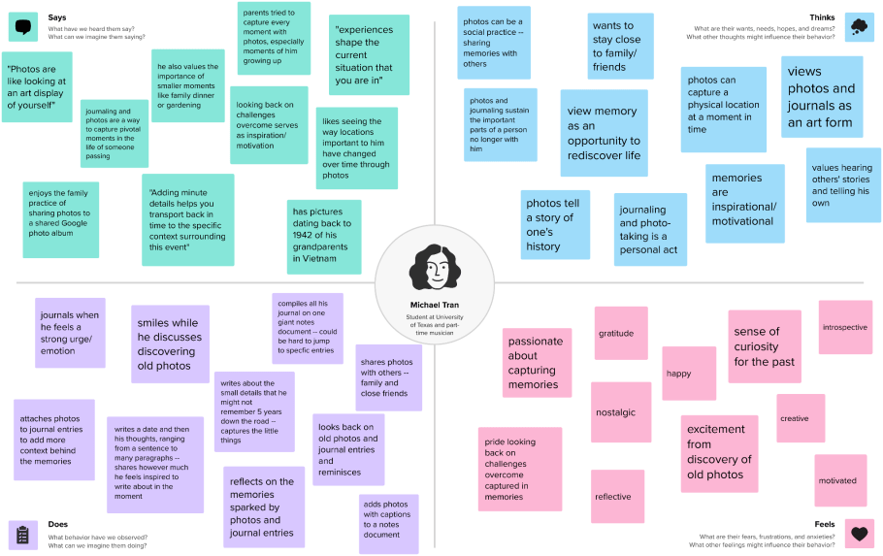

Slide 12
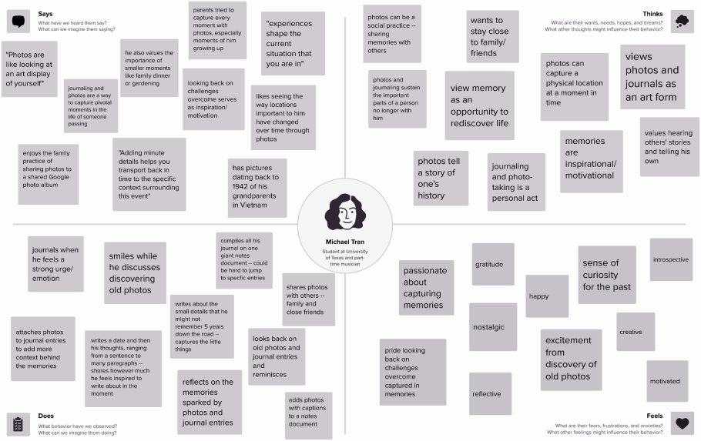

Photos and journaling sustain the important parts of a person no longer with him
“Adding minute details helps you transport back in time to the specific context surrounding the event”
Smiles while he discusses discovering old photos
Pride looking back on challenges overcome captured in memories

Slide 13
Asher
@ lunch on campus
average user
I like to have a grasp on life and remember where I am in the moment.
Notes:
Team member roles:
Interviewer = Kabir
Notetaker = Caleb

Slide 14
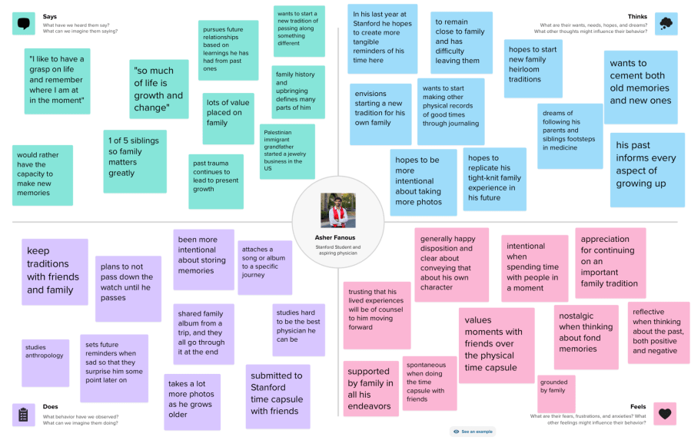

Slide 15
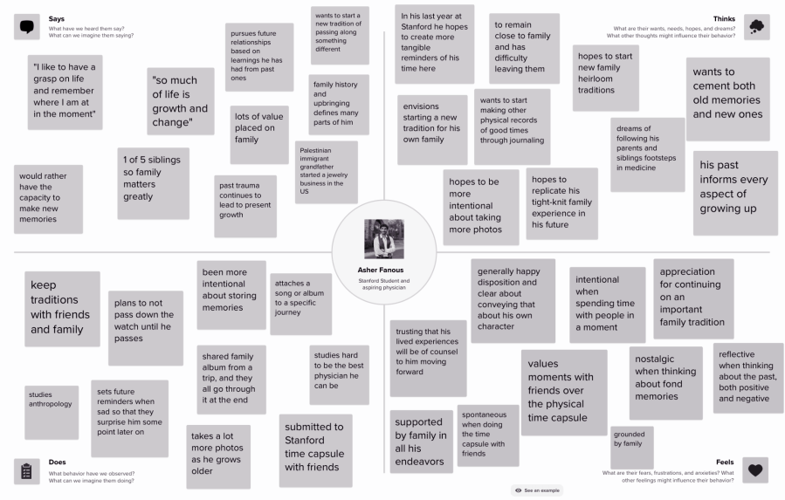
“So much of life is growth and change”
When feeling sad, he sets positive reminders to surprise himself later in the day
Spontaneous when doing the time capsule with friends

Slide 16
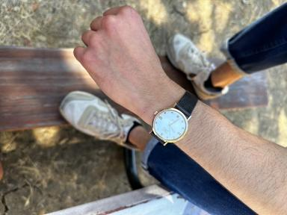
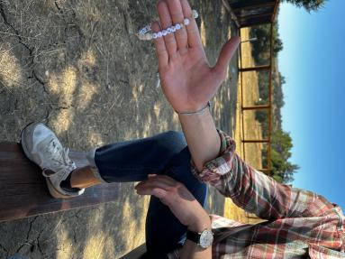
Artifacts
Bracelet
Friendship, Support, Shared Experience
Watch
Nostalgia, Identity, Upbringing

Slide 17
Matthew
@ Candid office
domain expert
I try to save the chaotic, smaller moments and be honest about them.
Notes:
Domain expert: Co-founder for an app that aims to provide a way for users to digitally journal everyday through videos (like a video version of BeReal) and has conducted extensive research into users in this space as a result.
Team member roles:
Interviewer = mostly Caleb, then Alyssa
Notetaker = mostly Alyssa, then Caleb

Slide 18
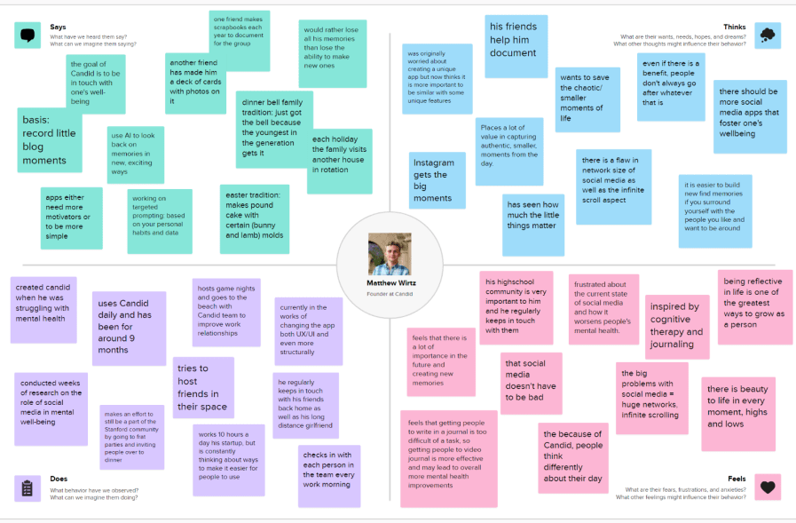

Slide 19
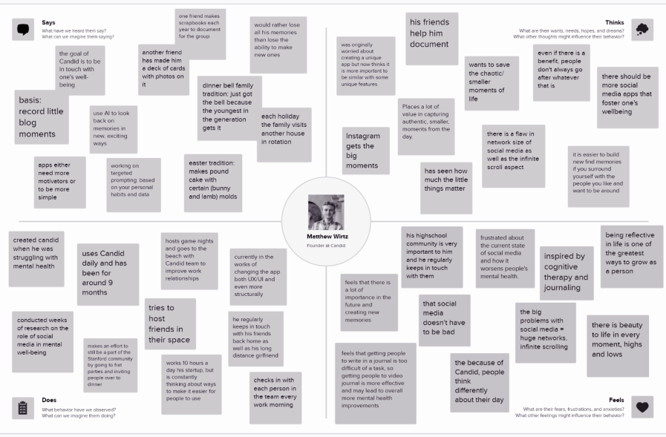
Places a lot of value in capturing authentic, smaller, moments from the day
“I like to utilize AI to look back on memories in new, exciting ways”
Has been using Candid, a video journaling app, every day for the last 9 months
Being reflective in life is one of the greatest ways to grow as a person

Slide 20
Zane
@ Candid Office
domain expert
To form a habit it needs to be simpler than thinking.
Notes:
Domain expert: Co-founder for an app that aims to provide a way for users to digitally journal everyday through videos (like a video version of BeReal) and has conducted extensive research into users in this space as a result.
Team member roles:
Interviewer = mostly Caleb, then Alyssa
Notetaker = mostly Alyssa, then Caleb

Slide 21
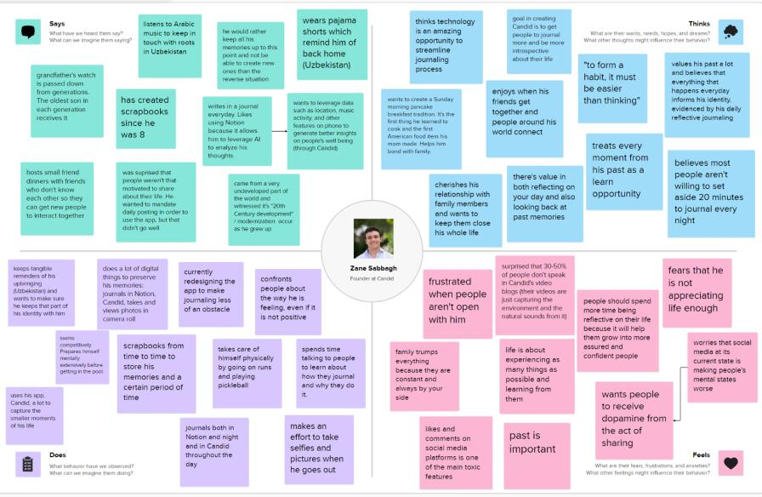

Slide 22
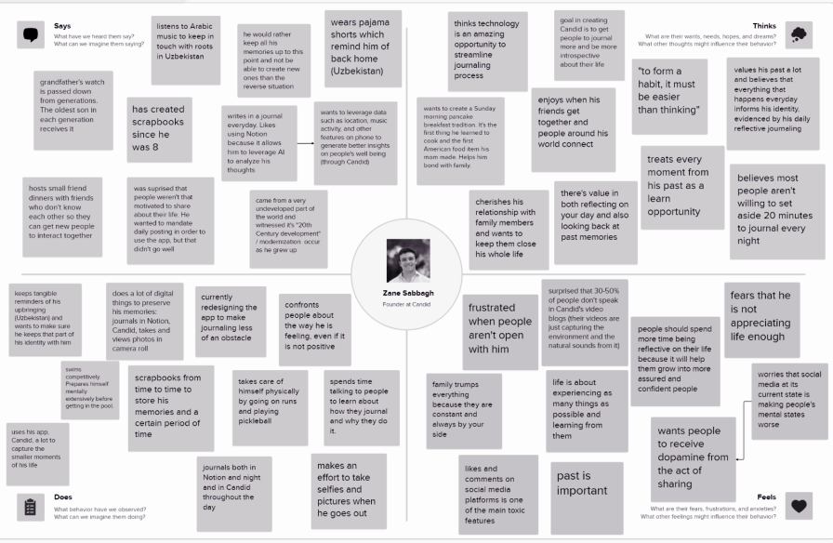
Likes to write in a journal everyday using Notion
Treats every moment from his past as an opportunity to learn
Keeps tangible reminders of his upbringing (Uzbekistan) and wants to make sure he keeps that part of his identity with him
Fears that he his not appreciating life enough

Slide 23
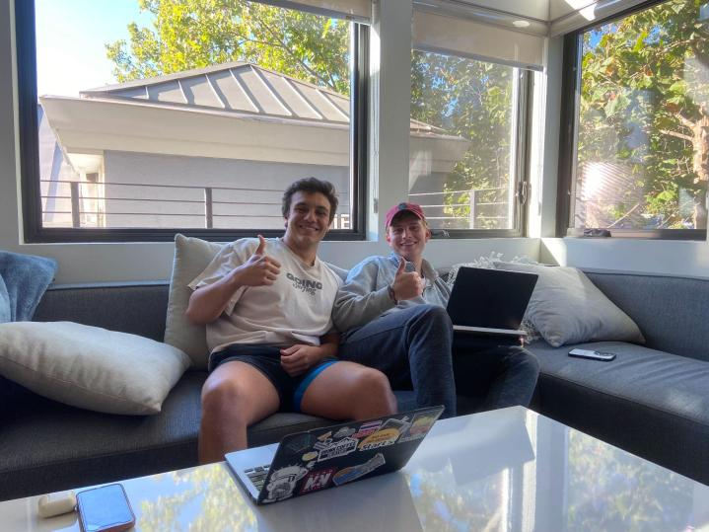
@ Candid
Office
Notes:
Chosen because: domain experts in that they have already researched and built an app that incorporates reminiscing in order to improve mental health

Slide 24
04
Analysis

Slide 25
Contradictions
Zane prefers journaling digitally over paper and pen because it streamlines the process and makes it easier to refuel the habit.
Asher’s decision to put something in the Stanford Time Capsule, something that will be preserved for years to come, was made on a whim.
Michael uses photos to capture memories but will add captions explaining photos that he feels don’t have enough context or miss important details.

Slide 26
Tensions
Michael enjoys looking back on old journal entries but doesn’t have an easy way to look through them.
Zane created a mobile app that allows him to journal on the go more easily, but he still journals using Notion everyday at night.

Slide 27
Surprises
Our interviewees were all very open about their journaling habits and ways to reminisce on the past, which could be considering a private topic.
All interviewees had no primary way they captured their past. Usually involved a combination of many methods.
Most interviewees would prefer to keep their past memories at the cost of not being able to create new memories (as opposed to vice versa).
Most interviewees had multiple tangible/physical objects that remind them of the past (ex: watch, pajamas).

Slide 28
Insights and Needs #1
Finding: All interviewees were most engaged when speaking about how the past has influenced their identity today.
Insight: People enjoy speaking about their past because it is a core part of their identity and distinguisher between them and other people.
Need: People should be given more opportunities to share and celebrate how their past has influenced who they are.

Slide 29
Insights and Needs #2
Finding: Each interview had a unique combination of physical and digital ways they’ve preserved their past.
Insight: Because everyone’s upbringing is so unique, there is no one-size-fits-all approach to storing memories. Often times, it requires a combination of many different mediums.
Need: People need to have access to a wide variety of mediums to most authentically capture their past.

Slide 30
05
Summary

Slide 31
Summary
Interviewed 4 people about ways they think about the past and how they have preserved it to today.
All interviewees greatly valued their past and have made big efforts to preserve it, from passing down a watch generation to sharing photos in a family Google Photo Album.
We concluded that there’s no single common approach to storing memories.

Slide 32
Next Steps…
Expand interview scope. Currently have only interviewed young adult males. 3 more ready to go!
Utilize interview insights to refine problem domain within memory storage.
Brainstorm HMW statements and prototype!

