Slide 1
define
+ ideate
team JACK

Slide 2


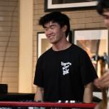
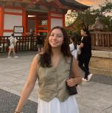
the team
Alyssa
Kabir
Caleb
Jasmine
product design, cs
computer science
cs, music
psychology, cs

Slide 3
original domain
capturing personal history
focused domain
capturing and sharing personal moments

Slide 4
01
interviews
here we go again

Slide 5
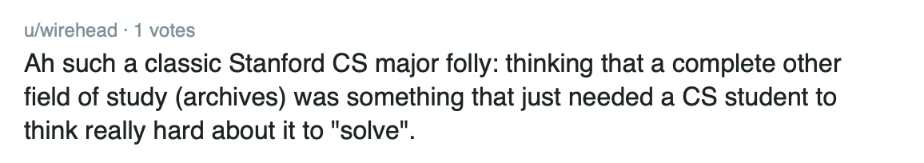
lots of enthusiasm for interviews!

Slide 6
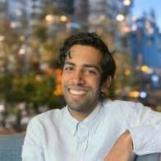

additional interviews
Akshay Jaggi
Taylor Pope
Student at Harvard Medical School
late twenties
Boston, MA
via zoom
found from Stanford Time Capsule
Software engineer for a startup
mid forties
Redwood City, CA
@ Town and Country
found on r/redwoodcity
* AI generated image
Notes:
Got a lot of diversity in participation from the younger/male/startup oriented participants that we interviewed last week.
Variety of age

Slide 7
Akshay
medical student
late twenties
“Using the 40 year old stovetop pressure cooker to recreate my grandmother’s recipes brings me closer to her, especially since she’s too frail to make them herself now”
Notes:
Grandparents vs parents dynamic
Heirloom = pressure cooker from grandma
Now he cooks the dishes she used to cook for him

Slide 8

takeaways from Akshay’s interview
records grandparents’ stories on his phone to capture them in an unobtrusive way, but still notices his grandparents’ discomfort from being recorded
motivated to capture stories or recipes by a strong feeling or impulse – sense of spontaneity
stark contrast between parent/child relationship vs. grandparent/grandchild relationship
as future generations continue in the US, there needs to be a way to breach the widening gap in language and religion barriers to retain rich parts of family history
Notes:
Things to consider;
-writes down his family recipes on a shared notes app
Would relay stories to parents and they hadnt heard them before
-records grandparents’ stories on his phone → first prompted to ask about their story immigrating to America after his pilgrimage to spread his grandfather’s ashes, but now takes out his phone to record every time they start telling a story spontaneously
Say tensions/contradictions here ->

Slide 9
Taylor
software engineer based out of Redwood City
“To me, the physical objects represent a holistic aggregation of the smaller moments”

Slide 10
takeaways from Taylor’s interview
physical objects, like a wood carving or 3D rendering of a rock from her grandparents’ backyard, prompt reflection for Taylor and represent a collection of memories and feelings
has diligently journaled every day for the past 15 years but rarely looks back on her entries
feels like she is hoarding but can’t figure out which saved items are junk and which possess lasting value
when prompted to reflect on how her past has informed her present, she feels like she is in pursuit of a constant quest to set her future self up for success but only recently started reaping the benefits
Notes:
-Uses journaling as a form of recordkeeping but rarely goes back to her entries except to look for travel logistics or specific facts
-she keeps a collection of tickets stubs, receipts, and other trinkets in a tin for their associated memories
-wood carving is from the tree that was in her grandparents’ house

Slide 11
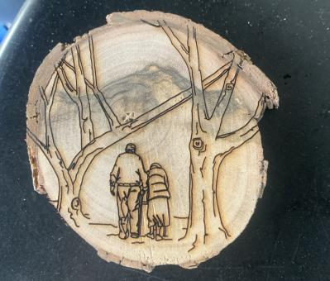
physical mementos
does preservation projects for her family
laser print on slice of tree branch from the tree in her grandparents’ yard
grandparents are depicted underneath the tree from which the branch was cut

Slide 12

02
POVs
3 POVs generated from our interviews

Slide 13
initial POV: Asher
We met Asher, a Stanford student and aspiring physician.
We were surprised to realize he no longer wants to continue his family heirloom tradition with his watch.
We wonder if this means physical heirlooms hinder some family members from connecting with strengthening connections between others.
It would be game-changing to help him create shared heirlooms.

Slide 14
POV #1: Asher (A)
We met Asher, a Stanford student and aspiring physician who cultivates connections to his family history through heirlooms and stories from immigrant grandparents.
We were surprised to hear that whenever he feels sad, he sets phone reminders containing memories that make him smile for random points in the near future to cheer his future self up.
We wonder if Asher believes he is the most effective person at improving his own mental well being.
It would be game-changing to provide a way to detect patterns in the types of memories that have the strongest impact on helping him overcome negative emotions.
how might we…
01
ruminate on sad moments for longer to lead to greater mental well-being?
figure out the appropriate moments for providing a positive reminder?
include loved ones in our own journey to deal with negative emotions?
02
03
Notes:
10+ HMWs:
HMW ruminate on sad moments for longer to lead to greater mental well-being?
HMW figure out the appropriate moments for providing a positive reminder?
HMW include loved ones in our own journey to deal with negative emotions?
HMW allow Asher to reflect on old phone reminders?
HMW target the future reminders to come at “sad” times?
HMW figure out the appropriate moments for prompting positive reminders?
HMW encourage Asher to find support in others outside himself as well?
HMW turn self care into a habit?
HMW provide a way to detect patterns in the types of memories that have the greatest impact?
HMW leverage personal memories to improve mental health?
HMW encourage Asher to set future positive phone reminders even when he is in a good mood?
HMW leverage AI to make these reminders more effective at capturing memories?

Slide 15
POV #2: Asher (B)
We met Asher, a Stanford student and aspiring physician who cultivates connections to his family history through heirlooms and stories from immigrant grandparents.
We were surprised to hear that Asher no longer wants to continue his family’s tradition of passing down a watch heirloom ot the oldest son.
We wonder if Asher doesn’t feel personally connected to the history and significance of the watch, and, as a result, doesn’t feel motivated to continue the tradition.
It would be game-changing to find a way for Asher to better connect stories from his relatives and ancestors to the family heirlooms in his possession.
how might we…
01
duplicate a family heirloom so that others in the family can also have it?
ensure future generations continue supporting family traditions after we pass?
crowdsource family history?
02
03
Notes:
10+ HMWs:
HMW duplicate a family heirloom so that others in the family can also have it?
HMW ensure future generations continue supporting family traditions after we pass?
HMW crowdsource family history?
HMW motivate Asher to create his own heirloom sto be passed down?
HMW gamify sharing family history for Asher’s relatives?
HMW find a way for Asher to better connect stories from his relatives and ancestors to the family heirlooms in his possession?
HMW encourage Asher to connect to his family in a way that is not through heirlooms?
HMW create a way to preserve family heirlooms that does not involve continuing to wear/use them?
HMW recover family heirlooms that may have been lost or forgotten?
HMW make the process of passing down heirlooms more personalized and meaningful?
HMW value the story/history of an heirloom to be greater than its physical value?
HMW share the responsibility of creating and passing down family history among all family members?
HMW bridge the generational gap that results in a loss of connectedness to family history and heirlooms?

Slide 16
POV #3 Michael
We met Michael, Austin resident and avid photographer and journaler.
We were surprised to find out that Michael frequently revisits his own journal entries as a source of motivation but keeps all the entries on one Notes app document without a meaningful method of organization.
We wonder if capturing memories and thoughts is done on an impulse or strong feeling without forward-thinking, resulting in disorganized record-keeping.
It would be game-changing to create a way for Michael to capture impulsive thoughts and memories in an organized way without detracting from the spontaneity of the act.
how might we…
01
take the effort out of organization (for journal entries and photos)?
record which journal entries Michael goes back to the most?
use the act of organizing after the fact to reflect?
02
03
Notes:
10+ HMWs:
HMW take the effort out of organization (for journal entries and photos)?
HMW record which journal entries Michael goes back to the most?
HMW use the act of organizing after the fact to reflect?
HMW organize Michael’s entries based on sentimental themes?
HMW turn written and photo journaling into a habit?
HMW capture thoughts and memories without using words or photos?
HMW create a way for Michael to capture impulsive thoughts and memories in an organized way without detracting from the spontaneity of the act?
HMW allow Michael to categorize and tag his entries without much effort?
HMW make organization fun and spontaneous?
HMW organize Michael’s notes app now so he can have more meaningful reflective practices?
HMW incorporate his love for photography into his journaling?

Slide 17
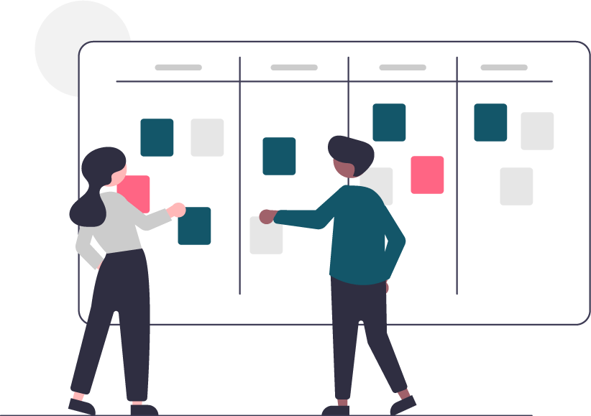
03
HMWs
top 3 HMWs and their POVs

Slide 18
HMW #1
We met Asher, a Stanford student and aspiring physician who cultivates connections to his family history through heirlooms and stories from immigrant grandparents.
We were surprised to hear that whenever he feels sad, he sets phone reminders containing memories that make him smile for random points in the near future to cheer his future self up.
We wonder if Asher believes he is the most effective person at improving his own mental well being.
It would be game-changing to provide a way to detect patterns in the types of memories that have the strongest impact on helping him overcome negative emotions.
How might we include loved ones in our own journey to deal with negative emotions?

Slide 19
HMW #2
We met Michael, Austin resident and avid photographer and journaler.
We were surprised to find out that Michael frequently revisits his own journal entries as a source of motivation but keeps all the entries on one Notes app document without a meaningful method of organization.
We wonder if capturing memories and thoughts is done on an impulse or strong feeling without forward-thinking, resulting in disorganized record-keeping.
It would be game-changing to create a way for Michael to capture impulsive thoughts and memories in an organized way without detracting from the spontaneity of the act.
How might we take the effort out of organization?

Slide 20
HMW #3
We met Michael, Austin resident and avid photographer and journaler.
We were surprised to find out that Michael frequently revisits his own journal entries as a source of motivation but keeps all the entries on one Notes app document without a meaningful method of organization.
We wonder if capturing memories and thoughts is done on an impulse or strong feeling without forward-thinking, resulting in disorganized record-keeping.
It would be game-changing to create a way for Michael to capture impulsive thoughts and memories in an organized way without detracting from the spontaneity of the act.
How might we record which journal entries Michael goes back to the most?

Slide 21

04
solutions
3 solutions we are moving forward with

Slide 22
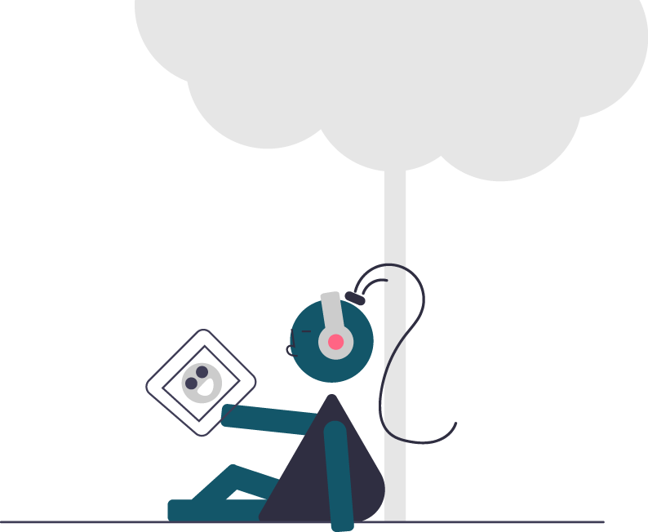


top 3 solutions
journal tagging
musically driven entries
virtual time capsule
Support searching through journal entries by tagging each one by location, emotion, and people.
Add songs to journal entries to be able to categorize based on feelings and emotions.
Create a digital vault where loved ones can send messages, videos, or pictures to be opened in the future.

Slide 23
05
prototypes
critical assumptions we are testing with our experience prototypes

Slide 24
1: journal tagging
solution
Support searching through journal entries by tagging each one by location, emotion, and people.
assumption
When people look back at their entries, they are intentionally looking for ones of certain emotions, locations, or people.

Slide 25

experience prototype
phase 1: journaling
Have participant journal adhering as close as possible to their usual process for 10 minutes in their preferred medium.
phase 2: reflection
Upon completion, engage in dialogue to identify the prominent emotions or themes of the entry, and more broadly explore the ways they introspect upon their previous entries.

Slide 26
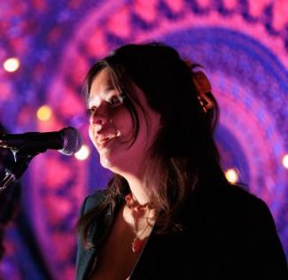
Dalynn
has journaled habitually since she was 15. She enjoys singing, songwriting, and design.

Slide 27
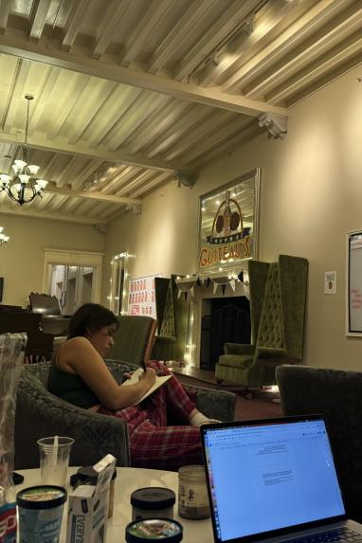
key insight
Only writes in journal during “turbulent” times. Thus, looking back is sometimes detrimental to well-being.
Wrote about a couple notable people during the day, and titled the entry as “feeling hopeful!!!”
Would love to see memories with loved ones, but looking at memories no longer applicable to your life may be “damaging to the peace”
Things she cared about in the past are a lot different than now.
Journaling is primary a way for her to figure where she is. It’s more about the act of doing it then the product created from it.

Slide 28
2: musically driven entries
solution
Add songs to journal entries to be able to categorize based on feelings and emotions.
assumption
Music and it’s associative power allows people to capture their thoughts in a way that words or pictures cannot.

Slide 29

experience prototype
phase 1: photo selection
Have participant choose 10-15 photos from their past. No further instructions given ensuring the choices remain genuine and uninfluenced
phase 2: “scoring” it
Have participating choose a piece of music that encapsulates the photos as a collection.
phase 3: reflection
Engage in dialogue aiming to delve deeper into their perceptions and their influence on their retrospection and connection to past memories

Slide 30
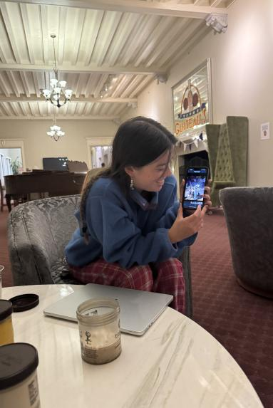
key insight
Music can bring you back to certain emotions and associated memories. “I’ve recently been stimulating myself with positive music to keep me up high”
Listened to a lot of sad music in the past, but realized it would often negatively affect her mood.
Believes music is at its core very emotional, and it’s impossible to have an emotionless song. It’s a way humans can communicate emotionally in a more cryptic, less vulnerable way.
Maps both music to memories and memories to music.

Slide 31
Jeannie
is a healthcare professional in her 60s with photographic memory.
key insight
Uses music to mark the transitions in her day to day life.
Music and nature are her driving forces.
Takes screenshots of songs at the parts that really hit home for her to look back on.
Uses music to emotionally regulate and believes this is really healthy for her.

Slide 32
3: virtual time capsule
solution
Create a digital vault where loved ones can send messages, videos, or pictures to be opened in the future.
assumption
Receiving premeditated surprises from the past gives a boost in one’s mental well-being.

Slide 33

experience prototype
phase 1: surprise!
Coordinate with family member/friend to send a picture with a message to the unknowing participant.
phase 2: reflection
Engage in dialogue to understand the emotional response to the surprise.

Slide 34
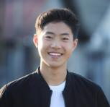

additional interviews
Thomas
Luc
Upbringing heavily emphasizes relationship with family and loved ones.
Has long distance girlfriend, which makes digital communication very important to him.
Notes:
Got a lot of diversity in participation from the younger/male/startup oriented participants that we interviewed last week.
Variety of age

Slide 35
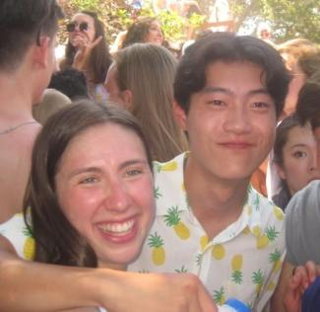
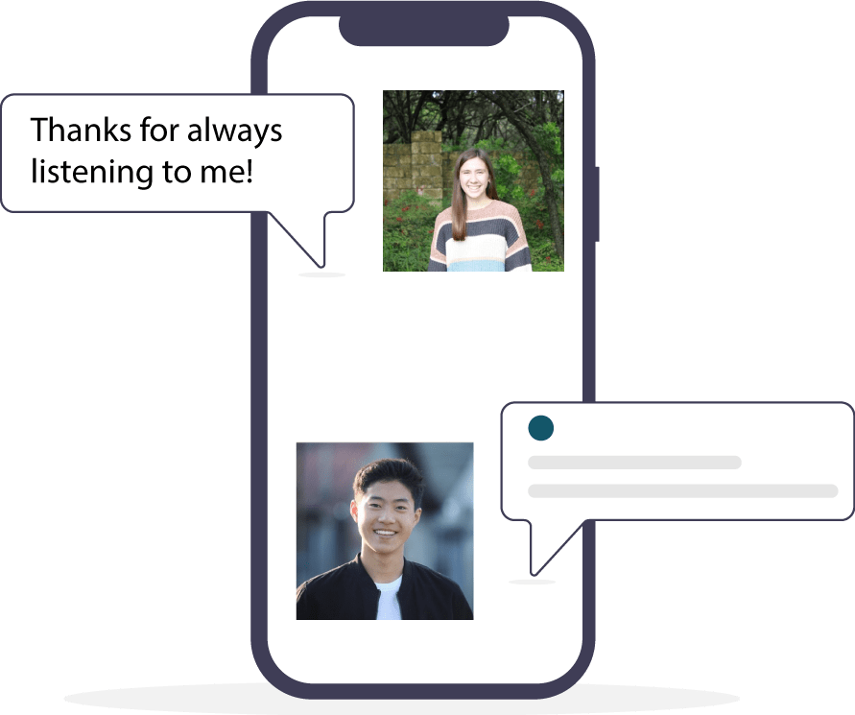

Slide 36
key insight
Despite valuing connectivity with loved ones, unexpected interactions evoke uneasiness because they are a deviation from regular communication patterns.
Doesn’t usually receive surprise messages, so felt like “something was up.”
“Generally, I don’t expect loved ones to reach out so it’s nice when they surprise you.”
Texted his brother to check in after not texting him for a while and received a “?” as a response.
picture sent by Katie (close friend)

Slide 37
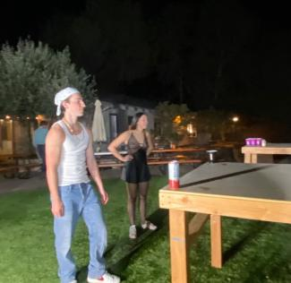
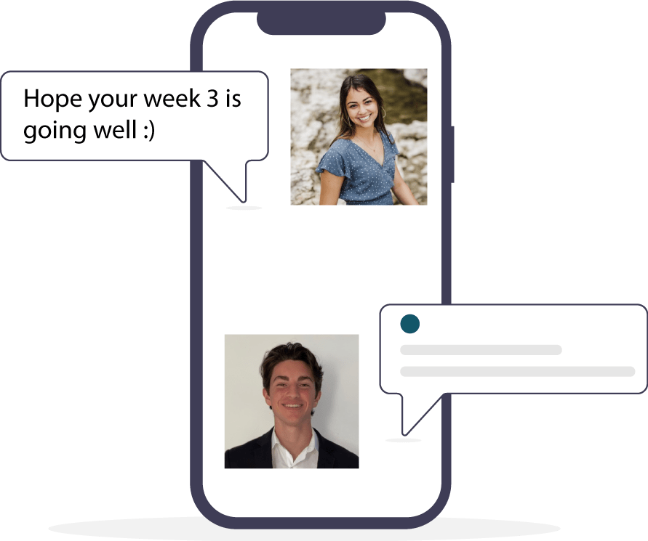

Slide 38
key insight
Surprises make you feel nice, but life is perfectly fine without them. It can be harmful to expect people to surprise you.
Questioned the genuinity of the act. Thought that the friend had other intentions than wanting to make him feel good.
Doesn’t feel that much closer to the person after receiving the text. It may have been more effective if the surprise required more effort than sending a text message.
Values relationships very highly but thinks that surprise text messages are not necessary to maintain them.
picture sent in by Emma (close friend)

Slide 39
SUMMARY
Reflection isn’t necessarily healthy for mental well-being.
Music, emotion, and memories are tightly linked.
Some journal for introspection rather than to have an end product.
Surprises can be cause for suspicion if they don’t happen that often
People anchor memories to certain people, locations, or emotions.

Slide 40
06
next up
our solution moving forward

Slide 41
Those who journal digitally tend to look reflect and look back on their entries.

Slide 42
moving forward with musically driven entries
Music correlates heavily to people’s moods.
It is an additive to journaling and reflection, rather than a substitute for anything.

Slide 43
07
appendix
HMW + solutions brainstorming

Slide 44
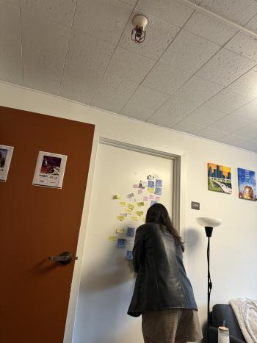
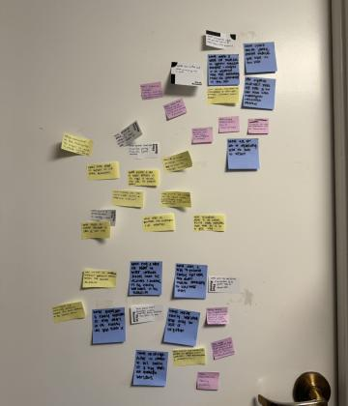
generating HMWs

Slide 45
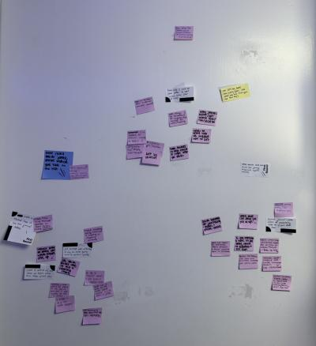
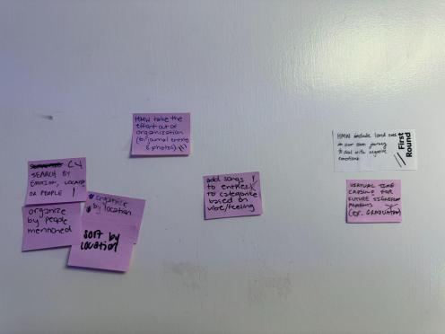
solutions (all & narrowed)

