Slide 1

team JACK
where story meets soundtrack

Slide 2
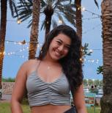

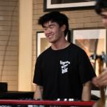
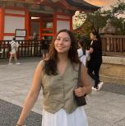
the team
Alyssa
Kabir
Caleb
Jasmine
product design
computer science
music
psychology

Slide 3
01
value prop

Slide 4
where story meets soundtrack
Why Noted?
Our name is a pun inspired by both the notes in the music and the term “noted” used when acknowledging something of importance. Our app encourages users to reflect on past memories through photos, invoking a new layer of emotional reminiscence with the additional inclusion of music. This is why Noted represents where your story meets your soundtrack.

Slide 5
02
overview

Slide 6
problem
Even diligent photo takers and journalers do not always look back on what they have generated, missing out on the opportunities for reflection and introspection
solution
Noted is a digital platform that prompts reflection through the pairing of photo and song which can be shared with friends and stored in a personal timeline

Slide 7
target audience
Individuals who enjoy looking at photos and listening to music that desire an organized way to chronicle and reflect on past experiences

Slide 8
03
market research
6 competitors & analysis

Slide 9

Instagram Stories
“Capture and Share the World’s Moments”
a social media app for sharing pictures and videos with friends
What works:
Network effects make it easy to connect with basically almost everyone you know IRL
Stories make it frictionless to post regular updates without social backlash from “overposting”
Easy to edit, add text, and pair with music
What doesn’t work:
Time spent by a user per story is around a second or two (low touch posting)
Emulates features loved by users in other apps like Snapchat

Slide 10
Instagram Stories
“Capture and Share the World’s Moments”
a social media app for sharing pictures and videos with friends
Implications & takeaways
Noted is unique in capturing attention via a customized curated feed, suggesting music that you were listening to at the time of the old memory
With a constantly growing user base, everyone connects with a larger and larger audience, resulting in many stories going unnoticed
While offering the opportunity for pairing music with a picture, Instagram Stories are not the central feature of the app. Memories are selected and not curated, leaving more to be desired in this type of content format.

Slide 11

Day One
“Capturing life as you live it”
a personal journaling app
What works:
Extremely low friction (one tap) to start a new journal entry
Extensive feature set lets you add all types of media to a post (photos/videos/text/audio/drawings)
Security is baked into the app from the ground up - on brand with the digital value of personal memories
What doesn’t work:
App-wide bug caused users to lose entries, creating distrust in digital journal (which already has to compete with the trust/bond with physical journaling)
Subscription model for premium features has pushed users away
Lives within the Apple ecosystem which reduces accessibility

Slide 12
Day One
“Capturing life as you live it”
a personal journaling app
Implications & takeaways
Noted is unique in that adds the element of music to remembering old memories, adding the auditory dimension to conventionally visual and textual modes
Day One is very intuitive and has successfully won the hearts of many longtime physical journalers
A picture is truly worth a thousand words. Memories driven by photos coupled with a musical component to create an emotional atmosphere like no other.

Slide 13

TikTok
“Make your day”
a social media app for watching and sharing short-form videos
What works:
Users can capture memories in both photo and short-video form and add additional effects, such as audios, voice-modulators, and filters
Users can get exposed to a variety of experiences and perspectives through exploration on the “For You” page
What doesn’t work:
TikTok’s “For You” encourages interaction with weak to medium ties, which is linked to lower mental wellbeing¹
Majority of users are passive consumers of content rather than creators
Users are extrinsically motivated to create content that can be monetized → leads to more sensational and performative content rather than meaningful content
Notes:
Kraut, Robert, and Moira Burke. "Internet use and psychological well-being: Effects of activity and audience." Communications of the ACM 58.12 (2015): 94-100.

Slide 14
TikTok
“Make your day”
a social media app for watching and sharing short-form videos
Implications & takeaways
Extrinsic motivators lead to less reflective or personal content
  Users focus on what can gain the most views
TikTok users are flooded with content from strangers and weak connections rather than connecting with content from their close friends
TikTok users are less focused on creating their own content
TikTok users miss out on opportunities for genuine connection and reflection
Notes:
Kraut, Robert, and Moira Burke. "Internet use and psychological well-being: Effects of activity and audience." Communications of the ACM 58.12 (2015): 94-100.

Slide 15

BeReal
“Your Friends for Real”
A social media app that prompts users to post themselves and their surroundings with a notification at a random point in their day
What works:
Encourages vulnerability through the prompting to take photos at a random point throughout the day
Uses notifications to drive engagement through a sense of urgency
Focuses on amplifying existing strong ties as users see realistic photos from immediate friends
What doesn’t work:
“Being real” lasted only temporarily on social media and has been dying as a fad
The randomness of the notification to post fails to consistently capture pivotal memories and leaves users with photos of many mundane moments → as a result, users are less likely to reflect on the photos they post

Slide 16
BeReal
“Your Friends for Real”
A social media app that prompts users to post themselves and their surroundings with a notification at a random point in their day
Implications & takeaways
Noted is unique in creating routine engagement while not creating the pressure behind posting daily in the moment
BeReal users are inundated with many photos of mundane moments (e.g., studying in the library, working on psets, laying in bed)
  Noted leverages past photos to encourage users to reflect on meaningful moments
BeReal users may no longer find mere “vulnerability” as an appealing way to stay connected with strong ties

Slide 17

Lapse
“The invite-only disposable camera”
A app for taking and sharing photos to a private group without editing or reviewing
What works:
Lapse capitalizes on the resurgence of disposable cameras by offering a similar experience (taking photos without knowing how they’ll turn out) in a digital form, accessing a wider audience
Lapse encourages strong ties through their private group that allow close friends to share photos together
What doesn’t work:
Users are forced to create new content to fully get value out of the app
Users have to be invited to the app
Users can’t choose the best photos to post to share but rather have to “risk it” without knowing how the photo with “develop”

Slide 18
Lapse
“The invite-only disposable camera”
A app for taking and sharing photos to a private group without editing or reviewing
Implications & takeaways
Users seem to have a desire to share photos within the close network of friends
  Due to the invite-only model, Lapse is leaving an opening in the market for strong-ties photo sharing that Noted can capitalize on
Noted offers the spontaneity of a randomly generated photo but still allows users to control their image, choosing whether or not to share the photo
Noted offers both control of your image as well as spontaneity and close connections with the uniqueness of music pairings

Slide 19
Competitive Analysis
Connect with friends | ✔️ |  | ✔️ | ✔️ | ✔️ | ✔️
Music-pairing functionality | ✔️ |  | ✔️ |  |  | ✔️
Share old memories vs. create new | both | both | both | new | new | both
Inspires reflection |  | ✔️ |  | ✔️ | ✔️ | ✔️
Accessibility |  | iOS only |  |  | invite only

Slide 20
04
values in design
utilizing the Tarot cards of tech

Slide 21
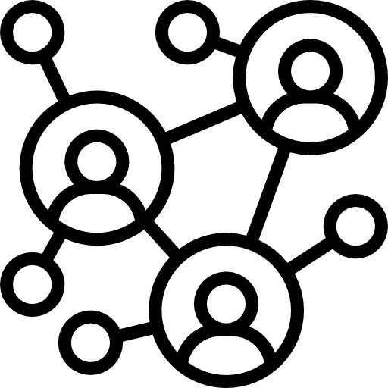
stakeholders
indirect
Artists of the songs used in Noted
Streaming platforms being integrated
Individuals featured in the photos of other users
Non-users who are friends/family of users
direct
Digital journalists
Photo takers
Music listeners

Slide 22
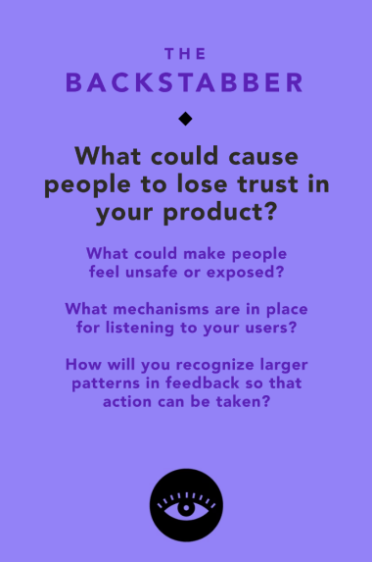
Potential for data leaks
  If users find out that their journal entries or music preferences are leaked, they will lose trust instantly
Feeling targeted by randomly generated photos
  Users could be deterred from interacting with if they are shown photos associated with bad memories or people they no longer interact with
Discomfort from AI used in song generation
  Users may experience discomfort from the use of AI, being shown songs that are uncannily tailored to their personal experiences

Slide 23
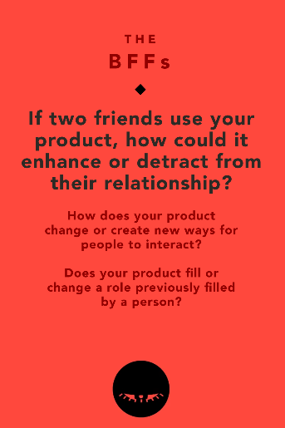
Deeper emotional bonding
  A song associated with a shared memory can become “their song” which could strengthen their relationship
  Engaging with strong ties is associated with improvements in mental health
Structured / collaborative reflections
  Friends can better understand their thoughts and past which can lead to deeper conversations
Difference in music taste
  Exposes friends to different types of music and could lead to new emotional experiences and associations
Oversharing
  Continuous sharing sharing could be overwhelming to a friend and make them feel like they aren't having enough private moments together
Reduce in person interaction
  If friends overlay depend on the app, this could cause distance in their in-person relationship

Slide 24

our values
Promote reflection and introspection through both audio and visual mediums
Strengthen connections with close friends and family members
Preserve the privacy and security of precious personal memories and photos
Low friction to making posts within the app, should be as easy as opening a journal and starting to write

Slide 25
05
tasks

Slide 26

3 tasks
simple
moderate
complex
pair songs to photos
share photo/song pairings with others
curate people who can appear in your randomly generated photos
Notes:
Simple (pair songs to photos): This is the most common task a user will accomplish, choosing a song that matches the photo generated by the app.
Moderate (share photo/song pairings with others): This is a more secondary task of our app, as the main focus is on creating photo-song pairings (simple) but only some users will choose to share these pairings on their timeline or directly message pairings to friends;
Complex (curate people who can appear in your randomly generated photos): The smallest amount of users will do this task (i.e., only those particularly driven to feature someone more or less on their timeline and willing to complete the extra steps to do so). Create a feedback-driven recommendation system that can curate a feed representative of those you would like to see more (or less) of within the Noted timeline.

Slide 27
06
storyboards

Slide 28

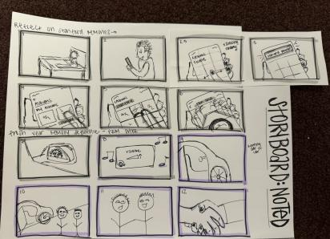
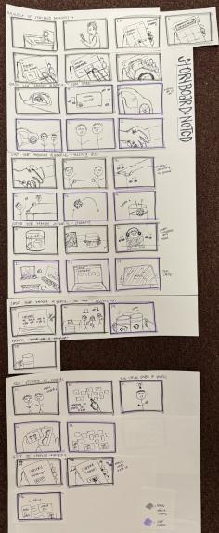
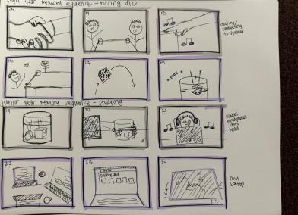

Slide 29
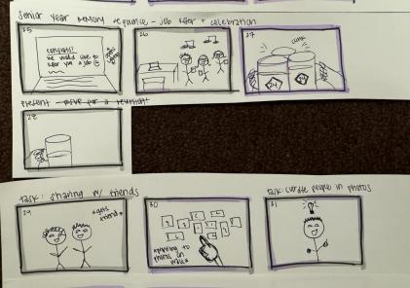
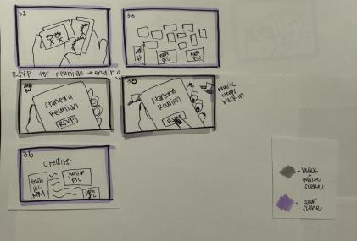

Slide 30
07
concept video!

Slide 31
click here
https://www.youtube.com/watch?v=5TMvqe0hZgQ

