Slide 1

team NOTED
where story meets soundtrack

Slide 2
01
intro

Slide 3


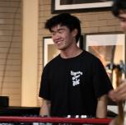

the team
Alyssa
Kabir
Caleb
Jasmine
product design
computer science
music
psychology

Slide 4
where story meets soundtrack

Slide 5
problem
Even diligent photo takers and journalers do not always look back on what they have generated, missing out on the opportunities for reflection and introspection
solution
Noted is a digital platform that prompts reflection through the pairing of photo and song which can be shared with friends and stored in a personal timeline

Slide 6
target audience
Individuals who enjoy looking at photos and listening to music that desire an organized way to chronicle and reflect on past experiences

Slide 7
table of contents
01
05
02
06
03
07
04
08
intro
low-fi prototype
sketching
testing methodology
selected interface
testing results
low-fi prototype construction
discussion

Slide 8
02
sketching

Slide 9
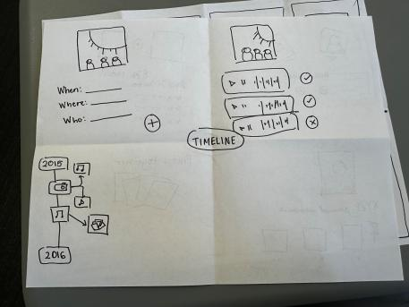
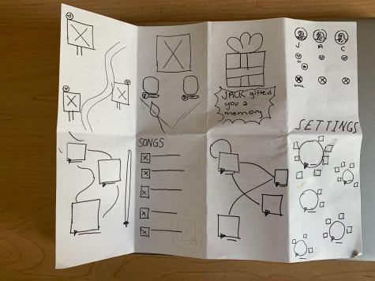
Photo/Song Pairing Interface
Display of “Hits” (Photo/Song Pairings)

Slide 10
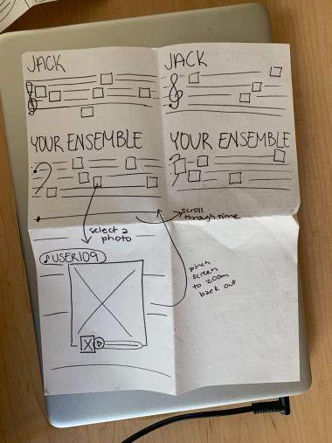
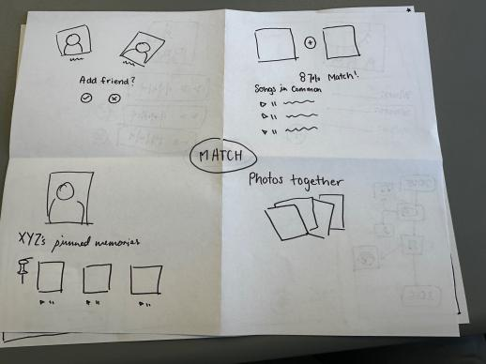
Profile Ideas
Timeline idea - Musical Staff

Slide 11
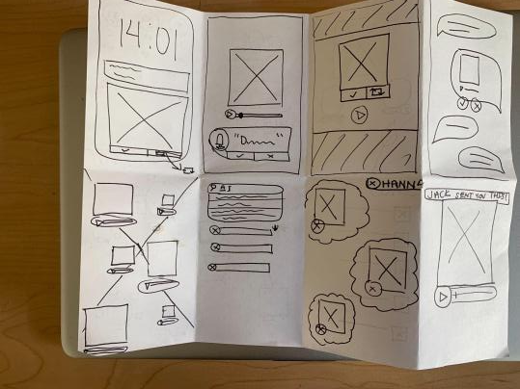
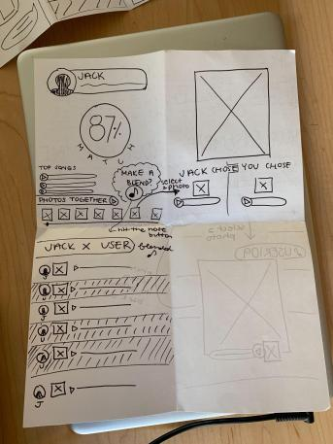
Profile Ideas
Miscellaneous Ideas (crazy 8)

Slide 12
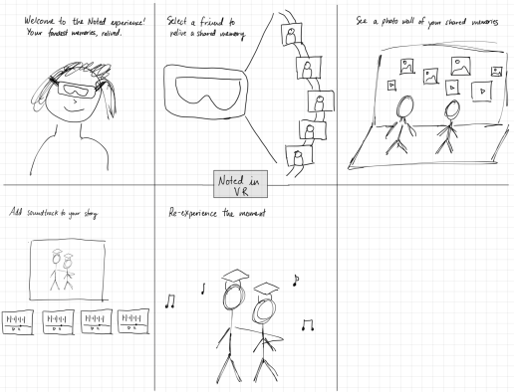
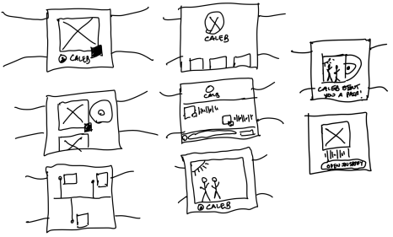
Apple Watch Realization
VR Realization

Slide 13
03
selected interface

Slide 14
Option 1: Apple Watch

Slide 15
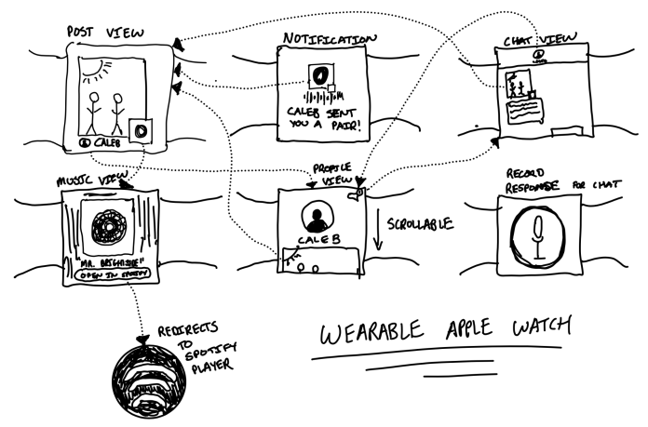
APPLE WATCH

Slide 16
APPLE WATCH
PROS (abridged)
CONS (abridged)
Watch is almost always easily viewable
Tracks health data
Discreet usage (people can use without being noticed)
Simplified UI - smaller screen size, only show important info
Small screen leads to potential clutter
Hard to type and voice dictation not always accurate
Don’t always have access to photos
Not as many people own apple watches compared to phone’s, tablets, and other mediums

Slide 17
Option 2: Mobile App

Slide 18
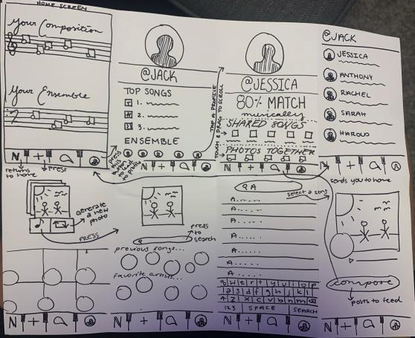
MOBILE APP

Slide 19
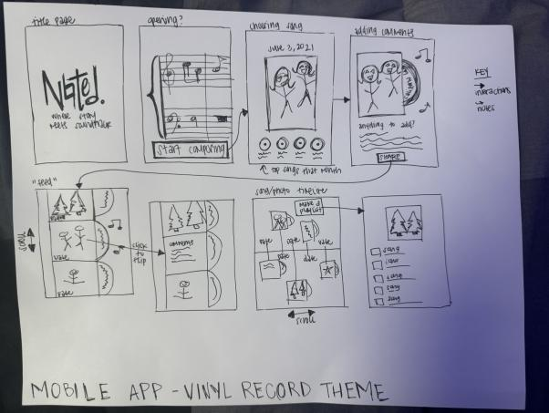
MOBILE APP

Slide 20
MOBILE APP
PROS
PROS (abridged)
CONS
CONS (abridged)
Easy to integrate photo libraries as most people use phone to store photos
Phone is primary music listening device for most people
Frequent use of phone can allow for consistent habit building
People may not want to type long descriptions on their phone
Larger screen than watch means more design decisions
Must compete for user’s attention with many other existing mobile apps

Slide 21
Our selection…

Slide 22
Mobile App!
Because…
Mobile devices are more ubiquitous than Apple watches
Primary device for music consumption and photo storage
Typing and engaging with applications on mobile device is much easier because of larger interface
Notes:
Mobile devices are more ubiquitous than Apple watches, giving us a broader audience.
Mobile devices serve as the primary device for music consumption and photo storage
Typing and engaging with applications is much easier on mobile phones due to larger interface

Slide 23
Mobile App Cont.
Further considerations…
1.46 billion worldwide iPhone owners versus 100 million apple watch owners
Mobile phone users tend to spend more continuous time on apps compared to Apple Watch users who engage in shorter, more sporadic interactions
Must combat mental health implications seen in other social media apps. Requires responsible design.
Higher screen real estate lends itself to better experience interfacing with multiple photos + songs
Having a camera enables you to capture moments live
Notes:
Mobile devices are more ubiquitous than Apple watches, giving us a broader audience.
Mobile devices serve as the primary device for music consumption and photo storage
Typing and engaging with applications is much easier on mobile phones due to larger interface

Slide 24
04
low-fi construction

Slide 25
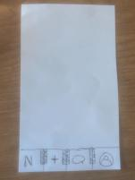
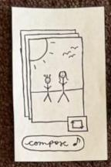
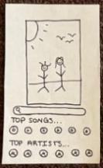
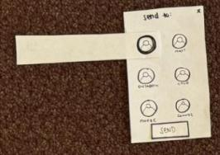
Basic Prototype Layout
Phone background
Example screens
Marker overlays
Prototype was built using a paper phone background with navigation bar, and paper cutouts of screen and focused button markers

Slide 26

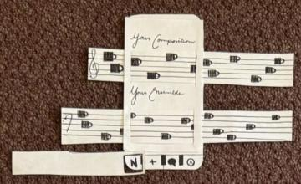
Scrollable Screens
home screen
personal feed
The home screen had two scrollable feeds, the user’s personal feed and a feed of the user’s friends’ content. The feed screen after the user posts is also scrollable

Slide 27
05
low-fi prototype

Slide 28

3 tasks
simple
moderate
complex
pair songs to photos
share photo/song pairings with others
curate people who can appear in your randomly generated photos
Notes:
Simple (pair songs to photos): This is the most common task a user will accomplish, choosing a song that matches the photo generated by the app.
Moderate (share photo/song pairings with others): This is a more secondary task of our app, as the main focus is on creating photo-song pairings (simple) but only some users will choose to share these pairings on their timeline or directly message pairings to friends;
Complex (curate people who can appear in your randomly generated photos): The smallest amount of users will do this task (i.e., only those particularly driven to feature someone more or less on their timeline and willing to complete the extra steps to do so). Create a feedback-driven recommendation system that can curate a feed representative of those you would like to see more (or less) of within the Noted timeline.

Slide 29
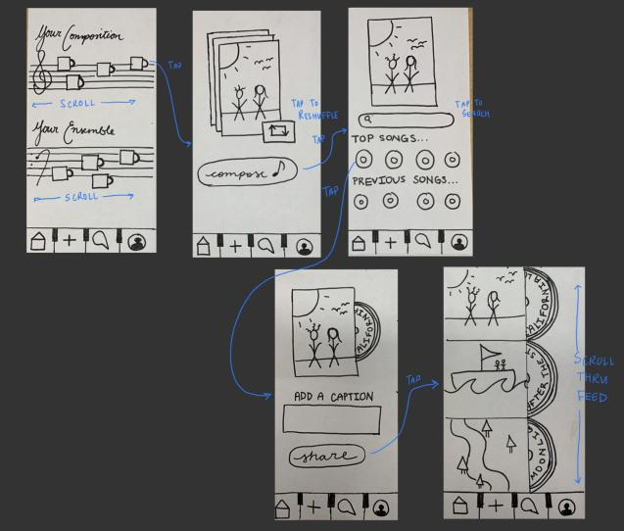
simple
share photo/song pairings with others

Slide 30
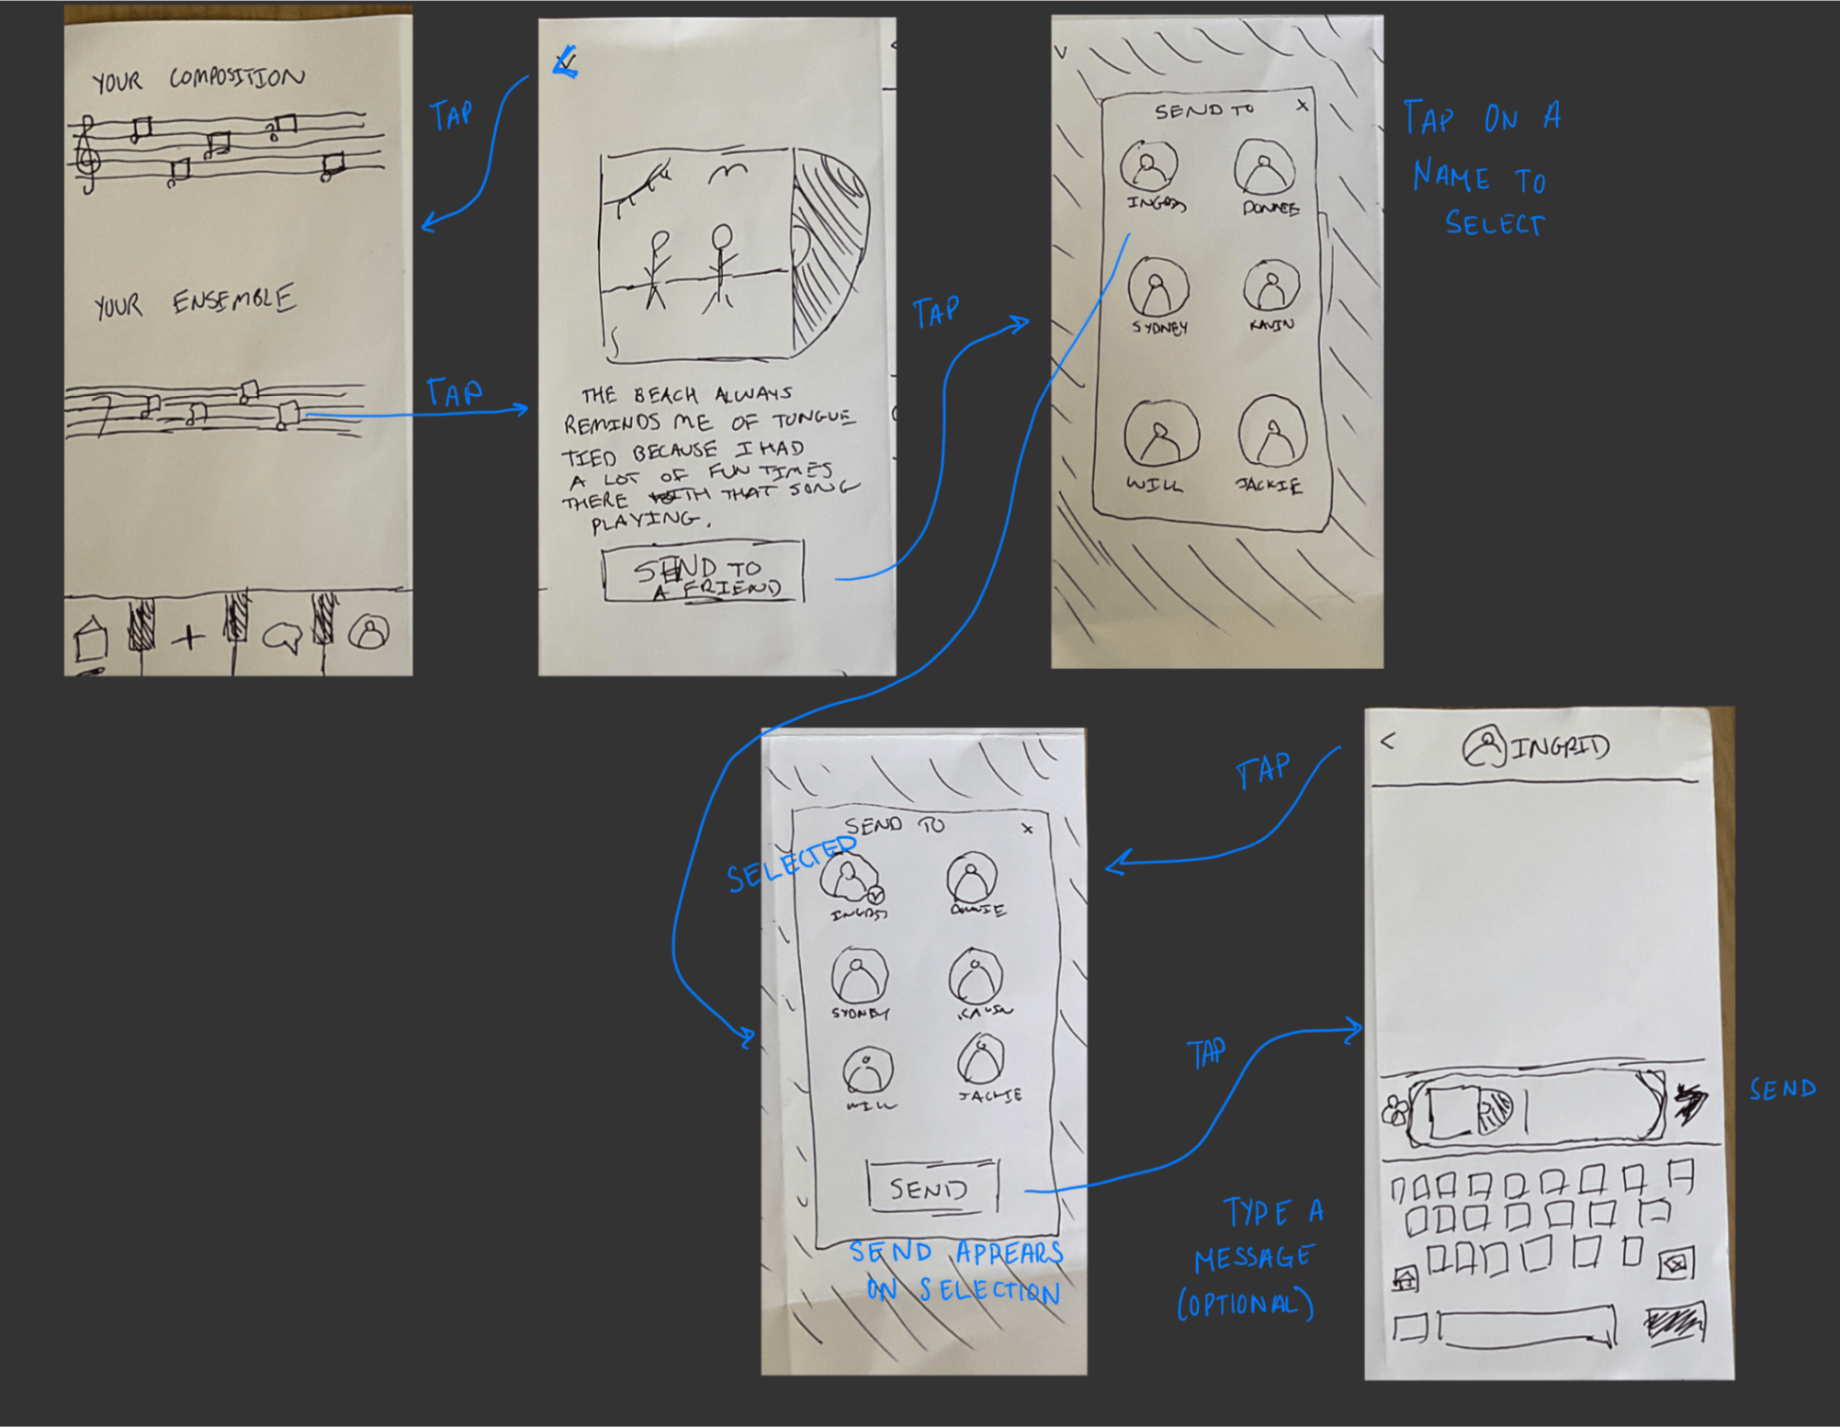
moderate
share photo/song pairings with others

Slide 31
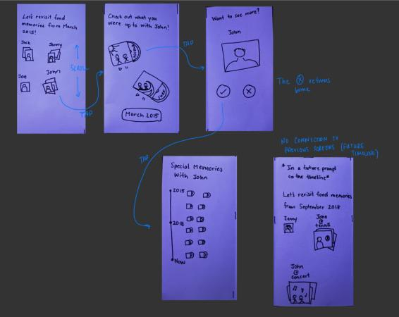
complex
curate people who can appear in your randomly generated photos

Slide 32
06
testing methodology

Slide 33
Recruitment Criteria
People who enjoy listening to music
People who take a lot of photos on their phone

Slide 34
Finding Participants
Found crowd members from Caleb’s music performance at CoHo (assumed they enjoyed music)
Approached individuals at Tressider on their phones with headphones (assumed they listened to music and use their phone)

Slide 35

Participant Demographics
Gender: 2 males, 3 females
Age range: 18 to 26 years old
Occupation: 1 high school student, 1 Stanford student, 3 young adult working professionals
All participants primarily use their phone to take photos
All participants listen to music on their phones
  4 participants were Spotify users
  1 participant was an Apple Music user
Notes:
***Compensation: We offered to buy coffee for each of the people we approached at CoHo Tresidder, but all of them were happy to test out our prototype for free.

Slide 36
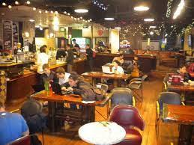

Environment & Apparatus
We conducted all 5 prototype tests in person
2 tests were conducted at CoHo
3 tests were conducted at Tresidder
Inside of CoHo
Outside of Tresidder
We used a paper cutout of a phone and used additional paper cutouts for each of the screens (including longer screens for scrollable content) and buttons

Slide 37
Team roles
Alyssa
Kabir
Caleb
Jasmine
computer
greeter
facilitator / computer
videographer / facilitator
Notes:
**some roles were shifted depending on who was available to run prototype-testing

Slide 38
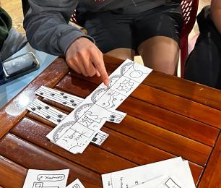
Description of Process
Sign consent form
Participants are asked to talk through their process and be clear about what they are intending to do at each step.
Present paper prototype starting on the home screen and prompt them to complete each task one by one
AFTER: Reflect on functionality of app by asking them questions:
  Which part of the app was most confusing to you?
  Did you have a favorite function of the app?
  Do you see yourself using this app regularly? Why or why not?
  Any other questions or critical feedback?
Paper prototype testing with Gerald

Slide 39
Usability Goals & Key Measurements

Slide 40
usability goal #1
Efficient
User is able to complete tasks quickly
Measure: time it takes to complete tasks

Slide 41
usability goal #2
Robust
User is able to complete tasks with minimal errors
Measure: number of errors per task
*error: taking an action that makes negative progress towards completion of task

Slide 42
07
testing results

Slide 43





Participants
AI
AI
AI
AI
Isabella J.
Emma N.
Justin C.
Monica C.
Gerald K.
25 years old
Career dev program @ Stanford
Nashville, TN
21 years old
Junior @ Stanford
Austin, TX
18 years old
Emma’s friend from home
Austin, TX
28 years old
SWE @ FAANG
SF, CA
17 years old
HS senior visiting older brother
Los Gatos, CA
Compensation: All participants were offered a free drink from Starbucks/CoHo but declined
Notes:
**some roles were shifted depending on who was available to run prototype-testing

Slide 44
All participants (+):
PROCESS DATA
Correctly associated the “plus” icon with creating a photo/song pairing
Correctly associated the “message” icon with sending a pairing to a friend
Understood that the staff in home screen was horizontally scrollable
Notes:
**some roles were shifted depending on who was available to run prototype-testing

Slide 45
All participants (-):
PROCESS DATA
Were confused when they reached nested screens with no button to go back to their previous screen
Didn’t try clicking on the photo-song pairing icons in home screen timelines → not much exploration on the homepage
General confusion about the purpose of the app
Notes:
**some roles were shifted depending on who was available to run prototype-testing

Slide 46
Task Breakdown
PROCESS DATA
Task 1 - completed robustly and efficiently by all users
Task 2 - completed somewhat robustly and efficiently by most users. Most users had a couple of errors.
Task 3 - most users made many errors. It seemed like most people were randomly tapping on buttons to find the right screen.
Notes:
**some roles were shifted depending on who was available to run prototype-testing

Slide 47
takeaways from Isabella’s test
AI
Held an inaccurate understanding of the main purpose of the app until we explained after the prototype testing -> thought it was just a music sharing app
Navigated by pressing each of the buttons at the bottom of the screen first and went through all the flows
Spent considerable time exploring the app at first rather than solely focusing on the tasks
Despite time spent exploring the app, she expressed that she had trouble remembering where everything is on the app → indicates a learning curve for using the app
Notes:
Things to consider;
-writes down his family recipes on a shared notes app
Would relay stories to parents and they hadnt heard them before
-records grandparents’ stories on his phone → first prompted to ask about their story immigrating to America after his pilgrimage to spread his grandfather’s ashes, but now takes out his phone to record every time they start telling a story spontaneously
Say tensions/contradictions here ->

Slide 48
takeaways from Justin’s test
AI
Found the profile button to be less intuitive than the other button; Justin had understood that it was a profile button but he was unsure what it would lead to
Completed the tasks quickly and with ease, taking just a moment to decide how to start
Expressed some confusion with the complex task (likely due to the wording of the instructions) but used process of elimination for which buttons he’d already tried to figure it out
navigated the interface with ease → bottom buttons made sense to him and was his primary mode of navigation
Notes:
Things to consider;
-writes down his family recipes on a shared notes app
Would relay stories to parents and they hadnt heard them before
-records grandparents’ stories on his phone → first prompted to ask about their story immigrating to America after his pilgrimage to spread his grandfather’s ashes, but now takes out his phone to record every time they start telling a story spontaneously
Say tensions/contradictions here ->

Slide 49
Usability Goal #1: Efficient
simple
moderate
complex
1 min 58 sec
on average
1 min 27 sec
on average
59 secs
on average
Notes:
Breakdown:
gerald:
simple: 78 sec / 0 errors
moderate: 45 sec / 0 errors
complex: 56 sec / 1 error
emma:
simple: 3:17 / 2 errors
moderate: 2:10 / 0 errors
complex: 1:45 / 0 errors
monica:
simple 1:10 sec / 0 errors
moderate: 42 sec / 0 errors
complex: 45 sec / 1 errors
isabella:
simple: 3:20 / 6 errors
moderate: 3:15 / 9 errors
complex: 50 sec / 0 errors
justin:
simple: 44 sec / 0 errors
moderate: 22 sec / 0 errors
complex: 39 sec / 0 errors
Simple (pair songs to photos): This is the most common task a user will accomplish, choosing a song that matches the photo generated by the app.
Moderate (share photo/song pairings with others): This is a more secondary task of our app, as the main focus is on creating photo-song pairings (simple) but only some users will choose to share these pairings on their timeline or directly message pairings to friends;
Complex (curate people who can appear in your randomly generated photos): The smallest amount of users will do this task (i.e., only those particularly driven to feature someone more or less on their timeline and willing to complete the extra steps to do so). Create a feedback-driven recommendation system that can curate a feed representative of those you would like to see more (or less) of within the Noted timeline.

Slide 50
Usability Goal #2: Robust
simple
moderate
complex
1.6 errors
on average
1.8 errors*
on average
0.4 errors
on average
Notes:
* this error rate was skewed by Isabella (see breakdown of times & errors by participant on previous slide speaker notes)
Simple (pair songs to photos): This is the most common task a user will accomplish, choosing a song that matches the photo generated by the app.
Moderate (share photo/song pairings with others): This is a more secondary task of our app, as the main focus is on creating photo-song pairings (simple) but only some users will choose to share these pairings on their timeline or directly message pairings to friends;
Complex (curate people who can appear in your randomly generated photos): The smallest amount of users will do this task (i.e., only those particularly driven to feature someone more or less on their timeline and willing to complete the extra steps to do so). Create a feedback-driven recommendation system that can curate a feed representative of those you would like to see more (or less) of within the Noted timeline.

Slide 51

General Takeaways
The purpose of the app may not be entirely apparent from the home screen
  Gap in clarity partially due to paper prototype vs digital prototype
Users were slow on initial screen of each task and far quicker in all screens that followed
The complex task was quicker and less error-prone than simple/moderate tasks
  Likely due to user gaining familiarity with the app interface
After getting past the initial screen associated with each of the bottom buttons, the experience was fairly seamless for all users
  Ensuring the bottom buttons are intuitive should be prioritized

Slide 52
08
discussion

Slide 53

Implications
The UI/UX of the photo-song pairings will be crucial to get right
Reusing similar components to the ones we know and love in existing social media platforms make for a seamless experience
Noted has great potential both for discovering new things (in the form of visual and auditory mediums) about friends as well as oneself

Slide 54
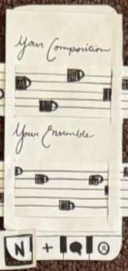
Design Changes
Problem: unclear that the “N” icon was connected to our logo and represented the home button
Add “Noted” logo to top of all screens
Add a splash screen with logo and value proposition
Home screen with noted Logo (circled) in the header
Notes:
Things to consider;
-writes down his family recipes on a shared notes app
Would relay stories to parents and they hadnt heard them before
-records grandparents’ stories on his phone → first prompted to ask about their story immigrating to America after his pilgrimage to spread his grandfather’s ashes, but now takes out his phone to record every time they start telling a story spontaneously
Say tensions/contradictions here ->

Slide 55
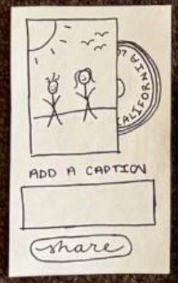
Design Changes
Problem: getting “stuck” on screens
Add “back-caret” buttons to screens that don’t have them
Add onboarding tutorial to guide them through various screens and critical tasks
Add close buttons to modals
Example of screen with left-caret back button (circled)
Notes:
Things to consider;
-writes down his family recipes on a shared notes app
Would relay stories to parents and they hadnt heard them before
-records grandparents’ stories on his phone → first prompted to ask about their story immigrating to America after his pilgrimage to spread his grandfather’s ashes, but now takes out his phone to record every time they start telling a story spontaneously
Say tensions/contradictions here ->

Slide 56
Design Changes
Problem: Confusion with broader purpose of the app
Add a splash screen with logo and value proposition
Implement an onboarding tutorial that shows a user the expected behavior and use cases of the app
where story meets soundtrack
Enhance the design of the music and record to make it more clear that it is a photo and song paired together
Draft of splash screen
Notes:
Things to consider;
-writes down his family recipes on a shared notes app
Would relay stories to parents and they hadnt heard them before
-records grandparents’ stories on his phone → first prompted to ask about their story immigrating to America after his pilgrimage to spread his grandfather’s ashes, but now takes out his phone to record every time they start telling a story spontaneously
Say tensions/contradictions here ->

Slide 57

Design Changes
Problem: Lack of clarity for the purpose of the profile icon
Experiment with different icons to make the profile icon more intuitive
Consider breaking up the functionality encapsulated in the profile screen into multiple icons
Remove the profile icon from the bottom row and move it to a corner of the homescreen
Profile icon
Notes:
Things to consider;
-writes down his family recipes on a shared notes app
Would relay stories to parents and they hadnt heard them before
-records grandparents’ stories on his phone → first prompted to ask about their story immigrating to America after his pilgrimage to spread his grandfather’s ashes, but now takes out his phone to record every time they start telling a story spontaneously
Say tensions/contradictions here ->

Slide 58
Outstanding Questions
How would a user familiar with the app interact?
All our users were completely new to the app interface, leading some to spend more time exploring rather than strictly completing the tasks
How would a user interact with the generated photos when shown their personal photos?
Our users interacted with an interface of stock photos, so we weren’t able to explore reactions to seeing their own photos generated
How would a user prioritize the social interactions versus personal reflection?
Our users were given set tasks to complete, so we weren’t able to see how a user would prioritize looking at their own photo-song pairings versus interacting with others on the app

Slide 59
09
appendix

Slide 60
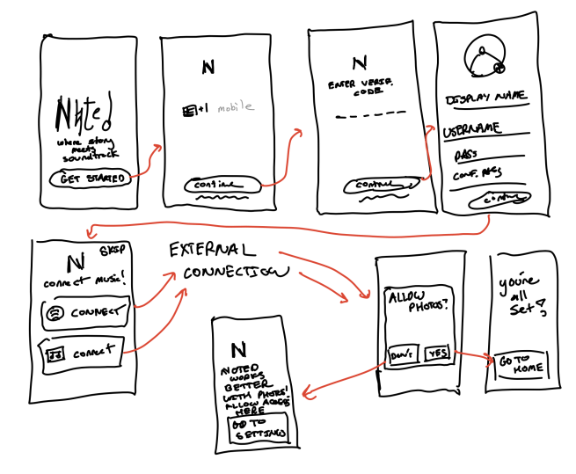
Account Creation
These are all “click” actions

Slide 61
FULL LIST OF MOBILE APP PRO/CONS
PROS
CONS
Easy to integrate photo libraries as most people use phone to store photos. Most phones have a lot of storage for photos
Phone is primary music listening device for most people
Frequent use of phone can allow for consistent habit building
Versatile device functions such as camera and location to create more comprehensive UX
Easier keyboard input (than apple watch)
Better processing power (than apple watch)
Distracting notifications
People may not want to type long descriptions on their phone
Larger screen than watch means more design decisions
Must compete for user’s attention with many other existing mobile apps
Less portable (than apple watch)
Concerns about addiction is causing some to greatly decrease phone usage
Photos are sensitive data in nature and privacy and security concerns become a paramount focus in the face of malware

Slide 62
FULL LIST OF APPLE WATCH PRO/CONS
PROS
CONS
Watch is almost always easily viewable
Tracks health data
Discreet usage (people can journal and reflect without being noticed if it is sensitive/personal information)
Simplified UI - smaller screen size, only show important info
Constant accessibility allows you to easily jot down thoughts/ideas on the go
Fitness integration - pair music with workout/health data (ex: hike in hawaii)
Enhanced music recommendations - recommend songs based on current location and environment noise detection
Small screen leads to potential clutter
Hard to type and voice dictation not always accurate
Don’t always have access to photos
Not as many people own apple watches compared to phone’s, tablets, and other mediums
Limited storage for photos and songs
Music playing functionality is limited
Limited browsing capabilities - small square screen size cannot fully represent some photos.
Difficult to edit photos before sharing (crop, brightness, filters).

Slide 63
Script for Usability Test Participants
Please say out loud your thought process so we can follow along with how you are making decisions. We are absolutely not testing YOU, we are testing the process! So don’t worry about clicking anything “wrong” because there is not wrong answer.
Also feel free to share any suggestions or concerns with us!
We’ll give you some tasks to perform. We won’t guide you in any way but feel free to click around to test your assumptions!
Create a new photo / song pair
Share a photo/song pairing with Grace
Curate your feed so that you see more of John
AFTER:
Was anything particularly confusing and why?
Do you have a favorite feature?
Would you use this regularly? Why or why not?

Slide 64
Scale for Critical Incidents Log
0 - User progressed without hesitation
1 - User hesitated or had to think about the next step
2 - User made an error when progressing to the next step
3 - User had to ask for help to progress
4 - User was unable to progress

Slide 65
Critical Incidents Log - Monica C.
Incident | Incident Log
Used the “plus” button to create a photo-song pairing | 0
Hesitated before pressing compose to progress to the next screen | 1
Opted to hit the search button to choose a song | 0
Had to talk through the share screen to figure out how to share | 1
Used the “message” button for the moderate task | 0
Hit the “message” button for the complex task instead of the “profile” button | 2
Unsure how to navigate backwards to get to the feed again | 3

Slide 66
Critical Incidents Log - Isabella J.
Incident | Incident Log
Didn’t understand that the “N” icon mapped to the home page | 3
Incorrectly switched out of the “compose screen” during the task of pairing song to photo | 3
Initially pressed the plus button to create a photo/song pairing | 0
Initially pressed the profile icon to complete task “see more of John” | 1
Scrolled through the horizontal timelines in home page | 1
Confused by wording of task: “see more of John” | 3
Didn’t understand that the “posts” were photos with records sticking out of them (photo/song pairings) | 2

Slide 67
Critical Incidents Log - Justin C.
Incident | Incident Log
Associated creation with “plus” button | 0
Identified that the vertical feed of pairings was scrollable, featured pairings from other users, and recognized his post at the top of feed | 0
Associated “chat” button with sharing a photo/song pairing | 1
Correclty pressed the “pairings library” button in DM screen in order to access user’s photo/song pairings | 1
Had to think a bit to adjust settings for John | 2
Generally about what the “staffs” were for in the home page | 3
Confused which screen the “profile” icon mapped to | 2

Slide 68

Critical Incidents Log - Emma N.
Incident | Incident Log
Identifying photo/song pairings “These are cute little mugs” | 3
Lack of horizontal scrolling on home page | 1
Adding music to selected photo was intuitive “This is just like instagram stories” | 0
Used create post feature last in test despite this being core feature | 1

Slide 69
Critical Incidents Log - Gerald K.
Incident | Incident Log
Hesitation with clicking “plus” icon to create photo/song pairing | 1
Interacted with the regenerate photo button, asking us to verify his understanding of what it was | 1
Unsure of what he was seeing when he arrived on his personal feed screen | 3

Slide 70
Potential Design Changes Overview
Add “Noted” logo to the top of all screens
  We added the logo to the paper prototype after the interview with Isabella and found users understood that the “N” button represented home much easier
Add a splash screen when users open the app with our logo and value proposition
  Allows users to connect the “N” button to the logo much easier as well as provides context for the purpose of the app
Add back buttons to allow users to step backwards in the flow without having to start all over
Experiment with different icons to make the profile icon more intuitive

