Slide 1



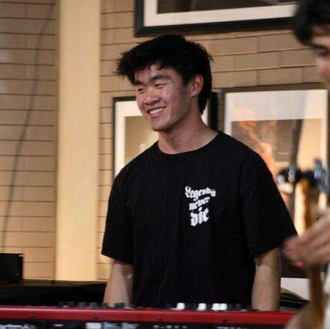

team NOTED
Alyssa
product design
Kabir
computer science
where story meets soundtrack
Caleb
music
Jasmine
psychology

Slide 2
01
intro

Slide 3
where story meets soundtrack
problem
solution
Even diligent photo takers and journalers do not always look back on what they have generated, missing out on the opportunities for reflection and introspection
Noted is a digital platform that prompts reflection through the pairing of photo and song which can be shared with friends and stored in a personal timeline
target audience
Individuals who enjoy looking at photos and listening to music that desire an organized way to chronicle and reflect on past experiences

Slide 4
02
values in design

Slide 5

our values
Promote reflection and introspection through both audio and visual mediums
Strengthen connections with close friends and family members
Preserve the privacy and security of users and their precious personal memories and photos
Low friction to making posts within the app → should be as easy as opening a journal and starting to write

Slide 6
encoding our values
Reflection & Introspection
Strengthen connections
Users can create photo-song pairings that associate memories in photos with songs significant to the user
  Users are also reminded of previous memories through the photos that Noted generates
  Compose screen is dedicated to creating these pairings
Users can look back on previous photo-song pairings
  Pairings are shown in a feed screen as well as in timelines which are on profiles for both the user and their friends
Users can add their thoughts to a caption for their photo-song pairing
  Can be done in the compose screen or by navigating to the edit pairing screen/modal
Send photo-song pairings to friends & family
  Messages screen is dedicated to sending pairings to an individual person
View photo-song pairings created by friends & family (also in messages screen)
Add friends to see their timeline and featured photo/song pairings

Slide 7
encoding our values
Privacy & Security
Privacy button → toggling to public makes photo-song pairing visible to friends/family while private is only visible by the user
Users are able to manage who can view their photo-song pairings and interact with them by being able to block other users
Low friction
Users are automatically directed to the photo-song pairing page with an auto-generated photo ready when they arrive
Users can easily change to a different photo with the regenerate button
In the song selection screen, users are provided with songs they already listen to pulled from their Spotify API data
  Users can also easily search for songs with the search bar in the song selection page
Posting process (with no caption) can take as few as three clicks

Slide 8

tensions between values
Privacy & Security vs. Less Friction
Noted pulls users’ Spotify API data to be able to offer a more frictionless experience in choosing songs for their photo-song pairings
Strengthen Connections vs. Reflection & Introspection
The social aspect of the app is at odds with reflection and introspection when the user creates posts that can be seen by friends and family → can become more performative and less reflective
Privacy & Security vs. Reflection & Introspection
Noted needs access to users’ camera rolls in order to provide photos for users to pair
Strengthen Connections vs. Privacy & Security
Allowing users to block other users for privacy and security reasons results in the stunting of social connections between blocked users

Slide 9
03
tasks

Slide 10

3 tasks
simple
moderate
complex
pair songs to photos
rediscover old memories*
share photo/song pairings with others*
Note: We reimagined our task priorities to emphasize our core value of reflection. Moderate task is designed encourage users to engage with past memories more. Our previous moderate task was repositioned as a complex task since we anticipate it being more frequently utilized by regular/active users. As a whole our task priorities more closely resonate with our values which makes the functionality more intuitive to the user
Notes:
Simple (pair songs to photos): This is the most common task a user will accomplish, choosing a song that matches the photo generated by the app.
Moderate (rediscover old memories): This task is secondary to the simple task as users will engage with rediscovery secondary to creating the photo-song pairings. We changed this task to focus more on the goal of encouraging users to reflect.
Complex (share photo/song pairings with others): This was previously “curate people who can appear in your randomly generated photos”. We changed it to what was previously our moderate task since, relative to our new set of tasks, sharing photo-song pairings is a task the user will complete the least.

Slide 11
04
goals & measurements

Slide 12
usability goal #1
Efficient
User is able to complete tasks quickly
Measure: time it takes to complete tasks
Rationale:
Journaling is often a spontaneous process. Creation flow should be quick and allow for capture of fleeting thoughts
Having low friction processes facilitates habit-formation which is vital to long-term journaling
Memories are often interlinked, so users may want to jump from one to another. Efficient navigation allows people to seamlessly explore their past

Slide 13
usability goal #2
Robust
User is able to complete tasks with minimal errors
Measure: number of errors per task
Rationale:
The app is only successful if user’s make content. Any errors can jeopardize user engagement which would lessen opportunities for reflection
Journaling is a very thoughtful activity. Distractions and interruptions through errors can impede genuine/authentic self expression
Noted has the potential to influence one’s emotional well being. Errors that lead to unexpected behavior have the potential to worsen one’s mental health state and hinder them from performing the intended tasks (which would be beneficial to their mental health)
*error: taking an action that makes negative progress towards completion of task

Slide 14


progress towards usability goals
Robust (error minimization):
Added back buttons to any nested screens to allow users to step backwards if they misclicked → speeds up error recovery and increases user control
Created a splash screen with our value propositions and musical logo to provide more context behind the purpose noted → lessens errors because users will have a better understanding of the expected functionality of our app
Used more recognizable icons in our new navigation bar (ex: noted N was confusing so switching to a ‘friends’ and ‘reflect’ icon) → makes the app feel more familiar, so people who have used mobile apps before will have less confusion at first
Back button icon
New navigation bar

Slide 15
progress towards usability goals
Efficiency (speed of task-completion):
Separate content of friends (previously in profile screen) to its own dedicated friends screen, marked by a ‘friends’ icon → allows people to find friend content quicker
Open app directly to a photo/song pairing screen → streamlines the completion of the simple task
Allow for users to pick their own pictures to pair when the user has a specific picture in mind to use → increases the efficiency of our simple task
Integrated past memories section to the home screen → streamlines process of reflection

Slide 16
05
interface sketches

Slide 17
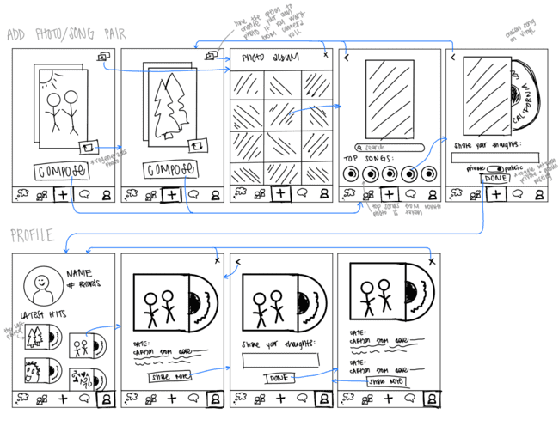
‘compose’ and ‘profile’ interface sketches

Slide 18
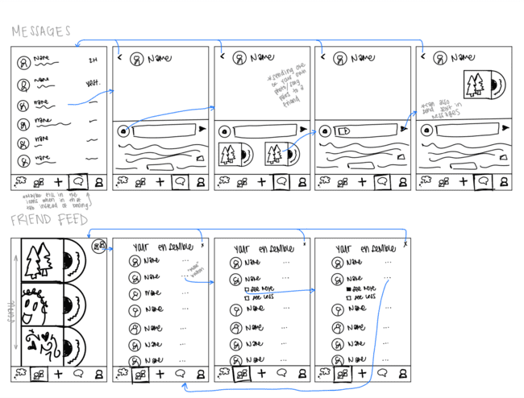
‘DMs’ and ‘friends’ interface sketches

Slide 19
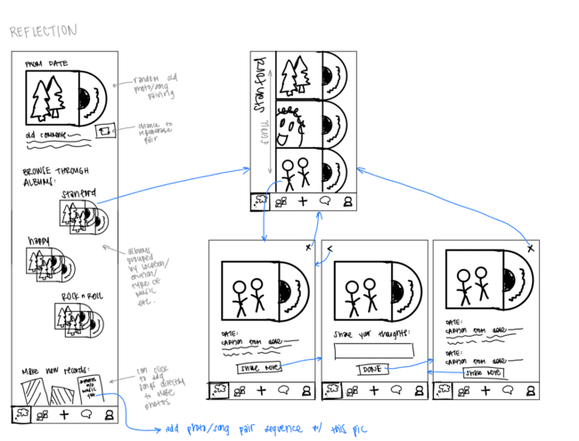
‘reflect’ interface sketches

Slide 20
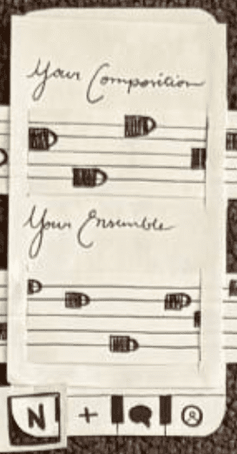
changing to a 5-icon set-up
major design change #1
Original design featured 4-icons representing (left to right) the home screen, create page, DMs, and the profile page
Issues with the original design:
Users were unclear about what could be found on the user profile page → curating which friends the user was shown was embedded in nested screens on this page
Homepage was cluttered with both user’s personal photo-song pairings and their friends’ photo-song pairings → impedes the act of reflection & difficult to navigate
original 4-icon design

Slide 21

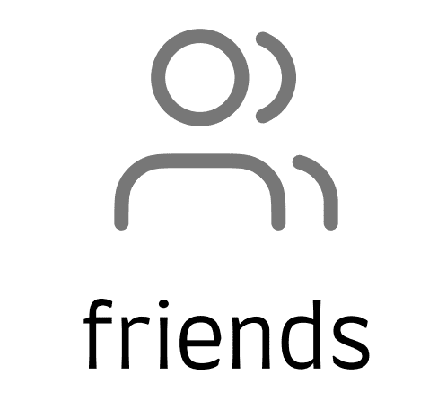
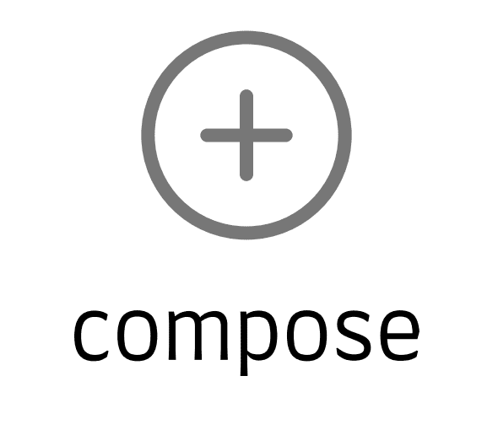


new 5-icon design
Leads to:
reflection page
friends feed
create photo-song pairing
DMs
user’s profile
Shifted from a 4-icon design to a 5-icon design that breaks up some of the functionality that was included in the user profile screen into a separate screens with more intuitive icons
Plus-sign icon for creating a photo-song pairing is shifted to the center to be the focus of the bottom bar → user’s eye is drawn to the center and thus more likely to engage with the simple task
‘N’ icon was replaced with a journal icon to represent the reflection home page where users can see and reflect on previously create photo-song pairings & rediscover old memories
Friends page was added to create a space specifically for viewing others’ photo-song pairings and curating the friends the user interacts with
Selected icon is labeled with text underneath to further clarify the purpose of the associated selected screen

Slide 22
redesigning the opening set-up
major design change #2
Original design brought the user directly to a homepage with both their personal feed and a feed of their friends’ content
Issues with the original design:
Users were unsure about the purpose of the app upon opening; some thought the app was about sharing songs
Users had to explore or navigate around the app to be able to create a photo-song pairing, leading to increased time to complete the simple task and potential to loss of user interest in completing said task
original opening screen – homepage

Slide 23
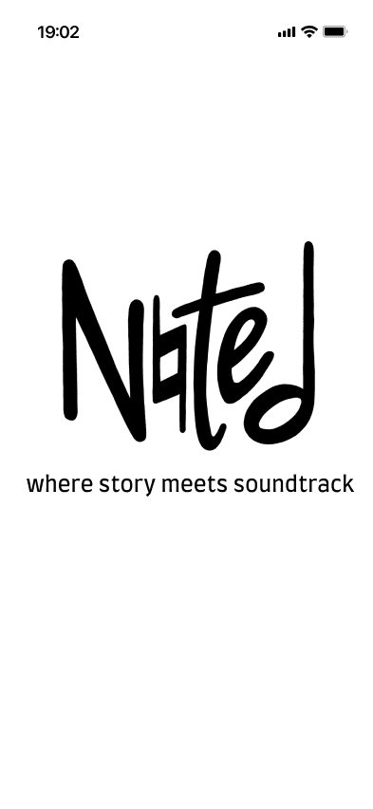
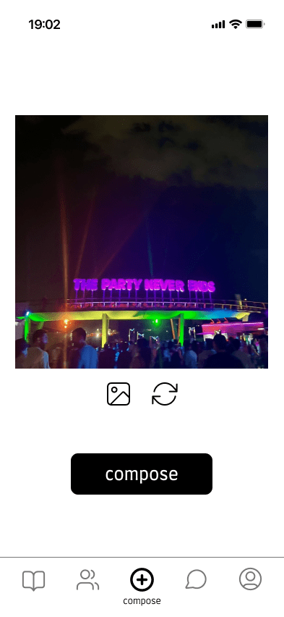
Splash screen & auto-direct to the ‘compose’ screen
Revised opening set-up
User sees a splash screen with our value proposition and logo → centers the user on the purpose of the app right from the start
then…
User is brought directly to the ‘compose’ screen to create a photo-song pairing → increases efficiency & reduces friction for completing the simple task
Splash screen with value prop
Compose screen

Slide 24
redesigning homepage
major design change #3
Original design featured a homepage with both the user’s personal feed of photo-song pairings and a feed of friends’ posts
Issues with the original design:
Prototype-testers had difficulty identifying icons as photo/song pairings due to small size and clutter
Reflection on previously created photo-song pairings was impeded by the wealth of (potentially distracting) content all on one screen
Horizontal scrolling on the two feeds was too unique for users to quickly understand, leading to less interaction with the homepage
original homepage

Slide 25
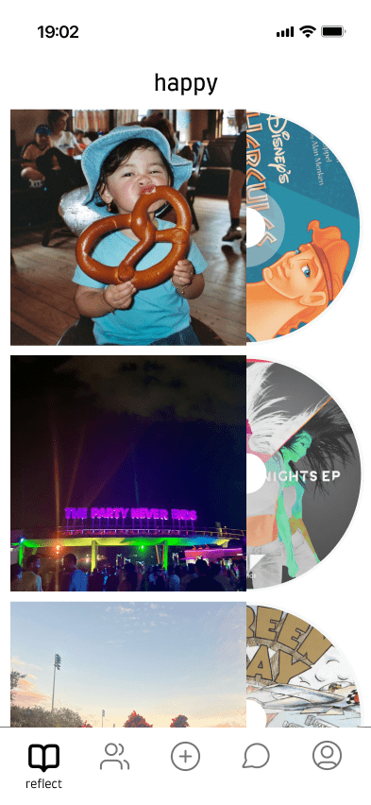
redesign of the homepage
aka the ‘reflect’ page
Removed the musical staff design in favor of clarity and increased image size
Switched from a horizontal scrolling feed to a vertical scrolling feed
Moved the friends feed to a separate screen to allow the main focus of the homepage to be on reflecting on
Significantly increased the size of the photos and their associated CDs to allow users to better see the photos and be more likely to interact with them
revised homepage

Slide 26
06
med-fi flows

Slide 27
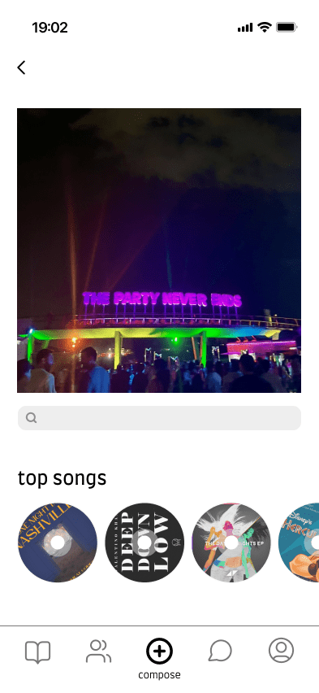
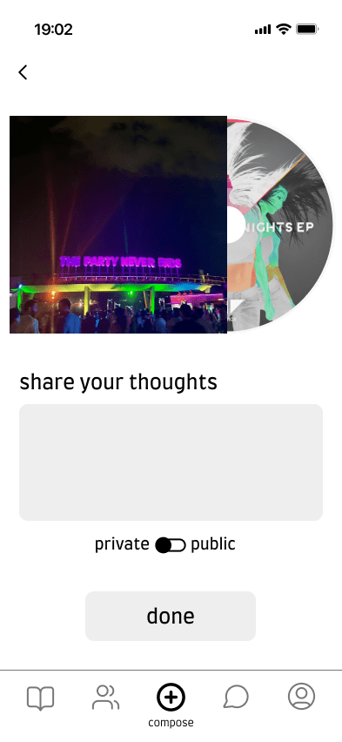
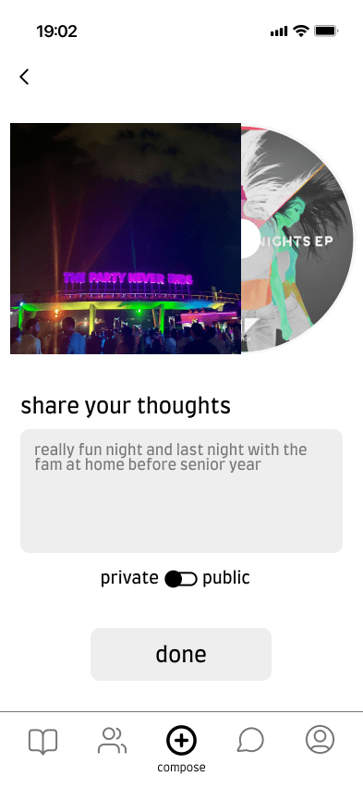
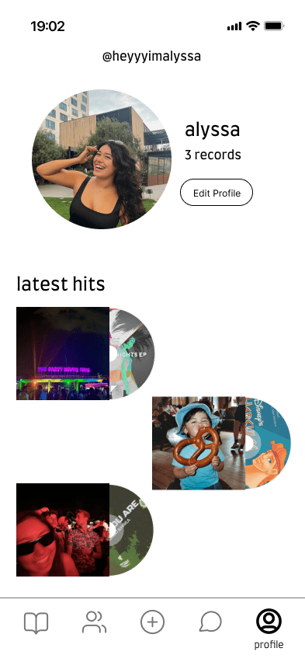
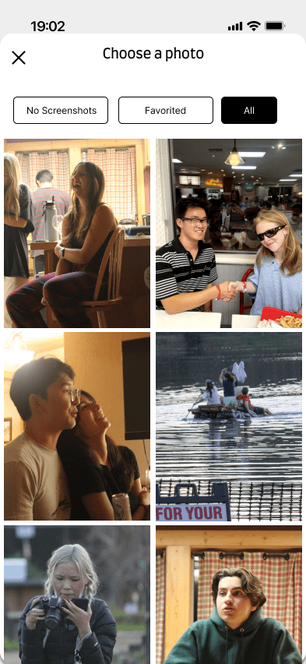
simple task flow
Custom photo selection modal. Users can choose to filter out screenshots, only show favorited photos, or show all of them.
Select a photo: Left photo button opens photo library where you can choose new photo. Regenerate button loads a new random photo from library. Compose takes current picture and moves to next screen.
Select a song: Top songs fetched from Spotify are displayed in horizontal scroll. User can search for a song to pair as well. Navigate to next screen by tapping on a song.
Add a Description: Tap on text input to write a description.
Toggle Visibility / Share: Toggle between private and public visibility. Hit done to share.
Confirmation: Pairing is shown in user’s timeline on the profile section, confirming that the post has been created and shared.
pair songs to photos

Slide 28
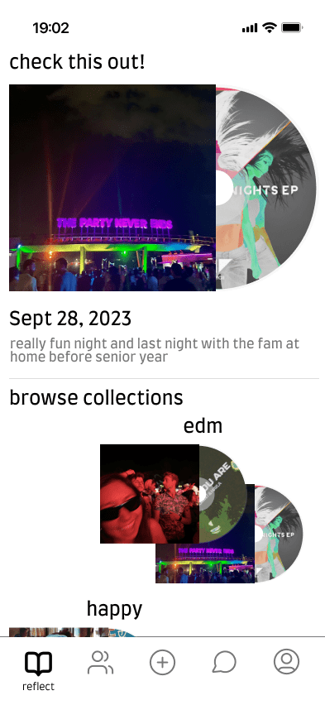

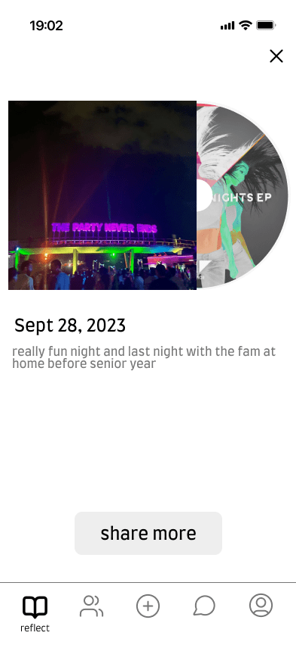
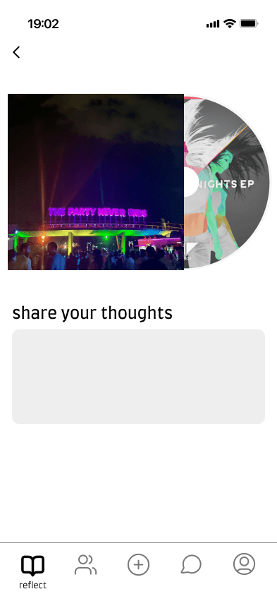


moderate task flow
Browse Curated Memories: A random past user pairing is featured at the top. Below are curated collections of user’s photo/song pairings, categorized by mood/genre of music. Click on collection to view it.
Explore a Collection: Collection page features vertical scroll of all pairings in that collection. Click on a pairing to view and expanded model of it.
Choose a Pairing: The pairing’s date and description are displayed. Press “share more” button to pull up a text input box to add a new description.
Add a description: Press the text input to add text.
Save Changes: Press done to save.
Confirmation: Updated information is now displayed, showing that the changes went through.
rediscover old memories

Slide 29
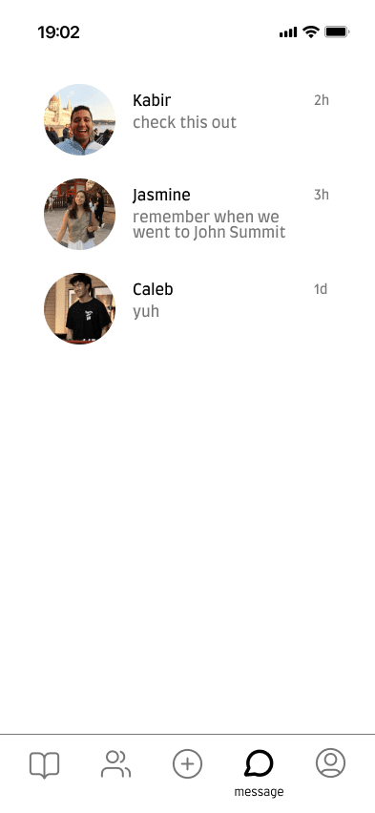
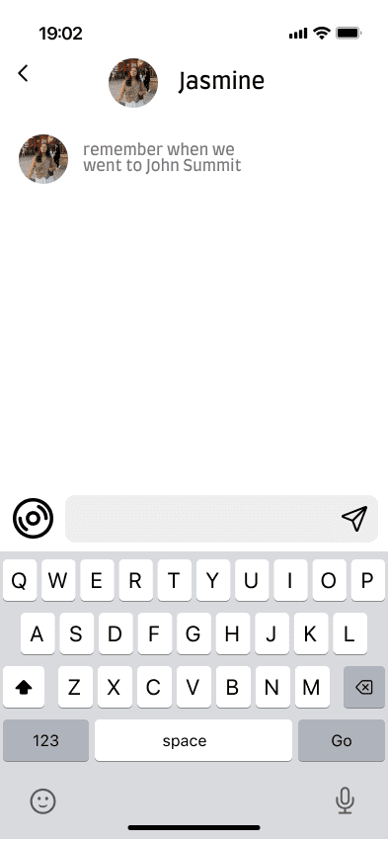
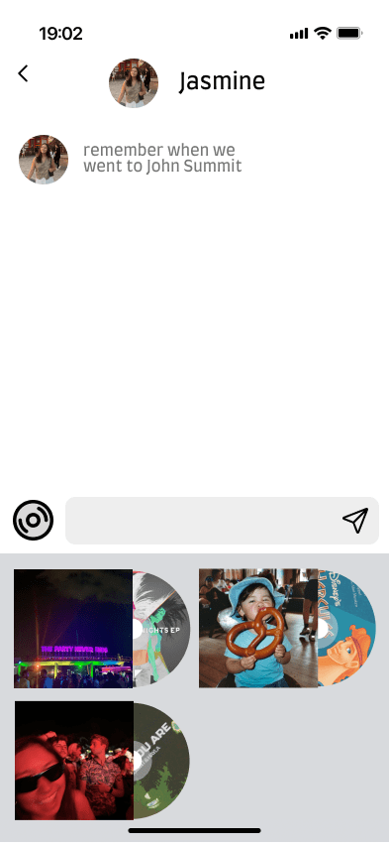
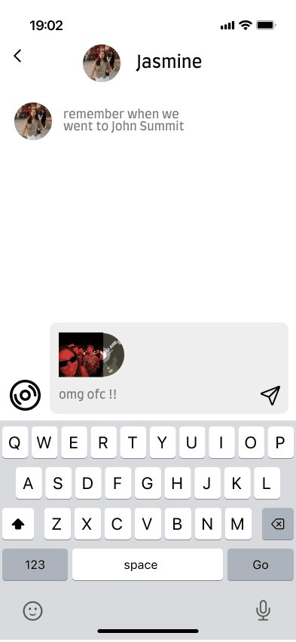
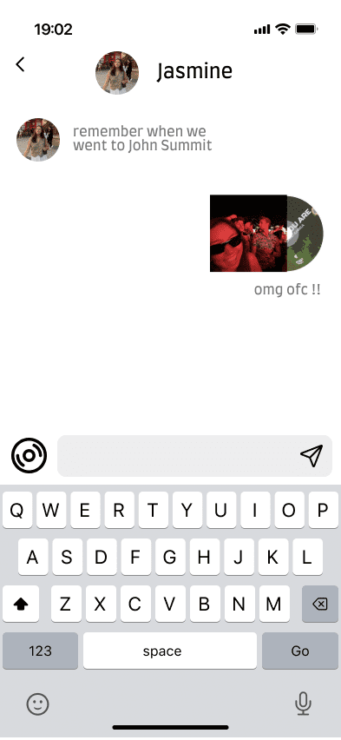
complex task flow
Navigate to Message Section: Friends are displayed in a vertical flatlist. Press a user item to navigate to direct message screen for that user.
Access User Photo/Song Pairings: Press the CD icon to access user’s photo song pairings.
Selecting Photo/Song Pairing: Press a specific photo song pairing to place it in message box.
Sending a Photo/Song Pairing: Optionally write a message and press send button to send it to the friend.
Confirmation: Pairing has been sent! It should now appear in the message history, confirming that it was delivered.
share photo/song pairings with others

Slide 30
07
implementation

Slide 31


prototype implementation
We sketched our logo using Procreate!
We built our prototype using Figma!
Pros:
Supports free hand drawing, ideal for brainstorming and ideation
Ease of use - Intuitive for people who have never used before
Supports copy/paste of drawings, allowing for reuse of components
Sketches are vectorized
Pros:
Supports real-time collaboration
Can easily reuse components found across screens
Abundance of community resources (ex: icon packs) makes it easy to come up with a design palette
Interactive prototyping allows for simulation of common mobile app gestures such as swiping through photos or tapping to play a song
Cons:
No real-time collaboration
Limited to iOS devices only. Most useful with iPad and apple pen. Not everyone in our group has an iPad
Cons:
No code extensibility so flow consists entirely of click transitions
Somewhat of a learning curve for non design majors
No native support to integrate sound (music) in prototypes
All assets are static, so it doesn’t account for loading times for music and images

Slide 32
limitations
what was left out?
Users cannot add custom text descriptions to photo/song pairing
  Not related to any major task flow
Social integration features
  Aside from directly sending a pairing to a friend, our major task does not involve adding friends, viewing their profiles, or blocking them
Login flow
  We assume the user has already created an account. Login flow is unrelated to any major task flow
No Spotify integration
  Figma does not support Spotify integration
Accessible design for deaf community
  We are continuing to think about either in-app lyric incorporation or linking to another app/Spotify for the lyrics

Slide 33

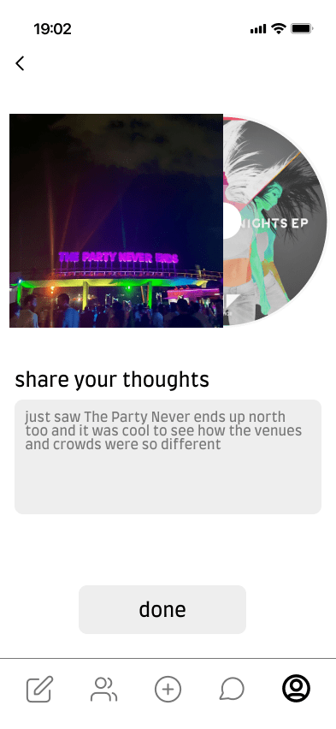
wizard-of-oz features
Top tracks based on Spotify listening history
Default descriptions for photo-song pairings

Slide 34



hard-coded features
All Wizard-of-Oz features are hard-coded
Spotify top tracks (user-specific)
The photo-song pairings themselves
User profile information

Slide 35
08
appendix

Slide 36
additional design changes
Added username to the top of profile pages
Supported multiple description/journal entries associated with each pairing
Added hover help text in compose screen
  Helps with the learning curve for new users
Switched from record to CD to represent musical component of photo/song pairing
  Interviews and people in section thought that songs were difficult to view whereas album art is much more easier to recognize
Added ‘back’ carets to screens to allow users to back out of errors and have greater control over their navigation
Redesigned the profile page to be focused solely on the user’s posts and settings
Added a image selection button on the ‘compose’ screen to allow users to select a photo of their choice rather than using a randomly generated photo

Slide 37
Figma link

