Slide 1
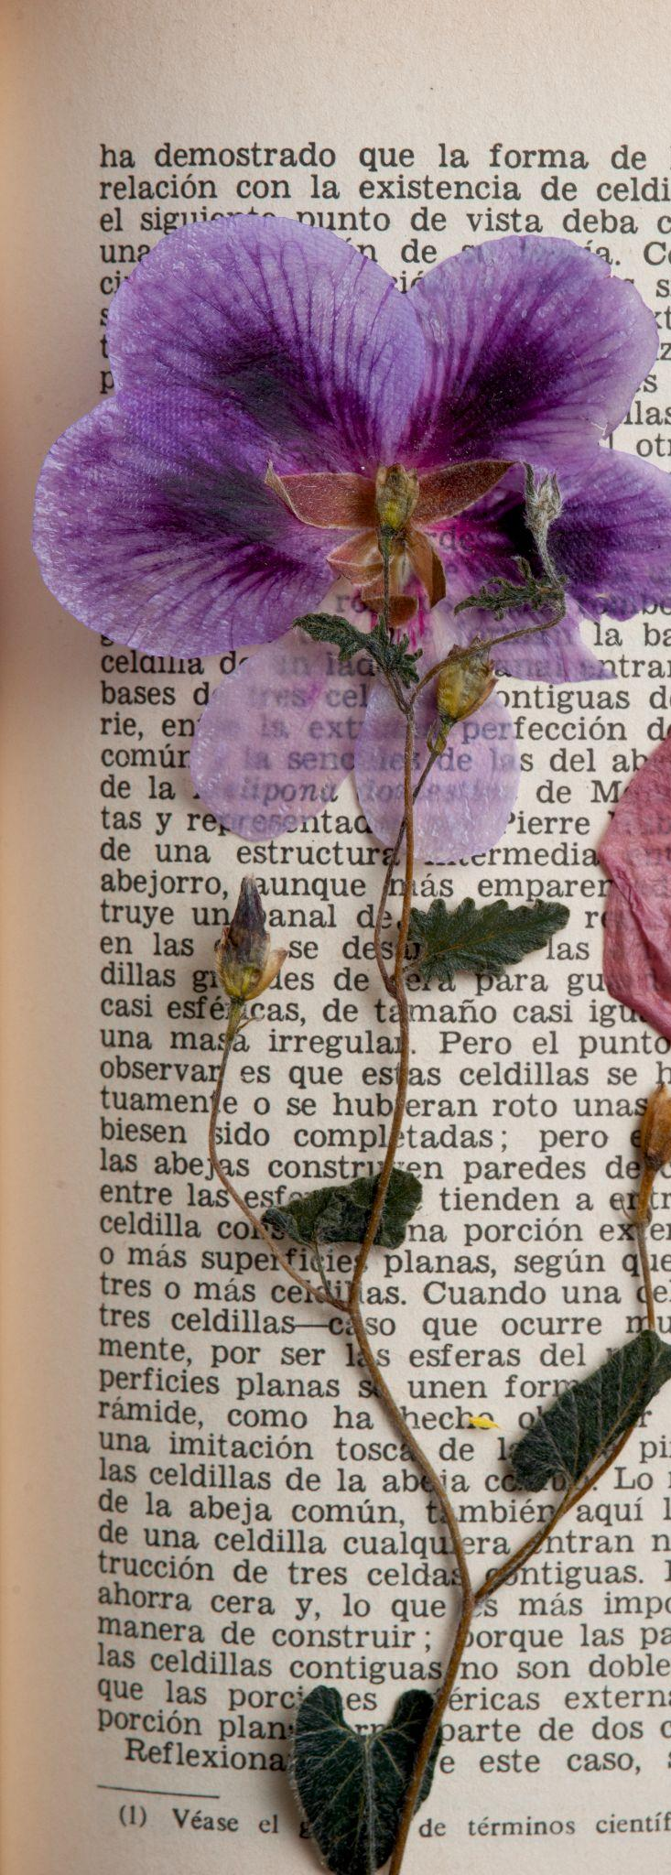
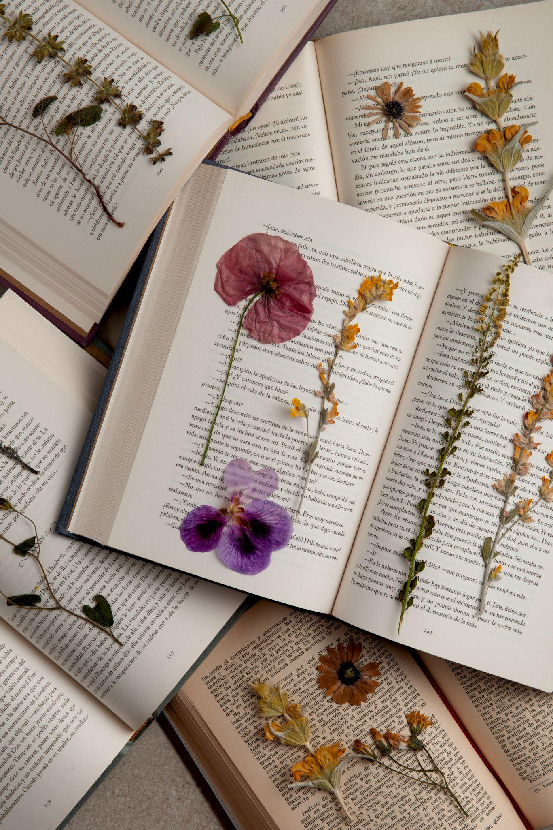
ARTX: Discussion community for isolated artists
Yutong Zhang, Winnie Chen, Georgia Limcaoco, Kongmeng Her
Needfinding Report

Slide 2
table of contents
01
02
03
04
Introduction
METHODS
Team & domain selection
Needfinding methodology & participants
Interview Analysis
Summary
Key quotes & surprises & empathy map & insights & needs
Everything together

Slide 3
01
Introduction
Team & domain selection

Slide 4

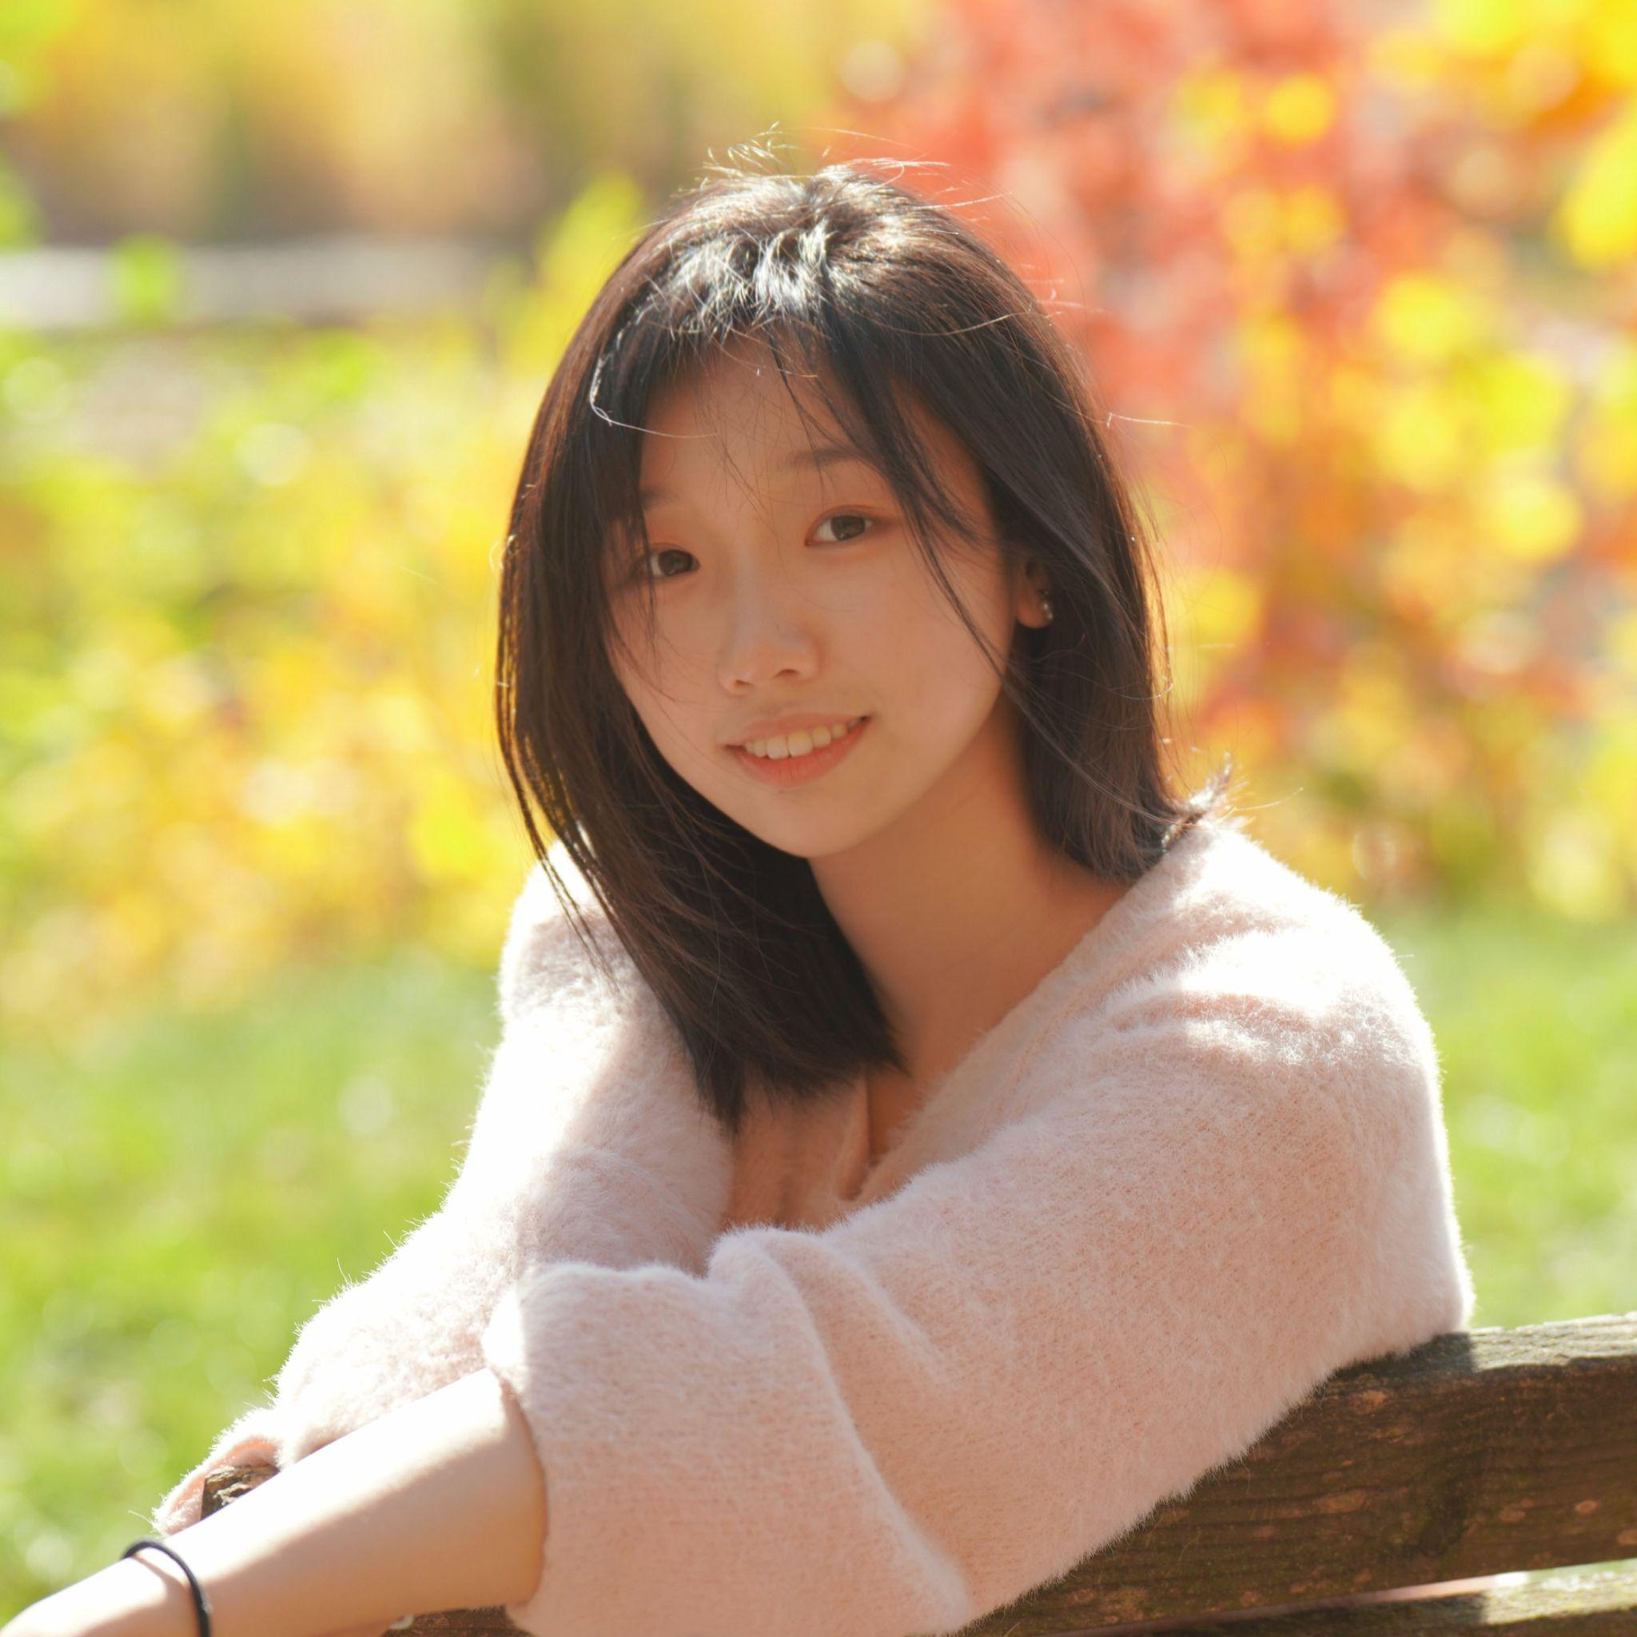
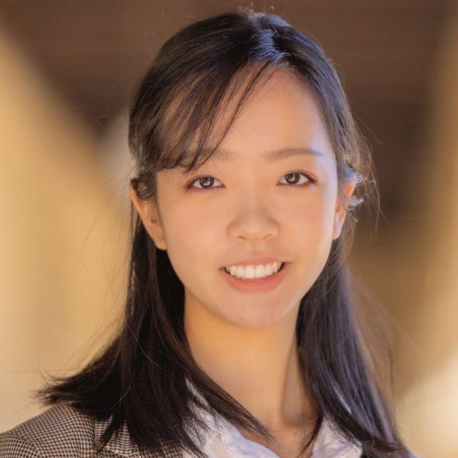
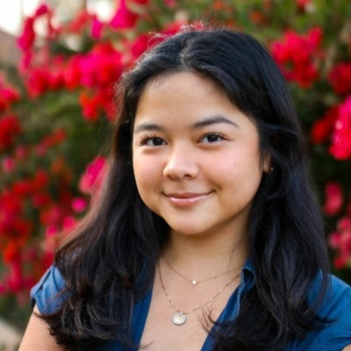
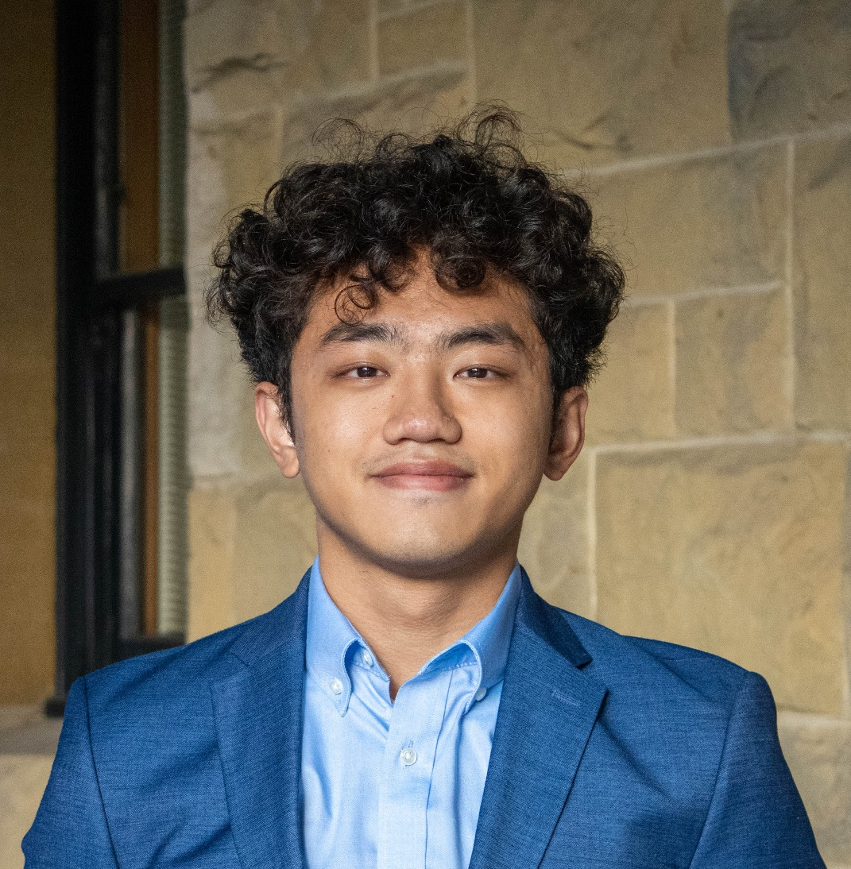
OUR TEAM
Yutong
Zhang
Winnie
Chen
Georgia
Limcaoco
Kongmeng
Her

Slide 5
domain selection
Interest in entertainment/the arts (from in section activity)
Experience as an isolated artist
Community for traditionally isolated artists/creatives
Community knowledge sharing

Slide 6
02
METHODS
Needfinding methodology & participants

Slide 7
SOURCING PARTICIPANTS
Full-time/highly committed to their art form
Non-Stanford
Considering more isolated versus less isolated art forms
Diversity of art forms or professions

Slide 8
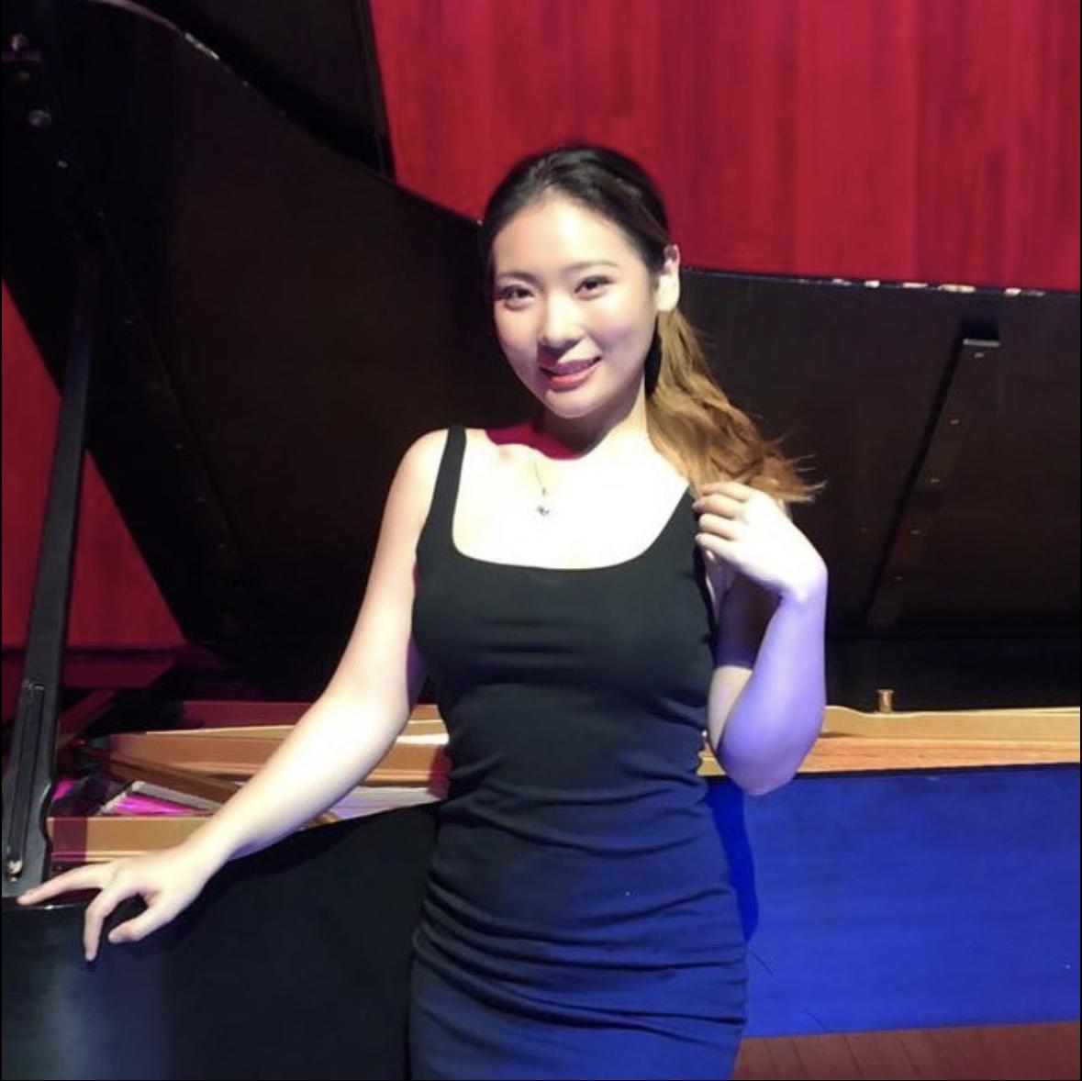
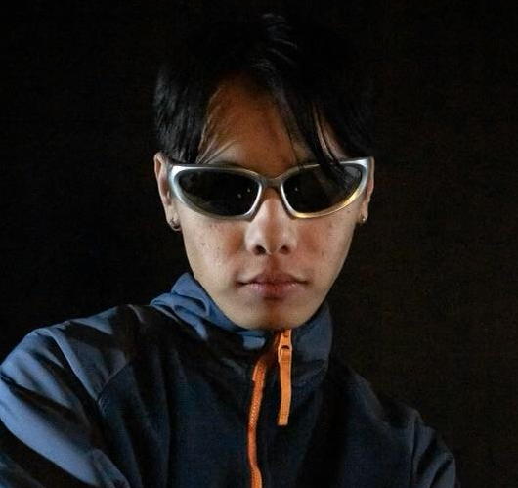
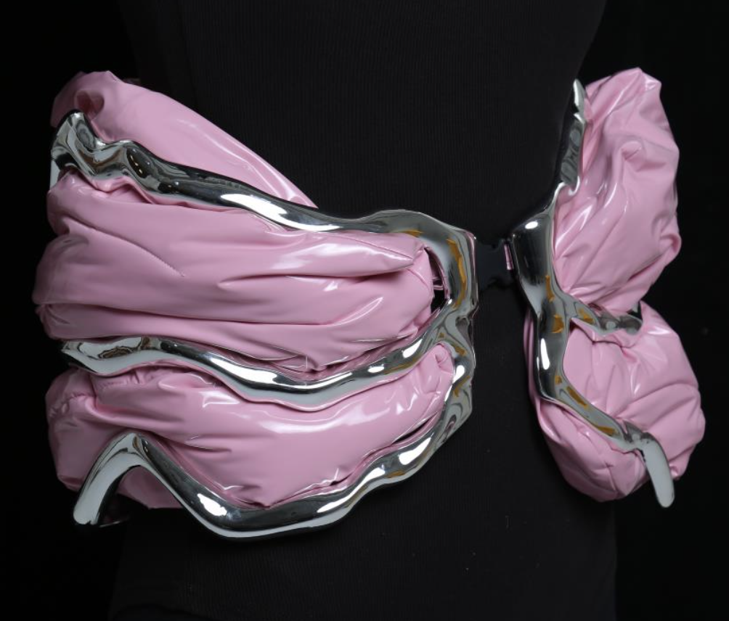
OUR participants
RU
Musicology PhD of UIUC
Vocal artist
Milpitas, CA
CHALI
Artistic Director of Dance Group
College student
Stanford, Ca
Kangyi
Master of Royal College of Art
Jewelry Designer
London, UK

Slide 9
Interview questions
What is your day-to-day workflow?
Are you satisfied with your current workflow?
How do you find inspiration when you’re feeling stuck?
What aspects of the creative process do you find most difficult?
When do you feel the need to reach out and speak to someone else?
Do you have any significant past collaboration experiences?
Who do you turn to when you need suggestions and inspiration?
Do you prefer offline or online communication?
Would you prefer discussing with a large or a smaller group of people?
Are you open to meeting new people in your local area?

Slide 10
03
Interview Analysis
Key quotes & surprises & empathy map & insights & needs

Slide 11
RU
[Hardest part of creative process] “When I was first starting to create art instead of performing art other people created, it was the organizing part and socializing part.”
"I would prefer to start with a big group but then small group talk, and then see how we can go from there. It will end with 1:1 to actually talk—that can actually make something happen.”
Surprise: went from having a community to being isolated

Slide 12
Chali
[When do you feel the need…someone else?] “My friends interact with me more regularly and understand my story, they can help me highlight and expand parts of myself.”
“I don't like dancing by myself anymore.”
“Dance is less about me and more about my team.”
Surprise: went from being isolated to having a community, finds that he creates for different reasons between these two situations.

Slide 13
KANGYI
"Sometimes designers will introduce to each other, but we kind of don’t care about each other."
"Artists already know what they want to do. They just are not sure about it – they just need other reactions to help them be sure."
Surprise: has never had a collaborative community and is not searching for one

Slide 14
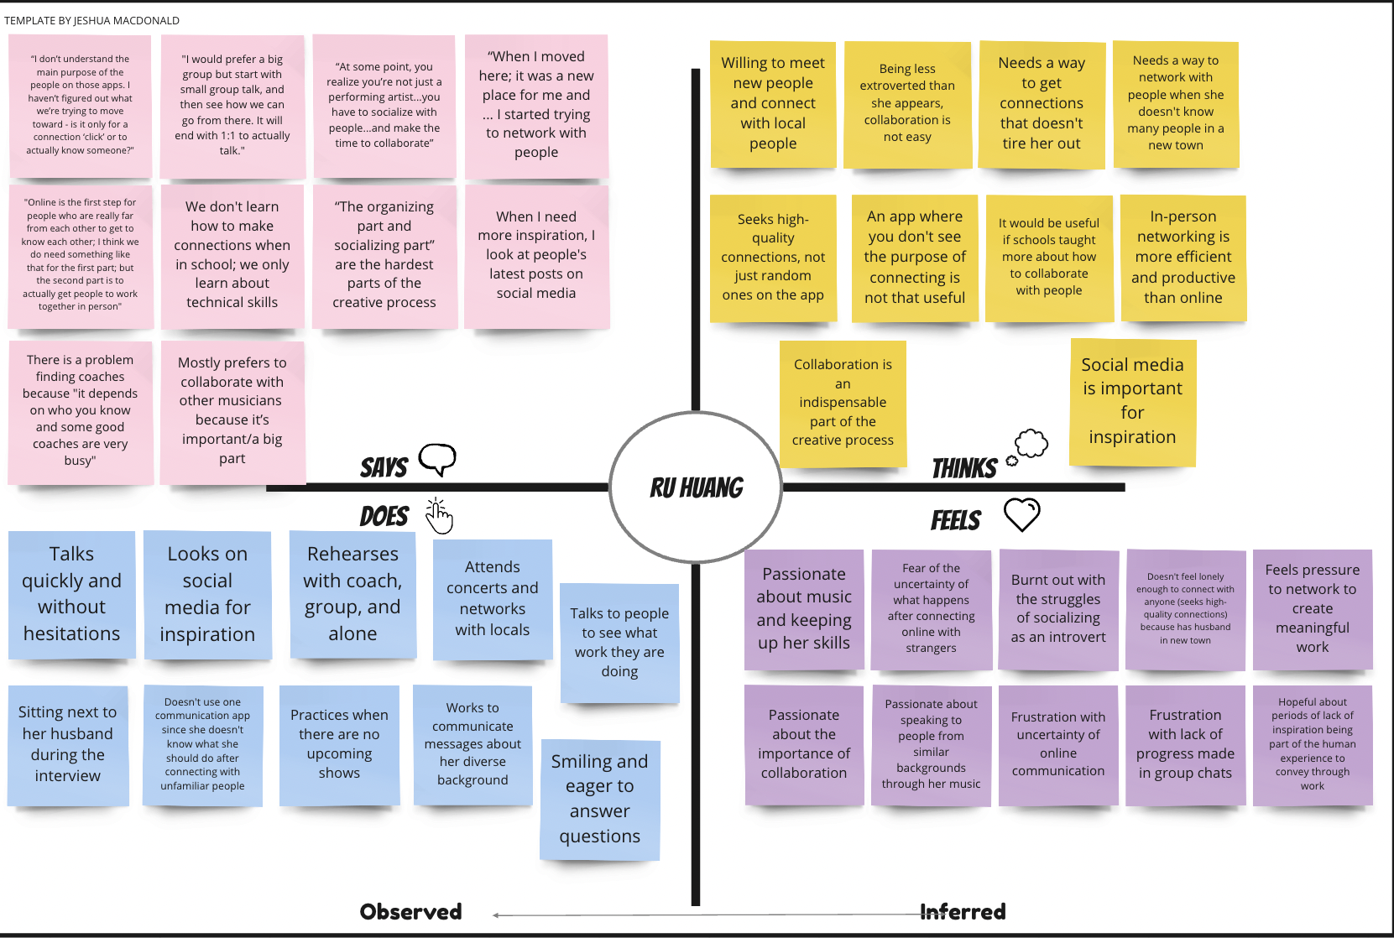

Slide 16
Ru
Insight
Insight
Need
Introverted artists struggle with networking for collaboration but feel the importance of creating connections for collaboration purposes.
Introverted artists need an avenue for easier connection with other artists.

Slide 17
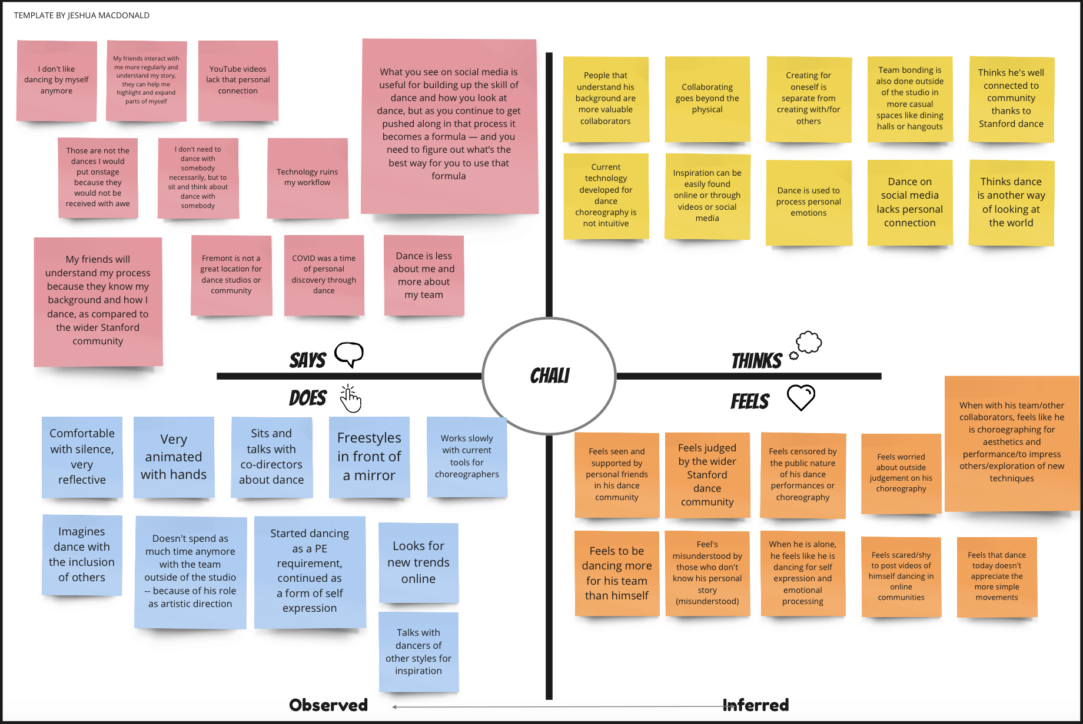
SAYS
THINKS
DOES
INFERENCES

Slide 18
SAYS
THINKS
DOES
INFERENCES

Slide 19
Chali
Insight
Need
Artists create differently for themselves and for others/performance.
Artists turn to their close circles for support and motivation.
Artists need opportunities to create for both audiences.
Artists need to feel understood personally and not just as a creative.

Slide 20
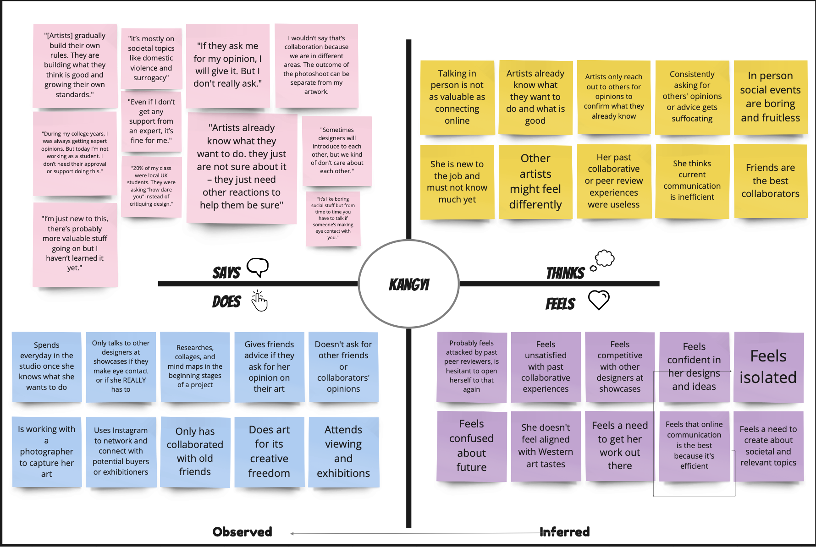
SAYS
THINKS
DOES
INFERENCES

Slide 21
SAYS
THINKS
DOES
INFERENCES

Slide 22
Kangyi
Insight
Insight
Need
Artists already have an internal sense of what they believe is good, but seek out others for validation.
Artists have a need for avenues to receive validation.

Slide 23
04
Summary
Takeaways

Slide 24
Here are three MAIN ideas
#1
#2
#3
The mode of collaboration needs to be conceived as comfortable and valuable for artists to opt in.
Different artists require different things
(Performance artists vs Visual artists).
Collaboration is an avenue to self understanding, not just external inspiration.

Slide 25
NEXT STEPS
#1
Further develop our interview scope to find other types of artists
#2
Explore different niches within our domain
#3
Brainstorm POVs and HMWs

Slide 26

Thank
you!

