Slide 1
Capsule
Needfinding Report

Slide 2
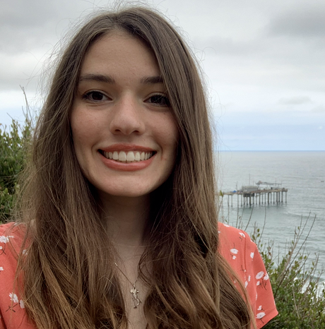
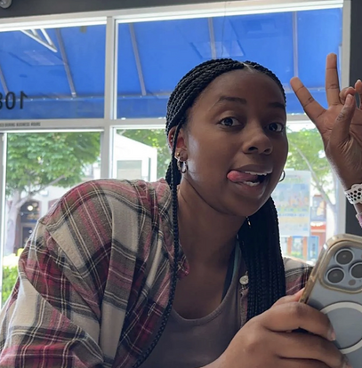
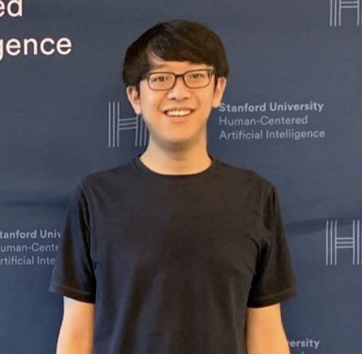
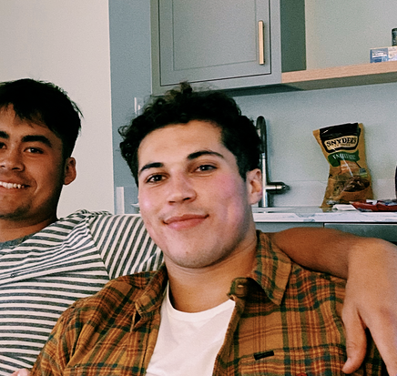
Meet the team!
Julia Markel
Kendal Murray
Allen Nie
Tristan Sinclair
3rd Year CS PhD
Pordenone, Italy
Junior in SymSys
Hayward, CA
5th Year CS PhD
Danville, CA
CS Coterm
Alamo, CA

Slide 3


Choosing a domain
Threads
Trends

Slide 4

Choosing a domain
Social Media

Slide 5

Choosing a domain
Social Media
Community

Slide 6
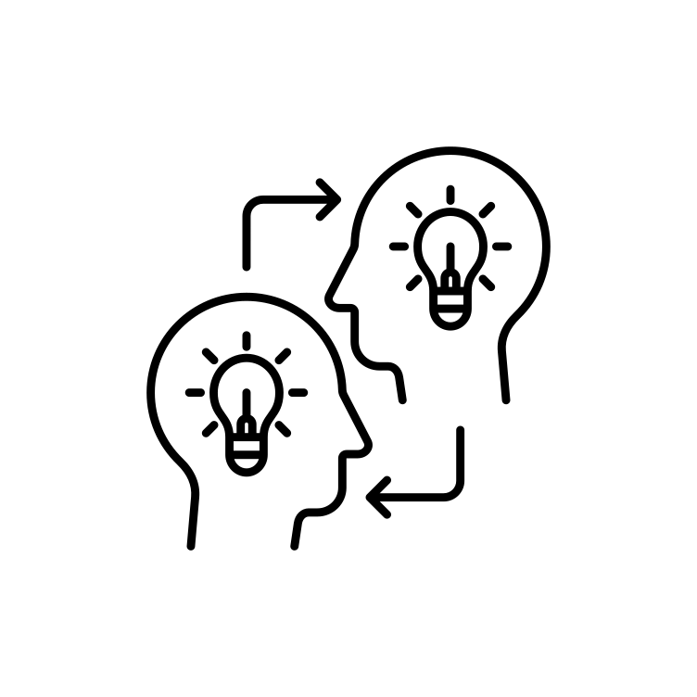
Choosing a domain
Social Media
Community
Knowledge Sharing

Slide 7
Participant selection
We went out …

Slide 8
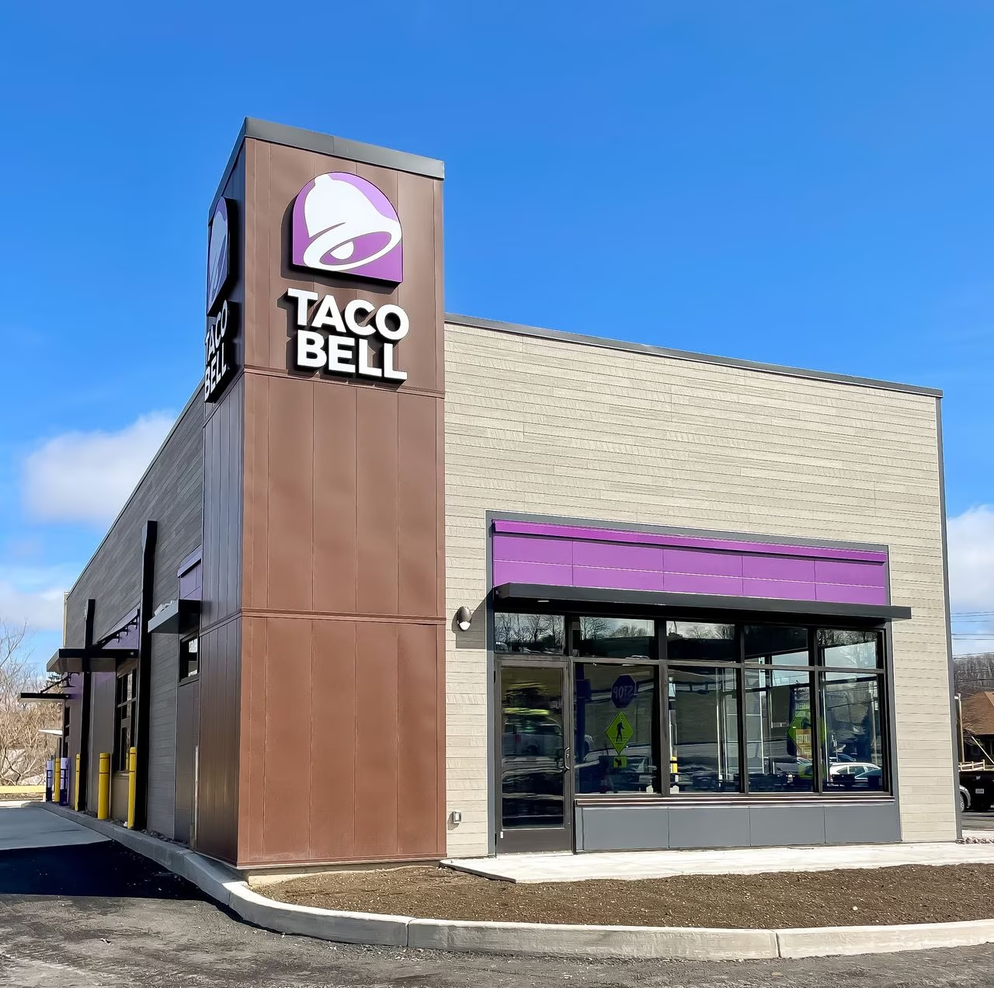
Participant selection
We went out …

Slide 9
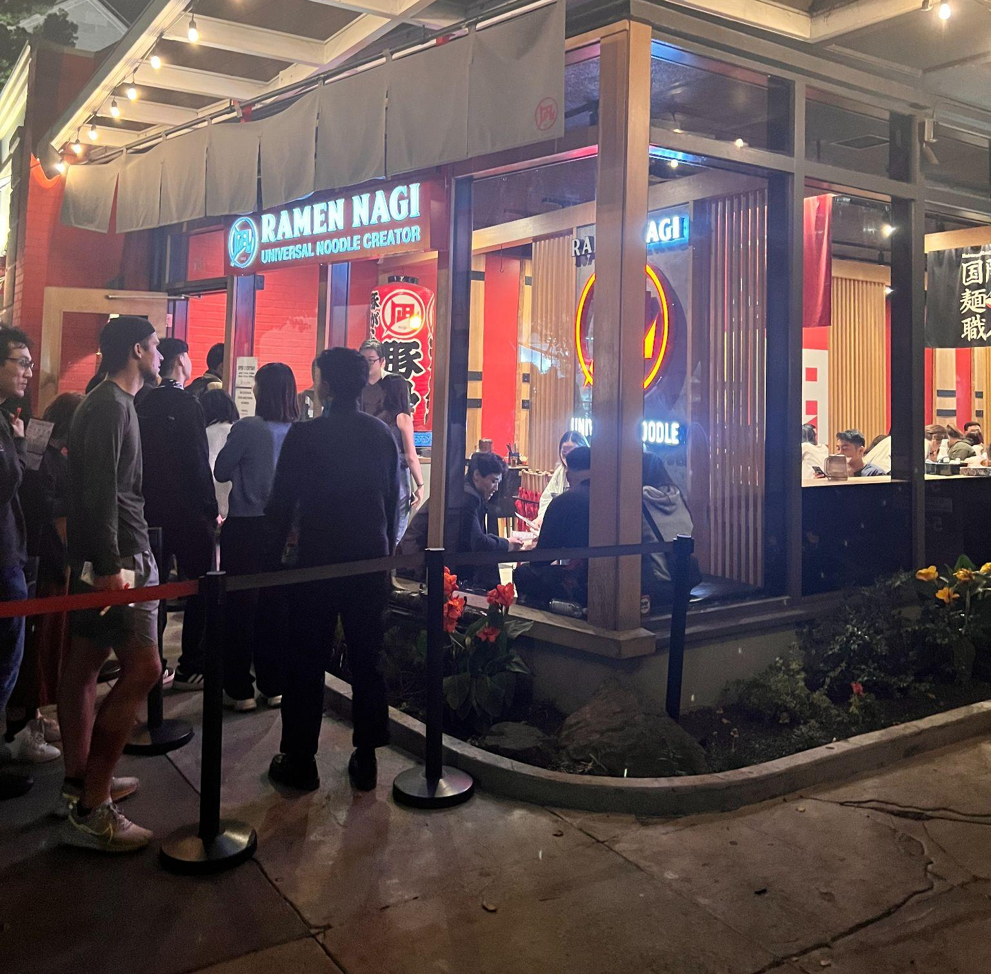
Participant selection
We went out …

Slide 10
Participant selection
We sought diversity …

Slide 11

Participant selection
We sought diversity …

Slide 12

Participant selection
We sought diversity …

Slide 13

Participant selection
We sought diversity …

Slide 14

Participant selection
We sought diversity …

Slide 15
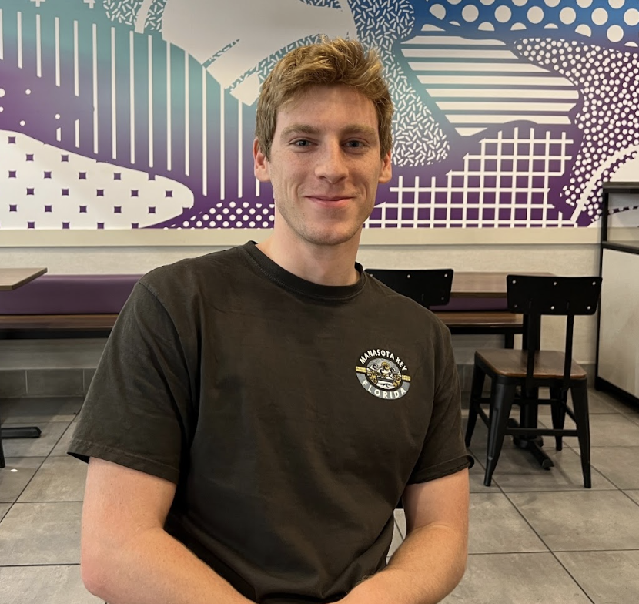
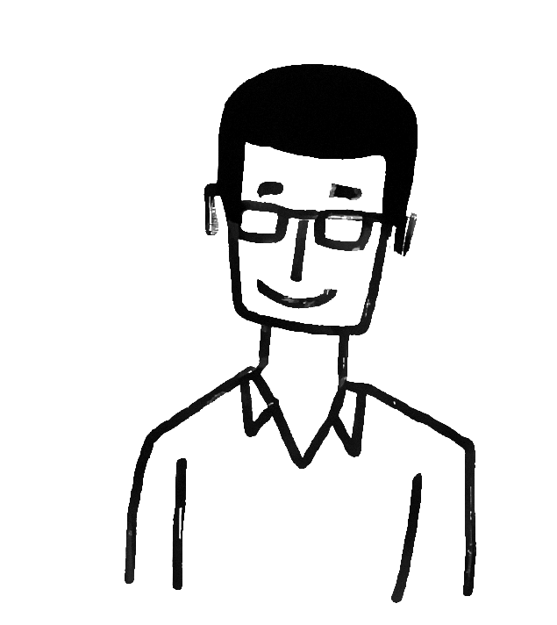
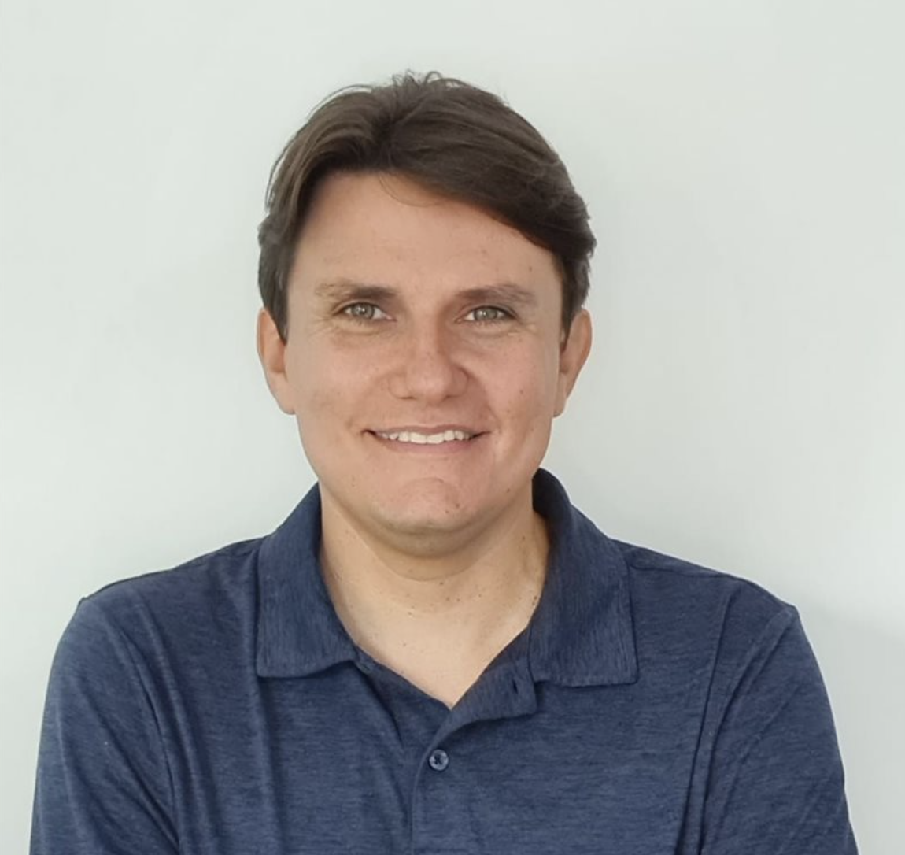
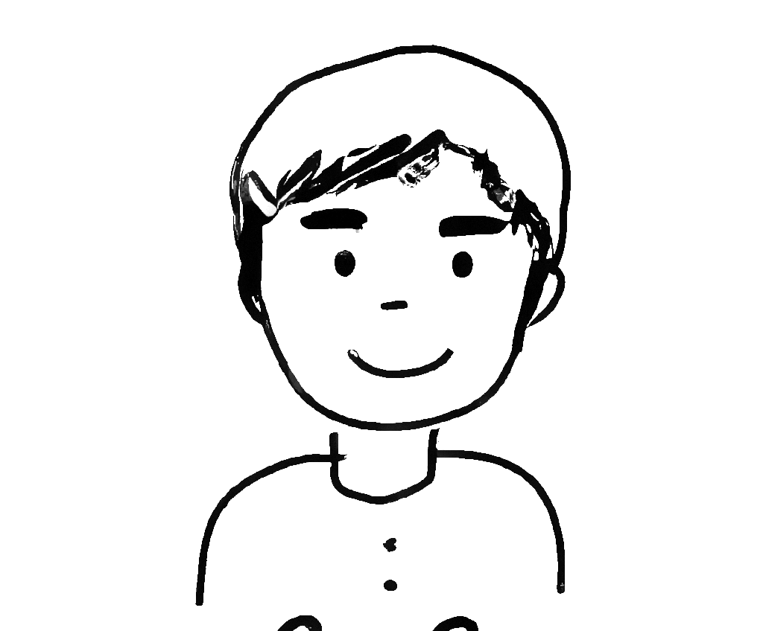
Who we spoke with
Hunter
Zed
Gustavo
Coco
Early 20s
Software Engineer @
Tesla
From Ohio
Late 20s
Data Scientist @
Survey Monkey
From India
Early 20s
Student @ Stanford
From Utah
Early 40s
Head of Legal Latin America @
Expedia
From Brazil

Slide 16



What we asked about
Relationship with social media
Sentiments toward fun facts
Definition of community

Slide 17
What we asked about
… and more!
Relationship with social media
Sentiments toward fun facts
Definition of community

Slide 18
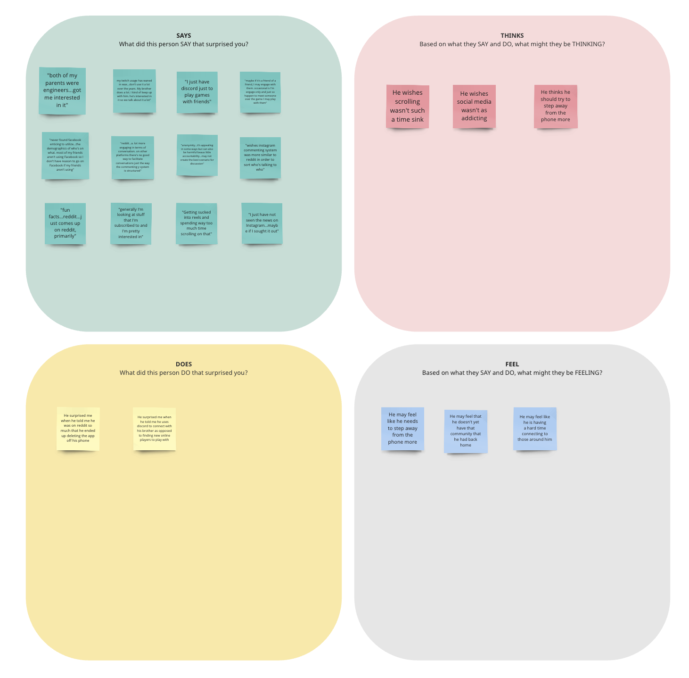
P1 - Hunter: Avg User

Slide 19
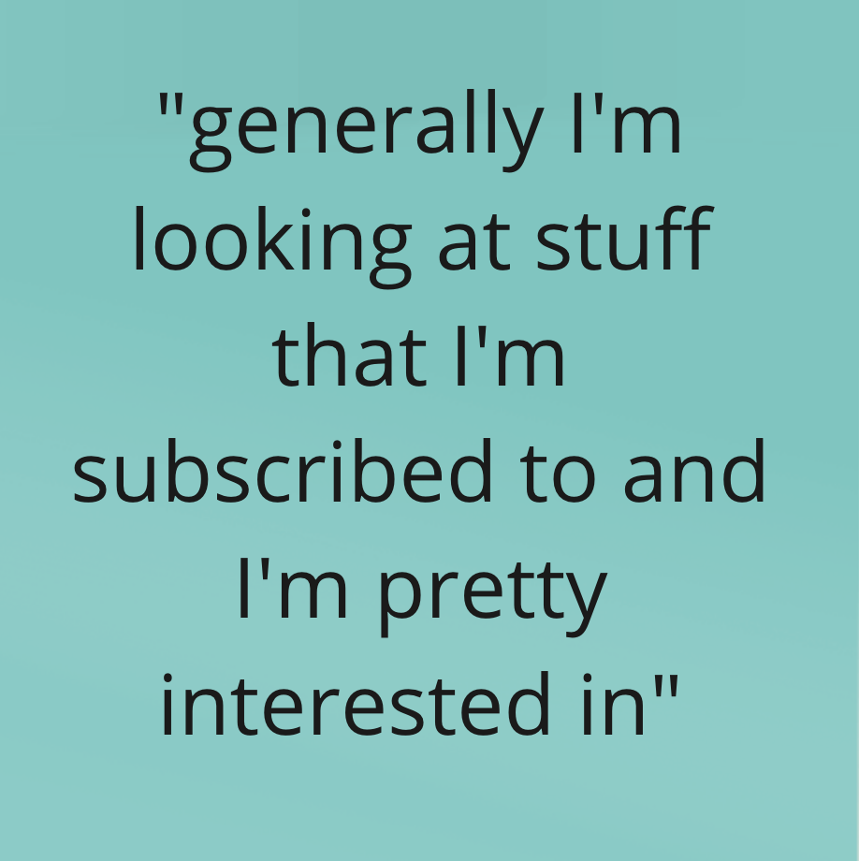
P1 - Hunter: Avg User
Says he looks at content he’s subscribed to

Slide 20
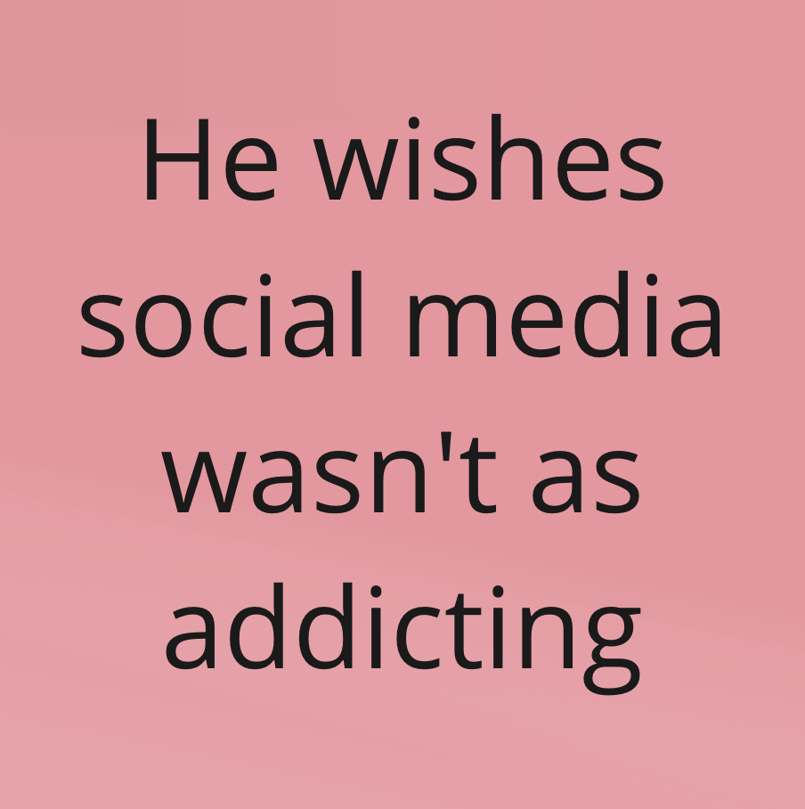
P1 - Hunter: Avg User
Says he looks at content he’s subscribed to
Wishes social media wasn’t so addicting

Slide 21
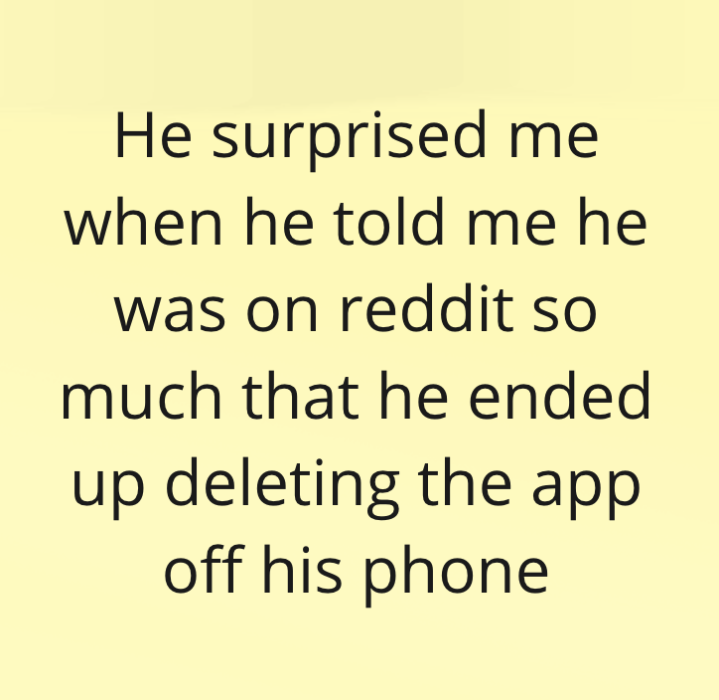
P1 - Hunter: Avg User
Says he looks at content he’s subscribed to
Wishes social media wasn’t so addicting
Has deleted an app due to overuse

Slide 22
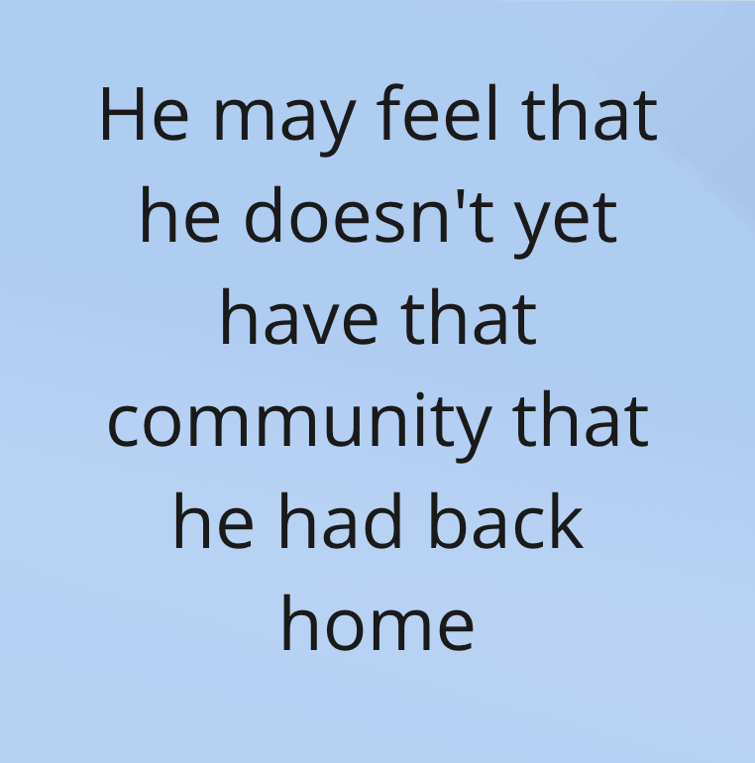
P1 - Hunter: Avg User
Says he looks at content he’s subscribed to
Wishes social media wasn’t so addicting
Has deleted an app due to overuse
Doesn’t feel a sense of community here yet

Slide 23
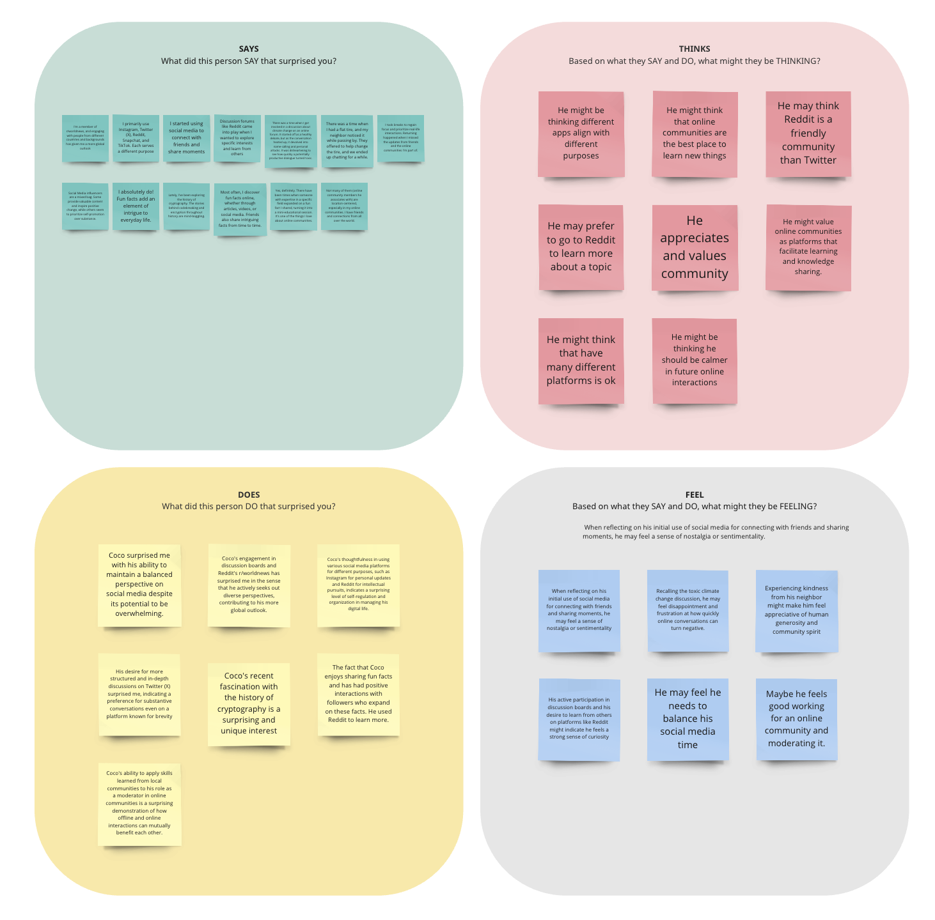
P2 - Coco: Strong User

Slide 24
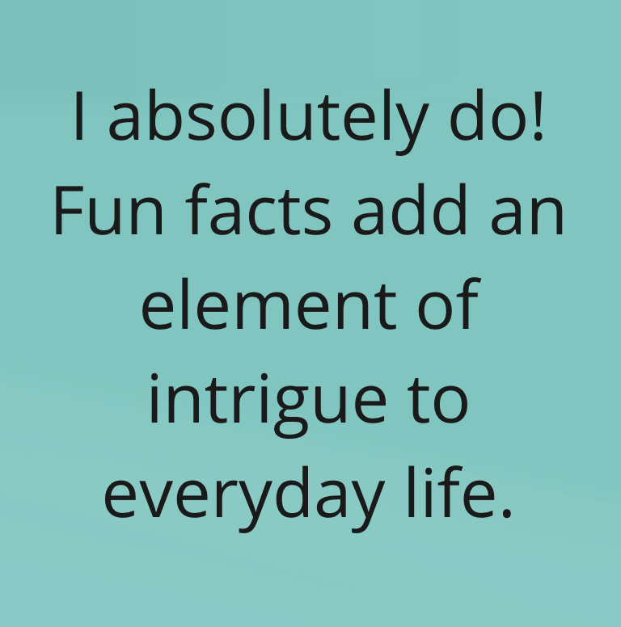
P2 - Coco: Strong User
Says that fun facts are intriguing

Slide 25
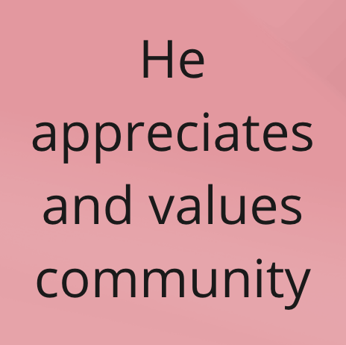
P2 - Coco: Strong User
Says that fun facts are intriguing
Appreciates and values community

Slide 26
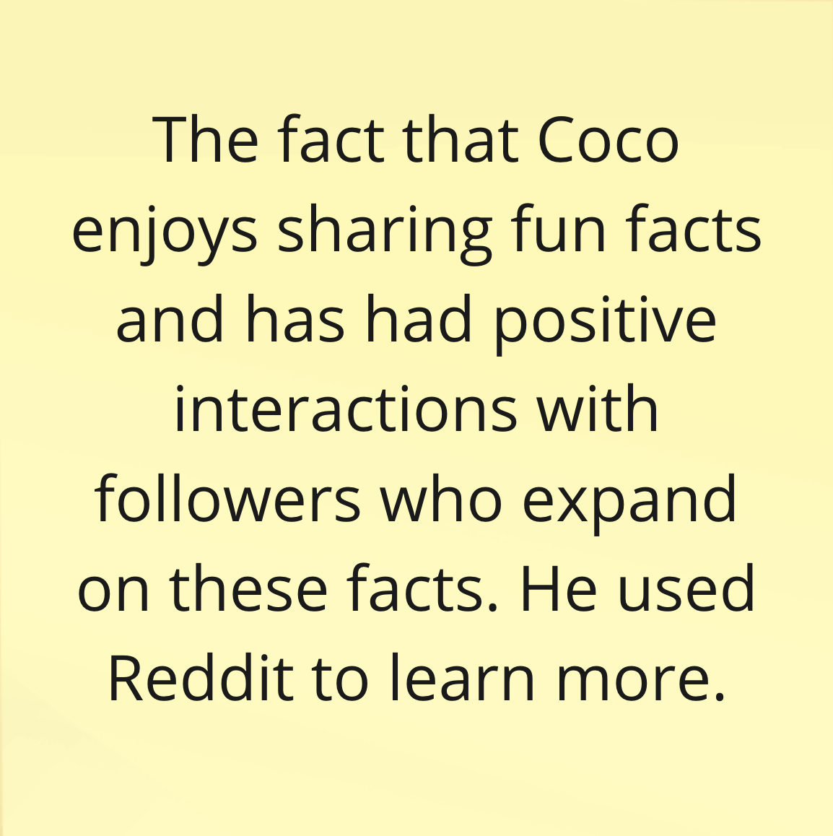
P2 - Coco: Strong User
Says that fun facts are intriguing
Appreciates and values community
Enjoys using Reddit to learn and share knowledge with followers

Slide 27
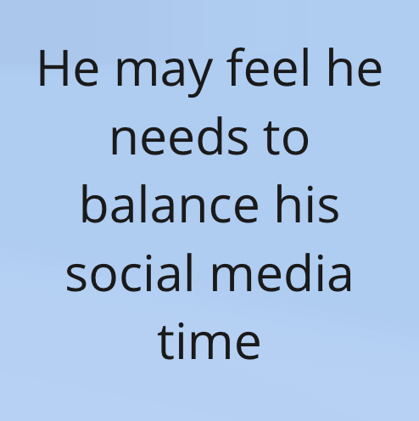
P2 - Coco: Strong User
Says that fun facts are intriguing
Appreciates and values community
Enjoys using Reddit to learn and share knowledge with followers
Feels like he needs to manage the amount of time spent on socials

Slide 28
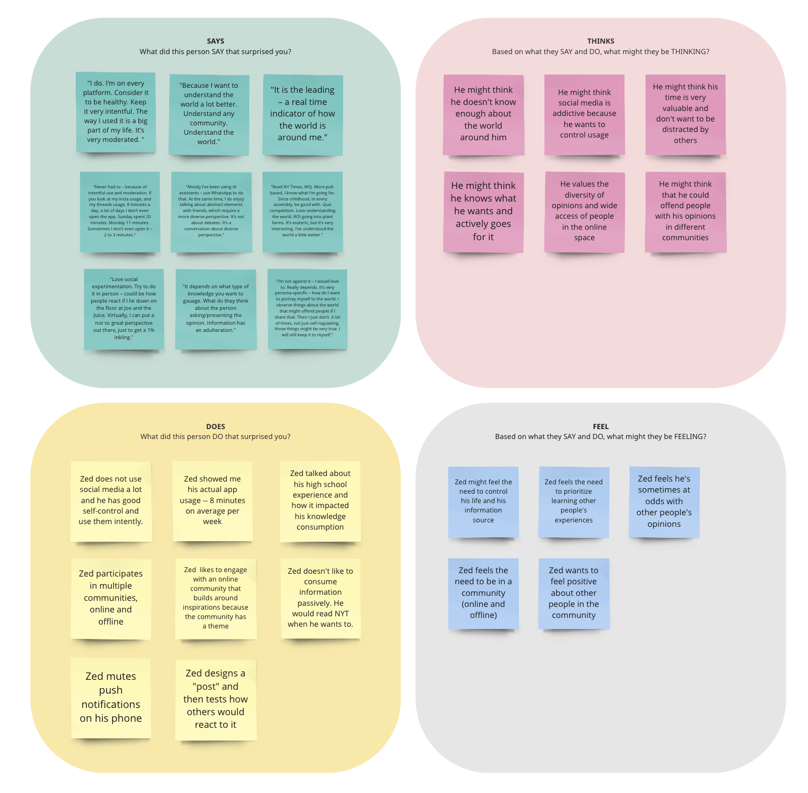
P3 - Zed: Light User

Slide 29
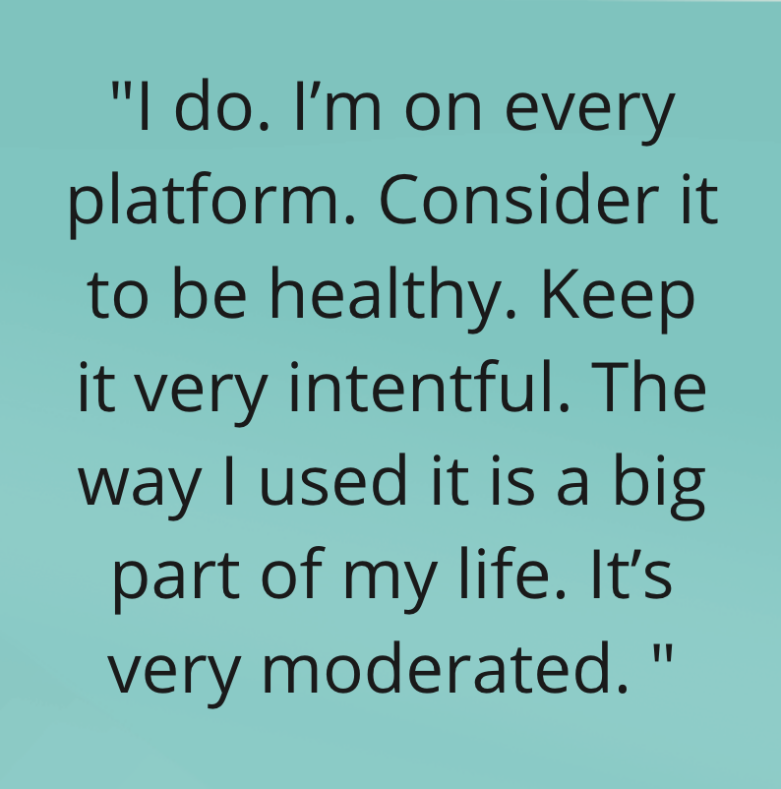
P3 - Zed: Light User
Says it’s healthy for him to be on every platform

Slide 30
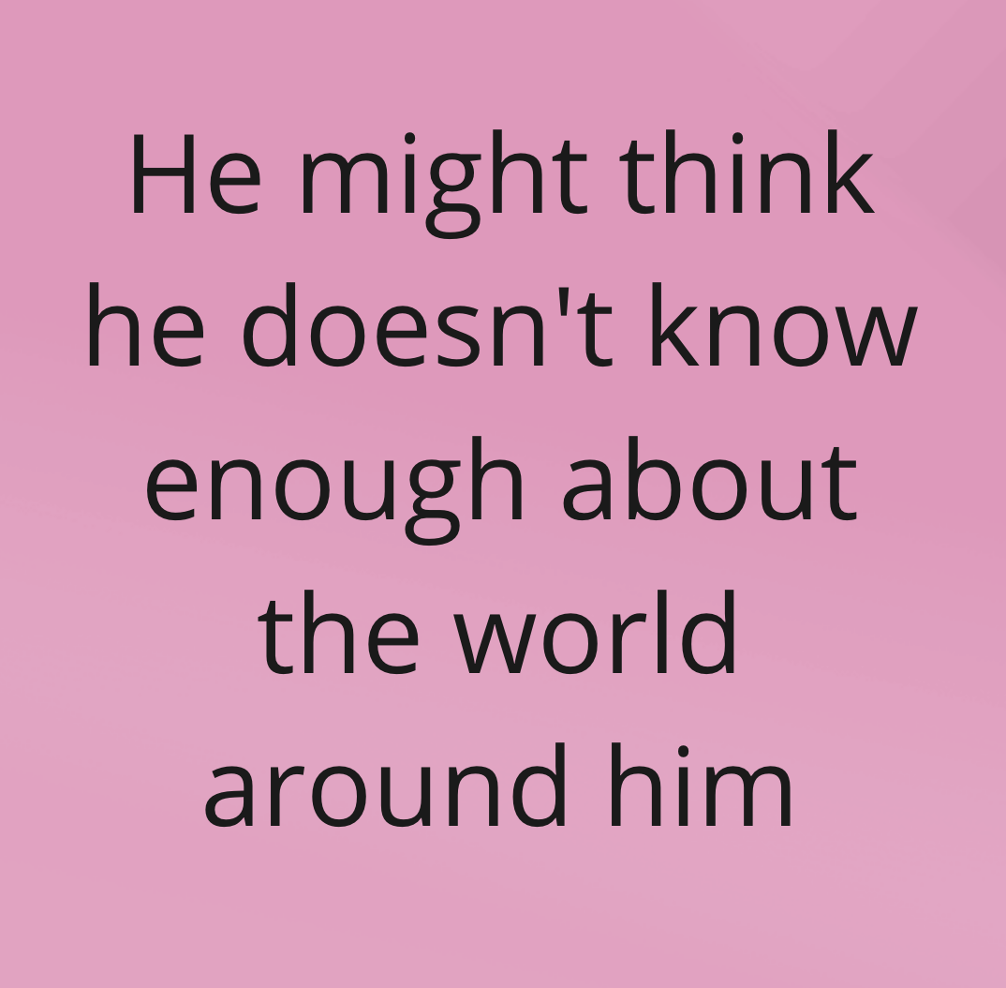
P3 - Zed: Light User
Says it’s healthy for him to be on every platform
Thinks he doesn’t know enough about the world around him

Slide 31
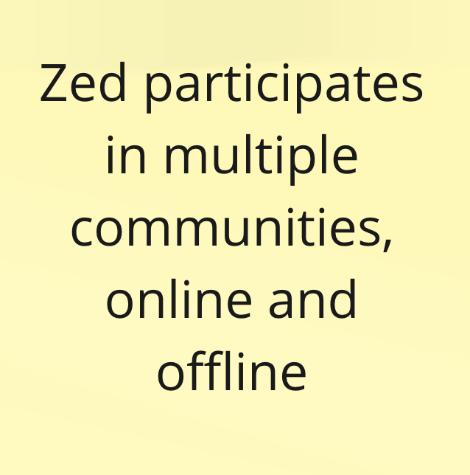
P3 - Zed: Light User
Says it’s healthy for him to be on every platform
Thinks he doesn’t know enough about the world around him
Is an active participant in several communities

Slide 32
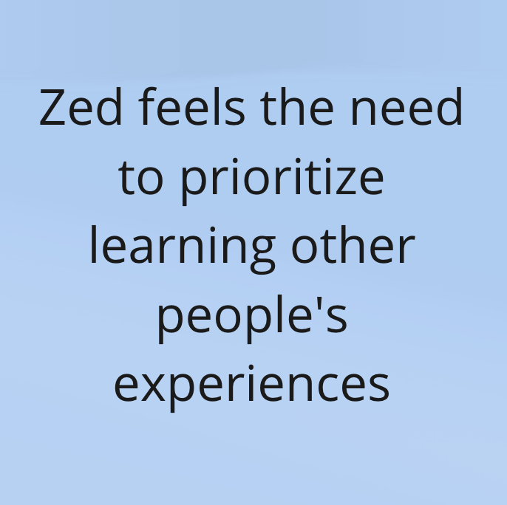
P3 - Zed: Light User
Says it’s healthy for him to be on every platform
Thinks he doesn’t know enough about the world around him
Is an active participant in several communities
Feels the importance of learning from others

Slide 33
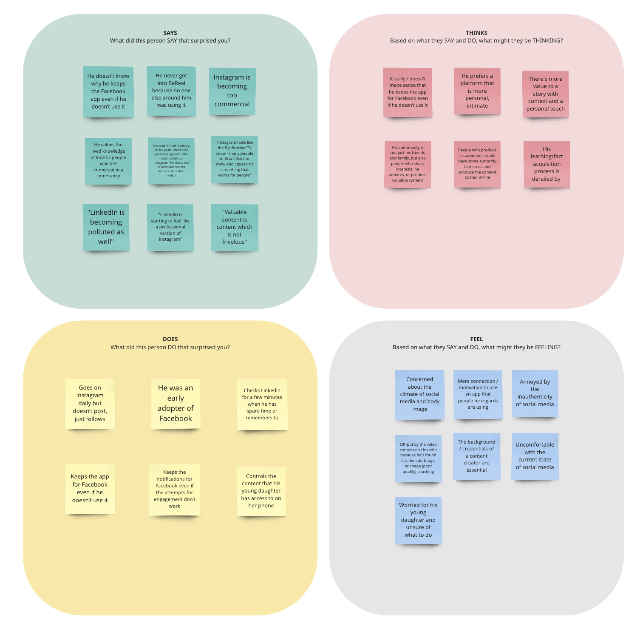
P4 - Gustavo: Light User

Slide 34
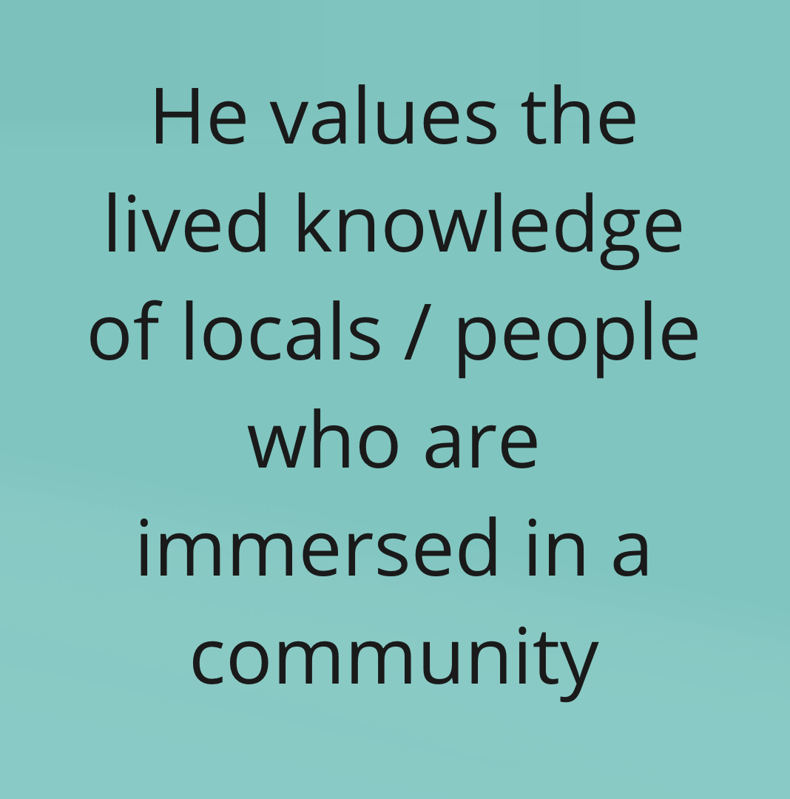
P4 - Gustavo: Light User
Says lived experiences from members of a community are important to him

Slide 35
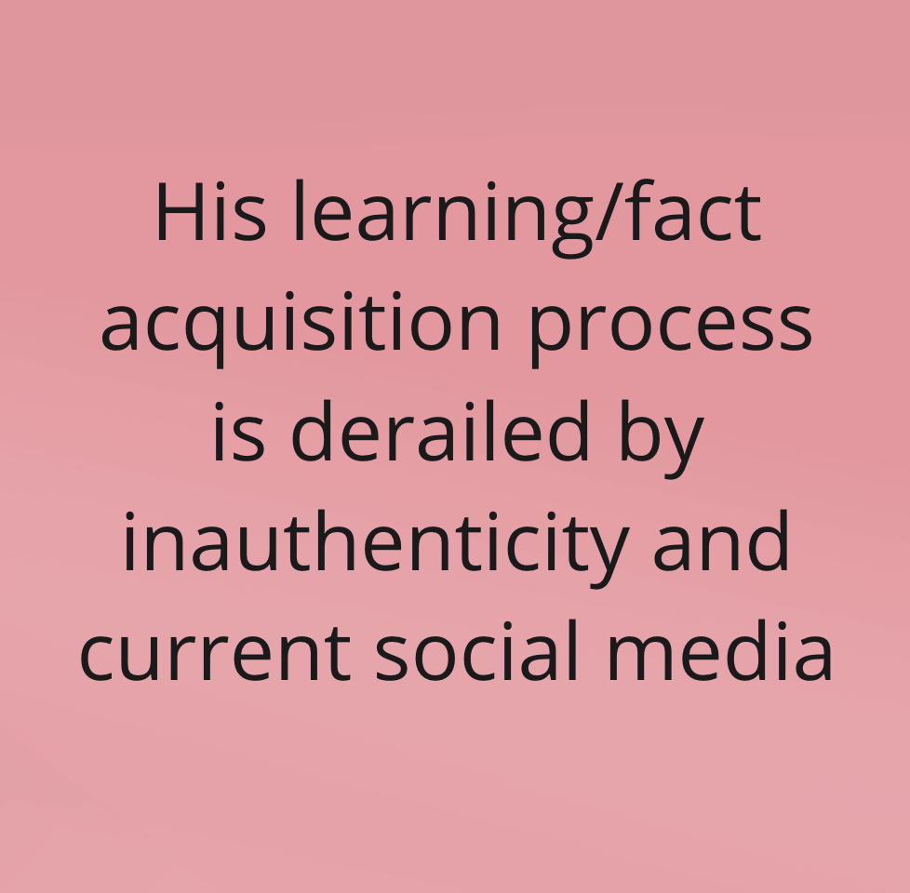
P4 - Gustavo: Light User
Says lived experiences from members of a community are important
Thinks his informal learning may be derailed by the nature of social media platforms

Slide 36
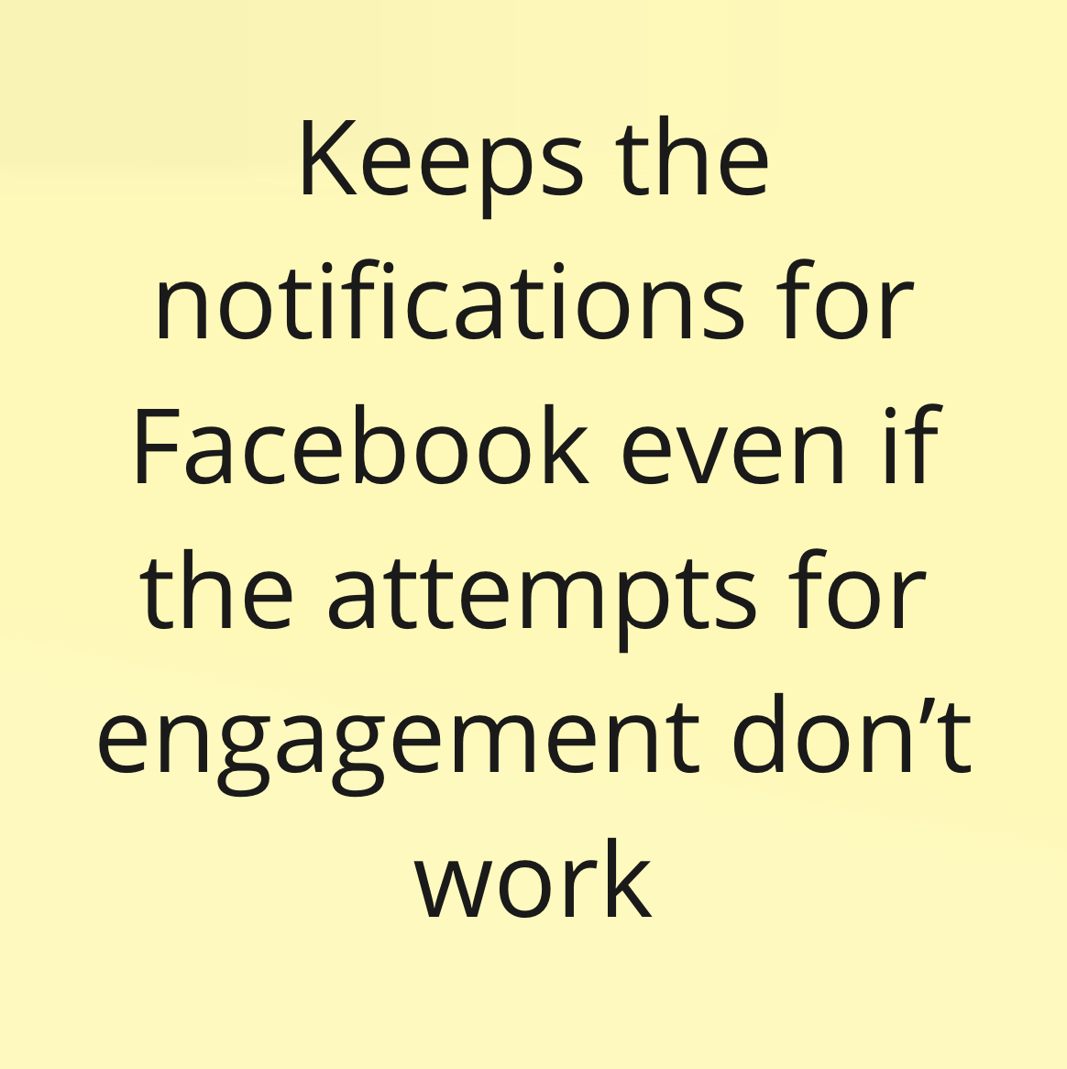
P4 - Gustavo: Light User
Says lived experiences from members of a community are important
Thinks his informal learning may be derailed by the nature of social media platforms
Keeps notifications for Facebook even if he doesn’t use the app

Slide 37
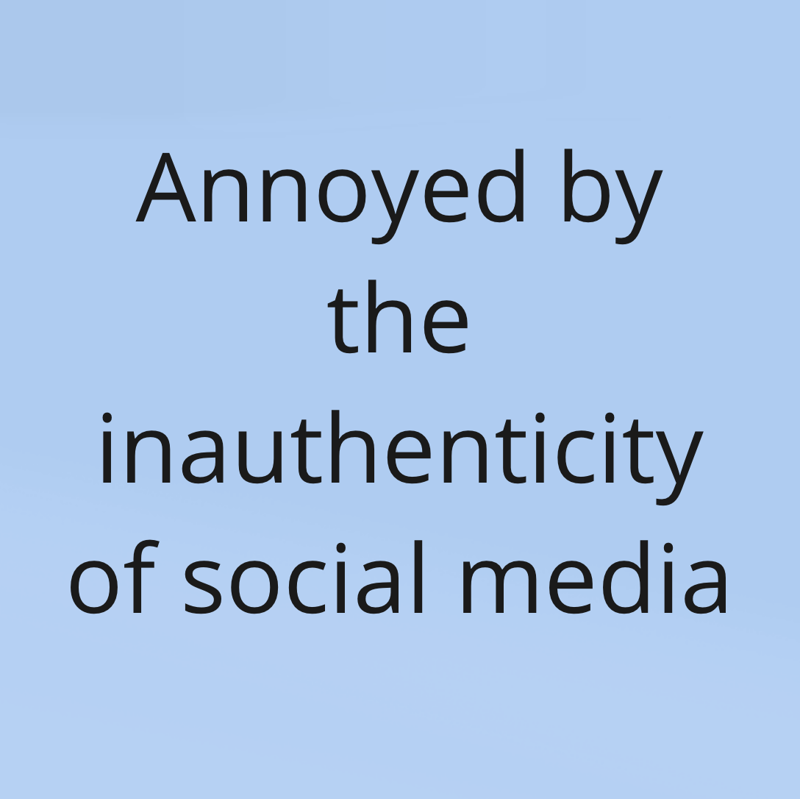
P4 - Gustavo: Light User
Says lived experiences from members of a community are important
Thinks his informal learning may be derailed by the nature of social media platforms
Keeps notifications for Facebook even if he doesn’t use the app
Annoyed with inauthenticity

Slide 38
Key insights
Things people value and are looking for [in social media]
  Community
  Learning - facts / knowledge / tips and tricks
  Authenticity

Slide 39
Key insights
Things people value and are looking for [in social media]
  Community
  Learning - facts / knowledge / tips and tricks
  Authenticity
How people feel during and after using social media
  Concerned
  Intrigued
  Wasted time

Slide 40
Key insights
Things people value and are looking for [in social media]
  Community
  Learning - facts / knowledge / tips and tricks
  Authenticity
How people feel during and after using social media
  Concerned
  Intrigued
  Wasted time
People want community and knowledge sharing from social media, but factors such as virality and information overload make it difficult to have an enjoyable experience which achieves the users’ goals.

Slide 41

What’s next?
Expand interviews to include more diversity yet
Continue to unpack these interviews and dig out insights
Focus-in on a problem
Craft HMW statements based on our POVs
Test out some experience prototypes

Slide 42

Thank you!

