Slide 1
CAPSULE
Sketching, Low-fi Prototyping & Pilot Usability Testing

Slide 2
01
Value Proposition

Slide 3
Project Title: Capsule
How did we land on the name?
We thought of the word “time capsule”, which is used to store and preserve information. We didn’t want it to sound too archaic, so we removed “time” and just kept “capsule”.
Value Proposition:
Share knowledge, receive knowledge, one capsule at a time.

Slide 4

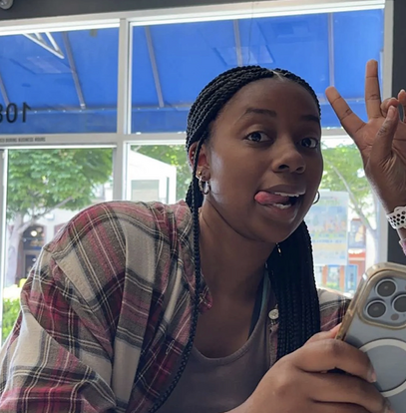

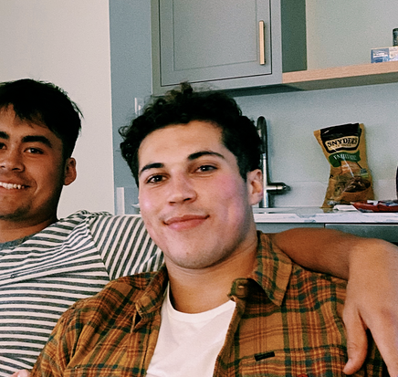
Capsule: The Team
Julia Markel
Kendal Murray
Allen Nie
Tristan Sinclair
3rd Year CS PhD
Pordenone, Italy
Junior in SymSys
Hayward, CA
5th Year CS PhD
Danville, CA
CS Coterm
Alamo, CA

Slide 5
Problem/solution overview
Primary User: college students, young people moved to in a new city
Problem: How might we empower people to share knowledge with others in their community?
Solution: An app that prompts you to do something and share them (e.g. share a fun fact, share what you learned)
Notes:
We are recognizing that a lot of people want a sense of community but have difficulty connecting with others. Trading information is an instinctive human behavior when we make connections (for example, telling others about a fun restaurant, a cool hiking spot, etc.). We want to help people feel connected and learn more about the community they are in.

Slide 6
Outline
Value proposition
Sketching and Explorations
Selected Interfaces and Rationales
Low-fi Prototype Construction
3 Task flows
Testing Methodology
Testing Results
Discussion

Slide 7
02
Sketching explorations

Slide 8
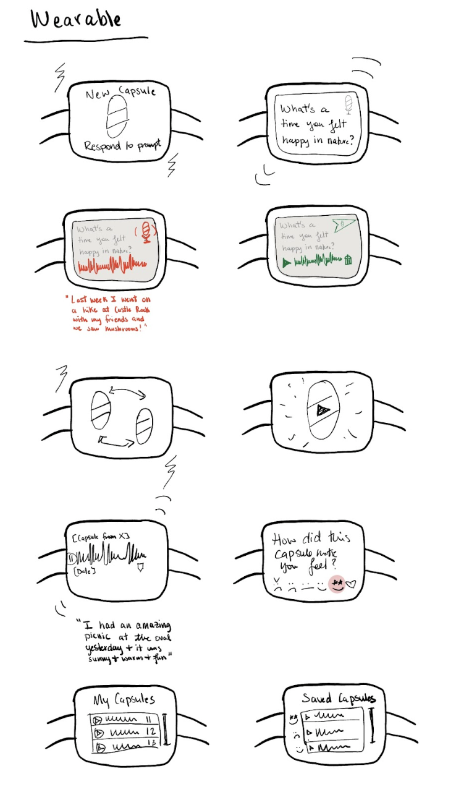
Concept Sketches: Wearable
This concept is for a smart watch app which focuses on voice recordings and simple reactions instead of written messages.

Slide 9
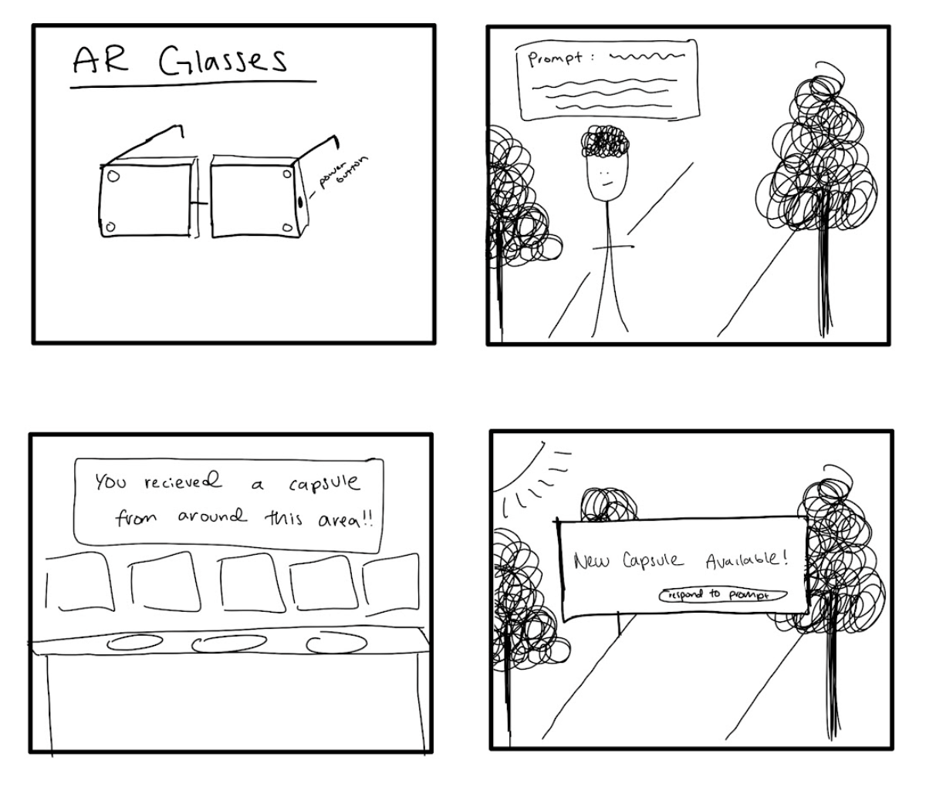
Concept Sketches: AR
This concept is an AR glasses app which focuses on location based capsules.

Slide 10
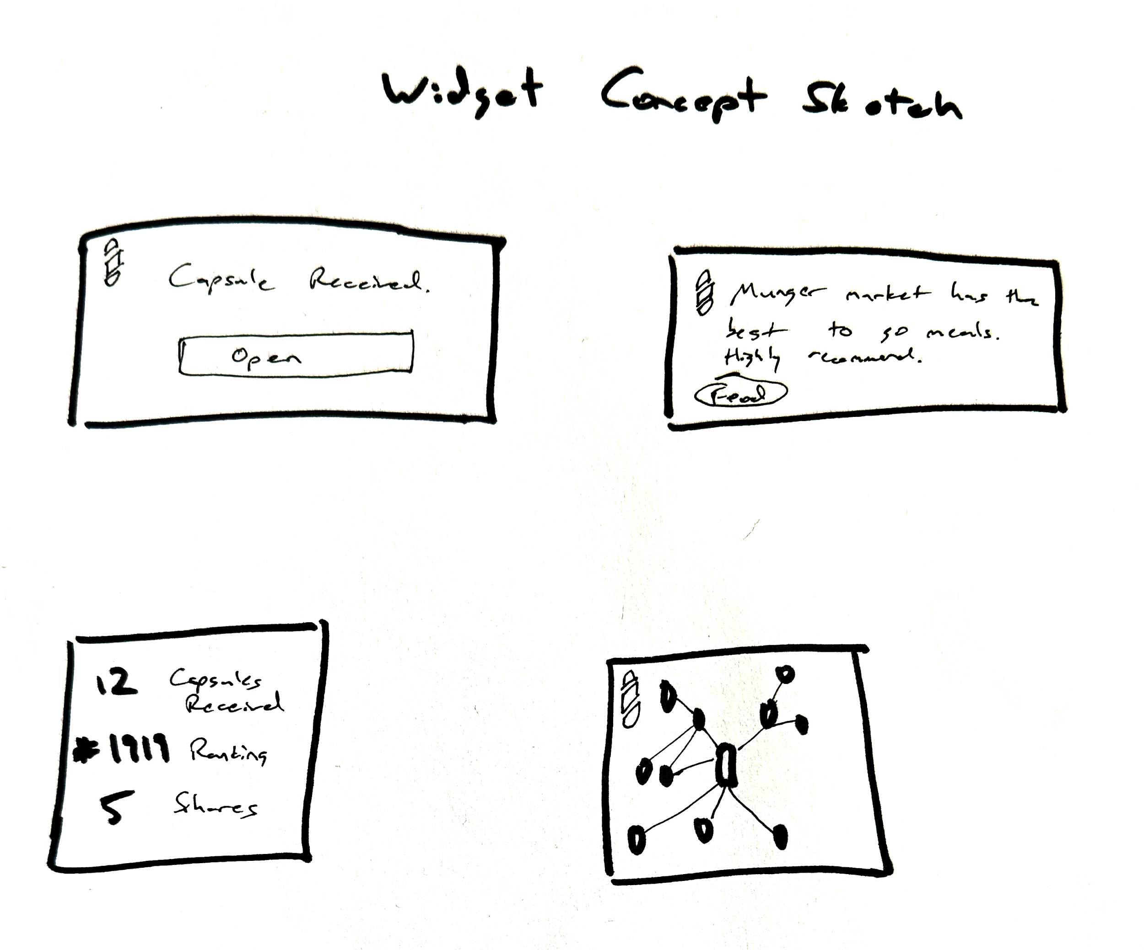
Concept Sketches: Widget
This concept is for simple home screen widgets on your mobile device to track and see your capsules.

Slide 11
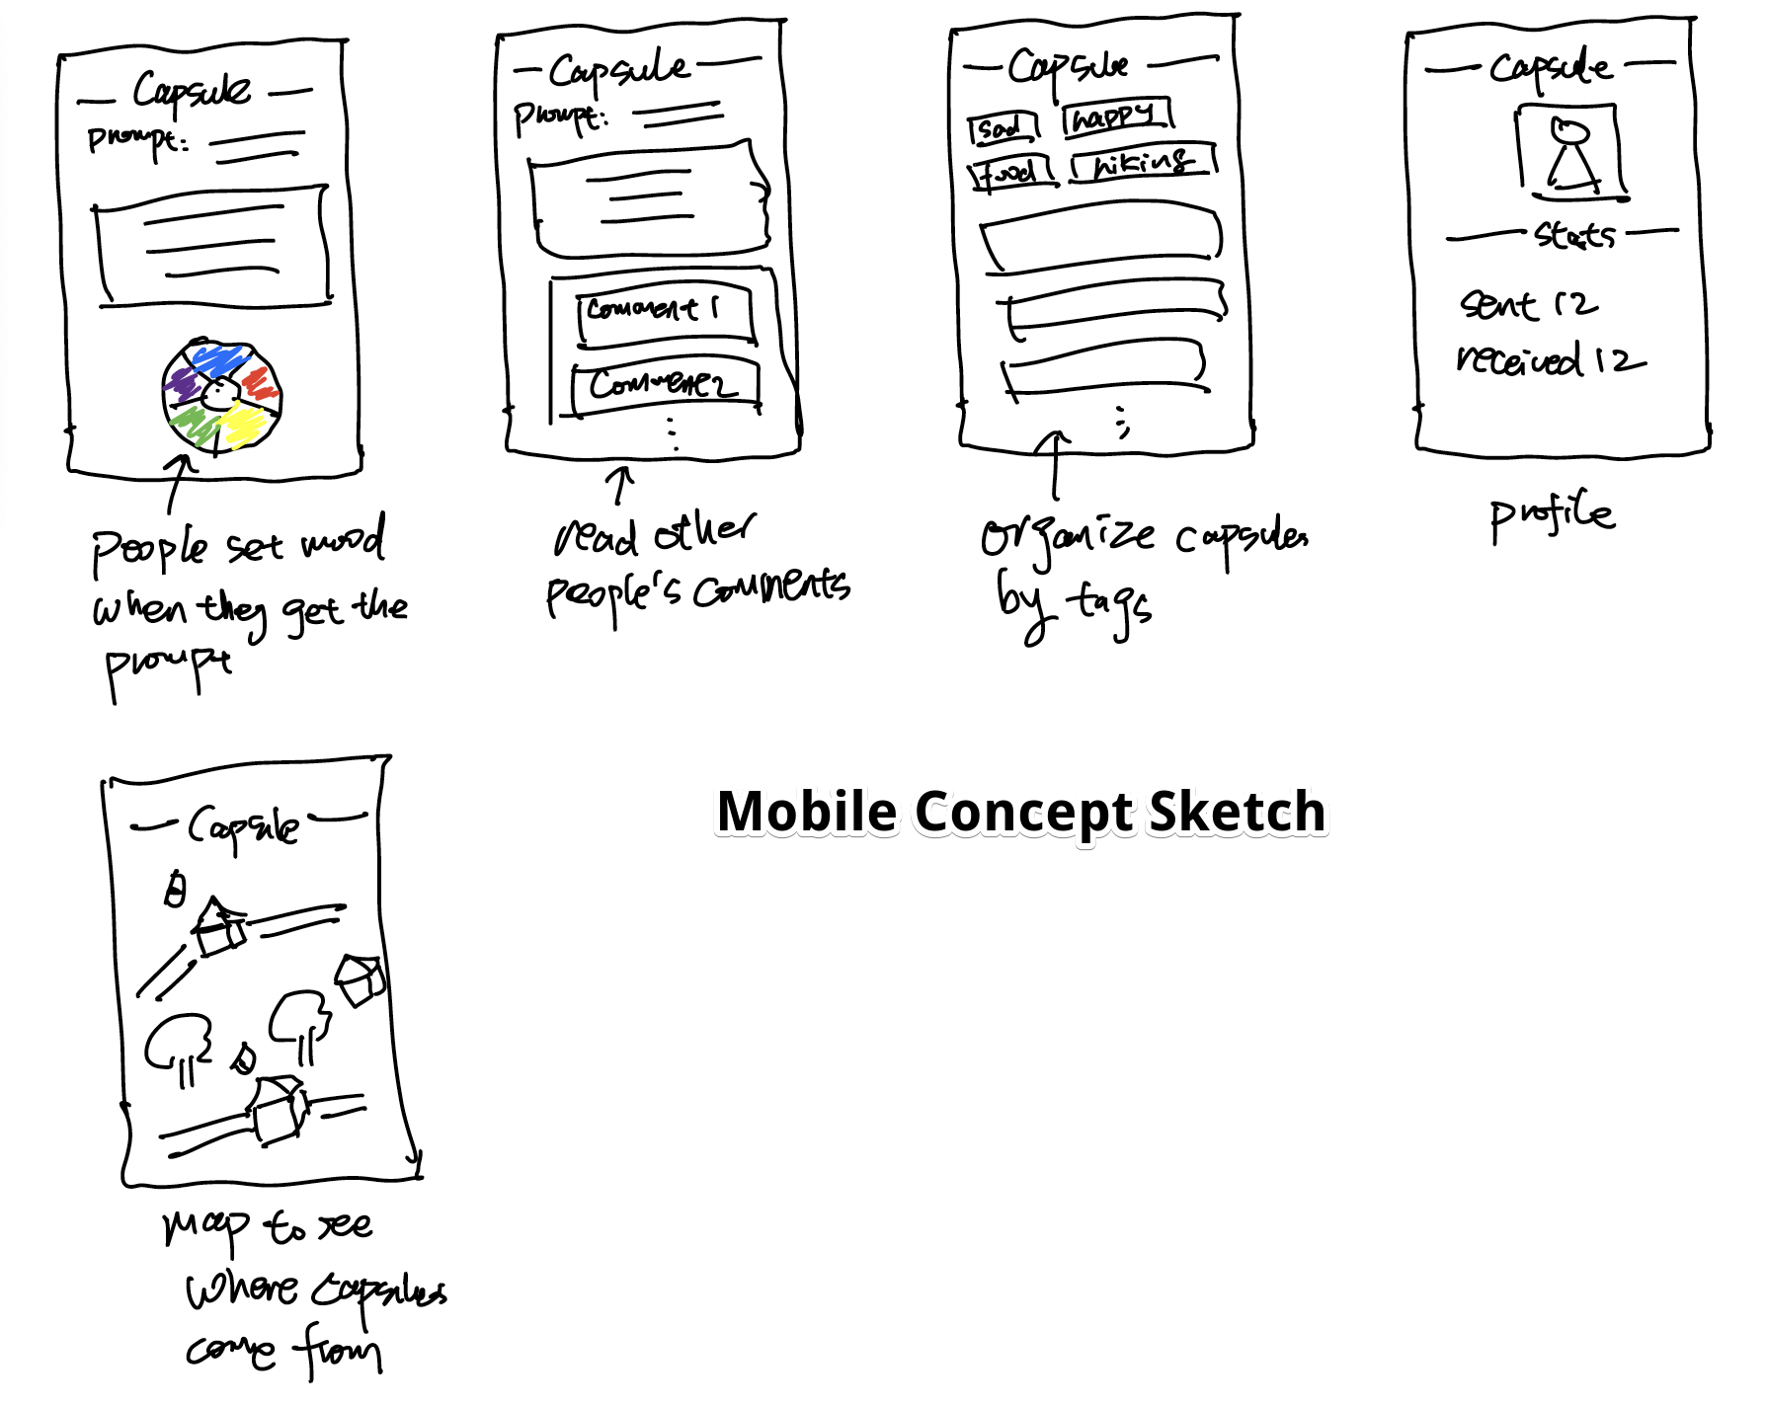
Concept Sketches: Mobile App
This concept is for our mobile version of our idea. Focuses on asynchronous receiving and sending capsules.

Slide 12
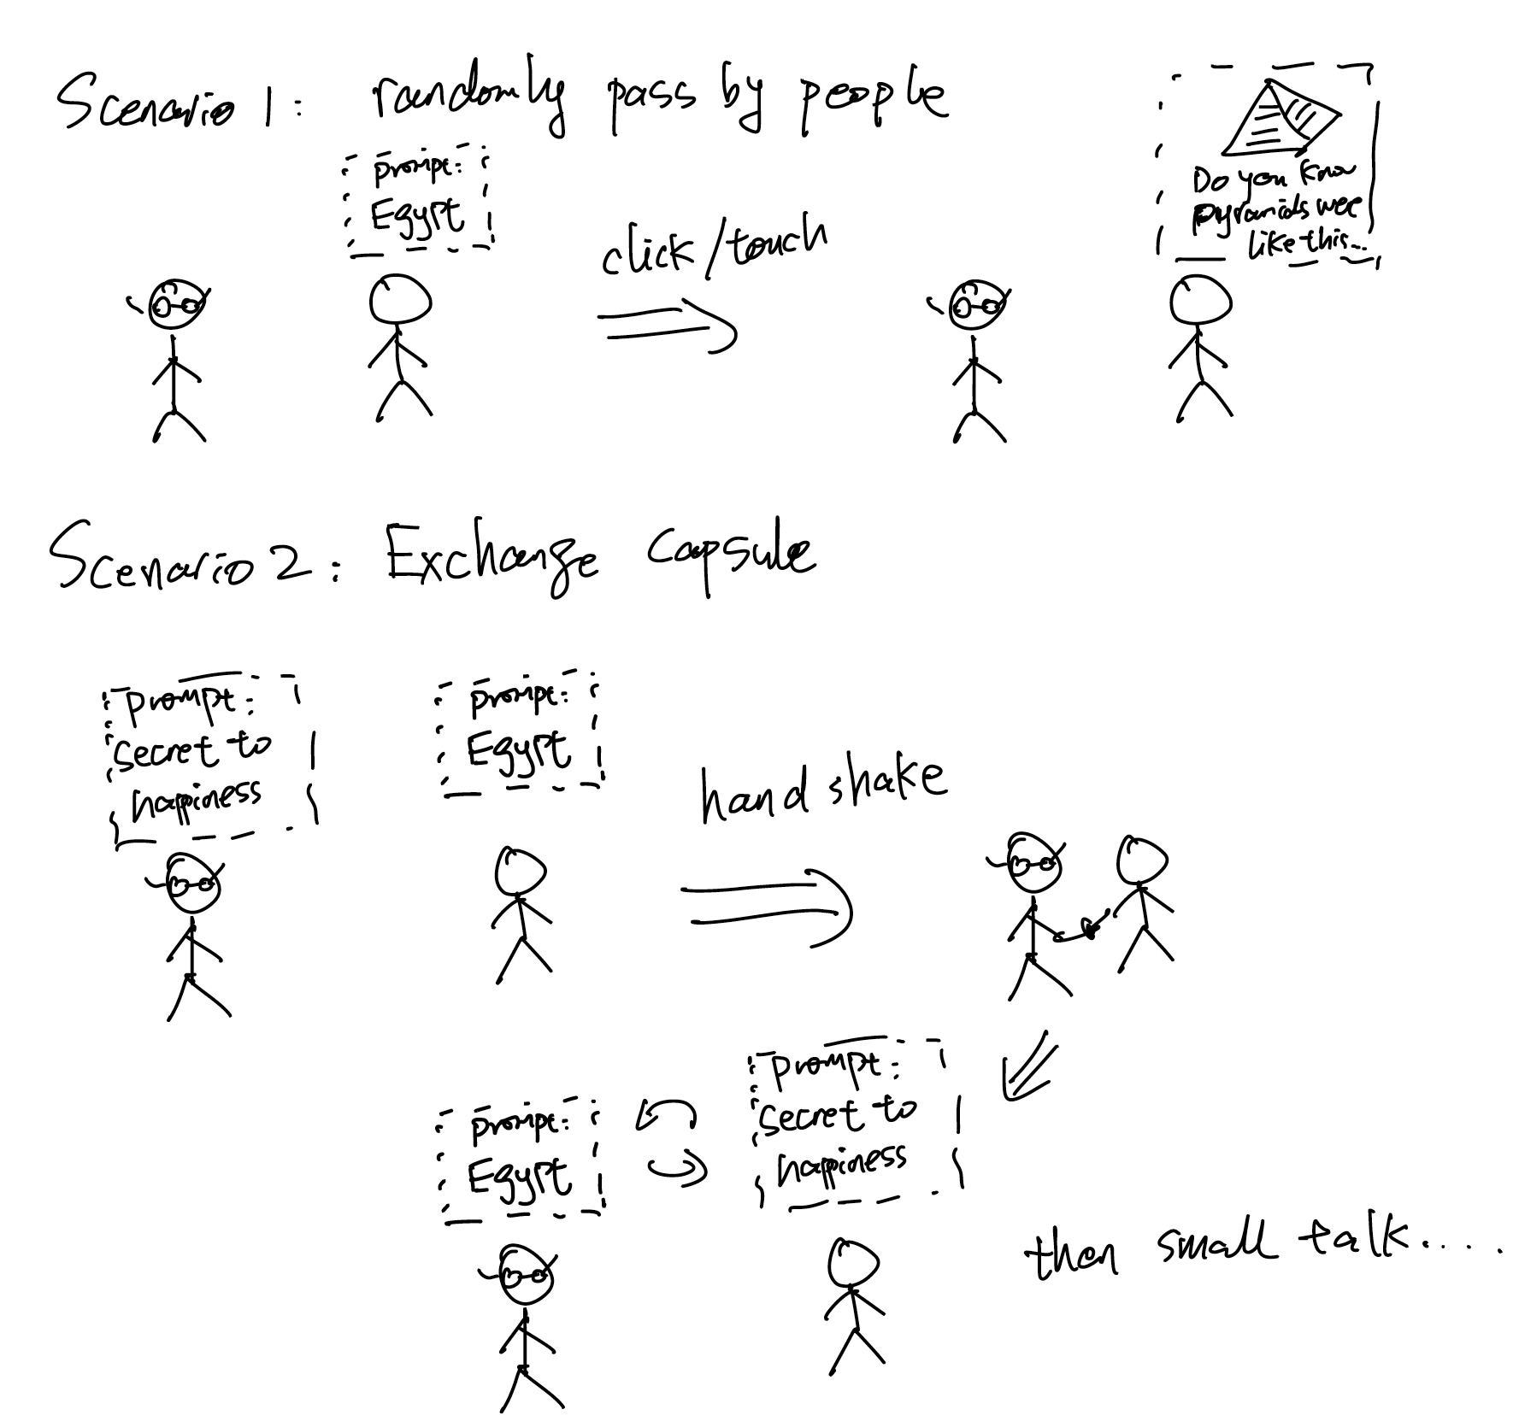
Realization: AR

Slide 13
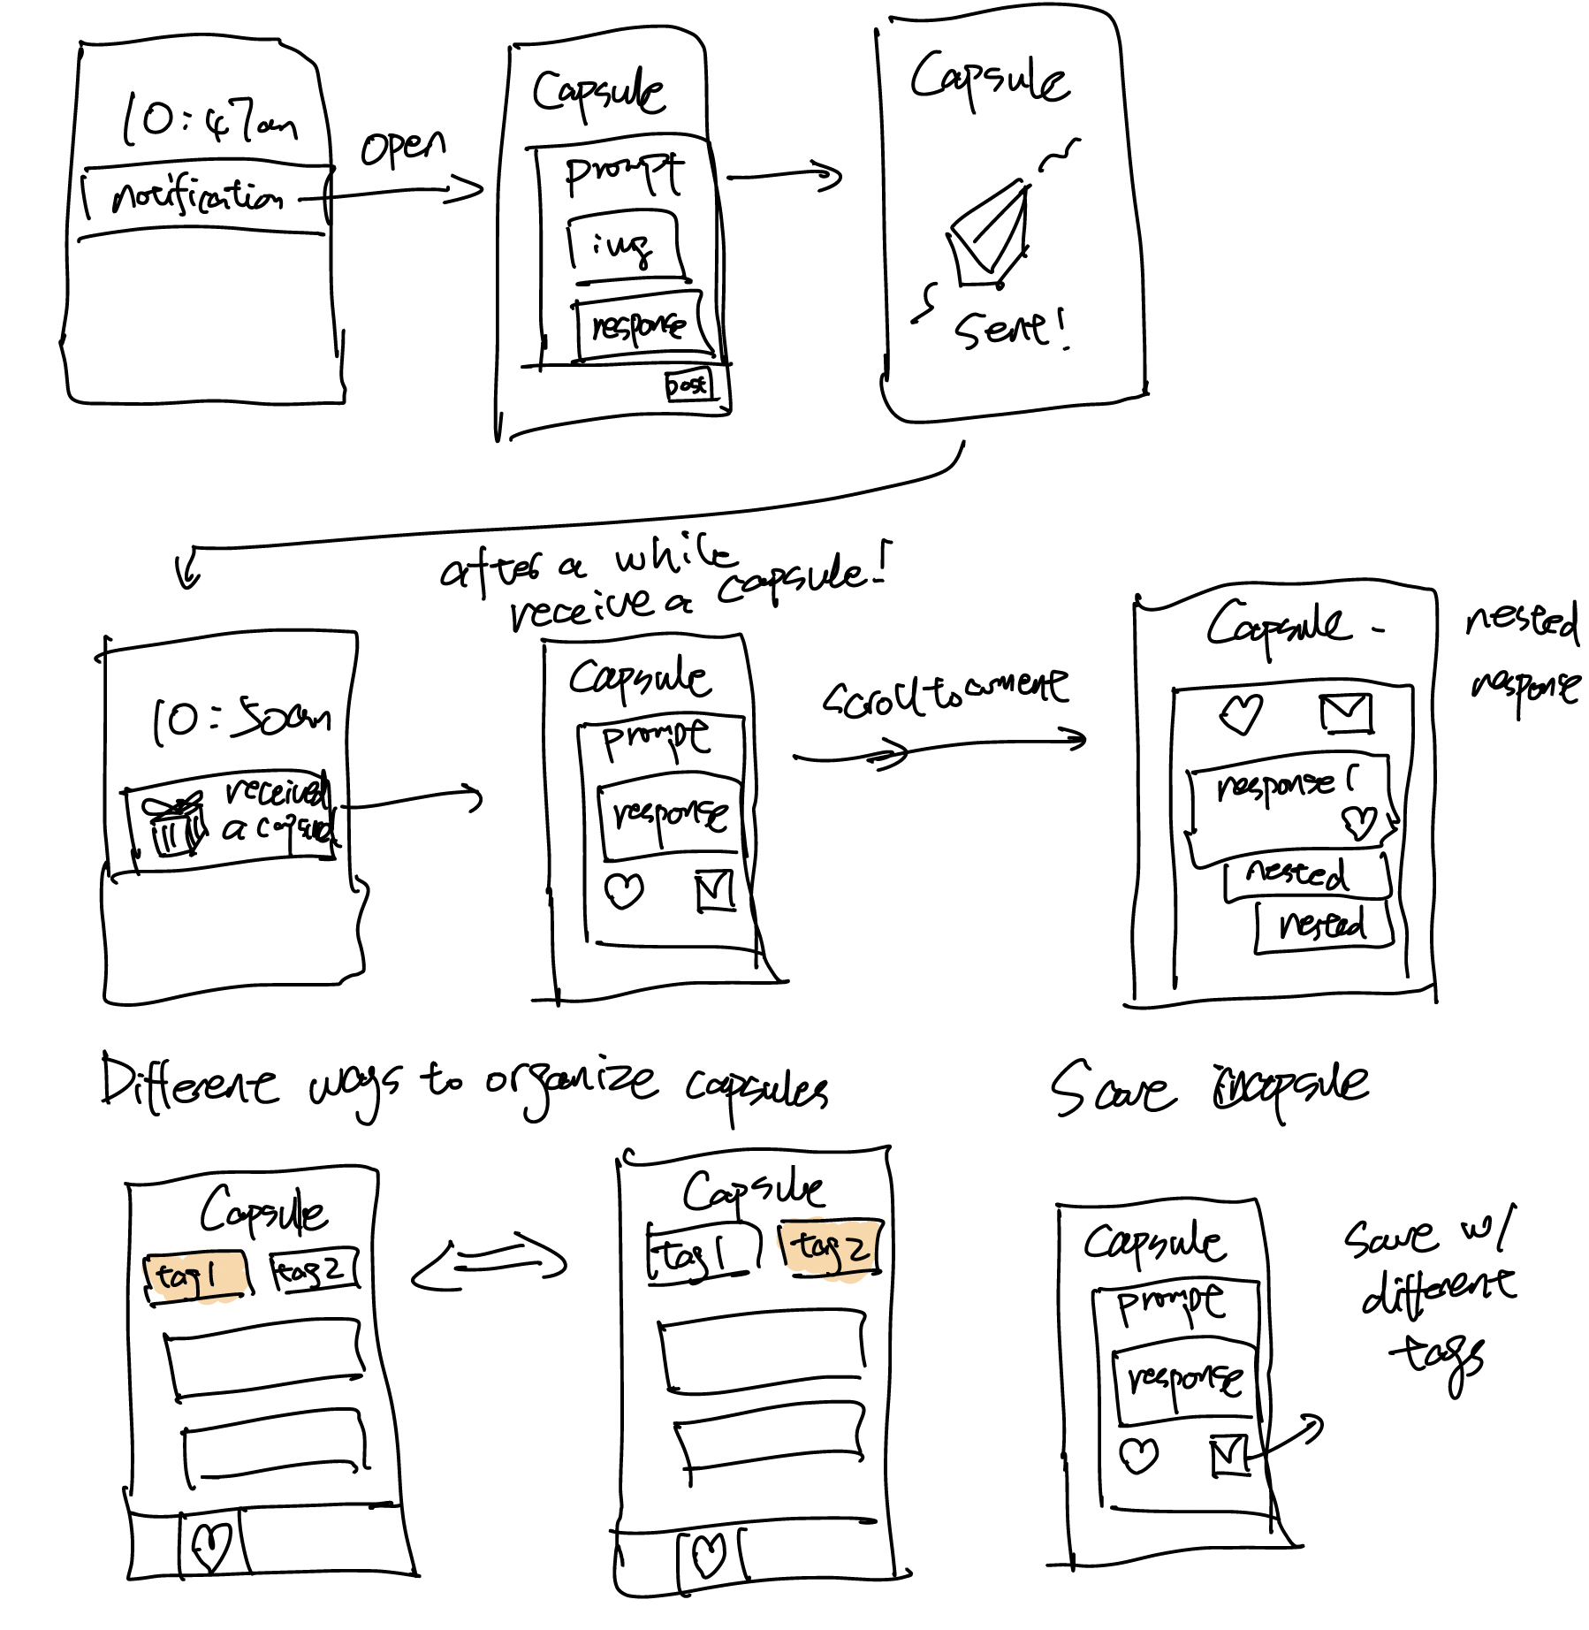
Realization: Mobile

Slide 14
03
Selected interface & rationale

Slide 15
AR
Pros
Cons
Enhanced User Experience
Distraction and Safety
Higher Development Costs
Better Visualization/Experience
Performance Issues
Battery draining and Streaming cost
Notes:
Enhanced User Experience: users can see capsules directly floating over another person’s head and start a conversation based on that.
Better Visualization: Instead of limiting the interface to a flat 2D screen, capsules can be displayed in a 3D world, where users can actually feel a sense of community when they see others who also send/receive capsules.
Distraction and Safety: Requires the user to interact with the environment through a screen – it can be distracting and takes additional effort to hold one’s phone for a while.
High Development Costs: none of our teammates knows how to build an AR app.
Performance Issues: sometimes AR apps are not very stable – tracking and displaying capsules over a person’s head might not be very easy and choppy display will cause users to lose trust in our app.
Battery draining and Streaming: AR app uses a lot of real-time compute and camera/recording consumes a lot of energy and use up a lot of data. Not everyone has an unlimited 4G/5G plan.

Slide 16
Mobile
Pros
Cons
Lower development cost
Less innovative user experience
Familiar user interface
On-the-Go Access
Rationale: we want users to be able to receive/send capsules whenever they want, in any environment.
Notes:
Lower development cost
Familiar user interface: most of the interactions we design are already familiar to the users. We don’t have to “teach” them any new interaction patterns.
On-the-Go Access: Unlike AR, where users have to interact with the app using a camera – a mobile app they can use it anywhere, anytime – lying in bed, on the couch, in a bus.
Less innovative and immersive than an AR/VR app. Less personal than a wearable. Less accessible than a widget.

Slide 17
04
Low-fi prototype construction

Slide 18
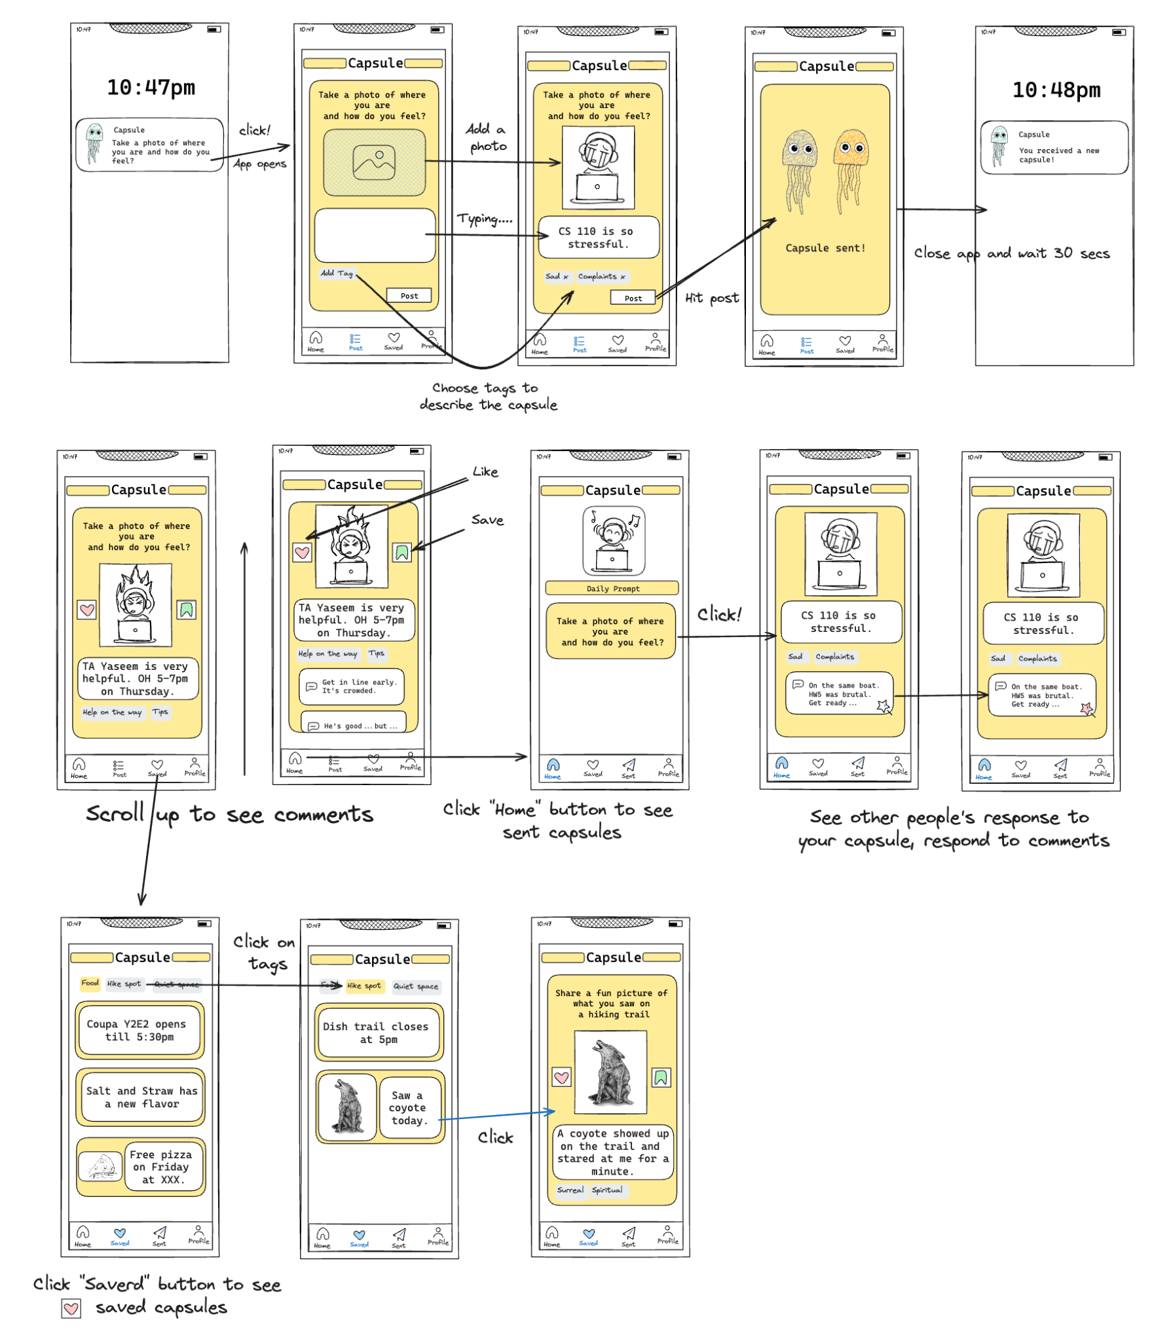
We started with the mobile realization and eventually dividing the screens into 4 task flows.

Slide 19
05
Low-fi prototype:
3 task flows

Slide 20
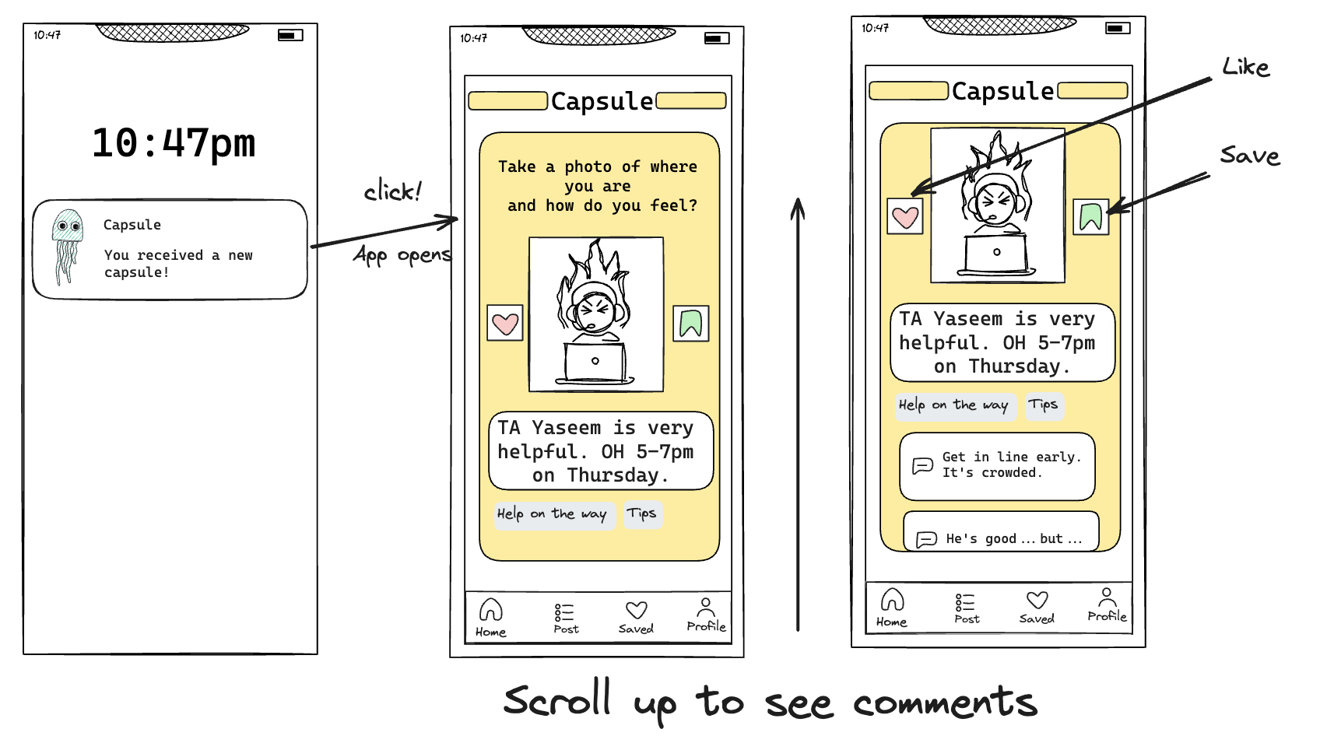
Simple Task: Receiving a Capsule

Slide 21
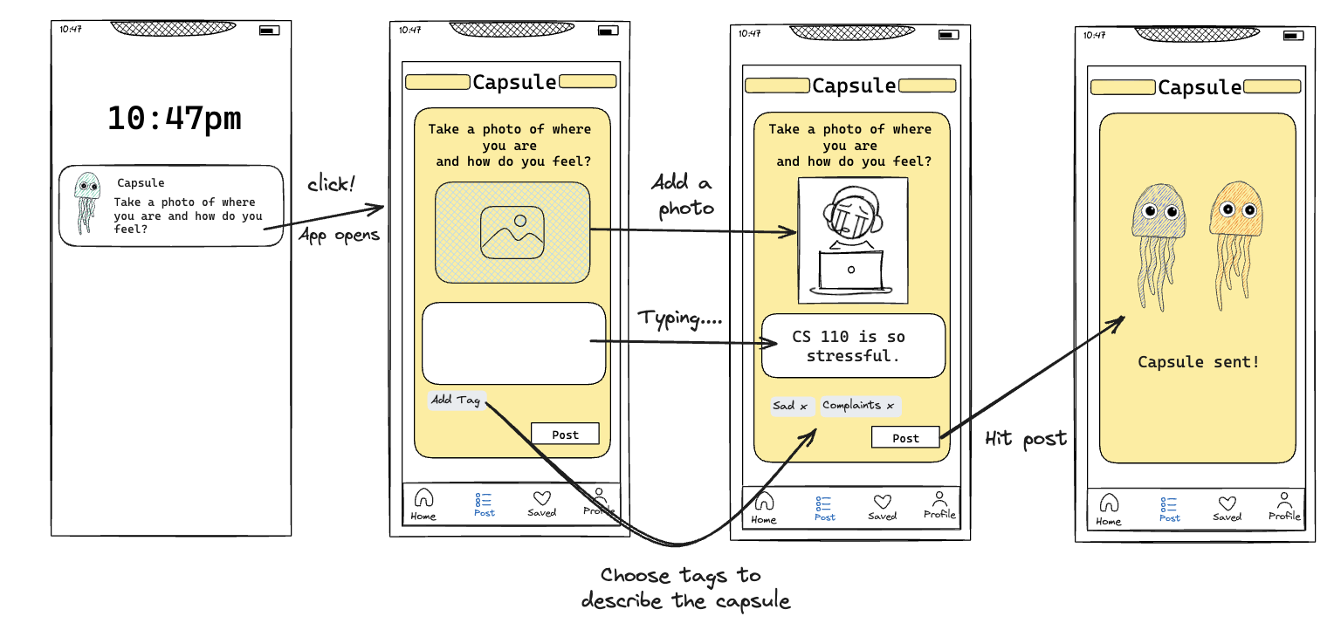
Moderate Task: Responding to Prompt

Slide 22
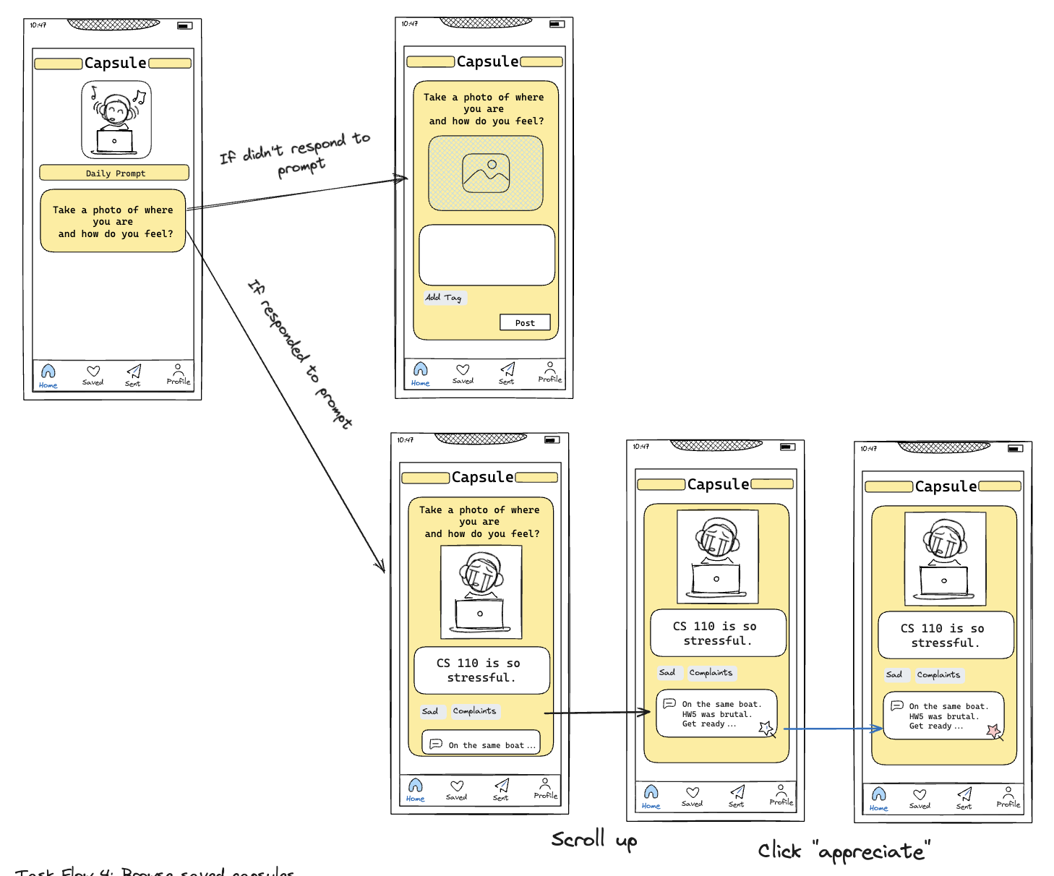
Complex Task: Home Page

Slide 23
06
Testing Methodology

Slide 24
Recruitment & Participants
All participants were recruited through friends of friends or out in the community by asking nicely!
They were not compensated.
We looked to get a balance of gender, and did our best with age as well.
We had 4 total:
  Ryan, 22, college student, Southern California
  Amelia, 31, tech worker, Menlo Park
  Dalton, 26, law student
  Lauren, 23, nurse, Stanford Hospital

Slide 25
Environment, Procedure, & Usability Goals
Environment & Apparatus
  In-person tests with screen printouts
  Locations: Munger, Coupa Cafe
  Observations: Button pressing, facial reactions, spoken feedback
Procedure
  Introduction & project overview
  Consent for participation & photos
  Explain "Capsule" app & test flow
  Encourage verbalized thoughts during use
  Gather post-test feedback
  Express gratitude
Usability Goals and Key Measurements
  Success Indicators: Smooth task execution, interest in the concept
  Error Indicators: Unexpected user actions, navigation confusion

Slide 26
07
Testing Results

Slide 27
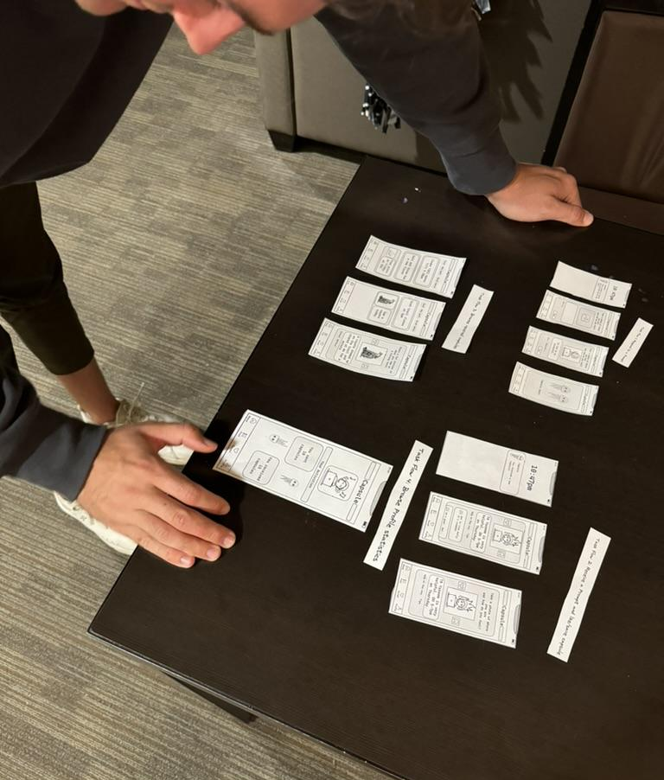
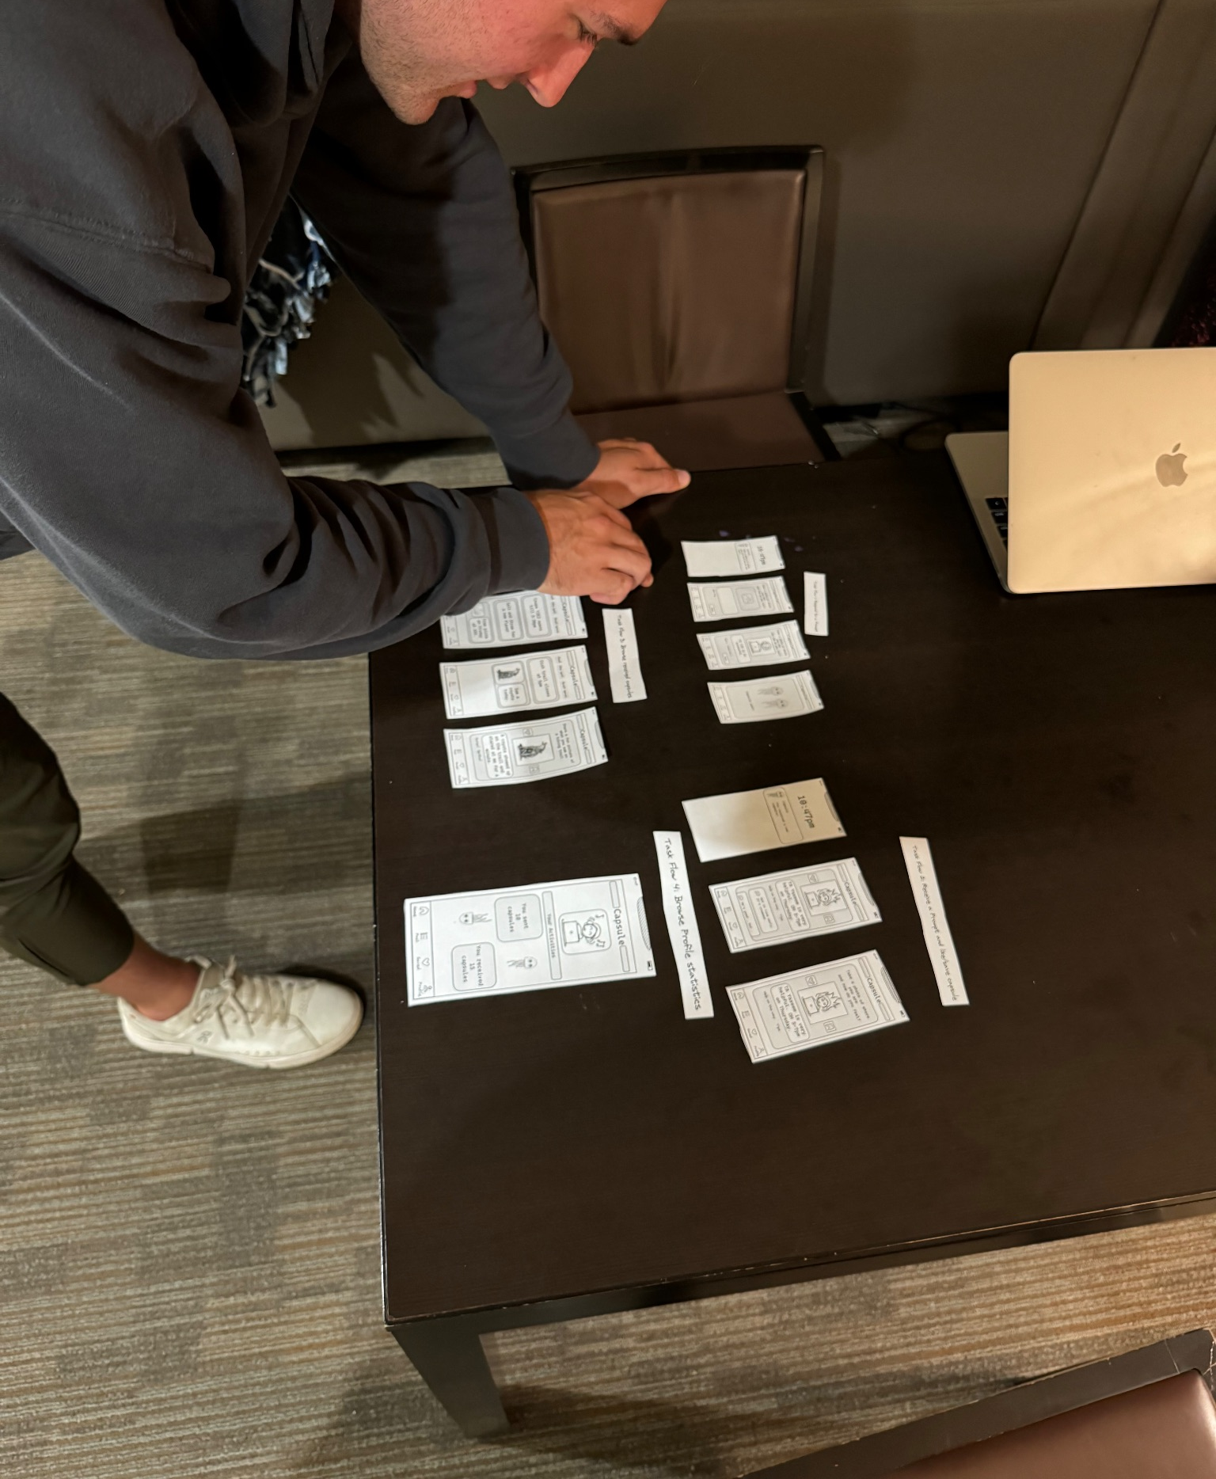
Ryan going through testing!

Slide 28
Big Picture
All four testers:
Were able to carry out the task with little confusion
Were interested to receive capsules full of knowledge that is useful or interesting
Weren’t sure if they’d always receive things they liked or enjoyed
Enjoyed the idea of some sort of anonymous situation, but again unsure of the content they would receive
Were interested in the ability to share capsules with friends and spark ideas to use the capsules they received
Wanted to see more capsules than only the ones they received
  Offered up the idea of searching through the capsules of a given prompt
Usability Success Indicators: Smooth task execution, interest in the concept

Slide 29
Suggestions / Relevant Observations
Three testers:
Wanted to make the capsules focused and specific, covering topics that were interesting to them
Wanted a sharing process that was simple and easy
Enjoyed the concept of 'give knowledge, receive knowledge'.
Were interested in the concept of choosing your prompt
  Some prompts were more deep than others, sometimes people aren’t in the mood to be deep and vulnerable
    Emphasized the importance of privacy here!

Slide 30
Suggestions / Relevant Observations
One tester:
Was curious about a timeline/scroll feature to see more capsules than their own
Suggested a forum or community feature for users to discuss popular Capsules.
Expressed interest in a “trending” page

Slide 31
08
Discussion

Slide 32
Key Takeaways
Content Relevance and Privacy: While users appreciated the idea of receiving intriguing capsules, there was concern about content relevance and potential unsolicited material. The desire for an anonymous setup highlighted a priority for privacy and data protection.
Interactivity and Engagement: Feedback showed a need for varied prompts, from deep to light interactions, and features like searching through capsules or a "trending" section to enhance engagement.
Sharing and Community: The interest in sharing capsules emphasizes the community aspect. Features like a community forum could foster a sense of communal learning and connection.
Navigation and UI Concerns: Users sought clearer navigation, suggesting a need for interface redesign to make the app more intuitive.

Slide 33
Change in our design
Include a trend page
Design functionalities that will increase interactivity.
Have stronger protection of privacy.

Slide 34
Thanks!

