Slide 1
capsule
Interactive HIgh-Fi Prototype
Julia M, Kendal M, Allen N, Tristan S

Slide 2
The problem
capsule
When in newer environments, it can be challenging to establish a sense of belonging and contribute to the collective knowledge of the community.
Value Proposition
The solution
Share knowledge, receive knowledge, one capsule at a time.
Capsule encourages individuals to foster connections and engage with people in their community by presenting daily inquiries or activities, motivating users to provide their responses, leading to them receiving a reciprocal "capsule" from a fellow member within the community.

Slide 3
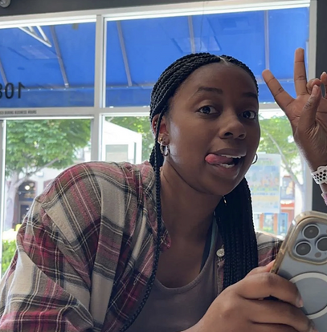


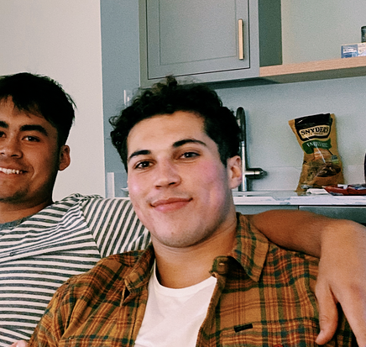
The team
Julia
Kendall
Allen
Tristan

Slide 4
Outline
Heuristic evaluation results
UI and product revisions
Prototype status
Demo

Slide 5
Heuristic evaluation results

Slide 6
49
Violations
Severity 1
Severity 2
14 total
4 Consistency & Standards
3 Match Sys & World
21 total
5 Recognition not Recall
3 Error Prevention
Severity 4
Severity 3
10 total
4 Consistency & Standards
2 Efficiency of Use
2 total
H6 & H11

Slide 7
Accessibility Issues (Severity 4)
Small Font Size for User Details: The font size in the simple task section is too small for comfortable reading.
Recognition Over Recall: Difficulty for users in finding where to type in a capsule if they miss the notification.

Slide 8
Consistency and Standards Issues (Severity 3)
Lack of Like/Save Options: No visible option to like or save capsules, causing confusion since there's a tab for viewing liked or saved capsules.
Unclear Notification Purpose: Uncertainty about whether the "new capsule available" notification and the "view capsule" button serve the same purpose.
Missing Multiple Capsule Check: No feature to check for multiple capsules, leading to potential user confusion.
Inconsistent Button Placement: The progress button is located at different vertical heights across various screens, hindering user navigation.

Slide 9
User Control and Freedom Issues (Severity 3)
Inability to Remove Flairs: Users cannot remove flairs once added, limiting their control over the capsule customization.
Redundant Back Options: The presence of both a back arrow and a "go back" text button, causing unnecessary complexity.
Indistinguishable Cabinet Naming: "Unsorted cabinet" appears in the same font as named cabinets, leading to confusion.

Slide 10
UI and product revisions

Slide 11
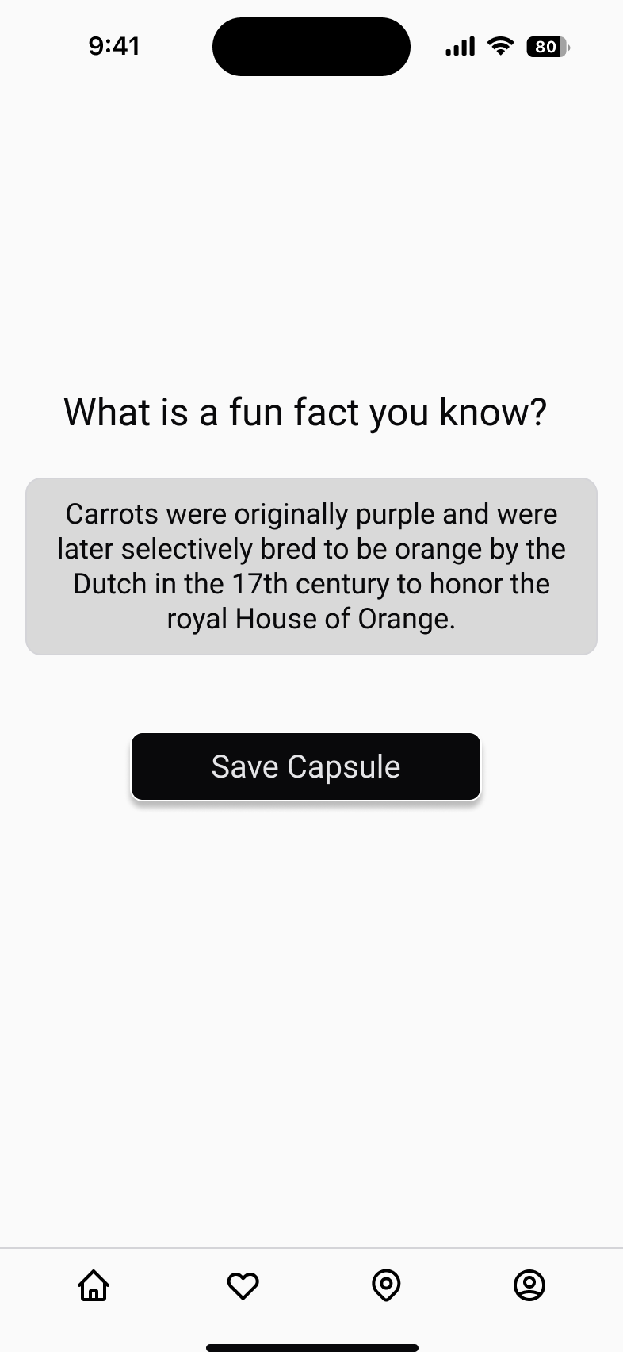
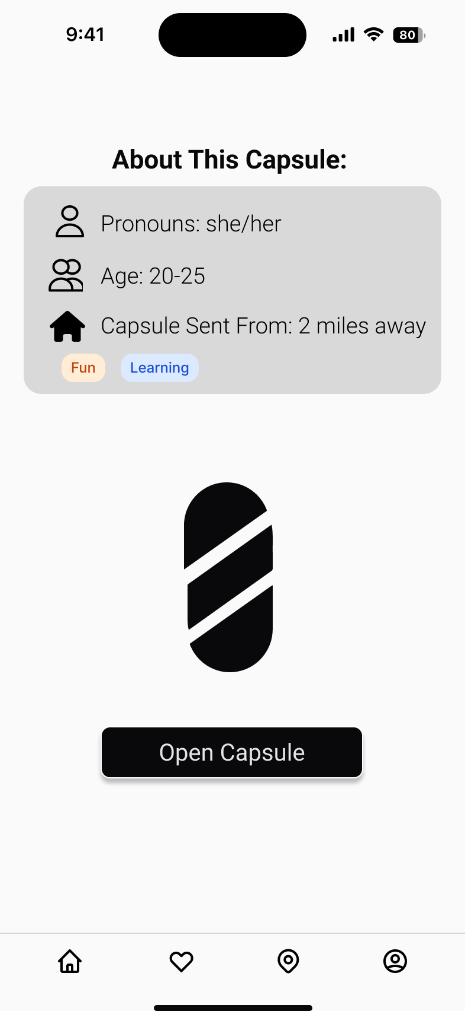
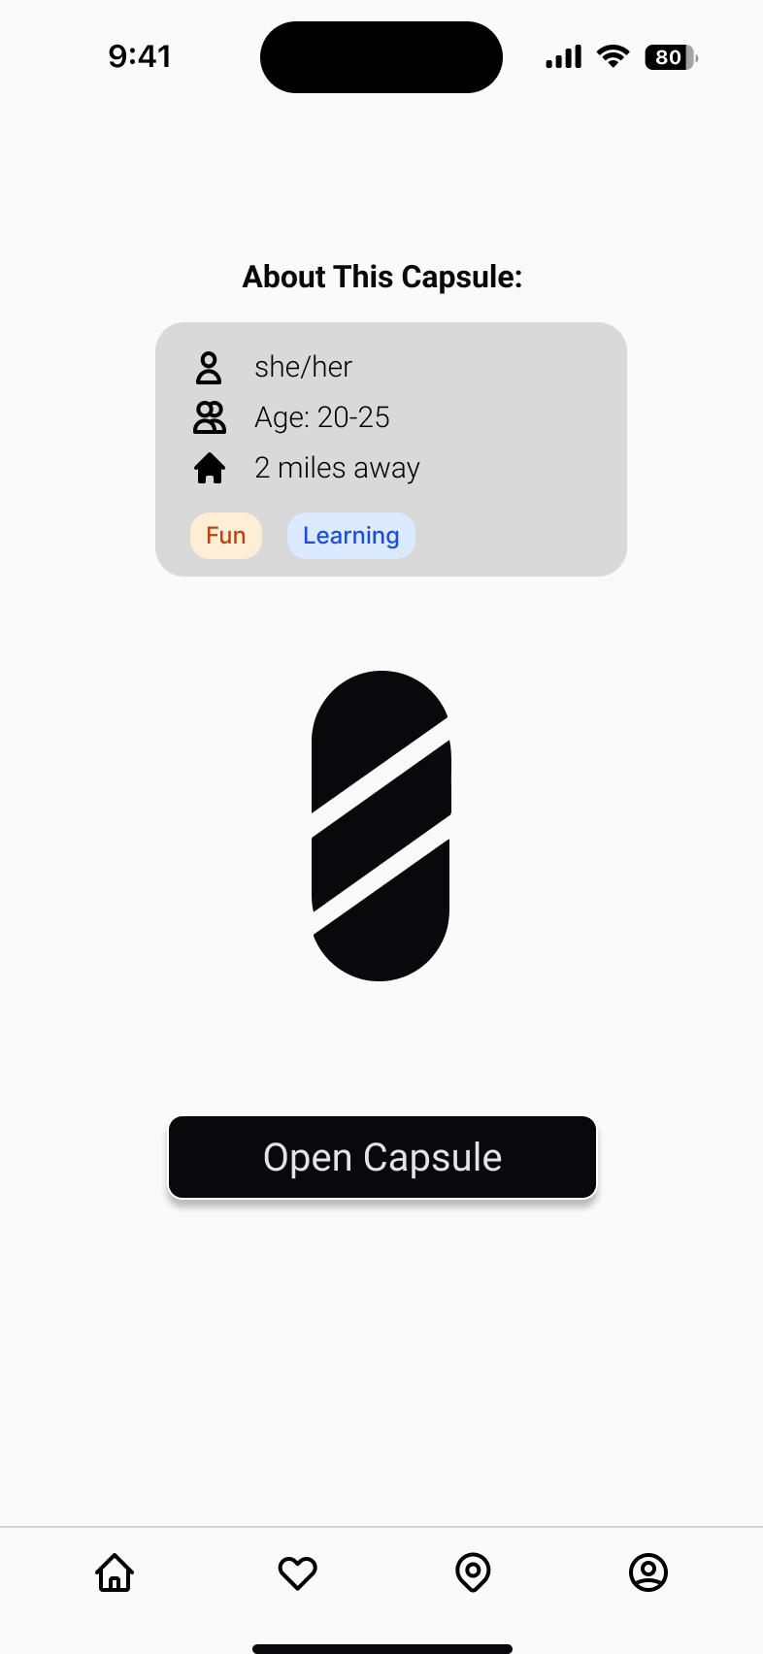
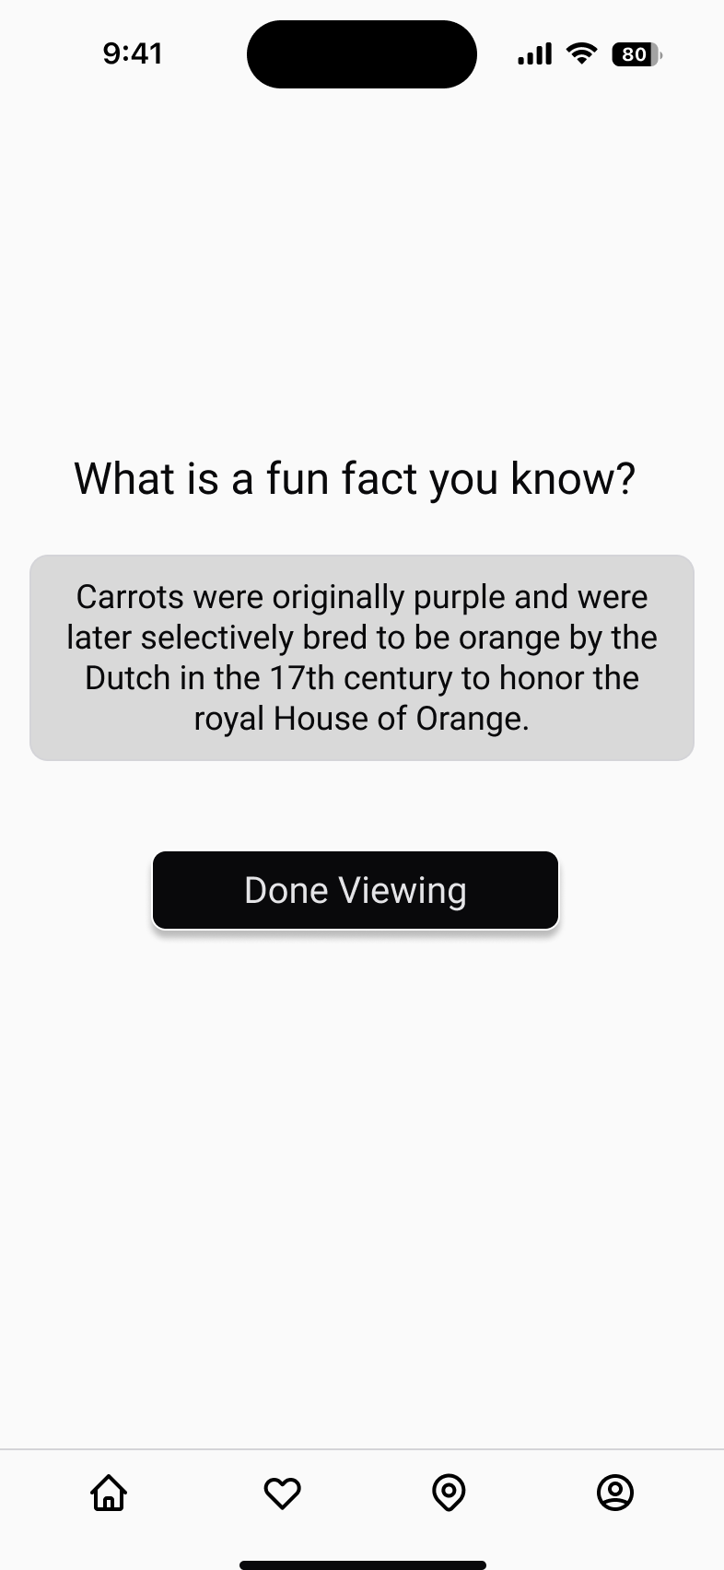
Capsule Available Screen
Severity 4: "Accessible Design"
Implemented larger font size for improved visibility and user accessibility.
→

Slide 12
Capsule opened Screen
Updated user interface: Replaced "Done Viewing" with "Save Capsule" for clarity on capsule management.
Enhanced capsule management: Users can now delete unwanted capsules from their saved list.
→

Slide 13
COnsistency - Buttons
Addressed inconsistent placement of progress buttons across different pages.
Enhanced user experience by positioning the progress button consistently in the same spot.

Slide 14
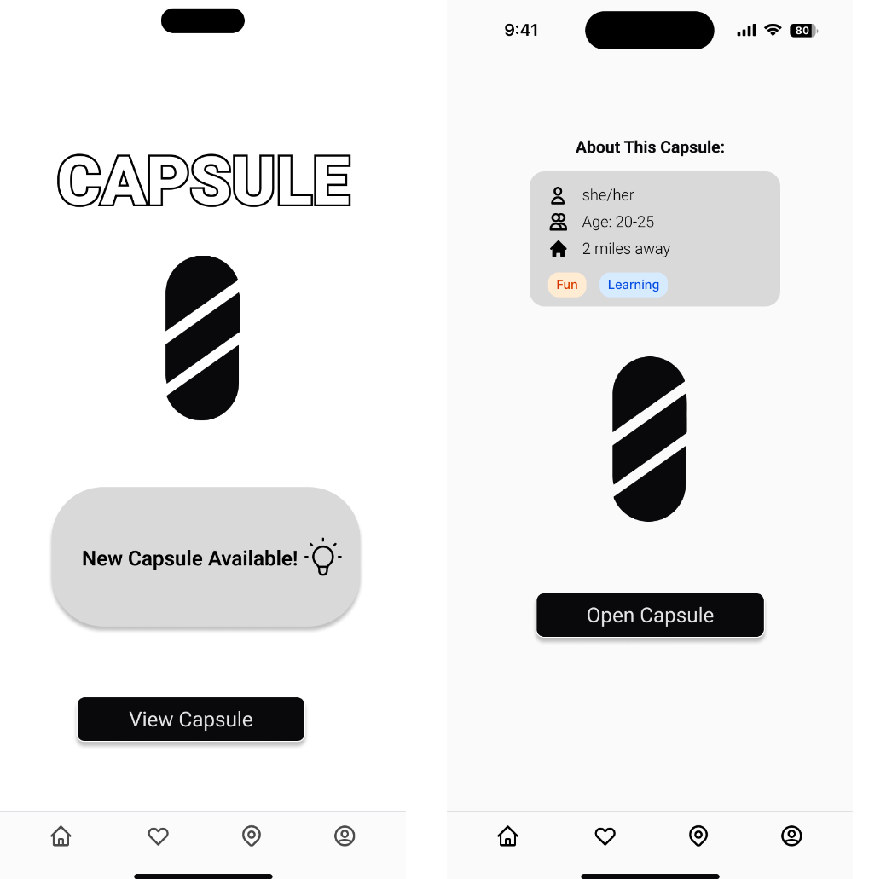
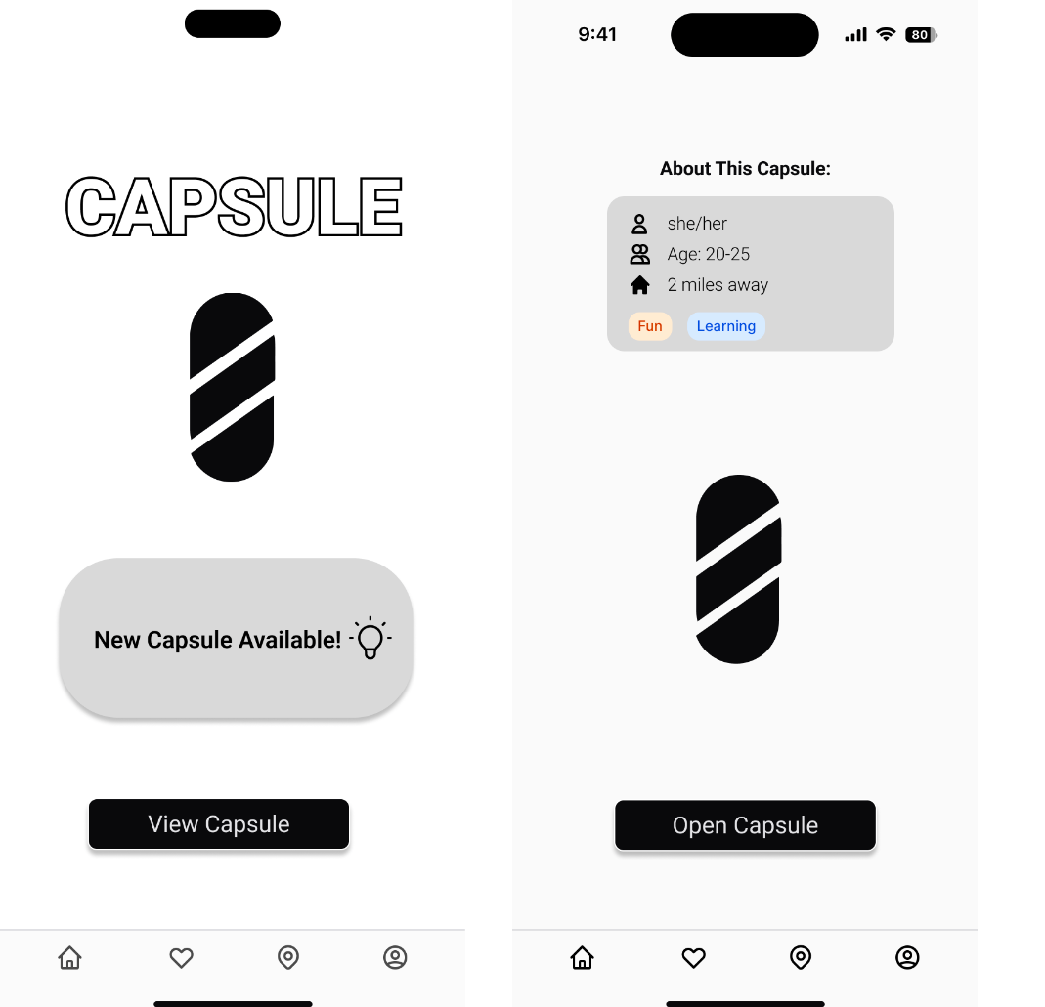
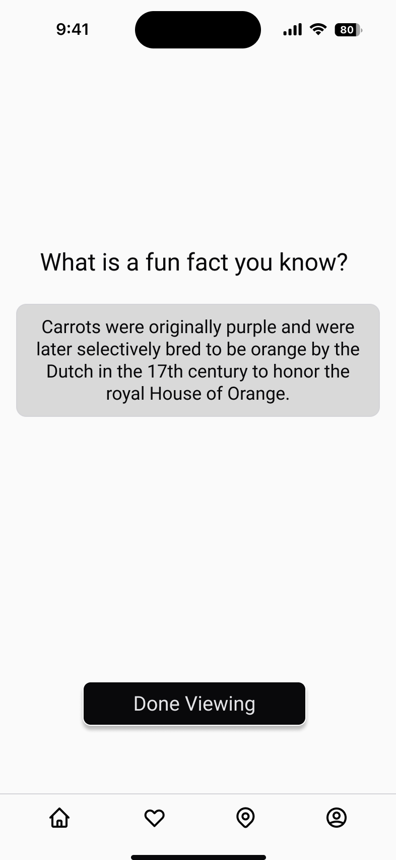
COnsistency - Buttons
→

Slide 15
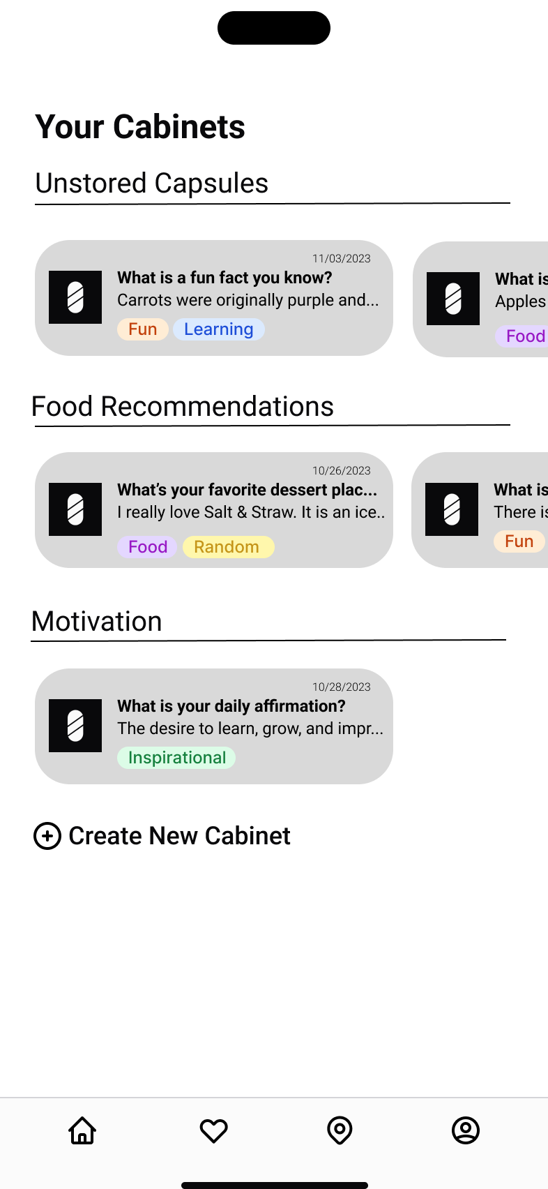
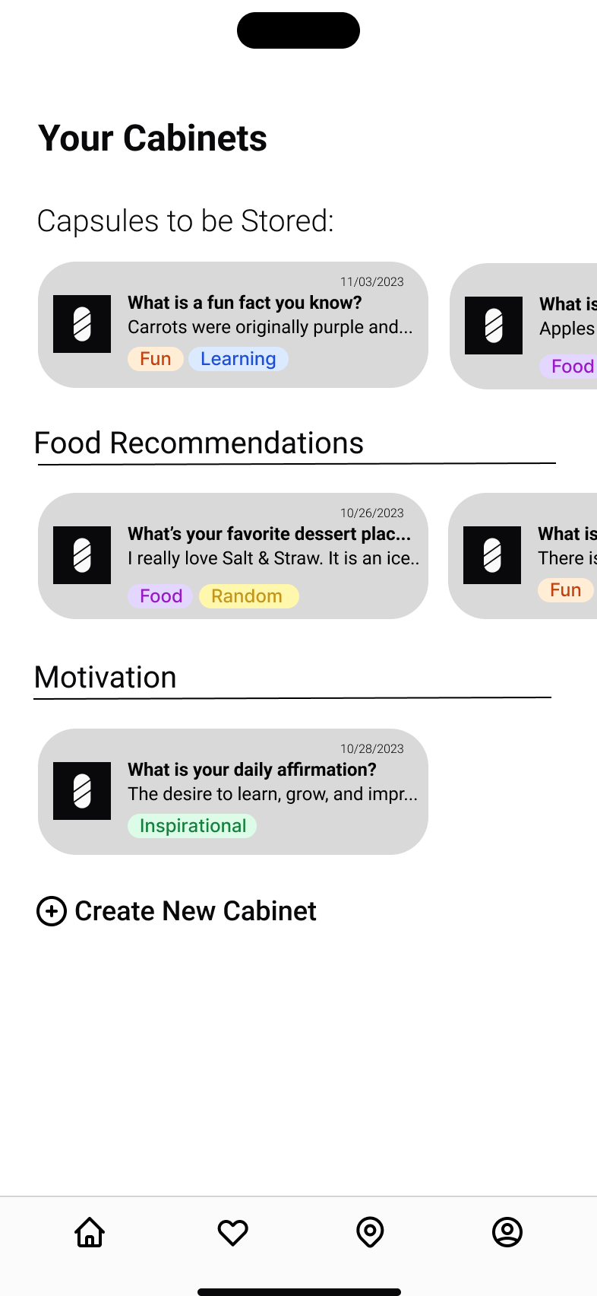
Cabinet Screen
Improved clarity in the user interface by removing the bar under "Unstored Capsules."
Changed font weight to avoid confusion with other "shelf/cabinet" sections.
→

Slide 16
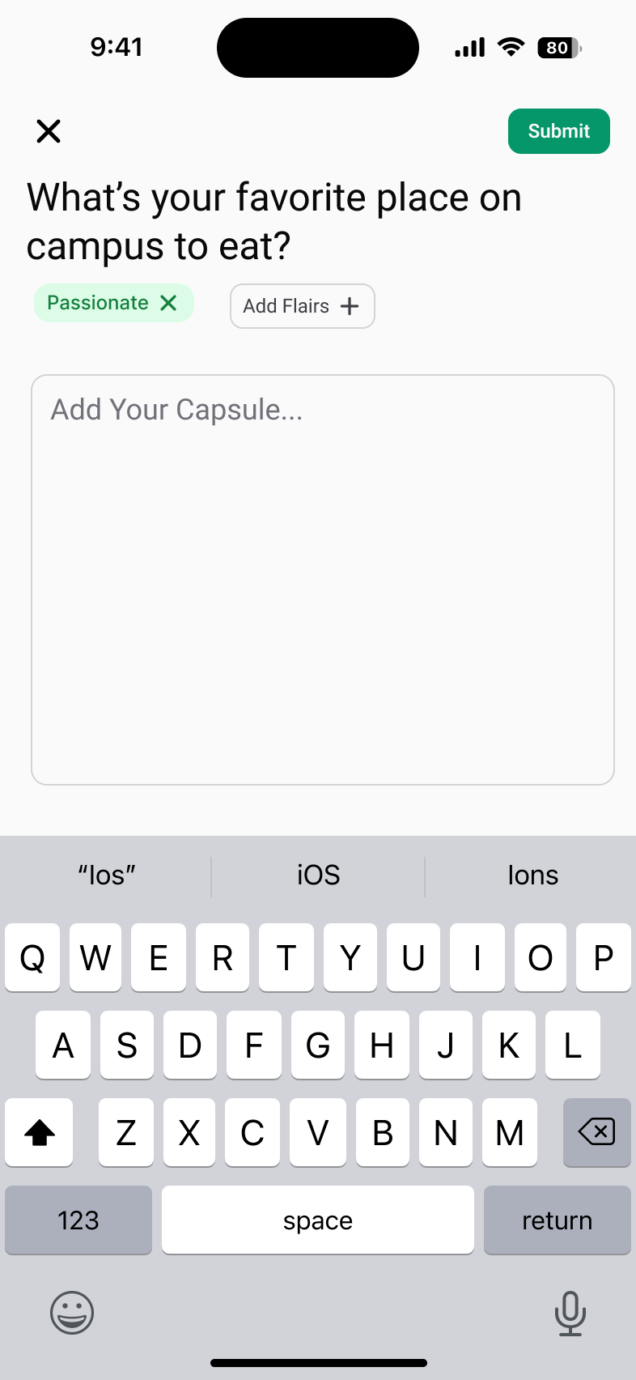
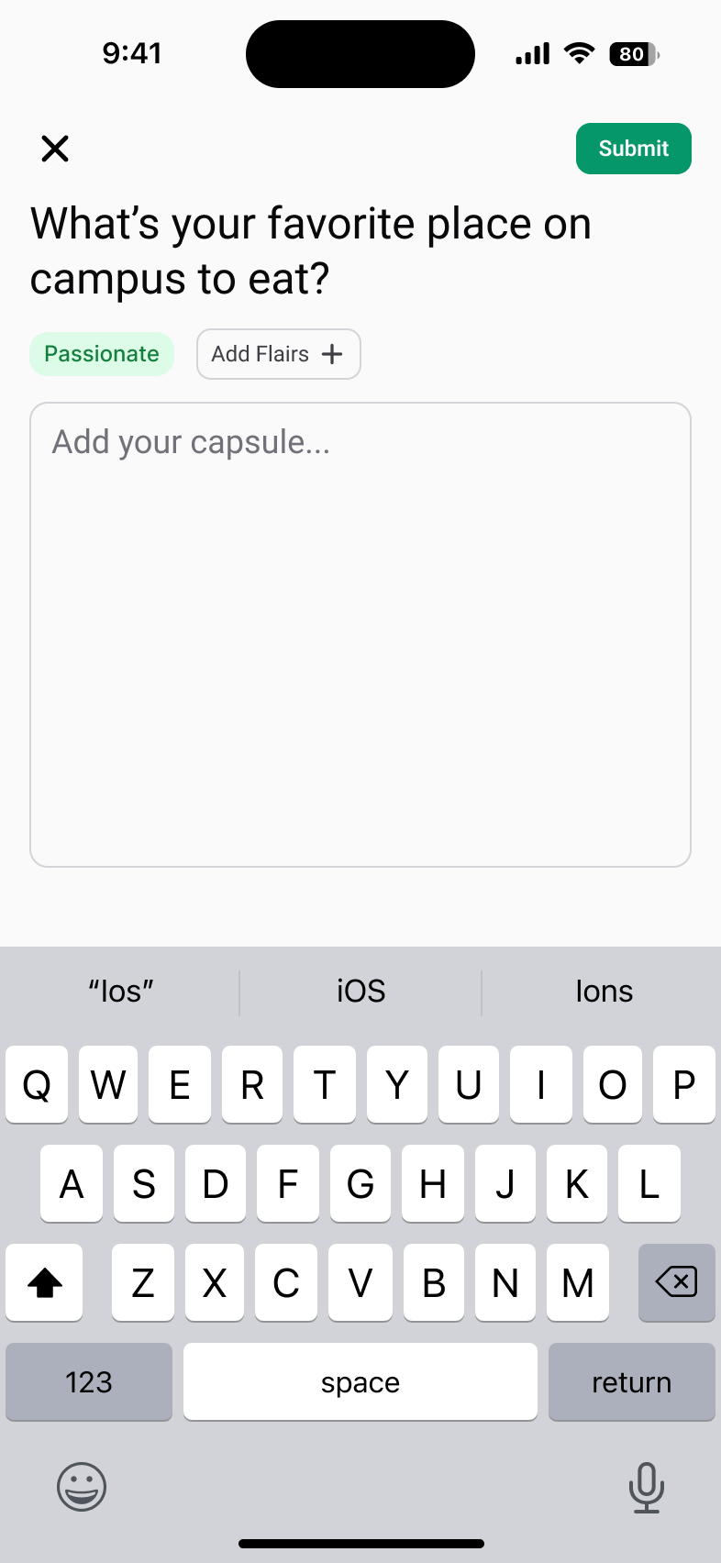
respond/Flair Screen
Added a delete option (an 'X') to the flair feature, allowing users to remove flairs that were added mistakenly or deemed unfit for the capsule.
→

Slide 17
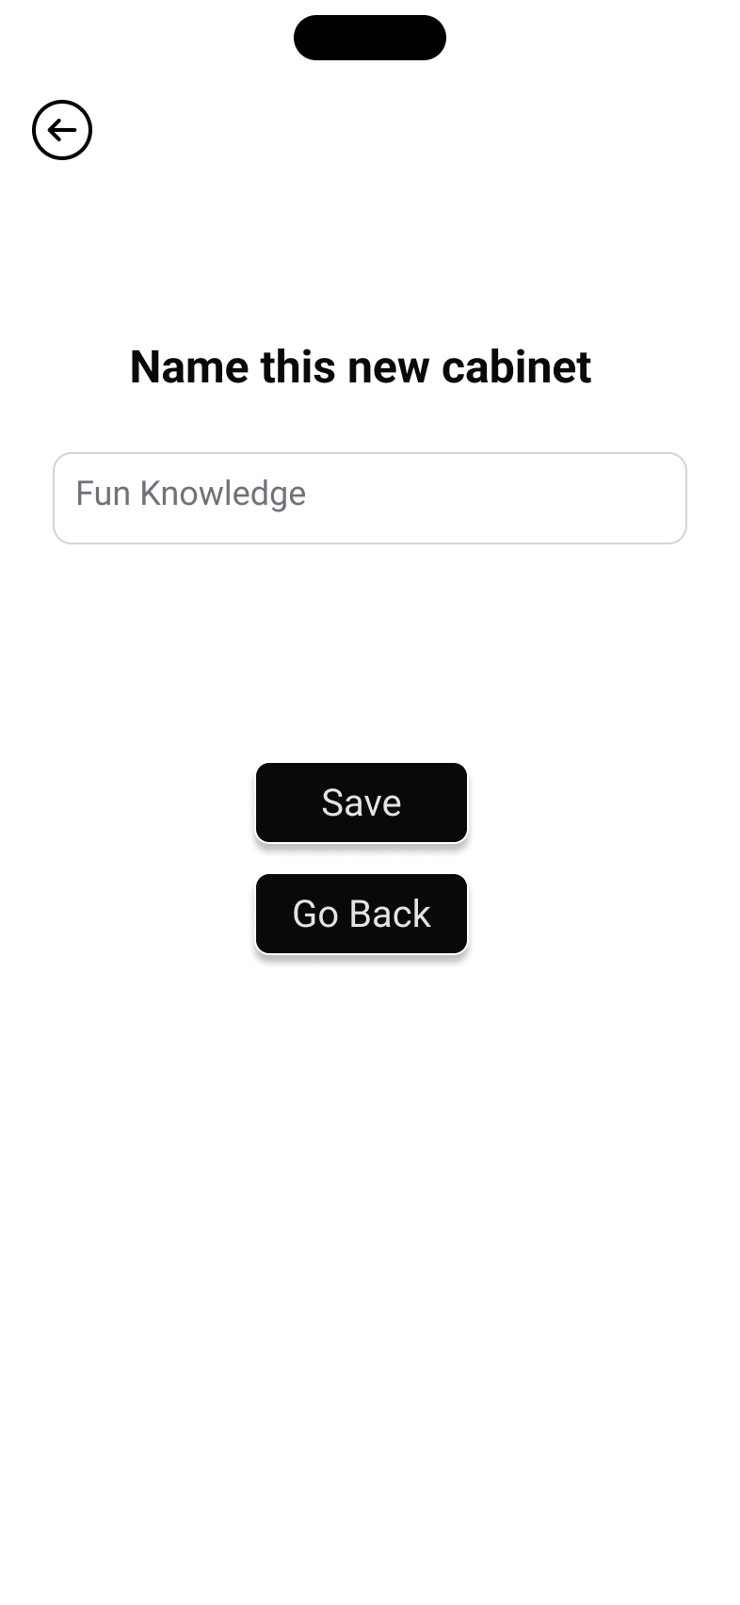
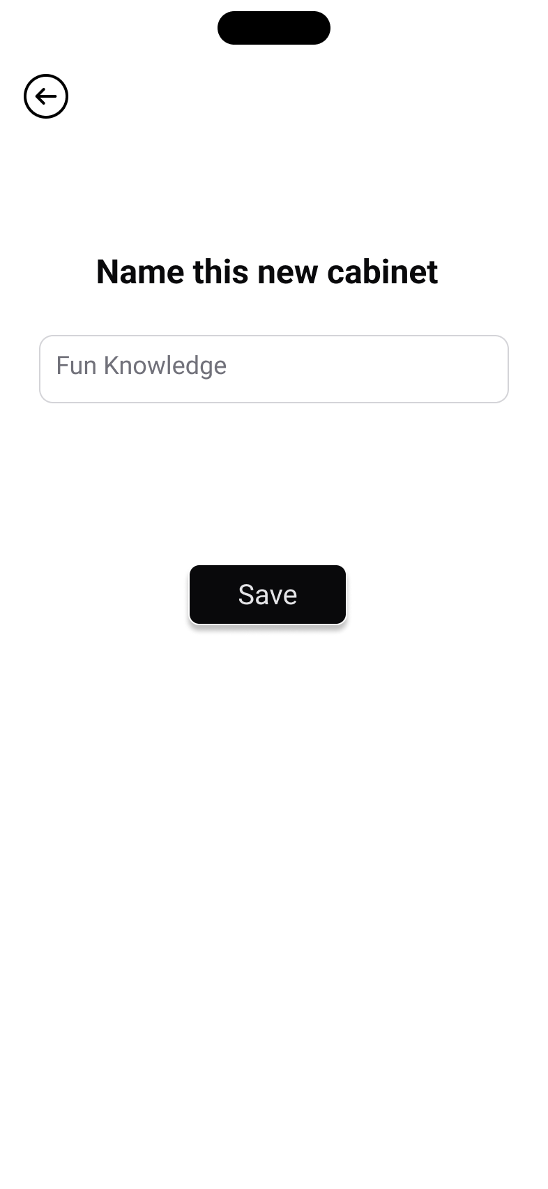
Create cabinet
Eliminated the "Go Back" button to prevent confusion caused by having two buttons with the same functionality on a single screen.
→

Slide 18
Prototype status

Slide 19



Frameworks

Slide 20
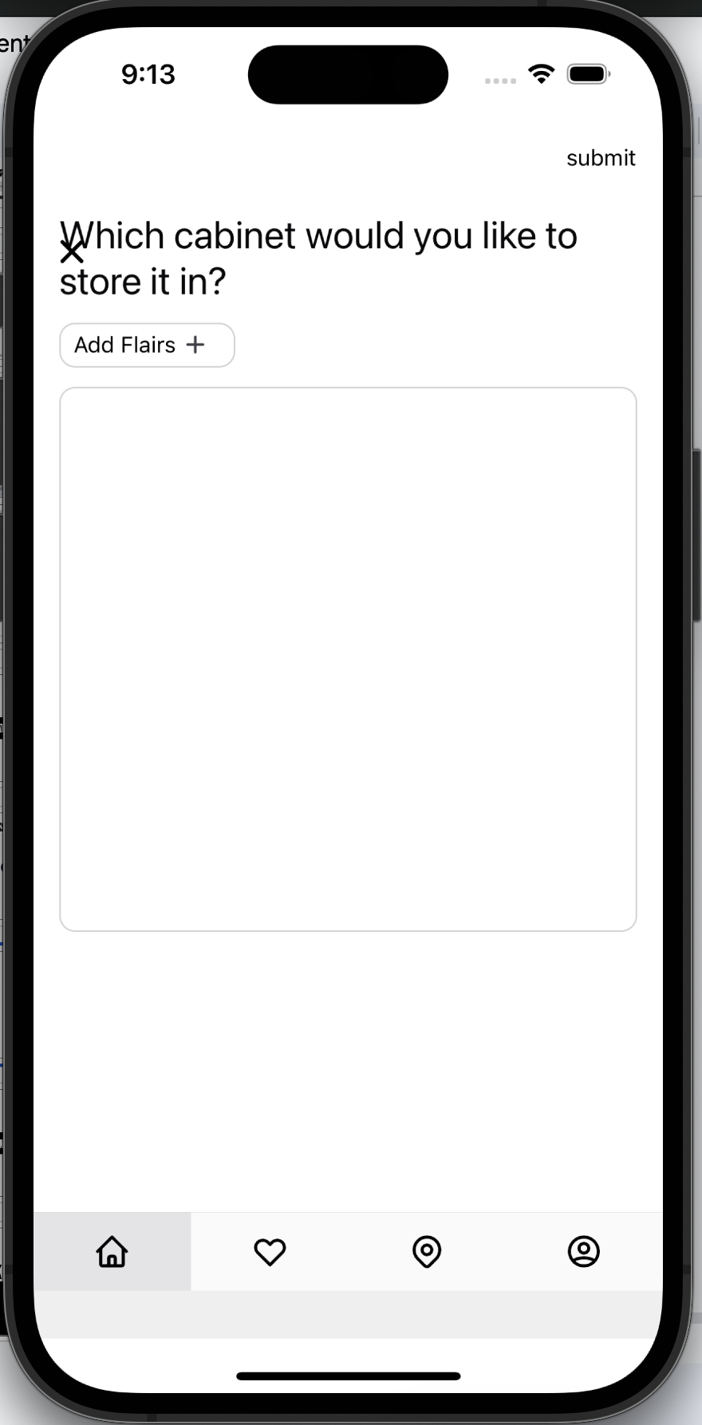
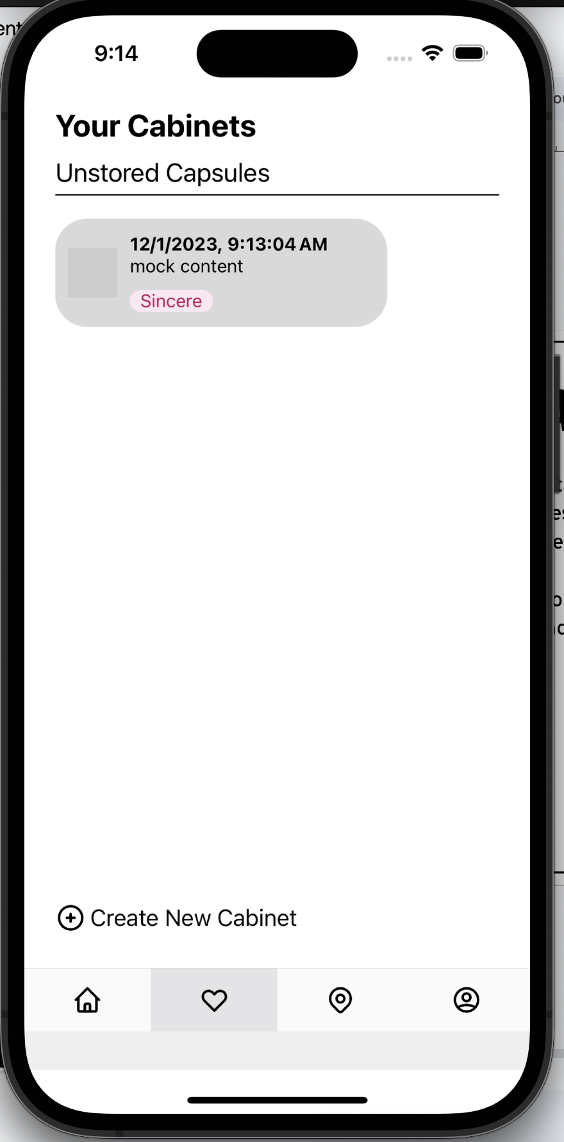
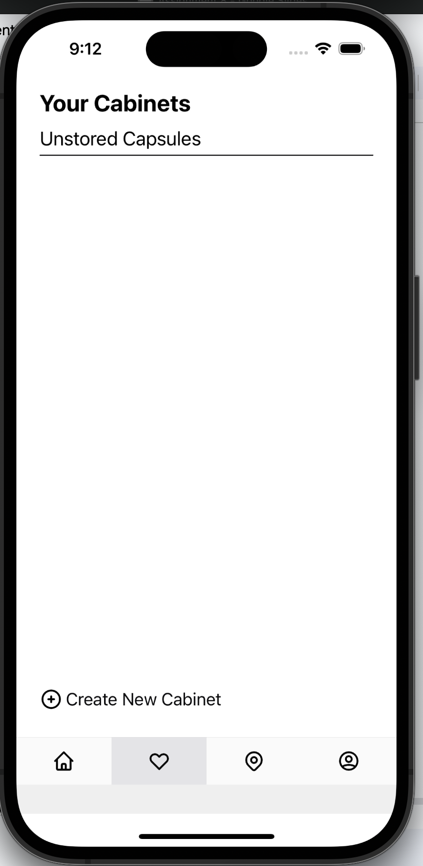
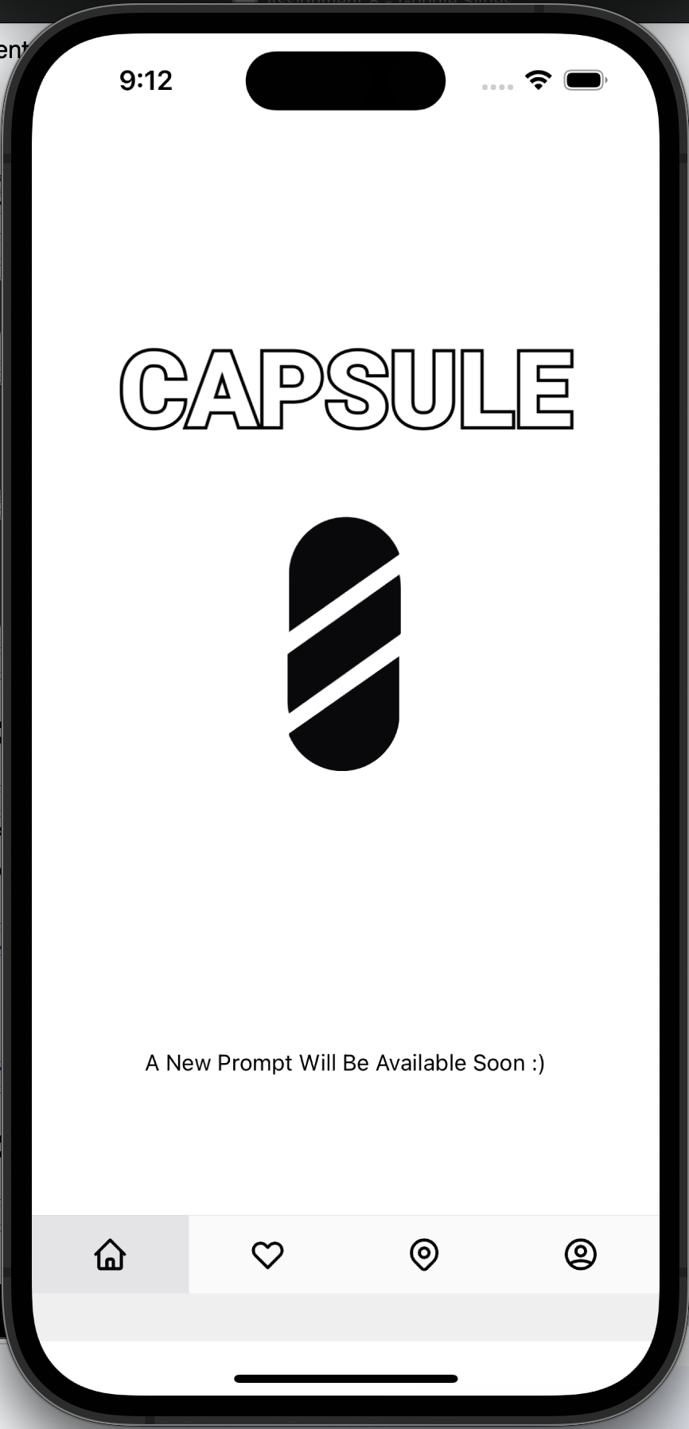
Current status
Implemented our first task
Responding to Capsules is in progress, layout has been started
Have made progress to managing Capsules and creating cabinets

Slide 21
Unimplemented features
A lot of the work is in progress
Need to begin working on our mapping feature
Need to fix some of the issues in our Redux store

Slide 22
Wizard of Oz - Hardcoded
Redux!
Stores all the data of Capsules that are collected
Also handles the Capsules you are prompted with
Need to think more about how we can trigger these notifications
  Timer?
All data is being hardcoded

Slide 23
Demo

Slide 24
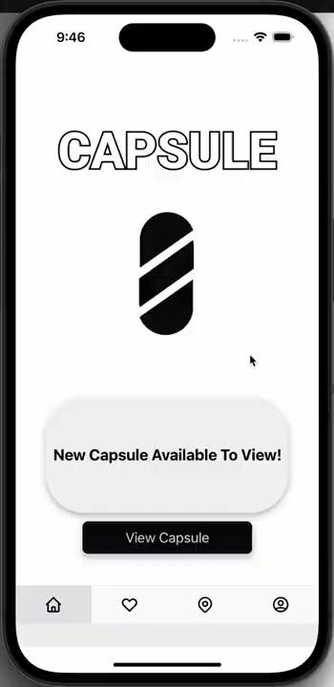

Slide 25
thank
you

