Slide 1

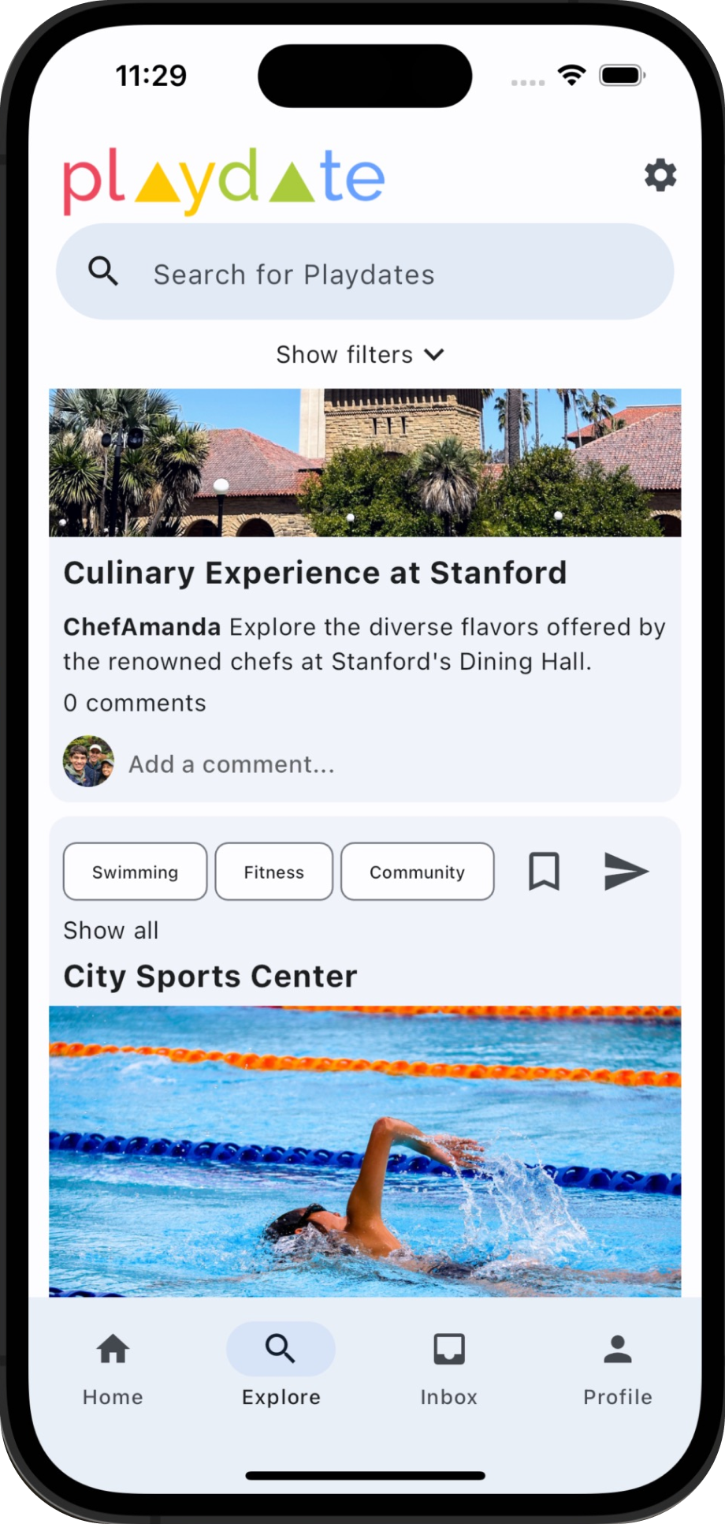
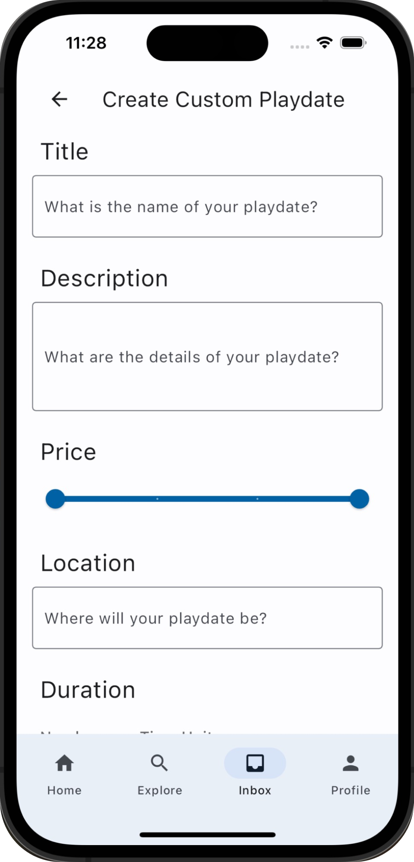
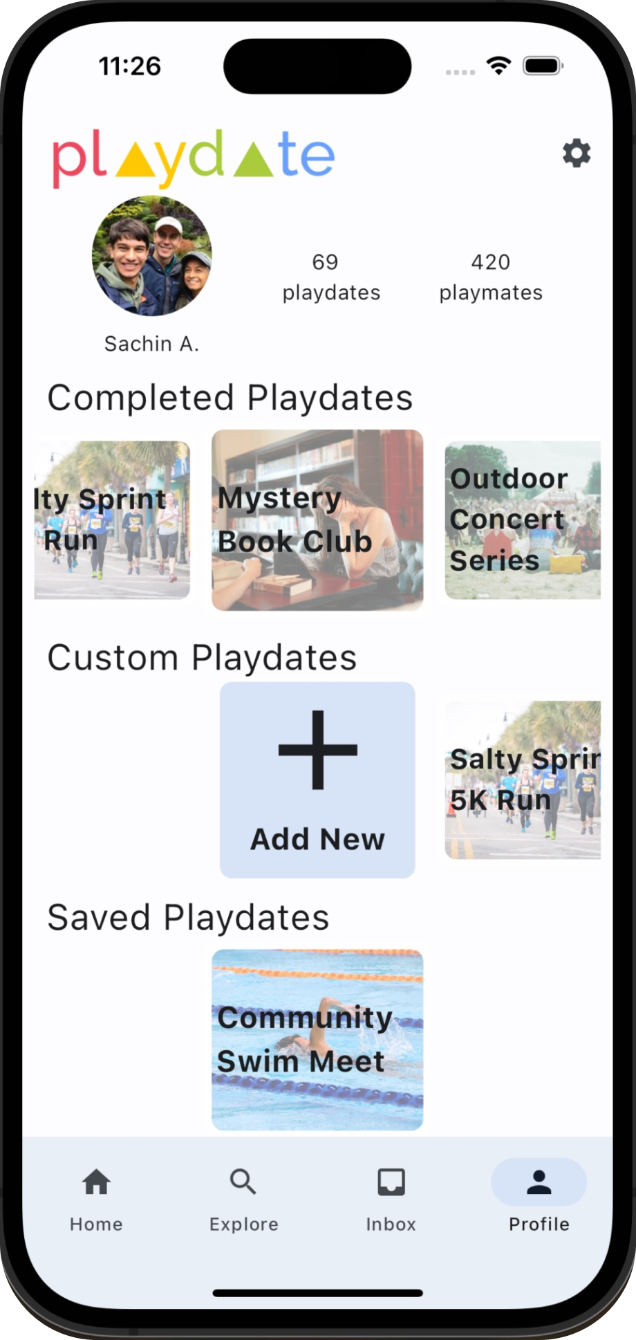
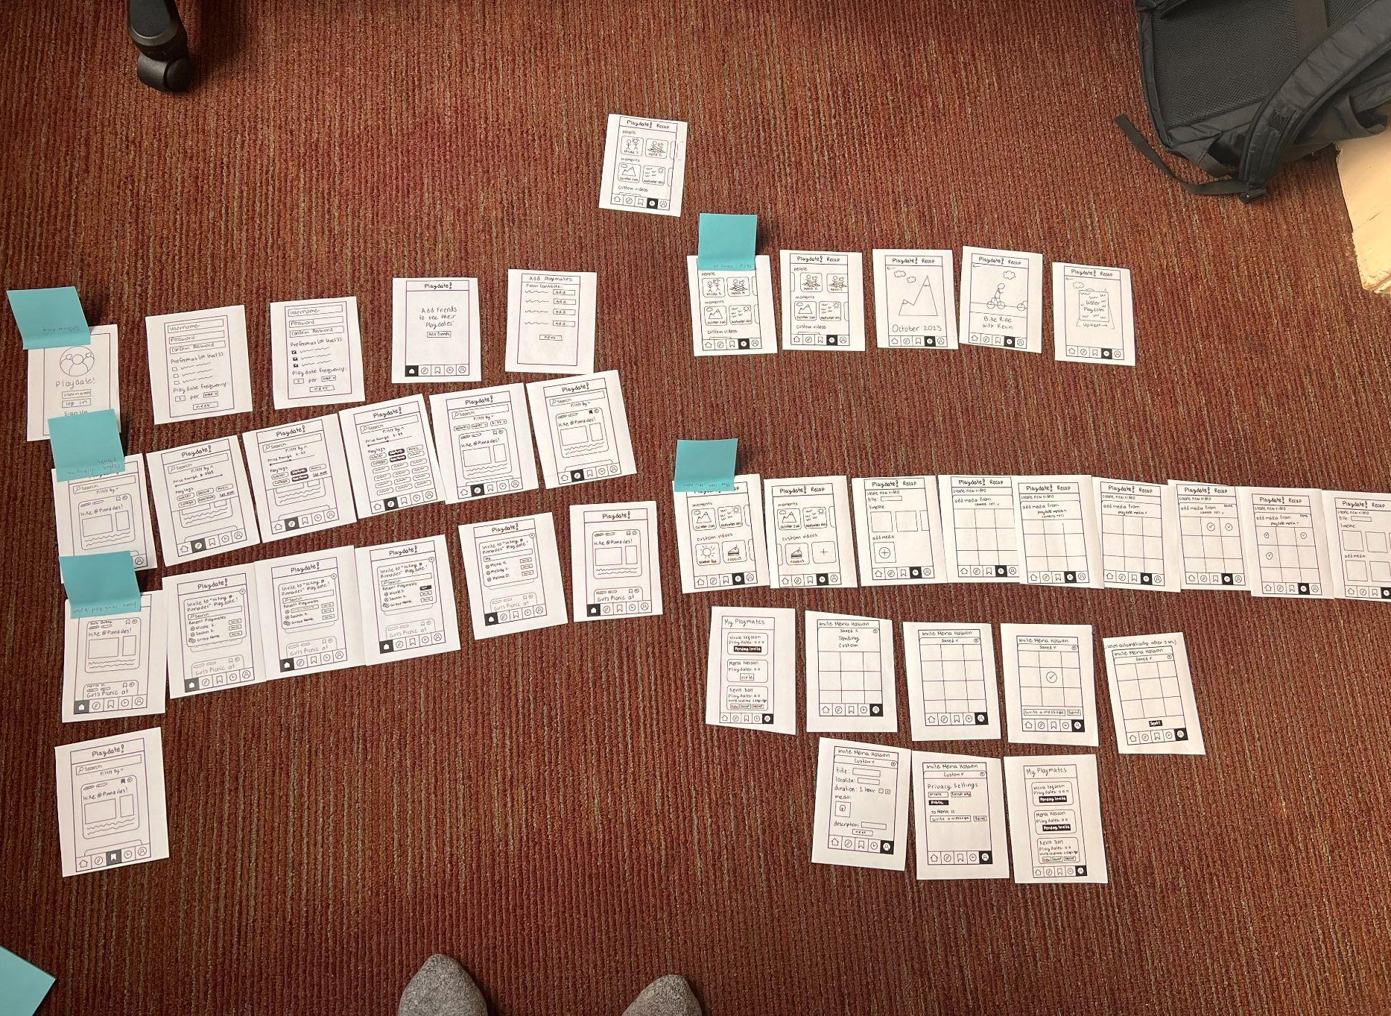
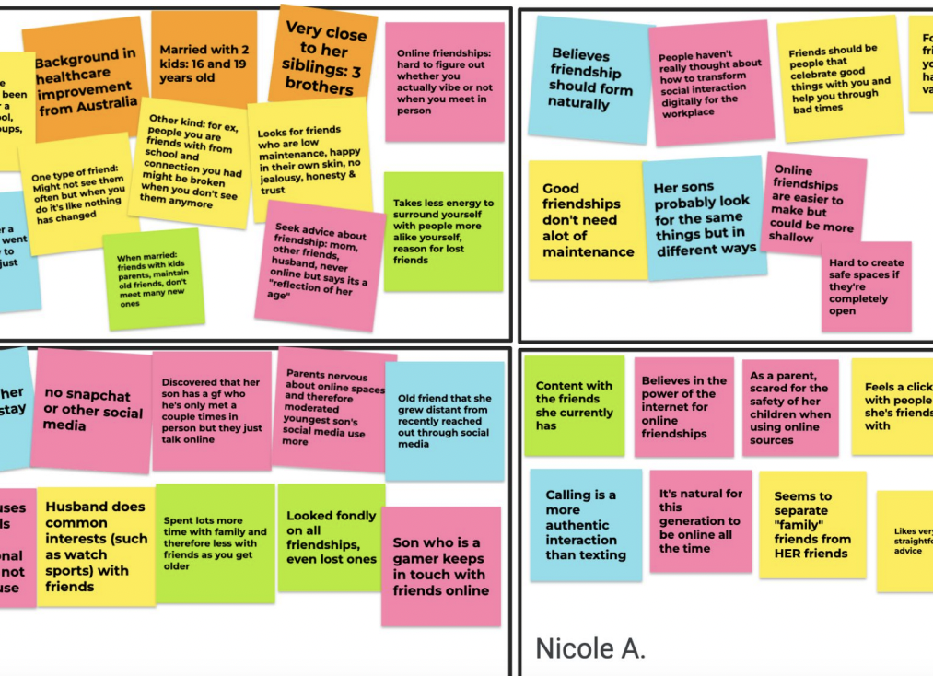
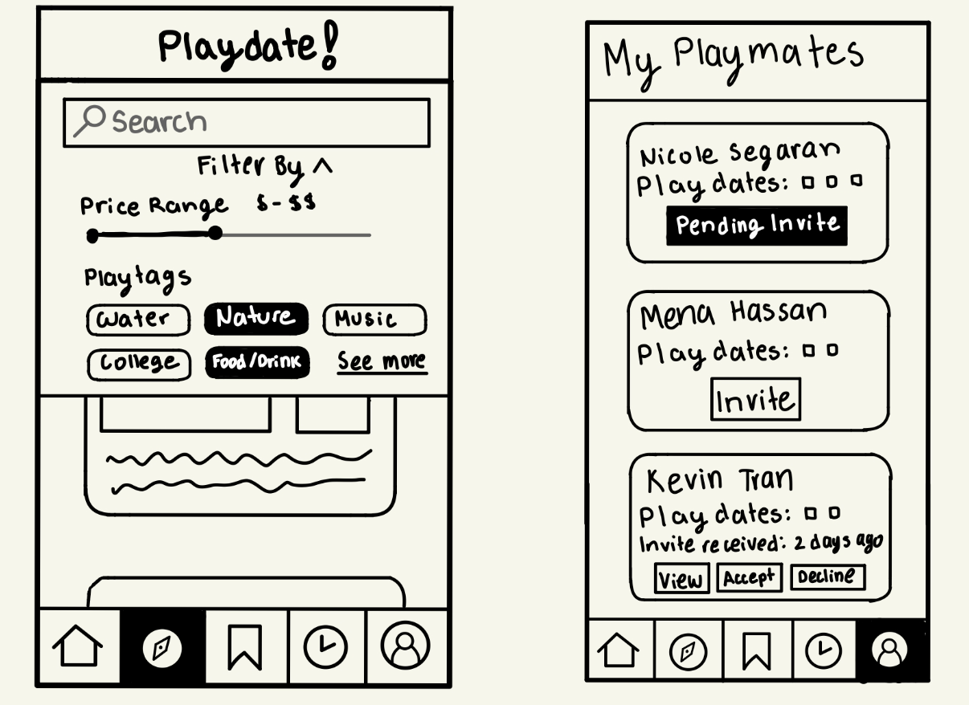
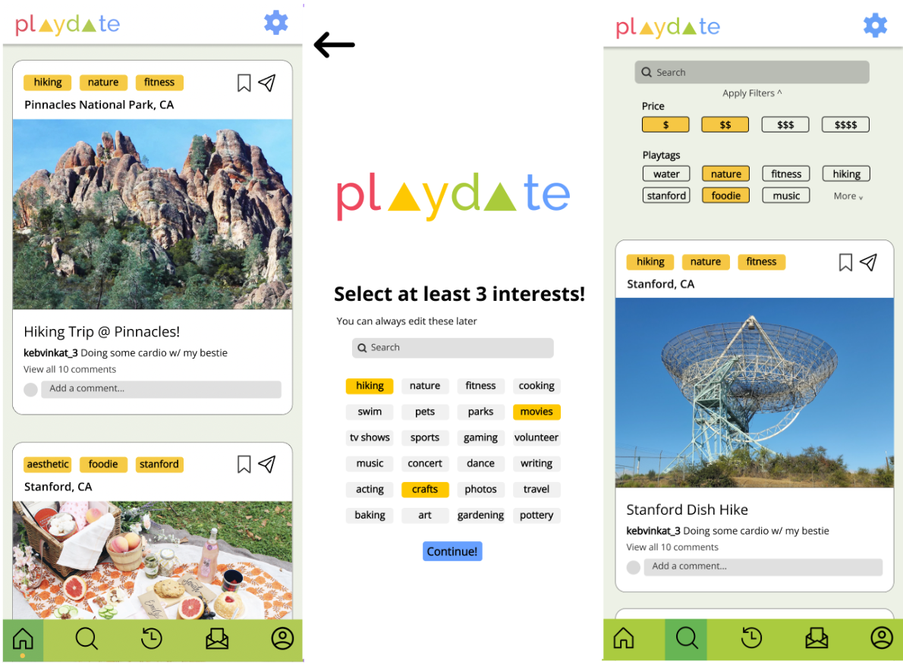
Strengthen your friendships with new adventures!
PROBLEM
People don’t prioritize making time for their friends, and when they can find time to meet up, they default to convenient and less meaningful activities since it is difficult to come up with new plans.
Explore Playdate Ideas
Create Custom Playdates
Save and Manage
Finished Playdates
SOLUTION
DESIGN ITERATION
Meet Playdate, an app that encourages and reminds people to stay connected with friends. Playdate helps users find playdate ideas, send invites to friends, keep accountable with deadlines, and share their experiences.
Needfinding
Testing
Low-Fi
Med-Fi
Sachin Allums, Mena Hassan, Kevin Tran, Nicole Segaran | CS147 Autumn 2023 | https://web.stanford.edu/class/cs147/projects/ThreadsandTrends/playdate/

