Slide 1

Sachin Allums
Nicole Segaran
Mena Hassan
Kevin Tran

Slide 2
Agenda
01
02
03
04
05
06
Project Prop and Solution
Heuristic Evaluation results
UI and product revisions
Prototype Status
Live demo
Appendix

Slide 3
01
Project prop and solution

Slide 4
playdate
Strengthen your friendships with new adventures

Slide 5
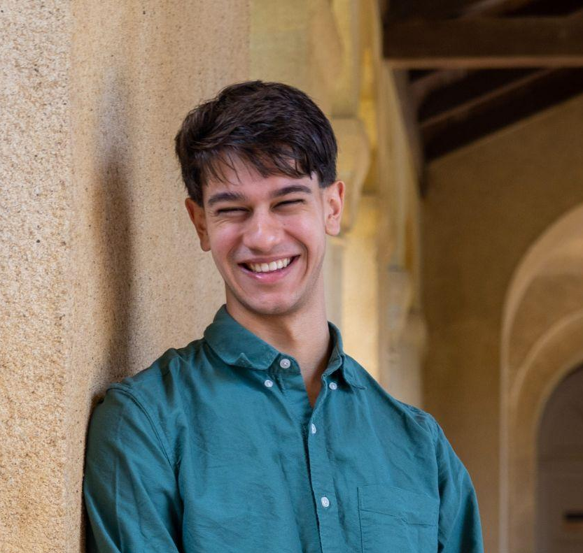
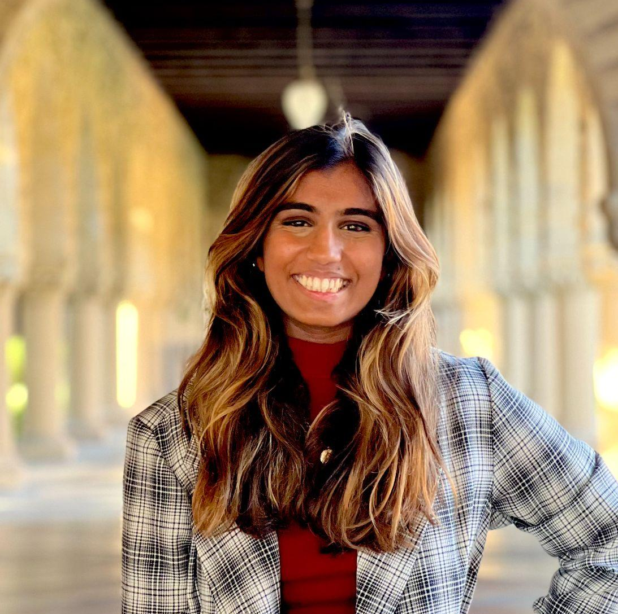
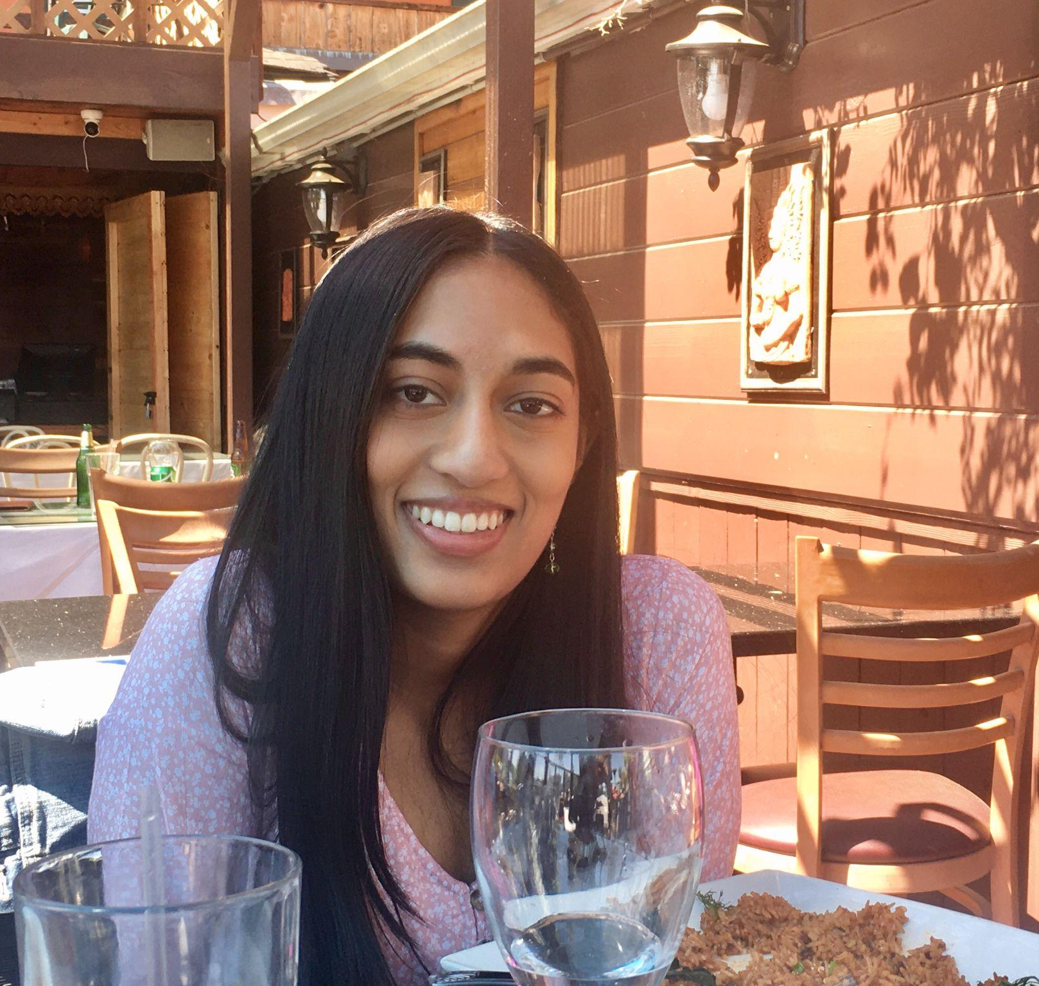
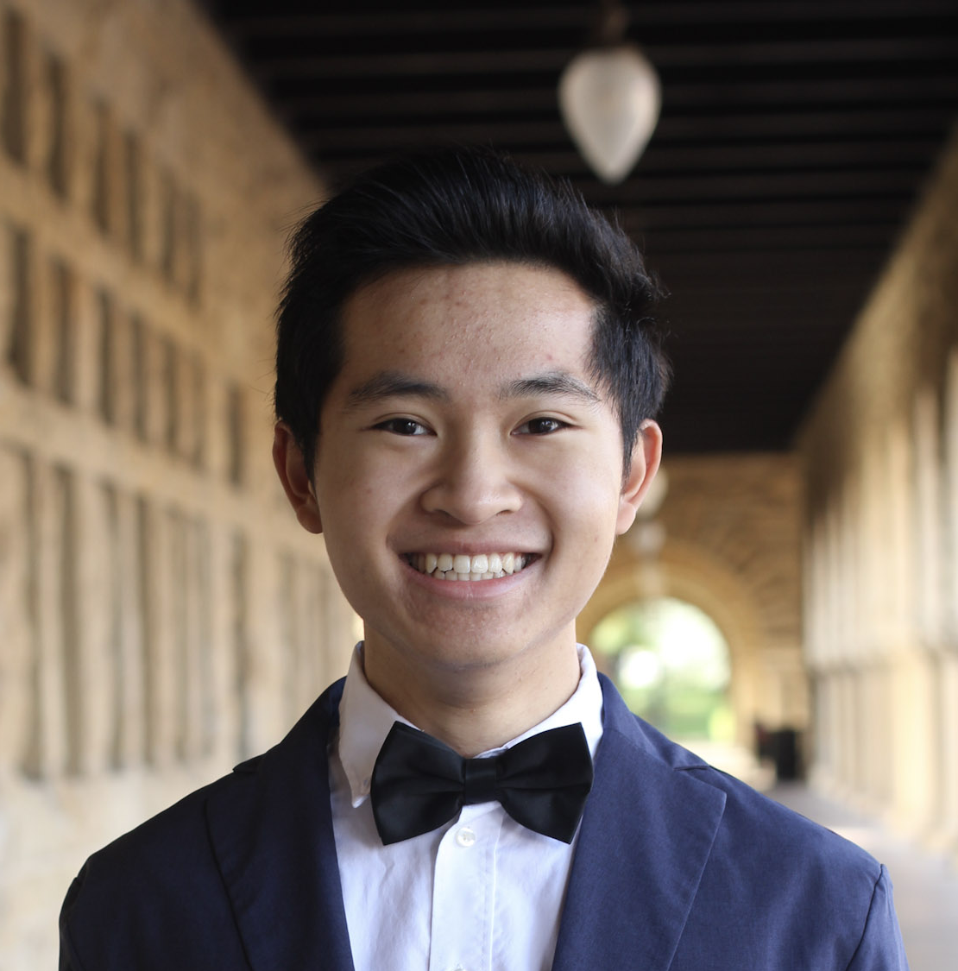
Sachin Allums (he/him)
Nicole Segaran (she/her)
Mena Hassan (she/her)
Kevin Tran (he/they)

Slide 6
Value proposition
• Sense of urgency to friendships
• Fostering connection with novelty
• Creating a space for reflection
Notes:
This last point might be one that changes depending on how we allow users to look back on the playdates they have completed

Slide 7
Problem and Solution
Problem
Solution
Young adults want to deepen their friendships, but aren’t sure how and when to
Give them ideas and a deadline for a playdate!

Slide 8
02
Heuristic Evaluation Results

Slide 9
82
22
23
16
Severity 1-2 Issues
Design Changes
Severity 3-4 Issues
Design Changes

Slide 10
HE Summary
We should emphasize deadlines
Making playdates should be easier
Consistent color meanings
More status signs and confirmation dialogs
Notes:
We compiled all of the feedback we received into a more digestible format in this document: https://docs.google.com/document/d/1INI1OsyY_oTKMpAPWb4cmKQGWOZuVrEoyM53BkCbujA/edit?usp=sharing

Slide 11
Severity 3 and 4 Violations
Most violated heuristics:
  H3: User Control
  H4: Consistency & Standards
  H5: Error Prevention
Most confusing tasks:
  Creating a Custom Playdate
  Recapping Playdates
Notes:
Our most confusing tasks are the 2 tasks with the highest amount of violations. Many of the UI changes we made are meant to mitigate these violations.

Slide 12
Unaddressed Revisions
Recap feature violations (26 violations)
  Recap feature has been removed (for now)
  Creating videos will be too complex to implement in hi-fi

Slide 13
03
UI and product revisions

Slide 14
General Sev 3 & 4 Revisions
Save button and checkboxes do not toggle
  Fix: Will be working in hi-fi!

Slide 15
General Sev 1 & 2 Revisions
Inconsistent behavior may distract users
  Fix: Make all buttons consistent color: Blue primary
  Fix: Consistent font & capitalization
Overlaid text is difficult to read
  Fix: Increase contrast between overlapping text and image
Lack of status updates
  Fix: More confirmation dialogs
Notes:
Primary button color is blue, and cancel/decline buttons are red. Confirmations are in yellow.

Slide 16
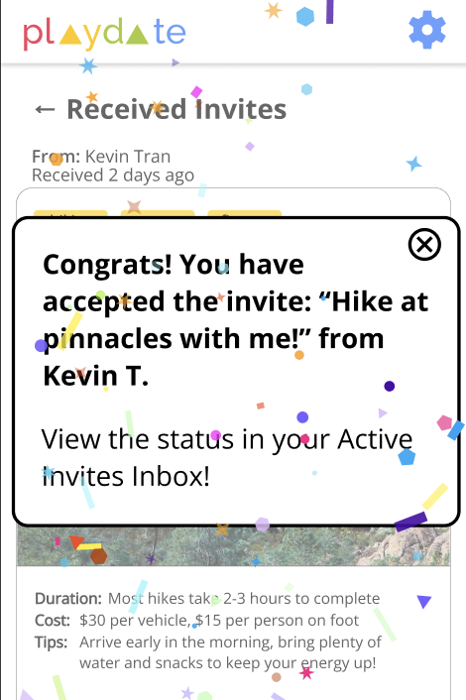
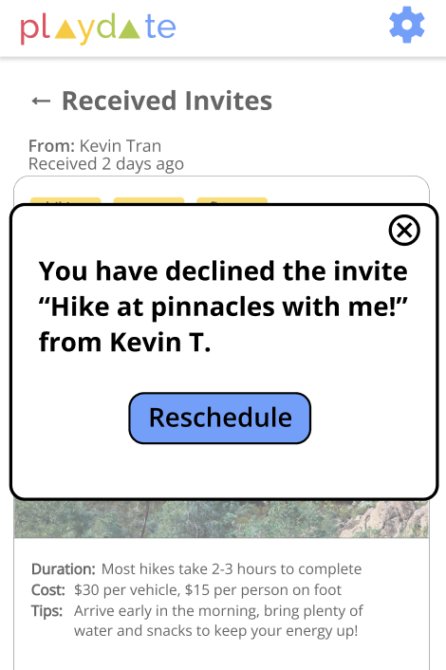
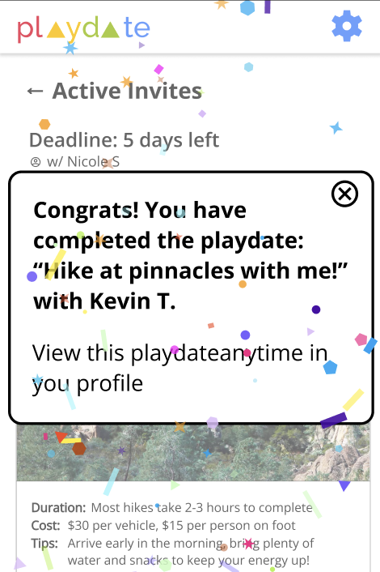
New Confirmation Dialogs
Accepting a Playdate
Declining a Playdate
Completing a Playdate
Notes:
There are now confirmation dialogs letting a user know that their acceptance or rejection of a playdate invite was successful. We also added confetti to the “Accept” action because we received feedback that creating a playdate activity and completing it should be more fun.

Slide 17
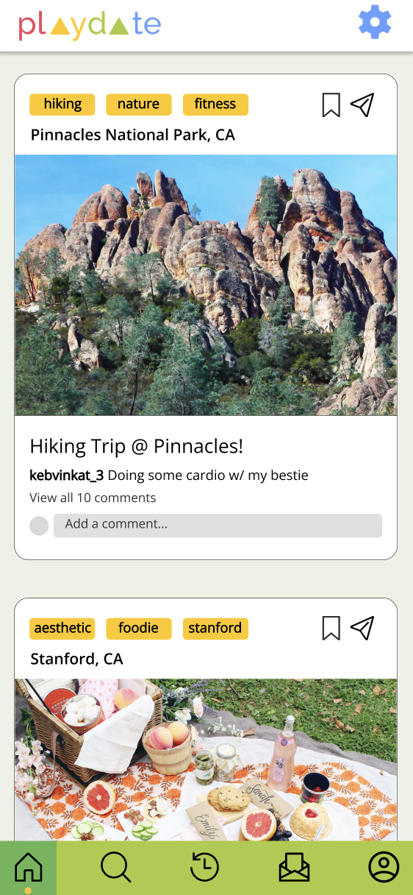
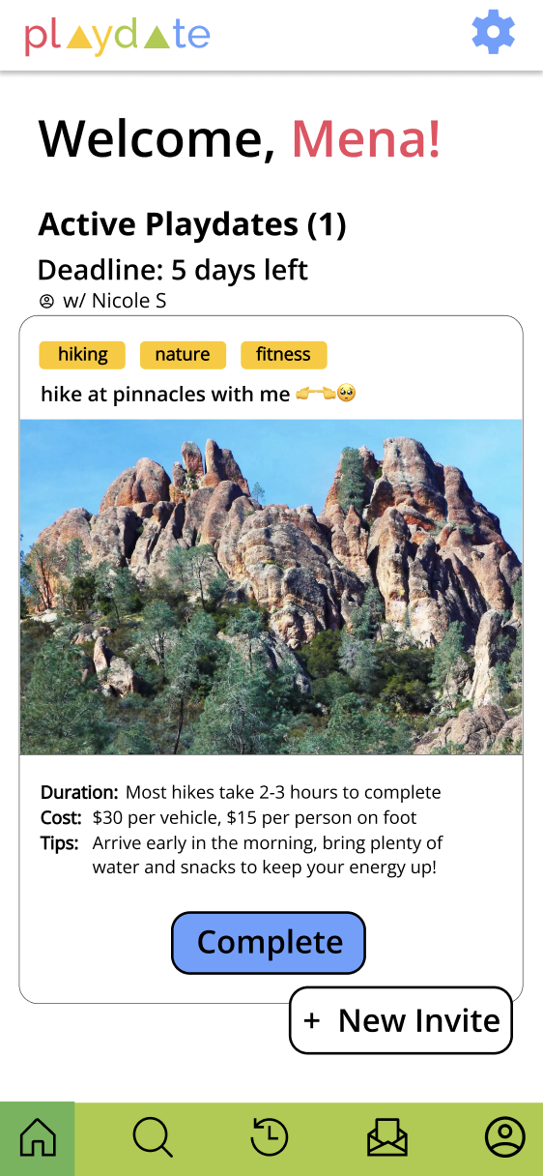
Revised Home Screen!
Only shows active playdates
Emphasizes deadline and creating a new invite
Notes:
We created our revised home screen based on our overall feedback to make the deadlines for playdates more emphasized in the home screen. In addition, since one of the main functionalities of our app is inviting people on playdates, we wanted creating an invite to be more discoverable (not just through the explore and inbox pages)

Slide 18
Account Setup

Slide 19
Account Setup Violations
Severity | Description | Fix & Rationale
4 | No way to get back to the first page after choosing to Sign Up | Add a back button to sign up pages to allow users to get back to first pages
3 | Continue button looks clickable even before 3 interests are selected | Continue button is disabled until 3 interests are selected so users know they cannot move on
4 | On the very first page, there is no log in or forgot my password button | Add ways for users to log in and reset their password

Slide 20
Account Setup:
Before and After Shots

Slide 21
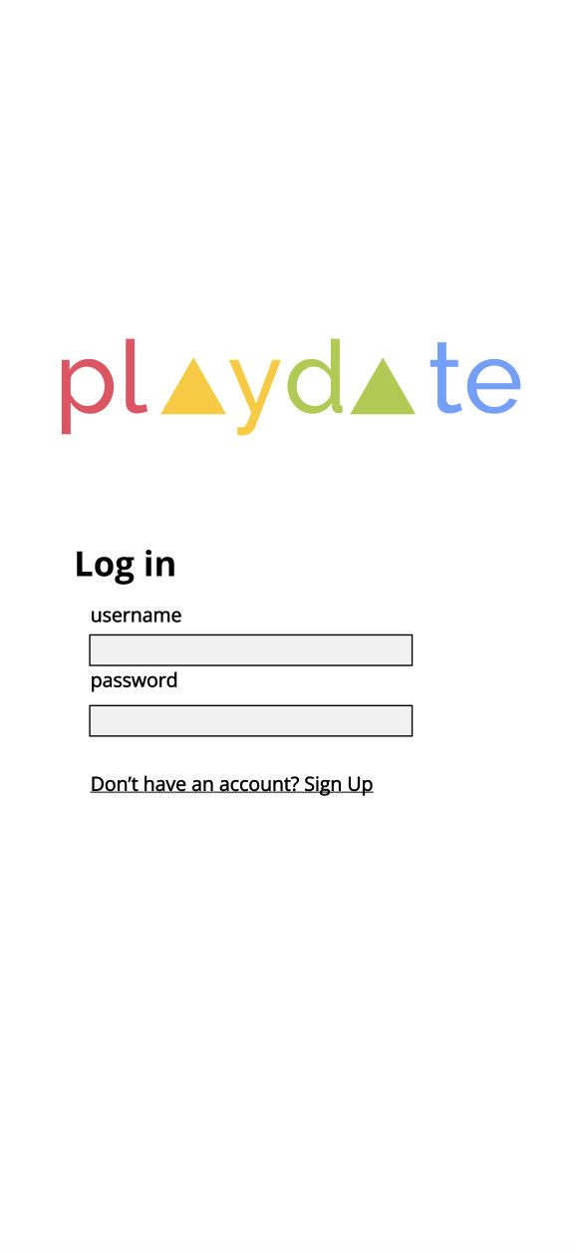
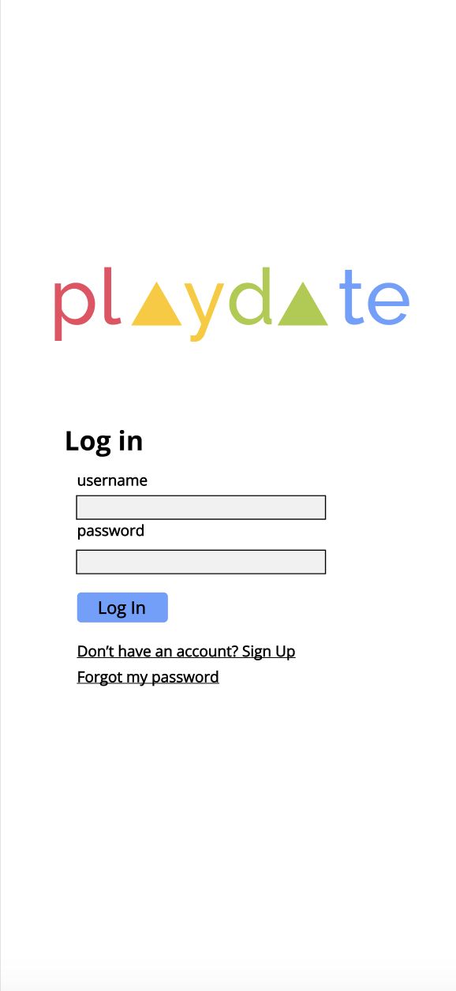
Notes:
There is now a Log In button and Forgot my Password link on the first sign up page. The Log In button allows a user to log in if they already have an account, and the forgot my password link allows a user to reset their password.

Slide 22
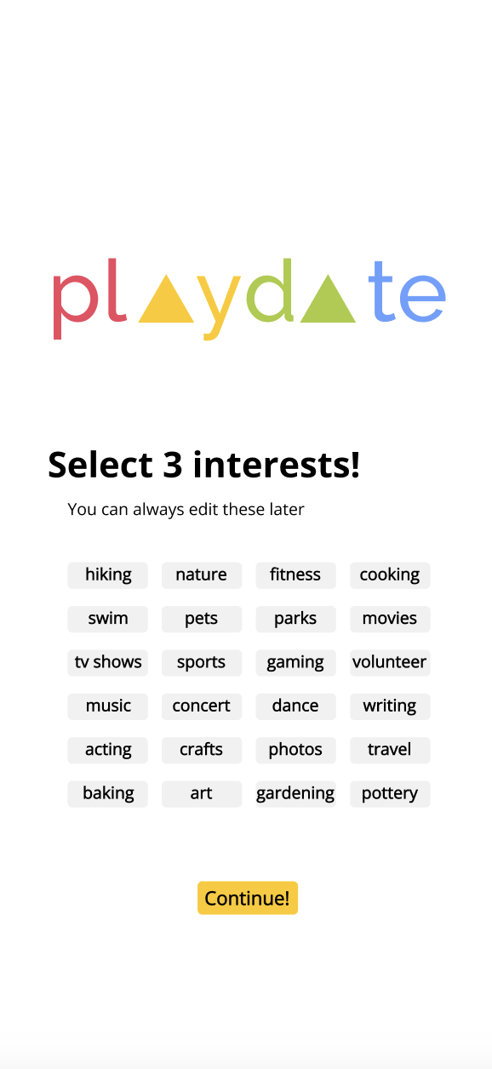
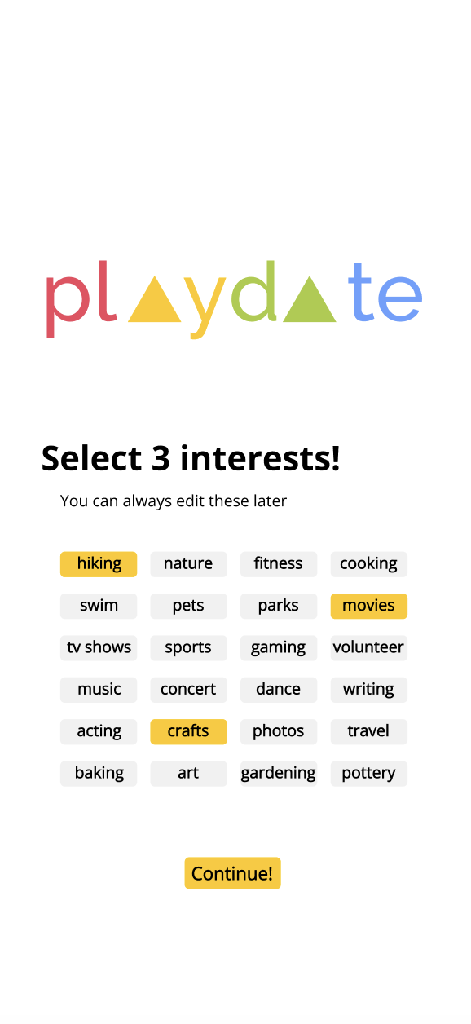
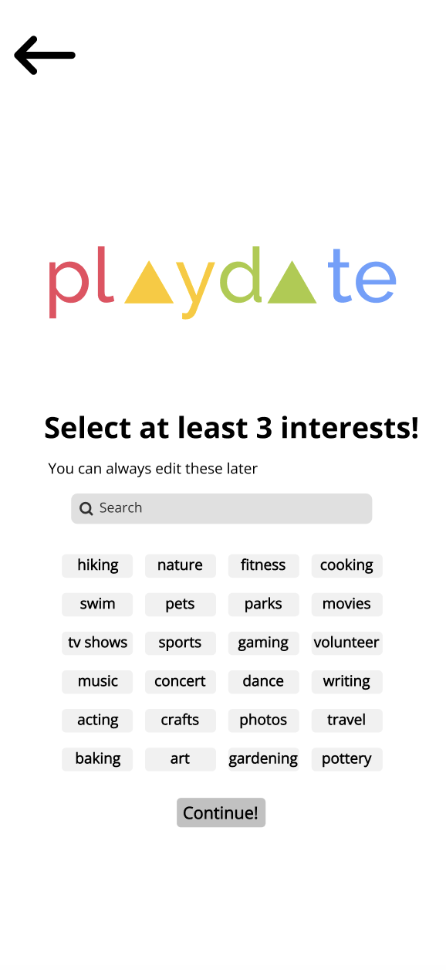
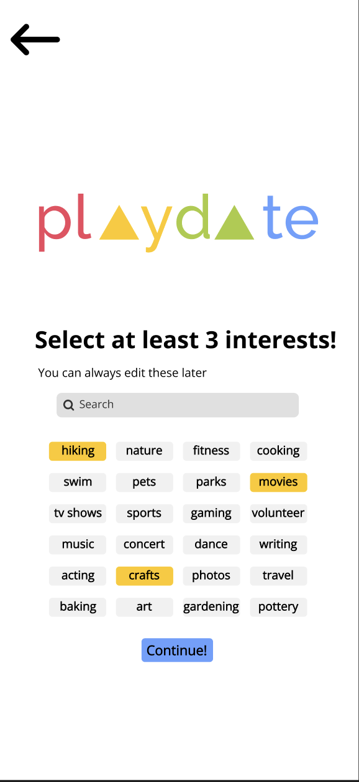
Notes:
Now, the continue button is disabled (non-clickable) until at least 3 interests are selected. There are also back buttons on every screen in the sign up page.

Slide 23
Task 1: Create a Custom Playdate

Slide 24
Create a Custom Playdate Violations
Severity | Description | Fix & Rationale
4 | No way back to profile page after clicking into Saved Playdates | Add a back button to each of the pages clickable from the user profile
4 | No save or create button to finish creating Custom Playdate | Make Create button discoverable that is disabled until Custom Playdate form is filled out
4 | Creating custom playdate form has two fields named ‘Description’ | Change one field to ‘Tags’ instead of having two ‘Description’ fields, which is confusing

Slide 25
Create a Custom Playdate Violations Cont.
Severity | Description | Fix & Rationale
3 | When back arrow is clicked from Custom Playdate form, no confirmation of cancellation | Add confirmation dialog when back arrow is clicked so users do not lose their information if it is clicked on accident
3 | ‘Duration’ field meaning unclear on create new custom Playdate page | Add description of ‘Duration’ under field to help users understand what it means
3 | ‘Description’ and ‘Duration’ fields have no elaboration on what these figures are changing | Add descriptions under both ‘Description’ and ‘Duration’ fields

Slide 26
Create a Custom Playdate Violations Cont.
Severity | Description | Fix & Rationale
2 | Clicking “Invite” button on specific playmate changes text to “Invited” but there is also a “Send Invites” button at the bottom | To give the user more clarity, playmates should be selected first and then click “Send Invites” button
2 | No way to return to “Choose Playdate” page from “Choose Playmates” page | Add a back button so users can change their choice of playdate if they would like
2 | Units for Duration is set in plain text for ‘days’, so there is no noticeable way to edit it to another measure | Create a dropdown for Duration with options such as days, hours, etc, so users are not restricted to choosing one unit of time

Slide 27
Create a Custom Playdate:
Before and After Shots

Slide 28
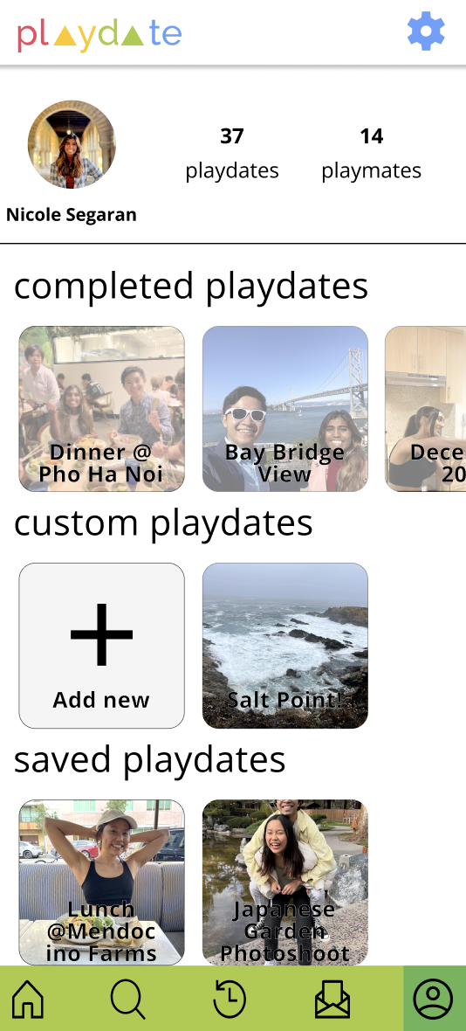
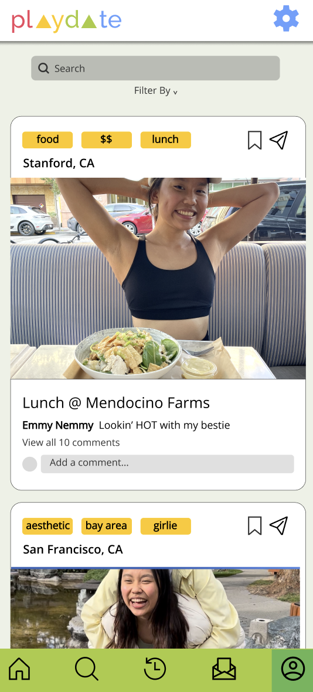
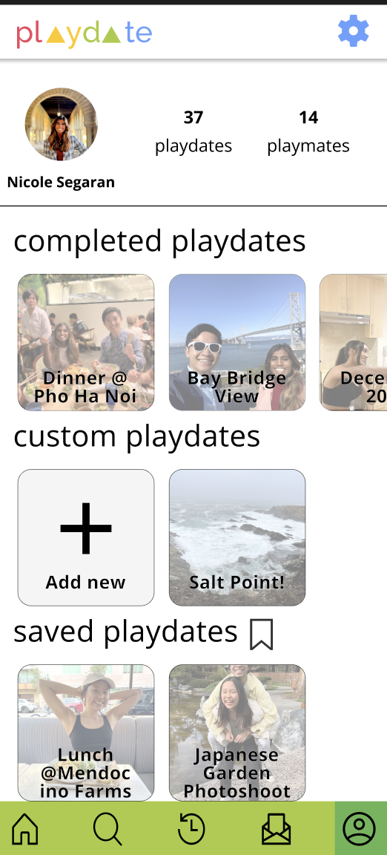
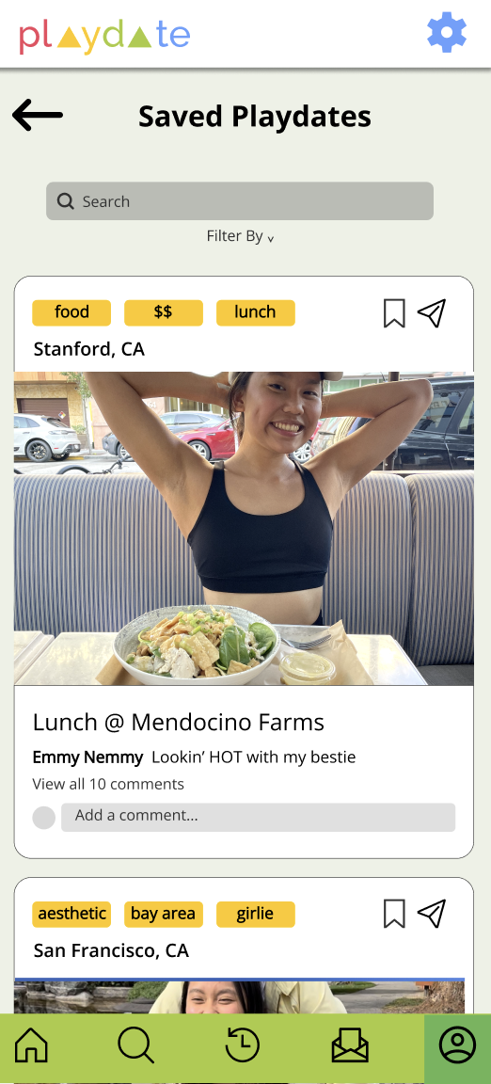
Notes:
When navigating to Completed Playdates, Custom Playdates, Saved Playdates, or another playmate’s posts, the new page is now labeled and has a back button to return to the profile page. Here, you can also see that we have created more contrast between the background photos and the overlaid text.

Slide 29
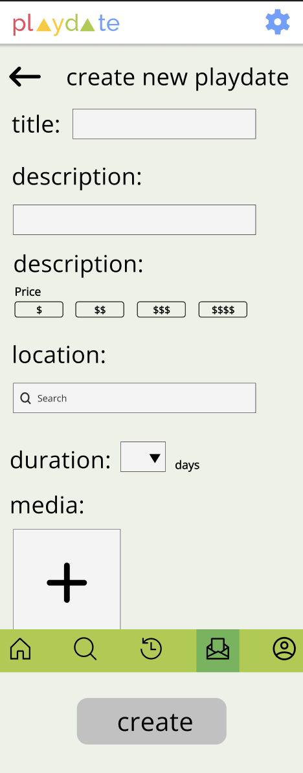
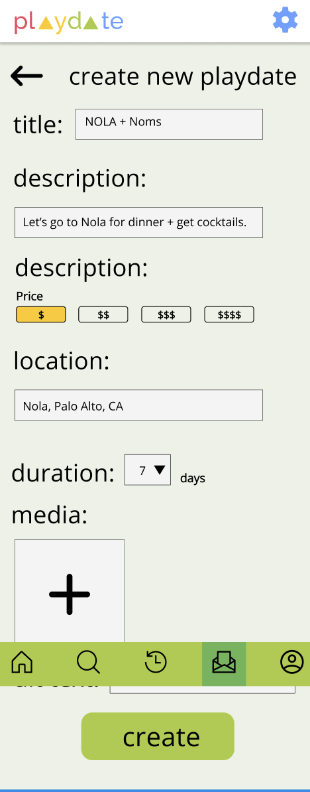
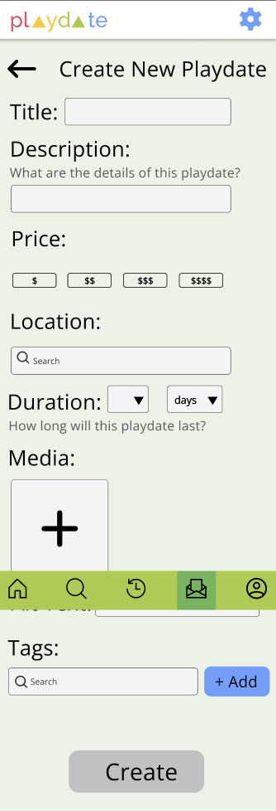
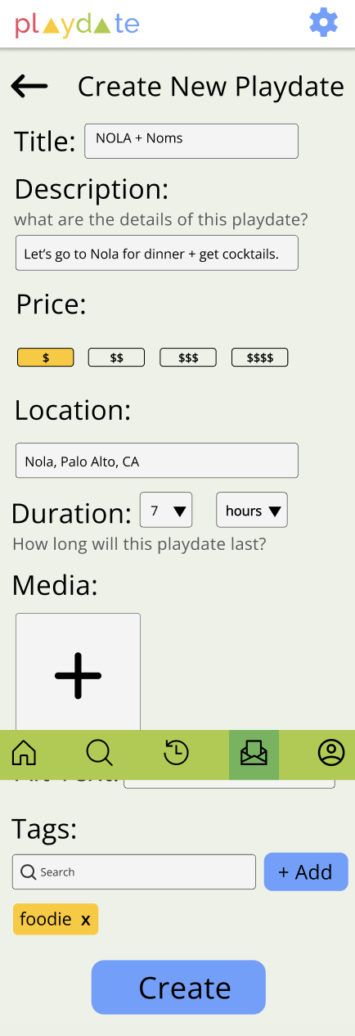
Notes:
When creating a new custom playdate, there are now description subtitled under the “Description” and “Duration” fields. In addition, you can now change the units of the duration. Instead of two description fields, there is a Description field and Tags field. The create button is now discoverable.

Slide 30
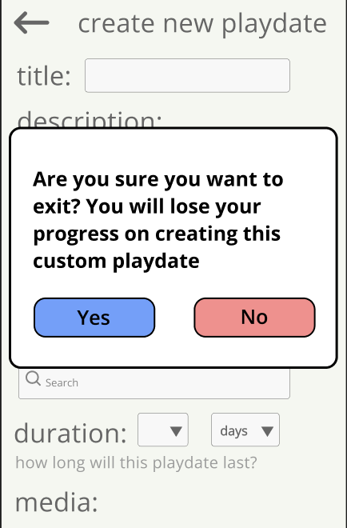
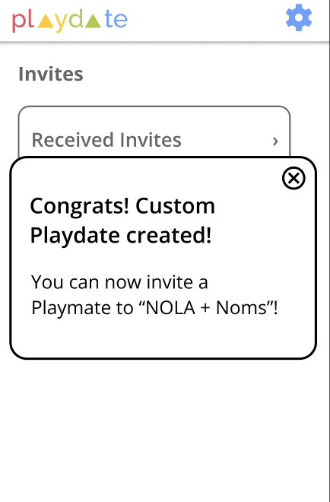
New Confirmation Dialogs (Creating Custom Playdate)
Clicking Back Button
Clicking Create
Notes:
In the revised designs, if the user clicks the back button on the create a new playdate form, a dialog box opens asking them to confirm their choice. When a user clicks create, a dialog is opened up which confirms the creation of their custom playdate, along with the title of that playdate. When they close the modal, they will be returned to the original screen from which they accessed the create new playdate form. The changes to the “New Invite” flow will be touched on in the next section of Sending Somone a Playdate

Slide 31
Task 2: Invite Someone to a Playdate

Slide 32
Invite Someone to a Playdate Violations
Severity | Description | Fix & Rationale
1 | No confirmation when cancelling a playdate | Add confirmation dialog after a user clicks “Cancel” so they know the action was successful
2 | Create new invite page does not have option to write a message | When sending invite from explore page, users can write a message, so should be able to write one in New Invite page
1 | Unclear whether header text in Received invites refers to invite message or playdate title | Add label to message so it is clear what is the playdate title and the invite message

Slide 33
Invite Someone to a Playdate:
Before and After Shots

Slide 34
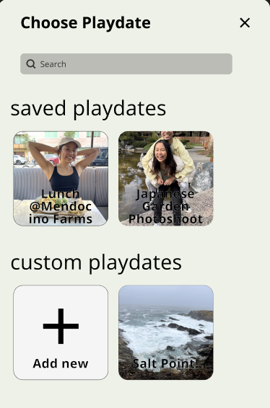
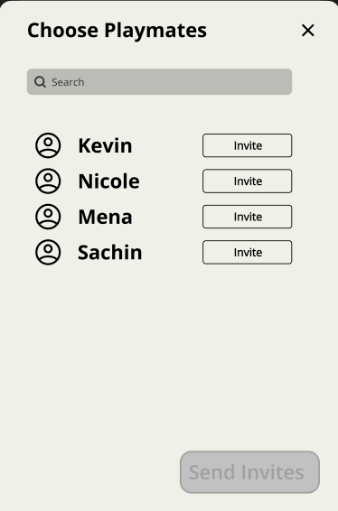
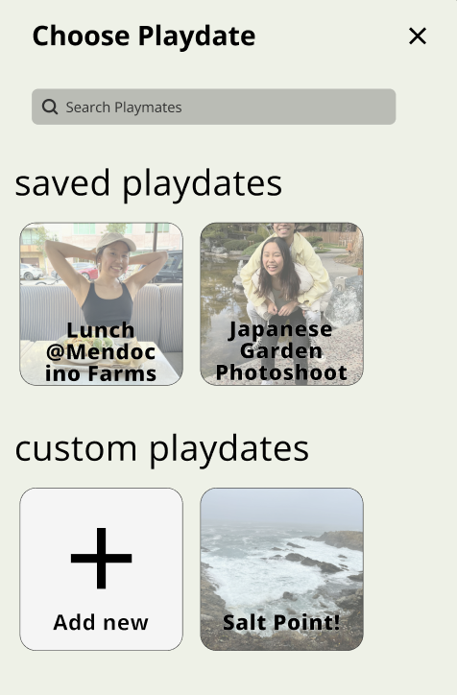
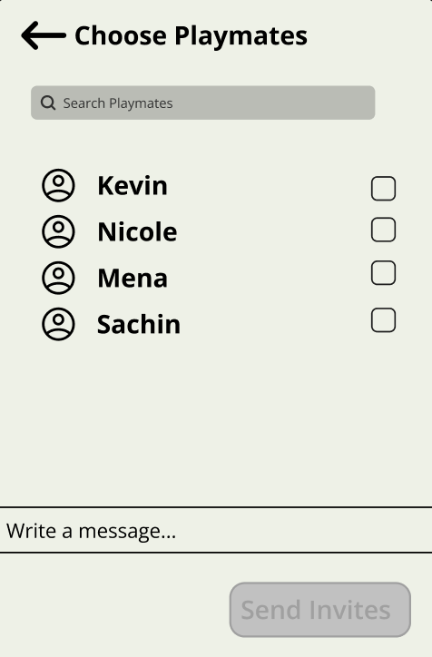
Notes:
To give the user more clarity, playmates can be selected first and then click “Send Invites” button. This is the same as how it is done when sending invites from the explore page. You can also now write a message when sending an invite, and click the back button to go back to the Choose Playdate screen.

Slide 35
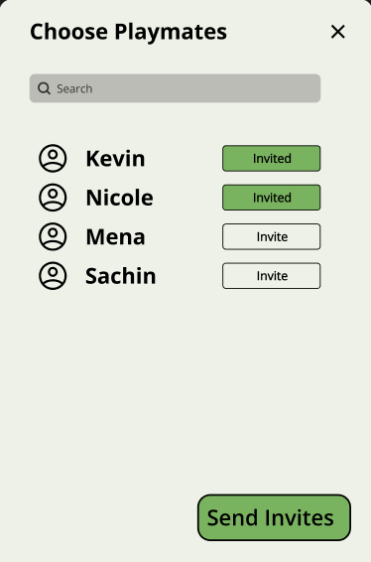
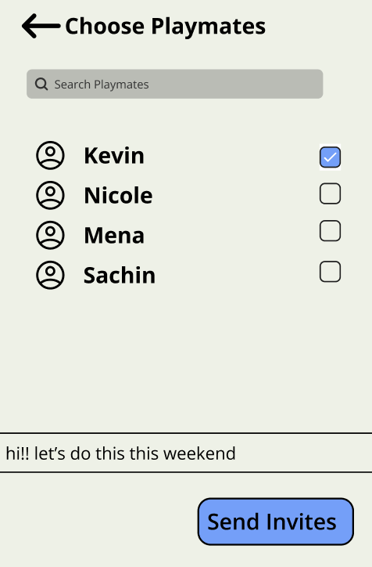
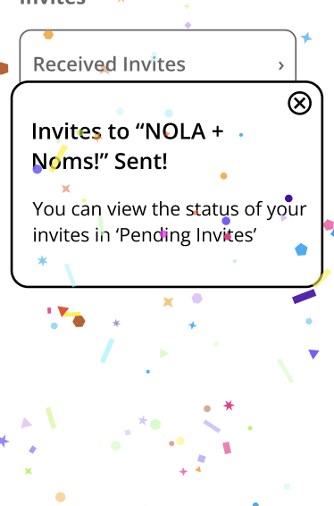
Clicking Send Invites Dialog
Notes:
The send invites button becomes enabled when at least one person is selected. There is also a dialog confirmation when an invitation is sent, along with confetti to create more encouragement when a user sends an invite. All the buttons are now blue to stay consistent with our primary button color. The user can close the dialog to return to their original screen when they first started the create new invite flow.

Slide 36
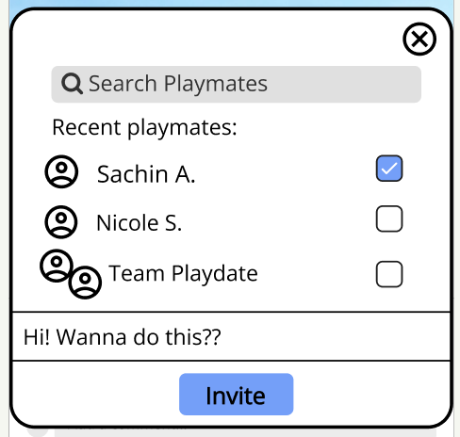
Design Alignment: Inviting Someone to a Playdate
Invite from Explore Page
Previous Design
Revised Design
Notes:
The current flow for inviting someone to a playdate when you click new invite is meant to mirror the way in which you can invite someone to a playdate from the explore page.

Slide 37
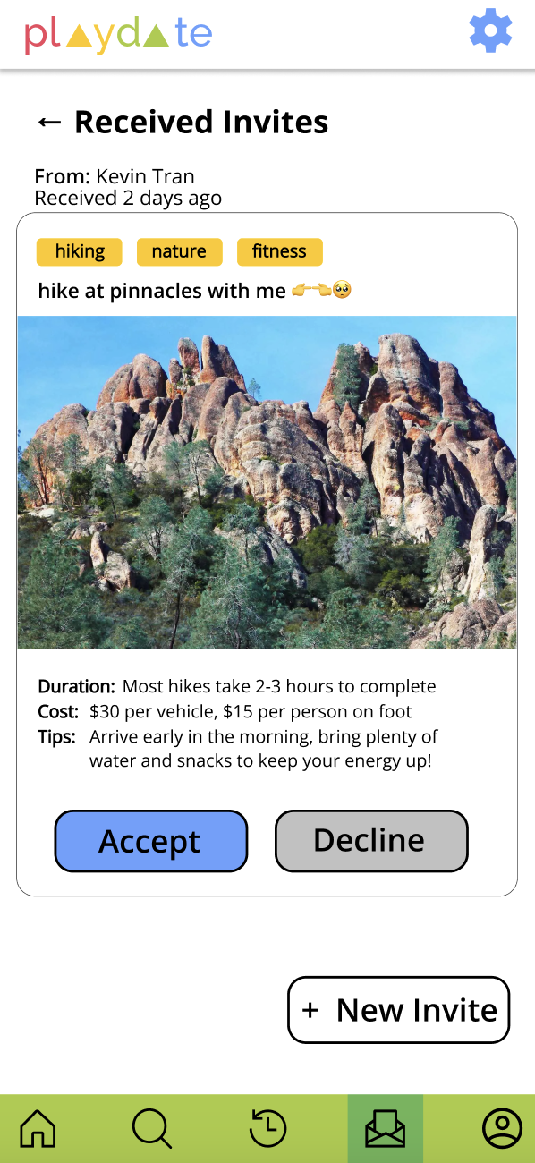
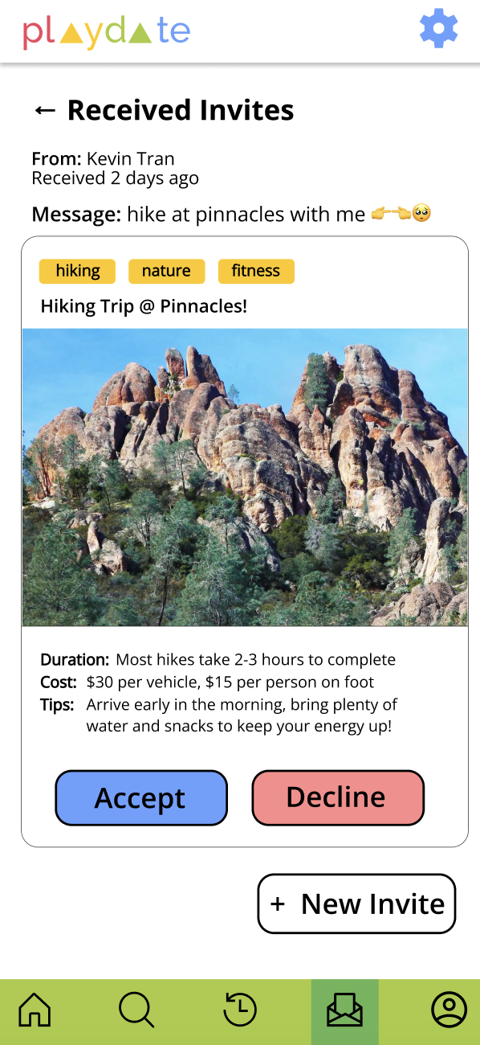
Notes:
The message is now clearly labeled, and the title is on the post. Another note is that the decline button was changed to be consistent with other cancellation type buttons.

Slide 38
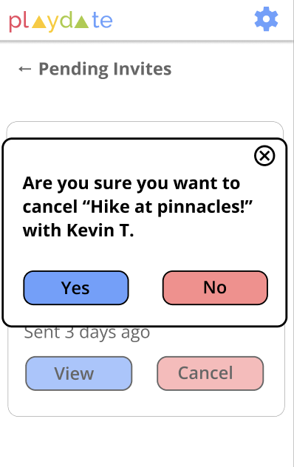
New Confirmation Dialog
Cancelling a Playdate
Notes:
Now, a user must confirm that they want to cancel a playdate, in case they clicked the button on accident. This also gives them more clarity that their action was successful.

Slide 39
Task 3: Filter & Sort Playdates

Slide 40
Filtering Playdates Violations
Severity | Description | Fix & Rationale
3 | No close menu button on expanded filters menu (after ‘More’ is clicked) | Add a ‘Less’ button on expanded filters menu so users can minimize it
3 | No clear way to fully apply filters since user has to close the filters box to apply filters | Add an ‘Apply’ button that allows users to apply chosen filters after selecting them to what is happening more clear

Slide 41
Filtering Playdates:
Before and After Shots

Slide 42
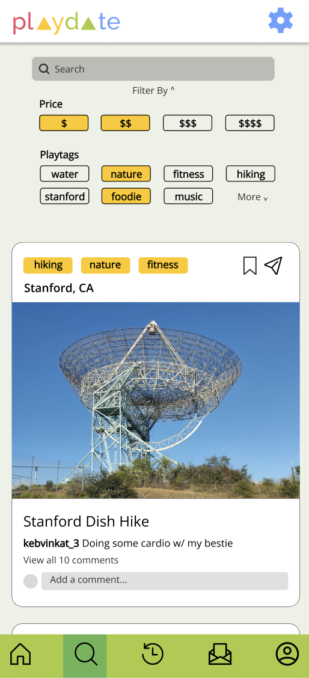
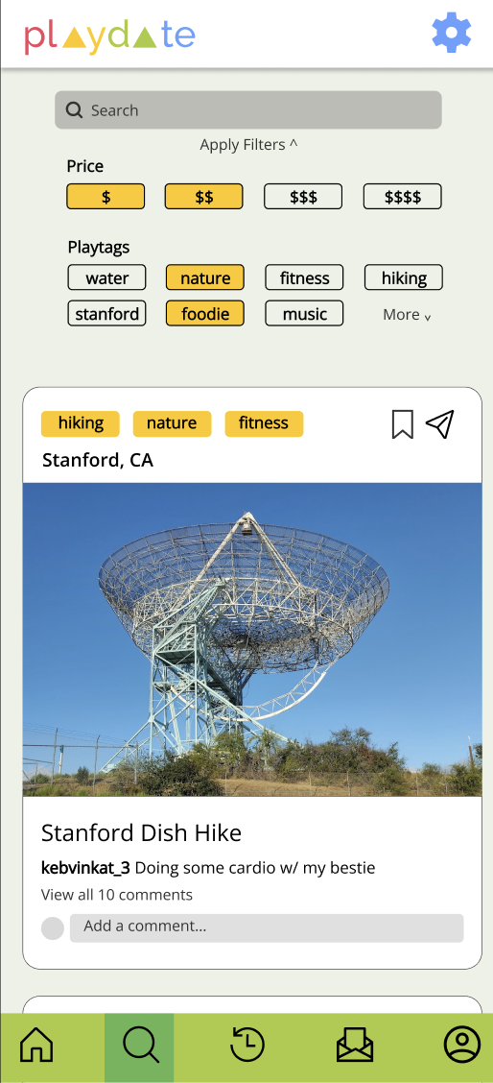
Notes:
The button to close the filters now says “Apply Filters”, clearly letting the user know what will happen when they click that button

Slide 43
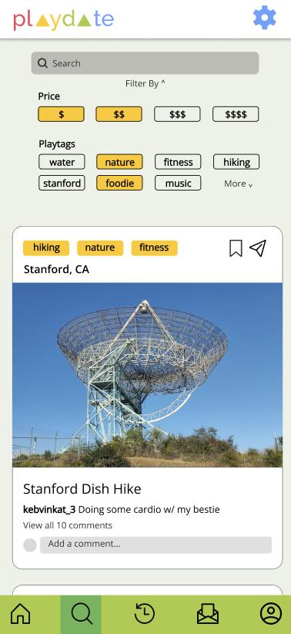
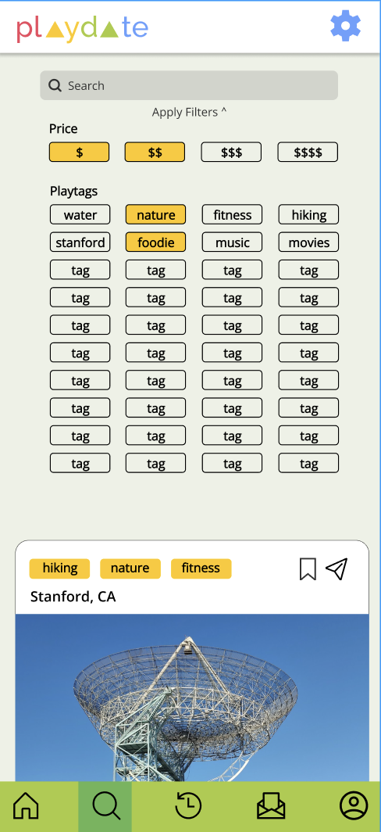
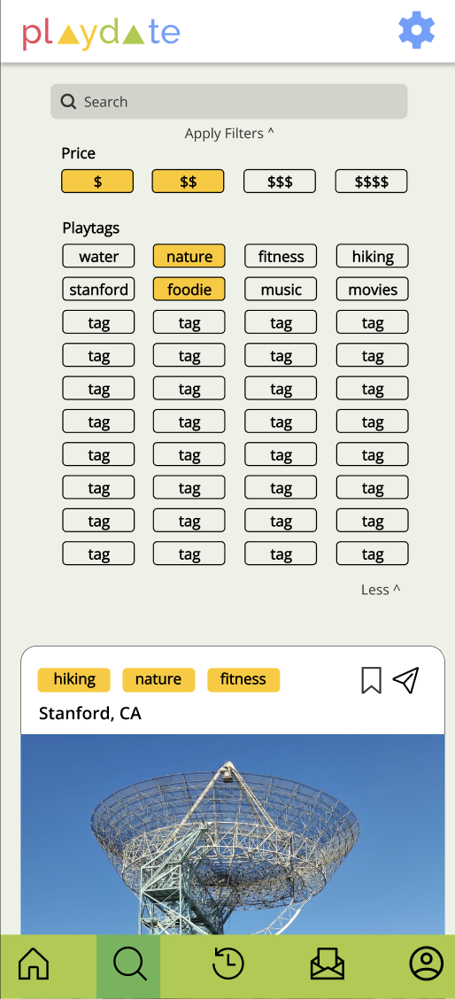
Notes:
There is now a Less button that allows users to minimize the expanded filters after More is clicked

Slide 44
Progress Towards Usability Goals
• Faster account set up
• Easier to make playdate
• More consistency in color and design
• No recaps so less overwhelming
Notes:
Received a lot of feedback from users and from Star that we have a lot of features going on in our app, so scrapping the recaps hopefully makes our app a lot less overwhelming to use. We expedited the account set up by not requiring people to choose 3 friends and also added a button to the home screen to allow someone to easily create a playdate

Slide 45
04
Prototype Status

Slide 46

Notes:
We chose to implement this app using flutter flow since some of our team members already have quite a bit of experience using both flutterflow and flutter. Flutter flow is a low code platform, very similar to figma, but it adds a ton of other functionality that allows a user to directly download their UI designs into flutter/dart code

Slide 47

Framework/Tools
• FlutterFlow
• Allows for easy collaboration
• Finishing touches in Flutter
Notes:
We will eventually be downloading all of the code from flutterflow into flutter and then coding all of the things we need to do after the UI has been set

Slide 48
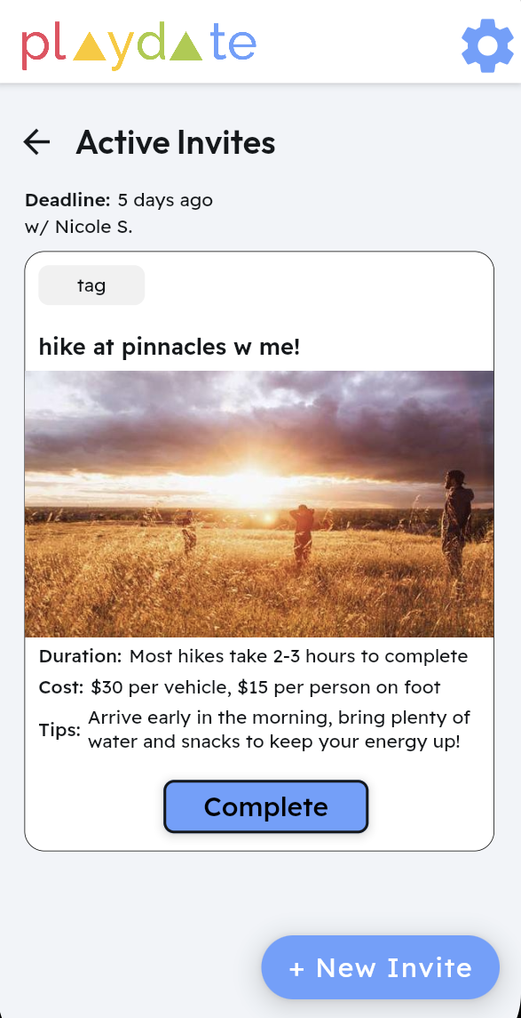
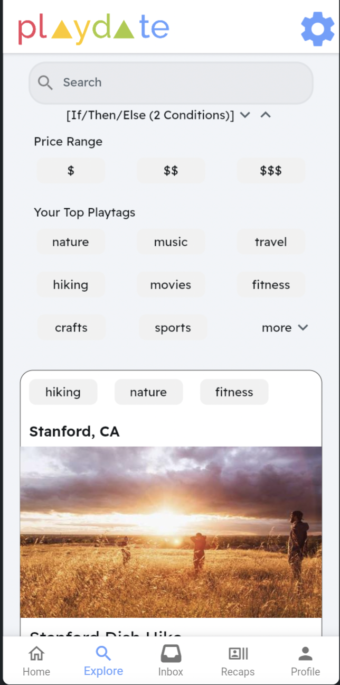
Implemented Features
Account Setup
1
3
2
Checking Inbox
Filter Explore
Notes:
Account Setup - Users can create an account
Checking Inbox - User can check inbox for active and recent playdates, and click on them to navigate to playdate details
Explore Page - Users can filter option to repopulate explore page feed

Slide 49
Plans to Finish
• Finish UI in FlutterFlow - task tracker
• Mena - Inbox Page
• Sachin - Home Page
• Nicole - Profile Page
• Kevin - Explore Page
• Set Functionalities in Flutter
• Set Up Backend in Firebase

Slide 50
Wizard of Oz Techniques
Sending Playmates Text Reminders - texts aren’t sent to users
Feed algorithm not personalized to user
Integration with contacts during account set up
“Filtering” algorithm in Explore page just checks if one tag is present
Notes:
Feed algorithm -> contact integration, sending playmate texts

Slide 51
Hard Coded Features
Preseeded Data
Populates hard-coded posts in Explore and Home Page
Pre-seeded invites populate inbox
Users
Completed Playdates
Notes:
Hard coded information

Slide 52
Issues and Questions
Issue: How to implement reflection after removing the video recap feature
Question: How to send reminders on phone
Question: Better way to mimic a feed algorithm
Question: How flexible should we make rescheduling playdates

Slide 53
05
Live Demo
Notes:
https://app.flutterflow.io/project/playdate-6bk2s9?tab=uiBuilder&page=HomePage

Slide 54
06
Appendix

Slide 55
Appendix
• Heuristic Evaluation Summary
• FlutterFlow

