Slide 1
A4: Concept Video
Ashley, Daphne, Eliza, Leon

Slide 2

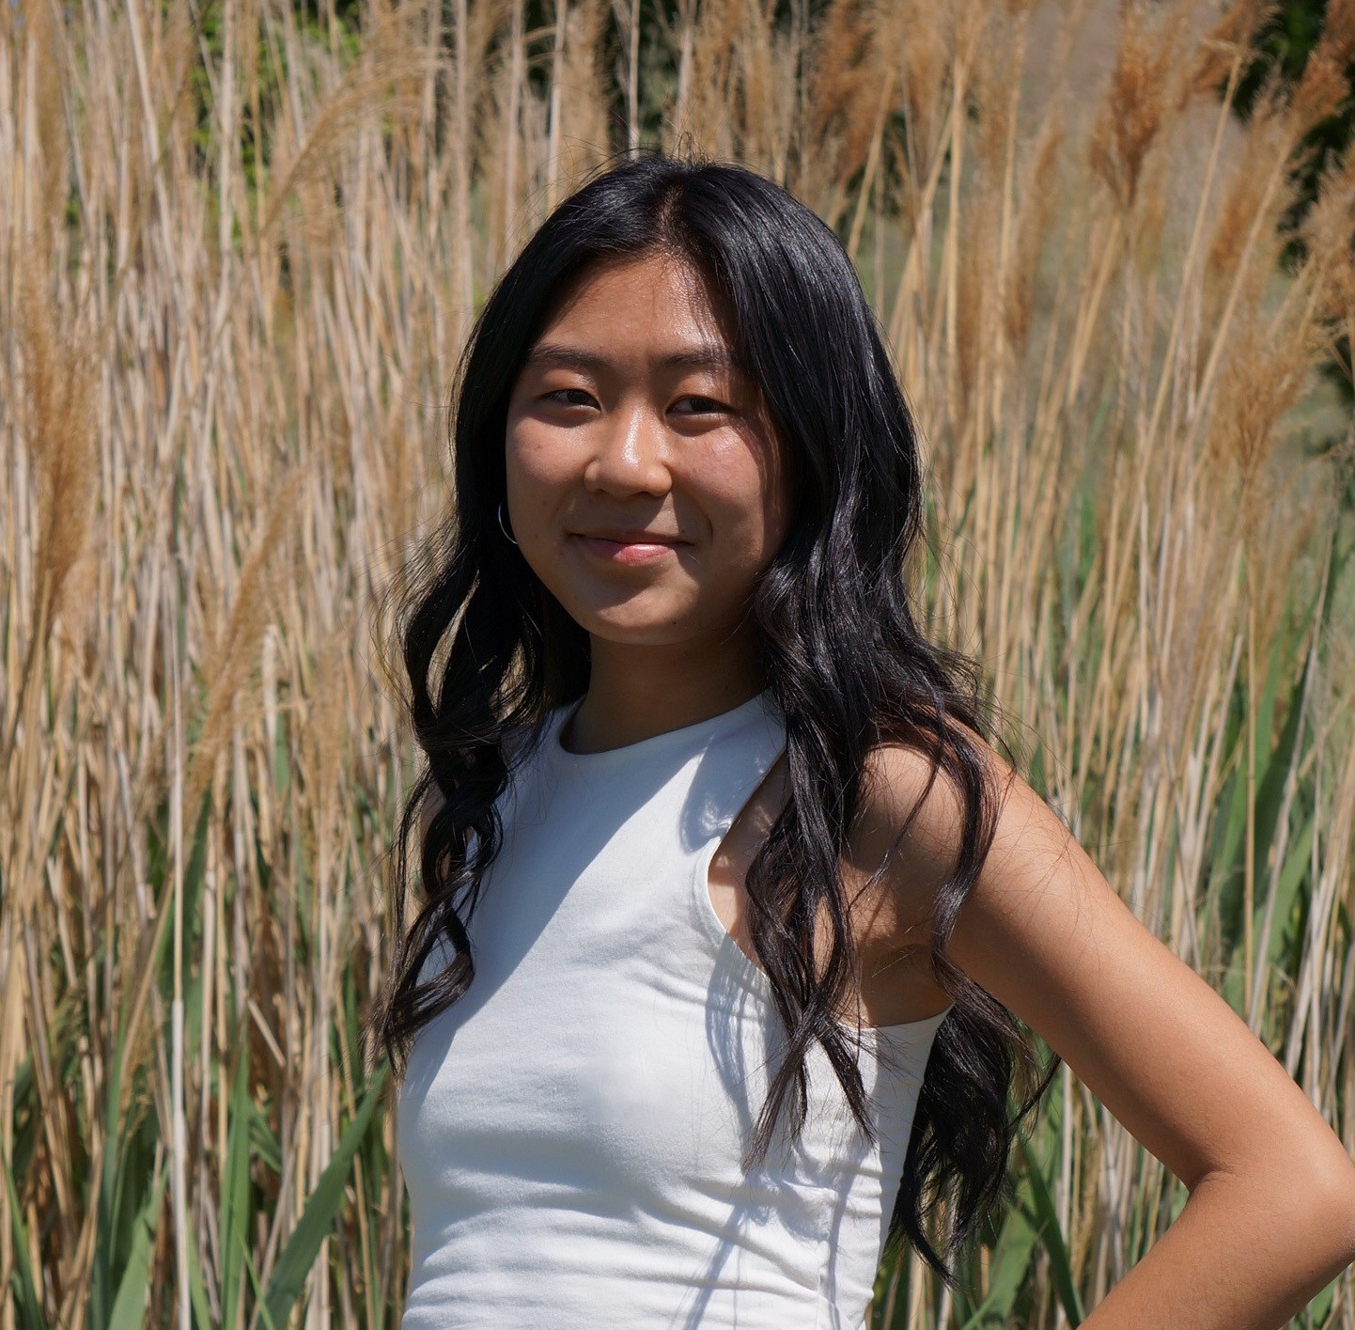

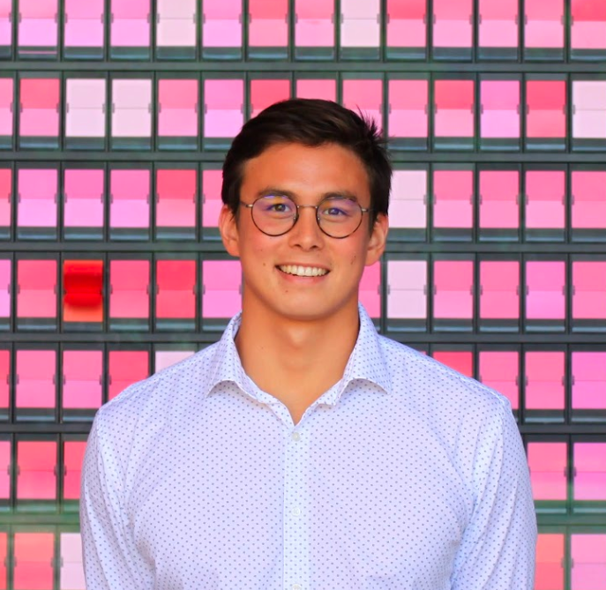
Our Team
Ashley Chen
Daphne Liu
Eliza Gallagher
Leon MacAlister
Senior
Computer Science
Los Angeles, CA
Junior
Computer Science
Salt Lake City, UT
Junior
Computer Science
Louisville, KY
Coterm
Computer Science
Sydney, Australia

Slide 3
OUR TEAM
Ashley Chen
Daphne Liu
Eliza Gallagher
Leon MacAlister
TEAM FITCAST

Slide 4
01
Project Info

Slide 5


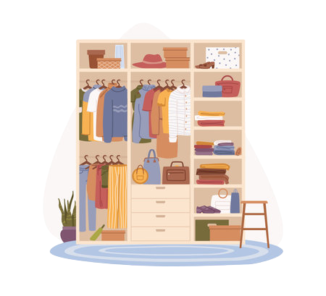
Name & Value Proposition
FitCast! 👚🔭
Interpreting the weather forecast to help you get dressed and prepare for the day ahead!

Slide 6
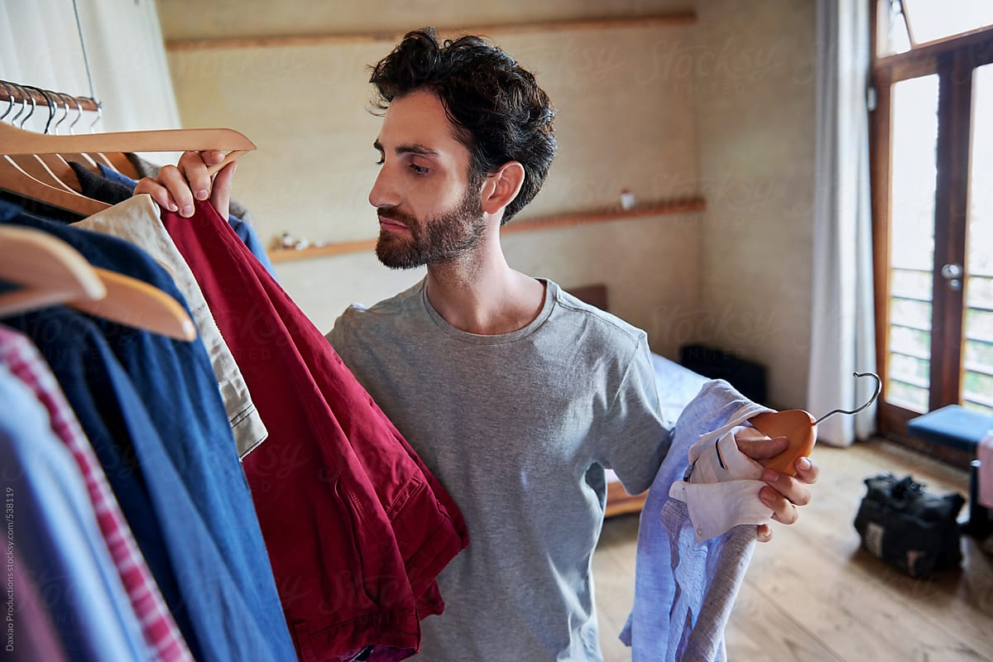
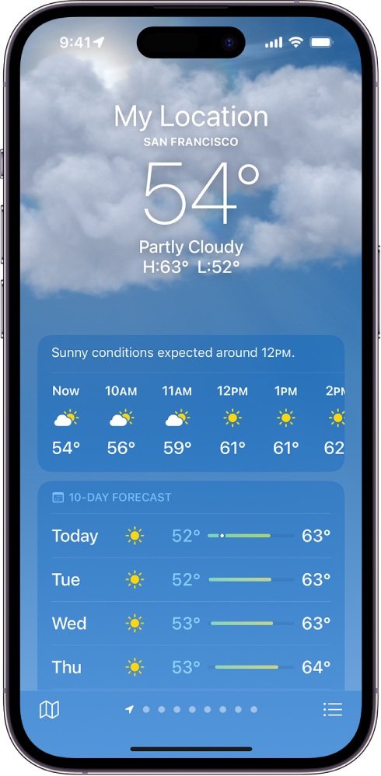
Problem/Solution
PROBLEM
Not knowing how to dress for the weather, weather changes and changes in environment e.g outdoors -> indoors
SOLUTION
Feedback log that helps make clothing/apparel suggestions based on the weather
Factors in temperature, humidity, wind, precipitation, changes throughout the day and time spent indoors

Slide 7
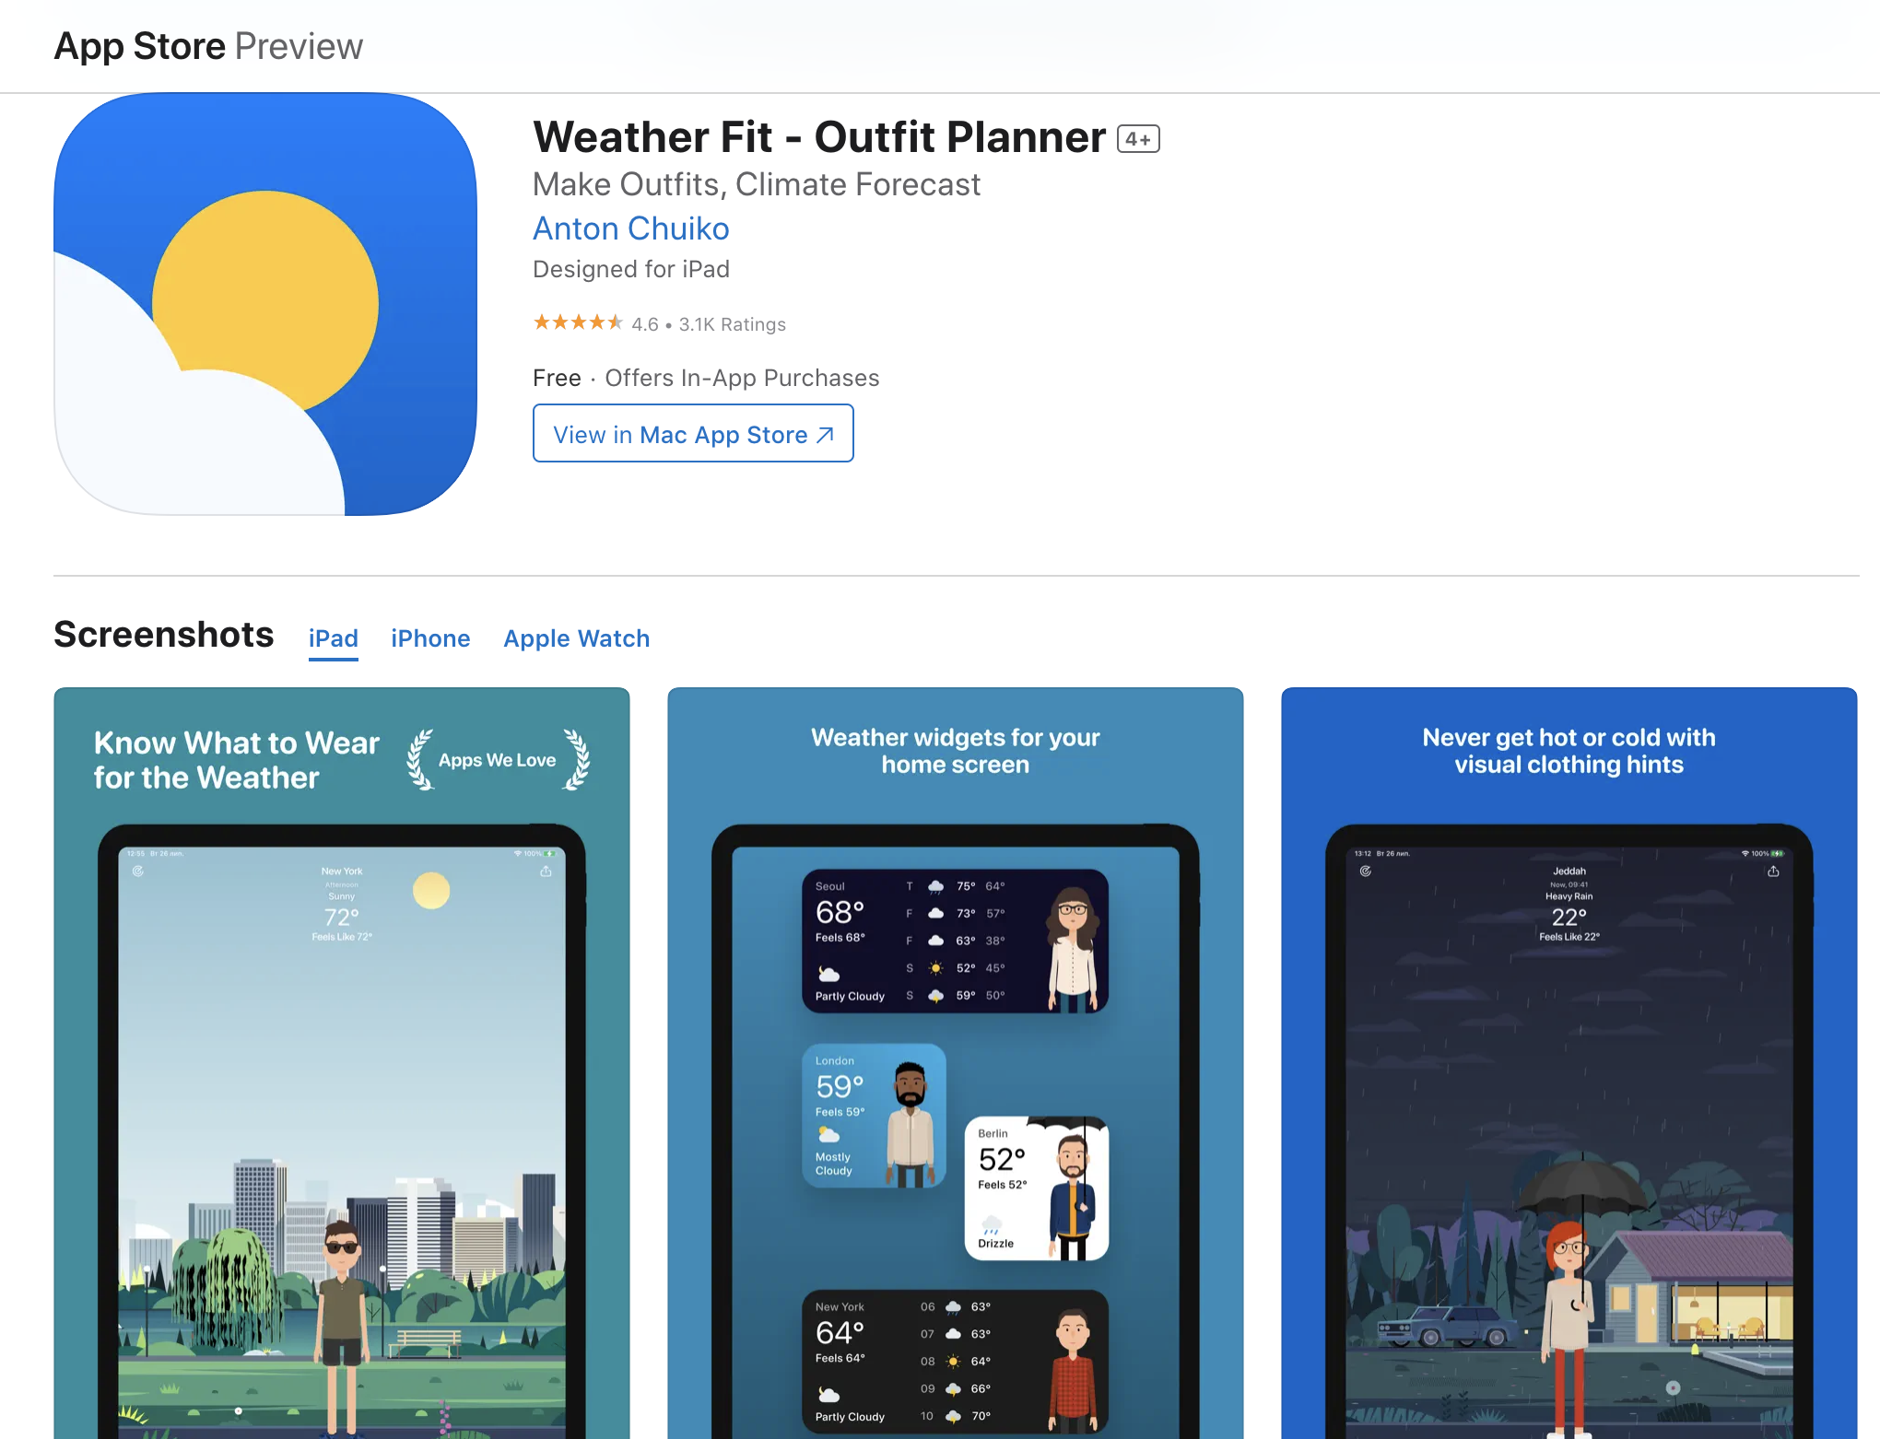
Market Research: Weather Fit
What works:
Real time weather updates → from several data sources
Incorporates wardrobe preferences
Home/lock screen widgets
Can view from your Apple Watch
What doesn’t works:
Very expensive paywall: 10$ a month
Doesn’t adapt based off a person’s reaction to wardrobe choices (ie someone has to compensate themselves if they know they are always cold)
Doesn’t take into account fluctuating temperatures, temperature indoors, travel, etc.
Is designed for iPads?!?
What we can take away:
There is demand for an app like this!
Similar to our concept but lacks some of the most integral (granted the most complicated parts) about dressing for the weather

Slide 8
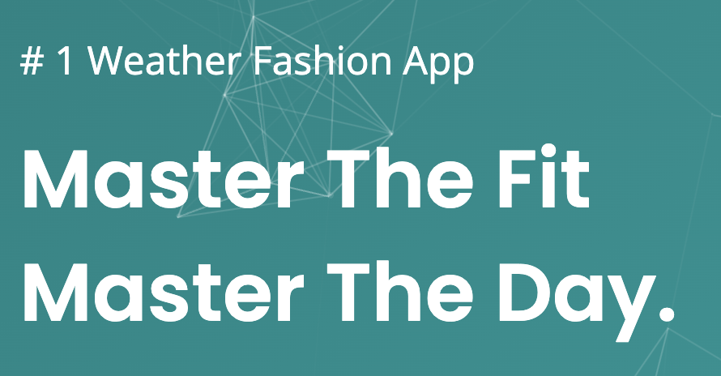

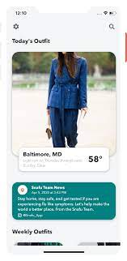
Market Research: Snafu
What works:
Plans outfits a week in advance and gives suggestions based on weather
Suggests new fashionable outfits given the clothes you own (could monetize through clothing adds)
What doesn’t work:
Does not suggest add-ons to outfits such as a hoodie, raincoat etc. for weather changes that occur throughout the day
Is no longer on the app store - assume it went out of business
What we can take away:
App is more focused on the fashion aspect
Static suggestions that plan a week ahead are less useful as forecasts are inaccurate, and documenting specific clothing articles to store in-app is a laborious process

Slide 9
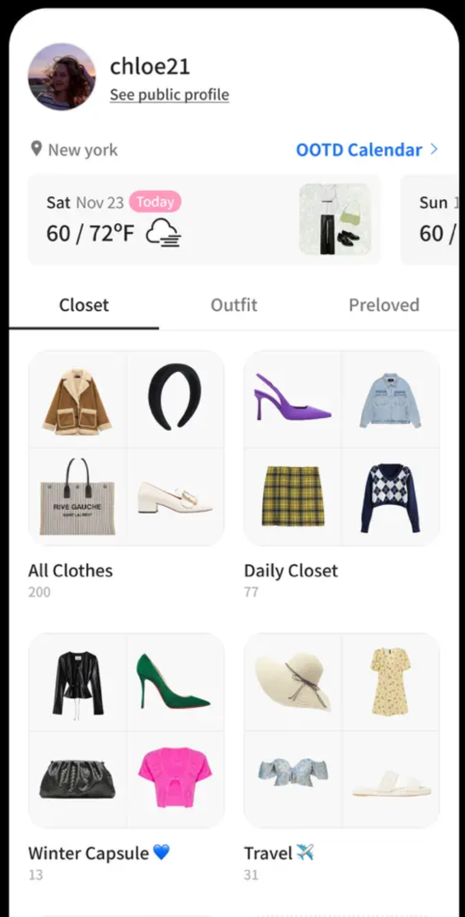

Market Research: ACloset
What works:
Digitizing your closet can aid your long-term mental energy
Includes outfit suggestions based on the weather you can rate
Has a lot of features for users interested in organizing their outfits
What doesn’t works:
Requires heavy setup and frequent use for outfit suggestions
Does not auto-suggest outfits- need to consistently navigate through the app to look for suggestions
App does not have organization systems set up (have to come up with systems to sort by warmth, layers, etc manually)
What we can take away:
Weather is often only one factor in how people style their outfits
Our app may not fit needs of people who care much more about fashion than weather.
We want to avoid excessive app setup
App focus on fashion and closet organization
Includes a weather display for today/upcoming days
Suggests outfits

Slide 10
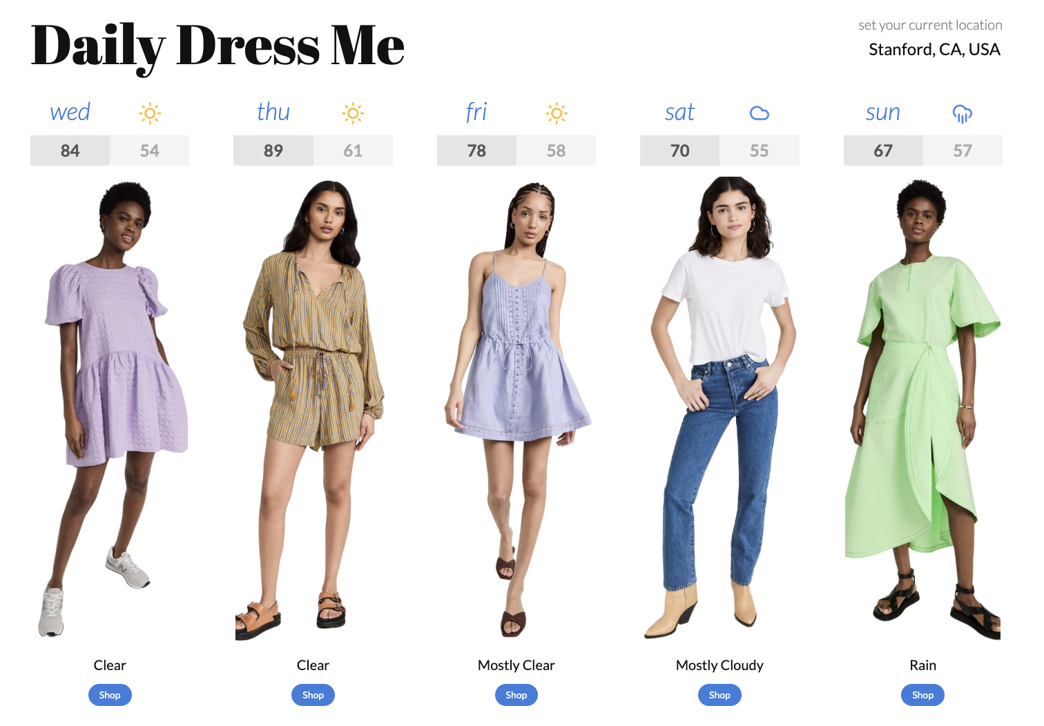
Market Research: Daily Dress Me
What works:
Free
Gives outfit suggestions for the entire week
Can reload to give you more suggestions
What doesn’t works:
Promotes consumerism (allows you to buy the outfit)
Does Not take into account weather at different times during the day (i was outside this morning and if i had worn the suggested outfit i would have been freezing)
Very specific style (millennial style)
What we can take away:
Free
Giving suggestions for the entire week (for planning ahead or travel)
The only page on the website

Slide 11
Market Research: Competitive Analysis
 | Weather Fit | Snafu | ACloset | Daily Dress Me
Need an account? | ✅ | ✅ | ✅ | ❌
Paywall? | 10$/month | Unk. | ❌ | ❌
Audience? | Anyone | Fashionistas | Fashionistas | Fashionistas?
Range of authority (just clothes, clothes + accessories, weather protection) | Just clothes | Clothes, some accessories | Clothes, some accessories | Just clothes
Addresses temperature change throughout the day | ❌ | ❌ | ❌ | ❌
Adapts based off your response | ❌ | ✅ | ✅ | ❌

Slide 12
Stakeholders
Direct
Everyday people
Temperature intolerant/sensitive individuals
People with temp-related health concerns (ex. raynaud's)
Infants and the elderly
Partygoers
Indirect
Clothing companies
Bag companies
Sunscreen/sun accessories companies
People who have their jackets taken away/have to hold jackets (caretakers, significant others)
Coat Checks

Slide 13
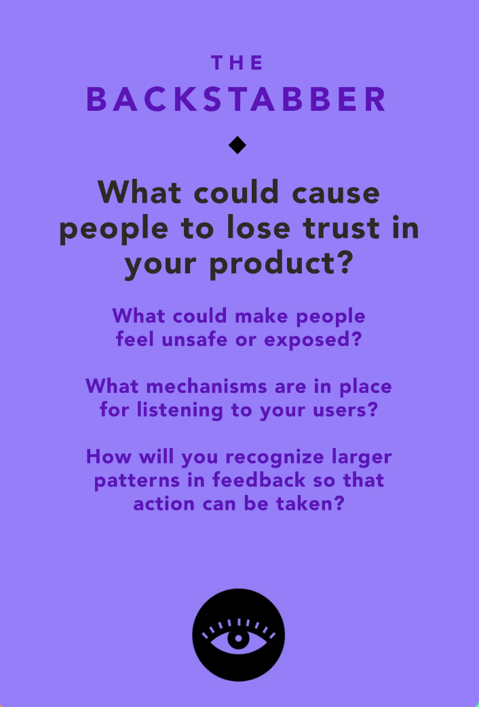
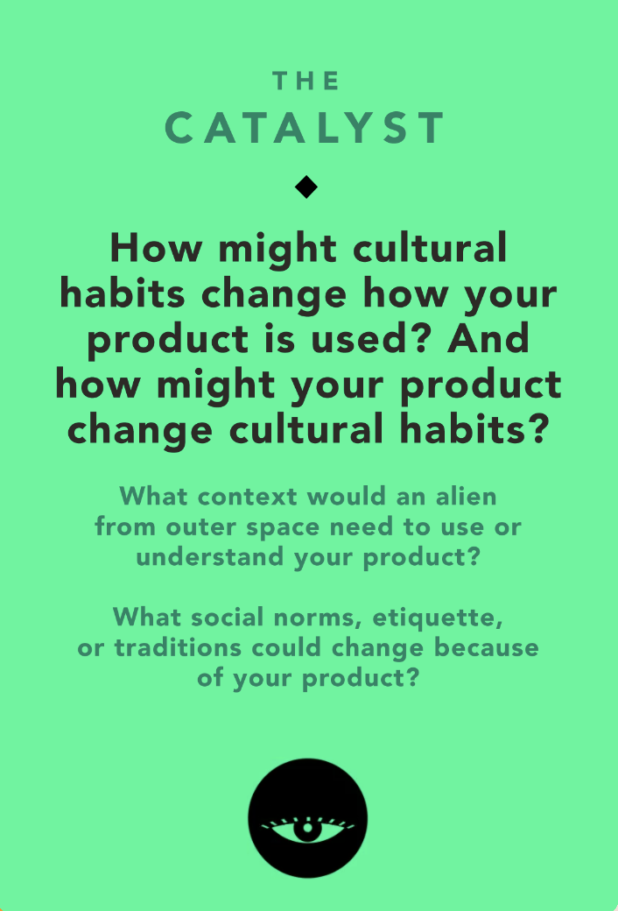
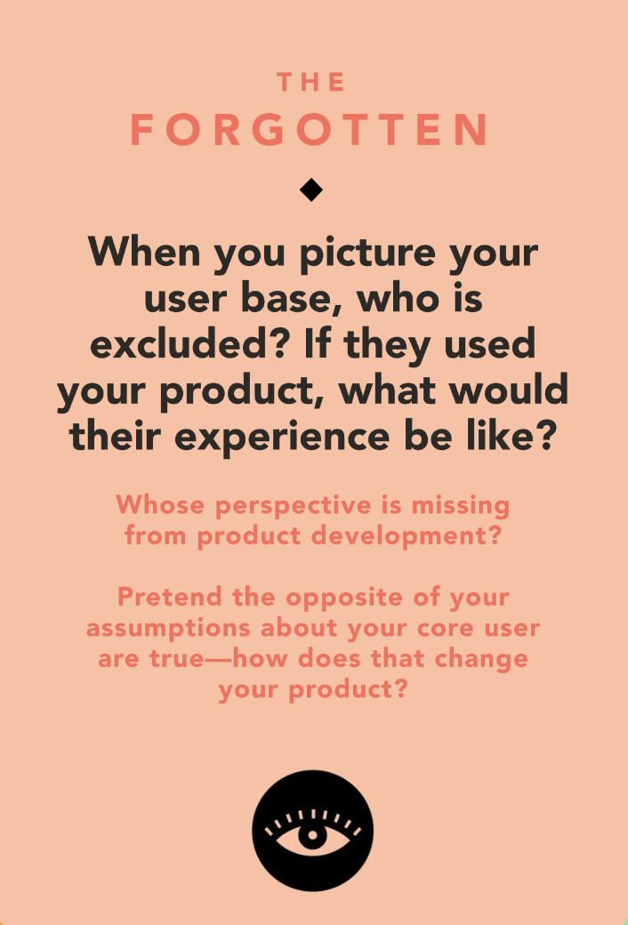
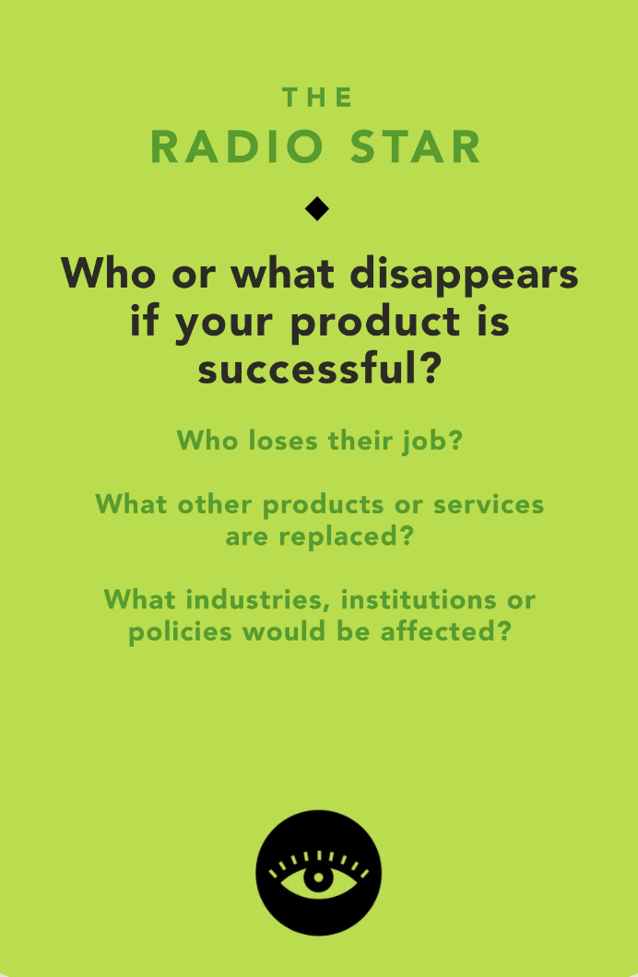
Ethical Implications

Slide 14
Ethical Implications
Implications
If our suggestions were wrong/don’t adjust fast enough
If there are factors we don’t consider in our suggestions
  Being inside/in AC
  Cultural ones
  Medical ones
We run ads/focus on monetization
Information about individual users- especially extreme users w/ temp sensitive needs- were leaked
Addressing
Constant refining of suggestion algorithms
Be cautionary about suggestions
Upfront ask users how temp sensitive they are/if they have cultural/medical needs

Slide 15
Ethical Implications
Implications
Underlying value tension: dressing for the weather vs modesty vs fashion
Cultural clothing- especially clothing preserves modesty, could alter the way our product is used
The product should adapt to the needs of people from various cultures/ comfort levels with modesty
Be mindful that not every individual has the ability to dress for the weather
Addressing
Ask people if there are any types of clothing they will not wear (shorts, anything form fitting)
Ask people what their priority is in terms of dressing

Slide 16
Ethical Implications
Implications
People who don’t use their phones that much
People w/o tech access, or have low storage
People who don’t have the ability to dress for the weather (due to modesty concerns or due to a financial barriers)
Addressing
We can't particularly access people without technology, but we need to be mindful of not increasing consumerism (by not recommending clothing that is too specific)

Slide 17
Ethical Implications
Implications
Maybe reduces the need for a weather app or weather tv channels, but wouldn’t eliminate it
We don’t intend our app to replace anything- it’s a ‘yes and’ product
Addressing
This does not particularly need to be addressed because no one is disappearing
Weather app industry will still have to be very intact

Slide 18
02
Tasks
*bolded tasks are executed in concept video
*9 total

Slide 19
Simple Tasks (3)
User is trying to decide if it’s hot/cold outside
User is trying to decide if they are going to wear sun protection/gear (glasses, hat, sunscreen)
User is trying to decide whether or not to bring an umbrella/rain jacket

Slide 20
Moderate Tasks (3)
User is deciding what to wear based off temperature outside AND inside
User is deciding what to wear based off their schedule, ie how long they will be out/if they have time to come back and change
User is trying to assess the weather and how to pack/dress for a different location

Slide 21
Complex Tasks (3)
User wants to share their preferences so they can be adapted to help others if they are traveling
User is trying to adapt their clothing wearing habits more closely to their personal temperature preferences
User wants to know how to dress when the weather changes throughout the day

Slide 22
03
Video Planning

Slide 23
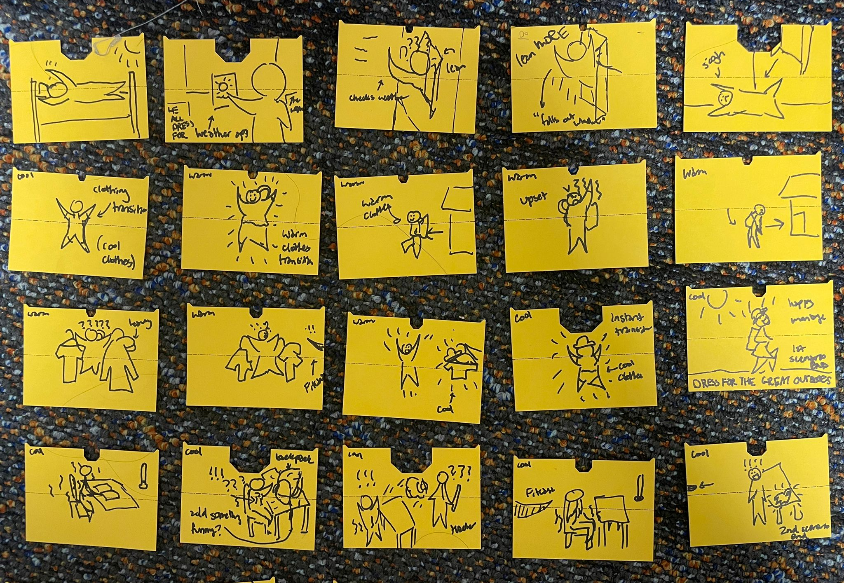
Storyboarding

Slide 24
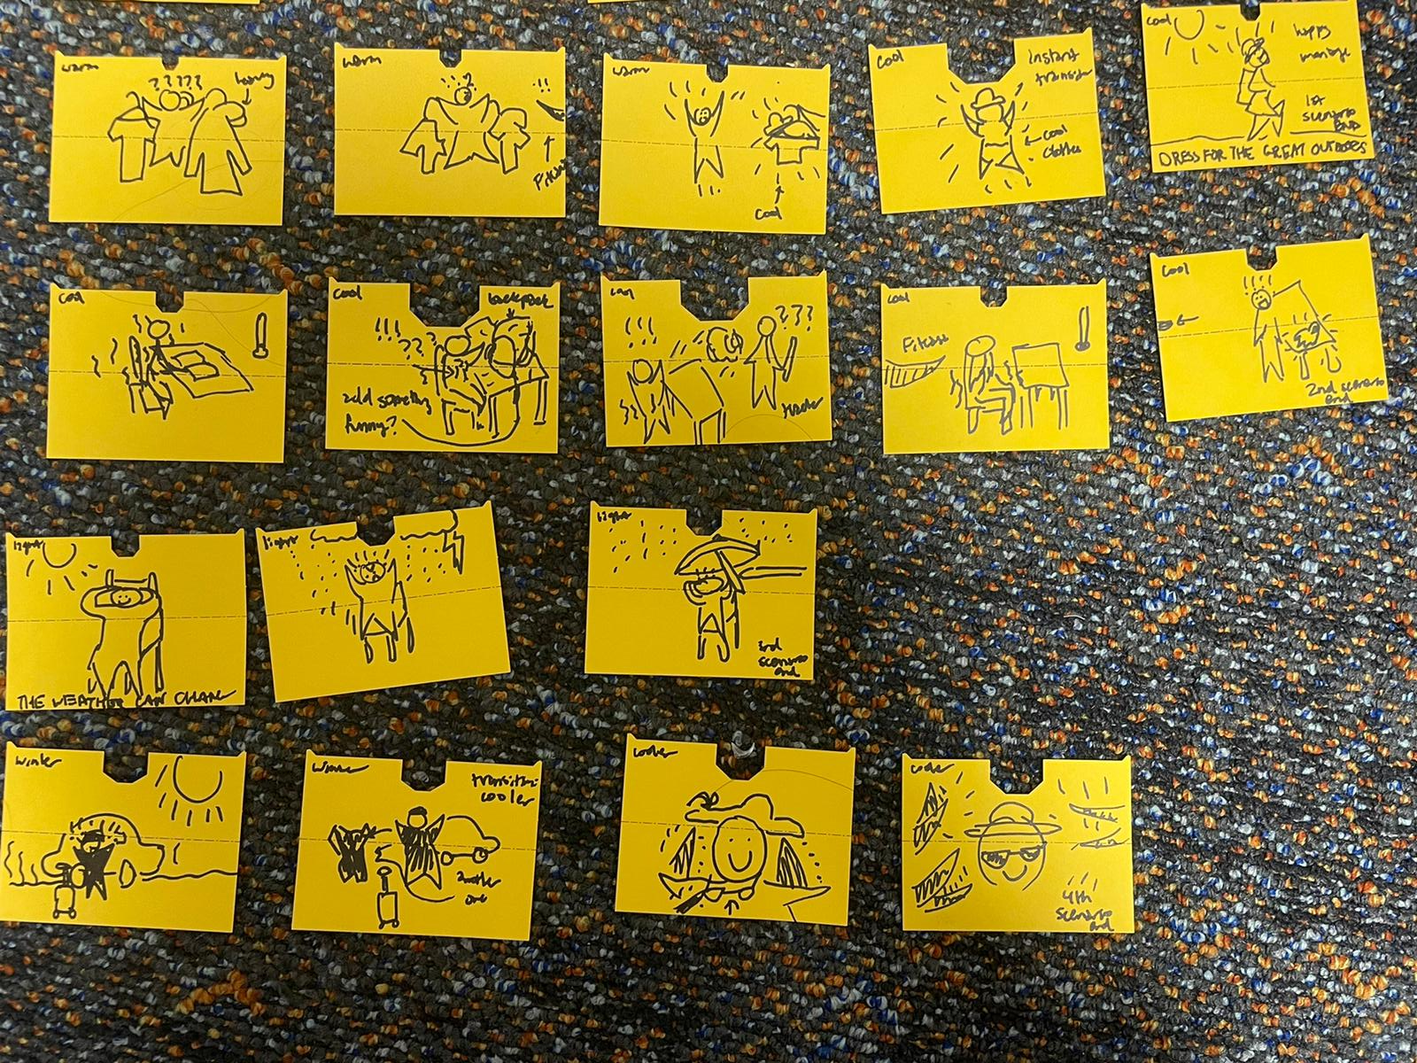
Storyboarding

Slide 25
04
Concept Video

Slide 26
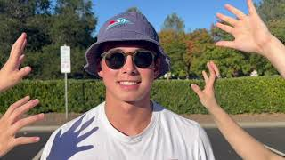
Concept Video
Link: https://youtu.be/ioIYUIZ2rBA

Slide 27
05
Appendix

Slide 28
Credits:
Ashley C: Actor, Writer
Daphne L: Director
Eliza G: Producer
Leon M: Actor
FitCast!
CS 147 2023au
https://hci.stanford.edu/courses/cs147/2023/au/projects/unintentional-good/fitcast
Interpreting weather forecasts to help you get dressed!

