Slide 1
A6: Med-Fi Prototype
Ashley, Daphne, Eliza, Leon

Slide 2
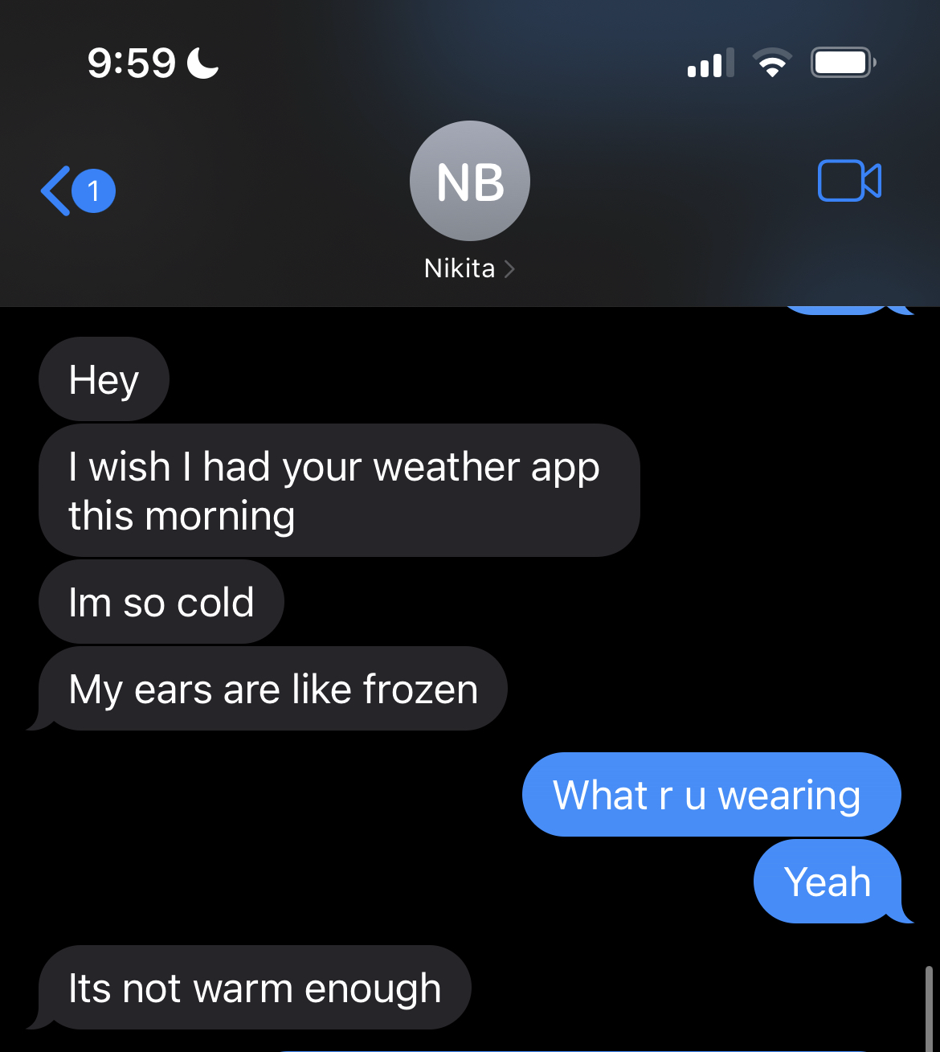
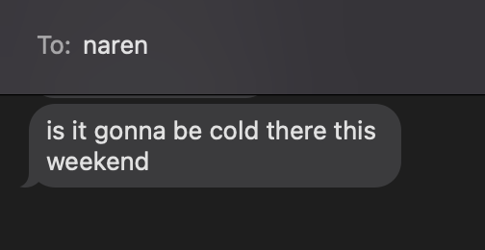
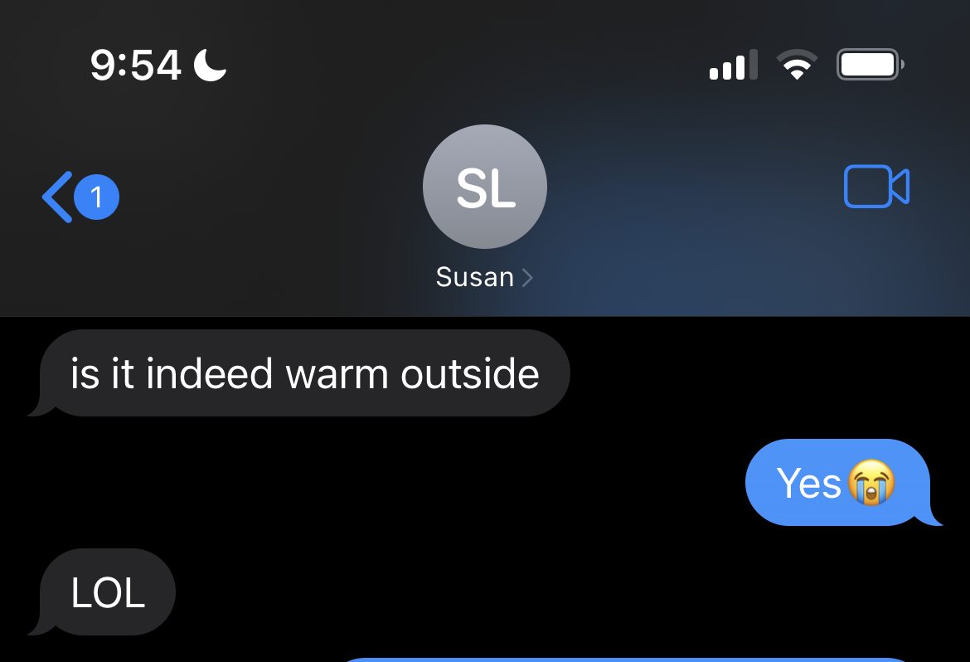
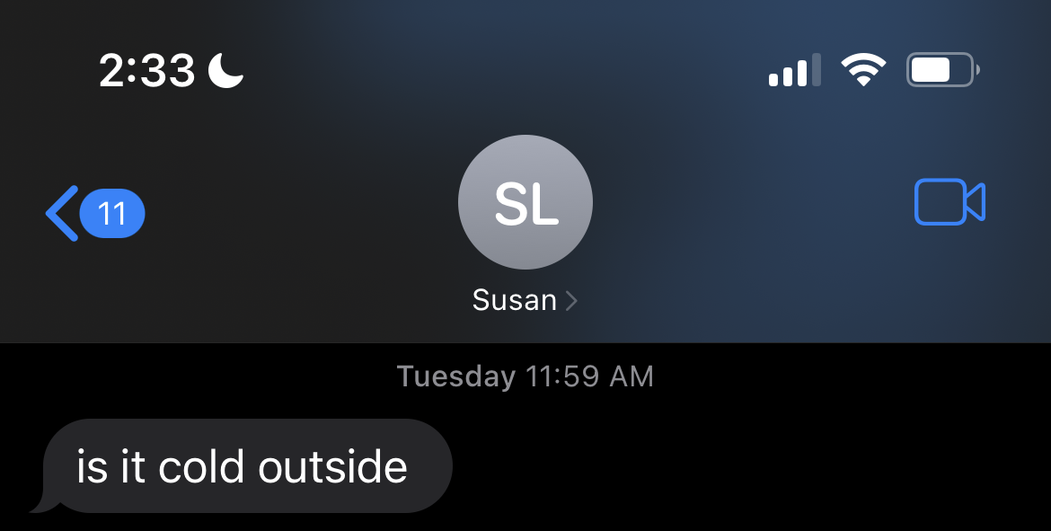
Problem
Wasting time and energy deciding on how the weather will actually feel + deciding what to wear/pack (and usually getting it wrong)
Real World Need! (our friends within the last week)

Slide 3
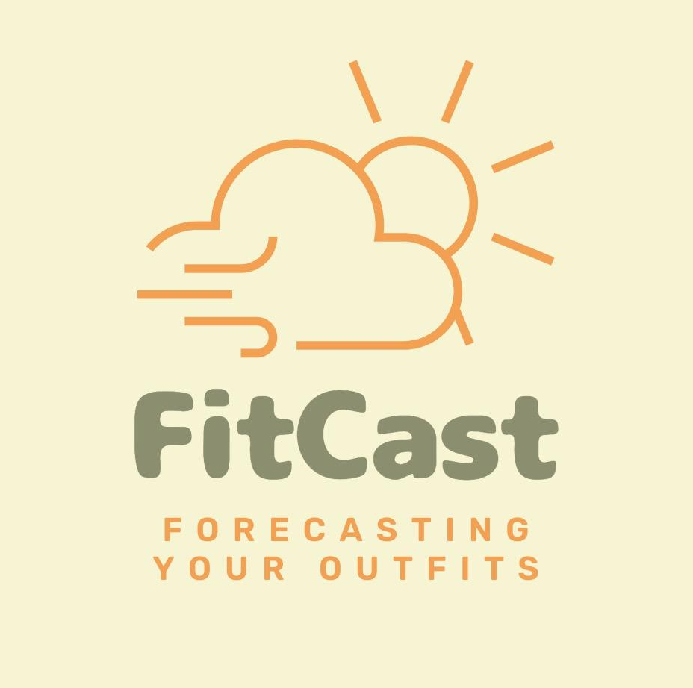
Solution
FitCast! A tool that determines how the weather truly feels + makes clothing/accessory suggestions based on the current weather, weather changes, your schedule, and your feedback
Value Proposition:
Interpreting weather forecasts to relieve clothing decision fatigue

Slide 4
Design Values
Simplicity:
Ensure that the app is simple enough for it to not increase mental burden of interpreting the weather
Adoptability:
Make design choices that ensures that tasks are intuitive, very easy to learn across all age groups
User Autonomy:
Preserve user autonomy when it comes to clothing choices, let the user choose whether or not to follow a suggestion
Inclusion:
Some people may have cultural attire, or aversions to certain articles of clothes that need to be accounted for
Accuracy:
Weather suggestions and true feel must be accurate otherwise users will not want to use the app at all
Empathy:
Our app is empathetic to the stress that goes into preparing for weather changes, and will maintain an empathetic tone

Slide 5
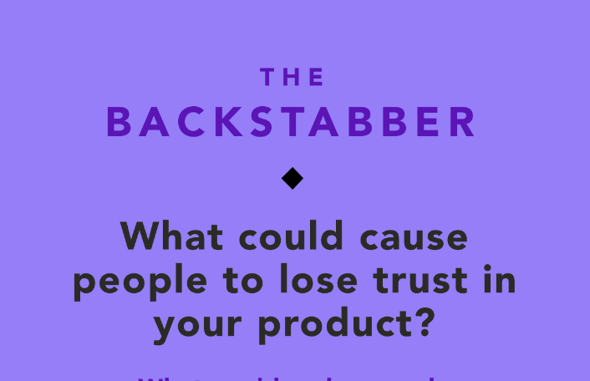
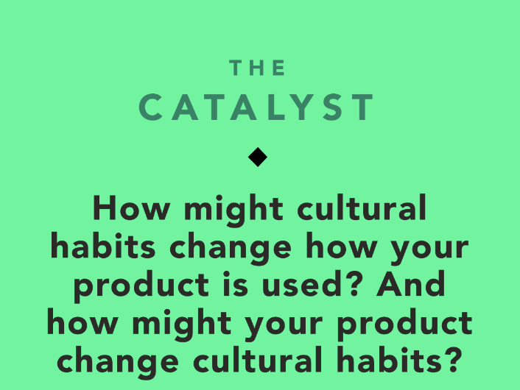
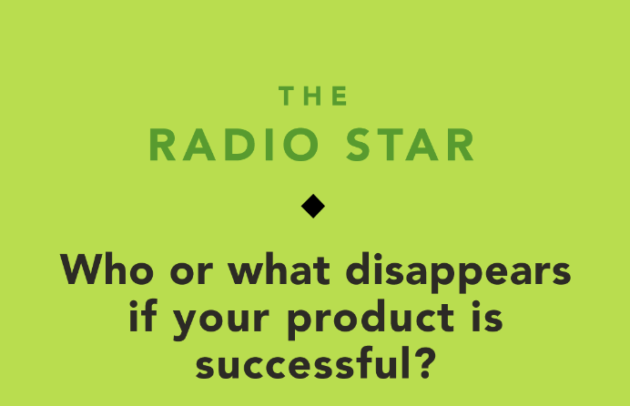
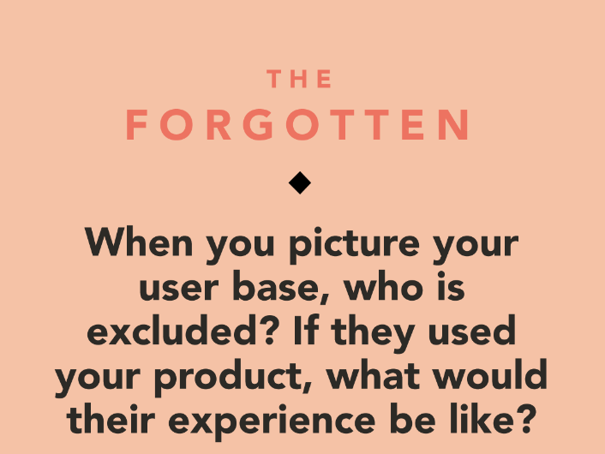
Ethical Implications x Design Values
Simplicity
Inclusion
Accuracy
User Autonomy
User Autonomy
Inclusion
Empathy
Inclusion
Adoptability

Slide 6
Key Features We Want to Implement
Simplicity
Automated Logging
Utilise apple watch and location tracking to help determine user preferences automatically to reduce mental overhead
Smart Suggestions
Based on aggregated user data and user’s personal preferences, tailor clothing suggestions and determine ‘true-feel’ of weather for each person
Accuracy
Adoptable
Empathy
User Autonomy
Manual Calibration
User can say what they typically wear what they don’t + when a user’s is not happy with a suggestion during or at the end of day, have the ability to immediately input feedback
Explanation of Clothing suggestions
Provide user with some autonomy given the information about the weather + explains why you should pack a hoodie or sunglasses etc.
User Autonomy
Inclusion
Notes:
Incorporate things we like from both of the top designs

Slide 7
Value Tensions
Accuracy
Simplicity, Adoptability
App may be too simple to show accurate details and get enough personalized information from the user
User Autonomy
Accuracy
Some users may feel constrained by suggestion rigidity, while others are would prefer to have detailed suggestions
Inclusion
Simplicity
More detail and nuance may have to be added to ensure it is more inclusive which may make tasks complex
User Autonomy
Simplicity
Some users would prefer to have lots of information on the weather to make their own decisions

Slide 8
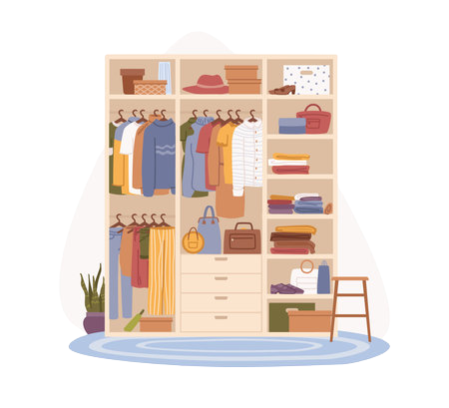



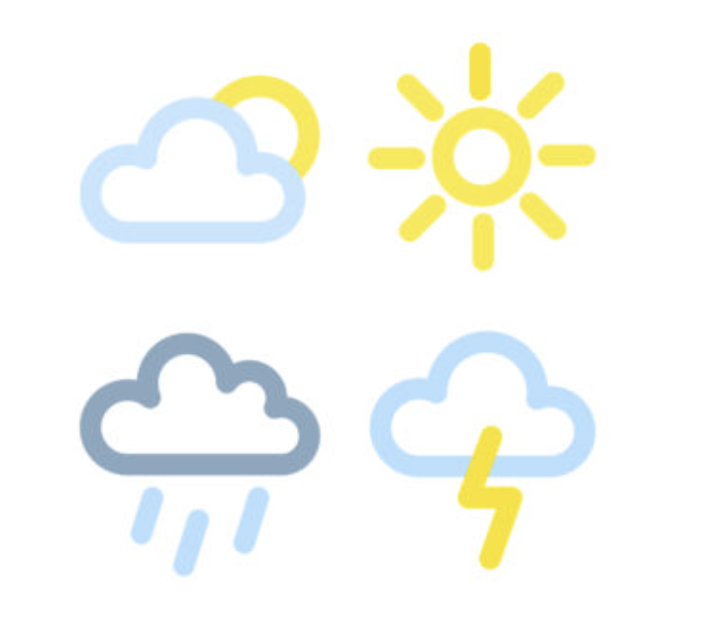
3 Tasks (no changes from A5)
#1 Simple
User is deciding what to wear based on the weather now
# 2 Moderate
User wants to know if/how they should prepare for indoor temperatures
#3 Complex
User is trying to adapt their clothing wearing habits more closely to their personal temperature preferences

Slide 9
Usability Goals/Measurements
Usability goals
Minimize number of mistakes
Maximize repeat users
Make the app a pleasing experience
Measurements
Count number of mistakes
Ask how likely users are to use the app
Ask the users their favorite aspect of the app
*from A5

Slide 10
Usability Progress
Usability goals
Minimize number of mistakes
Maximize repeat users
Make the app a pleasing experience
Progress Goals
Prevent mistakes through design, but also allow mistakes to still lead you to the right place
Promote the app’s smart capabilities and its benefit over a traditional weather app
Optimize pre-existing features + add gimmicks (e.g how you compare in terms of weather feel to the average person)
*will elaborate on how specifically later

Slide 11
Revised Interface Sketches

Slide 12
Lofi Prototype Changes Rationale
Observations
(1) Users clicked on icons that weren’t intended to be buttons
(2) Users felt they would never intentionally choose to go to the log/pin pages
(3) Home screen bottom bar was confusing
(4) Getting to the correct page is much harder than completing the task on the given page
Action Items
(1) Make pages accessible from those icons (as they seemed intuitive for the users)
(2) Rely more heavily on notifications and auto pop-ups rather than putting the burden on the user
(3) Revamp home screen navigation, remove the need for a bottom task-bar
(4) Focus on streamlining the process to the pages, but keep the steps after gotten to the correct page

Slide 13
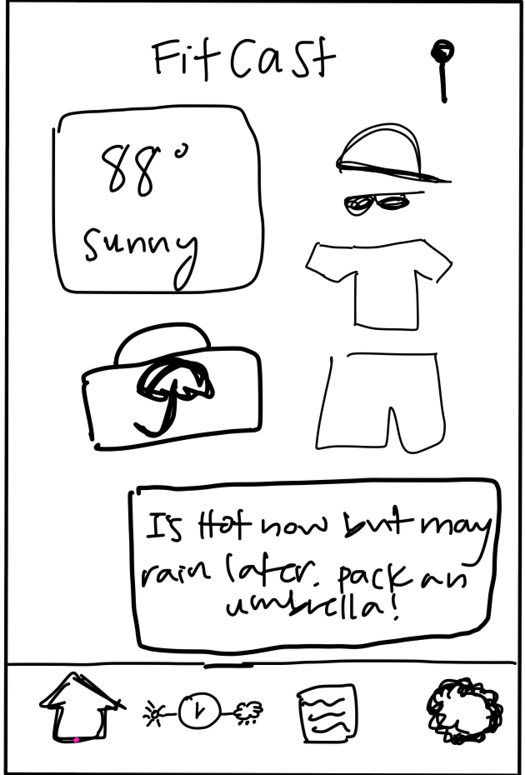
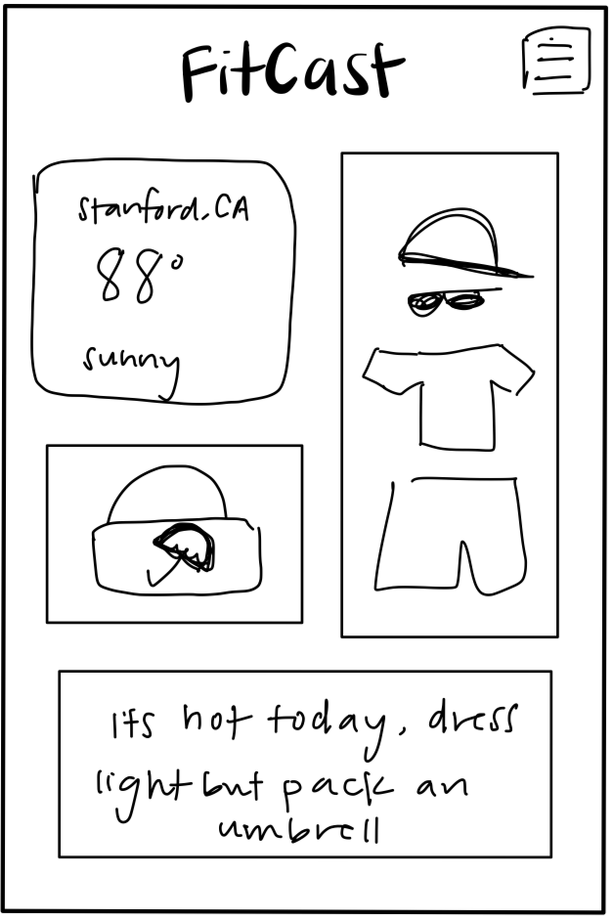
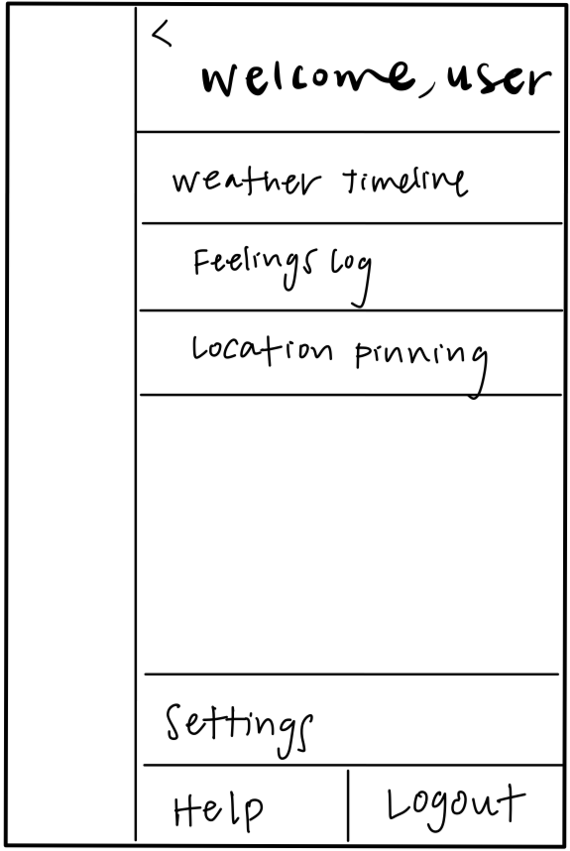
#1 Home Screen Changes
Removed bottom bar and moved buttons to a side navigation menu (hamburger menu)
Puts more focus on the contents of the home screen itself, which is the most important especially for simple users
Pages still accessible through pressing buttons on the homepage.
Debated between the menu and bottom bar, but ultimately decided that since these icons would only be used by a very small percentage of users (outliers in terms of preferences/willing to manually log), it wouldn’t make sense to have a bottom bar
before
after

Slide 14
#1 Home Screen Changes
before
after

Slide 15
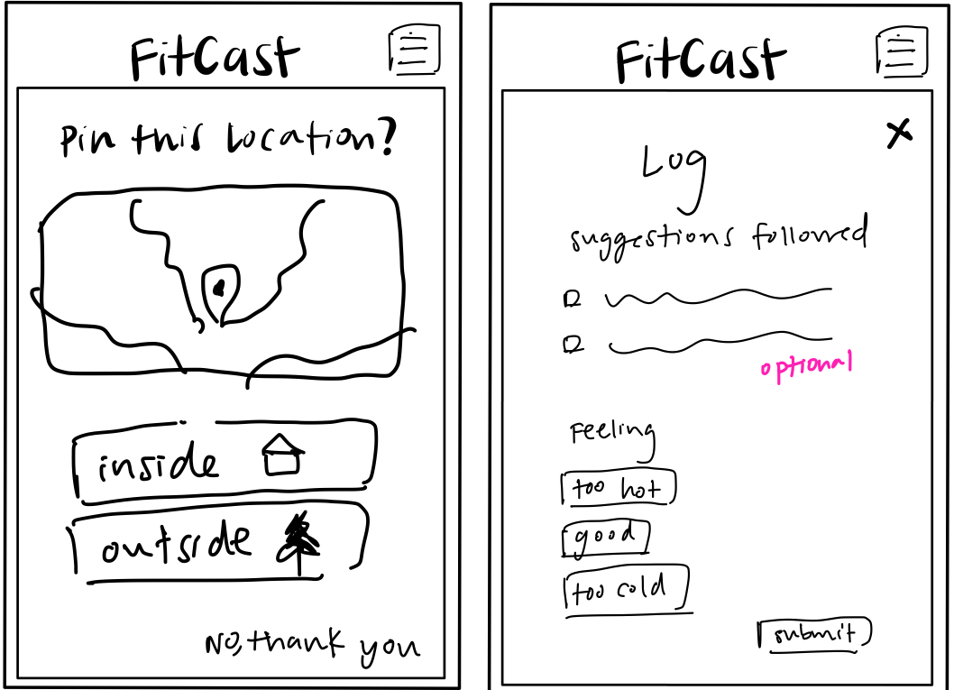
#2 Pop ups
Have pop ups overlay the home screen immediately upon opening the app (under certain conditions)
Takes the burden off the users shoulders, reduces need for buttons along bottom bar of home screen since they will be used rarely
Centers the app around the home screen, which contains the core functionality we need
Pops up immediately after 9pm
before
after

Slide 16
#2 Pop ups
Closeups
Pops up immediately after 9pm
Pops up immediately when location is detected as changed
Have to click buttons
before
after

Slide 17
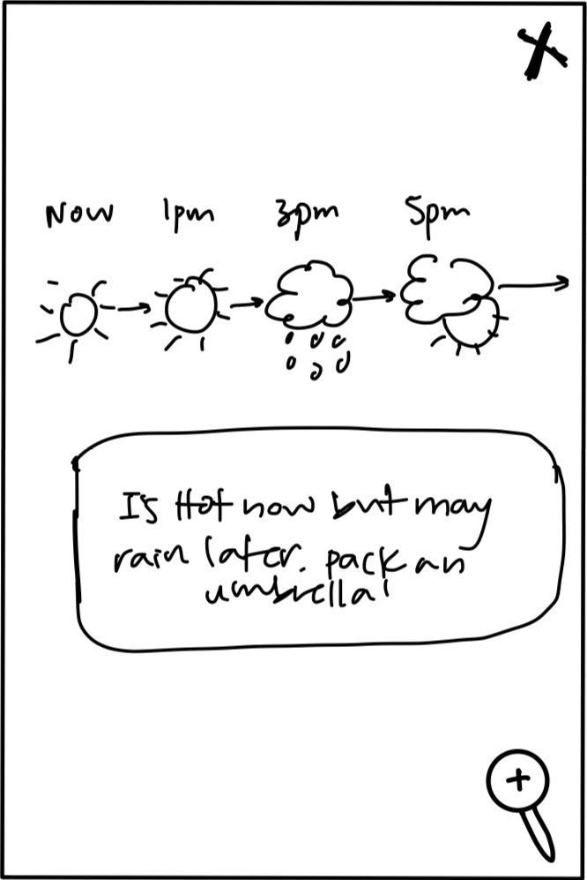
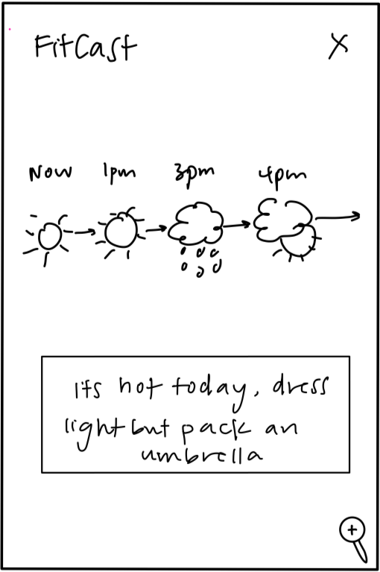
#3 Interconnectivity
Link up more of the graphics/screen components
  User can reach pages with more detailed information when they click on several intuitive places, rather than just one
  Did this with the icons on the zoomed out to zoomed in weather timeline flow (shown in the modified simple task flow slide)
accessible only from the bottom icon
accessible from multiple places, including explicitly from the side menu (not shown)
before
after

Slide 18
#3 Interconnectivity
Closeup
accessible only from the bottom icon
accessible from multiple places, including explicitly from the side menu (not shown)
before
after

Slide 19
Usability Progress
Usability goals
Minimize number of mistakes
Maximize repeat users
Make the app a pleasing experience
Mistakes were almost always:
Clicking icon that isn’t a button
Not knowing where to go to find something
Addressing this by
Making those icons clickable for interconnectivity
Relying more heavily on popups/notifications so the user doesn’t have to seek things out themself

Slide 20
Usability Progress
Usability goals
Minimize number of mistakes
Maximize repeat users
Make the app a pleasing experience
Noticed our app would likely cater better towards those who seek it out/see a need already
Want to refine our target audience → not just “everyone” even if everyone could benefit
Need to ensure that the benefits of FitCast vs. traditional weather app shine through

Slide 21
Usability Progress
Usability goals
Minimize number of mistakes
Maximize repeat users
Make the app a pleasing experience
Users really liked that the home screen itself was comprehensive enough
Taking advantage of this by centering the app around the home screen, and making all other screens be pop ups or extensions of the home

Slide 22
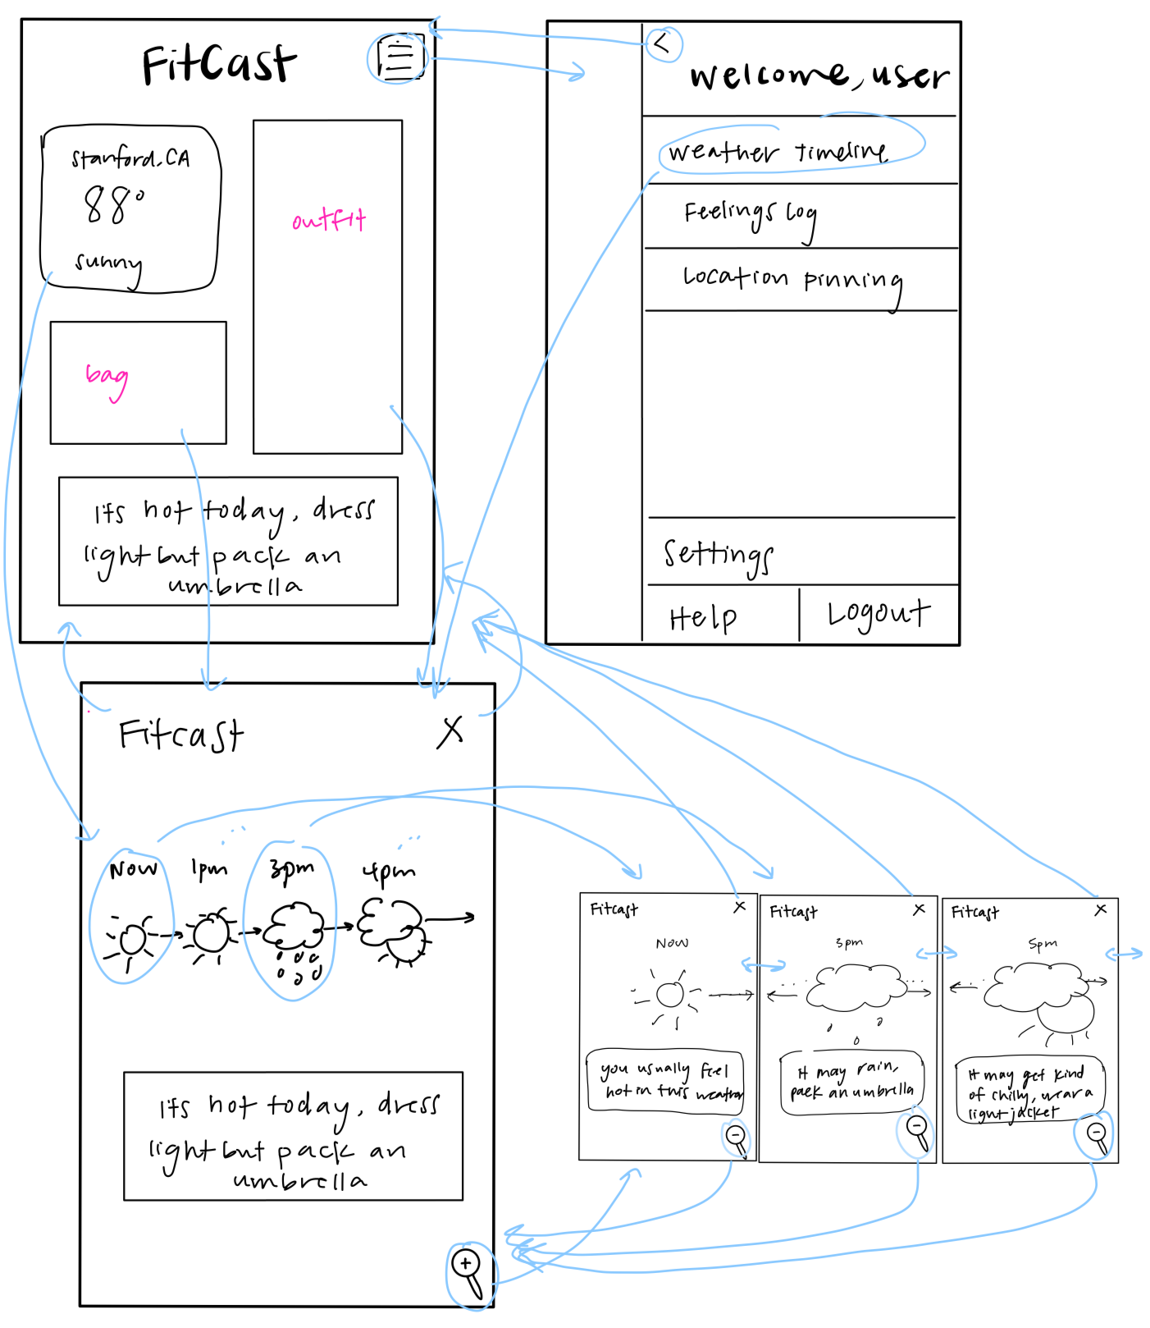
Simple Task Modifications
User is deciding what to wear based on the weather
Move weather timeline icon from bottom bar, and make accessible from large widget on home screen or sidebar menu
Make weather timeline more interactive: can click time icons to immediately zoom in, rather than pressing the zoom button

Slide 23
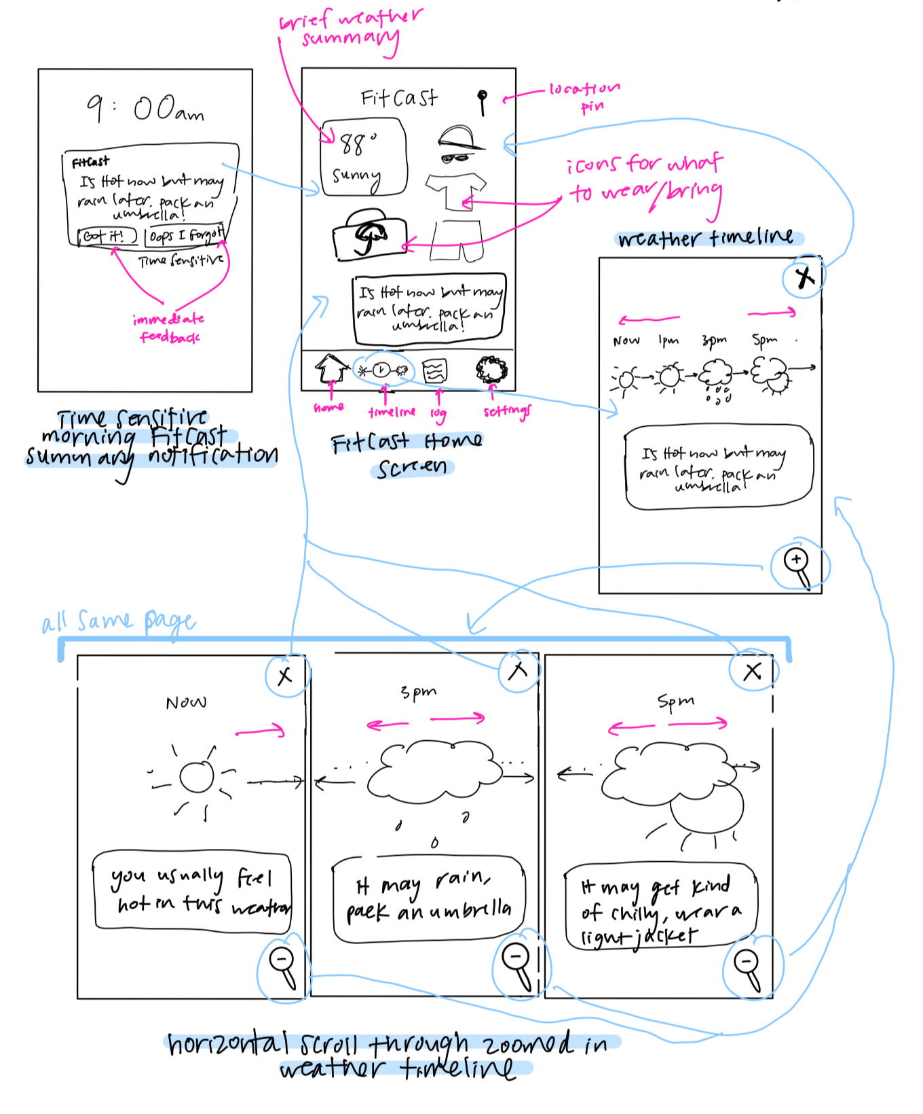
before
after

Slide 24
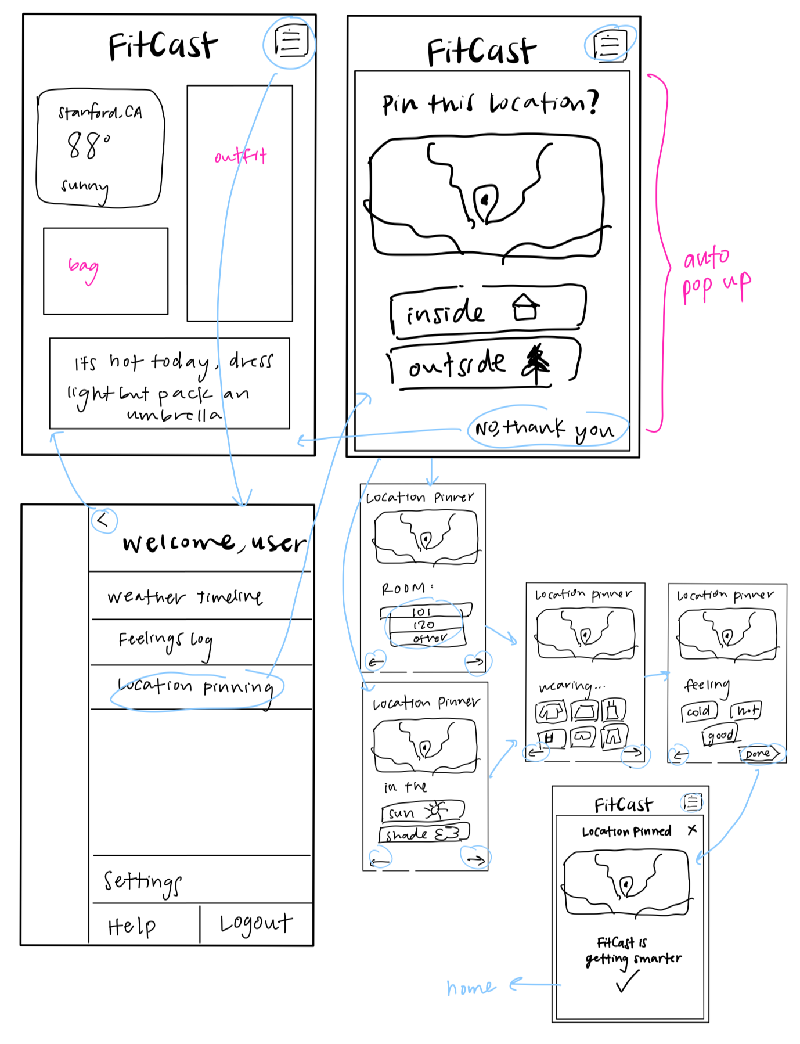
Moderate Task Modifications
User wants to know if/how they should prepare for indoor temperatures
Weather pinning page automatically pops up upon opening FitCast if location changed
Move icon from bottom bar and make accessible from menu if user wants to pin after exiting the popup earlier

Slide 25
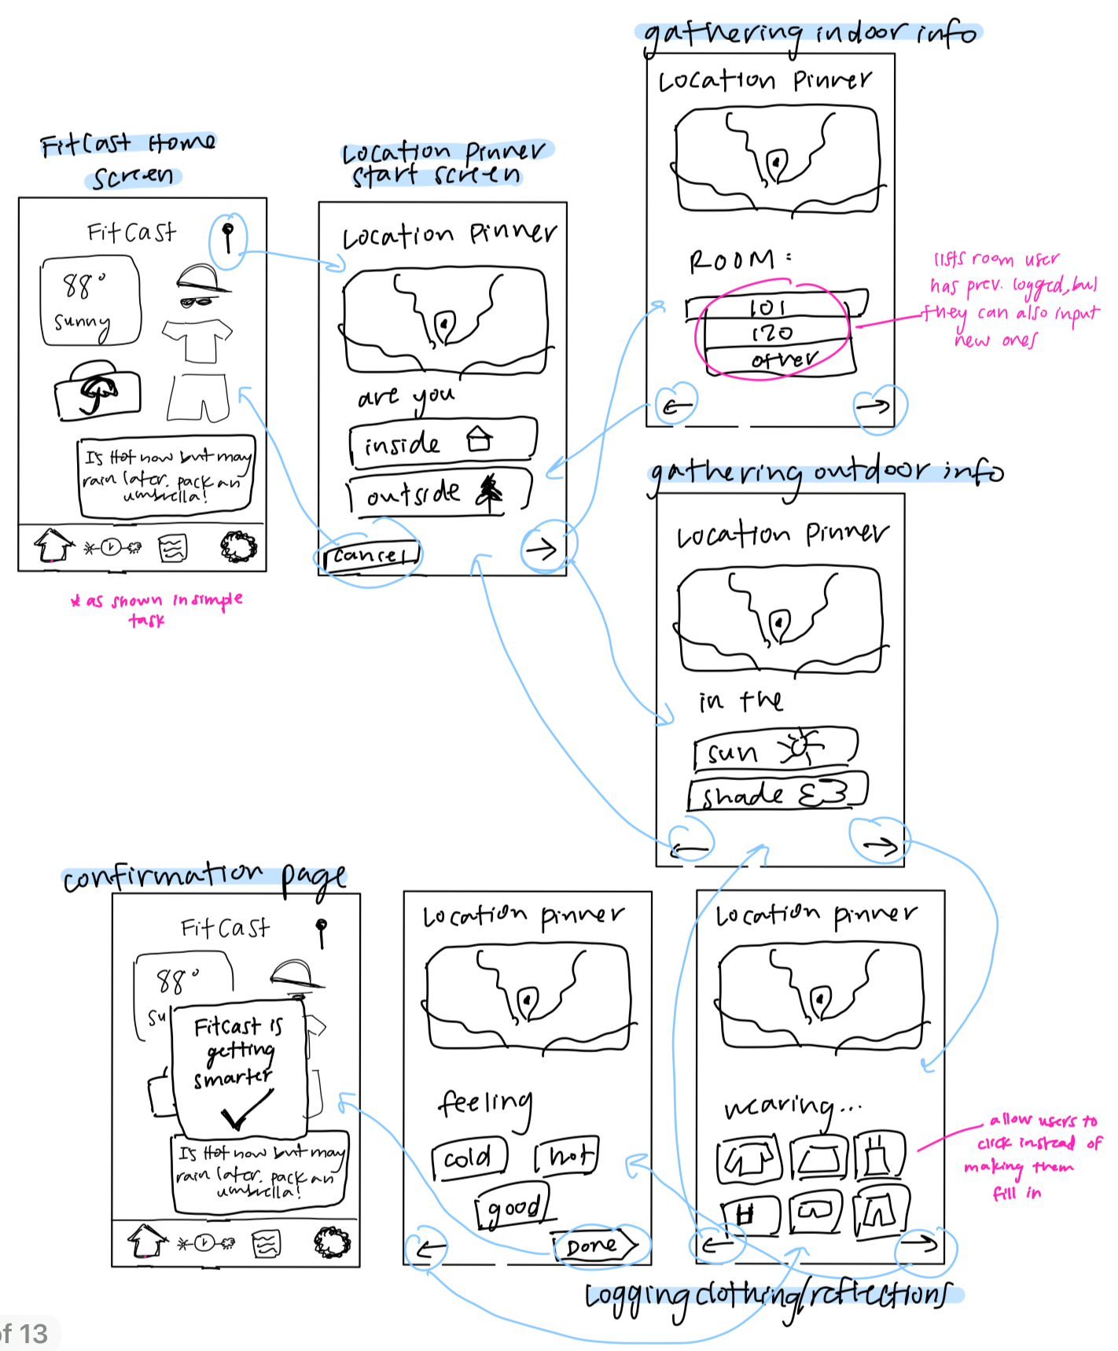
before
after

Slide 26
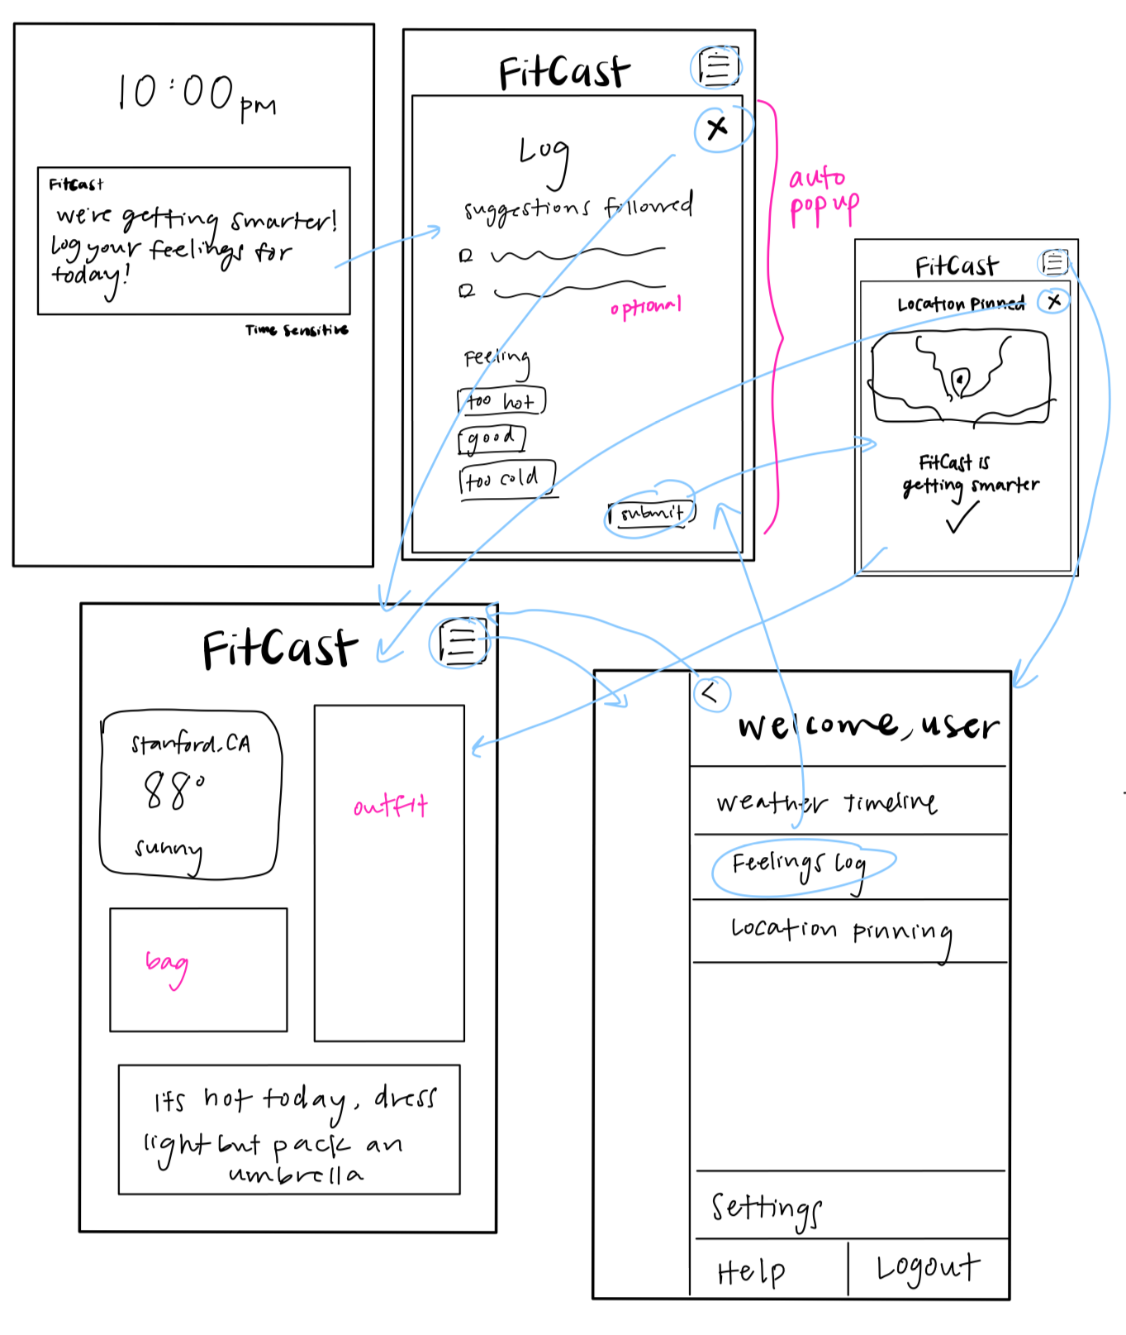
Complex Task Modifications
User is trying to adapt their clothing wearing habits more closely to their personal temperature preferences
Have the log auto pop up upon opening the app after 9pm, as long as it hasn’t already been filled out
Move icon from bottom bar and make it accessible from sidebar menu

Slide 27
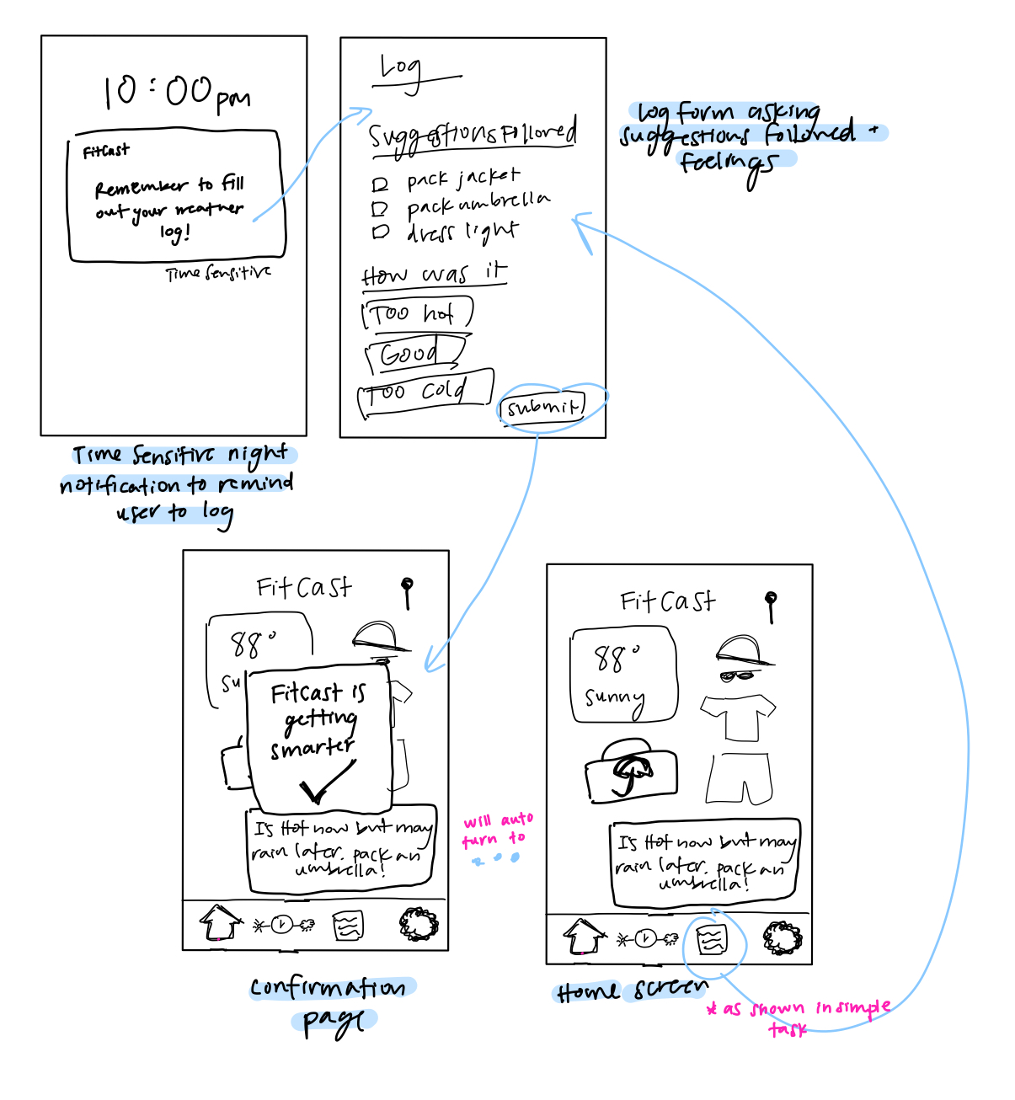
after
before

Slide 28
Med-fi

Slide 29
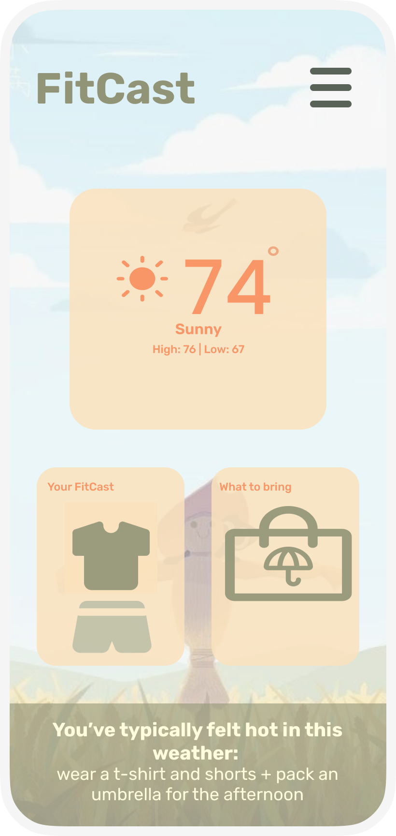
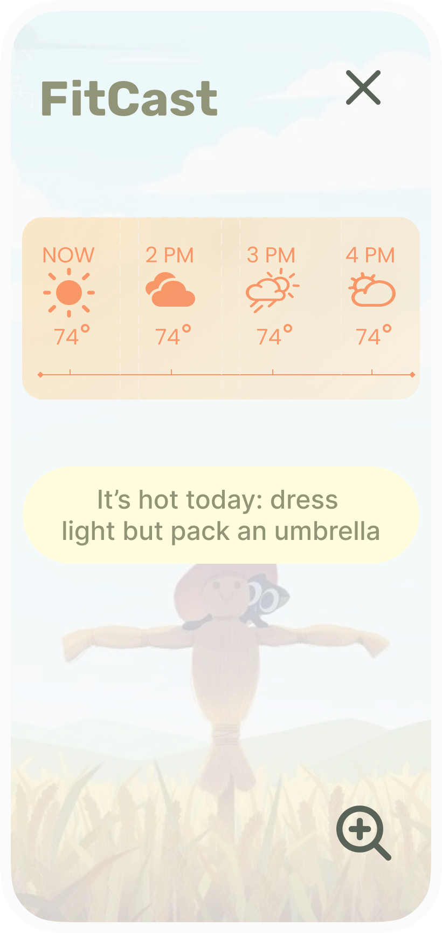
#1 Simple Task
User is deciding what to wear based on the weather now
User can decide what to wear from just our homepage, but can access the timeline for additional information
*also accessible from side menu, but that is not the core intention

Slide 30
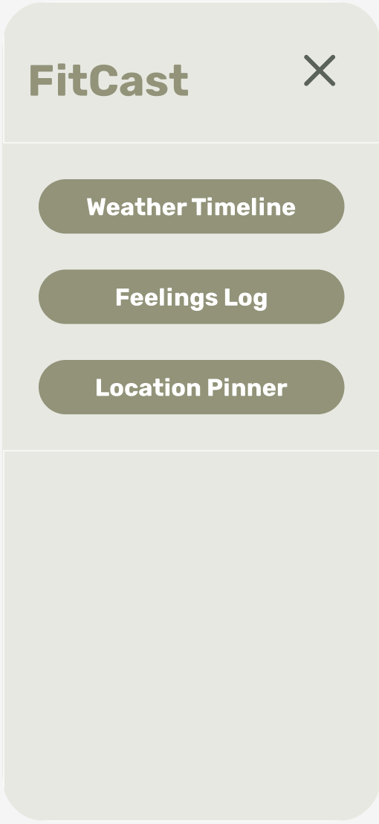

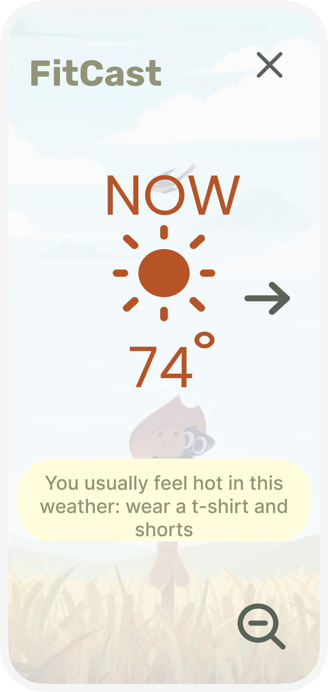
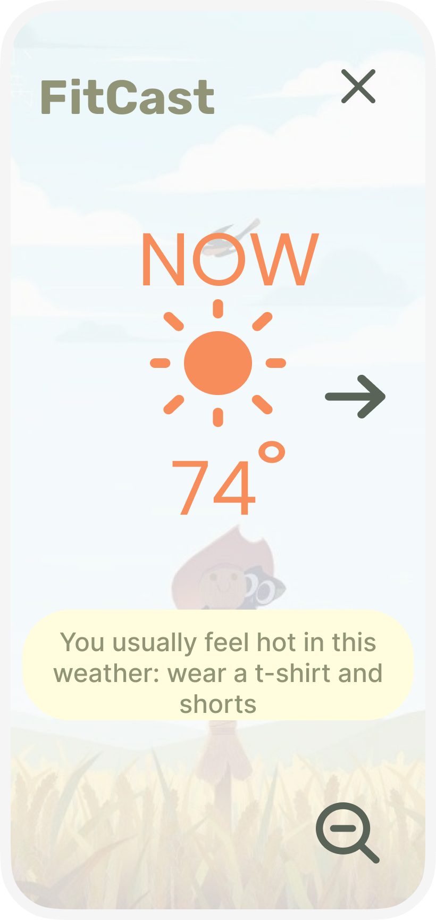
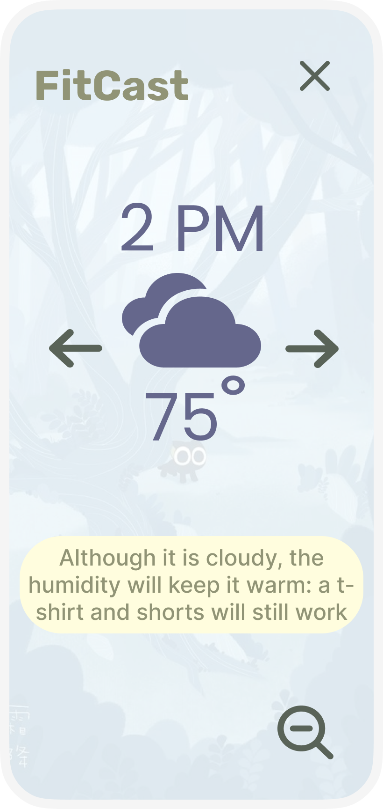
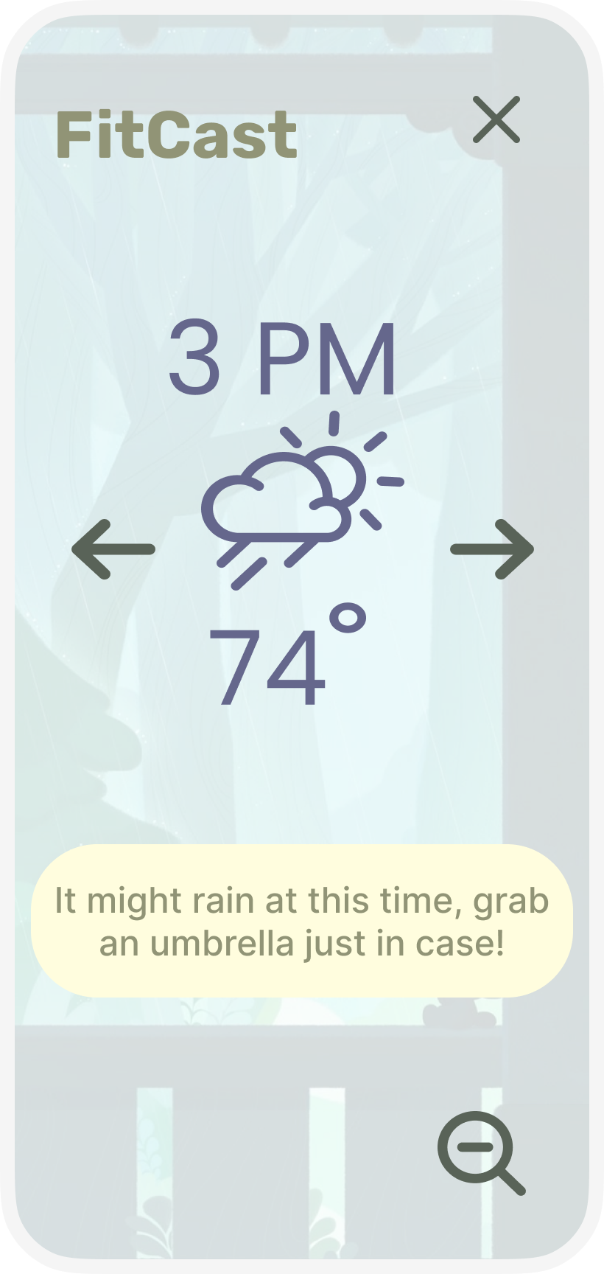
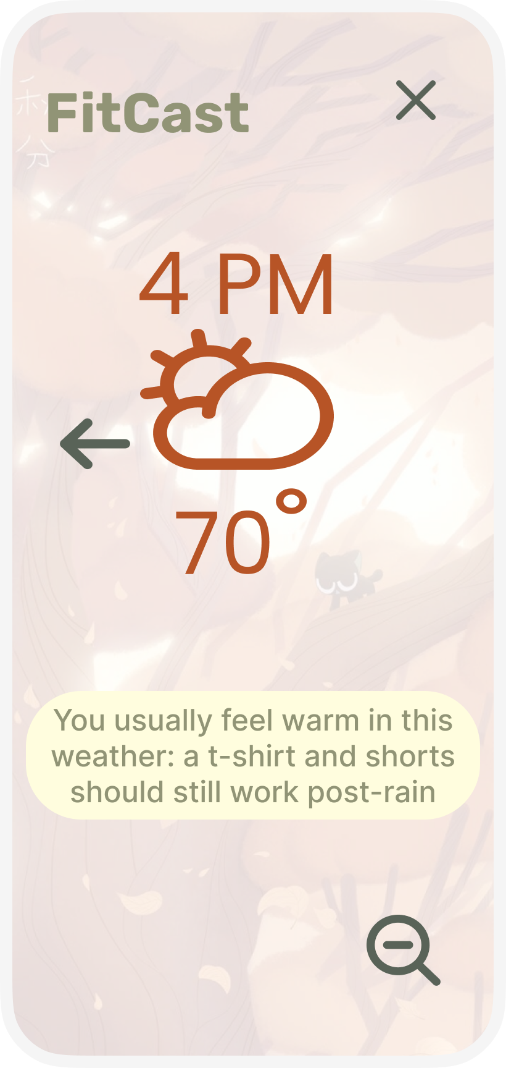
All x’s lead back to home screen
All lead to top right screen (zoomed out weather timeline)
All times on the zoomed out weather timeline lead to their corresponding zoomed in time
(didn’t put arrows for each because would look unreadable)
Expanded timeline view, with weather interpretations for each specific time of day

Slide 31
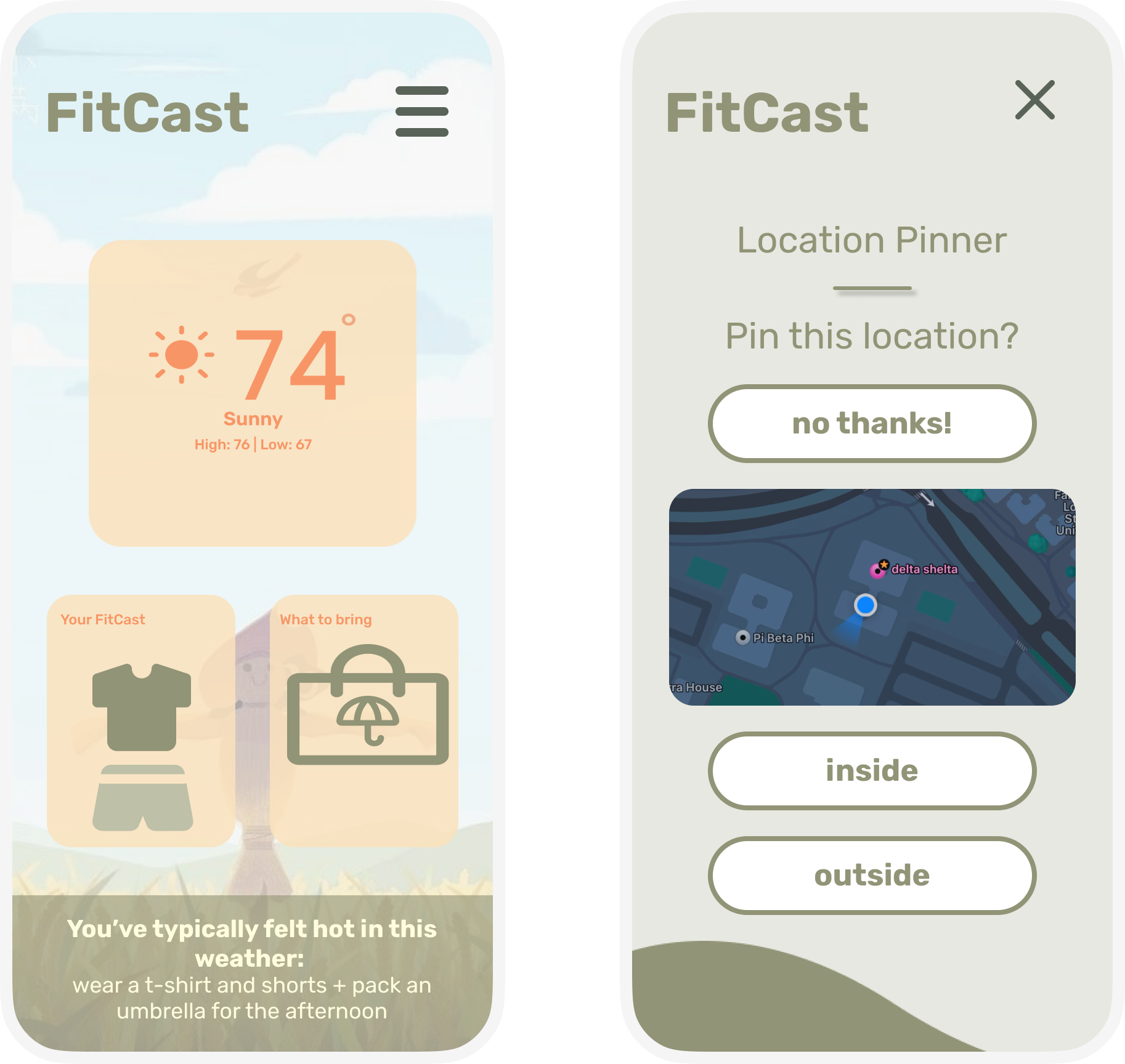
# 2 Moderate Task
User wants to update preferences to better prepare for indoor temperatures
*pops up immediately upon app opening
Also accessible from side menu

Slide 32
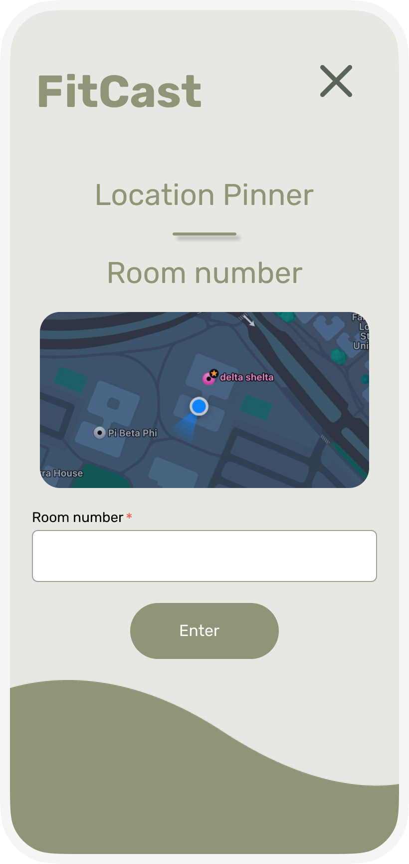
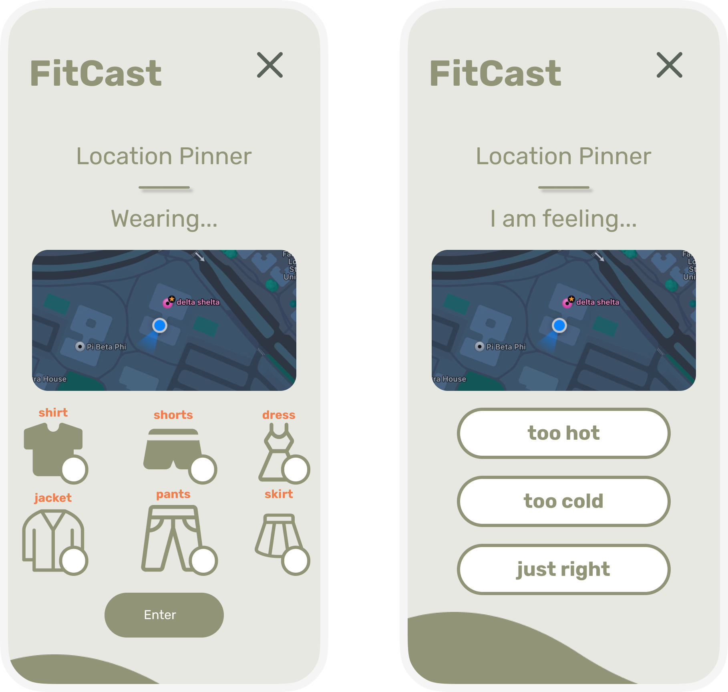
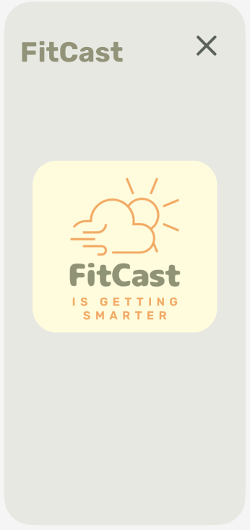
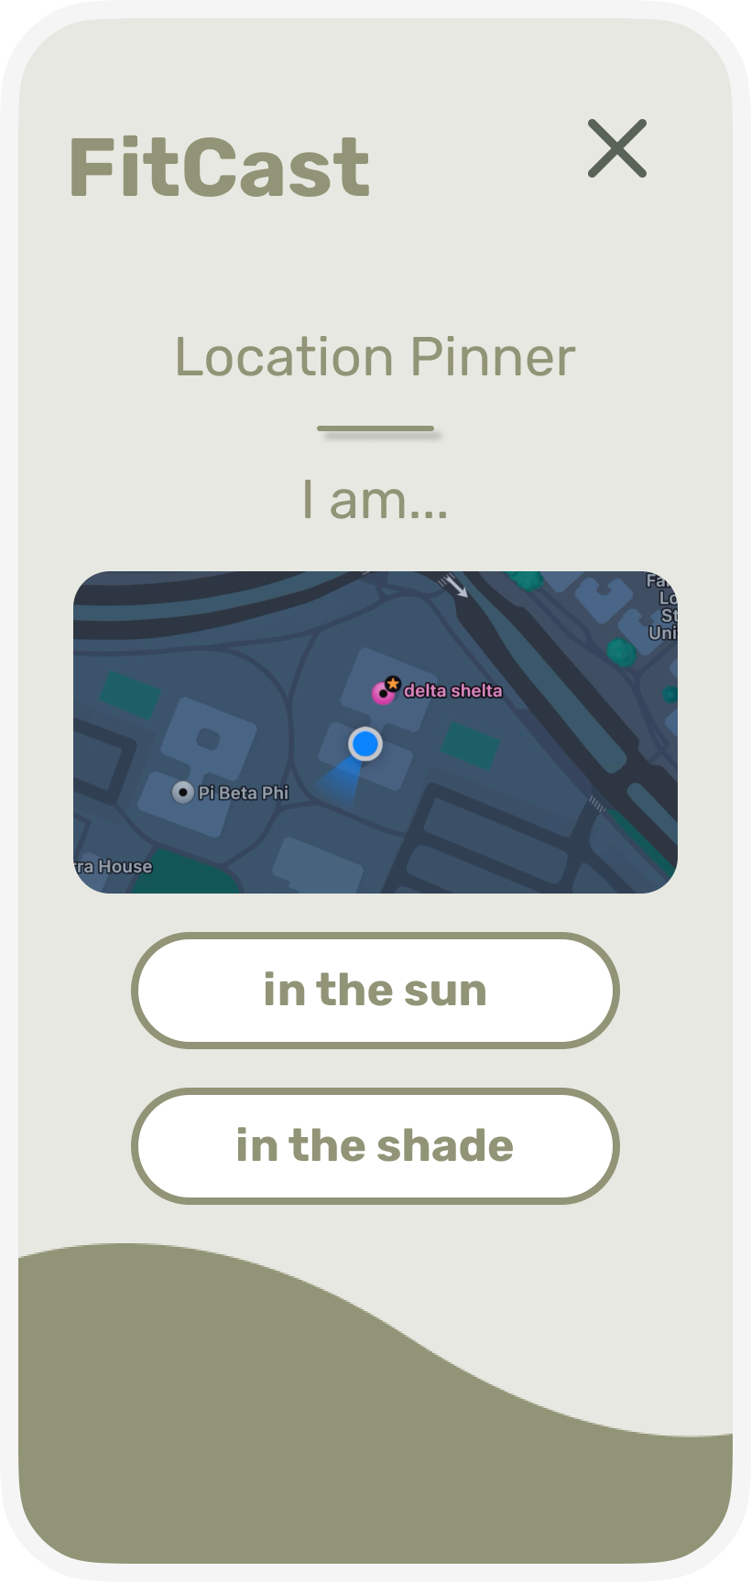
All x’s return back to home
When location changes, the location pinner auto pops up
Dependent on whether the user is indoors or outdoors

Slide 33
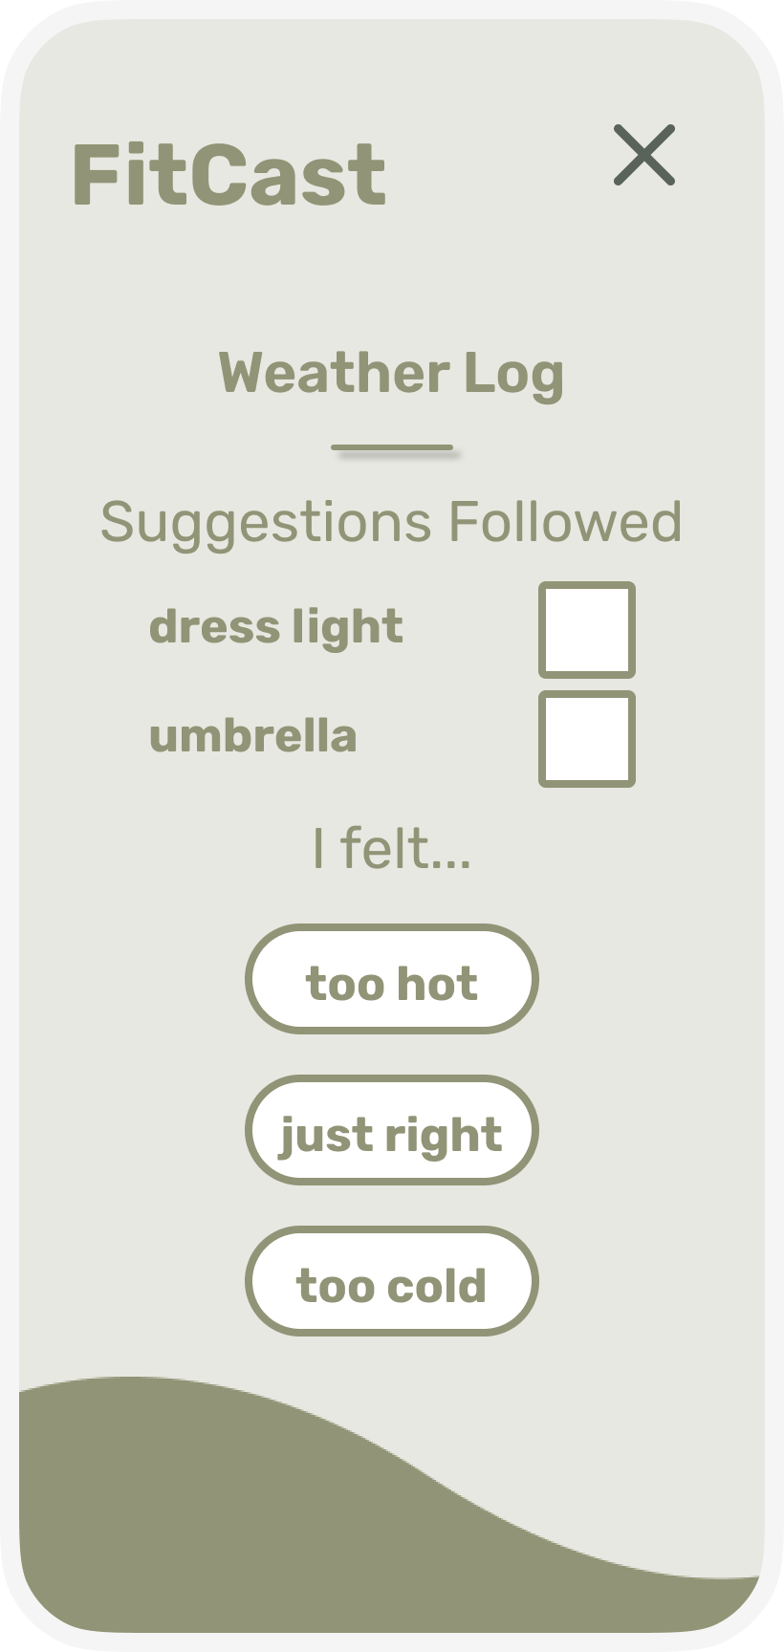
#3 Complex Task
User is trying to adapt their clothing wearing habits more closely to their personal temperature preferences
Note that we plan for most of this to done using a wearable device alongside the voluntary input from the user
*pops up immediately upon app opening, also accessible from side menu

Slide 34
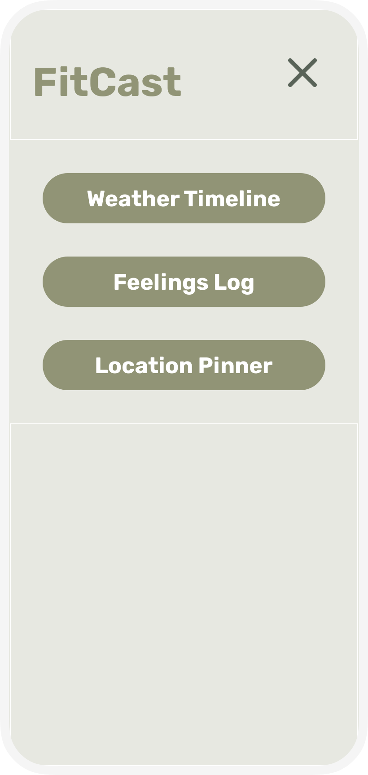
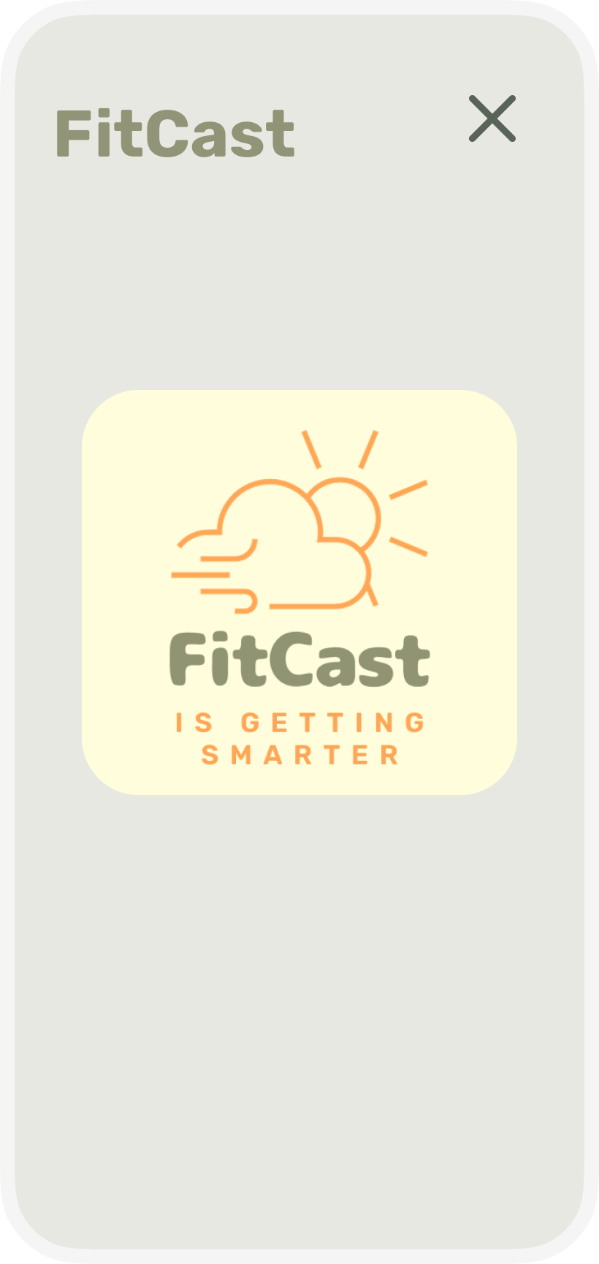
All x’s return to home
Auto pops up upon opening app after 9pm

Slide 35
Implementation

Slide 36
Tools: Figma!
Pros
Helps us visualize the task flows very easily
Has many of the core functionalities we rely on (ex. Pop ups, selection checkboxes)
Helped us to refine our plans/goals in terms of UI
Cons
Hides some of our core functionality
  Notifications
  Different visual elements and suggestions that we intend to change based on the weather changing
Cannot effectively differentiate between all the different ways to enter the app (first download, clicking notification, just opening the app, etc)
Lots of things have to be hardcoded

Slide 37
Limitations
Updating profile/general initial preferences
  Currently most functionality is hard coded, so allowing the user to input/update their preferences on this prototype would make the hard coded information mismatch what is shown
Notifications
  We intend to send scheduled notifications which remind the user to fill out the log/pin locations
  Since figma has no information about time/location, coding the notification panel wouldn’t add much to our prototype
Settings/Help/other side pages
  Didn’t feel they were currently necessary to showcase our task flows

Slide 38
Hard Coded + Wizard of Oz Features
User Info + Weather Preferences
Initial survey → hard coded so that the rest of the hard coding makes sense
Clothing suggestions → the text and the icons
Login information → username and passwords hard coded
Live Weather Information
Current time
Current location
Weather → temperature and precipitation
Wizard of Oz: Simulates AI capabilities that translate user preferences into clothing suggestions.
Wizard of Oz: Simulates specific weather conditions in a hard-coded area, as well as all weather statistics.

Slide 39
Appendix

Slide 40
Different Themes Based on Time/Weather

Slide 41
Links
FitCast Website: https://web.stanford.edu/class/cs147/projects/UnintentionalGood/FitCast/
Prototype Link: https://www.figma.com/proto/9Y4JpAEXMhna7KcYu1pjgQ/Medium-Fi-Prototype?type=design&node-id=167-2288&t=IVKNPoZqyGqXM6Ky-1&scaling=scale-down&page-id=14%3A2&starting-point-node-id=177%3A2738&show-proto-sidebar=1&mode=design

