Slide 1

DiarWe: Interactive
Medium-Fi Prototype
Team 1: Aaron Cho, Katie Liu, Eleanor Peng, Emma Su

Slide 2








Team DiarWe
Aaron Cho
‘25
[SymSys - HCI]
Katie Liu
‘25
[CS - HCI]
Eleanor Peng
‘25
[CS - HCI]
Emma Su
‘25
[SymSys - Neuro]

Slide 3
Value Proposition
Interactive journaling to connect, share, and learn between generations.

Slide 4
Problem + Solution Overview
Problem
Solution
People are all, in some capacity, part of some intergenerational relationship. Whether it’s grandparents with grandchildren or parents with children, miscommunication and disconnect are prevalent due to generational differences in slang, pop culture, technology, historical events, etc.
To reduce these barriers, we aim to bridge these generational gaps through interactive journaling – harnessing deeper connections and facilitating personal learning experiences through sharing first POV reflections.

Slide 5

01.
Values in Design

Slide 6
Human Connection
Intuitiveness
Empower stronger relationships and facilitate a sense of intimacy between distant generations
Have a simple interface with self-explanatory navigation to facilitate smooth task flows
Accessibility
Privacy
Allow users to customize their experiences when interacting with DiarWe based on their needs (ex. toggle larger font)
Offer agency over how much users want to share about themselves on the platform

Slide 7
Value-Aligned Features
Human Connection
Intuitiveness
Accessibility
Privacy
Ability to add friends and view their profiles
Feature to share + send entries with interactive features, such as audio recordings, photos, and songs
Ability to comment + react to others’ journals
Simple navigation bar at the bottom
Extra big, circular plus icon centered at the bottom navigation bar to highlight the journaling feature
“Helper captions” that clarify the purpose of certain icons
Compatibility with iOS settings to enlarge fonts
Larger button designs for clickables
Easy access to an archived calendar view of past journals to revisit and reflect
Ability to skip parts of the journal that they don’t wish to share about
Freedom to share as little or as much as they want for any journal prompt
Choice to share journal with all friends, or select friends

Slide 8
Value Tensions
One of our primary goals for DiarWe is to create deeper connections between individuals through shared journaling. However, in order for this connection to be built, users must be willing share and respond to prompts on the platform. Therefore, there exists a tension between human connection and privacy, as connection requires a degree of transparency, but we also give users full agency as to how much they wish to share on the platform.
Human Connection vs Privacy

Slide 9
02.
Revised Tasks

Slide 10
Revised Tasks
  Simple
  Moderate
  Complex
Read + react to other’s journal entries
Create a journal entry with elements of a user’s choice
Create + view a customizable “vault” of past journals with others where users can group journals by theme

Slide 11
Former Tasks
Rationale for Revision
We decided to merge our simple and moderate tasks into one task, as they had overlapping and interrelated functionality.
Based on expert feedback, we made our former complex task (“Read + react to other people’s journal entries”) our new simple task, and made our former simple task (“Create a journal entry consisting of only text or audio”) our new moderate task.
  This is because reading other’s journals is likely the feature that will be most frequently used, followed by creating a journal of your own.
To emphasize our app’s mission to bridge generations, we created a new complex task: Create a customizable “vault” of past journals with others where users can group journals by theme.
  Simple
  Moderate
Create a journal entry consisting of only text or audio
Create a journal entry with images and songs
  Complex
Read + react to other people’s journal entries

Slide 12
03.
Usability Goals & Key Measurements

Slide 13
Discoverable
Learnable
Rationale
Accessing features on DiarWe should be intuitive and discoverable, especially when considering the older generations
Key Measurement
Counting the number of main features of our app that participants successfully discover
Results
3 participants were able to discover 6/6 features
1 participant was only able to discover 5/6 features
Rationale
App should be intuitive enough so that users gain app fluency through repeated interactions
Key Measurement
Timing how fast participants can successfully navigate to certain features of the app
Results
Participants were able to navigate through the app faster the second time around
Older participant struggled with speed however

Slide 14
Discoverable
Learnable
Findings
The feature that our test users had the most difficulty discovering was the mailbox icon on the homepage (which leads to the user’s feed)
Users did not realize that the mailbox icon was clickable
Takeaway
We must make it clear to the user as to what is clickable, perhaps through color, captions, and/or special effects
Findings
Despite the users having already navigated through the process of creating a journal entry, it still took a bit of time for some users to re-navigate due to the amount of different screens that are involved in creating a journal
Takeaway
As the process of creating a journal includes multiple parts (voice/text, picture, song), we must aid users in navigating through the series of steps and buttons that allow them to complete a journal

Slide 15
Progress Towards Usability Goals
“You’ve got mail” caption to clarify that the homepage mailbox is clickable
Made “Home” footer icon more clear + identifiable
Added “Tap to Record” caption to record a voice memo journal entry
“Press to take photo” and “Click here to select a photo from your library” helper captions
“Edit” button on the journal summary page right before uploading

Slide 16
Revised Interface Sketches
04.

Slide 17
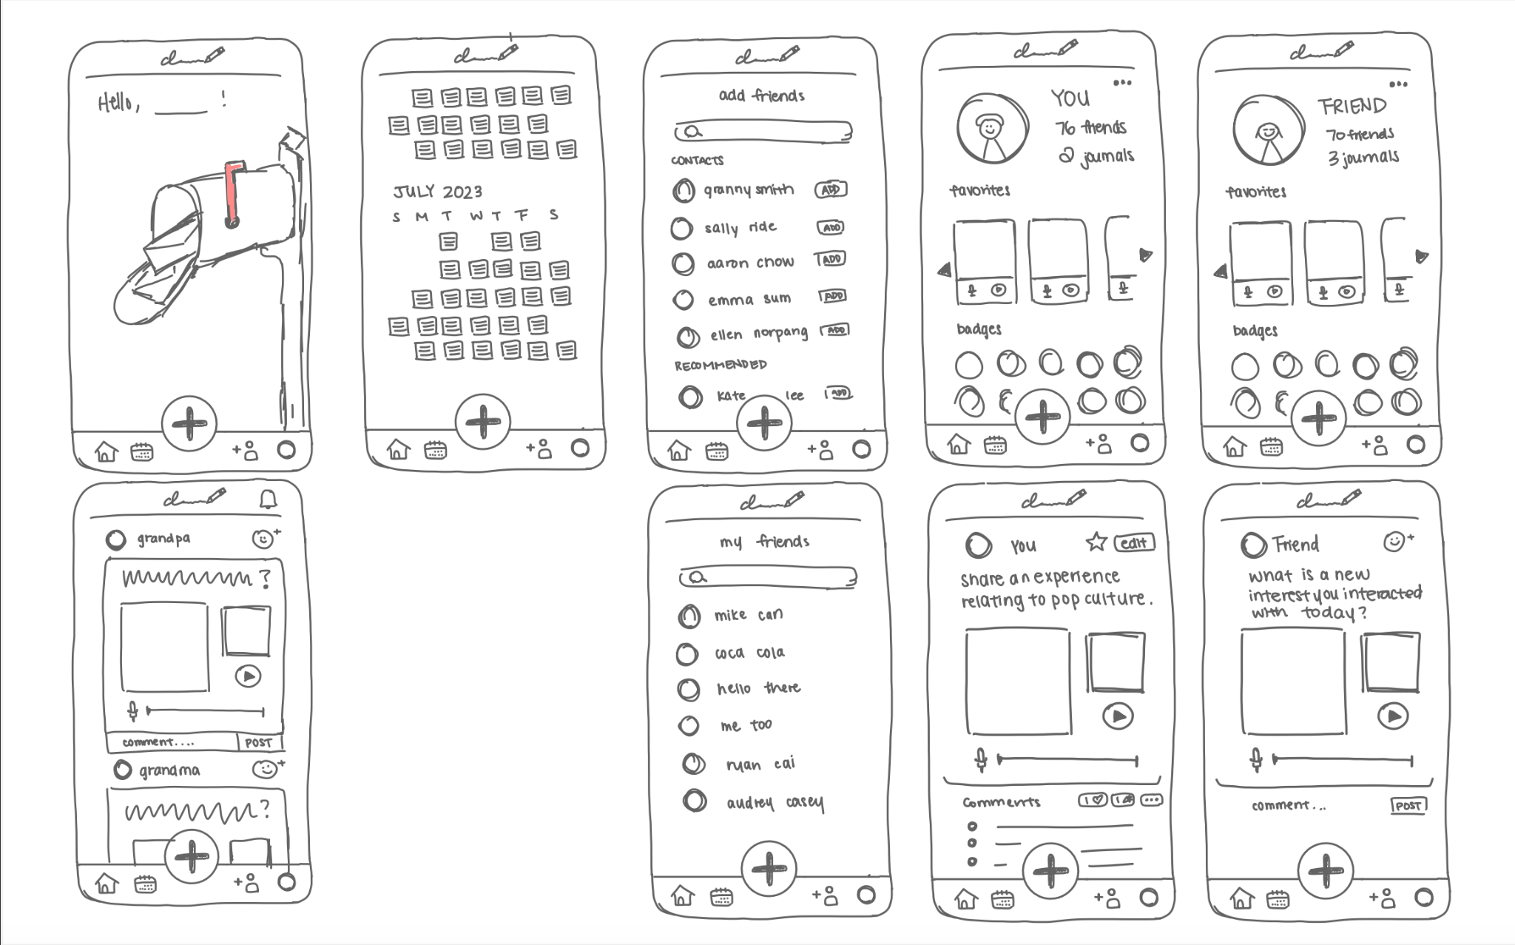


Slide 18
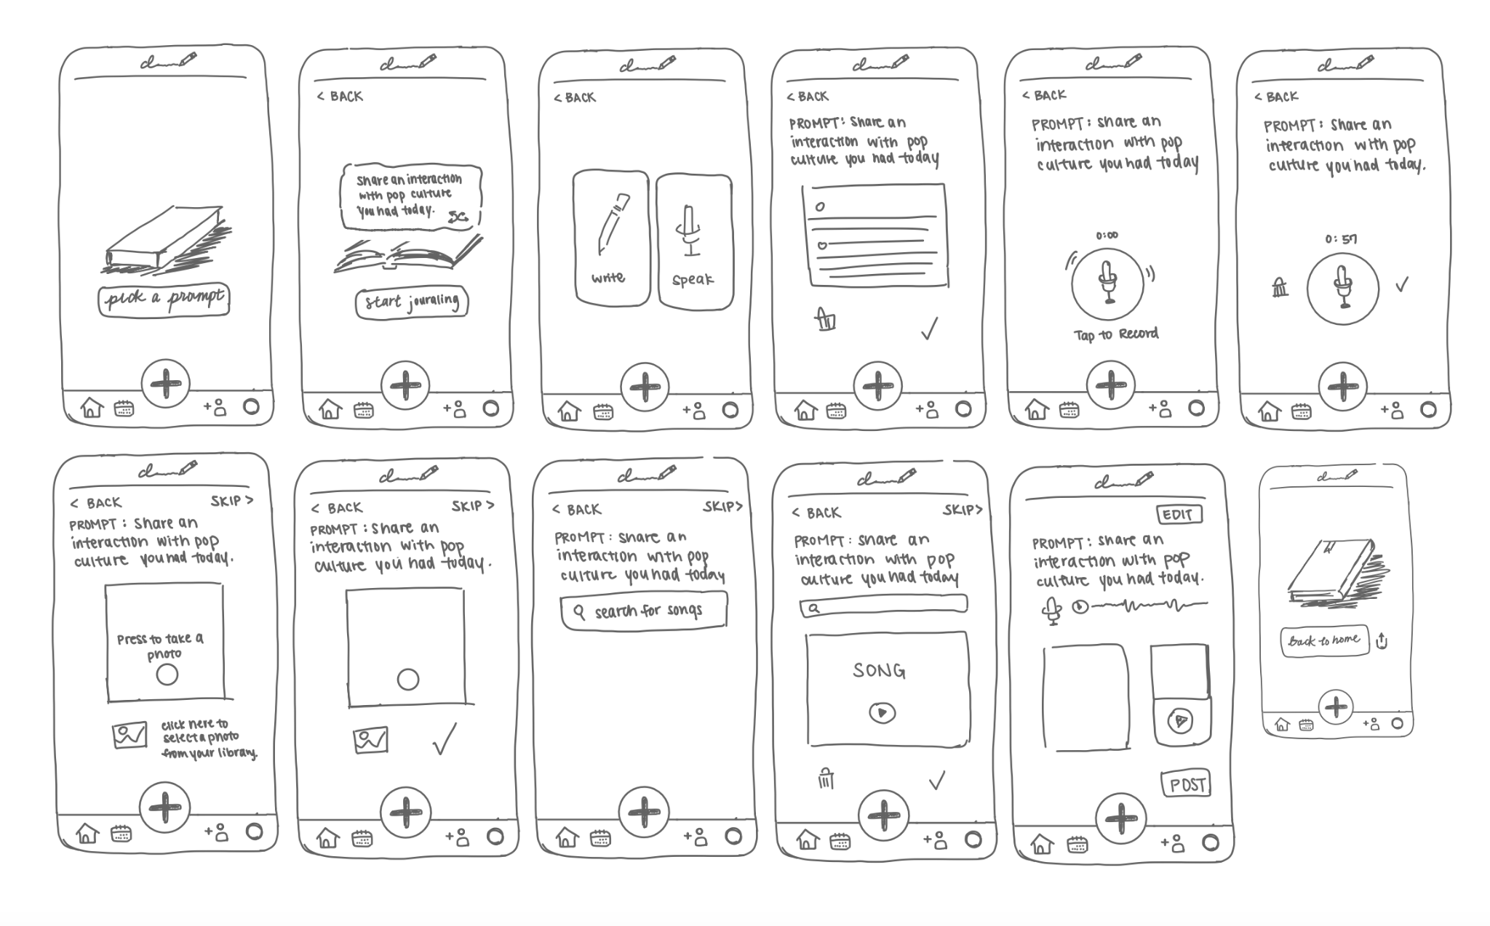

Slide 19
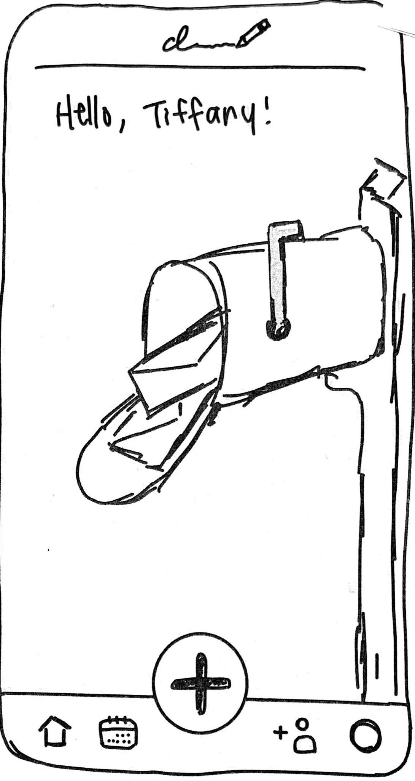
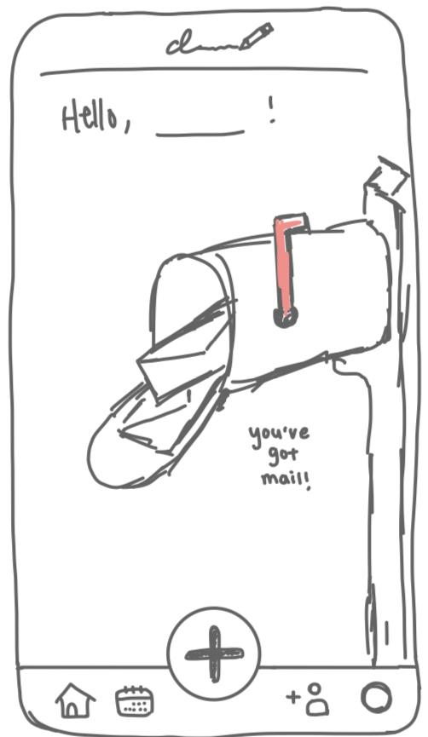
UI
Change
#1
  Home Button
The revised home button, with the little door feature, no longer looks like an upload button and clearly depicts a house (improves discoverability)
  BEFORE
  AFTER
Notes:
UI Change #1: The Home Button
The revised home button, with the little door feature, no longer looks like an upload button and clearly depicts a house

Slide 20
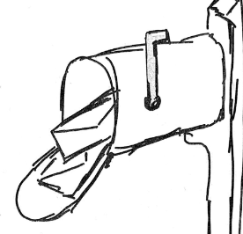
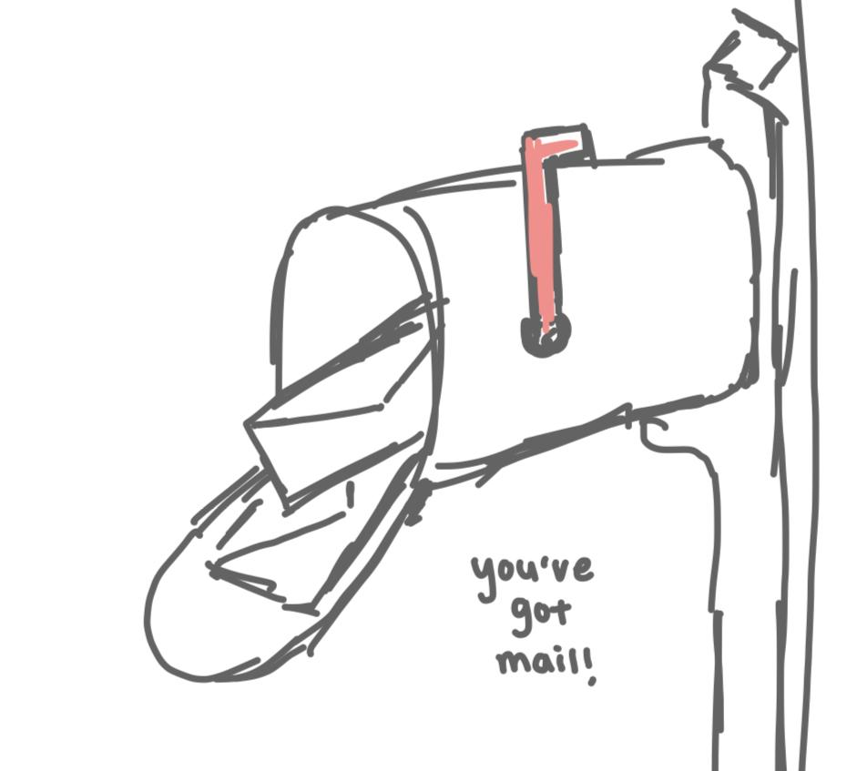
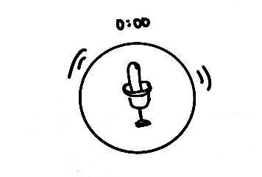
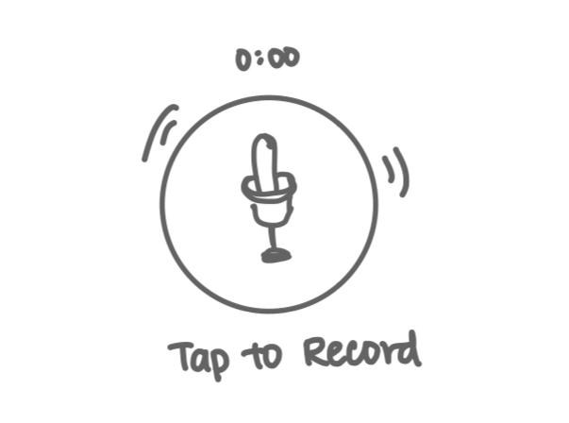
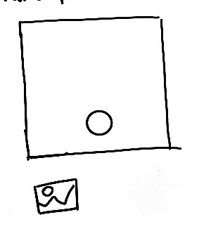

UI
Change
#2
  Helper Captions
Added helper captions throughout the app to increase learnability
  BEFORE
  AFTER
Notes:
UI Change #2: Explicit Instructions
Home page mailbox – added helper caption of ‘you’ve got mail’ to indicate that it is a clickable feature
Audio recording page – added “Tap to Record” for increased intuitiveness and accessibility
Photo page – added “press to take a photo” and “click here to select photo from your library”

Slide 21
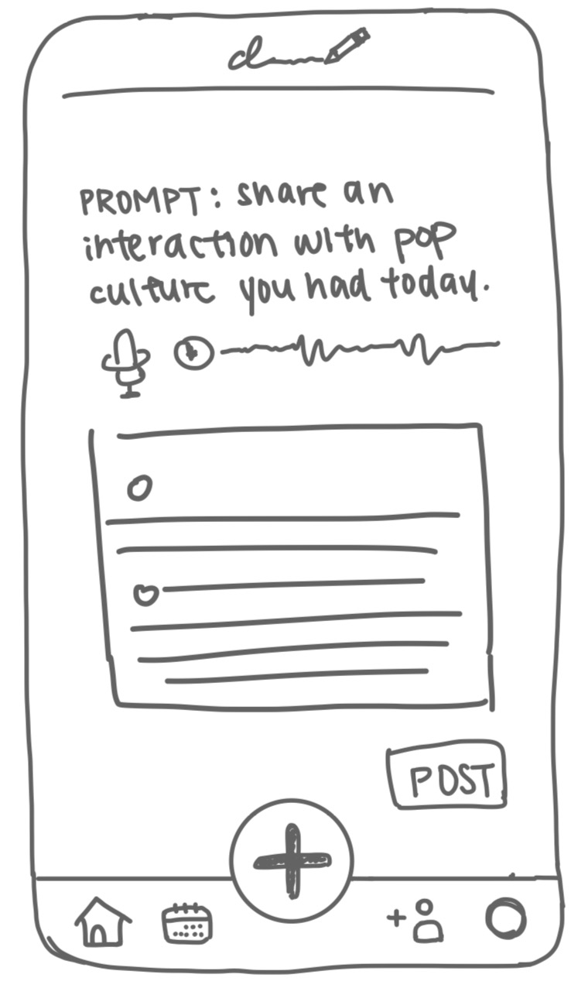
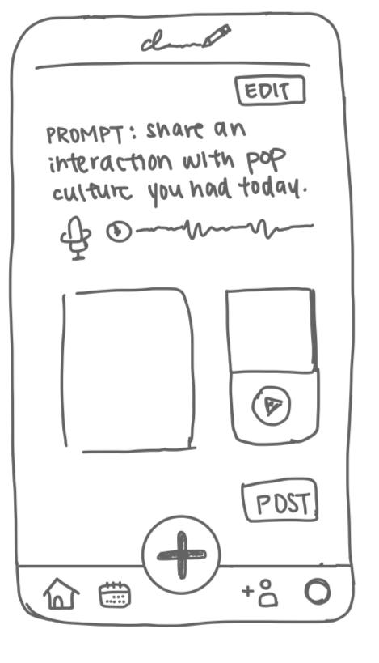
UI
Change
#3
  Edit Button
An edit button before posting to minimize back/next button navigation and increase flow efficiency of journal creation
  BEFORE
  AFTER
Notes:
UI Change #3: Edit Button on the Summary Page
An edit button was added to the journal summary page before posting to minimize back/next button navigation and increase flow efficiency

Slide 22
05.
Medium-Fi Task Flows

Slide 23
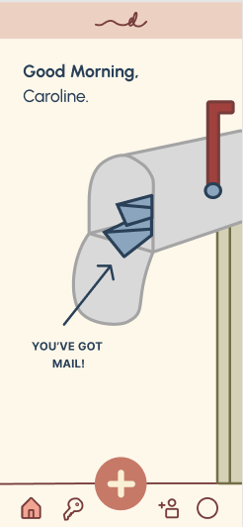
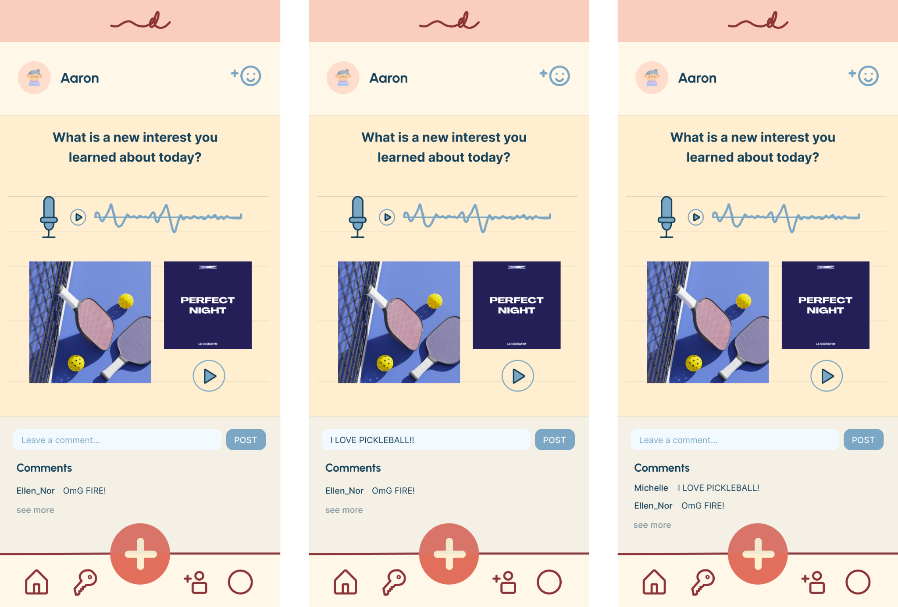
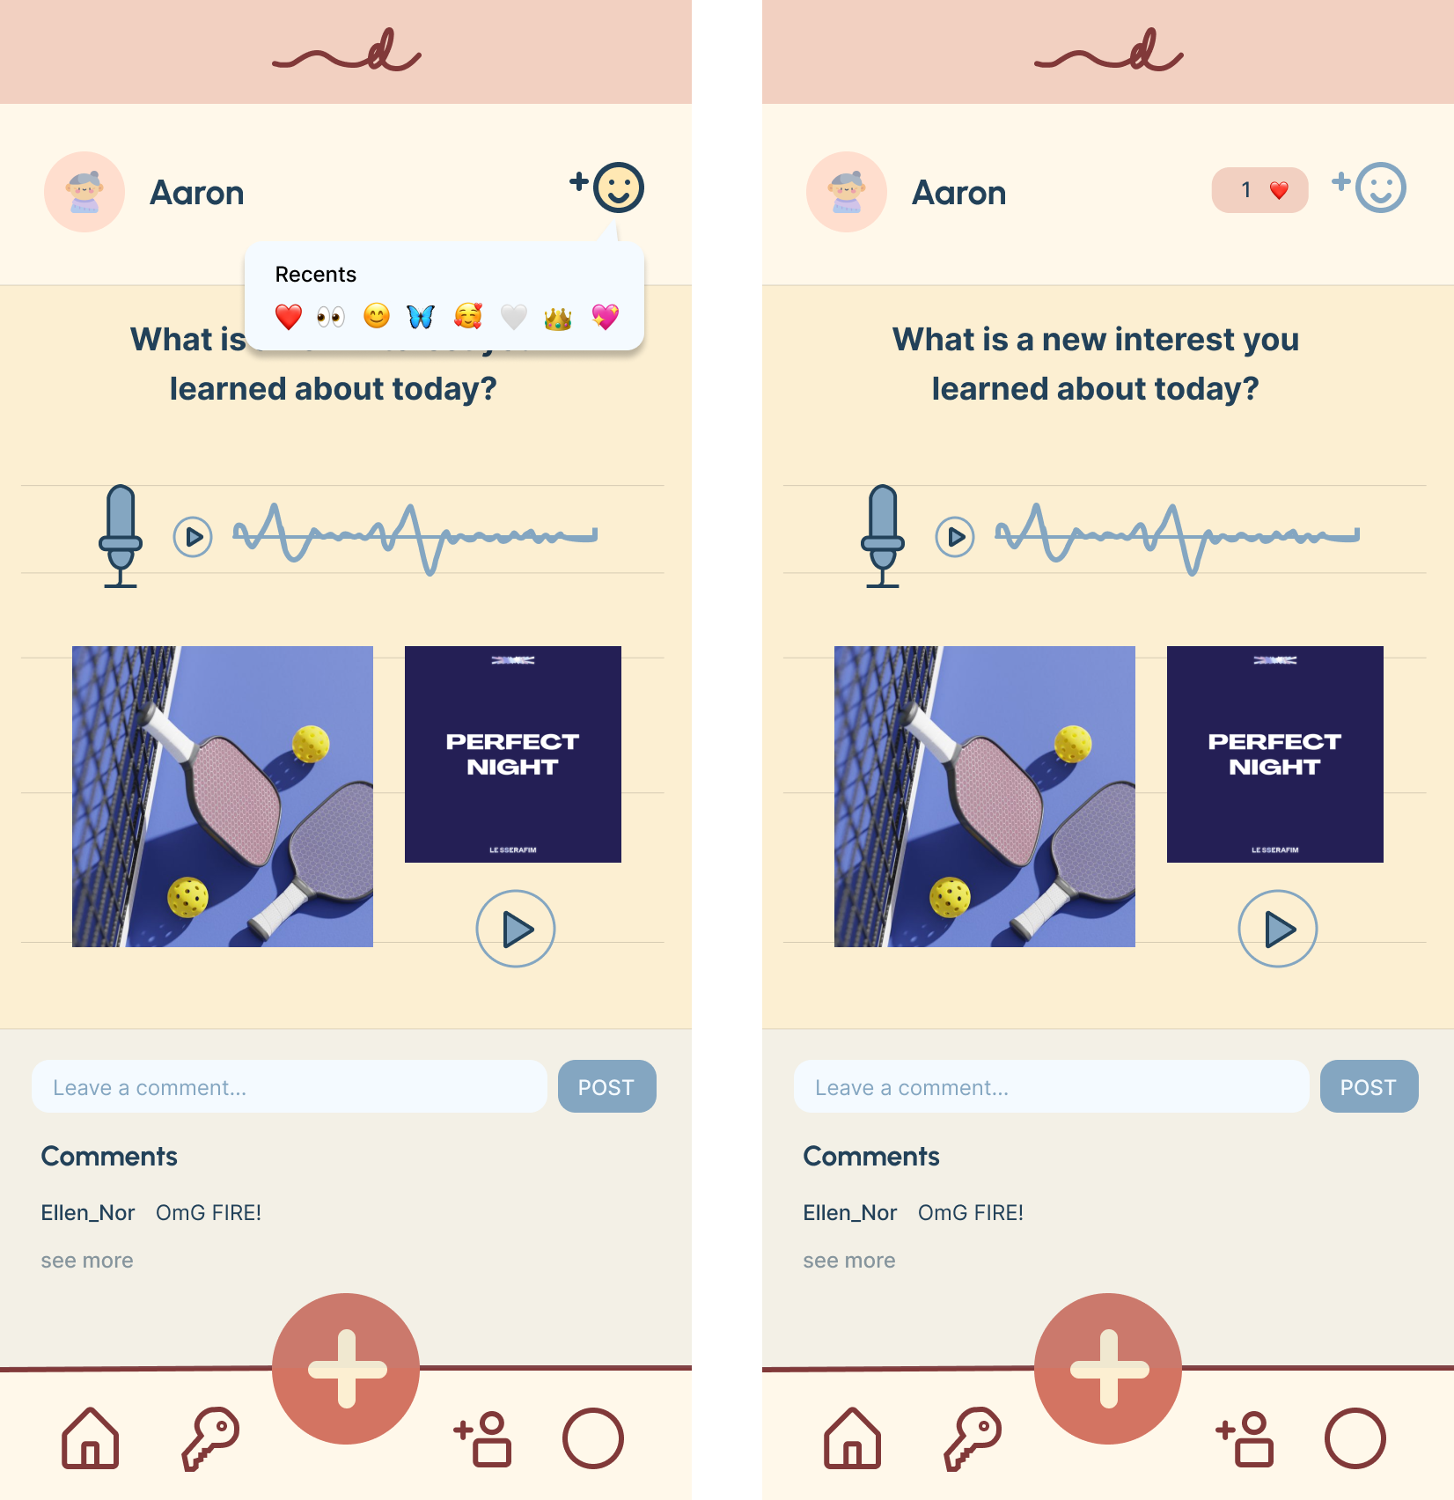
Simple Task: Read + react to other’s journal entries
Home screen. User taps mailbox to view feed.
User types + posts a comment in the comment text box.
User clicks on the react icon in the top right corner
User sees various options for reactions and chooses one.
Reaction appears at the top of the friend’s journal.
User views journal entry of a friend. Can react and/or comment on the friend’s journal.

Slide 24
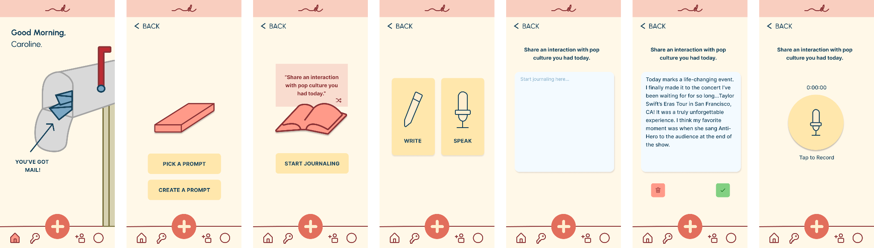
Moderate Task: Create a journal entry with elements of a user’s choice
Home screen. User taps plus to create a new journal entry.
Pick a prompt to write.
Can shuffle to a new prompt or start writing.
Choose to write with text or record.
Start writing.
Choose to delete or save the current entry.
Tap on recording button to start record.

Slide 25
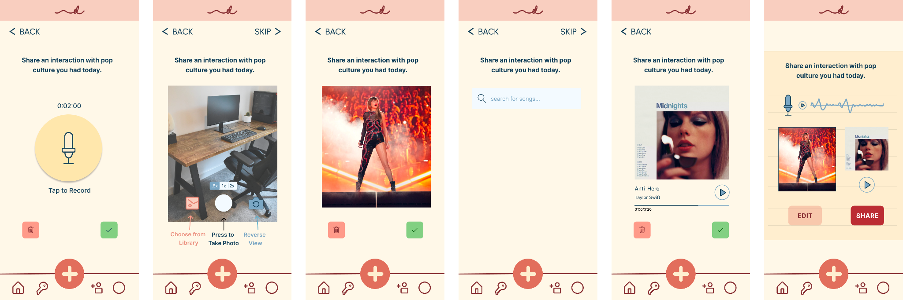
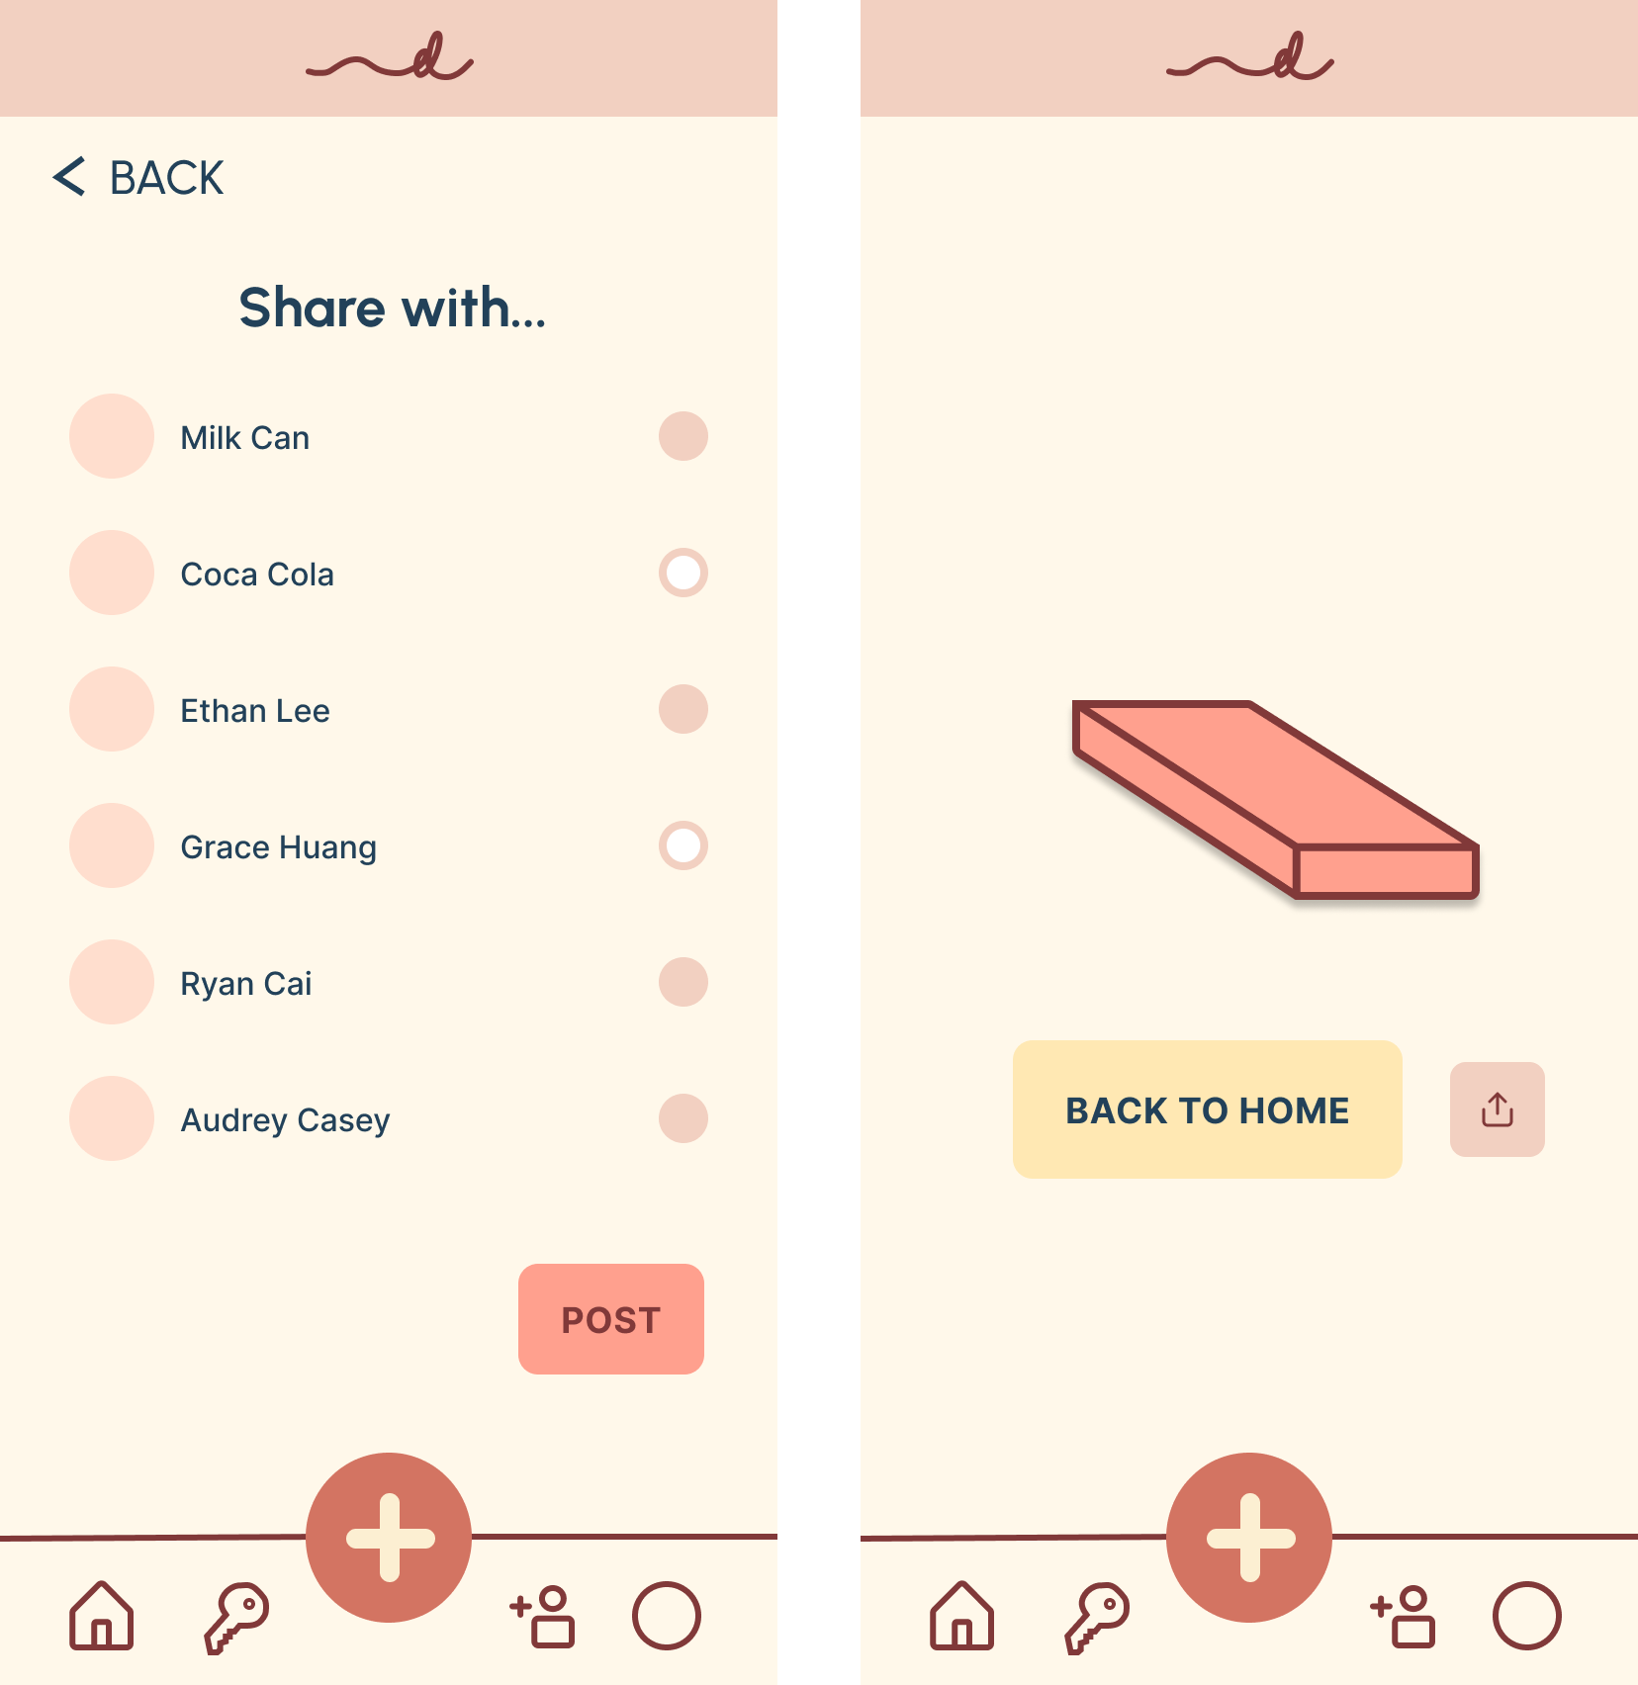
Moderate Task: Create a journal entry with elements of a user’s choice
Choose to delete or save the current recording.
Choose a photo that matches with the prompt, with the option of taking picture or uploading photo from photo library. Or choose to skip.
Delete current photo or save.
Pick a song that matches with the prompt, Or choose to skip.
Delete chosen song or save.
View the summary of journal entry.
Can choose to share journal with selected friends.
Journal complete! Can return to home page.

Slide 26
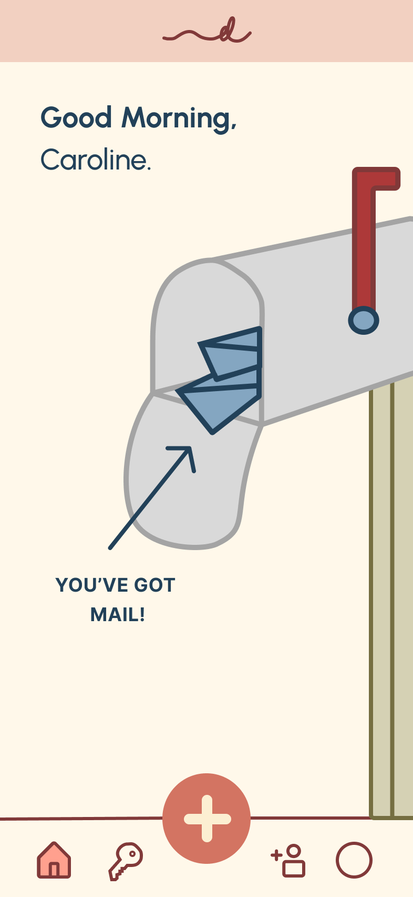
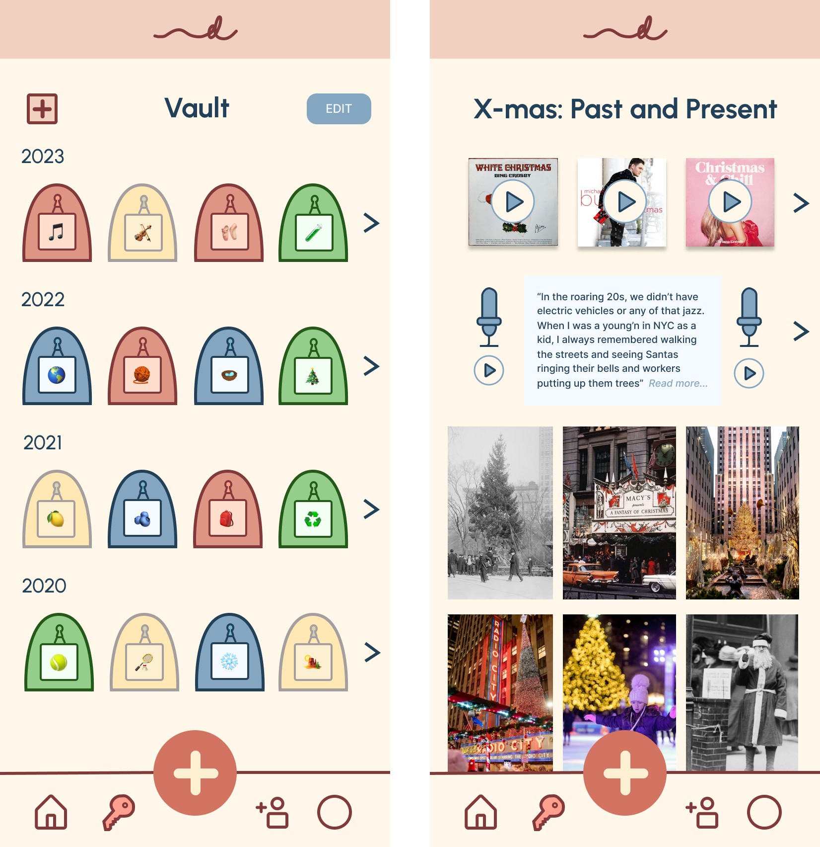
Complex Task: Create + view a customizable “vault” of past journals with others where users can group journals by theme
Home screen. User taps key icon at the bottom to view their Vault.
View gallery of collections of past journals, grouped by customizable theme
View themed collection, with archived voice/text memos, pictures, and songs

Slide 27
06.
Prototype Implementation

Slide 28
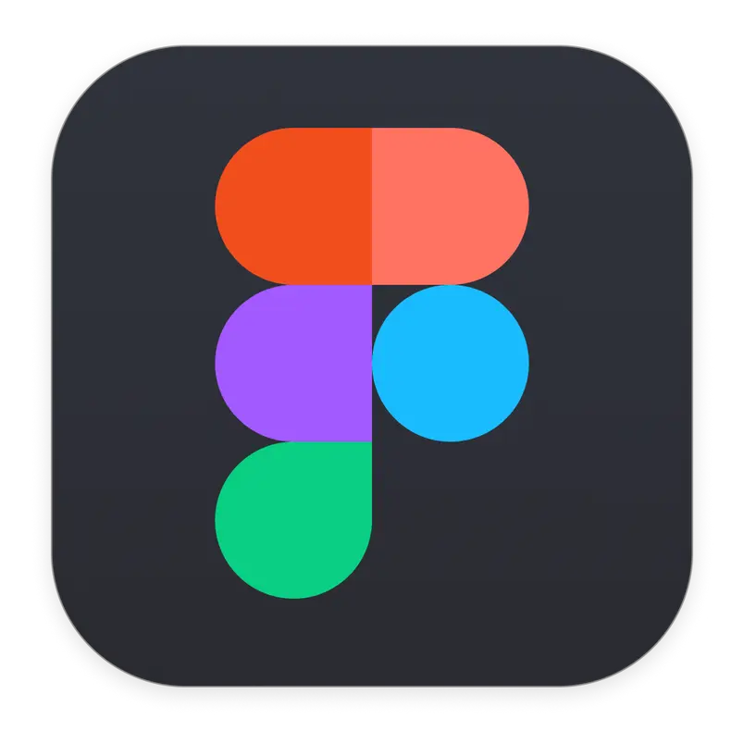
Prototyping Tool – Figma
Pros:
Easy collaboration amongst team members
Flexibility for developing design systems
Ability to simulate a mobile user experience
Cons:
Inability to determine how well our interface would display on different device types
Posed a learning curve; may have missed unfamiliar features

Slide 29
Limitations
No Typing or Recording Ability
No Music Library
No Camera Capability or Photo Library
While typing up and recording entries is a core element of our UX, the prototype has no ability to type or record an entry at the moment.
While sharing a song is a core interactive element integrated in our prototype, there is no search engine implementation at the moment to access songs and externally link a music library.
While sharing a real-time or past photo is a core interactive element integrated in our prototype, there is no way of snapping a real-time photo or accessing a pre-existing photo library.

Slide 30
Wizard of Oz Techniques & Hard-Coded Features
Journal Archives Feature
Journal Creation Process
Friends & Journal Reaction
When users view their personal journal archives via vault, they see existing journal entries on their profile despite using the app for the first time.
Instead of allowing users to write, record, or upload images/songs, the content automatically appears on the interface after the buttons are clicked, as if the users have completed the actions.
To simulate the interaction elements of the app, we provided pre-existing friends along with their corresponding journal entries that users can react to. In reality, users would have to create their own journal entries, add friends, and would only be able to react to others’ journals if their friends have posted new entries.

Slide 31
Figma Link (Prototype | Full)

Slide 32
THANK
YOU!
We hope you
enjoyed our presentation!

