Slide 1
DiarWe
interactive journaling to
connect, share, and learn
between generations
Team 1: Emma, Eleanor, Aaron, Katie

Slide 2
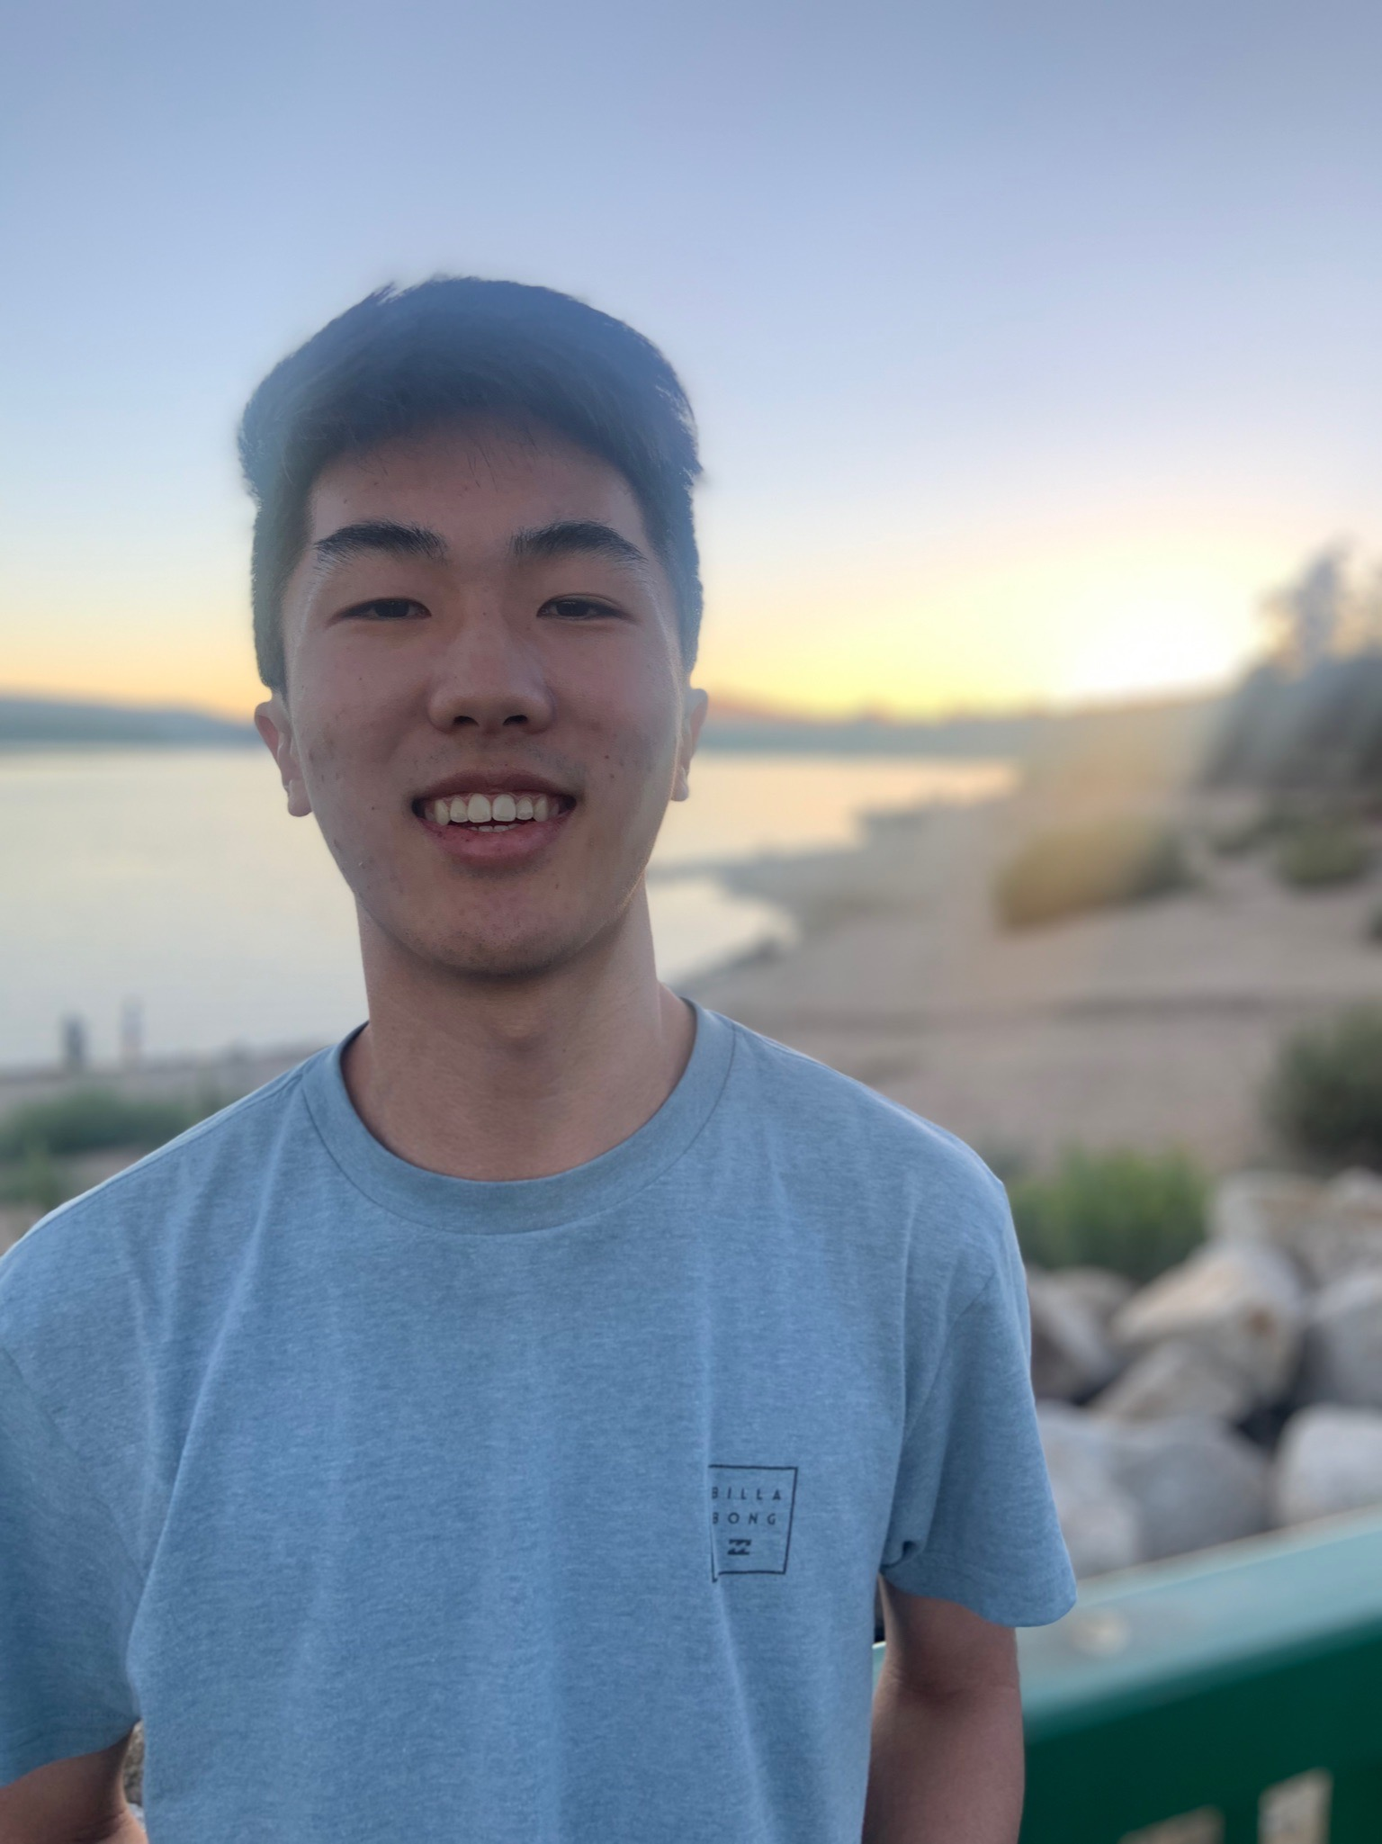
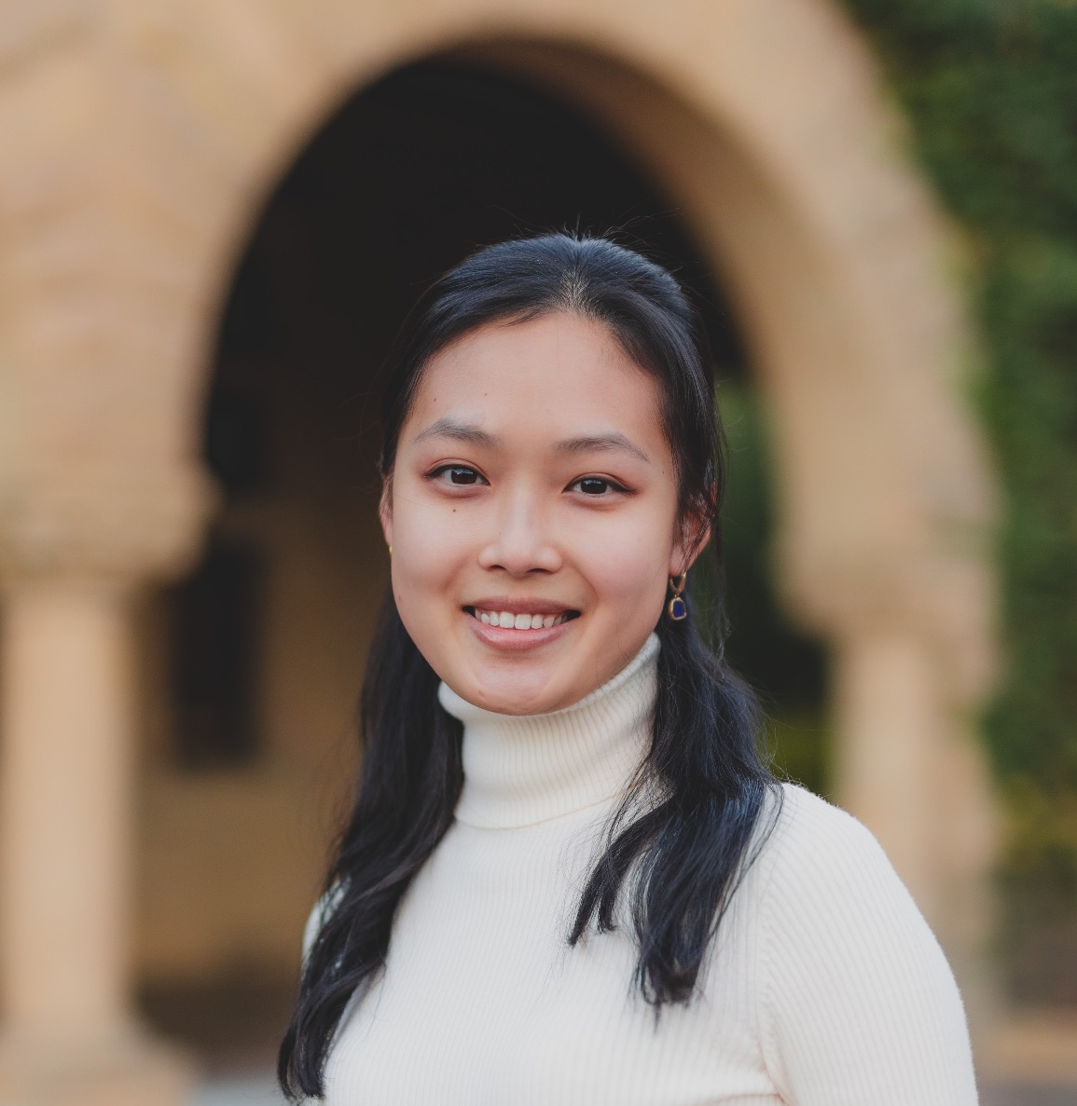

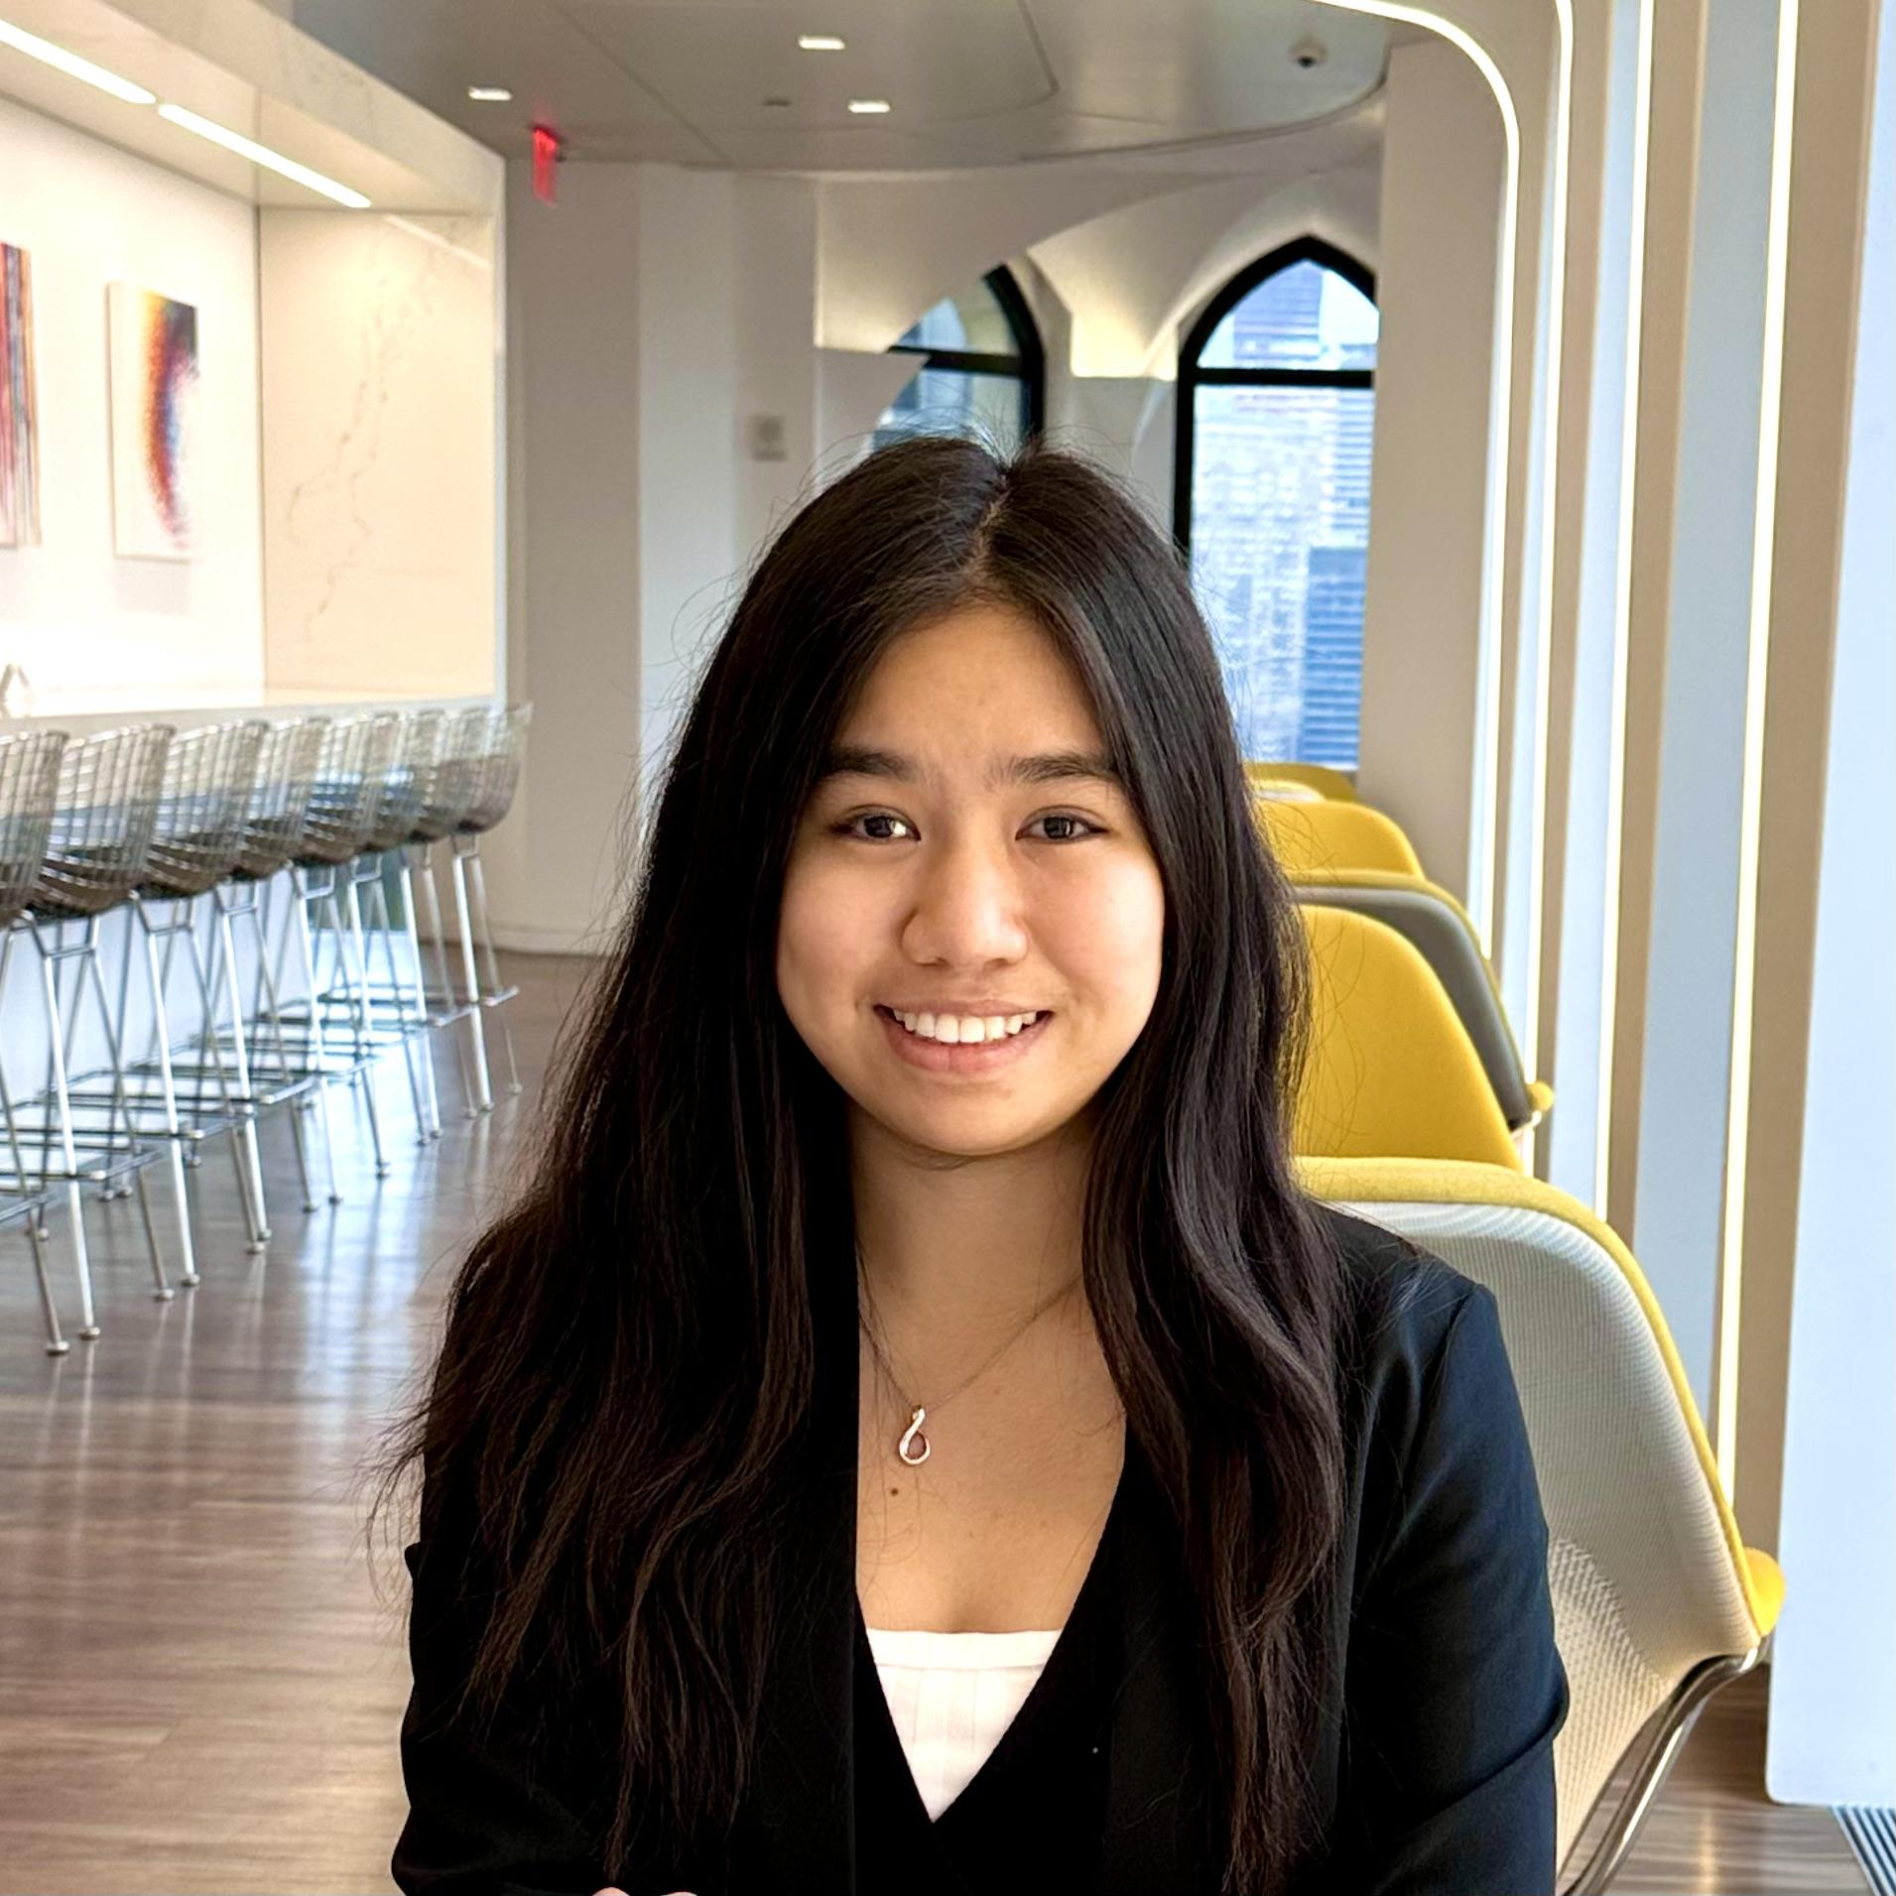
Team DiarWe
Aaron Cho
Actor
SymSys - HCI
Katie Liu
Actress
CS - HCI
Eleanor Peng
Videographer/Editor
CS - HCI
Emma Su
Videographer/Editor
Symsys - Neuro

Slide 3
1.
Why DiarWe?
Diary + You & Me
= DiarWe!

Slide 4

DiarWe
Interactive journaling to connect, share, and learn between generations
Most people have experienced generational gaps at some point in their lives. Our vision for DiarWe is to bridge that gap through daily, interactive journal entries.
Through DiarWe, we hope to turn the act of personal journaling into a shared experience between you and those you feel a generational disconnect with.

Slide 5
Problem
Intergenerational relationships are everywhere: between grandparents and grandchildren, parents and children, aunts and nieces.
Yet, miscommunication and disconnects often become prevalent due to generational differences in slang, pop culture, technology, and more.
Solution
An interactive journaling app that harnesses deeper connections, facilitates personal learning, and bridges intergenerational gaps through shared first-POV journal reflections.

Slide 6
2.
Market Research
who are our competitors?

Slide 7

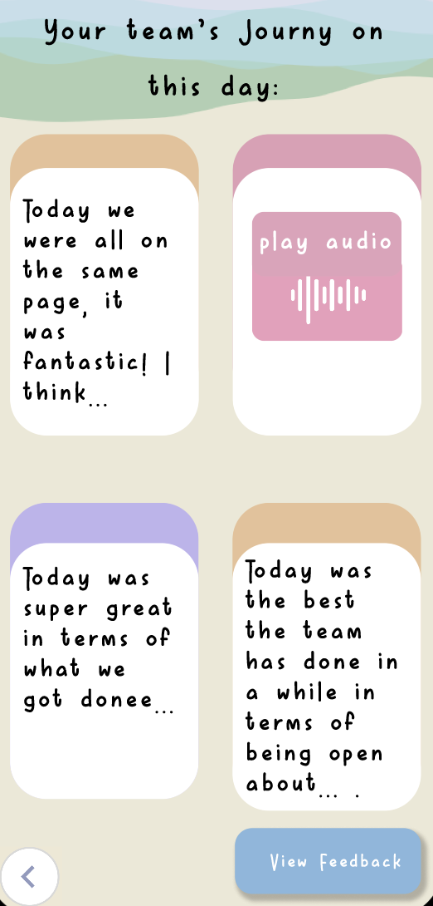
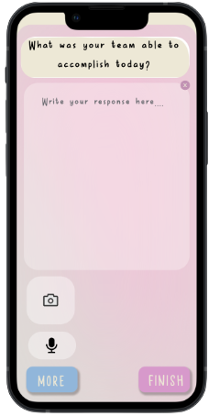
Journy
What Worked
Collaborators share daily reflections with their team via pre-generated prompts
Prompts helped users “scaffold the structure and content” of journaling
What Didn’t Work
Users expressed need for ability to join, facilitate, and navigate easily between multiple teams
Confusion surrounding task execution mentioned above due to unclear design

Slide 8
Journy
What Makes DiarWe Unique
DiarWe champions inter-user interaction, focusing on users being able to easily connect, interact with, and navigate between one another’s journal entries.
Implications
Users don’t like platforms that are hard to navigate. Especially considering DiarWe includes older generations in its target audience, we must focus on clean, simple, and accessible design

Slide 9

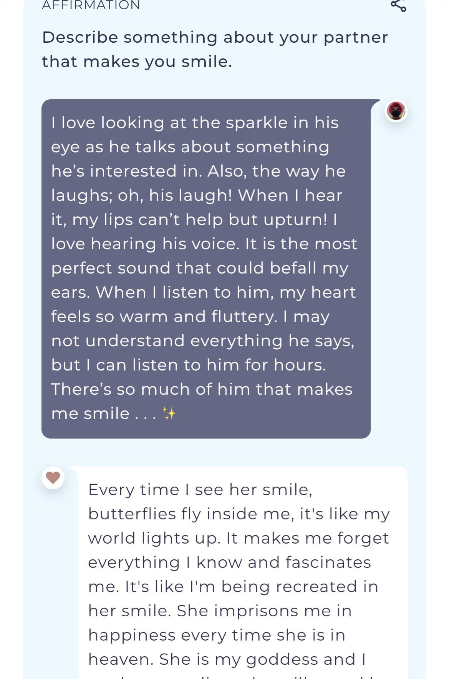
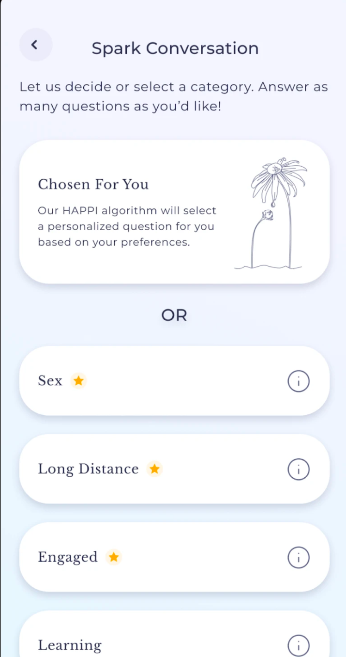
Agapé
What Worked
People in long distance relationships feel more connected with their partners when answering the app’s questions
Works well when both parties are invested into the app
What Didn’t Work
Some feel that the app sends too much notifications, which seems to frustrate users
Some features are only available to premium users

Slide 10
Agapé
What Worked
People in long distance relationships feel more connected with their partners when answering the app’s questions
Works well when both parties are invested into the app
What Didn’t Work
Some feel that the app sends too much notifications, which seems to frustrate users
Some features are only available to premium users

Slide 11
Agapé
Why DiarWe is unique
DiarWe is unique because in addition to text prompts, we leverage multimedia such as songs, pictures, videos, or even voice memos to more deeply engage parties
Implications
Need to ensure that our notifications are useful and don’t spam the users
Many users deleted Agapé for this reason

Slide 12

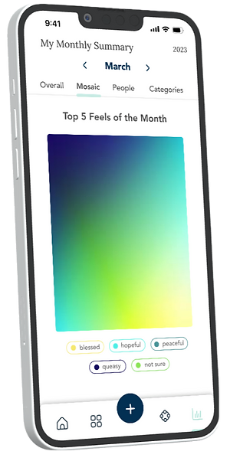
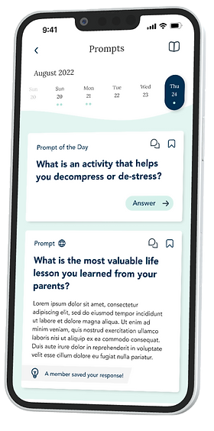
Penciv
What Worked
Social journal; users track emotions over time
Users can connect with their feelings via color and add voice + photos to share honestly with friends and loved ones (or anonymously) daily
What Didn’t Work
Users think optional prompts are quite removed from the main goal of the app: to unpack daily thoughts and current wellbeing
Users are unable to comment on other’s responses to the optional prompts

Slide 13
Penciv
What Makes DiarWe Unique
Prompts are integrated into the journaling experience to connect people via shared elements of culture and life.
More focused on learning about generations and broadening one’s worldview, not just reflecting
Implications
We must ensure that our prompts focus on bridging gaps and connecting users. We should also focus on intergenerational learning in addition to reflection

Slide 14


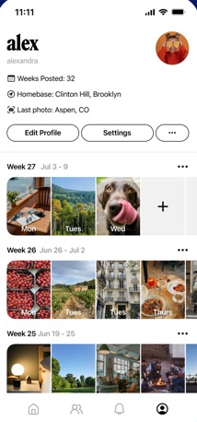
Retro - Feel Good Social
What Worked
Users feel they can be unfiltered and authentic when sharing their meaningful moments
Gives users opportunities to share freely with friends and family
What Didn’t Work
Writing features were not robust enough for description-rich photographs
Users felt that it was too similar to Instagram stories and other preexisting social media platforms

Slide 15
Retro - Feel Good Social
Why DiarWe is Unique
DiarWe allows users to share photos from both present and the past; we particularly encourage older generations to share photos from the past to help bridge the generation gap with younger generations
Implications
Users want to have a more customizable length when journaling and facilitate prompts that are niche/specific enough to drive valuable learning

Slide 16
 |  |  |  |  | DiarWe
inter-user interaction
supports 3+ multimedia
allows sharing past + present
pre-generated, dynamic journal prompts
intergenerational- focused

Slide 17
3.
Values in Design
stakeholders and ethical implications

Slide 18
Direct Stakeholders
Indirect Stakeholders
parents, teachers, students, working professionals, grandparents, grandchildren (those who commonly want to bridge generational gaps).
extended family and friends.
while they may not interact directly with the app, they are affected by the users’ increased communication & understanding thru it.

Slide 19
Ethical Implication 1:
Privacy
Ethical Implication 2:
Bad Actors
DiarWe is an social journaling platform, so privacy can be a big concern. We could lose users’ trust if their memories or journals suddenly disappeared from the database, and they no longer have access to those entries.
Bad actors could try to impersonate certain individuals and add a user’s close relatives on the platform with the intent of stalking.
Those who may be older and less tech-savvy are at greater risk of falling victim to this.
Notes:
Does this ethical implication reflect an underlying value tension? Does it point to any stakeholders you may have previously overlooked? How might you go about addressing these ethical implications in your designs?

Slide 20
Addressing:
Privacy
Addressing:
Bad Actors
We will ensure that users know exactly what data they are giving us by asking permission to whenever accessing photos or other forms of sensitive info.
DiarWe will draw from people whose contacts are in your phone and require two-step verification for each user. It will also employ blocking, reporting, and unfriending functionality to mitigate bad actors.
Notes:
Does this ethical implication reflect an underlying value tension? Does it point to any stakeholders you may have previously overlooked? How might you go about addressing these ethical implications in your designs?

Slide 21
4.
Tasks
fundamental
building blocks

Slide 22
Complex:
Being able to share + read + react to other’s journal entries
Reason:
Users feel seen + heard, knowing that the other side is listening to + appreciating their perspectives, completing the bridge
Simple:
Completing a journal entry
Reason:
This simple task opens up the users to sharing thoughts and feelings as an initial step
Moderate:
Incorporate interactive elements into the journal, such as audio, images, etc.
Reason:
Users are now able to share their stories in more immersive ways - allowing for a better learning experience on both sides

Slide 23
5.
Storyboard
ideating on our
concept video

Slide 24
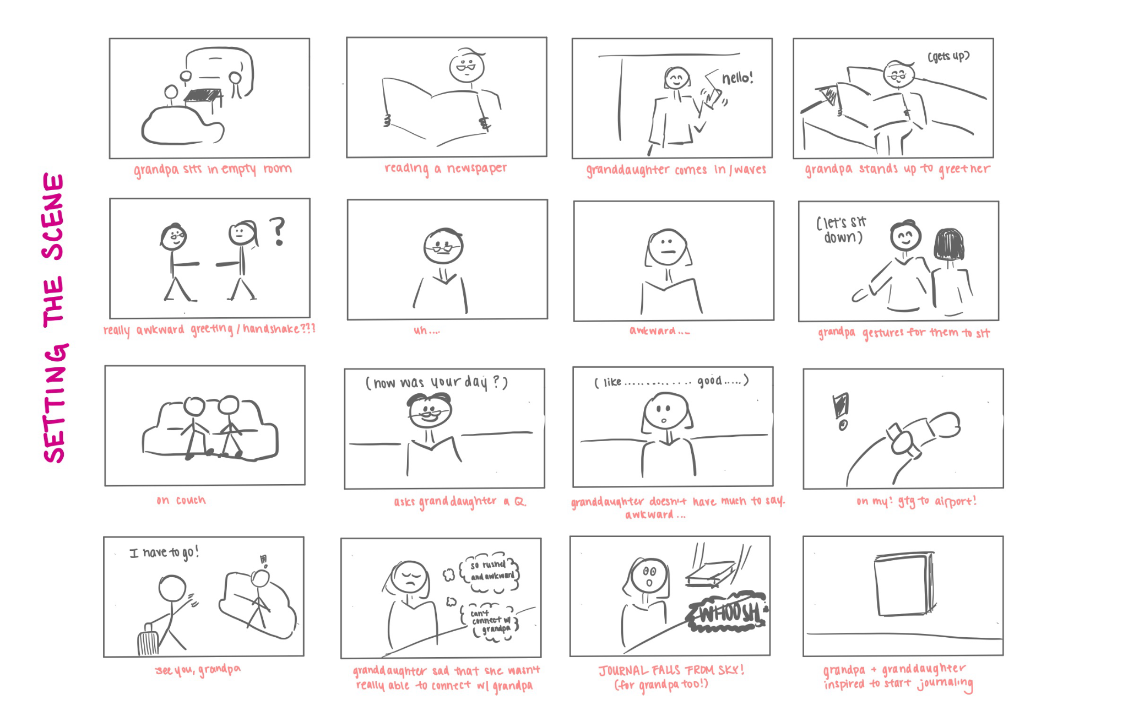

Slide 25
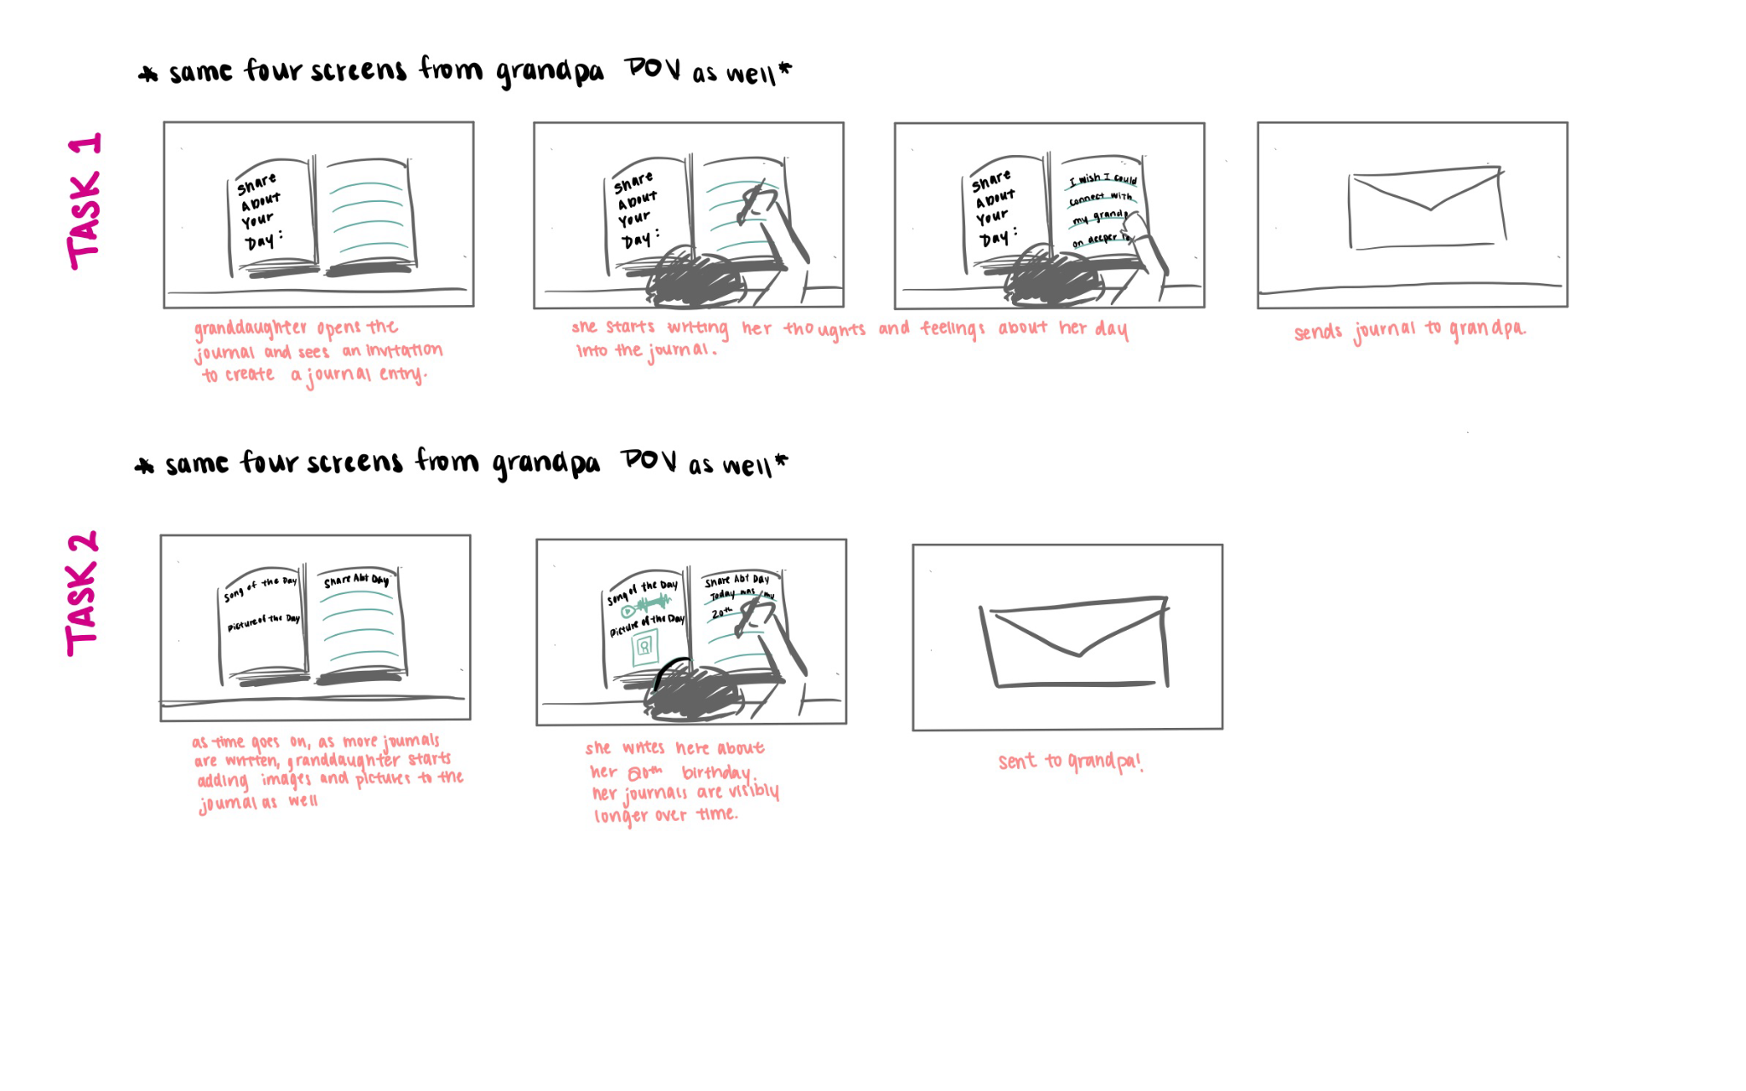

Slide 26
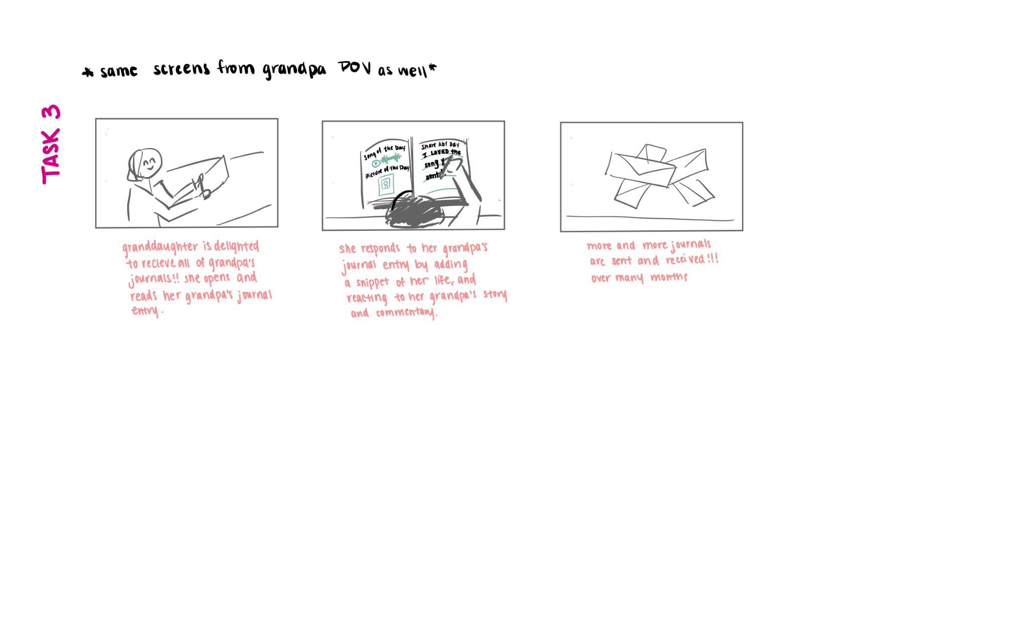
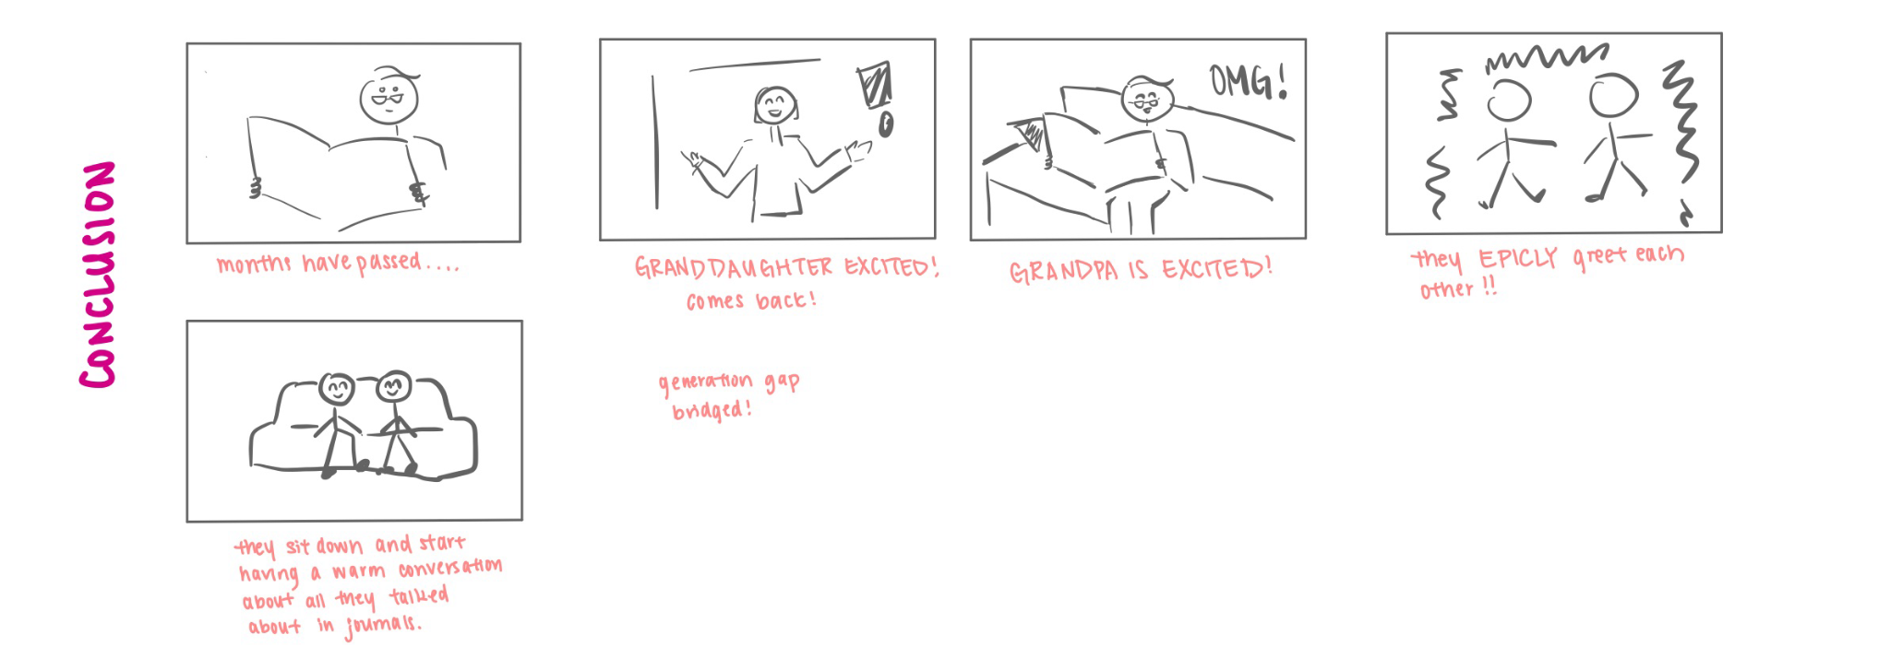

Slide 27
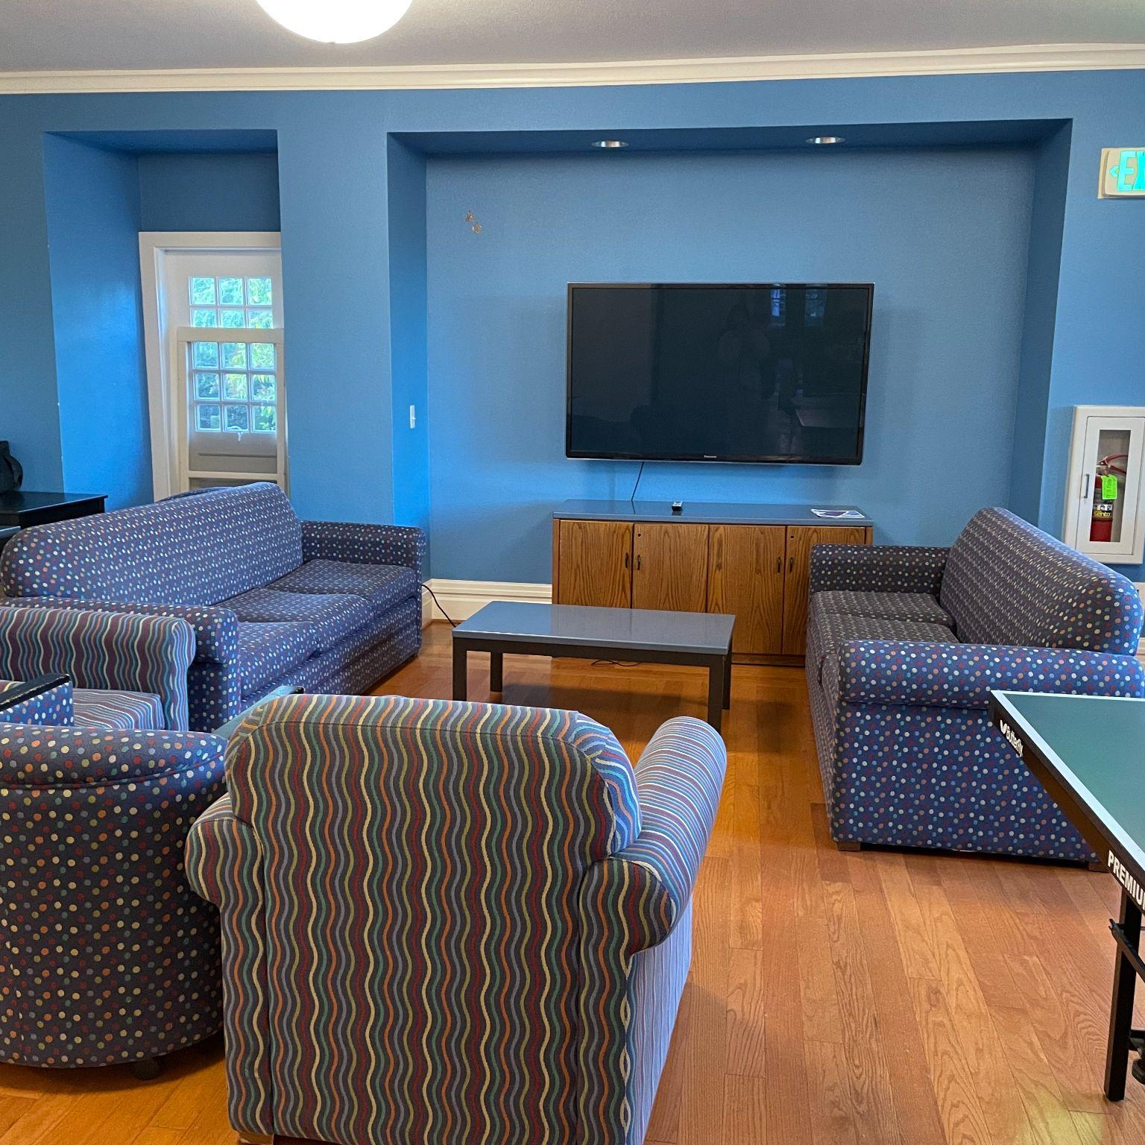
Concept Video!
Notes:
Google drive link for video: https://drive.google.com/file/d/1WxW_ChmSZ_VfJ0AICiVdsowyMXvGm8aL/view?usp=share_link

Slide 28
Thank
You!!

