Slide 1

DiarWe
Low-Fi Prototyping & Usability Testing

Slide 2




Team DiarWe
Aaron Cho
Katie Liu
Eleanor Peng
Emma Su
SymSys - HCI
CS - HCI
CS - HCI
SymSys - Neuro

Slide 3
Value Proposition
Interactive journaling to connect, share, and learn between generations.

Slide 4
Problem Solution
People are all, in some capacity, part of an intergenerational relationship in their lives. Whether it’s grandparents with grandchildren or parents with children, miscommunication and disconnects become prevalent due to generational differences in slang, pop culture, technology, and more.
To reduce these barriers, we aim to bridge these generational gaps through interactive journaling – harnessing deeper connections and facilitating personal learning experiences through first POV reflections.

Slide 5
Overview
Ideation
Prototyping
User Testing
Analysis
Concept sketches
Top 2 realizations
Selected interface
Low-fi prototype/features
Task flows
Testing methodology
Testing results
Implications
Next steps for UI changes

Slide 6
1
Sketches
Drawing Explorations

Slide 7
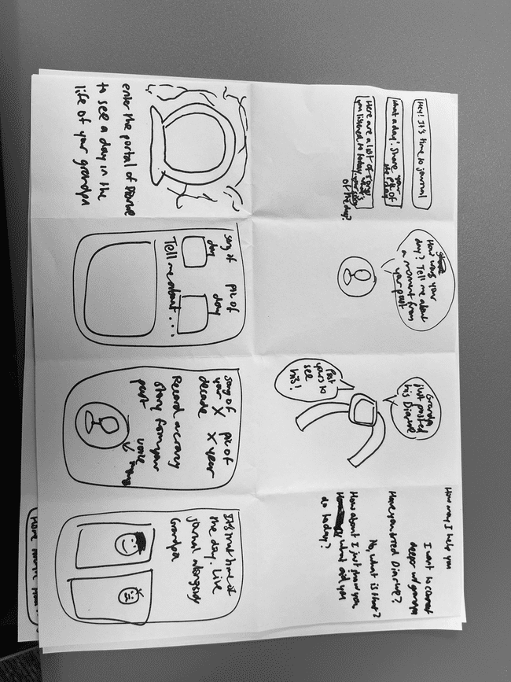
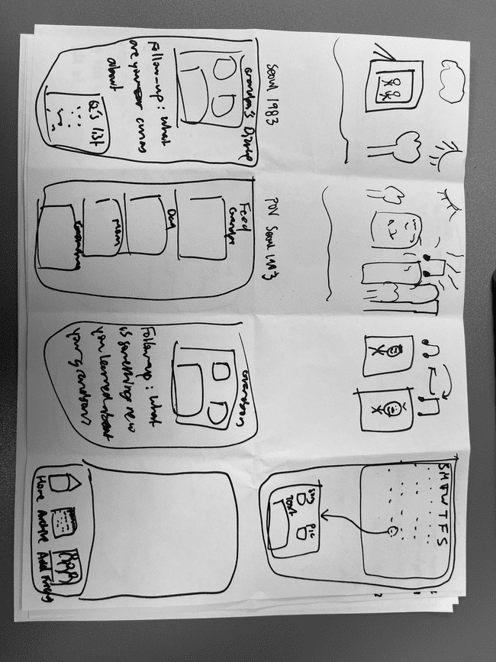
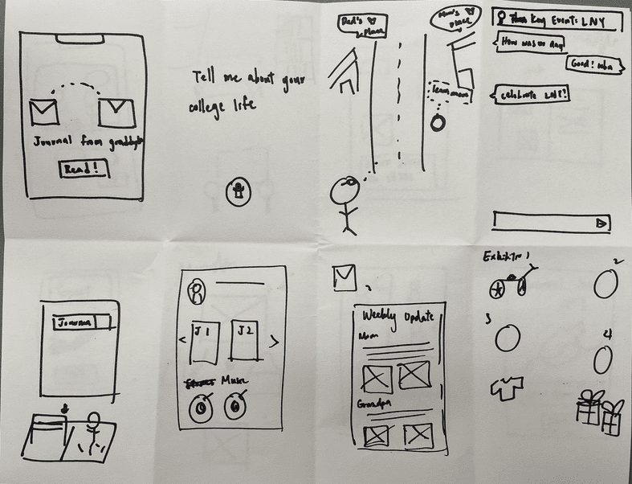
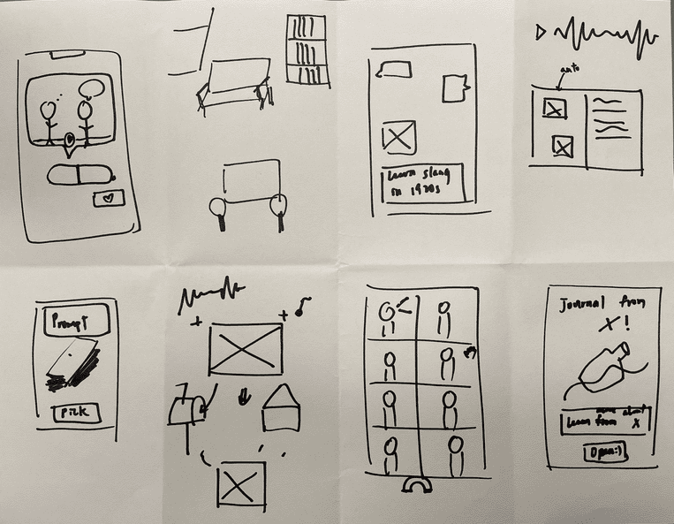

Slide 8
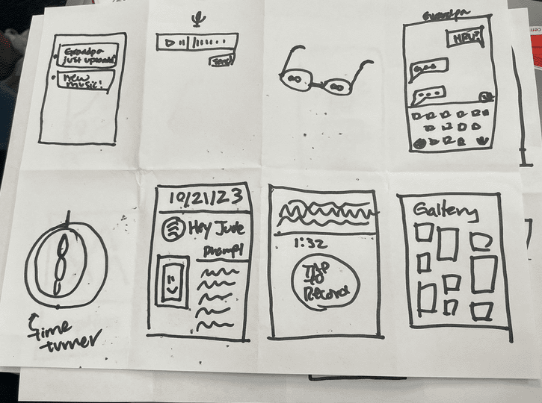
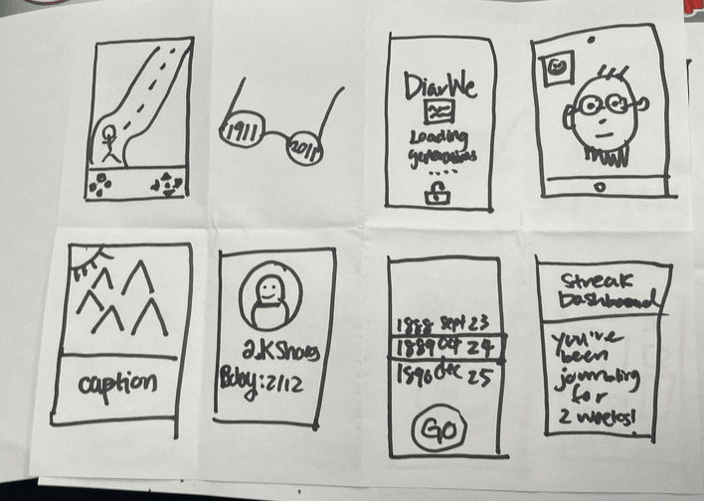
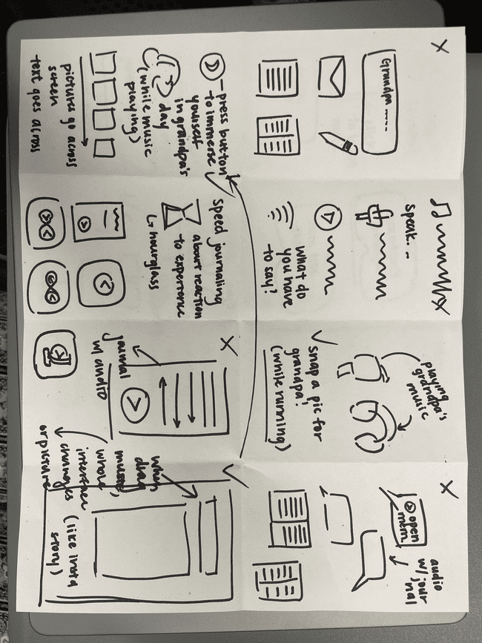

Slide 9
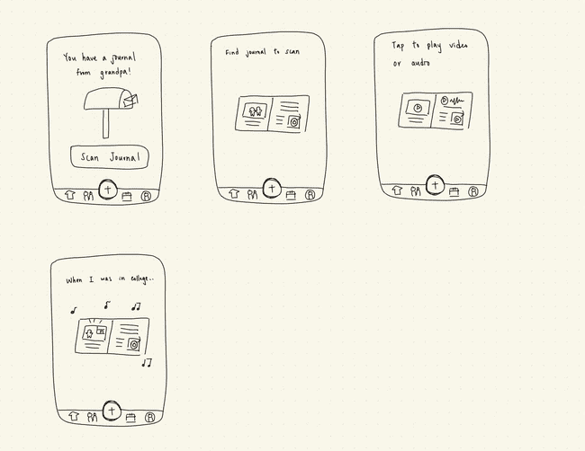
AR Realization

Slide 10
Pros
Cons
Immersive experience that taps into the user’s senses
Provides a richer user experience: leads to increased engagement and interaction
Sets DiarWe even further apart from other modern-day journaling apps
Potentially hard to navigate, especially for older generations who may not be as tech-savvy
Only accessible for users who own a physical journal/photo for digital scanning
Works against our priority of making DiarWe accessible, simple, and user-friendly for people of all generations

Slide 11
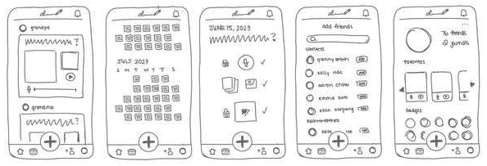
Mobile Realization

Slide 12
Pros
Cons
Simple interface
Integrates social features for inter-user experience
Implements intuitive navigation with a chronological/calendar view for archived journal entries
Requires users to know how to use a phone/tablet
Aligns with the “status quo” of common apps today
Fails to take advantage of today’s cutting-edge technology to provide an immersive experience

Slide 13
2
Selected Interface: Mobile

Slide 14
Why Mobile App?
AR is a relatively new technology that older generations may not be as familiar with
Only 3 out of 10 Americans currently use AR, while 9 out of 10 owns a smartphone
Want to prioritize the usability and ensure the accessibility of our app to our target audience
Notes:
While an AR realization of DiarWe could drive forward an immersive and unique experience to achieve intergenerational learning, it also implements a relatively new technology that older generations may not be as familiar with.
As such, our team decided to choose the mobile app realization. This is because we want to prioritize the usability and ensure the accessibility of our app, all while keeping our target audience in mind, which comprises of people across generations, young and old.
Source:
https://explodingtopics.com/blog/augmented-reality-stats
https://www.zippia.com/advice/us-smartphone-industry-statistics/#:~:text=Roughly%20307%20million%20people%20own,of%20all%20Americans%20owned%20smartphones.

Slide 15
Mobile App Realization
While an AR realization of DiarWe could drive forward an immersive and unique experience to achieve intergenerational learning, it also implements a relatively new technology that older generations may not be as familiar with.
As such, our team decided to choose the mobile app realization. This is because we want to prioritize the usability and ensure the accessibility of our app, all while keeping our target audience in mind, which comprises of people across generations, young and old.
Notes:
While an AR realization of DiarWe could drive forward an immersive and unique experience to achieve intergenerational learning, it also implements a relatively new technology that older generations may not be as familiar with.
As such, our team decided to choose the mobile app realization. This is because we want to prioritize the usability and ensure the accessibility of our app, all while keeping our target audience in mind, which comprises of people across generations, young and old.

Slide 16


Rationale
3 out of 10 Americans currently use AR
9 out of 10 Americans own a smartphone
People are much more familiar with mobile apps than AR.
Notes:
https://explodingtopics.com/blog/augmented-reality-stats
https://www.zippia.com/advice/us-smartphone-industry-statistics/#:~:text=Roughly%20307%20million%20people%20own,of%20all%20Americans%20owned%20smartphones.

Slide 17
3
Low-fi Prototype

Slide 18
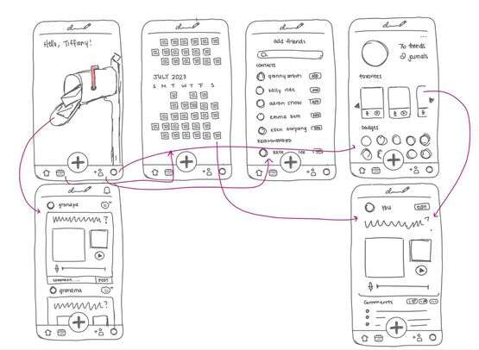
Low-fi Prototype
Notes:
Low-fi prototype

Slide 19
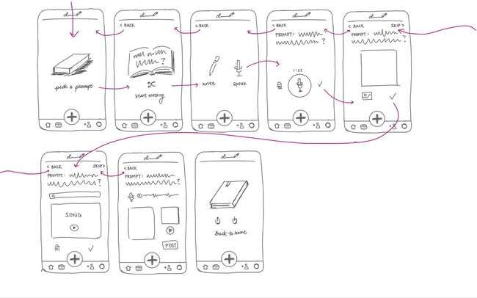
Low-fi Prototype
Notes:
Low-fi prototype

Slide 20
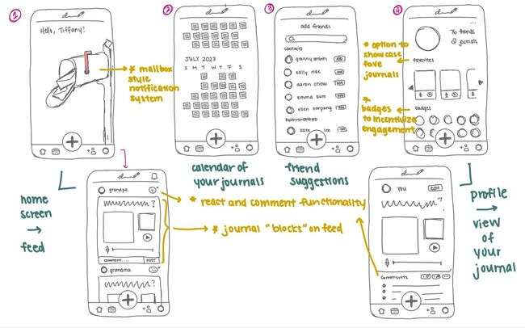
Features
Notes:
Low-fit prototype features

Slide 21
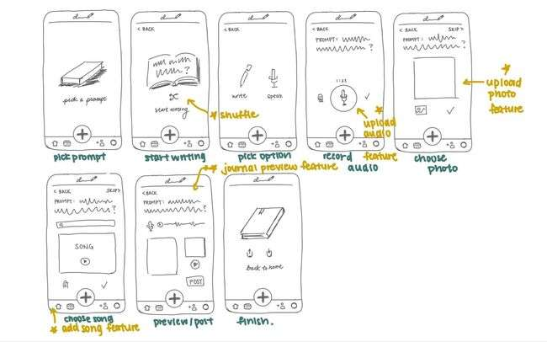
Features
Notes:
Low-fit prototype features

Slide 22
Revision after first prototype test

Slide 23
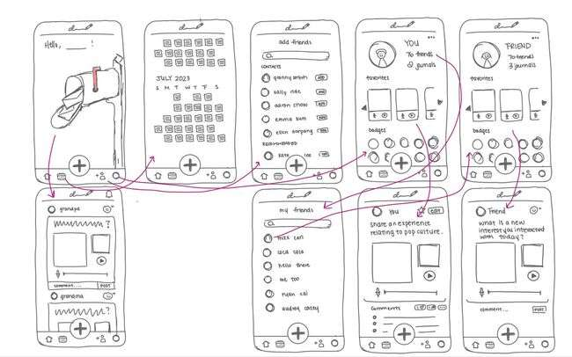
Notes:
Low-fi prototype revision

Slide 24
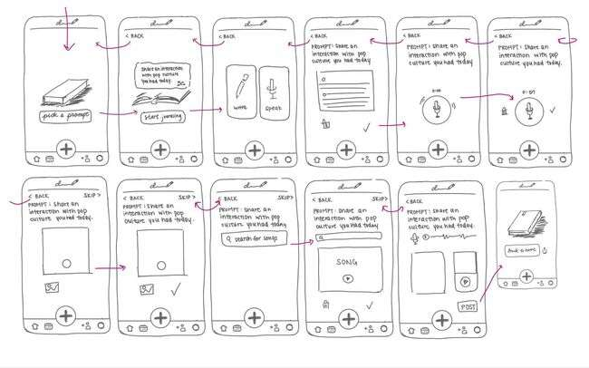
Notes:
Low-fi prototype revision

Slide 25
4
Task Flows

Slide 26
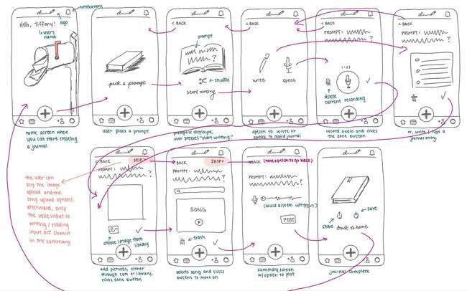
Simple: Create a journal entry consisting of only text or audio

Slide 27
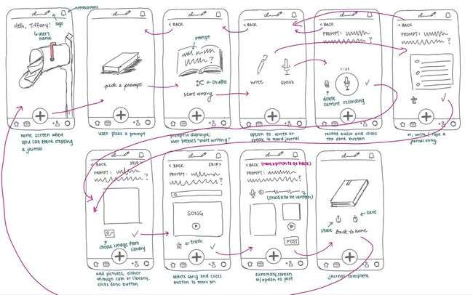
Moderate: Create a journal entry with images and songs

Slide 28
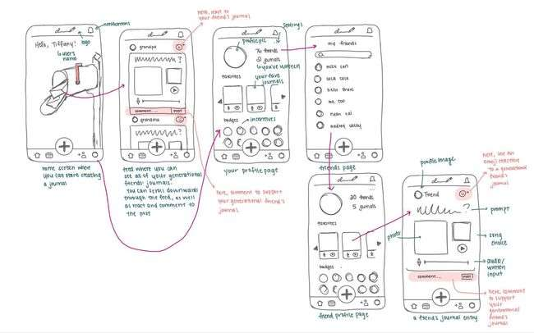
Complex: Read and react to other people’s journal entries

Slide 29
5
Testing Methodology

Slide 30




Roles
Procedure
Participants
Paper prototype, 1 page/screen
Participants pointed at icons to navigate through app/vocalized thoughts
Notetaker: Emma/Eleanor/Aaron
Computer: Katie/Emma
Facilitator: Aaron/Eleanor
DM
RL
AR
KW
Early 20s
Pre-med college grad
Compensation: meal
60+
Stanford Friends of Music
Compensation: N/A
40s
Stanford Dept. of Music
Compensation: N/A
Early 20s
Clinical psychology researcher
Compensation: meal
Notes:
How we recruited our participants:
DM was recruited through a random soccer game Aaron participated in.
Testing location: Stern Dining Hall
RL was recruited by randomly walking into the Stanford music office in passing.
Testing location: Stanford department of music office
AR was recruited by randomly walking into the Stanford music office in passing.
Testing location: Stanford department of music office
KW was recruited via a mutual of one of our first interviewees back in A1.
Testing location: Stern Dining Hall

Slide 31
Environment and Apparatus
Created Paper Prototype
Three Tasks
Participant Starts @ Home
Facilitator reads script + asks participant to complete set of three tasks
20+ different screens from our app
Computer hands participant a new screen based on button clicked

Slide 32
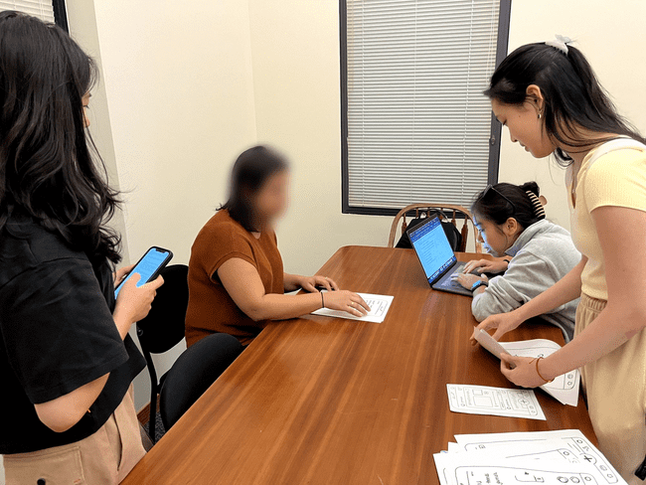
Sample Setup

Slide 33
Usability Goals
Learnable
Discoverable
Ability to remember how to navigate to certain features over time.
Ability to learn new features of our app over time.
MEASUREMENT
Timing how fast participant can successfully navigate to certain features of app.
MEASUREMENT
Counting number of main features of our app that participant successfully discovers.

Slide 34
6
Testing Results

Slide 35
Process Data
 | App goal and value are clear to the users
 | All participants were able to complete 3 tasks, but one needed more guidance compared to the others
 | Participants found the function of the mailbox on the homepage confusing
 | Task 3 was the most challenging task for all participants, while Task 1 & 2 had similar difficulty

Slide 36
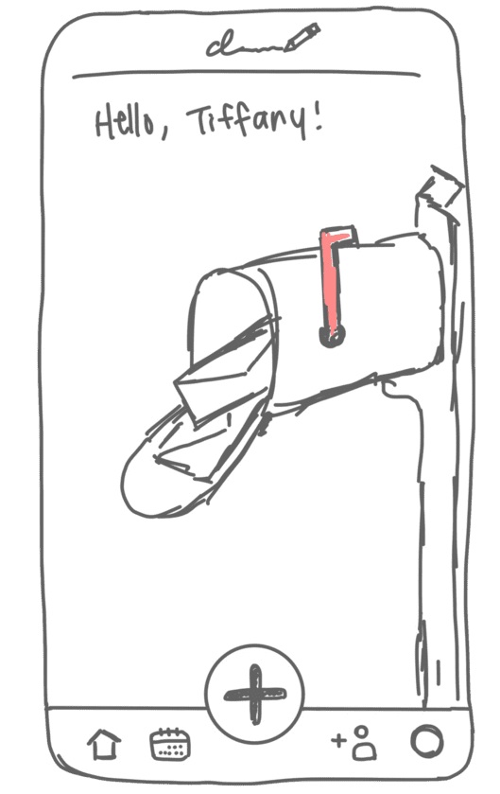
Usability Goal Measurements
Discoverable
~
3 participants were able to discover 6/6 features
1 participant was able to discover 5/6 features
DM
RL
AR
KW
Features Discovered
6 | 5 | 6 | 6

Slide 37
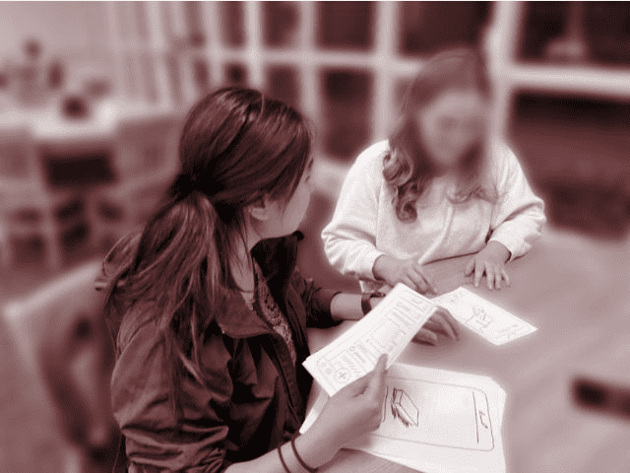
Usability Goal Measurements
Learnable
~
Participants were able to navigate through the app must faster the second time around
DM
RL
AR
KW
Task 1
1 min 42 sec | 6 min 46 sec | 1 min 53 sec | 0 min 32 sec
0 min 37 sec | 2 min 32 sec | 0 min 58 sec | 0 min 48 sec
2 min 26 sec | 8 min 13 sec | 3 min 35 sec | 0 min 18 sec
Task 2
Task 3

Slide 38
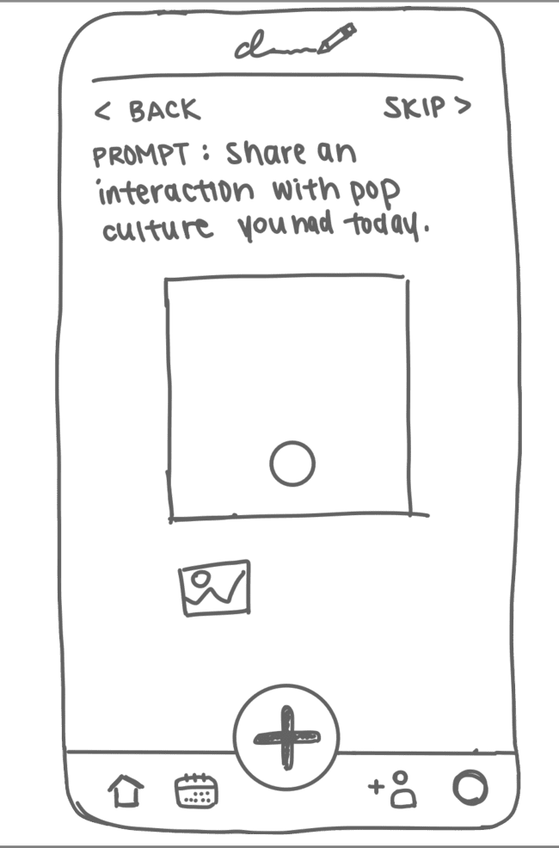
Observation: Journal Entry Creation
The + button to create journal is intuitive, but the process of creating a journal entry needs more guidance
Potential Reasons:
  Unclear as to which features are clickable
  Not enough guidance on uploading photo and songs for people who are unfamiliar with technology

Slide 39
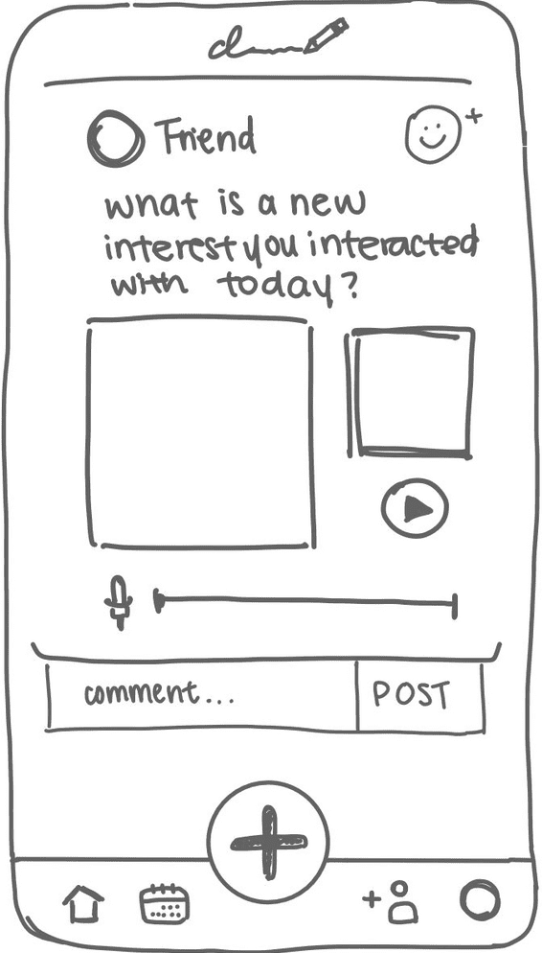
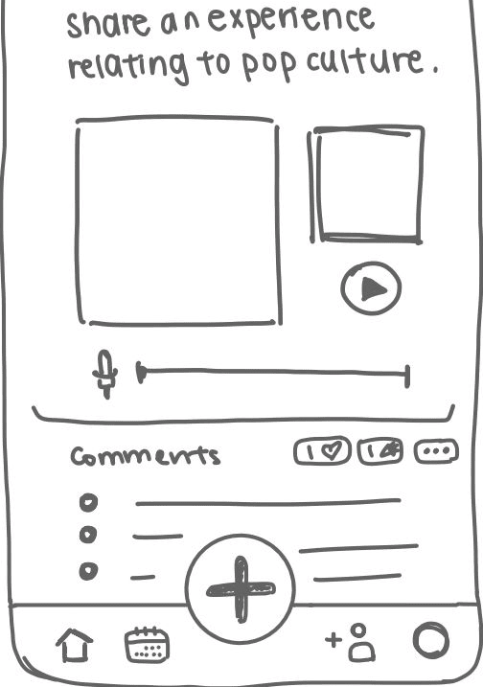
Observation: Reacting to Journals
Most participants are familiar with the reaction feature, but the navigation to the feed is unintuitive
Participants notice the number of likes immediately
Potential Reasons:
  Mailbox design on the homepage feels unconventional
  Reaction feature is similar to social media
Notes:
Implication - Number of likes might be detrimental to mental health

Slide 40
7
Analyses
Implications & Next Steps for UI Changes

Slide 41
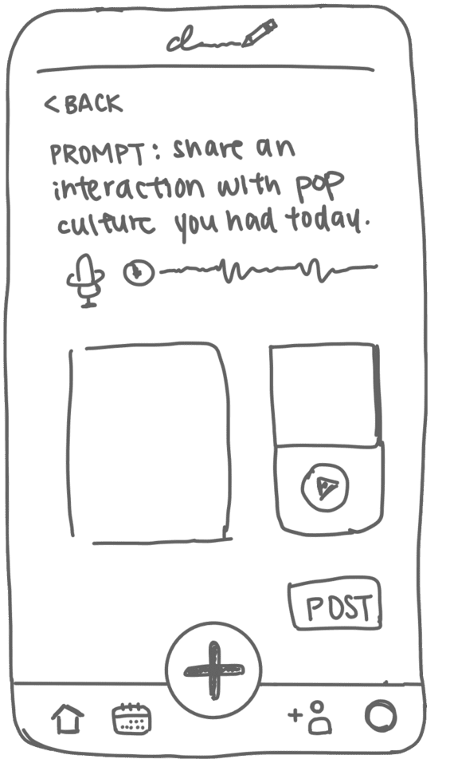
UI Change #1
Takeaway: the back button is no longer intuitive on this page.
Next Step: replace back with an edit button on the upper-right where users can alter any section before posting.
Achieve increased intuitiveness and smoother navigation.

Slide 42
UI Change #2
Takeaway: the home button confuses users and is often mistaken as an upload button.
Next Step: revise the home button illustration to clearly resemble a house.
Achieve a flawless navigation bar.

Slide 43
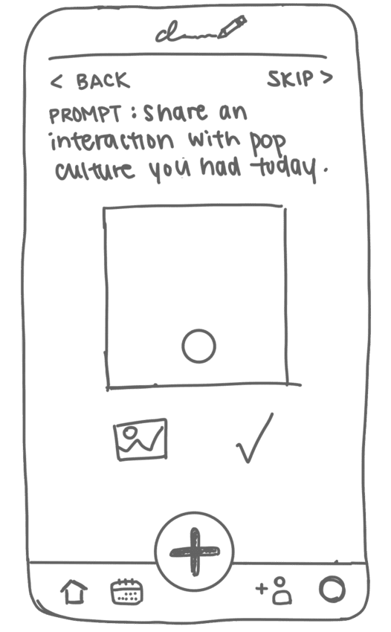
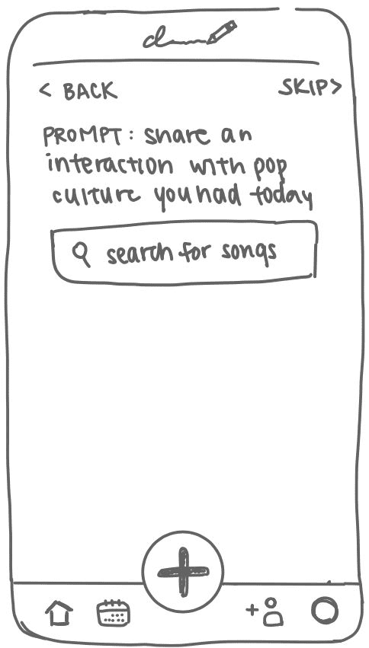
UI Change #3
Takeaway: task flow for image upload and song search/upload wasn’t always clear to users
Next Step: add clearer instructions and redesign buttons to facilitate user experience
Achieve a more intuitive approach for these moderate tasks.

Slide 44
Key Implications
Older generation’s preset dissociation from technology creates a barrier between our target user and our low-fi prototype.
Some flows are not immediately intuitive, and participants need some guidance to complete the tasks.
Need to integrate more clarity on clickable areas with more descriptive button designs
Pop-up tutorials and clear instructions could be transformative for smoother navigation

Slide 45
Our testing couldn’t reveal…
Whether color integration in the UI could have improved navigation intuitiveness
Whether our participant RL was an edge case and that their age range did not holistically demonstrate the capabilities of elder generation

Slide 46
Thank You!

Slide 47
8
Appendix

Slide 48
AR Realization
Pros
Cons
An extremely immersive experience that taps into the user’s senses
Provides a richer user experience; could lead to increased engagement and interaction
Sets DiarWe even further apart from other modern-day journaling apps
More visually engaging than a mobile app
Implements cutting-edge AI technology
Potentially hard to navigate, especially for older generations who may not be as tech-savvy
Can only be accessed when you have a physical journal/photo in front of you ready to scan
Works against our priority of making DiarWe accessible, simple, and usable to people of all generations
Difficult to engage with AR in public spaces; limits user interaction
People may not be too familiar with what AR is or how AR works
Potentially dangerous for people too distracted by the AR that they lose track of what’s happening around them in the real world

Slide 49
Mobile App Realization
Pros
Cons
Simple interface
Social component for inter-user experience
Implements easy navigation and chronological/calendar-like view for archived journal entries
Easier day-to-day use compared to AR, as users can use mobile apps wherever they are
Most people are already familiar with mobile apps
Users must know how to use a phone/tablet
Aligns with the “status quo” of common apps today in terms of realization
Fails to take advantage of today’s cutting-edge technology to contribute to an immersive experience
Not as engaging and memorable as an AR experience

Slide 50
Script
Notes:
https://docs.google.com/document/d/1r7t-47mFg2d_RcncB4Hoo0bn26E2VsGb7FS35YpuJ08/edit

Slide 51
Critical Incident Log - DM
Critical Incident | Severity
Confused by the point of the big mailbox on the home screen | 4
Confused by what the “badges” section was for on profile | 1
Confused about how there were certain blank days in the calendar | 1
“Okay so I click on this big plus button to create an entry.” | 0

Slide 52
Critical Incident Log - RL
Critical Incident | Severity
Facilitator had to provide hints throughout each task | 4
Thought the top DiarWe logo led to a ‘create journal’ page | 4
Save button was unclear for the photo upload – “The done button looks like a like button” | 2
“Okay so I just hit the play button and I can hear their recorded journal.” | 0

Slide 53
Critical Incident Log - AR
Critical Incident | Severity
Uncertain about the function of the mailbox | 4
“I’m not sure what the badge is.” | 2
“Can I edit the journal entry?” | 1
Click on the like button immediately | 0

Slide 54
Critical Incident Log - KW
Critical Incident | Severity
Thought a song’s play button was a play button for grandma’s audio recording | 1
“Oh and if I want to shuffle a prompt, I just click on this!” | 0
“I’m done writing…so i click this done button!” | 0
Understood the mailbox illustration on the home screen would lead to a feed of unread entries | 0

Slide 55
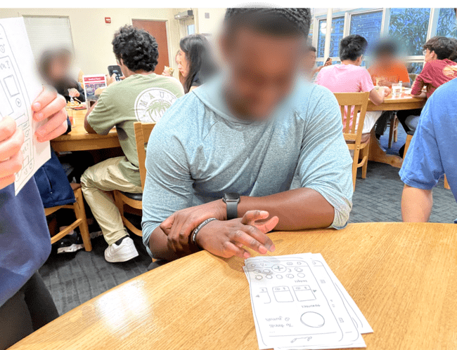
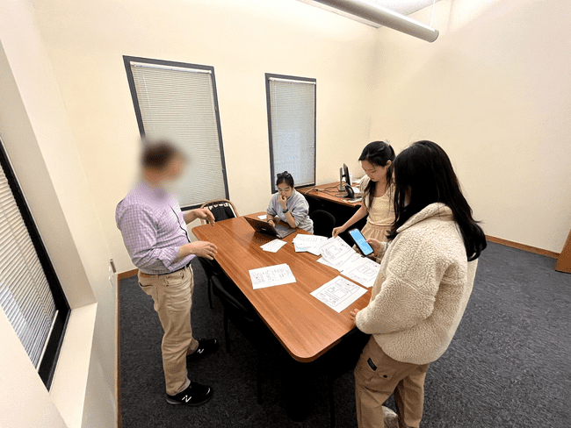
Photos
DM testing our prototype at Stern dining hall.
RL testing our prototype at Braun Music Center.

Slide 56
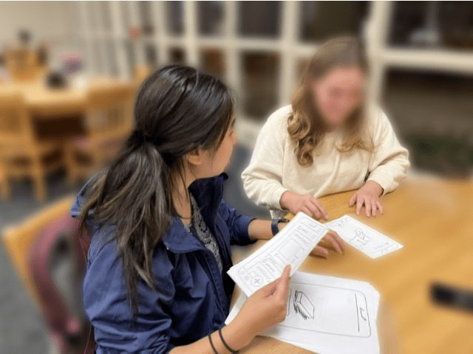
Photos
AR testing our prototype at Braun Music Center.
KW testing our prototype at Stern Dining Hall.

