Slide 1

Generations
Thru Learning
Team 1: Aaron Cho, Katie Liu, Eleanor Peng, Emma Su
Notes:
Emma’s notes:
Today I’ll be repping Team 1 to share out about our needfinding analysis in regards to our problem domain, which we’ve titled unlocking generations through learning.

Slide 2




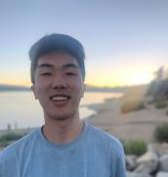
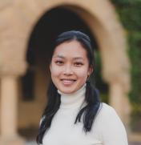


Team DiarWe
Aaron Cho
‘25
[SymSys - HCI]
Katie Liu
‘25
[CS - HCI]
Eleanor Peng
‘25
[CS - HCI]
Emma Su
‘25
[SymSys - Neuro]

Slide 3

Problem Domain
01.
Unlocking Generations through Learning.
Notes:
Emma’s notes:
As mentioned, our problem domain is unlocking generations through learning. So…what does that mean and how did we choose this domain?

Slide 4

The Generation [ ] Gap
Generation gaps are common, especially in families.
Slang, media, technology, pop culture, etc. change with time;
Inter-generational differences challenging to understand or adopt.
Results in communication barriers and disconnects.
Notes:
We chose this problem domain because…
Generation gaps is something that almost everyone experiences, especially amongst a family.
New generations come with different sets of slang/language that are hard to transfer over to older generations, creating communication barriers.
When time-based generations are made, there can be quite a disconnect between generations.
Emma’s notes:
After brainstorming a bunch of domains, our team really wanted to settle on a topic that is relatable, universal, and accessible to all age groups. A concept that ended up really resonating is that, when thinking about a family, there’s usually 2-3 generations existing in the same moment. Generation gaps are common, especially in families, and with the progression of time comes changes with slang, media, technology, pop culture, etc. We wanted to explore whether or not people are really experiencing different challenges and communication barriers in relation to intergenerational connections – how can we resolve potential disconnects through learning about (and other words, unlocking) past and present generations?

Slide 5
Methodology & Analysis
02.
Gathering observations and insights via 3 interviews.

Slide 6




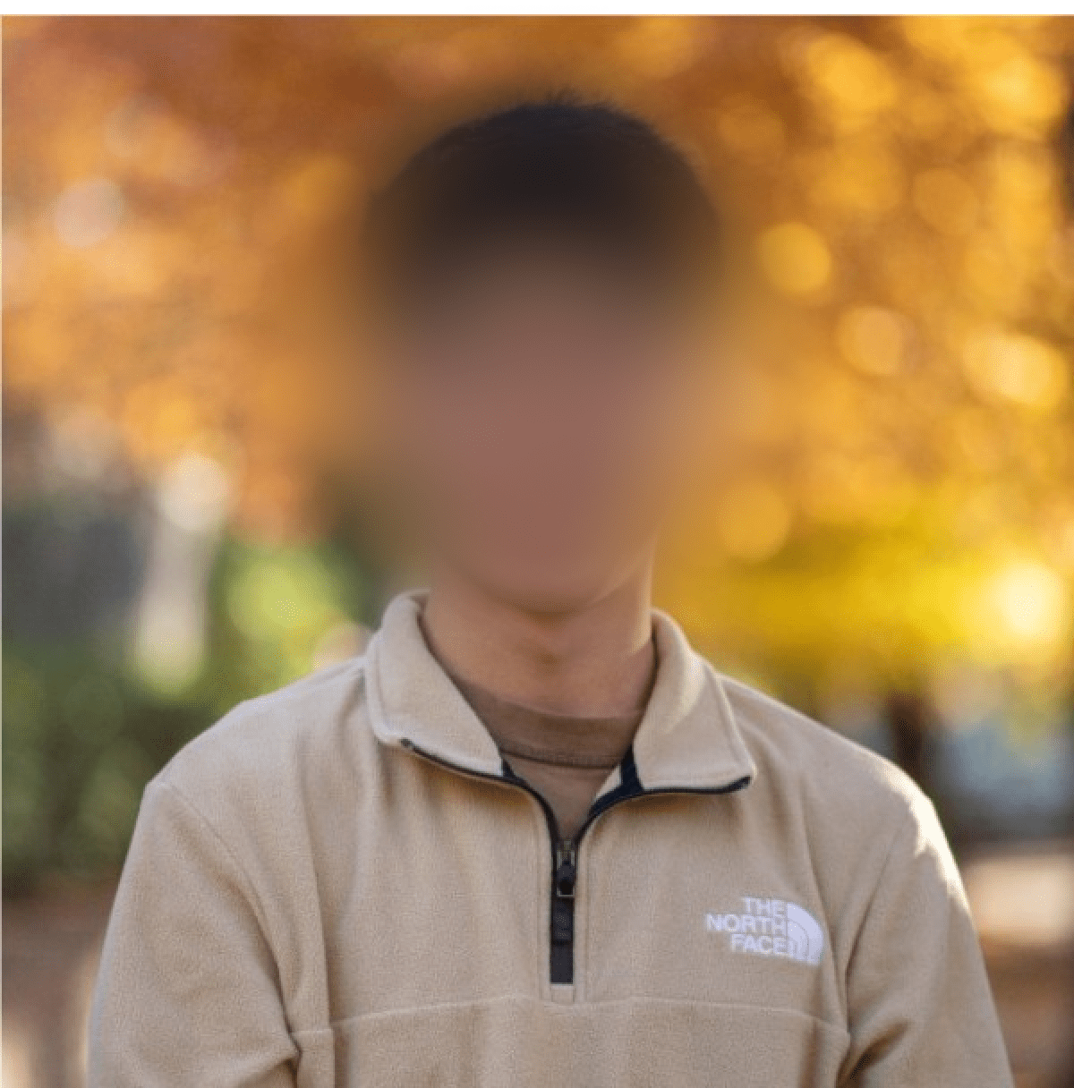
Participants
BF
KC
TG
  Professional musician,
  teacher at Julliard and Rutgers
CS coterm at Stanford ‘24, originally from Taipei
  PGM Intern at Tesla,
  M.S. Seattle University ‘24
Notes:
Why were they chosen? / Why are they appropriate?
BF (our extreme user) was chosen because he’s around 60 years old, has no grandchildren, interacts with younger cohorts of students in a teacher-student dynamic on a daily basis.
KC (our average user) was chosen because she has rich cultural background and a curiosity to learn more about her grandpa’s history.
TG (our non user) was chosen because he’s not a Stanford student and ….
How were they recruited?
We reached BG via a mutual’s flute teacher.
We reached KC via an acquaintance in the same cultural club at Stanford.
We reached TG via a Christian fellowship.
Compensation: TG was compensated with a free dinner at Stanford Dining; BF and KC were completely voluntary and required no compensation.
Group member roles in each interview:
BF: Eleanor (interviewer), Emma (notetaker)
KC: Emma (interviewer), Aaron (notetaker)
TG: Aaron (interviewer), Katie (notetaker)
Emma’s notes:
BF is ~60, has no children or grandchildren, interacts w/ diff age cohorts via musical teaching, considered as extreme user
KC is a Stanford coterm originally from Taipei, has a rich language background to better connect with grandparents, considered as an average user
TG is a non-Stanford student and intern at Tesla, he has very strong existing connections with his grandma, gave us insight about the shared values that helped them create that bond and learn/practice their beliefs together, considered as a non-user

Slide 7
What we asked
  Could you walk me through a time you interacted with someone from a different generation?
Tell me about a time you felt connected between you and someone from another generation or culture?
Tell me about a time you felt a disconnect between you and a younger/older generation?
Tell me about a time when you felt that a person from a different generation could not understand where you were coming from.
What aspects of your culture/heritage are you curious about?
Notes:
While this slide captures the main questions we asked during our interviews, we also improvised a lot via follow-up questions and geared it towards which direction the conversation was going.
For example, in the second half of BF’s interview, we asked “how did you feel the disconnect between you and your students was impacted during the pandemic?”
Emma’s notes:
Here are the five main questions we structured our interviews around. Obviously there were a lot of improvisation involved, and it all depended which direction the conversation was headed.
We purposefully tried to phrase our questions to prompt anecdotal responses, such as ‘could you walk me through a time you interacted with someone from a different generation” or “tell me about a time when you felt that a person from a different generation could not understand where you were coming from”

Slide 8
“Wish younger students could spend time to understand past references.”
BF
Zoom Interview by Eleanor Peng &
Emma Su
Notes:
This interview was conducted and recorded via Zoom. A laptop was used for notetaking.
Primary interviewer: Eleanor
Primary notetaker: Emma
Emma’s notes:
So to start diving in further into the insights we gathered from each participant, I’d like to start with our interview with BFt.
Something he said that stood out to us_____

Slide 9
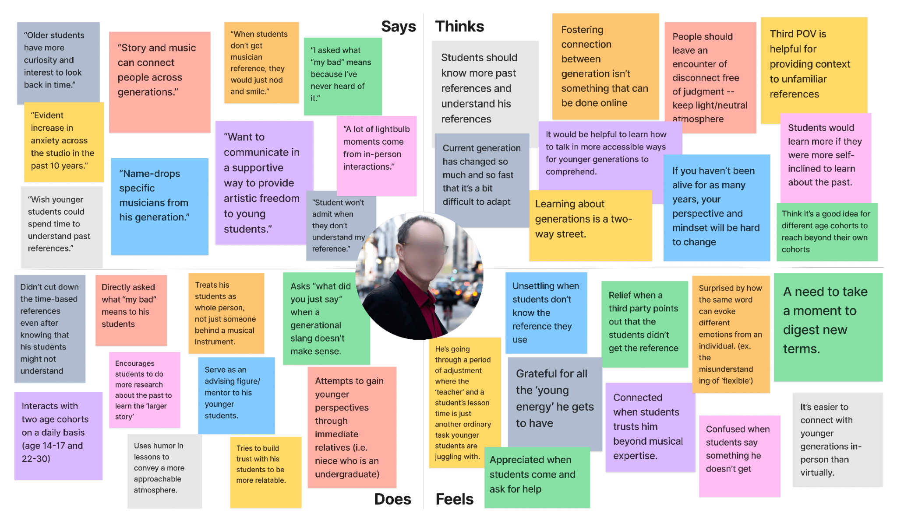

Slide 10
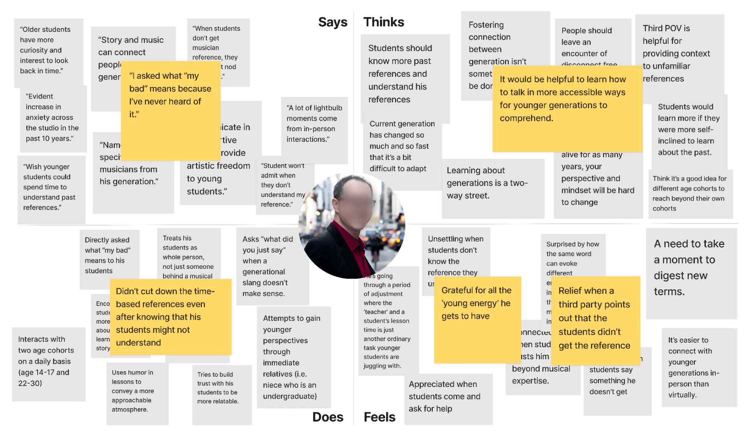

Slide 11
Intergenerational learning is a two-way street that stems from authentic interest.
INSIGHT
NEED
People need engaging methods to learn about the past and present.
Notes:
Insight: Intergenerational learning is a two-way street that stems from authentic interest.
Need: People need engaging methods to learn about the past and present.

Slide 12
“I wish I could understand more of what [my grandpa’s] environment was like when he was growing up.”
KC
In-person interview at Lathrop by Emma Su & Aaron Cho
Notes:
This interview was in-person and conducted at Lathrop. A phone was used to record and a laptop was used for notetaking.
Primary interviewer: Emma
Primary notetaker: Aaron
Emma’s notes:
Next, I’d like to share out about KC’s interview.
A quote that stood out to us for her was_____

Slide 13
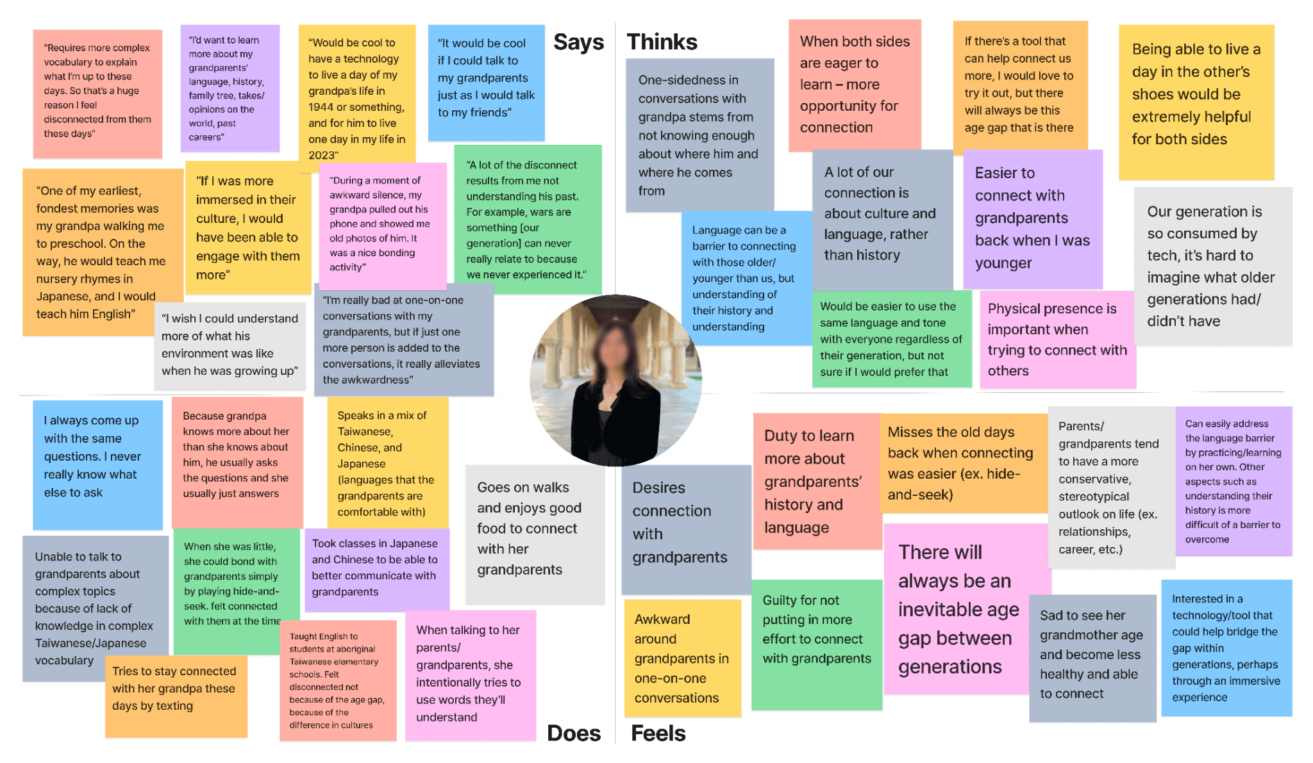

Slide 14
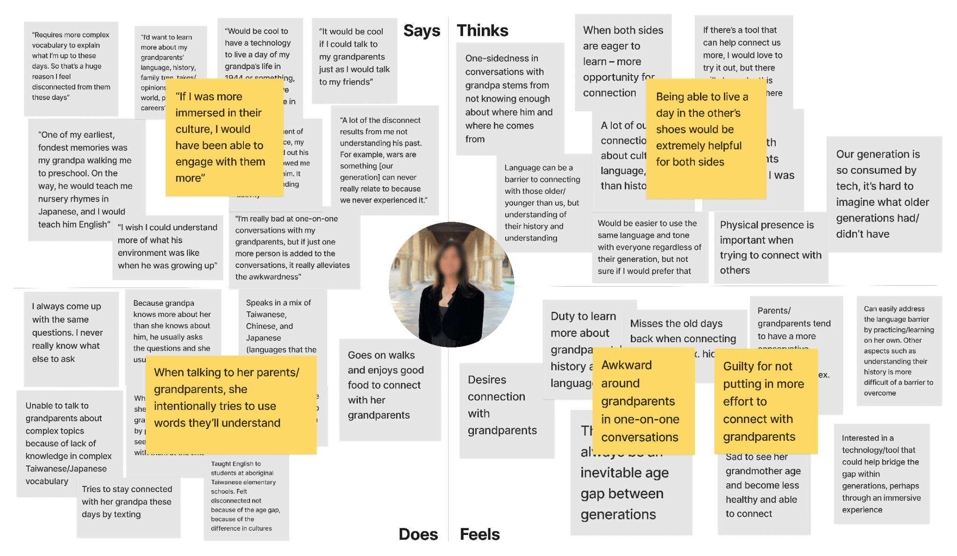
Notes:
Emma’s notes:
Says: “If i was more immersed their culture I would have been able to engage with them more.”
Thinks: being able to live a day in other’s shoes
Does: when talk to parents/granndparents, she intentionally uses words they’ll understand – actively avoids terms/slang typically used with her friends
Feels: awkward with older gens one-on-one; guilty not connecting more frequently

Slide 15
Generational disconnection arises from a deficiency in historical awareness.
INSIGHT
NEED
Individuals require a deeper grasp of the historical and cultural background of their predecessors.
Notes:
Insight: Intergenerational learning is a two-way street that stems from authentic interest.
Need: People need engaging methods to learn about the past and present.

Slide 16
“When [my grandma] became Christian, it became a lot easier to talk to her about things like Bible studies and fellowships.”
TG
In-person interview at Wilbur by Aaron Cho & Katie Liu
Notes:
This interview was in-person and conducted at Wilbur.
Primary interviewer: Aaron
Primary notetaker: Katie

Slide 17
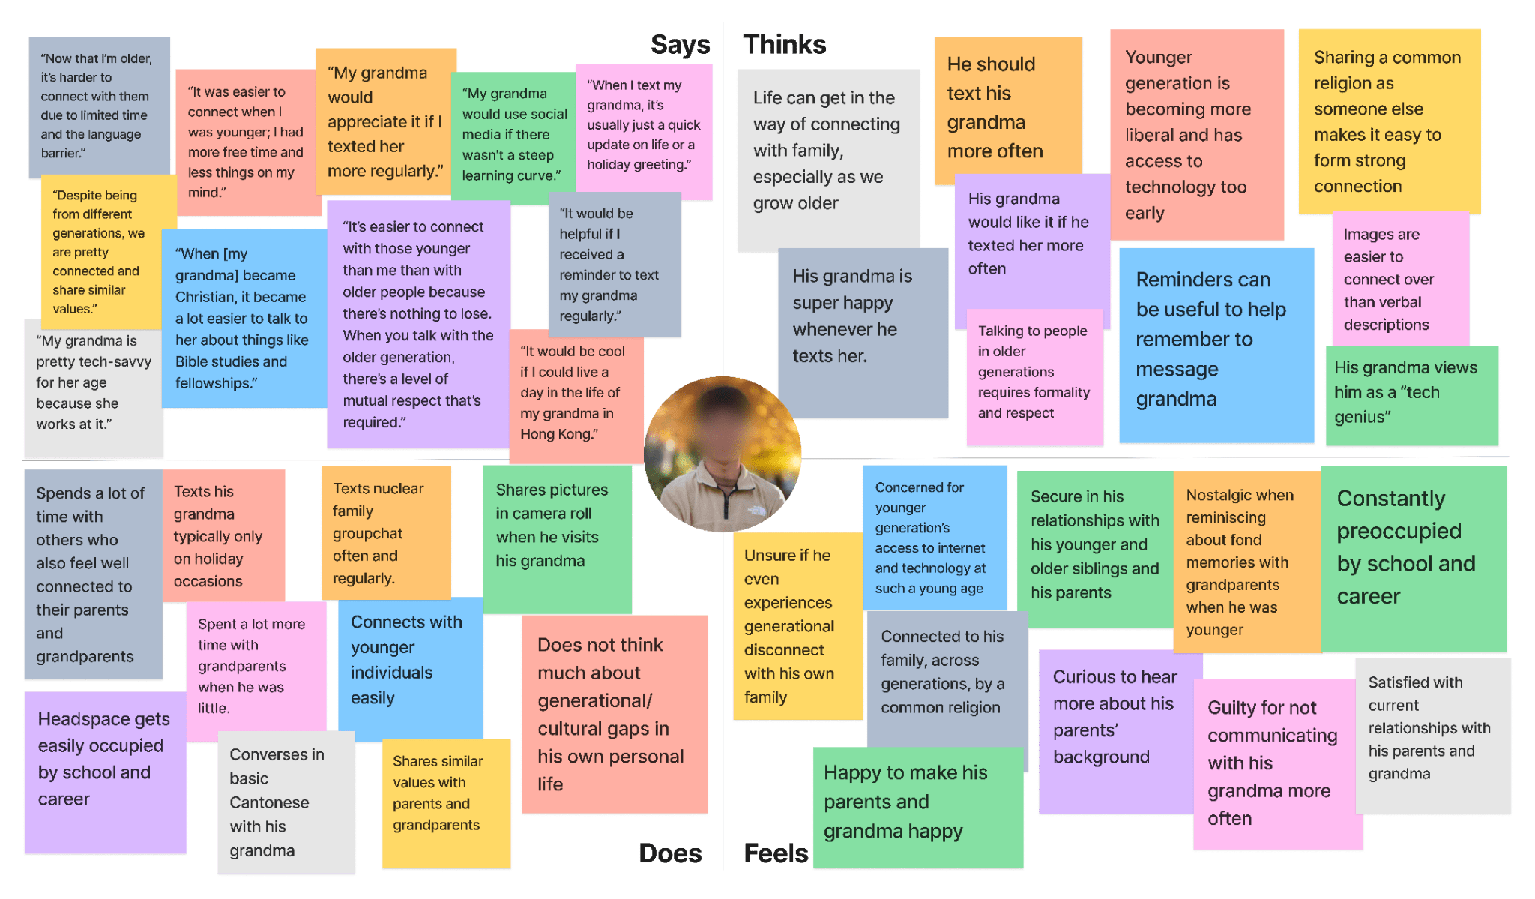
Notes:
Emma’s notes:
Says:
Thinks:
Does:
Feels:

Slide 18
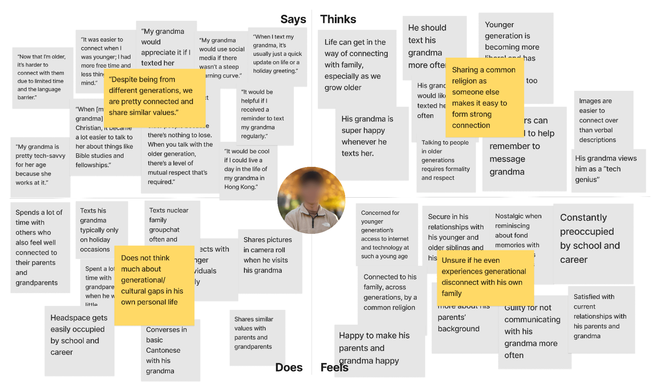

Slide 19
Mutual understanding of religion, values, and/or culture can strengthen intergenerational connection, despite age gaps.
INSIGHT
NEED
N/A. TG can be considered as a “non-user”.
Notes:
Insight: Intergenerational learning is a two-way street that stems from authentic interest.
Need: People need engaging methods to learn about the past and present.

Slide 20
03.
Summary

Slide 21
Key Learnings
Immersive learning experiences (i.e. ‘day in the life’) has the potential to bridge generations.
Storytelling through visual mediums feel more meaningful than oral/written storytelling.
A shared spark (i.e. music, religion, etc) fuels genuine curiosity and desire for mutual learning.
Notes:
We chose this problem domain because…
Generation gaps is something that almost everyone experiences, especially amongst a family.
New generations come with different sets of slang/language that are hard to transfer over to older generations, creating communication barriers.
When time-based generations are made, there can be quite a disconnect between generations.

Slide 22
Next Steps
Expand interviewee demographics
Continue to narrow problem domain
Craft POVs and HMWs
Brainstorm preliminary solutions
Experience prototyping

Slide 23

THANK
YOU!
We hope you
enjoyed our presentation!

Slide 24
Appendix

Slide 25
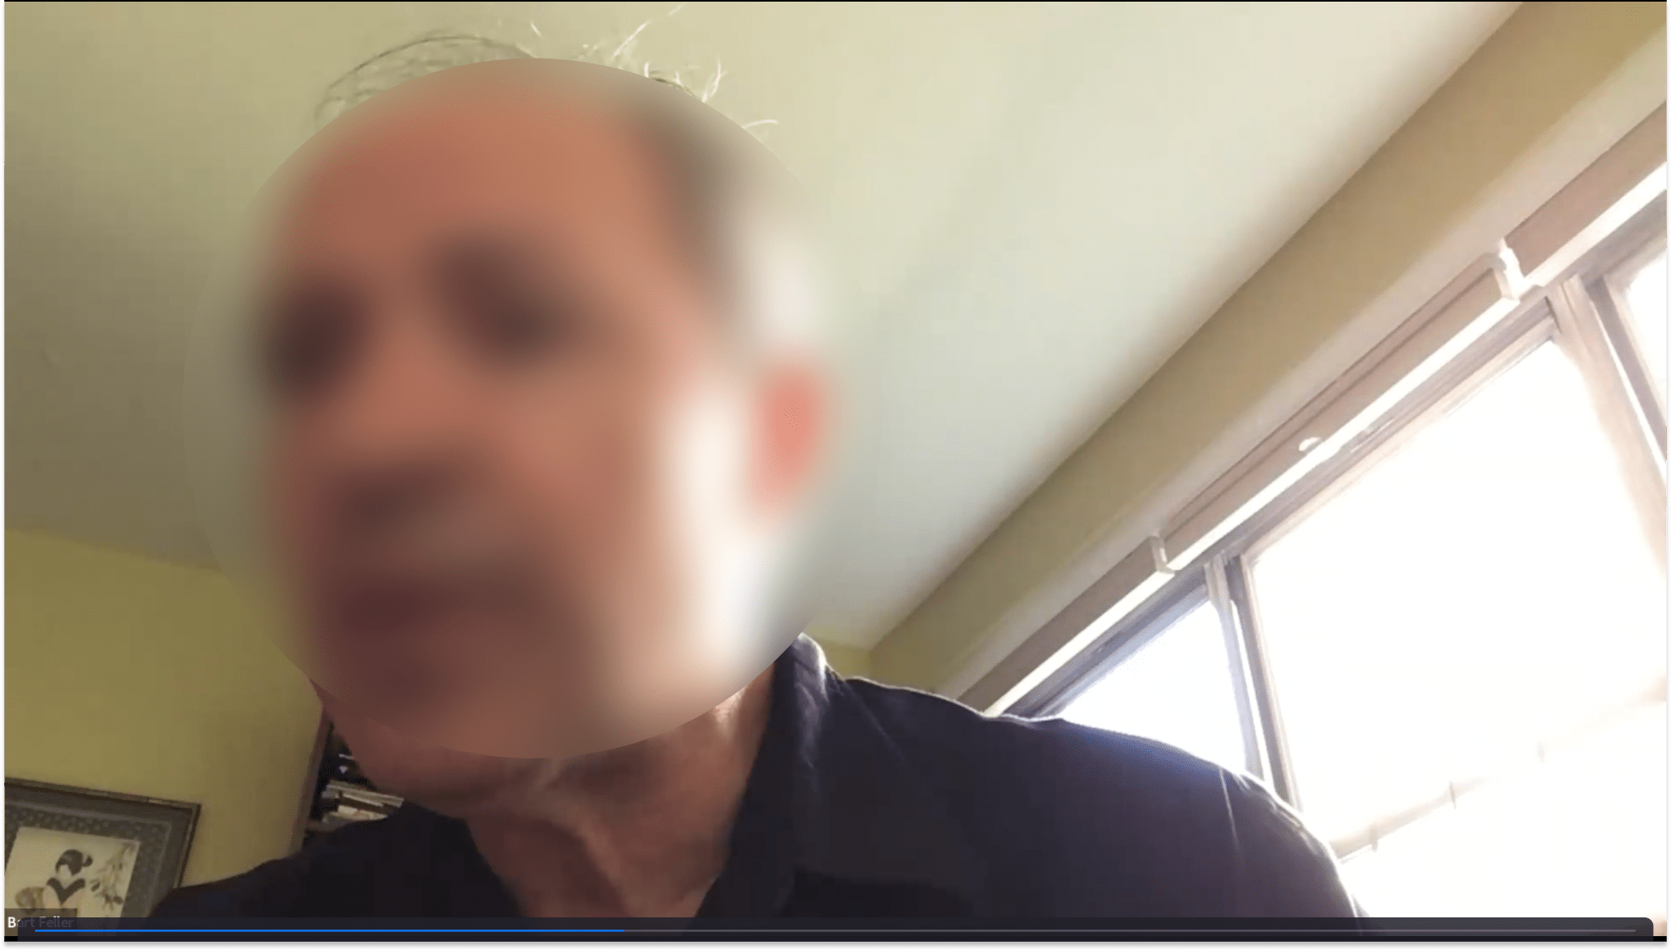
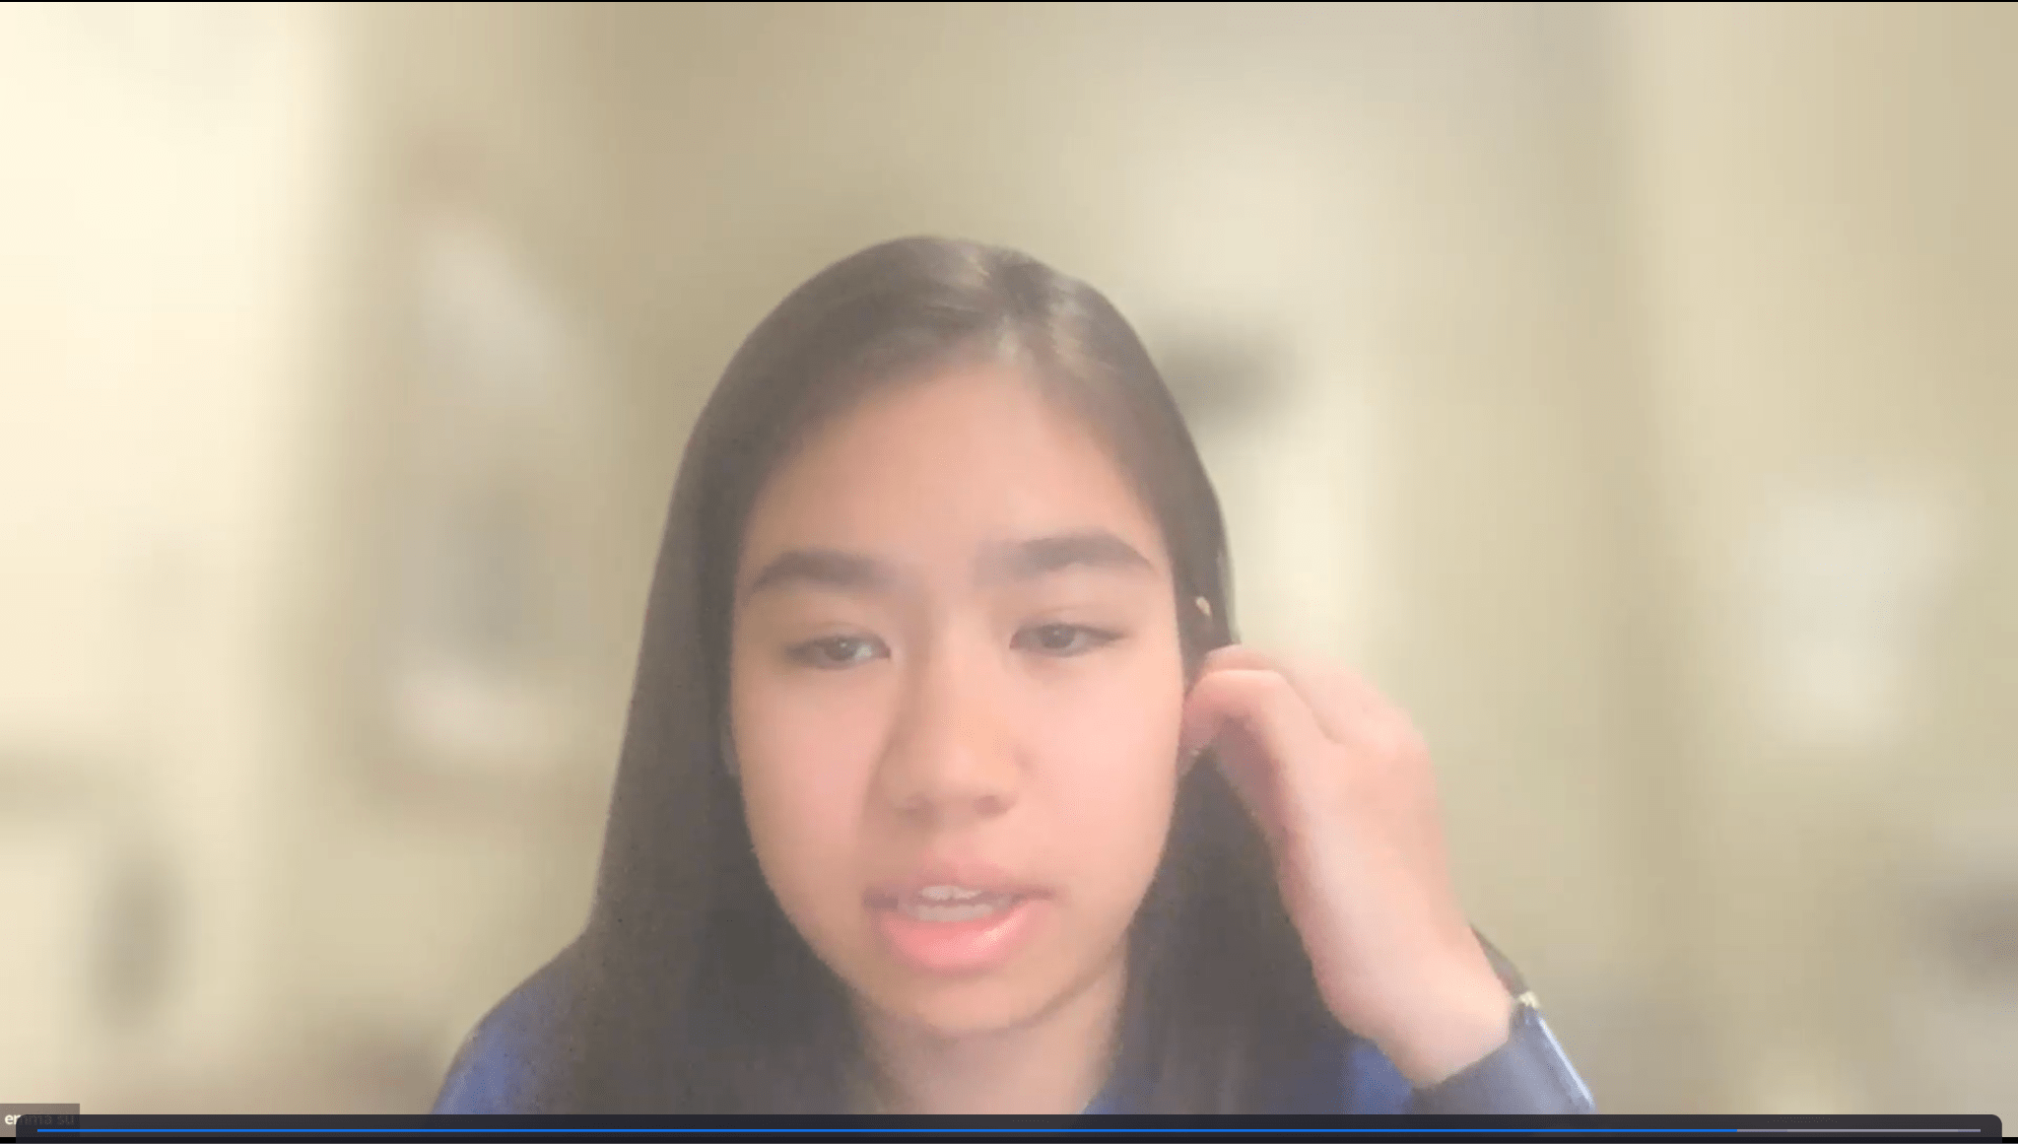
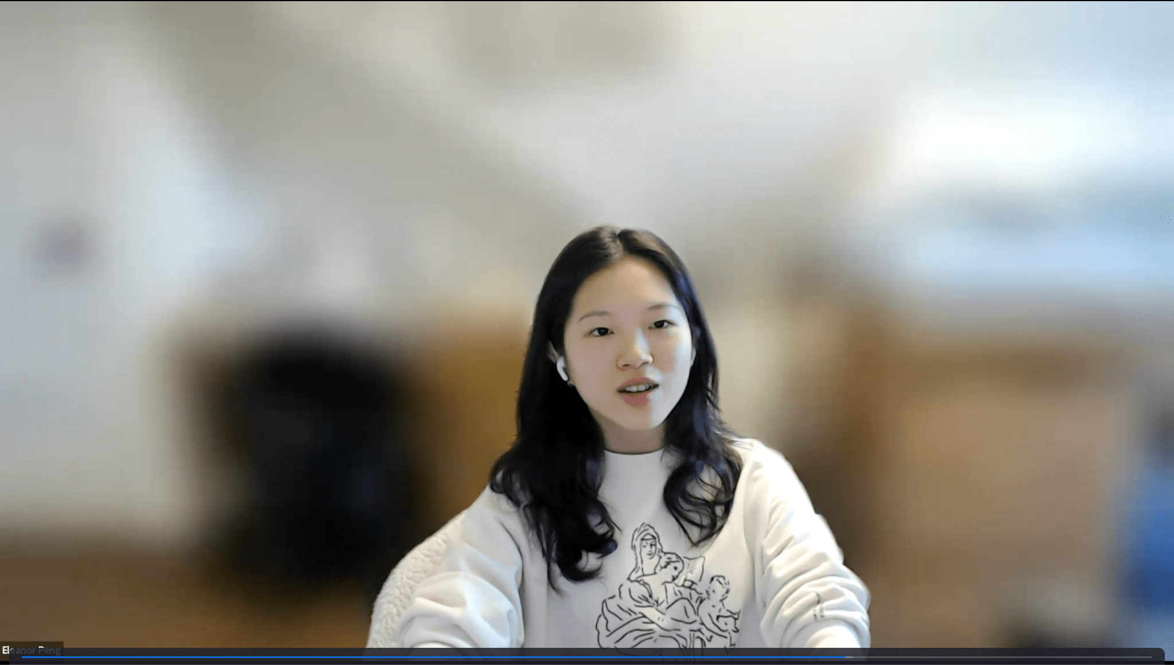
Interviewing with BF feat. Emma and Eleanor
Notes:
Photo artifacts from BF’s Zoom interview

Slide 26

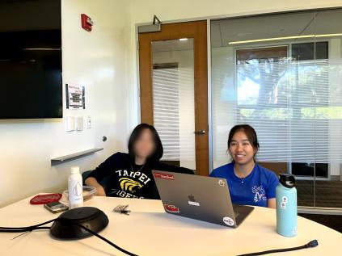
Interviewing
with KC
feat. Emma and Aaron
…THE END!!
Notes:
Photo artifacts from interviews

Slide 27
POV Template
We met…
BF, who is a 60-year-old teacher who interacts with multiple generations regularly.
We were surprised to realize…
He continues to make time-based references even when his students don’t understand them.
We wonder if this means…
He thinks time-based references can help with sparking curiosity to learn more about the past and interact with meaningful elements of earlier generations.
It would be game-changing to…
Have immersive ways to make learning/story-telling about the past more interesting, accessible, and dynamic.
Notes:
Walk through each part of the POV statement.

