Slide 1

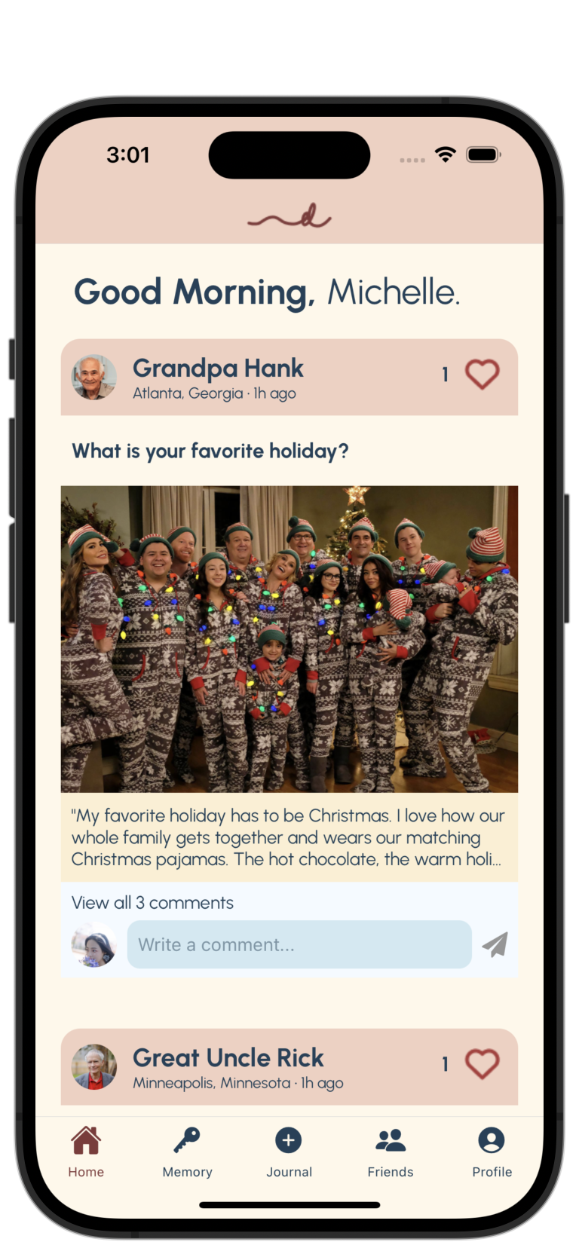

DiarWe
bridging generations through interactive journaling
Notes:
Eleanor’s Idea

