Slide 1

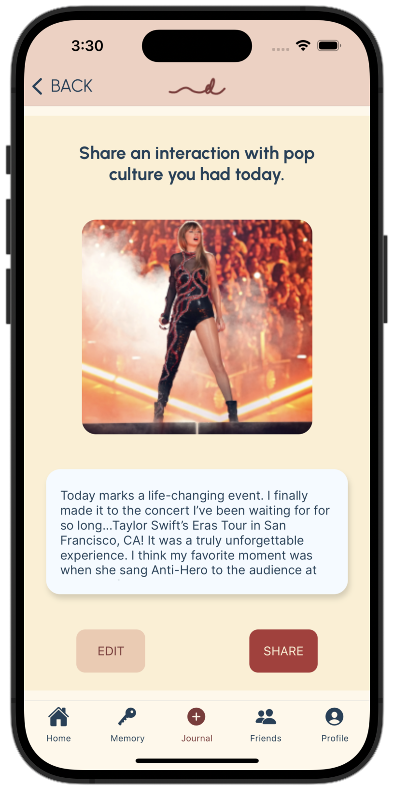
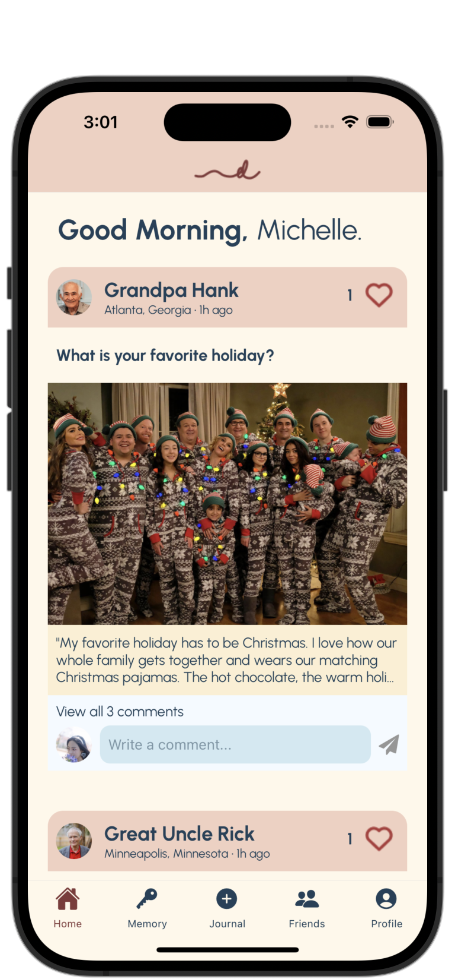
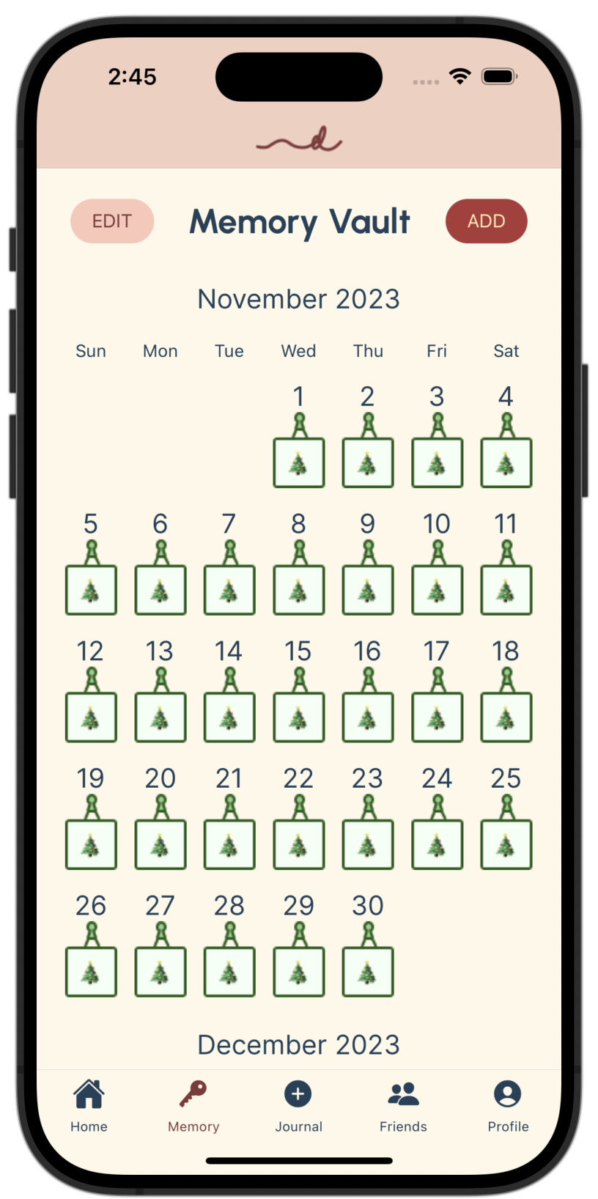


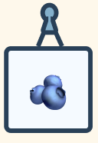




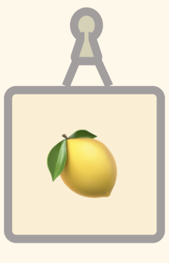


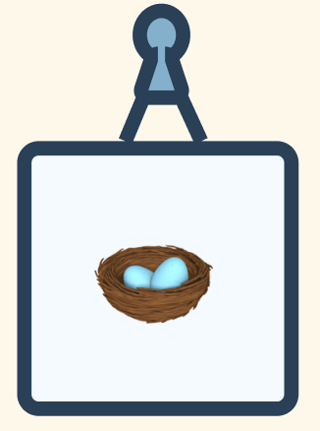
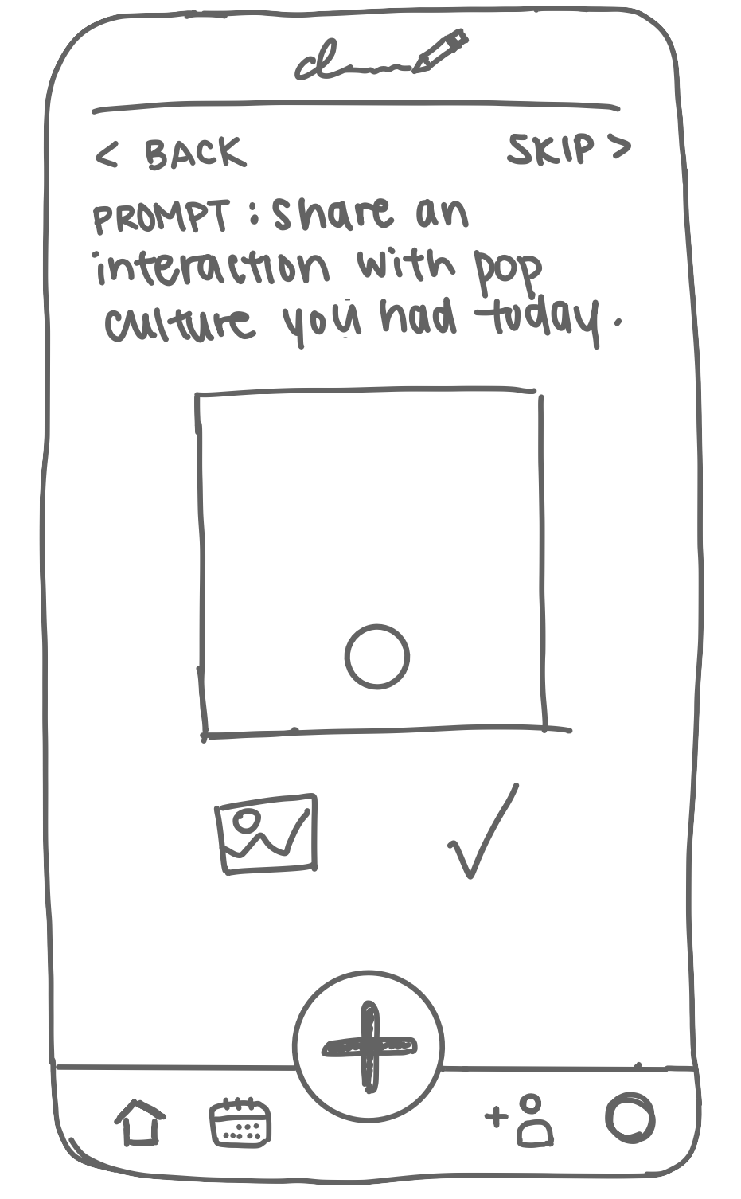
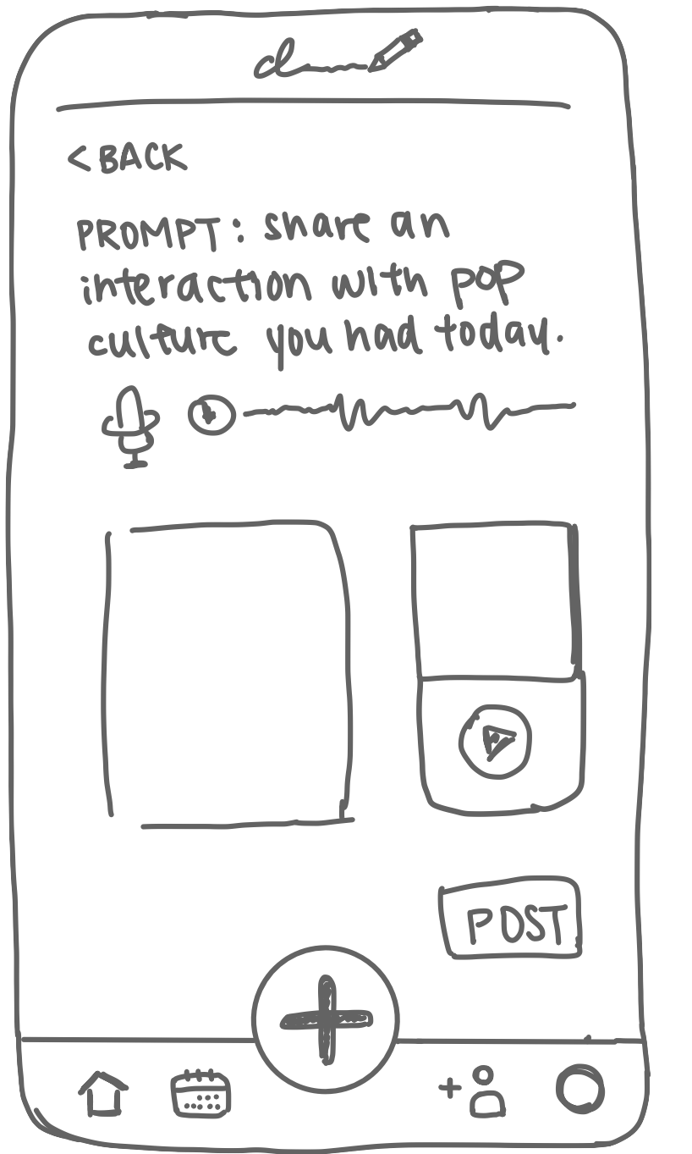
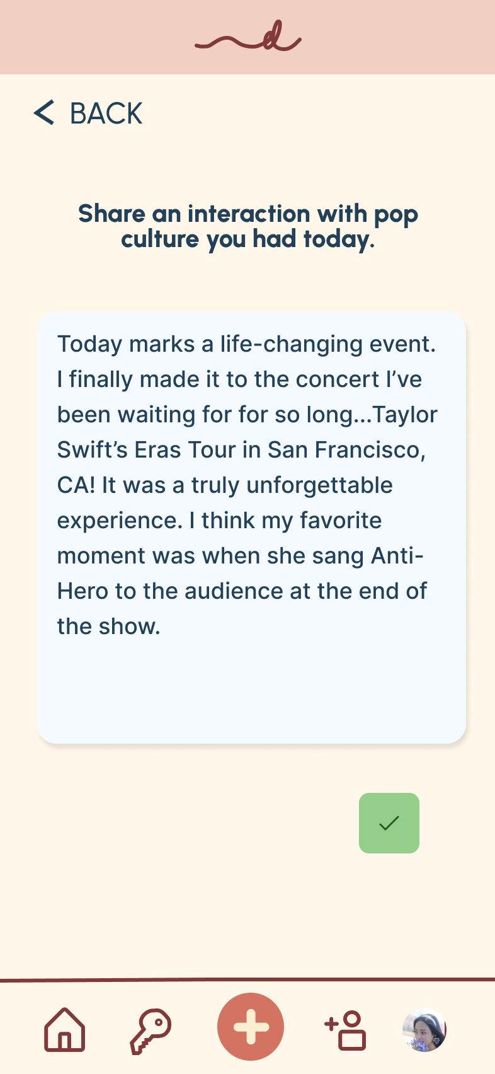
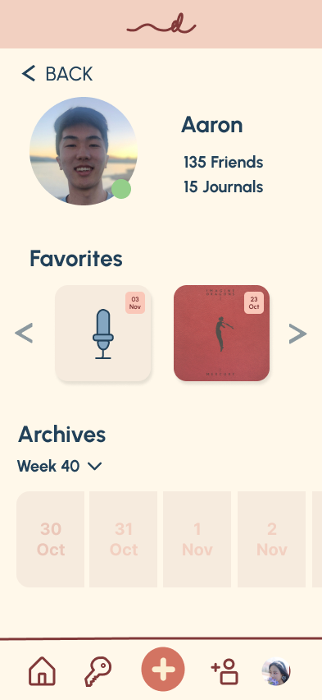
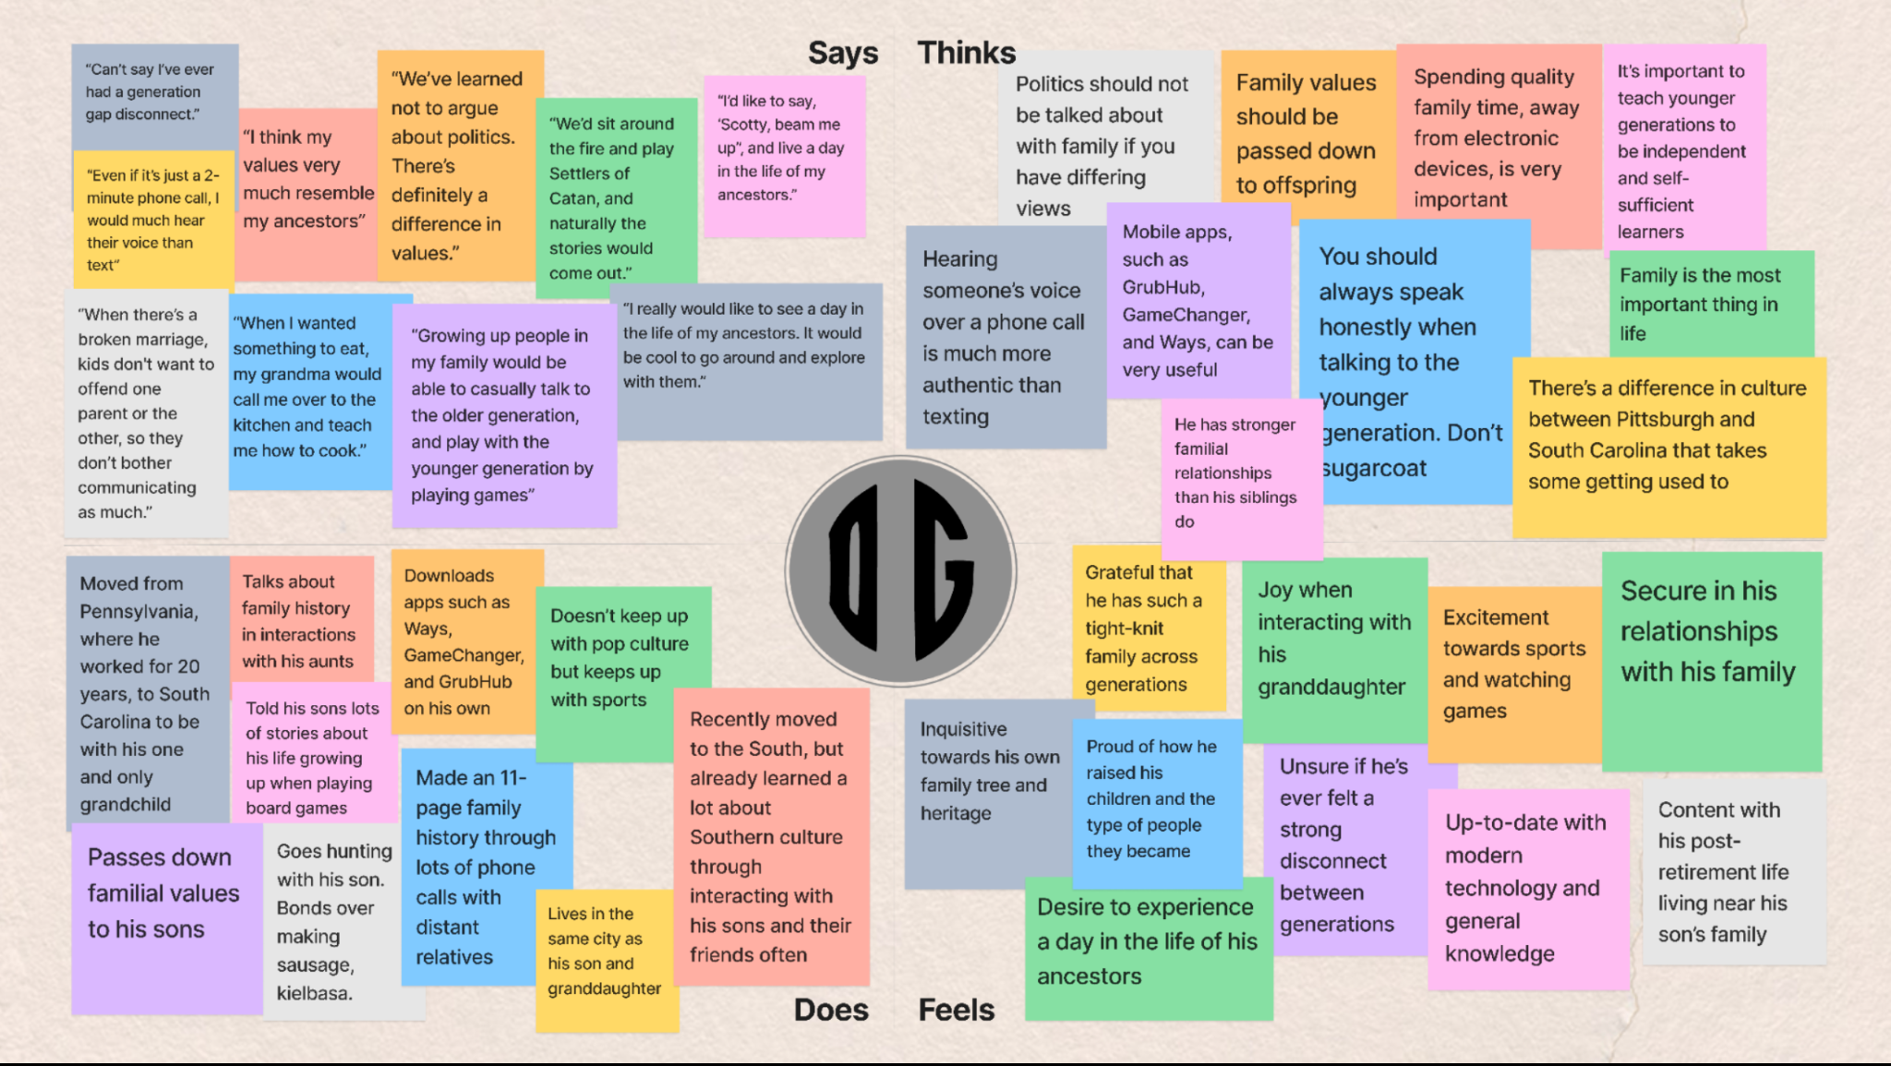
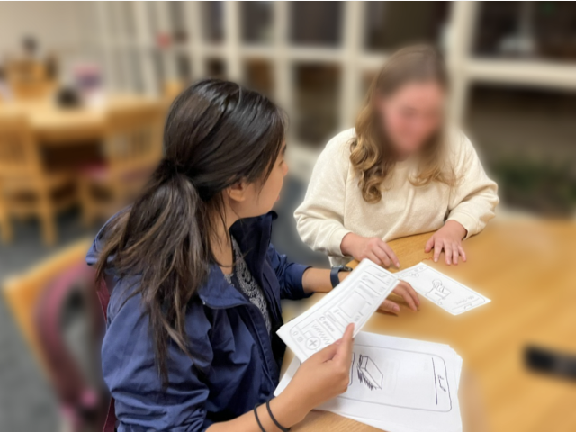
DiarWe
Problem
Solution
Design Process
Create interactive journals
Read & react to others’ entries
Relive special moments from your memory vault
bridging generations thru interactive journaling
Generational miscommunication and disconnect occur due to differences in pop culture, slang, technology, history, and more.
An interactive journaling app that allow individuals to learn from and deeply connect with other generations.
Needfinding
Testing
Low-Fi Prototype
Med-Fi Prototype
Aaron Cho, Katie Liu, Eleanor Peng, Emma Su | CS 147 Autumn 2023 | https://web.stanford.edu/class/cs147/projects/UnlockingLifelongLearning/DiarWe/

