Slide 1
Assignment 5: Sell-In
Anavi, Shardul, Saniya, Sara

Slide 2
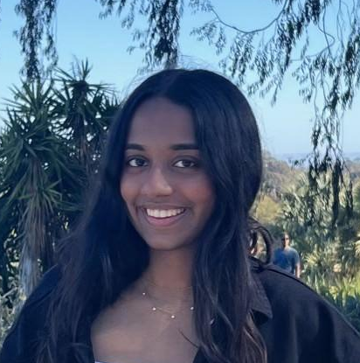
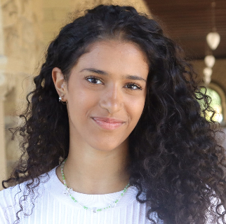


Our Team
Anavi Baddepudi
Sara Bukair
Saniya Vashist
Shardul Sapkota
Computer Science
AI track ‘25
Computer Science
HCI track ‘25
SymSys
HAI Track ‘25
First year Computer Science PhD

Slide 3
Value Proposition
Turn Your Passion Into Purpose
We want social impact to be aligned with people’s passions so they can do impactful work for the long term
We want to leverage their skills to help small and local non profits that are dedicated to systemic change
Sanity Check
One-liner is catchy and memorable, yet specific to our mission

Slide 4
Problem & New Solution Overview
Problem:
Upon entering university, students forego their social impact passions in pursuit of high paying, but less meaningful, jobs
Nonprofits, governments, and social enterprises need more talent
Solution
A platform that aims to establish a dedicated pipeline for social impact work for undergraduate students, focusing on mentorship, internships, and community

Slide 5
3 Task Clarification
Find a mentor
2. Find a job
3. Find a community
Encourage students that selling-in is possible
Provide students with job opportunities that they can apply to
Connect people with similar social impact related passions

Slide 6
Outline of Talk
01
02
03
04
Sketching explorations
Selected interface & rationale
Low-fi prototype
Testing

Slide 7
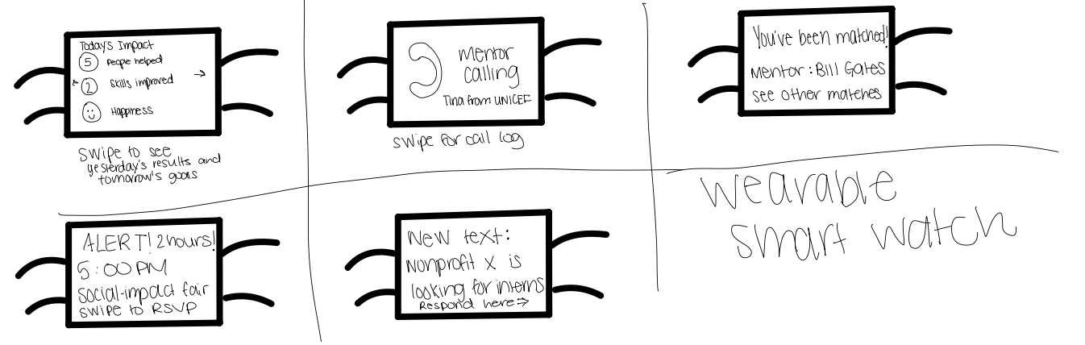
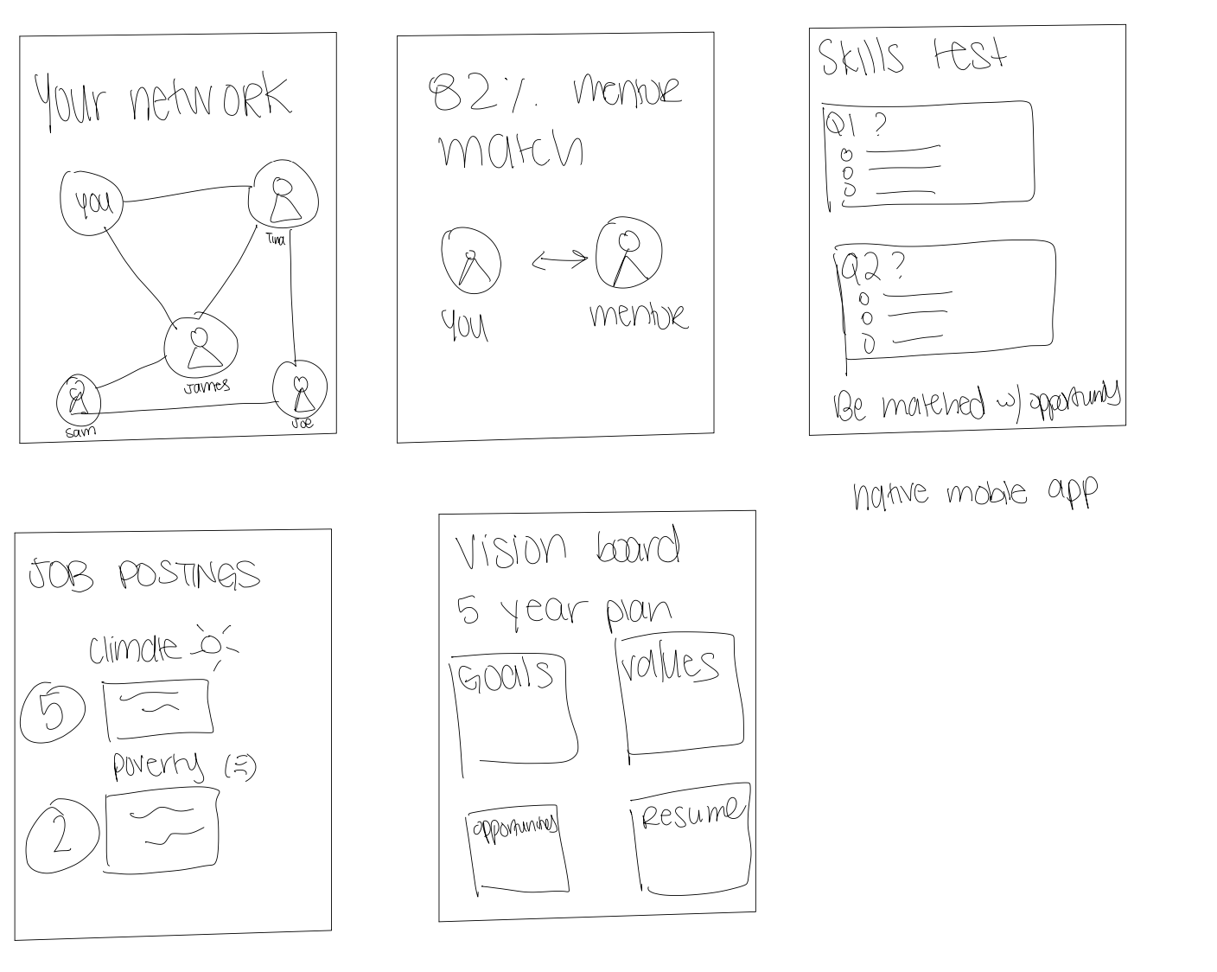
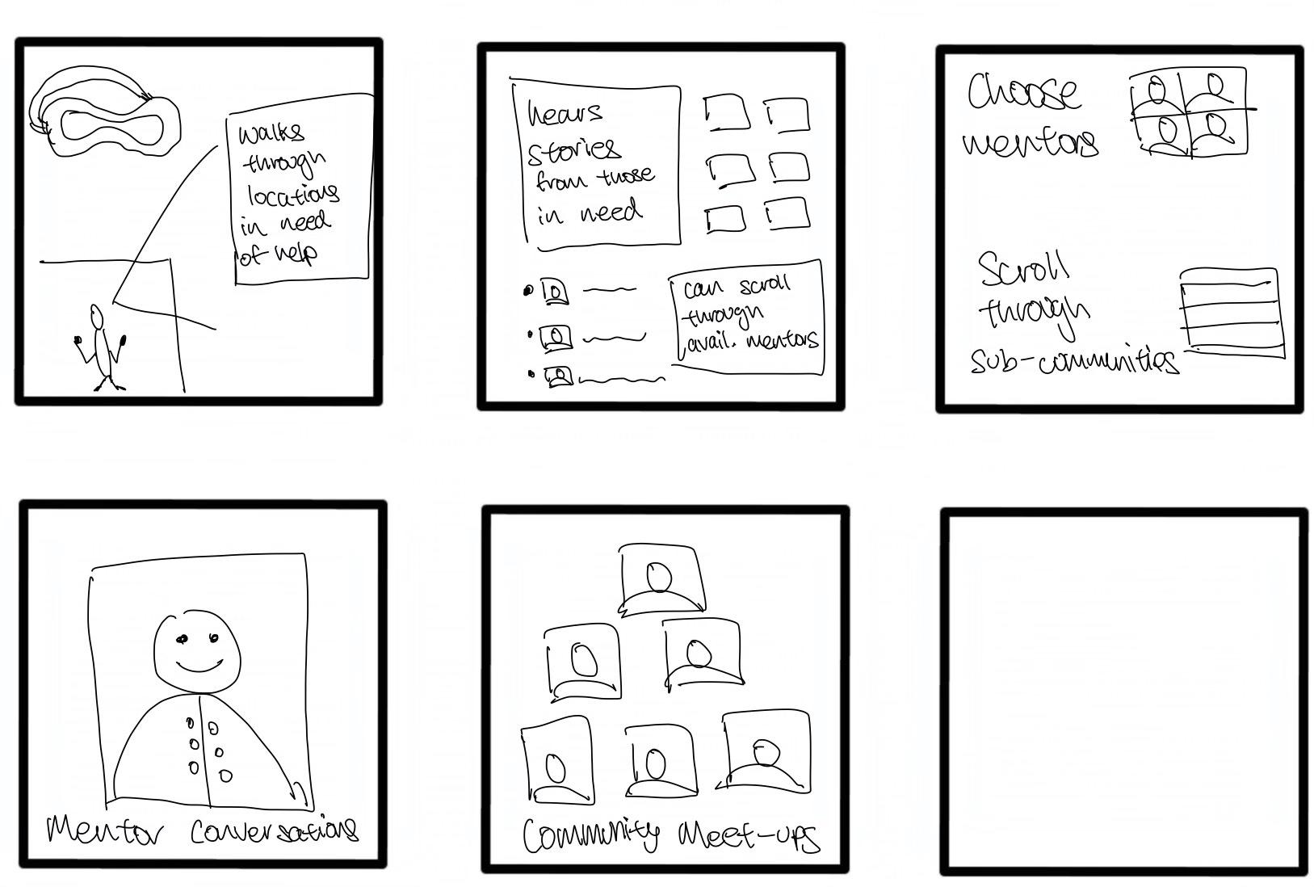
Sketching Explorations
Smart watch
Mobile
VR

Slide 8
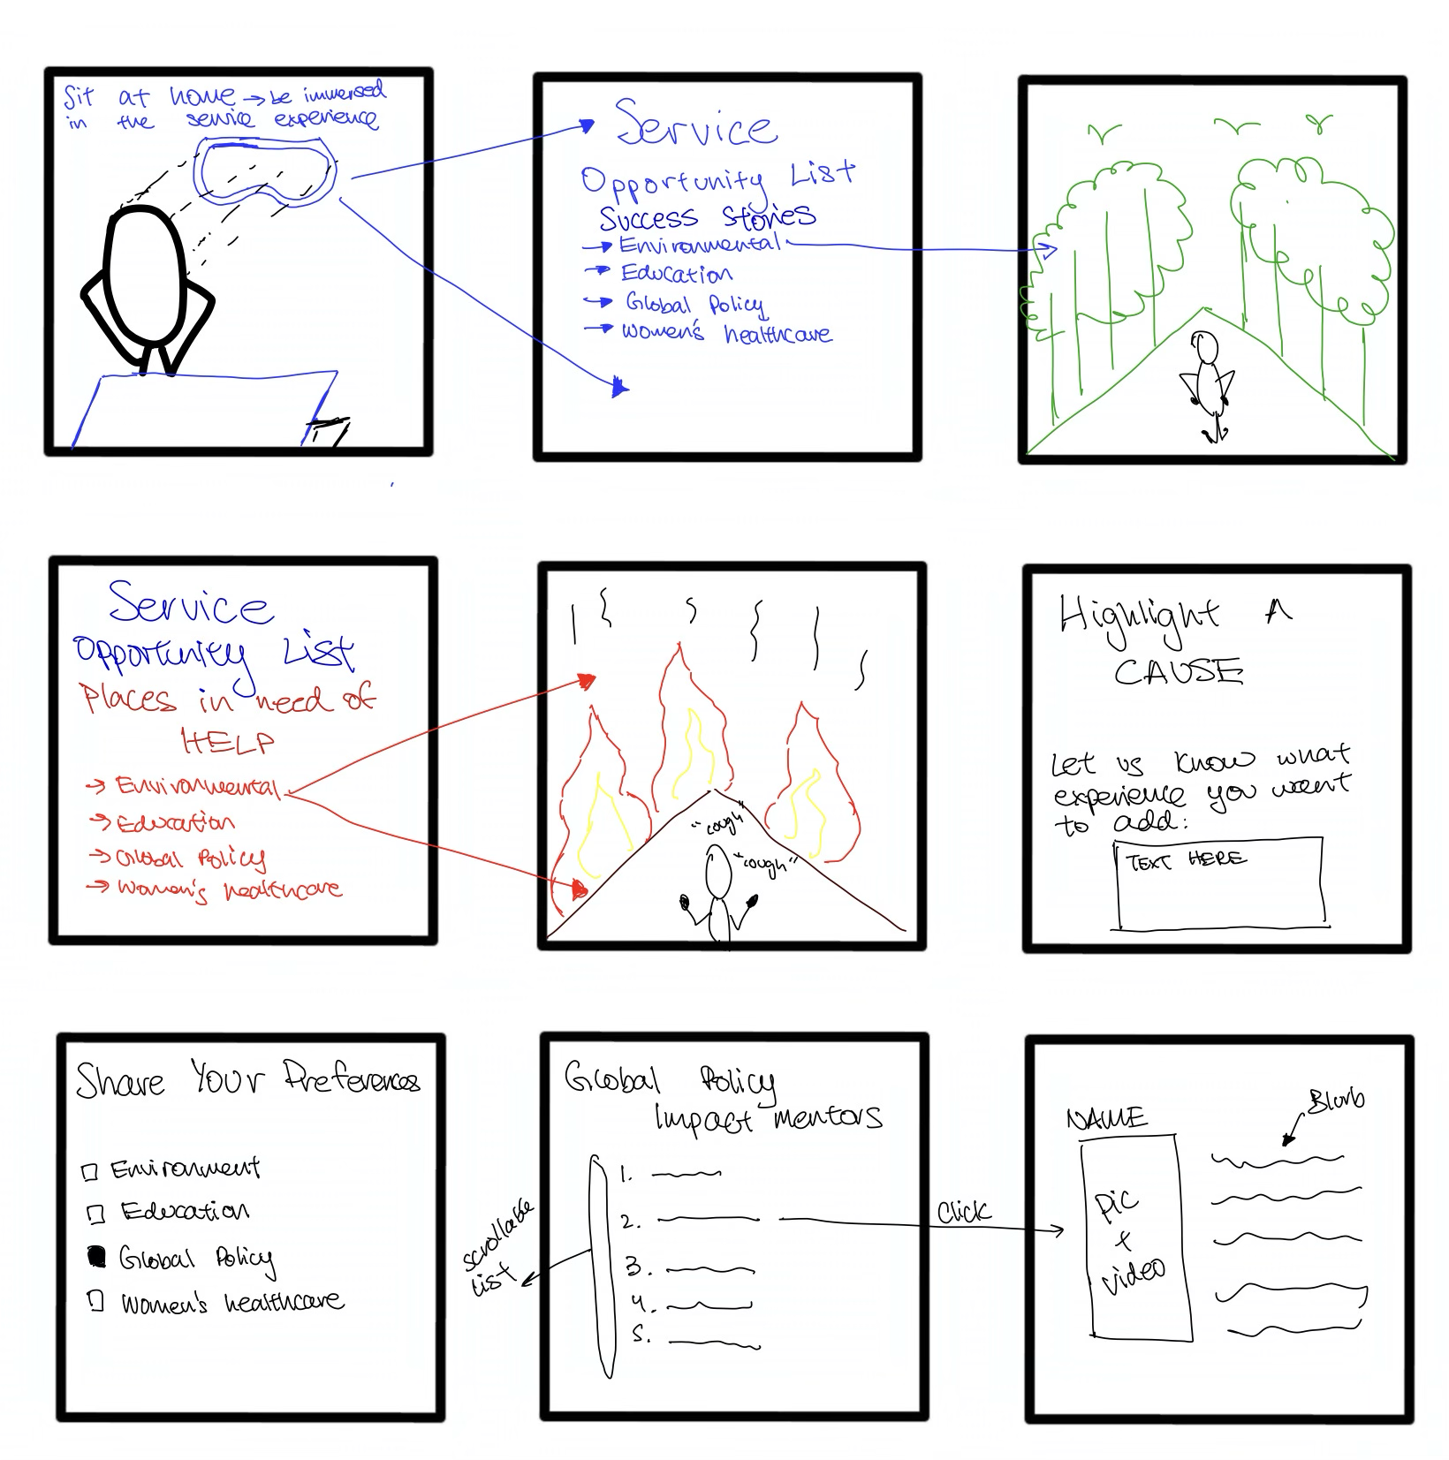
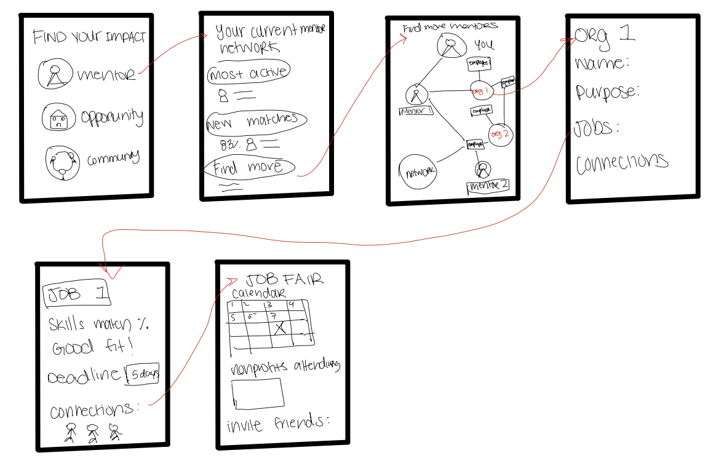
Final 2 Sketches
Mobile
VR

Slide 9
Mobile
Pros | Cons
Wide reach and less tech barriers | Less lifelike and meaningful
Maximizes accessibility and convenience | People may feel disconnected from the impact of their work (especially when it is remote)
Integration with Other Apps
Customizable User Experience
*Full list in appendix

Slide 10
VR
Pros | Cons
More interactive and visual, helping our users see the impact of remote opportunities up front | Less user friendly
Users feel more connected to remote service opportunities, leading to increased empathy and understanding. | Might be culturally insensitive to have a platform that immerses users in another culture (more logistical and ethical issues)
Allows users to interact with environments, situations, or challenges in ways that traditional platforms can't provide. | Creating high-quality, realistic AR experiences can be technically challenging and expensive.
*Full list in appendix

Slide 11
Comparing 2 Platforms
Considering the target audience and the goals of the platform, a mobile and web first approach seems more practical. It aligns with the lifestyles and tech habits of undergraduate students.
A mobile platform is ideal for students who often rely on their smartphones for daily activities. Mobile allows for quick access to mentor communications, internship updates, and community engagement.
User Accessibility: Mobile: Most undergraduate students have smartphones, ensuring broad accessibility and frequent check-ins.
Engagement and Experience: Mobile: Direct, efficient, and aligned with how many students currently engage with information and communities.

Slide 12
Why is the design you chose superior?
Since this is a platform targeting undergraduate students, nonprofits, and mentors the mobile design is superior due to its accessibility, user experience benefits, and alignment with current tech trends.
The mobile design is user friendly, efficient, and applicable to a variety of groups and contexts.
The VR version would be too limiting in its implementation

Slide 13
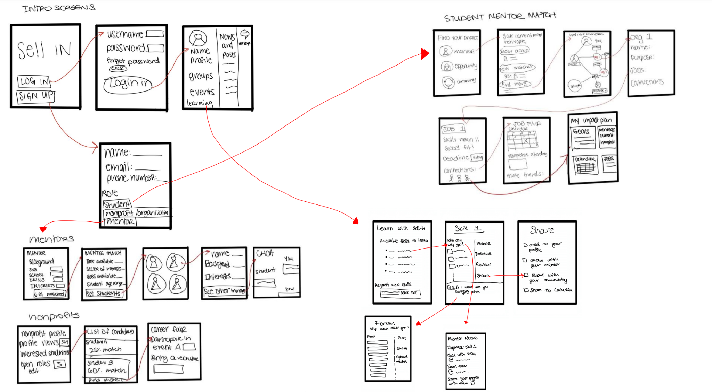

Slide 14
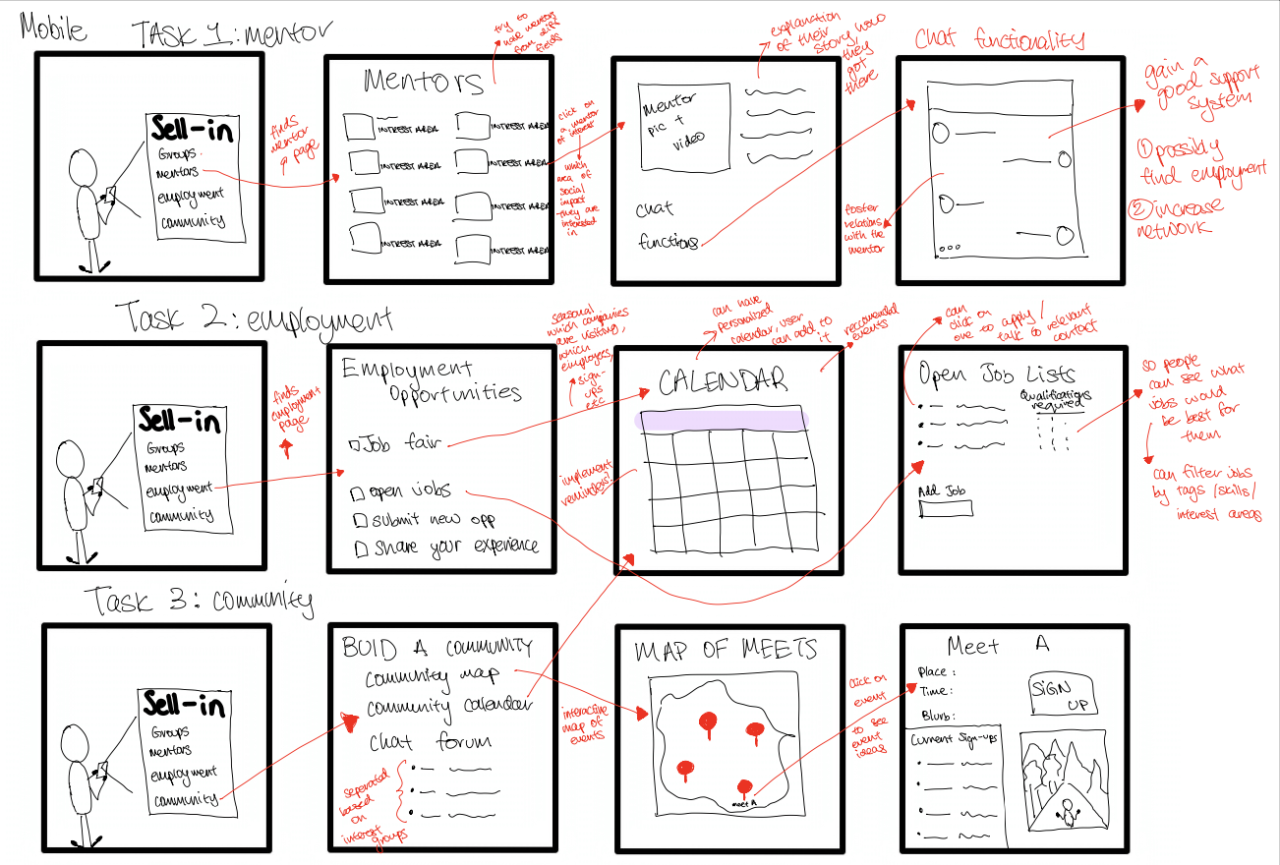
3 task flows

Slide 15
Testing methodology
a. Participants: demographics, recruitment, compensation
Demographics: undergraduate students, nonprofit leaders, and potential mentors
Recruitment: LinkedIn networks, social media, referrals
Compensation: Thank you notes, project updates, cookies/small meal
b. Environment and apparatus
We developed a paper model/prototype for our app on notability and tailored our actions to the user's moves.
We used an ipad and swiped between the different flows. Asked participants on zoom to take the call on their ipad, if possible.

Slide 16
Procedure: Team Member Roles, Description of Process
1) Facilitator: Saniya, Observer/note-taker: Shardul
2) Facilitator: Shardul, Observer/note-taker: Saniya
3) Facilitator: Saniya, Observer/note-taker: Shardul
4) Facilitator: Anavi, Observer/note-taker: Sara
5) Facilitator: Anavi, Observer/note-taker: Sara
For Zoom interviews: One observer/note-taker, one person to switch between the tabs
For In-person interviews: One observer/note-taker, one person to move around the pages on a phone

Slide 17
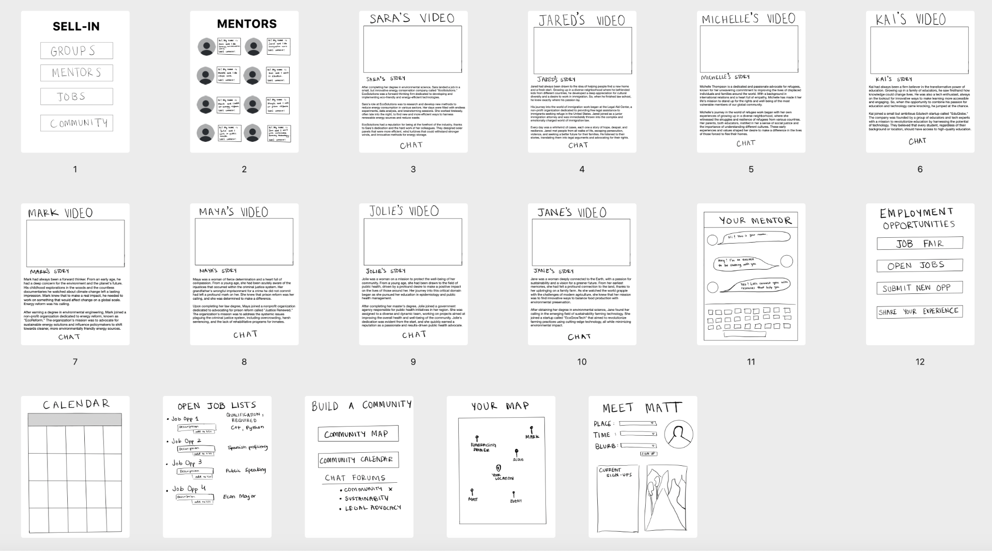
Low-Fi Prototype Bird’s Eye View

Slide 18
Description of Process
Provide users with deeper insight into "Sell In"
Establish the context for users
Introduce a hypothetical situation: users aim to link with mentors seamlessly, seek opportunities for social impact, and have installed the Sell In app and set up a profile
Showcase the system
Observing participants as they completed three specific tasks
Participants were prompted to vocalize their thoughts and clearly state their intentions at every stage, allowing us to assess both their grasp of the app and their desired actions
After each task, we sought users' opinions on the app's usability: which features felt intuitive and straightforward? Which ones were ambiguous, and what caused the confusion? Once all three tasks were done, we gathered final feedback, suggestions for enhancements, and checked if they had any inquiries for us.

Slide 19
Usability goals and key measurements
User ease to use
  Minimal errors and good navigational heuristics in the app
  Measure: number of errors per task
Efficiency
  Quick and intuitive navigation
  Measure: task completion time, number of questions asked per task

Slide 20





Interviewees
Yasmin
Ani
Emma
Claire
Alpa

Slide 21
Process and Bottom Line Data
Users were easily able to maneuver finding the available mentors, “chatting” with mentors
Bottom Line: Little to no errors across the participants for the first task and task completion time was under 10 seconds.
Users were able to find the community/group, but were confused about the difference between the two
Bottom Line: Only 1 error in joining the community, but task completion time was more than 20 seconds as there was confusion about what the task was asking for.
Users were unsure about how to review the community/groups that they have joined
Bottom Line: 3 errors across the 5 participants and task completion was around 20 seconds on average.
Notes:
Users were easily able to maneuver finding the available mentors, “chatting” with mentors
Participant 1 and 3 asked about the mentor video and chat functionality, seeming interested in this functionality
Bottom Line: Little to no errors across the participants for the first task and task completion time was under 10 seconds.
Users were able to find the community/group, but were confused about the difference between the two
Participants 2 and 3 asked about the difference between a community and a group, and also faltered with the various buttons present for this functionality.
Bottom Line: Only 1 error in joining the community, but task completion time was more than 20 seconds as there was confusion about what the task was asking for.

Slide 22
Other Observations and Comments
Participants emphasized wanting to see more information about non-profit organizations
Participants (No. 4 commented on this at the end) fared better in tasks when there were less options and simple user interfaces
Participants struggled with the task of looking back at what they have already done — navigation issues
Participants (emphasized by No.3) wanted the map to be clearer and more descriptive.
Participants wanted more information about the mentors on the mentor scrolling page.
When asked to rate if they would use this platform from 1-10, the answers from the users were 7, 7, 8, 8 and 5. The participant with the lower score is also the user that was recorded with the most amount of errors and was also the only mentor particpant.

Slide 23
Implications
Feedback from platform users indicates:
Groups/Communities: Participants want more clarity on the groups and communities sections, how to join them and how to see which ones they are a part of.
Non-profit involvement: Mentors want a clearer way to view and interact with nonprofit organizations.
Engagement Opportunities: Participants are keen to engage directly with opportunities, emphasizing the need for features that facilitate active participation in the sector.
Streamlined Functionality: Participants expressed confusion when there were too many buttons or options, hence simplification on some of the main task pages may be required.

Slide 24
Changes
UI Improvements
Adding a back button on each screen: Users felt that without a home screen icon on the top nav bar and a missing back button, they did not know how to exit the current interaction
Adding a default landing page: Some users mentioned that having a “default” option when opening the app is helpful to avoid the first use decision making in terms of what to do with the app. The first interaction that the users have with the app is choosing between group, mentorship, or jobs and we could default to mentorship while having the other features easily available.
Add information about the mentors rather than pictures: Users were confused about which mentors to choose — should have information about the mentors rather than pictures.
Add previews to names in community maps: Users wanted a preview description besides the names in the community map pins as reminder to who the person is or what kind of event they might be organizing without having to tap on each pin

Slide 25
Analysis and Next Steps
Our product benefits from and relies on network effects — our lofi testing could not test this.
This can be tested by asking more people if they would join this platform as network effects is based on large groups of people. The user interface would change depending on the size of communities, groups and the number of events.
Issues were mostly in the user interface rather than functionality.
Complete another round of testing with the new edits based on feedback from our participants.
Test mentors
Mentors are very important for our first task. Our product needs to be easy for them to use.

Slide 26
Thank you!

Slide 27
Appendix
Best idea: Mobile
Pros:
Wide reach and less tech barriers
Maximizes accessibility and convenience
Push Notifications → Direct engagement with users through timely updates, reminders, and calls to action.
Integration with Other Apps → Potential for integration with social media, calendars, or payment apps for seamless user experience.
Cost-Effective Development → Mobile app development can be more cost-effective compared to creating specialized AR hardware experiences.
Customizable User Experience → Mobile apps can adapt to user preferences and behaviors over time, offering a more tailored experience.
Easier to update mobile app and integrate with a web version
Cons:
Less lifelike and meaningful
People may feel disconnected from the impact of their work (especially when it is remote)

Slide 28
Appendix
Cons
Might be culturally insensitive to have a platform that immerses users in another culture (more logistical and ethical issues)
As AR apps are still uncommon, the learning curve may be steep
Less user friendly
Requires more access to technology and less intuitive
Ethical issues: Users might feel they're "doing enough" by just using the app, reducing actual
on-the-ground volunteer work.
Creating high-quality, realistic AR experiences can be technically challenging and expensive.
Keeping the app updated and ensuring accurate representation requires regular maintenance and oversight.
Users might engage with the AR experience more for its novelty than for a deep understanding or commitment to the cause.
Service is often for the people that you are helping, not to benefit ourselves and hence this “immersive” experience may be directing too many resources into bettering the experience of the volunteers/workers rather than those who are actually in need.
VR
Pros:
More interactive and visual, helping our users see the impact of remote opportunities up front
Users feel more connected to remote service opportunities, leading to increased empathy and understanding.
Allows users to interact with environments, situations, or challenges in ways that traditional platforms can't provide.
App can be accessible to anyone, anywhere
The immersive experience might motivate more users to get involved and be more impacted by their service
Much cheaper than organizing physical trips for community impact
Users can explore challenging or dangerous service environments without any physical risk.
AR can be tailored to each user's learning pace and interest areas.
App can be easily updated to reflect current events or newly arising service opportunities.

Slide 29
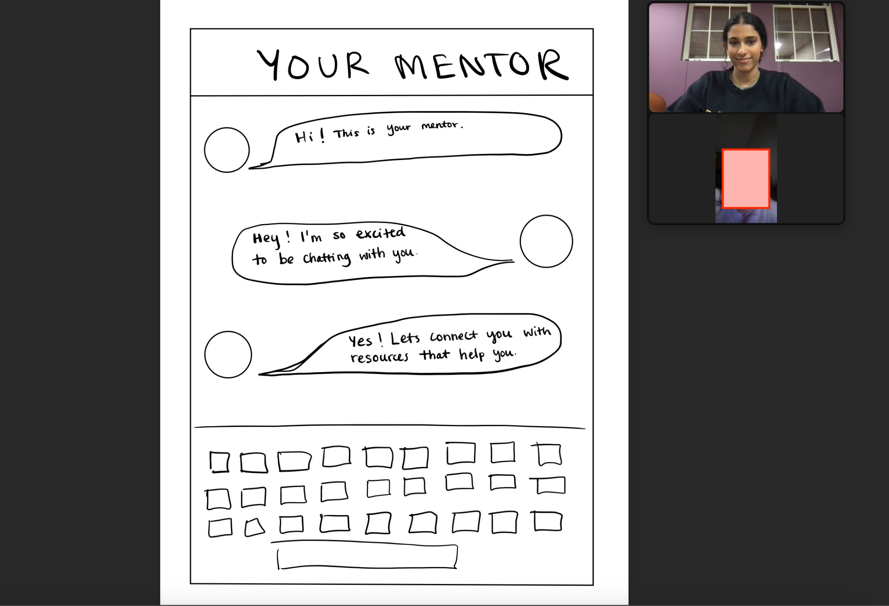
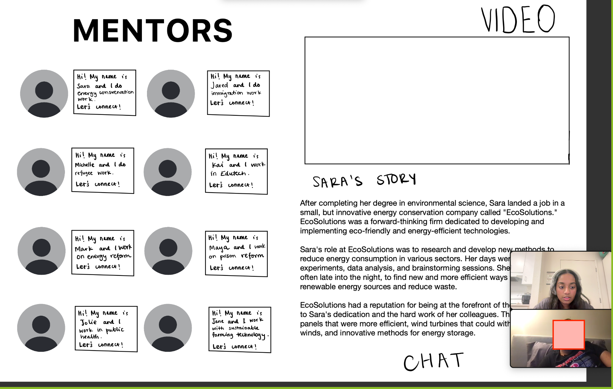
Zoom Interview

Slide 30
Script
Facilitator: “Hello! How are you today?”
Facilitator: “We invite you to experience a preliminary version of a platform we're developing. The primary mission of this platform is to create a streamlined pathway for undergraduate students into social impact work. It emphasizes mentorship, internships, and community engagement.”
Facilitator: “For our prototype, please imagine these paper mock-ups in front of you as the digital interface of our platform. Feel free to 'tap' on the paper as you would on a real screen, and Saniya, over here, will assist by presenting the subsequent screens based on your choices.”
Facilitator: “We'll be observing various elements, such as where you 'tap' and any impressions or feedback you might offer. You might see us taking notes, but please continue as naturally as possible.”
Facilitator: “Our goal is to understand how you organically interact with our platform and assess the intuitiveness of specific features. Let’s start with the onboarding process. As you navigate, please share your thoughts aloud.”
Facilitator: "Great! To begin with, can you try finding a mentor in your field of interest?"
Facilitator: "Thank you. Now, one core feature of our platform is to help you discover internships in the social impact sector. Could you try accessing internship opportunities?"
Facilitator: "Next, we'd like you to explore the community engagement section. Can you try joining a community or group?"
Facilitator: "Lastly, can you review the mentors and communities you've connected with or joined?"
Facilitator: "On a scale of 1-10, how likely are you to utilize each of the features we explored today?"
Facilitator: "Finally, how likely are you to recommend our platform to a fellow undergraduate student?"

Slide 31
Incident | Severity
“How can a mentor see nonprofits?” | 3
“How can a mentor also be connected to opportunities or volunteer with nonprofits? | 3
“I wish I could see the network of other mentors and students like the student view has” | 2
LOG OF
CRITICAL
INCIDENTS
Alpa

Slide 32
Incident | Severity
“There are a lot of possible choices, I’m not too sure what I want to see next” | 4
“Are there more mentors — can I scroll?” | 3
“Can I edit the calendar myself?” | 1
LOG OF
CRITICAL
INCIDENTS
Ani

Slide 33
Incident | Severity
“Where do groups lead to?” | 4
“Can pairs of people sign up for this platform?” | 3
LOG OF
CRITICAL
INCIDENTS
Emma

Slide 34
Incident | Severity
“Can I adjust settings on the map?” | 2
Asks about the first few buttons and what they do — seems confused | 3
Spends extra time on the mentor page - “Do I know if they’ve been successful mentors before” | 2
LOG OF
CRITICAL
INCIDENTS
Claire

Slide 35
Incident | Severity
“Can I see more information about the mentor before I click?” | 3
“Is there a back button?” | 3
“I wish I could see the network of other mentors and students like the student view has” | 2
LOG OF
CRITICAL
INCIDENTS
Yasmin

