Slide 1
Assignment 6: Sell-In
Anavi, Shardul, Saniya, Sara

Slide 2
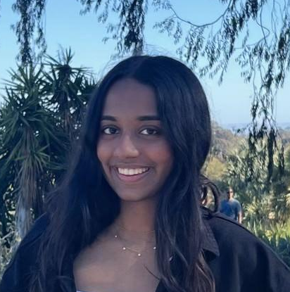
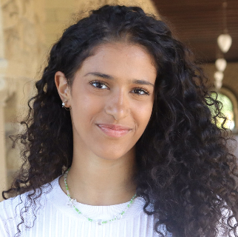


Our Team
Anavi Baddepudi
Sara Bukair
Saniya Vashist
Shardul Sapkota
Computer Science
AI track ‘25
Computer Science
HCI track ‘25
SymSys
HAI Track ‘25
First year Computer Science PhD

Slide 3
Value Proposition
Turn Your Passion Into Purpose
We want social impact to be aligned with people’s passions so they can do impactful work for the long term
We want to leverage their skills to help small and local non profits that are dedicated to systemic change

Slide 4
Problem & Initial Solution Overview
Problem:
Upon entering university, students forego their social impact passions in pursuit of high paying, but less meaningful, jobs
Nonprofits, governments, and social enterprises need more talent
Solution
A platform that aims to establish a dedicated pipeline for social impact work for undergraduate students, focusing on mentorship, internships, and community

Slide 5
Problem & New Solution Overview
Problem:
Upon entering university, students forego their social impact passions in pursuit of high paying, but less meaningful, jobs
Nonprofits, governments, and social enterprises need more talent
Solution
A platform that dedicated to fostering mentorship connections for undergraduate students in the social impact space, with a strong emphasis on supporting students find internships and build a community through their mentor relationships.
Notes:
We re-worded our solution to reflect the focus on mentors so that the simple, medium, and complex task flows are clearer

Slide 6
Values in Design
Inclusivity
  Students from all backgrounds are encouraged to join and use their skills to help
Empathy
  Students develop empathy for the nonprofits and projects they work with
Community
  Students feel like they are a part of a network of social good (helping the NGOs and society, and using those skills to help their companies)
Meaning
  Students find meaning through their social impact work and gain access to mentorship
Flexibility
  Opportunities are tailored to the students goals and schedules as well as nonprofits needs. Our platform should be fun, and not feel like work.
Long-term impact and sustainability
  Not just a 1-time volunteer event, but a sustainable cycle of giving with meaning
Learning by doing
  Encouraging lifelong learning of students through real-world projects, not just classes
Knowledge sharing and expanding
  Have students share their own skills and knowledge with nonprofits and vice versa
Step outside comfort zone
  Encourage students to try new things, develop new skills, and work on projects they may not have exposure to in their day to day academic life

Slide 7
Design Features that Encode These Values
Inclusivity
  Diverse student and mentor representation
  User generated events that show up as community events open to anyone on the platform
  Students can choose to chat with any mentor from the list of available mentors
Empathy
  Community building and event engagement where they can meet like-minded people and share resources for supporting one another for a sense of belonging
  The mentor profile page where they share the stories of their journey and how they overcame challenges
  Job opportunities from NGOs through which students learn the scope of their impact work and challenges that the students can help out with.
Community
  Community building through networking events and meetups that mentors, NGOs, or students themselves can add and organize
  Chat with mentors or other mentees advised by the mentor, which students can find from the mentor profile page.
Meaning
  Students find meaning through their social impact job opportunities and conversation with mentors and their peer network in the app.

Slide 8
Design Features that Encode These Values
Flexibility
  Students and mentors can schedule meetings that fit their schedule through the chat
  Mentors and events list can be filtered by pre-set criteria
Long-term impact and sustainability
  By design, the app is focused on long-term job opportunities from NGOs rather a 1-time volunteer event
  The relationship with mentors is focused on long term connections where they can revive existing chats to get advice at different points in their life
Learning by doing
  By connecting students to internships and job opportunities, students get a first hand experience to learn about social impact work
Knowledge sharing and expanding
  Through conversations with mentors and other like-minded people they find during events, students get the chance to learn and share new ideas
Step outside comfort zone
  By focusing on social impact events and internship and job opportunities, the app encourages students to try new things, develop new skills, and work on projects they may not have exposure to in their day to day academic life

Slide 9
Ethical Implications and Value Tensions
Work ↔ Compensation
  Encouraging students to give back without compensation introduces ethical risks. Is it fair to have people work on projects without payment?
  Solution: We will make these projects mutually beneficial for all parties involved. Students will feel impact with these opportunities, and gain new skills and experiences in the process.
Student Involvement ↔ Lack of inclusivity
  If we limit this platform to just students, is this platform inclusive?
  Solution: Encourage anyone, at all stages of their lives/careers can give back. We can market to struggling students, but not limit this platform to only them.

Slide 10
Stakeholders Overview
Direct
Students
Mentors who have dedicated their careers to social impact
NGOs they’re paired with
Indirect
Communities the nonprofits are helping
Students’ schools
Centers for Career and Professional Development

Slide 11
3 Task Clarification
Simple: Find a mentor
2. Moderate: Find a job
3. Complex: Find a community
Encourage students that selling-in is possible
Provide students with job opportunities that they can apply to
Connect people with similar social impact related passions
Notes:
Based on our discussions in the studio, the focus of our platform is to find a mentor– as we realized during our needfinding exercise and market research that existing solutions focus on connecting students to jobs but not to a figure they can look up to and seek guidance from. Thus, our simple task is to find a mentor, moderate task to find a job, and complex task to find a community through events.

Slide 12
Usability goals & key measurements
Goal 1: User ease to use
  Minimal errors and good navigational heuristics in the app
  Key measurement: Number of errors per task
Goal 2: Efficiency
  Quick and intuitive navigation
  Key measurement: task completion time
How is your product progressing towards hitting these goals?
We’ve revised our prototype features to enhance user experience and efficiency. We reduced redundant features to make sure the user experience is more efficient and easier to use, and users can quickly navigate where they need to go, with less errors per task.

Slide 13
Progress towards Usability Goals
User ease to use
  Removed the map interface that we used to pin for events around the users to simplify the interface
  Changed the calendar to be a list of events because there was a confusion around who can add events
Efficiency
  Changed the landing page from having the tabs for jobs/mentors/events to default to mentors
  Added a bottom menu navigation bar to quickly switch to jobs/events
  Added a chat button next to the icon of the mentors, in addition to having it in their profile page, so students can quickly resume or start chats

Slide 14
Task Flow Development

Slide 15
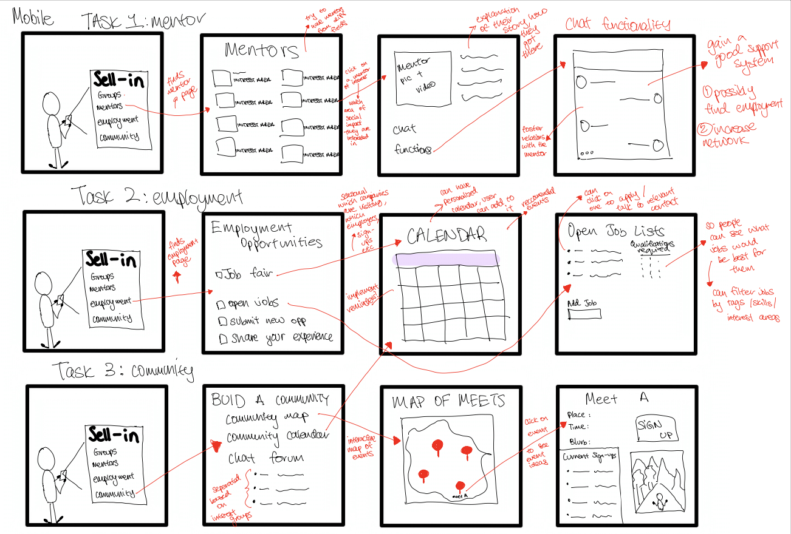
Stage 1: 3 task flows : Old
Simple
Moderate
Complex

Slide 16
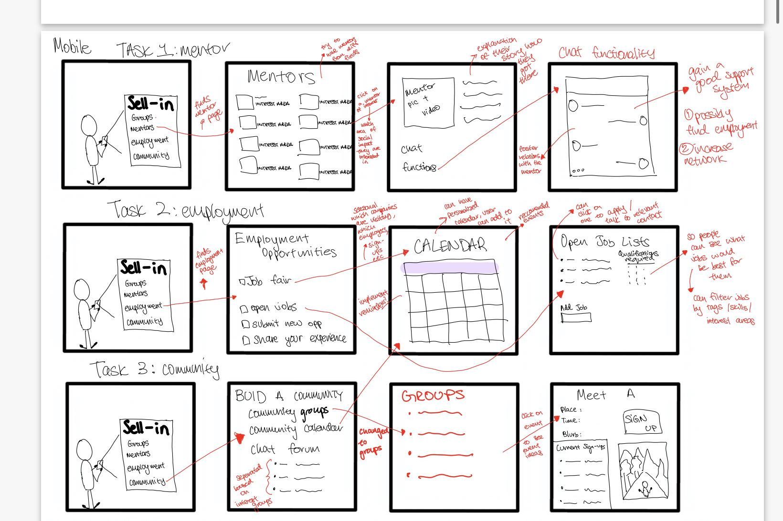
Stage 1: 3 task flows : New
Simple
Moderate
Main task flow change:
Removed map of meets because of feedback
Complex

Slide 17
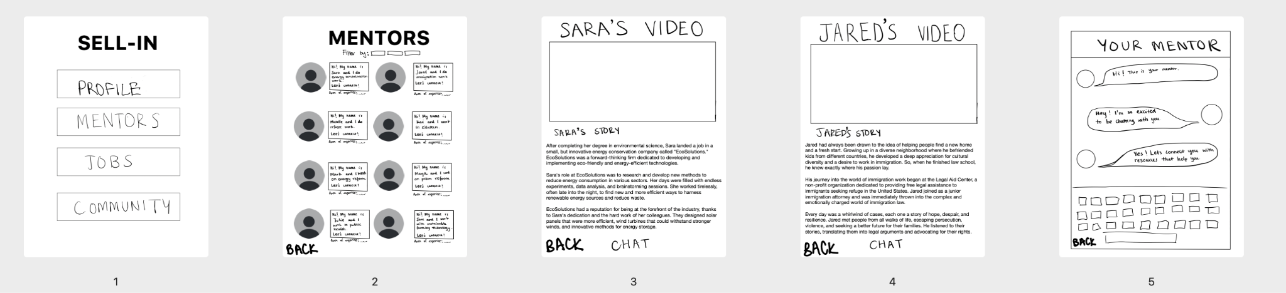
Removed confusion with the Groups/Community, and instead a page to look at your profile
Stage 2
Landing Page
Mentor list page
Example Mentor Profile
Example Mentor Profile
Example Mentor Profile
Click to get to the mentor page
Takes to individual mentor profiles
Chat with mentor option at the bottom
Click to next page
Added back button for back navigation
Got good feedback for this part, so was the same

Slide 18
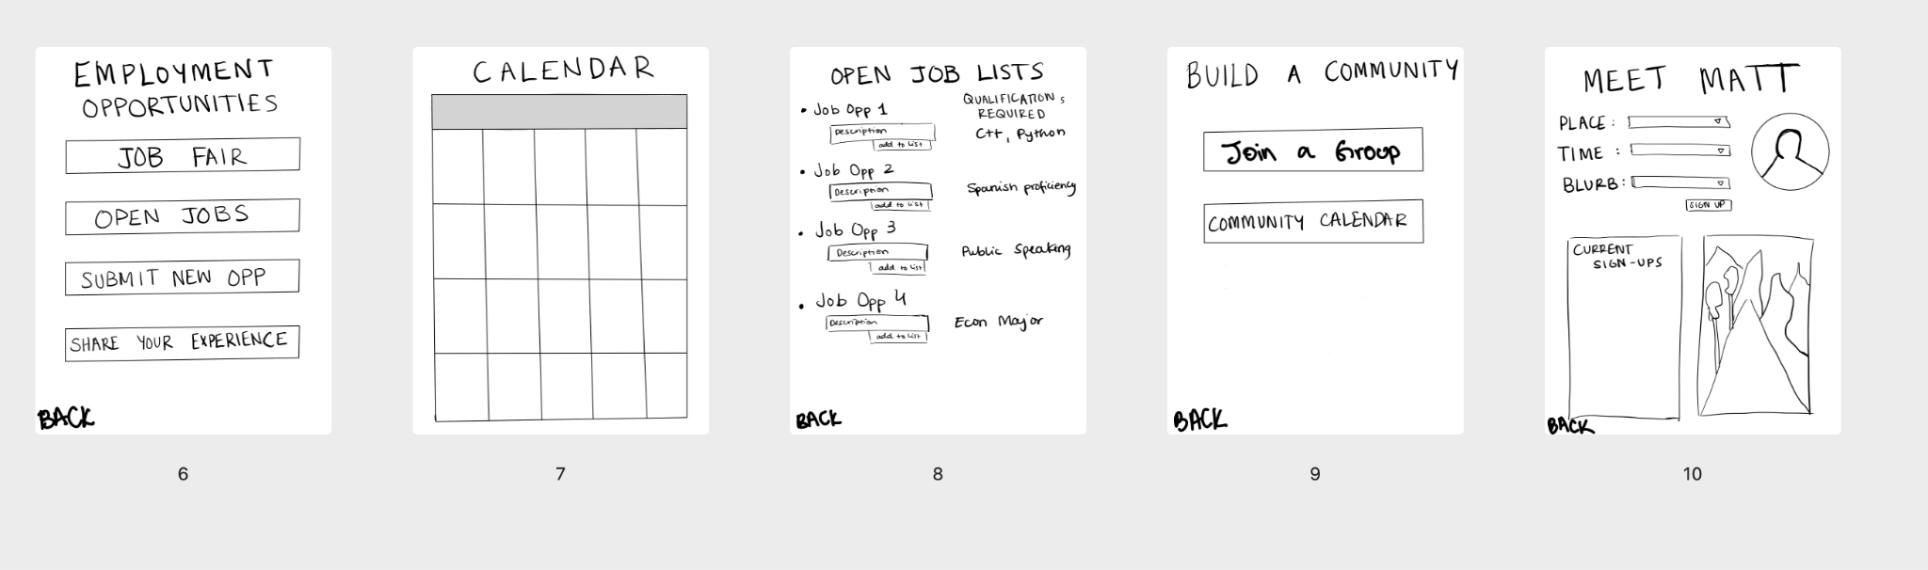
Stage 2 of Development
From community page on previous page, takes user to being able to see different groups / back to the calendar
Calendar for community events and job fairs
List of all open jobs that sell-In is aware of
Employment landing page
Click from previous page
“Join” Page
Click to see timeline of events
Click to see job listings page
Calendar leads to event calendar
People can access meets here
Removed unnecessary buttons, and removed map for simplicity
Added back button for back navigation

Slide 19
Medium-fi Design Changes

Slide 20
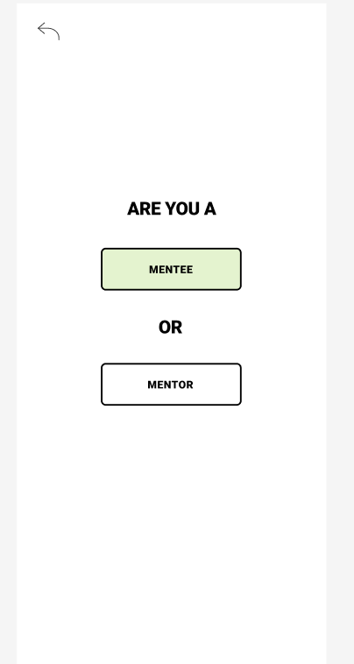
Major design change #1
How should we organize the user’s home page?
Removed confusion with the Jobs, Profile, and Community, and instead added a page to simply identify whether you were a mentee or mentor
Goal 1: User ease to use. Minimal errors and good navigational heuristics in the app. Users find it easier to create an account and log in by first identifying whether they are a mentor or mentee.
Goal 2: Efficiency. Quick and intuitive navigation. Task completion time of creating an account and logging in decreased by reducing to 2 buttons

Slide 21
Major design change #1
How should we organize the user’s home page?
Feedback from studio:
Prioritize the platform as one to facilitate mentorship and meaningful connections with role-models in social impact. Jobs and community are secondary.
Change:
Added a simple page where being a mentee versus mentor are selected
Rationale:
Reducing confusion and and emphasize the platforms purpose to bridge divides between mentors and mentees

Slide 22
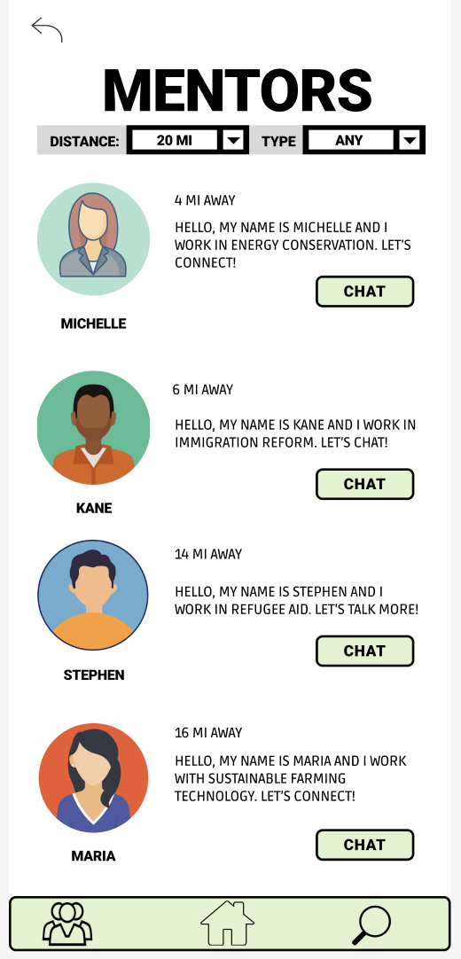
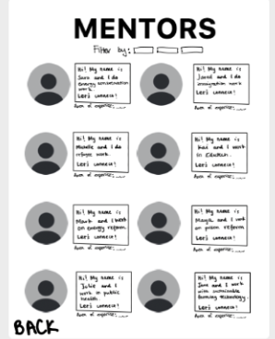
Major design change #2
Making mentor search easier and more organized
Added a filter to sort through mentors by location, and type
Add a quick chat button so they can easily connect
Goal 1: User ease to use. Minimal errors and good navigational heuristics in the app. Users find it easier to find mentors through these filters
Goal 2: Efficiency. Quick and intuitive navigation. Task completion time to chat with mentors decreased by adding a chat button

Slide 23
Major design change #2
How can we make finding a mentor easier?
Feedback from studio:
Make connecting with a mentor more convenient and effective. Have effective filters.
Change:
Added a filter to sort through mentors by location, and type. Added a quick chat button so they can easily connect
Rationale:
Increasing engagement with mentors and ease of accessibility/usage
Next steps:
Add a search button so people can search by name, as well as by company/organization

Slide 24
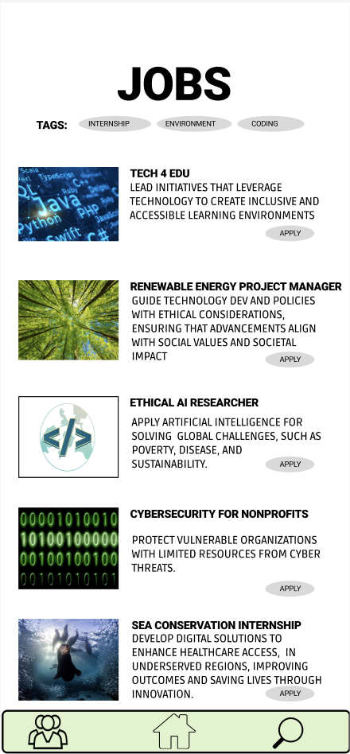
Major design change #3
How can we make finding, and applying for, a job easier?
Added a tag feature for jobs and an easy apply button
Added filtering by tags
Goal 1: User ease to use. Minimal errors and good navigational heuristics in the app. Users find it easier to find jobs through these filters
Goal 2: Efficiency. Quick and intuitive navigation. Task completion time of finding and applying for a job decreased by adding a chat button

Slide 25
Major design change #3
How can we make finding, and applying for, a job easier?
Feedback from studio:
Be able to apply for jobs directly without adding it to the “wish list.” Search through opportunities beyond qualifications/skills, but general areas.
Change:
Added a tag feature for jobs and an easy apply button. Added filtering jobs by tags
Rationale:
Increasing engagement with different opportunities and effectiveness of applying for jobs. Enhance ease of accessibility/usage
Next steps:
Add a specific job search by name/company feature, instead of just tags
See where mentors/connections work

Slide 26
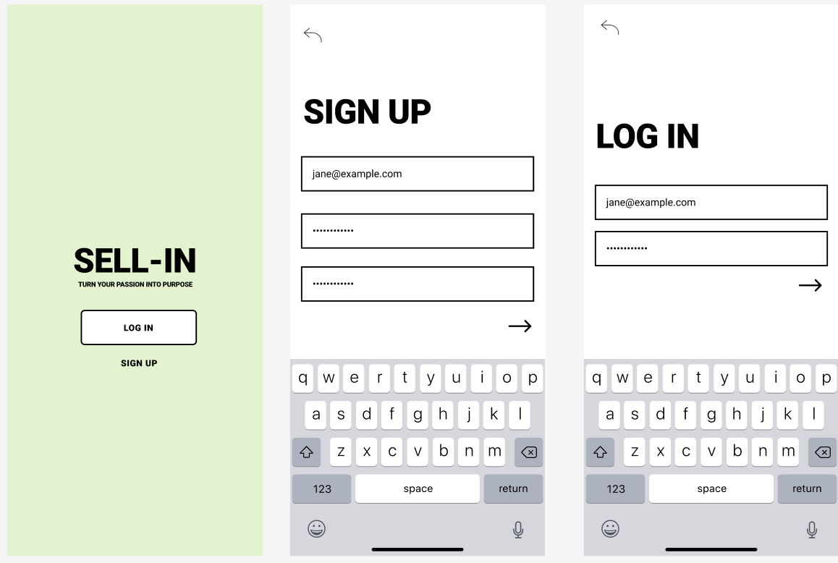
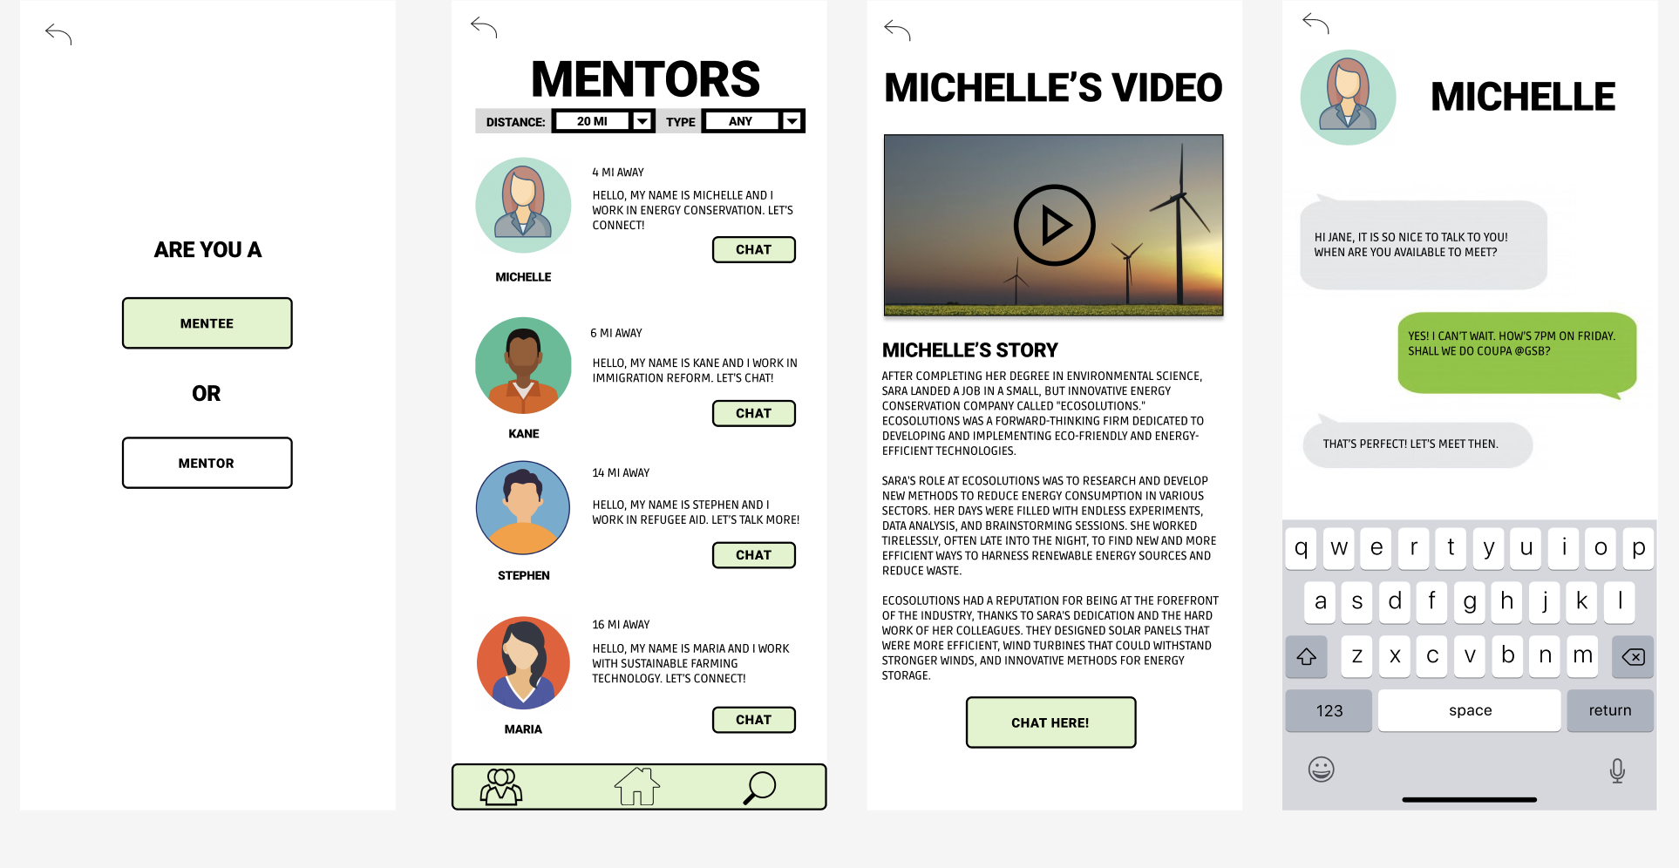
Simple task part 1: Find a mentor
Mentees can go see the mentor list
User logs in to see pre-saved information
Mentor/Mentee have different flows
Chat with interested mentor
Enter information for first time
Log in
Identify if mentee or mentor
See list of mentors and/or go directly to chat
See mentor profile
Chat with mentor
Log in or sign up

Slide 27
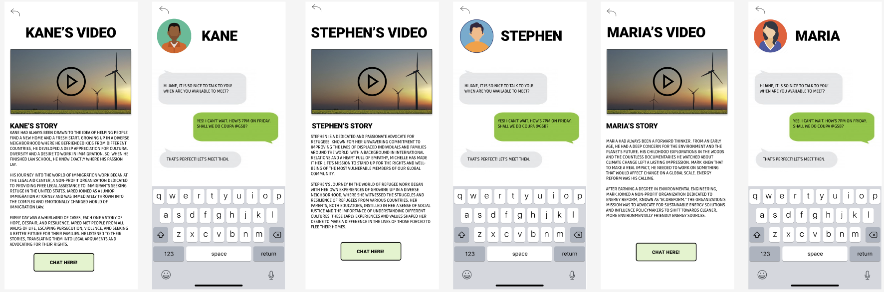
Simple task part 1: Find a mentor (pt 2)
Direct chat button takes the user to the chat, while clicking on the person's picture leads to the profile
See list of mentors and/or go directly to chat
See mentor profile
Chat with mentor
See mentor profile
Chat with mentor
See mentor profile
Chat with mentor

Slide 28
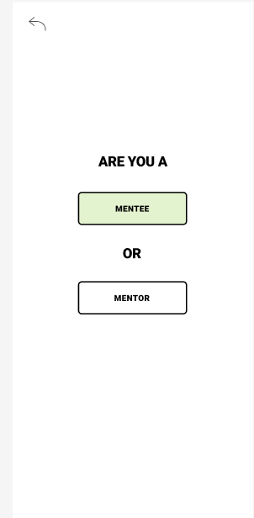
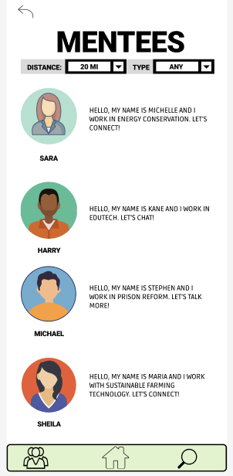
Simple task part 2: Find a mentee
Takes the mentor to find mentees
Identify as mentor
See list of mentees

Slide 29
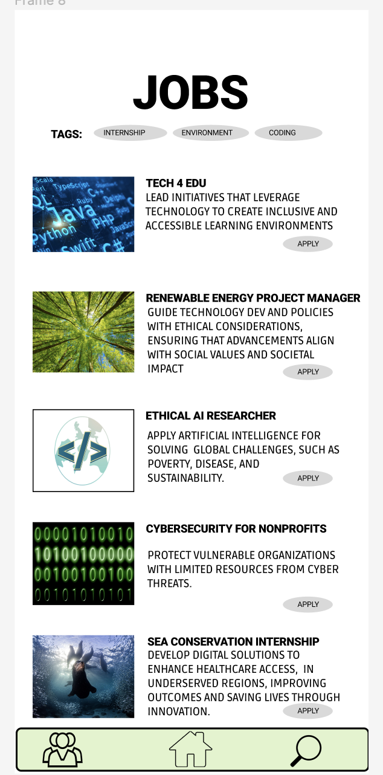
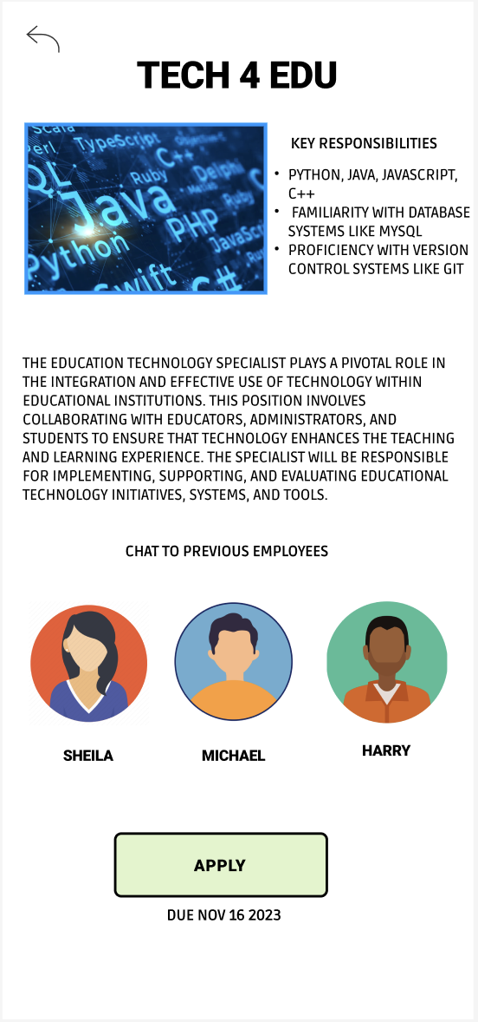
Moderate task: Find a job
Clicking on the job has the application hyperlinked, other employees to talk to, and job descriptions
Click on job search takes you to the list of jobs
Identify as mentee
See list of jobs with apply button

Slide 30
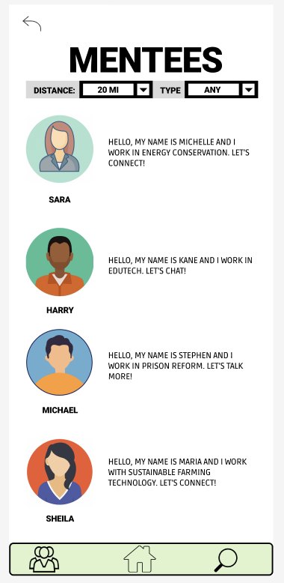
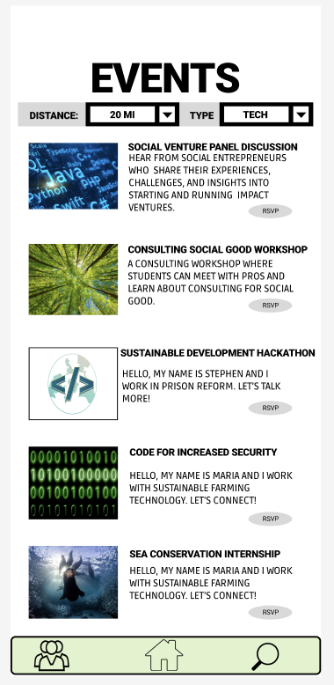
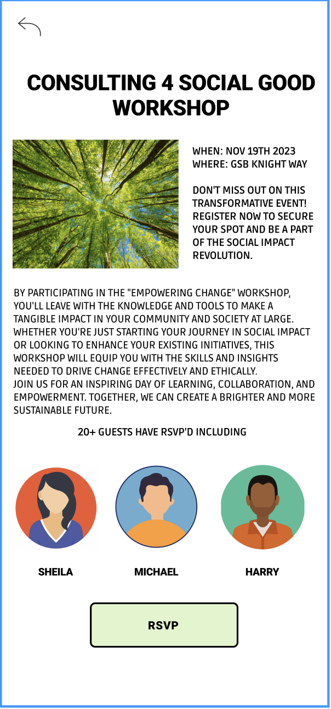
Complex task: Find a community
Clicking on event sees other RSVPS, and RSVP hyperlink
Community icon takes you to community events
Identify as mentee
See list of events with RSVP button

Slide 31
Prototype Implementation Overview
Tool: Figma
Pros:
Collaboration (multiple people can work on it at once)
Easy to get feedback and test it (shareable link to access)
Easy to use and user friendly interface
Cons:
Displaying the prototype through various screens can be difficult to navigate and demonstrate
Limited functionality to automatically go through screens - requires user to click through rather than automatically showing all functionalities

Slide 32
Design Tool: Figma (more details)
Pros
Easy to collaborate on and share prototypes for testing
Well documented and ton of resources available on the internet
Existing library of tools and design framework using grids and alignment makes it easy to use
Cons
Steep learning curve to navigate design components, frames, which seem a little unintuitive at first
Some functionalities like search/filtering are harder to simulate
Difficult to debug some transitions especially for complex task flows that require many frames

Slide 33
Limitations of Figma: Summary
Simulating workflows: While we can simulate workflows, we could not test the consequences of offering mentors or job opportunities
Testing: Harder to test 1) user feedback on the network or communities that are built around the different impact focus topics 2) how willing people are to reach out to mentors, how willing mentors are to connect with students, how long these conversations last and how fruitful these conversations can be.
Hardcoded features: The number of job opportunities presented as well as the number of mentors, the range of interest groups that the mentors represent are also hard-coded into this platform, which limits our ability to test the network aspects of our platform
Conflicting workflows: We were unable to set the security presets for mentors and mentees and the direct workflows that they can access because our simulation doesn’t allow for processing of user input / there is no backend database that we can access.

Slide 34
More: Prototype implementation
Limitation in simulating actual outcomes of mentorship or job opportunities within the med-fi prototype.
Inability to test the more crucial elements of our application, such as the long-term use and network effects.
Incapability to gather user feedback on the networks or communities formed around various impact-focused topics.
Lack of testing for the dynamics of personal connections that the platform aims to foster:
The level of users' willingness to initiate contact with mentors.
The mentors' responsiveness to connecting with users, especially students.
The duration and productivity of the conversations between users and mentors.
The preset number of job opportunities and mentors on the platform, and the fixed range of interest groups represented by mentors, which constrains testing the networking features of our platform.

Slide 35
Hard-coded Items
Mentor profiles, jobs, events, and related information as it is hard to get new mentors/jobs/events onto the platform
Directly populated the mentor bios, introductory video, and location tags so we could focus on the user interface and task flows
Dialogue and messaging components as well as alerts to users were preloaded
Job and networking events, such as the descriptions, scheduling, venues, and recommended invitees from nonprofits and mentors were pre-set

Slide 36
Wizard of Oz Elements
The mentor profiles are already filled out and a chat is already established. This is because the prototype cannot take in user input and simulate real-time responses and interactions, and hence there is already a pre-loaded chat.
The user is given a list of job opportunities that they can “apply” for, without any checks for the user’s required skill-set or experience, because this prototype does not have the capability to filter user characteristics input.
Joining a community straight away takes the user to a forum page of a large group of users, combating the cold-start problem of having few users on a platform that requires a multitude of users to flourish.

Slide 37
Wizard of Oz Elements
The security check which takes you to the mentor or the mentee page now happens automatically, whereas in our final application, we would only allow accounts that are registered to mentors to continue on through the mentor page, and the accounts that are registered as mentees to continue through to the mentee page. Right now, any tester of the med-fi prototype will be able to do both.

Slide 38
Appendix
Figma Prototype

Slide 39
Thank you!

