Slide 1
Assignment 8: Sell-In
Anavi, Shardul, Saniya, Sara

Slide 2
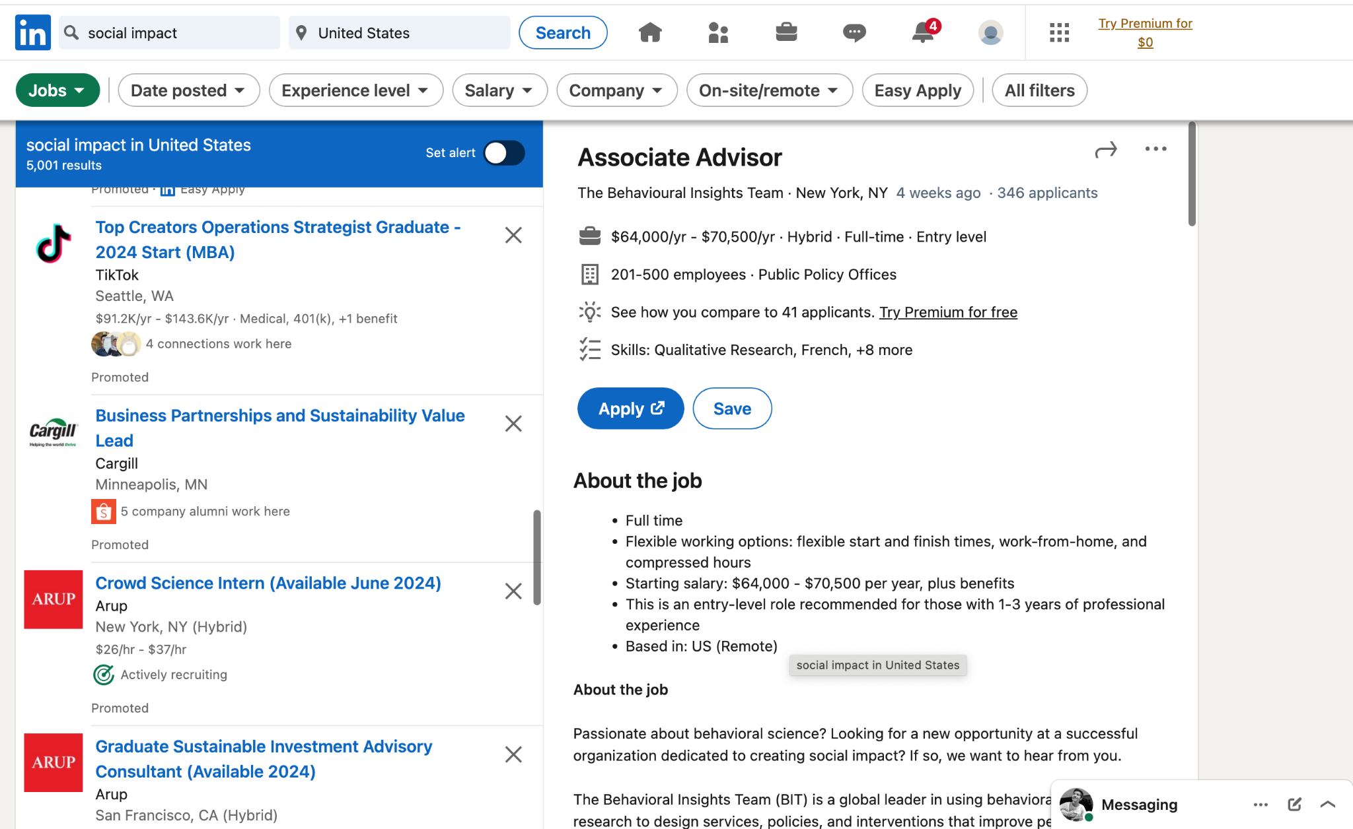

Slide 3
Value Proposition
Turn Your Passion Into Purpose
We want social impact to be aligned with people’s passions so they can do impactful work for the long term
We want to leverage their skills to help small and local non profits that are dedicated to systemic change

Slide 4
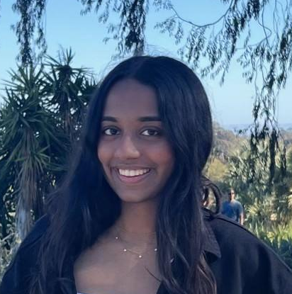
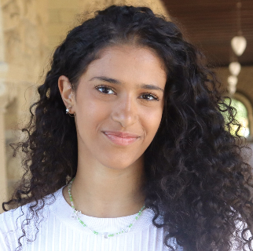


Our Team
Anavi Baddepudi
Sara Bukair
Saniya Vashist
Shardul Sapkota
Computer Science
AI track ‘25
Computer Science
HCI track ‘25
SymSys
HAI Track ‘25
First year Computer Science PhD

Slide 5
Talk Outline
Heuristic evaluation results
All UI and product revisions
Prototype implementation status
Demo

Slide 6
Heuristic evaluation results: High level summary
21 Severity 3
9 Severity 4
~ 31% of total violation were severity 3 and 4

Slide 7
Heuristic evaluation results: High level summary
Design and UI
UX
Personalization and User Profiles
App's Values and Purpose

Slide 8
Design, UI, and UX
Design and UI:
Enhance consistency in design elements like color schemes and patterns.
Improve help/documentation and UI functionality.
Avoid excessive use of caps lock for better readability and accessibility.
Differentiate page designs for finding jobs and events.

Slide 9
Design, UI, and UX
Design and UI:
Enhance consistency in design elements like color schemes and patterns.
Improve help/documentation and UI functionality.
Avoid excessive use of caps lock for better readability and accessibility.
Differentiate page designs for finding jobs and events.
UX:
Refine the "Find a community" task flow.
Provide more information after signing up for events or applying to jobs.
Reconsider the emphasis on location as a primary filter.
Clarify the app's purpose throughout the user's interaction.
Encourage long-term engagement and deep connections.

Slide 10
Personalization and Aligning Values
Personalization and User Profiles:
Expand sorting and filtering options for personalization.
Include a user profile section for achievements, resumes, and skills.
App's Values:
Reinforce the app's values and social impact throughout the user experience.
Emphasize fostering a sense of community and longevity in social impact efforts.

Slide 11
Heuristic evaluation results: High level summary
Design and UI:
Enhance consistency in design elements like color schemes and patterns.
Improve help/documentation and UI functionality.
Avoid excessive use of caps lock for better readability and accessibility.
Differentiate page designs for finding jobs and events.
UX:
Refine the "Find a community" task flow.
Provide more information after signing up for events or applying to jobs.
Reconsider the emphasis on location as a primary filter.
Clarify the app's purpose throughout the user's interaction.
Encourage long-term engagement and deep connections.
Personalization and User Profiles:
Expand sorting and filtering options for personalization.
Include a user profile section for achievements, resumes, and skills.
App's Values and Purpose:
Reinforce the app's values and social impact throughout the user experience.
Emphasize fostering a sense of community and longevity in social impact efforts.

Slide 12
Revisions not addressed
Task flows not working well or buttons not functioning → these have been fixed with the implementation and some were limitations of figma
Help and Documentation for how to support mentees → A walkthrough in an ideal prototype of the app
Event history or Jobs applied → Having a profile page with details would address this, but we have found a workaround for the time being
Type and Distance is undefined → Consistency with other apps that have distance based filtering and type options are self-descriptive
RSVP’ing for an event and alignment with overall values of the platform →Events are important and joining communities is an additional task flow that we envision to implement in another iteration. For now, we focus on highlighting recurring events from the same non-profits/clubs.
Workflows for mentors → Beyond the scope of the app implementation/design
Application materials for a job → Link them to the non-profits job portal

Slide 13
Overall HE Violations
User Interface & Navigation
Severity 4: Issues with tab visibility, inconsistent event access, and navigation problems.
Content & Information Display
Severity 3: Unclear icon functions, poor labeling, repetitive descriptors, excessive text without visuals, overuse of uppercase text, and ambiguous default option wording.
System Status & Feedback
Severity 3: Lack of clarity in job application status and missing input fields in chat.
Functionality & Features
Severity 3: Absence of a history page, no save option for searches or tags, and no direct return function in chat.
Help & Documentation
Severity 3: Ambiguity in metrics and profile access, with insufficient mentor guidance.
Inclusion & Community Focus
Severity 3: Missing non-profit sections, oversimplified mentor profiles, and event-focused community aspects.
Role Clarity & User Control
Severity 3: Unclear roles during signup and lack of mentor type indication.

Slide 14
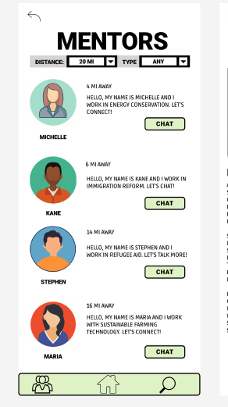
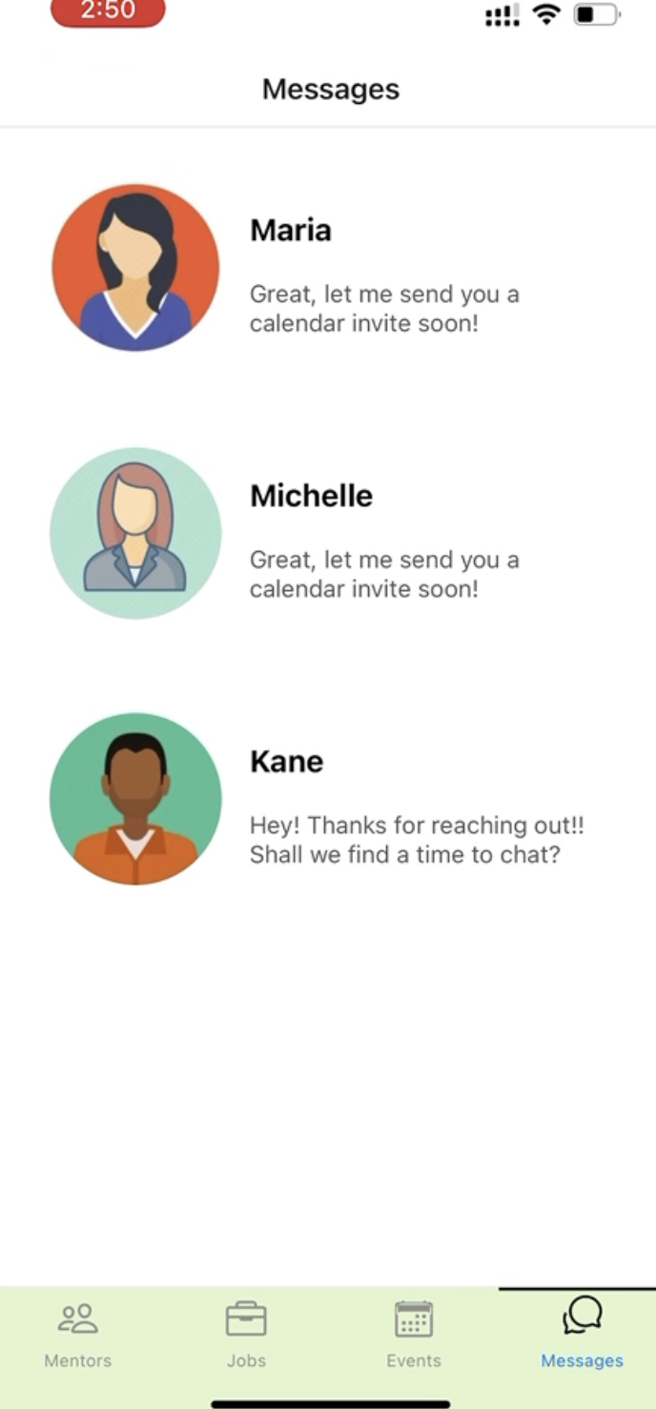
UI and product revisions: Navigation
Change: Added description for each navigation tab, current tab identification, and relevant icons
Reason: For first-time users, it might not be obvious to them what each tab represents.
Before
After

Slide 15
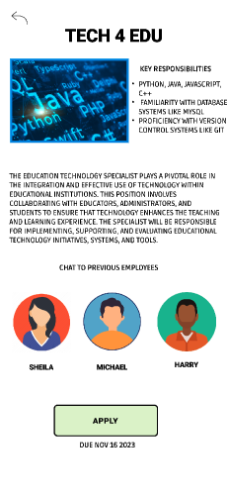
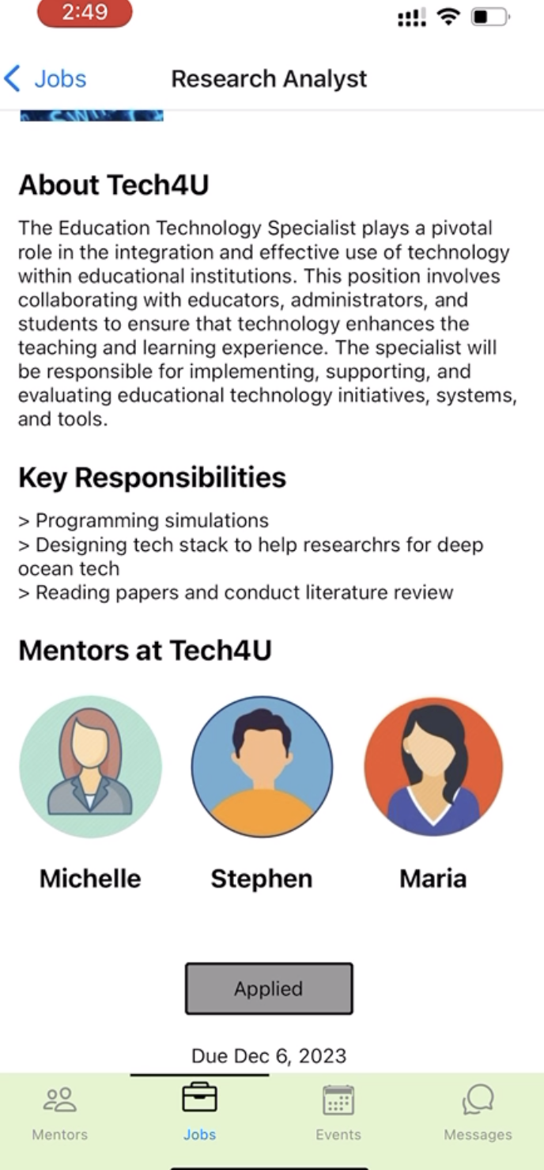
UI and product revisions: Non-Profits
Change: Added non-profit description
Reason: To help users develop empathy towards the work the non-profits are doing
Before
After

Slide 16
UI and product revisions: UPPER Case
Change: Removed all CAPS texts
Reason: To make reading text quicker and easier on the eye
Before
After

Slide 17
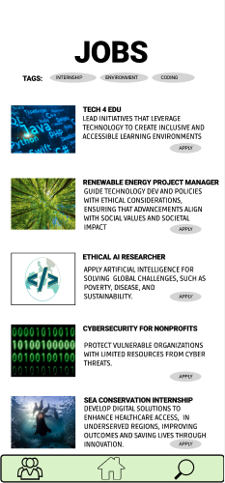
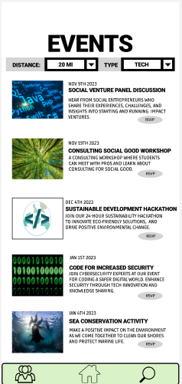
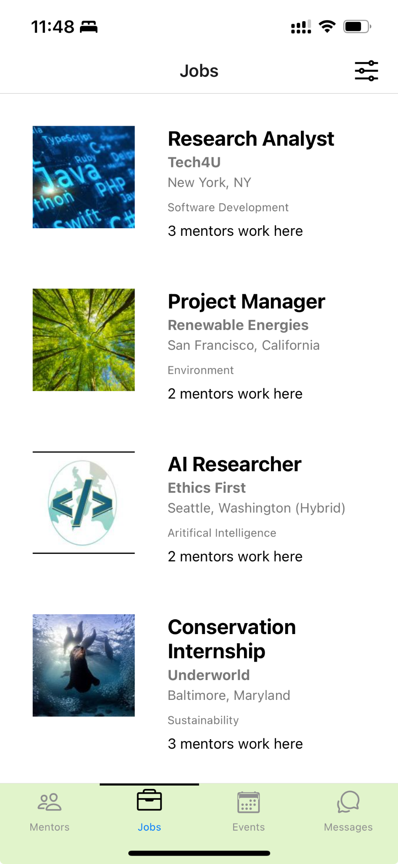
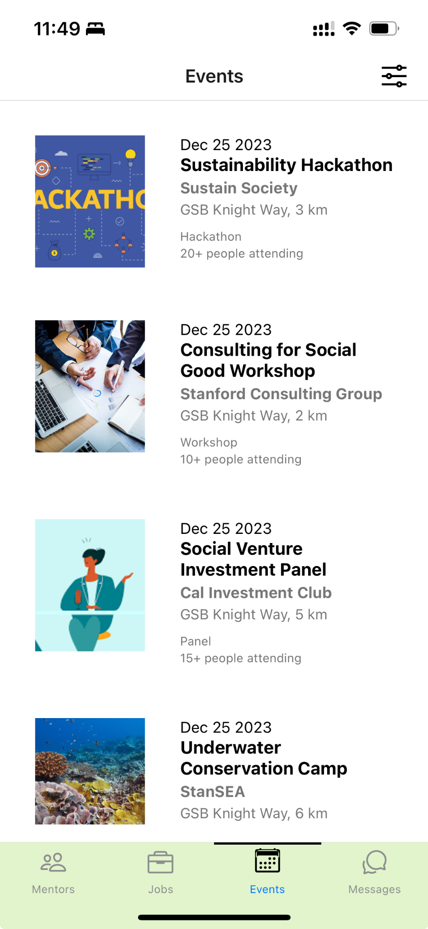
UI and product revisions: Different Designs
Before
After

Slide 18
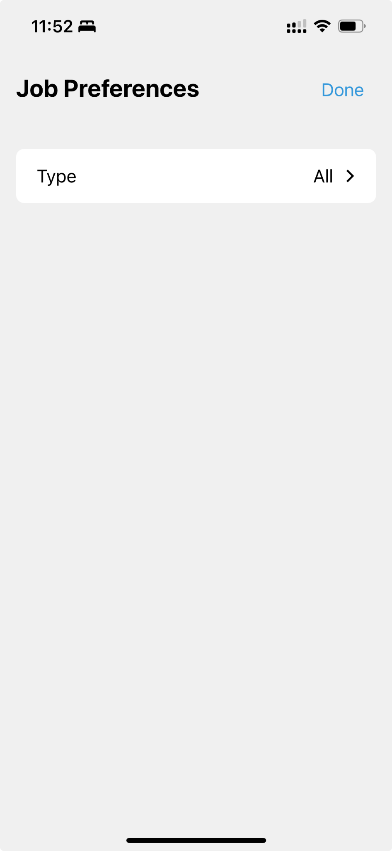
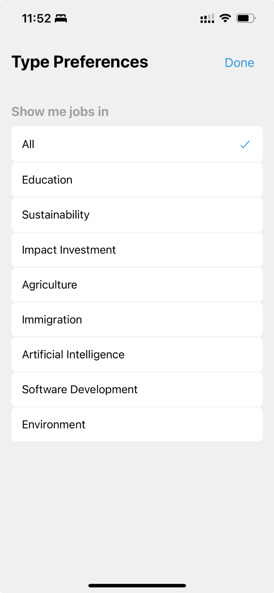
UI and product revisions: Job Tags
Change: Added selection for the filter, so it is easier to select from commonly used preference settings
Reason: To help make the workflow easier
Before
After

Slide 19
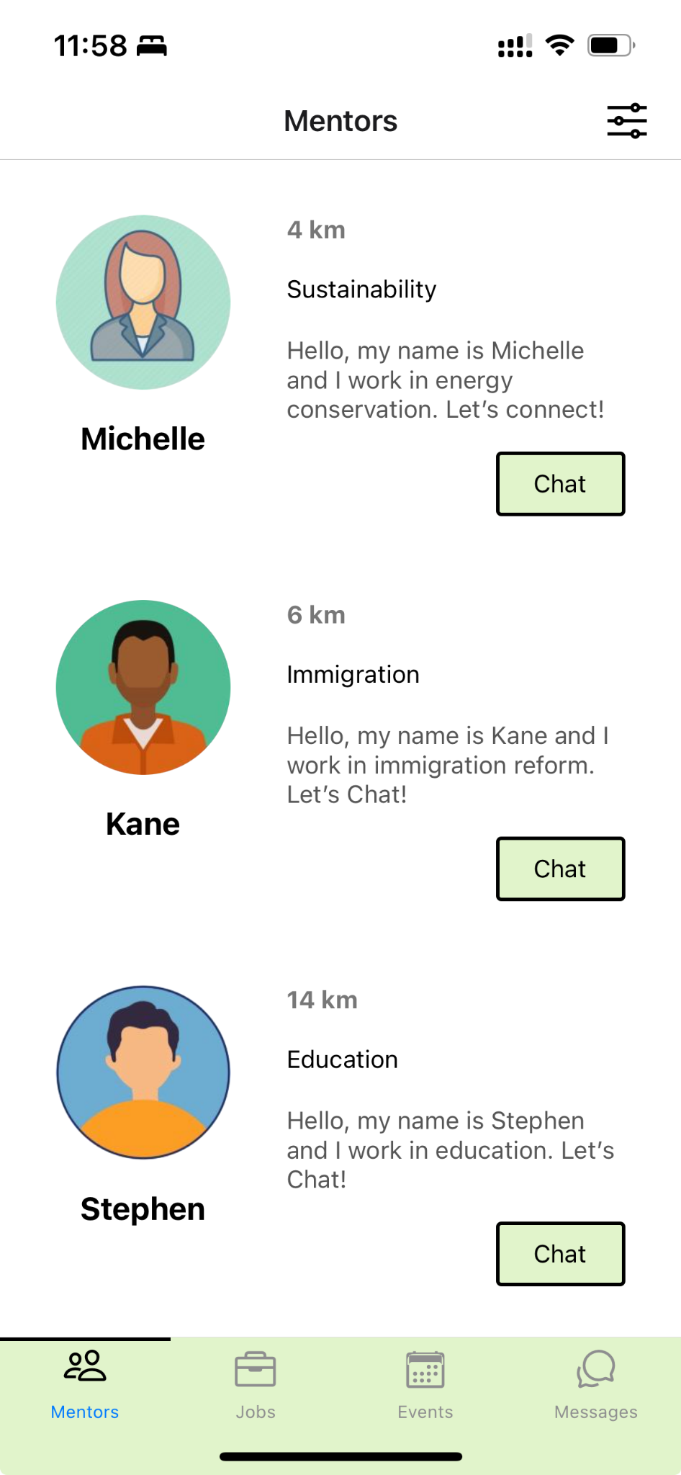
Task 1 revisions: Filter bar, Mentor Type
Change: Changed filter bar and added mentor type
Reason: Made the design consistent across the tabs and give an option to users to hide the preferences when they don’t need it
Before
After

Slide 20
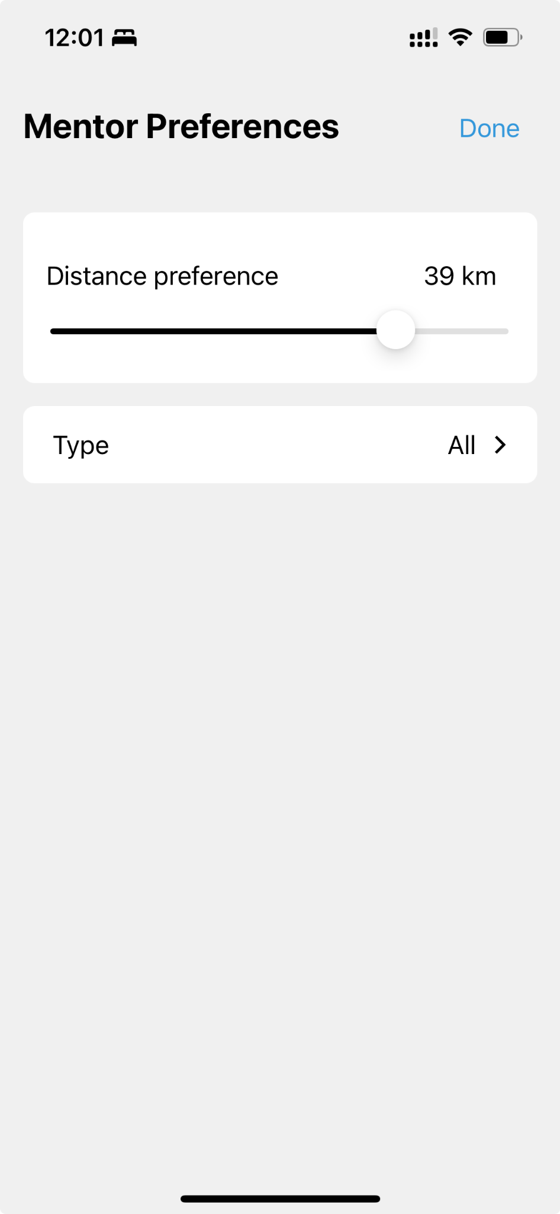
Task 1 revisions: Type Definition
Change: Type changed from “any” to “all”
Reason: Type: Any is more programmer/system oriented language and thus less friendly
Before
After

Slide 21
Task 1 revisions: Missing Mentor Type
Change: Type changed from “any” to “all”
Reason: Type: Any is more programmer/system oriented language and thus less friendly
Before
After

Slide 22
Task 1 revisions: Shortcut to see messages
Change: Added a messages tab in the navbar
Reason: Quickly access messages and resume conversations
Before
After

Slide 23
Task 2 revisions: Jobs Tab
Change: Added location, mentors working here, non-profit name, and type of job
Reason: To give users quick feedback and resources available to them to chat with the mentors working in these places
Before
After

Slide 24
Task 2 revisions: Applied Job Response
Change: Grey out the Applied button upon applying for a job
Reason: To give feedback to the users that they have already applied to a position or rsvp’ed for an event
Before
After

Slide 25
Task 3 revisions: Events Tab
Change: Highlight event, add date, location, and how many people are attending the event
Reason: To give users an idea of how big the event is going to be
Before
After

Slide 26
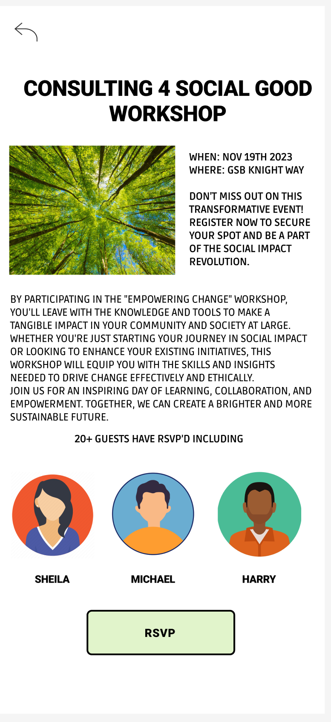
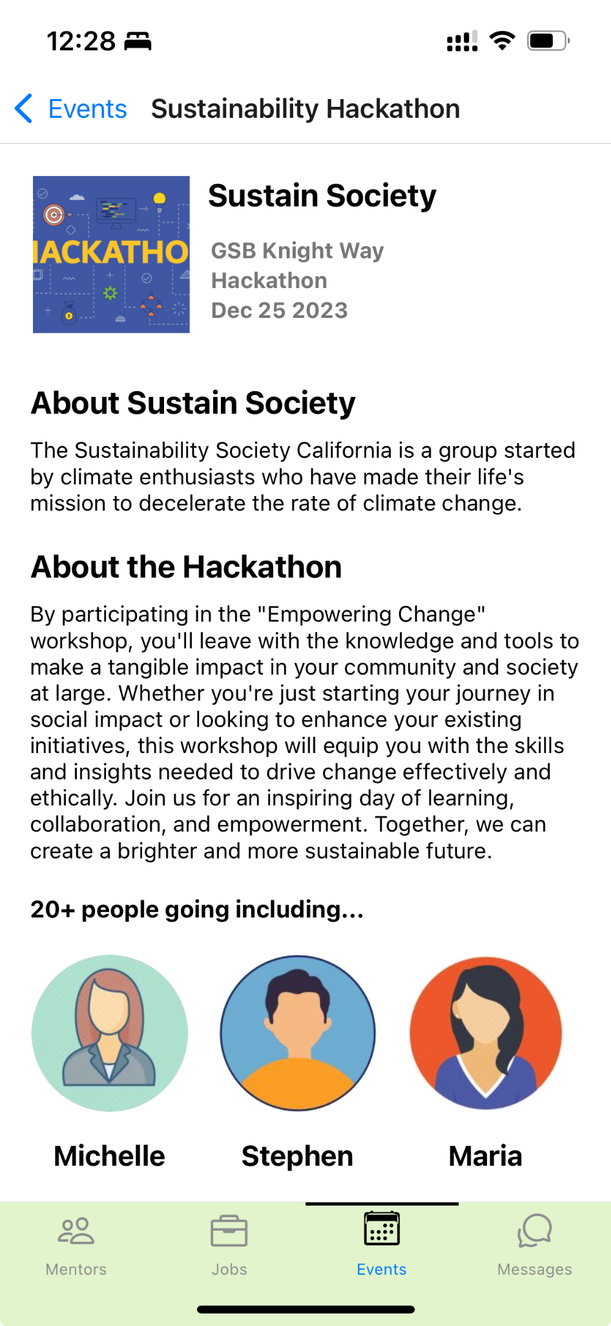
Task 3 revisions: Event Details
Change: Add Description of the non profit/club as well as the event
Reason: To give users an idea of the communities that they can join or reach out to
Before
After

Slide 27
Progress towards usability goals
The revised changes help our usability goals of task success and efficiency of tasks. They are focused on improving user experience and engagement in our app.
For example clear tab descriptions reduce the time and effort users spend figuring out where to go for specific functions, leading to more efficient navigation and task completion.
Easy access to history saves users time in recalling or reconstructing their past engagements, making it more efficient to reflect on their experiences and apply these insights to future activities
And by providing direct information about the non-profits and their projects, users can quickly decide where to contribute, streamlining their decision-making process, and enhancing their task success of finding an opportunity

Slide 28
Prototype implementation status
Framework/tools being used
Github
React Native
Expo

Slide 29
Prototype implementation status
Implemented features
Mentors (profiles)
  View Profile
  Send Messages
  View Message History
  Filter by category of impact work and distance from the mentee
Jobs (with filters)
Events (with filters)
Messages
c. Unimplemented features & plans to finish
Implemented all features

Slide 30
Prototype implementation status
Implemented features
Mentors (profiles)
  View Profile
  Send Messages
  View Message History
  Filter by category of impact work and distance from the mentee

Slide 31
Prototype implementation status
Implemented features
Jobs
  Filter by type
  View Job Description and Non-profit Description
  View Mentors working in the company
  View Mentor Profile/Chat with Mentors through the Jobs Tab

Slide 32
Prototype implementation status
Implemented features
Events
  Filter by type and distance
  View description about the non-profit hosting it as well as the event itself
  View the number of people going to the event
  View Mentor Profile/Chat with Mentors

Slide 33
Prototype implementation status
Wizard of Oz techniques
Pre-loaded chat in mentor profiles due to prototype limitations in simulating real-time interactions.
List of job opportunities available to "apply" for without filtering for user skill-set or experience.
Automatic redirection to mentor or mentee page in the prototype, whereas the final application will restrict access based on registered account type (mentor or mentee).
Pressing on “Apply” and “RSVP” changes to “Applied” or “RSVPed” as if you had already done that

Slide 34
Prototype implementation status
Hard-coded aspects
Hard-coded users, jobs, events, and related information in the app.
Direct population of user and mentor bios, as well as event details.
Mentor profile information, including bios, introductory videos, and tags for location and interests, were hard-coded.
Number of mentors that work at job
Preloaded job and networking event details, including descriptions, scheduling, venues, and recommended invitees.
Pre-set chat and messaging components

Slide 35
DEMO
Notes:
Due date
Blue text

Slide 36


