Slide 1
Education For Adults
Blain, Nolawi, Yarency, Yasser

Slide 2
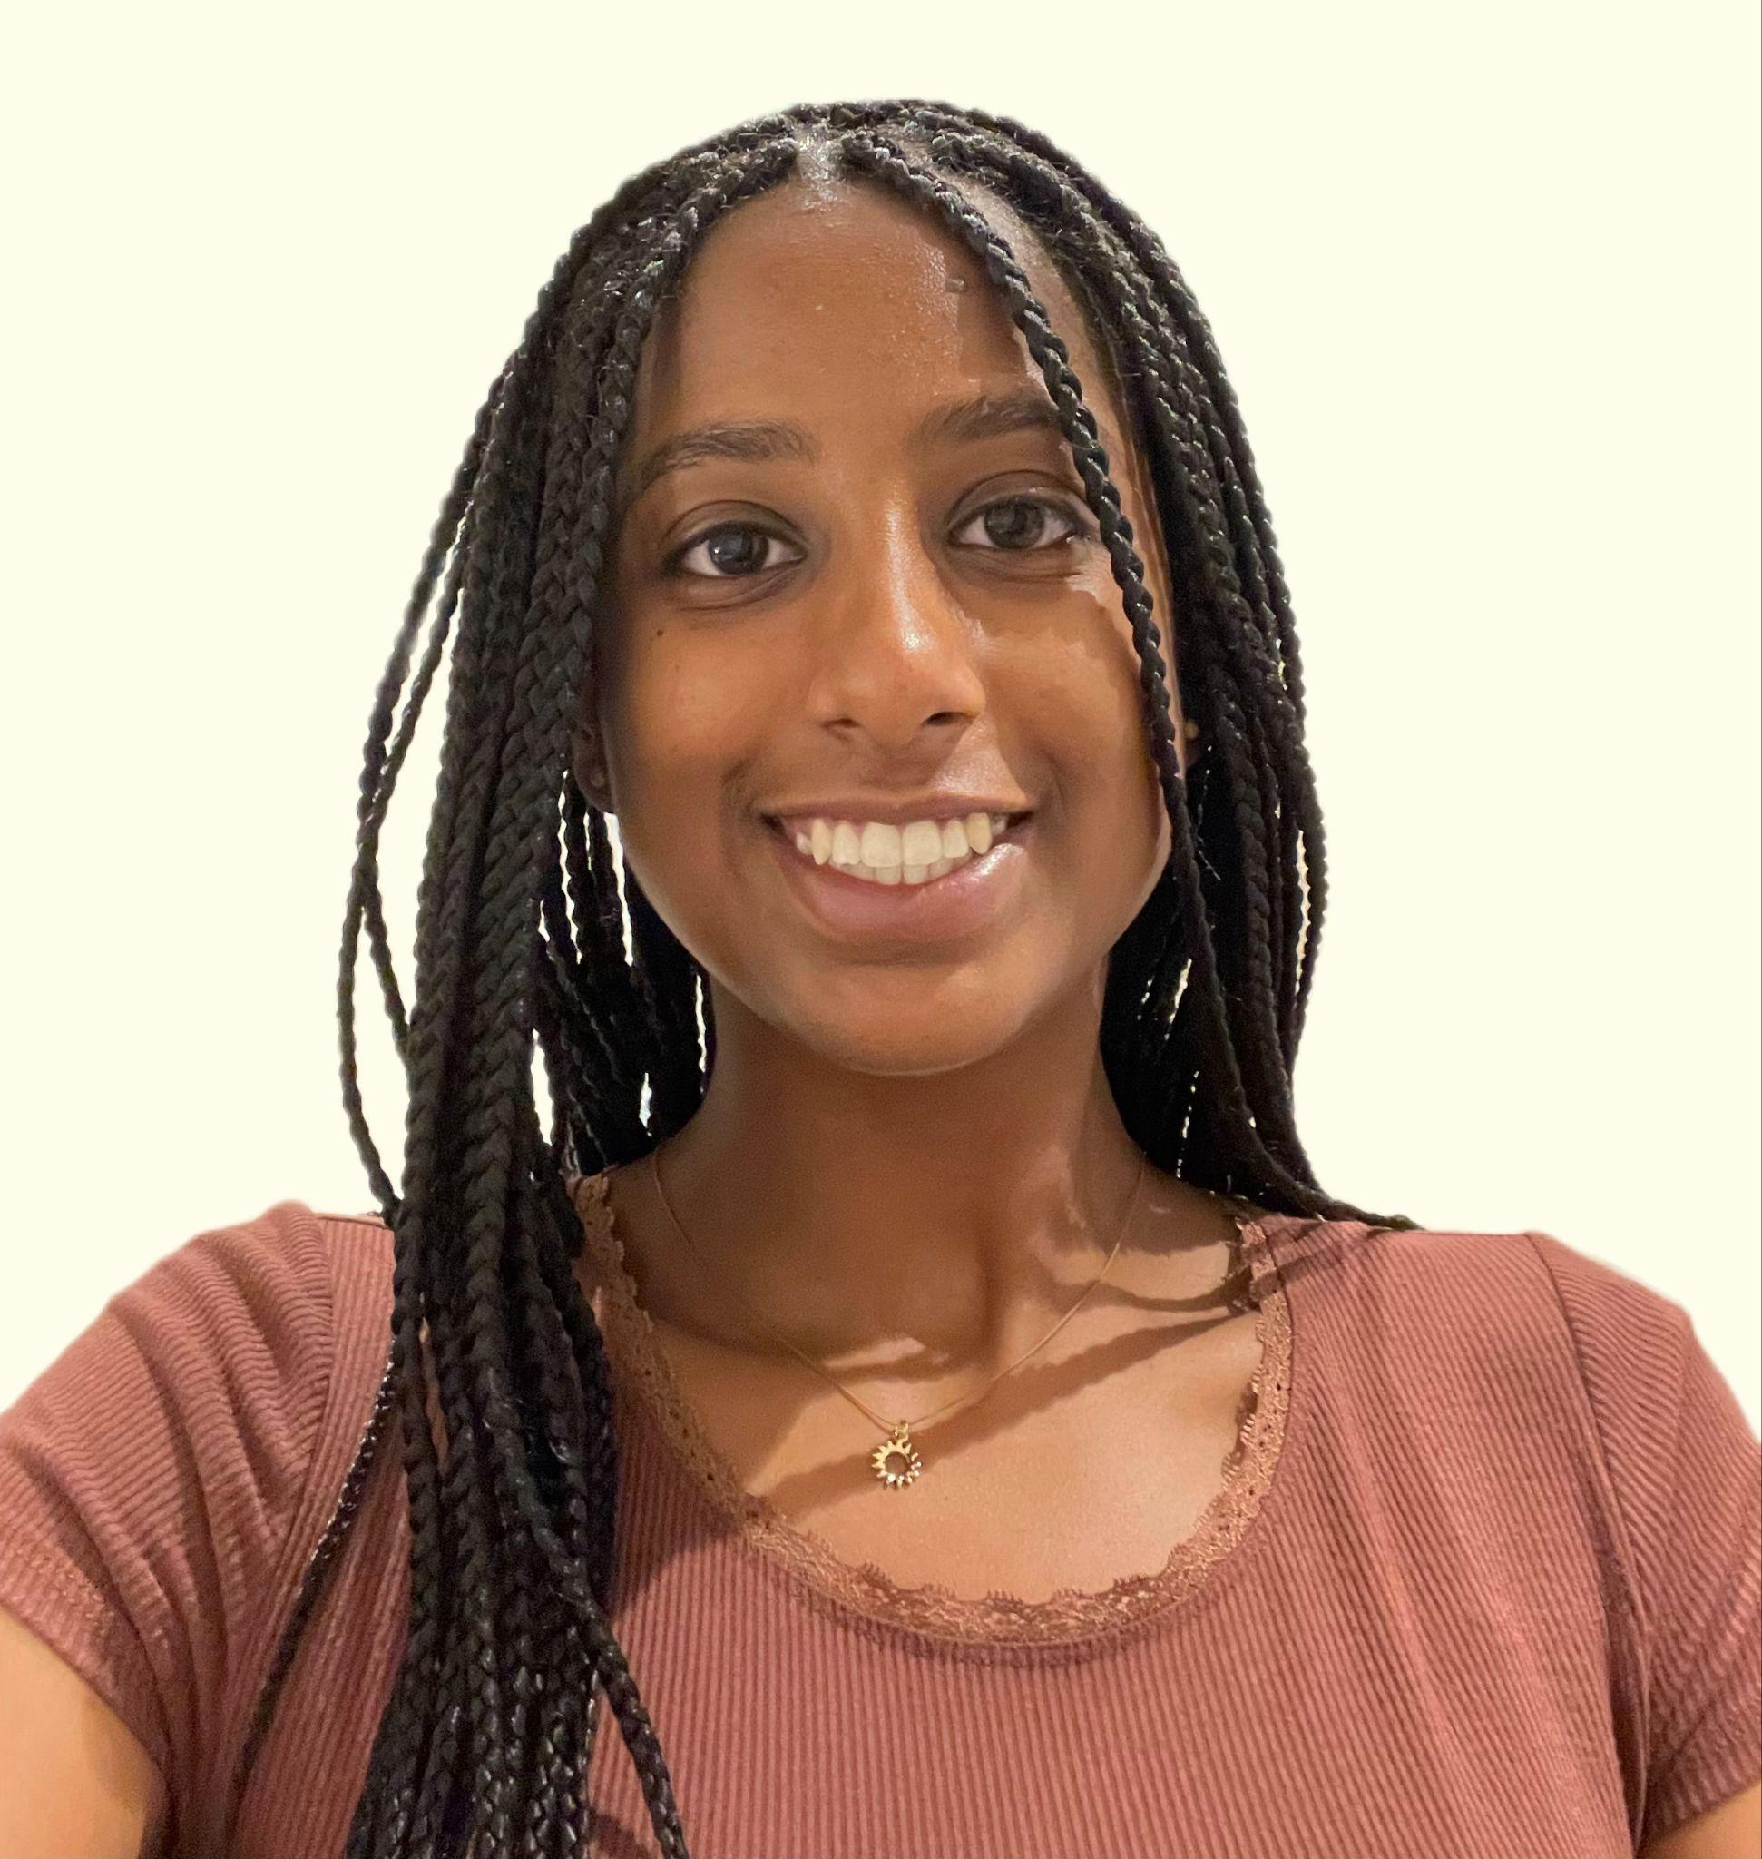

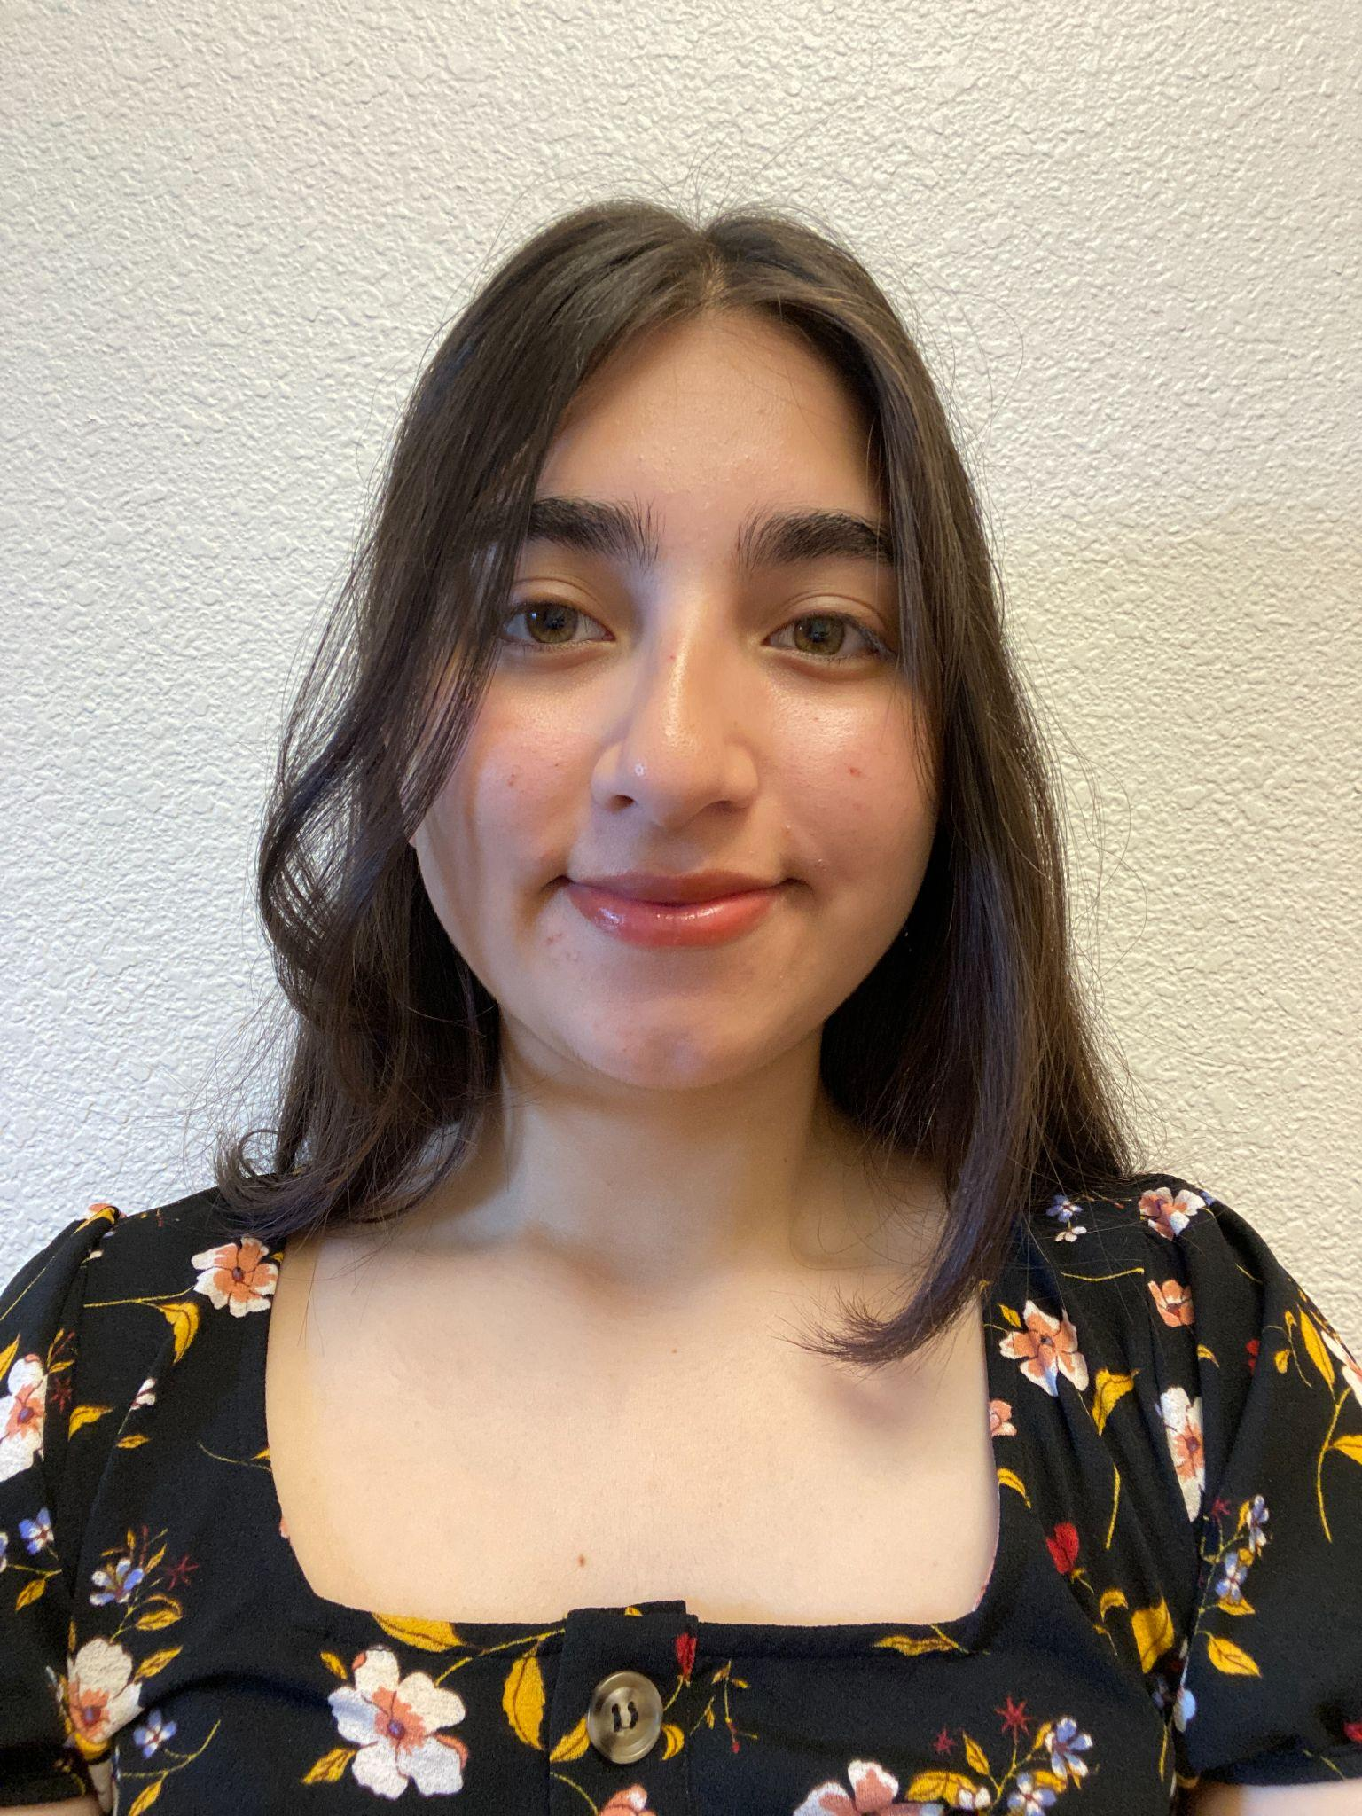
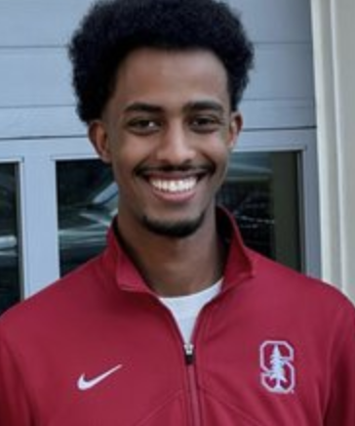
OUR TEAM
Blain Engeda
Nolawi Ayelework
Yarency Avelar
Yasser Jamal
San Leandro, CA
Silver Spring, MD
Oakland, CA
Boston, MA

Slide 3
DOMAIN SELECTION
Adults
Challenges
Lifelong Learning
Community
Resources
Notes:
Learning from the workforce - coming back to school

Slide 4
Participant Selection Process
Cold-Emailing
LINKEDIN
GOOGLE
Find People-in Context
Notes:
People-in-Context - people who are actively learning, trying to learn

Slide 5
Methodology
Who?
  students & educators
  full-time & part-time
  extreme & normal users
  different age, gender, interests
Where?
  In person & Zoom
How?
  1 interviewer, 1 recorder
  typed notes + audio recording + consent
Notes:
15

Slide 6
Key Questions?
What inspired you to continue your education?
Memorable challenges or experiences associated with learning?
How do you see your social life impacted by attending school?
What’s your day to day like?
What goals do you have for after education?
What's your community like inside of school and outside of school?
Notes:
mission

Slide 7
Participants
Peter : Director of Academic Programs @ SCPD
Sam: Candidate for a Masters in Liberal Arts
Leila: Current matriculated nursing student and full-time employee at BofA
**For purposes of this assignment, we have anonymized our participates by replacing their real names with pseudo-names**
Notes:
Extreme User

Slide 8
“How do you do 15-25 hours a week of school plus your regular life over 10 weeks? And how do you do that over and over again for [multiple] years?”
Peter
SCPD Employee, 35 MIN
Notes:
Don’t introduce

Slide 9
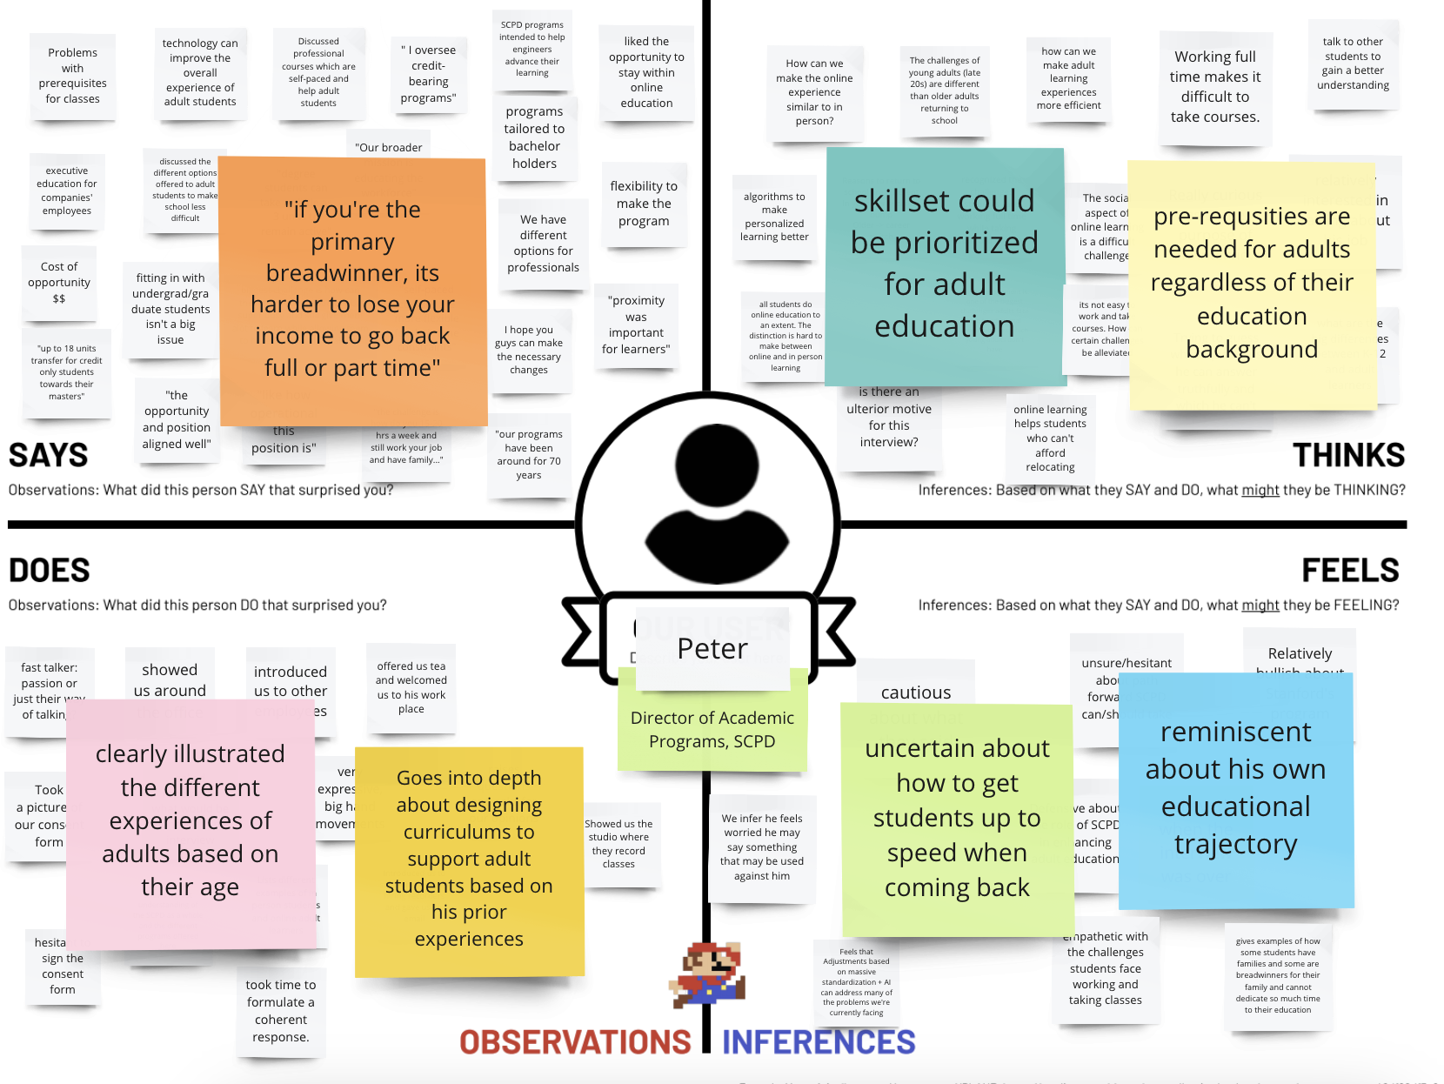
“
Notes:
Getting everybody up to speed
Making it easier for people who can’t necessarily go back full time

Slide 10
Insights
I. There are many options to accommodate different schedules
II. People like the flexibility of classes, but aren’t just looking to get the degree
Need
How can technology be utilized to make the flexible learning experience more interpersonal?
Notes:
Observation: He talked a lot about different ways that SCPD works around people’s needs, conflicts, etc., but also about how they haven’t been able to find a way that brings about completely the communal aspect of learning
Need: With flexible learning, students lose on the benefits of interpersonal relationships in learning.

Slide 11
“A lot of my colleagues are still working full-time….I’ve gotten more pleasure out of the program than they have. ”
Sam
MASTERS STUDENT, 40 MIN
Notes:
Extreme User - undergrad in ‘81 in Mechanical Engineering

Slide 12
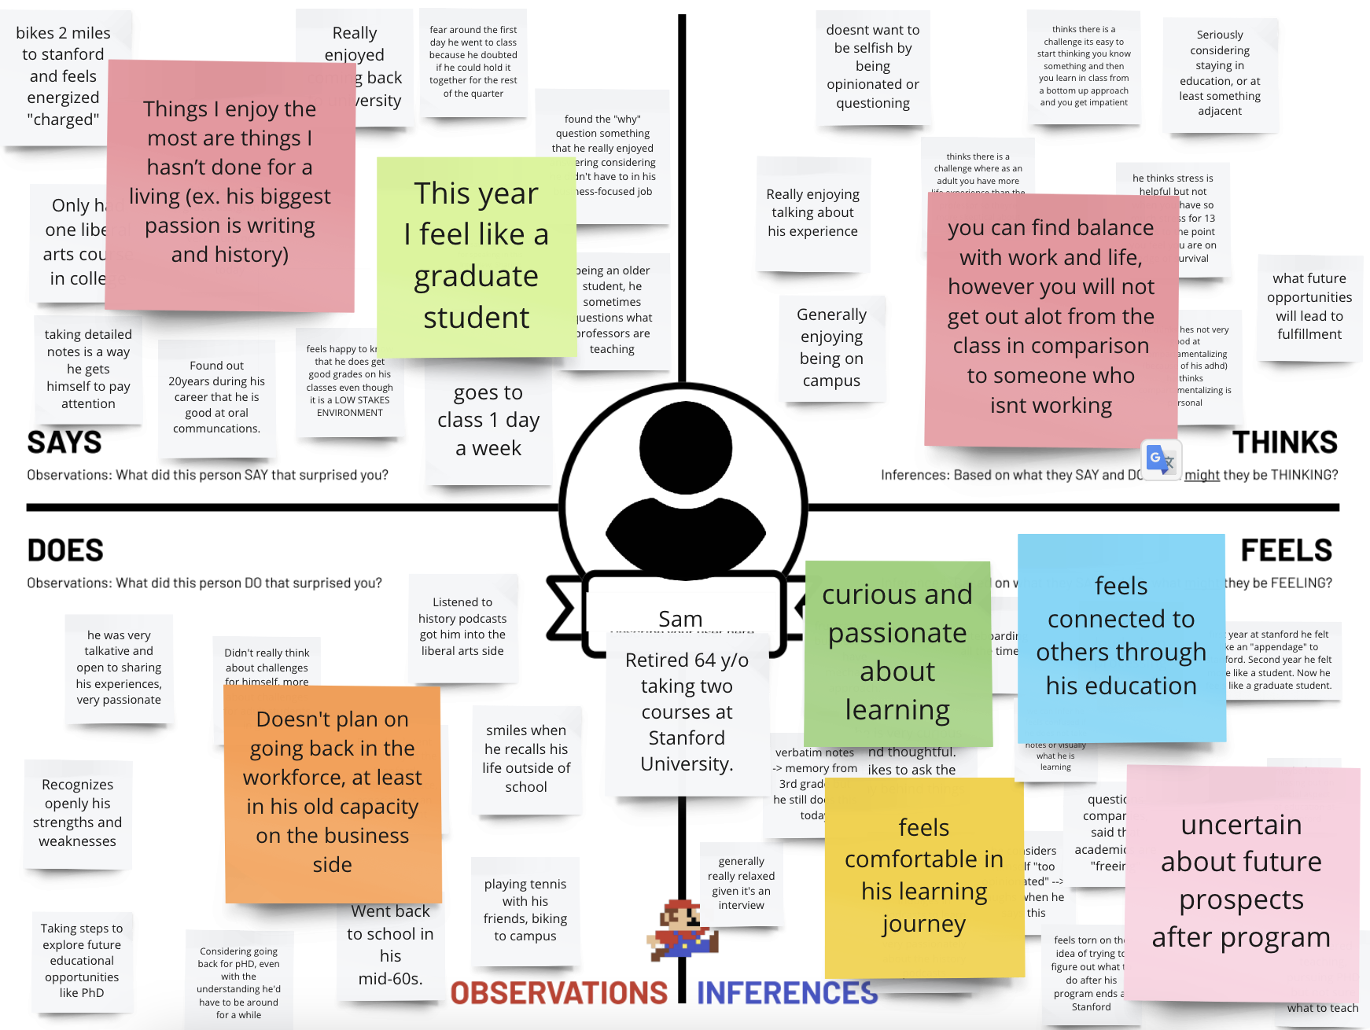
Notes:
Being around campus and students enhanced his experience
Going back for something completely different than what he learned invigorates him

Slide 13
Insights
Adult students’ educational experience varies based on their commitments outside of school
II. Being able to feel like one is part of the school community really enhances the educational experience
Need
Part-time students would really appreciate a way to feel connected to a school community,
Notes:
Need: …even with commitments that can make it difficult to solely focus on classes

Slide 14
“When you have a purpose, you pay the price for what you want.”
Leila
PART-TIME NURSING STUDENT, 40 MIN

Slide 15
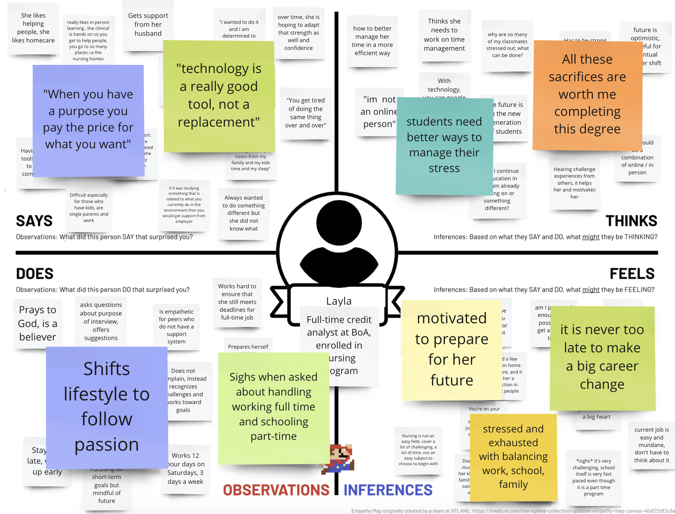
Notes:
Sacrifices are worth it
Can be stressful, especially without support

Slide 16
Insights
I. People learn the most when using a combination of online and in-person tools
II. Students who struggle the most are those without strong support systems (single parents, students with kids, etc)
Need
We need to alleviate the burden returning to school can cause on students and use technology to build-upon in-person learning
Notes:
Insight: All these tools seems to help, but at the end of the day the same issue remains in terms of balancing work and home with school.
Need: People want to continue their education but don’t have adequate support systems in place, both online and in-person.

Slide 17





Key Learnings
Notes:
Community & Social Life
Importance of Support Systems
Big Shifts & Future Uncertainty
Balance Between Responsibilities

Slide 18
01
NEXT
STEPS
02
More Interviews
Potential adult returners to school
Faculty / professors who teach adults
More Empathy Maps
Ideation
Conduct ideation sessions to brainstorm ideas to help address the current challenges adult learners face
HMW questions
Notes:
Ideation: For potential areas of focus
POV: Potential reframing our problems using our user needs and insights

Slide 19
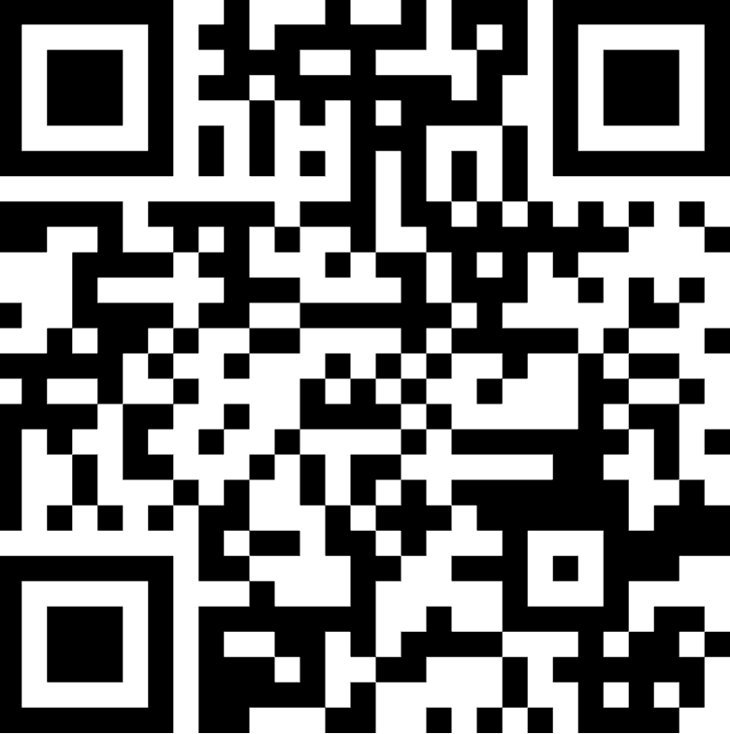
THANKS!
Got questions or comments?

