Slide 1
Education For Adults
Blain, Nolawi, Yarency, Yasser

Slide 2
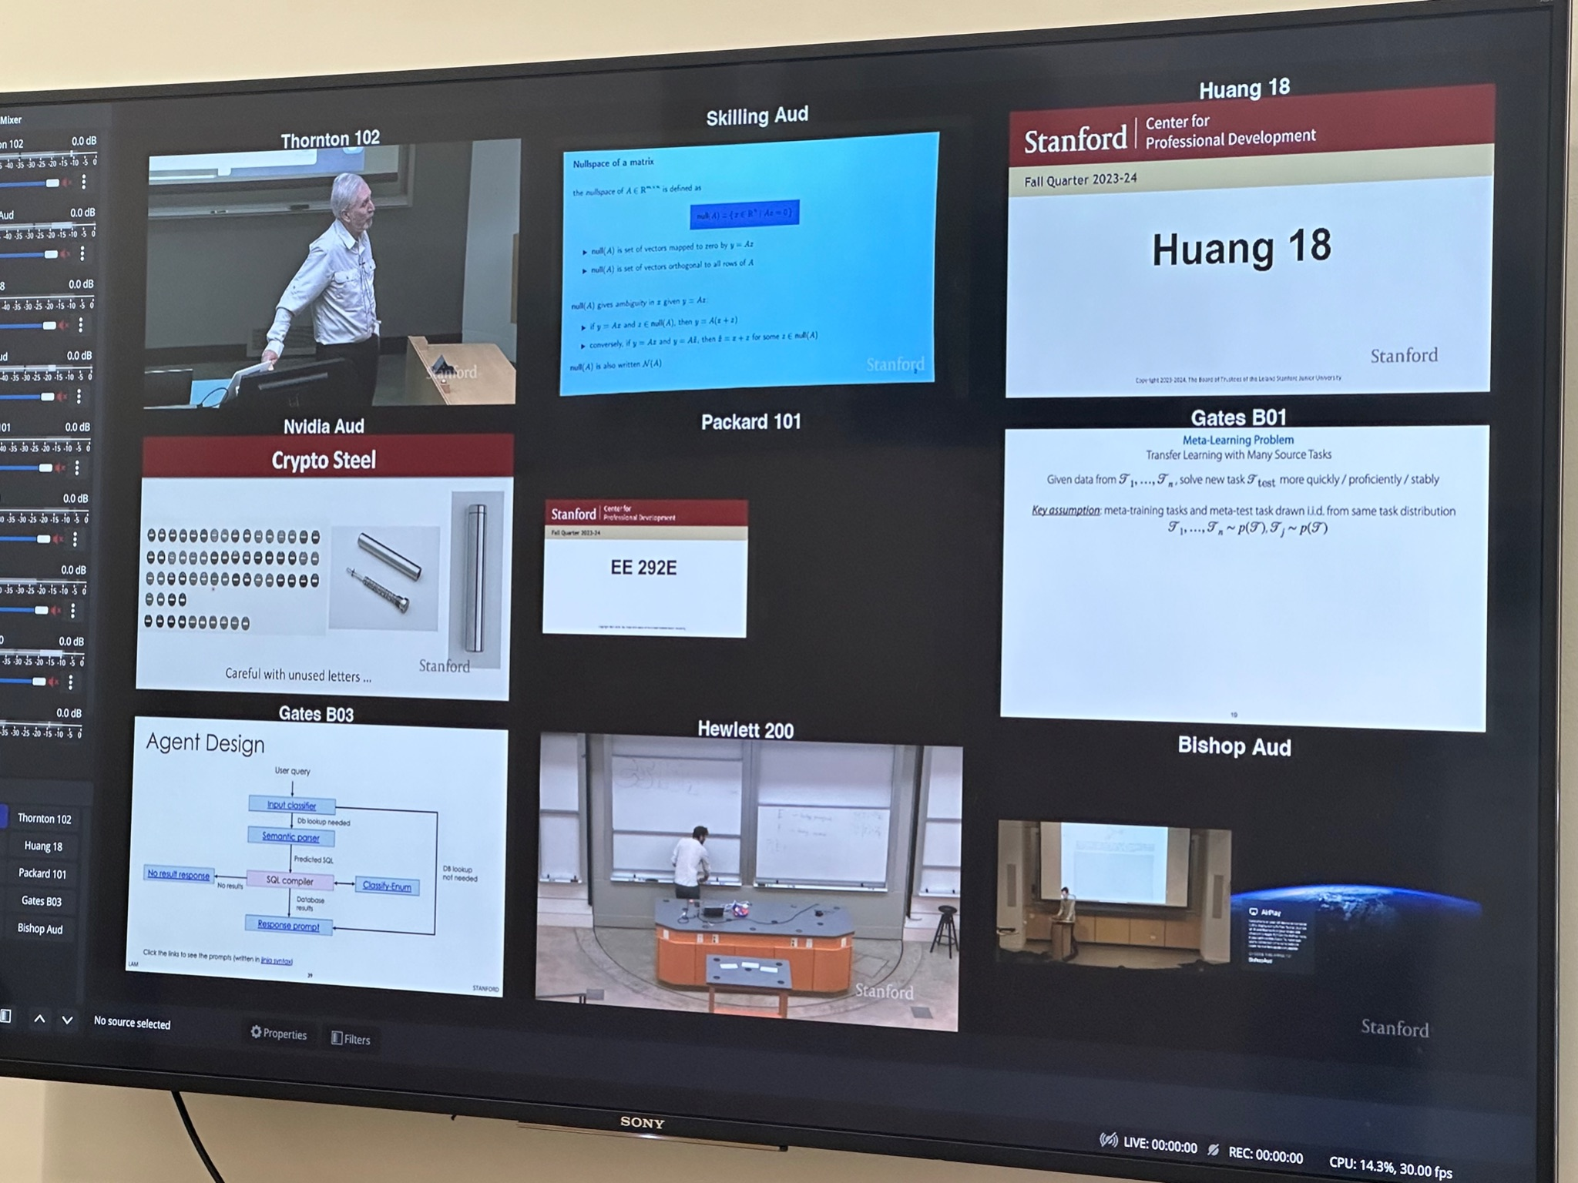
Recap
In our interviews last week, we learned that adult students enjoy their experience returning to school:
When they feel interconnected with the wider community
When they feel supported academically and socially.
Notes:
In our interviews last week, we learned that:
older students enjoy their experience going back to school when they felt as if they were connected with a broader community.
We also found that some type of support, both from the school and from friends and family, really made a difference in how well they dealt with the dual work and school stresses.

Slide 3

Original Domain
What can we find about older students’ experience with going back to school?

Slide 4
Original Domain
NEW
How can we alleviate older students’ lack of support and connection once returning to school?

Slide 5

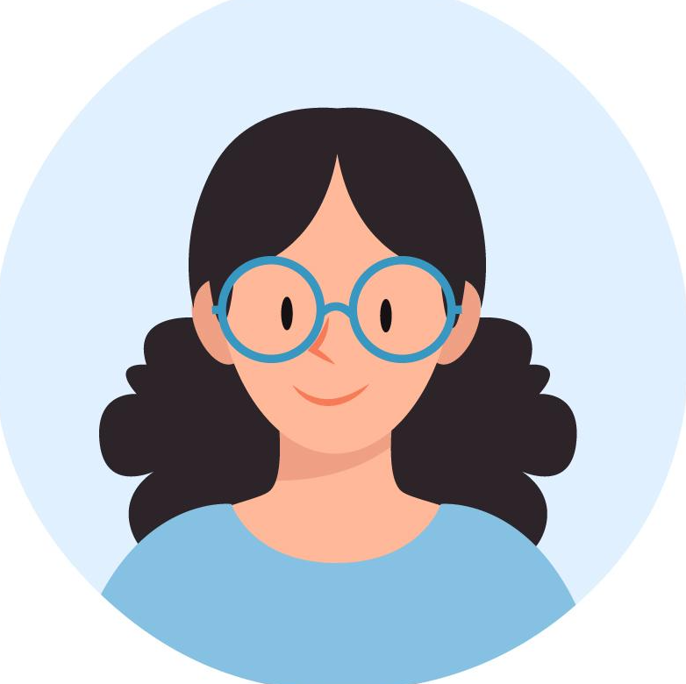
Additional Inter
Rachel
Current SWE at Intuit
Considering returning to school full-time to aid in career shift
Monica
Considering returning to school part-time to explore career in accounting or teaching
Notes:
Image by <a href="https://www.freepik.com/free-vector/hand-drawn-collection-different-profile-icons_17786264.htm#query=people%20profile&position=7&from_view=keyword&track=ais">Freepik</a>

Slide 6



Previous Key Findings
Notes:
Previous Findings: Community & Social Life; Importance of Support Systems; Big Shifts & Future Uncertainty; Balance Between Responsibilities

Slide 7

Additional Key Findings
Uncertainty
Notes:
Key findings really narrow down to having a support system and community within your learning journey as a student, and trying to find ways to balance other responsibilities outside of school, and lastly, the indecisiveness about making a career-shift adds to the hesitancy of returning to school (at least for the extreme users)

Slide 8
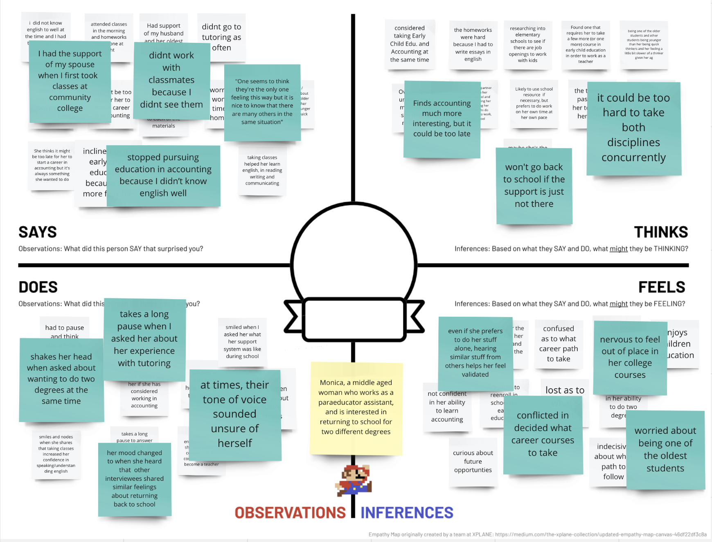
Empathy Map
Monica

Slide 9
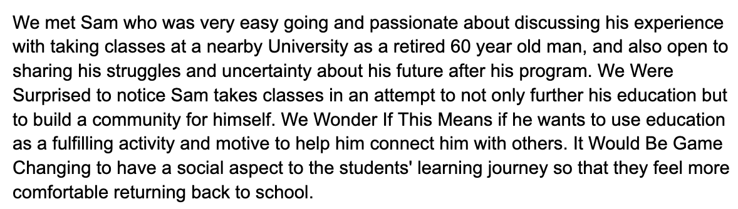
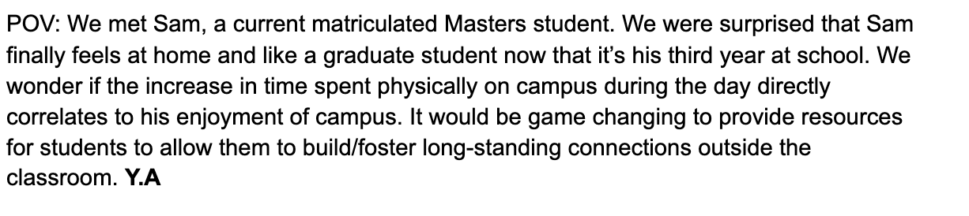
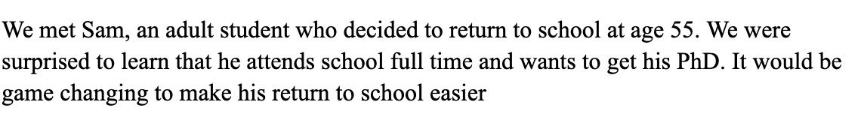
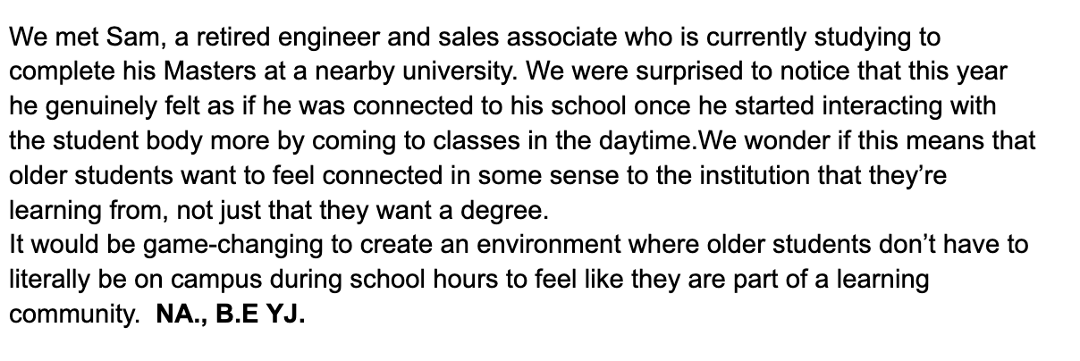
Initial POVs

Slide 10
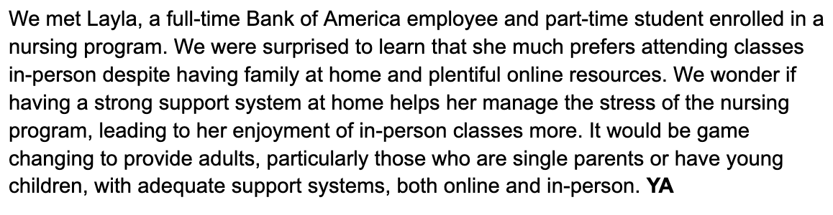
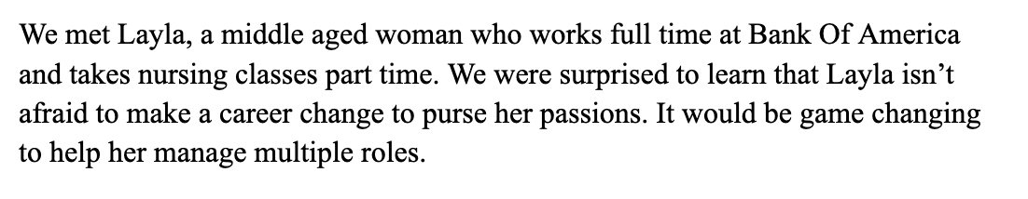
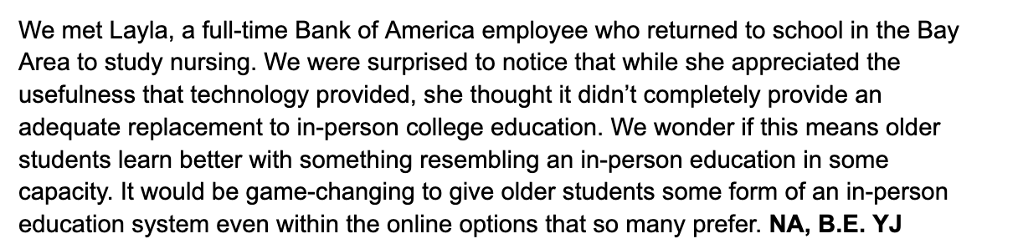
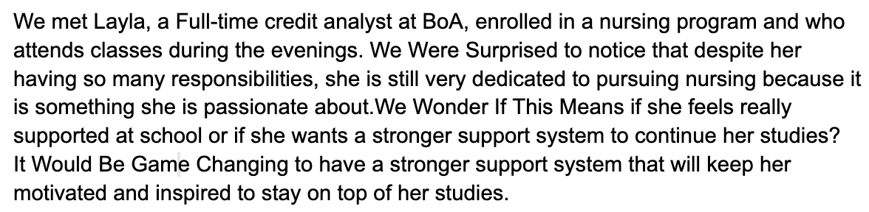
More POVs

Slide 11
Search Overview
Chose participants by going to the following locations…
Graduate Student areas and speaking with middle aged students
Main Quad around 4pm to speak to crowds there
Green / Coupa area
Participants
Older, middle aged students who’ve taken online classes / in-person
Mix of introverted / extroverted participants
Relevant to our domain of older adult education!

Slide 12
REVISED POVs
Notes:
HMWs:
HMW create opportunities for older students to connect with campus?
HMW empower younger students connect with their older classmates?
HMW get rid of any distinctions between older and younger college students?
HMW allow older students to be on campus full-time?
HMW de-emphasize the degree benefits of school in favor of the learning opportunities?
HMW give older students the chance to engage with younger colleagues?
HMW make older students’ experience more similar to the worklife that they’re used to?
HMW give older students the degree first and let them do the learning later without pressure?
HMW promote communication platforms between older and younger students?
HMW track older students’ feelings about their college experience beyond the learning standpoint?

Slide 13
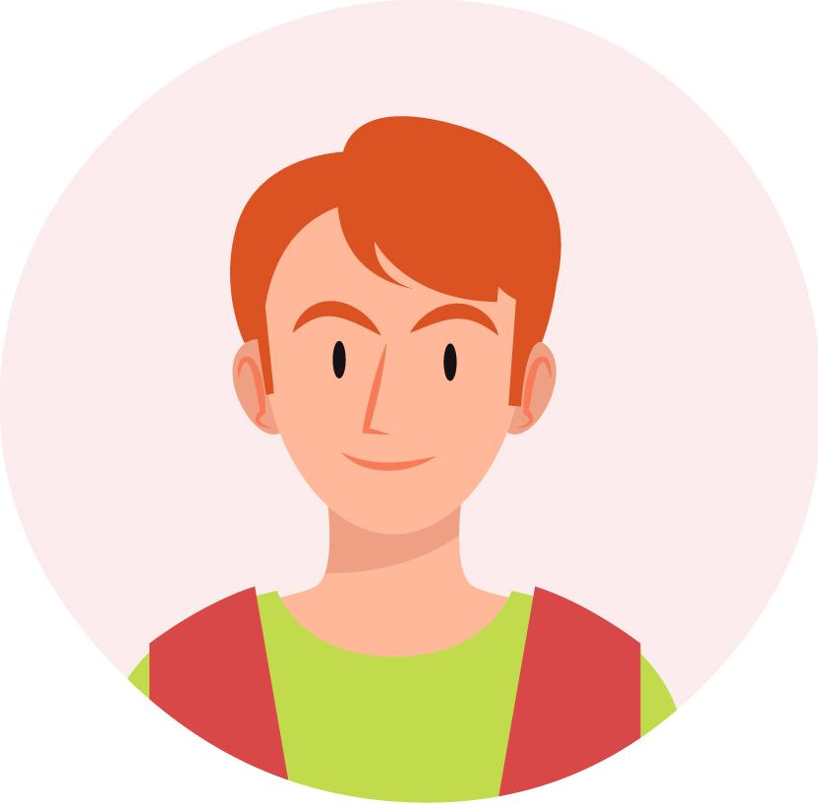

POV 1
We met Sam, a retired engineer and sales associate who is currently studying to complete his Masters in Liberal Arts at Stanford University
Sam

Slide 14

POV 1
We were surprised to learn that this year he genuinely felt as if he was connected to his school’s once he started interacting with the student body more by coming to classes in the daytime.
Sam

Slide 15

POV 1
We wonder if this means that older students want to feel connected in some sense to the institution that they’re learning from, not just that they want a degree.
Sam

Slide 16

POV 1
It would be game changing to create an environment where older students don’t have to literally be on campus during school hours to feel like they are part of a learning community.
Sam

Slide 17
HMW 1
HMW leverage classmates located in nearby areas to reduce stress and improve academic success?
Notes:
We’re saying that social connection matters.

Slide 18

Solution + Assumption
Key Assumption
Solution
Older students feel motivated and supported when they can share their goals and progress with others.
What if we institute a platform where students can find and create local support groups to stay on top of work, share their experiences and inspirations, and find community within school?

Slide 19
Experience Prototype
Task: Show students photos of progress bars and…
Ask them how they would feel about it, knowing it was a classmate of theirs
How comfortable do you feeling sharing your goals and progress with others
Do you like sharing your goals with others as a form of motivation?
Do you find it motivating to work towards a goal with others?
What effects does seeing others’ progress bars have on you?

Slide 20
Results
Adult students generally…
Find it motivating to work towards their goals with others
Enjoy having the progress bar to see their progress but not the progress of their peers
Like to share their progress/goals as a form of motivation
Notes:
Assumption was somewhat valid.

Slide 21
Experience Prototype # 1
Results
Students liked:
Flexibility
Go at own pace
Organized content
Organized videos and high quality imaging
Students disliked:
Lack of space for discussions
Easily distracted
Feels boring
Struggle to convey concepts
Content was tough and the interface of asking follow up questions was tough
Setting up meetings with professors was difficult
Interactions with Professors:
None
Email
Zoom
20 minutes of office hours
Nearby School With Resources:
Would attend the discussions
Prefers in-person lectures
Would benefit from additional support
Notes:
We surveyed five older students about their experience taking classes online:
What was the most difficult online class you've taken?
What did you like about taking that class online?
What did you not like about taking that class online?

Slide 22
HMW 2
HMW empower adults returning to school from the workforce to build and sustain lifelong connections with their classmates?

Slide 23
Solution + Assumption
Key Assumption
Solution
Interactive game with the goal to connect with as many different people as possible. Students receive weekly challenges to connect with specific people each week, and every new connection gets added to the user’s list of friends for future communication
Older students see value in connecting with other students regardless of if they are taking the same courses

Slide 24


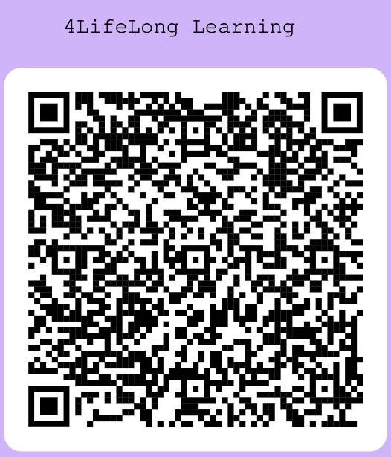
Experience Prototype
Task students with going up to someone new, introducing themselves, and finding things they have in common.
Find two graduate students who do not know each other
Ask them to get to know each other and find two similarities
Observe behaviors and debrief, participants filling out form

Slide 25

Results
People were open and willing to go up to a stranger!
Generally found it interesting to meet someone new
Some participants looked more excited than others
No participant felt that the experience worsened their day

Slide 26
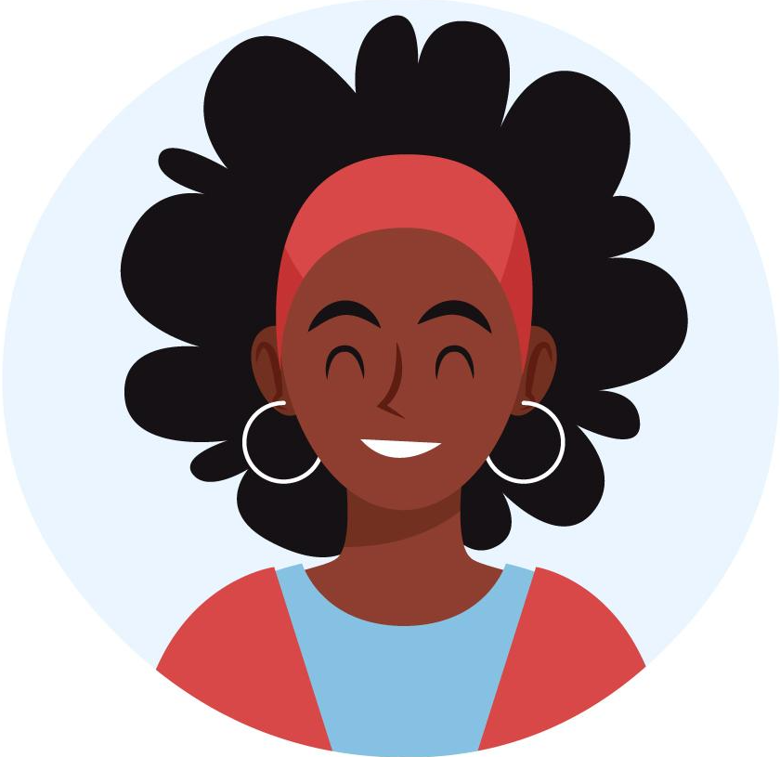
POV 2
We met Layla, a full-time Bank of America employee who
returned to school in the Bay Area to study nursing.

Slide 27
POV 2
We were surprised to notice that while she appreciated the usefulness that technology provided, she thought it didn’t completely provide an adequate replacement to in-person college education.

Slide 28
POV 2
We wonder if this means older students learn better with something resembling an in-person education in some capacity.

Slide 29
POV 2
It would be game-changing to give older students some form of an in-person education system even within the online options that so many prefer.

Slide 30
HMW 3
HMW provide middle-aged hybrid
students with the benefits of
in-person learning whilst at home?

Slide 31
Solution + Assumption
Key Assumption
Solution
Older students who are taking classes virtually still value access to in-person support resources like tutoring, constant feedback from instructors, group work.
What if we institute a cross-university program that uses partnerships to give students access to more resources across degree programs?

Slide 32
Experience Prototype
Surveyed older students about their experiences taking online courses and asked the following questions:
What was the most difficult online class you've taken?
What did you like about taking that class online?
What did you dislike about taking that class online?
What kind of interactions did you have with your professor & office hours?
Imagine there was a nearby school that offered resources specific to that course. Would that have helped you? Explain why or why not.
Would you utilize services like in-person tutoring and group work sessions at a nearby school for that class?
Notes:
Found randomly

Slide 33
Experience Prototype
Questions
Answers
Likes/dislikes about online Classes:
Interactions with professors
Nearby school that offered resources specific to that course
Notes:
We surveyed five older students about their experience taking classes online:
What was the most difficult online class you've taken?
What did you like about taking that class online?
What did you not like about taking that class online?

Slide 34
Experience Prototype
Questions
Answers
“Flexibility”, “Organized videos
“High-quality images””
“ Not having live interaction”
Likes/dislikes about online Classes:
Interactions with professors
Nearby school that offered resources specific to that course
Notes:
We surveyed five older students about their experience taking classes online:
What was the most difficult online class you've taken?
What did you like about taking that class online?
What did you not like about taking that class online?

Slide 35
Experience Prototype
Questions
Answers
“Flexibility”, “Organized videos
“High-quality images””
“ Not having live interaction”
Likes/dislikes about online Classes:
Interactions with professors
Nearby school that offered resources specific to that course
“Via Zoom + setting up another meeting was hard”
“ No space for discussions”
“Not easy to connect”
Notes:
We surveyed five older students about their experience taking classes online:
What was the most difficult online class you've taken?
What did you like about taking that class online?
What did you not like about taking that class online?

Slide 36
Experience Prototype
Questions
Answers
“Flexibility”, “Organized videos
“High-quality images””
“ Not having live interaction”
Likes/dislikes about online Classes:
Interactions with professors
Nearby school that offered resources specific to that course
“Via Zoom + setting up another meeting was hard”
“ No space for discussions”
“Not easy to connect”
“Yes, I think I would have gone to participate in person discussions and conversations.”
Notes:
We surveyed five older students about their experience taking classes online:
What was the most difficult online class you've taken?
What did you like about taking that class online?
What did you not like about taking that class online?

Slide 37
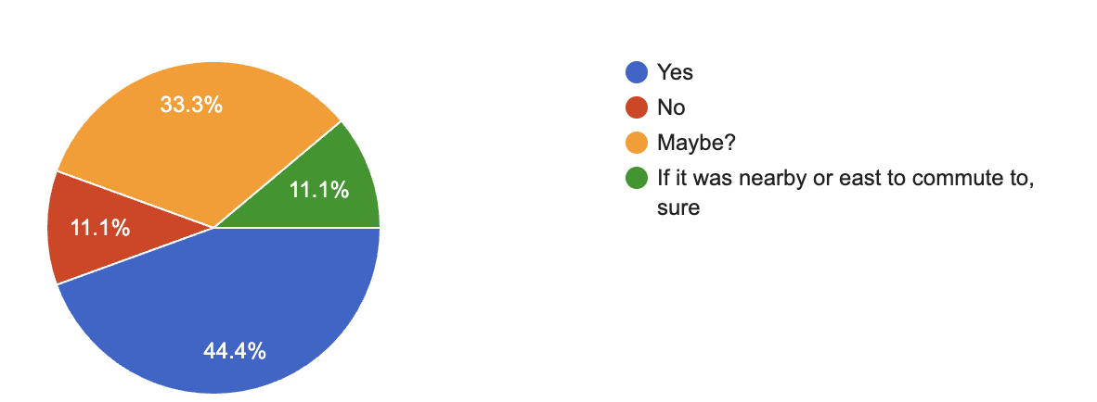
Results
Would you utilize services like in-person tutoring and group work sessions at a nearby school for that class?
Notes:
“I would’ve gotten direct help.”
“I would’ve benefitted from the support.”
Would you utilize services like in-person tutoring and group work sessions at a nearby school for that class?
67% said they might have or would have reached out to a nearby school that offered in-person resources to help with their class
89% of participants said they might have or would have utilized the in person tutoring / group work sessions

Slide 38
Top 3 Solutions
Interactive game with the goal to connect with as many different people as possible and receive weekly challenges to connect with specific people each week, and every new connection gets added to the user’s list of friends for future communication
What if we institute a cross-university program that uses partnerships to give students access to more resources across degree programs?
What if we institute a platform where students can find and create local support groups to stay on top of work, share their experiences and inspirations, and find community within school?

Slide 39
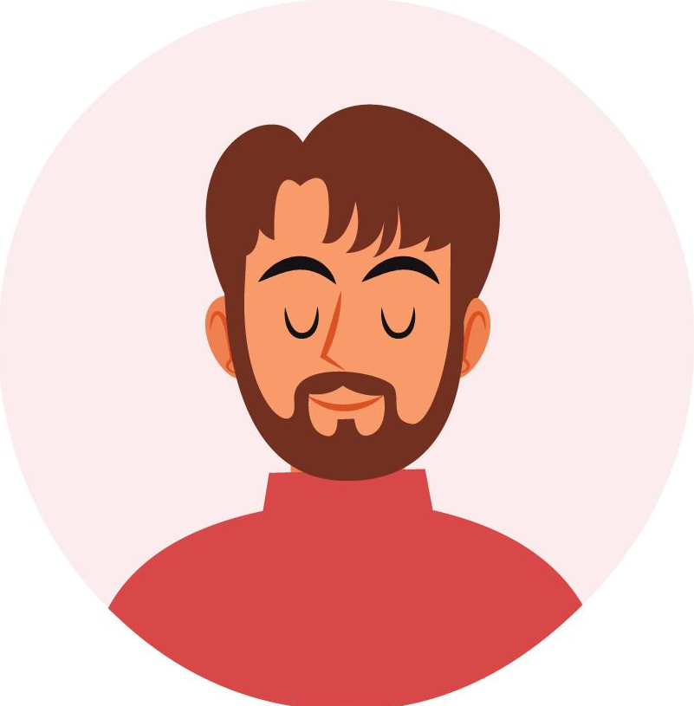
POV 3
We met Peter, an administrator in academic programs at Stanford.
Peter
Notes:
HMW level the playing field for adult learners before beginning academic programs?
HMW connect adults with others who have the same educational background and skill set?
HMW leverage adaptive technology to tailor programs to individual learners?
HMW foster support systems between learners with different skill sets to expand access to resources and knowledge?
HMW make academic programs even more flexible to accommodate the various motivations and experiences of students?
HMW redesign digital resources to improve its effectiveness on different learners?
HMW create feedback loops between adult learners and educators for iterative improvements?
HMW provide non-academic support outside the classroom?
HMW remove the prerequisites in skill required to enroll in an academic program?
HWM create virtual learning environments that are similar to in-person learning?

Slide 40
POV 3
We were surprised to learn that the biggest challenges he noticed had more-so to do with the various types of adult learners rather than the types of technology being used.
Notes:
HMW level the playing field for adult learners before beginning academic programs?
HMW connect adults with others who have the same educational background and skill set?
HMW leverage adaptive technology to tailor programs to individual learners?
HMW foster support systems between learners with different skill sets to expand access to resources and knowledge?
HMW make academic programs even more flexible to accommodate the various motivations and experiences of students?
HMW redesign digital resources to improve its effectiveness on different learners?
HMW create feedback loops between adult learners and educators for iterative improvements?
HMW provide non-academic support outside the classroom?
HMW remove the prerequisites in skill required to enroll in an academic program?
HWM create virtual learning environments that are similar to in-person learning?

Slide 41
POV 3
We wonder if he believes that improving adults' individual skill sets should be prioritized over improving technology. It would be game changing to tailor academic programs to the specific skills and needs of each adult learner.
Notes:
HMW level the playing field for adult learners before beginning academic programs?
HMW connect adults with others who have the same educational background and skill set?
HMW leverage adaptive technology to tailor programs to individual learners?
HMW foster support systems between learners with different skill sets to expand access to resources and knowledge?
HMW make academic programs even more flexible to accommodate the various motivations and experiences of students?
HMW redesign digital resources to improve its effectiveness on different learners?
HMW create feedback loops between adult learners and educators for iterative improvements?
HMW provide non-academic support outside the classroom?
HMW remove the prerequisites in skill required to enroll in an academic program?
HWM create virtual learning environments that are similar to in-person learning?

Slide 42
POV 3
It would be game changing to tailor academic programs to the specific skills and needs of each adult learner.
Notes:
HMW level the playing field for adult learners before beginning academic programs?
HMW connect adults with others who have the same educational background and skill set?
HMW leverage adaptive technology to tailor programs to individual learners?
HMW foster support systems between learners with different skill sets to expand access to resources and knowledge?
HMW make academic programs even more flexible to accommodate the various motivations and experiences of students?
HMW redesign digital resources to improve its effectiveness on different learners?
HMW create feedback loops between adult learners and educators for iterative improvements?
HMW provide non-academic support outside the classroom?
HMW remove the prerequisites in skill required to enroll in an academic program?
HWM create virtual learning environments that are similar to in-person learning?

Slide 43
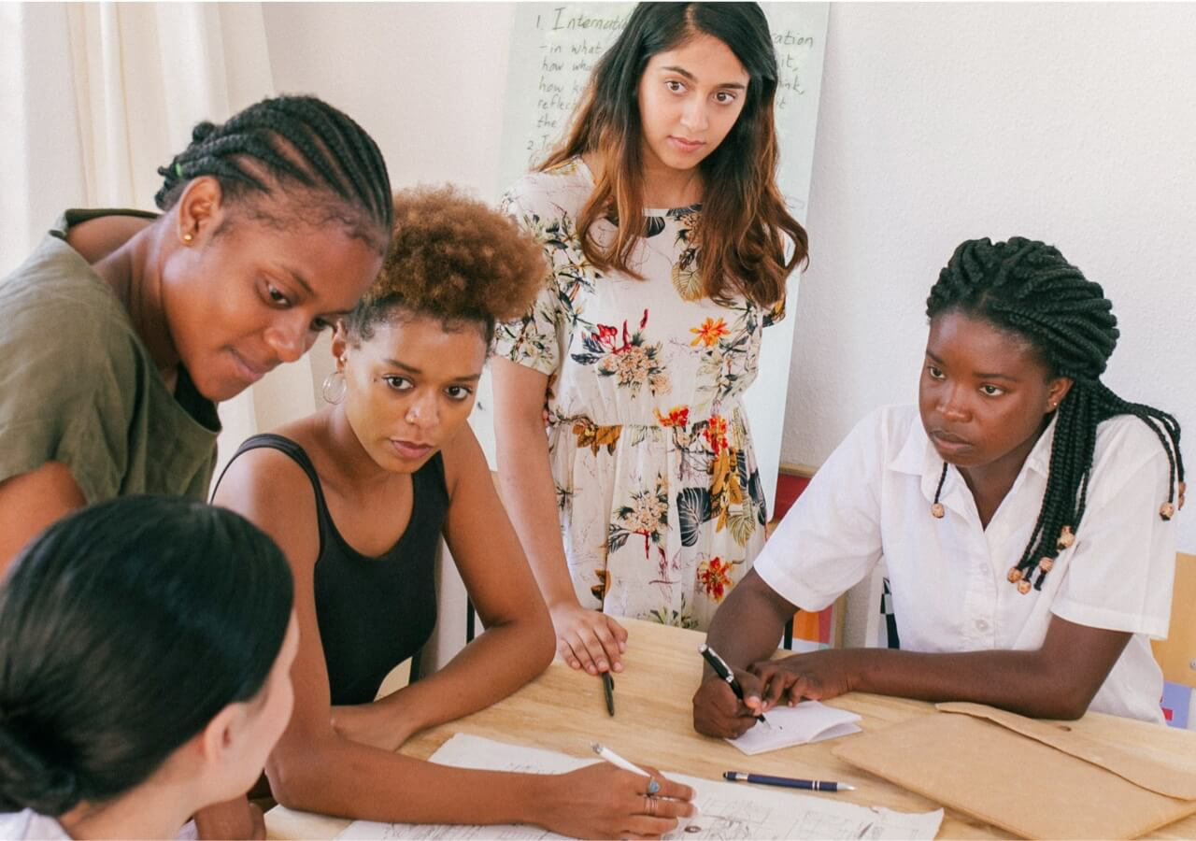

Summary
It is difficult to replicate the in person experience of learning
The social aspect of learning matters

Slide 44
ETHICS
Final solution
Combines our Progress bar (targets accountability and study groups) with Social aspect (which targets connections)
Main idea is to increase community / focus on social aspect
  Smaller feature would be to allow students to share their study goals with their connections
Who This solution serves:
Older students who are in school (primarily targets in person students)
  We hope to expand solution to virtual students
Part time students who find it hard to make connections with students
  This solution will help them connect virtually through digital app and help connection blossom from there
Does not really serve virtual students mainly because our solution is aiming to target social aspect to increase the sense of community
Ethics
  Can help students to feel like they are not alone on campus,
    See others going through the same assignments, making progress, etc.
  But… also can have the opposite effect
    Think impostor syndrome - seeing others doing well or speeding through, even if it’s not real, can make you feel less smart.
    Have to find a way to deal with this

Slide 45
What’s Next
Solution: Combination of social aspect and progress bar/accountability
    Give students the opportunity to meet others on campus, and then provide a chance from there to study together, share study goals, etc.
Ethics:
  Can help students to feel like they are not alone on campus,
    See others going through the same assignments, making progress, etc.
  But… also can have the opposite effect
    Think impostor syndrome - seeing others doing well or speeding through, even if it’s not real, can make you feel less smart.
Concept + Prototype Videos!
Notes:
Final solution
Combines our Progress bar (targets accountability and study groups) with Social aspect (which targets connections)
Main idea is to increase community / focus on social aspect
Smaller feature would be to allow students to share their study goals with their connections
Who This solution serves:
Older students who are in school (primarily targets in person students)
We hope to expand solution to virtual students
Part time students who find it hard to make connections with students
This solution will help them connect virtually through digital app and help connection blossom from there
Does not really serve virtual students mainly because our solution is aiming to target social aspect to increase the sense of community
Ethics
Can help students to feel like they are not alone on campus,
See others going through the same assignments, making progress, etc.
But… also can have the opposite effect
Think impostor syndrome - seeing others doing well or speeding through, even if it’s not real, can make you feel less smart.
Have to find a way to deal with this

Slide 46
THANK YOU

Slide 47
Appendix

Slide 48
A’s Empathy Map

Slide 49
All HMWs

Slide 52
Appendix

Slide 53
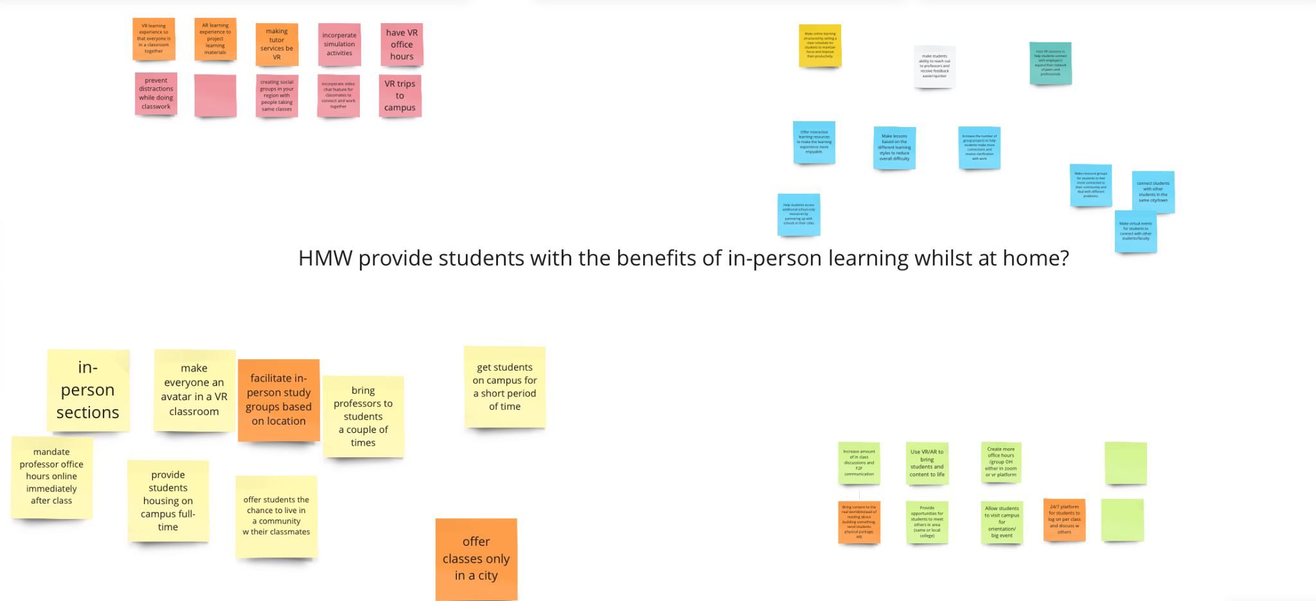
HMW 1

Slide 54
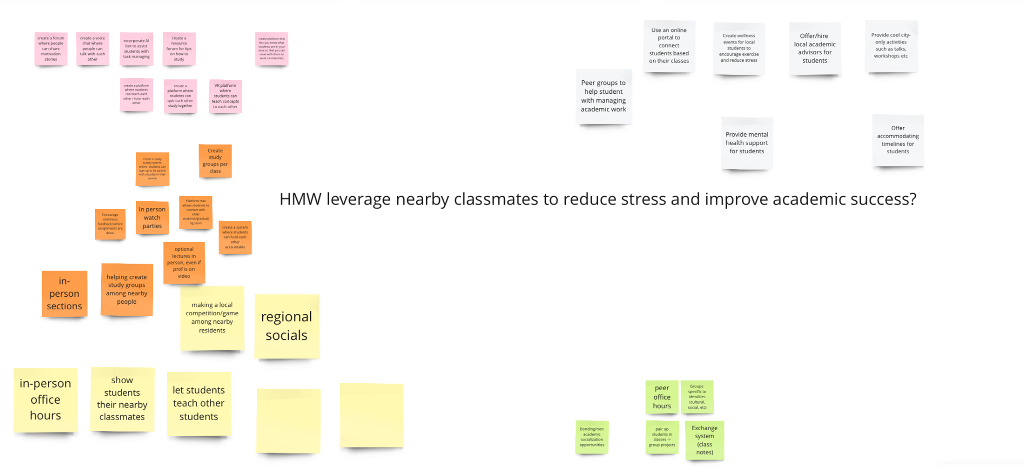
HMW 2

Slide 55
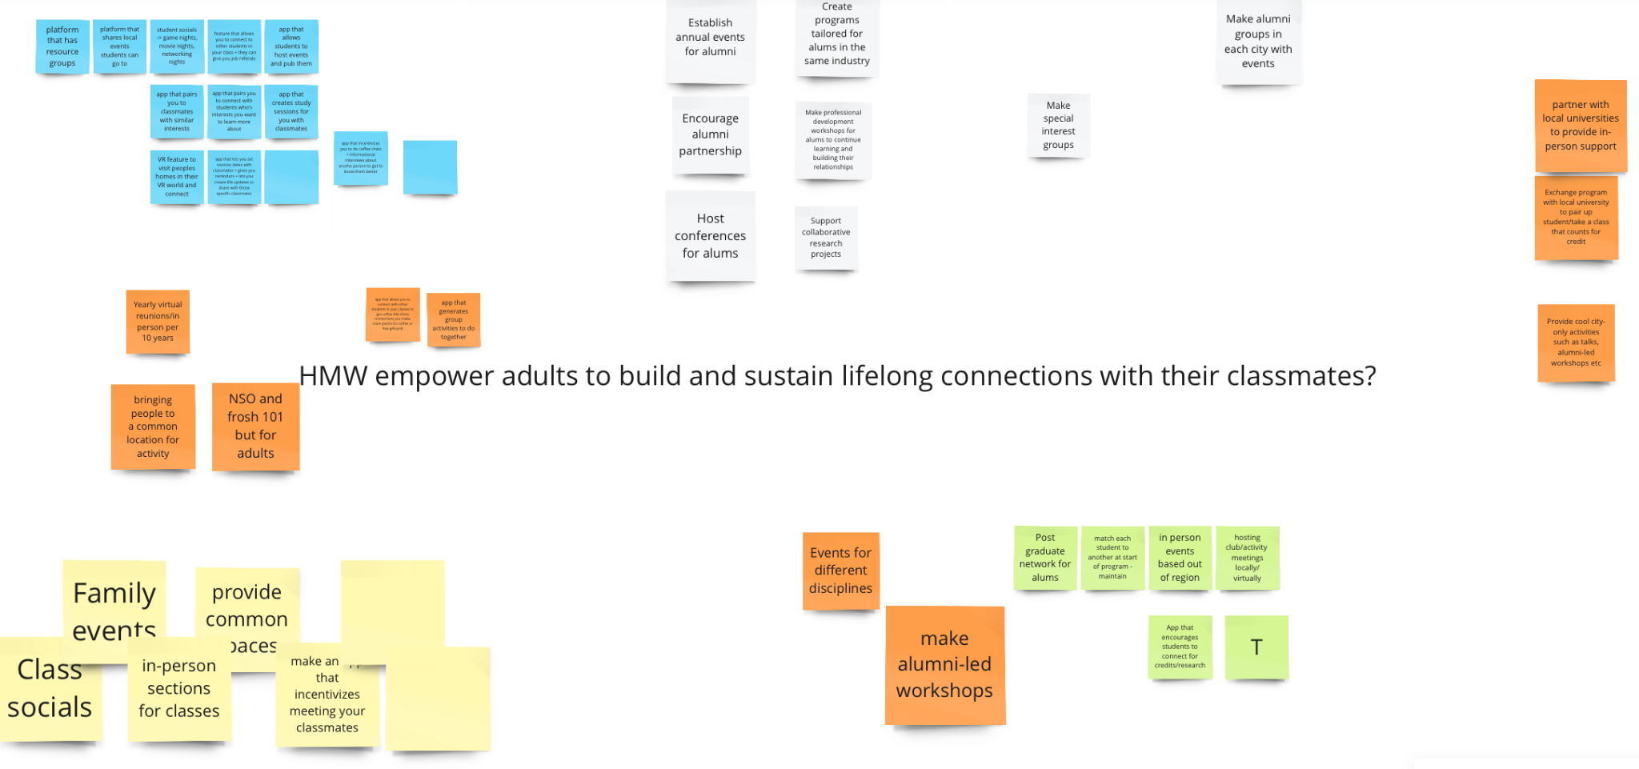
HMW 3

Slide 56
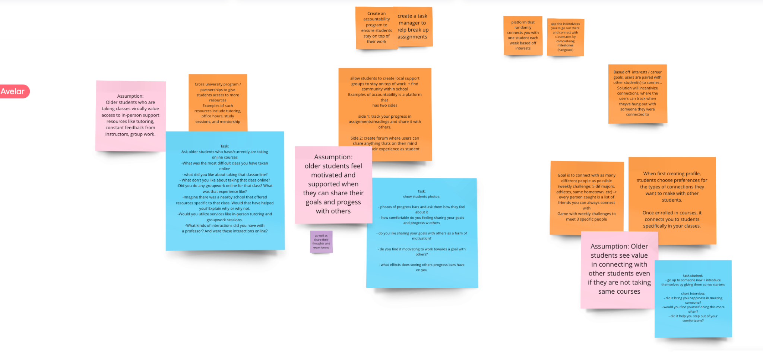
Final Product of Deliberations

Slide 57
Artifacts

