Slide 1




Star’s Stars
(Team 1)
Us shooting for the moon

Slide 2
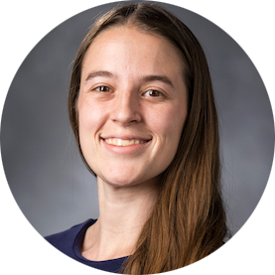

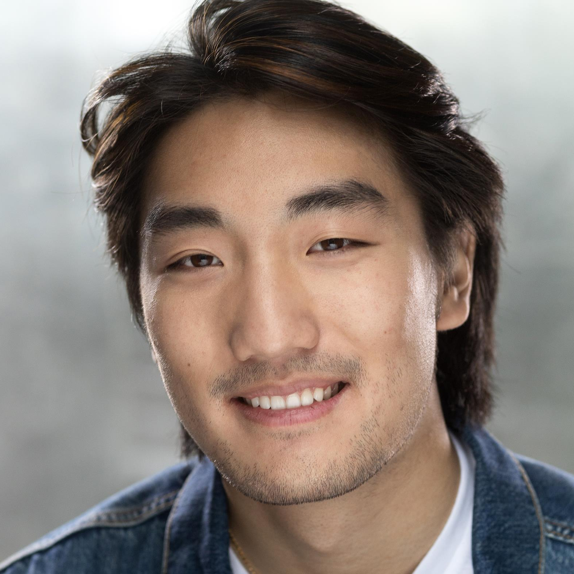
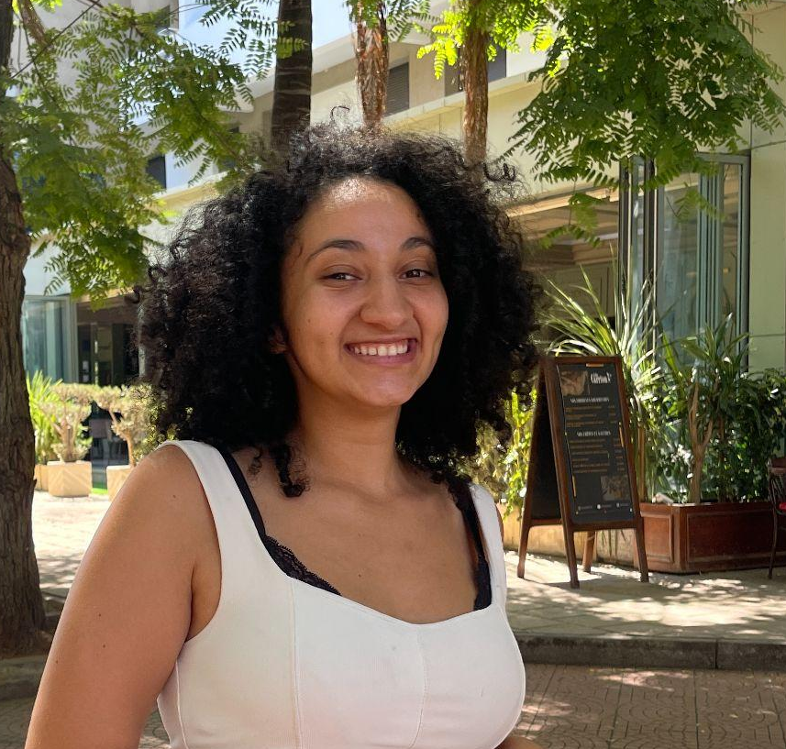
Meet the team!
Jessica
Matthew
Baihan
Oumnia
There’s literally only 1 other group…

Slide 3


Problem Domain:
Teachers Knowledge of Students’
Lives and Learning
As a group we brainstormed challenges faced by today's teachers:
  Students find the content challenging.
  Tasks that teachers are not trained for.
  Areas where practice has not caught up to research.
We focused on helping teachers to know their students better:
  This area has an underserved market.
  We have some pertinent experience.

Slide 4




Needfinding
Hannah
James
Samantha
Laurel

Slide 5


Hannah
Hannah is the founder of a graduate school focused on teacher preparation.
This makes her both a domain expert and a potential user as a teacher herself.
Other details:
  Hannah was the acquaintance of one of the team members.
  Matthew conducted her interview virtually.
  She was not compensated.

Slide 6


James
James teaches ancient texts and manages a residential liberal arts education program.
He is a potential user as a teacher and manages a group of teachers who are potential users.
James is an extreme user because he is expected to know students more than other educators but he is only given 10 weeks to do so.
Other details:
  He responded to a request for interview to professors at their institution.
  Baihan interviewed him on his university campus
  He was not compensated.
Notes:
James is an extreme user because the residential nature of his institution means he is expected to know students more than other educators but he also is only given 10 weeks to do so while many educators have 36 weeks.

Slide 7


Samantha
Samantha teaches acting at a large university.
She is a potential user as a teacher.
Other details:
  They responded to a request for interview to professors at their institution.
  She was not compensated.
  Baihan conducted their interview on their university campus.

Slide 8


Laurel
Laurel is a high school junior at a high achieving high school.
She is a stakeholder in any tool used by teachers as it would affect her experience.
Other details:
  She was the sister of an acquaintance of the one of the team members.
  Oumnia conducted her interview in her home.
  She was not compensated.

Slide 9
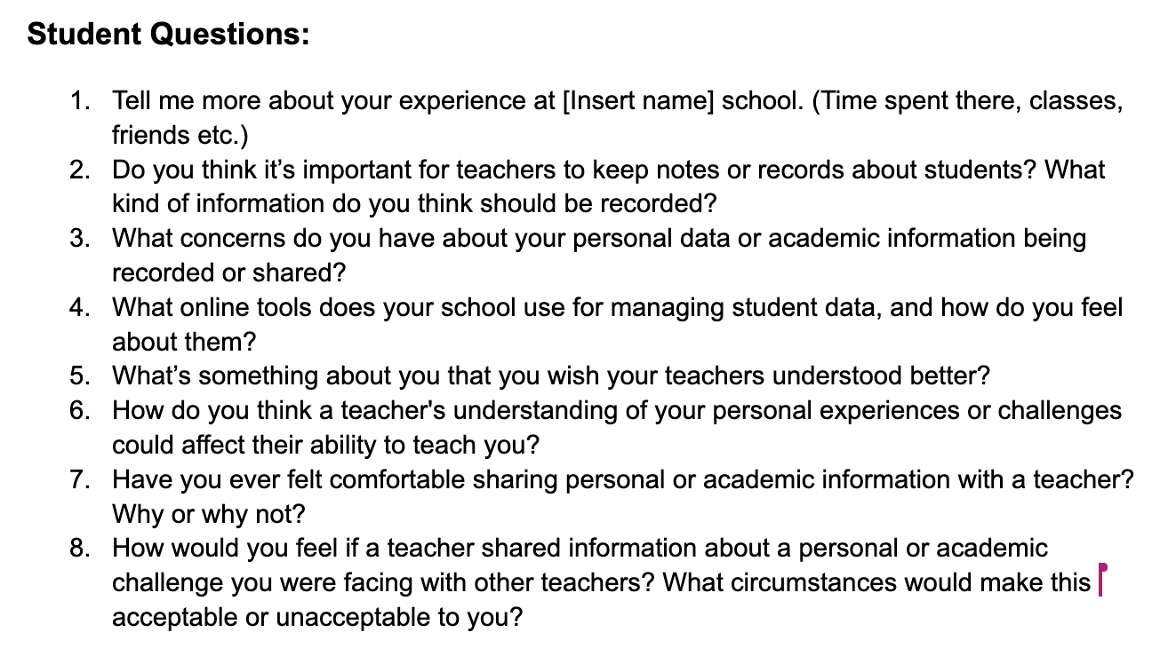
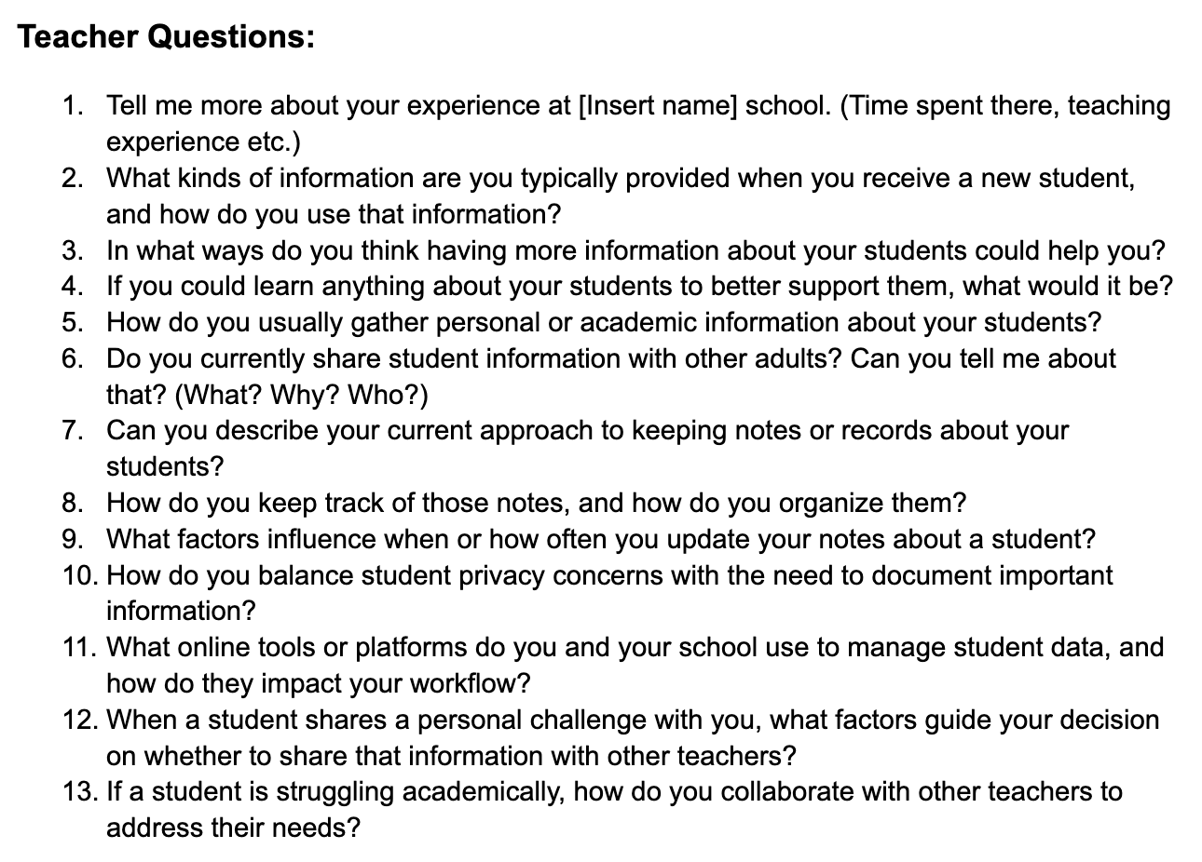
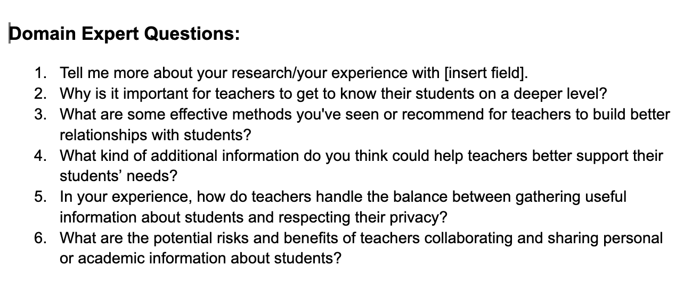
Scripts

Slide 10
Scripts
Explore emotions:
How would you feel if a teacher shared information about [...]?
Evoke stories:
Tell me about a time when you wish a teacher knew more [...]?
Reflection
Wrap-up:
What are the potential
risks and benefits of teachers sharing [...]
Building Rapport: What tools have you seen teachers use [...]?
Intro: Tell us more about your experience at [...]
Background
Notes:
Graph from design discovery lecture, shows that we’ve used course concepts in designing our script. I included some questions from the scripts, feel free to reference others.

Slide 11



Tools
Video Conference
Note Taking
Directories

Slide 12
Interview results
“Come teach in your community for your community so we are real big of theory as well as practice.”
“Teachers when they are empowered with this kind of data, make a difference and they help students succeed at higher levels.”
Hannah
“Stanford teachers usually do not see it as their job to care about the student as a whole person.”
“One-on-one meetings were essential to understand what the student thought college was going to be about!”
James

Slide 13
Interview results
“When you teach entry level classes, often students will come in with hugely varying levels of experience. You must make sure you level the class that will be useful and interesting for everybody.”
“Teachers want to get together to talk about students they share, but schedules are too tight and often there’s no time. It happens much more informally.”
Samantha
“It would be easier at times if teachers knew some important information about me, especially in situations where it would be weird to go up to a teacher and tell them."
Laurel
Notes:
Full quote: “When you teach entry level classes, often students will come in with hugely varying levels of experience. You must make sure you level the class that will be useful and interesting for everybody, reminding everyone that the work is useful.”

Slide 14
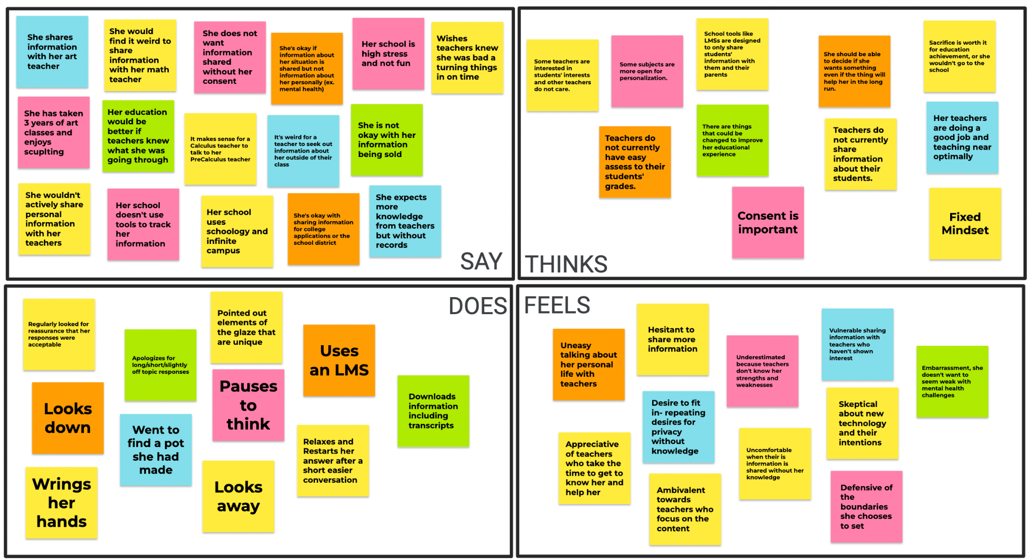
Empathy Map

Slide 15
Key Insights
Observations:
Special Challenge for New Teachers.
Teachers Gain Information Invisibly.
Confidentiality/Consent is Important.
Value of 1 on 1 Interactions.
Research is Not Applied.
Teachers Have No Time.
Insights:
General Goal of Personalization.
A Relationship is the Real Goal.
Teachers Lack Support.

Slide 16
Key Learnings
Teachers want to know more about their students.
Knowing additional information about their students would assist teachers.
Students may not necessarily want to share information with their teachers.

Slide 17
What’s Next
Gather more perspectives from different stakeholders including current K-12 educators and parents.
Gather the most applicable research with high impact and consider how that applies to potential solutions.
Create a list of requirements/limitations as a checklist.

