Slide 1
EKG
Engage. Know. Grow.

Slide 2
Get the Pulse on Your Classroom
As a team we wanted a name that conveyed that this app prioritizes connection and care in the context of information collection. The easy connection to “taking the pulse” to gauge the current mood of a class is an advantage in explaining the experience to teachers and students. The more formal name can be useful when interacting with adult stakeholders.
This choice to get to know students on a more personal level is one that many teachers do but there are no other apps in this space so it is very unique to our solution.

Slide 3
Problem/solution overview
Some teachers struggle to collect information about their students to help them teach.
Other teachers don’t collect information because it is so difficult.
We will build a platform that enables teachers to learn more about their students, and share that information with other teachers.
Knowing more about students' lives and learning can help teachers better support their students.
The primary user is teachers with students being an important secondary user.

Slide 4

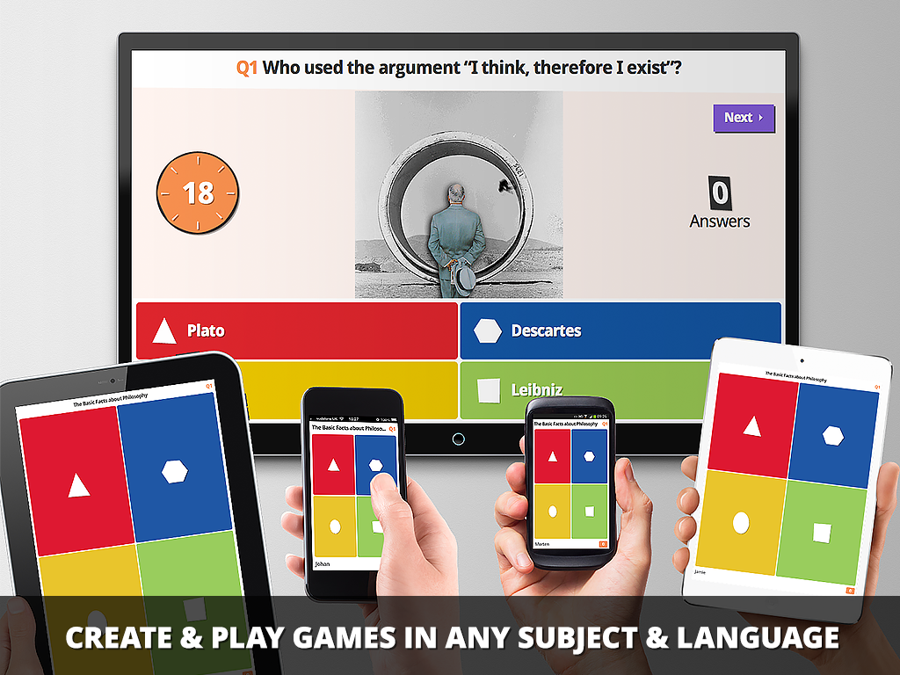
Market Research
Kahoot!
What works:
- Customizable and Gamified with AI.
- Ready-made quizzes
- Engaging interface especially encouraging for passive or shy students.
What doesn’t:
-Not able to help teachers collect information
- Game creation requires teacher’s time
- Disadvantage students struggling with reading or slow reaction time.

Slide 5
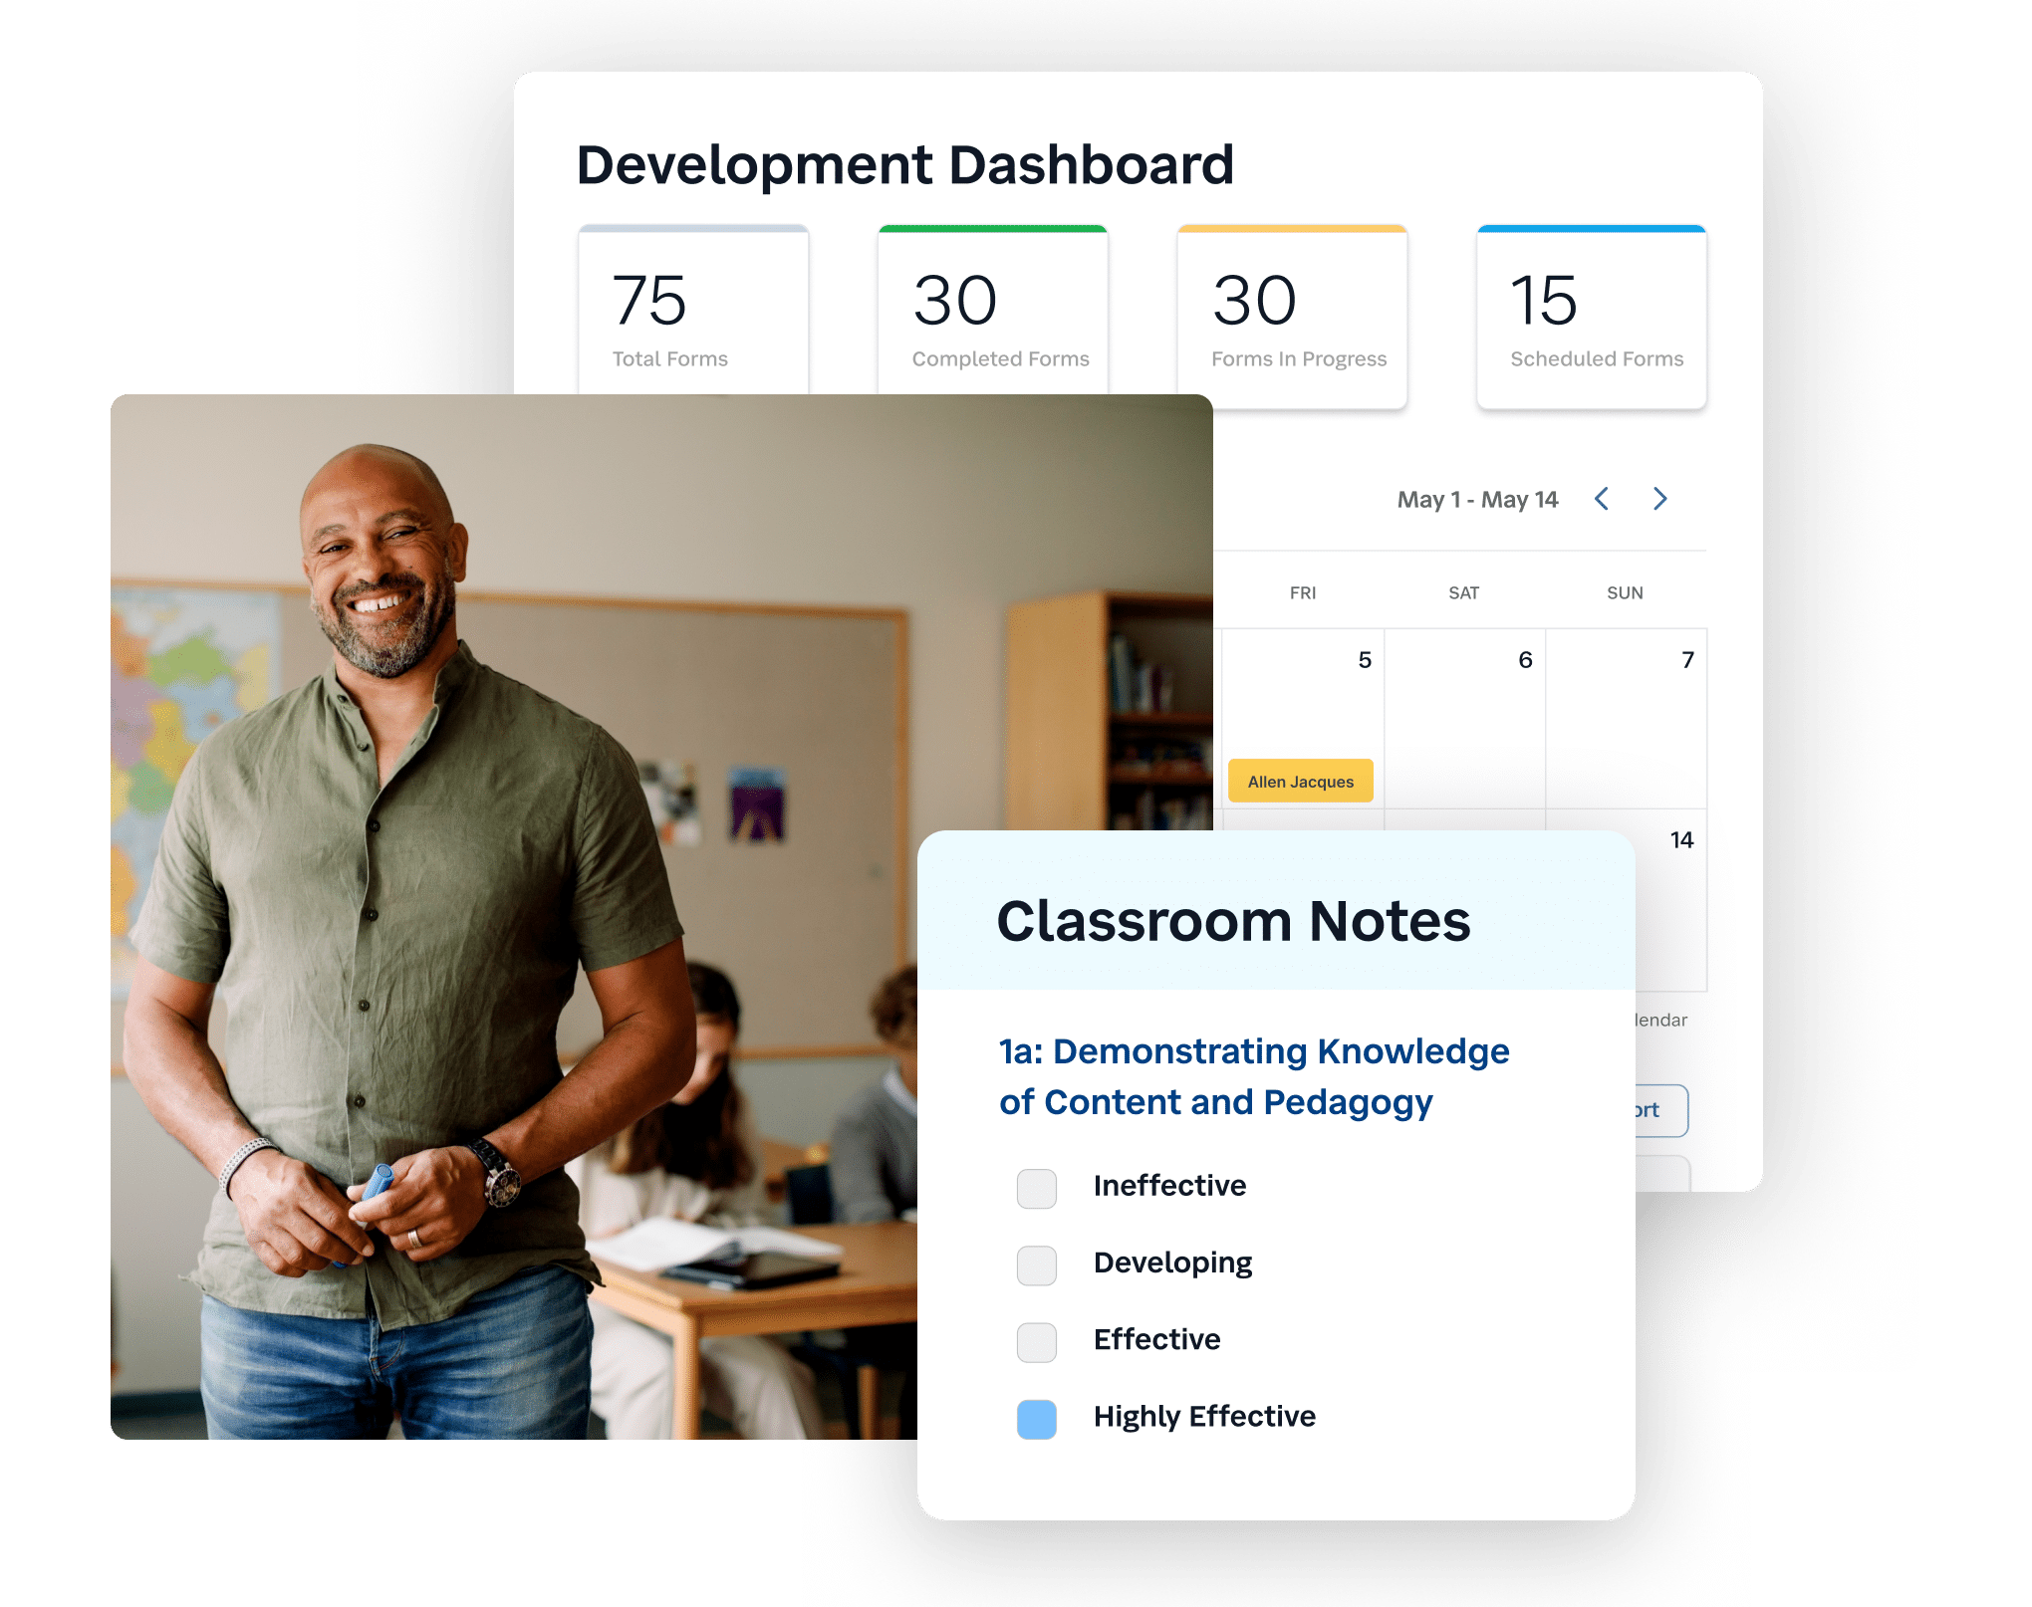
Market Research
SchoolStatus
What works:
- Facilitates communication between 2 parties (teachers and families).
- Generates automated interventions that improve attendance for teachers
- Lowers the workload for teachers
What doesn’t:
- engages student families instead of the students themselves.

Slide 6
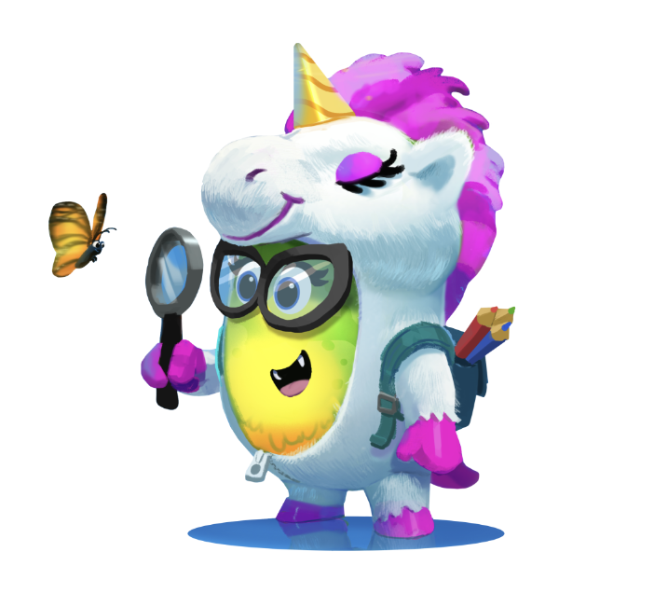
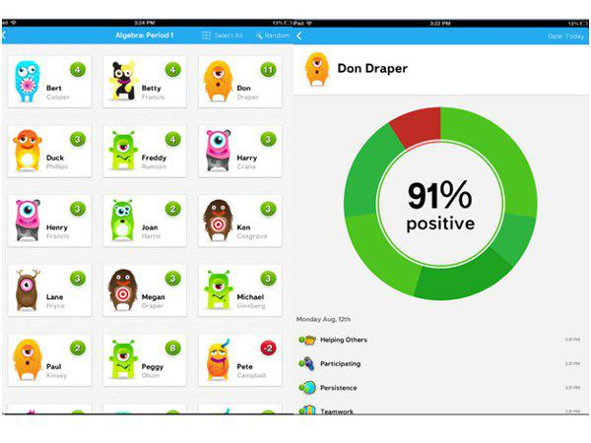
Market Research
Class Dojo
What works:
- Resources for teachers
- Free version, District version
- Fun for students
- Mobile Version
What doesn’t:
- Bring info in instead of sending it out
- Focus on older students
- Focus on students instead of families

Slide 7

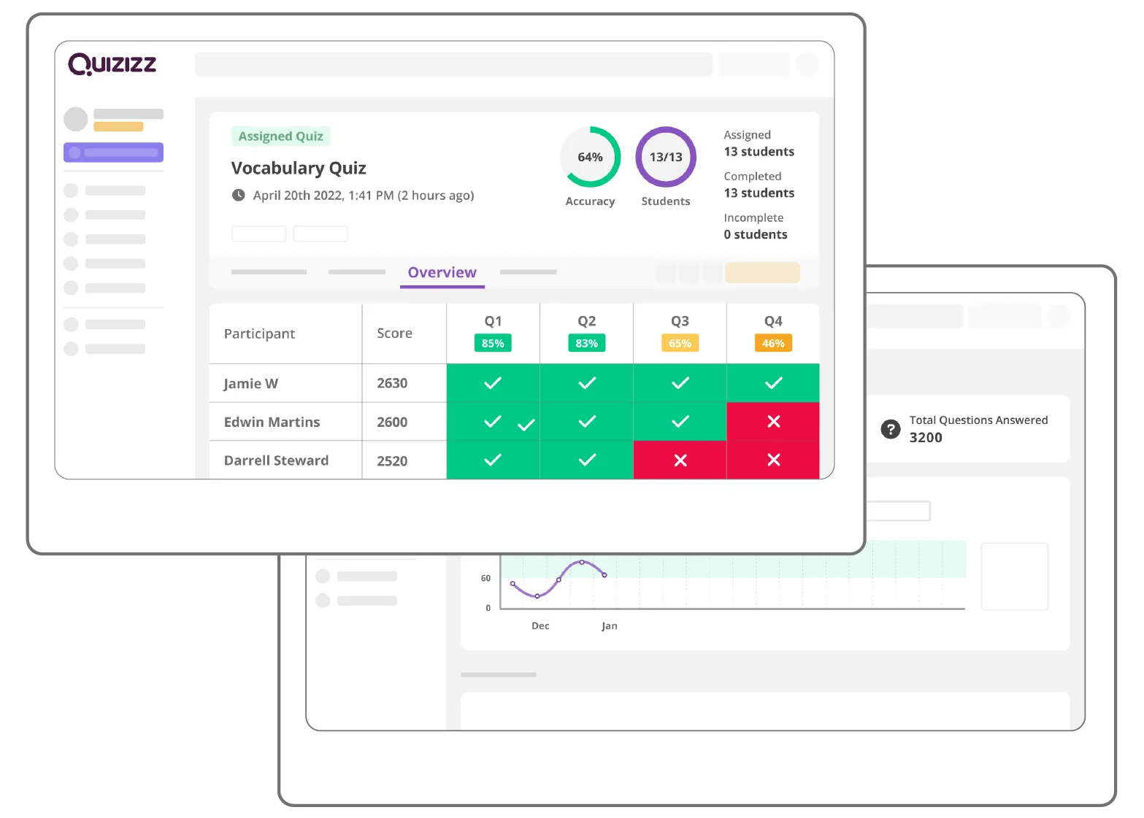

Market Research
Quizizz AI
What works:
Allows teachers to collect some metrics about student performance
Easy to use from student perspective
AI can quickly generate quizzes
What doesn’t work:
Not a practical way to gauge student wellbeing/ emotions.
AI-driven question generation and grading could reduce teacher involvement in content verification (students may be quizzed on potentially unrelated content).

Slide 8
Stakeholders
Direct
Indirect
Teachers
Students
Parents
Administrators

Slide 9
Ethical Implications
HEADLINE: “Teacher suspended after playing inappropriate game with students”
Any time that a teacher is forming a closer relationship with students there is a risk that the relationship may become or appear inappropriate.
HEADLINE: “App lets teachers gossip about their students’ mental illness”
It is important that students can continue to trust teachers to protect their privacy and collect only relevant information.

Slide 10
Tasks
0:42
0:44
Teachers facilitate games to obtain student information
Students play a game in which they share information
0:52
1:13
Teacher view student’s information
Teacher responds to alerts from AI about students’ needs
Moderate
Simple
Simple
Complex
Explanation in Speaker Notes
Notes:
Teachers facilitate games to obtain student information
Moderate
While this task is something that some teachers may use regularly, it is moderate because will require slightly more capability to intelligently select and set up prompts for students to complete.
Students play a game in which they share information
Simple
This task is the most important one to ensure it is simple and easy so that students enjoy the process with minimal friction. It is simple because students should see a prompt appear on their screen and be led through the interaction using text boxes to respond and buttons to submit. This will be their only interaction with the app.
Teacher view student’s information
Simple
The main value proposition of this application is that teachers can learn about their students. This is simple because teachers should be able to filter to a single student and view their information extremely quickly with less than 3 clicks.
Teacher responds to alerts from AI about students’ needs
Complex
If a teacher is a power user, with significant data in the app, an AI can draw the teacher’s attention to patterns like shared interests, changes in student behavior, etc. This is complex because it only works with large quantities of data and requires significant pedagogical knowledge to respond correctly

Slide 11
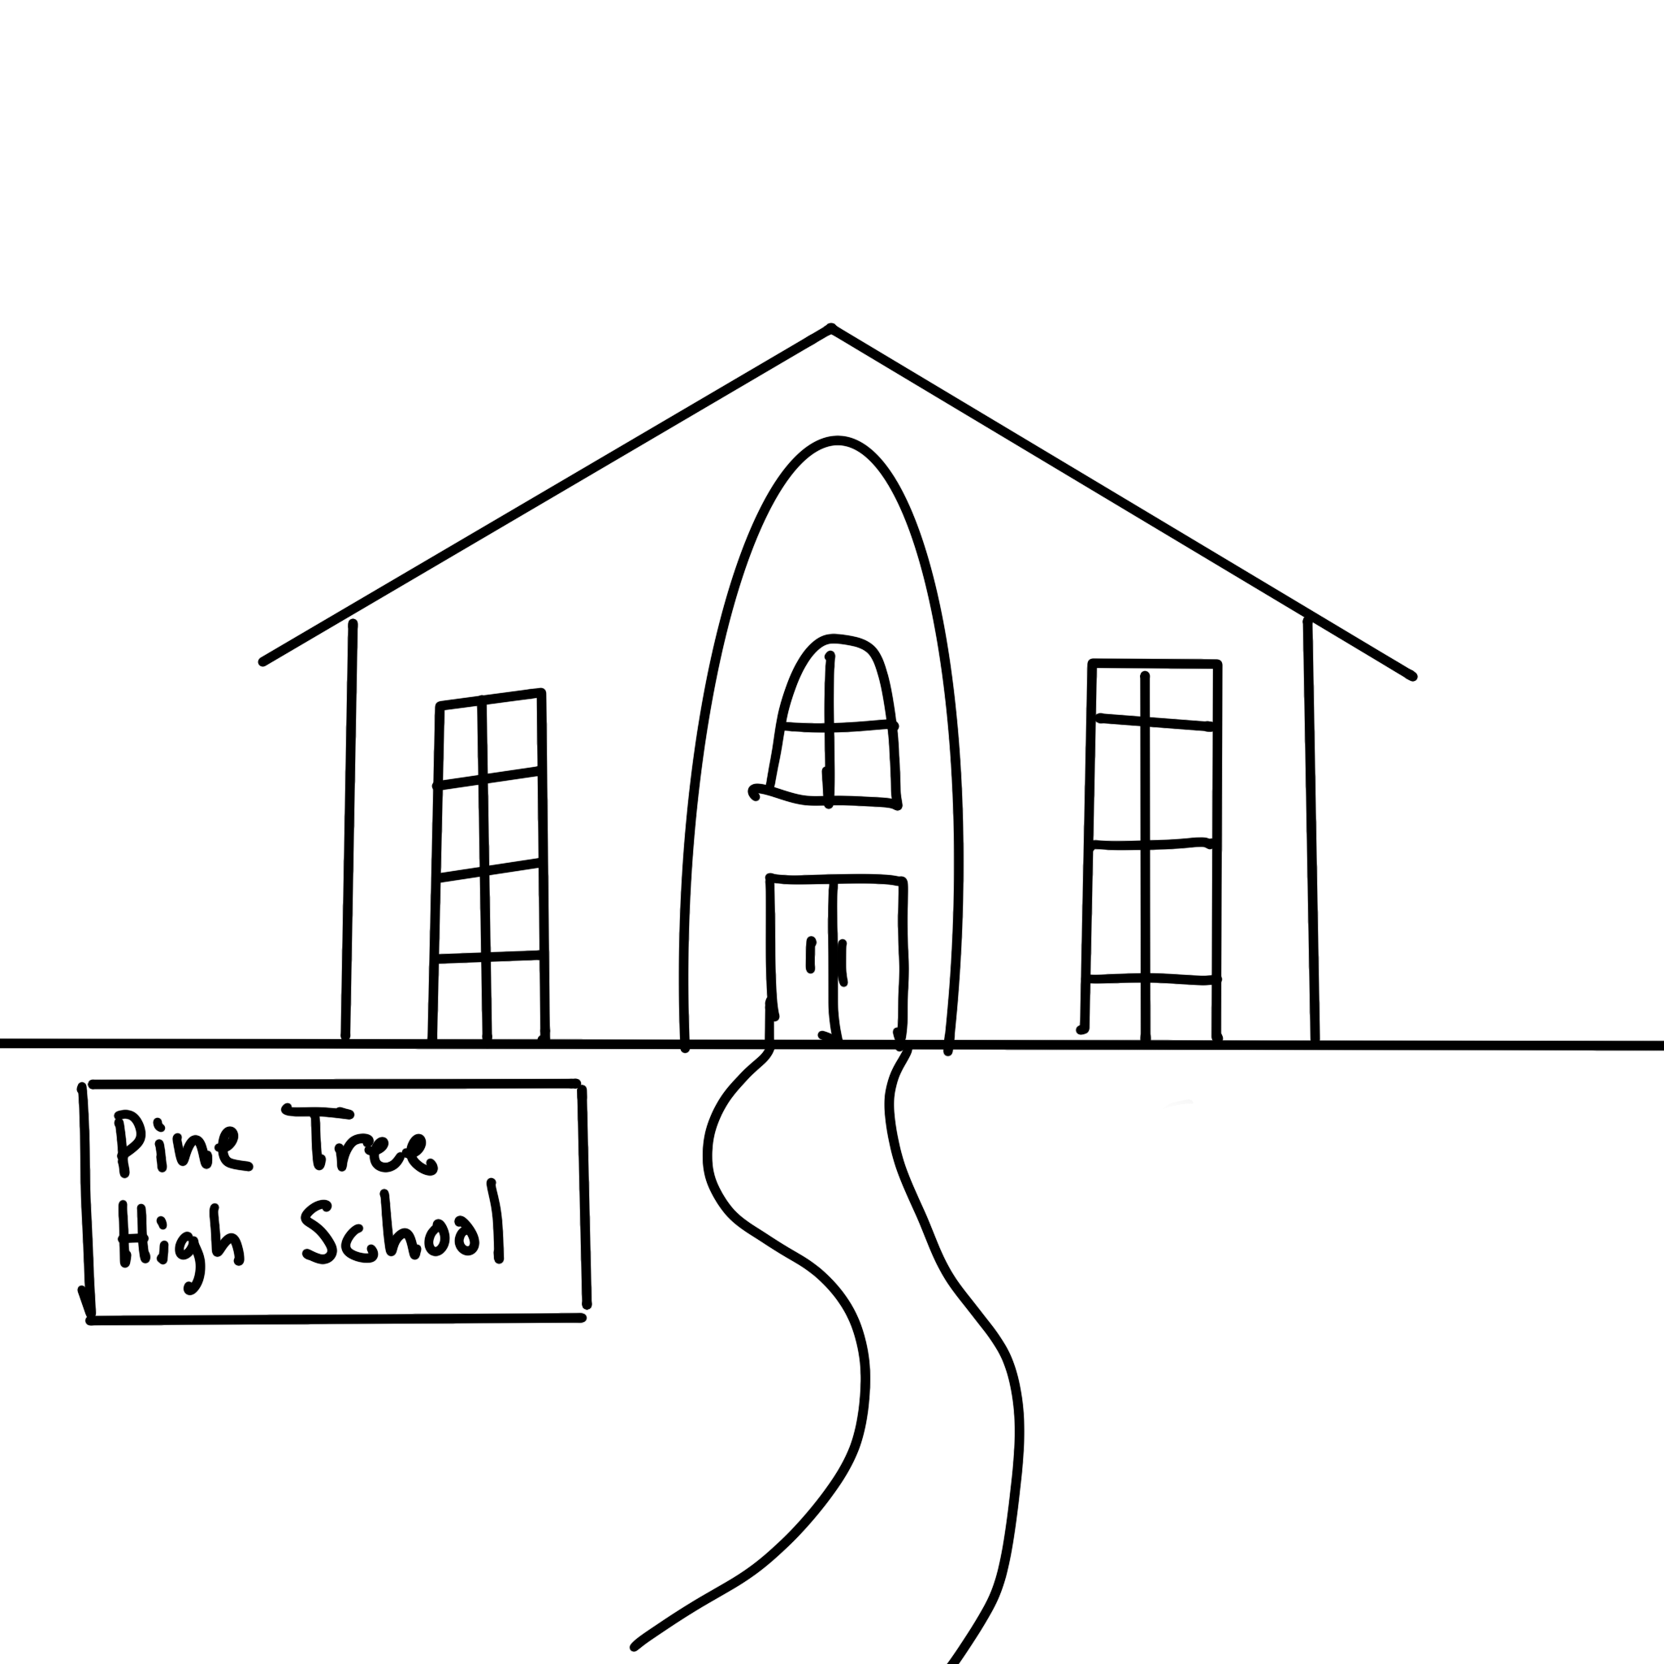
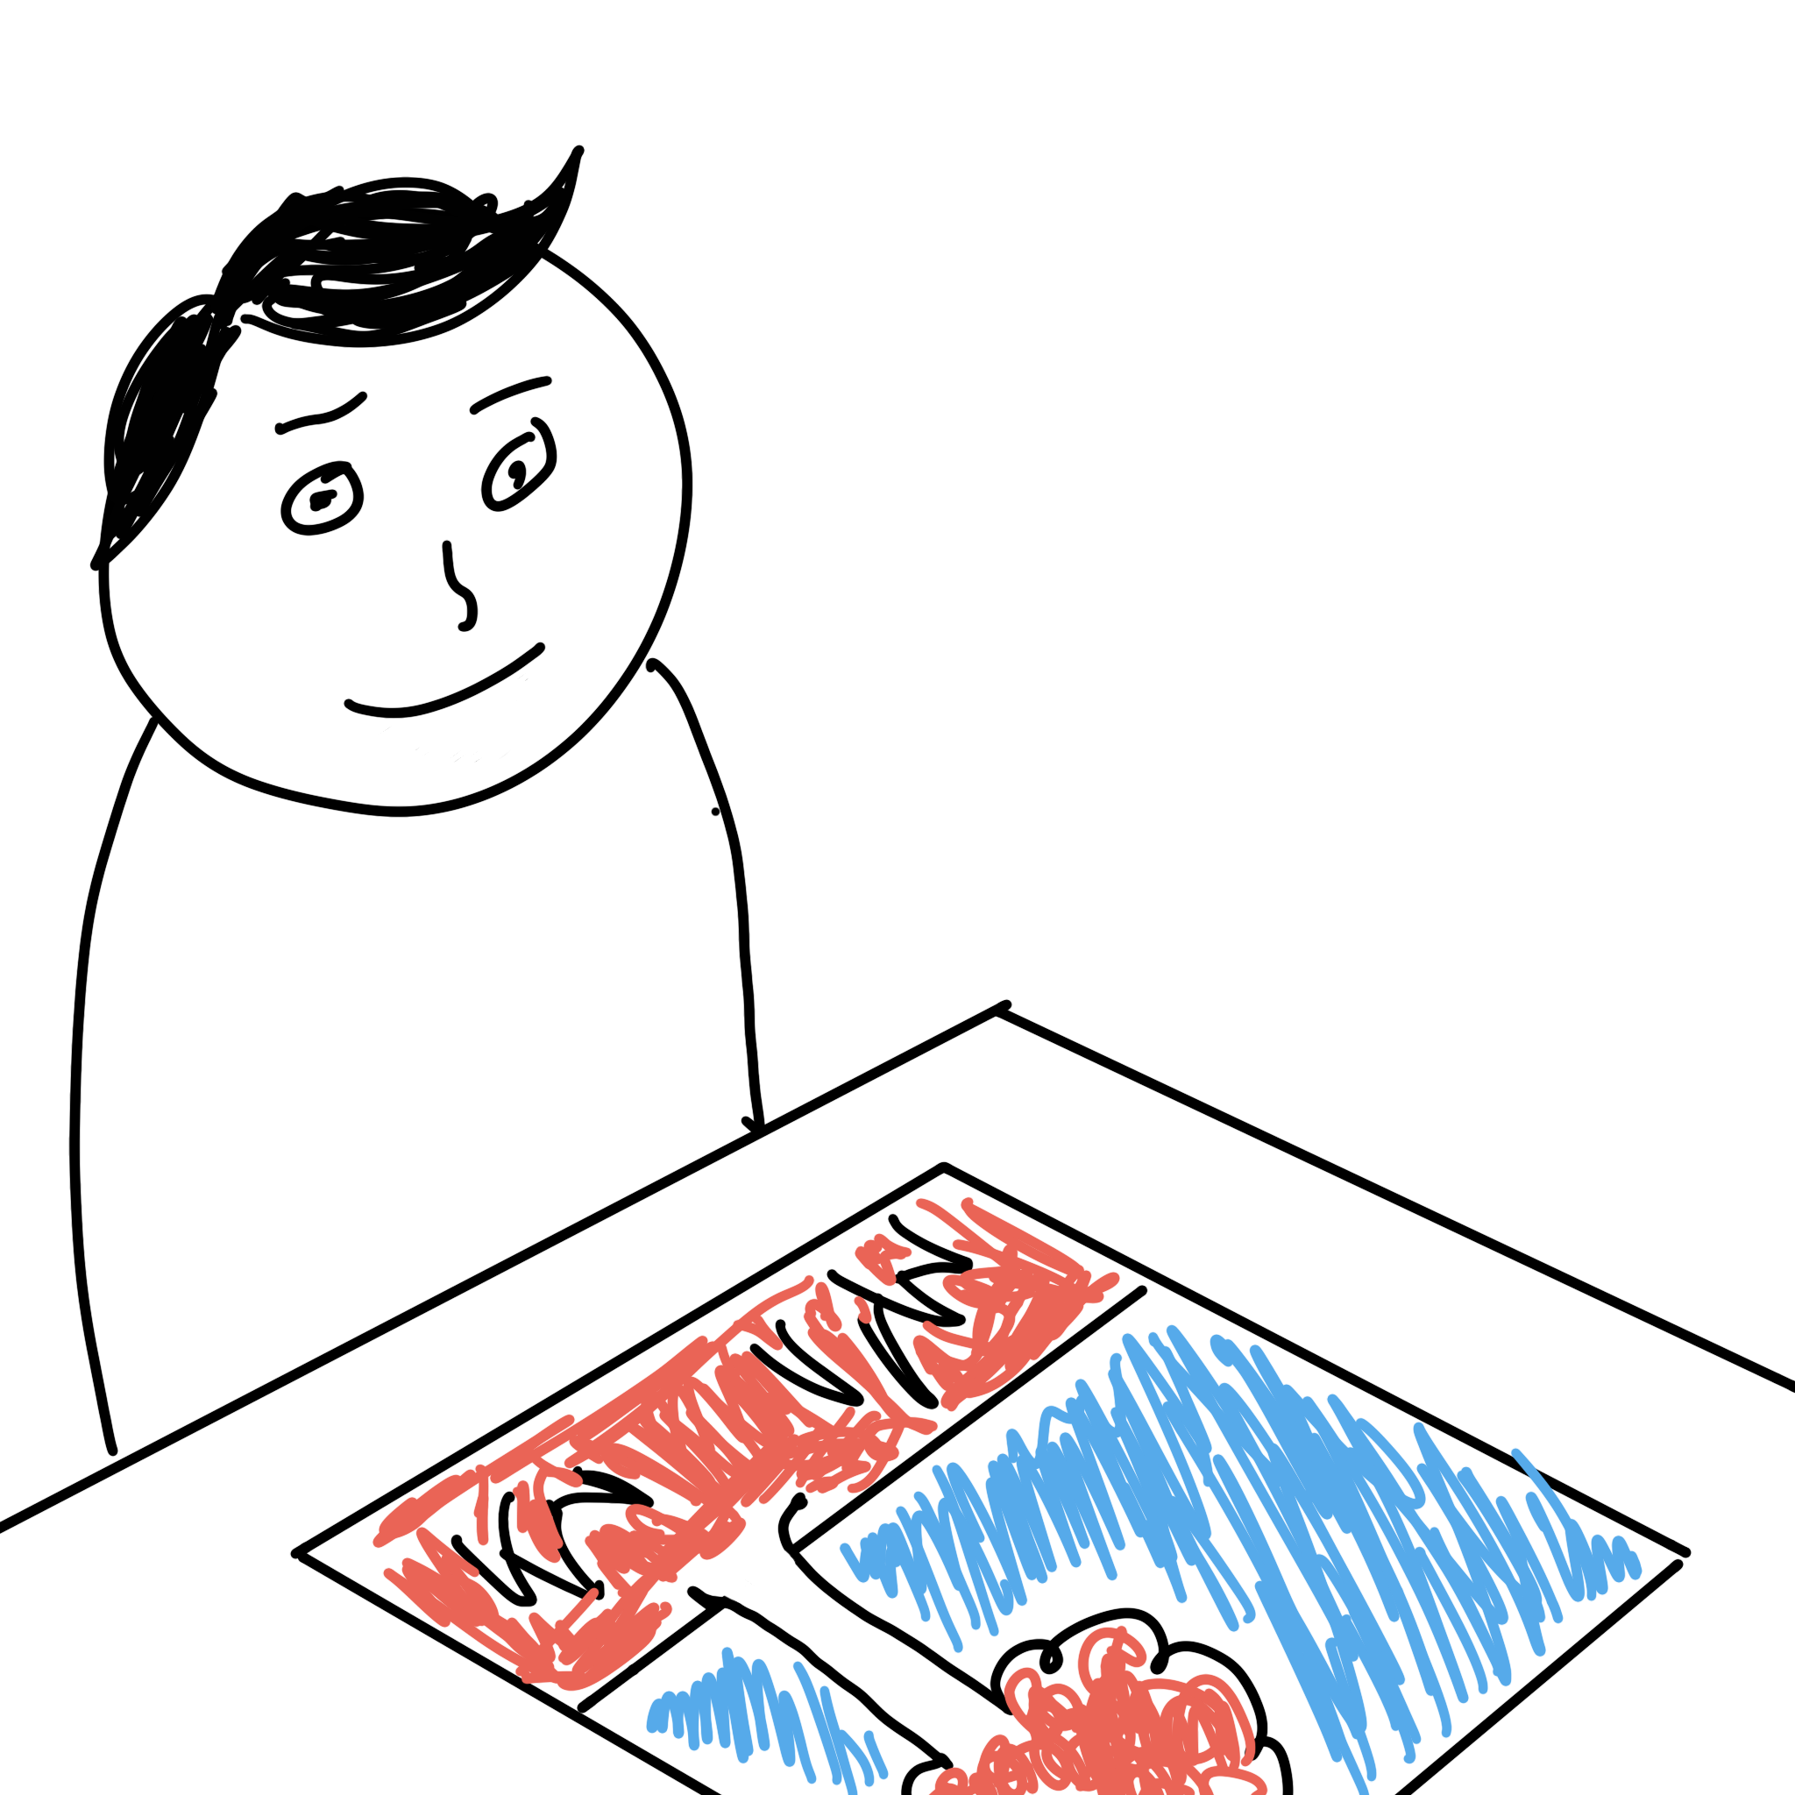

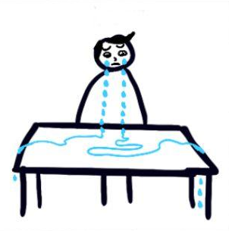

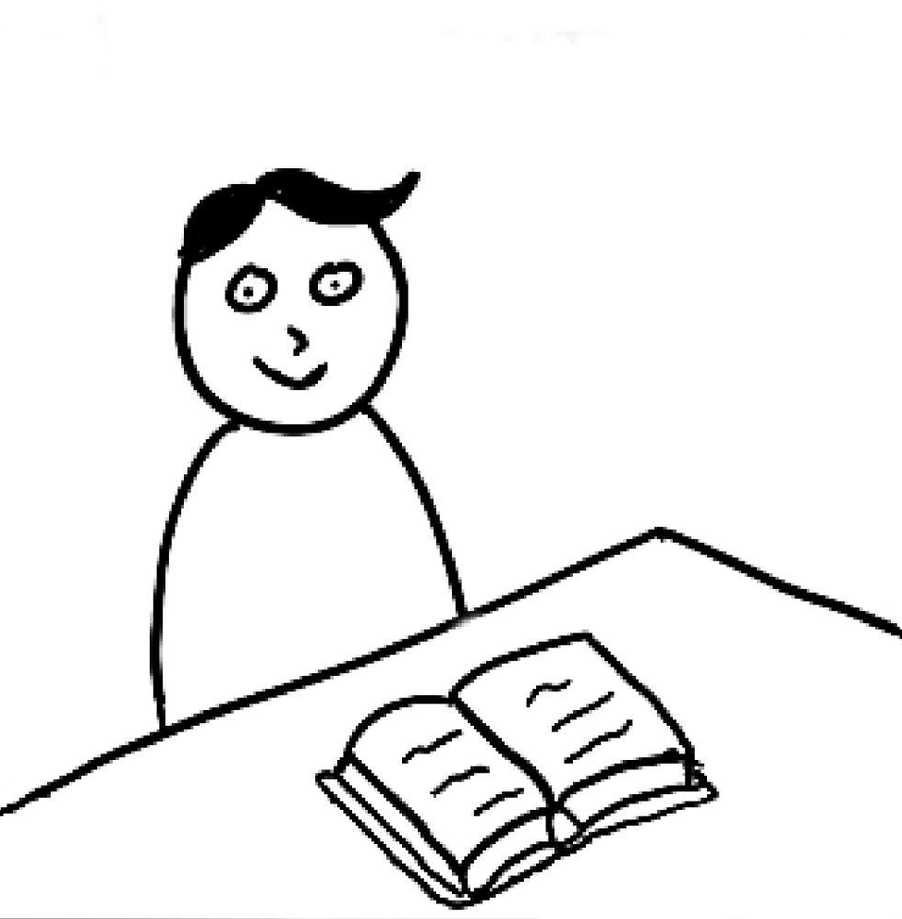
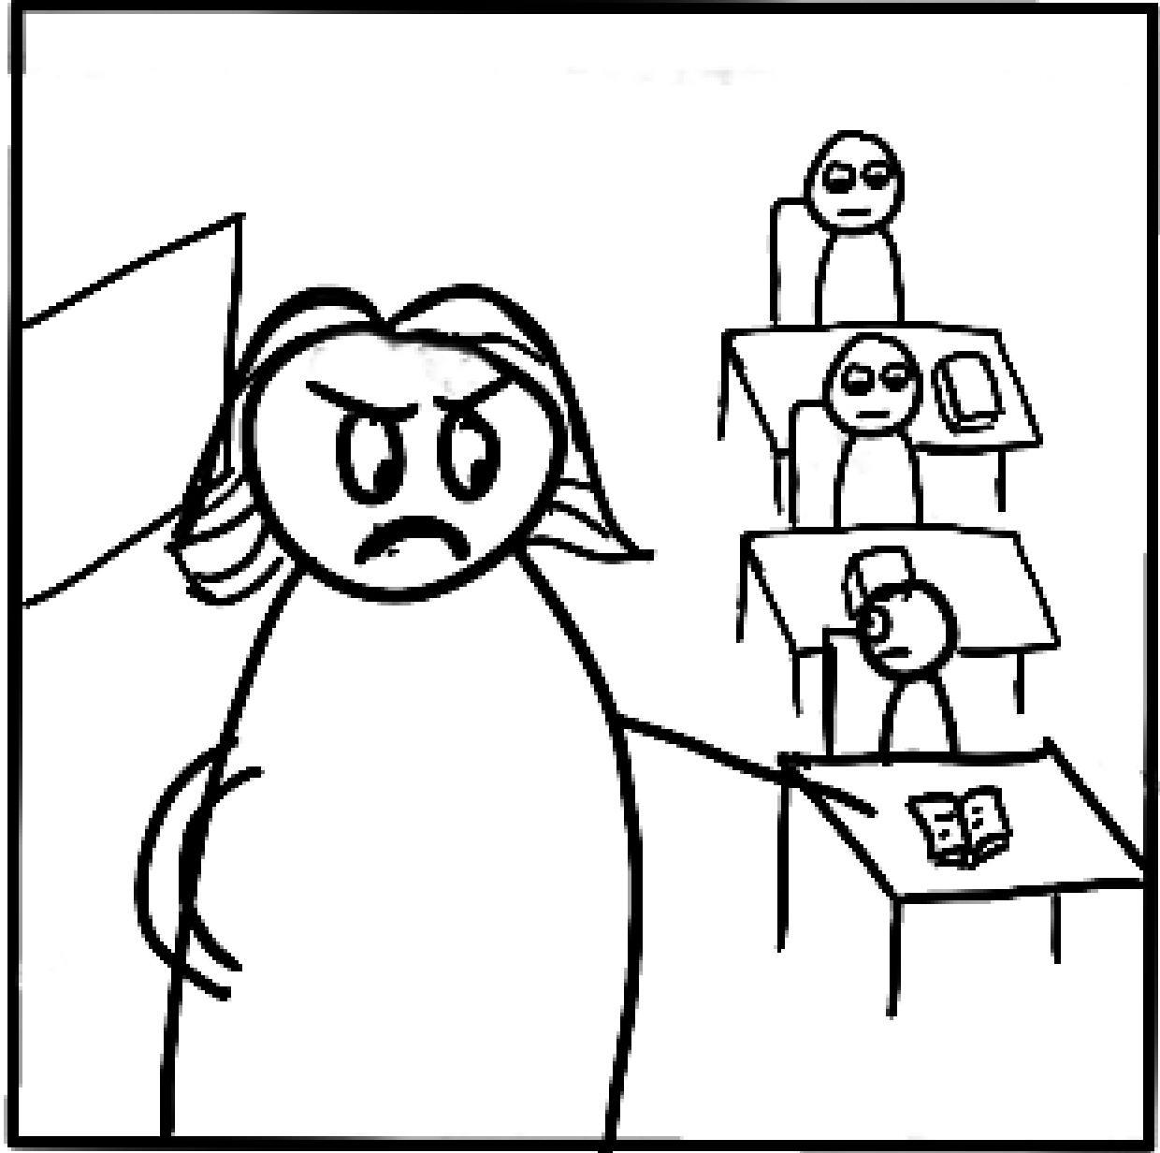
Video Storyboard
1. @ High School
2. Matthew, a color blind student colors the grass red.
3. Teacher yells at Matthew for choosing wrong color.
4. Matthew is embarrassed and starts crying.
5. Teacher tells students to close their books for an exam.
6. Alex doesn’t hear the teacher because he had turned off his hearing aids.
7. Teacher yells at Alex for not listening.
8. Alex is embarrassed and starts crying.

Slide 12


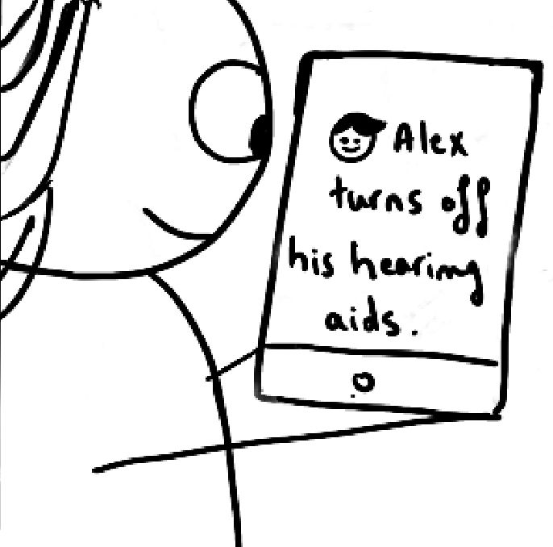


Video Storyboard
10. Alex, who just lost his dog, starts crying.
11. EKG reminds the teacher that Matthew is color-blind.
12. EKG reminds the teacher that Alex has his hearing aids off.
9. Teacher tells students to draw their favorite pet.
13. EKG reminds the teacher that Max’s dog just died.
14. end

Slide 13

Video
https://youtu.be/QJj67x6thMA

Slide 14
Appendix: Branding Brainstorm
What we are making: A platform that enables teachers to learn more about their students, and share that information with other teachers.
What do we want to convey: Care, connection, engagement, family
Relevant things: Classroom, teaching, pulse, data, insight, AI

Slide 15
List of Information Collected in App
Suggested Information:
Preferred Name
Home Language
Access to Technology at Home
Languages Spoken
Support Needed in School
Extracurricular activities
Part-time job
IEP/504
Reading Level
Attendance
Optional Information:
Parent/Guardian Occupation
Career Goals
Favorite Movie/TV/Music/Book
College Goals
Favorite Subject
Transportation to School
Emotional Status Today

