Slide 1

EKG
Engage, Know, Grow
Oumnia Chellah, Matthew Guck, Jessica Yauney, Baihan Zhang.

Slide 2

Problem
- Teachers struggle to develop meaningful connections with students.
- Consequences:
- Difficult to engage students effectively.
- Lower trust.
- Reduced motivation.
- Less effective learning environments.
Notes:
Problem: Educators struggle to develop meaningful connections with students due to limited time and a lack of resources dedicated to relationship-building. Without adequate student insights, teachers may miss opportunities to engage students effectively, leading to lower trust, reduced motivation, and less effective learning environments.
EKG, a platform for grades 6th-12th that uses truth/dare, 2 truths/lie, and AI generated improv games to collect both static and dynamic student information to be shared with teachers and offers suggested activities to improve teacher & student relationships. The platform teaches educators about the importance of relationship building in the classroom as it assists them in the process.

Slide 3
Solution:
Target: Grades 6th-12th
What it does: collects both static and dynamic student information to be shared with teachers and offers suggested activities to improve teacher & student relationships.
How it does it: uses truth/dare, 2 truths/lie, and AI generated improv games to collect information about students.
Notes:
Problem: Educators struggle to develop meaningful connections with students due to limited time and a lack of resources dedicated to relationship-building. Without adequate student insights, teachers may miss opportunities to engage students effectively, leading to lower trust, reduced motivation, and less effective learning environments.
EKG, a platform for grades 6th-12th that uses truth/dare, 2 truths/lie, and AI generated improv games to collect both static and dynamic student information to be shared with teachers and offers suggested activities to improve teacher & student relationships. The platform teaches educators about the importance of relationship building in the classroom as it assists them in the process.

Slide 4
Outline:
Initial Sketches
Selected Interface
Low-Fi Prototype:
  Construction
  Task Flows
Testing Methodology

Slide 5
Outline:
Initial Sketches
Selected Interface
Low-Fi Prototype:
  Construction
  Task Flows
Testing Methodology

Slide 6
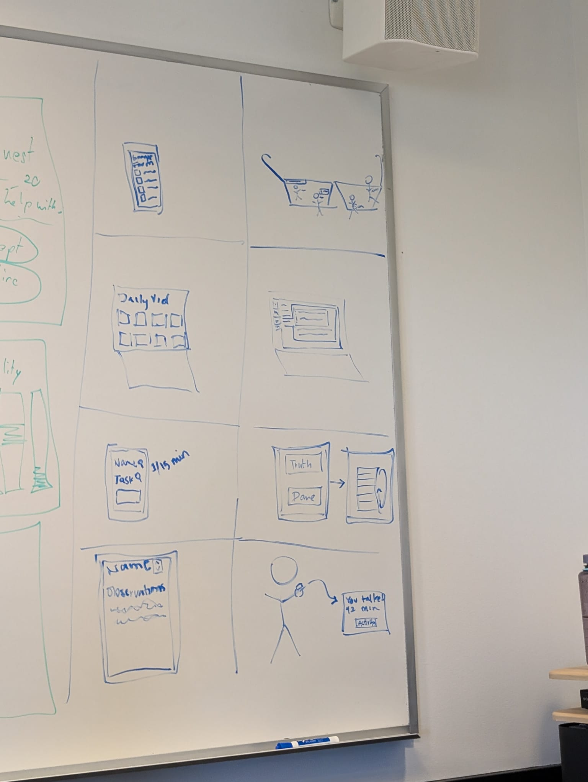
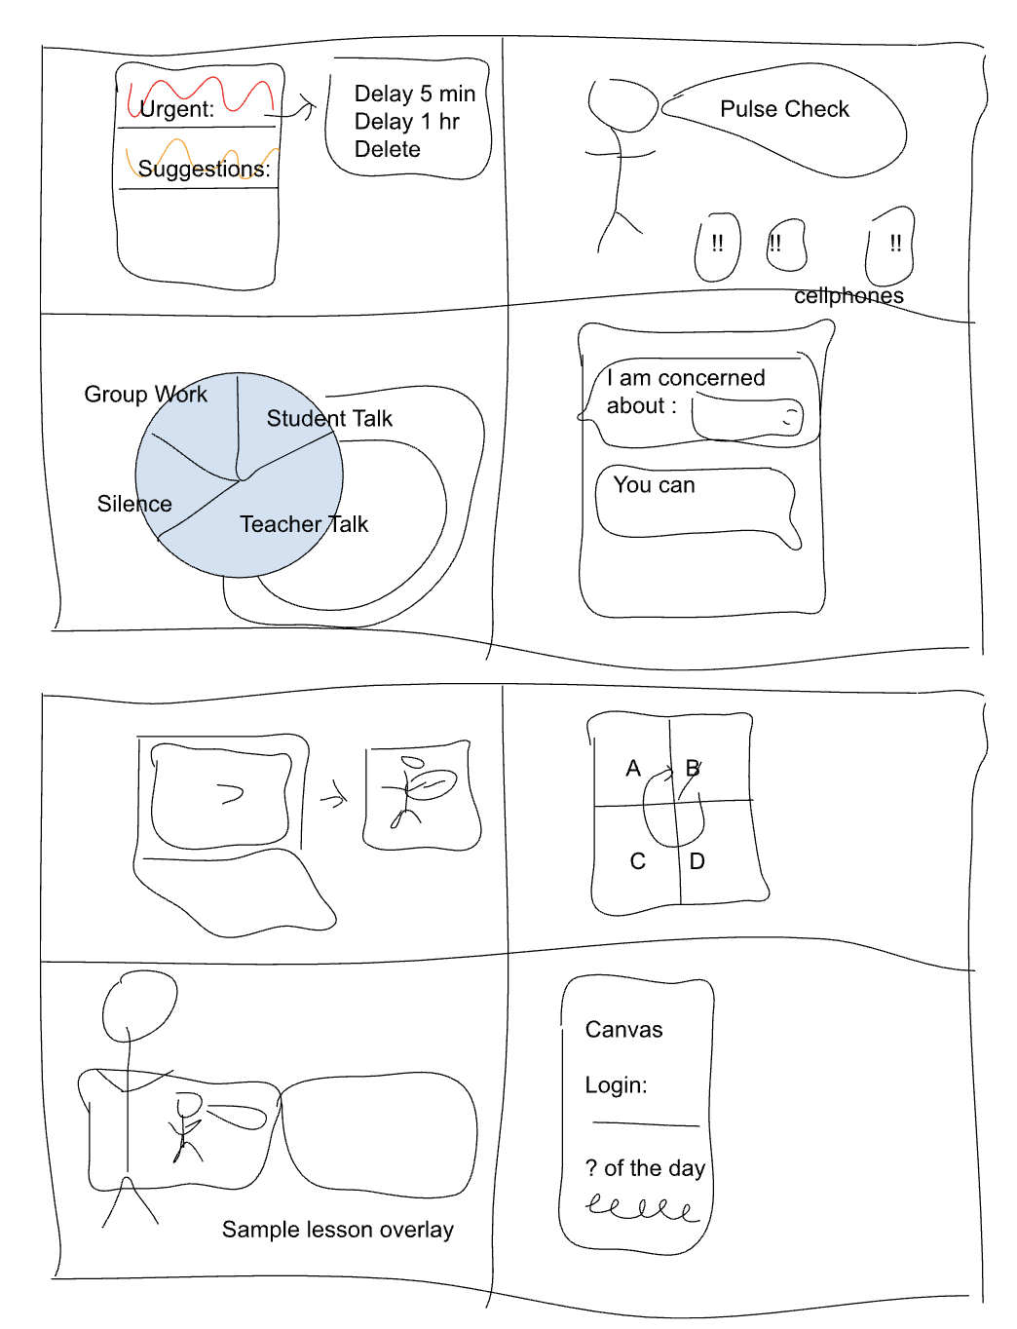
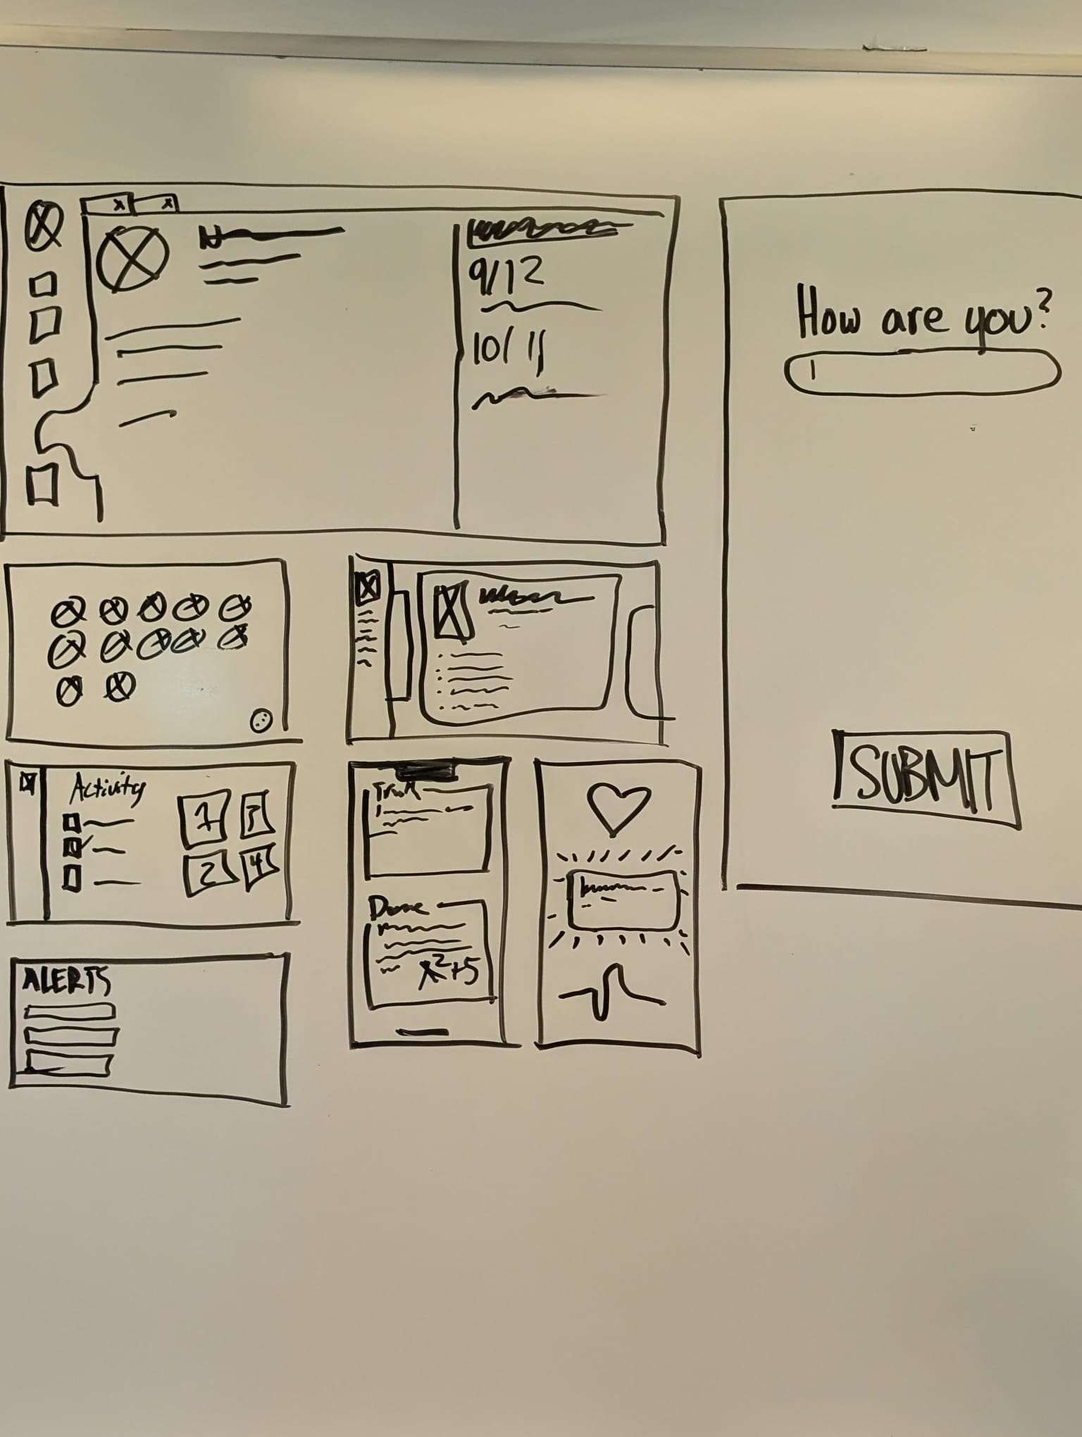
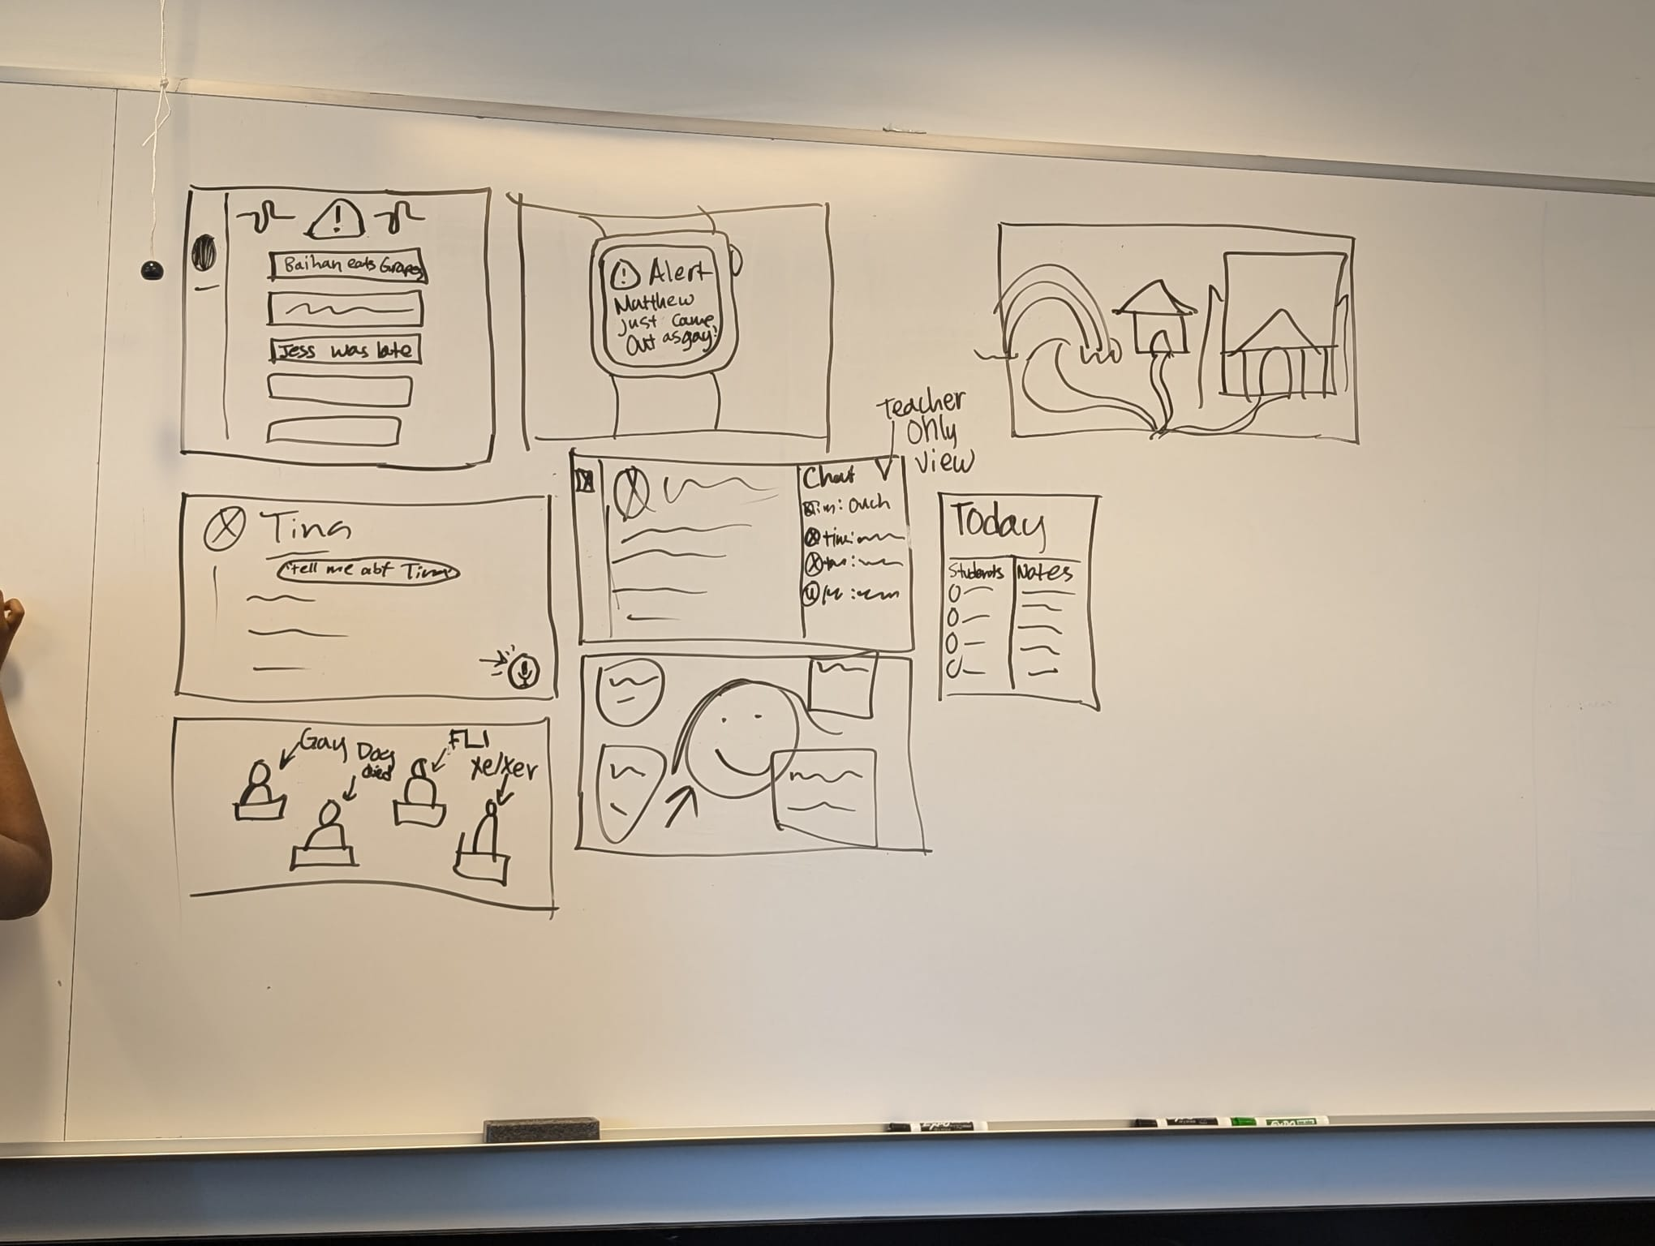
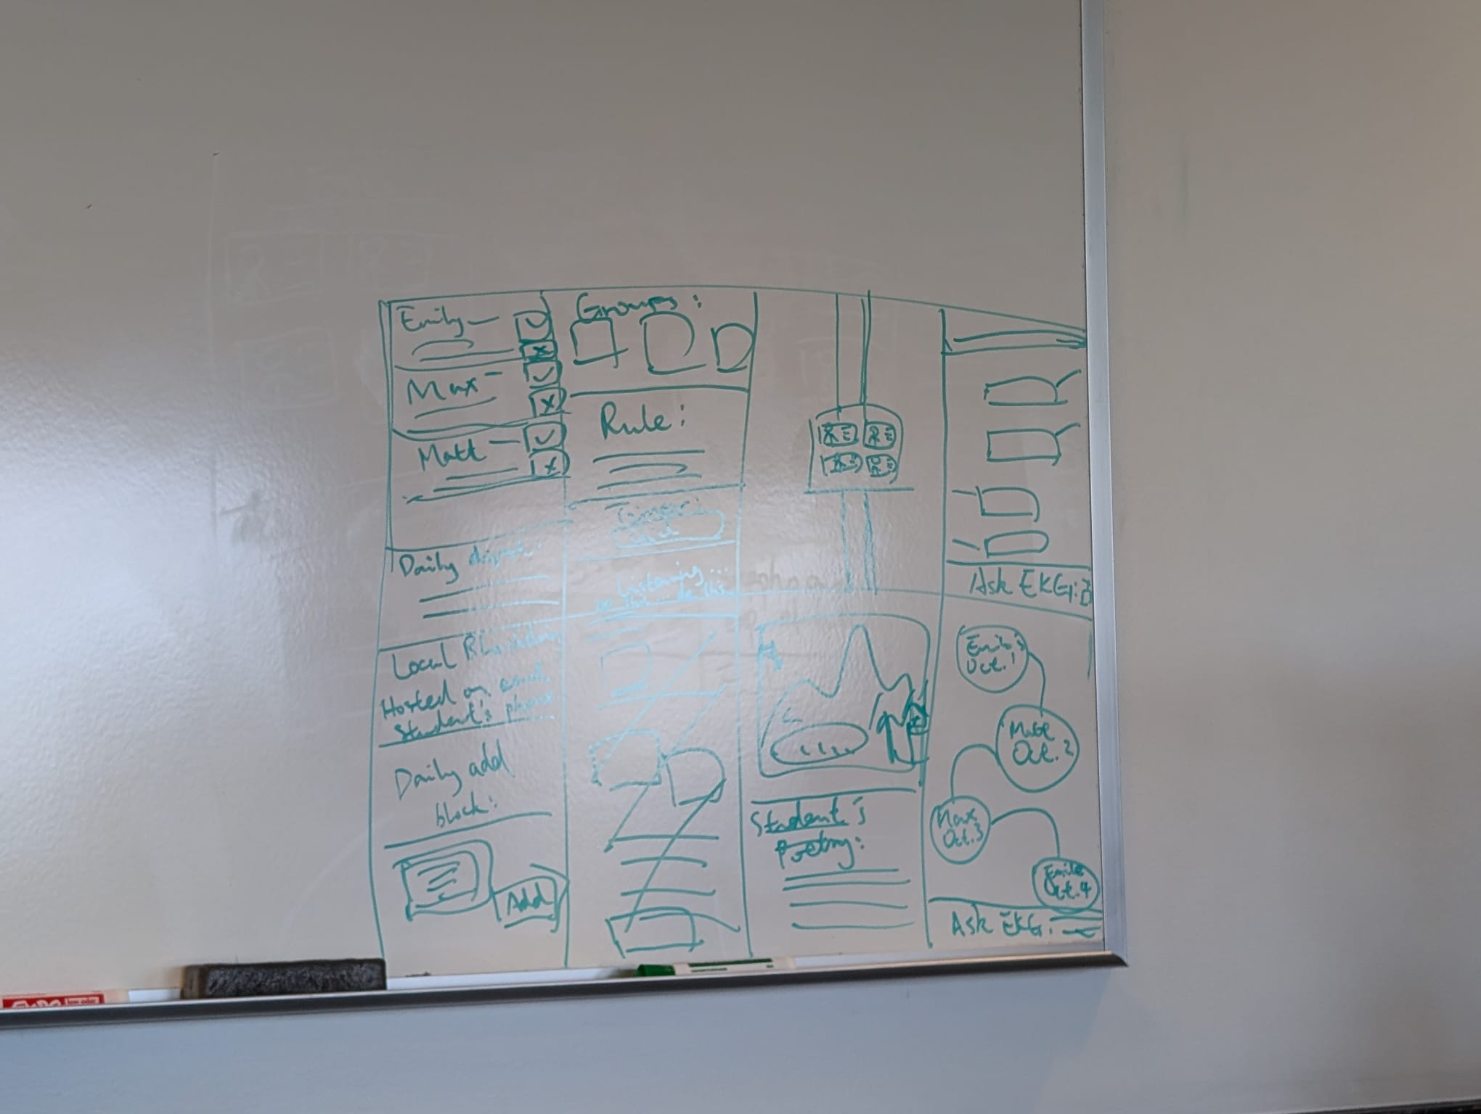
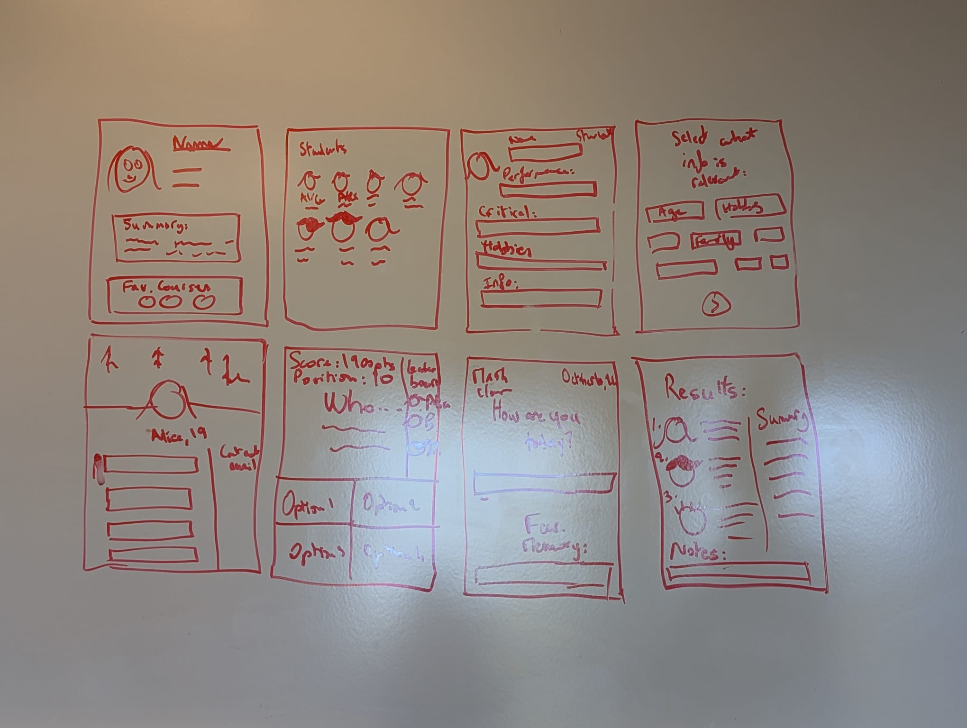
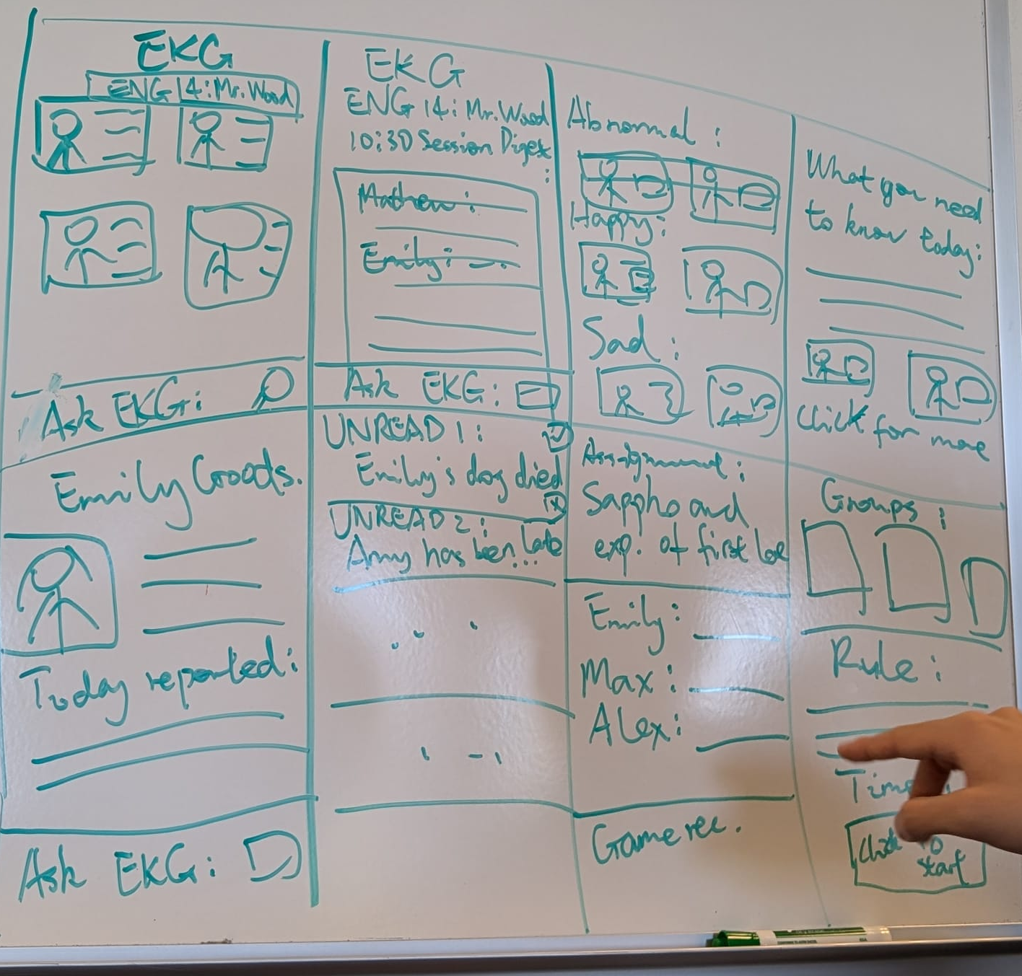
Initial Sketches:
Mobile
AR/VR
Desktop
Wearable

Slide 7
Concept Sketches
Mobile
Desktop
AR/VR
Wearable

Slide 8
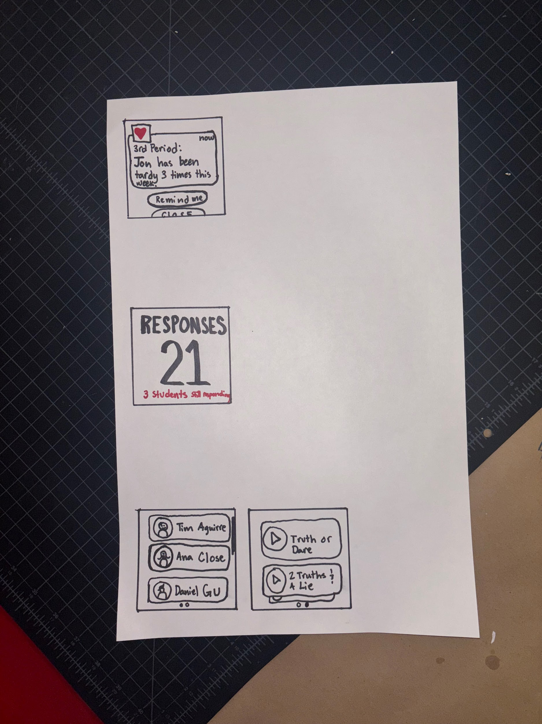
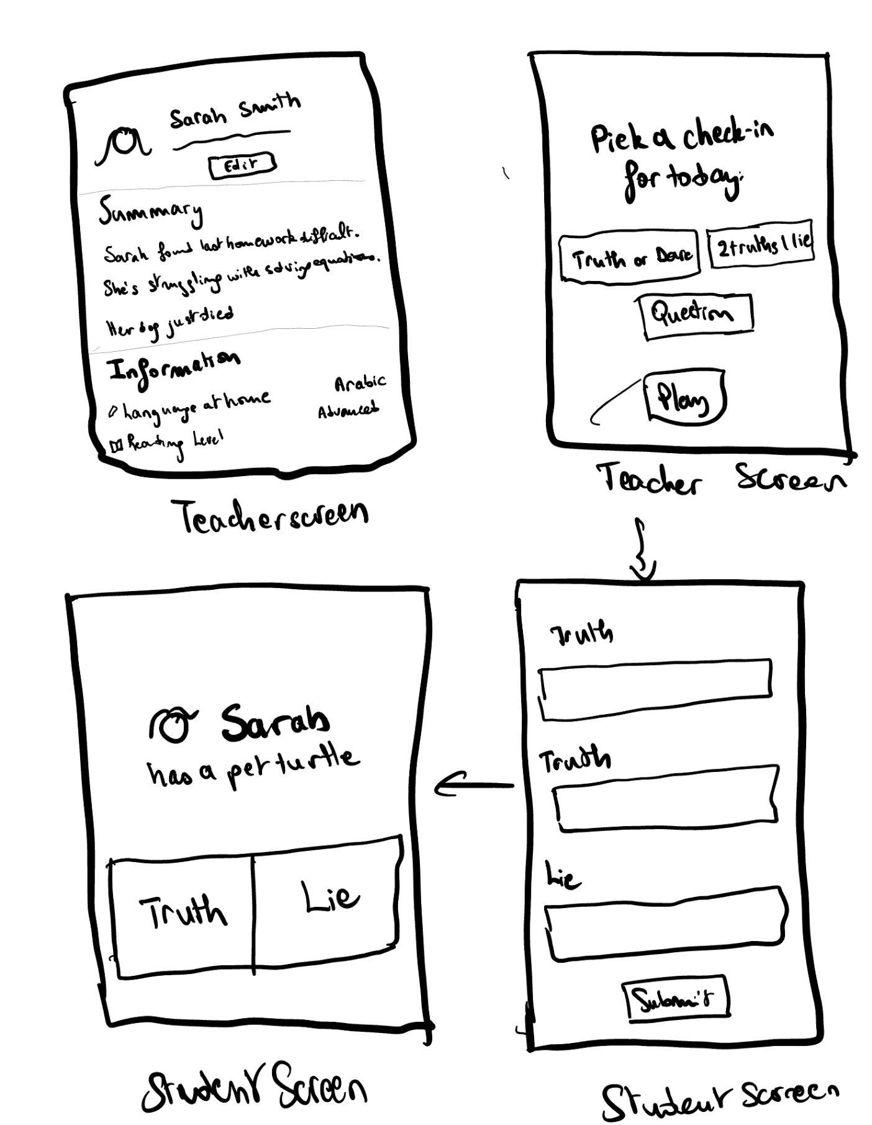
Initial Sketches
Mobile
Wearable

Slide 9
Outline:
Initial Sketches
Selected Interface
Low-Fi Prototype:
  Construction
  Task Flows
Testing Methodology

Slide 10
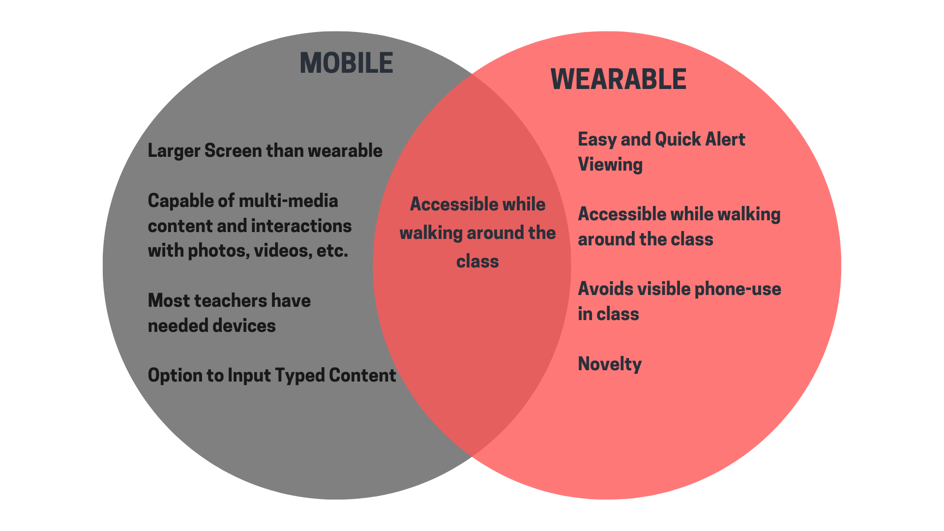
Two Realizations:

Slide 11
Why Mobile?
Importance of accessibility.
No additional cost to schools.
Doesn’t expand the digital divide.
Support both input and output of information.
Android/Apple mobile compatibility (CS147L).

Slide 12
Outline:
Initial Sketches
Selected Interface
Low-Fi Prototype:
  Construction
  Task Flows
Testing Methodology

Slide 13
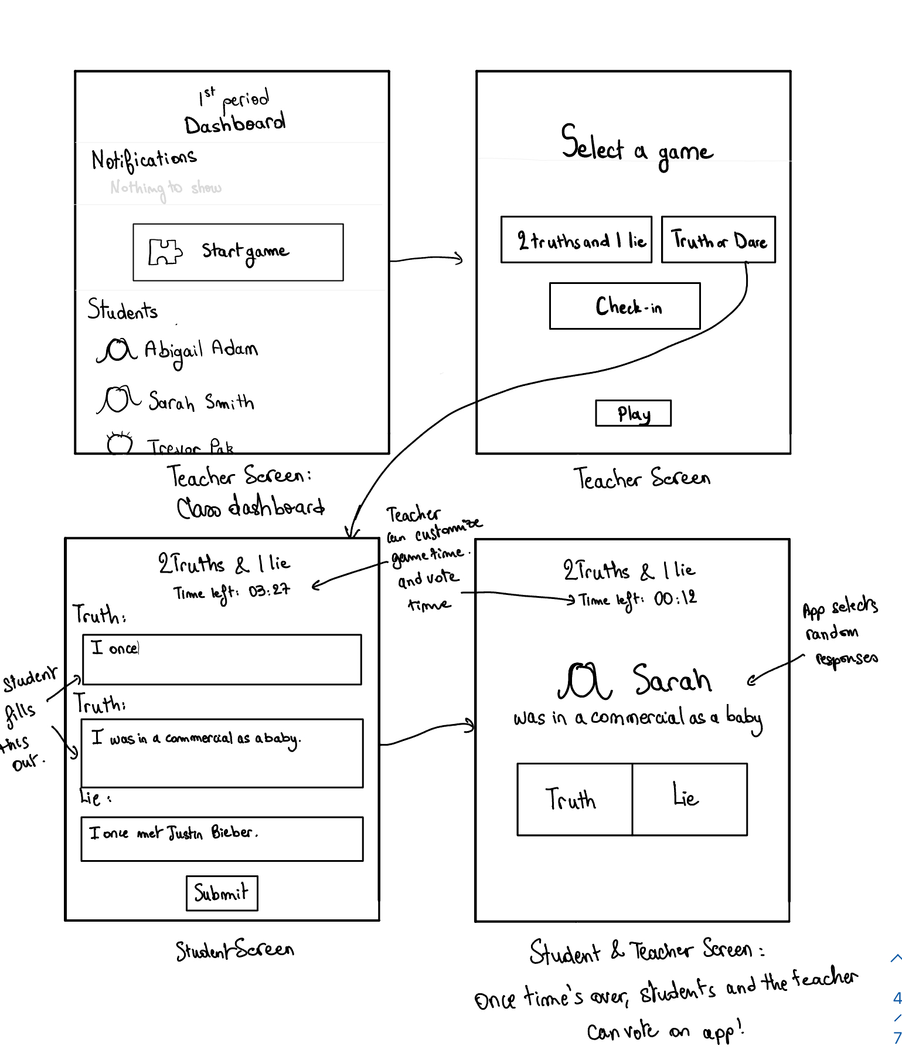
Low-fi prototype construction
Building it:
  We sketched a prototype using Procreate and took screenshots of each screen.
  We included the 4 main tasks that we want a teacher to be able to perform.
Operating it:
  We provided participants with the necessary screens.
  Then, we gave them a task and observed as they tried to accomplish it.

Slide 14
Low-fi prototype: 3 Task flows
Scenario: You are a new 9th grade teacher and it is two weeks into school, you are concerned about getting to know your students especially the more shy students so you can help them learn. You teach 5 periods each with 30 kids in them. Another teacher on campus suggested this app to you because the district uses it so it already has a lot of info.
a. Simple, moderate, and complex
b. Complete and clear with use of captions, labels, transitions, and annotations as required (can use a different color if helpful)

Slide 15
Low-fi prototype: 4 Task flows
Scenario:
You are a new 9th grade teacher.
It is two weeks into school.
You are concerned about getting to know your students, especially the more shy students.
You want to help your students learn.
You teach 5 periods each with 30 kids in them.
Another teacher on campus suggested this app to you because the district uses it so it already has a lot of info.

Slide 16
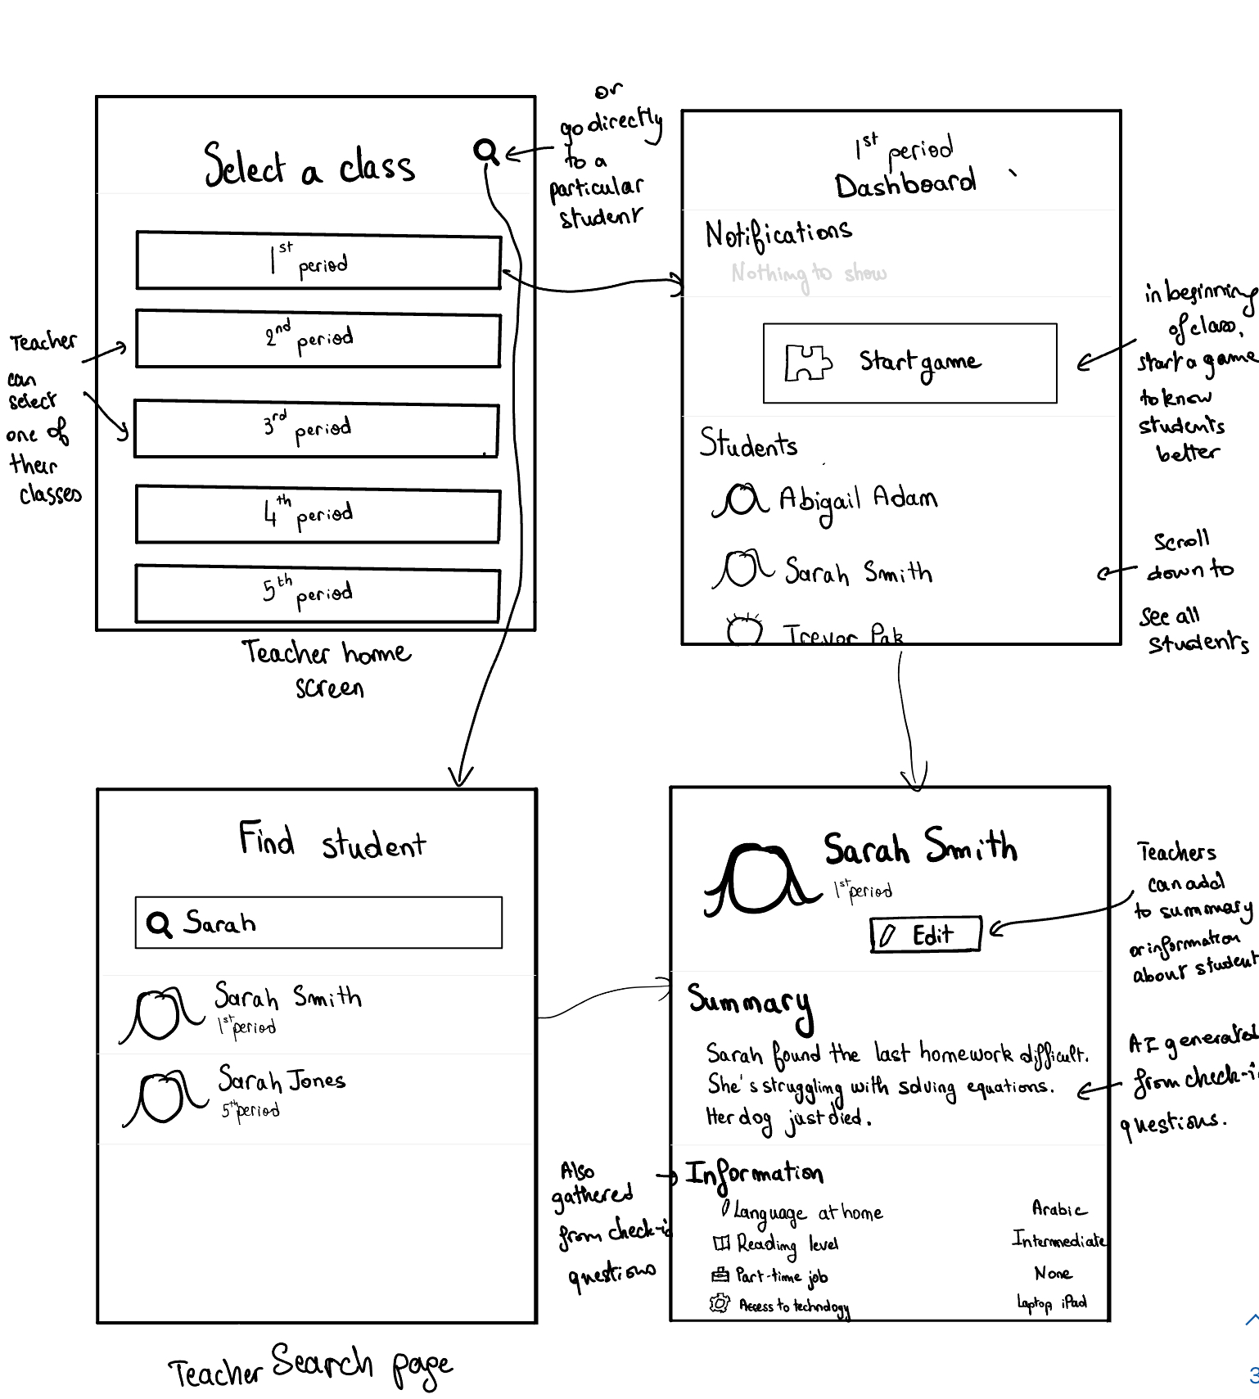
Simple: Teacher views
student information

Slide 17
Simple: Teacher runs a game
to collect student information

Slide 18
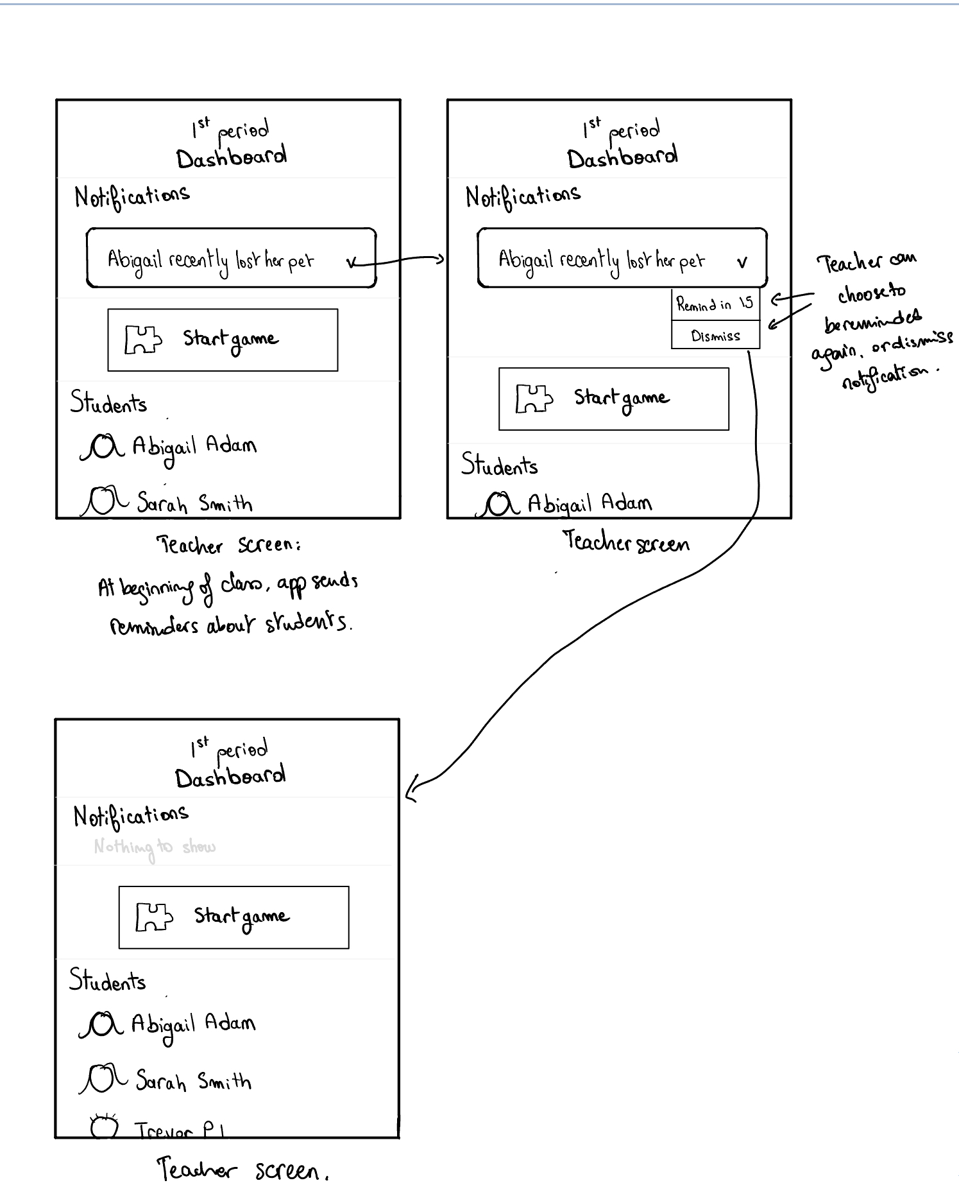
Moderate: Teacher receives AI
generated alerts about students

Slide 19
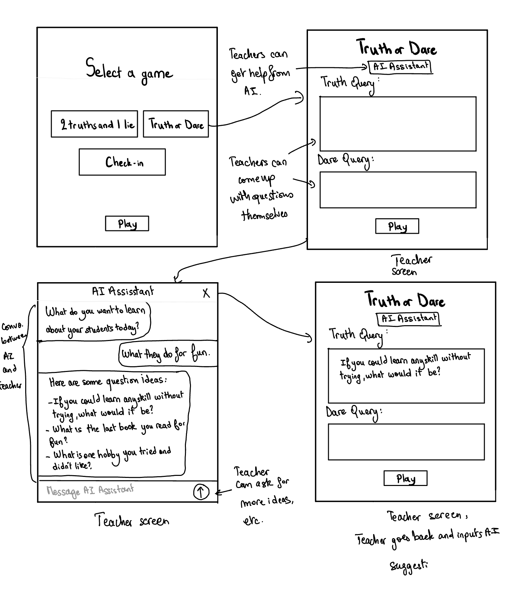
Complex: Teacher codesigns
a game with an AI chat bot

Slide 20
Outline:
Initial Sketches
Selected Interface
Low-Fi Prototype:
  Construction
  Task Flows
Testing

Slide 21
Testing methodology
Participants:
Kathleen, a singing teacher
Rose, a teaching assistant
Derek, Math and computer science teacher
Mary, English teacher.
Recruitment and compensation:
  All recruited in person/over email, not compensated.
Environment:
Tested in person, environment with clear lighting.
Gave them the screens, and described their role + task.
Goals:
Discoverable: Is the order of the screens logical?
Efficient: Is it easy and quick enough to use in a class setting?
Intuitive: Do the tasks make sense?

Slide 22
Testing results: Kathleen
Kathleen was looking for a “Back” button frequently
Kathleen was able to launch a game of Two Truth One Lie with ease and little confusion on what to click on and what things mean.
Kathleen found the button “Remind in 15” useless.
Kathleen was a little confused about how the notifications work: “Is the info from the notification collected from the game I just played? If so, why am I seeing a notification about it later on?
Kathleen pointed out a good problem - if “custom game” is offline, how does the database get updated? The teacher manually type new information in for each student?

Slide 23
Testing results: Rose
Was a bit confused as to when the notifications were generated. “Would this be right after the game? After class? ”
Found the UI navigable and was able to accomplish the tasks.

Slide 24
Testing results: Derek
Quotes:
“Why on earth would I want to be reminded in 15 minutes?”
“Heaven knows I’m not coming up with dares for 9th graders!”
“Why would I click on Abigail for anything other than to see the notification?”
Other:
Had trouble trusting the source of the summary info.
Pointed out that academic statements need to have labels of what class they pertain to
Didn’t initially see the search button, or recognize the ability to scroll

Slide 25
Testing results: Mary
Needed clarity on how they help them understand students better and how to use the information effectively.
Would appreciate more direct ways to search or sort students, especially when looking for specific personal details.
“If I’m using this in class, I need it to be quick and actionable. How do these personal details translate to teaching strategies?”
UI was generally navigable. No new insights beyond back buttons and scroll indicators

Slide 26
Results Overview: Process and Bottom Line Data
Navigation Issues: Users consistently seek clearer navigation cues, suggesting a disconnect between the platform's design and user expectations.
Feature Evaluation: While primary features like game launching are well-received, secondary features such as reminders are seen as unnecessary, highlighting a misalignment with user needs.
Information Transparency: There is notable confusion around the relevance and timing of notifications, signaling a need for more intuitive information delivery systems.

Slide 27
Results Overview: Observations and Goals
Other Relevant Observations
Offline Functionality Concerns: questions arise about how the platform handles data updates when offline.
Application of Data: Users express a need for clearer and more direct ways to apply gathered student data to teaching strategies.
Achievement of Usability Goals
The platform is generally navigable but lacks clear cues that align with user expectations.
There is a significant need to enhance how information is presented and explained to ensure it is understood and utilized effectively by the users.

Slide 28
Discussion: Implications
Navigational Challenges: The need for clearer navigation cues like a "Back" button suggests that users may struggle with the platform's overall flow.
Feature Relevance: The mixed reception of features such as "Remind in 15" indicates that some elements may not align with the user's actual needs or workflow.
Information Clarity: Confusion over notifications and data updates points to a need for clearer communication and demonstration of data relevance and timing.

Slide 29
Discussion: Design Next Steps
Enhance Navigation: Introduce more intuitive back-navigation options and visible scroll indicators.
Streamline Features: Evaluate the utility of less-used features, considering removal or modification to align more closely with user needs.
Improve Information Delivery: Redesign notification systems to be more timely and relevant, and ensure that all informational outputs are clear and directly useful.

Slide 30
Discussion: What Testing Couldn’t Reveal
Long-Term Usability: The tests might not have captured long-term engagement issues or the adaptability of users over time with the platform.
Comprehensive Data Usage: It's unclear how effectively teachers can implement the collected data into varied educational strategies beyond the immediate suggestions provided.
Broader User Experience: The feedback may not fully represent all user groups or contexts, possibly overlooking some nuances in different educational settings or among diverse user demographics.

Slide 31
Appendix

Slide 32
Appendix - Interface Pros and Cons
Wearable
Pros:
Easy and Quick Alert Viewing
Accessible while walking around the class
Avoids visible phone-use in class
Novelty
Cons:
Would require additional devices for some teachers
Smaller Screen than mobile
Cannot type effectively, so more for passive reception of information: limited interaction with AI to generate games/ask questions about alerts
Mobile App
Pros:
Most teachers have needed devices
Larger Screen than wearable
Accessible while walking around the class
Capable of multi-media content and interactions with photos, videos, etc.
Quicker access to sharing on social media
Cons:
Encourages phone-use in class
Relatively small screen for data analysis

Slide 33
Baihan’s Test
Baihan tested the prototype on his voice teacher, Kathleen, an experienced singer and teacher who teaches 1 on 1 lessons as well as studio singing classes (10-15 students)
Kathleen was looking for a “Back” button frequently
Kathleen was able to launch a game of Two Truth One Lie with ease and little confusion on what to click on and what things mean.
Kathleen found the button “Remind in 15” useless.
Kathleen was a little confused about how the notifications work: “Is the info from the notification collected from the game I just played? If so, why am I seeing a notification about it later on?
Kathleen pointed out a good problem - if “custom game” is offline, how does the database get updated? The teacher manually type new information in for each student???
Kathleen in general liked the concept of the app and validated the problem of teachers not knowing students on a personal level.
She liked the two game ideas we have built in and thinks they are good attendance checks.

Slide 34
Matthew’s Test
Test 1- Math & Computer Science Teacher
Insights:
4-We need to provide more instruction for new users.
3-We need to create a flow that determines what is worth saving and/or alerting on.
3-Need for back buttons.
Quotes:
3-“Why on earth would I want to be reminded in 15 minutes?”
3-“Heaven knows I’m not coming up with dares for 9th graders!”
3-“Why would I click on Abigail for anything other than to see the notification?”
Other:
2-Had trouble trusting the source of the summary info.
1-Pointed out that academic statements need to have labels of what class they pertain to
1-“I’m strongly of the belief that all search boxes should be fuzzy find. I’m aware you can’t tell right now but still”
2-Didn’t initially see the search button, or recognize the ability to scroll
0-Both Abigail and Sarah’s pets died according to the Lo-fi prototype

Slide 35
Jessica’s Test
The games are an interesting concept, but teachers need clarity on how they help them understand students better and how to use the information effectively.
Users would appreciate more direct ways to search or sort students, especially when looking for specific personal details.
“If I’m using this in class, I need it to be quick and actionable. How do these personal details translate to teaching strategies?”
UI was generally navigable. No new insights beyond back buttons and scroll indicators

Slide 36
Oumnia’s Test
Rose first asked if the students names would be organized alphabetically: “Would be a pain to have to scroll down each time through 30+ students just to find one.”
“Could I search for a student in the 1st grade dashboard instead of having to go back to the page that has all the dashboards?”
“What could the AI assistant do?” -> when i compared it to chatgpt it was intuitive to her, however she is younger than most teachers would be.
“How’s this information processed and when am i receiving it back?”
She didn’t see the point of having to be reminded in 15 minutes, instead wants to be able to save the notifications otherwise she’ll forget.

