Slide 1



Slide 2
Value Proposition

Slide 3
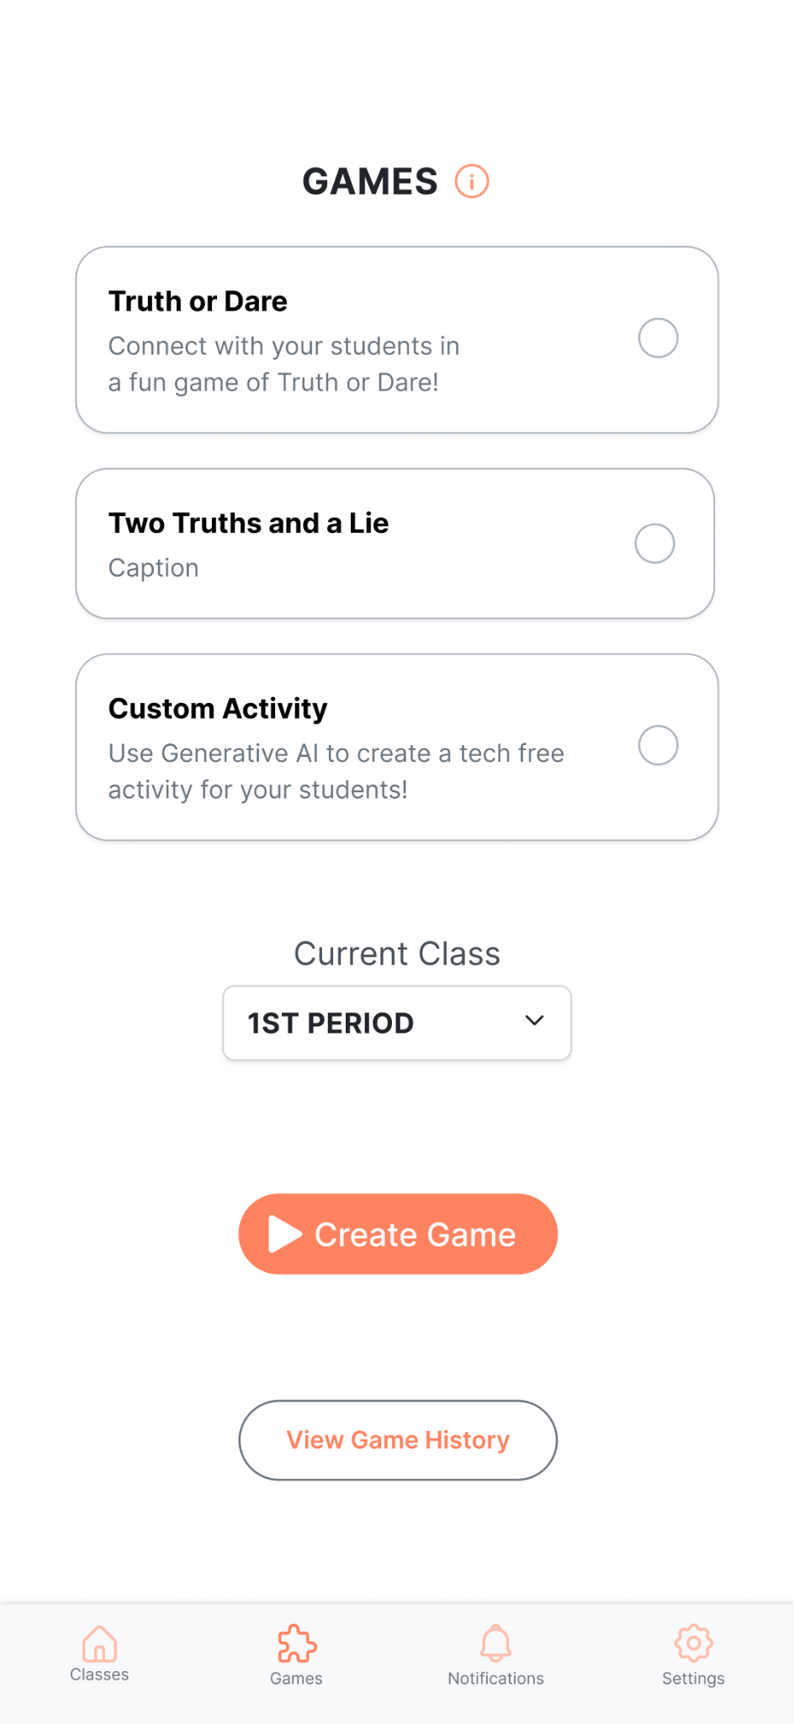
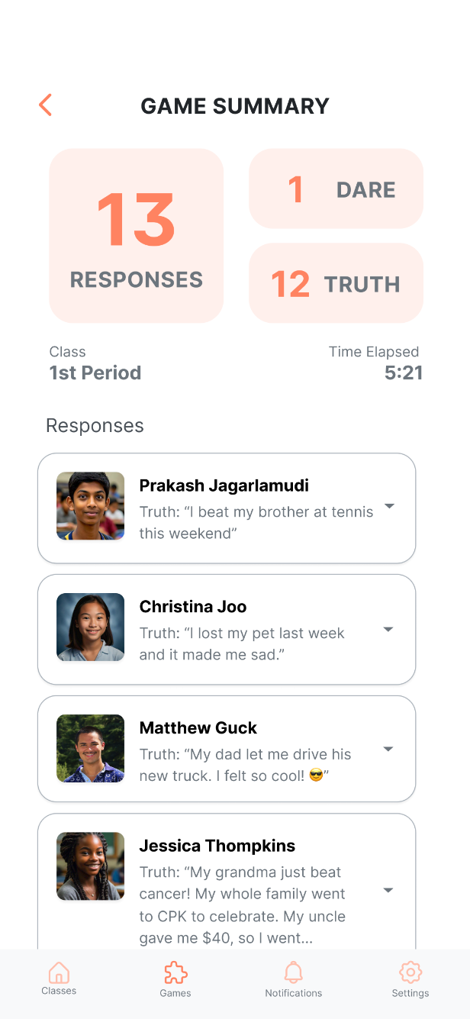
Gamified Getting-to-Know-You
A platform that enables teachers to learn static and dynamic student information through engaging, in-class games!

Slide 4


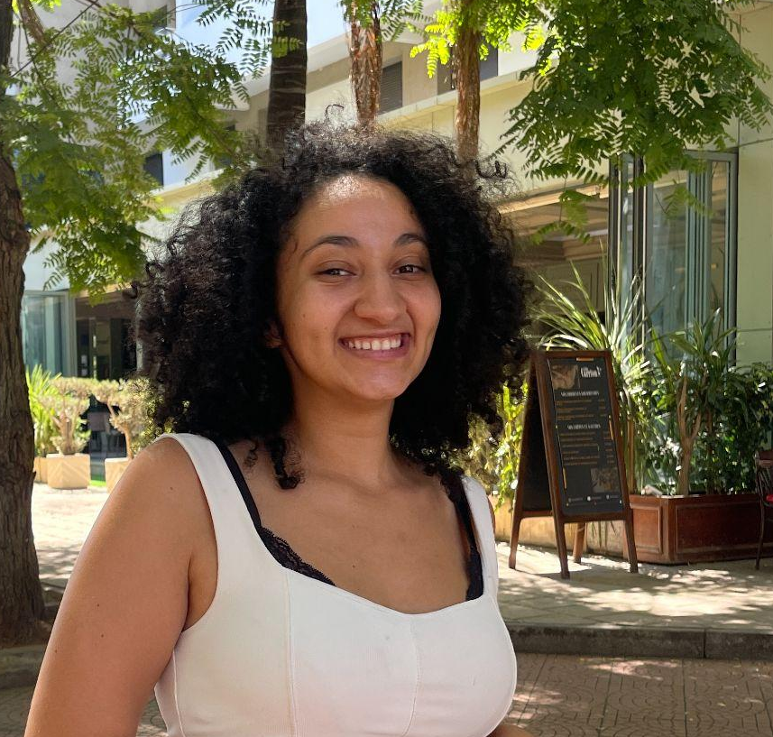

The E.K.G. Team
Matthew
Jessica
Oumnia
Baihan

Slide 5

Teachers Struggle to Develop Meaningful Connections with Students
Consequences:
- Difficult to engage students effectively.
- Lower trust.
- Reduced motivation.
- Less effective learning environments.

Slide 6
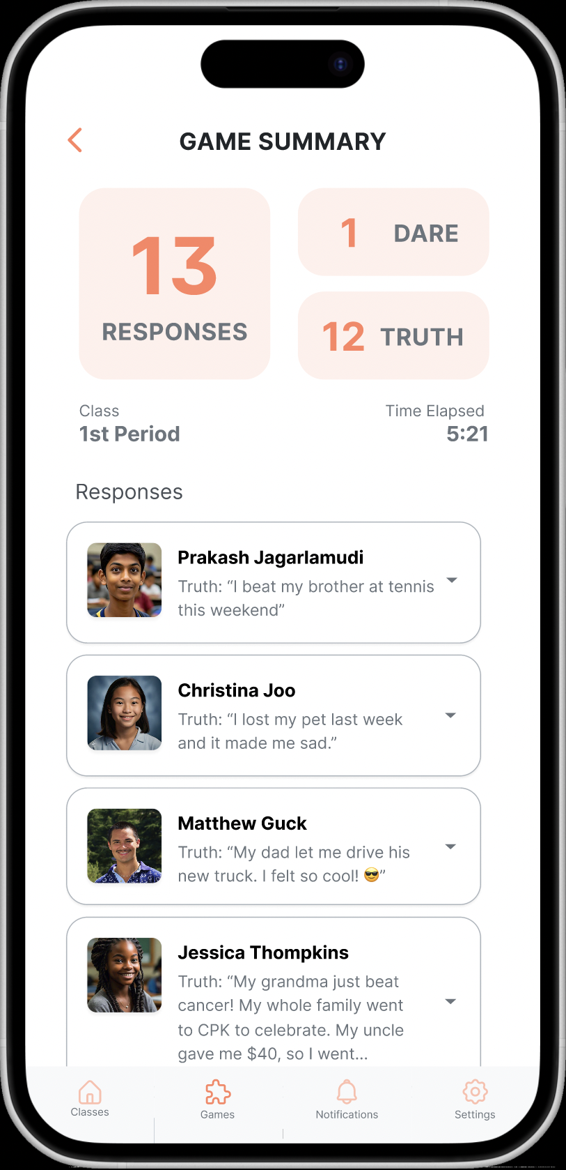
Solution: EKG
Target: Grades 6th-12th
Collects both static and dynamic student information to be shared with teachers and offers suggested activities to improve teacher & student relationships.
How it does it: uses truth/dare, 2 truths/lie, and AI generated improv games to collect information about the students.

Slide 7
Outline
2.
Prototype Implementation Status
1.
Heuristic Evaluation Results & Our Revisions
3.
Prototype Demo

Slide 8
Outline
2.
Prototype Implementation Status
1.
Heuristic Evaluation Results & Our Revisions
3.
Prototype Demo

Slide 9
Total Violations: 98
Severity Breakdown:
Level 3-4 Violations: 34
Total number of revisions: 28
Most Common Violations:
Heuristic | # Violations
H1: Visibility of System Status | 9
H2: Match b/w System & World | 4
H3: User Control & Freedom | 7
H4: Consistency & Standards | 20
H5: Error Prevention | 4
H6: Recognition not Recall | 12
H7: Flexibility & Efficiency of Use | 5
H8: Aesthetic & Minimalist Design | 17
H9: Help Users with Errors | 3
H10: Help & Documentation | 7
H11: Accessible Design | 3
H12. ​​Value Alignment & Inclusion | 7
Total Violations | 98
Severity | Percentage
0 | 4%
1 | 24%
2 | 32%
3 | 26%
4 | 9%

Slide 10
Design Revisions

Slide 11
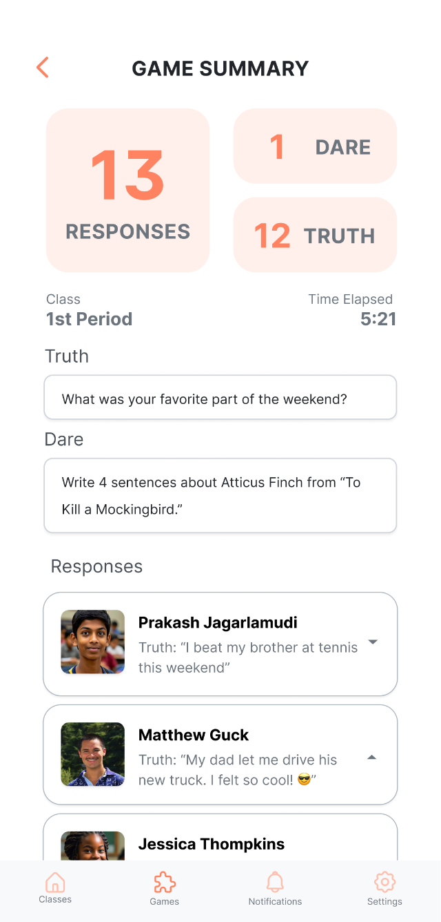
Prompt Visibility
Made Truth and Dare Prompts visible on Game Summary screens.
Rationale: This allows teachers to contextualize and understand student responses, without having to recall the prompt they used.
Usability goal: Efficient to Use

Slide 12
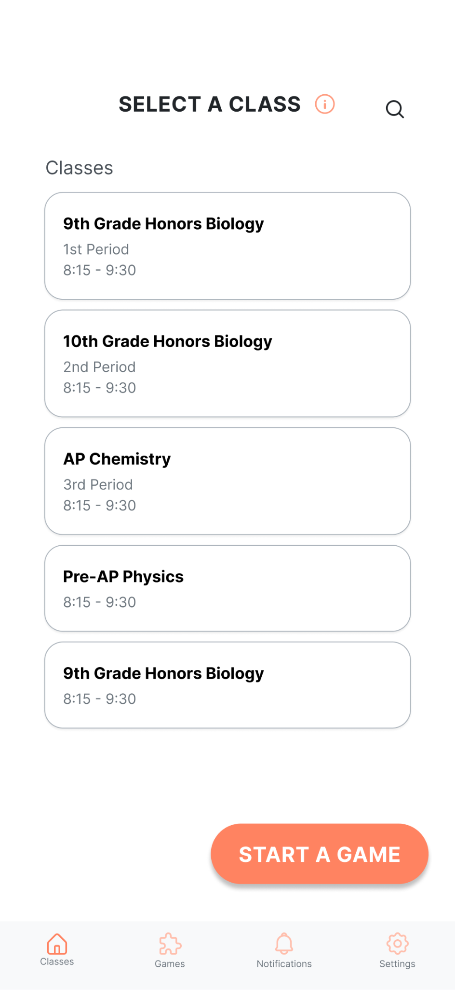
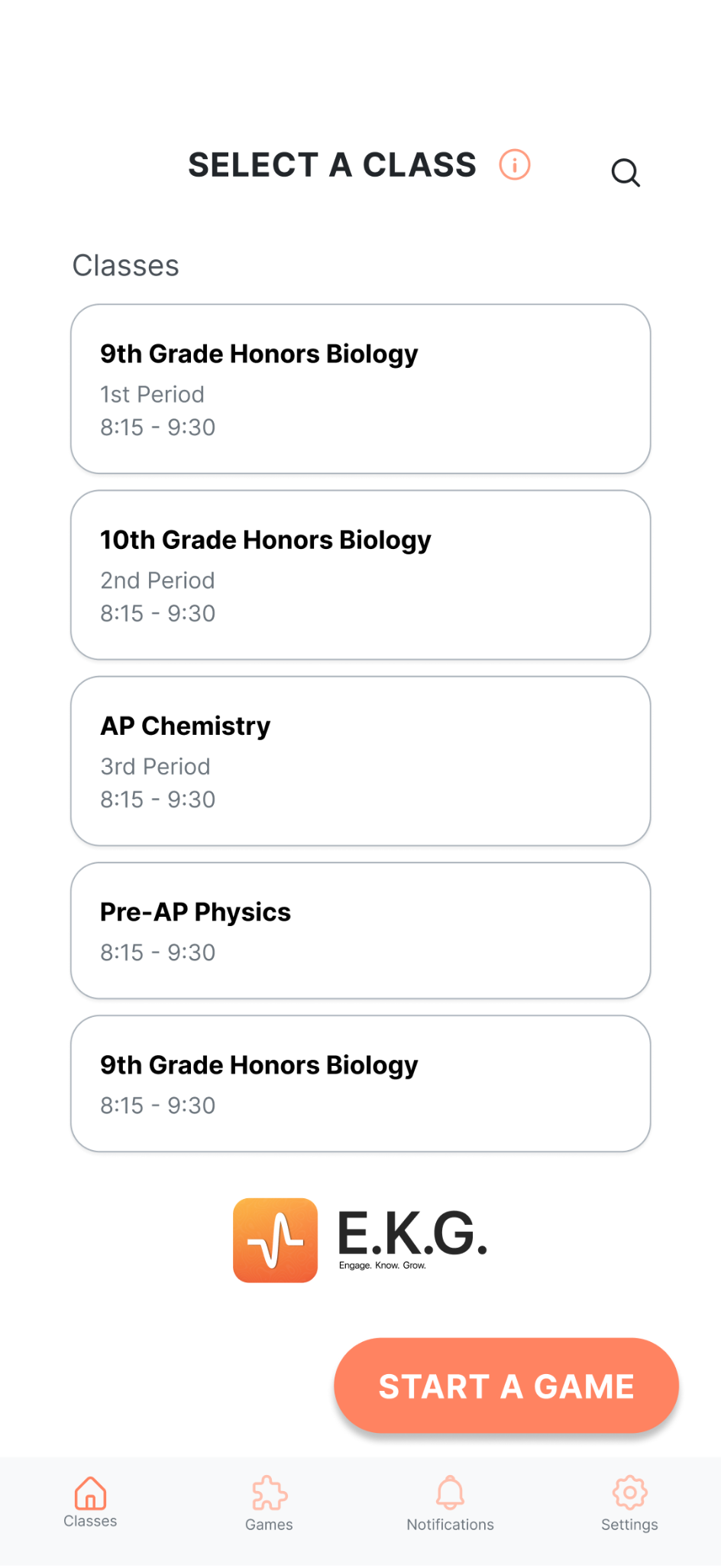
App Logo Visibility
This helps remind teachers not only of what app they are using, but also of our teams values and the app’s purpose— to Engage with students, Know about their lives, and facilitate their Growth, in and out of the classroom.
Usability Goal: Memorable

Slide 13
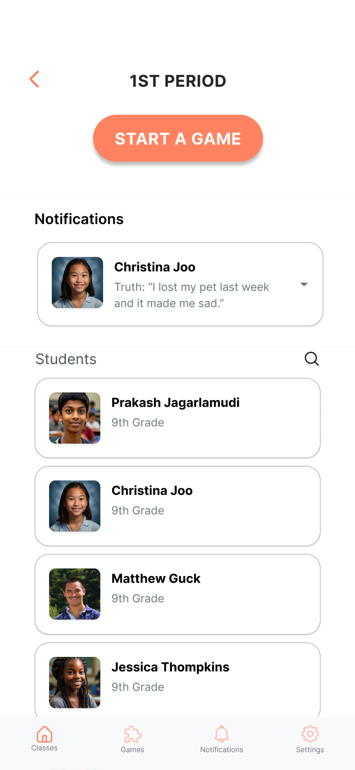
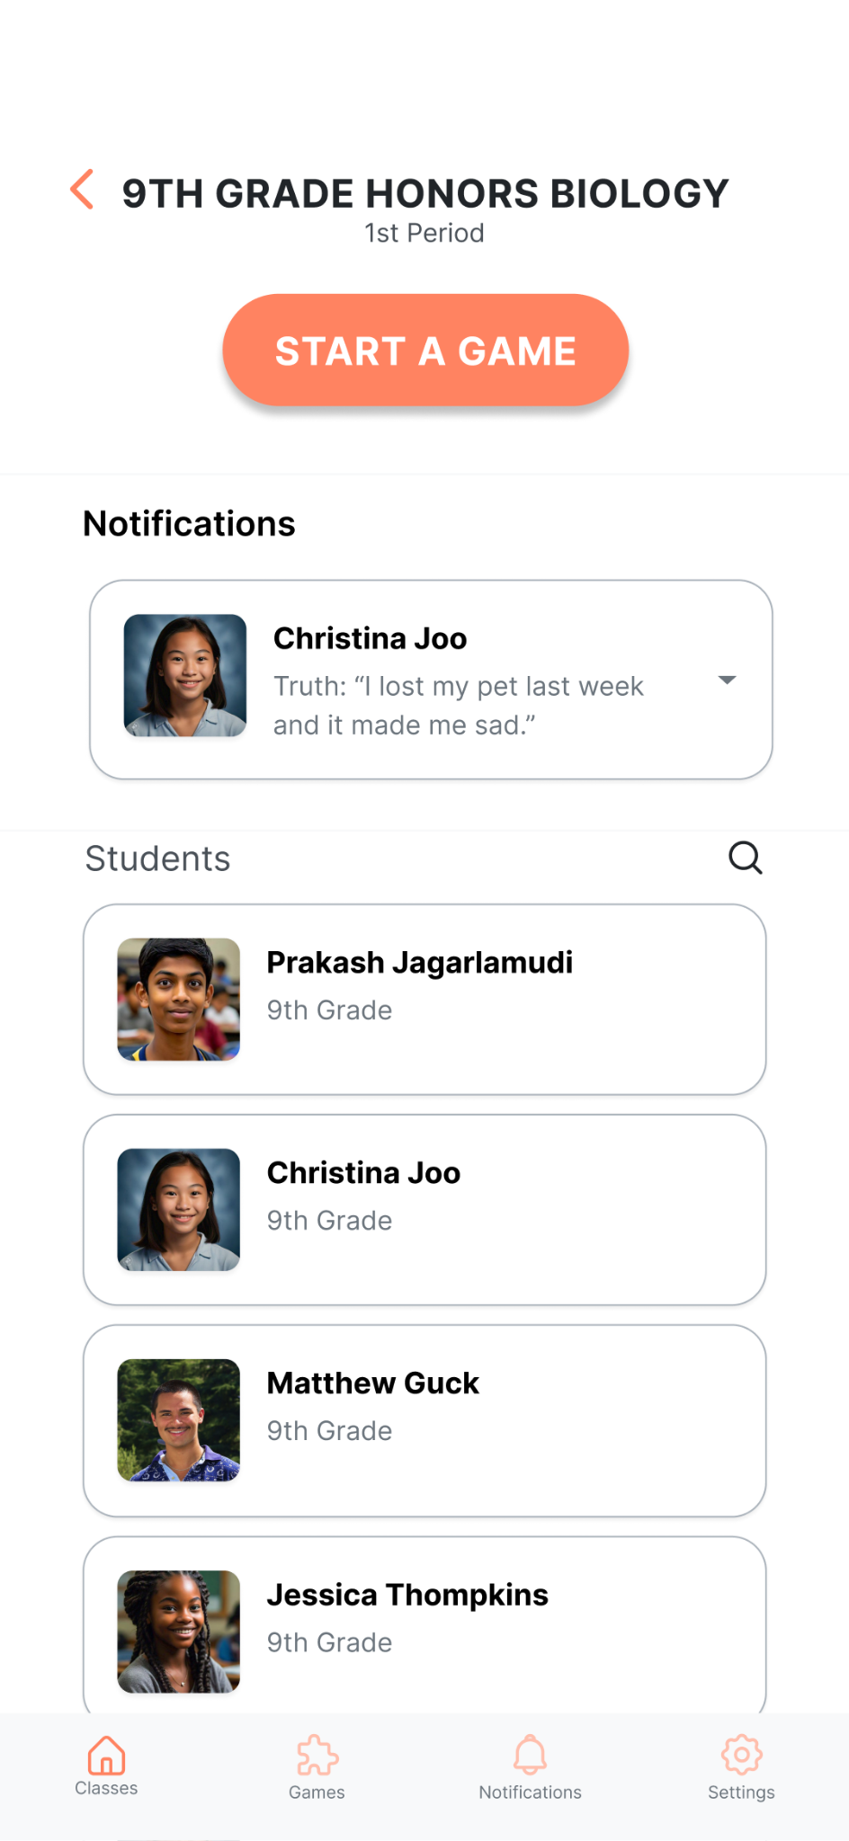
Period Identification
Changed Class Page header to display class title, not just class period.
Teachers now can identify the period through recognition as opposed to recollection.
Usability Goal: Efficient to Use

Slide 14
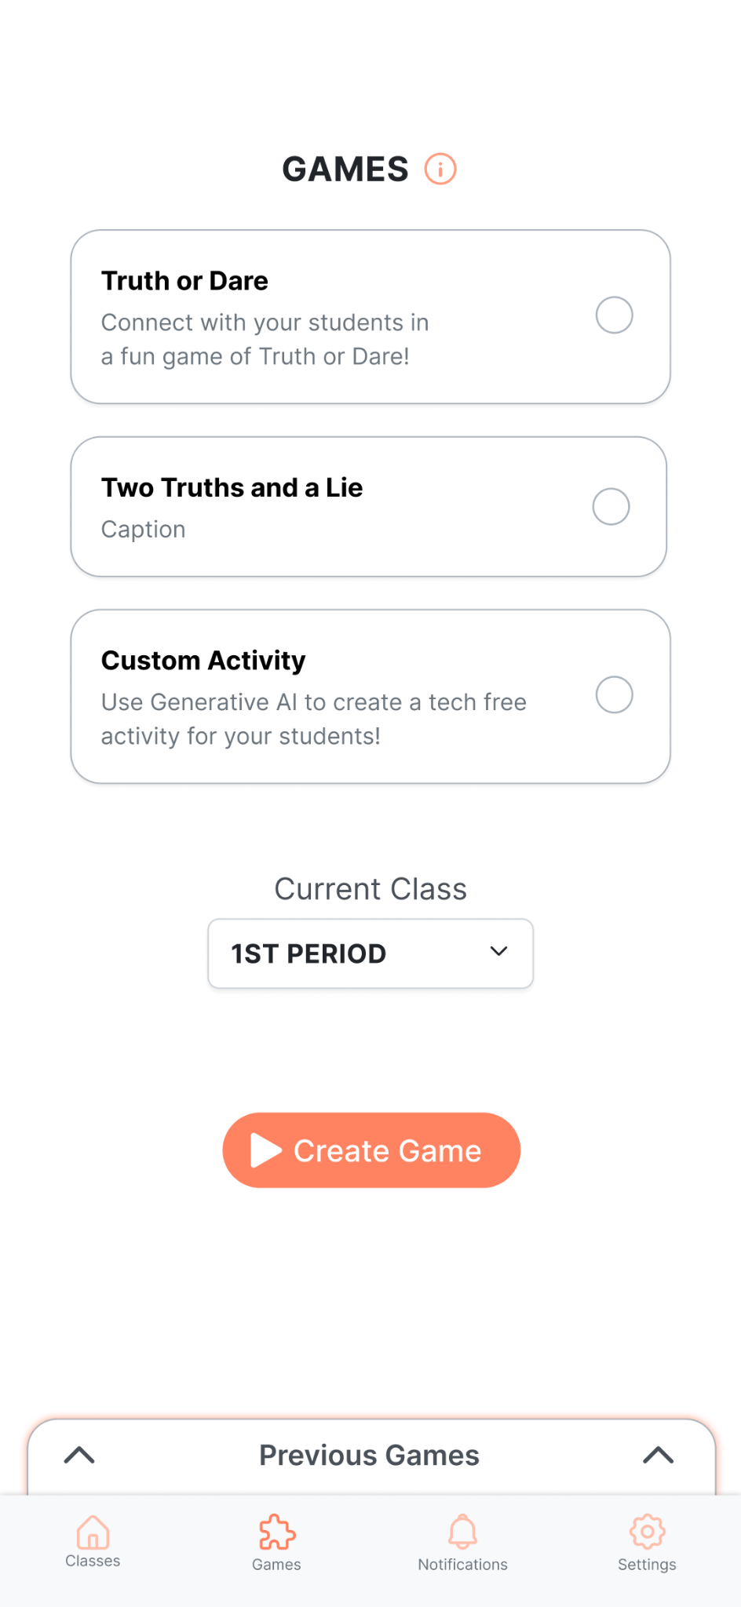
Game History Discoverability
‘Previous Games’ card changed to a ‘View Game History’ button.
Returning to a traditional button design is more intuitive for teachers to navigate.
Utility Goal: Easy to Learn

Slide 15
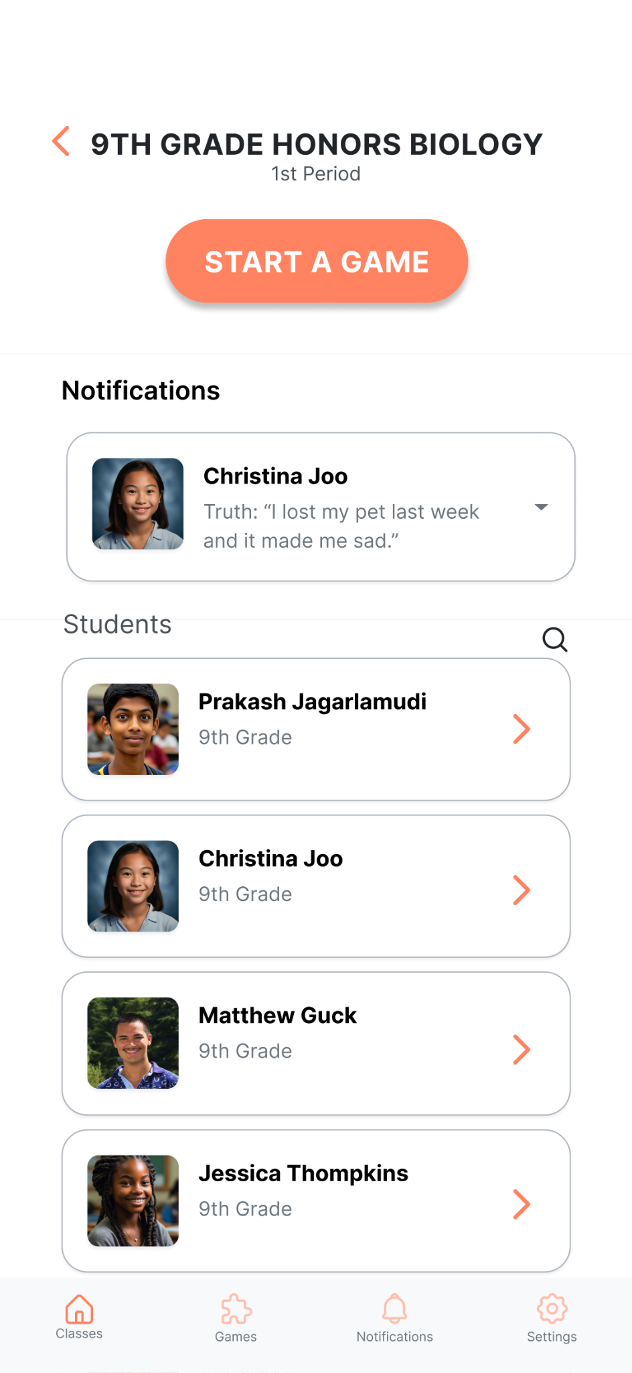
Intuitive Buttons
Student profiles now have an orange button on it as affordances that they can be clicked on.
Usability Goal: Easy to Learn

Slide 16
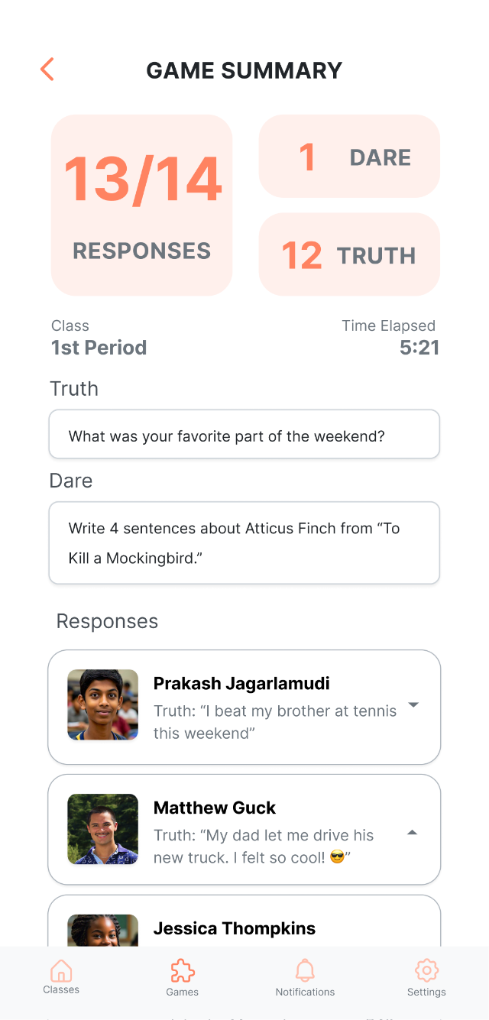
Total Student Count Visibility
Made “Responses” a fraction, showing how many students out of the total number of students in class submitted their responses.
Usability Goal: Effective to Use

Slide 17
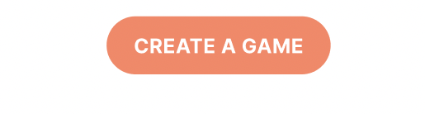
Start Game Wording
Changed the wording of “Start a Game” to “Create a Game” to better reflect the function of the button.
Usability Goal: Easy to Learn

Slide 18
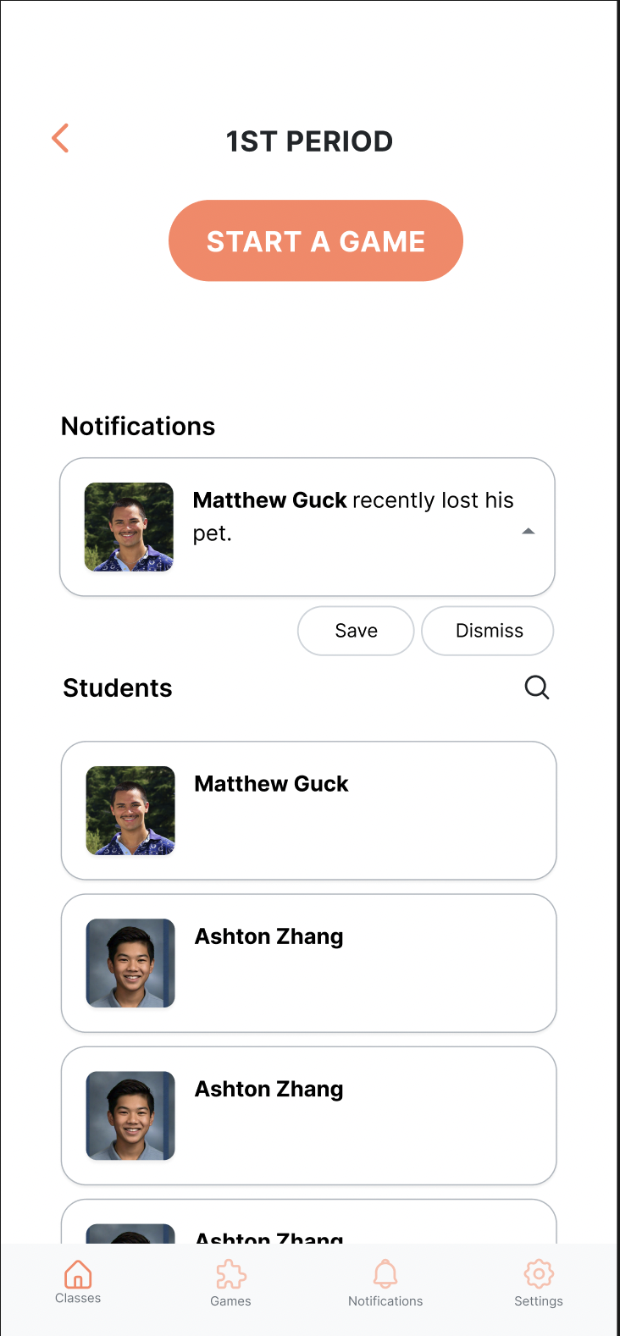
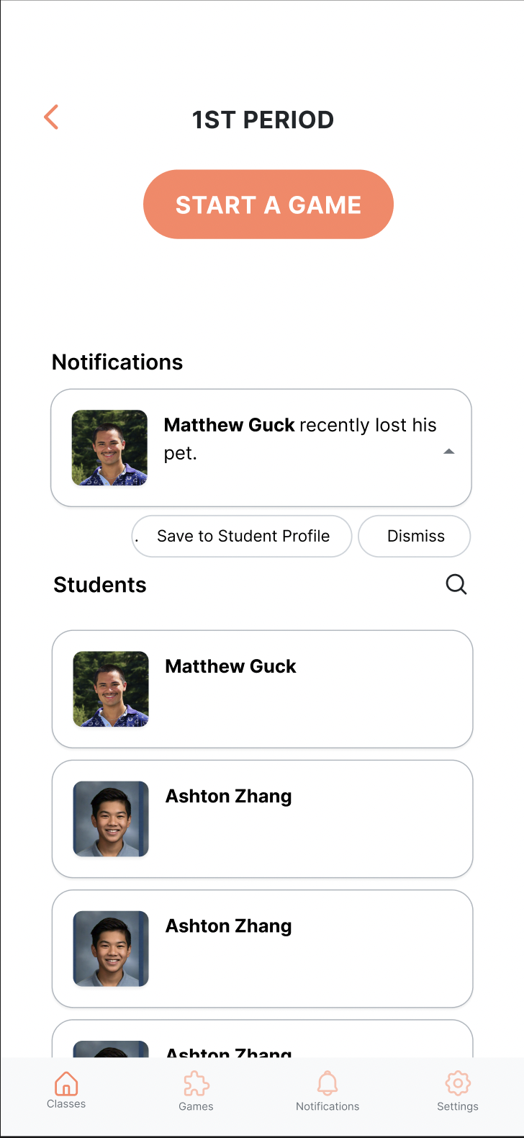
Save Info Wording
Detailed the wording of “Save” to “Save to Student Profile”, also made the button bigger because it’s a more frequent task.
Usability Goal: Easy to Learn, Efficient to Use

Slide 19
Outline
2.
Prototype Implementation Status
1.
Heuristic Evaluation Results & Our Revisions
3.
Prototype Demo

Slide 20
Outline
2.
Prototype Implementation Status
1.
Heuristic Evaluation Results & Our Revisions
3.
Prototype Demo

Slide 21


Tools Used
Front & Backend Dev
React Native
Database
Supabase

Slide 22
Implemented Features
Task: Look at Student Information

Slide 23
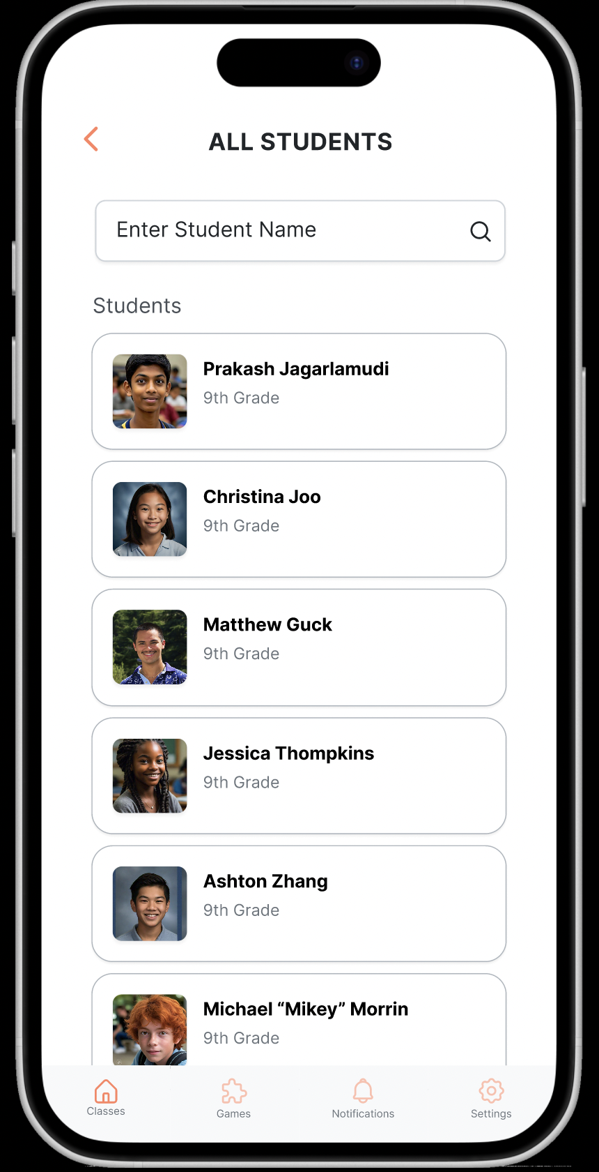
Searching for a Student

Slide 24
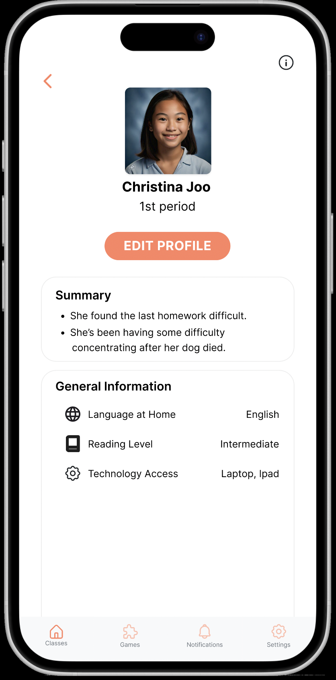
Opening a Student Profile

Slide 25
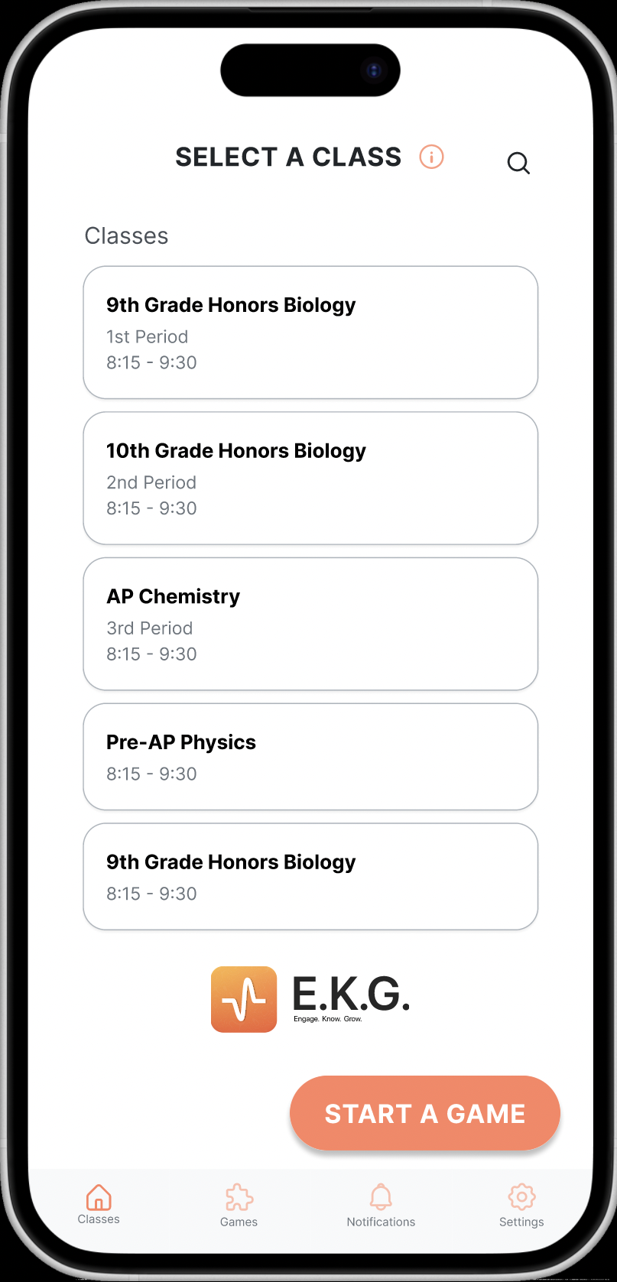
Selecting a Period from
the Dashboard

Slide 26
Unimplemented Features

Slide 27
Create and Host a Game
Unimplemented
Students’ responses to games are currently not added to their profiles.

Slide 28
Edit Student Information
Unimplemented

Slide 29
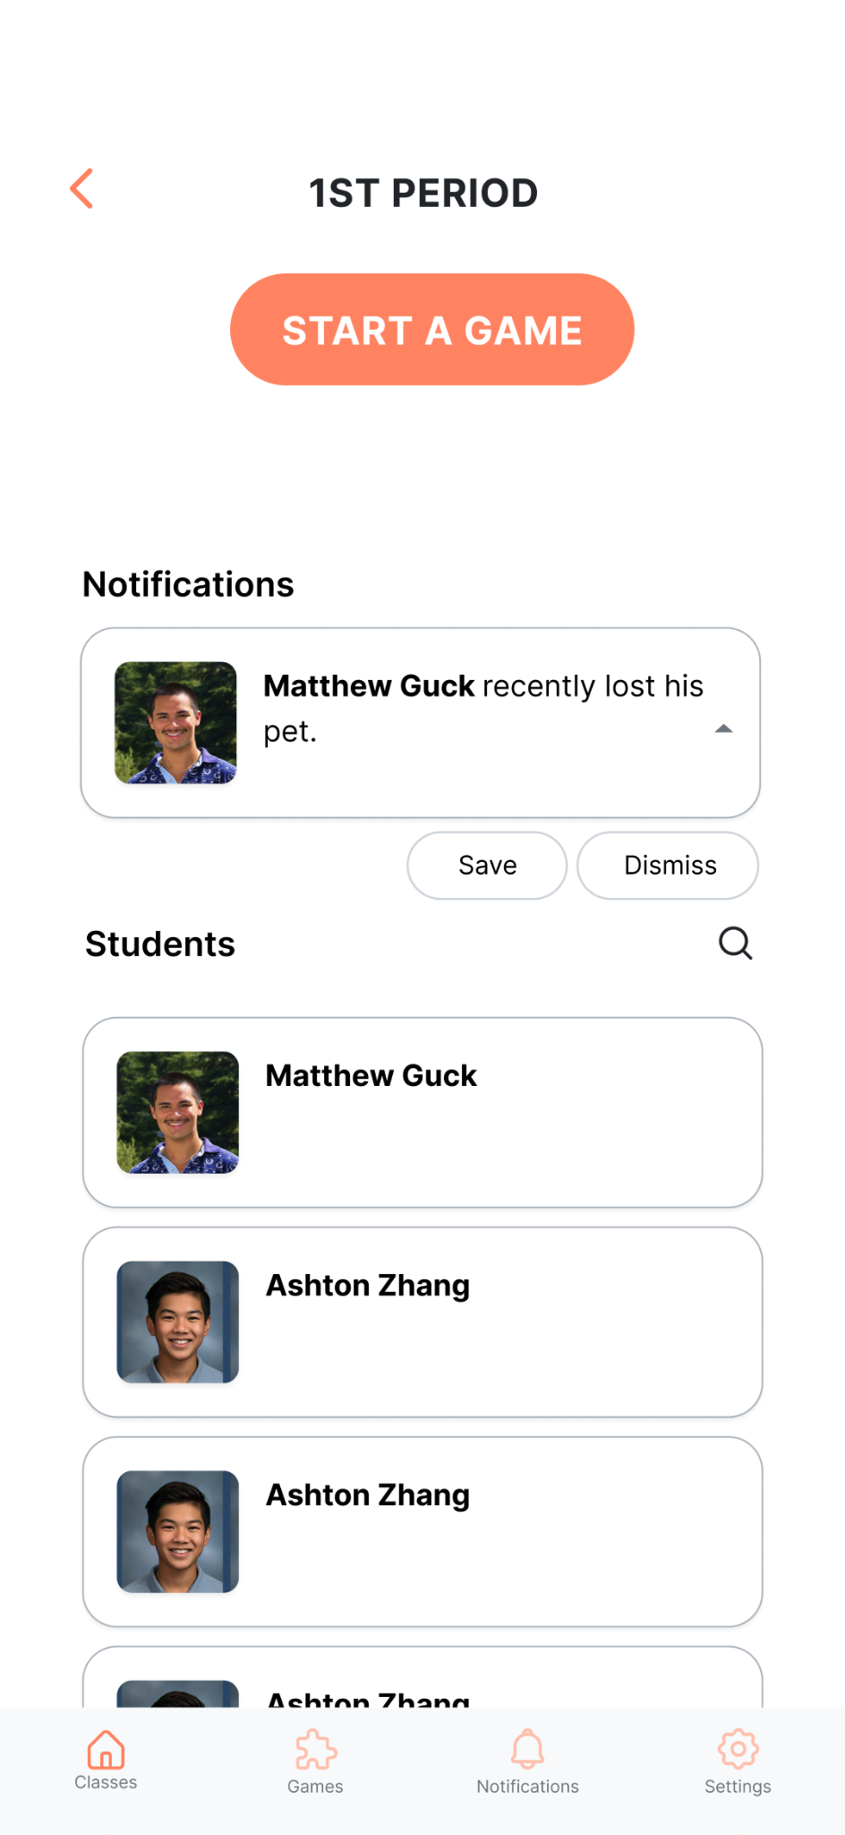
Alerts and Notifications
Unimplemented

Slide 30
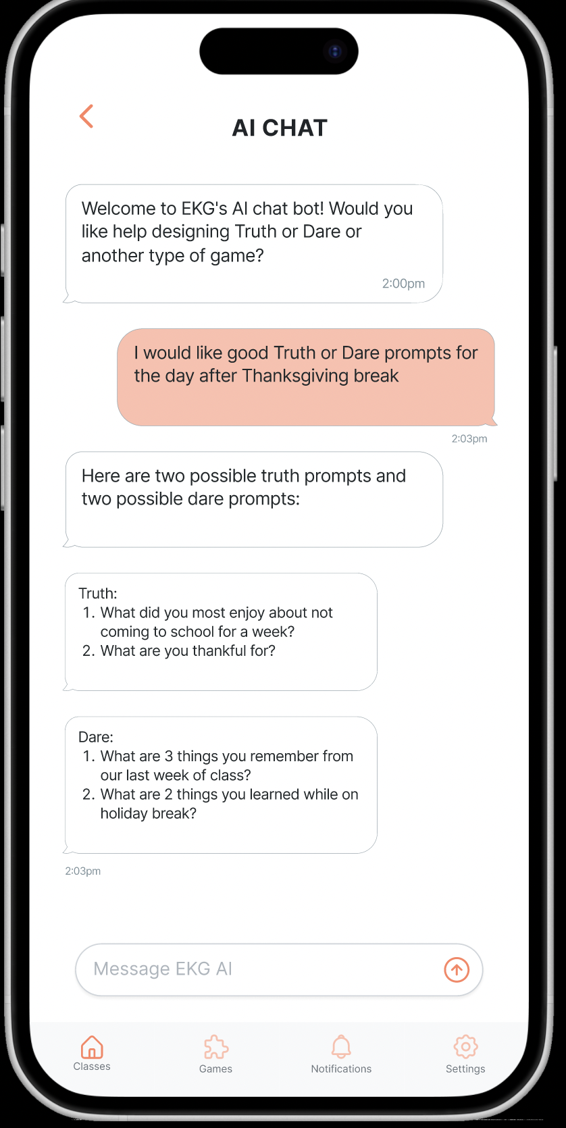
Wizard of Oz Techniques
AI Chatbot for Prompt Recommendation and Custom Game Design

Slide 31
Hardcoded
Student and Class Information in the Database

Slide 32
Issues
None!

Slide 33
Plans for Finishing
Implement Game task and Alert task:
1 week (Nov.22 - 29)
Implement All UI Designs on Figma into Code:
3 days (Nov. 30 - Dec. 2)
Implement Edit/Upload Info Task, Polishing the app, debugging:
3 days (Dec. 3 - 5)

Slide 34
Outline
2.
Prototype Implementation Status
1.
Heuristic Evaluation Results & Our Revisions
3.
Prototype Demo

Slide 35
Outline
2.
Prototype Implementation Status
1.
Heuristic Evaluation Results & Our Revisions
3.
Prototype Demo

Slide 36
Questions?

Slide 37
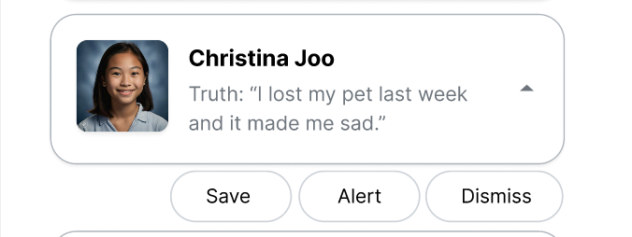
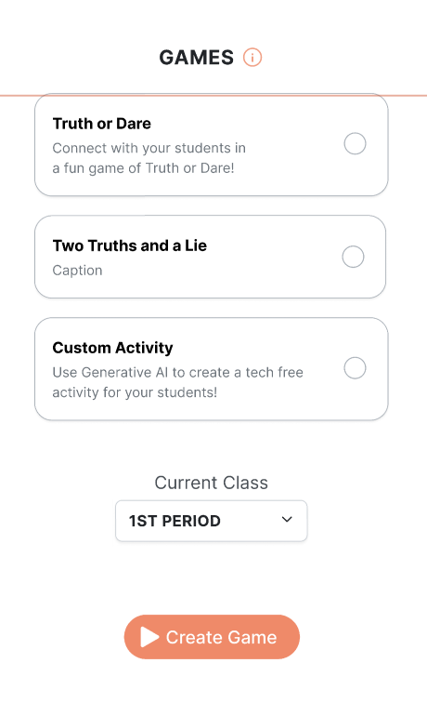
Appendix: Heuristic evaluation results - 4
On the student page, a lack of context about when the summary was created could lead to confusion or outdated information. When is the summary created and based on which questions / games? | summary might be outdated / confusing if teacher is unsure when it was written | Add a timestamp to the summary so teachers can see when it was created or last updated. | Add a timestamp to individual responses in Student Summary
The back button after viewing Christina Joo returns users to the choose class page, which interrupts their workflow when trying to view another student. | Teachers need to navigate between student profiles quickly. It may cause frustration and time spent searching through repeated actions | Make the back button return to the student list, allowing users to easily switch between student profiles. | Prototyping error; we will make back buttons go back to the previous page.
There's no visual feedback indicating that a notification action like "Save" or "Dismiss" was successful in a classes view on a student card | Users may not know if their action has been completed, creating uncertainty about whether they need to repeat the action or if they took some action | Have a confirmation message or animation (ex. “Saved!” or “Dismissed!”) after each action to confirm success | Prototyping Limitation, The button was never implemented. We will have a small confirmation message after users press “Save.”
The wording "Start Game" is unclear and misleading. Choice of words "start game" - may suggest that game will be started after clicking on the button. | Start game also appears in the next page - but they actually don't mean the same thing. First "start game" seems to refer to "build / create your game" instead of actually "starting the game" | Replace "Start Game" with "Build Game" or "Create Game" to clearly indicate the action. | We will use “Create Game.”

Slide 38
Appendix: Heuristic evaluation results - 4
There is no prompt to get teachers to check/review their responses before starting the game. Teachers may ask questions that are too personal or sensitive without realizing it. | While this can be a light-hearted way to get to know students, teachers should be more measured / considered / think more carefully when they ask more serious questions i.e what are the challenges you faced this week, because some of these questions may make certain students uncomfortable. | Add a prompt encouraging teachers to review their questions before starting the game, especially those that may touch on sensitive topics. | Add a reminder on the screen.
after responses are generated, clicking on the student response directs user to their profile | sometimes, the teacher may want to read the game responses more carefully - instead of going straight to student profile | Direct the user to the responses page first, allowing them to review the answers before navigating to the student profile. | Clicking a student response in a game will now take you to a larger view of the response, not the profile.
There is no way to delete games from the previous games page | The user does not have the freedom to delete games from the previous games page | Have a way to delete games in the previous game page | Add Delete Button
AI Help - does not actually explain anything to the user on how the AI will be used | The AI Help button is unclear in its purpose and doesn't explain how it can assist the teacher. | Revise the button label to something more descriptive, such as "Generate Prompt with AI" or "Ask AI for Assistance." | We will use: “AI Prompt Generation”
These is no mention of EKG | The user forgets the name of the app | Put the app logo or symbol in pages | Add Logo on HOME Screen

Slide 39
Appendix: Heuristic evaluation results - 3
Lack of subject/level details can lead to confusion about which class is being referenced. If user searches for the student via the search icon - 1st period is stated, but there is no indication of the subject / level | Teachers may not remember the additional details of the class they are teaching. | Add the subject and level below the period for clarity. | Add subject and level below the period
There's no label or icons that indicate that a user can click on student cards for more information when searching for students or in a class view | Without labels or icons indicating more information, users may not realize they can click on each student to view additional details and may miss important information | Add a subtle arrow or icon next to each student's name to indicate that it's clickable, reducing a need to remember this functionality | Add an arrow by each student’s name
Inconsistency between "Student Alert" and "1st Period Alert" | Unclear if Student Alert means the student is in multiple periods. | Change to the subject (can list multiple) | Get rid of the subject line.
Having an edit button on the student profile from teacher view | Teachers might think they can edit a student profile | Remove edit button or put an info icon explaining what it means. | Changed to “Edit Profile”
Header and "Start a Game" scroll with notifications when inside of a class view | If a user has a lot of students and/or notifications and they scroll down, the header and button are no longer visible, so they have to remember the period and that it's there | Have the period and button stay fixed to the top of the screen while the Notifications and Students sections are scrollable | Make the header and “Create Game” button always visible.

Slide 40
Appendix: Heuristic evaluation results - 3
Allowing multiple game selections at once can confuse users. I am able to select all three games (truth or dare / 2 truths 1 lie / custom activity) at the same time to start the game | Ensure the teacher knows exactly which game they are starting, preventing mistakes and confusion. | Limit the selection to one game at a time. | We never intended teachers to be able to do multiple games at once - it was a Figma problem with the radio buttons.
There is no indicator showing if each notification has been read or acknowledged | Having no clear indicators as to which notifications have been read or acknowledged forces the user to remember these details, which causes a lot of cognitive overhead | Add a "Read" or similar functionality to notifications for user acknowledgment | Add Checkmark for teacher to click on, then it shows “read”
while waiting for game response, I am unsure about how the game is progressing. I only see numbers increasing. No countdown or quick exit after starting game without notifying students | Teachers are unsure of the game’s progress without knowing how many students have completed the task or how much time is remaining. Without a countdown or quick exit, users might accidentally start a game and have to notify students. A countdown before the game starts (like 5...4...3) with a cancel option can give users more control if they make mistakes | consider adding a detail to show how many students were present in the class - so that the teacher knows when to end the game. Add a countdown after clicking "Start Game" and add the option to cancel as a form of confirmation | Add number on top that says how many students are present in class, in addition to how many responses.

Slide 41
Appendix: Heuristic evaluation results - 3
after game is played - there is a dismiss function when i click on individual function In the settings page, the checkbox labels such as “Technology Access” and “Computer Proficiency” might use terminology that's more system-oriented | The "dismiss" function is ambiguous and doesn't clearly communicate its purpose. Unsure what dismiss means. Does it mean I delete the response? or does it mean i just close the tab and can click onto next student? Users may not immediately recognize what “Computer Proficiency” or “Technology Access” mean in this context and there are no other options besides checking these | Replace "dismiss" with a more intuitive label such as "Close" Be clearer as to what different terminology means. Perhaps for technology access use "devices" as the terminology instead, but this is subjective | Change “dismiss” to “Close”
Back button missing on games page | Missing back functionality makes it difficult for teachers to return to the previous page or section. | Add back button | Add “Back” button
Lack of class details during game setup can confuse the teacher. 1st period in game page does not indicate to user which class they are teaching | Teachers may be juggling multiple classes & this may cause some confusion | Display the class name or subject alongside the period to provide better context. | Display class name in period header.
There is game history in the previous page - but no question history for truth or dare. | Lack of a history of questions asked during Truth or Dare may result in repetition. Sometimes the teachers ask questions that have been asked before. | Add a question history bank to allow teachers to view questions that have already been asked. | Show the completed Truth or Dare prompts when viewing the history of a game that has been played

Slide 42
Appendix: Heuristic evaluation results - 3
Once you finish a game, it doesn't say what the truth or dare was. | Teachers might forget what they asked. | Include truth + dare at the top. | Add truth or dare wording at the top of game finish page.
AI Help" and "Start Game" buttons are the same color and could be close to each other during game creation | The presence of two different orange buttons could confuse users about their purpose if they perform different actions and if are potentially close to each other | Change the color of the "AI Help" button or differentiate it with icons etc. | I think this proposed solution is in direct opposition to what we have learned about color in CS 147.
Each entry in the "Previous Games" page displays basic information but does not summarize the outcome or key results of past games | Users may have to recall the details of each session if they’re only given basic identifiers like the class name and date, which may be enough | Add a brief summary or outcome indicator (ex. "Summary Available”) for each entry to reduce cognitive load for users | Add basic identifiers: class name, date.
In the games page, to select agame one must click the litle selection circle at the right of the box, and clicking the box does not select the game | Someone with reduced finger mobility or vision might find it challenging to select a game | Make sure that a user can select a game by clicking the game box. I.e make the game box clickable, not just the little circle | Prototype issue. Not by design.
The user is not given a choice on game management after a game ends | The user doesnt have the freedom to decide weather a game is saved in previous games or disgarded | Put a save game and disgard game buttons at the end of the game summary page | Add “Delete Game” button at game end page

Slide 43
Appendix: Heuristic evaluation results - 3
The notifications screen doesn't have an option to mark notifications, delete them, or take an action directly from a notification card | Users might want more control over their notifications, such as clearing alerts, mark as read, or saving them for a future use | Add swipe actions on each notification (ex. swipe left to delete or mark as read) or buttons for these actions on each notification card | Add “Delete” in addition to “Save” and “Save and Alert”
There's no clear differentiations between alerts for each notification type, requiring users to recall the context of each alert | Users might not immediately recognize a notification type without carefully reading it, which may slow down their ability to address them | Add recognizable icons to each notification card or use a color-coding system to allow users to quickly recognize alert types | Add recognizable icons for different types of alert
after game is played - there is an alert and save function when I click on individual student | The alert and save functions are redundant and unclear, making it difficult for teachers to understand the difference between them. Alert and save may refer to the same thing. if I want to alert myself to it, I should also want to save the info | Clarify the functions of these buttons by combining them into one action (e.g., "Save and Alert") or providing distinct, clear icons that indicate their separate functions. | Make two buttons - “Save” and “Save and Alert”
The "View all responses" link in the game results page is only accessible after scrolling to the bottom | The page should have this link always accessible without having to scroll all the way to to bottom for ease of use and as a shortcut for experienced users | Have the "View all Responses" fixed to the bottom of the screen while having only responses scrollable | Have the "View all Responses" fixed to the bottom of the screen while having only responses scrollable

Slide 44
Appendix: Heuristic evaluation results - 3
On the home page, search bar placement is misleading, making teachers think they are searching for classes instead of students. | on first look, I thought that the search was to search for classes - but when I clicked, the student list came up. Nothing on the homepage told me that the search was for students | Clearly label the search bar as "Search Students" or add an icon to differentiate it from class-related searches. | Clearly label the search bar as "Search Students"
The placement of the edit button makes the function unclear and may lead to confusion. | UI elements need to be placed in intuitive locations that match user expectations. May be difficult for user to know that the edit button is used for | Move the "Edit" button? or just remove altogether. Not sure if there is a need to edit the student profile | We Disagree. We think it’s important that the teacher can edit information.
It is unclear what the save, dismiss and alert options do | The user might not understand at first what these buttons do | Add documentation to explain what these buttons do | Add documentation in the Info button screen.
In the notifications page it is unclear where the notifications are coming from | It is unclear to the user where the notifications are coming from | Mention the source of the notifications. Maybe make them expandable with more information | Make notification bars expandable with more information
Not clear user needs to enter truth and dare | Users might think they can enter just one. Categorized as level 2 because it can impact usability if a user can't progress. | Have a text box telling users to enter one of each | Our button is not clickable until you entered both fields. There are existing text indicating for you to input text.
User has to remember truths and dare. Would be nice to one click copy + paste | Users might have a hard time navigating back and forth and would want to write down the dare or highlight and try to copy + paste | Make text click to copy for the suggestions | This is doable without us needing to implement anything.

