Slide 1
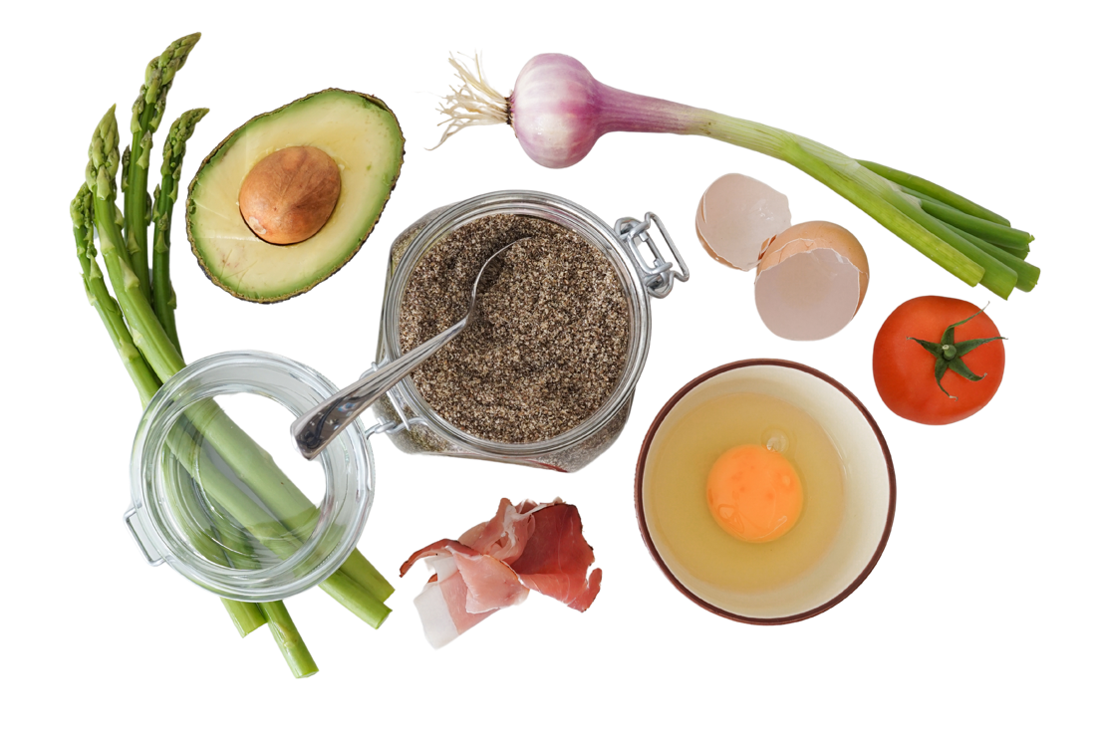


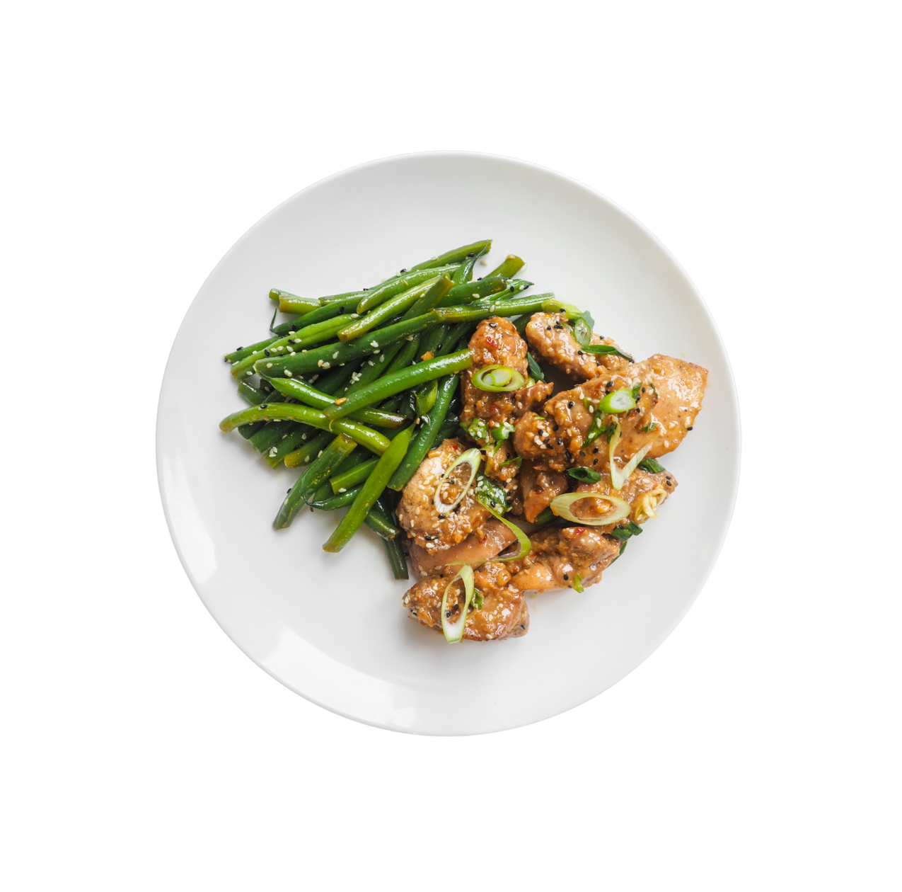



  CS 147 Assignment 8
Interactive Hi-Fi Prototype
Group 1
Ashley, Maya, Graham, Emma

Slide 2

ROAD MAP
Introduction
Problem & Solution
Value Design
Heuristic Evaluation Results
Major UI + Product Revisions
Prototype Implementation Status
Demo
Appendix

Slide 3




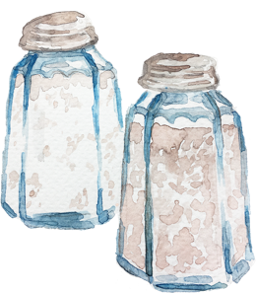


Graham
‘25
Indiana
Ashley
‘26
Georgia
Maya
‘24 & ‘25
California
Emma
‘25
Virginia
ABOUT US

Slide 4
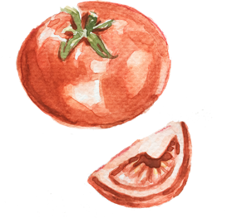

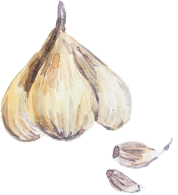
PLATED
Elevate your cooking one swipe at a time..
Value Proposition:
Discover and share recipes from local chefs, friends, and family effortlessly based on your current pantry. Gain the technical skills to be self-expressive and independent in the kitchen.

Slide 5

Problem & Solution
Primary User:
We aim to help amatuer chefs learn how to cook and enjoy the process.
Problem:
Many amatuer chefs feel like cooking is a chore that always takes longer than expected and has no room for creativity.
Solution:
Plated presents the user with a curated selection of recipes from other users that align with the users’ preferences and current ingredient inventory. Plated also incorporates an in-app chef helper, chef su, who can answer any common cooking questions during the process. With this solution, the plated team hopes to make the cooking experience more exciting and less tedious for amateur cooks through shared discovery and collaboration with chefs of all abilities.

Slide 6

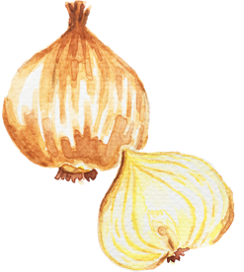


Heuristic Evaluation Results

Slide 7

Summary
Heuristic | # Viol. (sev 0) | # Viol. (sev 1) | # Viol. (sev 2) | # Viol. (sev 3) | # Viol. (sev 4) | # Viol. (total)
H1: Visibility of System Status | 0 | 0 | 1 | 2 | 1 | 4
H2: Match b/w System & World | 0 | 2 | 2 | 3 | 1 | 8
H3: User Control & Freedom | 0 | 0 | 0 | 1 | 3 | 4
H4: Consistency & Standards | 0 | 3 | 2 | 2 | 3 | 10
H5: Error Prevention | 0 | 0 | 3 | 0 | 1 | 4
H6: Recognition not Recall | 0 | 0 | 2 | 2 | 1 | 5
H7: Flexibility & Efficiency of Use | 0 | 1 | 2 | 4 | 2 | 9
H8: Aesthetic & Minimalist Design | 0 | 3 | 4 | 1 | 0 | 8
H9: Help Users with Errors | 0 | 0 | 1 | 1 | 0 | 2
H10: Help & Documentation | 0 | 1 | 0 | 1 | 1 | 3
H11: Accessible Design | 0 | 0 | 0 | 3 | 0 | 3
H12. ​​Value Alignment & Inclusion | 0 | 0 | 1 | 0 | 1 | 2
Total Violations | 0 | 10 | 18 | 20 | 14 | 62
Notes:
\

Slide 8


Summary
Intuitive Design
Violations of H4 Consistency, H7 Flexibility/Efficiency, and H8 Aesthetics and Minimalist Design
  Icon Design
  Inconsistent navigation bar placement
  Unnecessary features such as Calendar
  Confusion about Chef Su and Pantry
Application Flow
H2 Match btw System and World and H4 Consistency
  Unclear what icons in navigation bar mean
  Confusion about what the swiping means
  Lack of flexibility in Pantry
    Search, order of adding items
  Are recipes linked to AI?
Notes:
Intuitive Design
The most commonly violated heuristics for Plated were H4: Consistency, H7: Flexibility & Efficiency of Use and H8: Aesthetics and Minimalist Design. The most pressing issue around this area would be two-fold: inconsistency in aesthetics and function. Examples of aesthetic inconsistencies would be the icon design and how some icons are more simple vs. more complex compared to other icons. The weighting of the icon brush strokes is also different throughout the app, and also the sizing of the fonts is different throughout the app. Also, the navigation bar is inconsistent in placement throughout the various frames. Finally, the margins of the app are inconsistent, leading to a lot of visual clutter. We noticed a lot of the UI may also not be necessary such as the Calendar in the Profile tab that seems to jump out of nowhere, the unnecessary buttons for the Camera feature when posting a new recipe, and most importantly the "bookmark" and "next" buttons below each recipe presented to the user, but the users are told to instead swipe left or right.
There also seems to generally be an influx of too many features that are not fully fleshed out, which results in many of the violations limiting flexibility for the user, particularly H7. There are no categories for specific filters such as ‘Nut Allergy’ despite being present on the page, which would not fall under ‘ingredients’ or ‘cuisine.’ The Pantry items aren't linked to the types of recipes shown (it's not based on what ingredients you have); and Chef Su, although a great idea, isn't thoroughly implemented throughout the rest of the app. The involvement of Chef Su in the app is very unclear to the evaluators as all of us had different interpretations of how Chef Su is used in the app. In addition, despite this high count of additional features, integral ones like the moderate task of adding an ingredient to the pantry and onboarding are not implemented at all. Without onboarding, it was unclear what we had to do at each step such as swiping left and right without the ReadMe to guide us through. In addition, the Pantry tab is very confusing: There is no clear meaning in what the "This Week" folder means and where the rest of our ingredients in the pantry are if not in a specific folder we created. We would recommend going through each task flow individually and also looking at how they fit together into a cohesive app again and marking any areas that jump in logic or are underdeveloped.
Application Flow
Some heuristic violations were caused by unintuitive application flow that fell specifically under H2: Match b/w System & World and H4: Consistency. There were several parts of navigating the prototype that may not be immediately obvious to the user. To complete the simple task, there is an implied background knowledge of how apps like “Hinge” or “Tinder” work via the swiping functionality. But, for users who haven’t used the app before, it could be confusing that they need to swipe in the first place or what the directions each mean for the swiping, especially since there is no notification shown if they end up discarding (swiping left) or saving (swiping right) the recipe. Indicators, arrows, and confirmation notifications may be necessary to improve this overall process.
Relying on the swiping feature to look through recipes also limits the user experience significantly. In order to look through other users’ recipes, they must swipe through the recipes that are populated on their main screen. There is no implemented way for the user to look for particular recipes/users or to look at multiple recipes on their screen at one time, and, if they want to look at their saved recipes, they must navigate to the profiles page where the saved button is at the top right of the screen. It’s not immediately obvious to the user where their saved recipes are and, since saving or liking recipes is a significant part of the swiping feature, it might be worth adding a completely new page on the navigation bar dedicated to showing these likes or, in general, making the save page more visually obvious to the users.
The pantry from the moderate task also suffers from similar issues in application flow. The pantry feature lacks flexibility, making it cumbersome for users. Without the ability to search for ingredients, receive warnings for duplicates, edit or remove items, or automatically transfer items from the grocery cart to the pantry, managing inventory becomes tedious. This setup forces users to memorize ingredient locations by category, diminishing the pantry’s intended convenience. Furthermore, the recipes aren’t linked to what the user has in the pantry—even if the intention was to somehow utilize AI to do this, the current method of inputting ingredients prevent such functionality from working.
Overall, the prototype has many interesting ideas proposed for the final app, but the app should focus on user flexibility, aesthetic and consistent design, and intuitiveness in order to make these features accessible. Several issues can be resolved once more parts of the prototype are implemented, but you may want to consider features like a larger feed in conjunction to the swiping in order to ensure that users have the availability to see and explore all the recipes they would like.

Slide 9
Change Overview
Intuitive Design
Complete Revamp of Navigation Bar
  Includes titles, simple icons
  Fixed Navigation bar styles
Removed features that cluttered the app
Information tab for Chef Su
Application Flow
Revamped Swiping Interface
Quick Onboarding
Reworked Filters
Justifications
Inclusion (App Moderation, Chef Su Info)
Questions asked about functionality and purpose were already addressed in README
Notes:
Full Summary in Appendix

Slide 10
Major UI and Product Revisions

Slide 11
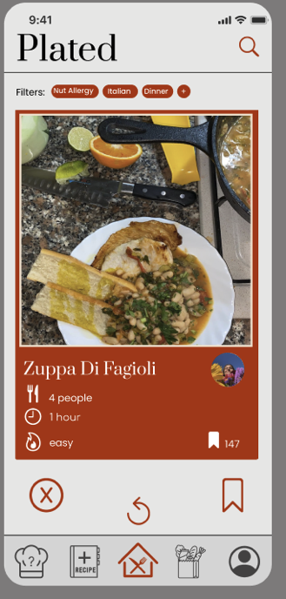
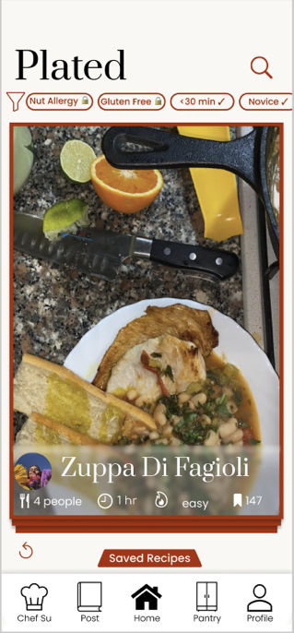
Home Page
Major Changes
Navigation Bar
  Titles + Icons
Safe-Area
  No conflicts with standard iPhone
Swiping Cards
  Easily swipe into Saved Recipes
Saved Recipes
  Easy Access

Slide 12
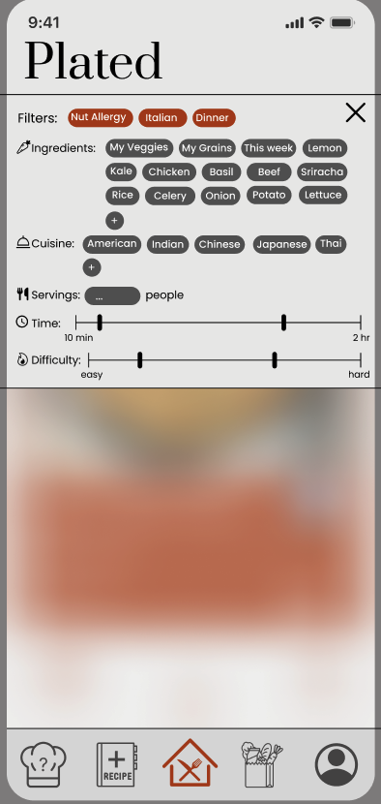
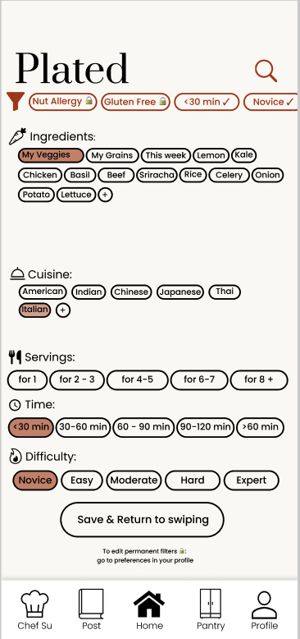
Filters
Major Changes
Easier to read
  Colors
Easier to recognize which have been selected
  Clear pattern with full vs empty background
Ensure users know options are saved
Permanent Filters
Full Screen

Slide 13
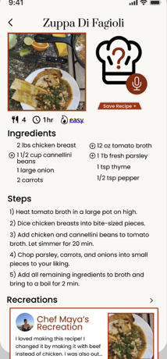
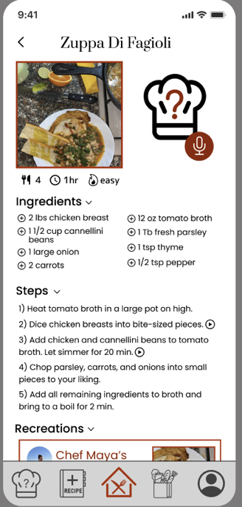
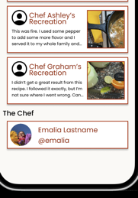
Recipe Page
Major Changes
Background consistent with app theme
Removed unexplained “play button” feature
Clearer Idea about what recreations are
  Option to see all
Easy option to “Save Recipe”
Making the recreations clickable to see more
Making the about chef a link to their profile!
Notes:
Intuitive Design
The most commonly violated heuristics for Plated were H4: Consistency, H7: Flexibility & Efficiency of Use and H8: Aesthetics and Minimalist Design. The most pressing issue around this area would be two-fold: inconsistency in aesthetics and function. Examples of aesthetic inconsistencies would be the icon design and how some icons are more simple vs. more complex compared to other icons. The weighting of the icon brush strokes is also different throughout the app, and also the sizing of the fonts is different throughout the app. Also, the navigation bar is inconsistent in placement throughout the various frames. Finally, the margins of the app are inconsistent, leading to a lot of visual clutter. We noticed a lot of the UI may also not be necessary such as the Calendar in the Profile tab that seems to jump out of nowhere, the unnecessary buttons for the Camera feature when posting a new recipe, and most importantly the "bookmark" and "next" buttons below each recipe presented to the user, but the users are told to instead swipe left or right.
There also seems to generally be an influx of too many features that are not fully fleshed out, which results in many of the violations limiting flexibility for the user, particularly H7. There are no categories for specific filters such as ‘Nut Allergy’ despite being present on the page, which would not fall under ‘ingredients’ or ‘cuisine.’ The Pantry items aren't linked to the types of recipes shown (it's not based on what ingredients you have); and Chef Su, although a great idea, isn't thoroughly implemented throughout the rest of the app. The involvement of Chef Su in the app is very unclear to the evaluators as all of us had different interpretations of how Chef Su is used in the app. In addition, despite this high count of additional features, integral ones like the moderate task of adding an ingredient to the pantry and onboarding are not implemented at all. Without onboarding, it was unclear what we had to do at each step such as swiping left and right without the ReadMe to guide us through. In addition, the Pantry tab is very confusing: There is no clear meaning in what the "This Week" folder means and where the rest of our ingredients in the pantry are if not in a specific folder we created. We would recommend going through each task flow individually and also looking at how they fit together into a cohesive app again and marking any areas that jump in logic or are underdeveloped.
Application Flow
Some heuristic violations were caused by unintuitive application flow that fell specifically under H2: Match b/w System & World and H4: Consistency. There were several parts of navigating the prototype that may not be immediately obvious to the user. To complete the simple task, there is an implied background knowledge of how apps like “Hinge” or “Tinder” work via the swiping functionality. But, for users who haven’t used the app before, it could be confusing that they need to swipe in the first place or what the directions each mean for the swiping, especially since there is no notification shown if they end up discarding (swiping left) or saving (swiping right) the recipe. Indicators, arrows, and confirmation notifications may be necessary to improve this overall process.
Relying on the swiping feature to look through recipes also limits the user experience significantly. In order to look through other users’ recipes, they must swipe through the recipes that are populated on their main screen. There is no implemented way for the user to look for particular recipes/users or to look at multiple recipes on their screen at one time, and, if they want to look at their saved recipes, they must navigate to the profiles page where the saved button is at the top right of the screen. It’s not immediately obvious to the user where their saved recipes are and, since saving or liking recipes is a significant part of the swiping feature, it might be worth adding a completely new page on the navigation bar dedicated to showing these likes or, in general, making the save page more visually obvious to the users.
The pantry from the moderate task also suffers from similar issues in application flow. The pantry feature lacks flexibility, making it cumbersome for users. Without the ability to search for ingredients, receive warnings for duplicates, edit or remove items, or automatically transfer items from the grocery cart to the pantry, managing inventory becomes tedious. This setup forces users to memorize ingredient locations by category, diminishing the pantry’s intended convenience. Furthermore, the recipes aren’t linked to what the user has in the pantry—even if the intention was to somehow utilize AI to do this, the current method of inputting ingredients prevent such functionality from working.
Overall, the prototype has many interesting ideas proposed for the final app, but the app should focus on user flexibility, aesthetic and consistent design, and intuitiveness in order to make these features accessible. Several issues can be resolved once more parts of the prototype are implemented, but you may want to consider features like a larger feed in conjunction to the swiping in order to ensure that users have the availability to see and explore all the recipes they would like.

Slide 14
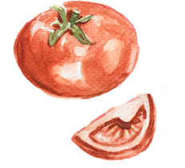


Progress Towards Usability Goals
Efficiency
Flexibility
Fun
  Intuitive Filter Design
  Leaner Features
  Access to Saved Recipes
  Saving Optionality
  Chef Su Accessibility
  Cleaner Colors
  Intuitive Swiping
  Revamped Navigation

Slide 15
Prototype Implementation
Notes:
Prototype implementation
a. Tools: What did you use? Pros and cons of using this tool(s)?
b. Limitations: What was left out? Why?
c. Hard-coded and Wizard-of-Oz features

Slide 16

Prototype Overview: Tools
Core Framework & Tools
React Native + Expo
Expo Router for navigation with tab directory structure
AI Integration
Google’s Gemini AI
Implemented chat interface with Gemini 1.5 Flash model
Maintains conversation context with custom system instructions for chef persona
Backend Integration
Supabase set up to store recipes, users, posts, ingredients, etc.
Notes:
\

Slide 17
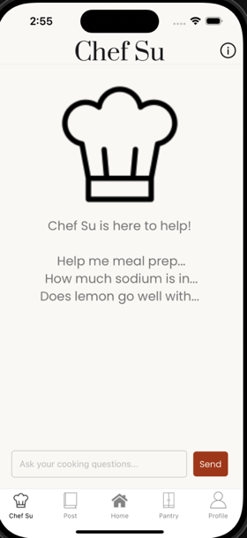
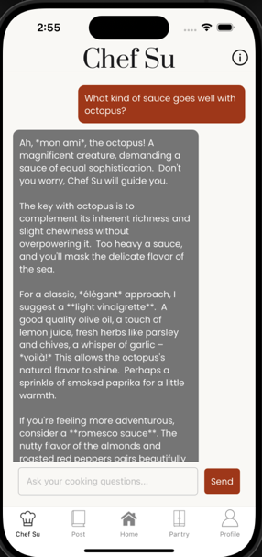
Implemented Feature: Chef Su
Implemented Features
Tab bar navigation to every page
Skeleton of every page
Connection to Backend
Chef Su Task
Fully implemented the AI-powered Su Chef
Customized version of Gemini
Information Tab to increase accessibility
Home Page
Hard-coded with minimal functionality besides navigation
Notes:
\

Slide 18
Future Implementation Plan
Priority #1 (Early Thanksgiving Break)
Implement core styling for all pages on home navigation
Fill pages with all necessary components
Priority #2 (Late Thanksgiving - Start of Week 10)
Enable touchable components to complete tasks
Fully implemented stack navigation flow for all pages
  Posting, viewing saved recipes, profile
Deploy Supabase backend to enable tasks
  Saving recipes, posting, viewing users
Priority #3 (Middle Week 10)
Implement advanced animation for swiping through recipes
Implement advanced filtering of recipes
Testing & Debugging
Notes:
\

Slide 19
Implementation Techniques
Hard-coded Features
  One “Test-User” logged in on demo to avoid setting up user authentication
  Home Page looks like it’s functional but only our “Chef Su” task if currently functional
  Simplified chat interface
    Hard-coded system for chef personality
    No loading states or typing indicators while waiting for responses
Wizard of Oz
  Chatbot doesn’t take into account what you have in the pantry, but we have a note saying to input what you have
  This simulates the idea that Chef Su knows what you have in your fridge/pantry
Notes:
\

Slide 20
Issues + Discussion
Advanced animation for Swiping
  React Native Gesture Handler: still need to research and learn for further implementation
Switching from SDK Expo 51 -> SDK Expo 52
  Bugs when transferring our code
  Currently keeping one version still in 51
Next Steps
  Finish remaining pages, components, and tasks in order of priority (Slide 18)
Notes:
\

Slide 21
Demo
Notes:
Medium-fi task flows
a. 1 task flow per task
b. Annotated screenshots from your medium-fi prototype (arrows indicating
transitions, labeling each screen and other relevant UI elements, captioning, etc.)

Slide 22
https://www.youtube.com/watch?v=GdWoM-H-FGo

Slide 23

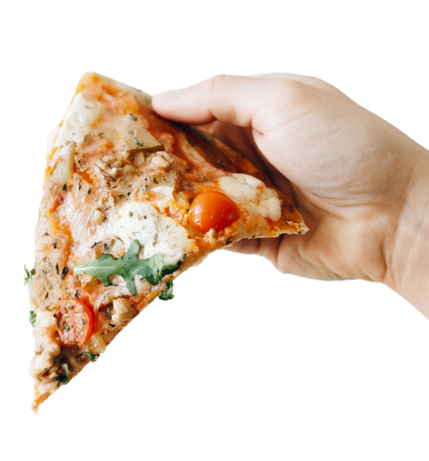



Feedback? :)
  Thanks for listening

Slide 24
APPENDIX/ LINK TO FIGMA
Ful Change Justification
Unimplemented Features

Slide 25
Change Justification
H1: Visibility of System Status - severity 3
  The placement and no text near the circular picture may make it difficult for users to assume that it represents the profile picture of the recipe creator.
  Our fix: we moved the profile picture to be grouped with the recipe text more so that it all seems related while also keeping the recipe card very simple
H11: Accessible Design - severity 3
  The filter selections and sliders are too small, making them hard to see and interact with for users with low vision or low touch sensitivity.
  Our fix: make the filters displayed on home screen larger font and then we also will make the filters drop down work farther down so that the text can be larger
H11: Accessible Design - severity 3
  No 'see more' button for Recreation reviews or About the Chef after clicking on the recipe
  Our fix: add a see more button that opens a modal pop up of the chef’s recreations or add some UI such that it is obviously pressable to see more
H12: Value Alignment & Inclusion - severity 4
  Current design assumes that the recipe speaks for itself, but most users may not recognize certain food names, like "Zuppa di Fagioli, which may exclude non-native users from fully understanding the recipe.
  Our justification: this person didn’t read the readme which tells them to click the card to read more about the recipe
H2: Match b/w System & World - severity 4
  The two bold lines in the slider design are unclear, leaving users uncertain about their purpose and whether they represent a range, or how to change them. Does not match how sliders conventionally work.
  Our fix: we will add lower and upper bound labels for the slider and color the range in between so it’s clear to the user
H4: Consistency & Standards - severity 4
  From the readme, swiping right and hitting save on a post should both "save" the post, but they are separate actions from the home page. The same applies for the "X" button, whose functionality overlaps with swiping left. Additionally, There is no way to follow a user whose recipe you see, but on the profile the number of followers and following is shown.
  Our fix: we are not going to make the swiping left and right anymore, they will be swiping up and down into a recipe box

Slide 26
Change Justification
H6: Recognition not Recall - severity 3
  Ingredients you have vs. not have are not listed
  Our fix: ingredients that are in your pantry will not have a plus button to add to your grocery cart and ingredients that are not in your pantry will have a plus button.
H7: Flexibility & Efficiency of Use - severity 3
  The difficulty level slider in the filters is not intuitive and definition of 'easy' vs. 'hard' recipes is not clear
  Our fix: we are making the sliders more clear with bounds
H9: Help Users with Errors - severity 3
  We can increase accessibility for those that don't have certain ingredients. Easily finding substitutes for certain ingredients would be amazing
  Our fix: users can ask for substitutions for ingredients using chef su AI helper
H2: Match b/w System & World - severity 3
  Pantry tab collections (Grains, Vegetables) don't add up to what is in the entire Pantry collection
  Our justification: not even really sure what this means and i just don’t think this was a well thought out HE
H6: Recognition not Recall - severity 4
  There is no clear indicator that you are able to swipe left or right, and is not intuitive from the prototype itself. There is a lack of visual confirmation that the user has saved or rejected a recipe when swiping.
  Our fix: got rid of the two save icons and just have one now
H7: Flexibility & Efficiency of Use - severity 4
  Nowhere to add 'Nut Allergy' and 'Dinner' customizable options in sections listed
  Our fix: listed in the read me to set your permanent preferences like allergies or food restrictions in the profile preferences page.
H3: User Control & Freedom - severity 4
  After adding an ingredient to the pantry, there is no way to remove it if it is depleted.
  Our fix: we just hadn’t implemented this yet
H4: Consistency & Standards - severity 4
  The "PaperClip" Icon in the Pantry sections do not link to anything except for in the "This Week" part of the Pantry. However, after clicking on the Paper Clip attachment icon, then pressing the back button, it leads to the Chef Su screen rather than reverse it back to the previous screen of "this week Pantry".
  Our fix: we just haven’t made it yet but we will make it link to something

Slide 27
Change Justification
H4: Consistency & Standards - severity 3
  Settings icon on Post page doesn't make sense intuitively -- settings for what?
  Our fix: true, deleting
H11: Accessible Design - severity 3
  Chef Su feature may be difficult to navigate for users who are unfamiliar with AI chatbot interfaces. The icon when clicking on a recipe is also confusing on whether or not it's a clickable button to redirect to Chef Su.
  Our fix: Rephrasing the wording on the Chef Su page to “ask me your cooking questions”
H7: Flexibility & Efficiency of Use
  The app lacks a clear way for users to input or adjust filters for difficulty, number of people, time, and cuisine, making it harder to customize recipe searches.
  Our fix: We need to make it more obvious how users can add filters. We can make the button bigger and add text that says “add filters”
H4L Consistency & Standards
  Users are unsure whether they should use the same method as posting a new recipe for a recreation.
  Our Fix: When adding your recipe, we will add a step asking if it is a recreation or new recipe OR
H1: Visibility of System Status - severity 4
  Unsure what calendar feature on Profile is meant for (also not included in ReadMe).
  Our fix: We decided the calendar is an unnecessary feature and have removed it
H10: Help and Documentation
  There is no menu explaining what each button throughout app (on nav bar, in main page, etc) does.
  Our fix: We are improving the wording in the README and are adding small titles to each button in the nav bar to make it clearer what each symbol means
H2: Match w system and world
  Confusion about what cookbooks, all recipes, and recreations mean.
  Our fix: We should change of cookbooks or make it more obvious that it is a category of recipes
H7: Flexibility & Efficiency of Use
  Restricts users from adding any content beyond the regulated ingredients and recipe, limiting creativity, personal expression, and flexibility.
  Our fix: add a box where you can optionally describe the recipe or give some history/contex

Slide 28
Unimplemented Features
Home Page
  Swiping, stack navigation, saving recipes, viewing recipe details, filters, setting preferences
Pantry Page
  Adding and removing items, to shopping list and to pantry
Posting Page
  Native camera integration, selecting photos from camera roll, adding comments and ingredients, connection with backend to enable posting
Profile
  Touchable components for viewing other profiles and recipes, browse through saved recipes and followers, etc.
Notes:
\

