Slide 1
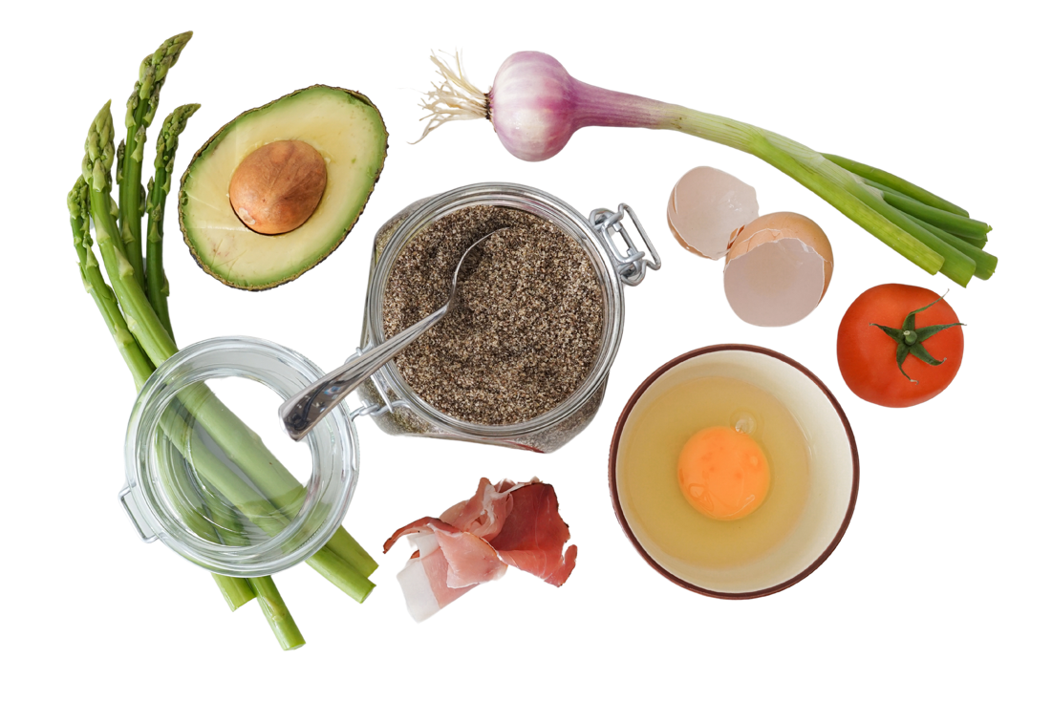


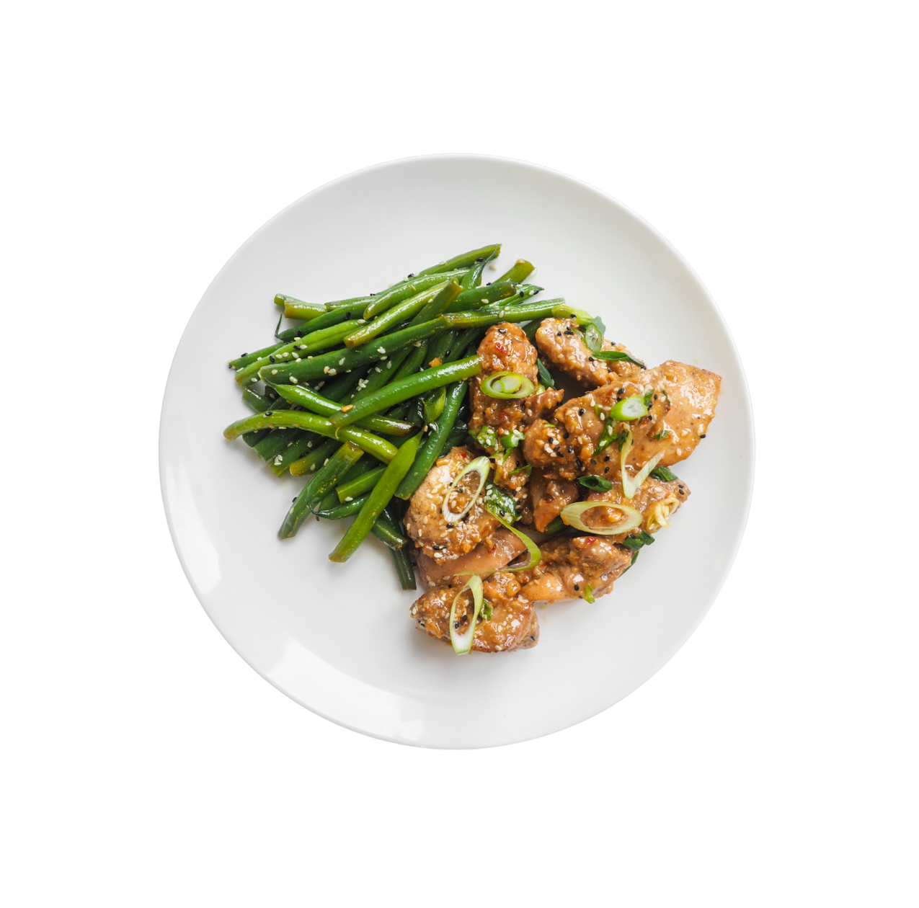



  CS 147 Assignment 6
Interactive Medium-Fi Prototype
Group 1
Ashley, Maya, Graham, Emma

Slide 2

ROAD MAP
Introduction
Problem & Solution
Value Design
Task Evolution
Usability Goals & Measurements
Interface Revisions
Medium-Fi Task Flows
Prototype Implementation
Appendix

Slide 3

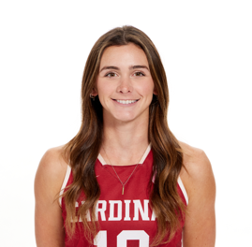

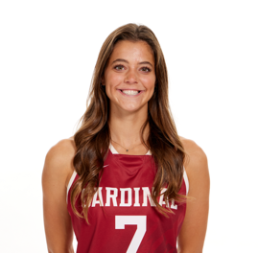
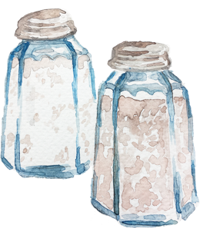


Graham
‘25
Indiana
Ashley
‘26
Georgia
Maya
‘24 & ‘25
California
Emma
‘25
Virginia
ABOUT US

Slide 4
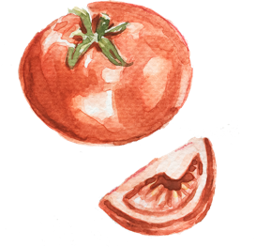
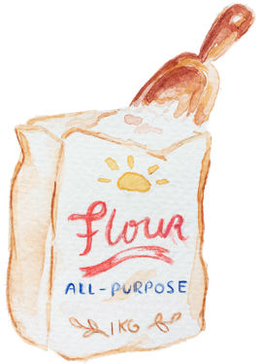
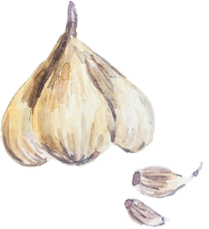
PLATED
Elevate your cooking one swipe at a time..
Value Proposition:
Discover and share recipes from local chefs, friends, and family effortlessly based on your current pantry. Gain the technical skills to be self-expressive and independent in the kitchen.

Slide 5

Problem & Solution
Primary User:
We aim to help amatuer chefs learn how to cook and enjoy the process.
Problem:
Many amatuer chefs feel like cooking is a chore that always takes longer than expected and has no room for creativity.
Solution:
Plated presents the user with a curated selection of recipes from other users that align with the users’ preferences and current ingredient inventory. Plated also incorporates an in-app chef helper, chef su, who can answer any common cooking questions during the process. With this solution, the plated team hopes to make the cooking experience more exciting and less tedious for amateur cooks through shared discovery and collaboration with chefs of all abilities.

Slide 6

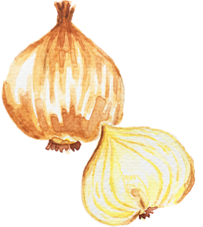

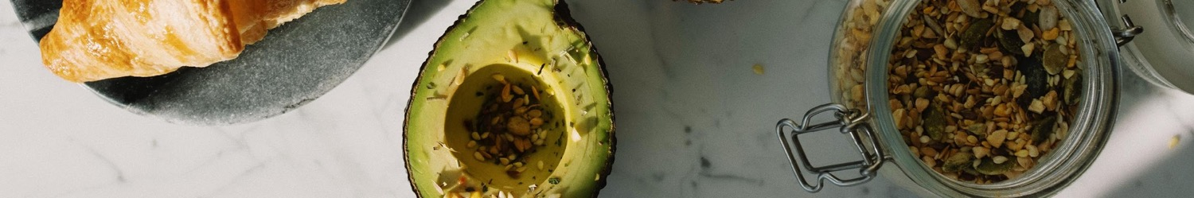
Value Design

Slide 7
Value design continued…
a. Define the values you intend to encode in your product
b. Which design features or decisions express these values?
c. Do any value tensions arise as a consequence of your design decisions?

Slide 8
…

Slide 9
…

Slide 10
Tasks

Slide 11
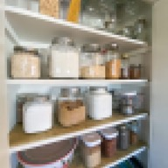

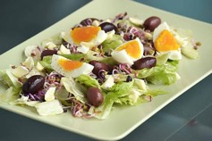
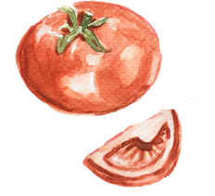
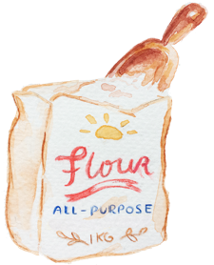

Revised Task Flows
Simple
Moderate
Complex
  Swiping to discover recipes
  Adding items to your pantry
  Upload your recipe
Note changes we have made from assignment 5!

Slide 12
Usability Goals & Key Measurements

Slide 13
…
a. 2 usability goals and 2 key measurements identified in Assignment 5
b. How is your product progressing towards hitting these goals?

Slide 14
Revised Interface Sketches
Notes:
a. Major changes – 3 biggest changes between original and revised sketches
b. How will these changes aid in progressing forward with your usability goals?
c. Rationale based on low-fi testing results, studio feedback, user needs, etc.
d. Before and after comparisons
e. If you have more than 3 changes you want to show, add the rest to the appendix

Slide 15
Major Change #1: Change the home screen icon to a figure that is intuitively “home” (ex. a house)

Slide 16
Major Change #2: Add the posting feature the the footer buttons

Slide 17
Major Change #3: Guide users to personalization features right when they first get on the app

Slide 18
Medium-Fi Task Flows
Notes:
Medium-fi task flows
a. 1 task flow per task
b. Annotated screenshots from your medium-fi prototype (arrows indicating
transitions, labeling each screen and other relevant UI elements, captioning, etc.)

Slide 19
Task Flow #1:

Slide 20
Task Flow #2:

Slide 21
Task Flow #3:

Slide 22
Prototype Implementation
Notes:
Prototype implementation
a. Tools: What did you use? Pros and cons of using this tool(s)?
b. Limitations: What was left out? Why?
c. Hard-coded and Wizard-of-Oz features

Slide 23

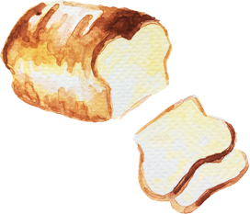
Prototype Overview: Tools
Notes:
\

Slide 24
Prototype Overview: Limitations
Notes:
\

Slide 25
Prototype Overview: Hard-Coded Features
Notes:
\

Slide 26
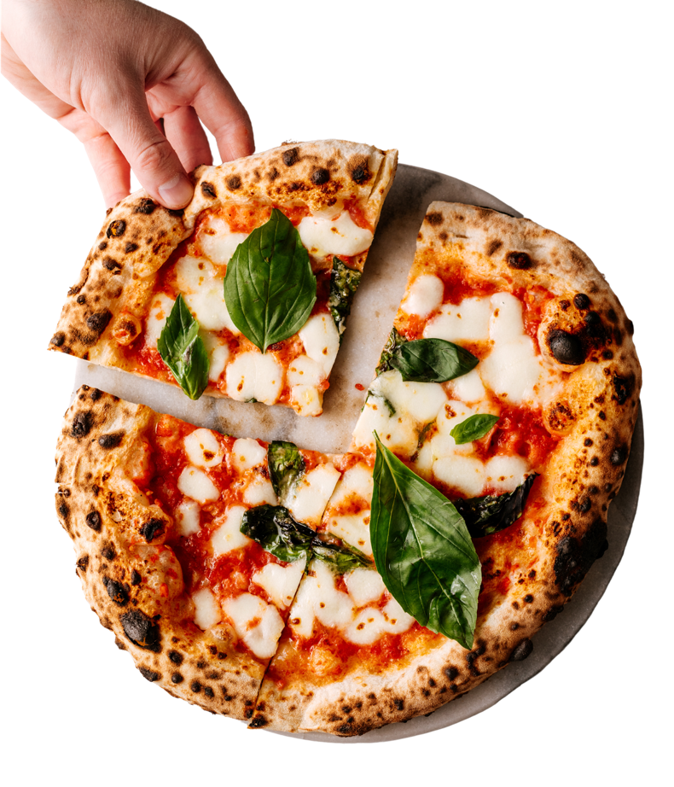
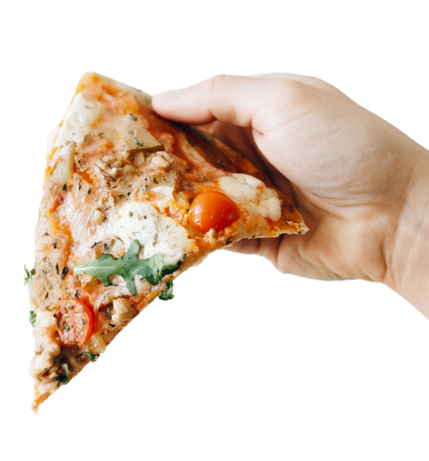



Feedback? :)
  Thanks for listening

Slide 27
APPENDIX/ LINK TO FIGMA
Full pros & cons list
Testing Preparations
Critical incidents log
link for full low fi

