Slide 1
A1: Needfinding
Studio 1, Team Candy Crush
Lianne C, Ethan B, Em H, Clare C

Slide 2
Team Members
Ethan B
Lianne C
Em H
Clare C
Class of 2025
Major in Computer Science and Digital Health
Class of 2026
Major in Computer Science
Class of 2025
Major in Computer Science
Class of 2024
Major in SymSys
Coterm in CS

Slide 3

Dementia Prevention

Slide 4

Participants
Ivy
Kevin
Lily
Dean
30-year old grandson w/ family history of Dementia
85-year old resident of Santa Clara
Social worker in Santa Clara Senior Centre
26-year old w/ family history of Dementia
Note: all names have been changed to protect interviewee privacy
Notes:
Kevin - 30M grandson w/ family history of Dementia (grandmother)
Dean- 26M w/ family history of Dementia (great-grandma and grandma) however, it seems to be isolated to the women in the family - this begs the question of whether someone like Dean is still the audience of our app given his familial relationship but low risk.

Slide 5

Extreme User
Questions
Roles and Equipment
Ivy
Age range for susceptibility for dementia
However extremely physically and mentally active, no signs
Could you tell us about your daily schedule?
What aspect of your day-to-day do you believe keeps your mind and body healthy?
Is dementia a worry for you? How/have you taken steps to try and prevent its onset?
What is your personal opinion of technology / your relationship with technology?
Audio recording and transcripts
Trade-off questioning, one member for note-taking
Some no audio recording, transcript level notes

Slide 6
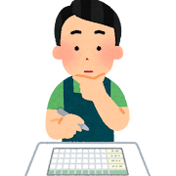

Results
“My great-grandchildren still finish all the food off their plates, because that’s what Uroma said to do” - Ivy
“I live every day like it is my last” - Ivy
“You can’t just let your problems swallow you up- you can’t just sit with them” - Ivy
“Coming here to socialise is certainly one of the reasons why the seniors stay so mentally healthy” - Lily
“Patterns and scheduling are important for dementia prevention. We host dance classes, puzzle games, anything with repetition and memorisation” - Lily
“If you sit in a room all day and waste away, that is how that [dementia] happens” - Ivy
Notes:
Surprised by the role of memory capture and scheduling / memorisation “jogging memory”
Surprised by how unconcerned interviewees were about dementia- not much life change can do, just want to live life
Surprised by their life stories

Slide 7
Results
[opinions on technology] “Tech is a tool to connect people, especially over long distances, but it shouldn’t be a replacement for people to connect… it should be as non-invasive as possible” - Kevin
“They weren’t particularly well off…and in Filipino culture…you don’t bring family members to institutionalized settings, even if it’s a nursing home, because it’s seen as your duty to take care of your loved ones” - Kevin
“It was well-meaning but misguided, not out of cruelty but…when they slept they would tie a belt to [the grandfather] and the son would sleep next to him, so he couldn’t wander off”
- Kevin
Notes:
Surprised by how people who either can’t afford a higher level of care for their family members manage dementia
Interesting to consider how some cultures look down upon sending family members to institutions that could provide better care
Seems to be a lack of accessible resources

Slide 8
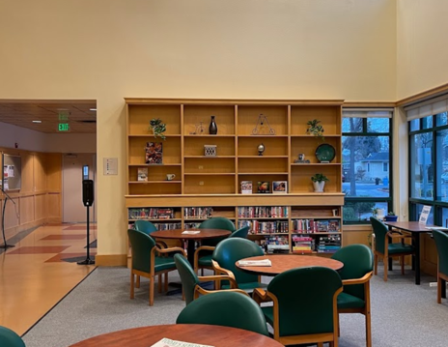
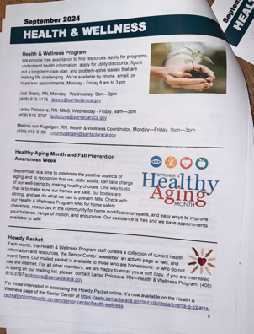
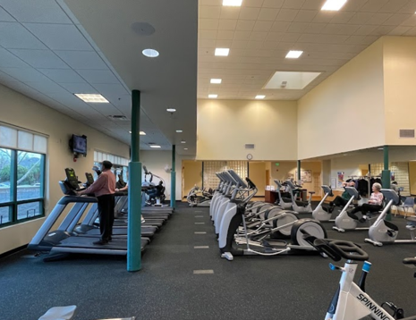

Slide 9
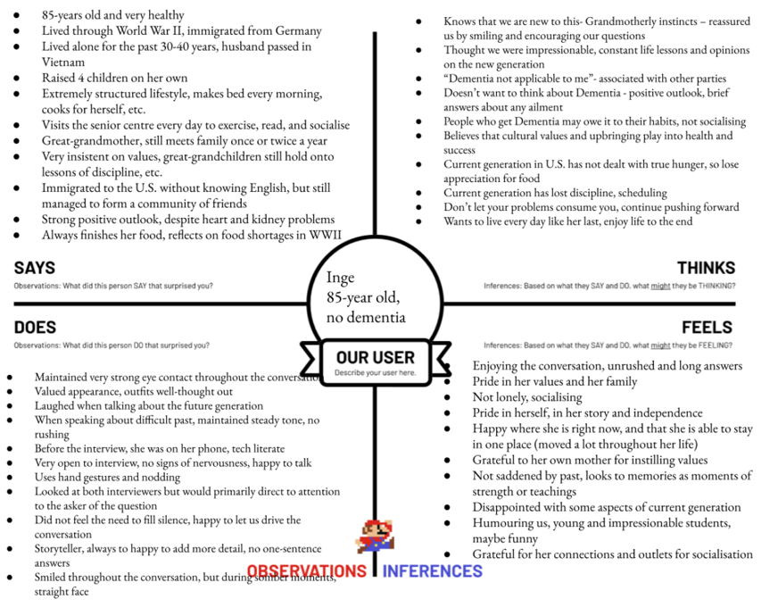
Empathy Map
Ivy

Slide 10
Empathy Map
Forced Independence
Strong values passed via history
Dementia is owed to habits and mindset/outlook
Ivy
Looks to the past as a teacher
History led discipline and ultimately health
Pride in herself and her family

Slide 11
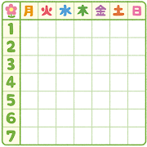
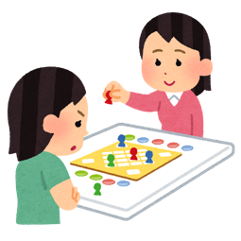

Summary
Needs
Facilitate socialisation among seniors
Increased presence of scheduling in daily life
Increased repetition and memorisation
Provide resources to people whose family members have dementia
Insights
Routine and scheduling is essential to dementia prevention
Correlation vs. causation?
Cultural influence on view of dementia
The nursing home “solution” does not always work
Socialisation plays an instrumental role
Routine memorization and games
Overcoming the tech literacy hurdle
What’s next?
Brainstorming and ideation
Further interviews
Research on dementia prevention- how do schedules and routines play a role and how can we harness this?

Slide 12
APPENDIX

Slide 13
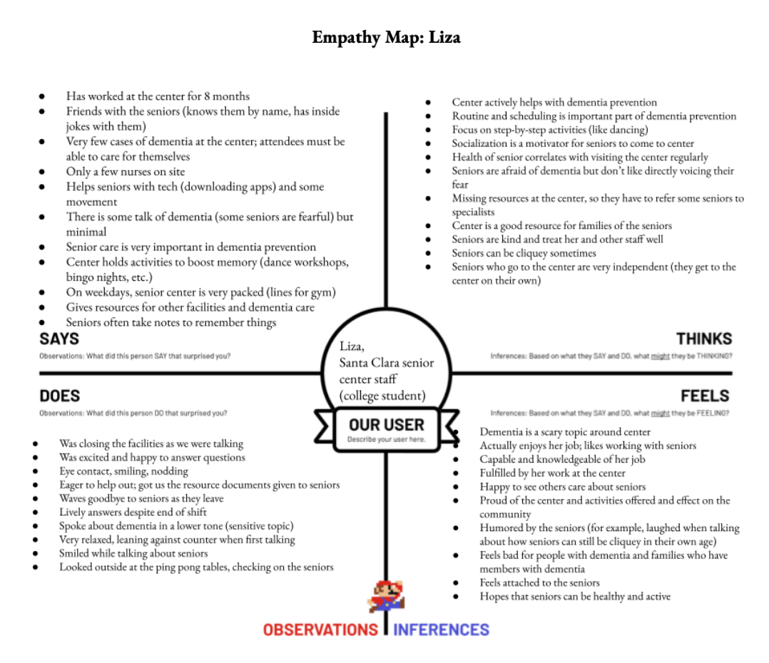
Lily

Slide 14
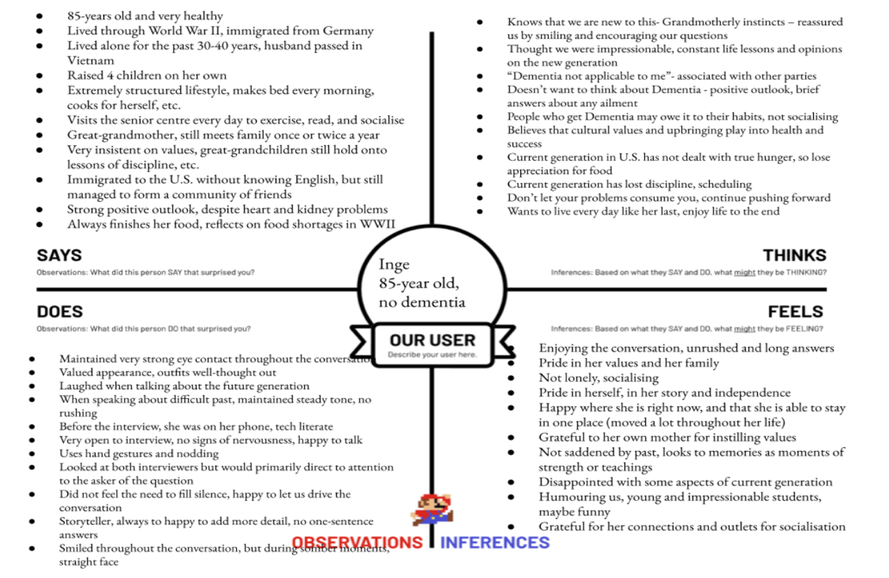
Ivy

Slide 15
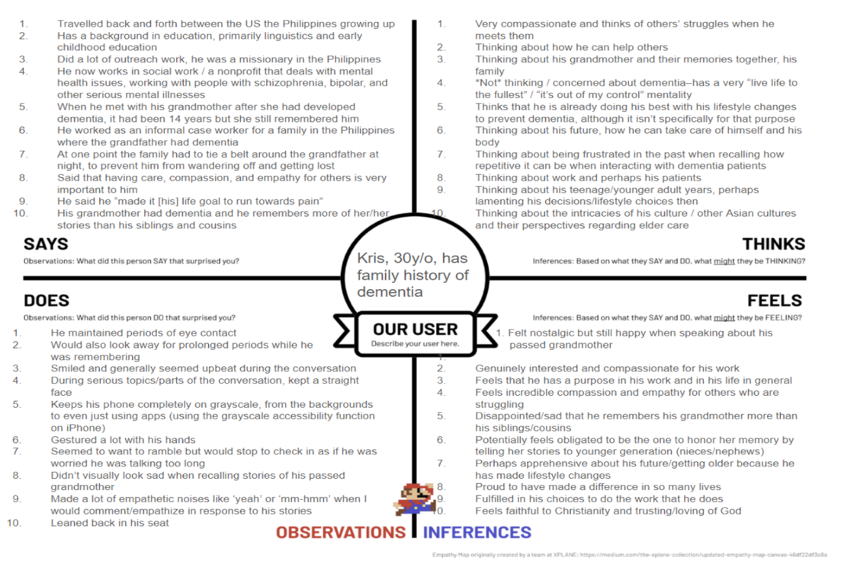
Kevin

Slide 16
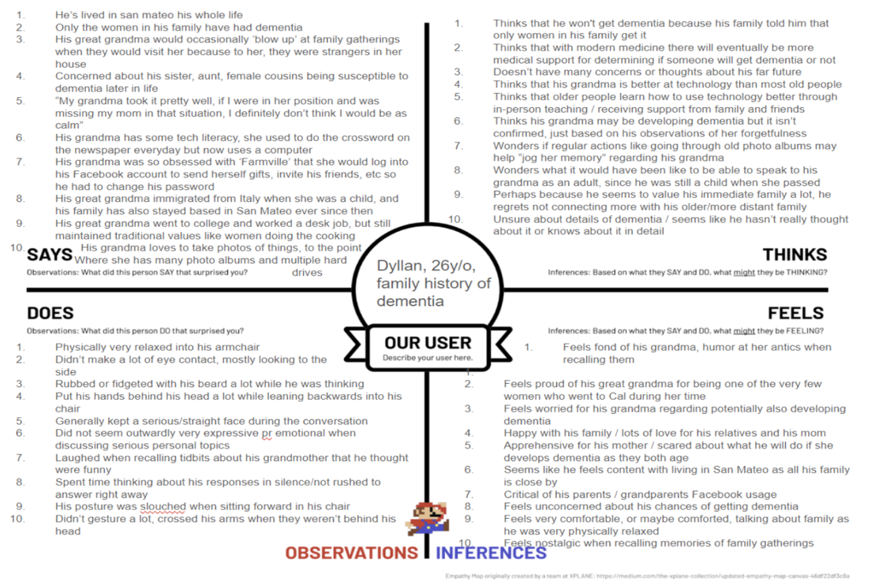
Dean

