Slide 1
A2: POV, HMW, EP’s
Studio 1, Team Candy Crush
Lianne C, Ethan B, Em H, Clare C

Slide 2
Team Members
Ethan B
Lianne C
Em H
Clare C
Class of 2025
Major in Computer Science and Digital Health
Class of 2026
Major in Computer Science
Class of 2025
Major in Computer Science
Class of 2024
Major in SymSys
Coterm in CS

Slide 3
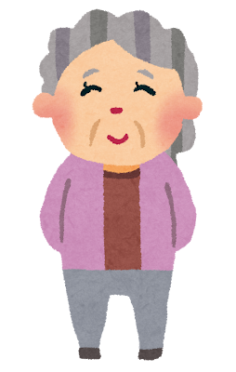
Dementia Prevention
Notes:
* Original and more focused problem domain
* Original problem was dementia prevention for older adults
* This has progressed into our more focused problem domain which centers on support for dementia patients and their caretakers, including aspects that combat the stress and tension of the overall experience on both sides.

Slide 4
Interviews

Slide 5

Participants
Sean
Ellie
Late 80-year old grandpa in SF
22-year old new college grad
Note: all names have been changed to protect interviewee privacy
Notes:
* Two new interviewees - one of them is named Sean and he is an older Chinese grandpa who moved to the US to live with his son after retirement. His wife had dementia and passed a couple years ago from reasons unrelated. He was her primary caretaker as she struggled with memory loss and other symptoms.
* The second interviewee is a 22 year old new college grad who lived with her grandmother growing up and had very strong feelings about her experience as a primary caretaker for her grandmother when she got dementia.

Slide 6
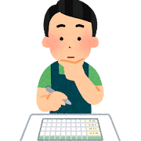
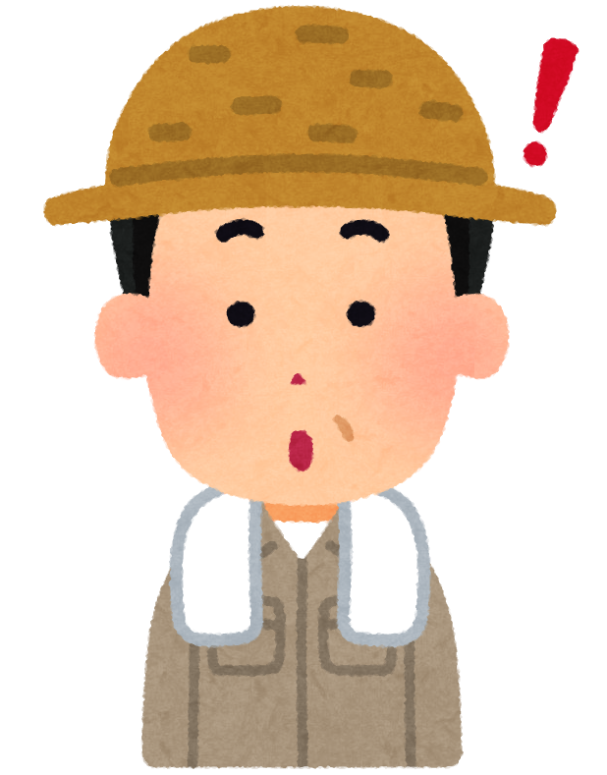
Quotes
“It was like dealing with a child in the body of an 80 year old”
Ellie
“I had to sit out in the living room 24/7 to make sure she wouldn’t escape through the back door”
Ellie
“It was always arguments because she denied what she did. Her reality wasn’t aligned with the truth”
Sean
“All her things would disappear all the time. Except for the things in her purse, those were always together”
Sean
Notes:
Surprised by the role of memory capture and scheduling / memorisation “jogging memory”
Surprised by how unconcerned interviewees were about dementia- not much life change can do, just want to live life
Surprised by their life stories

Slide 7
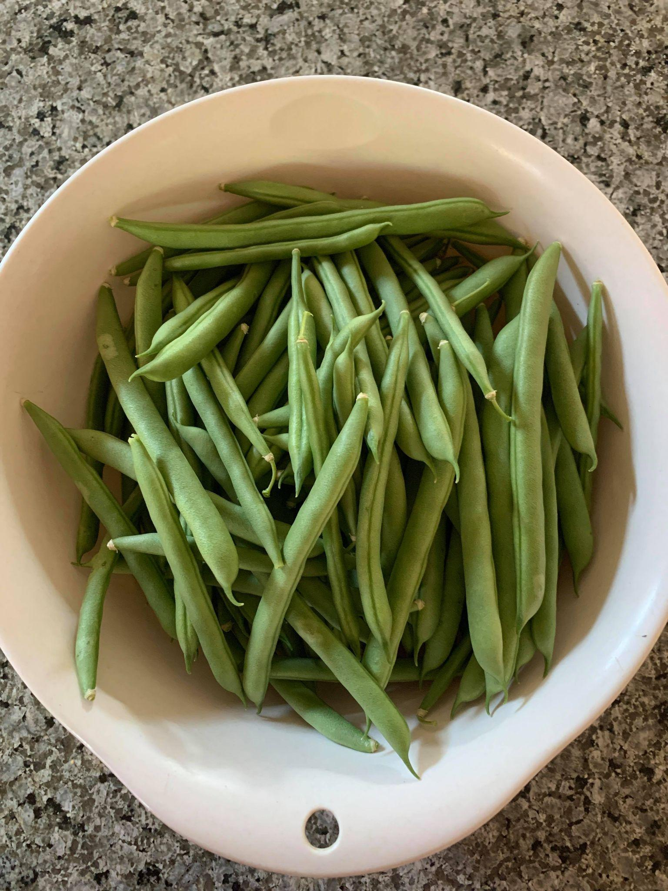
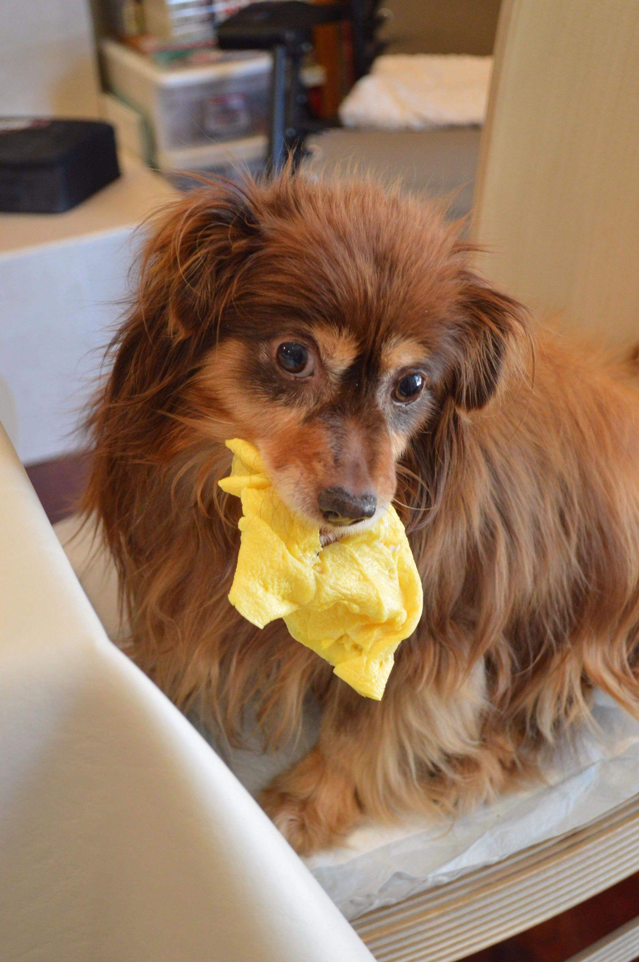
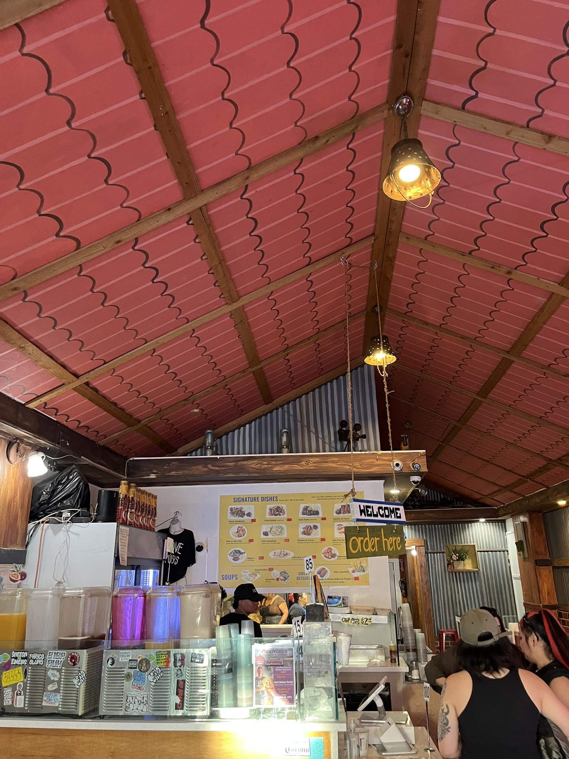

Slide 8
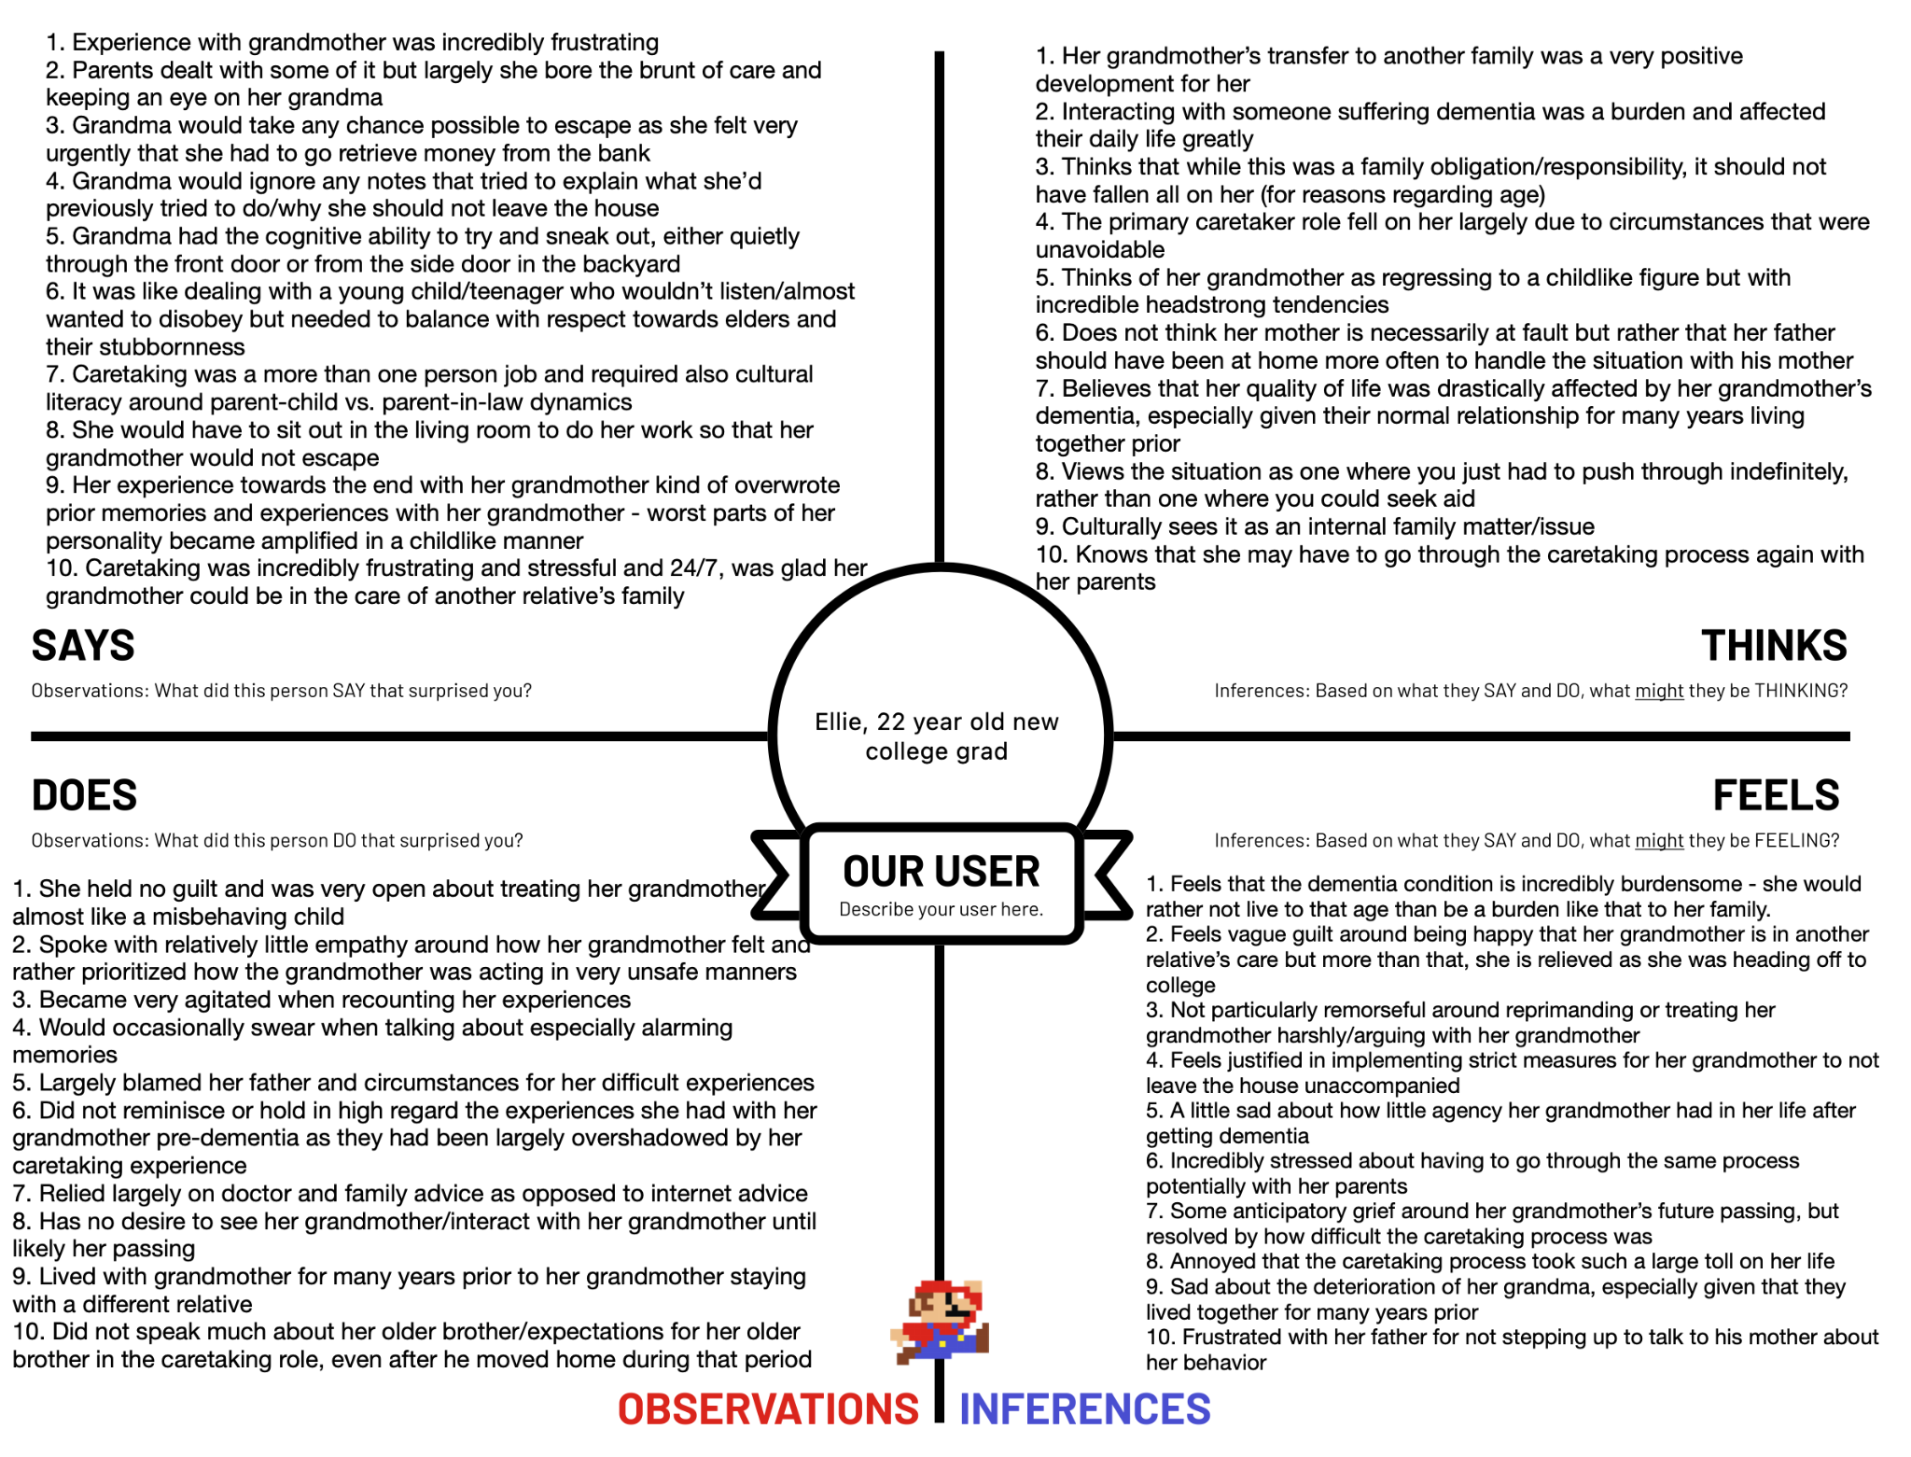
Empathy Map

Slide 9
Takeaways
Dementia overshadows all other family memories
A cycle: her parents are next
Family tensions due to keeping grandmother at home
Notes:
I think some things that we’re seeing this time are some very strong feelings around the interviewee’s personal experiences with family who had dementia. Compared to last week, we are seeing a more complete picture of how we should be considering culture in the development of our application. From last week, we heard about a Filipino family who did not place their grandfather into a care home largely because of lack of financial resources. However, this week we are seeing elderly not being placed into care homes, not because the families were lacking funds, but rather because it was culturally inappropriate to do so. This made it clear that based on our interviews, we should be targeting accessible at-home solutions for dementia patients and their caretakers.

Slide 10
POV & HMW

Slide 11
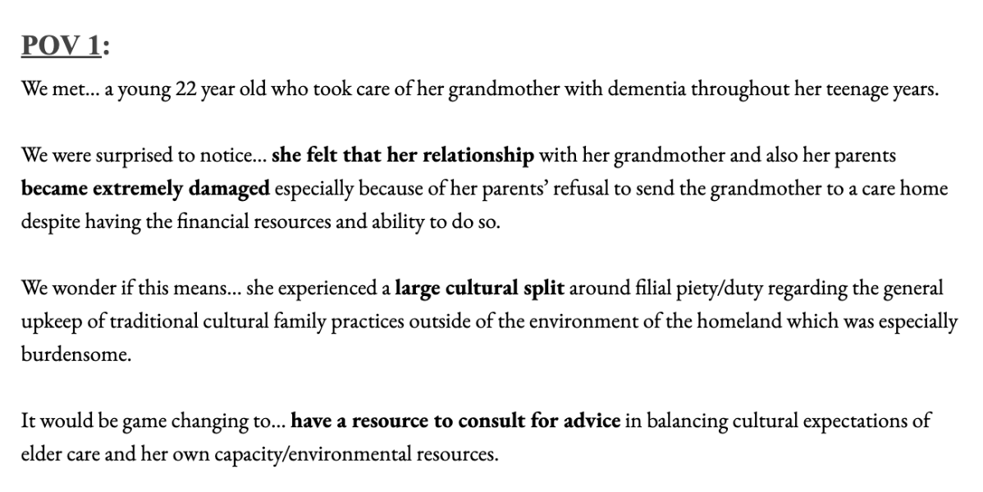
POV 1: Ellie
Note: all names have been changed to protect interviewee privacy
Notes:
Kevin - 30M grandson w/ family history of Dementia (grandmother)
Dean- 26M w/ family history of Dementia (great-grandma and grandma) however, it seems to be isolated to the women in the family - this begs the question of whether someone like Dean is still the audience of our app given his familial relationship but low risk.

Slide 12
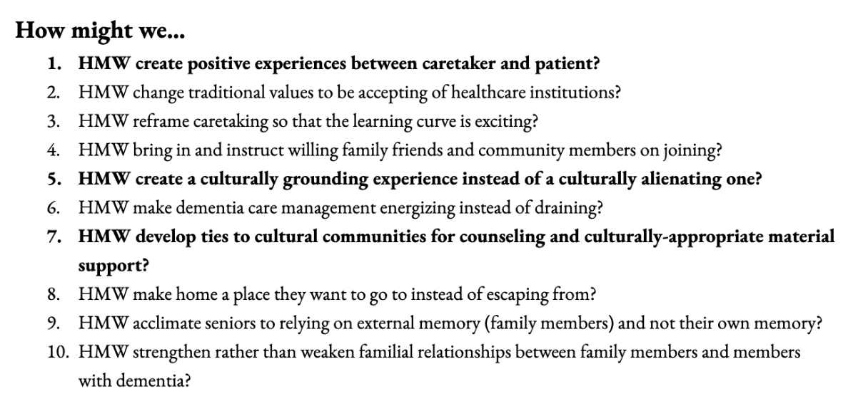
HMW 1: Ellie
Note: all names have been changed to protect interviewee privacy

Slide 13
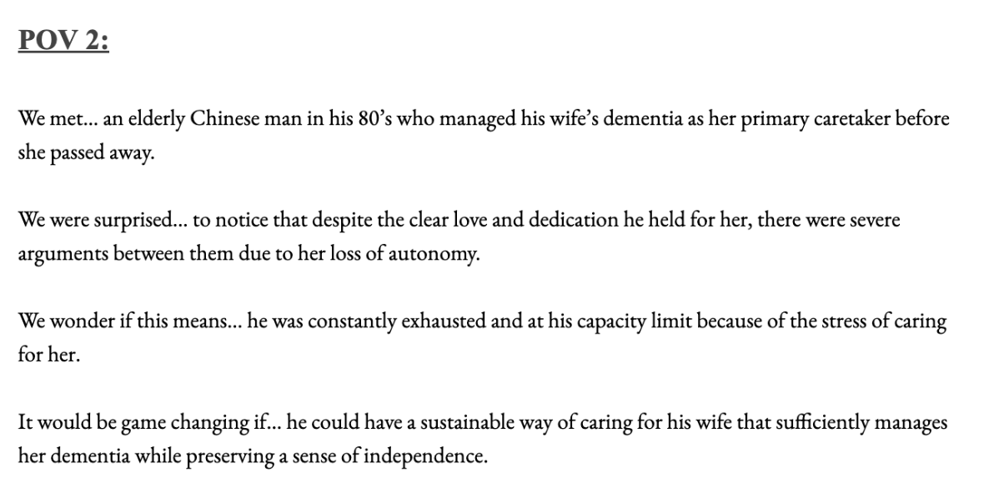
POV 2: Sean
Note: all names have been changed to protect interviewee privacy
Notes:
Kevin - 30M grandson w/ family history of Dementia (grandmother)
Dean- 26M w/ family history of Dementia (great-grandma and grandma) however, it seems to be isolated to the women in the family - this begs the question of whether someone like Dean is still the audience of our app given his familial relationship but low risk.

Slide 14
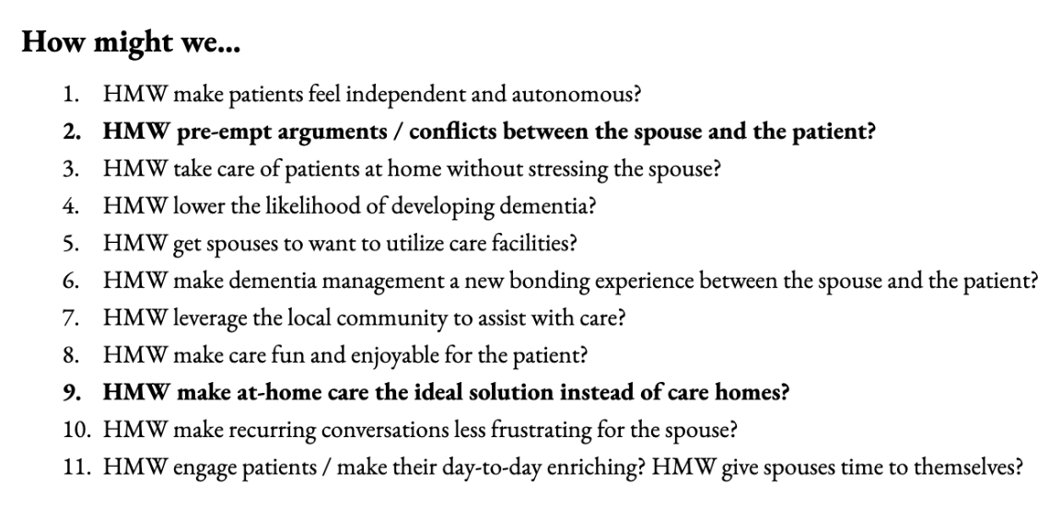
HMW 2: Sean
Note: all names have been changed to protect interviewee privacy

Slide 15
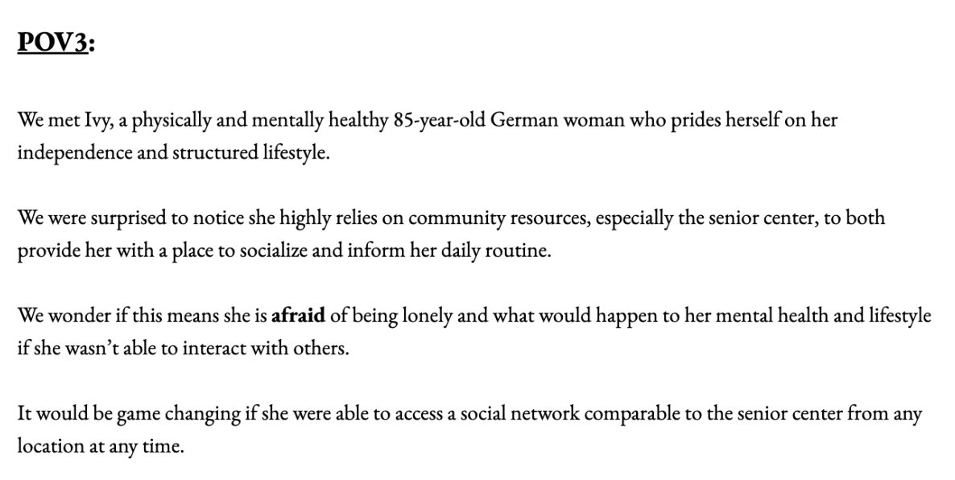
POV 3: Ivy
Note: all names have been changed to protect interviewee privacy
Notes:
Kevin - 30M grandson w/ family history of Dementia (grandmother)
Dean- 26M w/ family history of Dementia (great-grandma and grandma) however, it seems to be isolated to the women in the family - this begs the question of whether someone like Dean is still the audience of our app given his familial relationship but low risk.

Slide 16
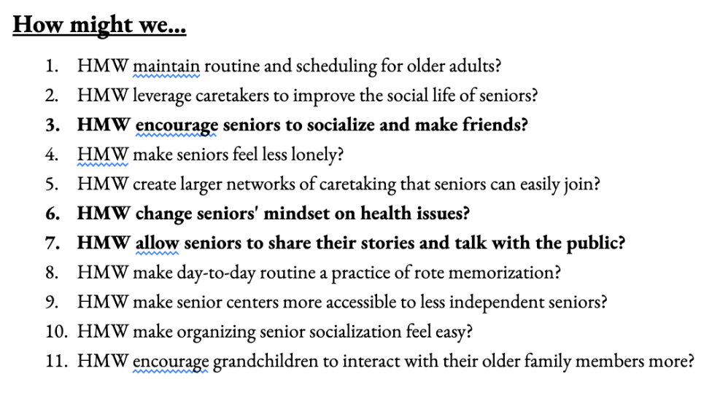
HMW 3: Ivy
Note: all names have been changed to protect interviewee privacy
Notes:
Kevin - 30M grandson w/ family history of Dementia (grandmother)
Dean- 26M w/ family history of Dementia (great-grandma and grandma) however, it seems to be isolated to the women in the family - this begs the question of whether someone like Dean is still the audience of our app given his familial relationship but low risk.

Slide 17
POV 1: Ellie
HMW develop ties to cultural communities for counseling and culturally-appropriate material support?
Note: all names have been changed to protect interviewee privacy

Slide 18
POV 2: Sean
HMW make at-home care the ideal solution instead of care homes?
Note: all names have been changed to protect interviewee privacy
Notes:
Kevin - 30M grandson w/ family history of Dementia (grandmother)
Dean- 26M w/ family history of Dementia (great-grandma and grandma) however, it seems to be isolated to the women in the family - this begs the question of whether someone like Dean is still the audience of our app given his familial relationship but low risk.

Slide 19
POV 3: Ivy
HMW pre-empt arguments and conflicts between spouse & patient?
Note: all names have been changed to protect interviewee privacy
Notes:
Kevin - 30M grandson w/ family history of Dementia (grandmother)
Dean- 26M w/ family history of Dementia (great-grandma and grandma) however, it seems to be isolated to the women in the family - this begs the question of whether someone like Dean is still the audience of our app given his familial relationship but low risk.

Slide 20
Solutions

Slide 21
Top 3 Solutions
A pen pal app to connect groups of culturally-aligned seniors (also app can scan written letters, AI fills in the typed transcript to send, provide audio support to read aloud etc)
Chatbot that pretends to be an expert in whatever domain the argument is in (i.e. patient wants to go to the bank to withdraw money, caretaker gets chatbot pretends to be a bank employee that is “sending them cash”)
Teaching app to show spouses how their relationship may change and how to manage their spouses dementia
Note: all names have been changed to protect interviewee privacy

Slide 22
Experience Protoypes

Slide 23
Top 3 Solutions
A pen pal app to connect groups of culturally-aligned seniors (also app can scan written letters, AI fills in the typed transcript to send, provide audio support to read aloud etc)
Chatbot that pretends to be an expert in whatever domain the argument is in (i.e. patient wants to go to the bank to withdraw money, caretaker gets chatbot pretends to be a bank employee that is “sending them cash”)
Teaching app to show spouses how their relationship may change and how to manage their spouses dementia
Note: all names have been changed to protect interviewee privacy

Slide 24
Assumptions
Seniors are afraid of loneliness and want to connect with peers of their own culture.
Dementia patients want to complete tasks that require leaving the house, which places stress on caretakers (notably loved ones or family members), so if the task were to be completed remotely, they would not feel the need to leave.
Seniors don’t know how to interact with someone who has dementia, even if they are family
Notes:
Critical assumptions being tested
Assumption: Seniors are afraid of loneliness and want to connect with peers of their own culture
Assumption: Dementia patients want to complete tasks that require leaving the house, which places stress on caretakers (notably loved ones or family members), so if the task were to be completed remotely, they would not feel the need to leave.
Assumption: Seniors don’t know how to interact with someone who has dementia.

Slide 25
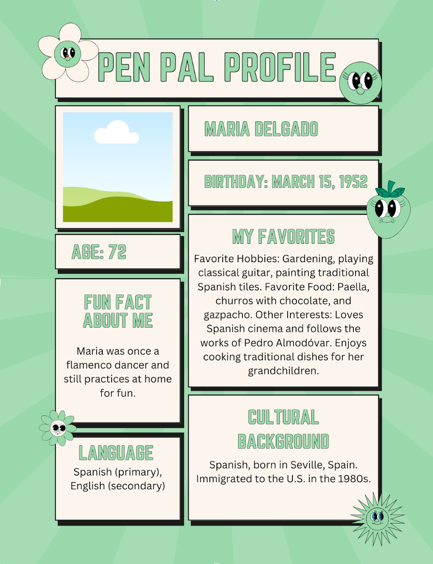
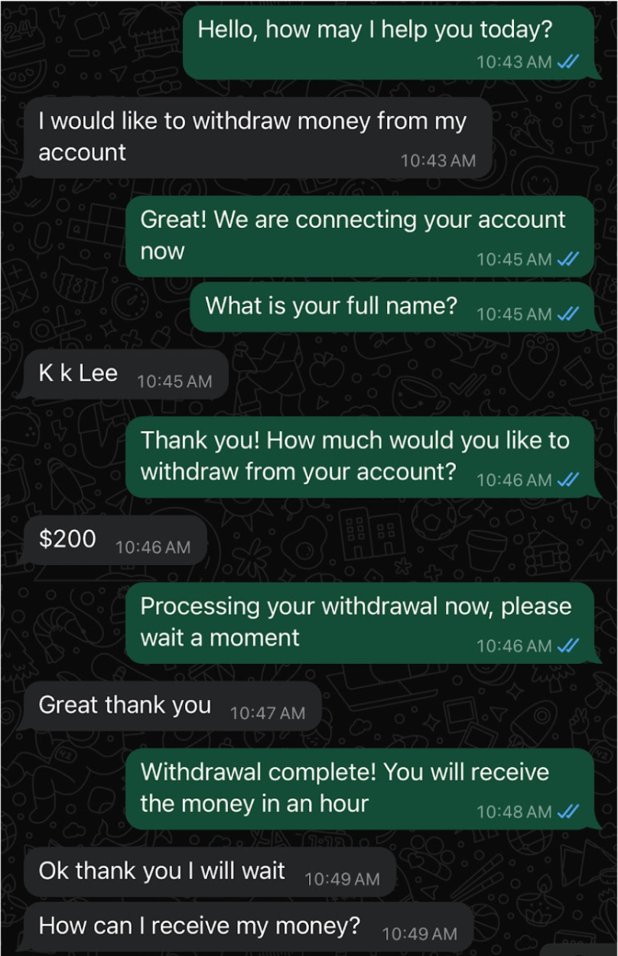
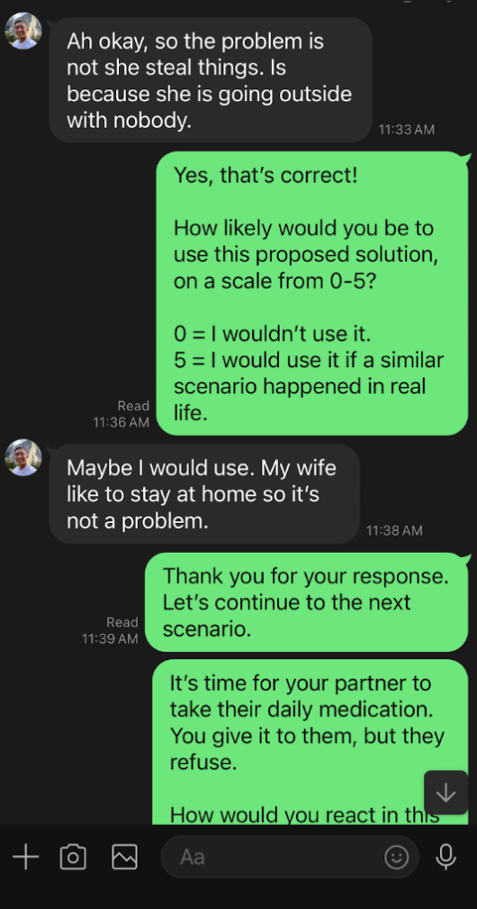
Prototypes
Notes:
Steps:
Create 5 user profiles containing information about cultural background, preferred language, and interests.
Present the senior with the three profiles and see which profiles the senior resonates with most and would like to befriend (and would want to be matched in pen pal group).
Ask user why they chose that profile and what part of the profile they resonate with. Also, if they are willing and able to, to describe how their own profile might look and what they would say.
Steps:
Act as a chatbot over text that completes any task that the senior would want to complete that may require leaving their home
Engage in conversation with the user as the chatbot and “complete” the task for them
Observe what was most effective and where doubts possibly came from
Steps:
Describe a visualization of a scenario where the user must make a choice on how to respond to their partner/family/etc who has dementia.
Ask the user how they would respond–they can type out what they think they would do.
Have an “AI” examine their answer, and formulate a response based on how effective their response would be. It would be evaluated based on the standards of an ‘ideal’ response/reaction in care facilities. If it was a poor response, respond with a gentle explanation why their solution may not work, and provide an ideal solution.
Provide a side-by-side comparison. One side will be their original response, and the other side will be how they could improve or change their response.
Repeat this a few times with different scenarios.
After each round, ask the user to rate the following scale from 0-10. This would evaluate what their opinion on the teaching material is, if they thought it was useful or not.
How likely would you be to use this proposed solution? 0 = I wouldn’t do this. 10 = It would be a great way to handle this situation.
At the end, ask the user to rate the following scale from 0-10. This would be to see how engaged they felt in the experience.
How much do you feel like you learned from these practice scenarios? 0 = I didn’t learn anything. 10 = I learned a ton about how to respond to dementia patients.

Slide 26
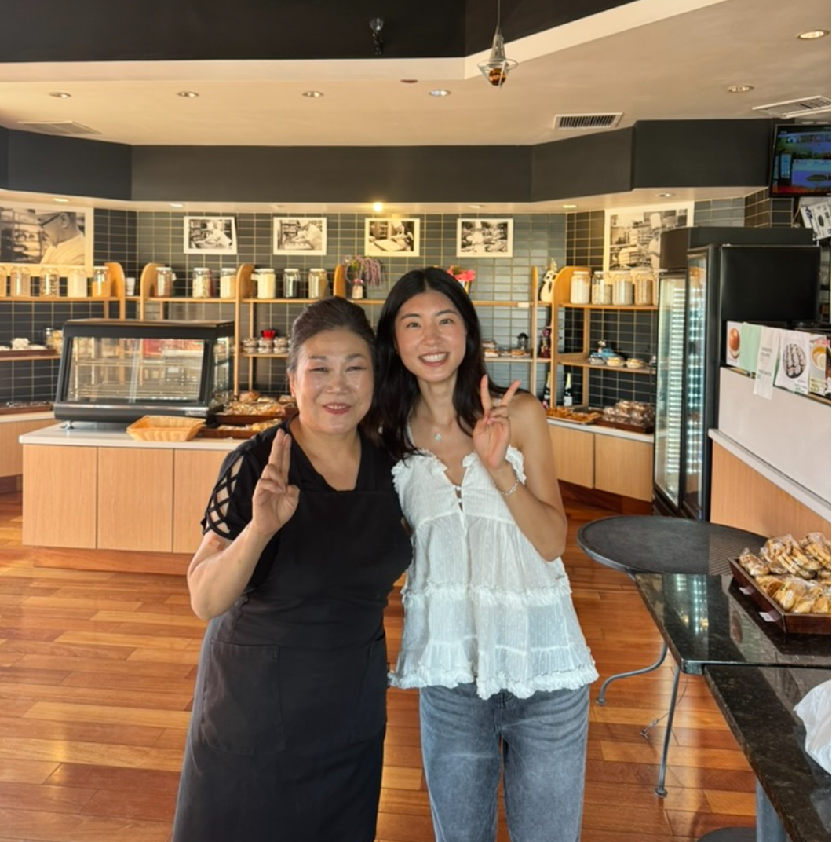

Participants
66 year old Korean resident in Santa Clara
Senior with good health and mental fortitude
67 year old retired Taiwanese businessman
Note: all names have been changed to protect interviewee privacy
Notes:
66 year old Korean lady from Santa Clara, recruited her because like many other seniors, her primary language is not English so we wanted to assess the cross cultural range of our prototype
The second participant was a senior who is both physically and mentally healthy and had working knowledge of WhatsApp. He was recruited on the basis of his age and having average technical abilities within that age group. His mental faculties meant that he could flag anything that appeared nonsensical for us to assess the most minimal experience within the app (aka dementia patient who is experiencing symptoms but still has understandings of reality and real world experiences.)
The final participant was a 67 year old retired Taiwanese man who moved to the US later in life but operates in Taiwanese and Chinese exclusively. He holds strong traditional values and cultural norms around caretaking for family with dementia and could give us a good sanity check on whether our AI-based solutions were acceptable within this cultural framework

Slide 27
What worked? What didn’t?
Notes:
Results: What worked/didn’t work? New learnings? Was the assumption valid?
In terms of what worked and what didn’t, we wanted to highlight that within the pen pal app, the things that worked is that language was less of an issue and that we were able to create cross cultural collaboration.
For the chatbot prototype, it seemed that seniors would generally latch onto “differences” in the processes that they were used to as opposed to what the AI was able to provide them, even if the AI was providing a relatively complete process from start to finish.
In our last prototype, it seemed that it was helpful as a sort of help line but didn’t necessarily have a metric by which we could “solve” their issues or give them what felt like personal support for a very personal issue.
What does it mean for your work going forward?
It means that we are going to narrow down on a solution that seemed to solve one of our largest issue which is creating an accessible social platform for seniors to meet and interact with other seniors in spite of hurdles around culture, language, and disability

Slide 28
What’s next?
Notes:
What’s next?
Which solution (or combination) will move forward?
In the end we are moving forward with the pen pal app as it has the largest scale potential impact and is not necessarily hindered by local or individual-specific variations.
What are the ethical implications of this solution?
Assessing who is allowed on the app, how we are screening to make sure the app stays in our intended audience base, how are we monitoring the language and ideas being transferred across this app especially given that seniors may have outdated ideas
How we make sure that seniors aren’t being fished for sensitive information or scammed on this app?
Who does it serve? Who might it leave out?
This app definitely serves seniors who are outgoing or have the faculties to type/write/speak. What about disabled seniors who may be mute or not have any sort of mobility but have the mental faculties and are still suffering the senior loneliness epidemic

Slide 29
Pen Pal App!

Slide 30
APPENDIX

Slide 31
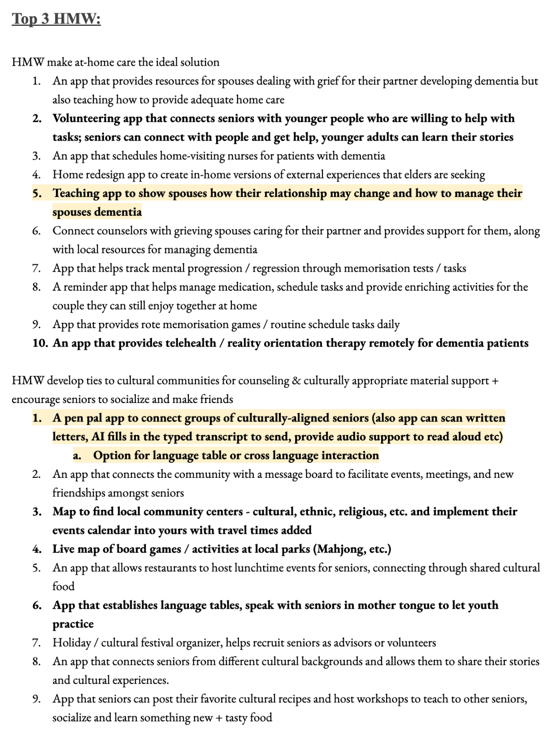
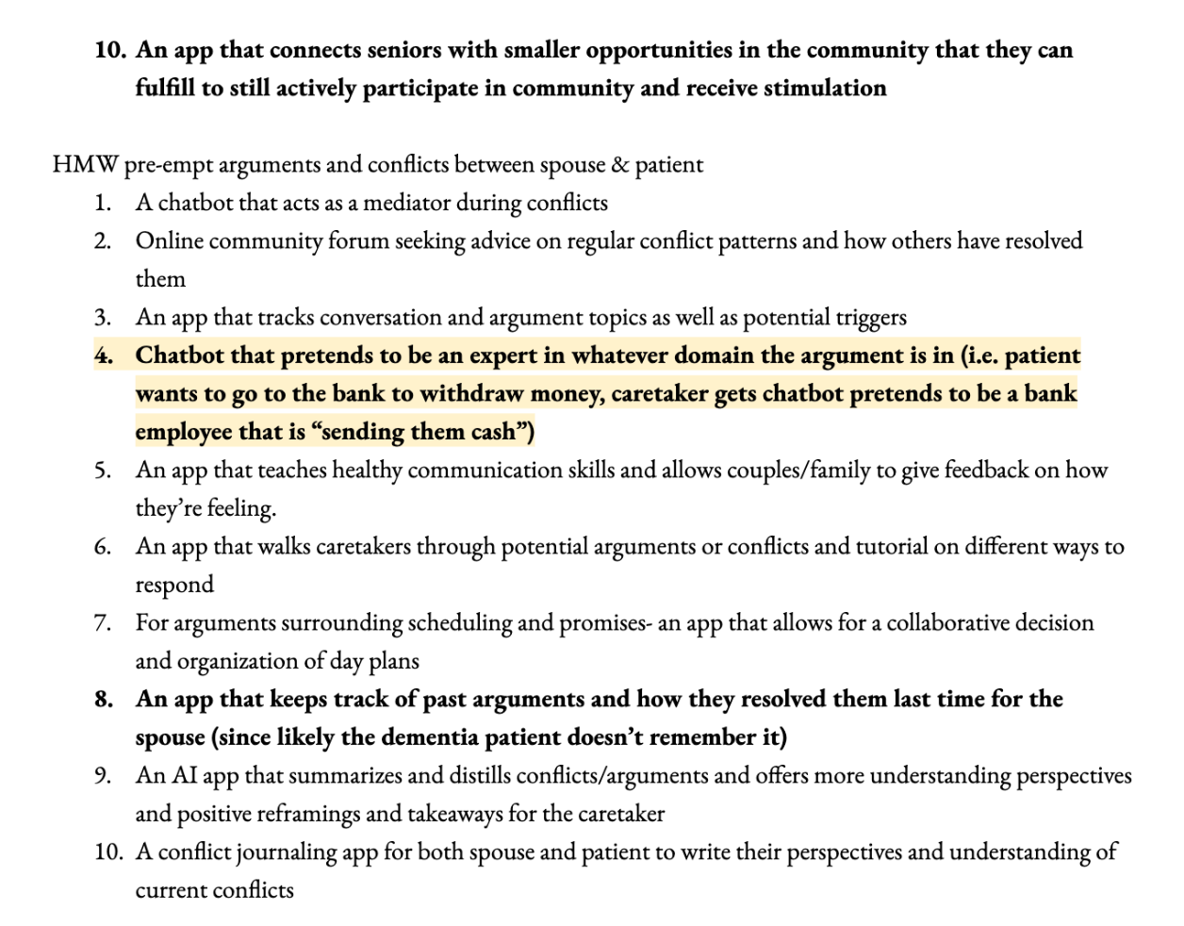
Solutions Brainstorms

