Slide 1







Lucky Day
Ethan Bell Em Ho
Clare Chua Lianne Cha

Slide 2

Road Map
1.
2.
Problem + Solution
-- Market Research
-- Value Proposition
Ethical Implications
-- Tarot Cards of Tech
3.
4.
Tasks
Storyboard + Concept Video

Slide 3


Problem Statement
Seniors, especially those who have recently moved to the US, experience loneliness and have difficulty establishing a strong social network due to cultural and language barriers. Older adults may put themselves at greater risk of dementia and other neurocognitive disorders if they do not exercise their brain and socialize.

Slide 4

Market Research
1
Wyzr: New Activity-Based Friendship App for Adults
2
Amintro Inc.: Life’s Better in Company

Slide 5
Market Research
3
SilverSurfers: Over 50s Lifestyle & News Website
4
Stitch: The Social Community for Anyone Over 50

Slide 6

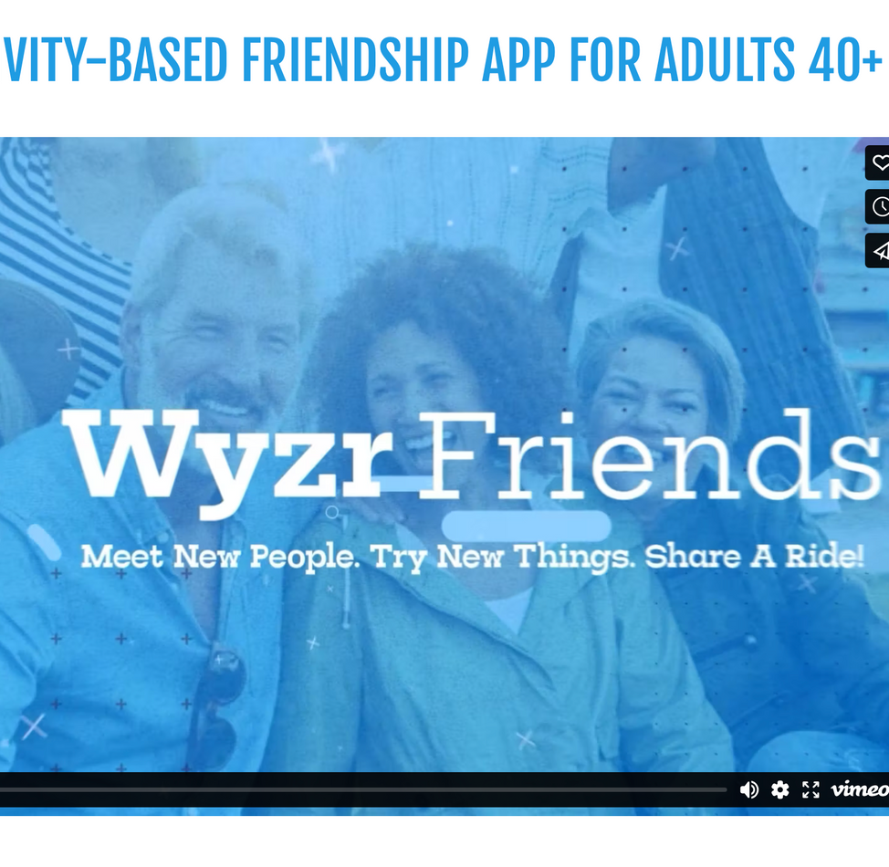
Wyzr
Product: Activity-based friendship app for people 40s and up
Features: “Friend Blast” allows you to send out invitations to certain matches so you can easily schedule plans with them. “Carpool” allows you to coordinate pick-up spots.

Slide 7
Wyzr
What worked: Encourages offline socialization, a major appeal for users who seek meaningful face-to-face friendships. ID verification system helps foster trust within the older adult community.
What didn’t: Not enough users in some areas. Their main selling features (Carpool and Friend Blast) require a critical mass of active users to function effectively.

Slide 8
Wyzr: Implications
  Trust and safety is crucial in creating an online community, especially for seniors. Our app should also have privacy features to protect our users.
  Since our app also facilitates in-person interactions, we will also face the challenge of convincing a demographic that may not be as familiar or comfortable with using technology to use our product.

Slide 9

Amintro
Product: Combat social isolation for those 50 and up.
Features: Filters through members to make friendship suggestions according to people’s profile outline, interests, past experiences and future aspirations.

Slide 10
Amintro
What worked: Secure platform where users’ personal information is confidential, helping to build trust among older adults who may be hesitant to engage online​. Detailed friend profiles.
What didn’t: Confusion that it is a dating app.
Low user engagement – hard to form connections if inactive on app.

Slide 11
Amintro: Implications
Though we are moving away from “matching” users and focusing on the cultural nuances in presenting social events for seniors, we should also be careful about coming off as a dating app or something other than a hub of social events.

Slide 12
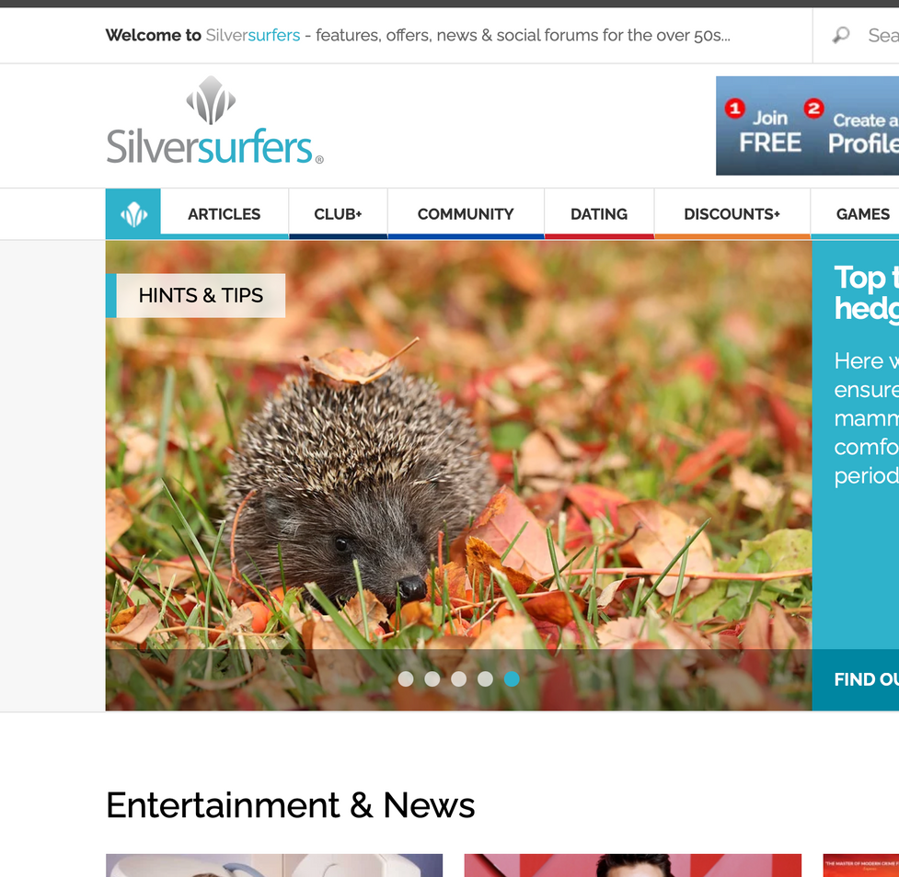
SilverSurfers
Product: Social forum for people aged 50+ with a large user base in the UK.
Features: Offers a mix of community-driven content and commerce. Content includes articles on travel, health & wellness, technology, finance & retirement, lifestyle. Has section for games, dating, shopping, online health classes.

Slide 13
SilverSurfers
What worked: Curated content with articles and discussions around travel, health, and lifestyle attract regular engagement. Partnerships with brands have been successful in keeping the audience engaged.
What didn’t: Fails to fully address the varying needs of its younger (50s) vs. older (70+) users. Over-relies on traditional lifestyle content; doesn’t have dynamic, innovative content to engage users

Slide 14
SilverSurfers: Implications
Even when considering seniors, there is a huge range of lifestyles and needs that our users are experiencing. We should include events in our app that aren’t limited to just one type of user and activity so that it is accessible to all seniors.

Slide 15
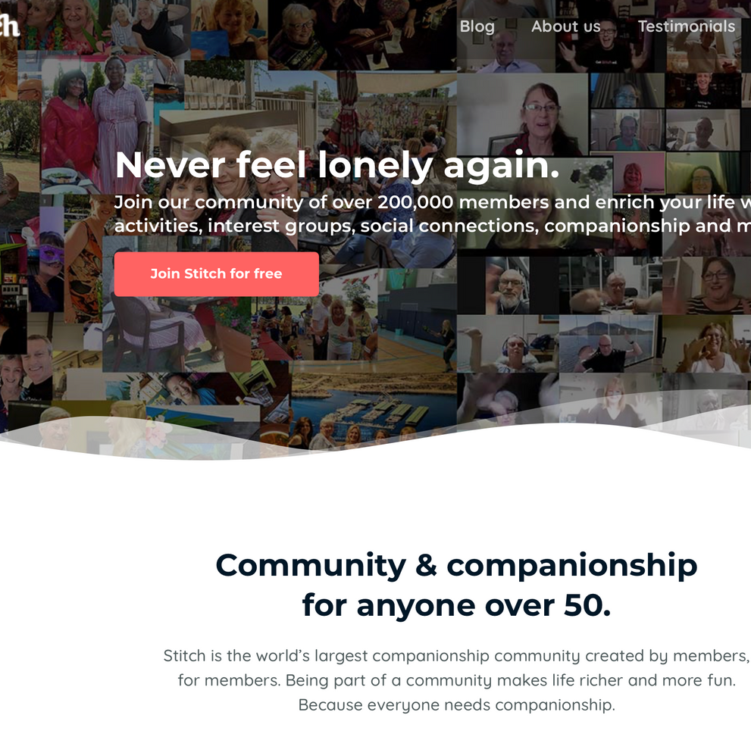
Stitch
Product: Online community specifically designed for adults aged 50 and over
Features: Features include scheduling and going to local events, social groups, and forums where members can connect over hobbies, interests, and life experiences.

Slide 16
Stitch
What worked: Accessible on various devices. Encourages real-world connections through in-person community events (dinner, movies, etc.). Offers tech support for older adults (guides them how to use website).
What didn’t: Users in less populated areas struggle to find nearby events or matches. Lower engagement from men.
Competes with general social media platforms (not age range specific).

Slide 17
Stitch: Implications
Since technology and new apps can be challenging to figure out, we should keep our app as simple as possible so that seniors are able to use all the features easily. We can also offer guides/tutorials for how to use the app.

Slide 18

Our Solution

Slide 19

Name
思い立ったが吉日
(omoitatta ga kichijitsu)
An old phrase that translates to “the day you think of it is the right day to do it”
Kichijitsu roughly translates to “lucky day” or “auspicious day”
Thought that this captured the idea of encouraging seniors to take the social leap through our product - also contains cultural imagery associated with our east Asian immigrant population niche

Slide 20

Primary User and Solution
Older Adults and Seniors
Solution: A live map and social calendar that provides culturally-aligned activities and translations, allowing seniors to find, attend, and create social events of their choice.

Slide 21
Stakeholders
Direct:
  Older Adults and Seniors
  Third-party hosts (restaurants, etc.)
Indirect:
  Caretakers and family members
  Social welfare services / care facilities

Slide 22
Value Proposition
Culturally-congruent social calendar for seniors

Slide 23


Ethics

Slide 24
Ethical Implication 1
  Encourages seniors to go outside and travel more than before in a system that is not built to sufficiently support their physical needs, thus potentially exposing them more to accidents or physical harm

Slide 25
Reflection
This ethical consideration requires us to work with local governments on support within public spaces, especially with pub trans options, to mitigate risk and create safer environments for seniors to attend events that we platform

Slide 26
Ethical Implication 2
  Third-party hosts on the platform may view seniors as an exploitable customer base without the mental faculties to recognize or retaliate against/report financial exploitation and scams

Slide 27
Reflection
This ethical consideration requires us to conduct regular and strict auditing, as well as implement approval/rating systems such that we do not expose seniors to scams, financial exploitation, or generally unsafe environments

Slide 28
Tasks

Slide 29
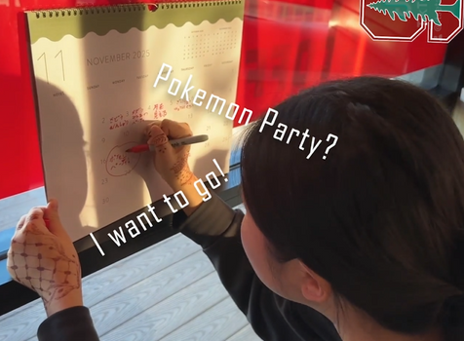
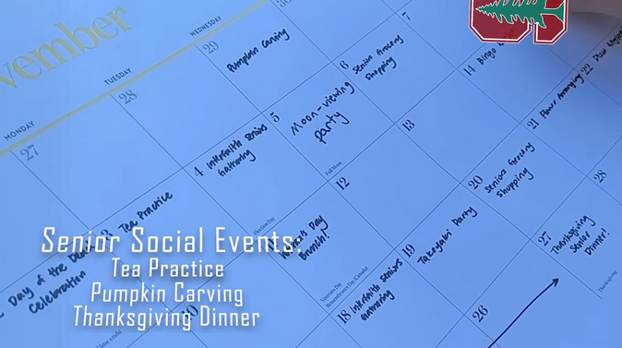
Simple Task
User can browse and sign up for events on the live map / social calendar

Slide 30
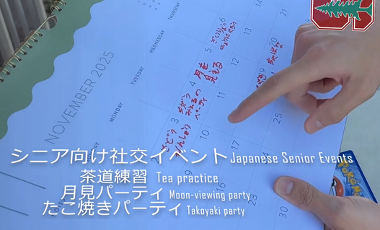
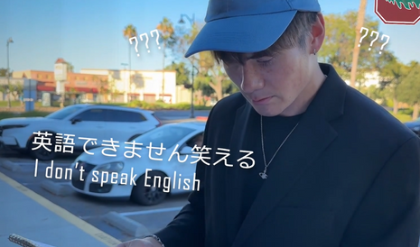
Moderate Task
User can receive and utilize a culturally-compatible social calendar based on their background and language ability

Slide 31
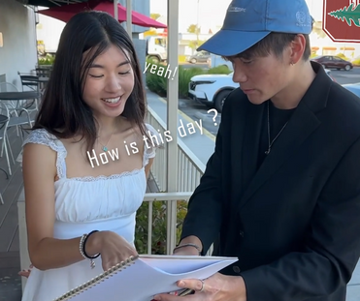
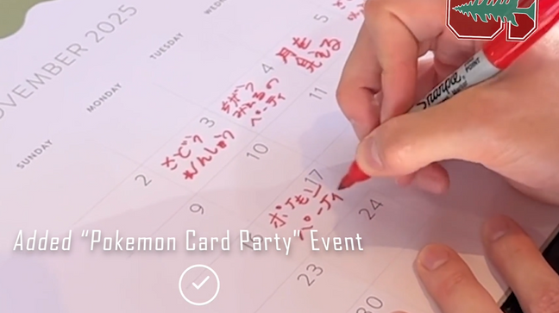
Complicated Task
User can collaborate with third-parties (restaurants, centres, etc.) to host an event of their own

Slide 32
Storyboard

Slide 33
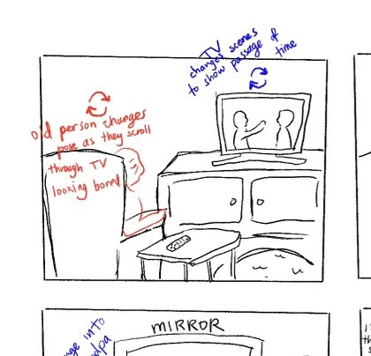
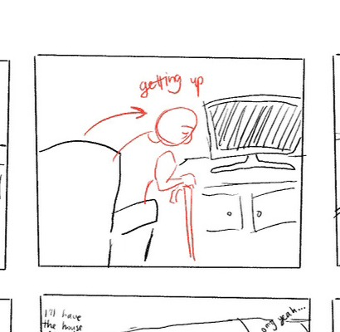
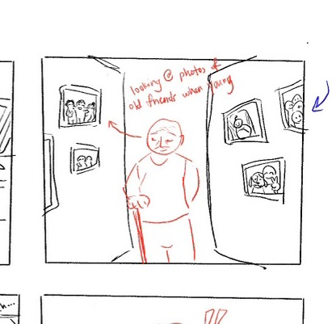

Storyboard
1
2
Gets up
3
Lonely and bored at home
Reminisce days with friends

Slide 34
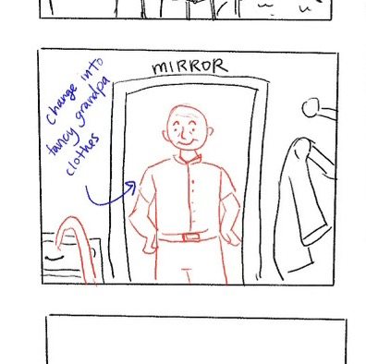
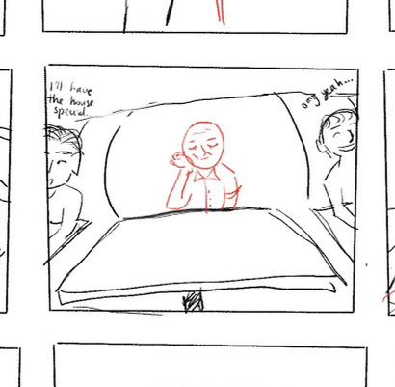
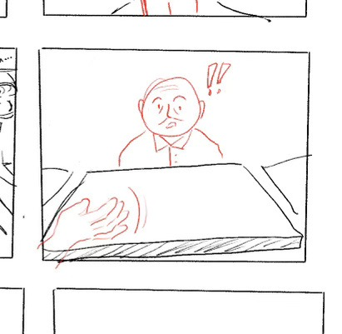
Storyboard
4
5
Waits alone (sad)
6
Store owner waves to him before he leaves
Gets ready to meet new people

Slide 35
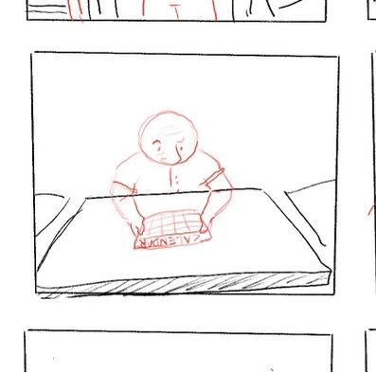
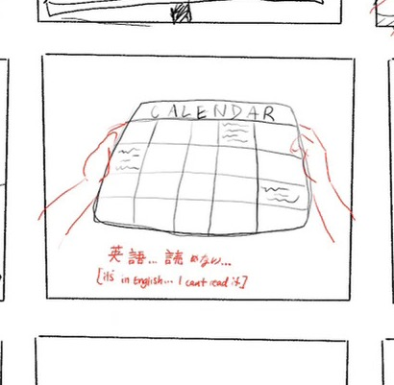
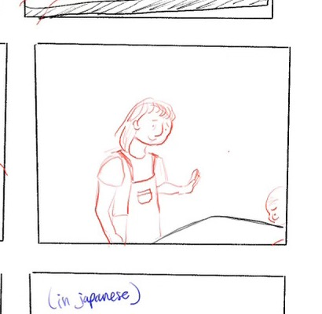
Storyboard
7
8
9
Gets handed a social calendar
In English.. can’t read
But wait! There’s a solution...

Slide 36
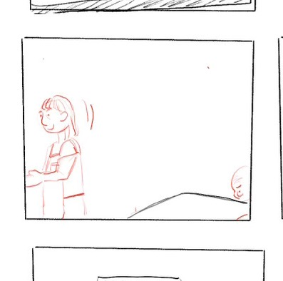
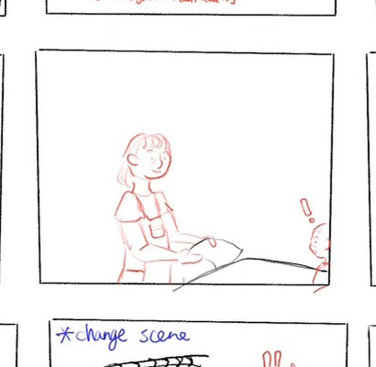
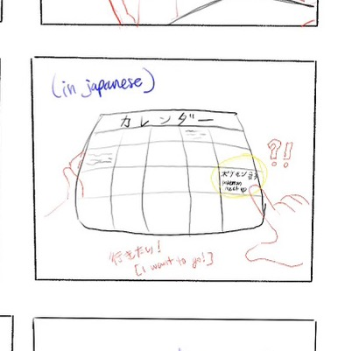
Storyboard
10
11
Presents him with a new culturally aligned, Japanese calendar
12
Owner turns to get something
Finds event he wants to go to

Slide 37
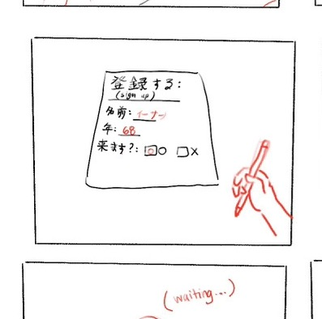
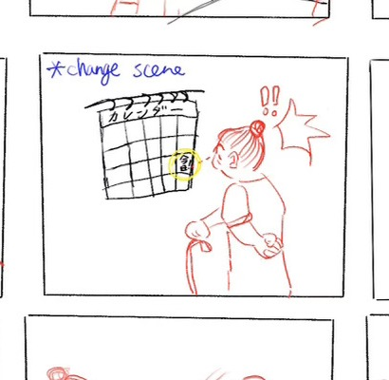
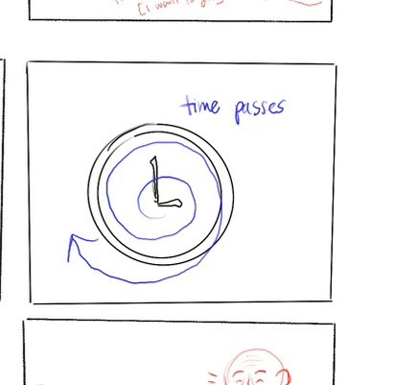
Storyboard
13
Creates his own event to add to social calendar
14
Someone sees the event and wants to go
15
Few days pass leading up to event

Slide 38
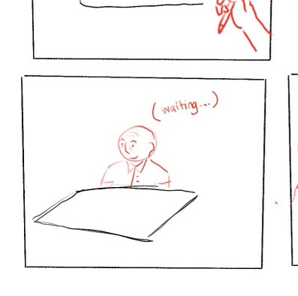
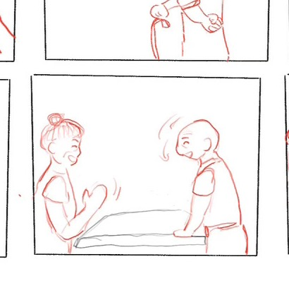
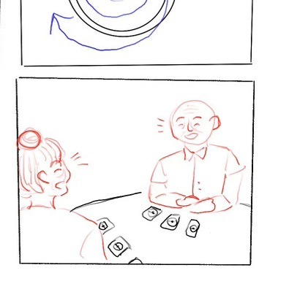
Storyboard
16
Waits for people to show up at his event
17
18
New friends!
Someone shows up to play!

Slide 39
Concept Video

Slide 40
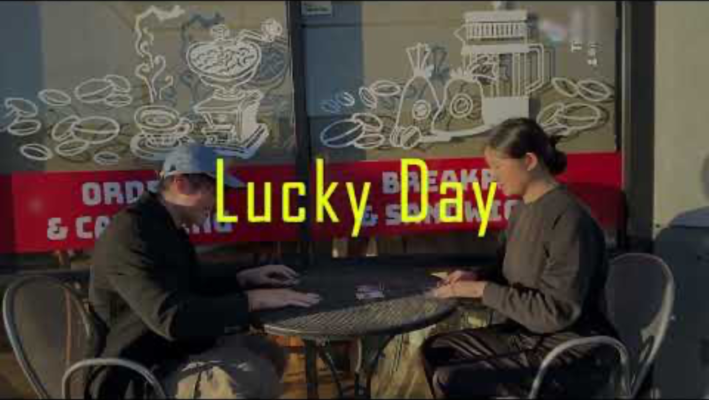

Slide 41
Questions

