Slide 1










LUCKY
DAY
clare, em, ethan, lianne

Slide 2

VALUE PROPOSITION
Connecting Hearts, Protecting Minds
Helping seniors build new friendships and find connection through culturally aligned events and activities.

Slide 3
PROBLEM STATEMENT
Older adults who face language barriers and cultural differences struggle to find social connection in their communities, leading to loneliness and raising their risk of dementia and cognitive disorders.

Slide 4


SOLUTION
A tablet app for seniors offering a social calendar with language support and culturally-tailored activities, enabling seniors to easily discover, join, and organize events that resonate with their cultural background and fostering social connections to prevent the onset of dementia and cognitive disorders.

Slide 5





ROADMAP
SKETCHES
SELECTED INTERFACE
LOFI CONSTRUCTION

Slide 6








ROADMAP
TESTING
METHODOLOGY
TESTING
RESULTS
LOFI PROTOTYPE

Slide 7

SKETCHES

Slide 8
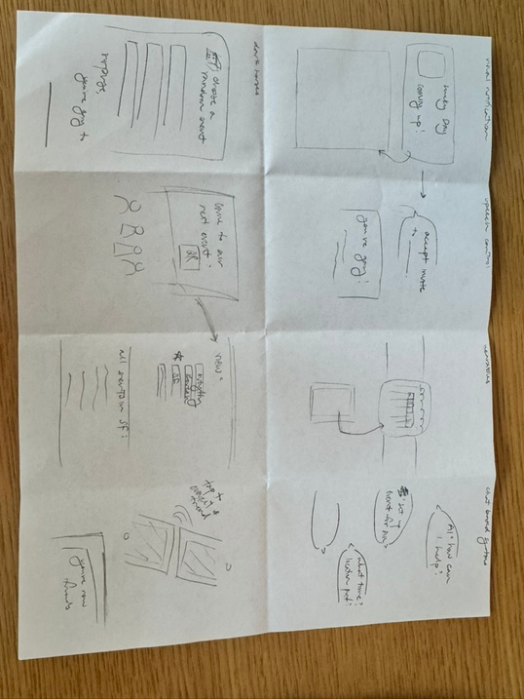
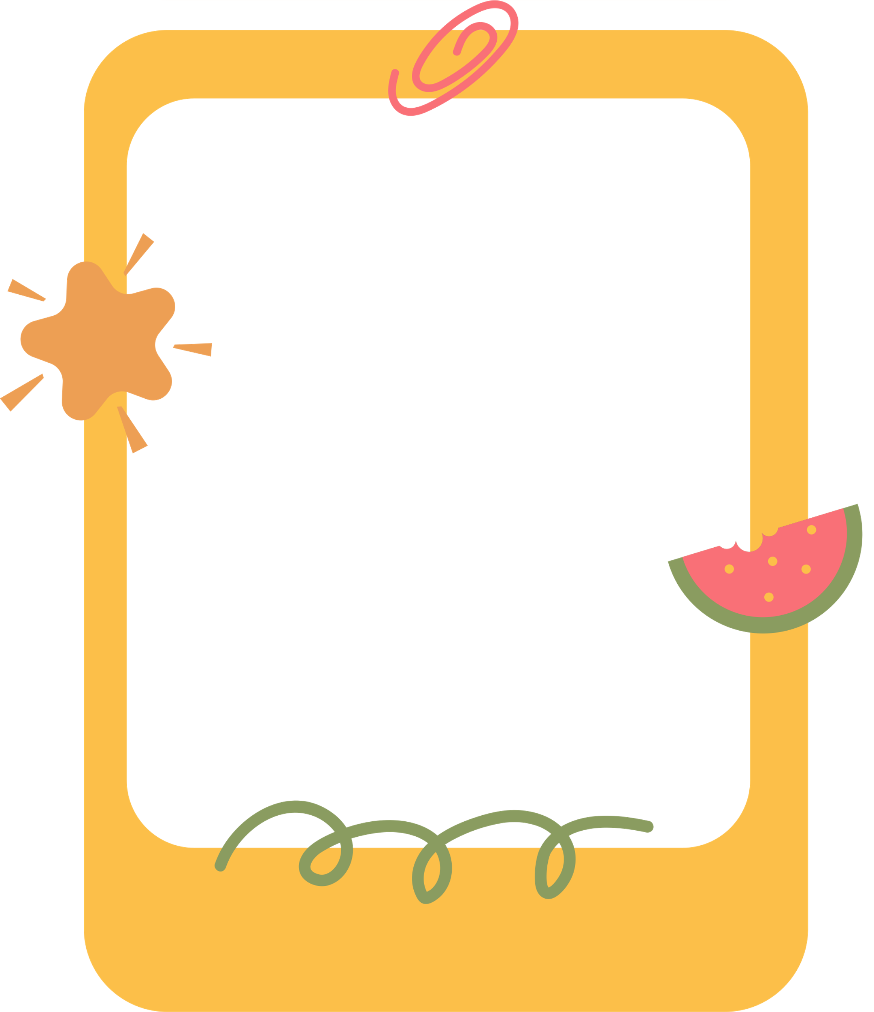
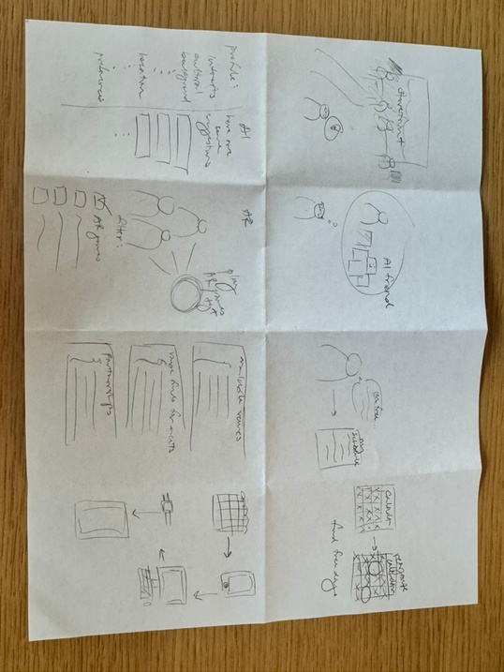
SKETCHING
EXPLORATIONS
Two rounds of Crazy-8s.
Categories: visual notifications, speech control, wearables, chat-based systems, AR, VR, Dark Horse, etc.

Slide 9
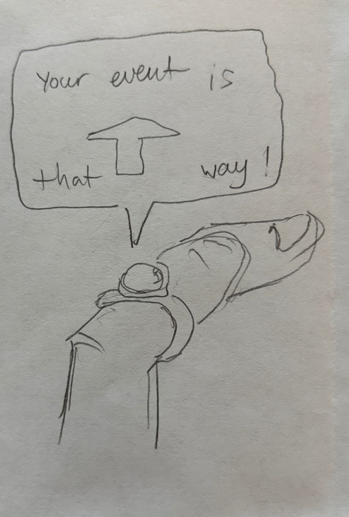
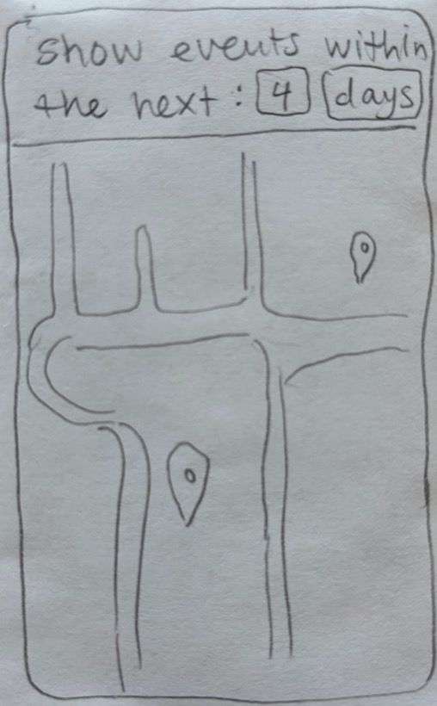
SKETCHING:
REALIZATIONS
Product 1: Ring Projector
Wearable application that provides seniors with directions to nearby events
Product 2: iPad App
Live map of social events with ability to filter events by preferences and create your own events.

Slide 10
SELECTED INTERFACE

Slide 11
PRO
CON
RING PROJECTOR
  Straightforward and serves a single purpose, making it easy to learn and use.
  Helps seniors avoid getting lost by providing simple, step-by-step directions.
  Especially helpful for those who can’t read signs in English.
  Location services for seniors to navigate streets and for caretakers to track them
  Not enough information for joining, posting, or searching for events.
  Would function better as an extension to existing infrastructure rather than a standalone device.
  Device too small for seniors to read directions.
  Prone to damage or loss due to size and wear

Slide 12

PRO
CON
IPAD APP
  Can use while propped up on a stand or in a case (comfortable for at home use).
  Easier for typing; less frustrating than small keyboard on phone.
  Large surface allows for more features on the screen and larger text (easier to see).
  Seniors often already own tablets/iPads
  Bulkier and less convenient to carry around an iPad.
  Potentially no access to data while in transit, which could be crucial for last-minute updates or changes to events.
  Less hands-free usage; needs more user interaction.
  On-the-go usage may cause dangers for seniors (lower situational awareness during usage)

Slide 13

SELECTED INTERFACE
..drumroll..

Slide 14

SELECTED INTERFACE
iPad App!

Slide 15
LOFI CONSTRUCTION

Slide 16
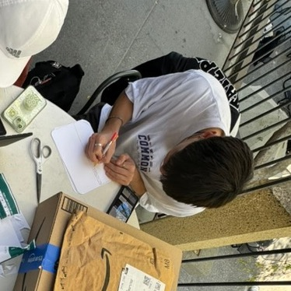
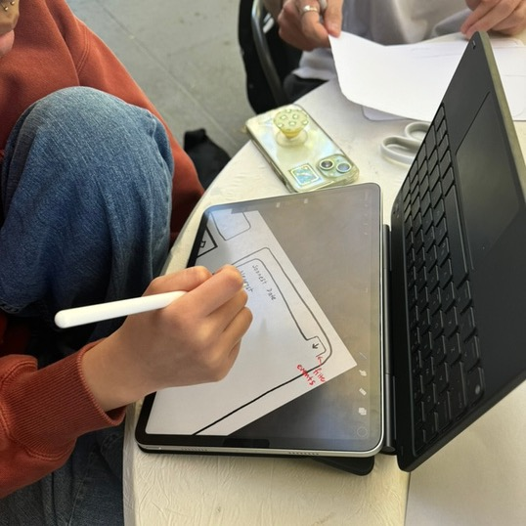
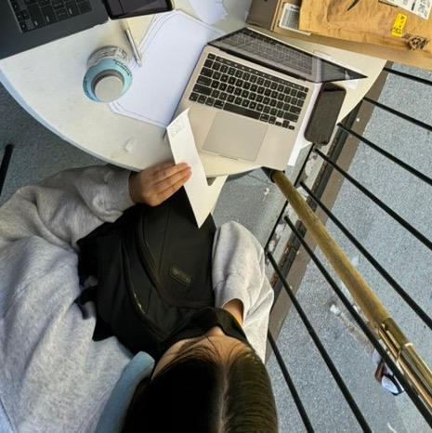
PROTOTYPE CREATION

Slide 17
OUR PROCESS
Storyboard
Plan out interface and features. Understand how many screens & transitions might be necessary for the features we want to include.
Features
(1) Login/sign-up (2) Build profile (3) View events (3) Filter events
(4) Create your own events (5) View messages from friends
01
03
02
Build
Handcrafted prototype with pen, paper, scissors, and tape. Printed iPad-sketched calendar for recurring scenes.
04
Interactions
(1) Click to login/sign-up (2) Type to fill out profile (3) Scroll to view events (4) Click to add event to your calendar (5) Type and click to filter events and create your own

Slide 18
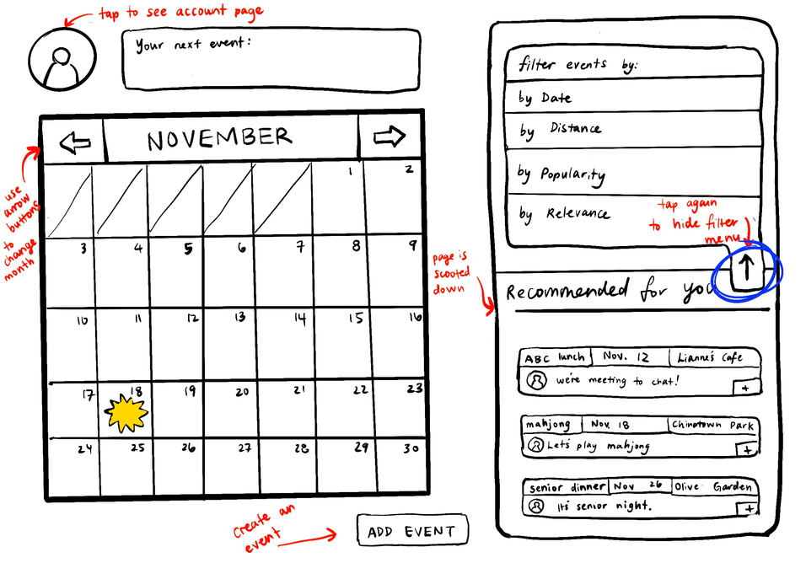
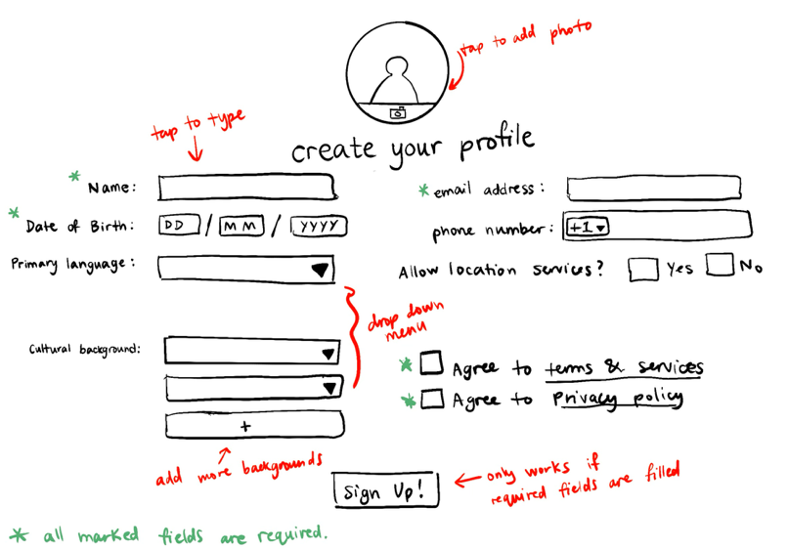
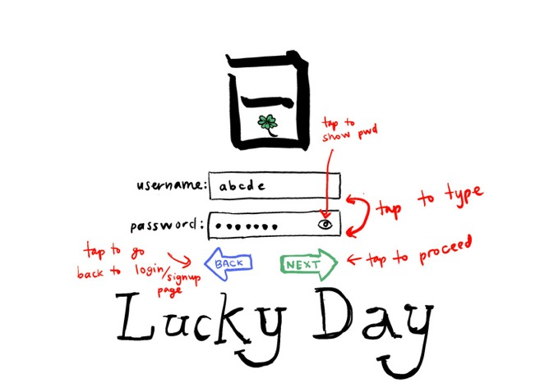
STORYBOARD

Slide 19
LOFI PROTOTYPE

Slide 20
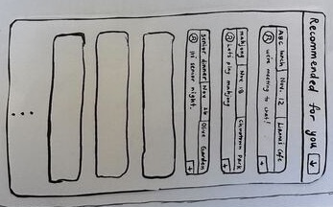
SIMPLE
User starts on the main page and adds recommended events onto any given day.

Slide 21
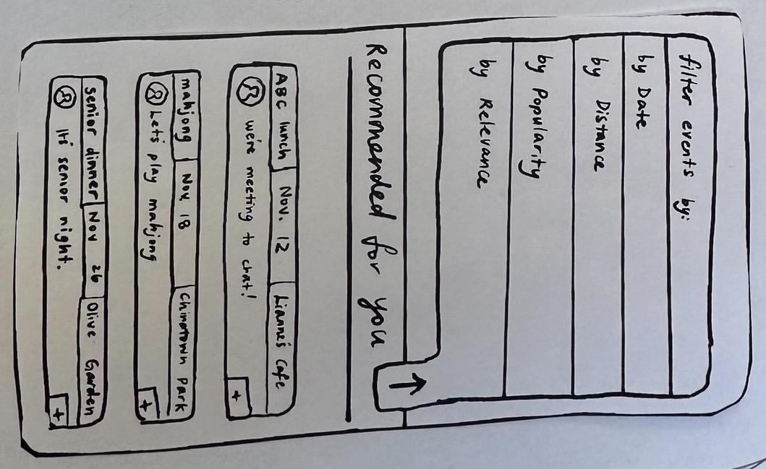
MODERATE
User starts on the main page and swipes through to the following month and taps on a new day to pull up more recommended events. They add a recommended event and then change to all events tab and add a non-cultural event.

Slide 22
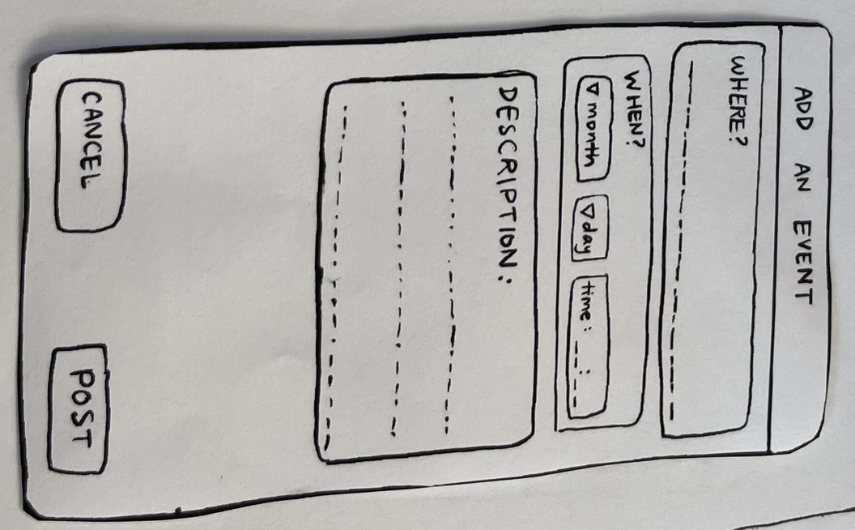
COMPLICATED
User starts on the main page and picks a specific day and looks at what events are going on/might conflict. They find an empty time slot and click the “new event” button. They create and publish their own event and add appropriate tags for the algorithm to sort it. They go back to the main page and see their event on the right list + add it to their own calendar.

Slide 23
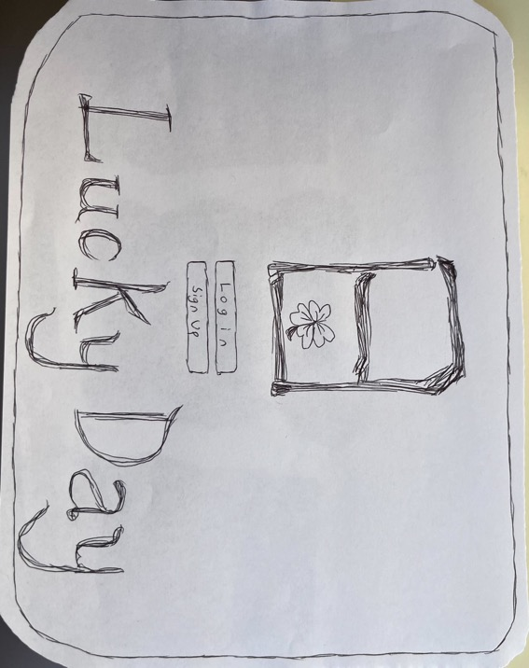
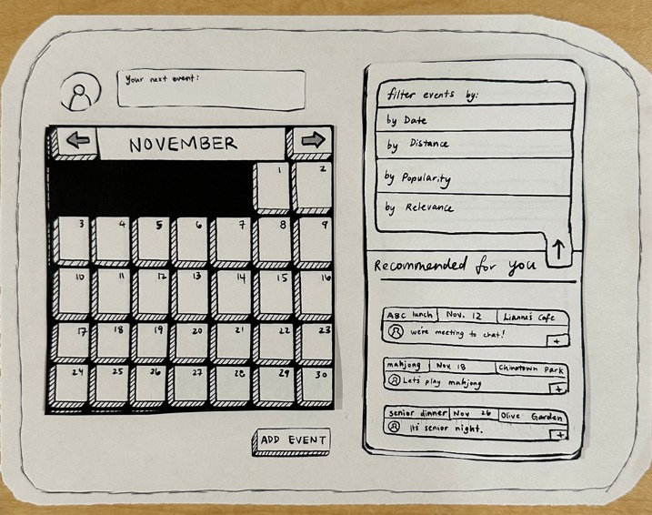
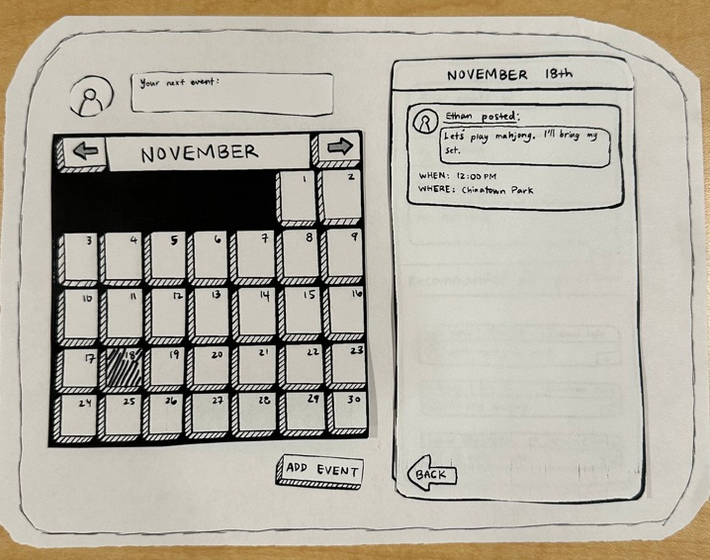
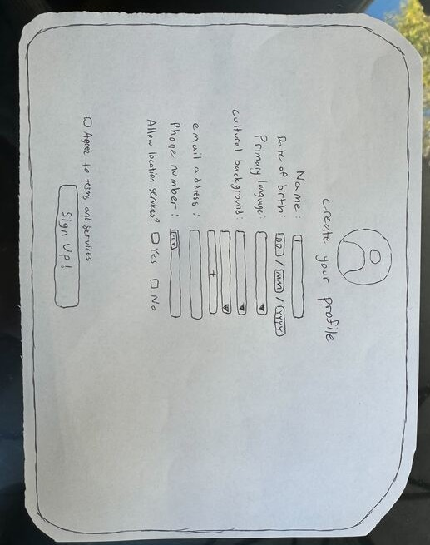
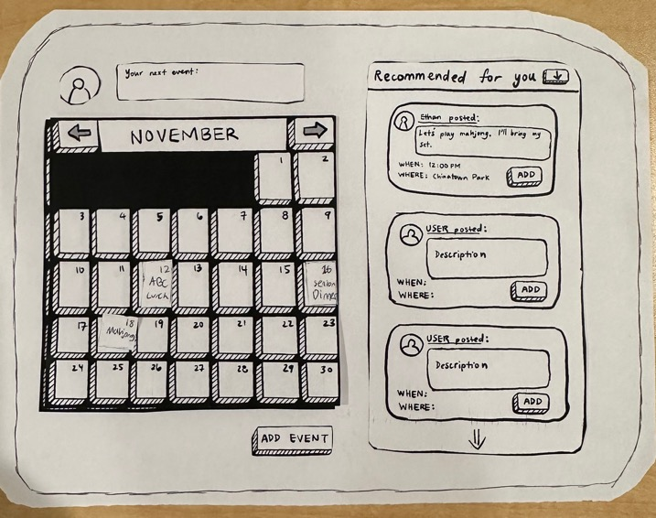
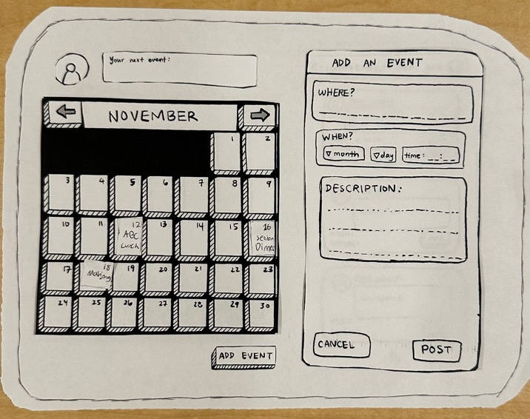
SCREENS

Slide 24
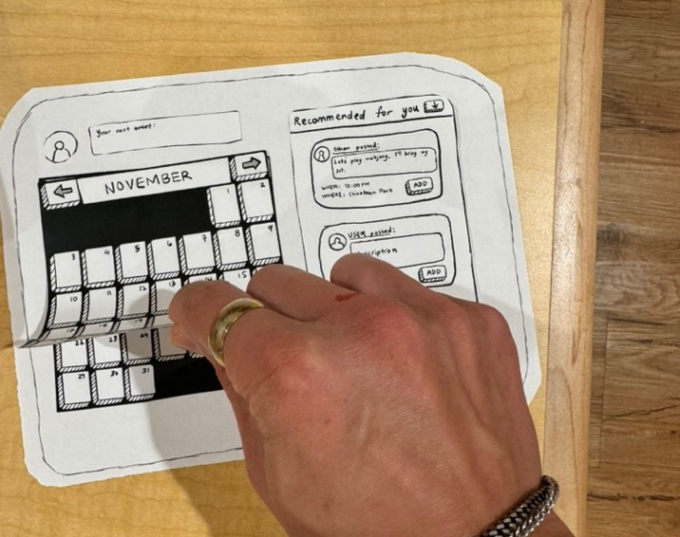
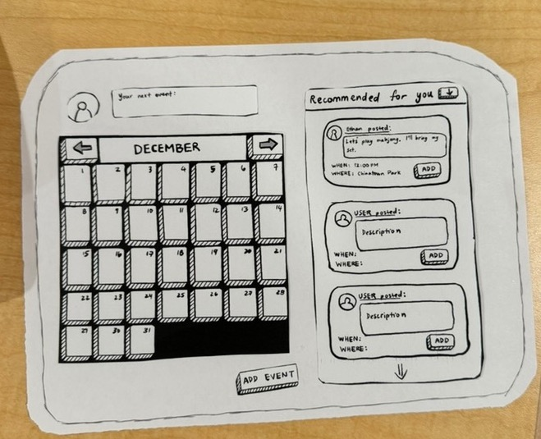
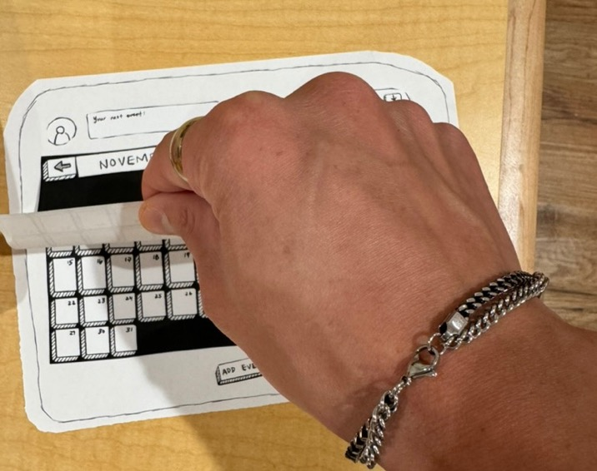
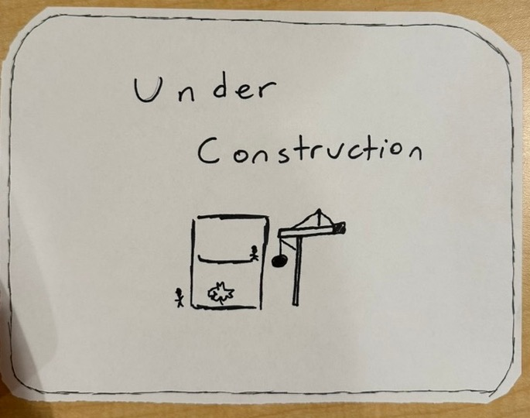
SCREENS

Slide 25

SCREENS
Title screen where user either logs in or signs up. (For testing, assumed everyone was a new user that needed to sign up.)

Slide 26
SCREENS
Enter information to create your profile. Asks for cultural background (which will be used to curate recommended events in later screens.)

Slide 27

SCREENS
Shows all events and options for how you can filter/sort them.

Slide 28

SCREENS
Events are sorted by recommended based on cultural background.
Here, user can add Mahjong (first event) to their calendar.

Slide 29

SCREENS
Highlights specific day that Mahjong event is selected for.
This event is added to the user’s calendar.

Slide 30

SCREENS
User creates their own event by filling in details and posting.
(Complicated task!)

Slide 31

SCREENS
Scrolling mechanism (press arrow to see the next month’s calendar).

Slide 32

SCREENS
Scrolling
Exhibit B.

Slide 33
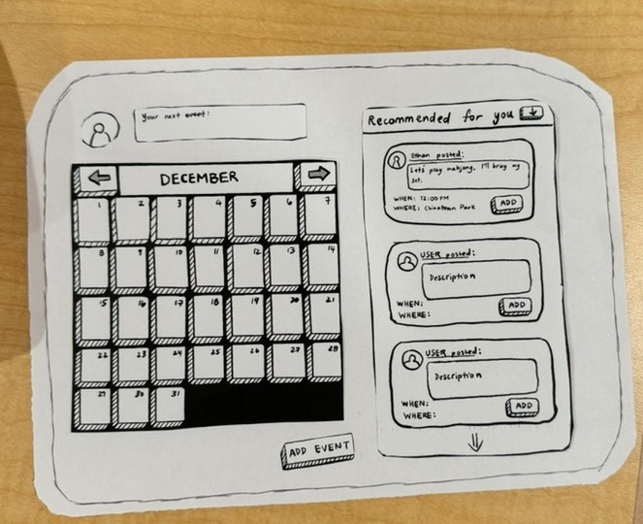
SCREENS
Finished scrolling to next month’s calendar. Can now see December’s events.

Slide 34
SCREENS
Screen shown for any links clicked that are not ready.

Slide 35
TESTING METHODOLOGY

Slide 36
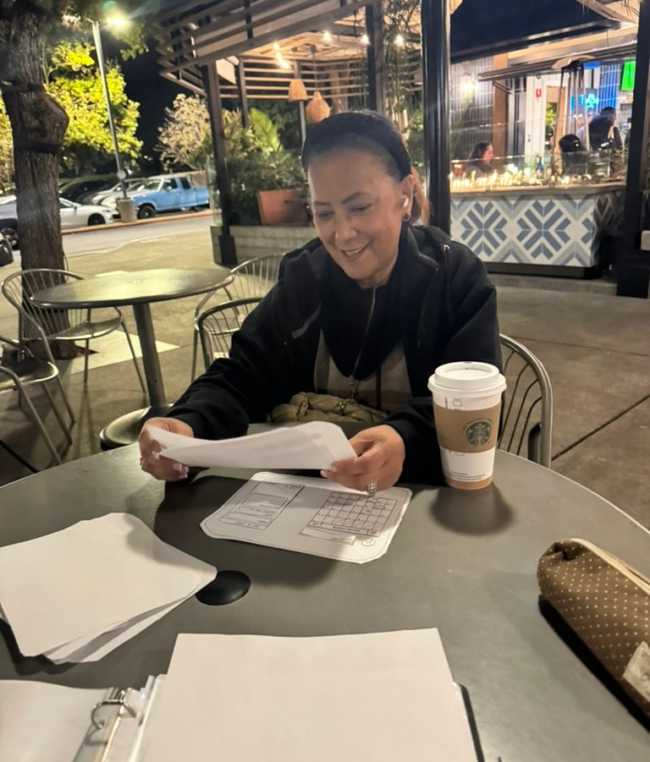
PARTICIPANT 1:
VALERIE*
Demographics: age 65+, female, part Irish and Vietnamese, fluent in English
Recruitment: cold outreach on street, verbal screening questionnaire
Compensation: none
Environment: in-person; natural setting (outside in public mall)
Apparatus: lofi prototype
*Name changed for anonymity.

Slide 37
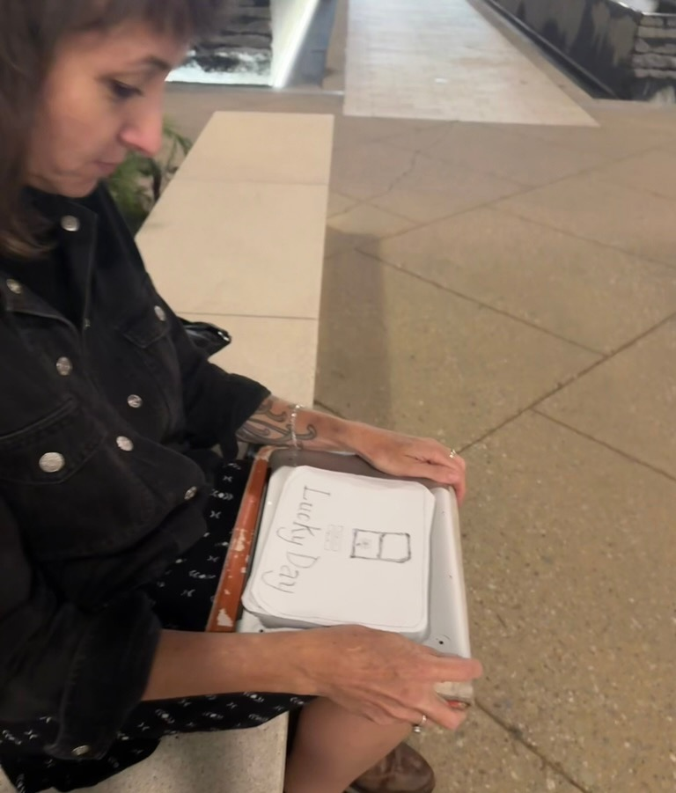
PARTICIPANT 2:
BELLA*
Demographics: age 55+, female, German, fluent in English
Recruitment: cold outreach on street, verbal screening questionnaire
Compensation: none
Environment: in-person; natural setting (outside in public mall)
Apparatus: lofi prototype
*Name changed for anonymity.

Slide 38
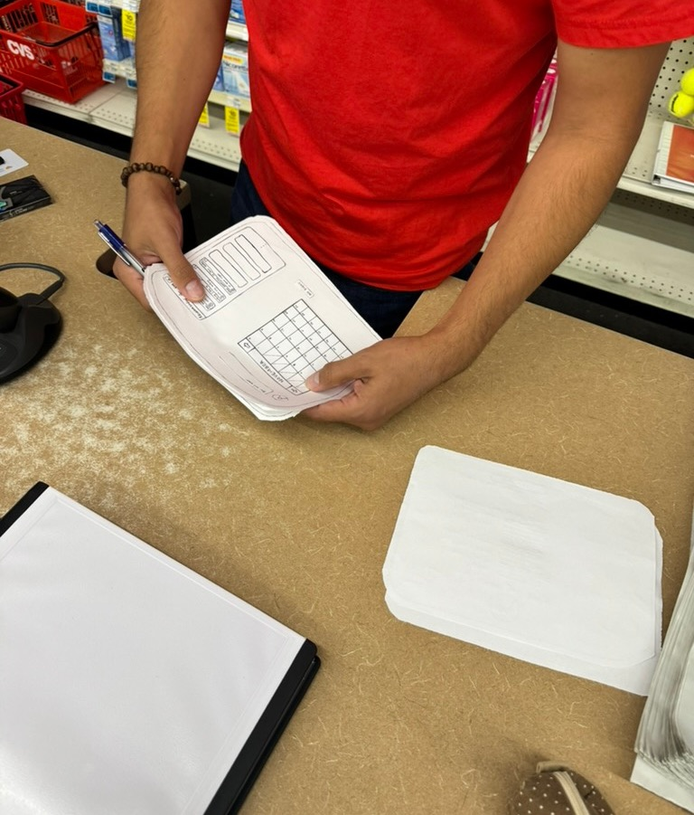
PARTICIPANT 3:
FINN*
Demographics: age 50+, male, half Argentinian and Bolivian, fluent in English
Recruitment: cold outreach on street, verbal screening questionnaire
Compensation: none
Environment: in-person; natural setting; inside store (CVS)
Apparatus: lofi prototype
*Name changed for anonymity.

Slide 39
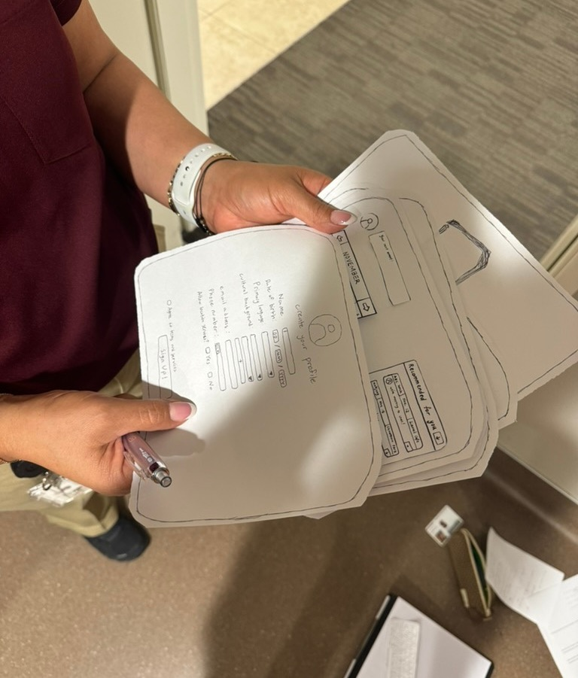
PARTICIPANT 4:
MADDY*
Demographics: age 60+, female, primary language Spanish (not fluent in English)
Recruitment: cold outreach, verbal screening questionnaire
Compensation: none
Environment: in-person; natural setting; at Stanford (EVGR)
Apparatus: lofi prototype
*Name changed for anonymity.

Slide 40
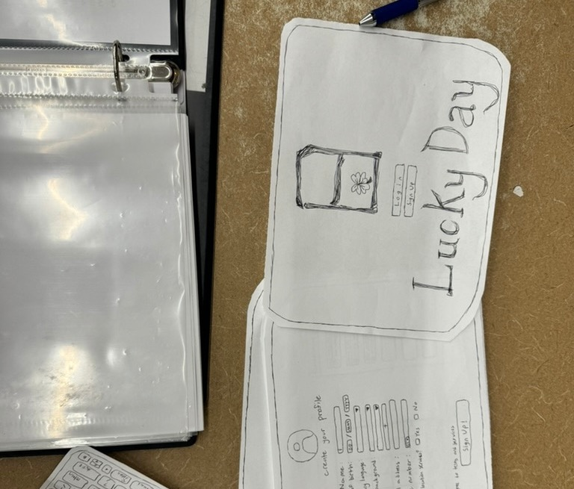
PARTICIPANT 5:
TAY*
Demographics: age 65+, male, Japanese, semi-fluent in English
Recruitment: cold outreach on street, verbal screening questionnaire
Compensation: none
Environment: in-person; natural setting; inside store (CVS)
Apparatus: lofi prototype
*Name changed for anonymity.

Slide 41
TEAM ROLES
Facilitator
Screening questions; explains gist of app; walks user through each task.
Computer/iPad
Moves pieces around; changes user’s screens.
01
03
02
Note-taker
Transcribes interactions and dialogue; records any feedback given by user.
04
Data Collector
Sets a stopwatch to measure how long it takes to complete all tasks. (Can also count how many steps taken to complete each task.)

Slide 42
TEAM ROLES
Facilitator
Round 1: Lianne
Round 2: Clare
Round 3: Ethan
Round 4: Em
Computer/iPad
Round 1: Ethan
Round 2: Em
Round 3: Lianne
Round 4: Clare
01
03
02
Note-taker
Round 1: Clare
Round 2: Ethan
Round 3: Em
Round 4: Lianne
04
Data Collector
Round 1: Em
Round 2: Lianne
Round 3: Clare
Round 4: Ethan

Slide 43
PROCEDURE
Pre-screening/Consent
Begin by asking pre-screening questions (follow script). If participant matches target user profile, provide consent form to sign.
Test Features
Go through screen by screen and have the user test the features on the lofi prototype.
01
03
02
Project Background
Give brief introduction to team and overview of the project/app (according to the script). Outline the three main features that will be tested.
04
Ask for Feedback
Finish by asking for any feedback on design or the user experience and thank them for their time.

Slide 44
USABILITY GOALS
  User can easily navigate between the different sections (calendar view to panel view).
  The text and icon sizes are easily readable for users with varying vision abilities.
  Users can easily recover from mistakes (e.g. press back button).
  Users can complete all three key tasks in a minimal number of steps and amount of time.

Slide 45
  Number of participants who successfully completed all tasks.
  Number of times user asks to go back to a previous screen.
  Amount of time taken for user to complete all tasks.
  Number of times user stops to ask questions.
KEY
METRICS

Slide 46
TESTING
RESULTS

Slide 47
PROCESS DATA
  Engagement: All users were extremely engaged and excited to test out our prototype. They readily gave feedback at the end and wholeheartedly participated.
  Timing: Surprisingly, the screen that took the longest time was the sign-up and profile creation.
  Design: Users appreciated the landscape layout of the app and found all features were easy to navigate since they are on one screen.

Slide 48
BOTTOM- LINE DATA
According to our post-testing verbal feedback survey, all four participants found the app easy to navigate with intuitive features.
Goal 1: Users can easily navigate between different sections of the app.

Slide 49
BOTTOM- LINE DATA
According to our post-testing verbal feedback survey, two of four participants wished the text was larger. There were no comments about changing the icon sizes.
Goal 2: The text and icon sizes are easily readable for users with varying vision abilities.

Slide 50
BOTTOM- LINE DATA
None of our four participants made any mistakes in completing the tasks. We provided a back and cancel button in the event of a mistake, but neither were used during testing.
Goal 3: Users can easily recover from mistakes (e.g. press back button).

Slide 51
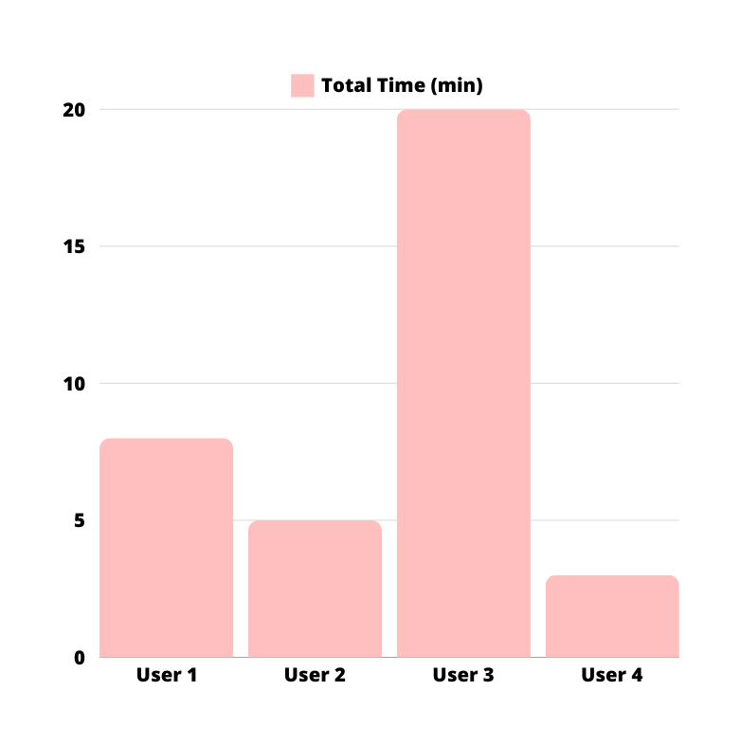
BOTTOM- LINE DATA
Goal 4: Users can complete all three key tasks in a minimal number of steps and amount of time.
*User 3 was on shift and pre-occupied during our testing, leading to an outlying high data point.

Slide 52
  “Cultural background” can be confusing for users, especially if they identify with multiple countries and cultures.
  For those hosting events, would like to have a funding/pooling option to pay for venues and other costs.
ADDITIONAL
OBSERVATIONS

Slide 53
  Front logo was pressed like a button (is not actually a button) on the login/sign-up page.
  Would like to invite friends to events and wonders how to message people on app.
  Users either hold iPad up in the air to read screen or put it down on table to type.
ADDITIONAL
OBSERVATIONS

Slide 54
HOW DID WE DO?
Overall, our lofi prototype was a success since all four participants completed all tasks. Users found it intuitive to use and understood the different parts of the screen. When in an undistracted environment, the tasks took a reasonable time to complete. No major mistakes were made. Some text was hard to read, so we will enlarge all text on the app.

Slide 55
IMPLICATIONS

Slide 56
IMPLICATIONS
The fact that all participants completed the tasks without major mistakes indicates that the interface design is user-friendly and intuitive. This suggests that future iterations should maintain this simplicity to ensure a positive user experience.

Slide 57
IMPLICATIONS
The users' ability to understand different parts of the screen highlights the effectiveness of the current layout and visual hierarchy. Any new features or elements introduced should align with this intuitive understanding to avoid confusion.

Slide 58
IMPLICATIONS
The user’s environment factors into the usability of the app. If the user is in a distracted environment, they may find it difficult to handle the features of the app. We can have the app automatically save any progress and send gentle reminders to remind the user they have an ongoing task/event to finish adding/creating.

Slide 59
FEEDBACK
CHANGES
  “It’s hard to read some text.”
  “‘Cultural background’ on sign-up page is confusing.”
  “What if I don’t want location services on?”
  “The calendar takes up a lot of space when I can see the event on the panel without the whole calendar.”
  Enlarge font on all text.
  Allow user to choose as many cultures as wanted.
  Create option to manually put in address/location.
  Potentially consider shrinking the calendar when using side panel.

Slide 60
  Did not reveal how people react when users make mistakes.
  Did not a to manage the cold start problem (especially for users who are interested in more uncommon cultures in their area)
TESTING LIMITATIONS

Slide 61
APPENDIX

Slide 62
FULL LIST OF PROS/CONS

Slide 63
PRO
CON
RING PROJECTOR
  Straightforward and serves a single purpose, making it easy to learn and use.
  Helps seniors avoid getting lost by providing simple, step-by-step directions.
  Especially helpful for those who can’t read signs in English.
  Location-based design that facilitates finding events in a physical space
  Location services for seniors to navigate streets and for caretakers to track them
  Allows seniors to navigate even in newer locations, familiarize them with routes they aren’t already used to so they can attend new events
  Not enough information for joining, posting, or searching for events.
  Would function better as an extension to existing infrastructure rather than a standalone device.
  Device too small for seniors to read directions.
  UI difficult to navigate and construct
  Intimidating technology- ring wearable too newfound for older adults
  Accessibility and relevancy- not many seniors use wearables / affordability
  Prone to damage or loss due to size and wear
  Single-function device would not be popular
  Difficult to wear for seniors with rheumatoid and vascular conditions

Slide 64
PRO
CON
IPAD APP
  Can use while propped up on a stand or in a case (comfortable for at home use).
  Easier for typing; less frustrating than small keyboard on phone.
  Large surface allows for more features on the screen and larger text (easier to see).
  Relevancy- seniors utilise iPads for ease of use over mobile devices
  Universal popularity of iPads/tablets amongst seniors
  Bulkier and less convenient to carry around an iPad.
  Potentially no access to data while in transit, which could be crucial for last-minute updates or changes to events.
  Less hands-free usage; needs more user interaction.
  Accessibility- not all have the ability to afford iPad
  Requires more tech literacy
  On-the-go usage may cause dangers for seniors (lower situational awareness during usage)

Slide 65
SCRIPTS

Slide 66
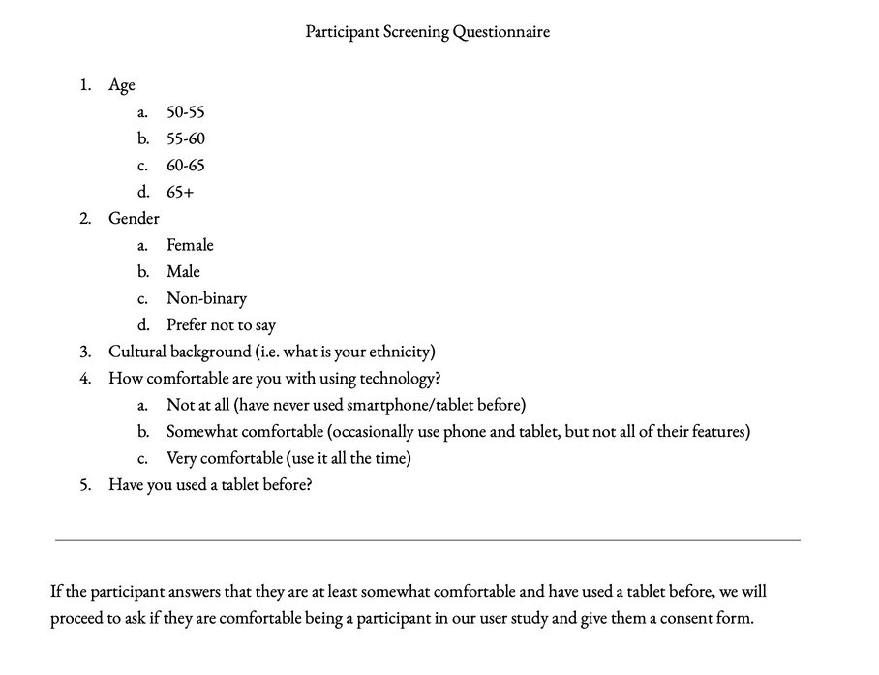
SCREENING QUESTIONNAIRE
Questions asked:
  Age?
  Gender?
  Cultural background?
  Familiarity with technology?
  Use of tablet?
If the participant answers that they are at least somewhat comfortable and have used a tablet before, we will proceed to ask if they are comfortable being a participant in our user study and give them a consent form.

Slide 67
DEMO SCRIPT
Hi, my name is ____. I’m a student at Stanford working on a project to design a social event calendar app for seniors. Do you have 5-10 minutes to help test out our initial prototype?
Thanks so much for helping out! I would love to get to know you a bit better before starting, do you mind if I ask a few preliminary questions? You don’t have to answer anything you aren’t comfortable with.
First, can I get your name?
So nice to meet you, ____! Since we’re running a product for seniors, do you mind telling me how old you are or what age range you’re in?
Our app also has special features regarding selecting what cultural events you might be interested in. I’d love to know where you’re from and what your cultural background is.
Just a couple last questions… how comfortable are you with technology and have you used an iPad or some sort of tablet before?
(If they answer “no,” can try to compare usage to a smartphone, but otherwise it might be a bit difficult to continue. Can just say “thank you for your time and chatting with me.”)
Great! Glad to hear that you’re already familiar with using tablets. Before we begin testing, do you mind filling out this consent form? It outlines what kind of data we might collect and what it’ll be used for. In today’s testing experience, we won’t be audio recording or video recording, but we might take some pictures and will be taking notes if you are comfortable with that.
Thank you for signing the consent form! As a quick overview of what we’ll be doing today, we’ve created a mock up of our app on paper to test its most important features and see if they’re intuitive for the user. The app will be a social calendar for seniors with language support and culturally-tailored activities, enabling seniors to easily discover, join, and organize events that resonate with their cultural background. The three features we will have you test are (0) signing up from the main page, (1) viewing and adding events to your calendar, (2) swiping through to the following month and tapping on a new day to pull up more recommended events and then adding a non-cultural event, and (3) creating and publishing your own event with the right tags.
(At this point, hand over the prototype and see if they can figure it out. Give them reminders what task they are completing and explain the next one after they finish each task.)

Slide 68
LOG OF CRITICAL EVENTS

Slide 69
CRITICAL EVENTS
(2) “I’d rather see what I’m signing up for than the big calendar on most screens.” (Bella)
(2) “I’m Argentinian and Bolivian and I’d want to go to both kinds of events if I can select multiple cultures.” (Finn)
(1) “I want to go shopping and invite friends over to cook. Can there be a feature to add money to help fund the event?” (Valerie)
(0) “I really like the ‘your next event’ pop up so that I don’t have to go to a separate screen to see it.” (Finn)
(0) “I wanna play mahjong! Do you play mahjong?” (Valerie)

Slide 70
ADDITIONAL
FIGURES

Slide 71
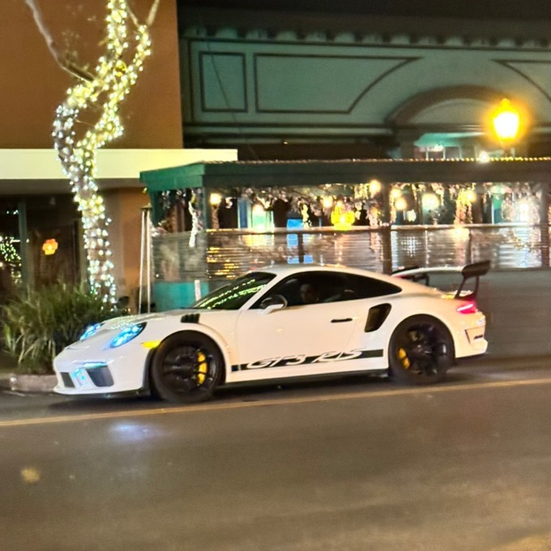
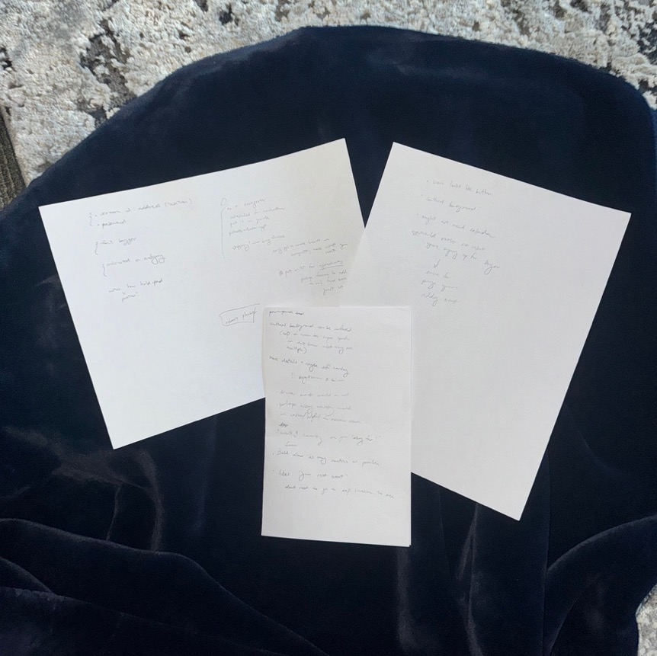
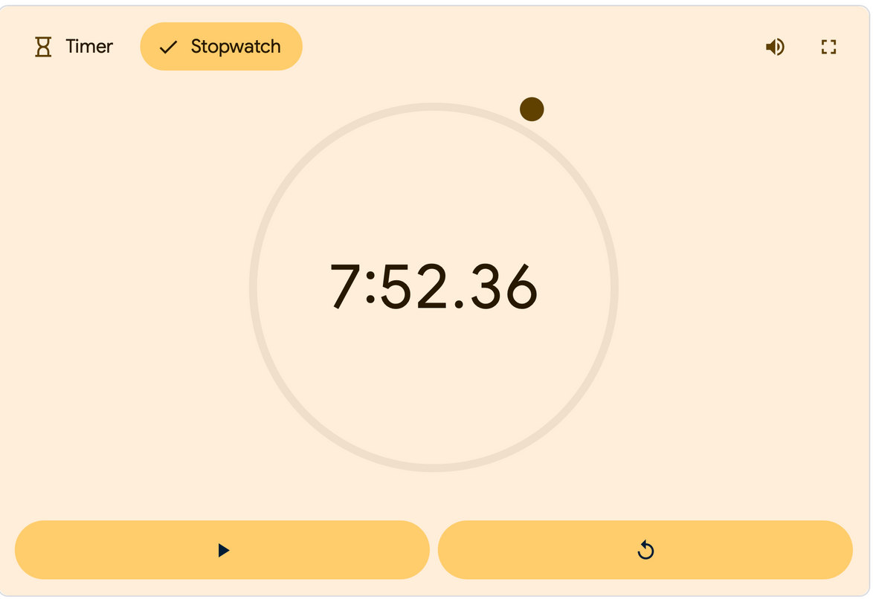
Time-keeping for participant 1 during testing to complete all tasks.
Feedback notes from testing. (Summarized in slides.)
Very nice GT3RS we saw on the street while scouting for old people.

