Slide 1

A6: Lucky Day
Lianne Cha, Ethan Bell, Em Ho, Clare Chua

Slide 2
Team Members
Ethan Bell
Lianne Cha
Em Ho
Clare Chua
Class of 2025
Major in Computer Science and Digital Health
Class of 2026
Major in Computer Science
Class of 2025
Major in Computer Science
Class of 2024
Major in SymSys
Coterm in CS

Slide 3
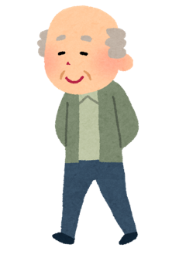
Dementia Prevention

Slide 4
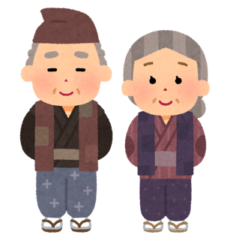
Problem Statement
Older adults who face language barriers and cultural differences struggle to find social connection in their communities
Loneliness and higher risk of dementia and cognitive disorders

Slide 5

Connecting Hearts, Protecting Minds

Slide 6
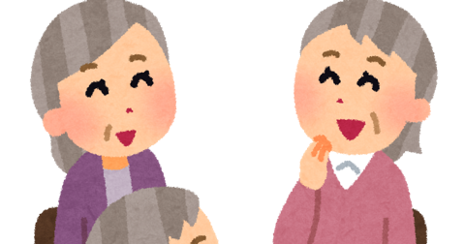
Value Proposition
Helping seniors build new friendships and find connection through culturally aligned events and activities

Slide 7

Solution
A tablet app for seniors offering a social calendar with language support and culturally-tailored activities
Fosters social connections to prevent the onset of dementia and cognitive disorders
Enables seniors to easily discover, join, and organise events that resonate with their cultural background

Slide 8
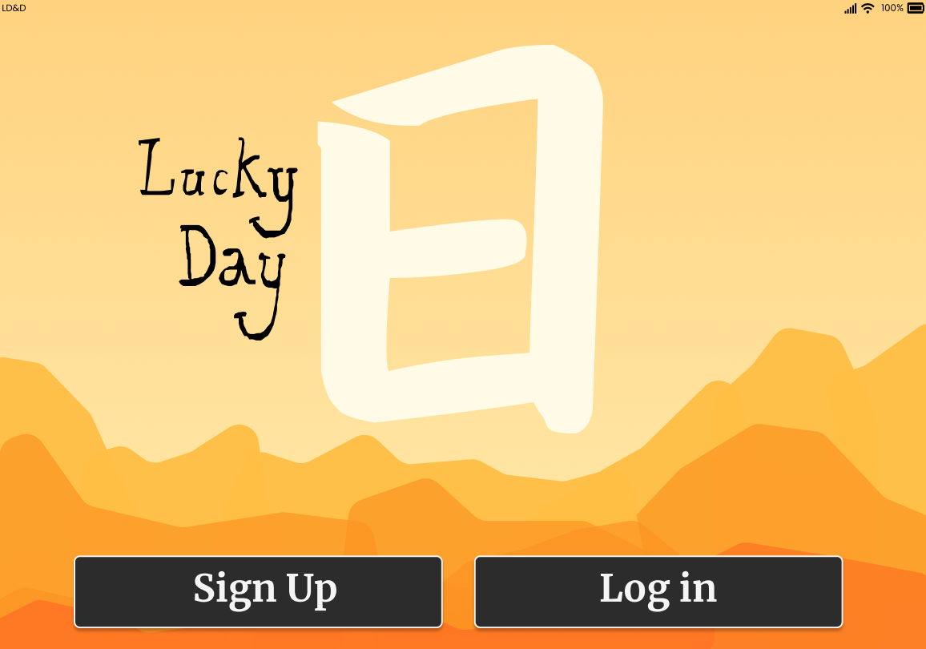
Design Values
Accessibility and readability
Minimal screen changes - static screens
Help and assistance, clarity
Match to the real world
Error prevention and having events happen

Slide 9
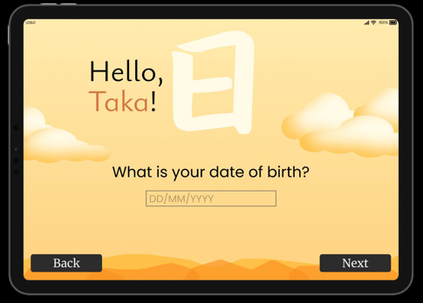
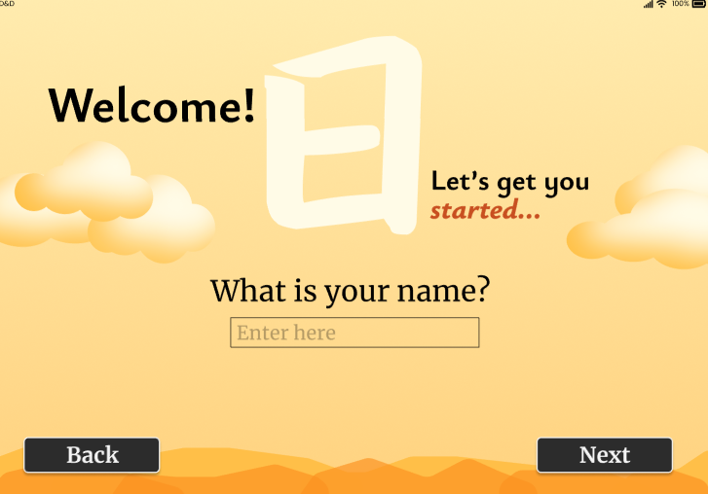
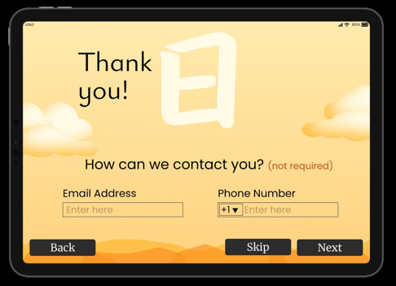
Help and documentation
Accessibility / navigability

Slide 10
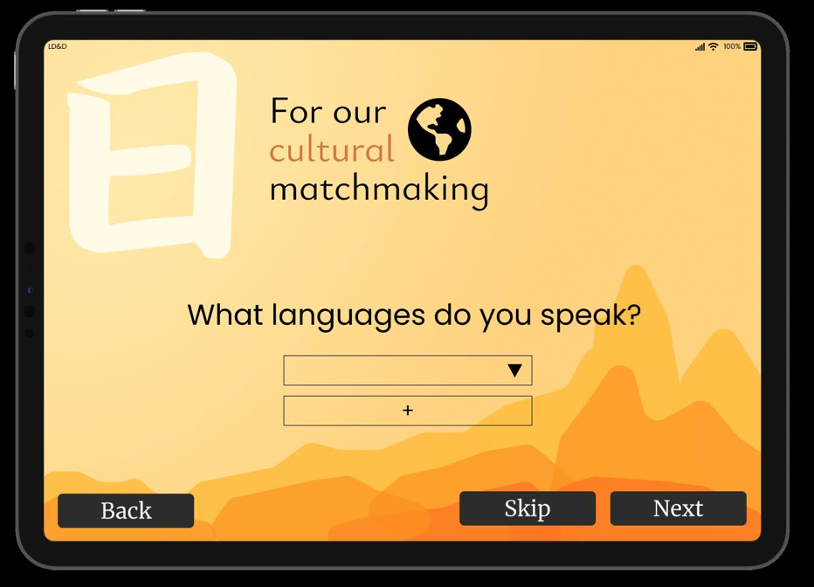
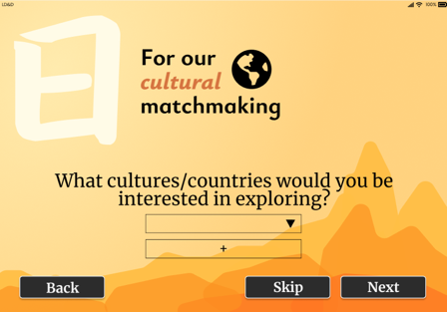
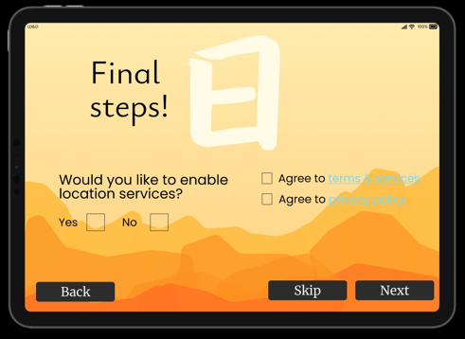
Clarity
Error prevention

Slide 11
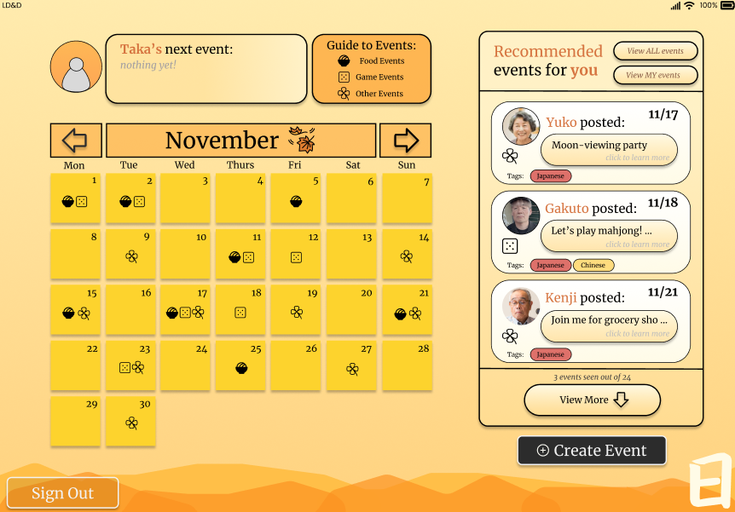
Match to real world
Calendar
Static Screens
Unchanging
Accessibility
Large buttons, icons, clear format for seniors

Slide 12
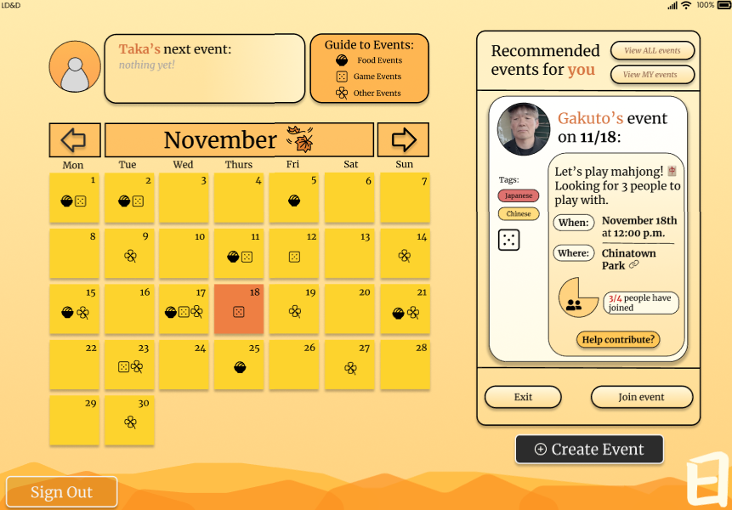
Error Prevention
Exit buttons, large- multiple ways to exit
Recognition
Repetition of information

Slide 13
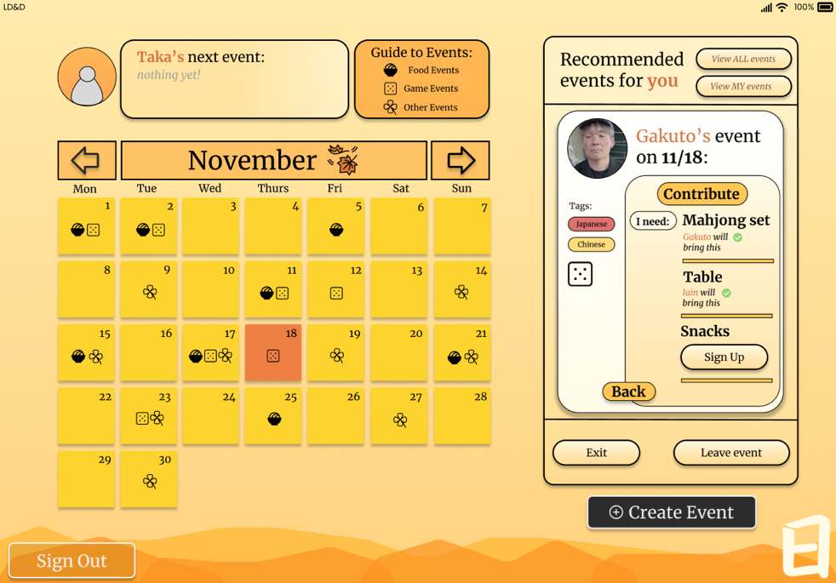
Having events happen
Contributions, status, and ease of joining

Slide 14
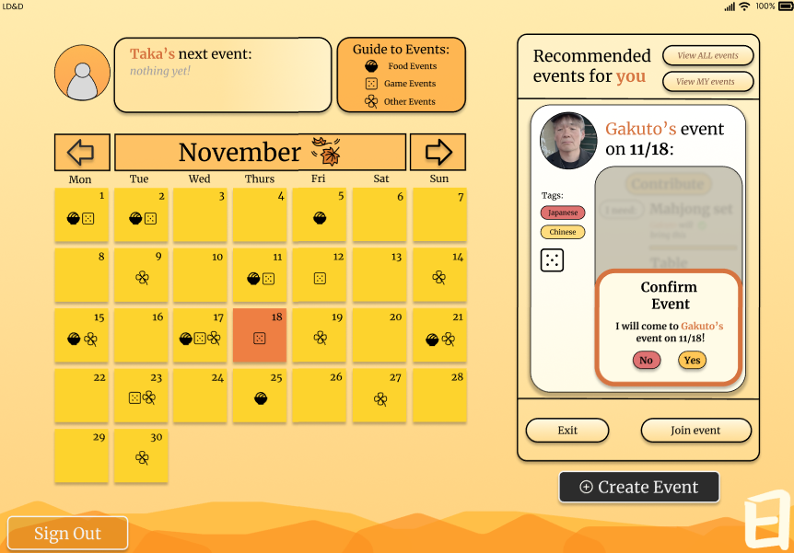
Value Tensions
Navigability made more difficult as a result of static screens
Unnecessary use of space for real world matching- less clear?
Accessibility vs. Accessibility (more inviting to specific demographic)

Slide 15
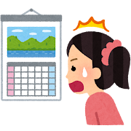
Tasks
Simple Task
Changes from
Assignment 5
Add events
Combined moderate and simple task into one task
More specific actions user takes to add task
User starts on main page- then views and adds culturally based recommended events onto any given day
Notes:
Old task - User starts on the main page and adds recommended events onto any given day

Slide 16
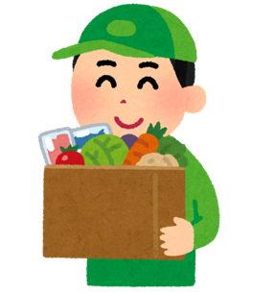
Tasks
Moderate Task
Changes from
Assignment 5
Contribute to Events
Feedback from low-fi to add contributions / pooling
Used less frequently than culturally-based event search
After adding event to their calendar, the user clicks to contribute supplies to the event
Notes:
Old- User starts on the main page and swipes through to the following month and taps on a new day to pull up more recommended events. They add a recommended event and then change to all events tab and add a non-cultural event

Slide 17

Tasks
Complex Task
Changes from
Assignment 5
Create event
More concise description of task
Removed part about finding an empty time slot
User starts on main page, then clicks “Create Event” to create and tag an event with appropriate descriptors, including contributions
Notes:
Old - user starts on the main page and picks a specific day and looks at what events are going on / might conflict. They find an empty time slow and click the “new event” button. They create and publish their own event and add appropriate tags for the algorithm to sort it. They go back to the main page and see their event on the right list + add it to their own calendar.

Slide 18
Usability Goals
The text and icon sizes are easily readable for users with varying vision abilities.
Used iPad Type size xxxLarge for easily readability. Small number (3-4) main icons used to prevent confusion and flatten the learning curve.
Users can easily recover from mistakes.
We implemented a back button (and other exit buttons) so that the user can fix any mistakes they made. These buttons are large and there are multiple ways to click out of a screen.
However, we still want to minimize the number of times they ask to go back by having a clear interface.

Slide 19
Key Metrics
Our medfi prototype features many more features compared to our bare bones lofi prototype (toggling views on the side panel, contributing to an event, etc.). We kept our original, simple interface with clear directions for each task, so despite the added features, we want a high ratio for users completing all tasks vs. not.
Number of participants who successfully completed all tasks.
Number of times user stops to ask questions.
We will later implement a “help” and a “tutorial” feature in our final product.

Slide 20
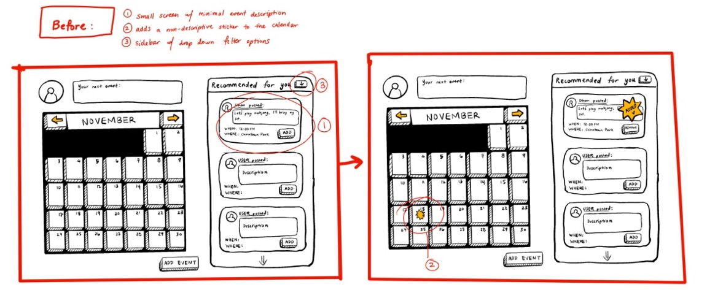
Interface changes
Notes:
Old - user starts on the main page and picks a specific day and looks at what events are going on / might conflict. They find an empty time slow and click the “new event” button. They create and publish their own event and add appropriate tags for the algorithm to sort it. They go back to the main page and see their event on the right list + add it to their own calendar.

Slide 21
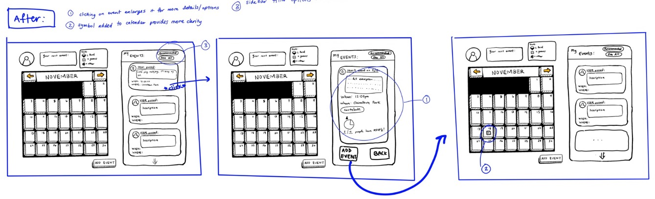
Interface changes
Notes:
Old - user starts on the main page and picks a specific day and looks at what events are going on / might conflict. They find an empty time slow and click the “new event” button. They create and publish their own event and add appropriate tags for the algorithm to sort it. They go back to the main page and see their event on the right list + add it to their own calendar.

Slide 22
Interface changes
Allowing users to skip information
Less wasted space (while avoiding clutter), especially pertaining to the calendar
More functionality to the calendar - navigating through this interface
Rewording of cultural questions, ability to add more than one
Sidebar utility- less complex sorting algorithms
Option to contribute to events (request and sign up for items)
More obvious buttons
Vibrant background and design
Notes:
Old - user starts on the main page and picks a specific day and looks at what events are going on / might conflict. They find an empty time slow and click the “new event” button. They create and publish their own event and add appropriate tags for the algorithm to sort it. They go back to the main page and see their event on the right list + add it to their own calendar.

Slide 23

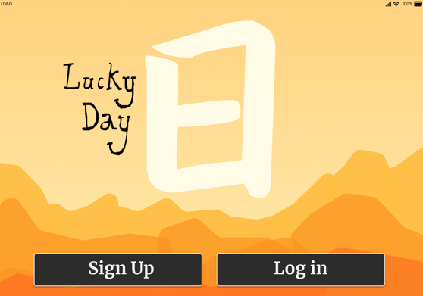
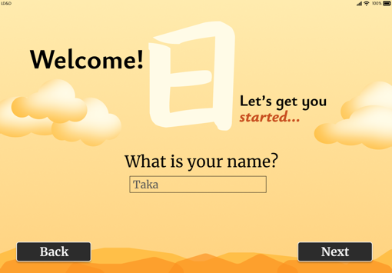
Task Flow: Simple task
Populated on click for ease of prototyping
User “logs in”, enters in personal information
Notes:
Old - user starts on the main page and picks a specific day and looks at what events are going on / might conflict. They find an empty time slow and click the “new event” button. They create and publish their own event and add appropriate tags for the algorithm to sort it. They go back to the main page and see their event on the right list + add it to their own calendar.

Slide 24
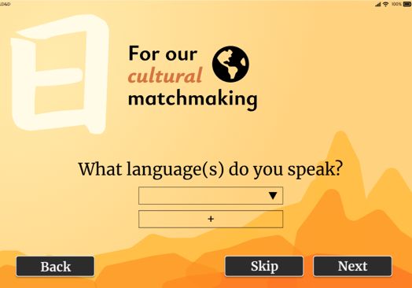
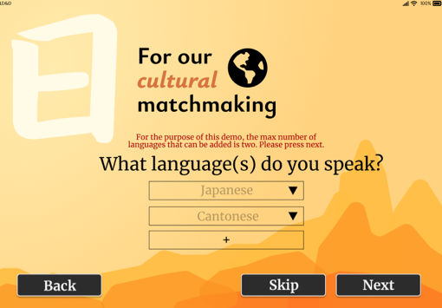
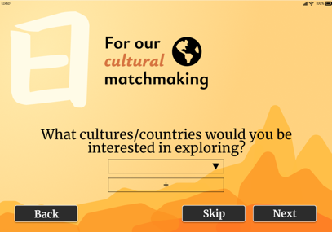
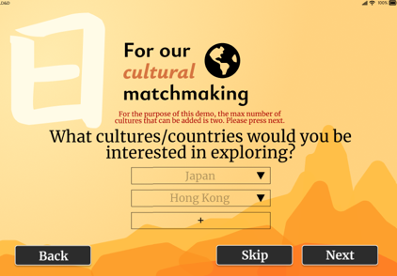
Task Flow: Simple task
Error message to guide user- “Wizard of Oz”
Onboarding screens, for cultural event matchmaking
Skip button allows user to withhold personal information
User enters from dropdown menu- can add more than one
Notes:
Old - user starts on the main page and picks a specific day and looks at what events are going on / might conflict. They find an empty time slow and click the “new event” button. They create and publish their own event and add appropriate tags for the algorithm to sort it. They go back to the main page and see their event on the right list + add it to their own calendar.

Slide 25

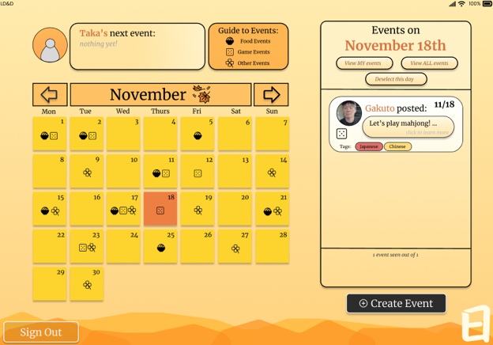
Task Flow: Simple task
Use of icons for tagging events
Can sort to all or my events
Can click on calendar date for navigation
Day highlighted, calendar functionality
Sidebar now displays events for this specific day
Post sign-up screen, culturally recommended events displayed in sidebar
Notes:
Old - user starts on the main page and picks a specific day and looks at what events are going on / might conflict. They find an empty time slow and click the “new event” button. They create and publish their own event and add appropriate tags for the algorithm to sort it. They go back to the main page and see their event on the right list + add it to their own calendar.

Slide 26



Task Flow: Simple task
Use of icons for tagging events
Click to see more
Screen that grants more information on the event and ability to join event
Event details are displayed on the sidebar
Notes:
Old - user starts on the main page and picks a specific day and looks at what events are going on / might conflict. They find an empty time slow and click the “new event” button. They create and publish their own event and add appropriate tags for the algorithm to sort it. They go back to the main page and see their event on the right list + add it to their own calendar.

Slide 27

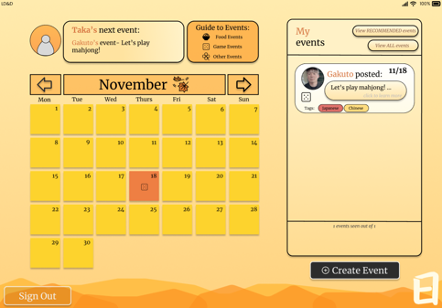
Task Flow: Simple task
Confirm joining event
Can exit or leave event at any step
Navigate to
“My events”
Your next event now displayed at the top of the screen
Join event directly
Event is now added to your calendar!
Notes:
Old - user starts on the main page and picks a specific day and looks at what events are going on / might conflict. They find an empty time slow and click the “new event” button. They create and publish their own event and add appropriate tags for the algorithm to sort it. They go back to the main page and see their event on the right list + add it to their own calendar.

Slide 28
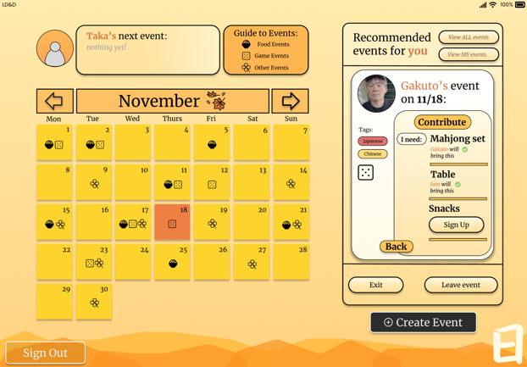
Task Flow: Moderate task
Contributions that are already made are listed
Sidebar now displays contributions needed for the event
Sign up for contribution
Click “help contribute?”
Notes:
Old - user starts on the main page and picks a specific day and looks at what events are going on / might conflict. They find an empty time slow and click the “new event” button. They create and publish their own event and add appropriate tags for the algorithm to sort it. They go back to the main page and see their event on the right list + add it to their own calendar.

Slide 29
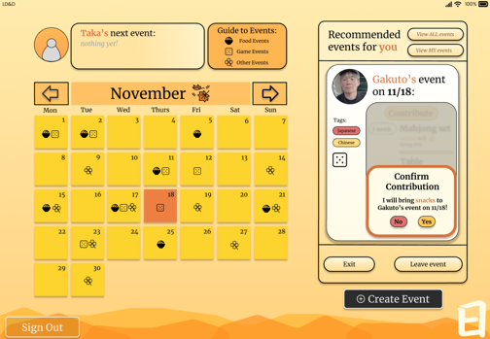
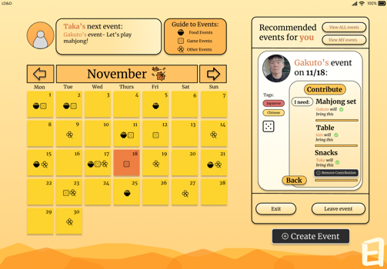
Task Flow: Moderate task
Will ask to confirm contribution, and will include contribution in updated sidebar
Confirm contribution
Sign up for contribution
Can go back and return to general event information
Can remove contribution
Notes:
Old - user starts on the main page and picks a specific day and looks at what events are going on / might conflict. They find an empty time slow and click the “new event” button. They create and publish their own event and add appropriate tags for the algorithm to sort it. They go back to the main page and see their event on the right list + add it to their own calendar.

Slide 30

Task Flow: Moderate task
Contribution is confirmed and made, moderate task complete
Can remove contribution
Notes:
Old - user starts on the main page and picks a specific day and looks at what events are going on / might conflict. They find an empty time slow and click the “new event” button. They create and publish their own event and add appropriate tags for the algorithm to sort it. They go back to the main page and see their event on the right list + add it to their own calendar.

Slide 31
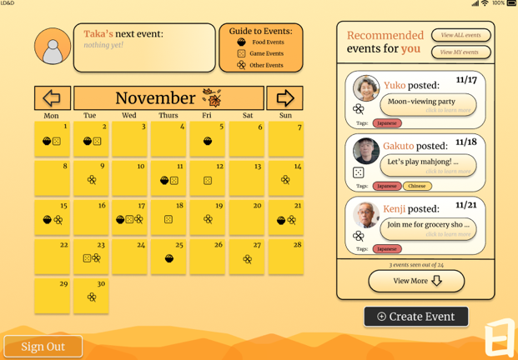
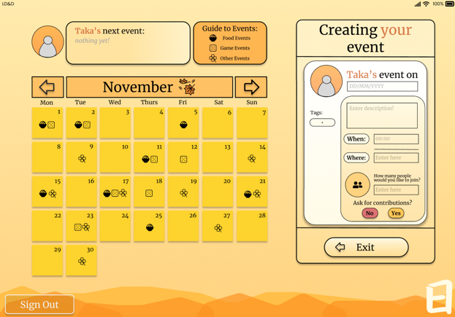
Task Flow: Complex task
Structure is same as viewing an event, but with left blanks
Sidebar now displays information needed to create an event
Can return to main screen at any time
Click “create event” (will work for any given page)
Notes:
Old - user starts on the main page and picks a specific day and looks at what events are going on / might conflict. They find an empty time slow and click the “new event” button. They create and publish their own event and add appropriate tags for the algorithm to sort it. They go back to the main page and see their event on the right list + add it to their own calendar.

Slide 32
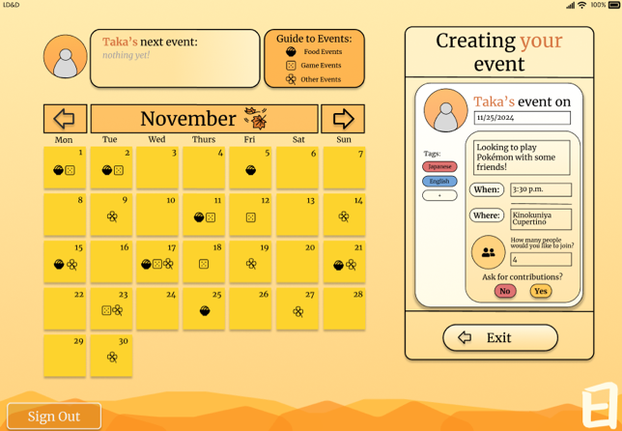
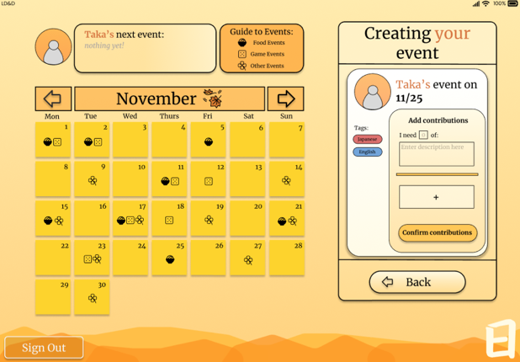
Task Flow: Complex task
Add your own language / cultural tags
Empty blanks left for user to populate
Sidebar now displays guide on how to request a contribution
Request (or don’t) contributions for navigation
Can navigate back to main creation screen
Populate blanks with information on time, location, etc.
Notes:
Old - user starts on the main page and picks a specific day and looks at what events are going on / might conflict. They find an empty time slow and click the “new event” button. They create and publish their own event and add appropriate tags for the algorithm to sort it. They go back to the main page and see their event on the right list + add it to their own calendar.

Slide 33

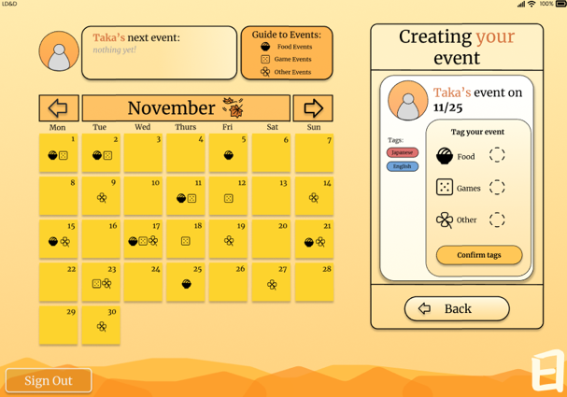
Task Flow: Complex task
User can populate contributions
Sidebar now displays how to add tags for event sorting (icons)
Confirm contributions to navigate
Add as many contributions as required
Can select tags from three choices to categorise event
Notes:
Old - user starts on the main page and picks a specific day and looks at what events are going on / might conflict. They find an empty time slow and click the “new event” button. They create and publish their own event and add appropriate tags for the algorithm to sort it. They go back to the main page and see their event on the right list + add it to their own calendar.

Slide 34
Task Flow: Complex task
User can populate contributions
Can select tags from three choices to categorise event
Sidebar now displays how to add tags for event sorting (icons)
Confirm contributions to navigate
Add as many contributions as required
Confirm tags to navigate to next screen
Notes:
Old - user starts on the main page and picks a specific day and looks at what events are going on / might conflict. They find an empty time slow and click the “new event” button. They create and publish their own event and add appropriate tags for the algorithm to sort it. They go back to the main page and see their event on the right list + add it to their own calendar.

Slide 35
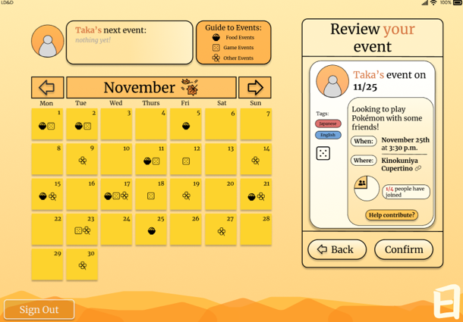
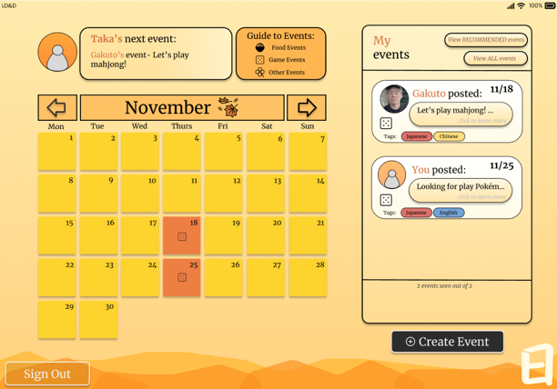
Task Flow: Complex task
With all steps complete, can now review your event from the POV of another user!
My events now display your own created event, event is now published, complex task complete
Your own event
Tags and information entered are displayed in correct format
Confirm to complete creation of event
Highlighted on calendar alongside attending events
Notes:
Old - user starts on the main page and picks a specific day and looks at what events are going on / might conflict. They find an empty time slow and click the “new event” button. They create and publish their own event and add appropriate tags for the algorithm to sort it. They go back to the main page and see their event on the right list + add it to their own calendar.

Slide 36
Tool Used: Figma
pros
cons
Many built-in prototype functions, such as viewing/testing on iPad screen
Ability to reuse screens/buttons
Navigational ability to connect to different screens to provide a smooth user experience
Can collaborate in real time with team
Inability to simulate many user paths (takes too many transitions)
User can’t provide typed input
Animations/transitions are difficult to include or difficult to smooth out
Difficult to track user status for prototype testing

Slide 37
Limitations
Difficult to create unique user paths for every event listed
General app continuity, notably with the “updating” of certain screens or navigations
No translate feature for those that can’t speak English (to come in high-fi!)
Many links go to “under construction” page since we can’t simulate ever possible user path yet
Information like “your next event”, or “my events”, are dependent on user path (view slides about hard-coding)
Force the user to navigate one path, notably joining one specific event
Notes:
Old - user starts on the main page and picks a specific day and looks at what events are going on / might conflict. They find an empty time slow and click the “new event” button. They create and publish their own event and add appropriate tags for the algorithm to sort it. They go back to the main page and see their event on the right list + add it to their own calendar.

Slide 38
Hard-coded Features
Force users to undergo a pre-set path
The navigable day on the calendar (Nov 18th) – User may only explore events on this day
The functional event (Gakuto’s) – User may only explore details of this event
User information: name, email, phone number, cultural interests, language spoken
Notes:
Old - user starts on the main page and picks a specific day and looks at what events are going on / might conflict. They find an empty time slow and click the “new event” button. They create and publish their own event and add appropriate tags for the algorithm to sort it. They go back to the main page and see their event on the right list + add it to their own calendar.

Slide 39
Wizard-of-Oz Features
“Compiling Events” page for a pre-set user
Error messages
“Please add an option from the dropdown menu before adding another!”
“Please fill in your name before clicking next!”
Provides the illusion of a backend system that is analysing input to create a set of recommended events for the given user
“For the purpose of this demo, the max number of languages that can be added is two. Please press next.”
Notes:
Old - user starts on the main page and picks a specific day and looks at what events are going on / might conflict. They find an empty time slow and click the “new event” button. They create and publish their own event and add appropriate tags for the algorithm to sort it. They go back to the main page and see their event on the right list + add it to their own calendar.

Slide 40
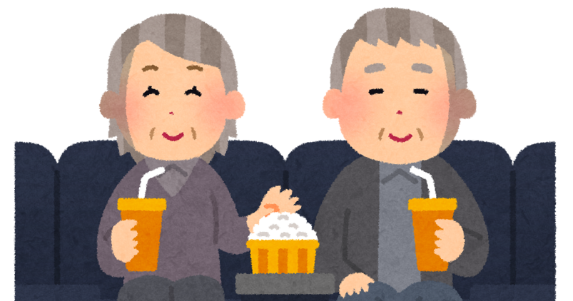
Appendix

Slide 41
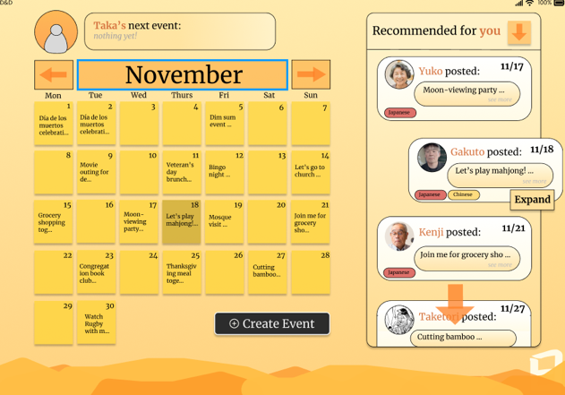

Interface sketches
Kept events within the sidebar to save space and improve readability
Changed from words to icons on calendar for simpler view
Text consistency and more obvious buttons / scrolling
Notes:
Old - user starts on the main page and picks a specific day and looks at what events are going on / might conflict. They find an empty time slow and click the “new event” button. They create and publish their own event and add appropriate tags for the algorithm to sort it. They go back to the main page and see their event on the right list + add it to their own calendar.

Slide 42
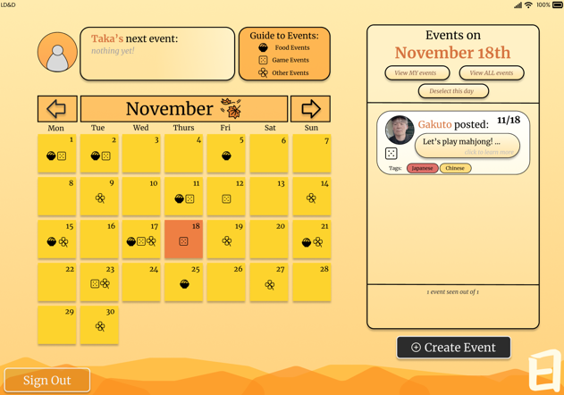
Interface sketches
Increase calendar functionality - can navigate to events by clicking on calendar date
Notes:
Old - user starts on the main page and picks a specific day and looks at what events are going on / might conflict. They find an empty time slow and click the “new event” button. They create and publish their own event and add appropriate tags for the algorithm to sort it. They go back to the main page and see their event on the right list + add it to their own calendar.

Slide 43
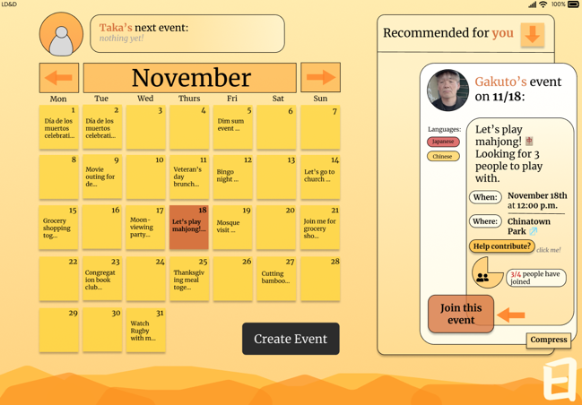

Interface sketches
Buttons are same size and more obvious- critique from class
Changed to keep event within the sidebar, more readable and digestible interface
Notes:
Old - user starts on the main page and picks a specific day and looks at what events are going on / might conflict. They find an empty time slow and click the “new event” button. They create and publish their own event and add appropriate tags for the algorithm to sort it. They go back to the main page and see their event on the right list + add it to their own calendar.

Slide 44
https://www.figma.com/proto/d4G9IO108N2zY6Y4NtvP9m/Lucky-Day?node-id=72-1035&t=iQ4SPLhYBb7tVlfO-1
Link to Figma

