Slide 1



Lo-fi Prototyping
ConcertBuds
Henry Greenman
Izzy Meyerson
Sarah Teaw
Matthew Vilaysack
Make your commute part of the concert

Slide 2
Connect with concert-goers on your ride and start the fun before the show!
Our app connects you with fellow concert-goers on the same public transport, so you can share the ride, plan meetups, and start the party early.
Value Proposition

Slide 3
Problem
Solution
Problem/solution overview
Concert goers have trouble finding people to go to concerts with.
ConcertBuds connects people in near proximity going to the same concert to share a commute—and memories.

Slide 4
Outline of Talk
01
02
03
04
05
06
07
08
Concept Sketches
Selected Solution
Low-fi Prototype
Task Flows
Testing Methodology
Testing Results
Discussion
Appendix

Slide 5
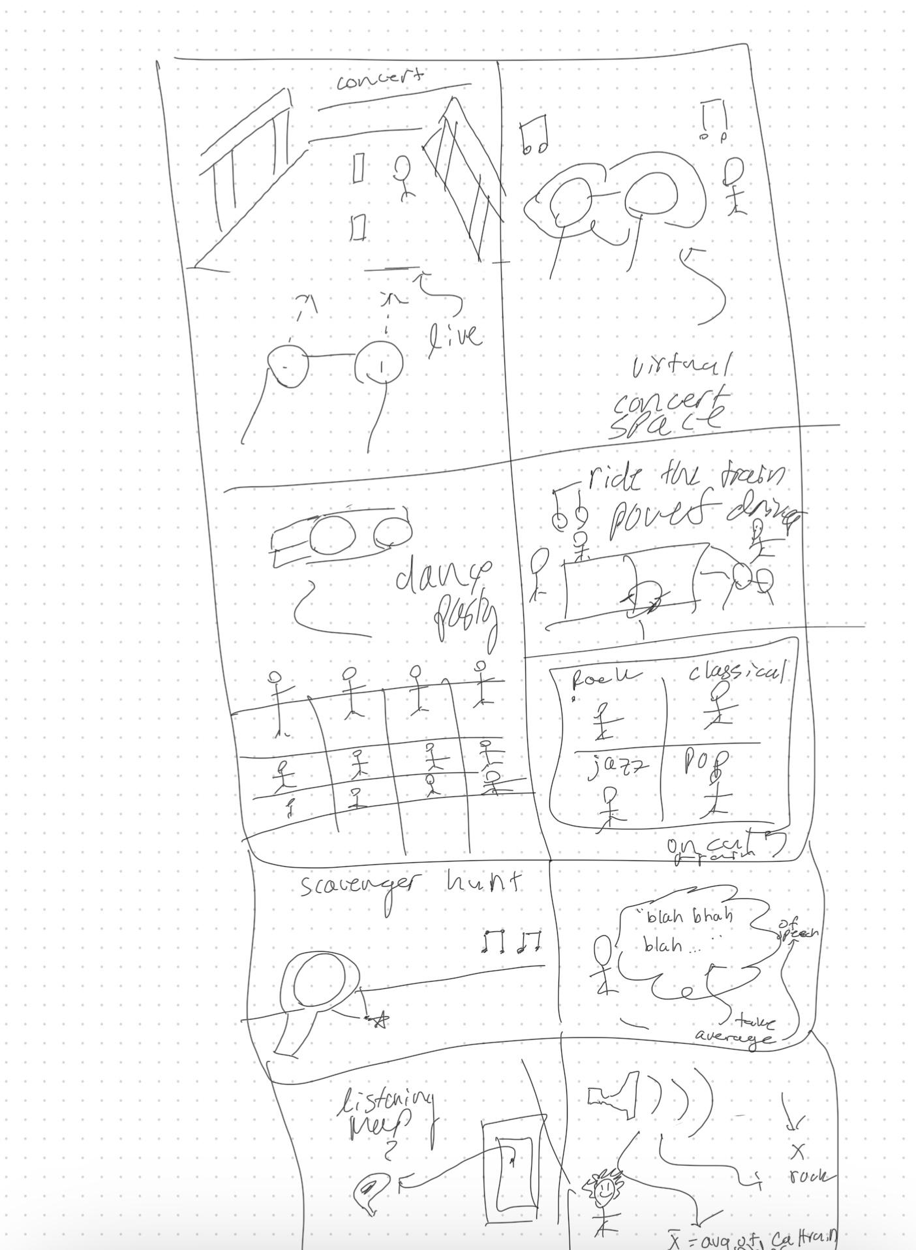
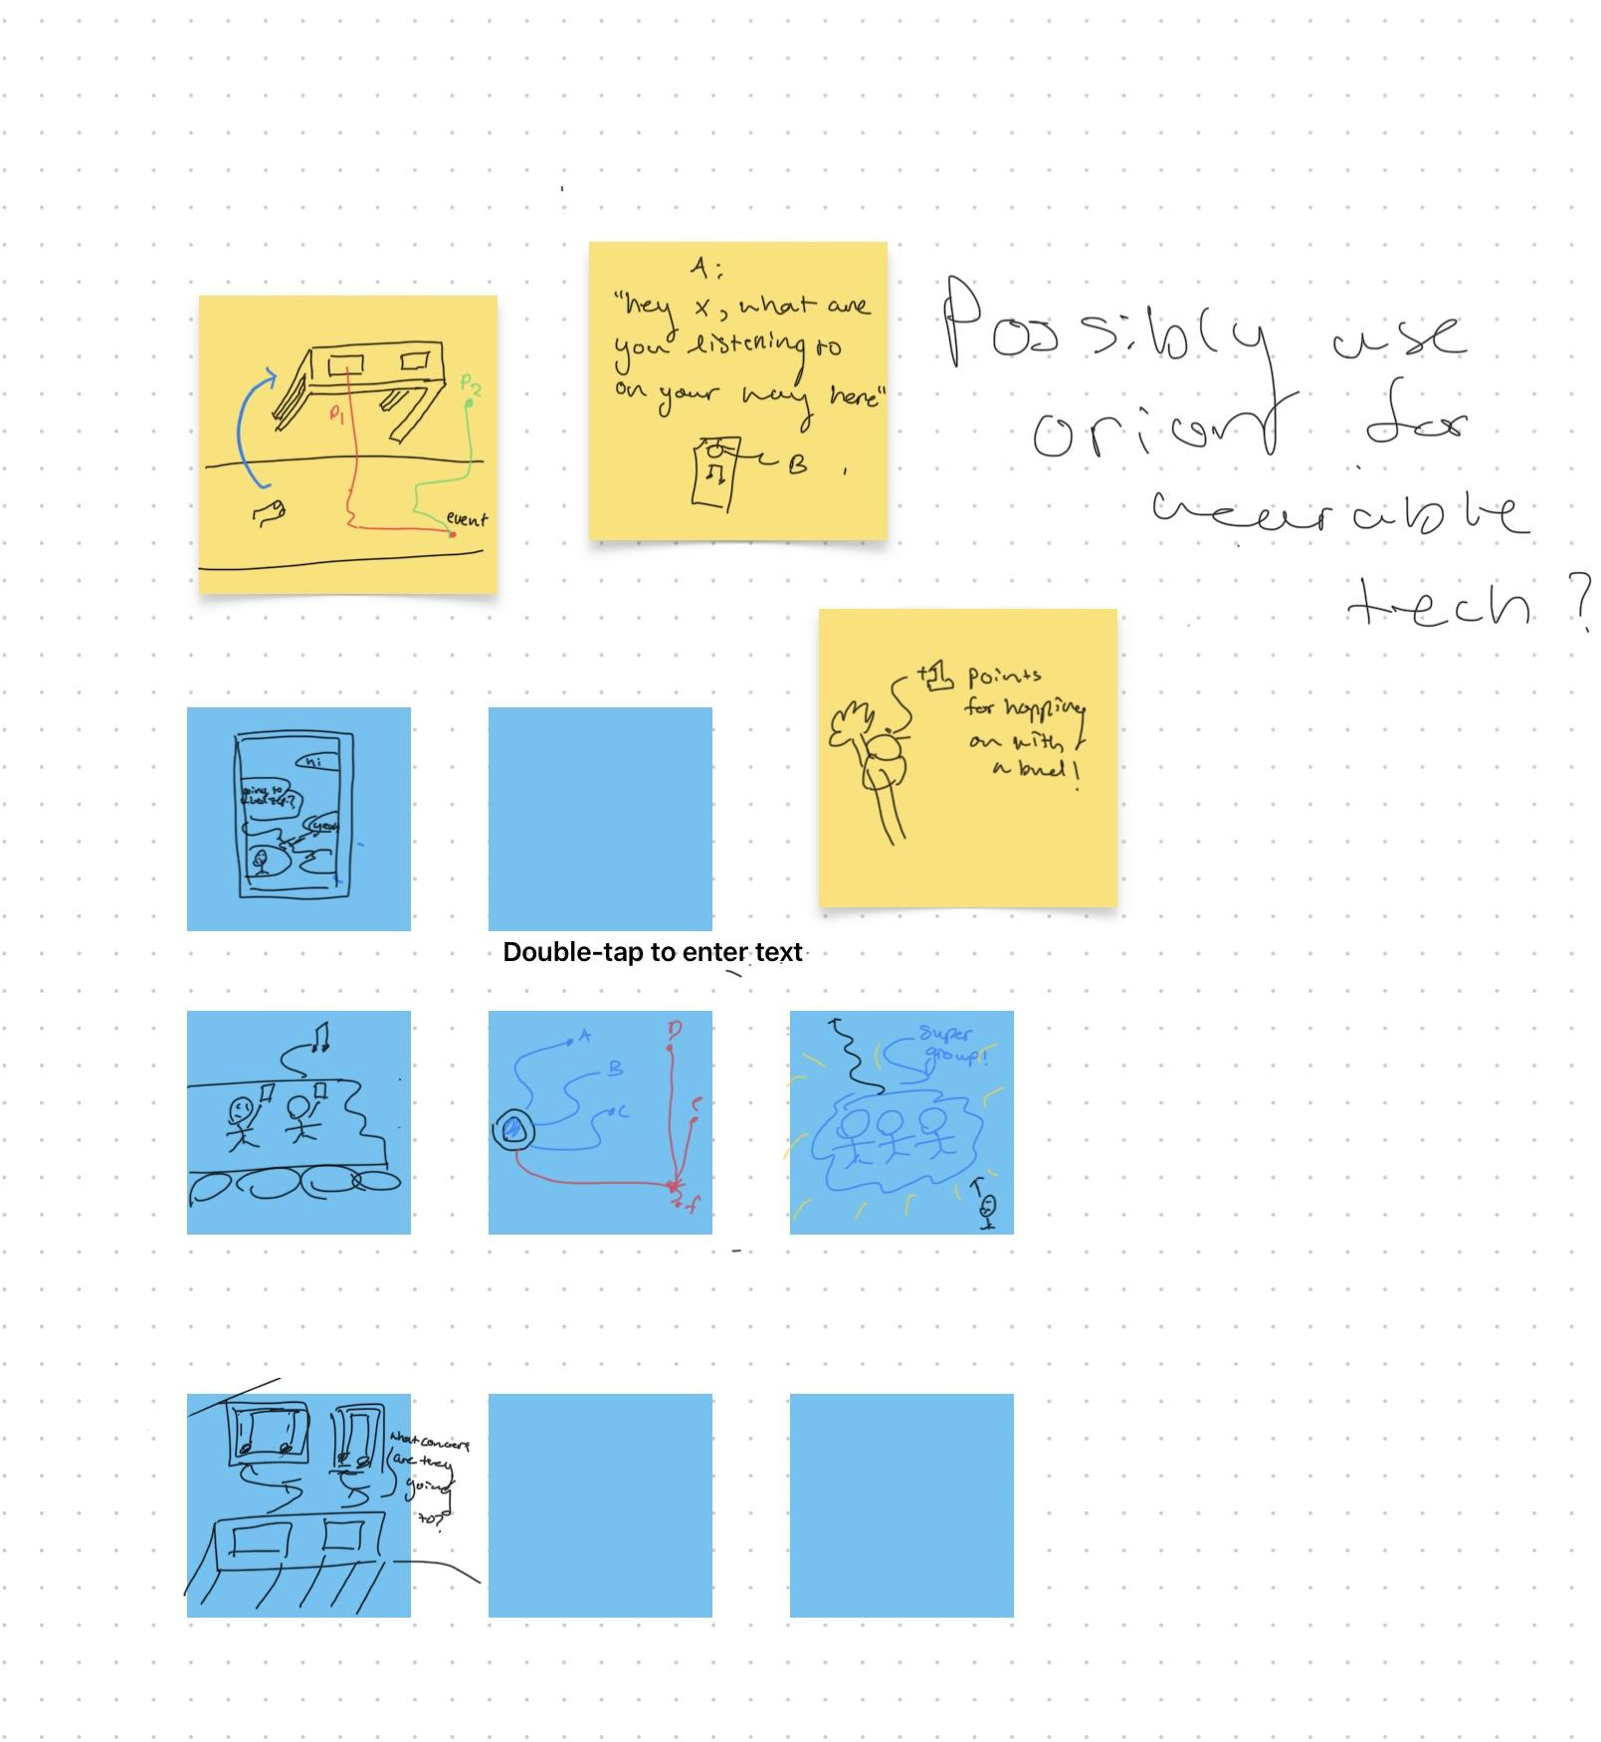
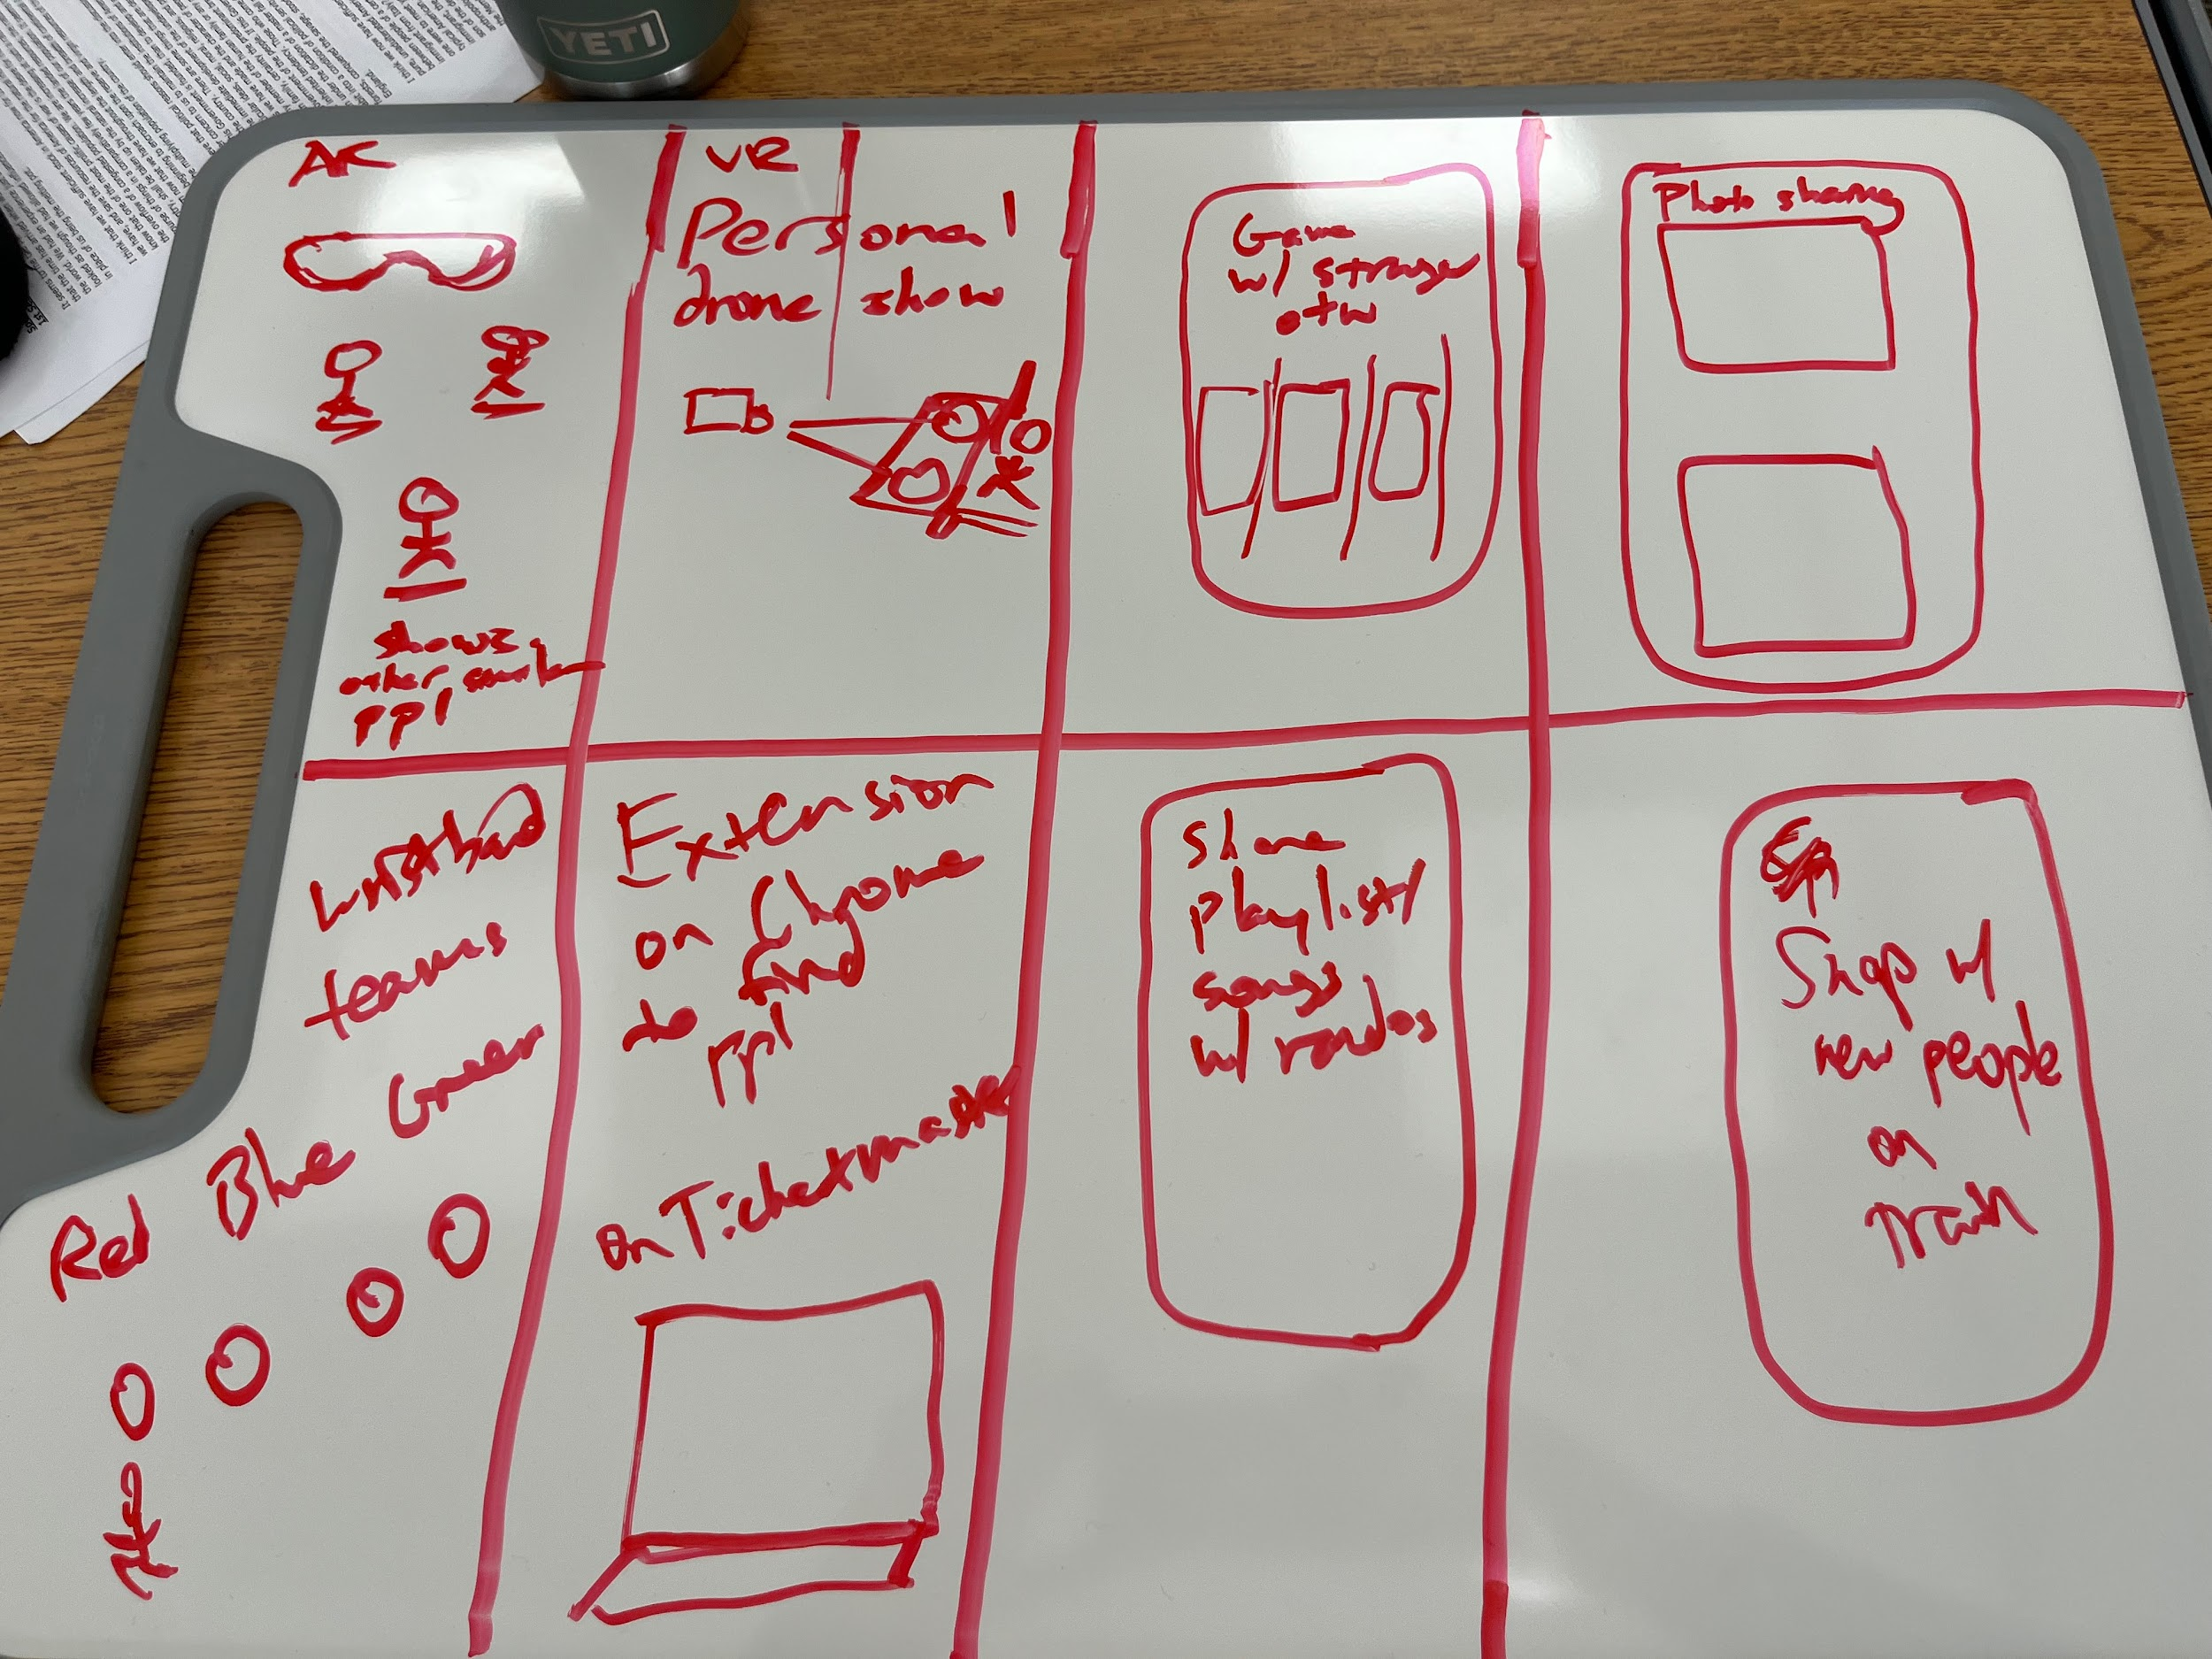
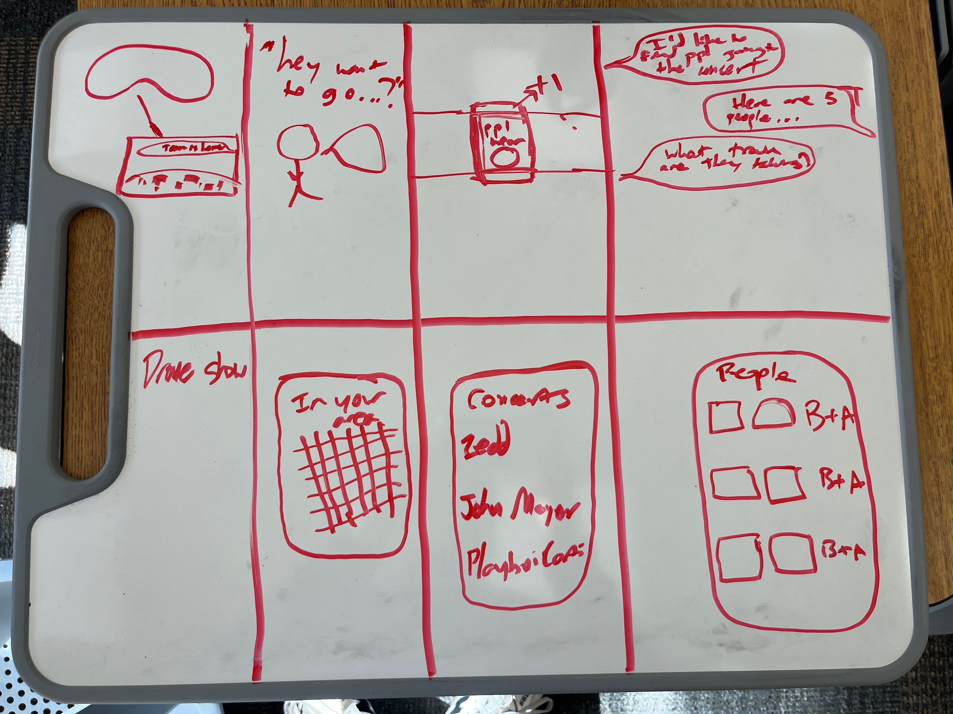
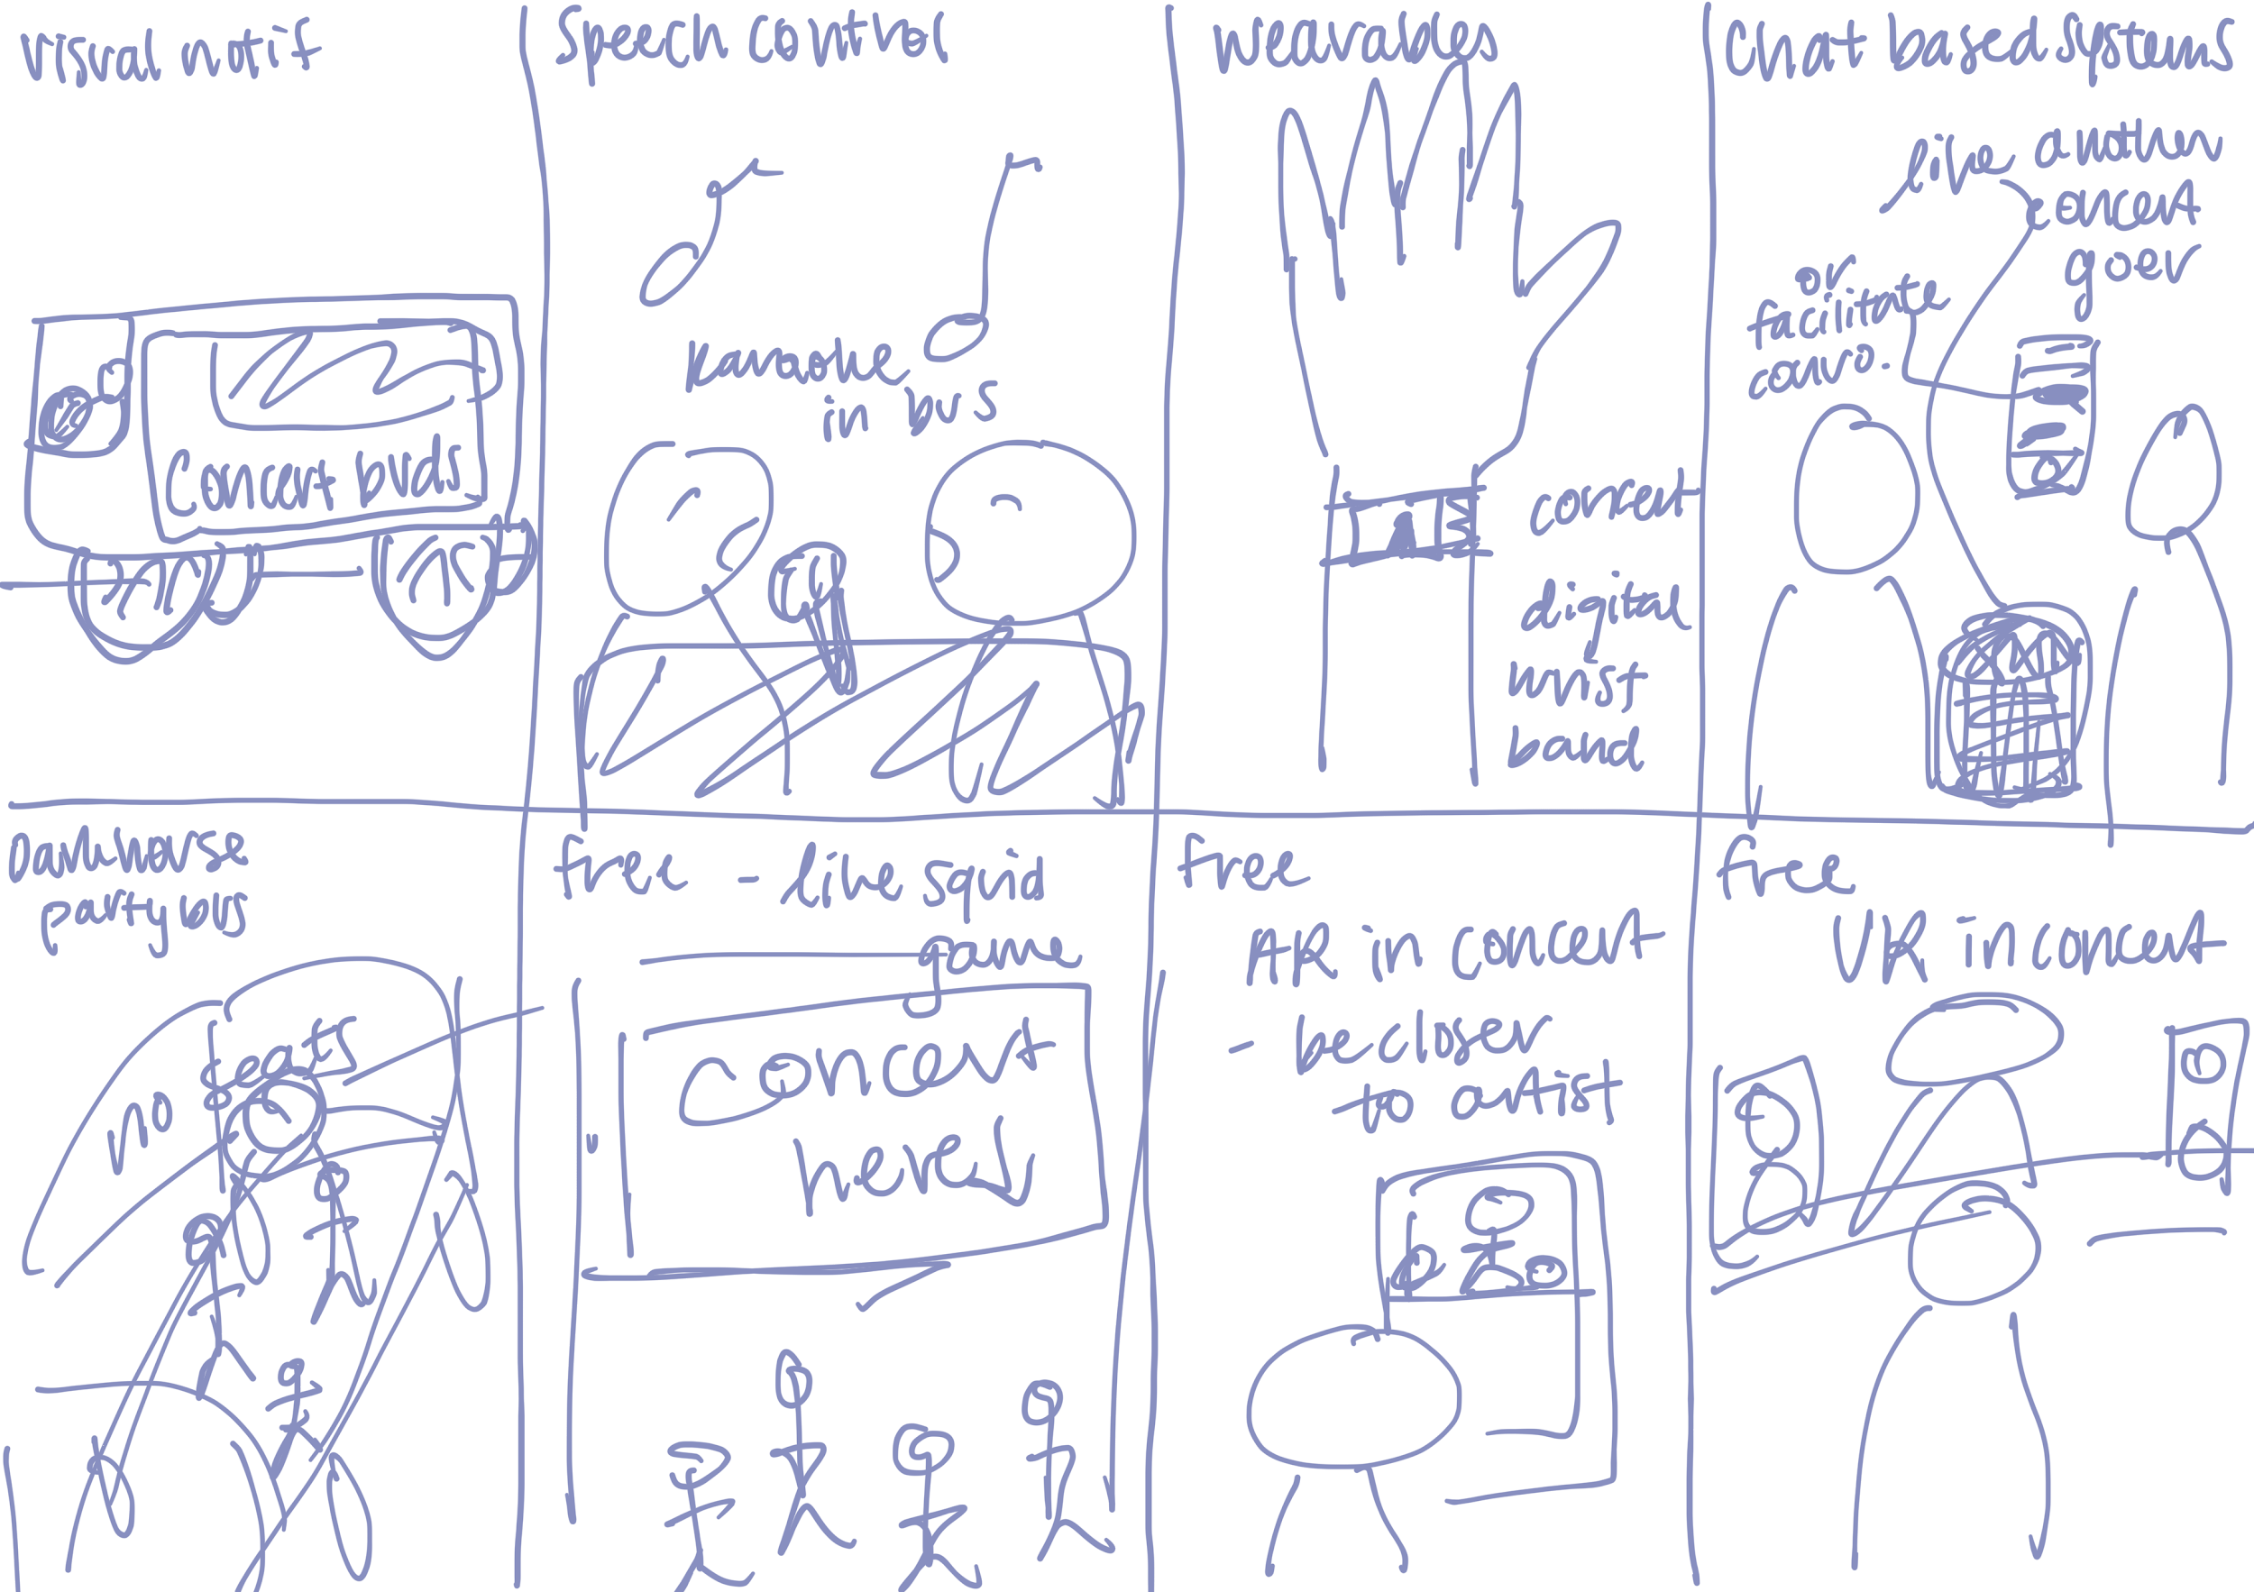
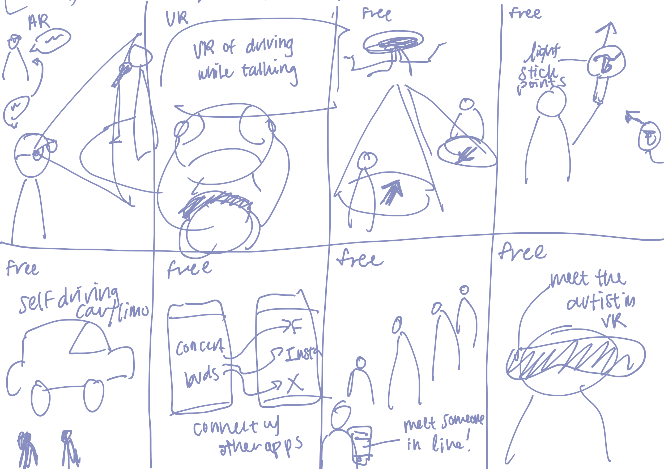
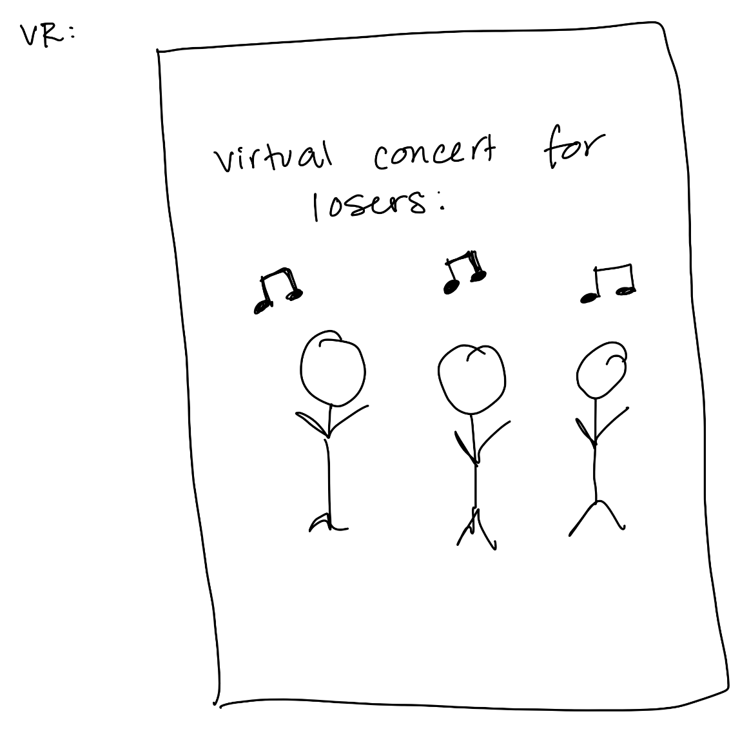
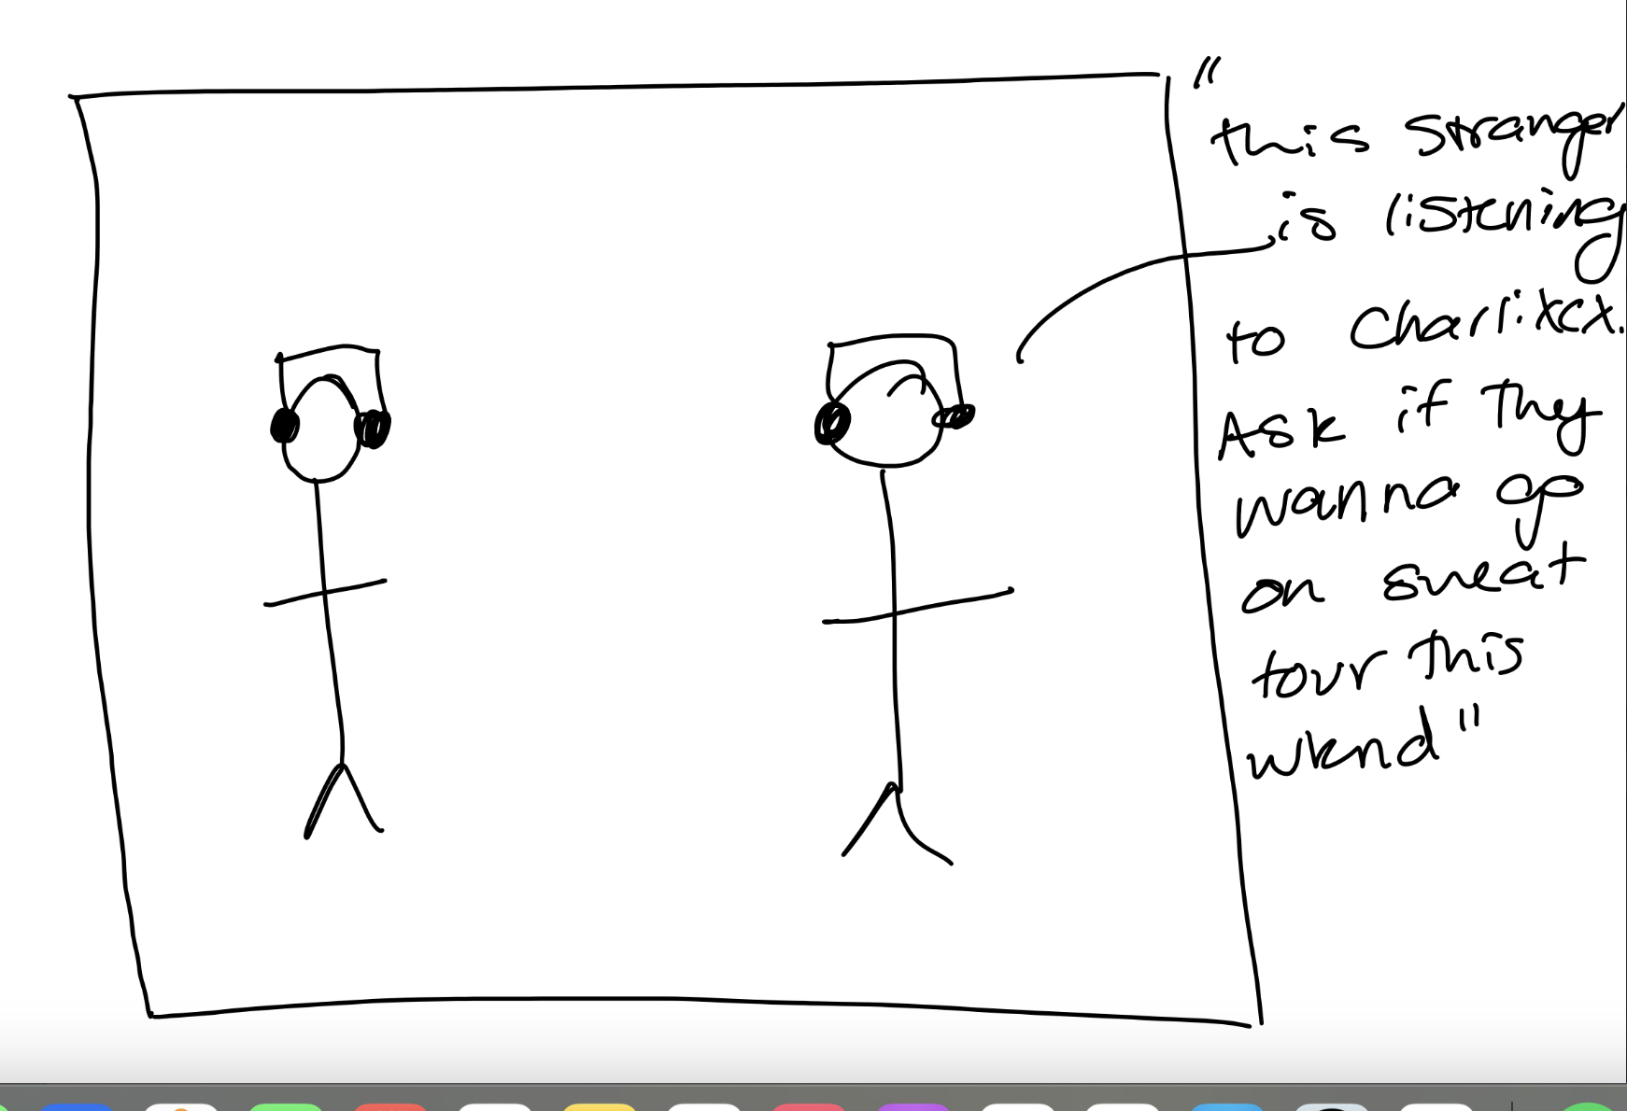
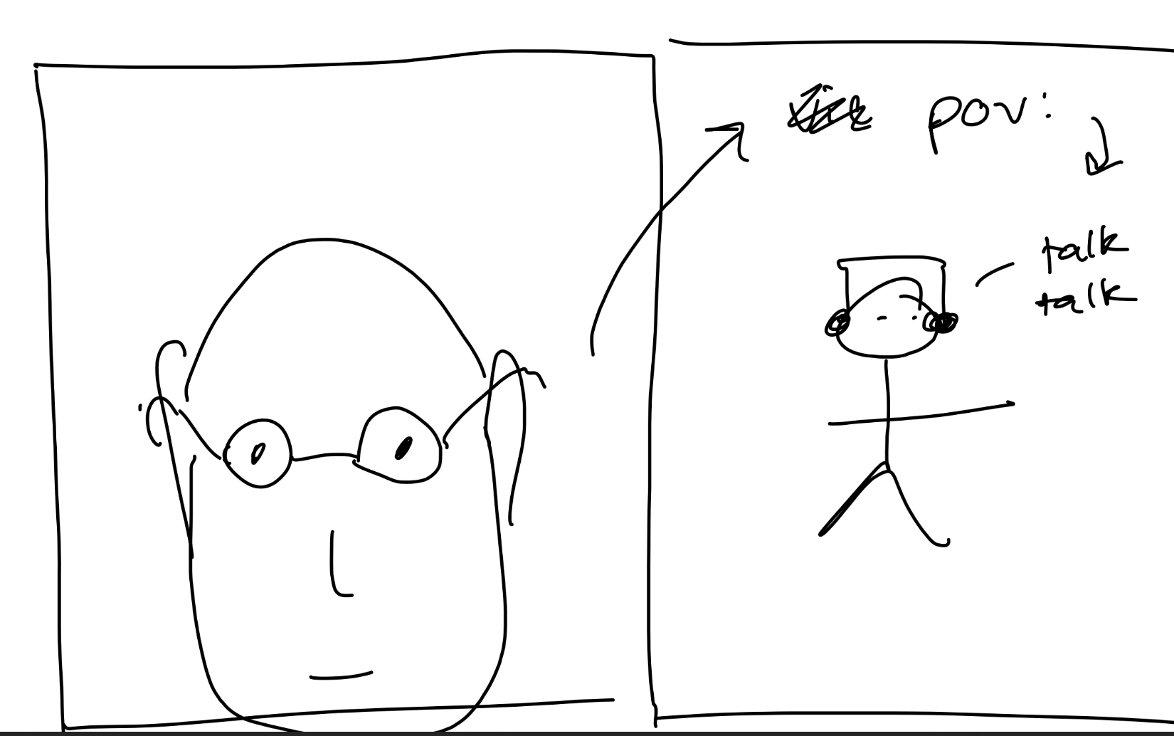
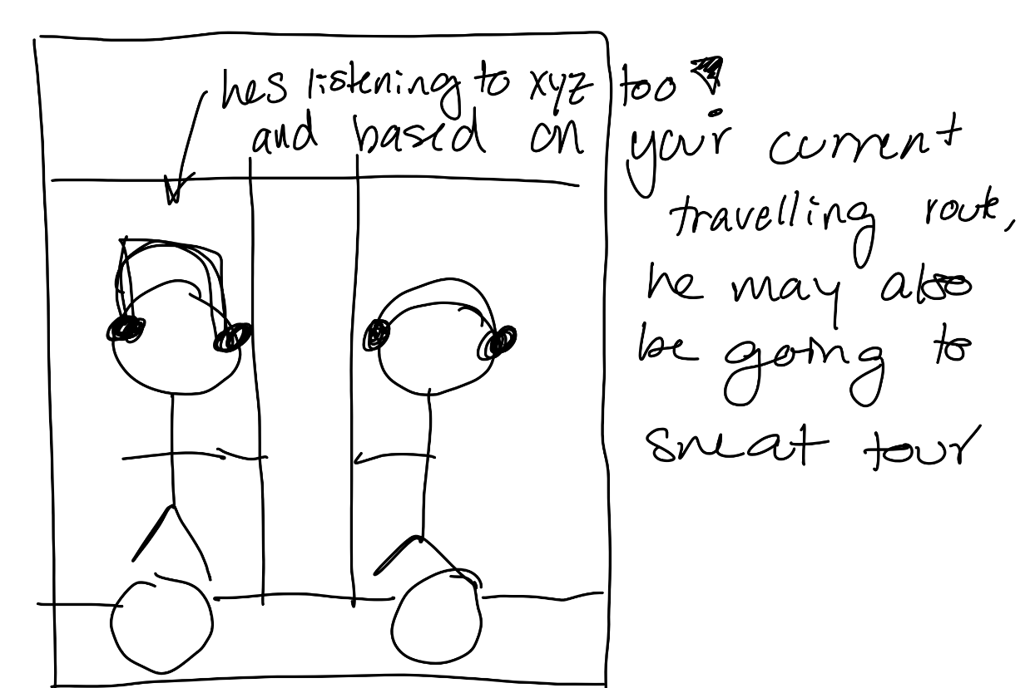
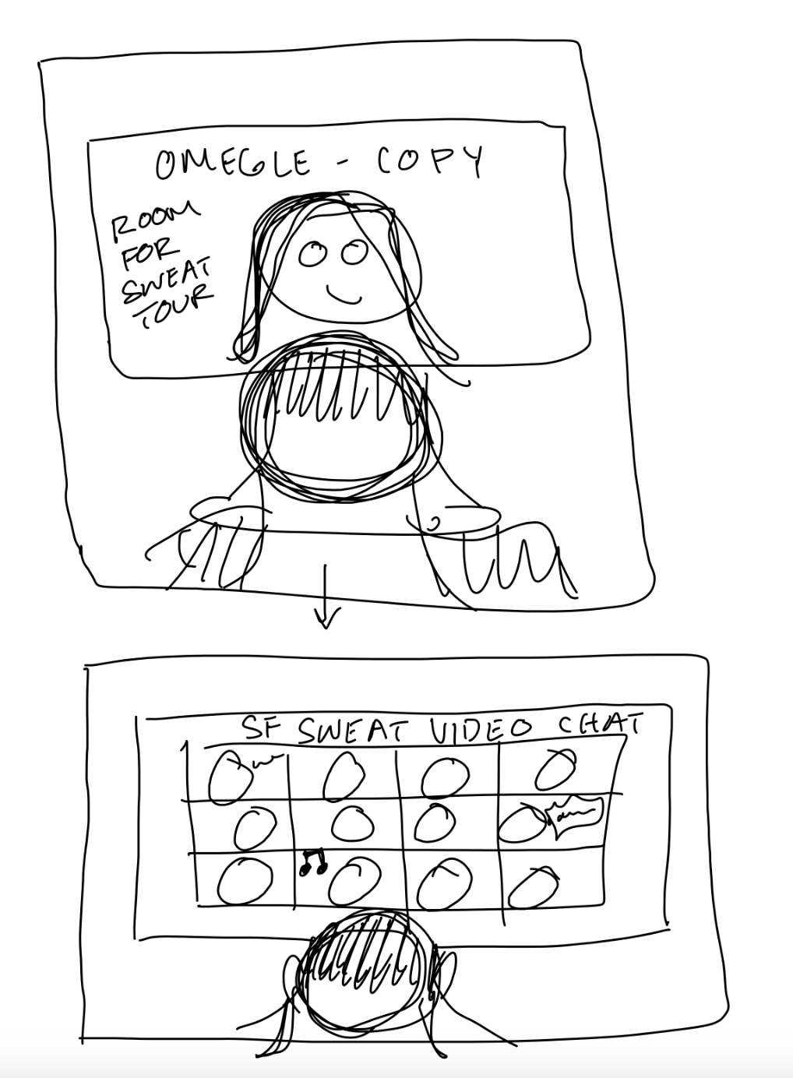
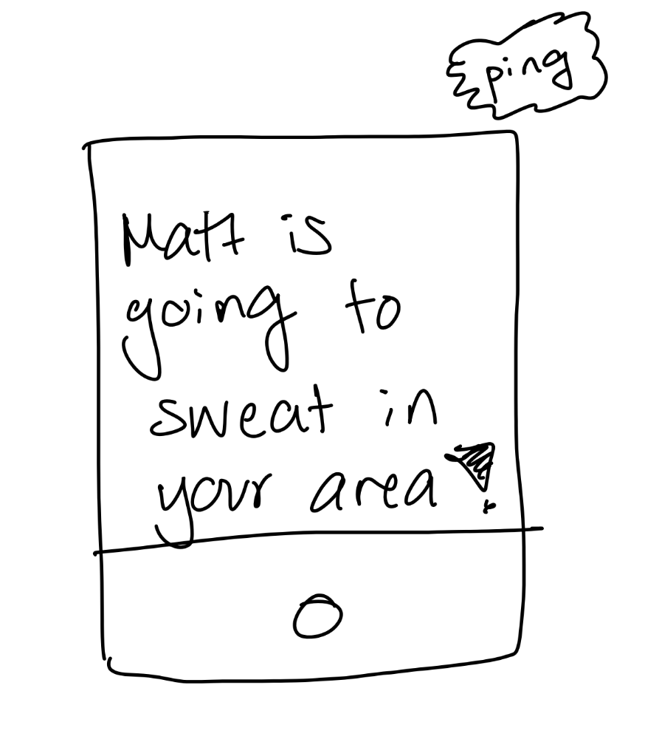
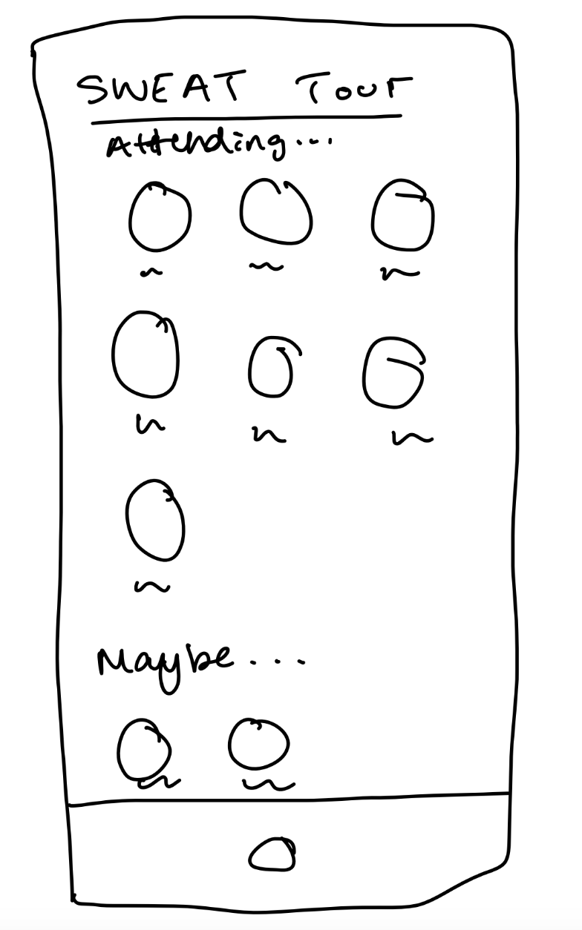
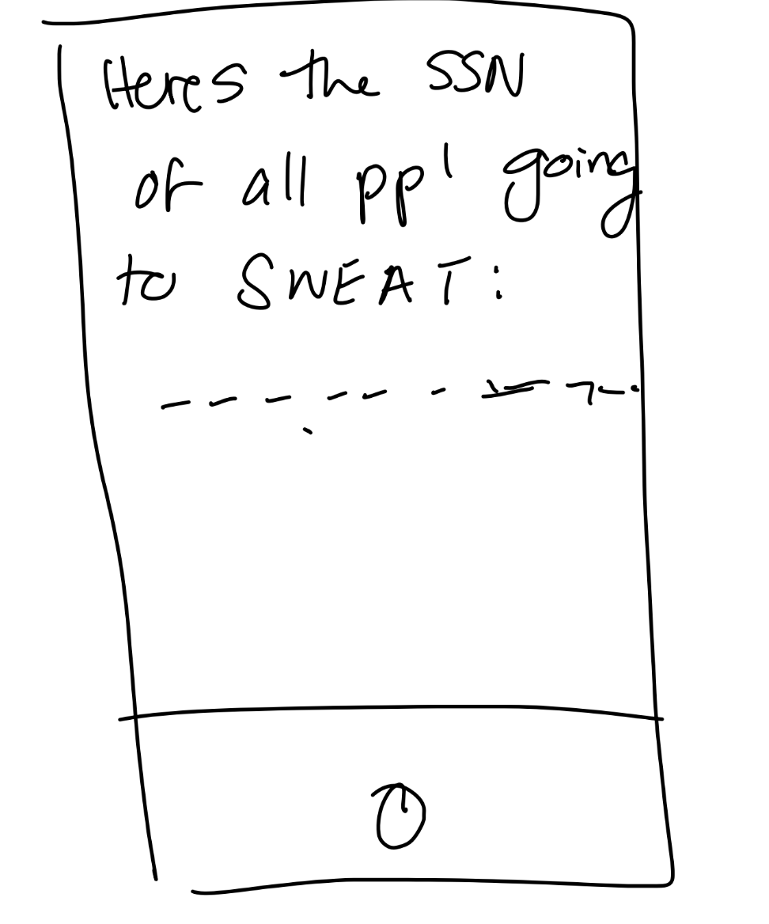
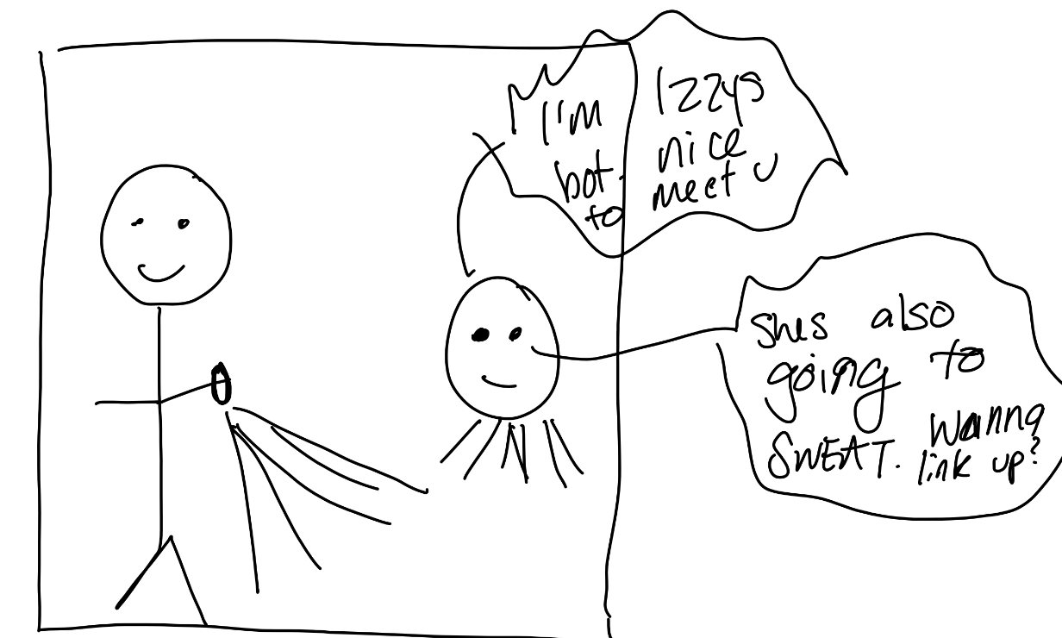
Sketching Exploration

Slide 6
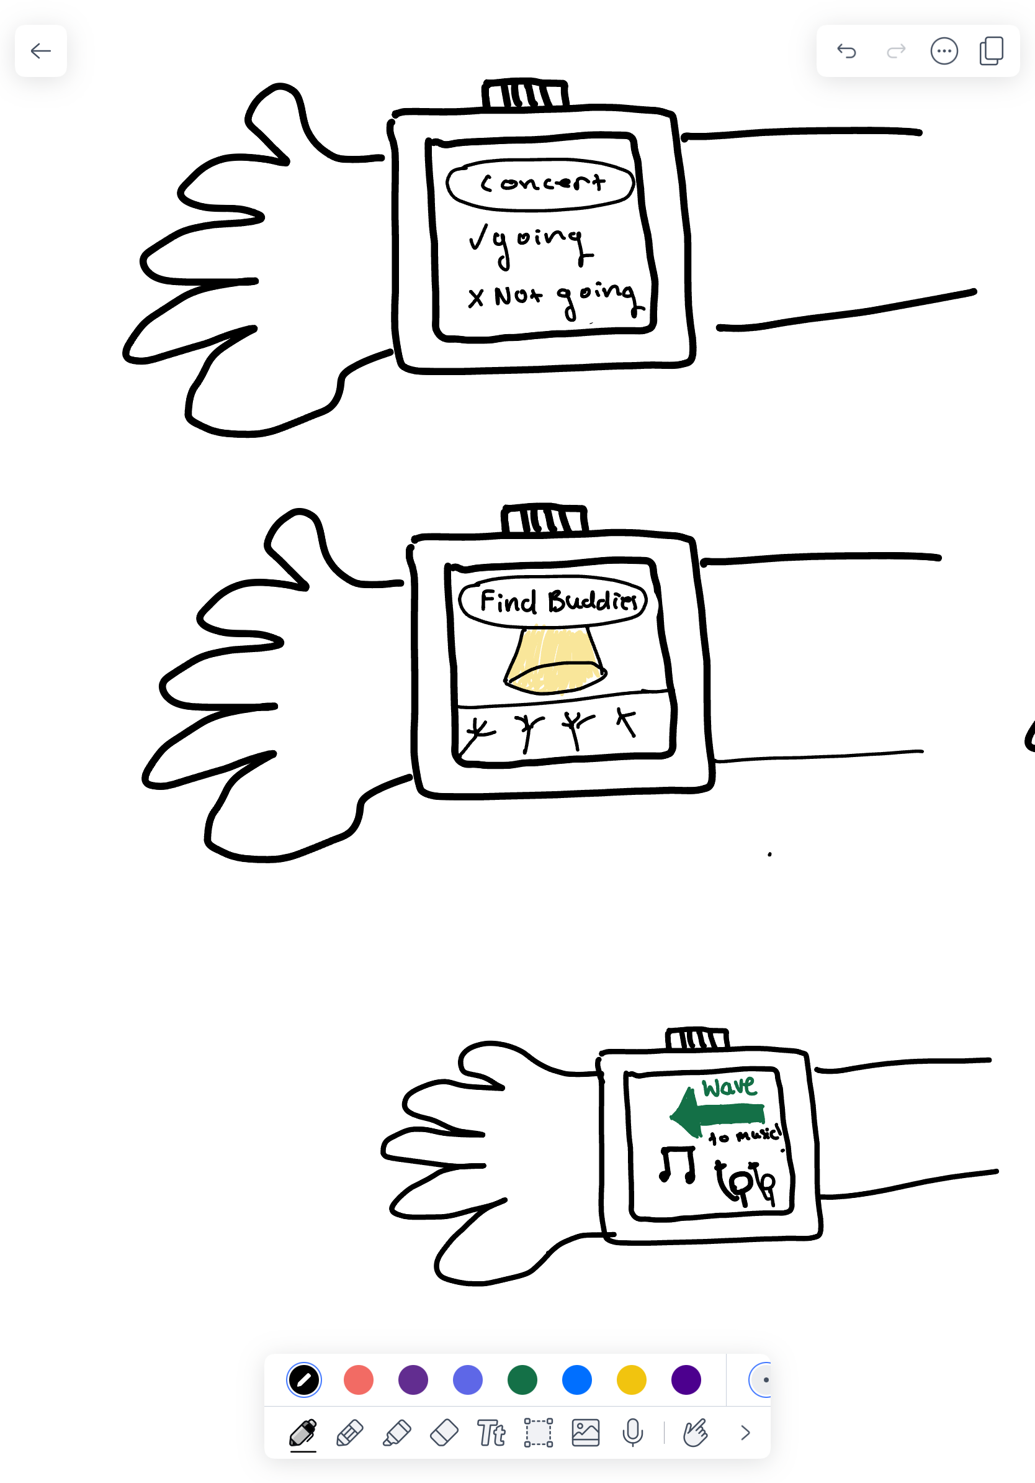
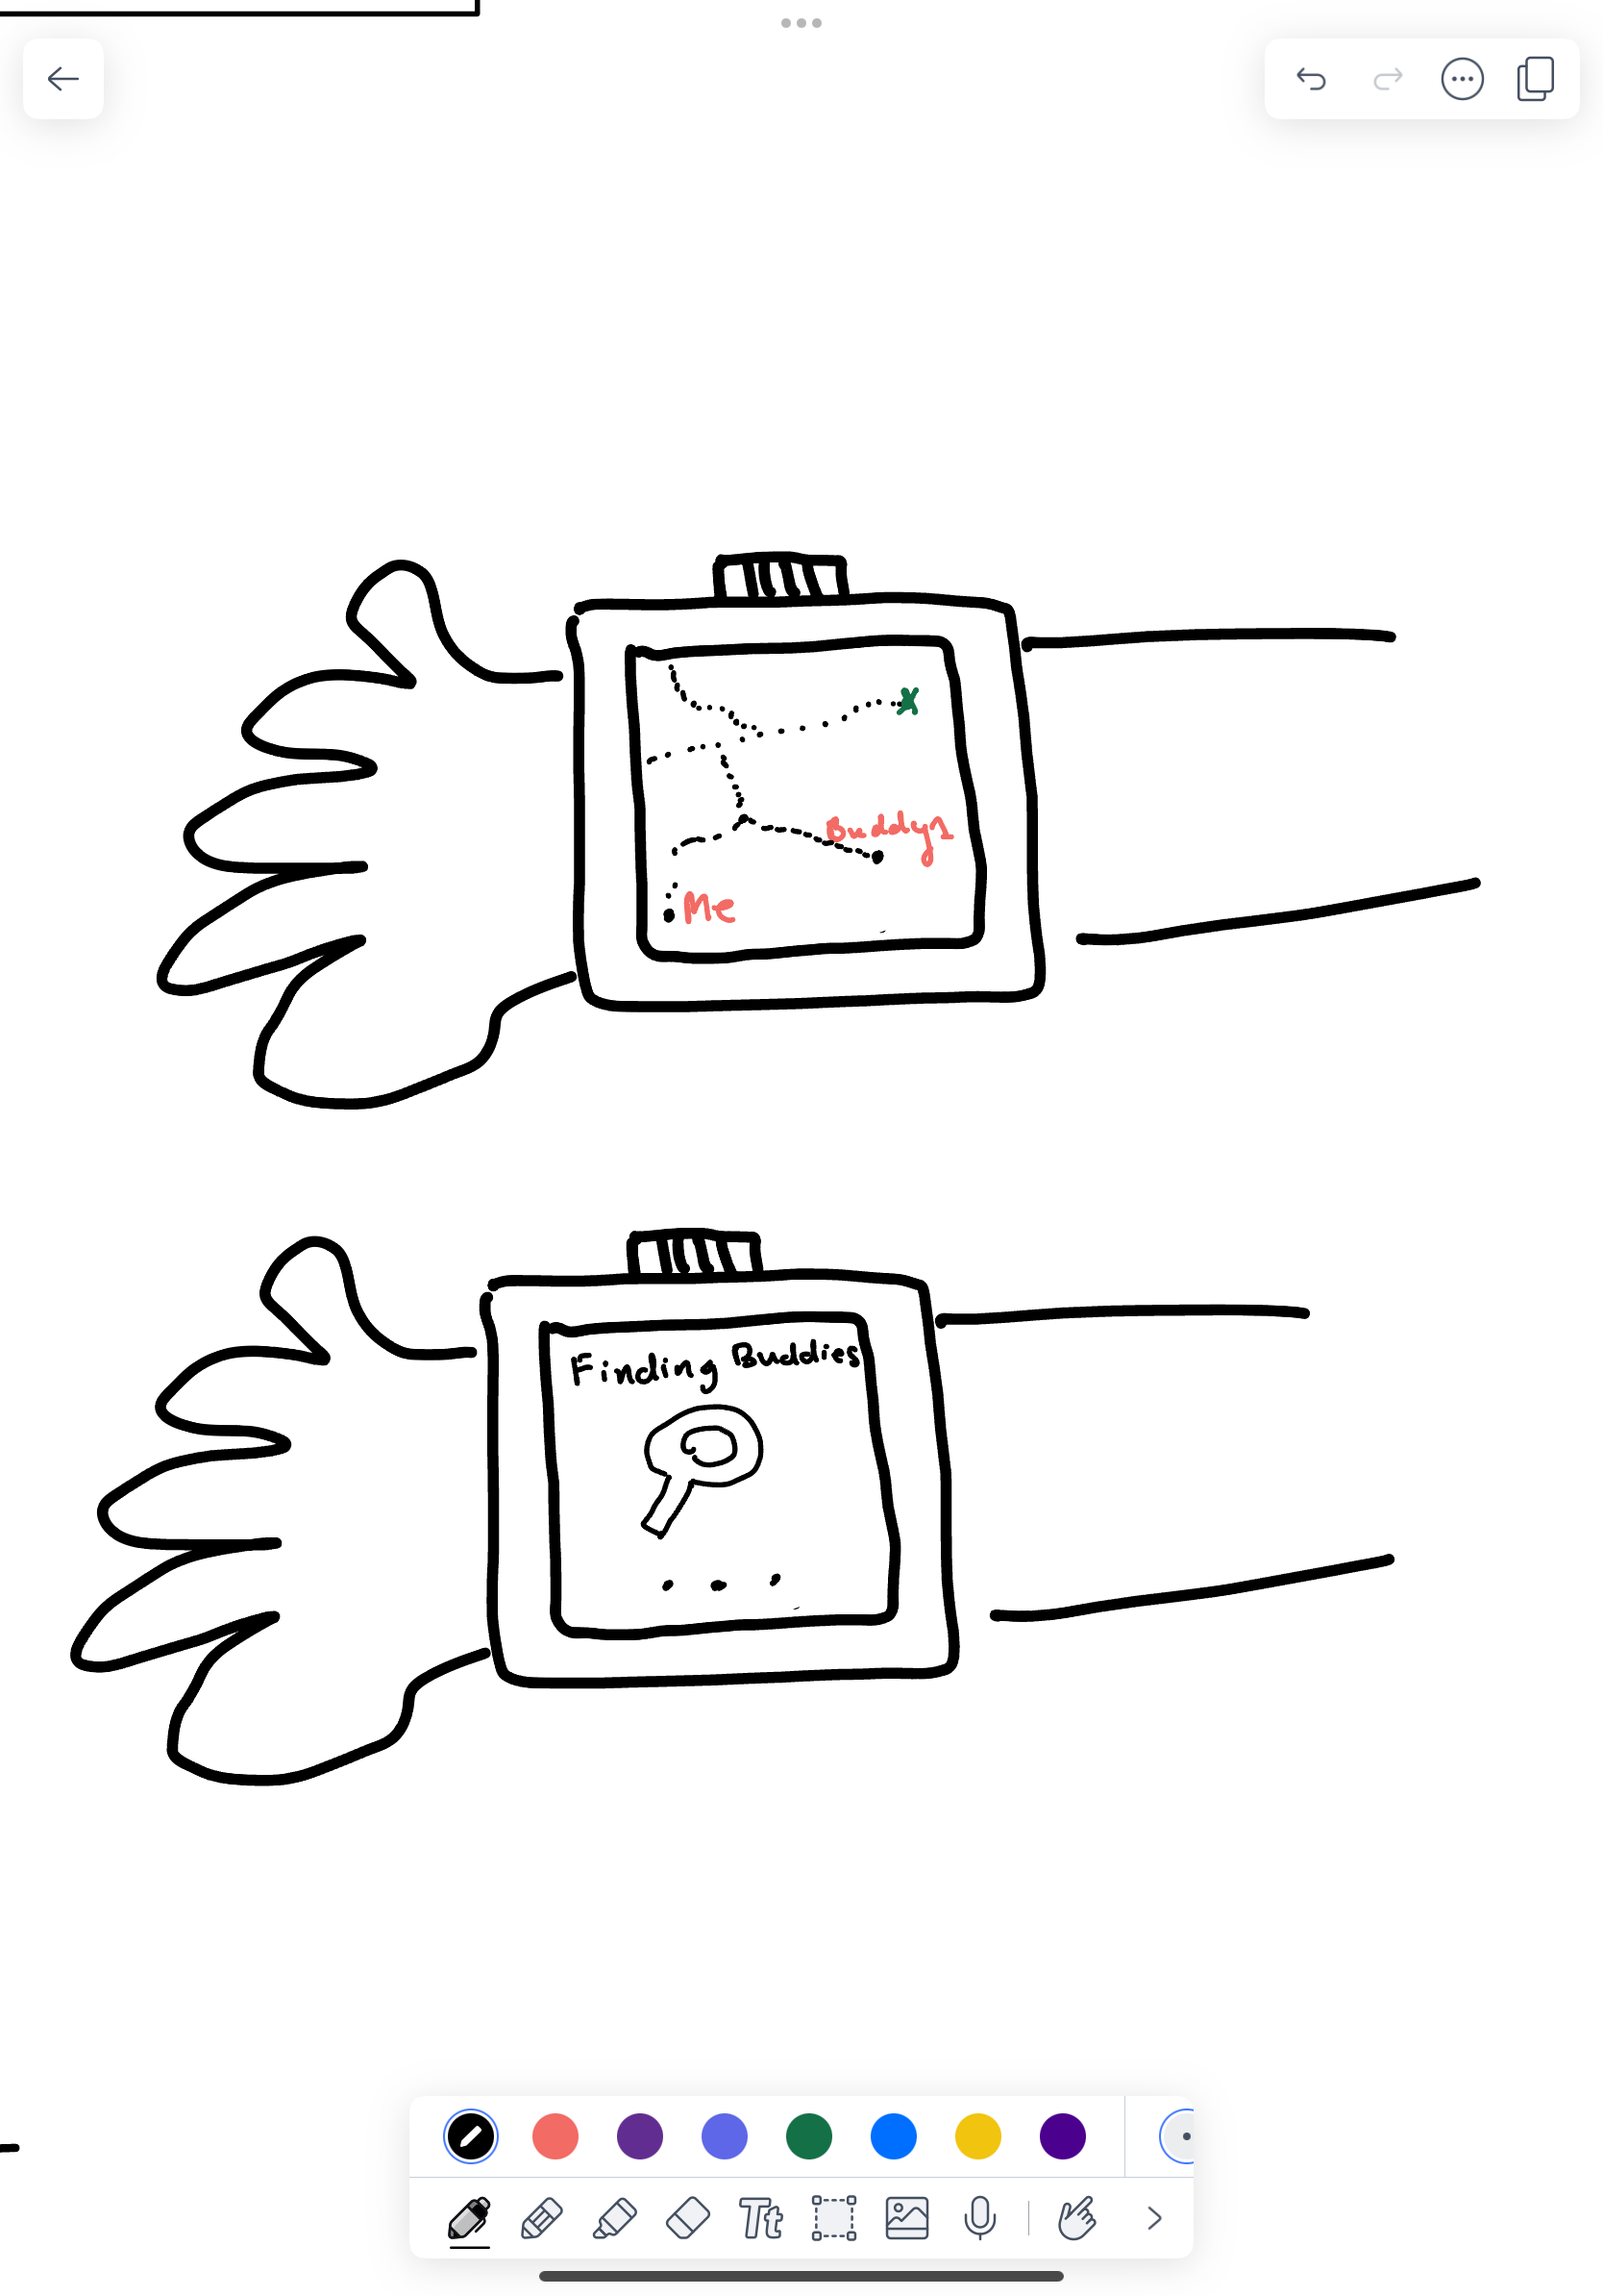
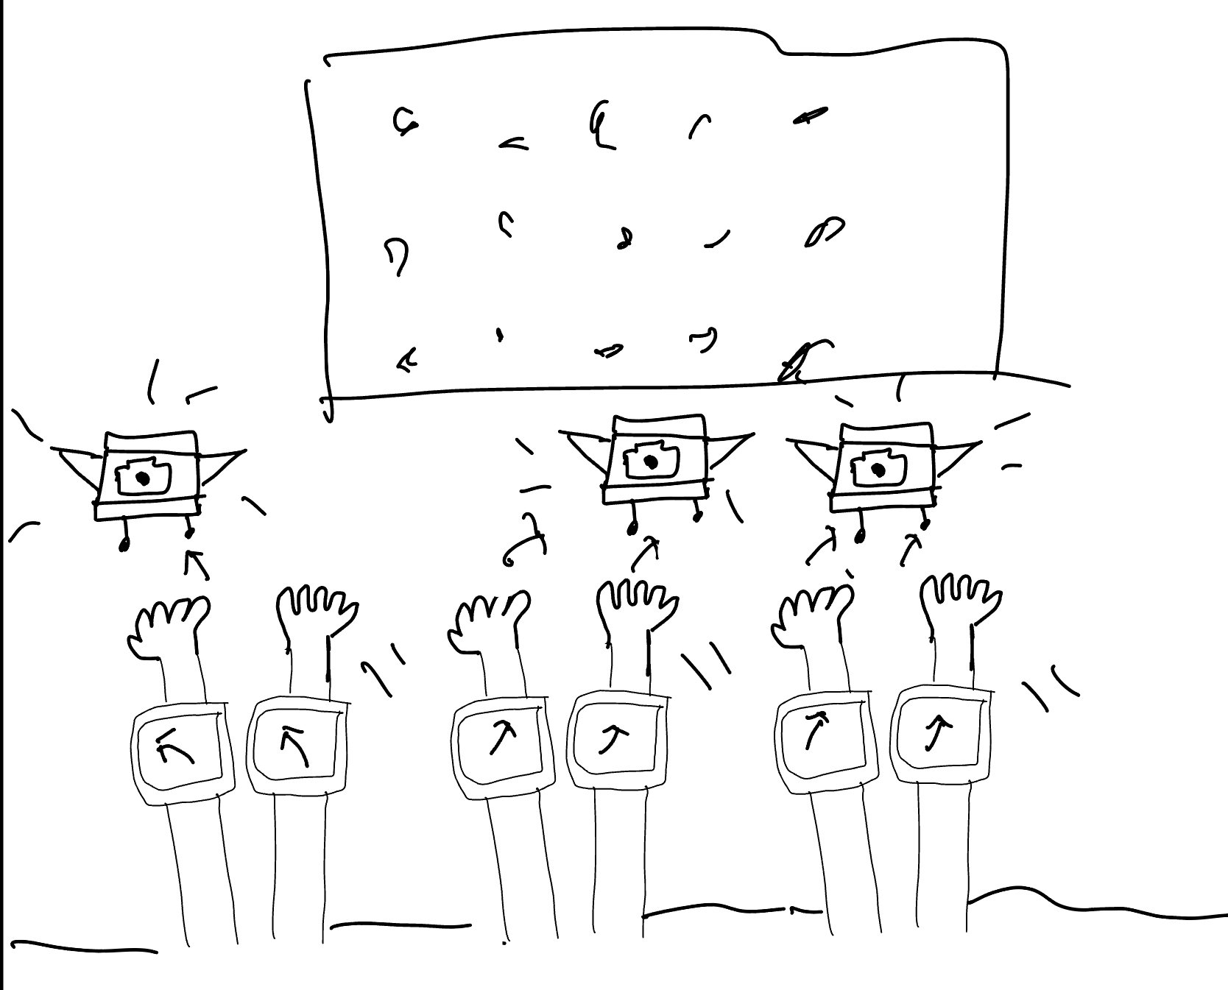
Concept 1: Wearable Watch App + Drones
Add self to list of people going to concert on watch, find buddies going to the same concert nearby!
With a group at the concert, wave at drones as they move in the same direction. They will be taking live shorts of the group, making memories unforgettable.
User locations are easy to visualize, and route-mapping to the concert is optimized by distance and similarity to keep in mind user public transportation preferences and location
Sketches by Matt
Notes:
Safety concerns:
Privacy -> people don’t always consent to be filmed

Slide 7
Wearable Watch App + Drones
PROS
CONS
Very interactive, allowing attendees to interact with a live concert
Innovative and futuristic
No competition on the market (i.e. we can corner the market)
Lots of expensive hardware
Super disruptive at a live music show
Probably violates some aviation/drone laws
Notes:
Pros:
Fun
Controlling drones is new and exciting
Live cameras are exciting
Cons:
If drones get hacked into, could be a extreme threat
Very hard to implement syncing motion of hands with the drone movement

Slide 8
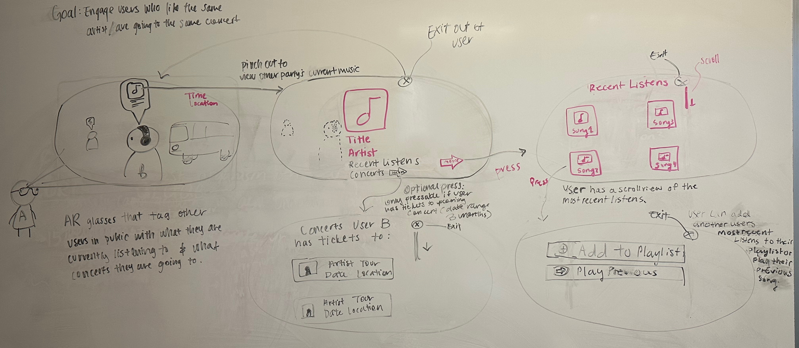
Concept 2: Augmented Reality Goggles
Notes:
t

Slide 9
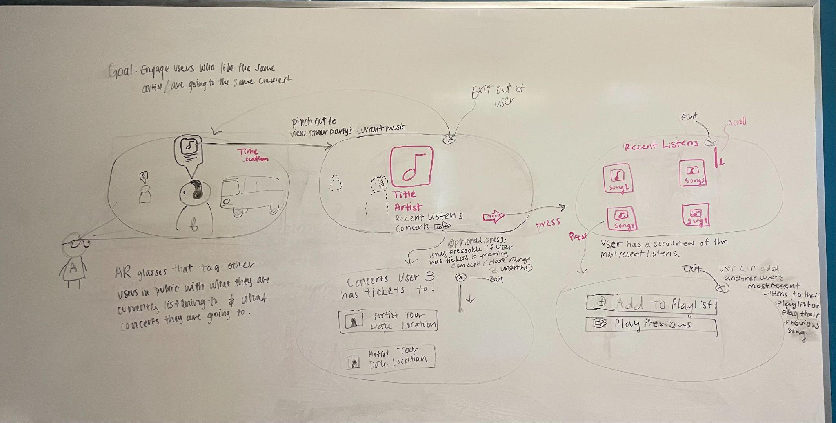
AR Glasses
Wearing glasses will allow user to view what other users are listening to.
Help users find their ConcertBud more easily in a crowd.
Record memories through snapping photos on the glasses at random times/doesn’t need to be prompted by the user.

Slide 10
AR Glasses
View in detail what other user is listening to, as well as the recent concerts others have been to.
This screen can be exited easily to view “reality” again.

Slide 11
AR Glasses
View the most recent listened songs on glasses, with the option of adding to a playlist.

Slide 12
AR Glasses
PROS
CONS
Fun interaction module
More immersive and interactive visuals
Break the ice with other concert goers easier
Steep learning curve to use
Privacy concerns
Relies on AR technology
Notes:
Additional Pros:
Innovative technology
New avenue of promoting social interactions
Feel connected to other concert goers
Additional Cons:
Stalking
Hard to implement

Slide 13
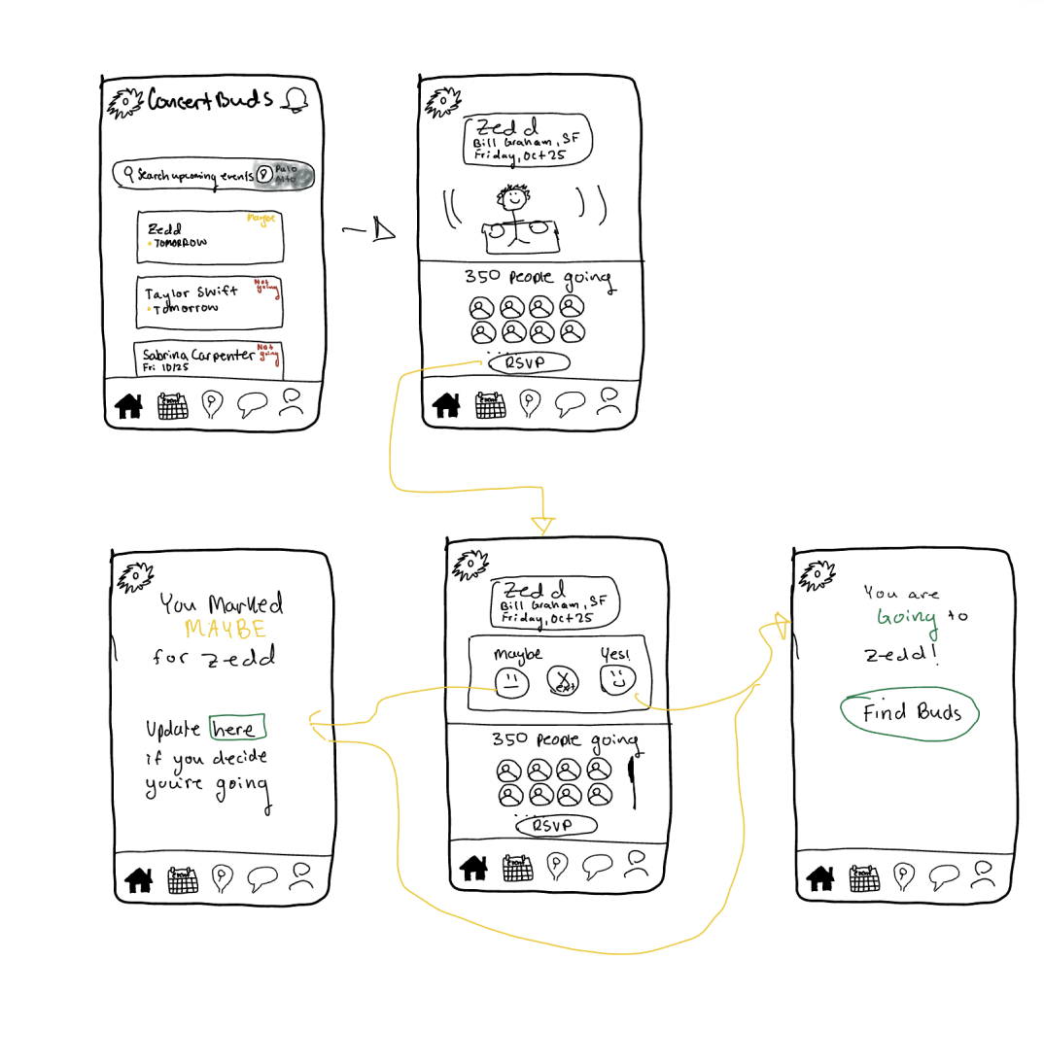
Concept 3: Mobile App
Notes:
t

Slide 14
Mobile App
PROS
CONS
Easier to use
Accessible to our user base
Good method of communication and sharing media
High functionality
Barrier of having to download an app
Data storage limitations on phone
Crowded apps market makes it harder to stand out
Safety concerns
Notes:
Additional Pros:
Novel App
Additional Cons:
Matching is hard to implement on the development side
Stalking

Slide 15
Selected Interface and Rationale
Findings:
A mobile app: most feasible and accessible to broad range of individuals (lower income, older populations, etc.)
Data:
81% of concert-goers say mobile apps improve their experience with features like digital tickets and real-time updates.
Notes:
Augmented Reality boosts fan interaction by 30%, offering immersive elements like virtual effects and meet-and-greets.
Drones are enhancing concerts through aerial light shows and live streaming, contributing to the $30.6 billion global drone market.
With the smartwatch market reaching $96.31 billion by 2027, wearables are key for contactless payments and hands-free navigation.
CITATIONS FOR DATA:
https://learn.g2.com/augmented-reality-statistics
https://pixelplex.io/blog/web-accessibility-statistics/
https://www.moshcam.com/feature/the-future-of-concert-going-balancing-digital-and-physical-experiences

Slide 16
Lo-fi Prototype Construction
Prototype drawn on iPad and printed on paper
Printed at different sizes to test how different buttons would be clicked and text would be read (simulate large and small screen sizes)
Pages implemented: landing page, chat page, navigation page
One screen per page to imitate a real app!
Manually responded to user input
Notes:
CITATIONS FOR DATA:
https://learn.g2.com/augmented-reality-statistics
https://pixelplex.io/blog/web-accessibility-statistics/
https://www.moshcam.com/feature/the-future-of-concert-going-balancing-digital-and-physical-experiences

Slide 17
Lo-fi Prototype: 3 task flows
Simple: RSVP to a concert and see who else is going
Moderate: Connect with others going to the concert
Complex: Plan a commute and get matched with concert buddie(s)
Notes:
CITATIONS FOR DATA:
https://learn.g2.com/augmented-reality-statistics
https://pixelplex.io/blog/web-accessibility-statistics/
https://www.moshcam.com/feature/the-future-of-concert-going-balancing-digital-and-physical-experiences

Slide 18
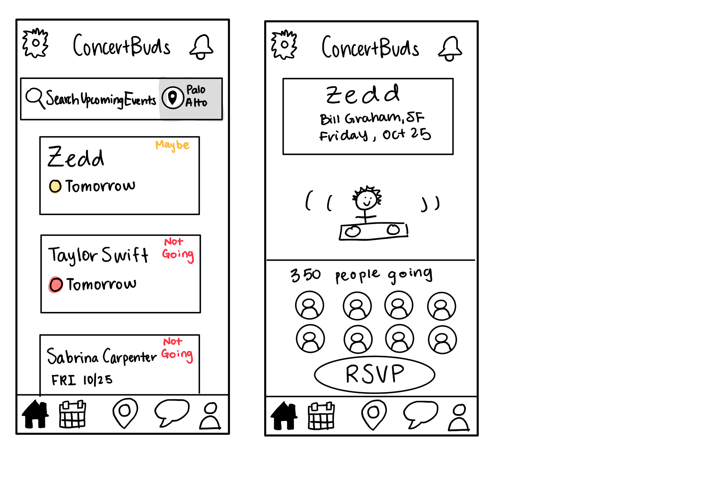
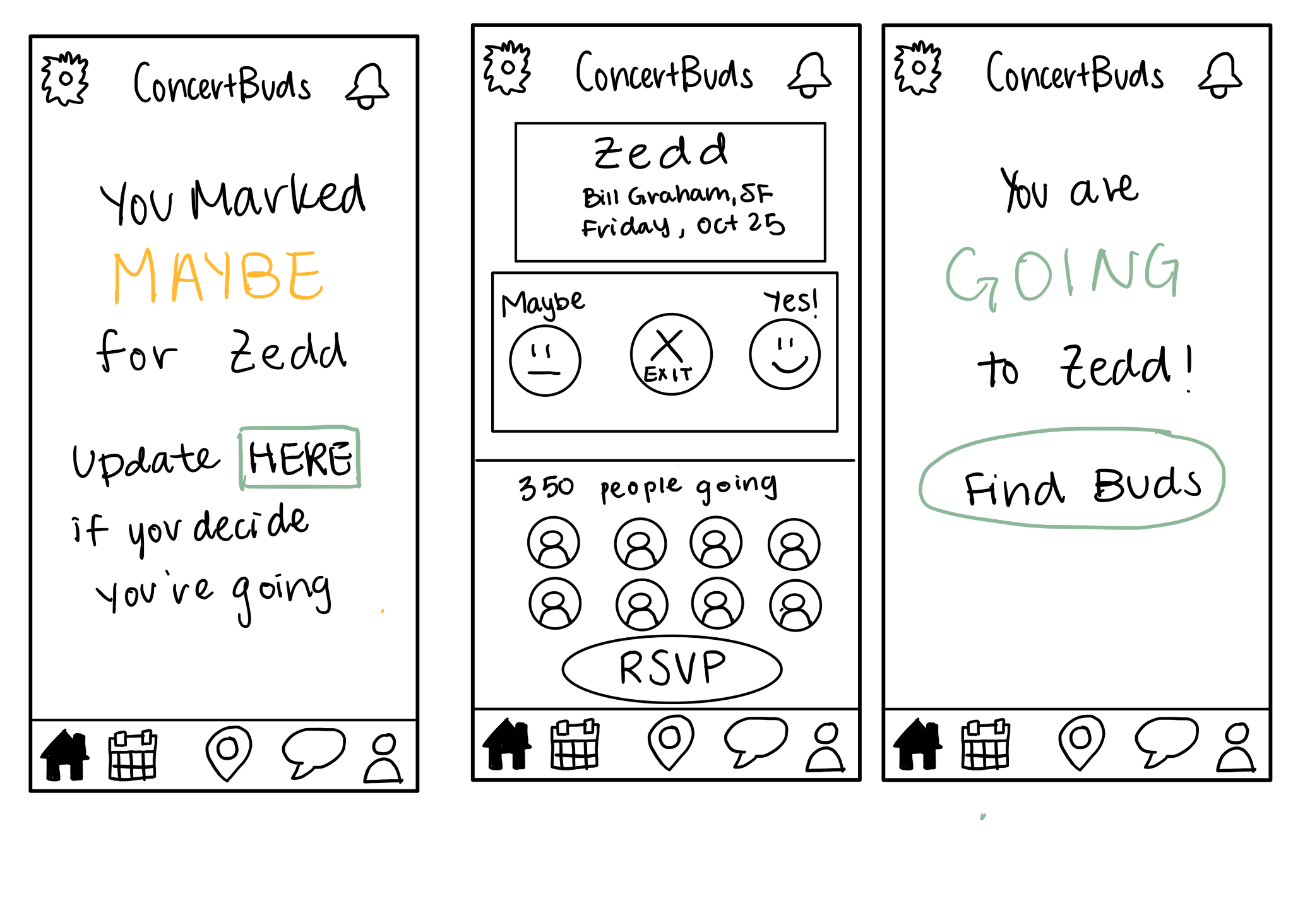
Simple: RSVP to a concert and see who else is going
App opens to upcoming concerts nearby. User clicks on “Zedd” concert tomorrow to navigate to the concert RSVP screen
App goes to the MAYBE screen for user who is undecided. Allow user to change their mind if they click HERE
User can view concert information including number of people going and their profile picture icons. User then clicks RSVP
App goes to the GOING screen for concert-going user. They are now able to Find Buds for Zedd by clicking the Find Buds button.
Modal pops up for RSVP decision.

Slide 19
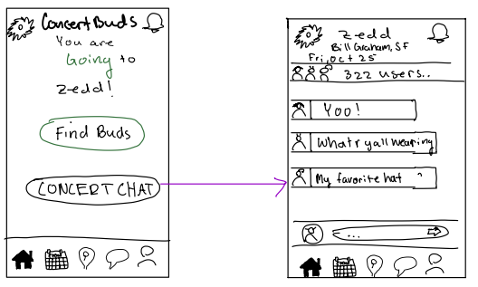
2. Moderate: Connect with others going to the concert
All going users to Zedd can chat on this screen
App prompts user to join concert specific chat

Slide 20
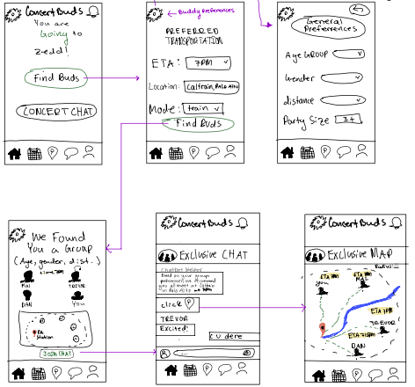
3. Complex: Plan a commute and get matched with concert buddie(s)
- User can find buds with their own preferences in the settings
- User can input their own preferred transportation settings
- Users get matched based on all preferences
- Buddy Group is formed, all people in the same Buddy Group can see each other on a map within a specific radius
- Buddy Group specific chat allows users to connect and share more about each other

Slide 21
Testing Methodology
Participants: found random participants in SF and around campus; cold-recruited a diverse set of strictly non-Stanford student participants who we did not know
Environment: SF, Stanford Campus
Procedure: approached them politely, asked for a couple minutes of their time, ensured they were concert goers, asked them to explain thought process as they were using our prototype, final feedback
We had them complete one or two tasks by explaining the app idea to them and presenting them with a prototype. We then asked about their experience using our prototype. There was no guidance on usability from the tester.
Member Roles:
Izzy: tester for SF participants, Matt: notetaker for all participants, Henry: tester for Stanford Campus participants, Sarah: tester for Stanford campus participants
Notes:
CITATIONS FOR DATA:
https://learn.g2.com/augmented-reality-statistics
https://pixelplex.io/blog/web-accessibility-statistics/
https://www.moshcam.com/feature/the-future-of-concert-going-balancing-digital-and-physical-experiences

Slide 22
Usability Goals
Time for Task Completion
How much time did each task take?
Was there overcrowding? Were there necessary visual prompts?
Intuitive
I.e. How likely were they to join a group chat, or meet up with other Concertbuds?
Desire to Explore App
# of Errors
Were there misclicks? How many?
Notes:
CITATIONS FOR DATA:
https://learn.g2.com/augmented-reality-statistics
https://pixelplex.io/blog/web-accessibility-statistics/
https://www.moshcam.com/feature/the-future-of-concert-going-balancing-digital-and-physical-experiences
Time for task completion
Overall intuition (was there overcrowding? Were the necessary visual prompts there?)
Desire to explore different functionalities within the app (i.e. joining the group chat, meeting up with other ConcertBuds)
Were there any misclicks? How many?

Slide 23
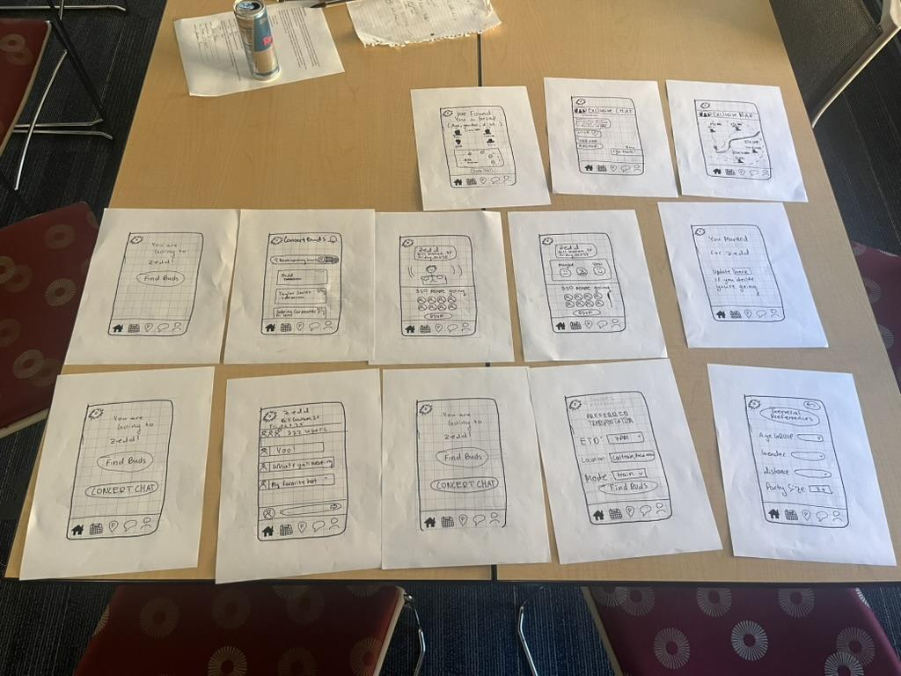
Lo-fi Prototype Testing
We tested our UI prototype with 4 individuals: Jason, Janelle, Sarah, and Ben.

Slide 24
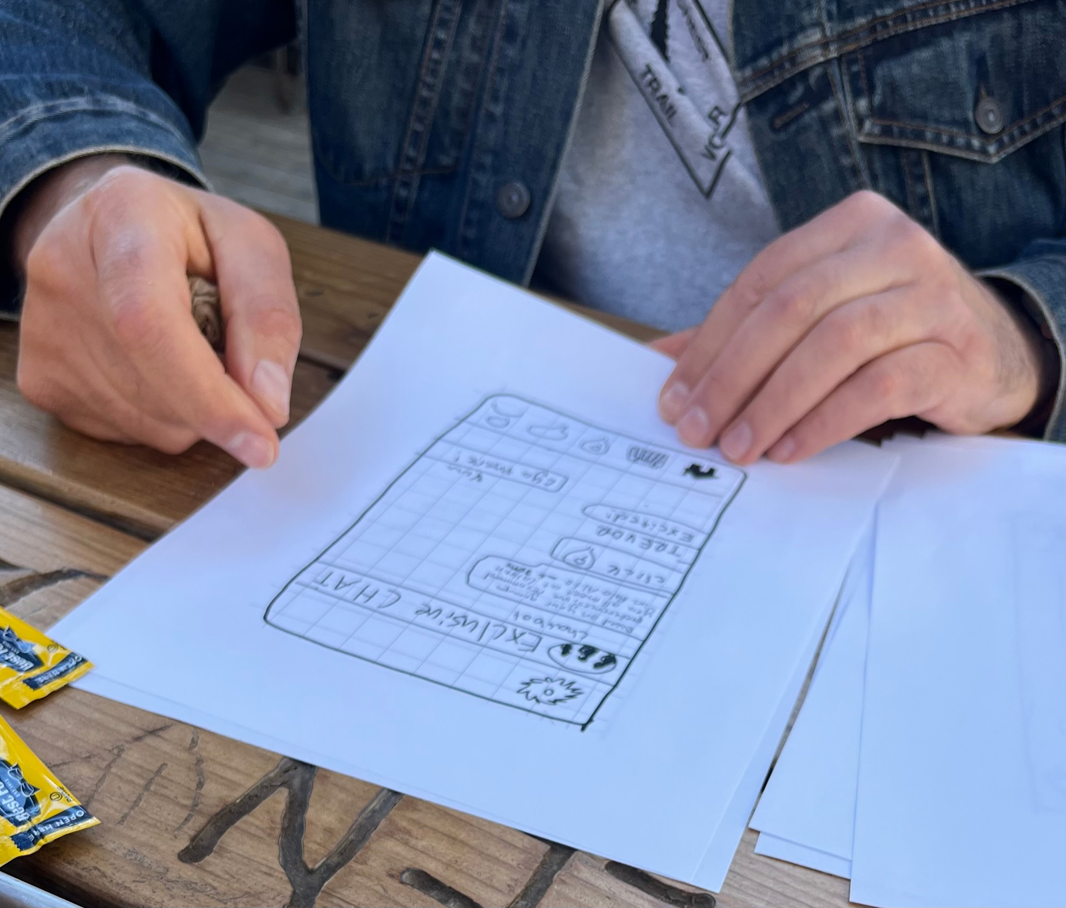
Jason (pt 1)
Simple Task:
  Jason first clicked to sign up for Zedd’s event, and then RSVP’d.
  Wished the yes/no/maybe was more distinct, perhaps with green, red, and yellow color.
  Curious why “RSVP” was still shown again on the yes/no/maybe page.
  “I want an indicator of what you marked (yes/no/maybe) that takes you back to your main page with all the concerts”. He also wanted a status page that was on the home page, with all planned concerts and one’s status.
Jason only wanted his hands pictured

Slide 25
Jason (pt 2)
Moderate Task
  Insightful quote: “If I’m not with anyone yet, I can’t use the concert chat yet, right?” — shows flaw in our UI that makes concert chat seem exclusive, when it is not
  Wanted to add his own friends and send out invitations (instinctual)
  Wanted frequent/regular “Concert Buds”
  Asked: “Does it know your seat number?” Wants to see if his other friends are at the same concert. Wanted to see that on a map
  Wishes “Concert Chat” said “All-Concert Chat” because it was unclear
Complex Task
  This was the easiest task for Jason to complete
  Though the “ETD” label was unclear/not useful — “I think inputting ETA would be helpful as people need to know when to leave so as to arrive on time.”
  Wanted (in the chat) information about openers and when headliner shows up, with a countdown timer to the main act

Slide 26
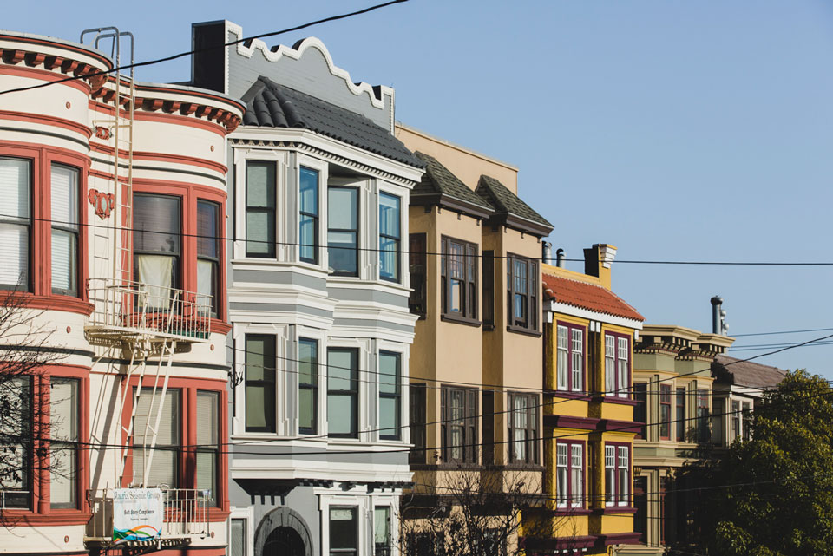
Sarah: Person in Hayes Valley (pt 1)
Simple Task:
Very straightforward layout
Little to no confusion
Was excited by our app idea
Slightly hesitant to click/describe buttons
  Points to our drawing capabilities :O
Moderate Task:
Had some confusion and hesitation about joining a big group of concert goers but seemed on board when I explained motivations
** Sarah declined to take a picture :(

Slide 27
Sarah: Person in Hayes Valley (pt 2)
Complex Task:
Fast to figure out
Liked the map
Thought the matching process was cool
** Sarah declined to take a picture :(

Slide 28
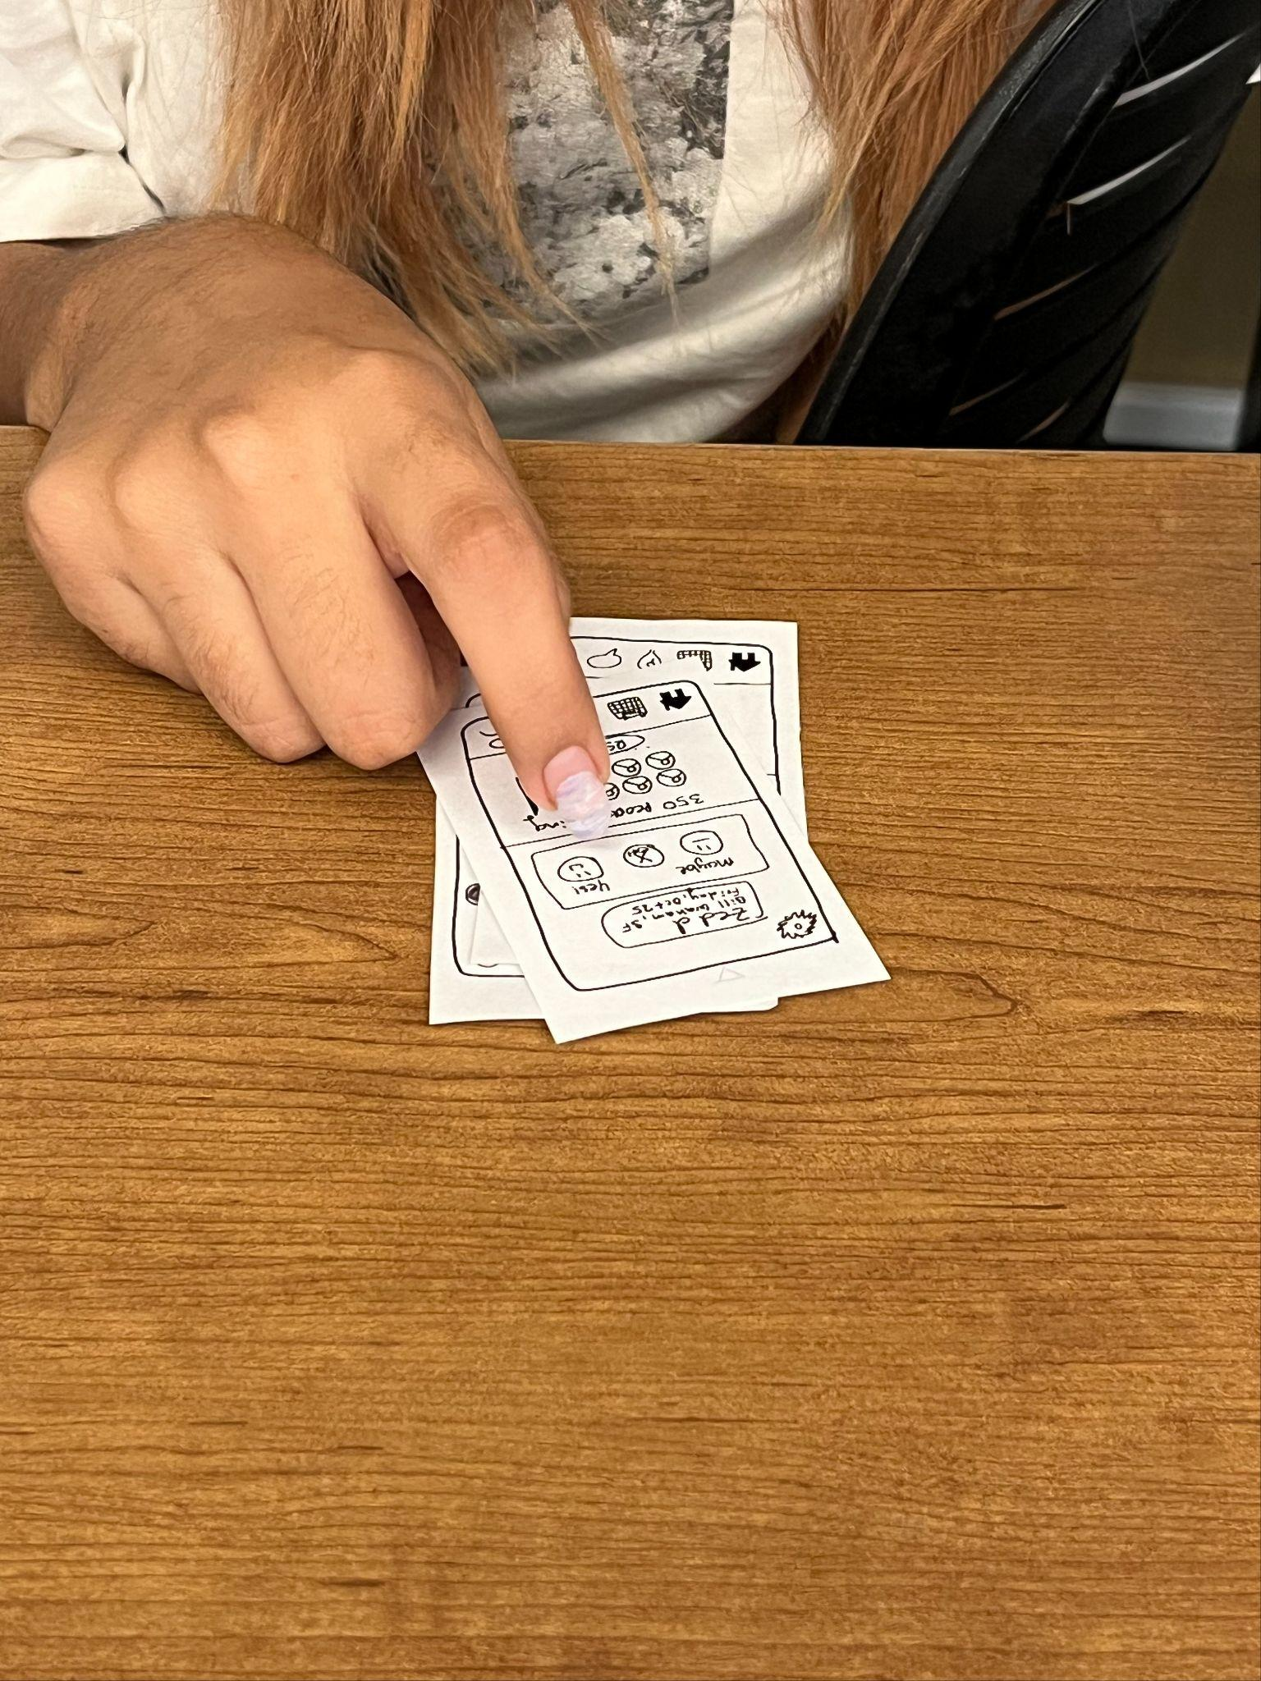
Janelle (pt 1)
Tried to click on the calendar icon when asked to find a concert buddy
Immediately clicked yes on the RSVP even though instructed to rsvp “unsure but then deciding to go”
Tried to change ETA
Liked the exclusive map, wondered what the chatbot did – clicked on the location button and liked the exclusive map but noted it was hard to find
Found the general chat more engaging than the exclusive chat
Was curious to see what would happen if she clicked on a profile picture
FEEDBACK: wanting to plan a concert journey in the far future + not at the location they are physically at, giving users the ability to add a concert they don’t see on the list
Number of questions asked: 3
Confusions: 4 (a lot in general for moderate and complex)

Slide 29
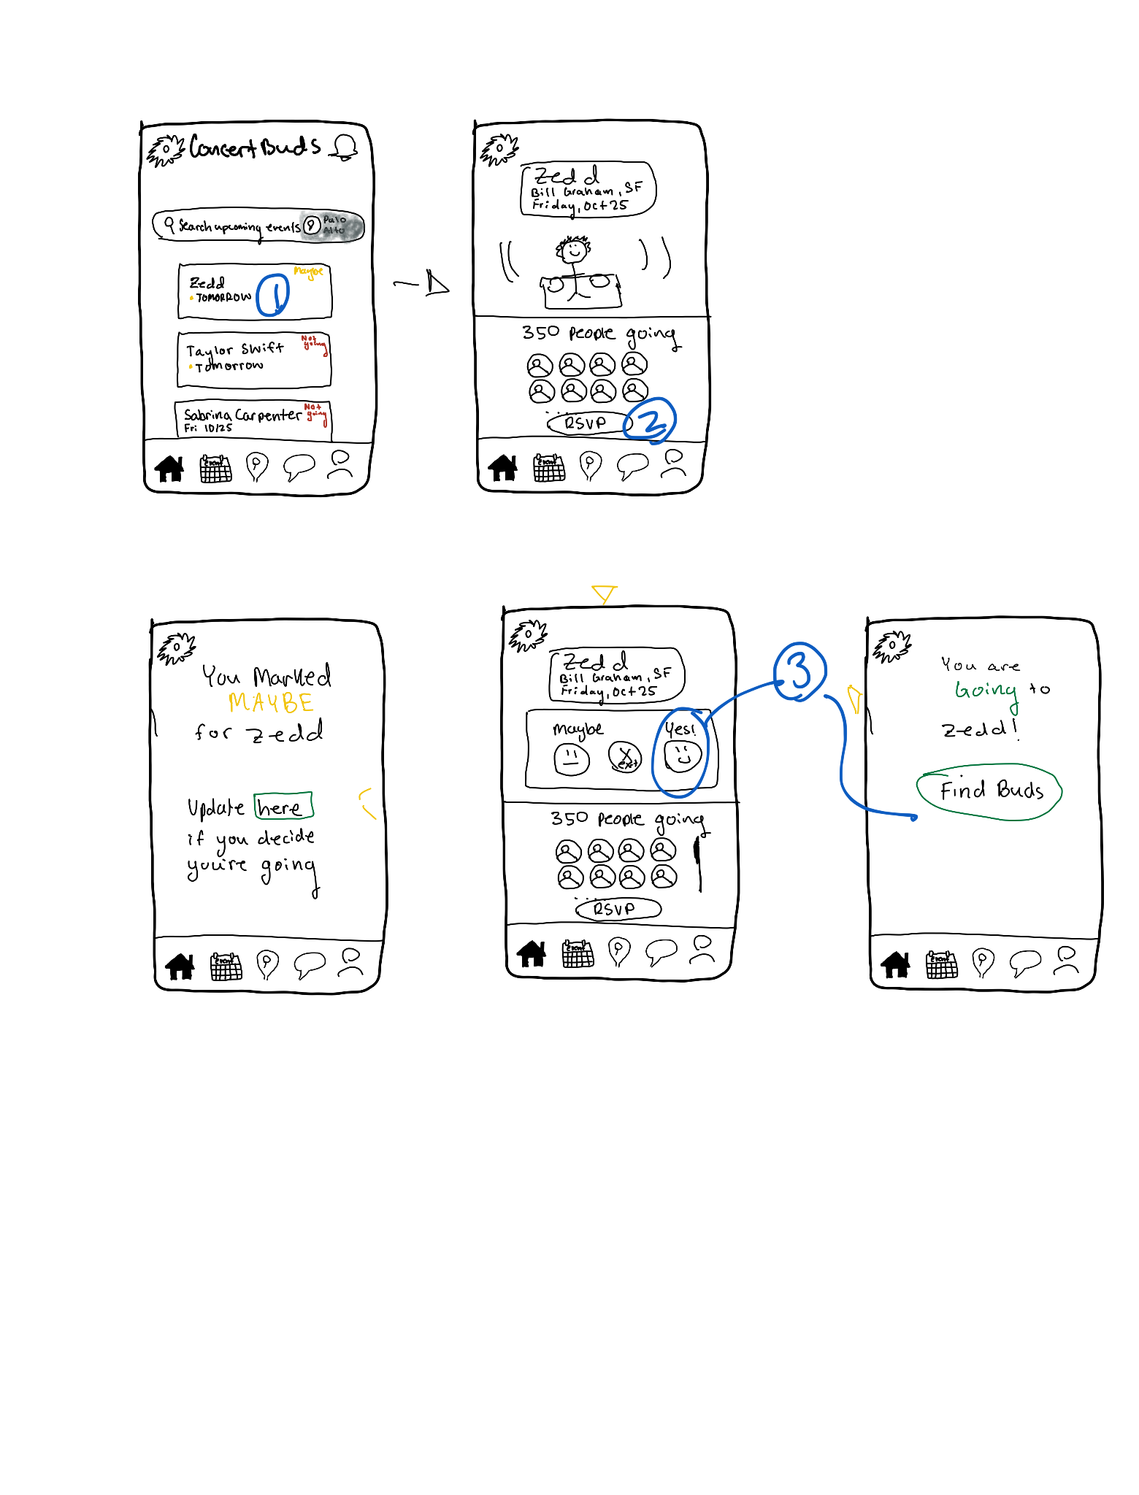
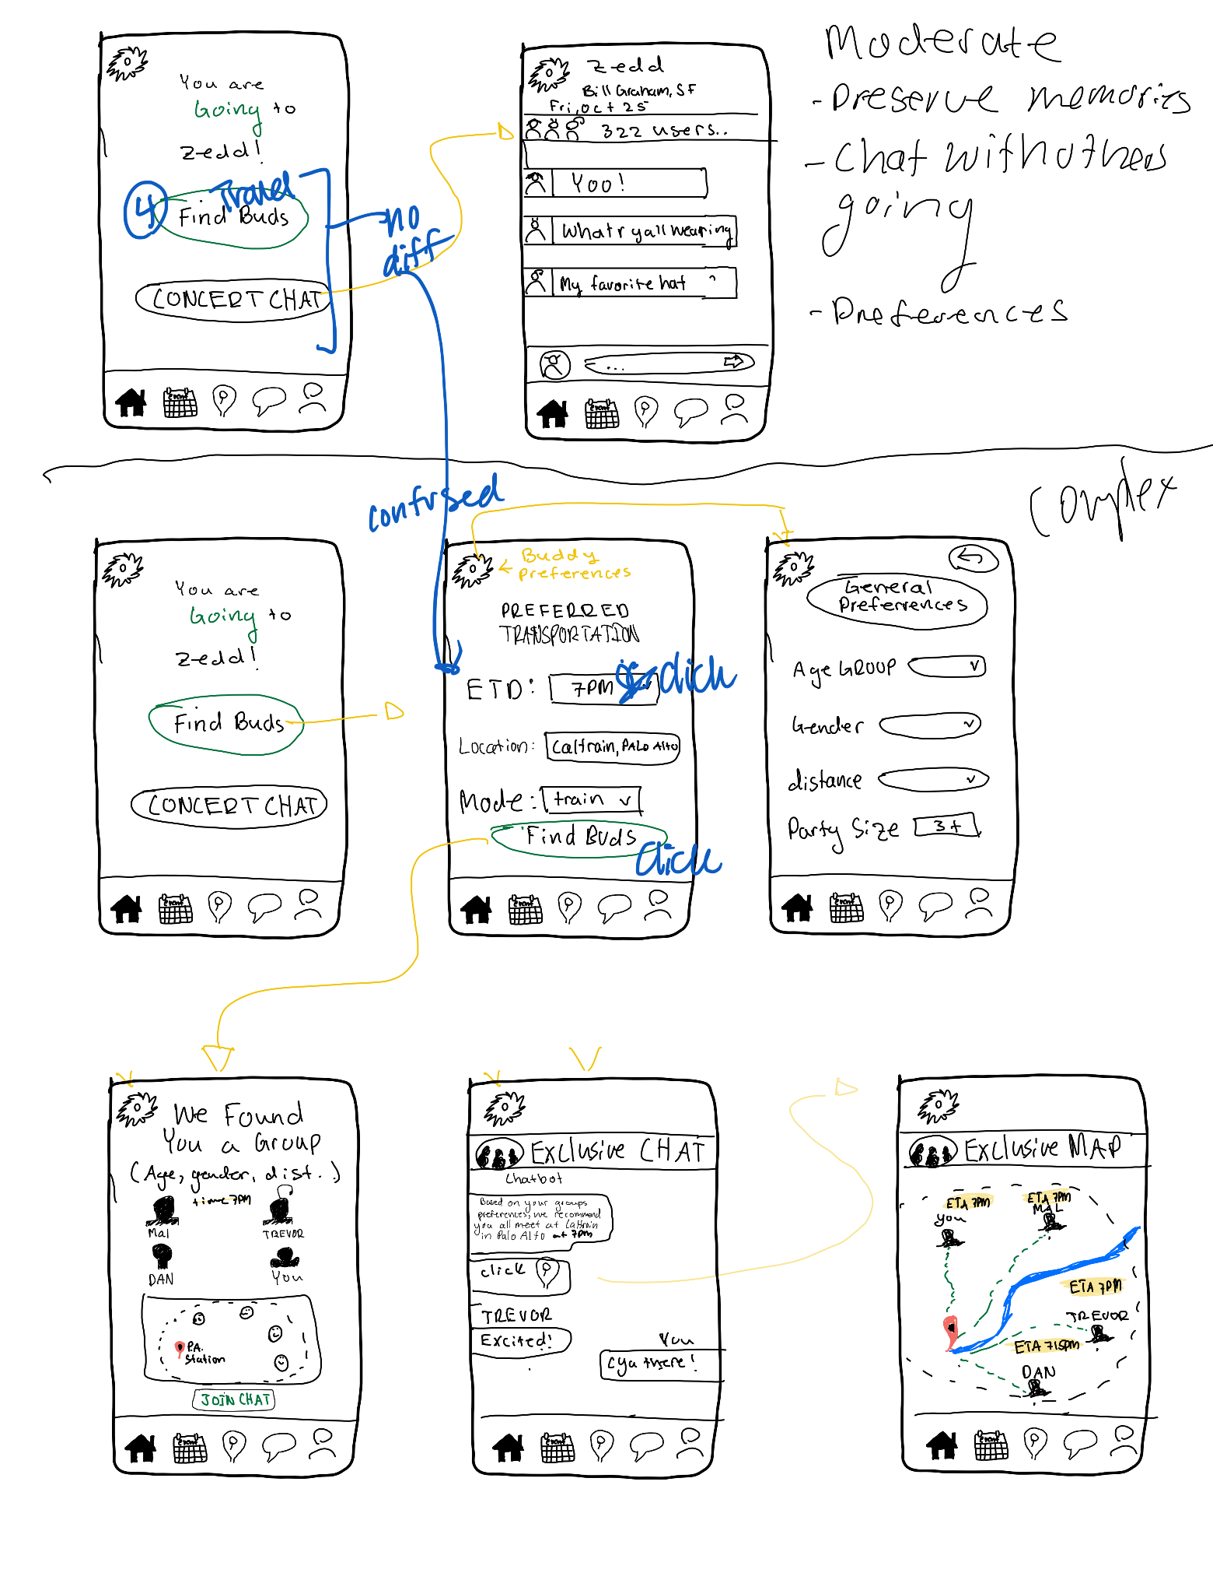
Janelle (pt 2) - map of user’s clicks

Slide 30
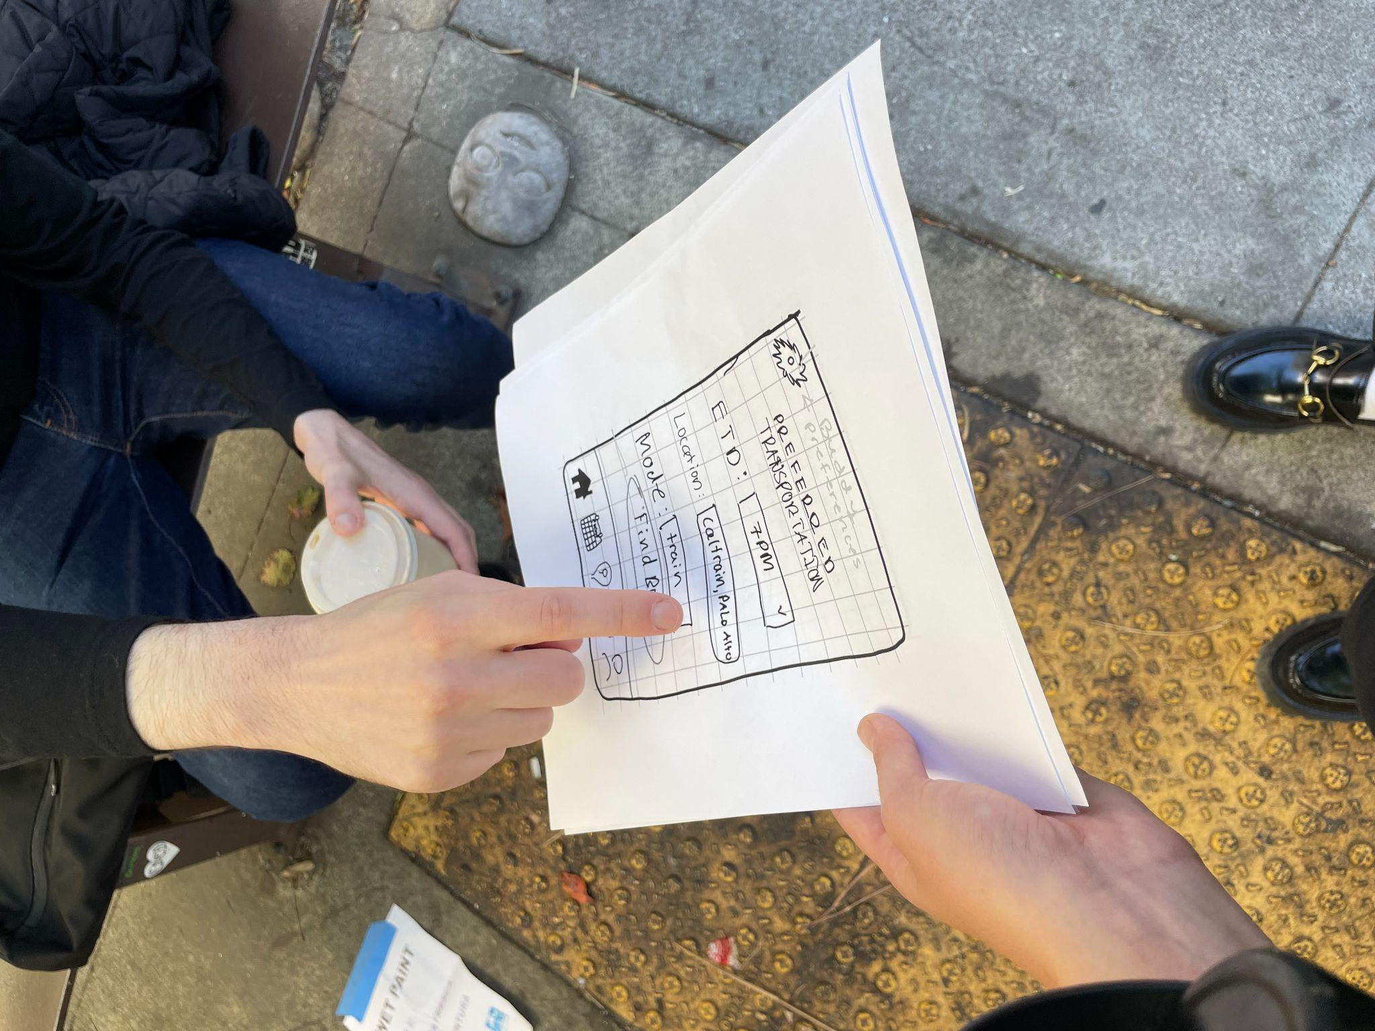
Ben: person in Hayes Valley (pt 1)
Complex Task:
Most functionality was intuitive to Ben
He was confused by the acronym “ETD”
Also seemed hesitant to join a group chat after matching with concert going group
Confused by “swirly button” in the top left (it was our settings button)
Ben clicking away!!

Slide 31
Lo-fi Prototype Testing Takeaways
a. Process data (what’s happening in the big picture)
Most users are confused by the RSVP feature
b. Bottom-line data (usability goal key measurements)
Usability goals:
Quick, easy use:
simple task was easy to navigate
moderate and complex tasks were harder to navigate due to ambiguity in labeling buttons
Defined, clear tasks:
yes
Intuitive Interface & Workflows:
Missing steps in navigation, more customizable,
Notes:
Process data (what’s happening in the big picture) b. Bottom-line data (usability goal key measurements) c. Other relevant observations d. How well did you achieve your usability goals based on the key measurements?

Slide 32
Lo-fi Prototype Testing Results
Process data
Most users are confused by the RSVP feature
Confusion on “swirly button” (i.e. settings)
Hesitation and lack of motivation for joining a big group chat of concert goers
Users want to see additional features (e.g. history, adding an unpopular artist) that our simple, moderate, complex tasks do not cover
Bottom-line data
Some misclicks! (4 total)
Quickly managed task flows, especially for simple and moderate tasks (average total time: 15 minutes)
Usability goals:
Simple task was easy to navigate
Moderate and complex tasks were harder to navigate due to ambiguity in labeling buttons
Missing steps in navigation, more customizable options for user searching concerts & locations
Notes:
Process data (what’s happening in the big picture) b. Bottom-line data (usability goal key measurements) c. Other relevant observations d. How well did you achieve your usability goals based on the key measurements?

Slide 33
Lo-fi Prototype Discussion - Implications
Implications:
The social feature is the most engaging part of our app, while navigation takes the backseat.
Multiple screens looked similar but in the design, are different in functionality (e.g. exclusive chat + general chat).
Icons draw attention but if their meaning/functionality is ambiguous, could confuse users.

Slide 34
Lo-fi Prototype Discussion - Changes
Future changes to our design:
We need to update our RSVP functionality and add a back button!
We need a clearer distinction between the functionality of finding concert buds and joining the general concert group chat
Only one participant used our taskbar. We need to add ease of navigation such as back buttons, functionality for searching concerts and viewing countdowns of concerts

Slide 35
Lo-fi Prototype Discussion - Limitations
Testing couldn’t reveal:
Accuracy of using icon buttons – a limitation since they were hand drawn
Navigating backwards – how long it would take a user to correct a misclick
How likely users would participate in concert chatroom vs passively read messages

Slide 36
Appendix

Slide 37
Full List of Pros and Cons - AR
PROS
CONS
Fun planning; feels like part of the concert vibe
Cool, immersive visuals that match the concert theme
Easy way to meet other concert-goers
Real-time directions to transit, meetups, venue
Creates shareable, unique memories (concert-themed filters)
Social boost: group up, share rides, hype each other up
Real-time transit alerts; no more missed stops
Learning curve—AR isn’t easy for everyone
Privacy concerns with location sharing
Dependent on newer phones, good internet
Major battery drain; need a portable charger
Can distract from surroundings (public transit)
Info overload: might get too chaotic
Limited accessibility; not great for all users

Slide 38
Full List of Pros and Cons - mobile app
PROS
CONS
Easy to use; familiar for most people
Accessible on most smartphones
Great for messaging, media sharing, connecting fans
High functionality—supports navigation, social features
Push notifications for instant updates
Offline access for saved maps, schedules
Customizable profiles, preferences for a personal touch
Requires download; might deter some users
Takes up phone storage
Hard to stand out in crowded app market
Data privacy concerns, especially with location use
Compatibility issues on older devices
Battery drain from GPS, background features
Needs frequent updates for OS compatibility
Notes:
Additional Pros:
Novel App
Additional Cons:
Matching is hard to implement on the development side
Stalking

Slide 39
A ton of sketching on Figma and then Notability (Figjam is a pain.)
https://www.figma.com/board/GedqG1YsNXGDhTHpWmO4K0/lofi-prototype?node-id=0-1&node-type=canvas&t=F8wyXYfUNjrvDW1X-0

Slide 40
Henry’s Sketches

Slide 41
sarah

Slide 42
Matt Sketches

Slide 43
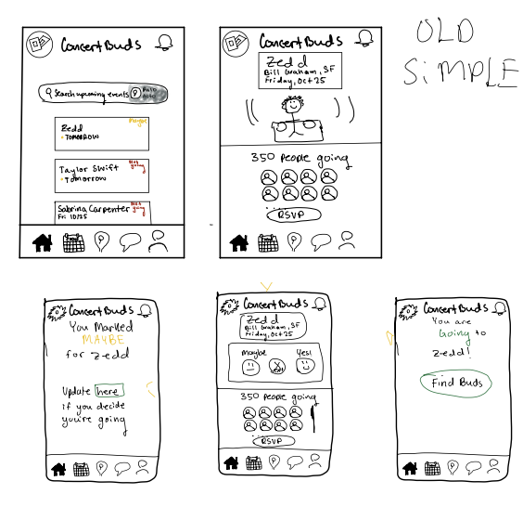
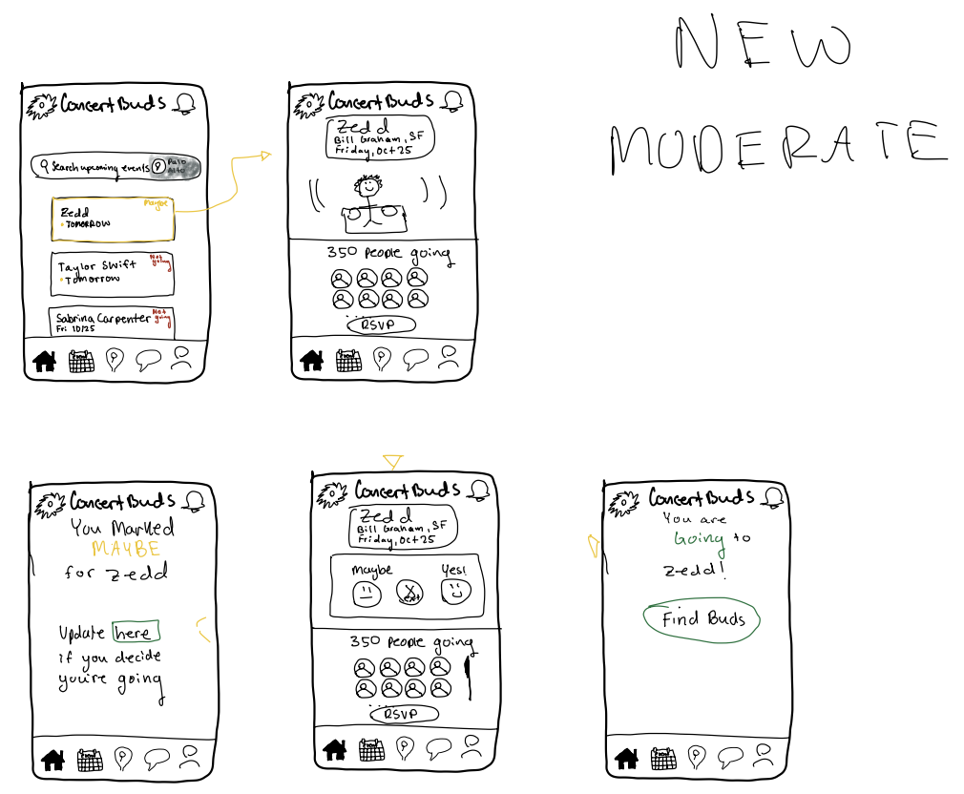
Matt Sketches
Content here

Slide 44
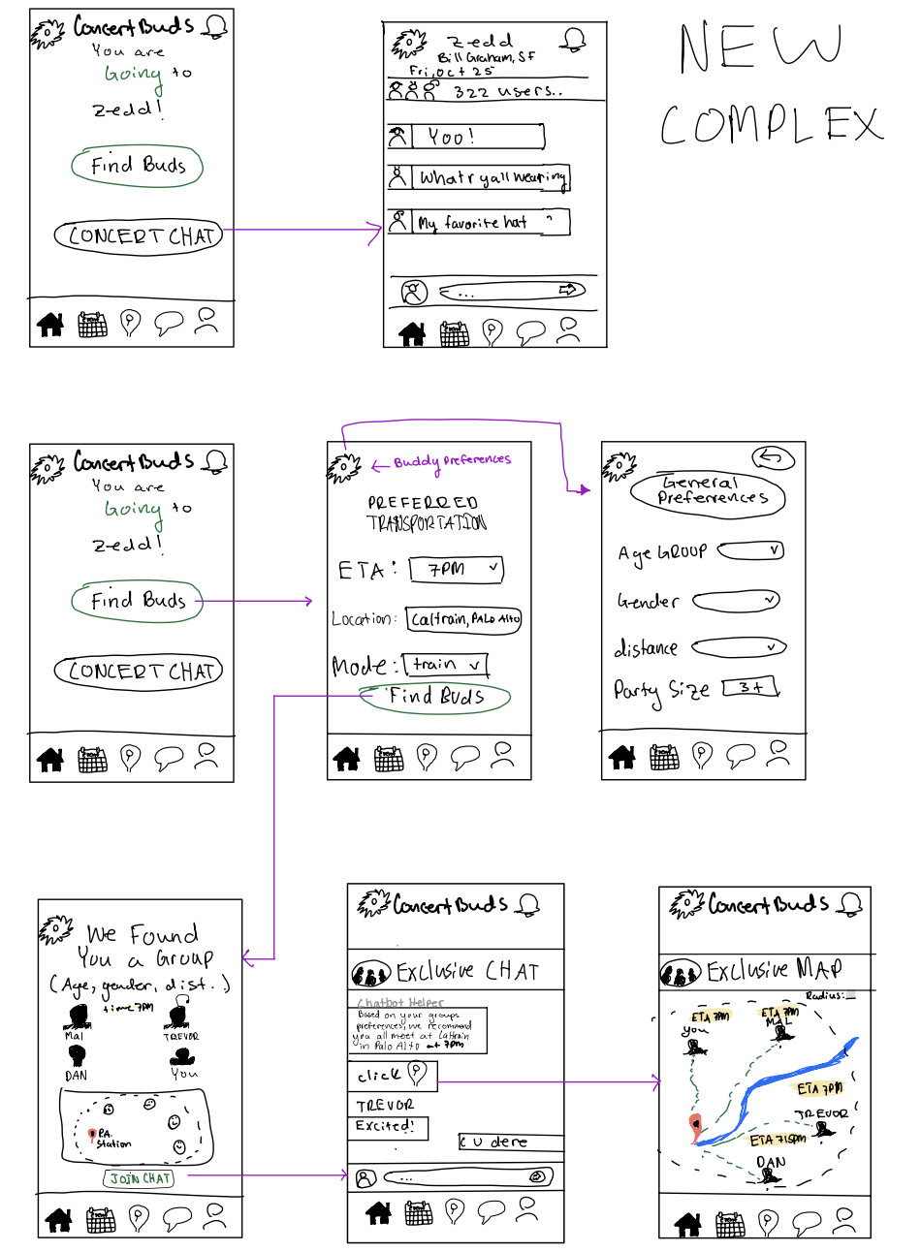
Matt Sketches

Slide 45
Izzy Sketches

Slide 46
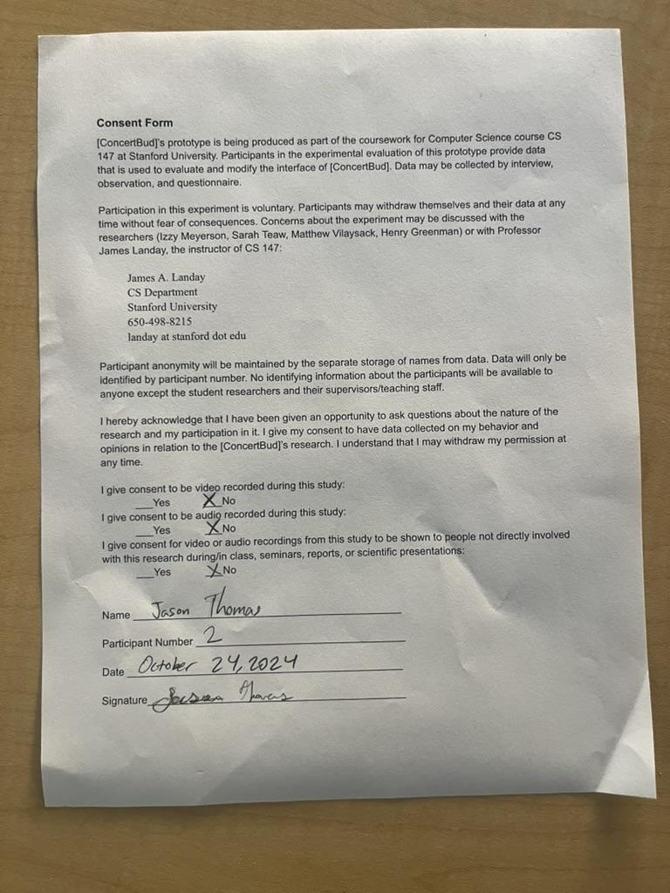
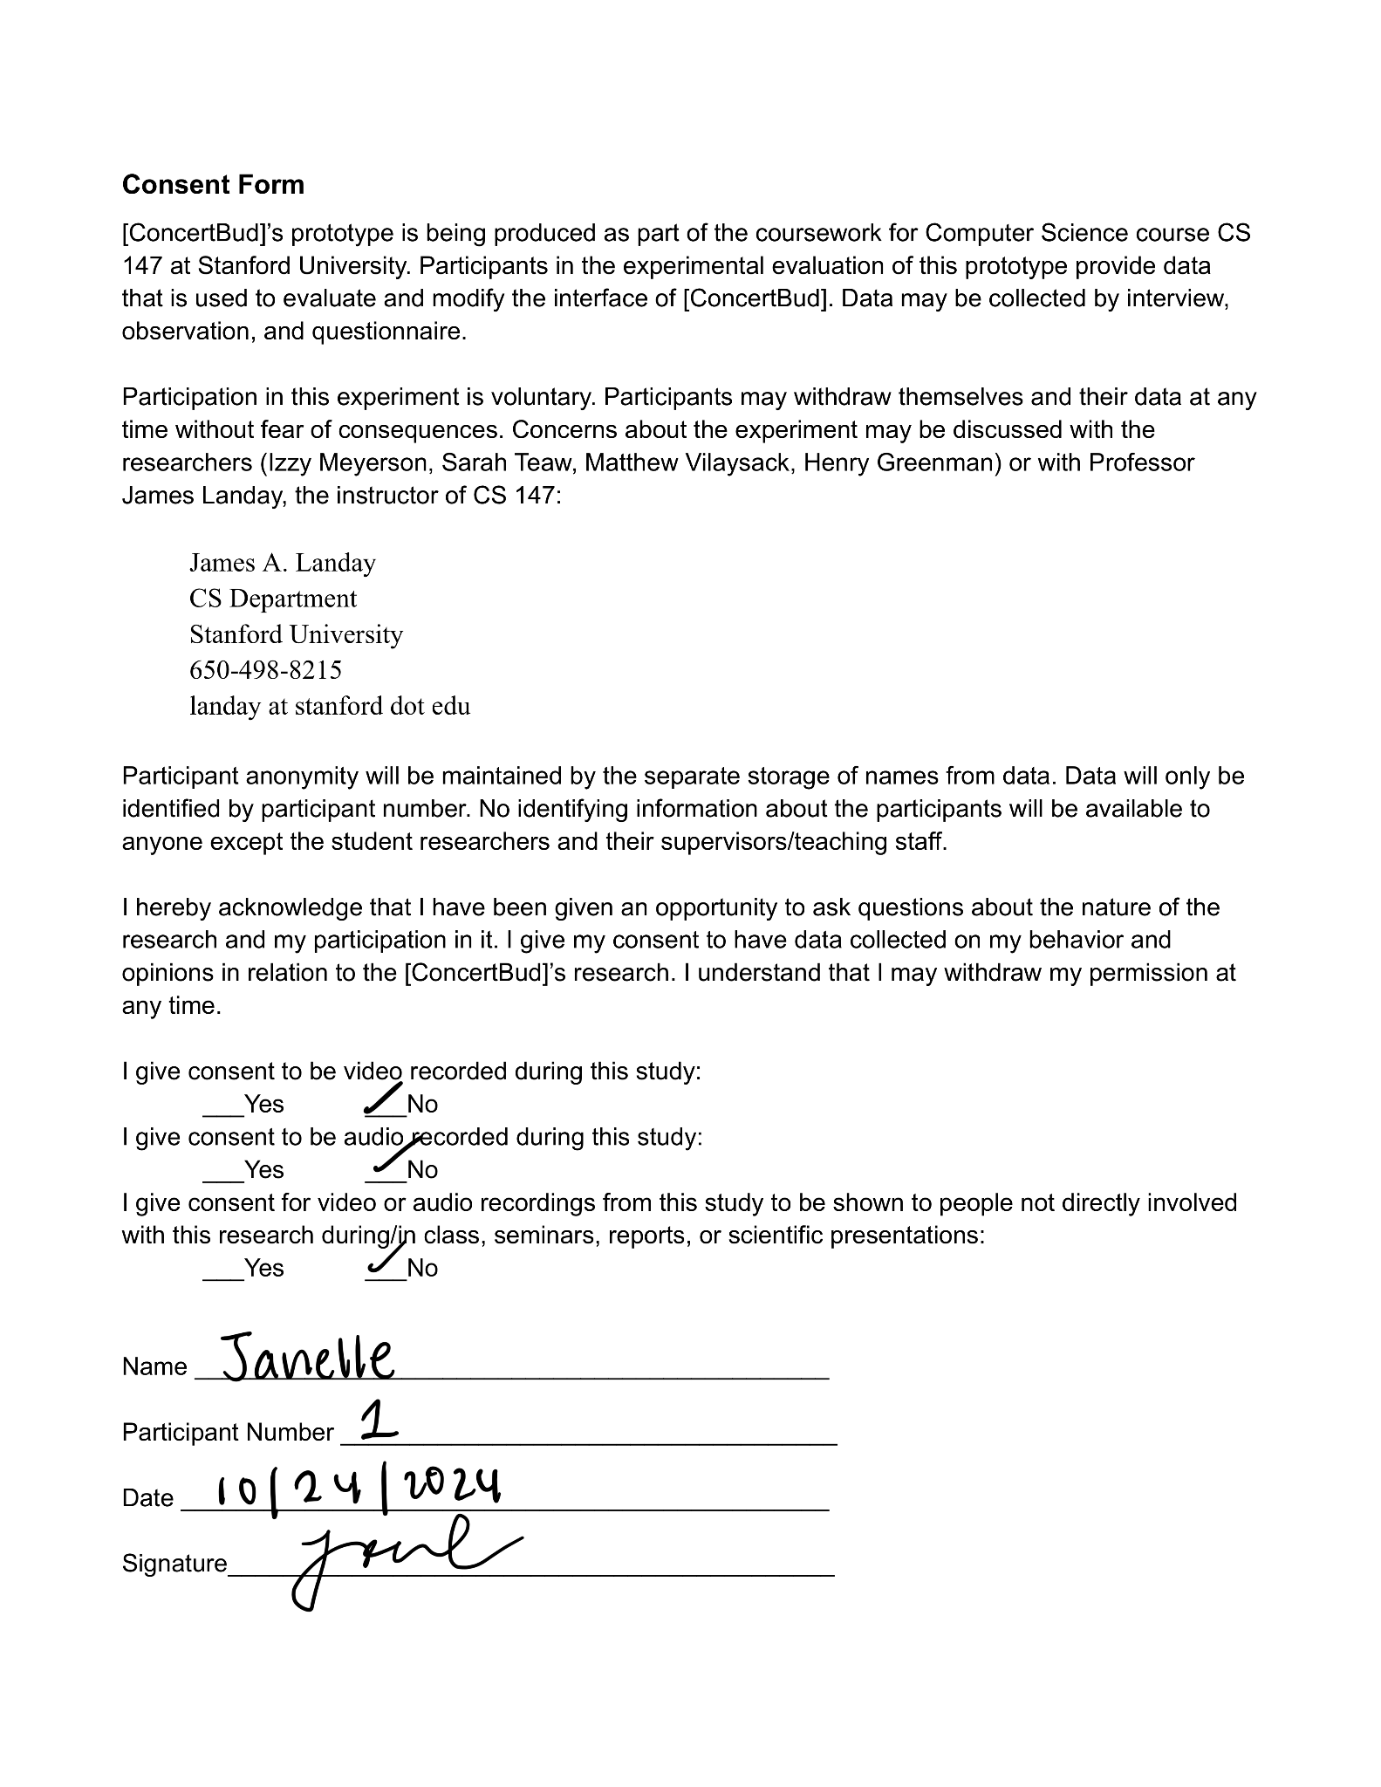
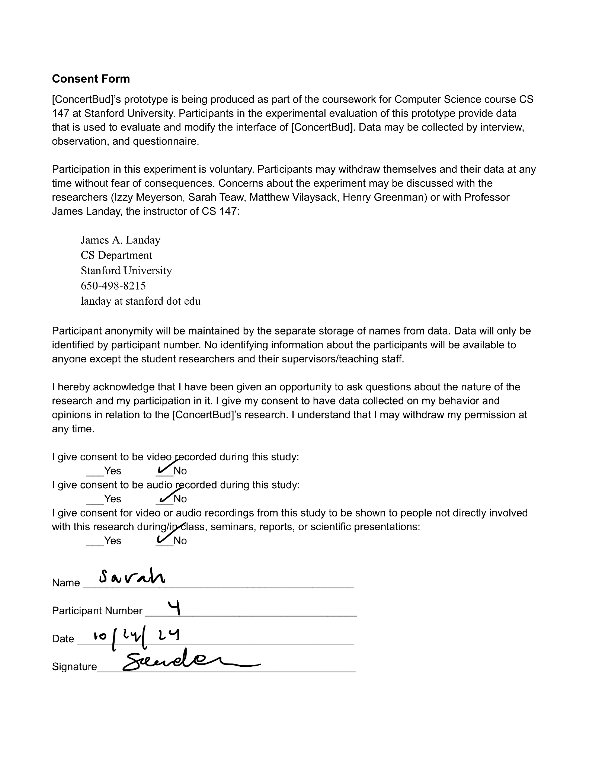
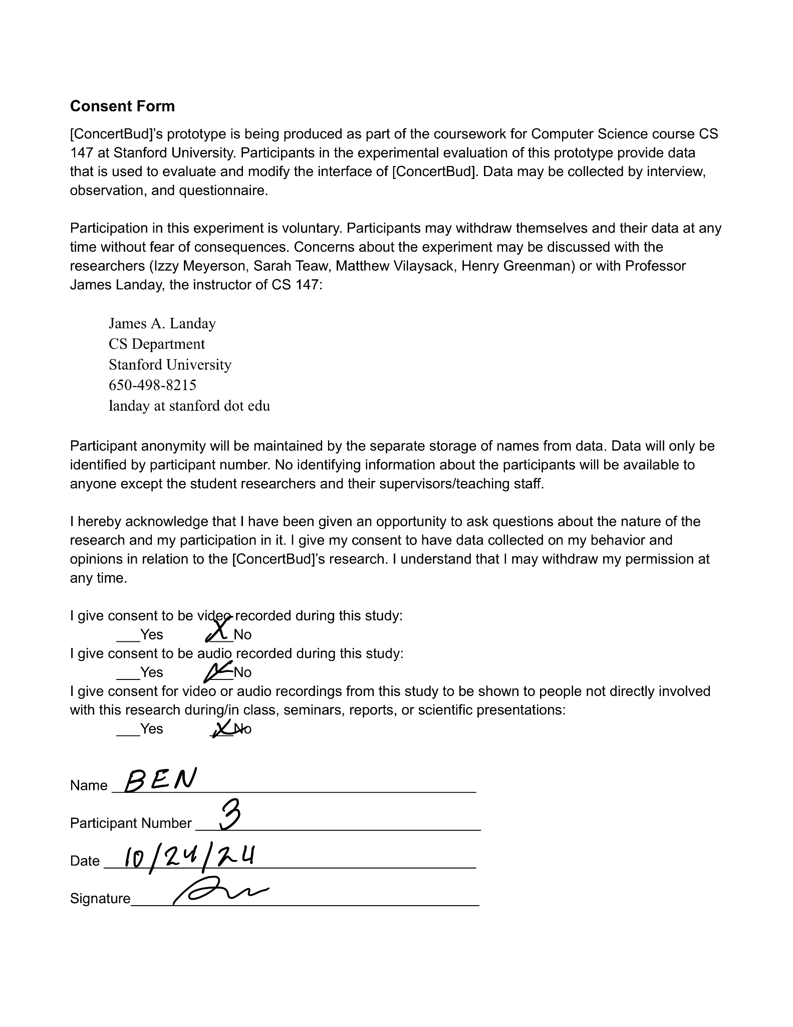
Consent Forms

Slide 47
Link to our script
https://docs.google.com/document/d/1Gt2Kk55MlI2AGGK2Ucgc3F2xInZAvnZPbqW-h9om3NM/edit

