Slide 1
Collabrio Concept Video
Alexander, Armita, Cate, and Manas

Slide 2
Collabrio
Through brainstorming on a whiteboard, we landed on this name because it is short, memorable, and focused on our core value, which is long-term collaboration.

Slide 3
One-Liner
A platform where an employer’s network is used to match them with freelance collaborators for long-term project partnerships.

Slide 4
Problem & Solution
Problem: It is very hard to find people outside of one’s typical network when you have a specific need
Primary User: Freelancers
Solution: Collabrio aims to connect people with those outside of their typical network in order to work on collaborative projects and form and maintain professional relationships

Slide 5
Market Analysis - LinkedIn
What Works
What Doesn’t
Takeaways
Facilitating professional, networking across degrees (first, second, third)
Top tool for finding jobs and recruiting talent
Visibility across multiple diverse industries
Overly broad focus and tailored to traditional career paths
Noise and irrelevant content from unsolicited sales pitches and posts
Underutilized features such as event planner
Greate for traditional careers and long-term paths
Less suited for freelancers and project-based collaborations
Opportunity for niche platform to create more streamlined experience for freelancers

Slide 6
Market Analysis - Upwork
What Works
What Doesn’t
Takeaways
Organization of industries for freelancers
Jobs suggested based on matching tags
Can import your resume from LinkedIn
Reviews post-gig to build credibility
Have to pay for “connects” just to bid on jobs
Employers are impersonal with no profile besides stats
Freelancers compete by paying for ads
Limited tags - only pre-existing options
Import your resume, not just your network
Allow users to self-describe and then organize
Focus on the connection between employer and employee

Slide 7
Market Analysis - Sprout
What Works
What Doesn’t
Takeaways
Connects musicians with one another quickly
The music train product is a creative solution
Creates a space for content creators to network
Doesn’t foster long-term relationships
Doesn’t leverage a user’s existing network
Only targets musicians
Unclear whether it is a content creator tool or networking tool
Target user base needs to be well-defined
Need way to effectively match collaborators
Prioritize aspects of product which promote long-term relationship growth

Slide 8
Market Analysis - TaskRabbit
What Works
What Doesn’t
Takeaways
Taskrabbit helps connect people to solve problems
  Targeted problem: home improvement
  Customers sometimes reach out to the same workers if satisfied
Taskrabbit fails in fostering long term-relationships
  Workers > users for their app
  Lack of accountability / visibility between groups
Taskrabbit:
  Connects People
  Solves short-term problems
  Helps maintain employer / customer relationships
We must help foster connections more as equals

Slide 9
Market Analysis - Overall
 | Collabrio | LinkedIn | Upwork | Sprout | TaskRabbit
Sets freelancers and employers as equals
Builds long-term relationships
Works for gig work
Works for niche projects

Slide 10
Direct & Indirect Stakeholders
Freelancers
Project managers
Direct: Independent professionals looking to collaborate on projects and expand their work opportunities
Direct: Individuals overseeing freelance projects and looking for skilled people to join a team
Clients of freelancers
Productivity Platforms
Indirect: Individuals and businesses who benefit from higher quality work
Indirect: Platforms like Google Workspace, and Notion may see increased usage as freelancers find project partners

Slide 11
Ethical Implication #1
Over-reliance on digital connections
  Can lead to lack of personal interactions, making it more difficult to maintain long-term relationships
Reflects a tension between the value of efficiency (finding collaborators quickly online) and authenticity (fostering genuine relationships)
  Relationships are instrumental to Collabrio as we focus on long-term partnerships and connections
Can be addressed through opportunities for virtual or in-person meetings, video calls, and collaboration sessions
  Build rapport

Slide 12
Ethical Implication #2
Collabrio utilizes one’s existing network, so two friends can become collaborators. Challenges that may arise:
  Their relationship can become transactional
  They may not work well together / get into conflict
  Someone may anticipate to be picked for a project solely on the basis of their connection
Can be addressed by offering tools to set clear expectations, professional boundaries, and to resolve conflicts
Prioritize finding the people with the right skill set before network

Slide 13
Simple Task
Find someone from your extended network for a specific project
This task is defined as simple because it is the main functionality of our app, and a goal of almost every user. It is constant because freelancers often need multiple collaborators for simultaneous projects.
TIME IN VIDEO: 0:51

Slide 14
Moderate Task
Share the project you worked on and connect it to a new tag
This task is defined as moderate because most users will want to share and organize their work as it furthers their portfolio and resume. This task is frequent as freelancers are often completing projects.
TIME IN VIDEO: 1:21

Slide 15
Complex Task
Organize your portfolio and profile with AI
This task is complex as profile organization is infrequent and not every user will feel the need to get assistance. However, for freelancers who want to enhance their portfolio, it is a helpful tool.
TIME IN VIDEO: 0:43

Slide 16
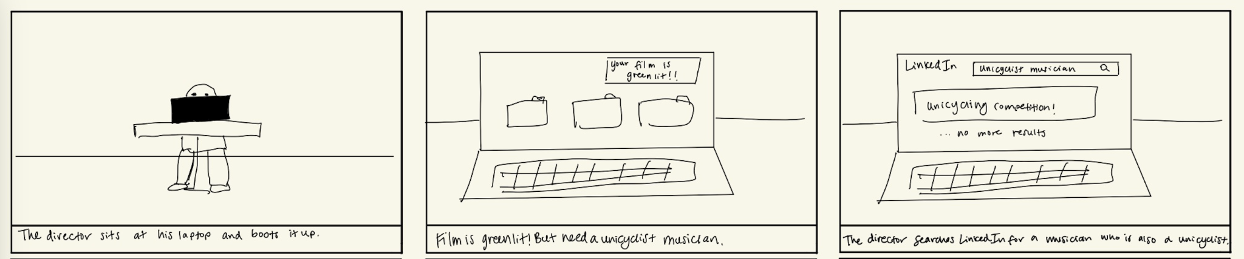
Storyboard - Premise

Slide 17
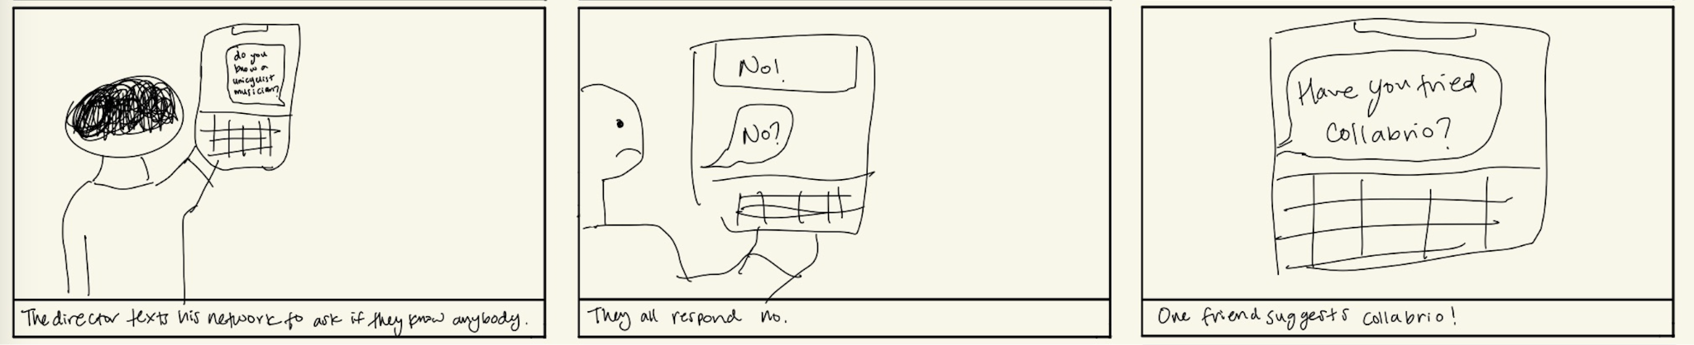
Storyboard - Problem Space

Slide 18
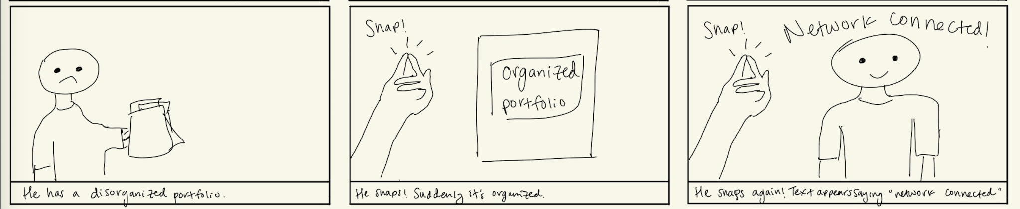
Storyboard - Onboarding
Complex Task!

Slide 19
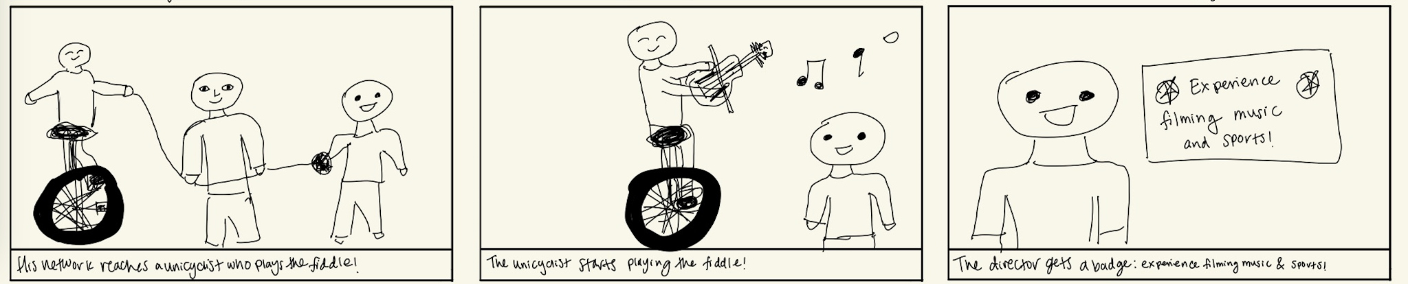
Storyboard - Resolution
Simple Task!
Moderate Task!

Slide 20
https://youtu.be/L2YgkFx09ps

