Slide 1
Team 2: Hi-fi Prototype
Alexander, Armita, Cate, & Manas

Slide 2


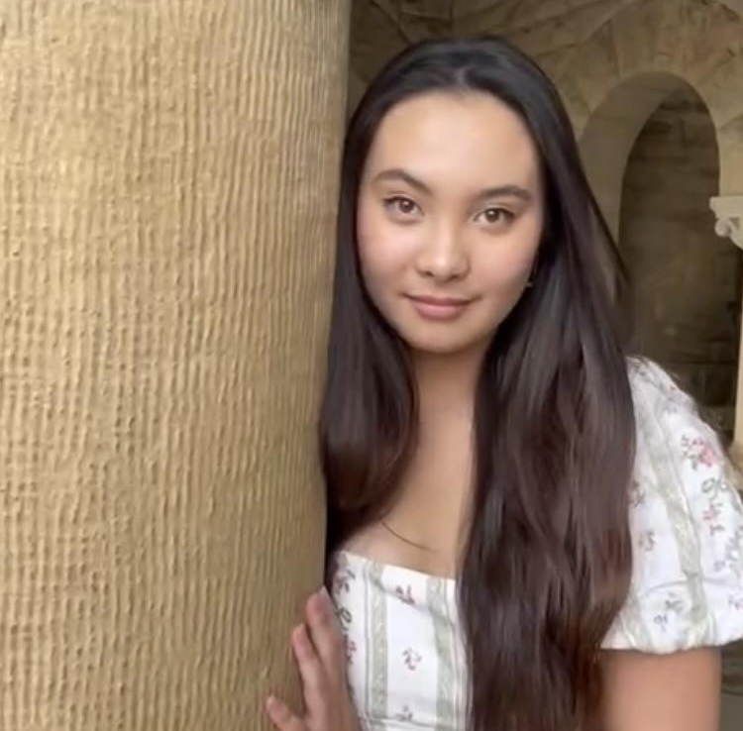
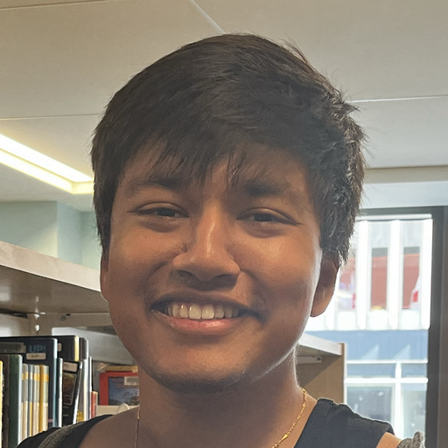
Our Team
ALEXANDER
ARMITA
CATE
MANAS

Slide 3
Value Proposition
Collabrio is a platform where an employer's network is used and expanded to match them with freelance collaborators for long-term project partnerships.

Slide 4
Problem & Solution
Problem: It is very hard to find people outside of one’s typical network when you have a specific need
Primary User: Freelancers
Solution: Collabrio aims to connect people with those outside of their typical network in order to work on collaborative projects and form and maintain professional relationships

Slide 5
Presentation Outline
01
02
03
04
Prototype Implementation
Heuristic Evaluation Results
UI & Product Revisions
Prototype Demo

Slide 6
01
Heuristic Evaluation Results

Slide 7
Heuristic Evaluation Results
Most Common
Total Violations
Violation Severity
75
1: 32
2: 28
3: 15
4: 0
H4: Consistency & Standards
- 18
H1: Visibility of System Status
- 9
H3: User Control & Freedom
- 9
H8: Aesthetic & Minimalist Design
- 8

Slide 8
Heuristic Evaluation - Overall Insights
Make critical information about users available on all relevant pages
Adjust padding, terminology, and margins to appear consistent on all pages
Create streamlined feature dedicated to DMs
Make all three tasks easier for users to complete
  Additional tabs
  Implicit feedback
  Incorporation of home screen into tasks
Reduce clutter on search page
A way for users to directly access their connections
Add cancel buttons for uploads

Slide 9
Heuristic Evaluation - Revisions
Total number of revisions: 26
Level 3 Violations – Addressed
Improving search page:
  “Find people like you” button
  Remove existing connections from search tab
Add “your connections” button to profile page
Add cancel button for sync AI portfolio and website
Change messaging system to chat format
Change notifications tab to a chat icon
Remove unnecessary features like “sort by”
Removing pressable icons are within text box of message
Level 4: None listed

Slide 10
Heuristic Evaluation - Revisions
Level 3 Violations – Suggestions Not Addressed
Further explanation of tab icons – standard icons used, self-explanatory
Scrollable bar showing person’s portfolio is too small – merely a preview, meant to be scrolled through for examination
Add website or resume buttons are limiting for people in music/video – website can link to video/music
Share button is unclear – it is a send icon, meant to be sent through messages
Level 4: None listed

Slide 11
02
UI & Product Revisions

Slide 12
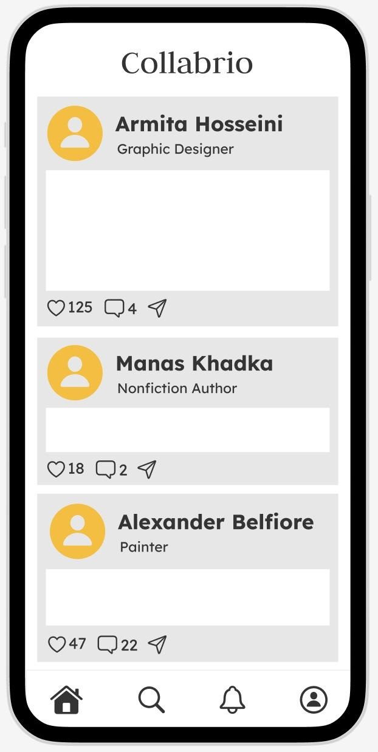
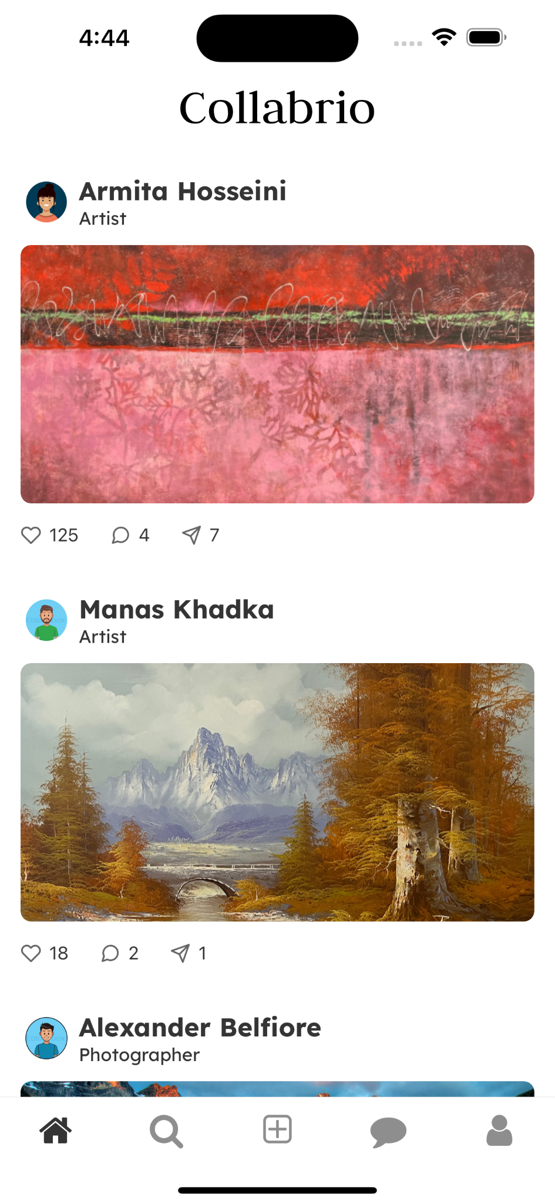
UI & Product Revisions
White boxes → user’s recent portfolio upload
Profile pictures
Intuitive: users are directly aware of the purpose the home page serves and can quickly recognize people in their network
H11: Colour contrast between white grey might be challenging for someone with low vision

Slide 13
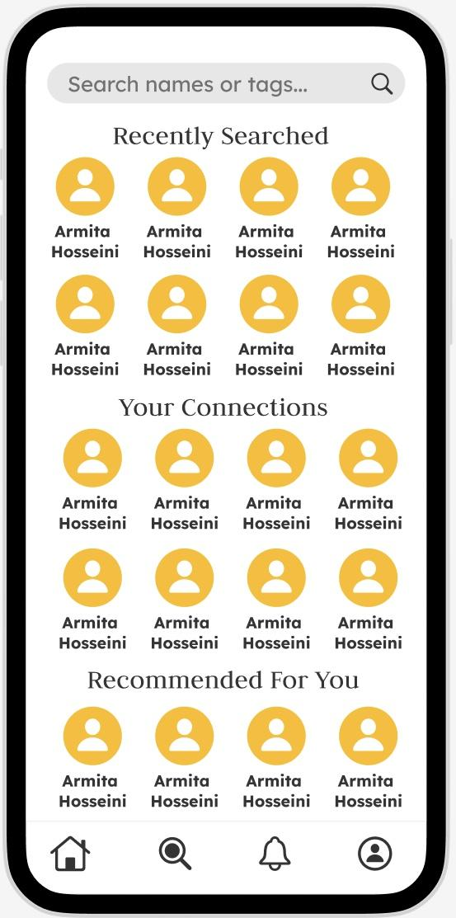
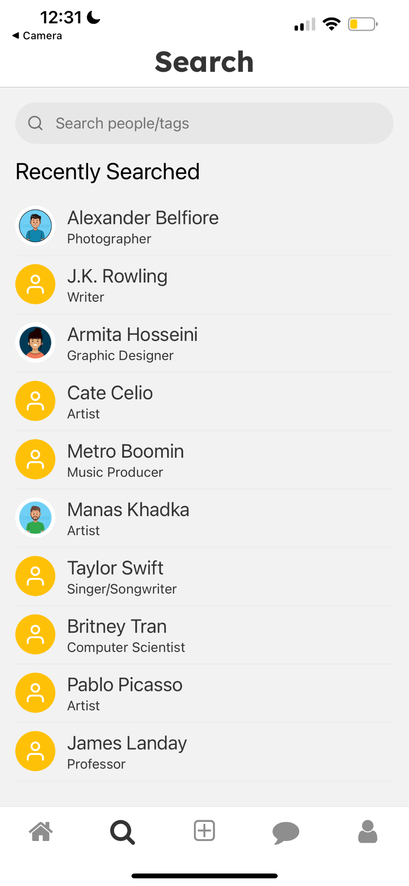
UI & Product Revisions
Removed “Your Connections” section of search page
Converted to list view
H8: Too much information on the search page, causing clutter
H2: Users expect to use searching button for searching purposes, not viewing connections. Especially with large networks

Slide 14
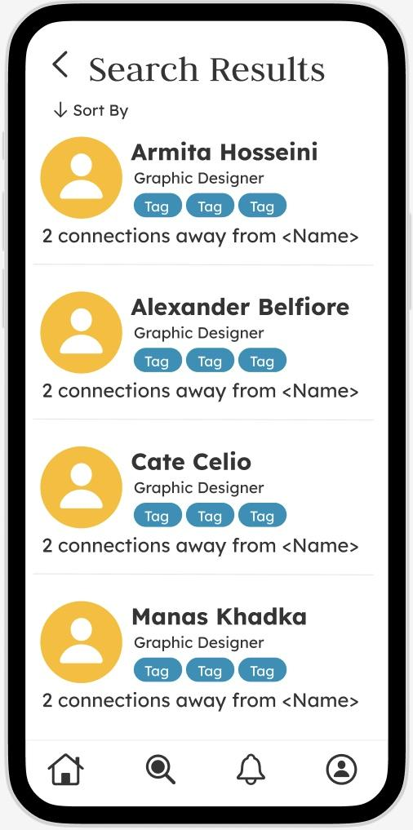
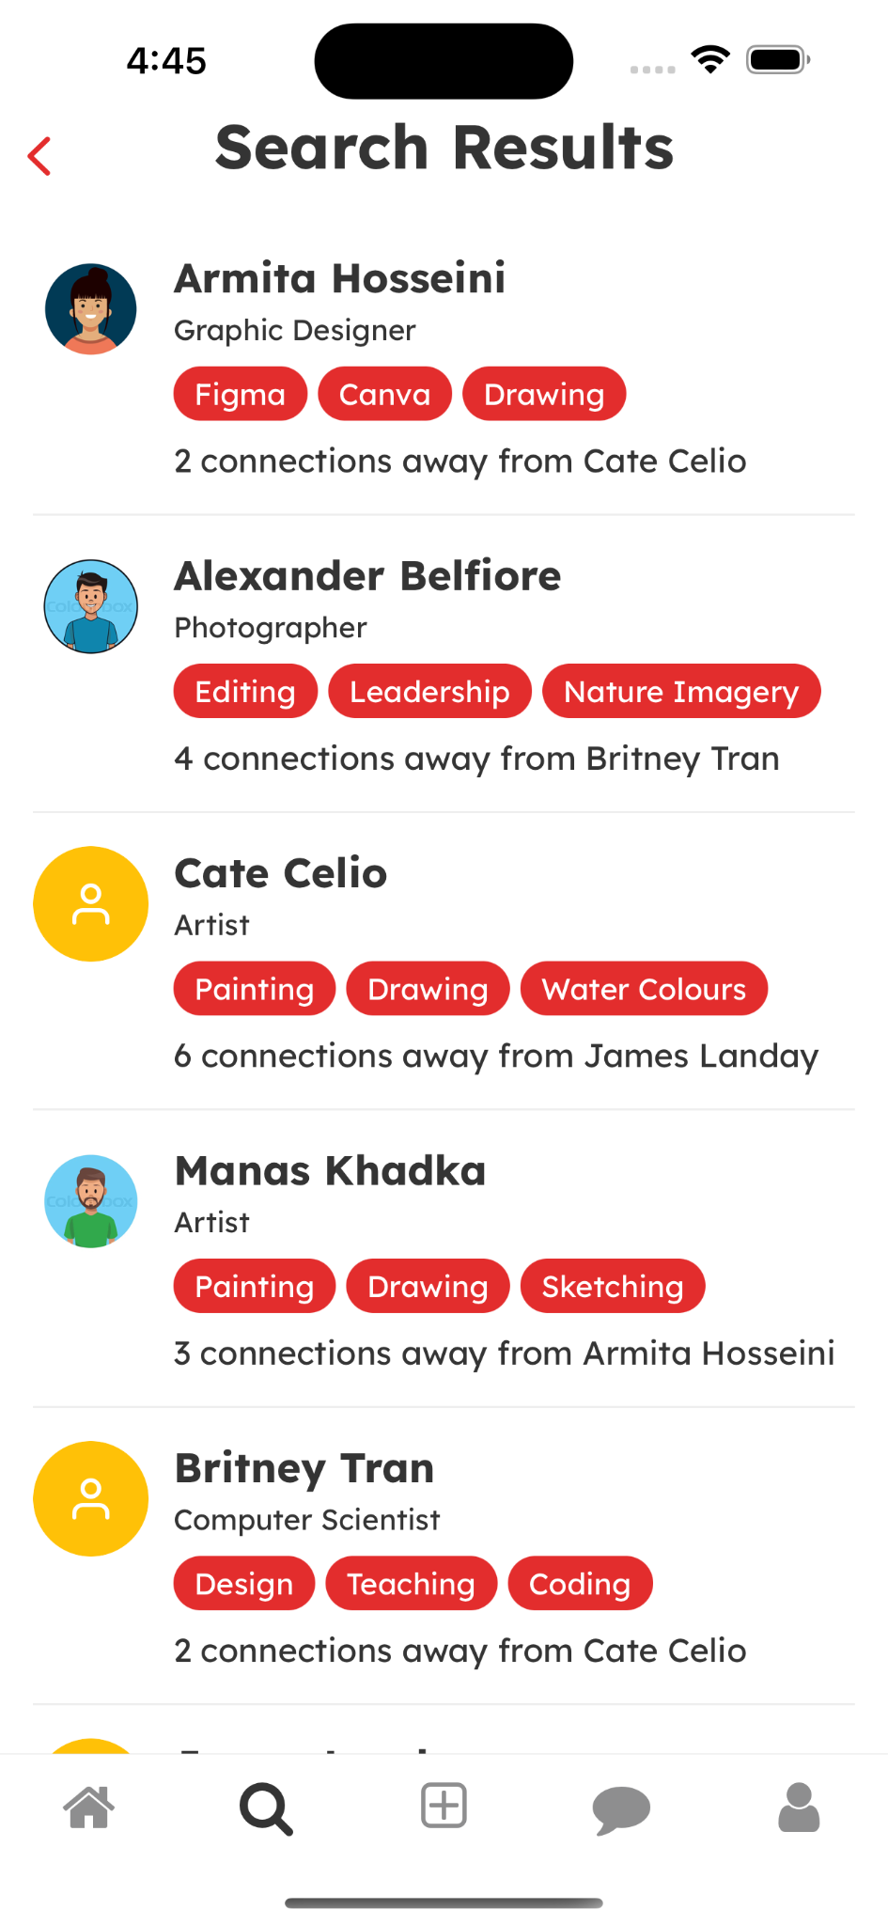
UI & Product Revisions
Tags: blue → red
  Consistency in app colours
Included content in tags, “connections away from”
Removed unnecessary sort feature
Efficient: user does not wonder purpose of unneeded features
Intuitive: Design aligns with rest of app, easy to follow

Slide 15
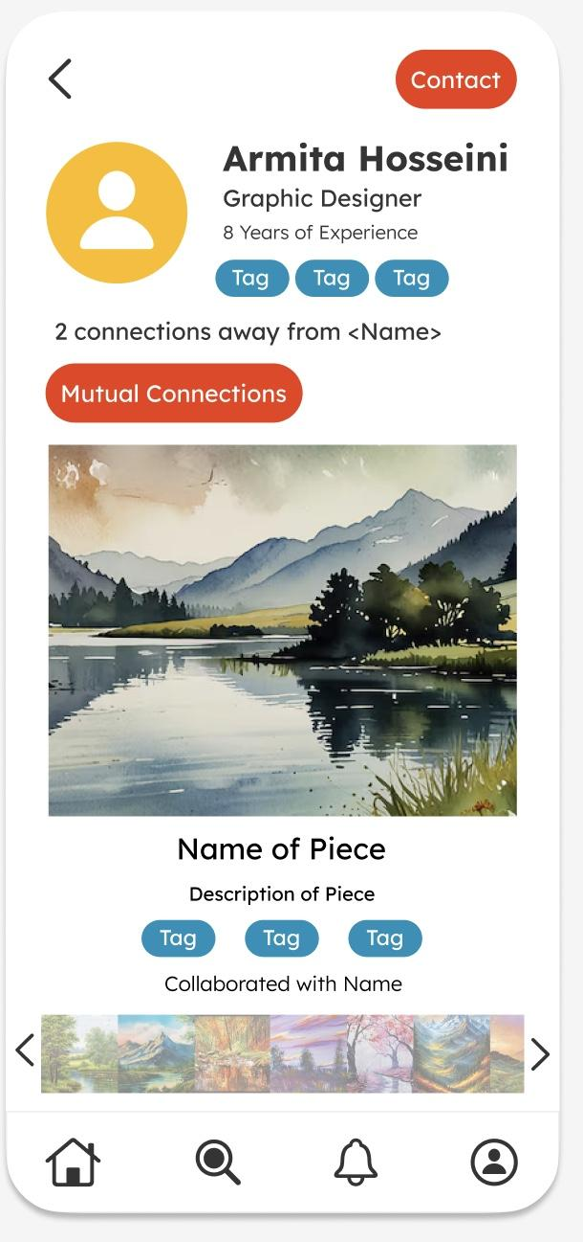
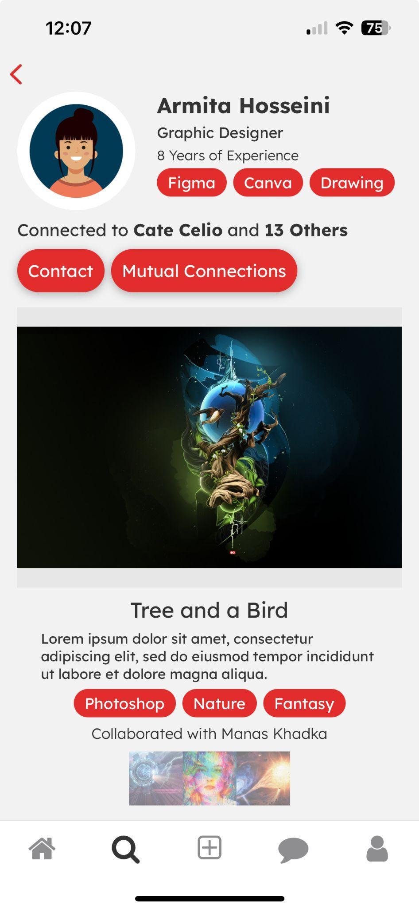
UI & Product Revisions
Moved contact button next to mutual connections
H4: Contact button was in the header of the screen, and this button layout was not seen on any other page
Intuitive: Users can focus their attention on the center of the person’s profile and see all the functionality they need there

Slide 16
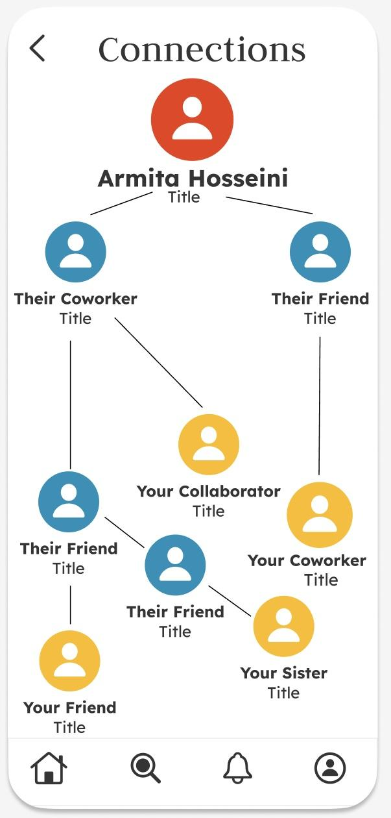
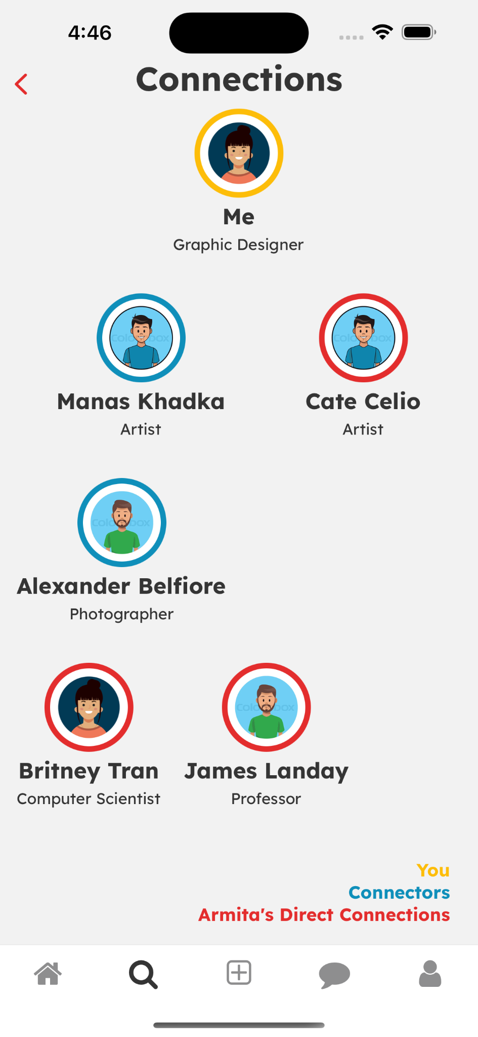
UI & Product Revisions
Added profile pictures to better simulate
Added color-coded borders and a key
Swapped colors to standardize your profile color as yellow
Intuitive: explaining the color-coding and standardizes it helps users understand the tree at a glance
H8: Removed unnecessary lines for clear, uncluttered appearance

Slide 17
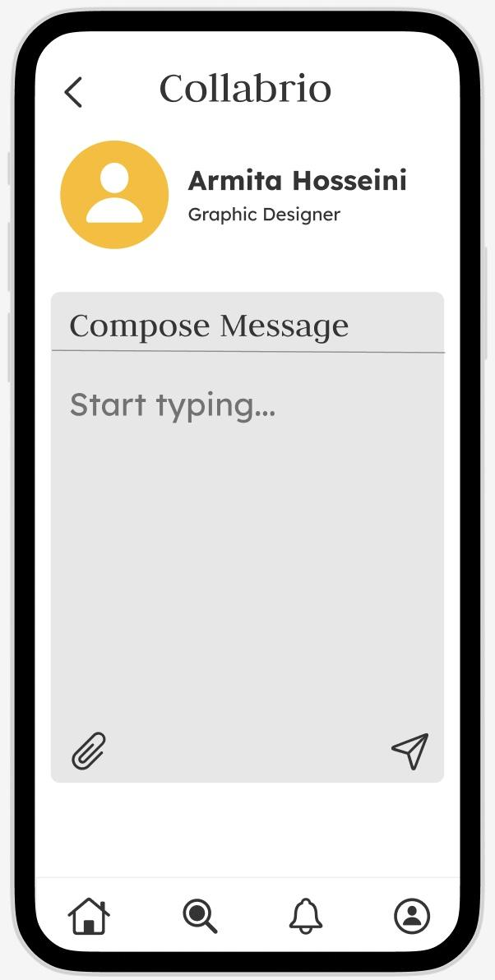
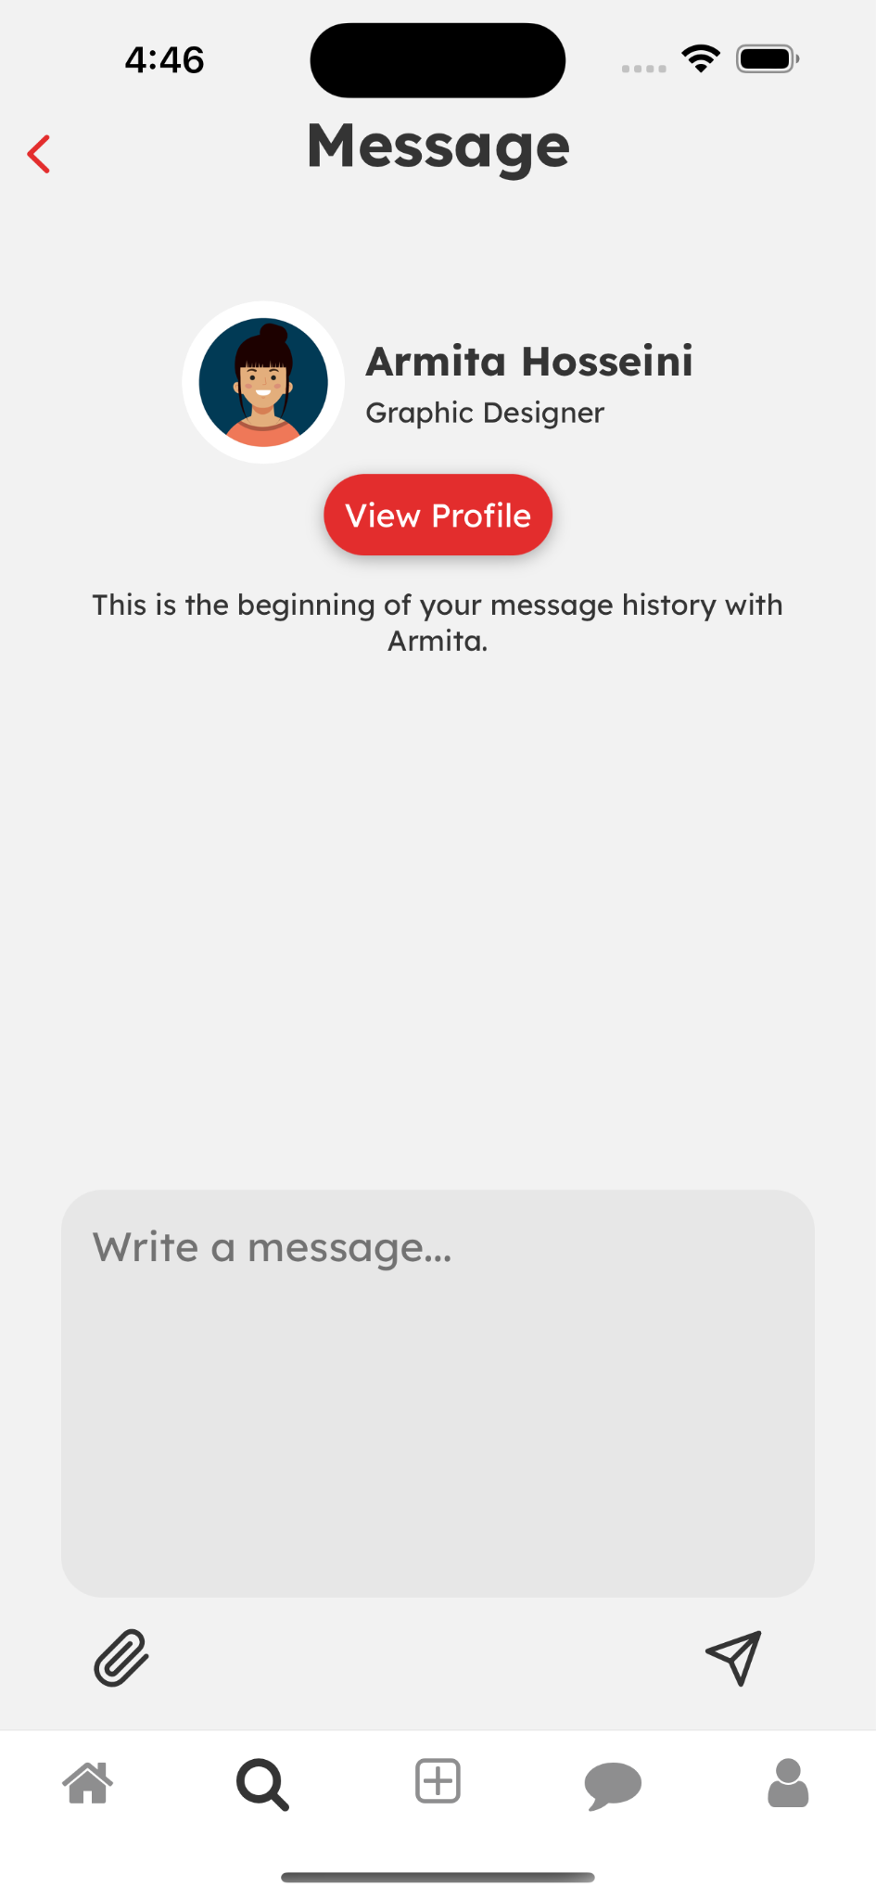
UI & Product Revisions
Email-style to chat-style to facilitate stronger relationships
Consistent fonts
View profile button
Efficient: users don’t have to scroll through a long inbox to find the last message they sent to someone. Message history allows for this.
H5: Moved pressable icons outside of text message box
H6: View profile button provides a clear & quick way to see the user’s profile to be reminded of what they do

Slide 18
UI & Product Revisions – Overall
H4: Consistency & Standards:
Made margins and padding across all pages consistent
Changed colour of tags from blue to red
Back buttons are red to match button & tag colours
Made all fonts and font size the same
H8: Aesthetic & Minimalist Design:
Changed red colour shade → slightly more pleasant on the eyes
H2: Match Between System & Real World:
Changed bell to messages icon for the tab containing direct messages
New tab in navigation bar for updating one’s portfolio through uploads (+)

Slide 19
03
Prototype Implementation

Slide 20
Prototype Implementation
Tool Used: React Native
Implemented features: Simple task – find someone from your extended network for a specific project
Home page – network’s most recent portfolio uploads
Search page – search for a specific role, navigate to search results, and click on a user to look into their profile
Draft & send a message, connections tree

Slide 21
Prototype Implementation
Unimplemented features:
User’s profile page, with the ability to edit
Add new project to portfolio tab – upload new work and edit portfolio with AI
The ability to edit/change/delete previous uploads
Update with AI complex task to be more clear and comprehensive
  Three pages: sync content, edit/view generated content, confirm to add content
The direct messages tab showing current messages and their timestamps
Change “message sent” banners to users redirected to relevant pages

Slide 22
Prototype Implementation
Hardcoded Aspects:
Cannot like, comment, or send posts from home page
Names and title
Profile pictures
Messages page is static – messages do not appear in message history
Wizard of Oz Techniques: None
Plans for Project Completion:
Complete moderate and complex tasks
  Add remaining features not addressed by these
Change hard-coded feature to allow updating user information and user interaction
Allow real-time updates in messages page

Slide 23
04
Prototype Demo

Slide 24
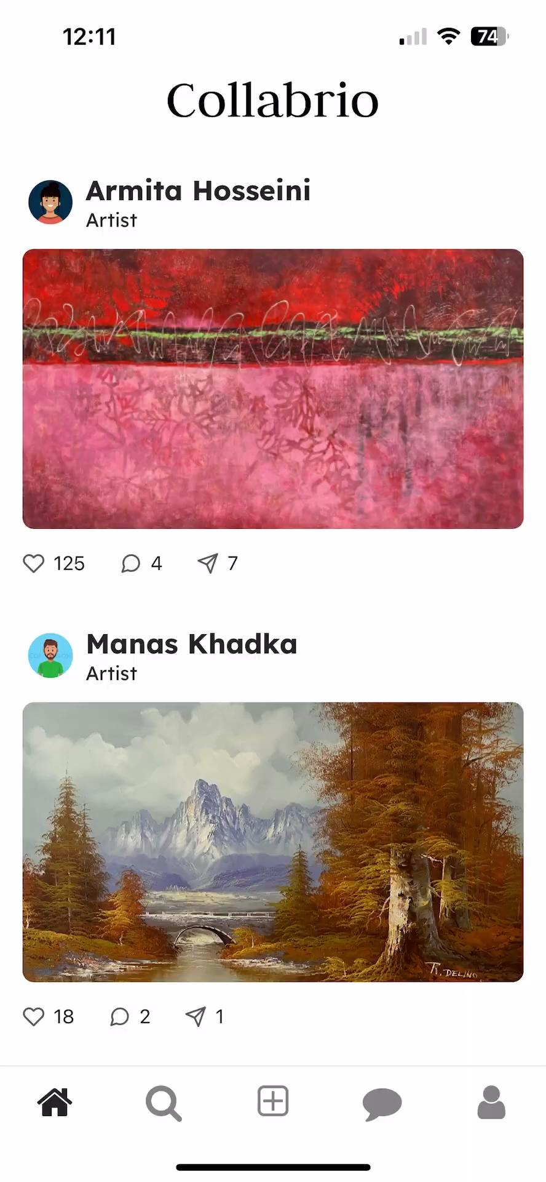
Prototype Demo

Slide 25
THANK YOU!
DO YOU HAVE ANY QUESTIONS?
Please keep this slide for attribution

