Slide 1
Cracking the Career Code
Team 2 | David Z, Betty W, Maxim I, Cristobal A

Slide 2
Content
Team
Problem
Needfinding Methods
Interviews
Interview results & analysis
Key Insights
Appendix

Slide 3

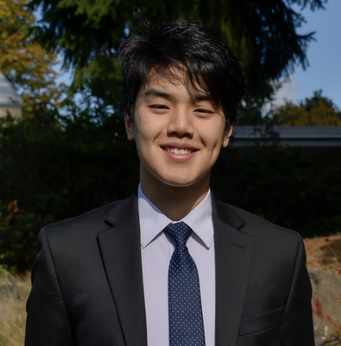
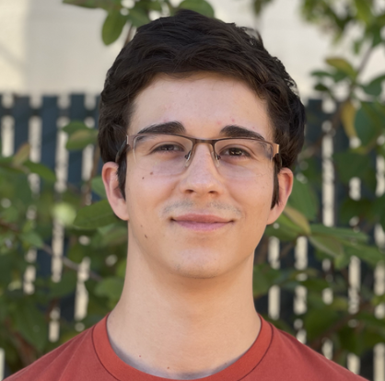
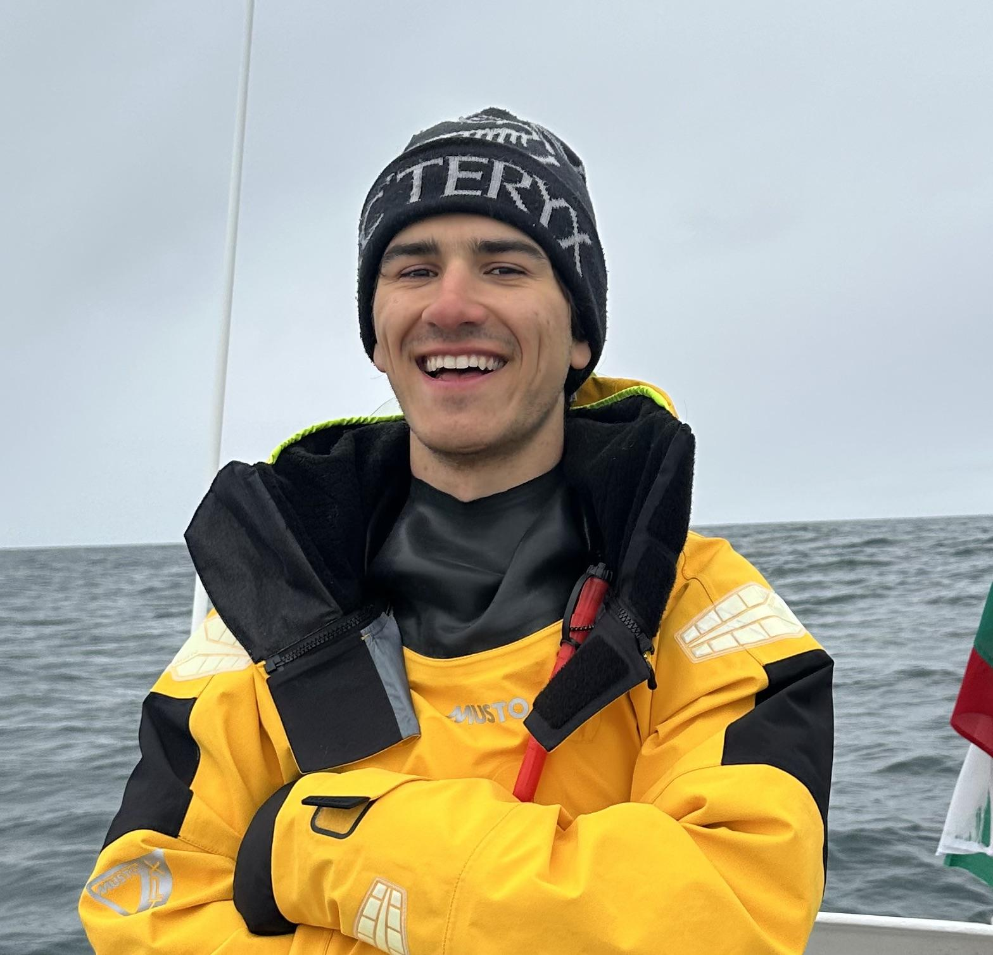
Introducing Team 2
(highkey very cracked)
Betty Wu David Zhou Cristobal Alcazar Maxim Ivanov

Slide 4
What Problem?

Slide 5
Finding
A
Good
Job!

Slide 6
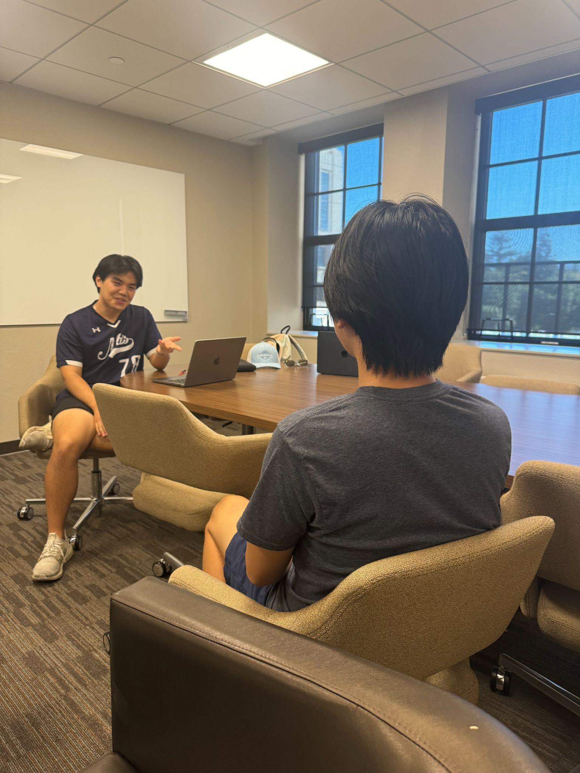
Needfinding Through Interviews

Slide 7
Alexander (our first victim)
Studies CS on the AI track
We met at the BASES club fair stand
He is interested in startups and is seeking to be recruited this summer
Alex is an extreme user of social media for recruiting purposes like Twitter and LinkedIn as he has a big following and is very active.
“Twitter is the most useful when finding jobs/internships for startups” (regarding tech space)
“Housing for internships is especially hard”
Alex mentioned that he doesn’t consider pay an important factor when deciding where to work

Slide 8
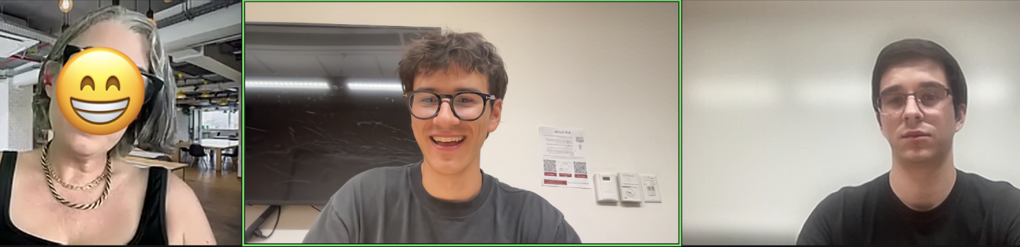
Karen
Karen is the founder of a recruiting agency for creatives
She has worked in the recruiting space for over 20 years
We connected with Karen over LinkedIn (a platform she relies on for her job)
She works both with brands and clients seeking jobs
We gained deep insights into the strategies and tools recruiters employ
Learned more about the priorities of recruiters and their business purpose

Slide 9
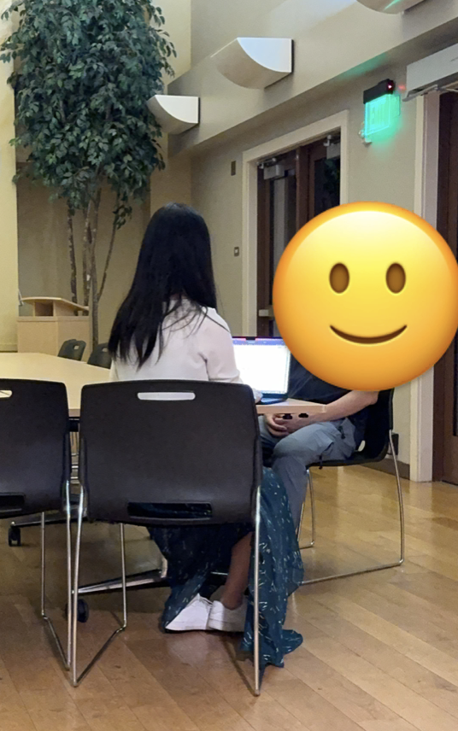
Andrea
She is an engineer with 10+ yrs of experience in consumer and automotive electronics
Betty was recruiting for hardware engineering and stumbled upon Andrea during her application processes
Andrea isn’t new to the recruitment process—she is a senior staff engineer
She is currently seeking new opportunities in the industry
Andrea moved to the Bay Area for her education 20 years ago and now has a family in Santa Clara
We discussed her experiences with the recruitment process for more senior positions

Slide 10

Additional Information
Where were the interviews conducted?
Alex: EVGR-A huddle
Karen: Over Zoom
Andrea: Kennedy commons
Who was your “extreme user”?
Alex: recruiting heavily for internships
Team member roles for each interview:
Alex - David interviewer, Betty note taker
Karen - Maxim interviewer, Cristobal note taker
Andrea - Betty interviewer, David note taker
Apparatus
All were transcribed via hand typed notes

Slide 11
Analysis
(kowalski)

Slide 12


Alexander’s Analysis
Seasonal interns are in a large need of support given their niche situation
Hiring for startups is still an unrefined process and talent search has yet to be streamlined
Twitter and other networking platforms are essential in today's tech job-finding landscape but have challenges of their own

Slide 13
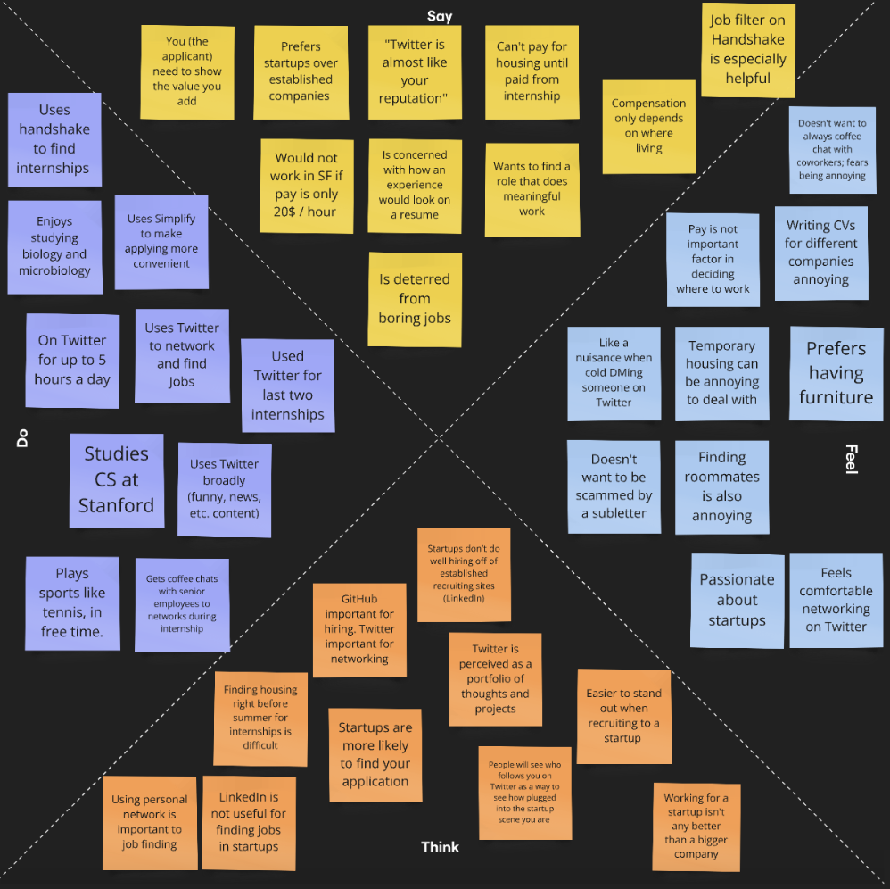
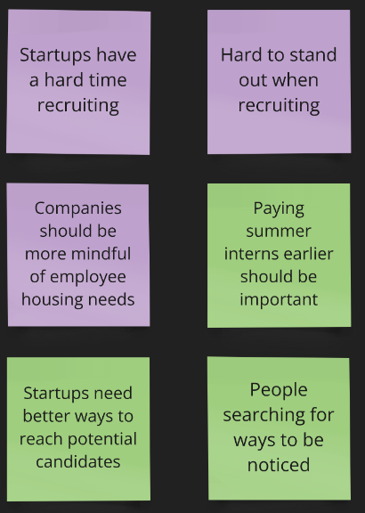
Alex’s Empathy Map
Insights:

Slide 14


Karen’s Analysis
The expectation from candidates are increasing
A CV and website is "no longer enough"
LinkedIn is “how you show up”
Recruiters leverage AI daily and are looking for optimization services
Market is flooded with lackluster recruiter tools
Friction between remote workers and company in-person demand
Finding the right culture fit is very important and often looked over!!

Slide 15
Andrea’s Analysis
Too much information on social media like LinkedIn, making it difficult to identify the most relevant and helpful content
Challenging to assess skills and team dynamics in early interviews rounds; cultural fit becomes clearer in later stages.
Life stages shape career decisions: Andrea's job search shifted from relocation as a new graduate to a preference for a 30-minute commute.
Close connections significantly expedite the job search process by providing access to unlisted opportunities as well as direct referrals

Slide 16
Summary and Key Findings
Emphasis on personal branding and showcasing value
Importance of social media, especially Twitter and LinkedIn
Focus on meaningful work and company culture
Growing presence of AI and optimization tools in recruiting
Networking and personal connections are the bread and butter of startups
Leveraging data and trends to stay up to date is of great importance
Smaller, niche markets face a unique set of challenges and opportunities in recruiting for specialized or smaller companies.

Slide 17
Where do we go from here?
Need for a comprehensive personal branding/portfolio development tool that integrates with most major platforms.
Automating company and candidate matching using AI, using data like skills, personality and cultural fit.
Need for a platform showcasing company culture, community and meaningful work, helping startups and established companies alike to attract talent.
A system for tracking and analyzing industry trends for both recruiters and job seekers
Creating a networking tool that facilitates genuine connections between professionals, especially in niche or specialized fields.

Slide 18
Appendix (interviewee referrals)
Twitter’s uncertain Future
LinkedIn and Networking

Slide 19
Thank you for your attention!

