Slide 1
HireReel
CS147 Concept Video
David, Maxim, Betty, Cristobal

Slide 2




Our Team
Betty
David
Cris
Maxim
MS&E ‘25
Economics ‘25
MS CS ‘25
BS CS Major ‘26

Slide 3
Problem and solution
Problem
It is hard for job seekers to showcase real-world skills and credibility in a more authentic way than traditional resumes
Solution
A platform for video endorsements from peers, former coworkers, or whoever, highlighting skills and capabilities of potential candidates.
Notes:
1-3 sentences total
b. Who the primary user is
c. Problem you are tackling
d. Brief synopsis of your proposed solution

Slide 4

What’s HireReel?
HireReel: A platform for video endorsements from peers, former coworkers, or whoever, highlighting skills and capabilities of potential candidates.
Name Inspo:
A filmmaker’s reel (or a demo reel) is a compilation of that film maker’s best work often showed to attract jobs and clients.
HireReel is a platform that will get you hired by showcasing your career’s highlight reel in the form of short video endorsements by those most familiar with your skills.
One Liner
Let your skills shine through video endorsements

Slide 5
Value in Design: Stakeholders
Applicant
Potential Co-workers
Endorser
Hiring Company
Direct
Indirect
Recruiter
Job Boards
Notes:
Values in design
a. b. List several direct and indirect stakeholders
Present two ethical implications and your reflections on them

Slide 6
Value in Design: Ethical Implications
Bad Actors
(The Big Bad Wolf)
Change Market
(The Radio Star)
Bad actors
Affect Competitors and Recruiter Market
A bad actor could misrepresent their skills for a lucrative role.
Analysis: Market disruption affects competitor viability. It is important to consider how this could create job loss in certain sectors.
Analysis: Referrals after all are based on trust. How will referral videos be verified and who will moderate and remove content?
Recruiters may have less of an impact in the hiring process. This could affect that job market.
A malicious extreme user could leverage the platform credibly.
Early career platforms (Handshake/12twenty) could lose market share.
Notes:
Values in design
a. b. List several direct and indirect stakeholders
Present two ethical implications and your reflections on them

Slide 7

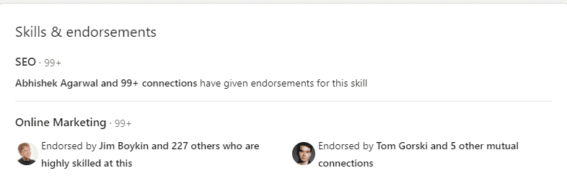
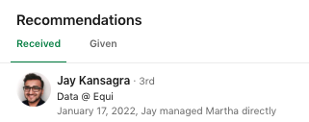
Market Research - LinkedIn Skill Endorsement
LinkedIn allows users to provide written recommendations and endorse skills for their connections.
Linkedin leverages existing professional networks, and LinkedIn endorsements add credibility and social proof to candidates
However, skill endorsements like “Online Marketing” and “SEO” can be generic, and the written recommendations can be impersonal and lack engagement
HireReel video endorsements offer a more dynamic and personal approach to showcasing skills.

Slide 8

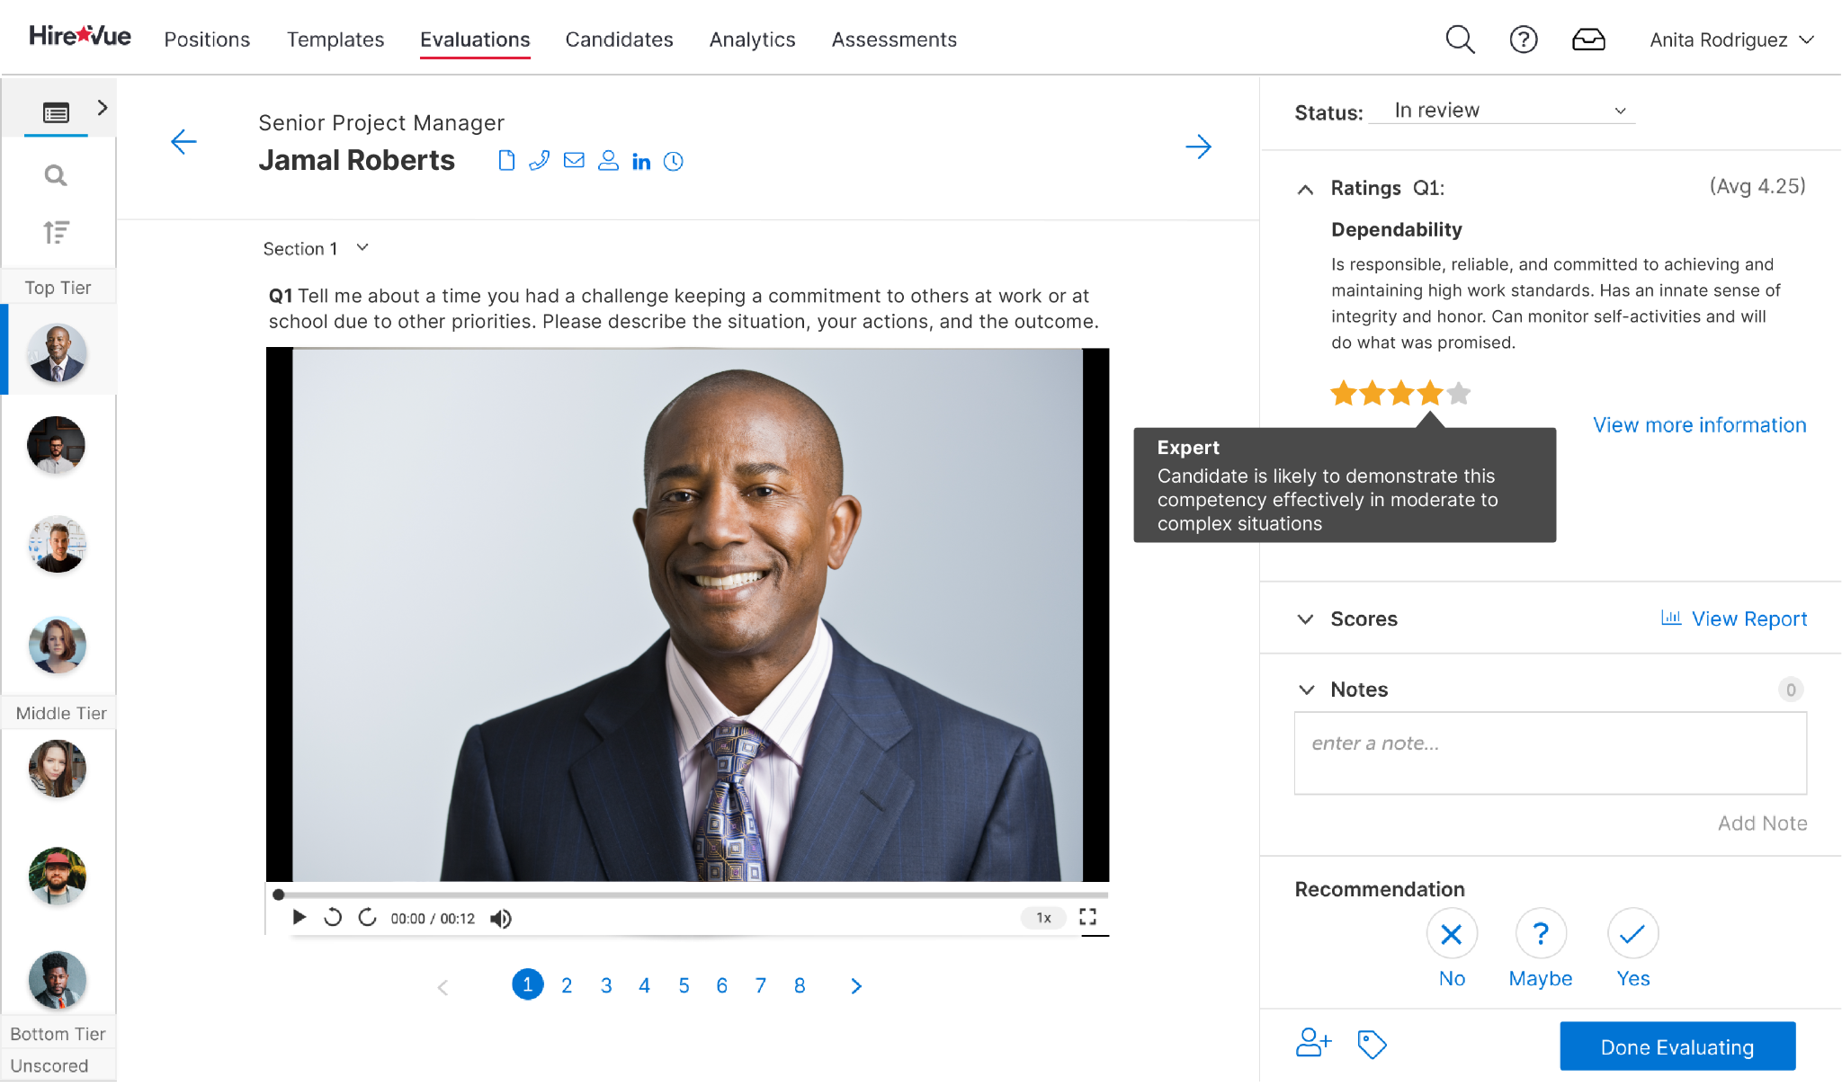
Market Research - HireVue
HireVue is an AI-powered platform that analyzes candidate video interviews. This automated candidate evaluation can speed up hiring. By analyzing video content, HireVue allows candidates to show what’s beyond their resume
However, relying heavily on AI can strip away the personal touch that comes from human interaction. AI can also introduce bias and potential for misinterpretation of expressions or behaviors. ​
HireReel focus on human-centric video endorsements, fostering genuine connections and insights that AI tools may overlook, creating a more humane hiring process.

Slide 9

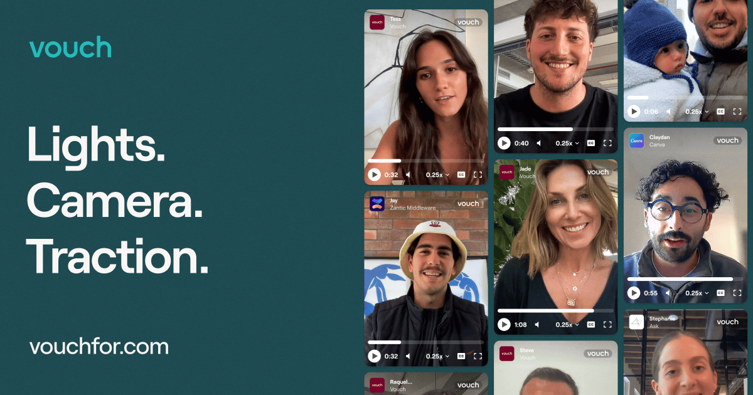
Market Research - Vouch
Market Research - Vouch
Vouch allows users to create positive video testimonials for businesses and services, focusing on uplifting endorsements. Video content is inherently more engaging and can convey emotions and enthusiasm more effectively than text.
However, Vouch is tailored towards business and marketing use cases. Meanwhile, it focuses primarily on positive testimonials, potentially overlooking the value of more balanced feedback
HireReel shifts the focus from business marketing to skills validation and professional development. It includes both positive and constructive feedback for a balanced candidate profile
LinkedIn allows users to provide written recommendations and endorse skills for their connections.
Linkedin leverages existing professional networks, and LinkedIn endorsements add credibility and social proof to candidates

Slide 10

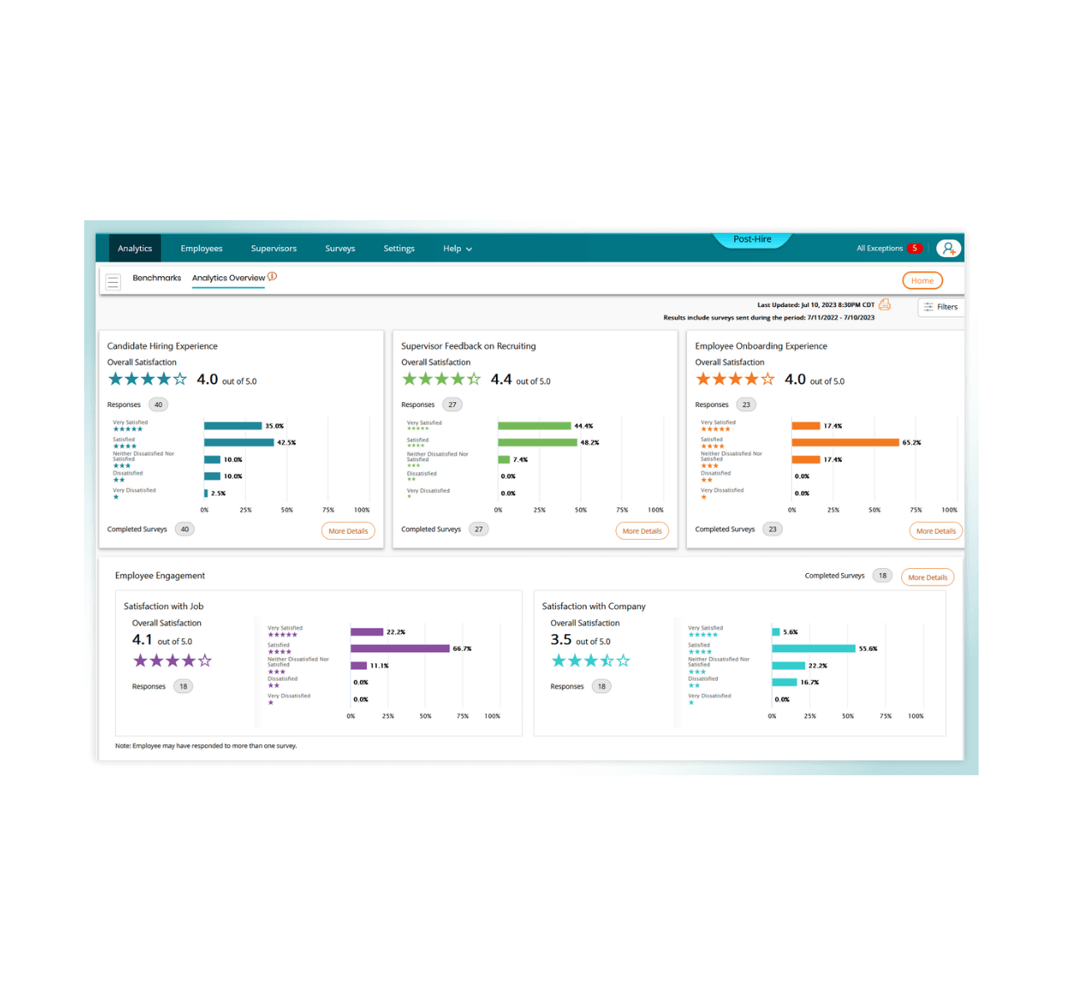
Market Research -SkillSurvey Reference
SkillSurvey Reference is a platform that helps employers gather feedback about candidates through surveys from references. It collects anonymous, detailed feedback from peers, offering constructive criticism and insights to recruiters.
However, SkillSurvey Reference lacks engagement due to its static, text-based format. Anonymity can reduce accountability and credibility, and its structured surveys limit the depth of feedback
HireReel provides video-based, personal endorsements, offering a more engaging way to present candidate skills while still supporting constructive feedback like SkillSurvey.

Slide 11
Competitor Comparison Matrix
Job seekers, professionals, recruiters
Job seekers, professionals, recruiters
Large companies, recruiters
Businesses, individuals
Target Audience
Recruiters, companies, job seekers
Video Feedback
(AI)
Written Feedback
Constructive Feedback
Human Connection
Focus
Skills validation and personal branding
Skills validation and networking
Hiring efficiency through AI
Customer reviews and marketing
Candidate reference validation

Slide 12
Key Tasks
Send a Request
Chat w/ Recruiters
Request a HireReel from a professional connection.
Simple: Should be no harder than sending an email. (n/a)
Users can get messages and offers from recruiters that have seen their HireReels.
Simple: The system would be simple and ease communication. (1:17)
Send HireReels to Recruiters
View Analytics
Once you have a referral you forward it to select recruiters.
Moderate: The user has to select recruiters and send other information based on the referral and the job apps.
(1:06)
A user can see the impressions and metrics for their HireReels to see how their approach is working.
Complex: The metrics displayed would have dynamic options for deeper analysis. (1:13)
View HireReel
Watch the video referrals.
Simple: Just a standard web player with engagements. (0:55)

Slide 13
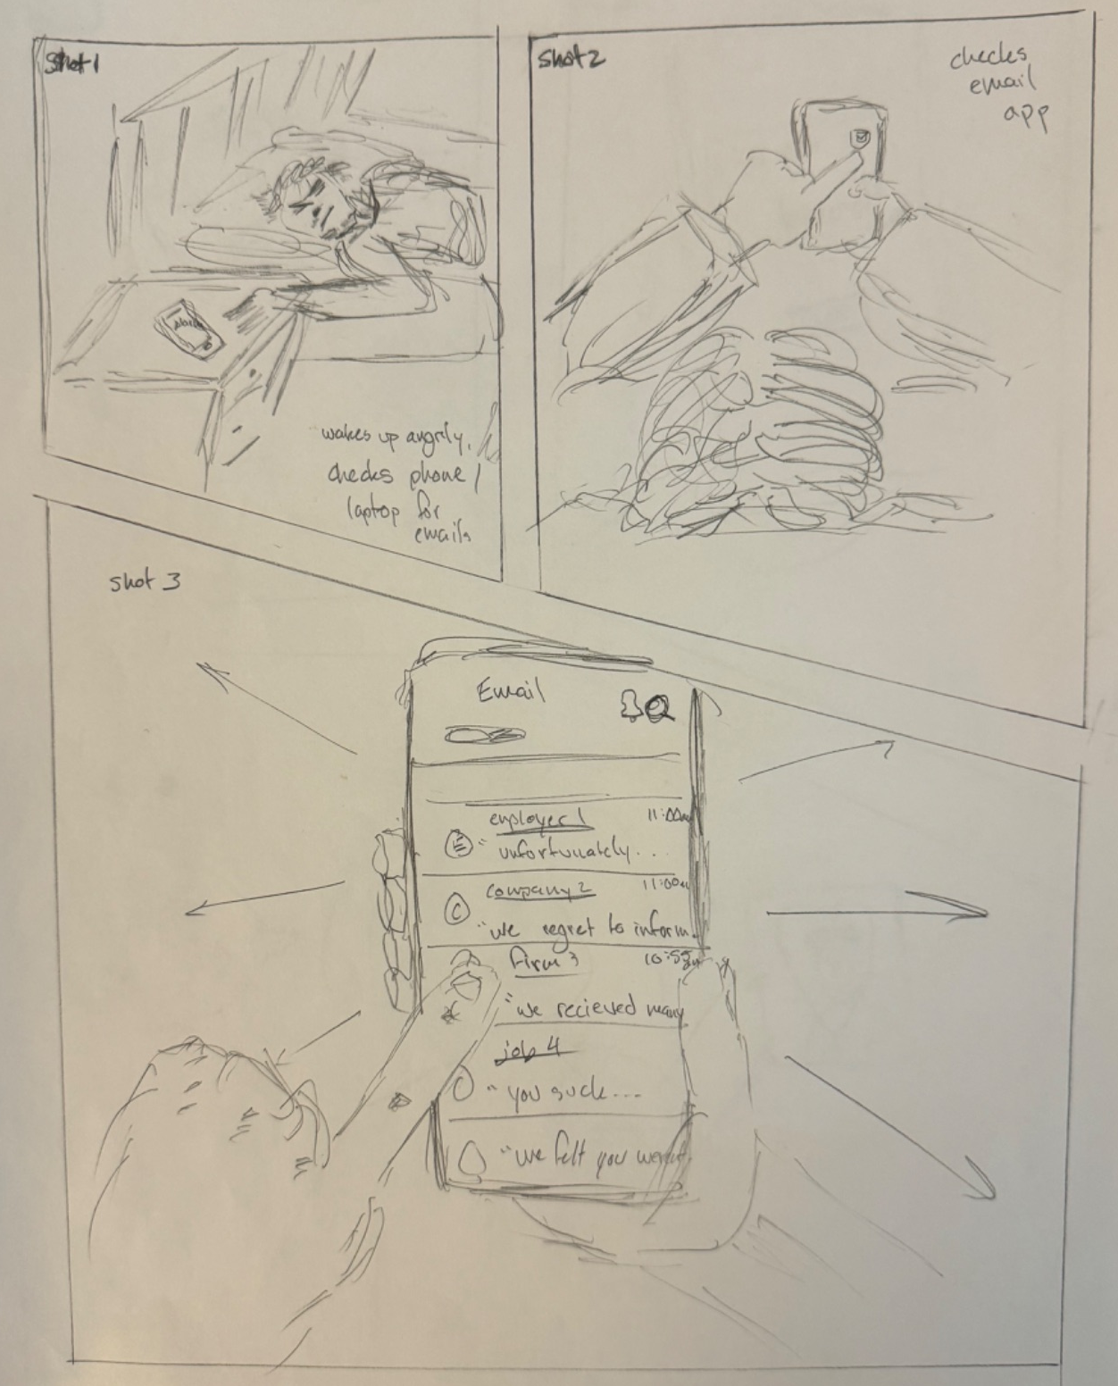
Storyboards

Slide 14
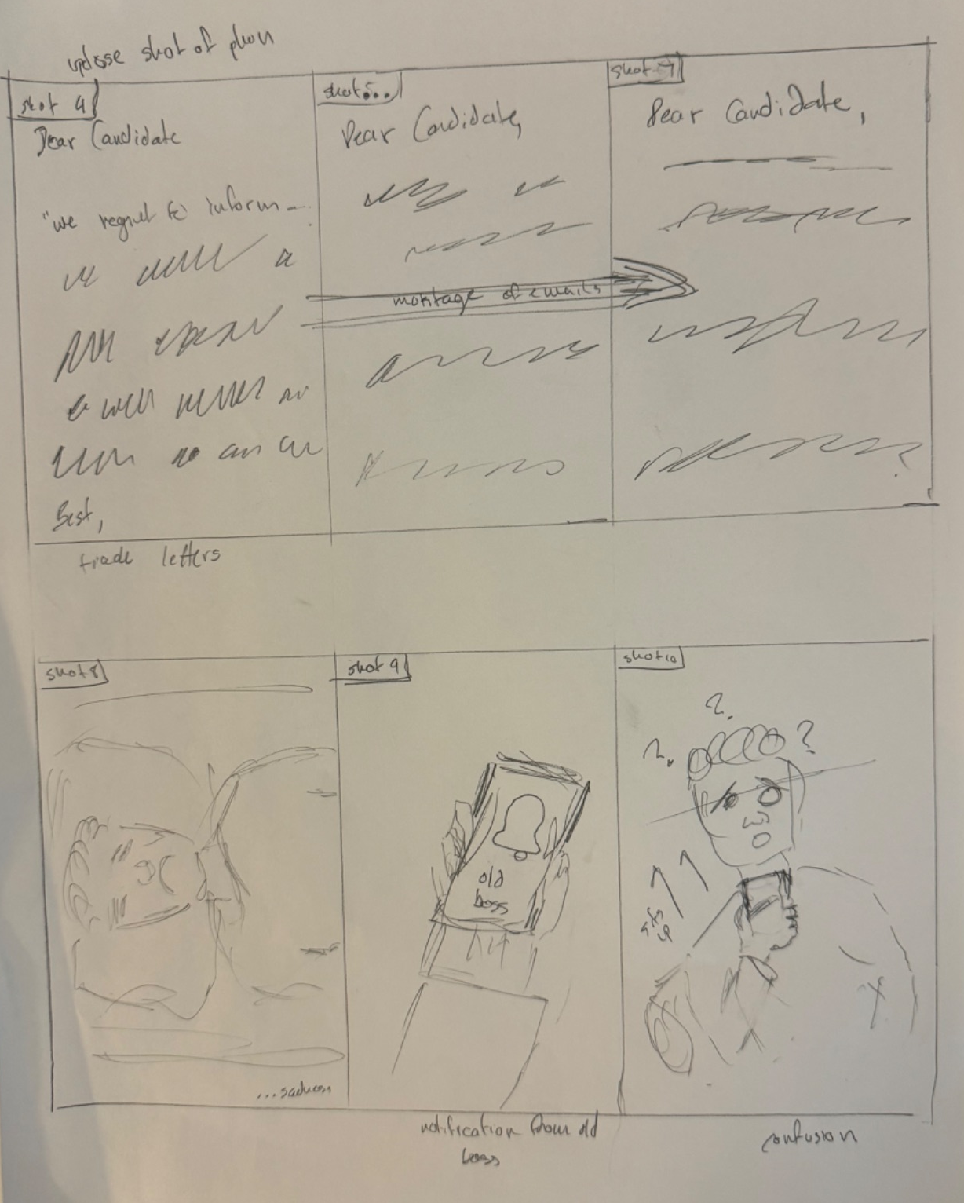
Storyboards

Slide 15
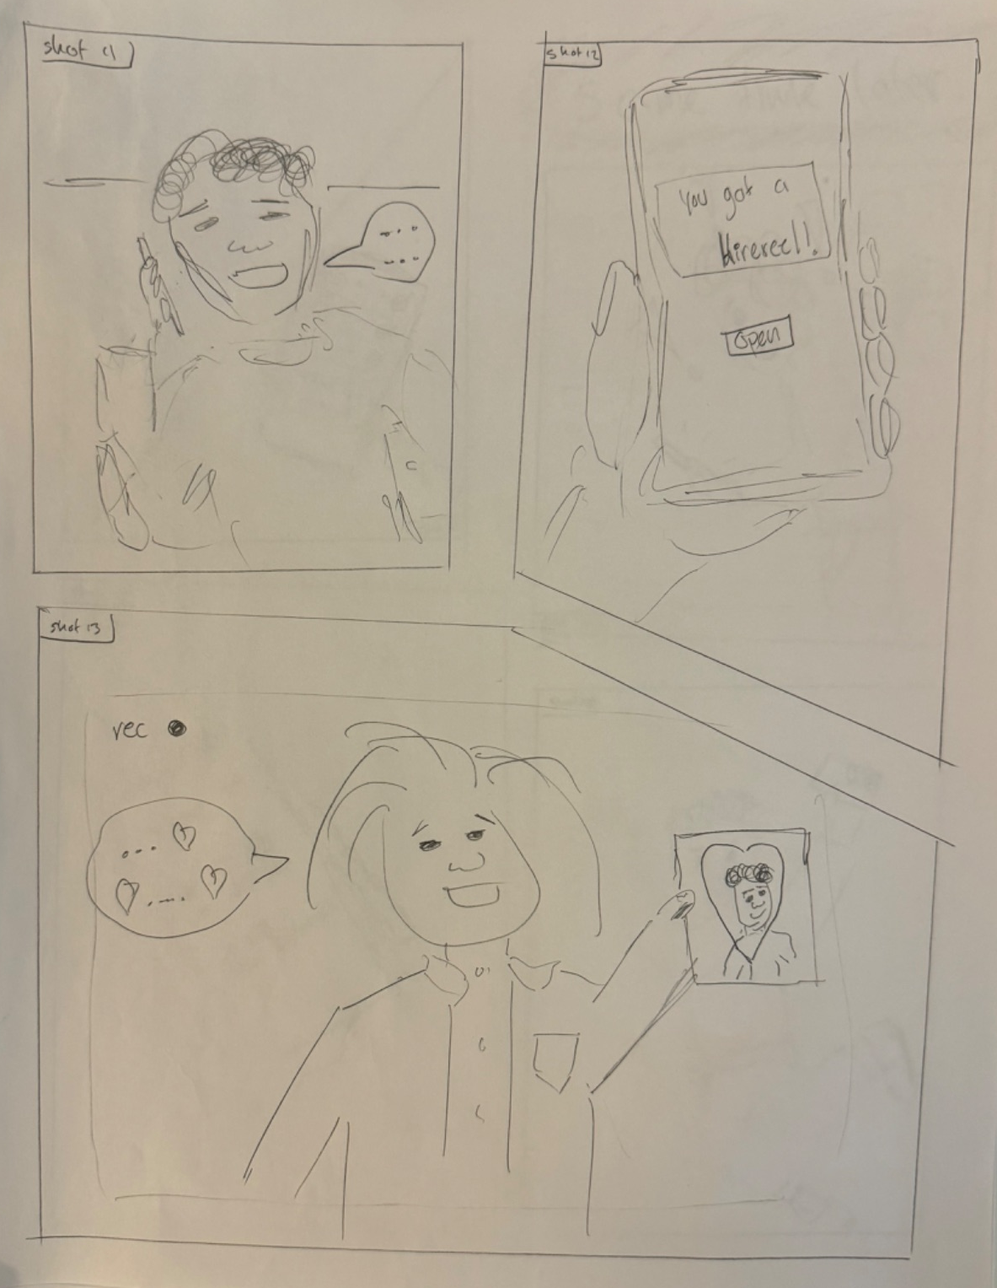
Storyboards

Slide 16
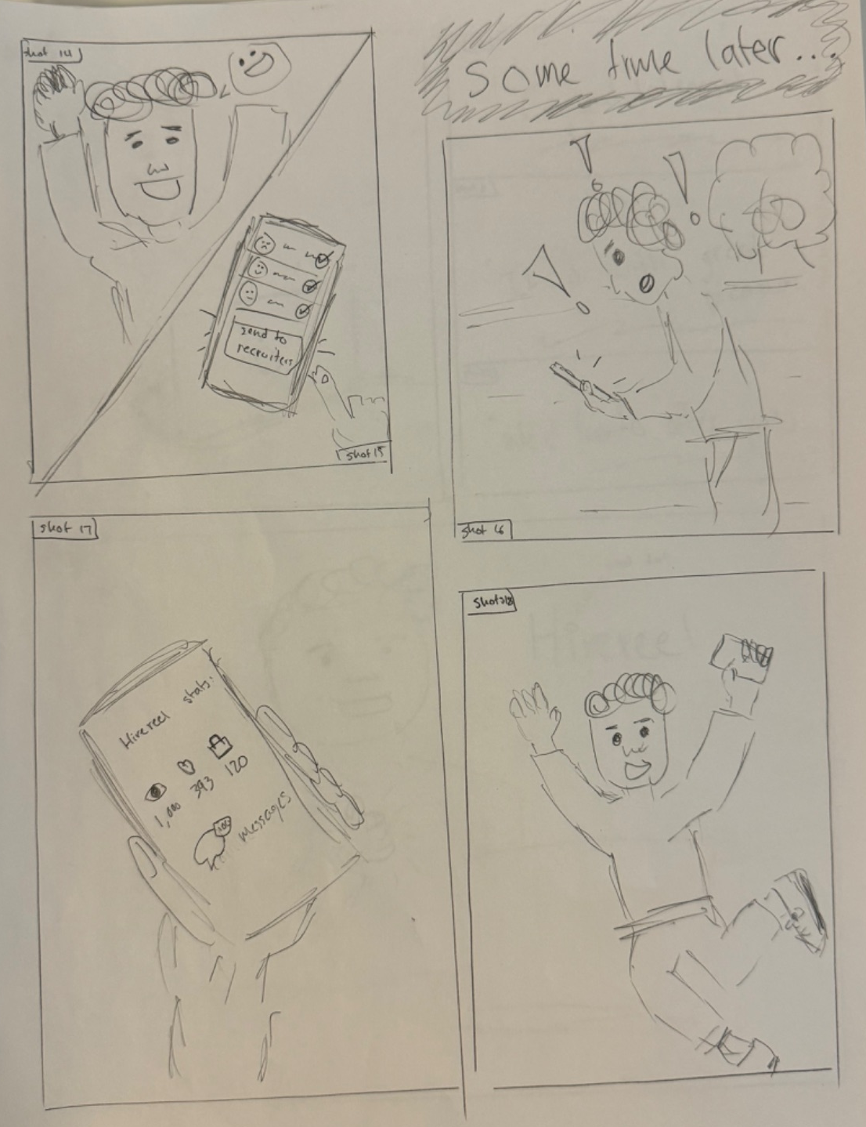
Storyboards

Slide 17
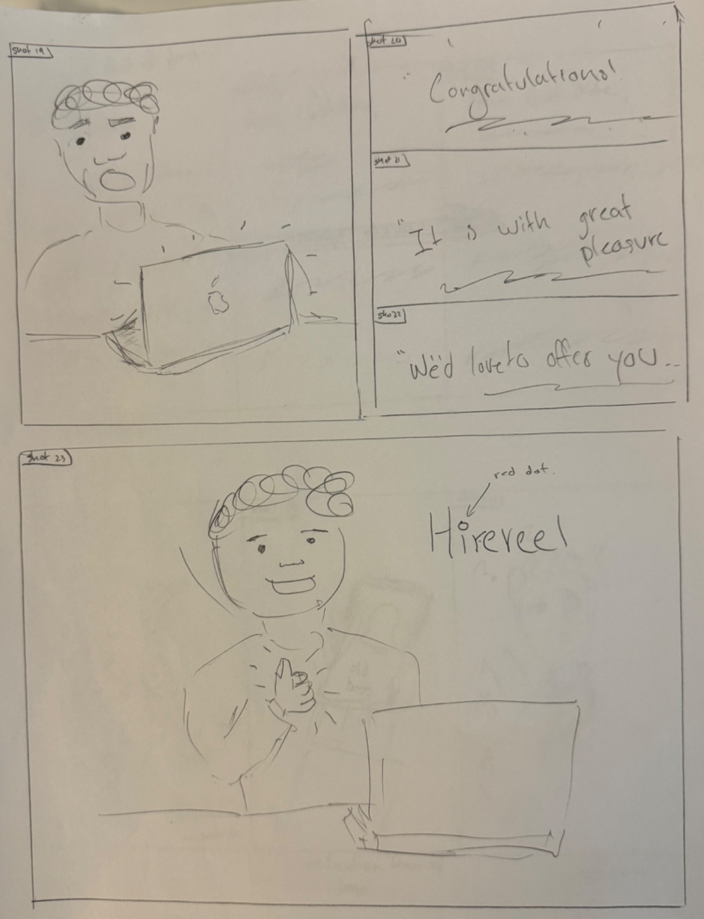
Storyboards

Slide 18
Link to Video
https://youtu.be/i0ECMZAC8DQ

