Slide 1
HireReel
Interactive High-fi Prototype
“Let your skills shine through video endorsements”
Notes:
Good morning everyone. I hope yall had a good week 9 so far. Today I’ll be presenting the hi-fi prototype for HireReel

Slide 2




Meet the team
Betty
David
Cris
Maxim
MS&E ‘25
Economics ‘25
MS CS ‘25
BS CS Major ‘26
Meet

Slide 3
The Problem
It’s hard for early career applicants to highlight their professional qualifications
Notes:
HireReel targets the problem that Many early-career applicants struggle to effectively highlight their professional qualifications. Traditional resumes and cover letters don't always capture their abilities.

Slide 4
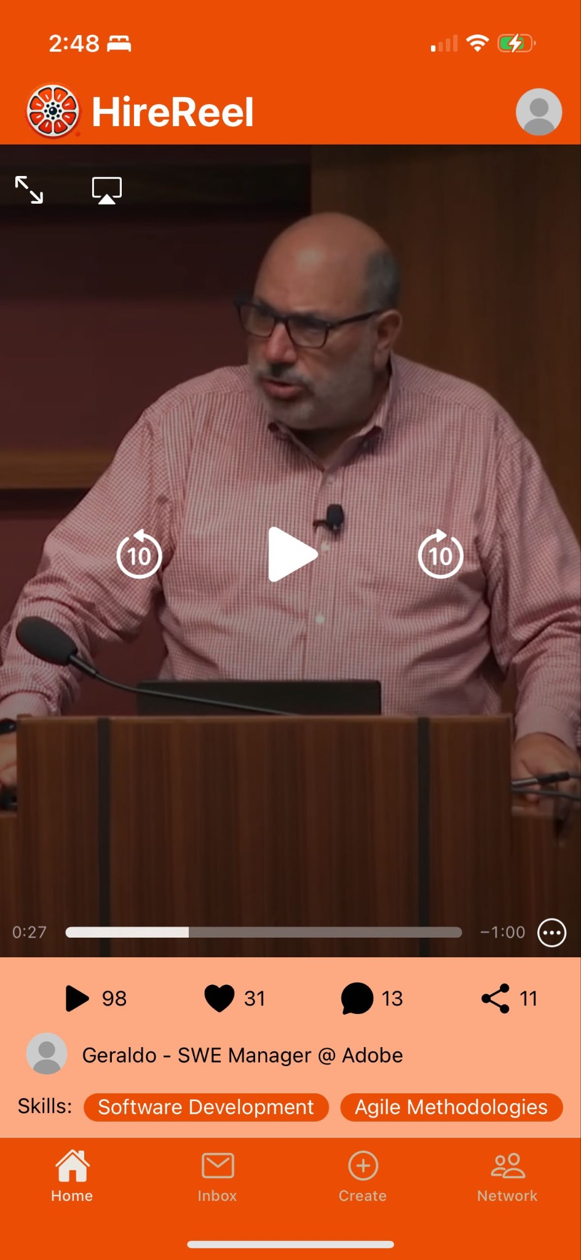

HireReel
A platform for video endorsements from peers, former coworkers, or whoever, highlighting skills and capabilities of potential candidates.
“Let your skills shine through video endorsements”
Notes:
We offer a platform for video endorsements that better showcase their skills and experience

Slide 5
Tasks
Simple
Moderate
Complex
Ask a friend on the platform for a HireReel
Share HireReesl to Recruiters
View Analytics on the HireReels

Slide 6
Table of contents
01
02
03
04
Heuristic Evaluation Results
Revisions for Hi-Fi
Hi-Fi Prototype
Demo of a Task
Notes:
We’ve structured our presentation to four parts, first we’ll go through the heuristic evaluation results, and introduce our revisions based on the feedback, then we’ll show the current state of the prototype, and we’ll end with a demo

Slide 7
01
Heuristic evaluation results

Slide 8
Quantitative Summary
Heuristic | # Viol. (sev 0) | # Viol. (sev 1) | # Viol. (sev 2) | # Viol. (sev 3) | # Viol. (sev 4) | # Viol. (total)
H1: Visibility of System Status | 0 | 0 | 3 | 0 | 0 | 3
H2: Match b/w System & World | 0 | 0 | 3 | 1 | 1 | 5
H3: User Control & Freedom | 0 | 0 | 1 | 2 | 0 | 3
H4: Consistency & Standards | 0 | 4 | 4 | 1 | 1 | 10
H5: Error Prevention | 0 | 0 | 0 | 2 | 0 | 2
H6: Recognition not Recall | 0 | 0 | 1 | 2 | 0 | 3
H7: Flexibility & Efficiency of Use | 0 | 0 | 0 | 0 | 0 | 0
H8: Aesthetic & Minimalist Design | 0 | 4 | 0 | 0 | 0 | 4
H9: Help Users with Errors | 0 | 0 | 0 | 0 | 0 | 0
H10: Help & Documentation | 0 | 1 | 0 | 0 | 0 | 1
H11: Accessible Design | 0 | 0 | 0 | 4 | 0 | 4
H12. ​​Value Alignment & Inclusion | 0 | 1 | 0 | 0 | 0 | 1
Total Violations | 0 | 10 | 12 | 12 | 2 | 36
Notes:
Our evaluators identified 36 violations. The most comes in H4 (consistency and standards) where we had 10 violations. What’s also worth noting was that the H11 accessible design violations are all high severity.

Slide 9
H4 - Interface and Aesthetic Consistency
Inconsistent icon design between the Analytics page and the Home page
Inconsistent fonts and styles throughout the app
Inconsistent location for the profile button placement
Inconsistent formatting between Friends and Recruiters tabs (Recruiters has “search”)
Same "+" button used for different actions
Notes:
Most of the H4 violation comes in interface and aesthetics inconsistency. We’ve received feedbacks like font sizes and style, inconsistent icon design, button placement, and same button used for different purposes

Slide 10
Qualitative Summary
Onboarding/signup
General Functionality
Transition between sign in/sign up/sign out
Mandatory contact import
Can’t edit user profile
Unclear if friends/recruiters can overlap
Send HireReel
Terminology Clarity
Can’t see “draft” messages
Can’t see who users sent HireReel/request to
No confirmation before sending hirereels
First-time users might not understand “HireReel”
Unclear analytics metrics
Notes:
We also categorized these violations into themes.
During onboarding and signup, users reported that we didn’t provide easy transitions between signin, signup, and signout, and they felt that contact import is mandatory; in terms of general functionality, users found limited profile and unclear overlaps between friends and recruiters. For sending hirereel, there was no drafts, no tracking, and no confirmation before sending. They also identified limitations in terminology clarity, as New users struggled to understand key terms like 'HireReel' and analytics metrics.

Slide 11
High Severity Violations
H11: Accessible Design
H5: Error Prevention
HireReel videos lack captions or transcripts for users with disability
The contrast of the colors chosen is very low
Sending HireReels without confirmation
Can’t go back to sign-in once clicked “sign up”
H3: User Control
H3: User Control
H6: Recognition not Recall
Have to select > 1 contacts once clicked “import contacts”
Can’t see who users sent HireReel/request to
Unclear meaning of HireReel
Unclear definition for analytics insight metrics
Notes:
For the high severity violations,
We’ve received strong feedbacks on accessible design as videos lacked captions and subtitles and the UI design had low color contrast. There are also error prevention strategies as there’s no confirmation before sending HireReels.

Slide 12
02
UI/Product
Revision

Slide 13
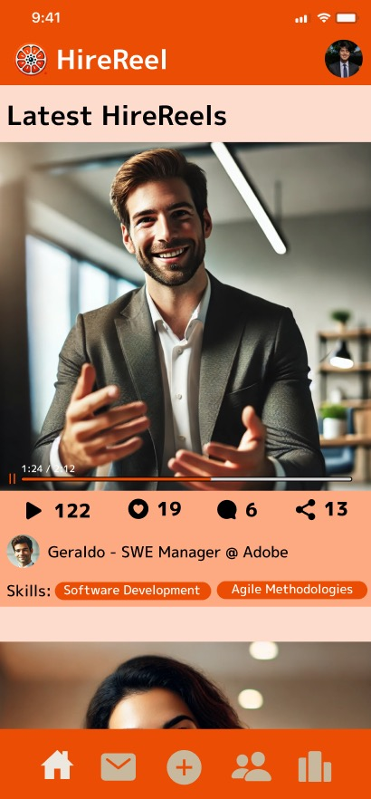
Home Screen Changes
Home Screen
Change to Tiktok style video viewing experience
Add captions to the navigation bar icons for better clarity and usability
Move Analytics to profile page
Further Changes
Have AI generate subtitles or even translated subtitles for videos
Users can choose to turn on/off subtitles
Notes:
"Enhanced home screen design for clarity and accessibility. To improve usability, we redesigned the home screen to adopt a TikTok-style video viewer. Navigation icons now have captions for clarity, and we’ve moved analytics to the profile page."

Slide 14
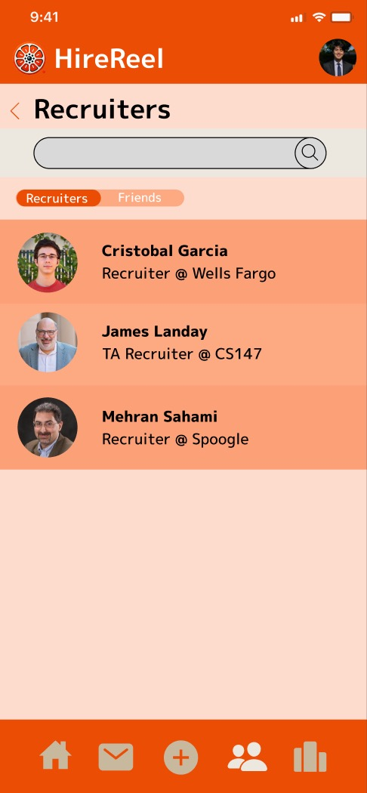
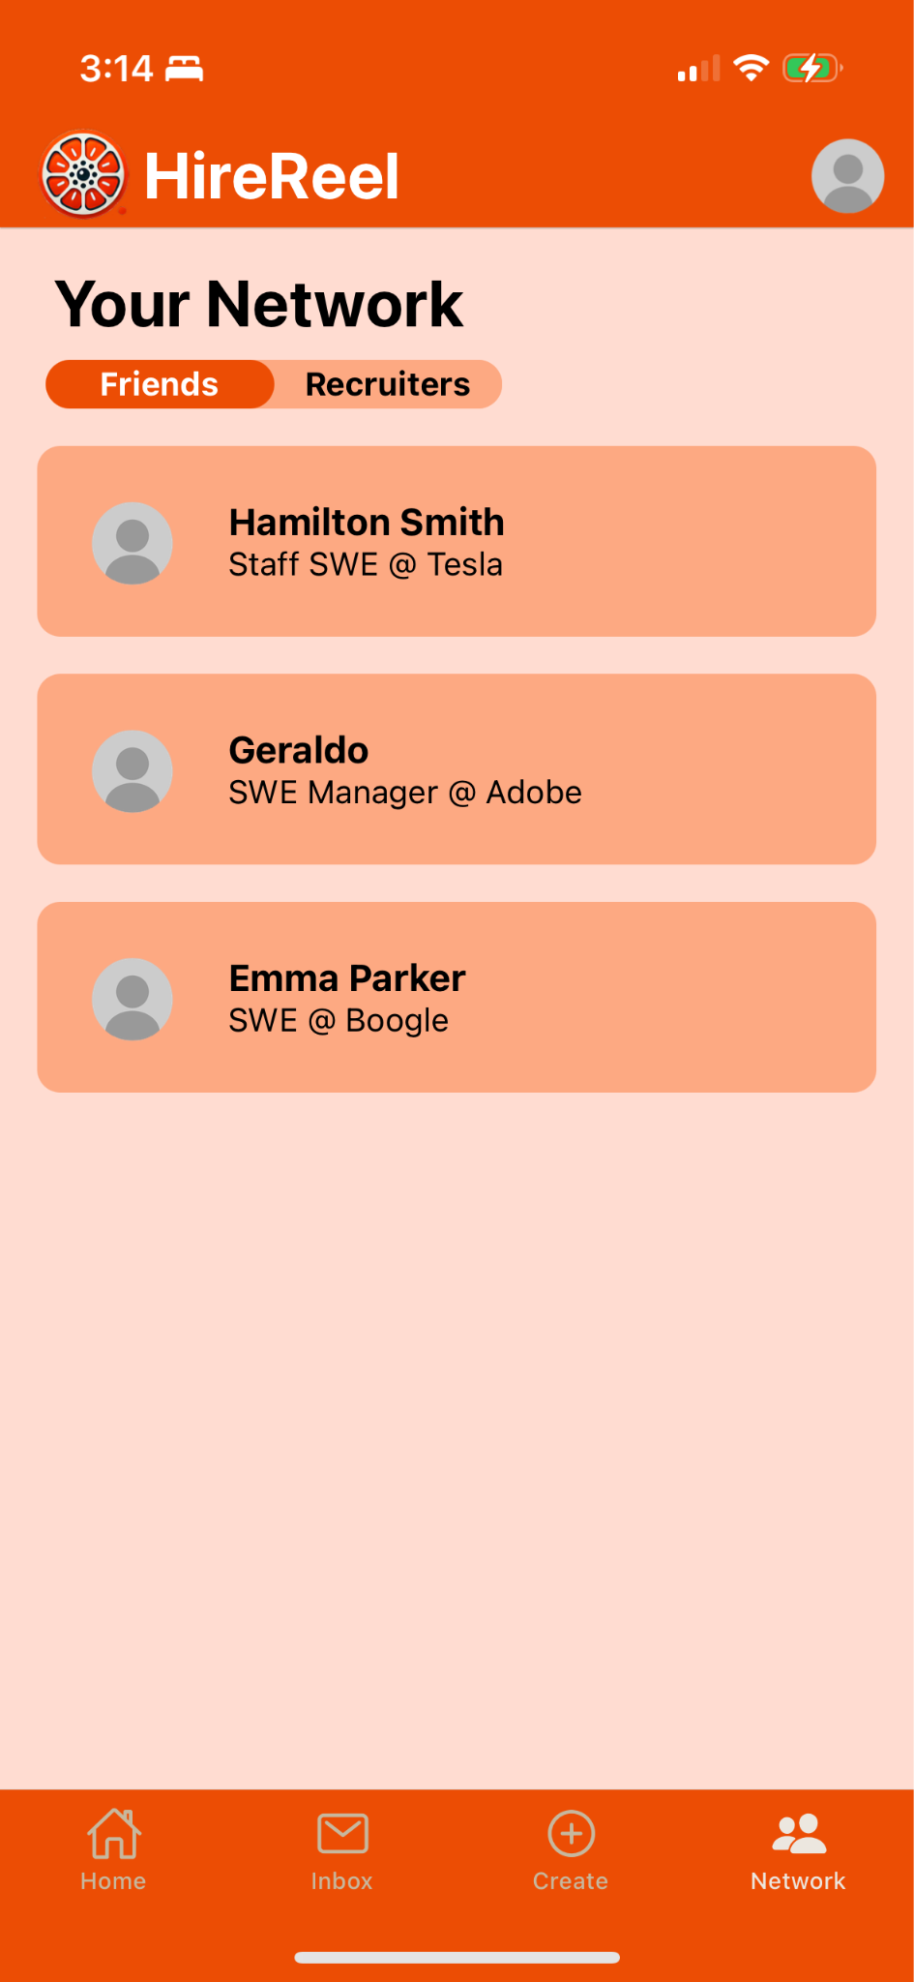
Network Page Changes
Network Page
Adjust the page layout to enhance color contrast and visibility
Make spacing/font size consistent
Notes:
Improved network page layout and functionality. "We revamped the network page to improve visibility and consistency. Changes include increasing the spacing for better color contrast, and standardized font sizes."

Slide 15
More UI Changes based on HE
Log in /Sign up
Send HireReel Request
Allow easy sign in/out
Make contacts import optional
More onboarding guidance for users to understand “HireReel”
Potentially add a bot to help responses for common queries
Save drafted message
Show sent HireReel requests in the network tab
Add confirmation prompt before sending requests
Share HireReel with Recruiter
Profile Setting
Enable selection of positions and HireReels to send
Make it easy for users to update the profile
Notes:
Other revisions include:
Simplifying login/signup flows.
Making contact import optional.
Adding a bot for onboarding guidance.
Introducing confirmation prompts for sending HireReels and enabling position selection for recruiters."

Slide 16
03
Prototype Checkpoint

Slide 17
Tech Stack
Mobile App
Backend
Wizard of Oz Items
React Native (iOS focus) w/ Expo Go
Expo-Video: Video playback
Ionicons: Icons
Supabase: Authentication & Database
Twilio SendGrid: Account authentication (email)
AWS Route 53: Email DNS hosting
AWS S3: Video hosting
Sample account has no database content
No stateful database
Video metrics
ML subtitle generation
Notes:
Our Tech Stack for our mobile app:
React Native (focus on ios) w/ expo go
expo-video for video playback
Ionicons for icons
Backend:
Supabase for Authentication and database
Twilio SendGrid for emails (currently for authenticating accounts)
AWS Route 53 for email domain DNS hosting
AWS S3 for video hosting
What’s Wizard of Oz:
Demo shows a sample account with no database content
Video metrics are WoZ
No data from the demo is stored in a stateful database (Frontend changes are made by using temporary local variables/flags)

Slide 18
Other Tech Stack
Hard-Coded Aspects
Sample user profiles: preloaded user names and job titles for demo purposes
Placeholder videos to simulate uploaded HireReels
Fixed metrics: hardcoded likes, view, shares

Slide 19
HiFi Simple Task
Ask a friend on the platform for a HireReel
[x] Home screen
[x] Network page
[x] Friends’/recruiters’ profile page
[x] HireReel sending confirmation

Slide 20

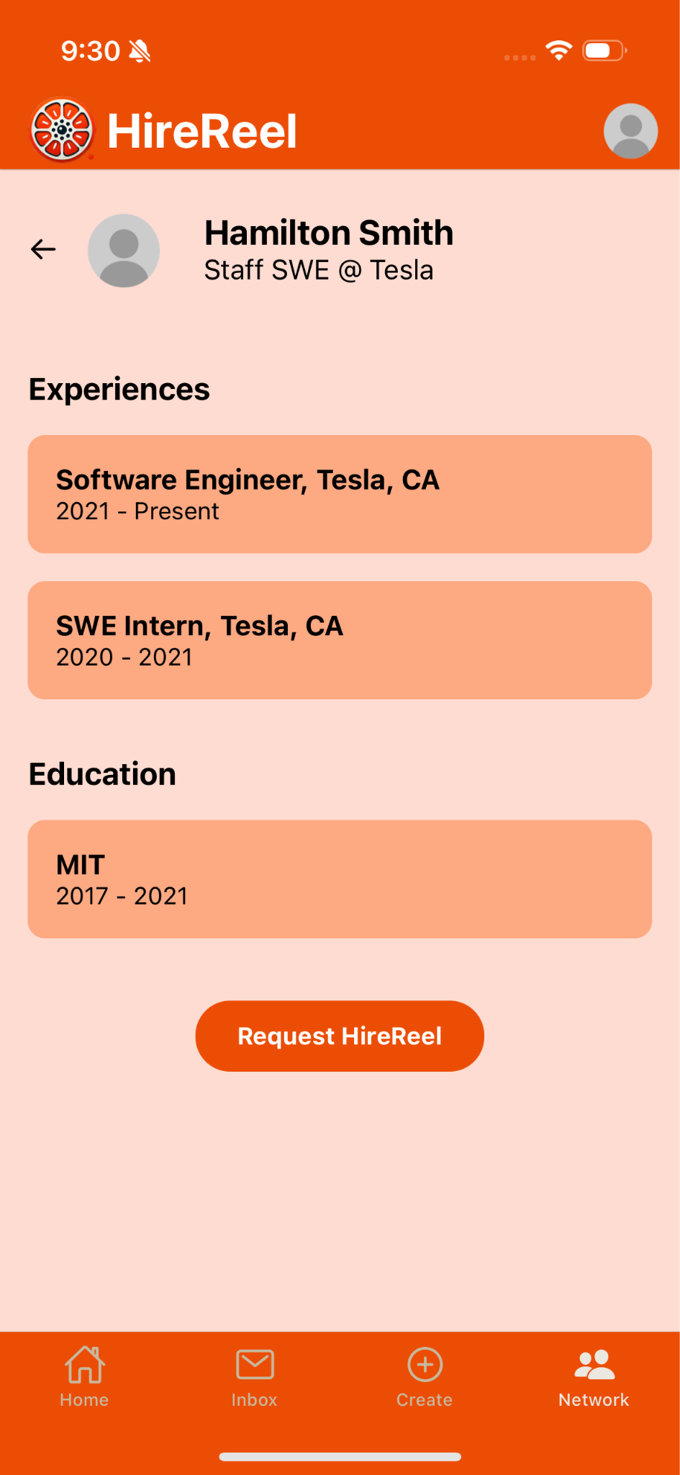
HiFi Simple Task

Slide 21
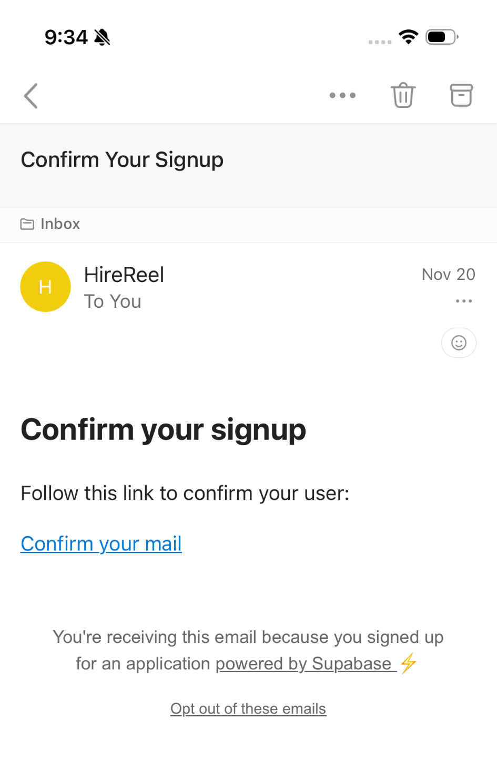
Backend Authentication
Notes:
Our team member Cris implemented backend authentication for the signup process. Once users sign up with their email, they receive a confirmation email to complete the signup.

Slide 22
Plans to Finish
✅
Task 1
Task 2
Task 3
Ask a friend on the platform for a HireReel
Share HireReesl to Recruiters
View Analytics on the HireReels
Login/signup
Aesthetics
User Profile
Users create accounts
Color/font are consistent and things are aligned
Make it easy to update user profile
✅

Slide 23
04
DEMO

