Slide 1

ATHENA SHIRAVI, ZOYA GARG, ESHA GUPTA
Assignment 1:
Needfinding

Slide 2

Introduction
Needfinding Methodology
Interview Results
Analysis
Summary

Slide 3




Who we are
Athena Shiravi
B.A. Econ
B.S. CS
HCI Coterm
Esha Gupta
B.S. SymSys
B.A. IR
Zoya Garg
B.S. Computer Science
B.A. Classics

Slide 4


Problem Domain
Moms!
Why Moms?
Neglected demographic
All-girl team :)
Inspired by podcast shared in class

Slide 5
Introduction
Needfinding Methodology
Interview Results
Analysis
Summary

Slide 6

Participants:
The How: Local grocery stores
Why Them?: Varying cultural background and English fluency*
Why Appropriate?: Captured working/stay-at-home/immigrant moms’ experiences
*Extreme user:
couldn’t speak English; spoke via translation app

Slide 7


Needfinding Methodology: The Where
Esha
2 interviews done later at participants’ home
Recruited @
grocery store
2 interviews done while grocery shopping
Zoya
Athena

Slide 8

We asked about routines, frustrations, and joys.
Some of our questions were:
Could you walk us through your morning routine?
What’s your least favorite part of your day?
What does support look like to you?
What’s your favorite part of motherhood?
What does childcare look like for you?
Has anything changed in your life since becoming a parent?

Slide 9
Introduction
Needfinding Methodology
Interview Results
Analysis
Summary

Slide 10




Who’d we speak to?
Jane D.
Working Mom of 2
Anna B.
Stay-at-home Mom
Extreme User
Emma N.
Foster City Mom
Extreme User
Ulla J.
Working Mom of Newborn

Slide 11

Notable Quotes
“
Motherhood requires you to live with a lot of anxiety, forever.
“
Sometimes I just wish I could come home and have necessities covered for the day.

Slide 12
Introduction
Needfinding Methodology
Interview Results
Analysis
Summary

Slide 13
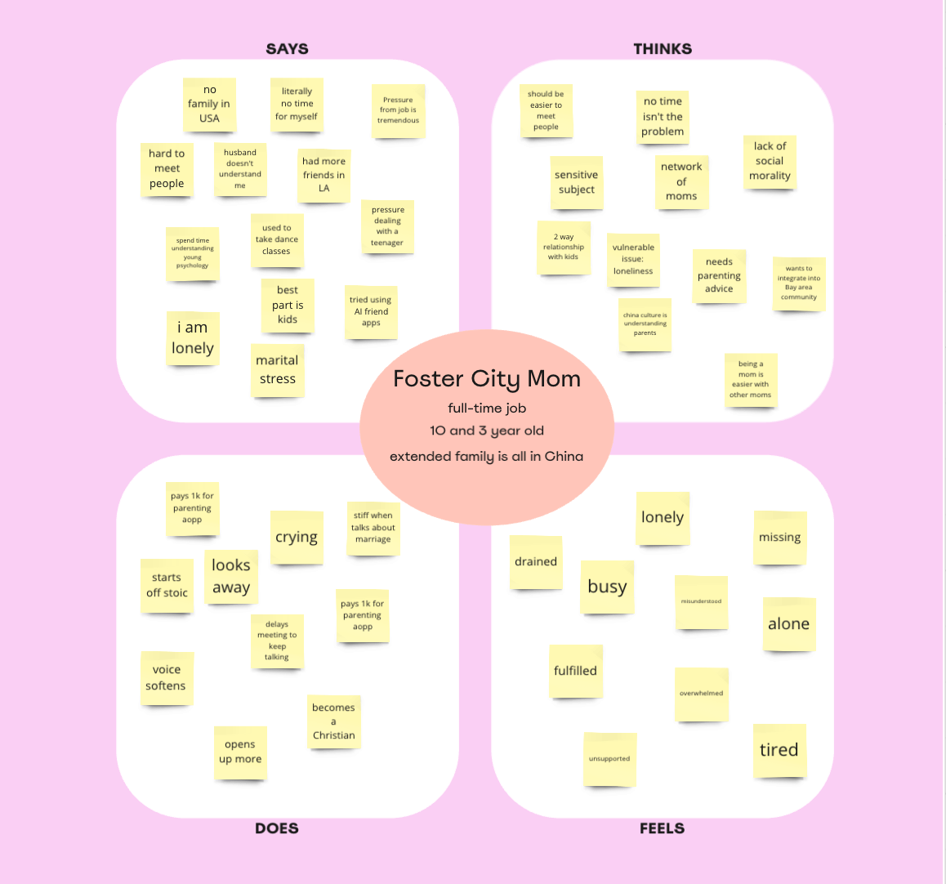



Empathy Map

Slide 14




Empathy Map

Slide 15
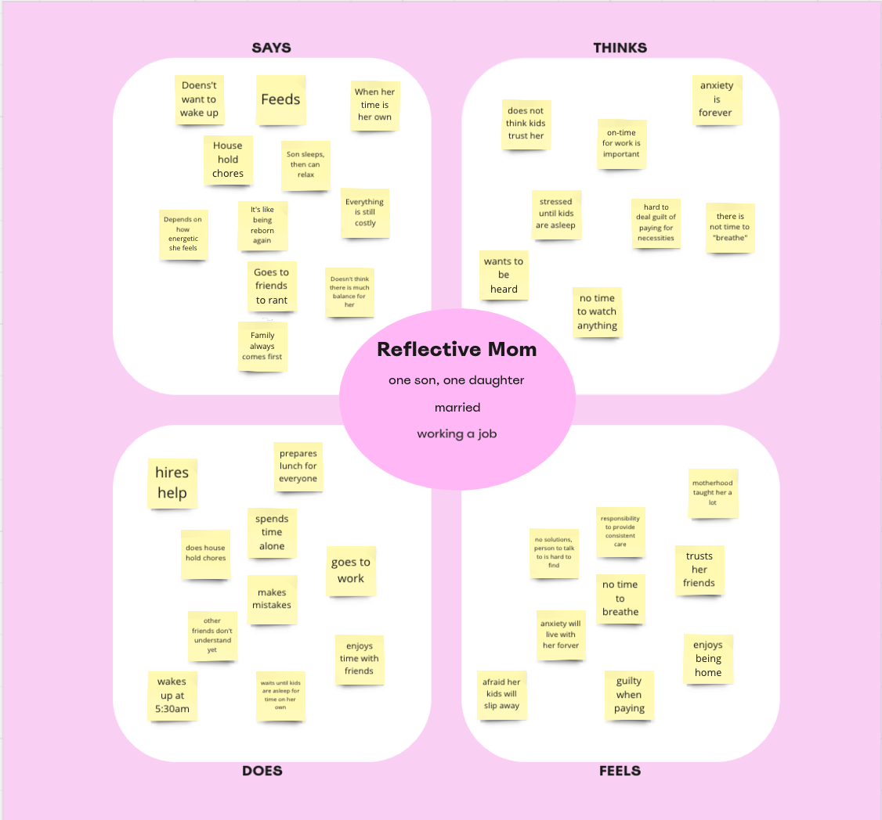



Empathy Map

Slide 16
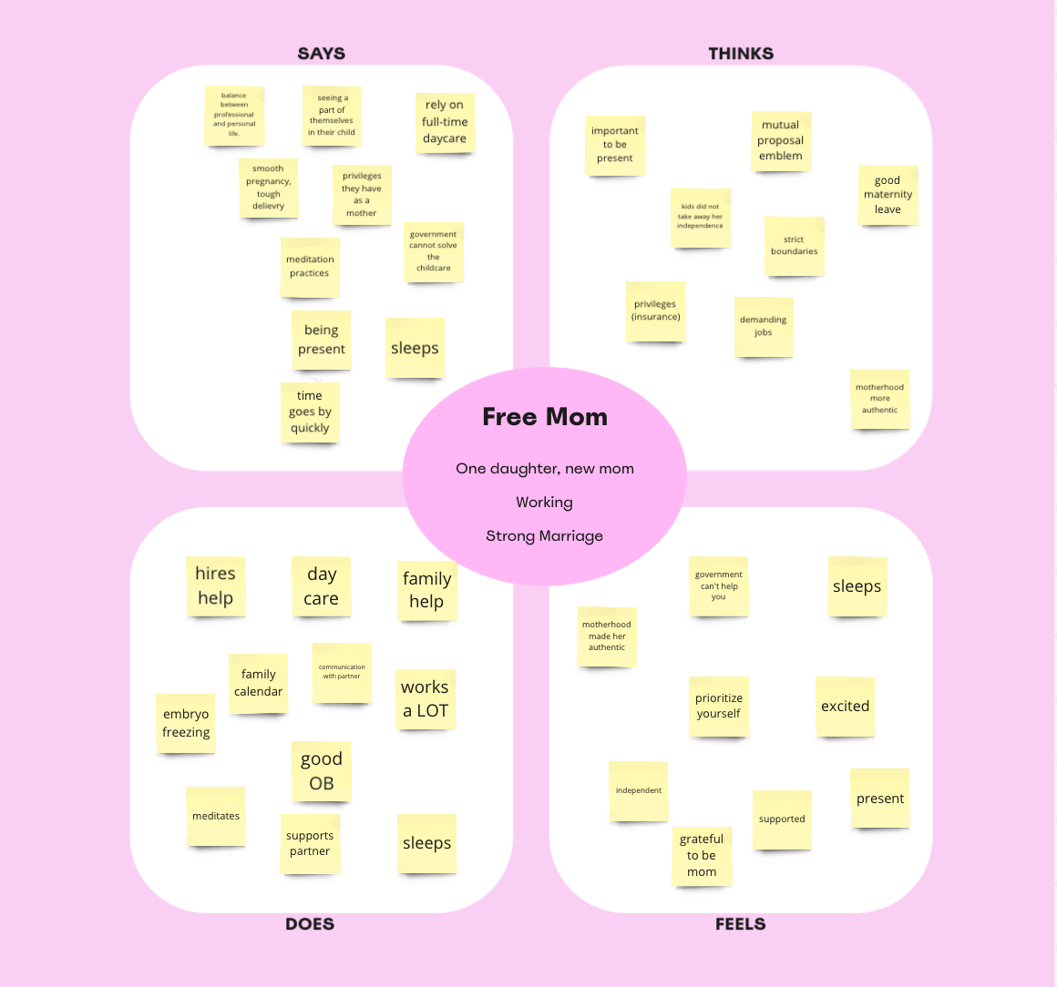



Empathy Map

Slide 17

Insights and Needs #1
Finding: Moms expressed severe anxiety as a part of their day-to-day experience.
Insight: Moms who experience this anxiety only feel peace when it is late at night and the kid(s) are asleep.
Need: Moms crave more opportunities to alleiviate their anxiety.

Slide 18
Insights and Needs #2
Finding: Moms who have childcare support, whether through family or hired help, have less to do but are still stressed.
Insight: Paying for support is a source of guilt for moms who either see it as an indulgence or wish they could be at home.
Need: Moms want support systems to alleviate the guilt and stress associated with outsourcing domestic work.

Slide 19
Insights and Needs #3
Finding: Moms often feel lonely without access to a support network.
Insight: Emotional support from family, especially parents, or a strong marital relationship greatly reduces loneliness.
Need: Moms want spaces where they feel emotionally connected and supported in their parenting journey.

Slide 20
Introduction
Needfinding Methodology
Interview Results
Analysis
Summary

Slide 21

MOMS NEED TO FEEL SEEN, HEARD, AND APPRECIATED... JUST LIKE THE REST OF US
MOMS WITH CHILDCARE AND STRONG EMOTIONAL SUPPORT SYSTEMS ARE HAPPIER
Putting it all together

Slide 22

Next Steps
Interview: moms from underrepresented demographics in our current sample
Define: identify further needs of moms and challenge assumptions
Ideate: brainstorm directions to explore key problems

Slide 23

Appendix
Tools Utilized
Granola.AI for Transcription
Miro for Empathy Maps
NextDoor
Canva
Zoom

