Slide 1

ATHENA SHIRAVI, ZOYA GARG, ESHA GUPTA
A2: Defining and Ideating
POVS, HMWS, BRAINSTORMING & EXPERIENCE PROTOTYPES

Slide 2



Team Cybele
Athena Shiravi
B.A. Econ
B.S. CS
HCI Coterm
Esha Gupta
B.S. SymSys
B.A. IR
Zoya Garg
B.S. CS
B.A. Classics

Slide 3
Roadmap
PROBLEM DOMAIN
SOLUTIONS
NEEDFINDING
PROTOTYPES
POV & HMWS
NEXT STEPS

Slide 4
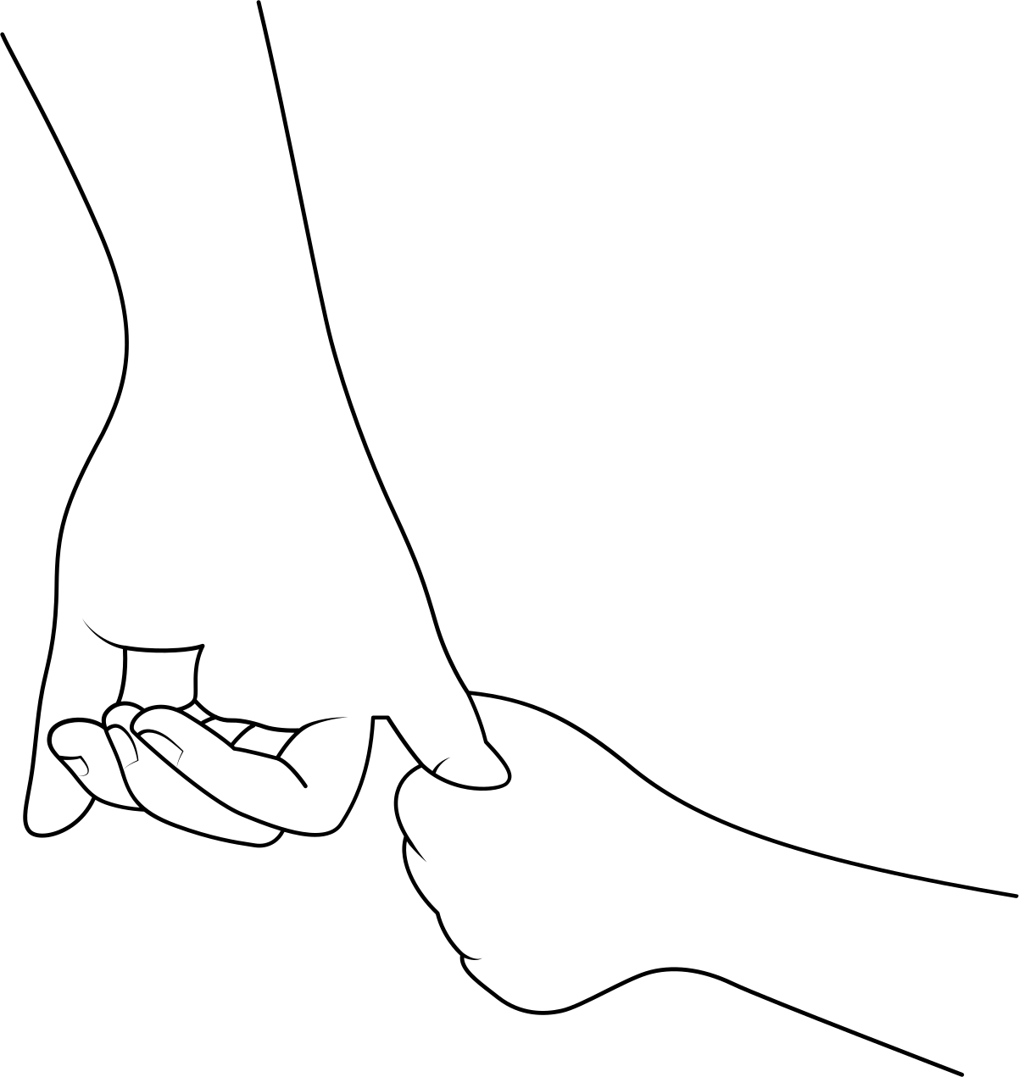
PROBLEM DOMAIN
Working Moms
Working moms experience mental health challenges as they navigate career demands and family responsibilities, often without adequate support systems

Slide 5


NEEDFINDING
Interviewees
We met these two moms on Stanford campus — the Stanford Bookstore and Green Library!
MEDITATIVE MOM
EMPTY NESTER MOM

Slide 6

NEEDFINDING
WHEN MY DAUGHTER AND I STARTED DOING TAI CHI TOGETHER WE WERE ABLE TO GET CLOSER AND I FELT SHE WAS MORE UNDERSTANDING OF MY STRESS
“I wish someone had told me of these resources two years ago so I didn’t have to research it all so intensely”

Slide 7
NEEDFINDING
TAI CHI
APP
BOOKS
AGE
COMMUNITY
TIME
ADVICE
SUPPORT
Finds community by practicing Tai Chi with daughter and moms in group exercise class
Wants to be more intentional with her time, using a scheduling app to stay organized
Wishes self-help books and parenting advice were more accessible and widely available
Child care becomes easier as kids grow older and form friendships with peers their own age.

Slide 8
NEEDFINDING
“THE KIDS ALWAYS CAME FIRST. I FELL WAY DOWN THE PRIORITY LADDER OF THINGS TO TAKE CARE OF.”
“SHE'S JUST NOT ALWAYS VERY MUCH INTO TEXTING BACK.”
" I WANTED TO EARN MY OWN MONEY AND JUST GET BACK INTO HAVING MORE OF MY OWN LIFE. "

Slide 9
NEEDFINDING
LUNCH
BOOKS
WORDLE
COMMUTE
SELF-CARE
TIME
COMMUNICATION
SUPPORT
Favorite hour of the day is “her last free hour” to relax and unwind alone
Missed earning her own money and doing work that she could receive positive feedback on
Plays New York Times Wordle and Spelling Bee with her son to stay connected in a fun ritual
Drives up to Concord, CA to visit family like her brother and dad. She misses her mom

Slide 10
POV & HMWS
We met a working mom of two young kids separated from her extended family who is all in China. We were surprised to notice that despite living in Foster City for 5 years, she does not feel like she has a community there or in the larger Bay Area. We wonder if this means she forgoes actively building relationships to prioritize child care. It would be game-changing to alleviate this loneliness for moms.
Studio 2
POV:COMMUNITY

Slide 11
POV & HMWS
We met a working mom of two young kids separated from her extended family who is all in China. We were surprised to notice that despite living in Foster City for 5 years, she does not feel like she has a community there or in the larger Bay Area. We wonder if this means she forgoes actively building relationships to prioritize child care. It would be game-changing to help her feel less lonely.
Revised
POV:COMMUNITY

Slide 12
POV & HMWS
We met J, a mom working part-time at the library and recently an empty nester. We were surprised to realize playing and discussing New York Times Spelling Bee game every week was a main method of digital communication for her and her recently graduated son. We wondered if this helps them remain in communication over long distances. It would be a game changer if we could create playful, enjoyable interactions between moms and their children.
Selected
POV:PLAY

Slide 13
POV & HMWS
We met a working mom of two young kids separated from her extended family who is all in China. We were surprised to notice that despite living in Foster City for 5 years, she does not feel like she has a community there or in the larger Bay Area. We wonder if this means she forgoes actively building relationships to prioritize child care. It would be game-changing to help her feel less lonely.
COMMUNICATION
CONNECTION
COMMUNITY
HMW use shared interests to keep families close over long distances?
HMW leverage play to foster meaningful connections between family members?
HMW make childcare and relationship-building simultaneous activities?
We met J, a mom working part-time at the library and recently an empty nester. We were surprised to realize playing and discussing New York Times Spelling Bee game every week was a main method of digital communication for her and her recently graduated son. We wondered if this helps them remain in communication over long distances. It would be a game changer if we could create playful, enjoyable interactions between moms and their children.

Slide 14
SOLUTIONS
ROSE-BUD-THORN
VOICE NOTES
PUZZLE
Once a week family members can provide an overview of how they’re feeling
Storytelling app where family members voice note their days and it stays up for their family to listen to for 24 hours
Group puzzle piece reveal but each person has to do a mindfulness thing to unlock their portion of the picture everyday

Slide 15
PROTOTYPES
Experience
Prototypes
We tested 3 Core Assumptions about our solutions
with local working moms found at Stanford and the local Palo Alto community, and with students to test both spectrums of a family connection mechanism.

Slide 16
PROTOTYPES
Assumptions
Shared Rose-Bud-Thorn journaling improves people’s mood
People are comfortable sharing their day for a minute unprompted
Costs impede the ability of moms to see their loved ones

Slide 17
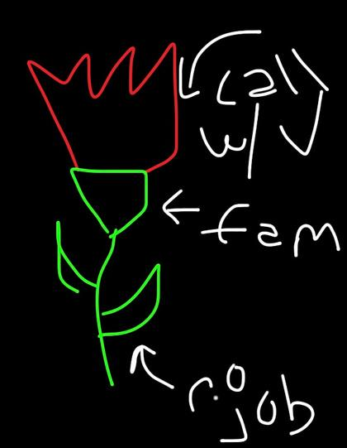
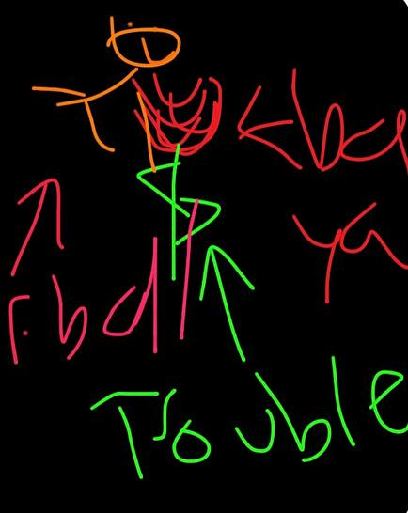
PROTOTYPES
Shared Rose-Bud-Thorn journaling improves people’s mood
INSIGHTS
PROCEDURE
Surprised how much he enjoyed drawing out the RBT vs. the words
Created engaging conversation including starting one about baskteball that day
What’s your mood before RBT? 5
What’s your mood after RBT? 6
(scale 1-10)

Slide 18
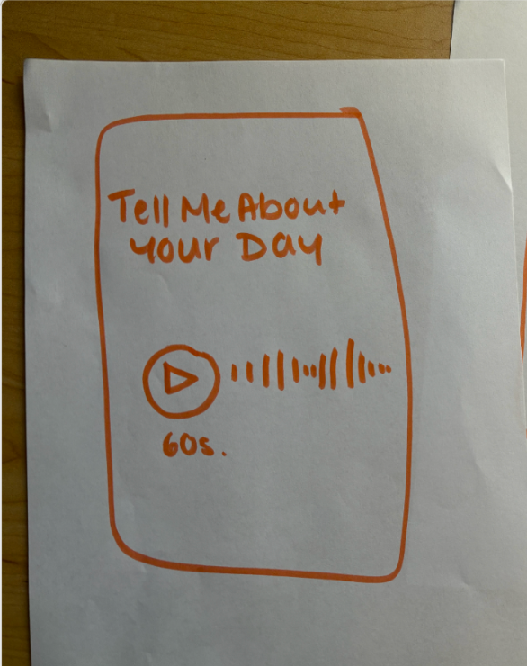
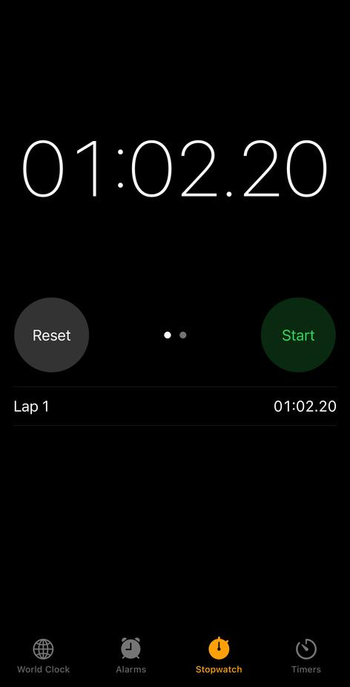
PROTOTYPES
People are comfortable sharing their day for a minute unprompted
INSIGHTS
Difficult to speak for the whole
minute
PROCEDURE
Easier if there were prompts
People are not always able to share without supplemental prompts
“Pretend we are your children”
“I live in a different city. I’d love to hear about your day”

Slide 19
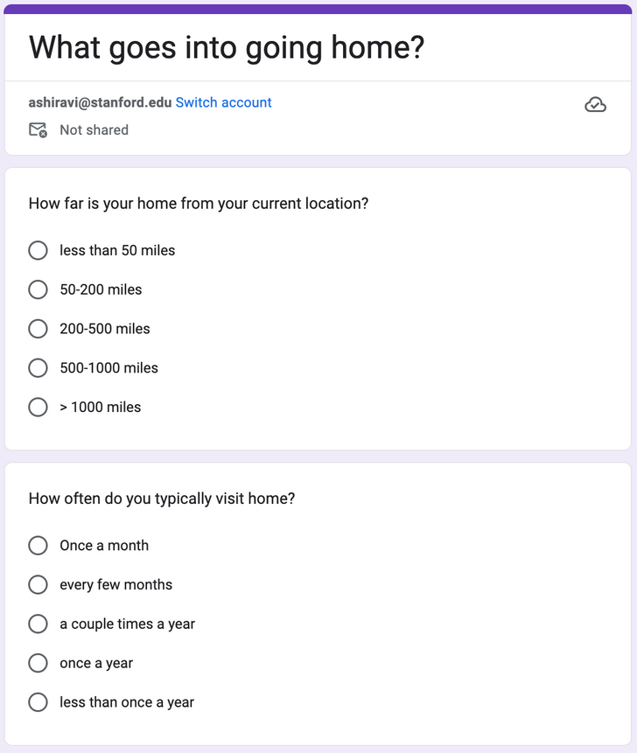
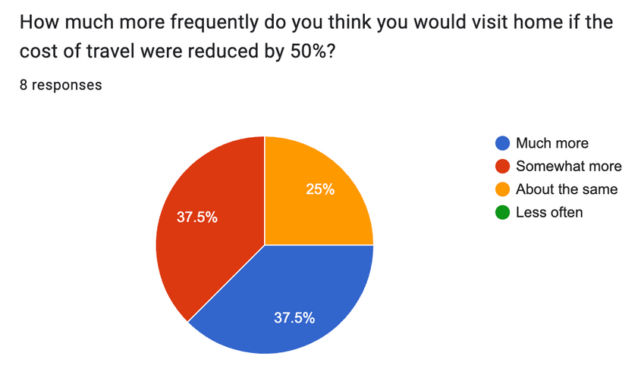
PROTOTYPES
> 37% of students
delayed or skipped a trip home due to cost concerns
Costs impede the ability of moms to see their loved ones
“It’s so far and so much money that I feel guilty when I go all the way back for just a week (like thanksgiving) but I love my family so much I want to anyway”
PROCEDURE
INSIGHTS

Slide 20
NEXT STEPS
SOLUTION
ETHICAL IMPLICATIONS
INCLUDES/EXCLUDES
Rose bud thorn is a solution for moms and kids to share highs, challenges, and hopes in a fun, bonding way
We can add prompts to help foster communal sharing
Storing personal moments could raise privacy concerns if data isn't secured or shared with consent
Includes moms and kids of all ages; may exclude those uncomfortable sharing personal feelings or without tech access;
difficult for parents with toddlers
.

Slide 21
Thank You

Slide 22
Appendix

Slide 23
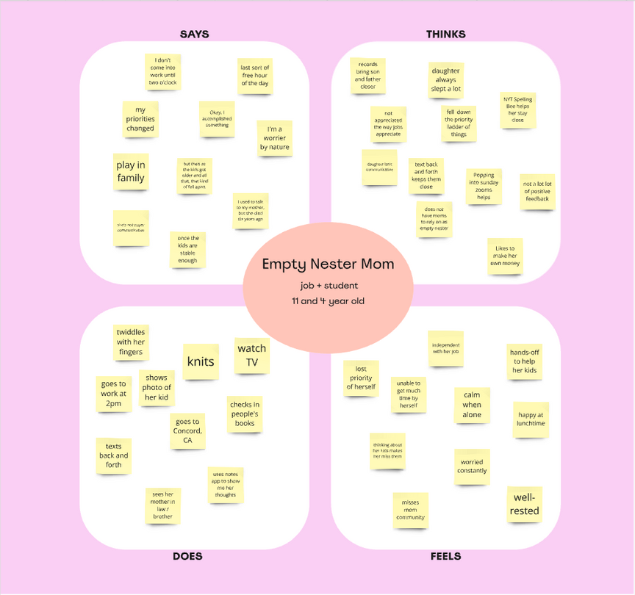
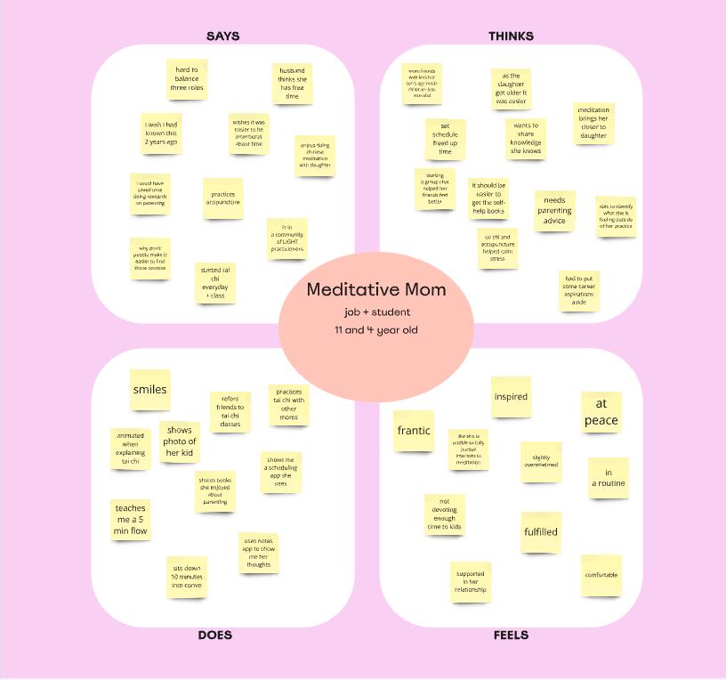
APPENDIX
EMPATHY MAPS

Slide 24
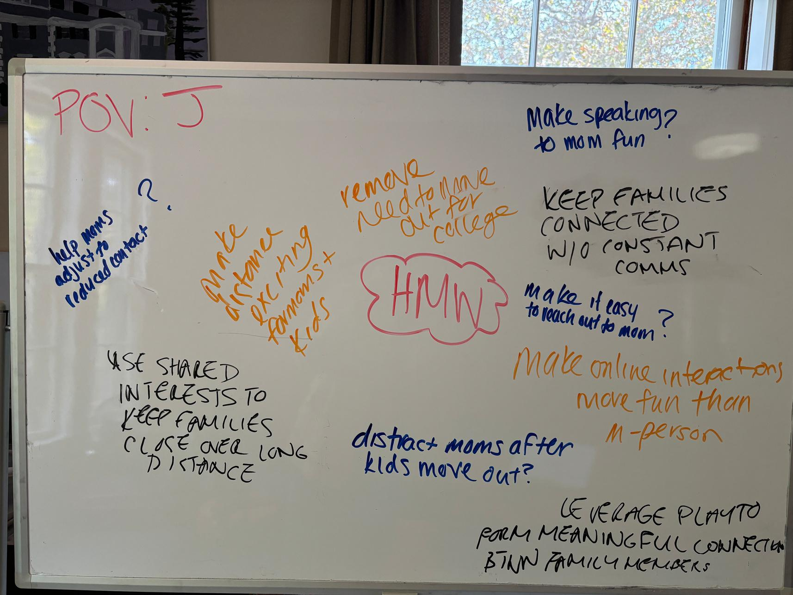
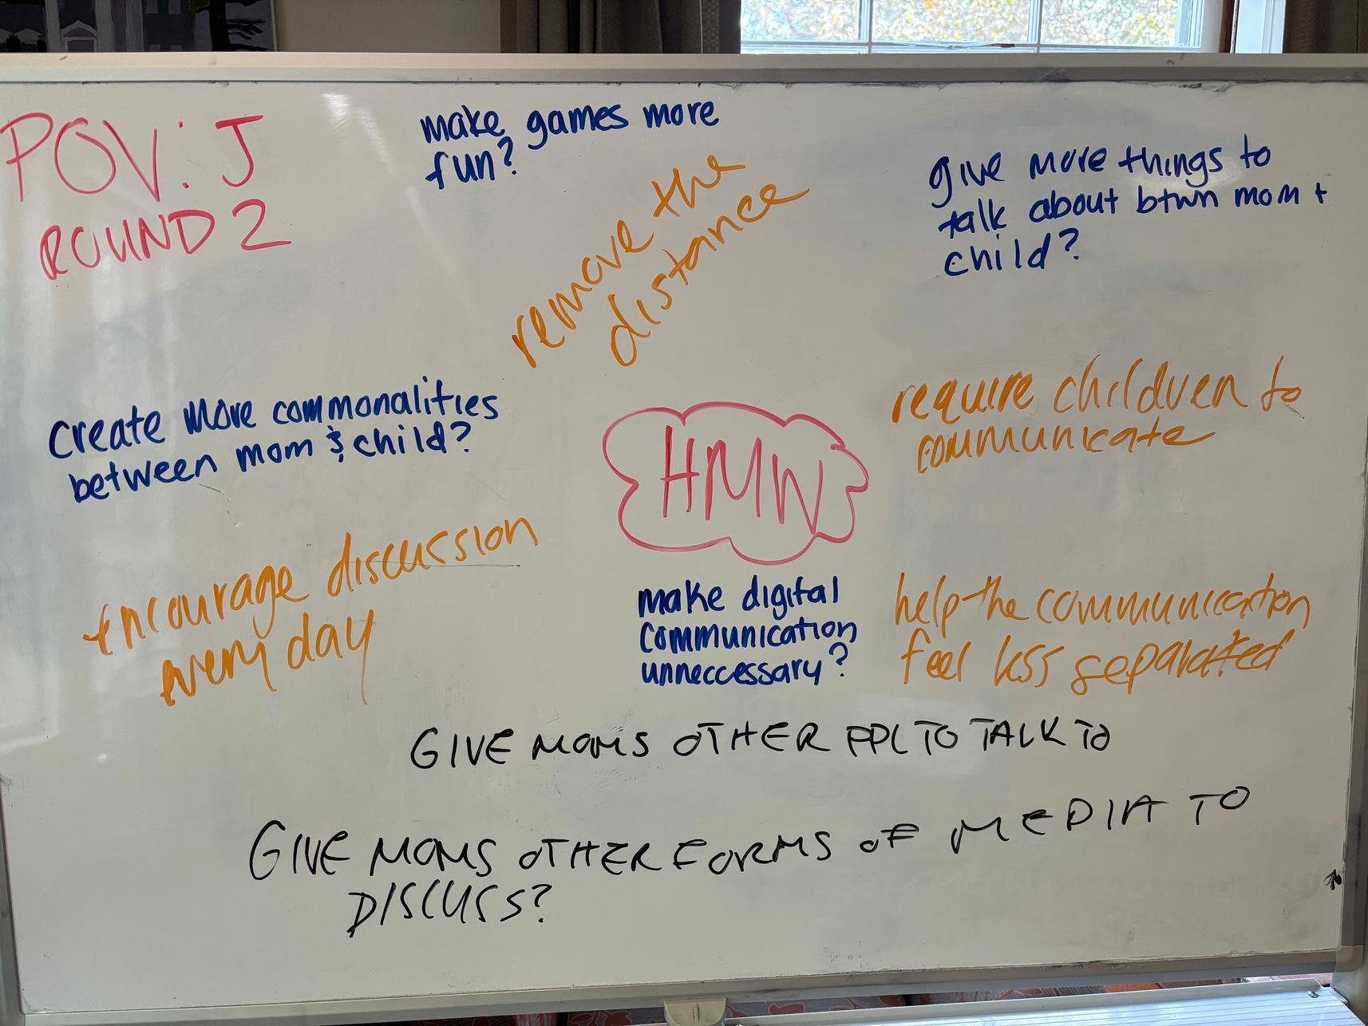
APPENDIX
BRAINSTORMS: HMW FOR POV 1

Slide 25
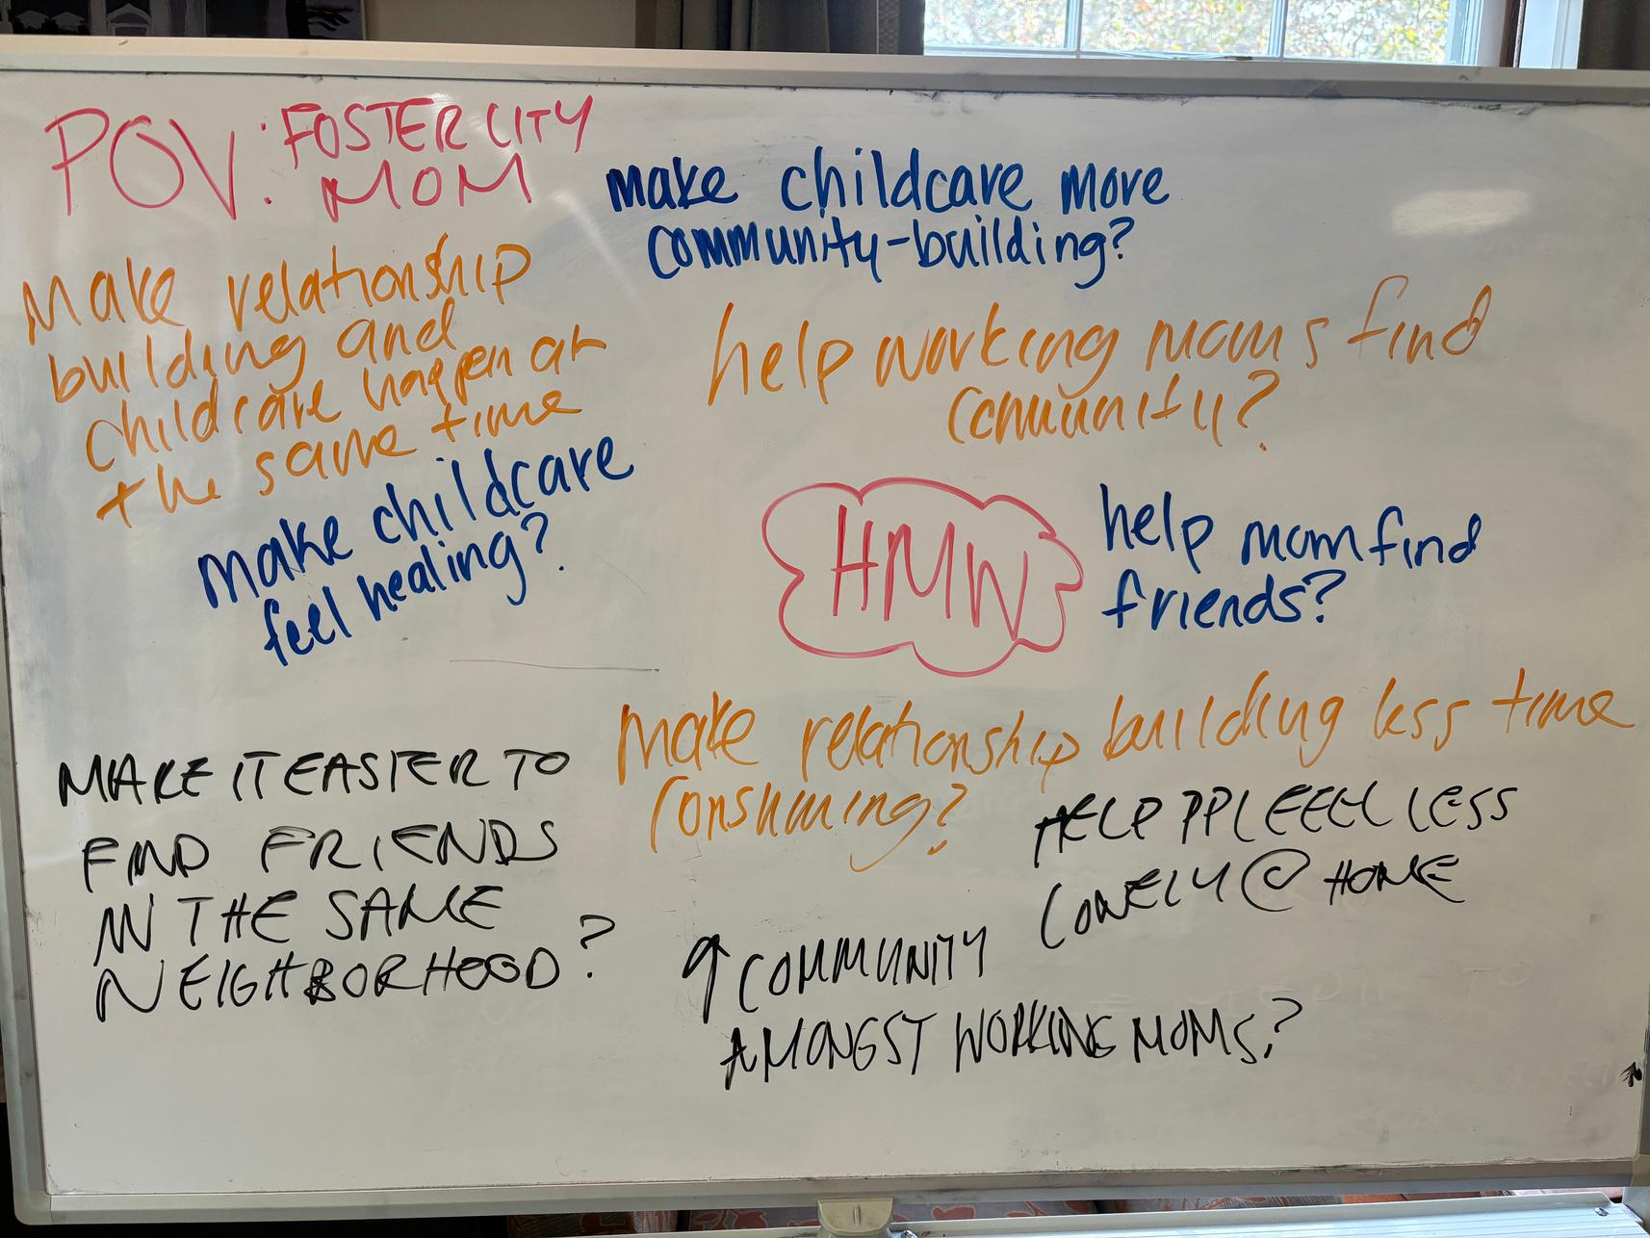
APPENDIX
BRAINSTORMS: HMW FOR POV 2

Slide 26
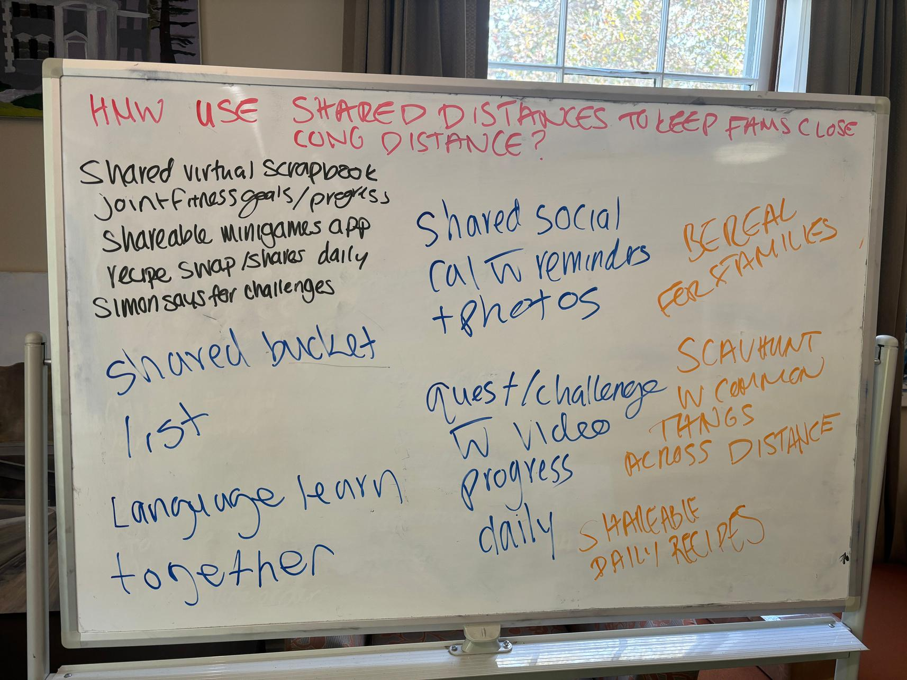
APPENDIX
BRAINSTORMS: SOLUTIONS FOR HMW 1

Slide 27
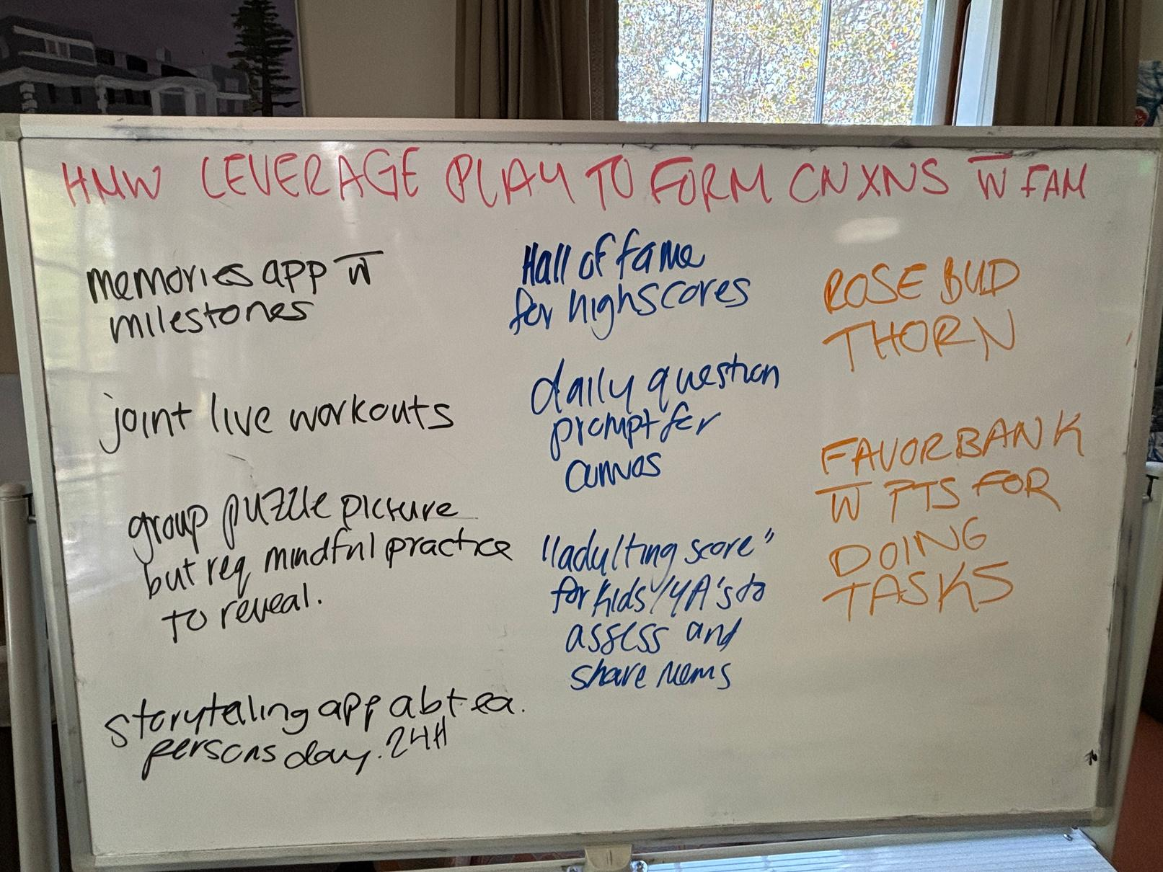
APPENDIX
BRAINSTORMS: SOLUTIONS FOR HMW 2

Slide 28
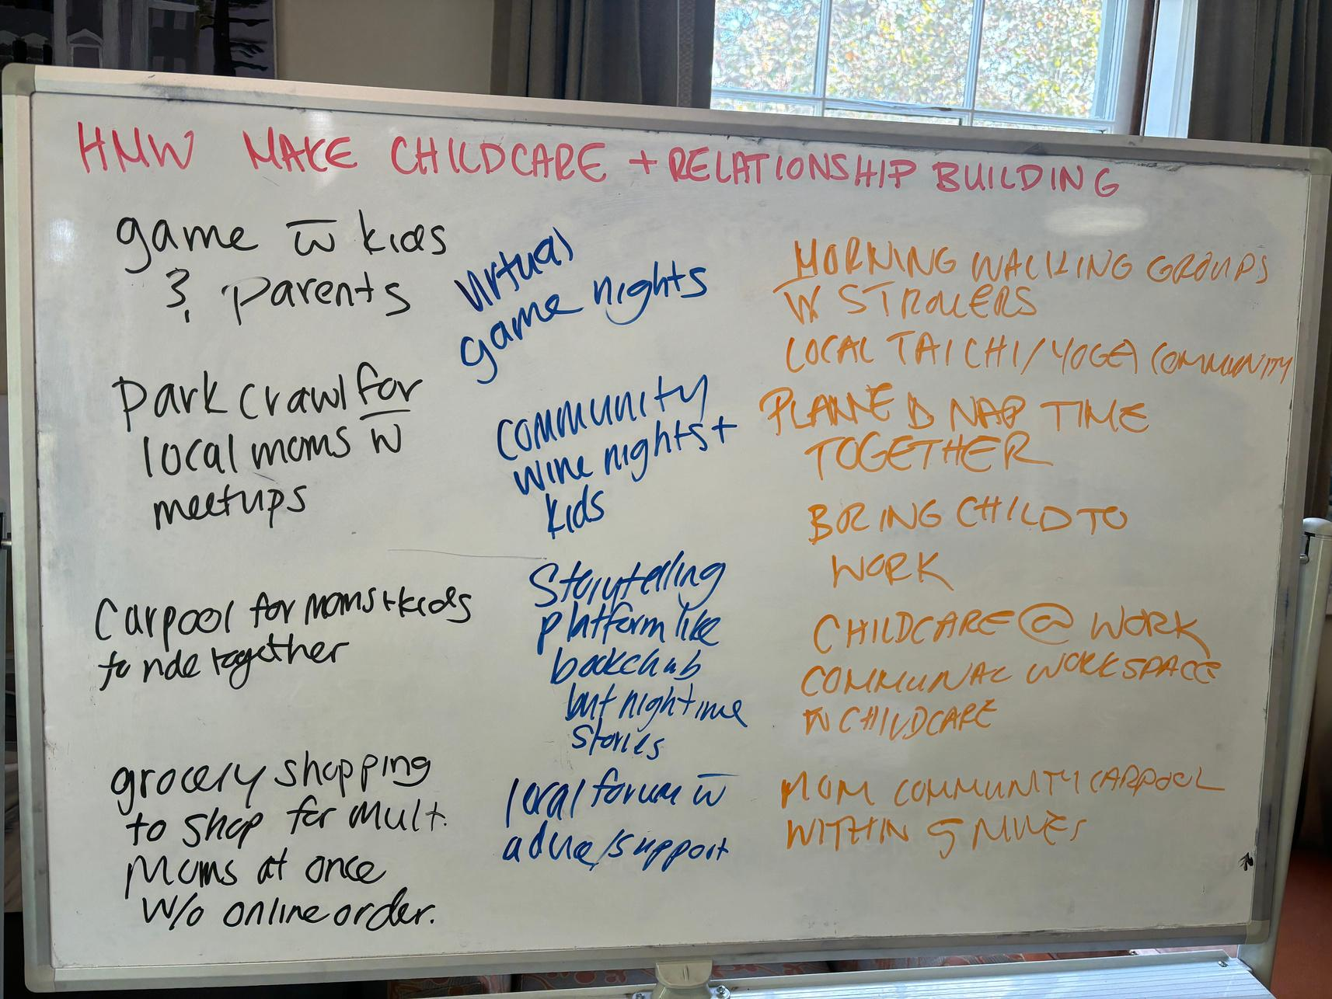
APPENDIX
BRAINSTORMS: SOLUTIONS FOR HMW 3

