Slide 1

ATHENA SHIRAVI, ZOYA GARG, ESHA GUPTA
A6: Med-Fi Prototypes
INTERACTIVE MEDIUM-FI PROTOTYPE

Slide 2
INTRODUCTION
PROBLEM/SOLUTION
VALUES
Roadmap
TASKS
USABILITY
REVISED SKETCHES
MED-FI TASK FLOWS
IMPLEMENTATION

Slide 3
INTRODUCTION
PROBLEM/SOLUTION
VALUES
Roadmap
TASKS
USABILITY
REVISED SKETCHES
MED-FI TASK FLOWS
IMPLEMENTATION

Slide 4
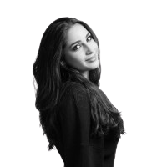
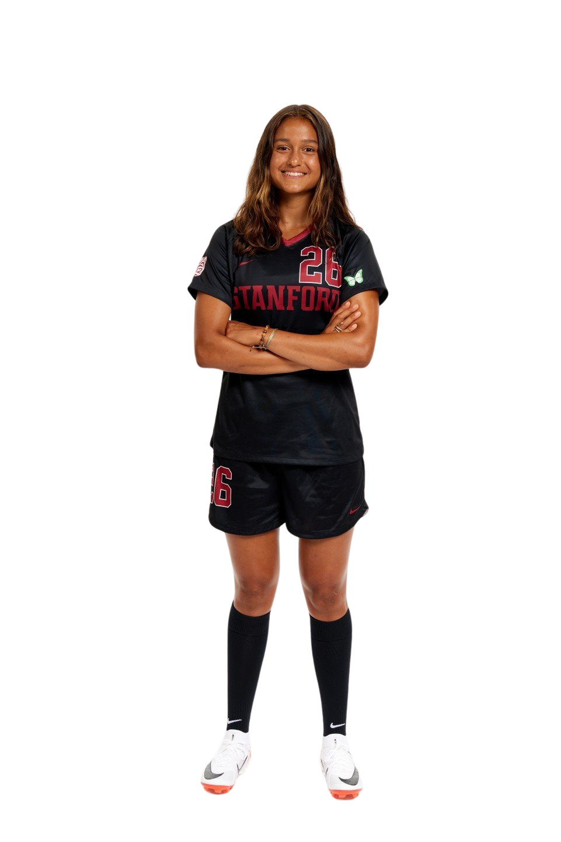
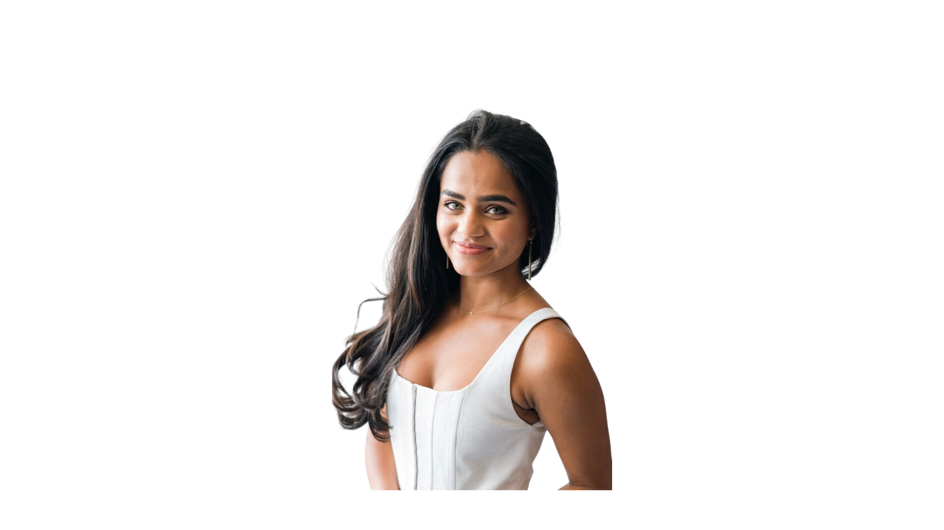
Team Cybele
Athena Shiravi
B.A. Econ
B.S. CS
HCI Coterm
Esha Gupta
B.S. SymSys
B.A. IR
Zoya Garg
B.S. CS
B.A. Classics

Slide 5
INTRODUCTION
PROBLEM/SOLUTION
VALUES
Roadmap
TASKS
USABILITY
REVISED SKETCHES
MED-FI TASK FLOWS
IMPLEMENTATION

Slide 6
In case you forgot...
(It’s been a week. We get it.)

Slide 7
Moms often experience moments of isolation or mental fatigue throughout the day.
Our Solution:
MUSE

Slide 8
Moms often experience moments of isolation or mental fatigue throughout the day.
An interactive, online mural to doodle on with their loved ones offers them a playful, creative outlet to express themselves and connect with others.
Our Solution:
MUSE

Slide 9
Moms often experience moments of isolation or mental fatigue throughout the day.
An interactive, online mural to doodle on with their loved ones offers them a playful, creative outlet to express themselves and connect with others.
This helps foster a sense of community and mental well-being.
Our Solution:
MUSE

Slide 10
MUSE provides moms with a low-friction space to leverage creativity to build community. In moments of isolation or fatigue, moms said they wanted spaces for communal comfort and self-expression. MUSE brings community to these moms in a playful, inviting way.
Our
Value Add:

Slide 11
INTRODUCTION
PROBLEM/SOLUTION
VALUES
Roadmap
TASKS
USABILITY
REVISED SKETCHES
MED-FI TASK FLOWS
IMPLEMENTATION

Slide 12
VALUES IN DESIGN
Here’s what we care about

Slide 13
VALUES IN DESIGN
From our interviews we learned...
Moms missed their sense of identity, often neglecting their interests and hobbies

Slide 14
VALUES IN DESIGN
From our interviews we learned...
Moms missed their sense of identity, often neglecting their interests and hobbies
Moms turn to play and levity to connect with their families

Slide 15
VALUES IN DESIGN
From our interviews we learned...
Moms missed their sense of identity, often neglecting their interests and hobbies
Moms turn to play and levity to connect with their families
Moms crave community and belonging

Slide 16
VALUES IN DESIGN
From our interviews we learned...
Moms missed their sense of identity, often neglecting their interests and hobbies
Moms turn to play and levity to connect with their families
Moms crave community and belonging
Moms are busy. Very busy.

Slide 17
VALUES IN DESIGN
From our interviews we learned...
Moms missed their sense of identity, often neglecting their interests and hobbies
Moms turn to play and levity to connect with their families
Moms crave community and belonging
Moms are busy. Very busy.
We wanted to return to moms a sense of autonomy, through giving them a creative outlet they can conveniently use to build community.

Slide 18
VALUES IN DESIGN
Values:
Autonomy
Creativity
Convenience
Community
Empowering moms to first reflect on and identify their own needs through prompts and express themselves through art

Slide 19
VALUES IN DESIGN
Values:
Autonomy
Creativity
Convenience
Community
Muse challenges moms to reconnect with their creative side, giving them a means to connect with what often takes a backseat role in parenting

Slide 20
VALUES IN DESIGN
Values:
Autonomy
Creativity
Convenience
Community
By implementing Muse as a tablet app, we allow moms to leverage a portable device to doodle whenever’s convenient, while also being mindful of what interface is best suited for drawing

Slide 21
VALUES IN DESIGN
Values:
Autonomy
Creativity
Convenience
Community
Muse exists as a communal app, providing a digital space for moms to connect with and get vulnerable with other moms, facilitating community

Slide 22
VALUES IN DESIGN
Tensions:
Sometimes being creative is hard. And it takes a lot out of you. Creativity may come at a cost to convenience, especially if the need to be creative dissuades moms from doodling on a tiring day.
Creativity Convenience

Slide 23
VALUES IN DESIGN
Tensions:
Do you doodle to communicate with others? Or do you do it to express yourself regardless of what others perceive? Is art for the artist, or the audience? We’ll never know.
Autonomy Community

Slide 24
INTRODUCTION
PROBLEM/SOLUTION
VALUES
Roadmap
TASKS
USABILITY
REVISED SKETCHES
MED-FI TASK FLOWS
IMPLEMENTATION

Slide 25
Here’s what we changed
(Let’s just say it was a productive week...)

Slide 26
Our wording needed work.
Gallery confused our interviewees

Slide 27
Our wording needed work.
Gallery confused our interviewees
So we categorized murals by starting a new mural, live murals, and completed murals

Slide 28
Our wording needed work.
Gallery confused our interviewees
So we categorized murals by starting a new mural, live murals, and completed murals
Distinguishing between Neighborhoods and Comunities was 1) confusing and 2) didn’t add much for the moms

Slide 29
Our wording needed work.
Gallery confused our interviewees
So we categorized murals by starting a new mural, live murals, and completed murals
Distinguishing between Neighborhoods and Comunities was 1) confusing and 2) didn’t add much for the moms
So we ditched Neighborhoods alltogehter and reworked our task flows to only consider Communities

Slide 30
Drawing on your phone is hard.
This should be relaxing, not a finger-fumble-fest.
Mobile didn’t feel like the most intuitive interface for drawing on-the-go

Slide 31
Drawing on your phone is hard.
This should be relaxing, not a finger-fumble-fest.
Mobile didn’t feel like the most intuitive interface for drawing on-the-go
So we redid our flow for an iPad/tablet realization
(thank you guys for the feedback!)

Slide 32
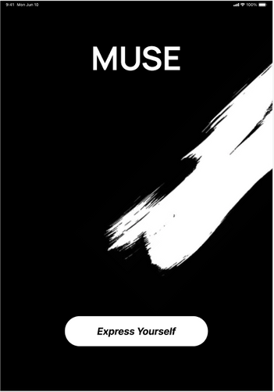
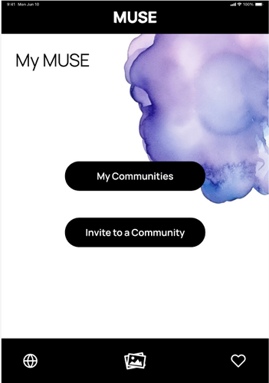
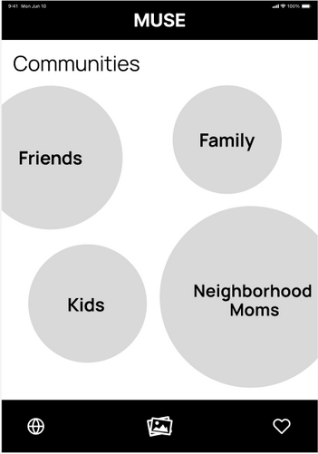
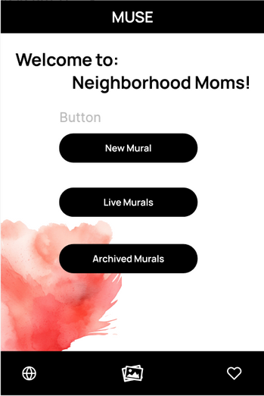
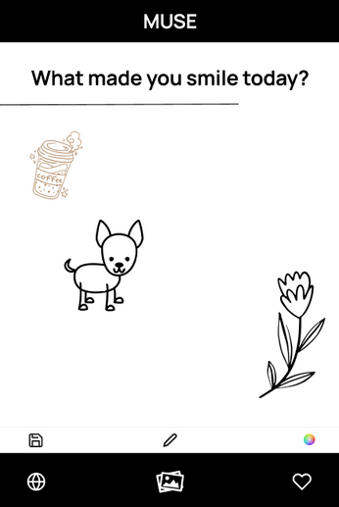
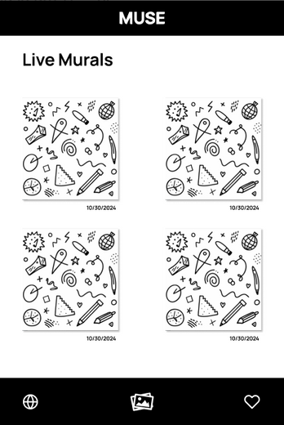
Simple Task
Making a Doodle

Slide 33
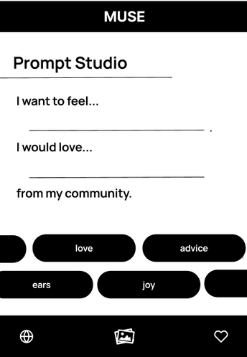
Moderate Task
Making a Mural

Slide 34
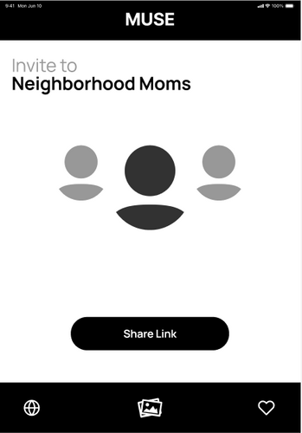
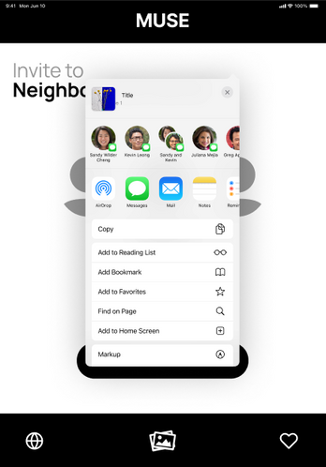
Complex Task
Inviting a Mom

Slide 35
INTRODUCTION
PROBLEM/SOLUTION
VALUES
Roadmap
TASKS
USABILITY
REVISED SKETCHES
MED-FI TASK FLOWS
IMPLEMENTATION

Slide 36
Usability Goals + Key Measurements

Slide 37

Usability Goals
Intuitiveness
Community Building
Rationale
Users should be able to quickly move through each slide without delays, ensuring a smooth and engaging experience.
Key Measurement
Number of user questions or requests for assistance per screen
(target: <= 2 )
Rationale
Our goal is to help moms build connection with their kids, friends, and family in a low friction, creative way.
Key Measurement
Percentage of moms who report wanting to doodle more (target: >= 80%)

Slide 38
Progress Toward Usability Goals
Intuitiveness
Community Building
  Categorized murals by new, live, completed. Helps users process each slide faster without confusion.
  Reworked our task flows to focus solely on community groups to reduce unnecessary onboarding slides before a “reward” (doodle) working toward our goals
  Redesigned the flow for an iPad/tablet realization, allowing for a more comfortable and immersive doodling experience
  By designing for larger screens, we are honoring a shared creative space, building towards creating a stronger sense of community among users

Slide 39
INTRODUCTION
PROBLEM/SOLUTION
VALUES
Roadmap
TASKS
USABILITY
REVISED SKETCHES
MED-FI TASK FLOWS
IMPLEMENTATION

Slide 40
Change 1:
Simplified Mural Categorization

Slide 41
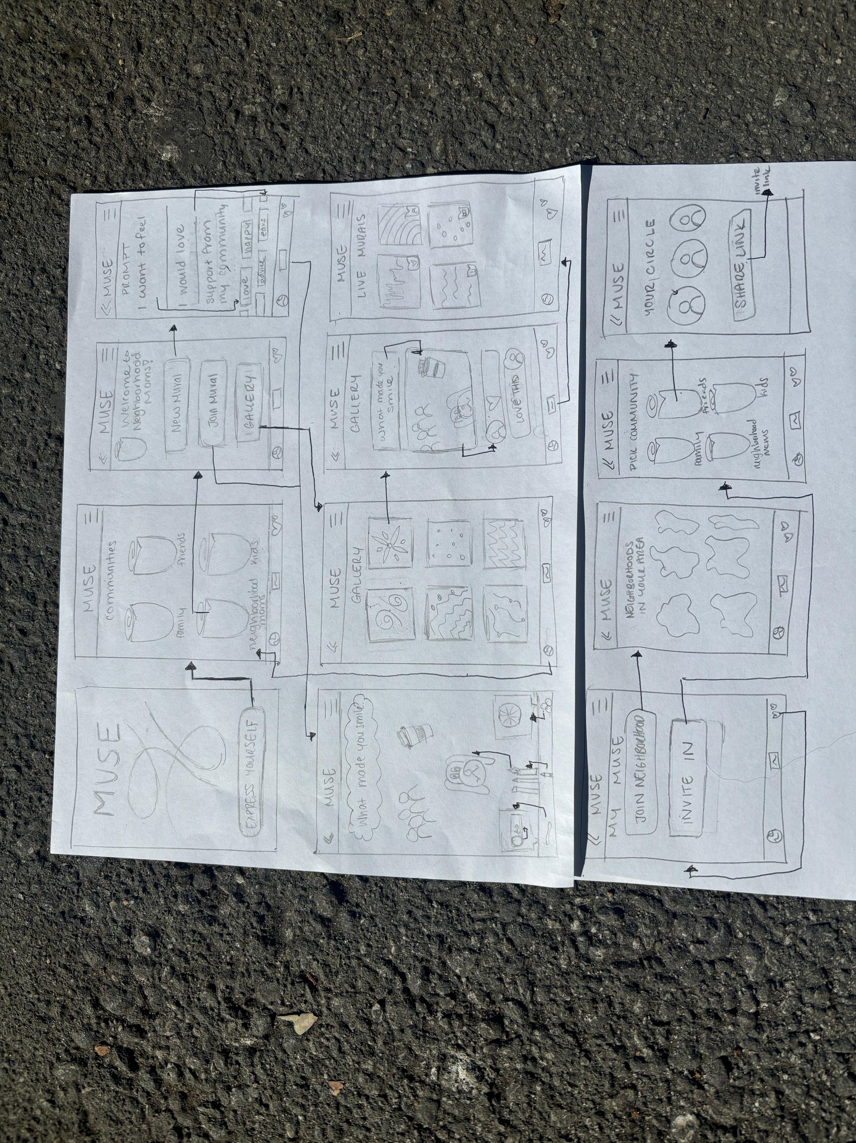
Instead of having a "Gallery" page that confused our interviewees, murals are now categorized into "New Mural," "Live Mural," and "Archived Mural."

Slide 42
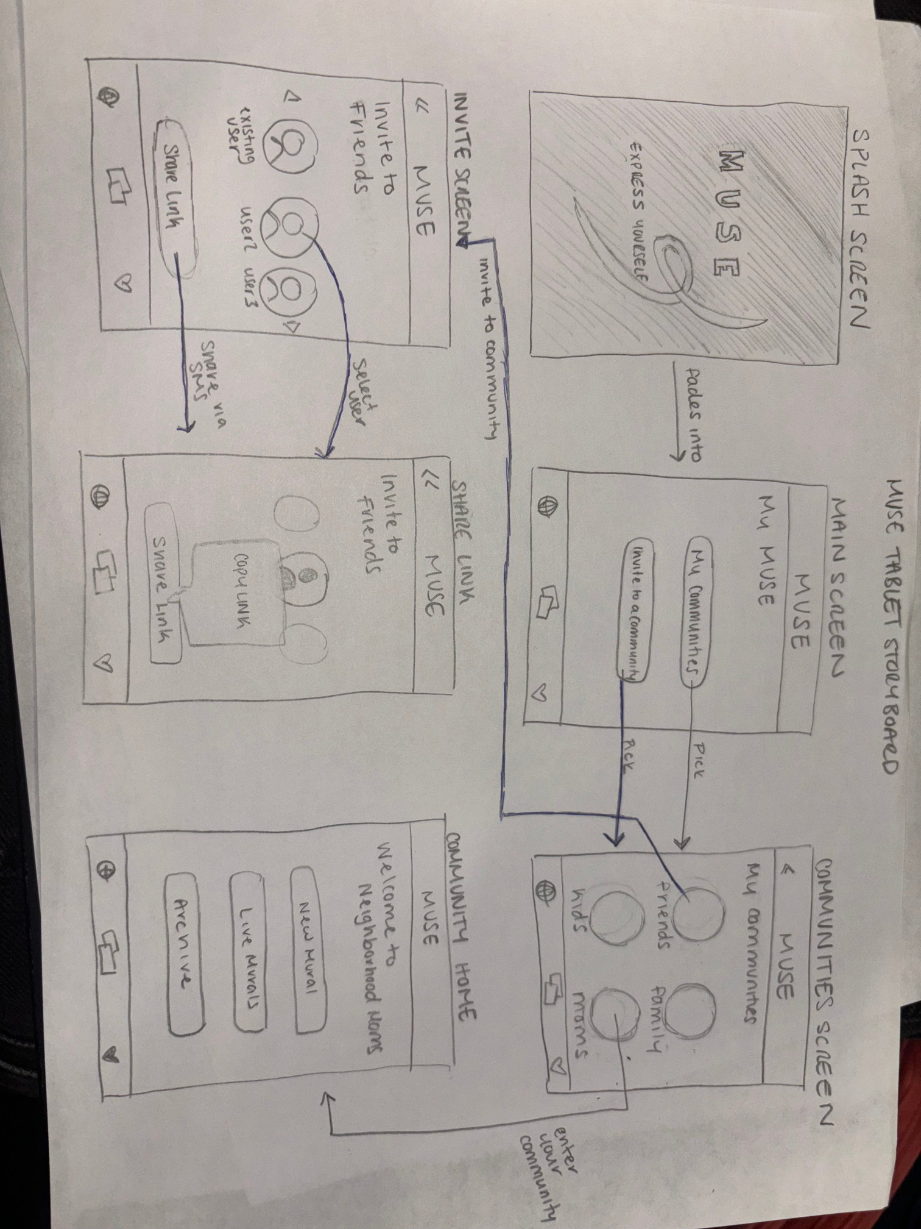
Instead of having a "Gallery" page that confused our interviewees, murals are now categorized into "New Mural," "Live Mural," and "Archived Mural."

Slide 43
Change 2:
Shift from Neighborhoods
to Communities

Slide 44
Distinction between "Neighborhoods" and "Communities" was removed -> a focus solely on "Communities" to better align with user needs.
Impact: This change streamlined the task flows and removed unnecessary complexity, making the app easier for moms to navigate and find their community groups.

Slide 45
Distinction between "Neighborhoods" and "Communities" was removed -> a focus solely on "Communities" to better align with user needs.
Impact: This change streamlined the task flows and removed unnecessary complexity, making the app easier for moms to navigate and find their community groups.

Slide 46
Change 3:
Tablet-Optimized
Doodling Interface

Slide 47
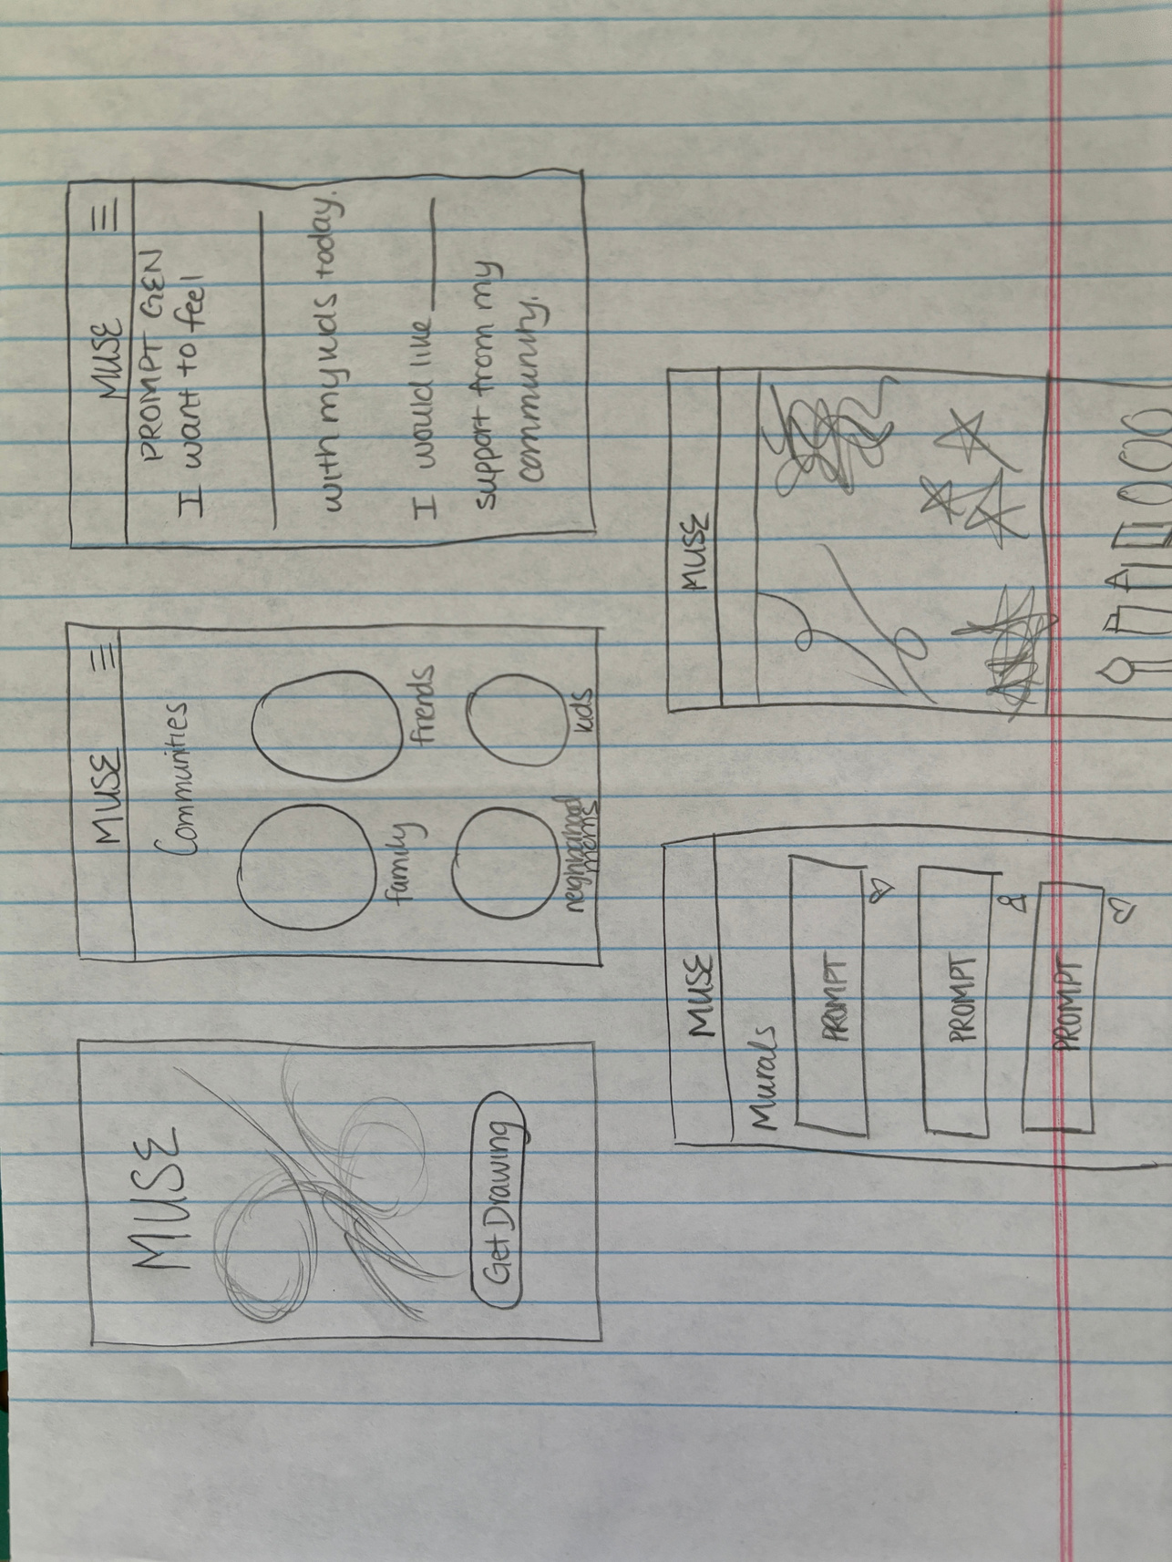
Change: Due to the challenges of drawing on a small phone screen, the doodling feature was optimized for iPads and tablets to provide a more comfortable and engaging experience.
Impact: This adjustment supports a more relaxed, user-friendly doodling experience, aligning with the app’s goal of fostering creativity and connection.
Mobile Realization

Slide 48
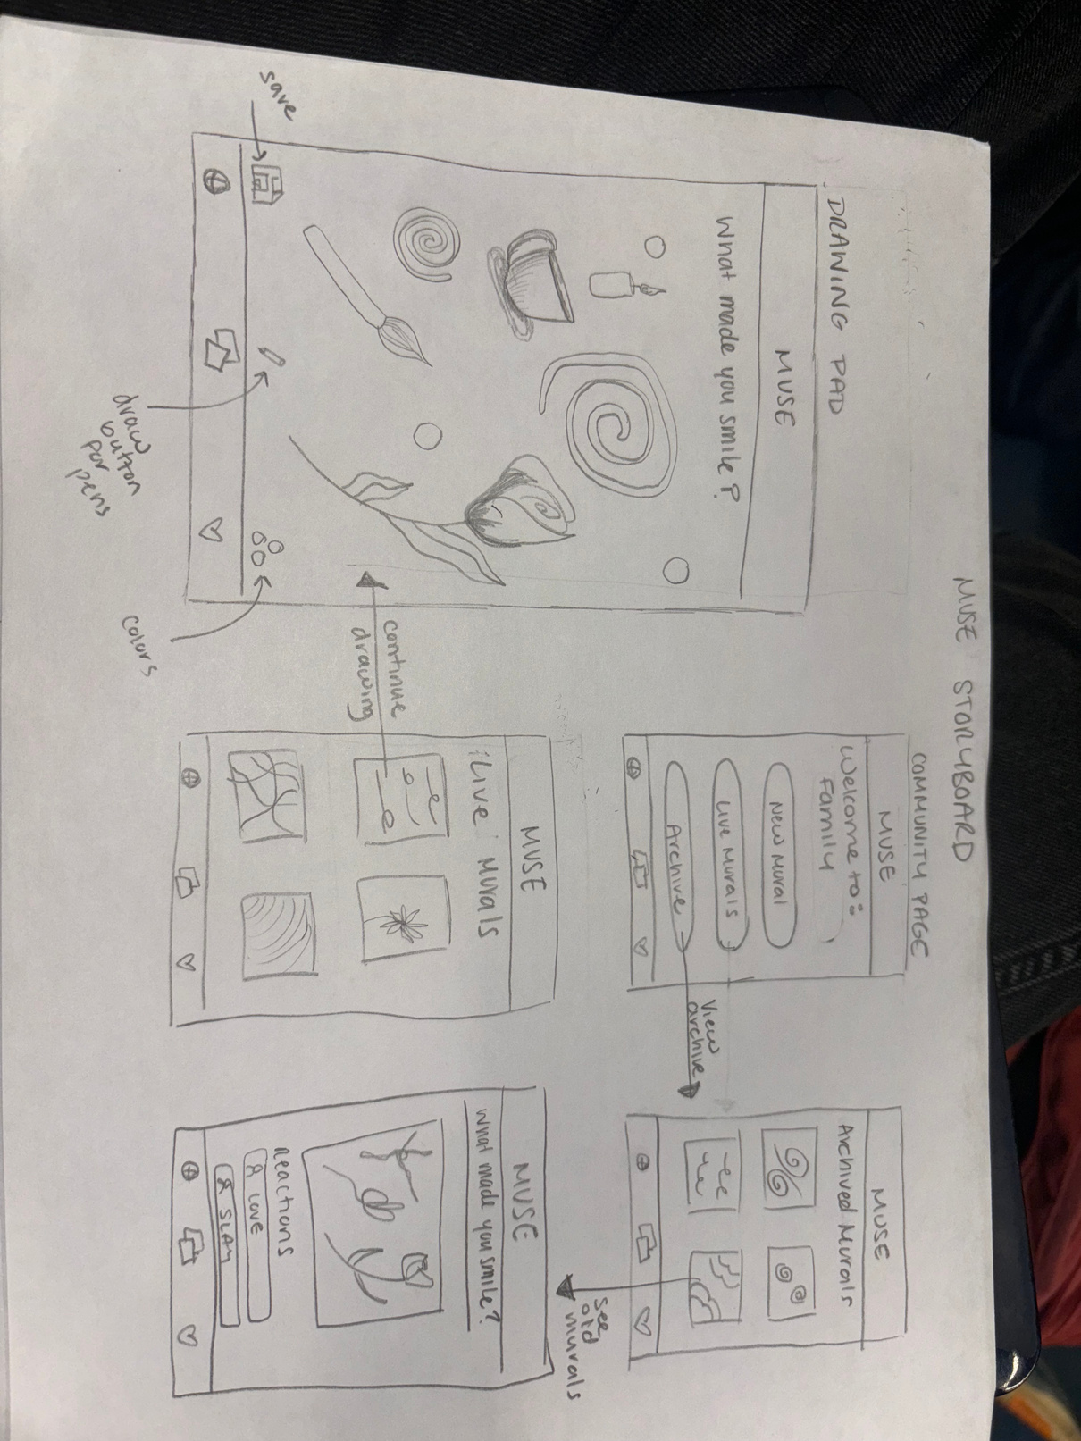
Change: Due to the challenges of drawing on a small phone screen, the doodling feature was optimized for iPads and tablets to provide a more comfortable and engaging experience.
Impact: This adjustment supports a more relaxed, user-friendly doodling experience, aligning with the app’s goal of fostering creativity and connection.

Slide 49
INTRODUCTION
PROBLEM/SOLUTION
VALUES
Roadmap
TASKS
USABILITY
REVISED SKETCHES
MED-FI TASK FLOWS
IMPLEMENTATION

Slide 50
Med-Fi Prototype Task Flows

Slide 51
Simple Task
Making a Doodle

Slide 52
Moderate Task
Making a Mural

Slide 53
Complex Task
Inviting a Mom

Slide 54
INTRODUCTION
PROBLEM/SOLUTION
VALUES
Roadmap
TASKS
USABILITY
REVISED SKETCHES
MED-FI TASK FLOWS
IMPLEMENTATION

Slide 55
Prototype Implementation

Slide 56
Pro Con: Paper
Design and Prototyping Tools (Paper)
For task flow sketching and early ideation
Pros
  Simple, intuitive, and commonly used application for sketching
  Highly flexible, allows for quick iterations to refine ideas
  Doesn’t require heavy equipment availability
  Works offline
Cons
  Requires step-by-step designing and wireframing, which can be time-consuming.
  Hard to iterate if you want quick revisions (need to erase/start entirely anew)
  Limited in visual fidelity, which makes it hard to envision the final product.

Slide 57
Pro Con: Figma
Design and Prototyping Tools (Figma)
For prototyping and building out screens
Pros
  Powerful online tool with access to templates and plugins.
  We can create a really specific realization of what we’re hoping to create
  Ability to iterate quickly through design ideations without having to start entirely anew
  High-fidelity visuals to represent user interactions accurately.
Cons
  Plugins can be overwhelming and may lead to wasted efforts.
  Debugging prototyping flows can be time-consuming.
  There’s a learning curve to understand how to create the prototype

Slide 58
Limitations and Trade-Offs
  Community Interactions: Real-time commenting and reactions on doodles are simulated but not yet implemented
  Link Sharing: The "Share Link" feature is currently hard-coded and doesn’t yet support actual link generation
  Dynamic Mural Updates: The murals displayed in "Live" and "Archived" sections are fixed samples, not yet connected to live user data
  Mobile Optimization: The current prototype is optimized for tablets, with limited functionality for mobile devices.
  Tag Personalization: Tags in the Prompt Studio (like "love" and "joy") are fixed, not yet dynamically generated based on user input.

Slide 59
Wizard of Oz
Community Engagement: The “Invite to Neighborhood Moms” page simulates user invitations and community-building interactions, even though the backend functionality for sharing and community engagement is not yet fully implemented.
Categorized Murals: The app displays "New Mural," "Live Mural," and "Archived Mural" categories to demonstrate how users can organize and interact with mural types, though only the visual organization is functional at this stage.
Doodling Prompts: The “What made you smile today?” doodle prompt is pre-set to simulate user interaction, giving a sense of the final functionality without requiring real-time feedback or community responses.

Slide 60
Hardcoded Features
Fixed Mural Samples: The “Live Murals” and “Archived Murals” sections show hard-coded mural samples, providing a visual reference for users but not yet reflecting live or user-generated murals.
Prompt Studio Tags: Tags such as “love,” “advice,” and “joy” in the Prompt Studio are hard-coded to display commonly selected themes, helping to demo the feature but without real personalization or dynamic tag generation.
Share Link: The "Share Link" button in the "Invite to Neighborhood Moms" screen is hard-coded to demonstrate the sharing interface, even though actual link sharing is not yet operational.

Slide 61
Future Plans
Enhanced Community Functionality: Develop full backend support for real-time community interactions, allowing users to invite, join, and collaborate within live communities dynamically.
Interactive Doodling Feedback: Implement features for users to comment, like, and interact with other users’ doodles to foster a genuine sense of community.
Tablet-Optimized Drawing Tools: Refine the drawing tools to be more intuitive for tablet use, with features like pressure sensitivity and multi-touch gestures, aligning with the iPad/tablet realization.
Expanded Mural Options: Create live and archived mural options that allow users to interact with mural statuses in real-time, including tools for viewing mural histories and contributing to live murals.
Multilingual Support: Introduce language options to make the app accessible to a broader audience, especially for communities with diverse language needs.

Slide 62
Appendix
Figma linked here!

Slide 63
Complex Task
Inviting a Mom

