Slide 1

ATHENA SHIRAVI, ZOYA GARG, ESHA GUPTA
A8: Hi-Fi Prototype
HI-FI PROTOTYPE CHECKPOINT

Slide 2
INTRODUCTION
PROJECT
Roadmap
PROBLEM/SOLUTION
HEURISTIC EVAL RESULTS
REVISED FIGMA
APP PROGRESS
NEXT STEPS

Slide 3
INTRODUCTION
PROJECT
Roadmap
PROBLEM/SOLUTION
HEURISTIC EVAL RESULTS
REVISED FIGMA
APP PROGRESS
NEXT STEPS

Slide 4
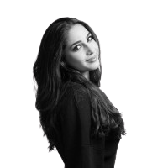
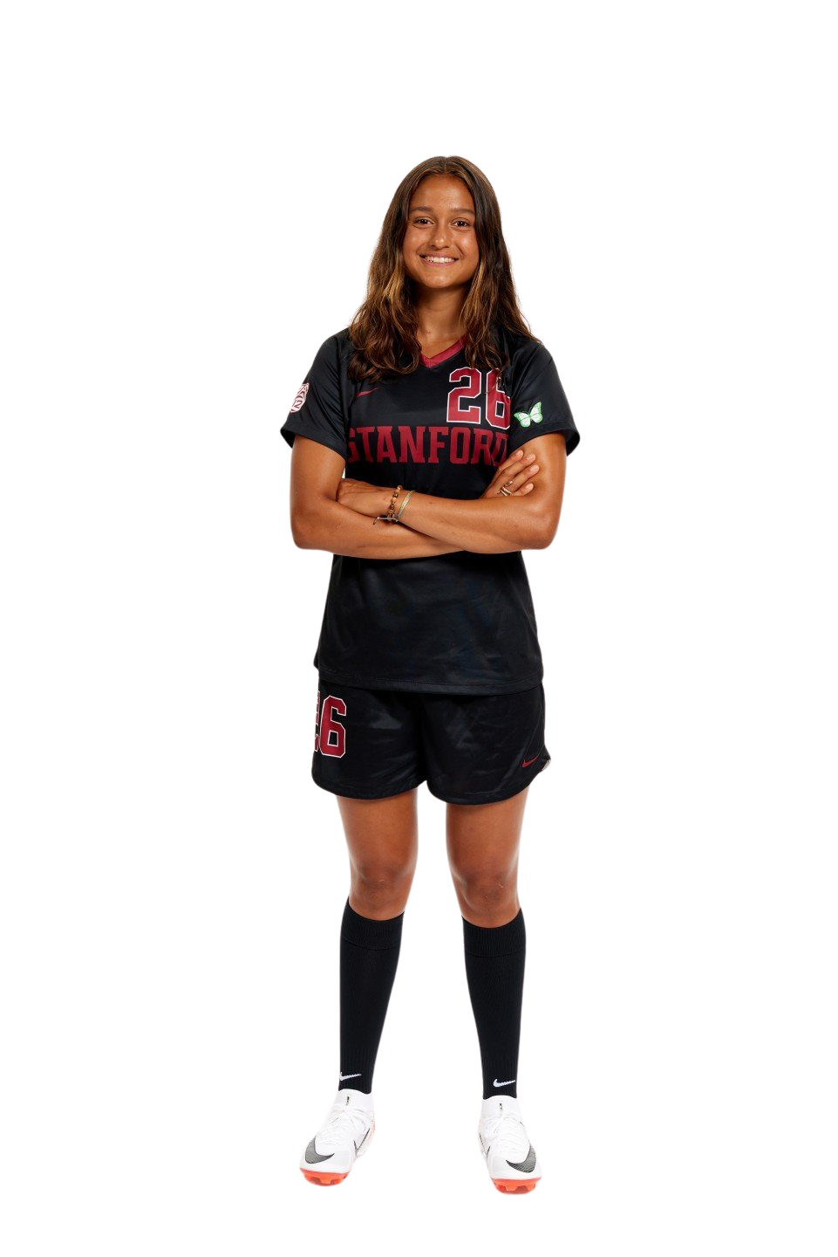

Team Cybele
Athena Shiravi
B.A. Econ
B.S. CS
HCI Coterm
Esha Gupta
B.S. SymSys
B.A. IR
Zoya Garg
B.S. CS
B.A. Classics

Slide 5
INTRODUCTION
PROJECT
Roadmap
PROBLEM/SOLUTION
HEURISTIC EVAL RESULTS
REVISED FIGMA
APP PROGRESS
NEXT STEPS

Slide 6
PROJECT
MUSE
MINDFUL ART FOR MOMS

Slide 7
But how did we get there...

Slide 8
INTRODUCTION
PROJECT
Roadmap
PROBLEM/SOLUTION
HEURISTIC EVAL RESULTS
REVISED FIGMA
APP PROGRESS
NEXT STEPS

Slide 9
Moms often experience moments of isolation or mental fatigue throughout the day.
Our Problem Space

Slide 10
Moms often experience moments of isolation or mental fatigue throughout the day.
Moms face intense loneliness and struggle to make new friends or find communities around them
Our Problem Space

Slide 11
Moms often experience moments of isolation or mental fatigue throughout the day.
Moms face intense loneliness and struggle to make new friends or find communities around them.
Our Problem Space
We want to help moms destress and engage in communal reflection.

Slide 12
Our Solution:
MUSE
An interactive mural app that offers moms a creative outlet to express themselves and connect with others.

Slide 13
Our Solution:
MUSE
An interactive mural app that offers moms a creative outlet to express themselves and connect with others.
MUSE provides moms with a low-friction space to leverage creativity to build community.

Slide 14
INTRODUCTION
PROJECT
Roadmap
PROBLEM/SOLUTION
HEURISTIC EVAL RESULTS
REVISED FIGMA
APP PROGRESS
NEXT STEPS

Slide 15
HEURISTIC EVALUATION RESULTS
We received ....
4
High Severity (4)
67
13
Moderate Severity (3)
27
Mild Severity (2)
20
Violations
Low Severity (1)
3
No Severity (0)

Slide 16
HEURISTIC EVALUATION RESULTS
There were some common pain points
No back button to toggle backwards in a task flow

Slide 17
HEURISTIC EVALUATION RESULTS
There were some common pain points
No back button to toggle backwards in a task flow
Our NavBar icons were confusing
(How do we go home again?)

Slide 18
HEURISTIC EVALUATION RESULTS
There were some common pain points
No back button to toggle backwards in a task flow
Our NavBar icons were confusing
(How do we go home again?)
The screen flow was non-intuitive...why are there two community screens?
It takes too long to create a mural, join an identity, and find a community

Slide 19
HEURISTIC EVALUATION RESULTS
We also addressed all S4 and S3 Issues
The heart and globe icons navigated to the same screen
You could contribute to an existing mural
There was no save button for the active murals
There was no Finish Drawing button
Nothing mom specific and confusing community labes

Slide 20
INTRODUCTION
PROJECT
Roadmap
PROBLEM/SOLUTION
HEURISTIC EVAL RESULTS
REVISED FIGMA
APP PROGRESS
NEXT STEPS

Slide 21
Here’s what we changed
(Simplification was our friend here)

Slide 22
Way too many screens
We had a“My Communities” and “Invite to Community” buttons that linked to identical screens

Slide 23
Way too many screens
We had a“My Communities” and “Invite to Community” buttons that linked to identical screens
We decided to remove the intermediate screens and make all key navigation flows originate from the home screen

Slide 24
Way too many screens
We had a“My Communities” and “Invite to Community” buttons that linked to identical screens
We decided to remove the intermediate screens and make all key navigation flows originate from the home screen
What even are “Communities”

Slide 25
Way too many screens
We had a“My Communities” and “Invite to Community” buttons that linked to identical screens
We decided to remove the intermediate screens and make all key navigation flows originate from the home screen
What even are “Communities”
We rebranded to “identities” for clarity and indication that only moms would be on the app

Slide 26

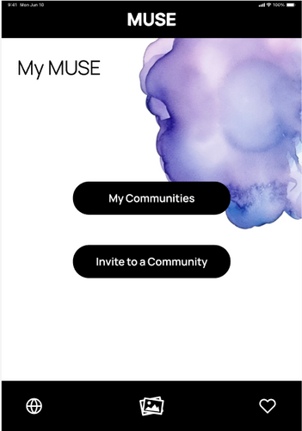
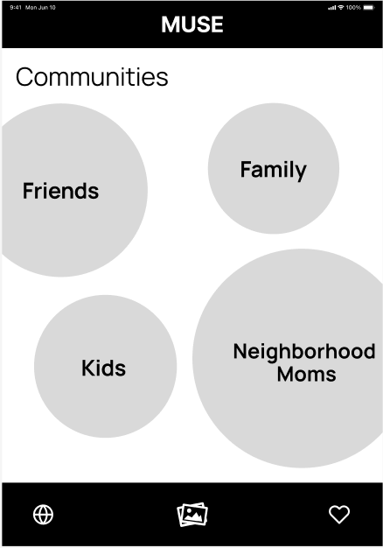
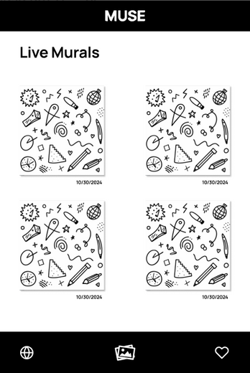
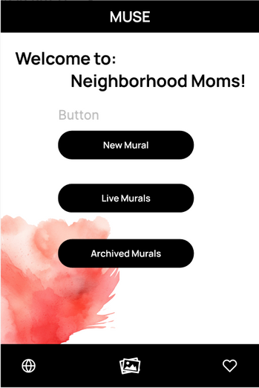
OLD Flow
Making a Doodle
Problems:
4 screens to get to the task
Community bubbles sizing
“MyMuse” is inefficient

Slide 27
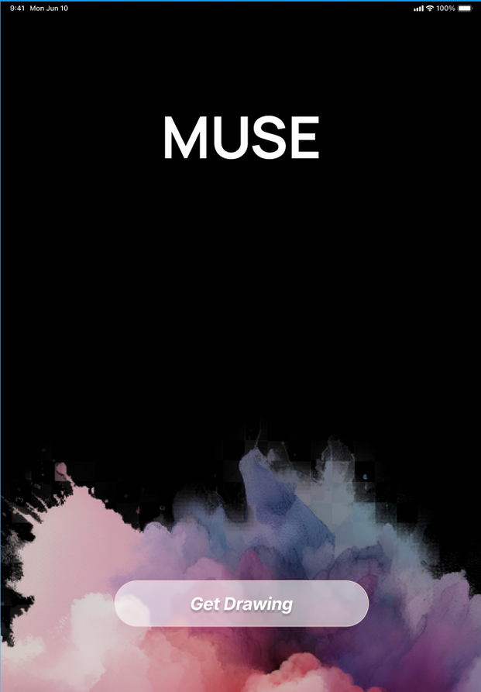
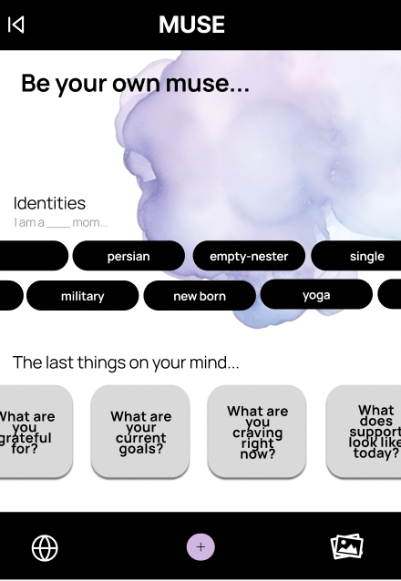
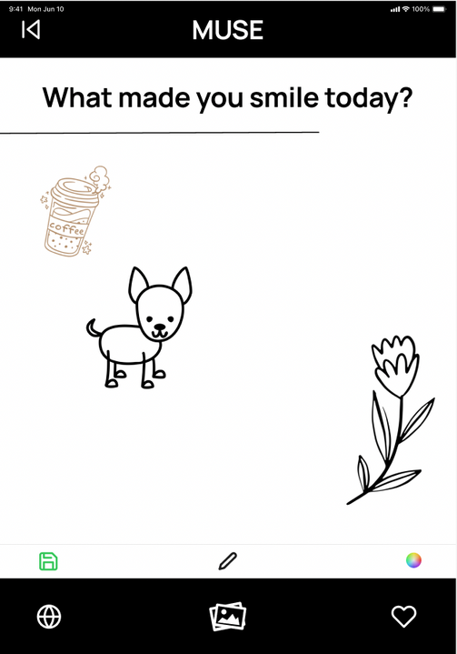
NEW Flow
Making a Doodle
Splash Screen
Home Screen
Draw Screen
2 screens total
Identities screen and current murals are now
merged into one homepage

Slide 28
Our homepage also needed to change...
Simply having “communities” with 4 abstract circles did not indicate what would happen next

Slide 29
Our homepage also needed to change...
Simply having “communities” with 4 abstract circles did not indicate what would happen next
We merged identies and murals together to create an all in one place

Slide 30
Our homepage also needed to change...
Simply having “communities” with 4 abstract circles did not indicate what would happen next
We merged identies and murals together to create an all in one place
The colors did not create an inclusive, reflective space

Slide 31
Our homepage also needed to change...
Simply having “communities” with 4 abstract circles did not indicate what would happen next
We merged identies and murals together to create an all in one place
The colors did not create an inclusive, reflective space
We added a purple selective color scheme and cleared up the homepage so it is not overwhelming to our mom demographic

Slide 32
OLD FLOW
Homepage

Slide 33
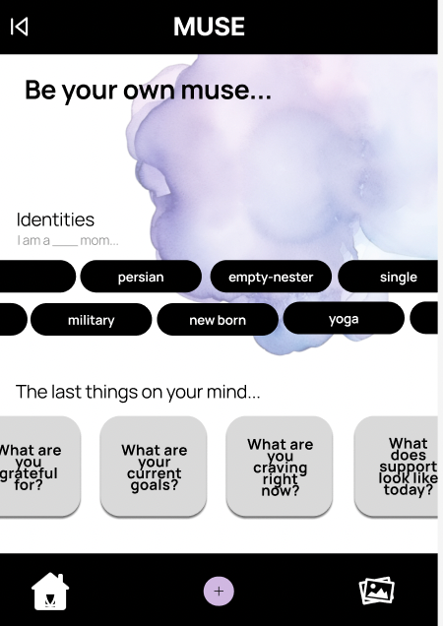
NEW FLOW
Homepage

Slide 34
KEY CHANGES
  New Back Button
  Identities sliding feed to increase usability
  New home icon instead of the globe in the NavBar
  Added a ‘+’ icon for new posts
  Purple splash background for visual appeal
NEW FLOW
Homepage

Slide 35
INTRODUCTION
PROJECT
Roadmap
PROBLEM/SOLUTION
HEURISTIC EVAL RESULTS
REVISED FIGMA
APP PROGRESS
NEXT STEPS

Slide 36
Where are we right now?

Slide 37
Mobile App Development
React Native and Expo Go Tablet App
We decided to develop our complex task first
(see appendix for revised flow)
So far we have our splash screen, navigation, gallery, and share features implemented

Slide 38
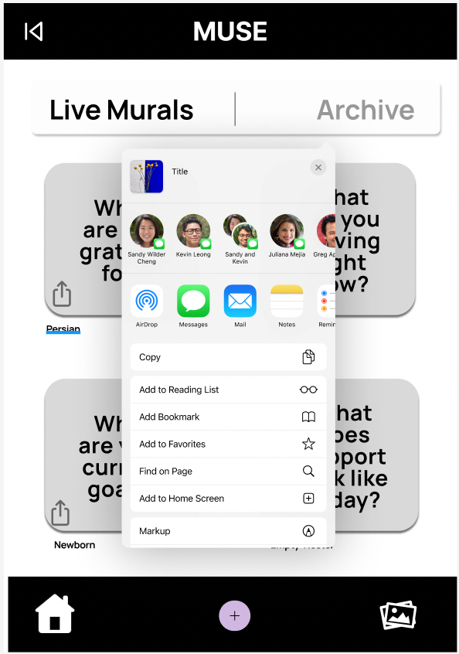
Wizard of Oz
We’ve simplified some of the backend
Our share link generates a generic link since we do not actually store the murals in an online database right now
The live drawing is prepopulated so that one user can test it without requiring simultaneous users to be on the app

Slide 39
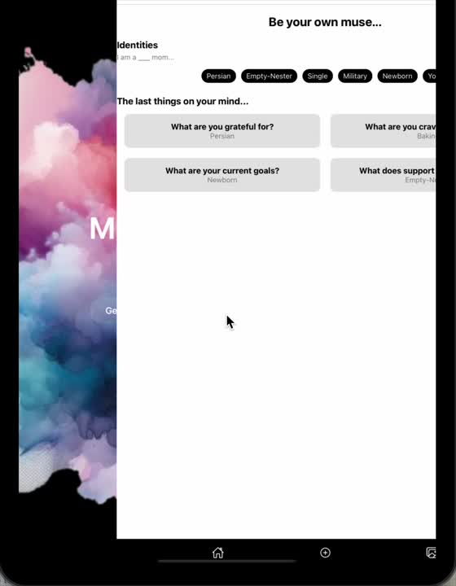
Demo
https://drive.google.com/file/d/1uENioh7ubvDKk4G97ADAGuRgMbPOqRkV/view?usp=drive_link

Slide 40
Next Steps
HomePage: Implement a dynamic home page where all elements are fully interactable
Mural Doodles: Work with existing APIs to create drawing features and image uploads onto a blank mural canvas
Prompt Generation: Connect with an AI backend to turn user-input into reflective prompts for drawing and expression
Flexible Sizing: Although we are only building a tablet app, we need to make sure that the UI is compatible across various forms of tablets
Accessibility: Including a questions page on the top right corner of our app for any users that need further assistance; Including loading screens to indicate back-end generation

Slide 41
Appendix

Slide 42
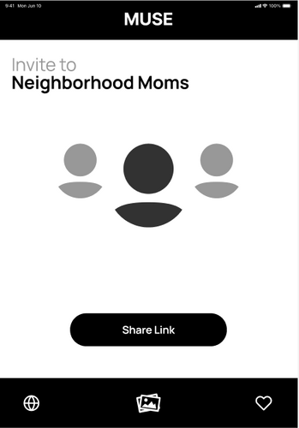
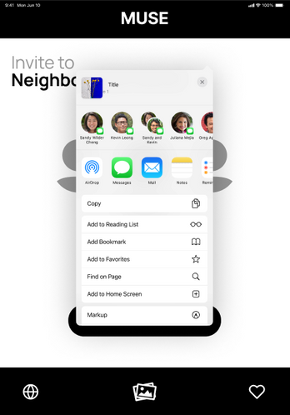
OLD FLOW
PROBLEMS:
  Too many steps
  Navigation flow is completely independent from the main app flow
  Must invite them to a community which allows people not affiliated with that identity to join
Inviting a Mom

Slide 43
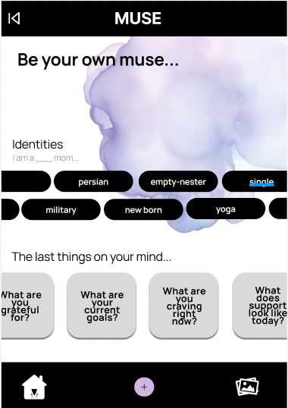
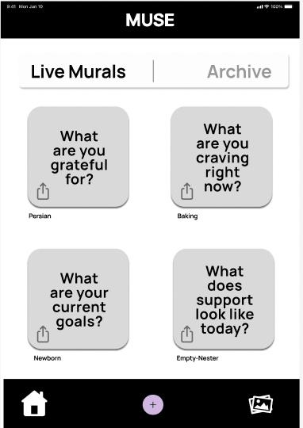
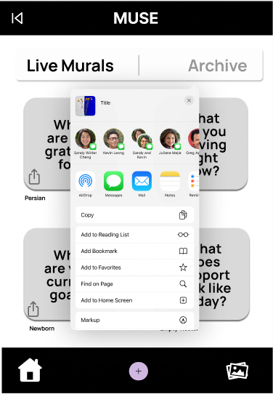
NEW FLOW
Inviting a Mom
Homepage
Gallery
Share
KEY CHANGES
Invitation is by mural rather than community for specific reflection
Fewer screens
Share is in a tab flow that is always accessible while using the app

Slide 44
REVISIONS
Removed the favoriting feature
Murals are 24hr to emphasize daily reflection
REVISED VIEW
Added a tab switch between live and archive for simplicity
Share is directly on the mural
Switched from graphic displays to a prompt display since compressing a drawing size would not render well
Gallery View

Slide 45
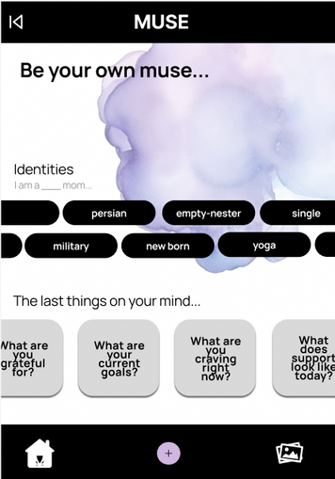
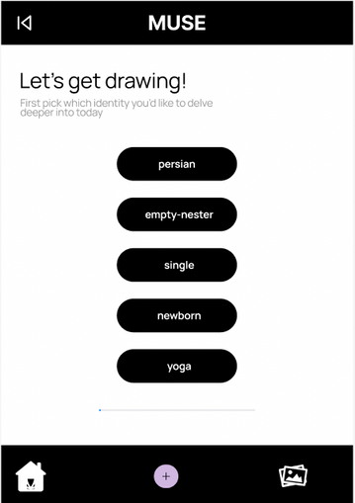
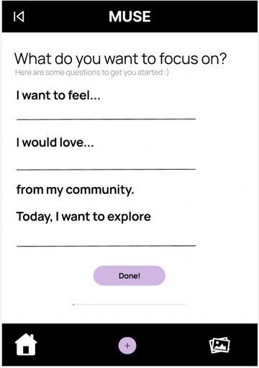
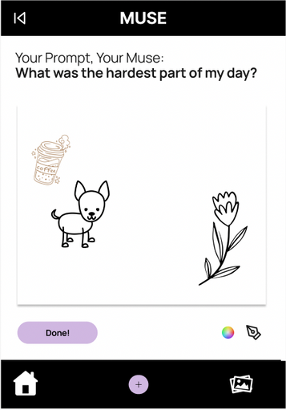
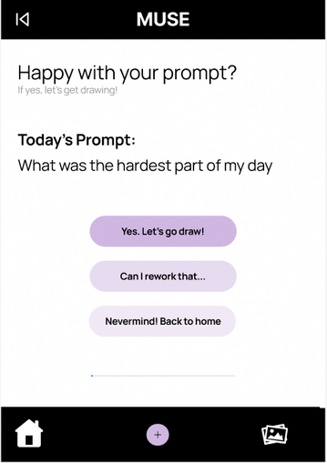
NEW FLOW
Creating a Mural
REVISIONS
  Progress bar indicates how close the user is to prompt completion
  Allows the user to go back through back buttons and check-in buttons
  Streamlined for all communities

