Slide 1
A4: Concept Video
superbloom

Slide 2
01
Project Name + Value Proposition

Slide 3
superbloom
celebrate life

Slide 4

superbloom
celebrate life
A superbloom is a rare natural phenomenon where wildflowers bloom together in a desert.
Our name intends to celebrate life and promote happiness in an otherwise desolate process
We focus on the positive remembrance as a way to process grief

Slide 5
02
Problem + Solution Overview

Slide 6
Problem + Solution Overview
Individuals in grieving often struggle to cope with their emotions and loss of a loved one.
Superbloom is an app that allows for grieving individuals to dull their pain and take control of their emotions by memorializing and remembering their loved ones.
By actively sharing those they’ve lost, as well as interacting with others’ losses, users become united together in grief and memoriam.

Slide 7
03
Market Research

Slide 8

Untangle Grief
Supporting grief communities via moderated groups, one-on-one chats, and Zoom events.
What works:
Builds a supportive community for those grieving.
Easy to connect with others through experience-based groups.
Safe space ensured by content moderation.
What doesn’t:
Subscription model (£4.99/month) feels exploitative.
Only allows tracking for one loss.
Implications for our project:
Moderation is crucial for safe communities.
Specific experience-based groups are valuable (e.g., parent, baby, addiction loss).
Unlike Untangle, we'll use digital memorials to foster connection.

Slide 9

Grief Refuge
An app offering daily support to help users manage grief.
What works:
Soothing, therapeutic audios
Emotion-based "Journal" feature
Regularly updated community resources
What doesn’t:
Expensive, with most features behind a paywall
"Intentions" audios don’t guarantee actionable outcomes
Lacks strong community or companionship features
Users need to be proactive, which can be tough during grief
Implications for our project:
Align features with emotional support
Strengthen the community aspect to foster connections.

Slide 10

HUG
An app for creating virtual memorials.
What works:
Allows collaborative memorialization of loved ones
Pages can be shared and contributed to by multiple people
What doesn’t:
No distinction between friends and family viewers
Design resembles Facebook
No prompts for content creation, leaving it fully user-driven
Implications for our project:
Separate personal and public views
Implement varying social circles
Add prompts for content to ease curation
Focus on dynamic, customizable pages to foster community connection.

Slide 11

Empathy
An app offering a structured roadmap for handling logistics and support after a loved one's death.
What works:
Clean design (Apple Design Awards finalist)
Game-changing account settling feature
Accessible chatline, simple mental health check-ins
What doesn’t:
Limited support circle size
Billing relies on insurance or employer coverage
Implications for our project:
Strong roadmap and logistical support
Validates the inclusion of simple mental health check-ins in our project.

Slide 12
 | Untangle Grief | Grief Refuge | HUG | Empathy | superbloom
chat room | X
chat w/ experts |  | X |  | X
comments |  |  | X |  | X
community resources | X | X |  | X
mood journaling | X | X |  | X | X
content of loved ones |  |  | X |  | X
customizable |  |  |  |  | X
tiered social circles |  |  |  |  | X
prompts user for interaction |  |  |  |  | X

Slide 13
04
Values in Design

Slide 14
Stakeholders
Direct stakeholders:
Users (people that have lost a loved one)
Developers
Content Moderators
Indirect stakeholders:
Friends/Family of users
Therapists or Grief Counselors
Notes:
direct: users, us, and content moderators for the outer garden
indirect: family and friends of users, therapists (maybe they either recommend our app or hear abt it thru their patients)

Slide 15
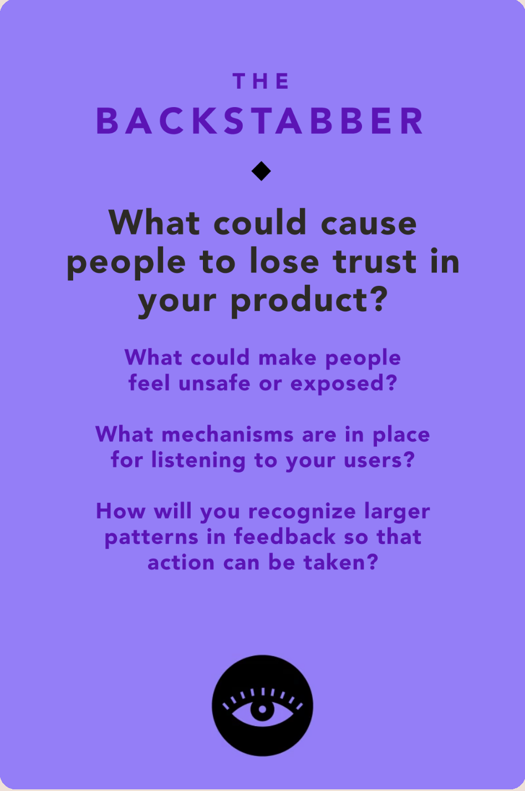
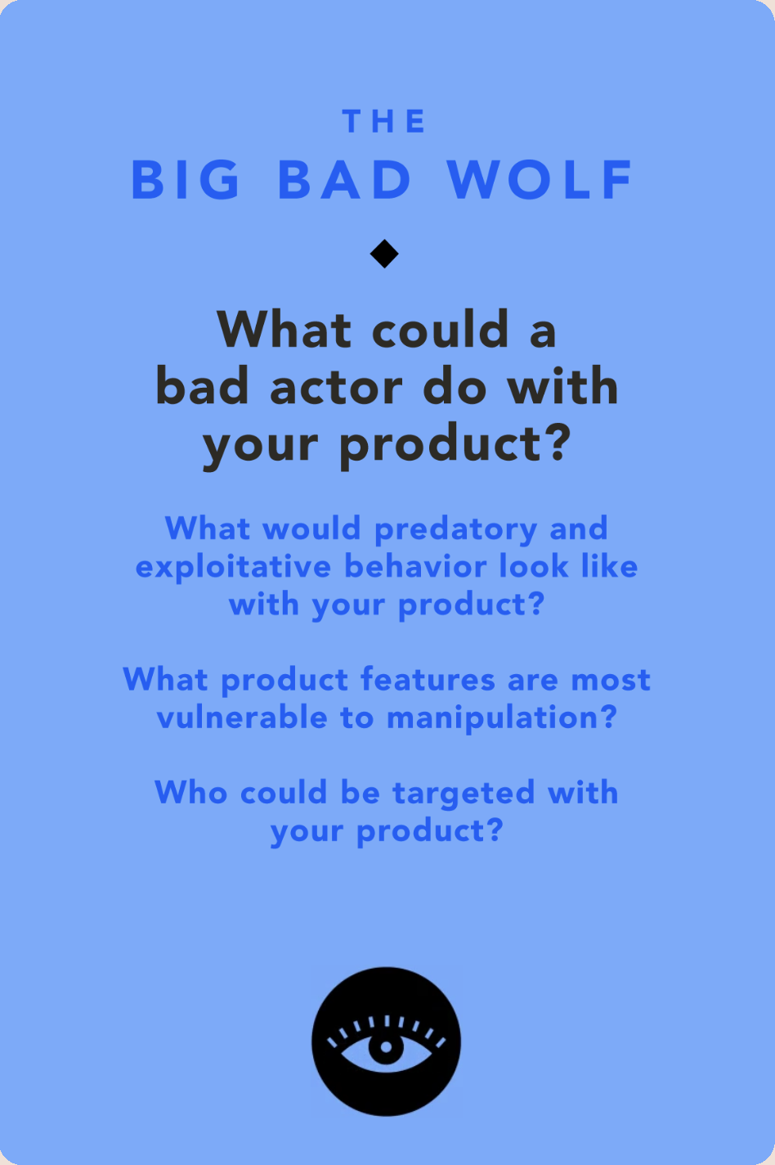
Ethical Implications
Backstabber
Data privacy is a top concern when dealing with such sensitive data
We give full power to the user to determine what's private and what's shared
Big Bad Wolf
Could be trolls on here that create triggering outer gardens (most of our user base vulnerable)
Have to moderate what is shown to greater community

Slide 16
05
Tasks

Slide 17
Tasks
Simple
Moderate
Complex
Answer a reflection question about your loss
Upload a memory to your memorial garden
Share your garden with other users

Slide 18
Tasks
Simple
Complex
Answer a reflection question about your loss
Users will frequently answer questions that prompt them to reflect and write down their thoughts.
Video time: 00:22
Share your garden with other users
This task is less frequent and requires more steps, including making inner (private) and outer (public) gardens and connecting with other users on Superbloom.
Video time: 00:40
Moderate
Upload a memory to your memorial garden
Most users will be uploading memories and customizing their memorial gardens, though frequency is based on their own interest.
Video time: 00:30

Slide 19
06
Video Storyboards

Slide 20
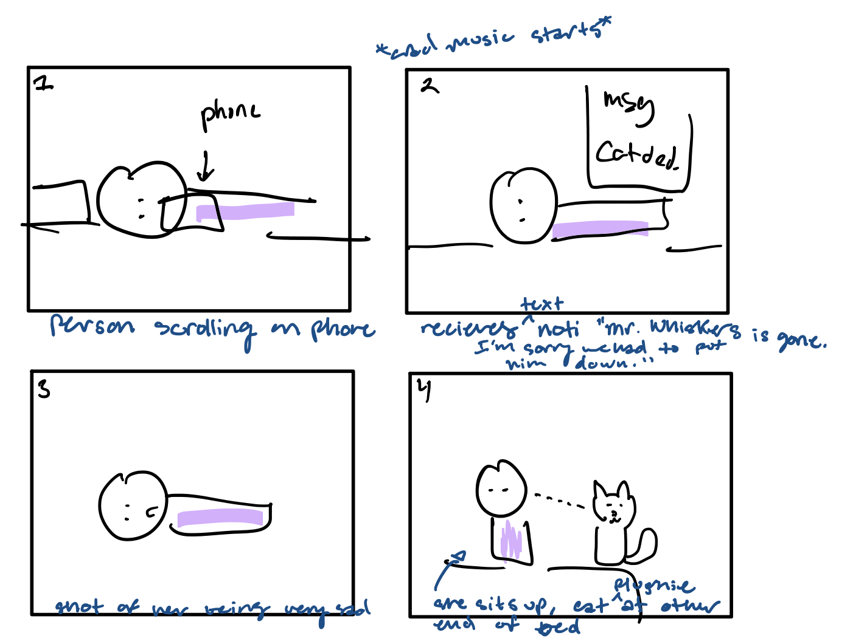

Slide 21
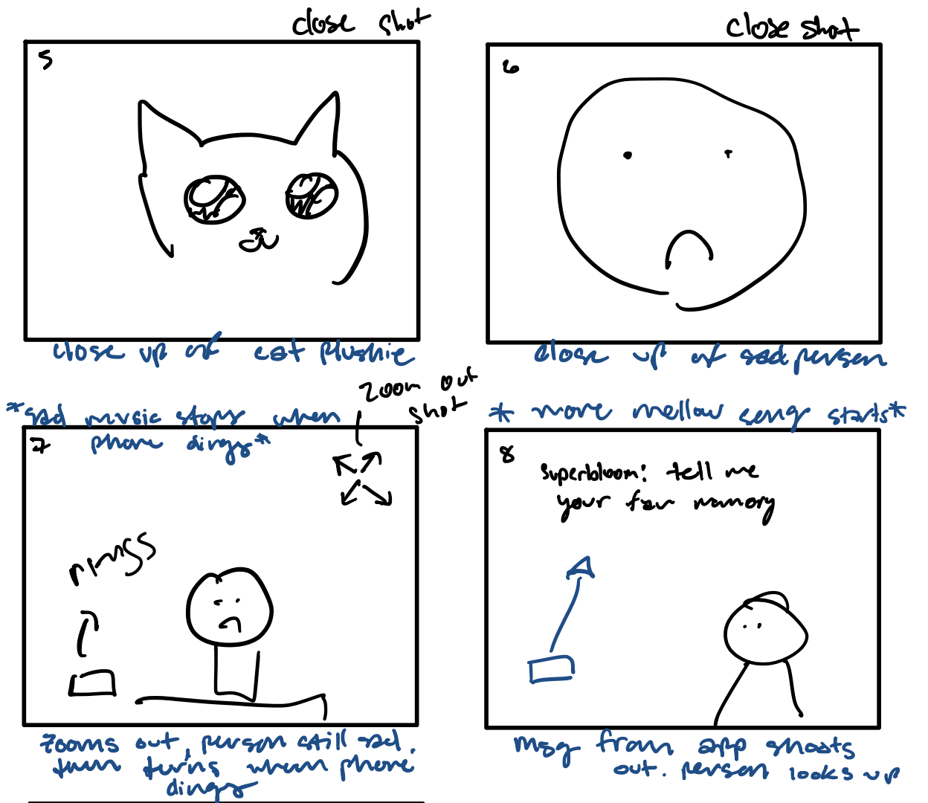
TASK: Answer a reflection question about your loss

Slide 22
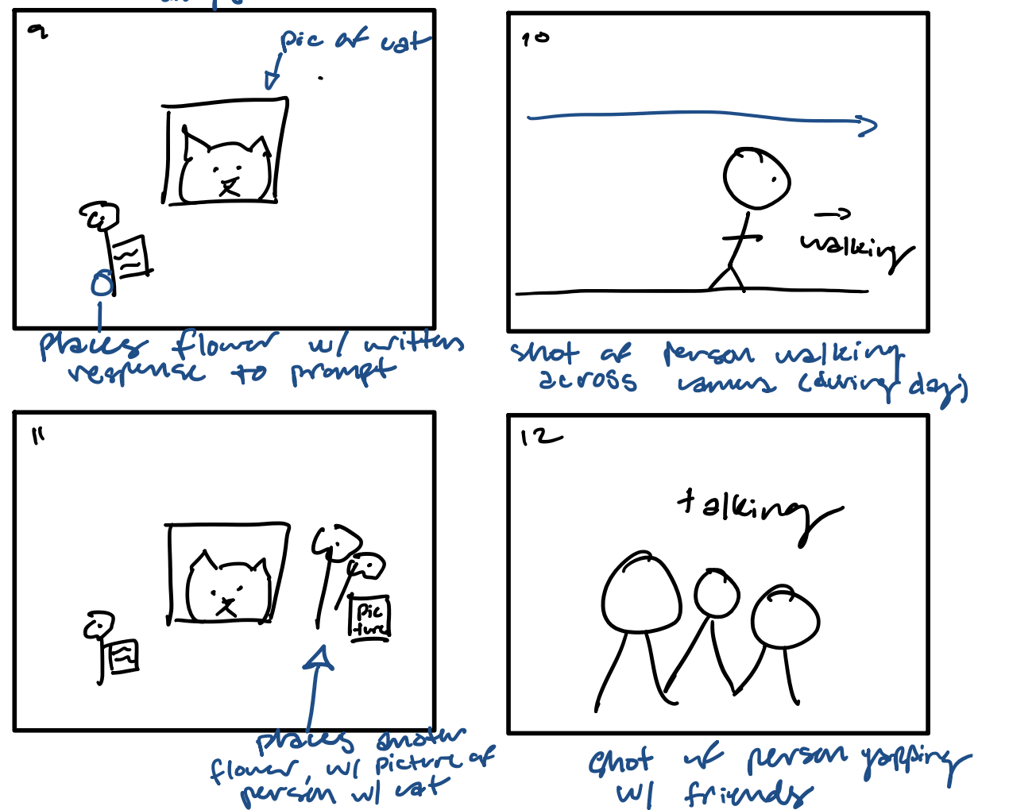
TASK: Upload a memory to your memorial garden

Slide 23
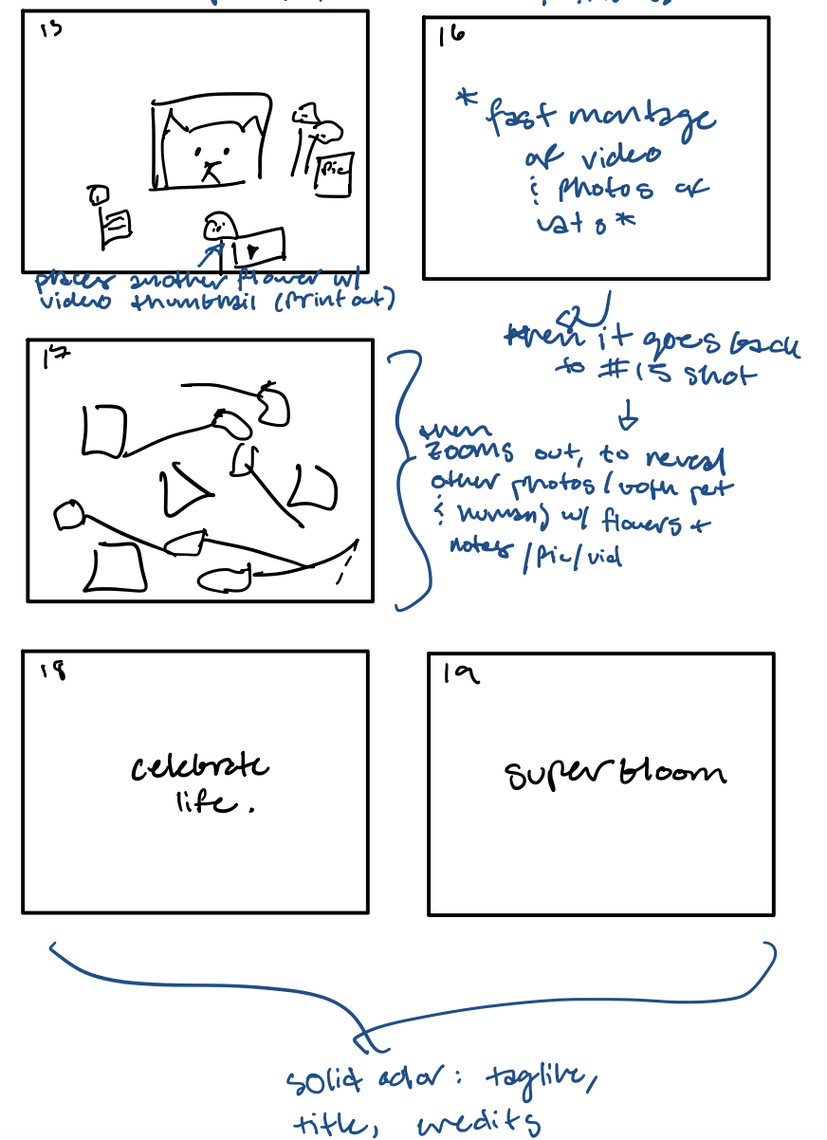
TASK: Share your garden with other users

Slide 24
07
Concept Video

Slide 25
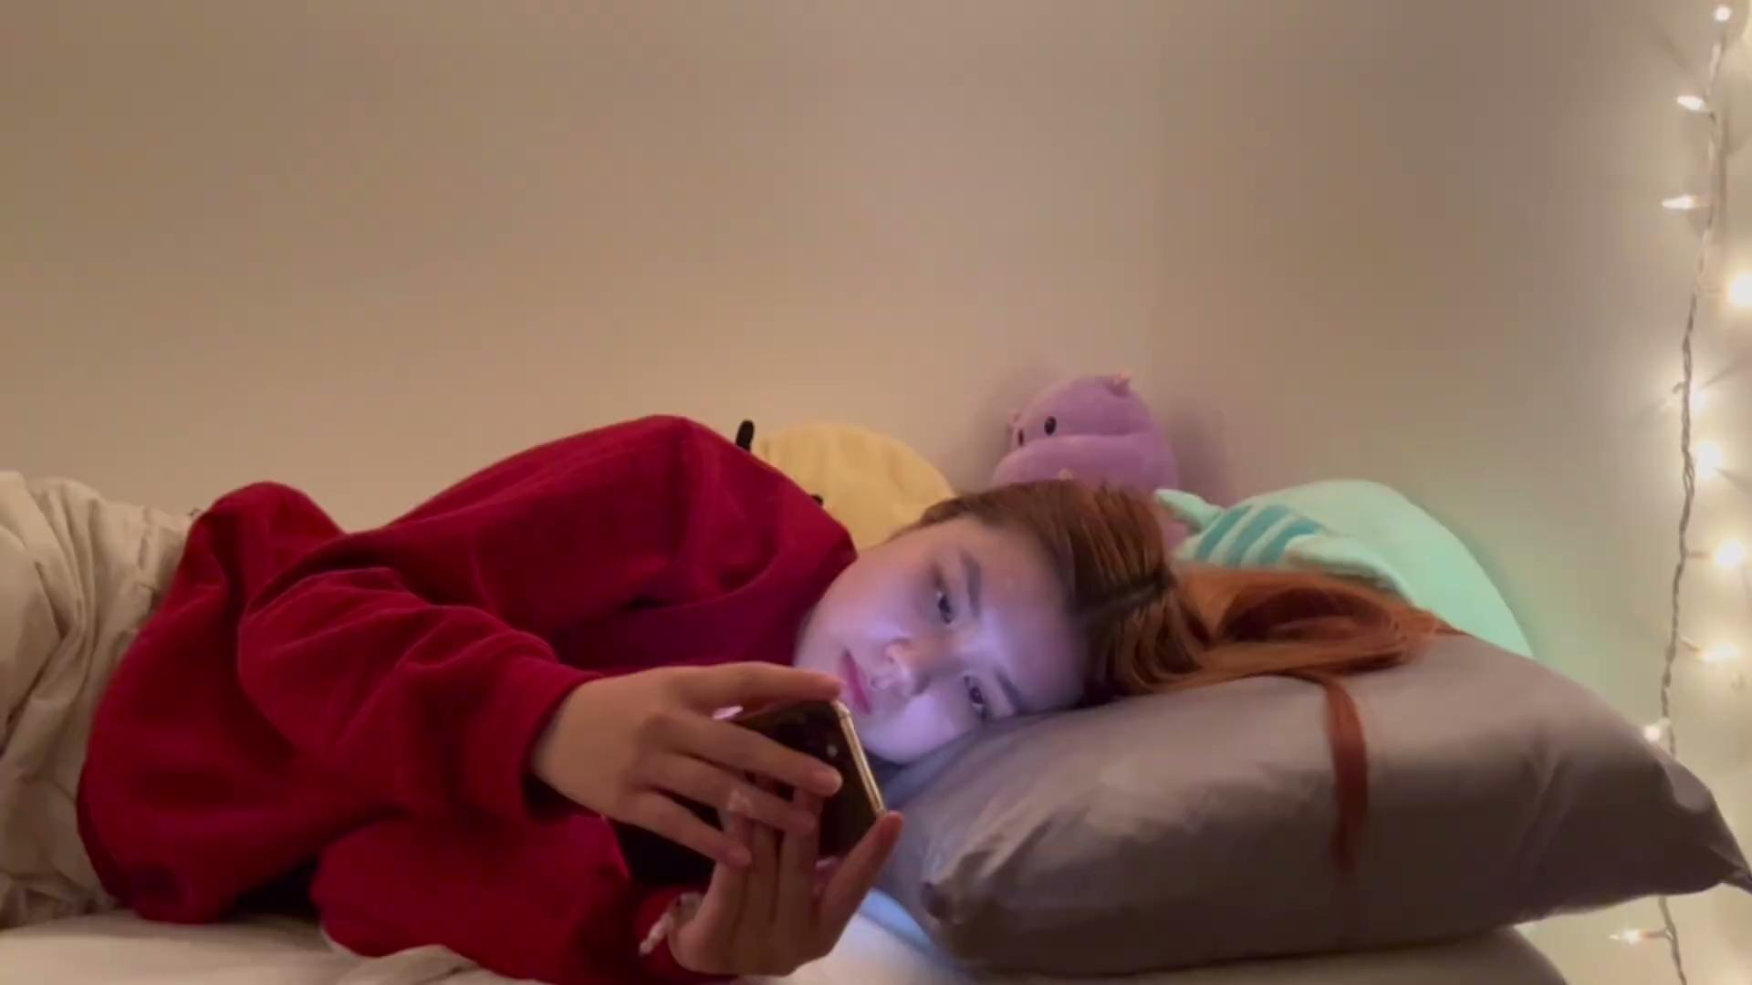
Notes:
https://youtu.be/M-8R5IykpBs

Slide 26
08
Appendix

Slide 27
Untangle Grief
An app that facilitates grief support groups including moderated communities, one-on-one chats, and Zoom session events
What works?
  Builds sense of community, helps people grieving feel not alone
  Easy to find people you can relate to with groups sorted by common experiences, a “support network at your fingertips”
  Moderation of content to make a safe community for grieving people
What doesn’t work?
  Subscription based model (£4.99 per month) – some people feel it is exploitative and profiting off of their grief
  Limits to tracking the loss of 1 person, cannot add multiple

Slide 28
Untangle Grief
Implications for our project:
Group chats/forum style apps require moderation to create responsible, safe communities
Making it easy to find people who have the same experience is very valuable, and these categories should be very specific (e.g. parent loss, addiction loss, baby loss)
Though Untangle focuses on connection through more typical digital social interactions (group chats, one-on-one chats video calls), we will focus on using digital memorials to facilitate connection

Slide 29
Grief Refuge
An app designed to help users recover from grief by “providing daily support so your grief feels more manageable”
Main features
  Guidance
    Daily refuge (subscription-only)
    Intentions (therapeutic audios about advice)
  Self-care
    Journal
      Divided into sections for each emotion
    My Grief Journey (subscription-only)
  Community
    Grief-care (contact therapist)
    Podcast

Slide 30
Grief Refuge
What works?
  Audios are quite soothing and therapeutic, can help the users calm down
  “Journal” feature is very specific, breaks down common emotions into categories
  “Community” feature provides resources (e.g. podcasts) which are constantly updated
What doesn’t work
  Very costly! Have to subscribe to use most features
  “Intentions” modules are advice audios that can’t ensure that users take these actions
    Simply telling users to “set boundaries” or “reach out” cannot immediately make the users feel better
  Lacks community/companionship component
    Users have to be very proactive in navigating the app, which is often challenging for people who are processing grief

Slide 31
Grief Refuge
Implications for our project
Map each module/feature to the kind of support provided
Connect emotions to features in the app
Enhance the community aspect by bringing people together

Slide 32
HUG
An app where users can create virtual memorials
Main features
  Make a page
    Add image
    Add audio
    Add video
    Add text
  Share the page with others
  Have the option to make the page private or public

Slide 33
HUG
What works
  Allows for a page that can memorialize loved ones online
  Can share page with multiple people that others can contribute to
What doesn’t work
  There isn’t a separation of friends and family for viewing
  The design strongly resembles Facebook
  Uploading content is purely up to the user – there isn’t any prompting of any sort

Slide 34
HUG
Implications for our project
  Separate the personal and the public
    Make different degrees of social circles instead of only one
    Encourage public viewing for a sense of community
  Make the page more dynamic and customizable
  Recreate memories
  Focus on the user and their relationship and can allow users to zoom out and see what the memories look like for others
  Help prompt the user to add content instead of giving users the full responsibility to curate the page

Slide 35
Empathy
An app that provides a structured roadmap in the event of a loved one’s death, complete with common logistics, expert support, open account handling, and mental health.
Main features
  Logistics
    Care plan – common logistics
    Care manager chatline
    Settling accounts
  Wellness
    Mental health mindness and mood
    Support circle

Slide 36
Empathy
What works
  Clean design. Apple Design Awards finalist.
  Settling open accounts is game changing
  Chatline is useful and accessible
  Simple, yet effective mental health check-ins
What doesn’t work
  Support circle is limited by number of people
  Billing is done through insurance or is provided by employers

Slide 37
Empathy
Implications to our project
  Perfect implementation of the roadmap. Effective logistical support, simple mental health aspect.
  Simple mental health aspect was well-received by users, validates our ideas for mental health check-ins

