Slide 1




A6: medium-fi prototyping
superbloom
celebrate life
Felicia, Myan, Thu, Sunny

Slide 2
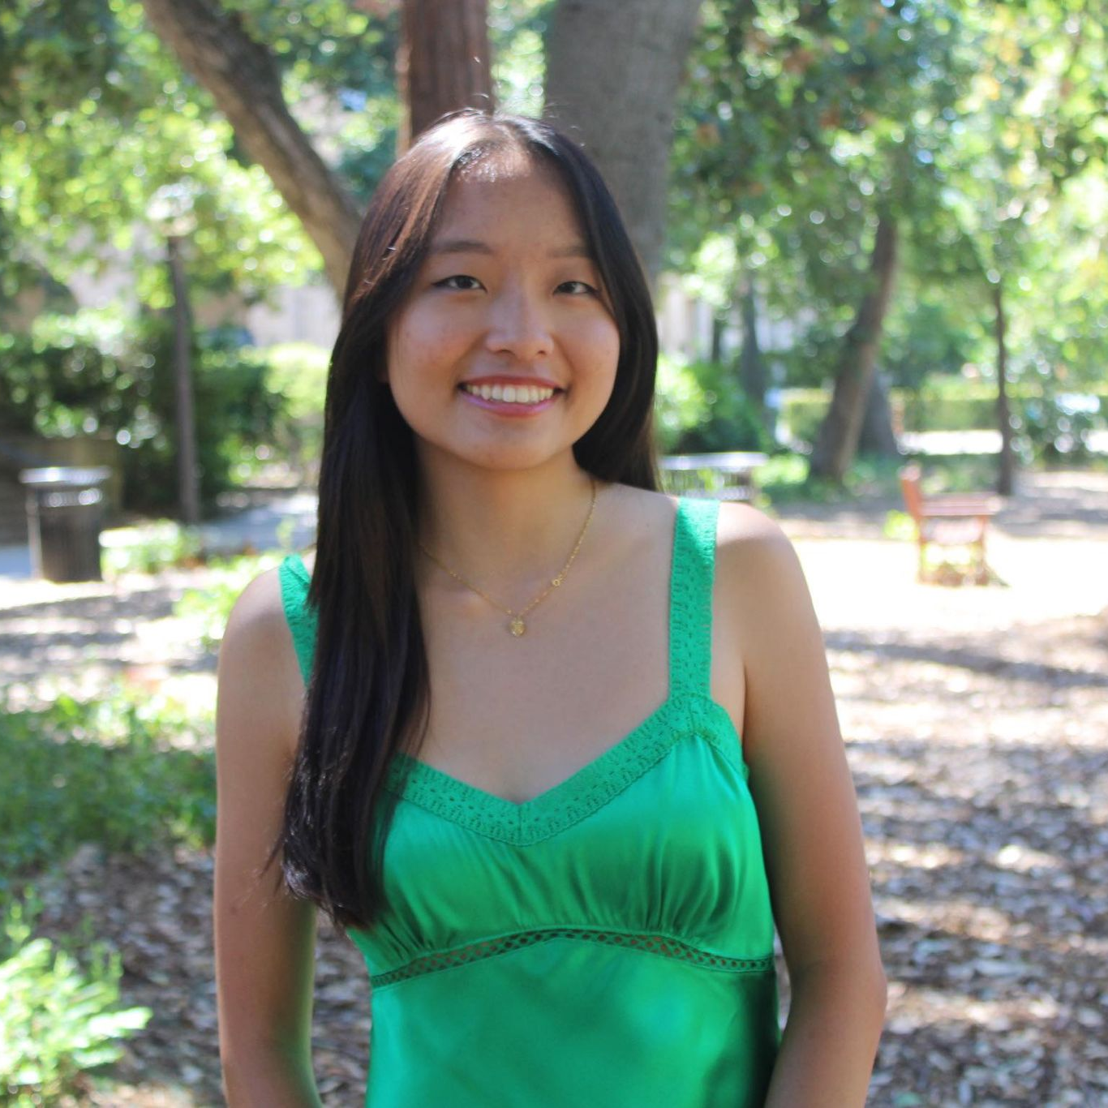


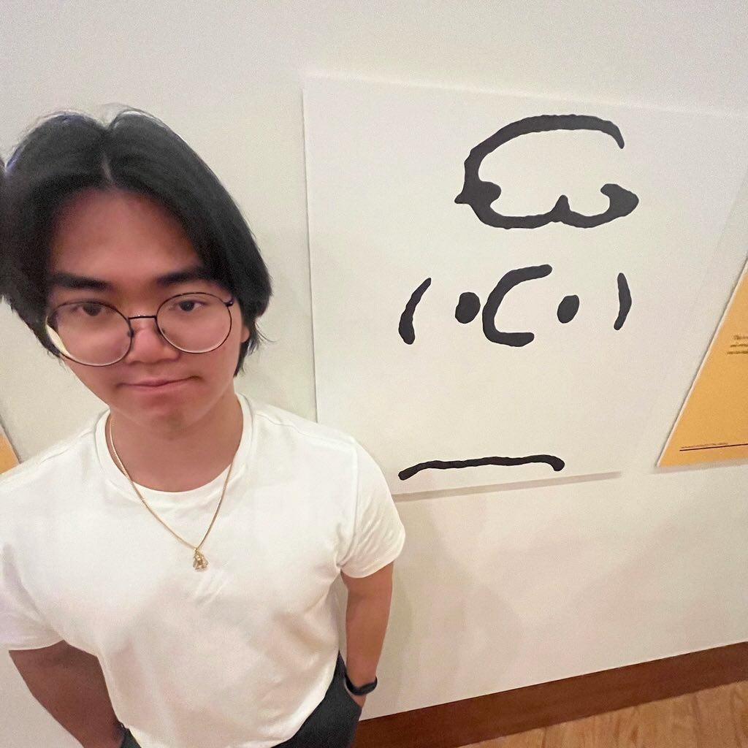
Team Members
Felicia
Myan
Sunny
Thu

Slide 3



Table of Contents
01.
02.
Values in Design
Problem and Solution Overview
03.
04.
Tasks
Medium-Fi Prototype

Slide 4

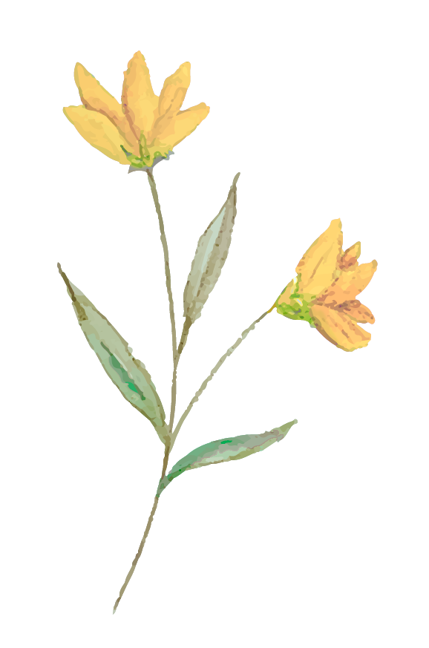


Problem & Solution
Problem
People who have recently lost a loved one often struggle to process their grief and feel isolated.
Solution
As a solution, our app superbloom provides a “virtual memorial” space for users to commemorate the death of their loved ones and heal: In superbloom, users plant their inner (private) and outer (public) garden, where each flower is a piece of memory. Users can also browse the outer gardens and create superblooms to see how their loved ones are remembered by other users.

Slide 5
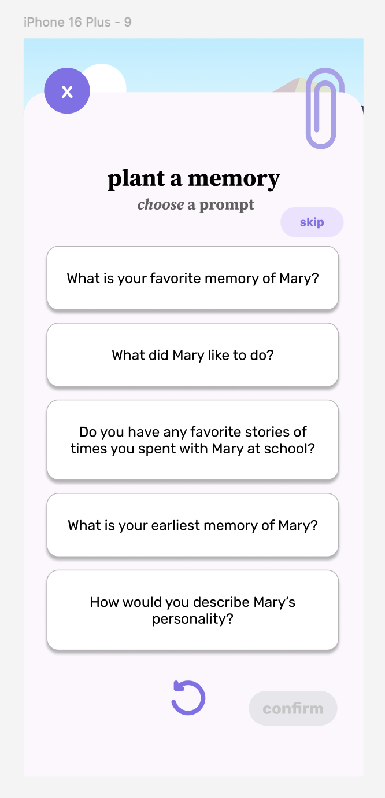
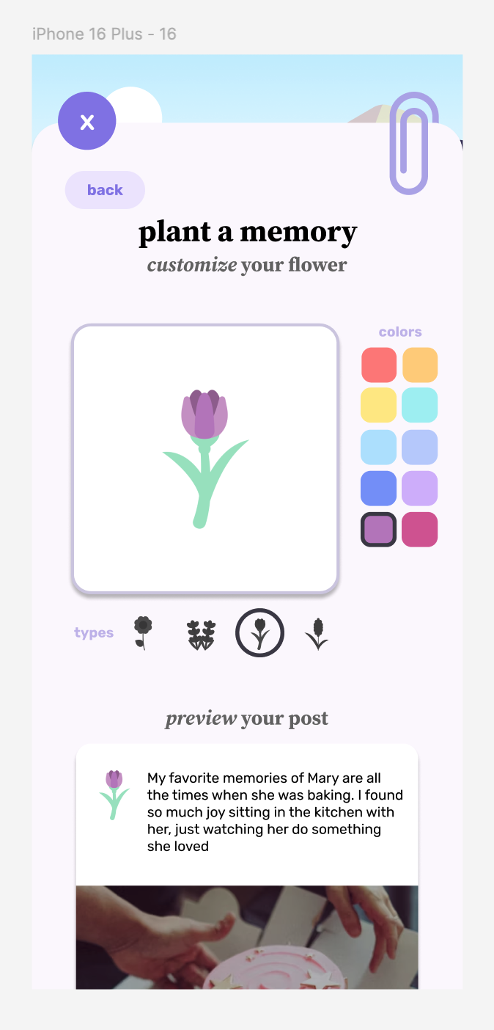
VALUES IN DESIGN
Value 1: positivity – users should experience positive emotions such as relief from using the app
The provided prompts guide users to focus on positive memories
A flower represents each piece of memory, providing a relaxing, peaceful feel

Slide 6
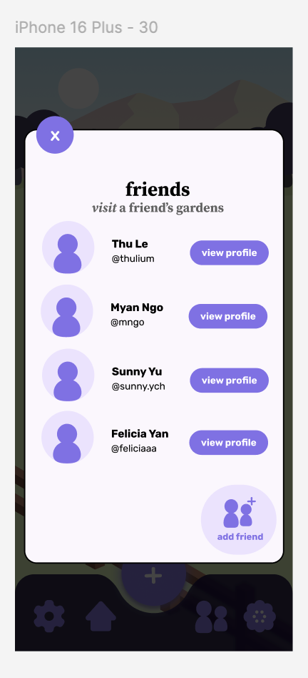
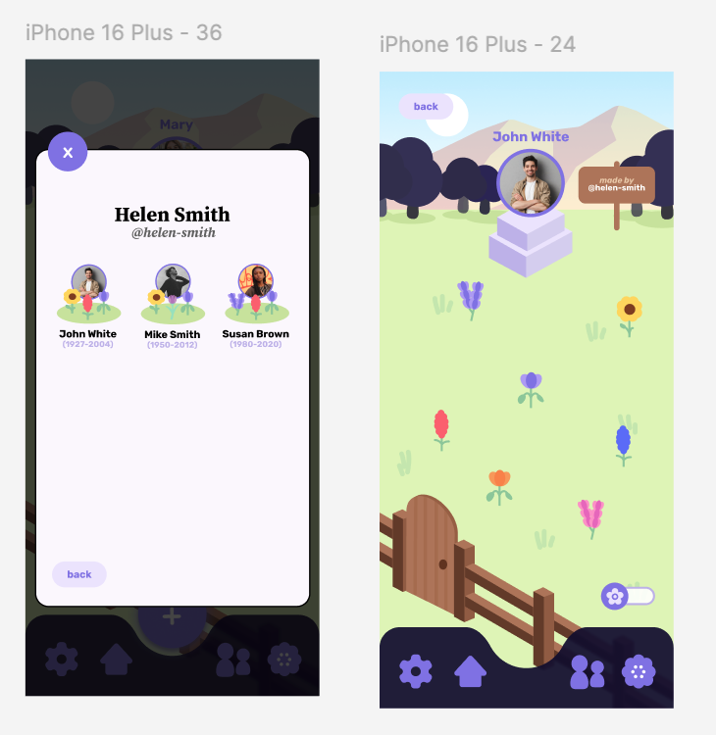

VALUES IN DESIGN
Value 2: community – users can connect with others with similar experiences and learn about how their loved ones are remembered by others
Users can add friends and view their friends’ gardens

Slide 7
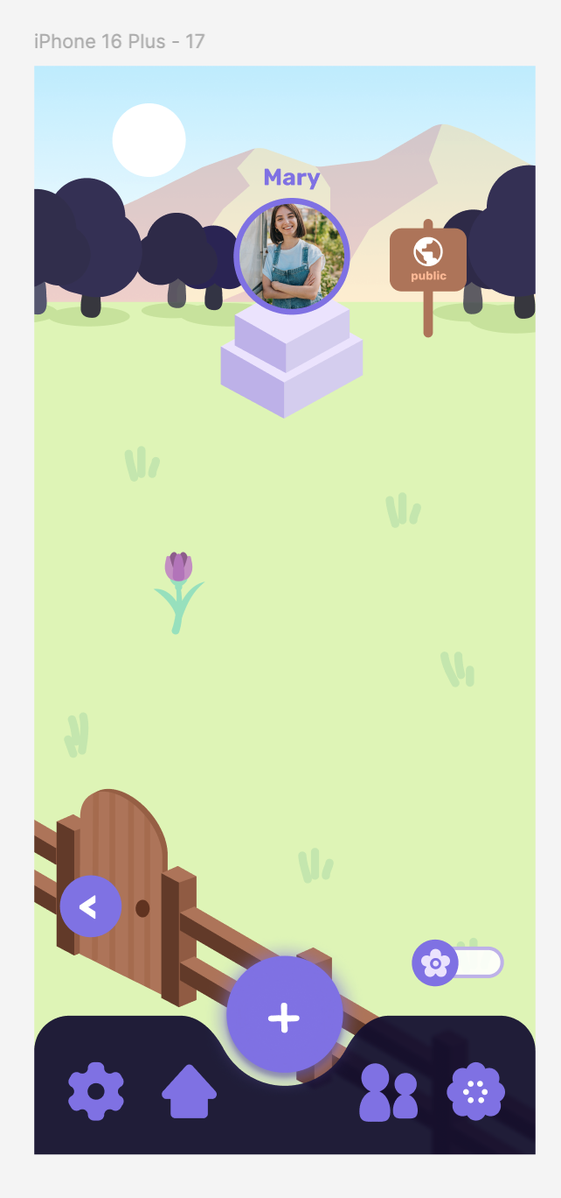
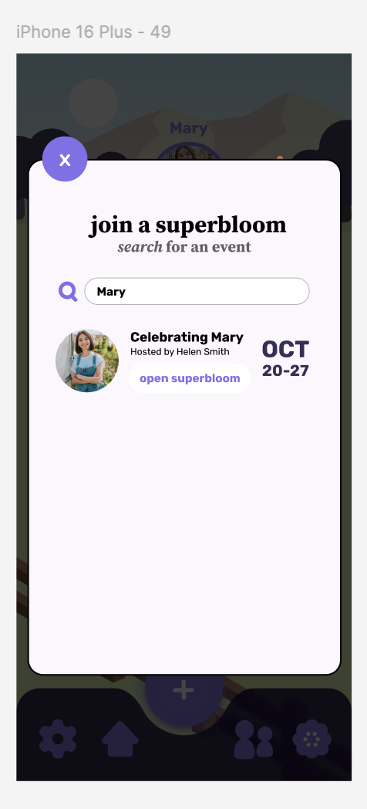
VALUES IN DESIGN
Value 3: outward-orienting – users should be empowered to share their memories and turn an otherwise private process into a communal, public experience
Separate public and private gardens allow users to choose what content to share with others
The superbloom functionality creates a virtual memorial for a person that multiple people can contribute to

Slide 8
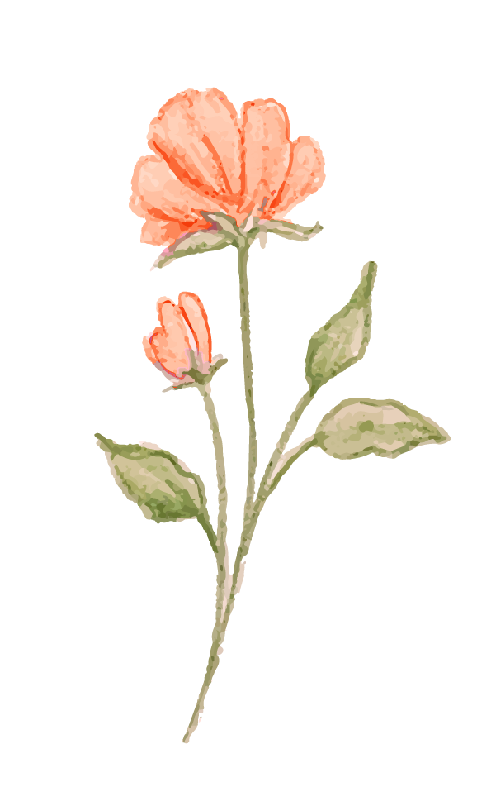
Tensions in Values
Value 1 (positivity) + Value 3 (outward-orienting)
01.
Value 2 (community) + Value 3 (outward-orienting)
02.
Positive remembrance might take away the authenticity of sharing all emotions associated with the memory
Users’ awareness that their memories will be seen might also affect authenticity and discourage sharing

Slide 9
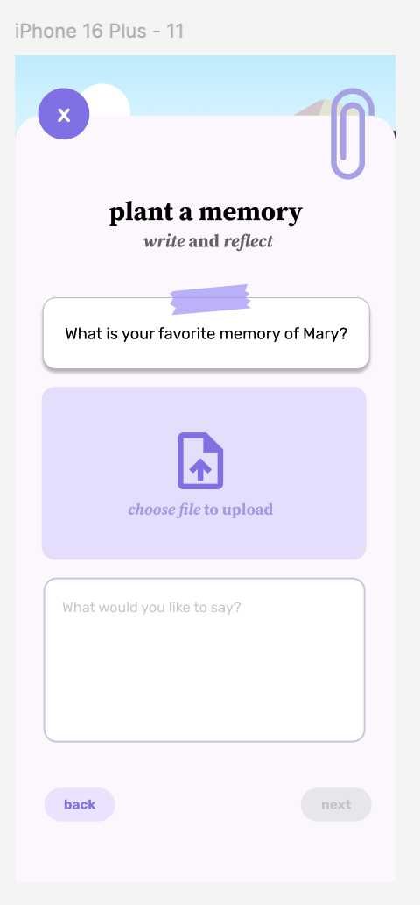
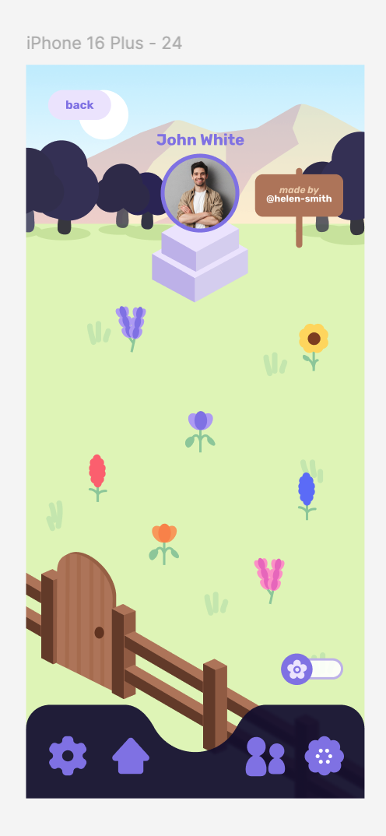
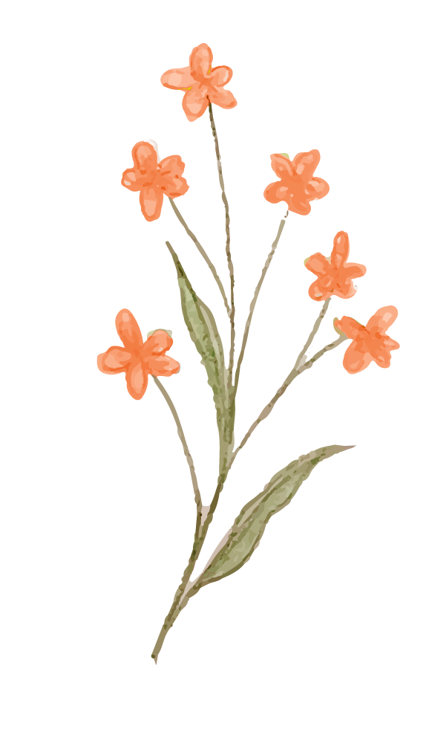
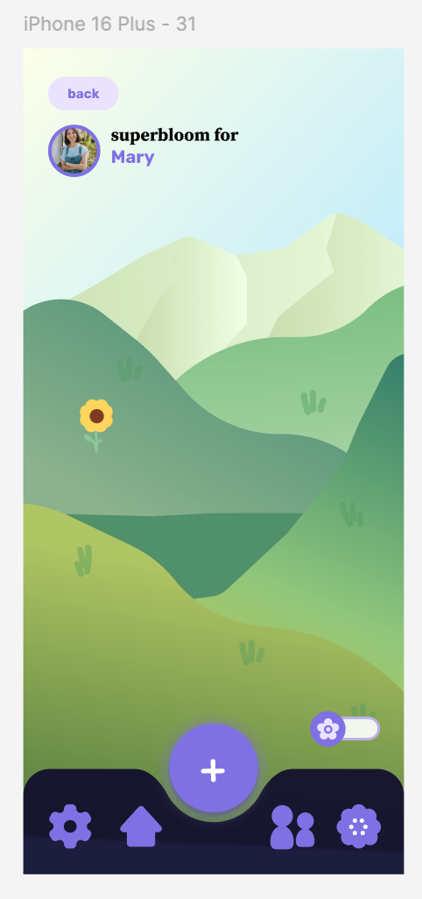

Tasks
01.
02.
Simple
Moderate
03.
Complex
Plant a memory flower in your garden
Interact with a friend’s garden
Contribute to a superbloom (field of multiple gardens) on a set date

Slide 10
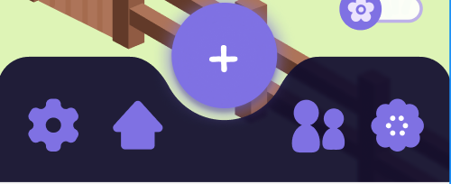
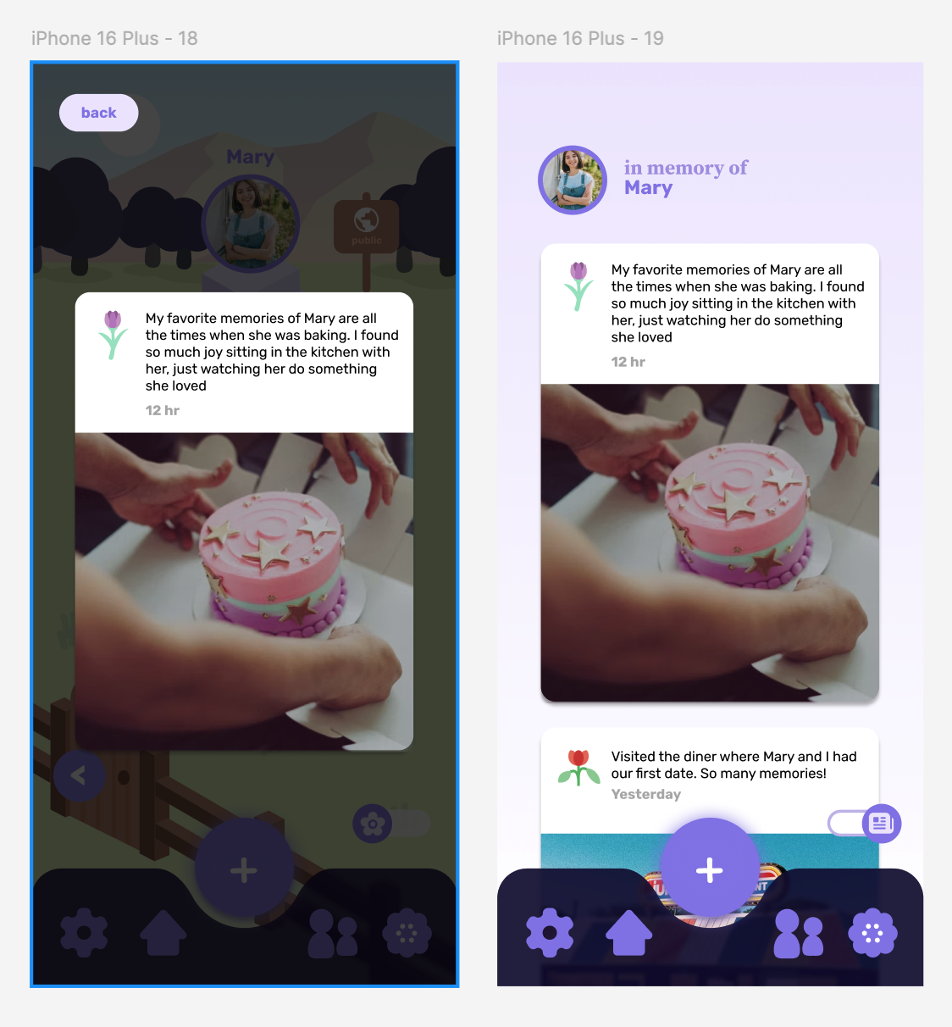
Usability goals and measurements
Efficient: able to perform tasks quickly
  Measured by task completion rate
  Design features to enhance efficiency
    Big and self-explanatory icons
    Collage view that stacks all uploaded memories in a feed
    Flower view that displays the memory once clicked

Slide 11
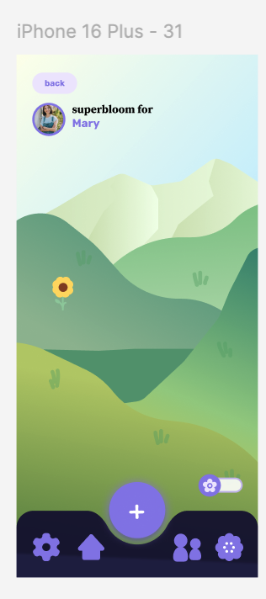
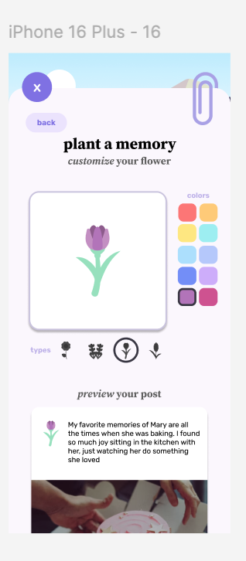
Usability goals and measurements
Pleasing: user is likely to use the features
  Measured by interviewing users how likely they are to use the features
  Design features for pleasing
    Customizable flowers (users can choose the color and form)
    Nature-themed background

Slide 12

Revised interface sketches

Slide 13
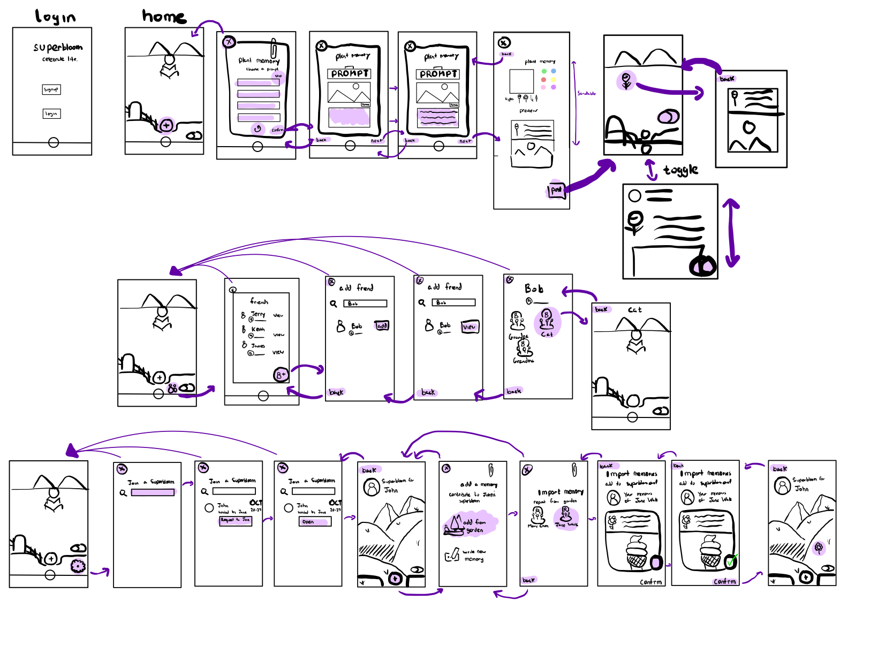
simple task: uploading a memory
moderate task: interacting with friends
complex task: joining, adding, viewing superbloom

Slide 14
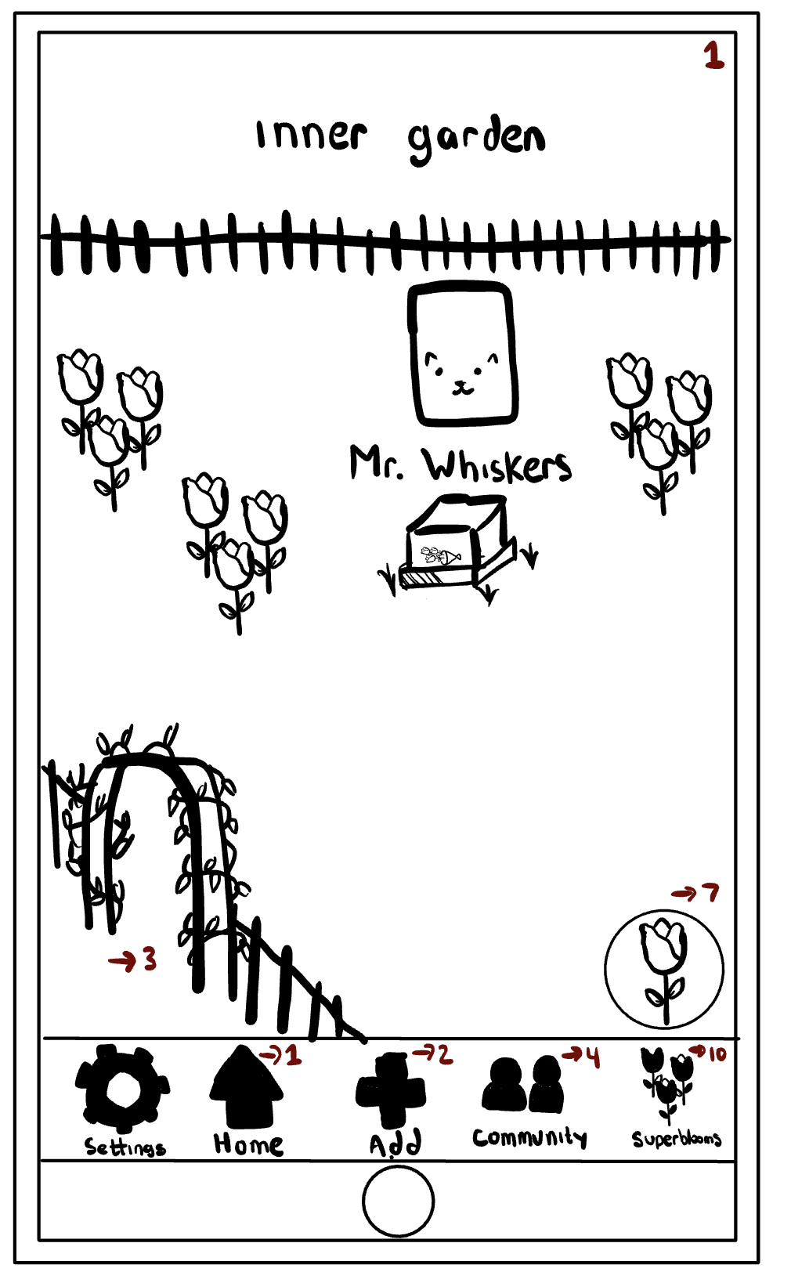
Change 1: Users can access the uploaded memories from clicking the flower
Before:
After users plant the flower (upload a piece of memory), the flowers are static and not interactable
Users can only view the memories through the collage view, where memories are displayed chronologically
Feedback:
General confusion around the two views (garden view and collage view) (low-fi prototype testing)
Icon is confusing (expert feedback)

Slide 15
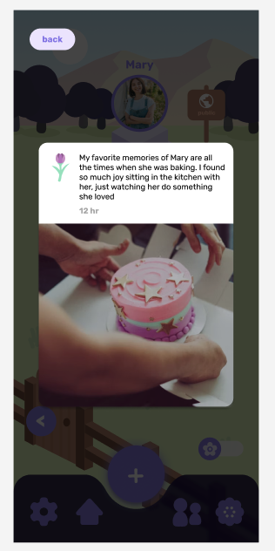
Change 1: Users can access the uploaded memories from clicking the flower
Change:
Every flower is clickable and would display the memory that it represents
Rationale:
Make it easier to access a memory
  One click to open instead of scrolling through the collage display
Garden view serves both aesthetic and functional purposes

Slide 16
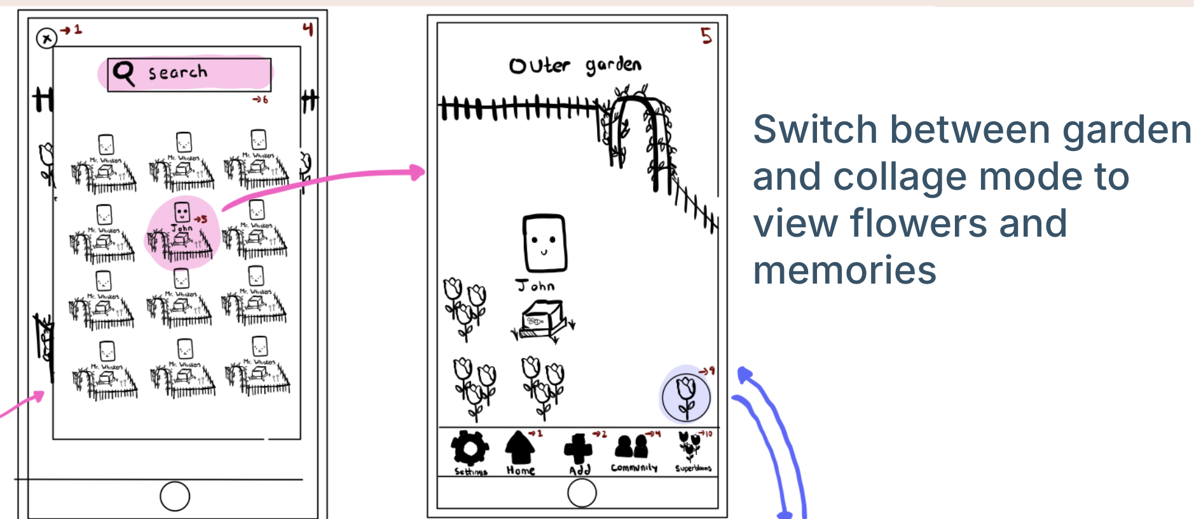
Change 2: Users search for friends instead of gardens
Before:
Feedback:
There should be a way to connect friends and family members (low-fi prototype testing)
Design raises privacy concerns (expert feedback)

Slide 17
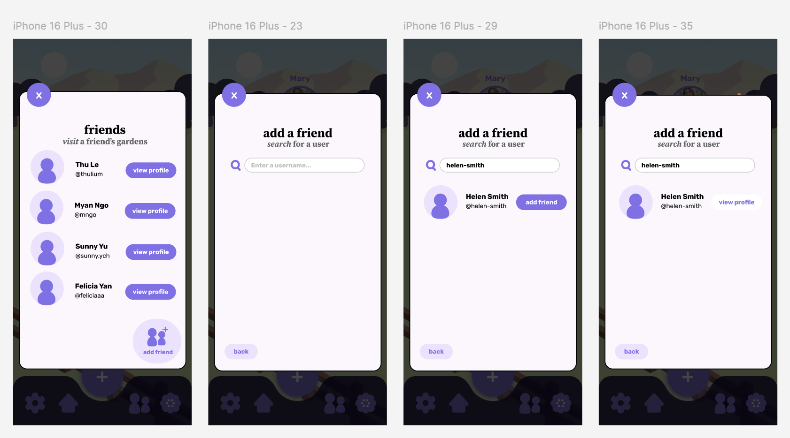
Change 2: Users search for friends instead of gardens
Change:
Instead of searching for any public garden by name, users can add friends and only view the public gardens of their friends
Rationale:
Users need to send friend requests and be added to be able to see the public gardens
  Protects the privacy of users
Friend request feature enhances sense of community by connecting users with each other

Slide 18
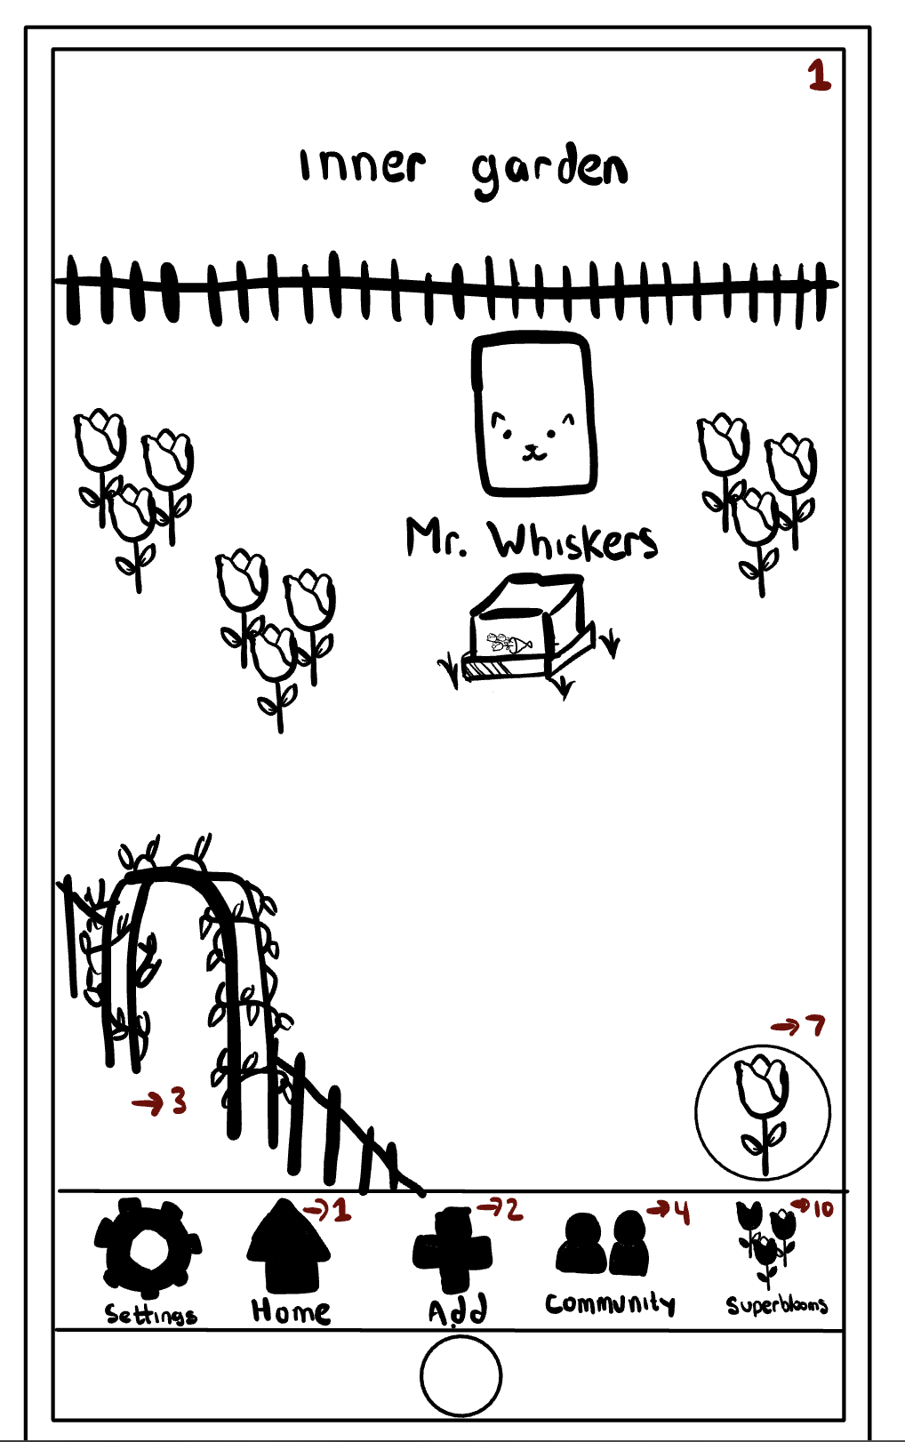
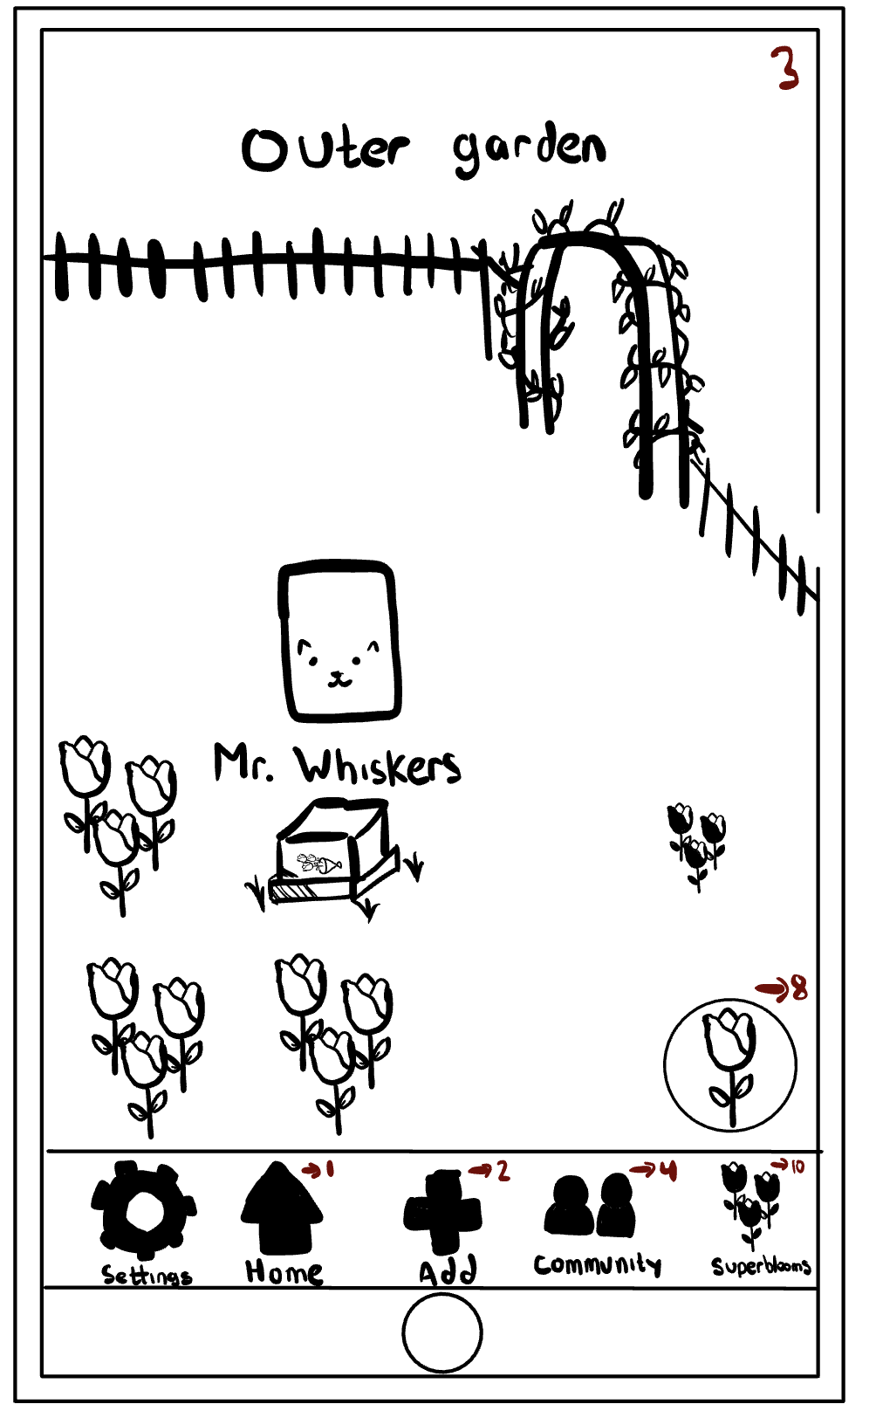
Change 3: Distinction between private & public content
Before:
Users click the gate to switch from inner garden to outer garden
Feedback:
Users confused by the difference between the two modes (low-fi prototype testing)
Language used does not accurately capture the design itself (expert feedback)

Slide 19
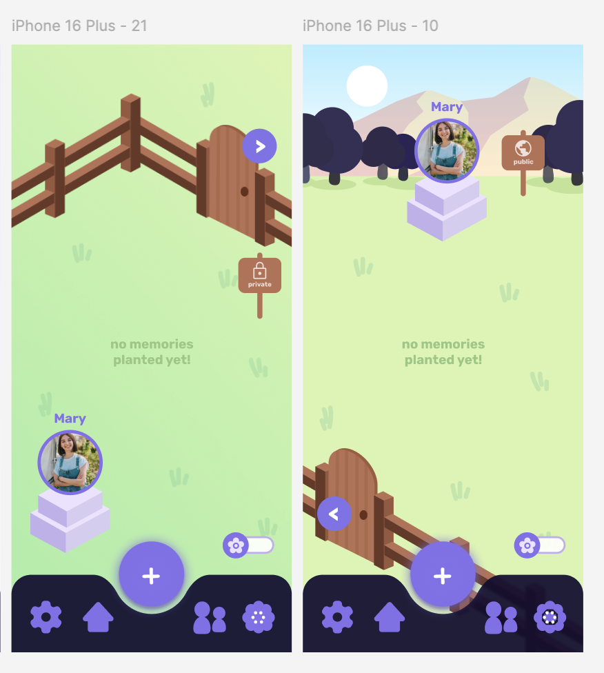
Change 3: Distinction between private & public content
Change:
Added an arrow icon as a pressable item to navigate between the two modes
Use different colors and visuals to distinguish between the two modes
Change the size and location of the statue
Added the private and public signs to further clarify the functionalities
Rationale:
Design visually distinguishes the two modes
Fence serves as a clear visual metaphor for the separation between inside and outside

Slide 20
Medium-fi task flows

Slide 21
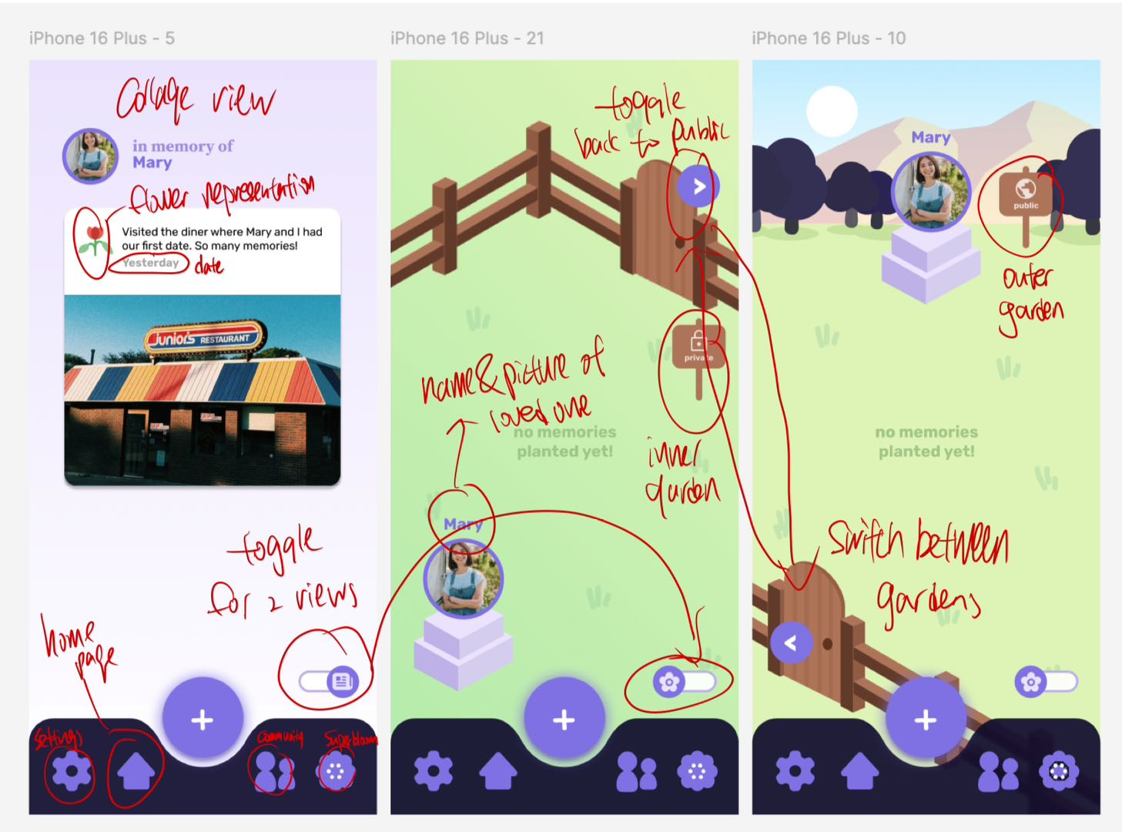
Simple task: upload memory
Before adding memories, users can switch between the inner and outer garden
Can use the toggle to switch between garden view and collage view

Slide 22
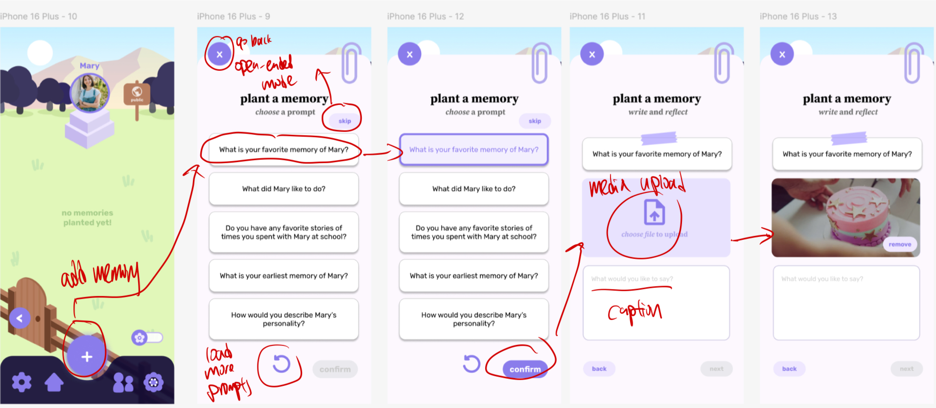
Simple task: upload memory
Click the button to add memory
Select a given prompt for skip the prompt
Click to select a prompt to use
Upload memory and write captions

Slide 23
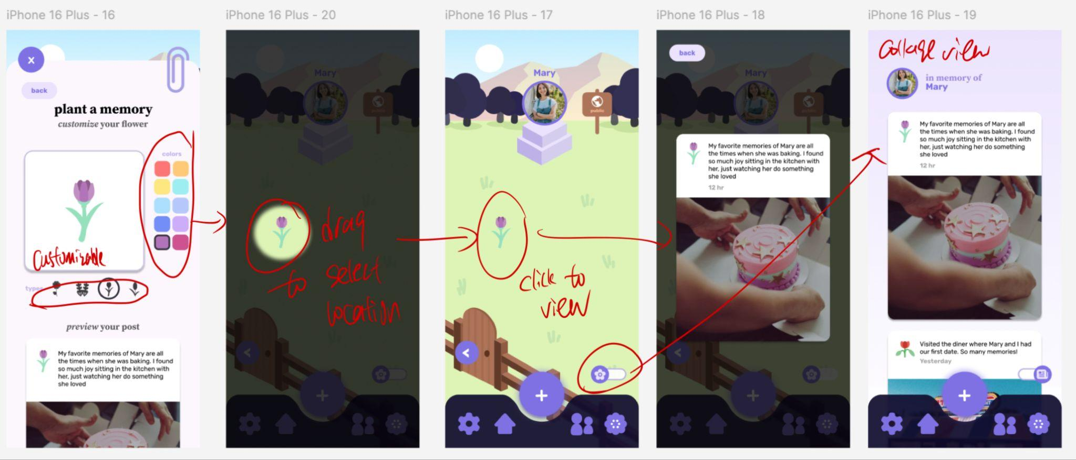
Simple task: upload memory
Customize colors and flower types
Flower is placed on screen + highlighted to show where
Click the flower to see the memory
Upload memory and write captions
Collage view shows memories chronologically

Slide 24
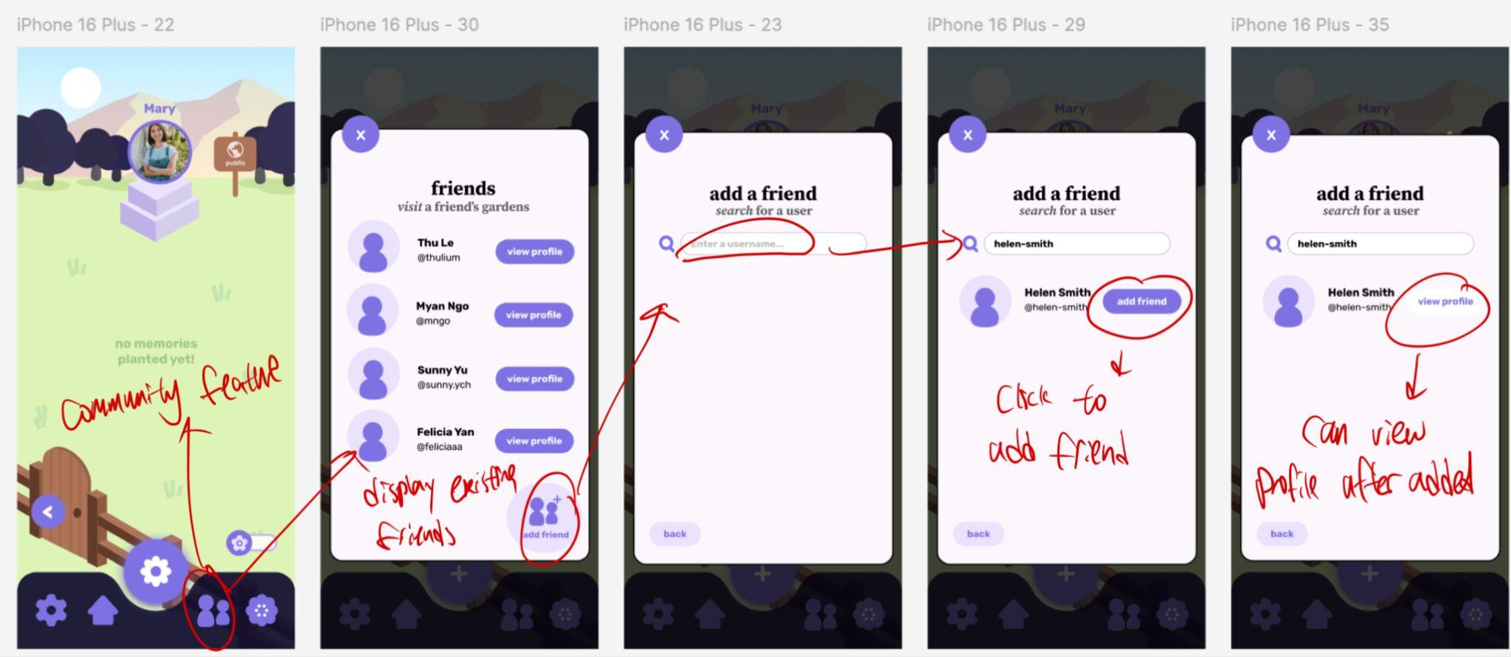
Moderate task: view the gardens of friends
Click the community button to navigate to the friends page
View profiles of friends or add friends
Can access the profile page of the user once added as friends

Slide 25
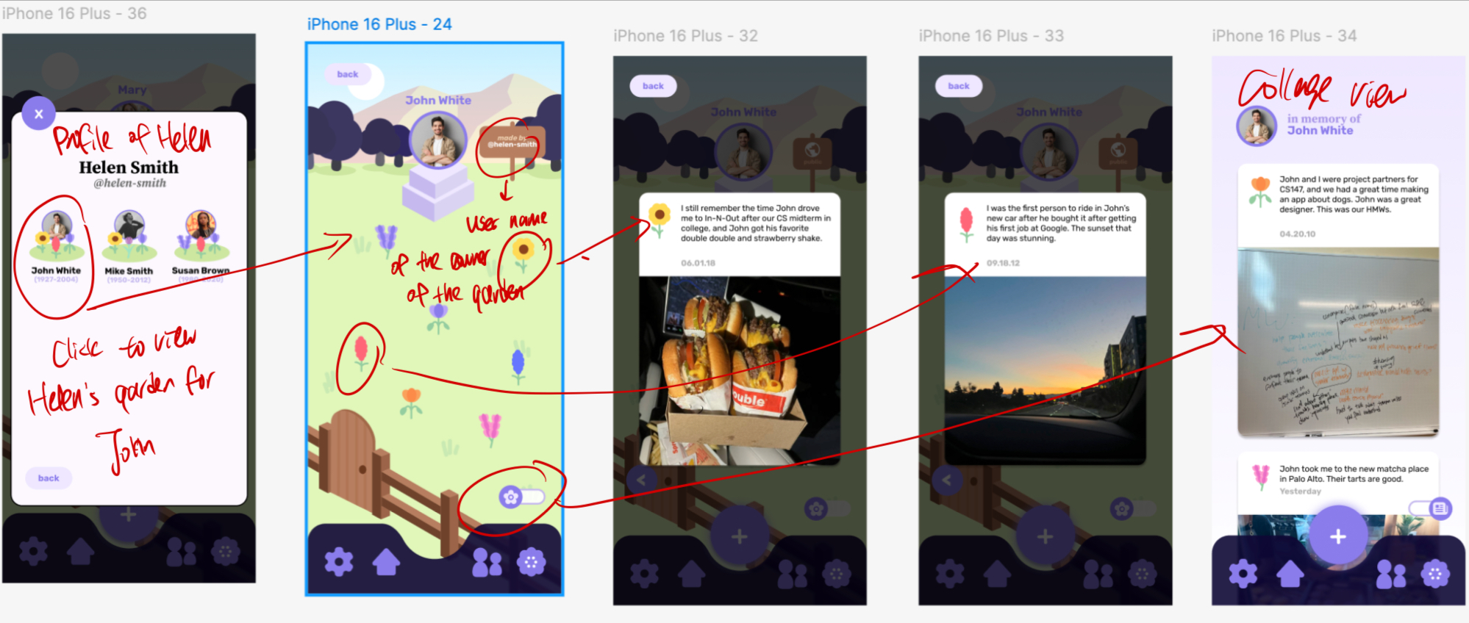
Moderate task: view the gardens of friends
The profile page displays the gardens of a user
Users can click the flower to access individual memories
Collage view displays the memories in chronological order

Slide 26
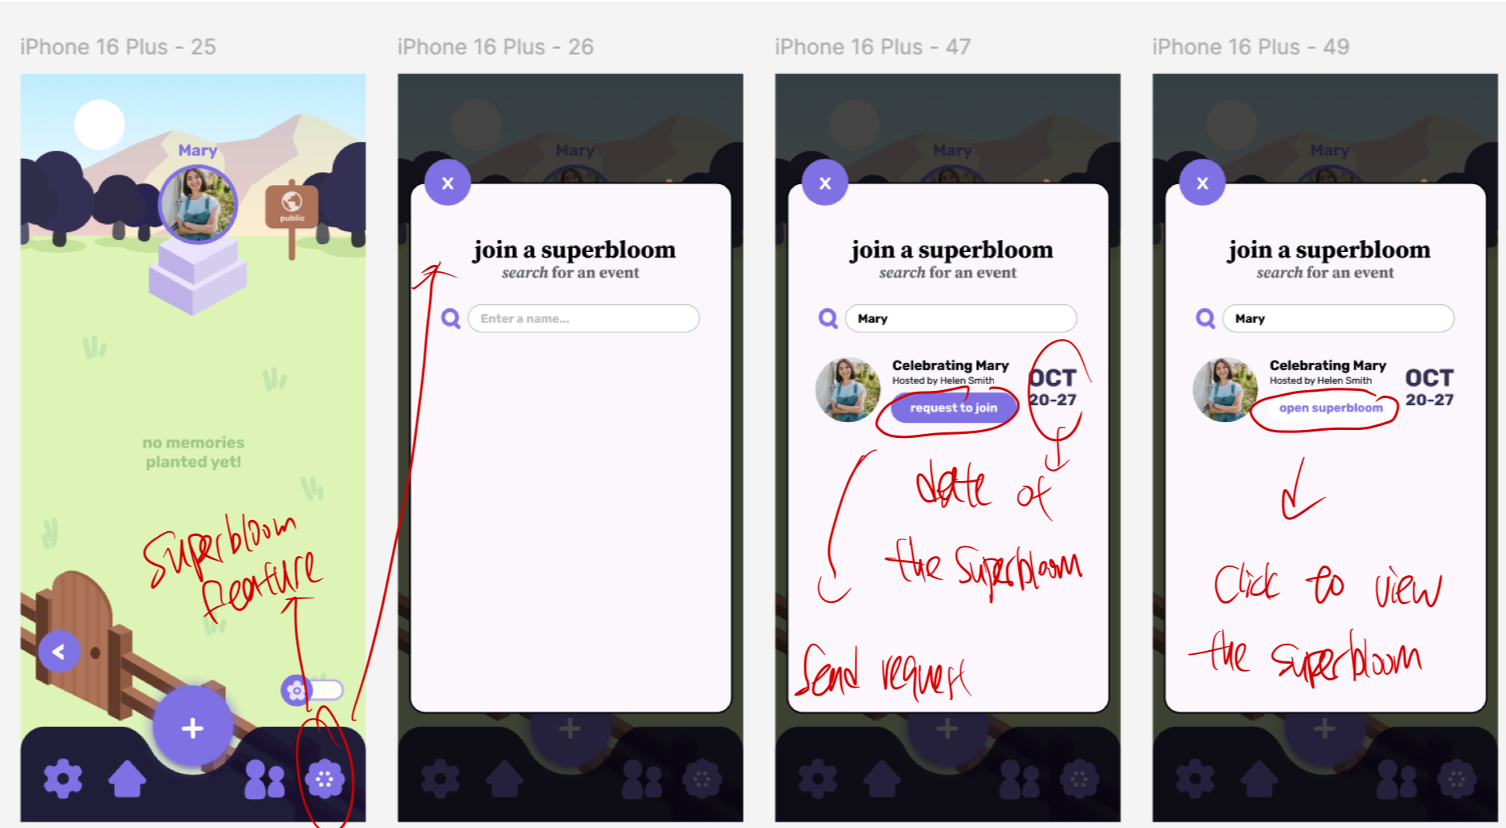
Complex task: join and contribute to superblooms
Search for the event name and request to join the superbloom during a specific time window

Slide 27
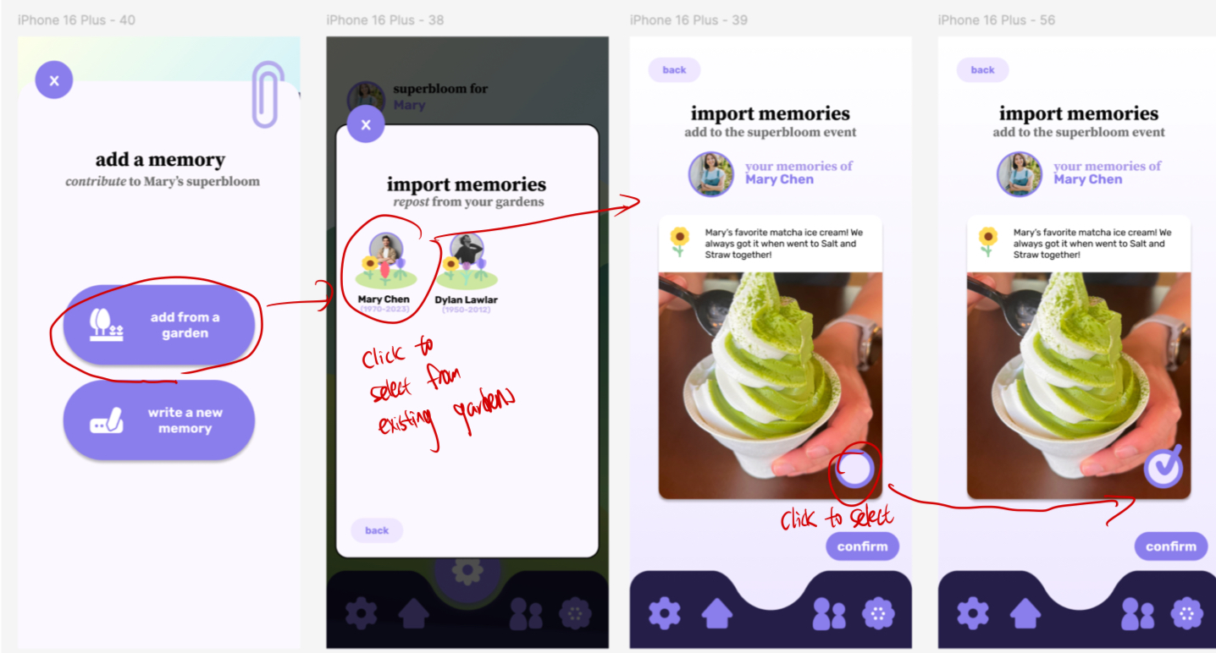
Complex task: join and contribute to superblooms
Select from 2 ways to add memory: add from an existing garden or write a new one
To add from an existing garden, users can pick from their garden which ones to add to the superbloom

Slide 28
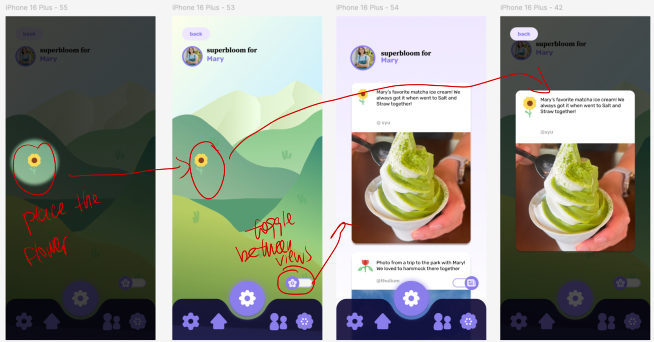
Complex task: join and contribute to superblooms
Similar to placing the flower in the garden, users can tap the flower on a selected location on the screen to place it
The toggle allows users to switch from the superbloom view to the collage view
Users can click the flower to view the memory

Slide 29

Prototype implementation: tools
Pros
Can easily copy and paste common elements without having to redraw
Easy to align elements and items
Environmentally friendly
Can easily bring back erased/previous elements
Cons
Difficult for synchronous collaboration
Time-consuming to work with

Slide 30

Prototype implementation: tools
Pros
Helpful for synchronous collaboration
Prototyping functionality allows for better organization and previewing
Can edit at a very detailed level
Cons
Not very beginner friendly
Requires access to digital devices

Slide 31
Limitations and tradeoffs
Can’t simulate uploading different forms of media (e.g. audio, video, etc.) and how the display for each may differ
Can’t simulate actually placing the flowers
Can’t simulate what happens when there are too many flowers on the screen
Can’t simulate the actual search process

Slide 32
Wizard-of-oz features
The media was automatically uploaded and the actual selection process was omitted
The friend request was instantly approved
After logging in users can directly view “Mary”’s page
The existing memories in Mary’s garden are pre-populated
The existing friends that the user has were pre-populated
The superbloom event was already created

Slide 33
Hard-coded features
The memories
  The memories on Mary’s page
  The memory added
  The memories in the friend’s garden
  The memories in superbloom
Friends
  The friends of the user
Memory upload
  The prompts provided to the user when planting a memory

Slide 34
Appendix

Slide 35
Link to Figma
Dev mode link: https://www.figma.com/design/FyJo3cd4BCsMpRngH9zRBq/superbloom?node-id=0-1&m=dev&t=04ZKnqUb0Gcrqlli-1
Prototype link:
https://www.figma.com/proto/FyJo3cd4BCsMpRngH9zRBq/superbloom?node-id=0-1&t=04ZKnqUb0Gcrqlli-1

Slide 36
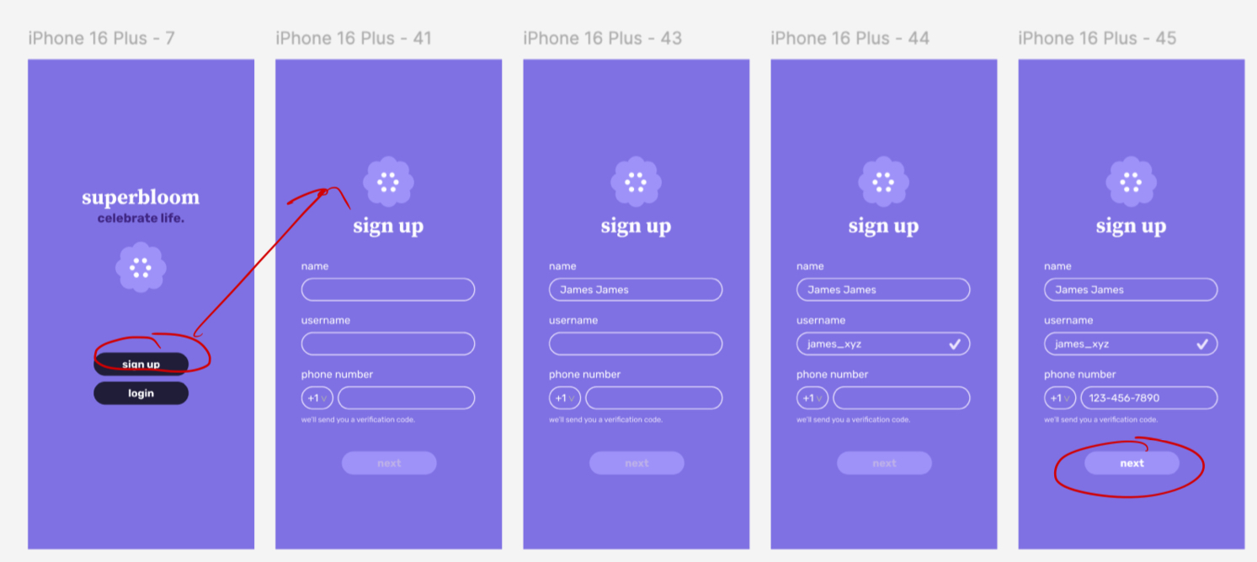
Onboarding task flow

Slide 37
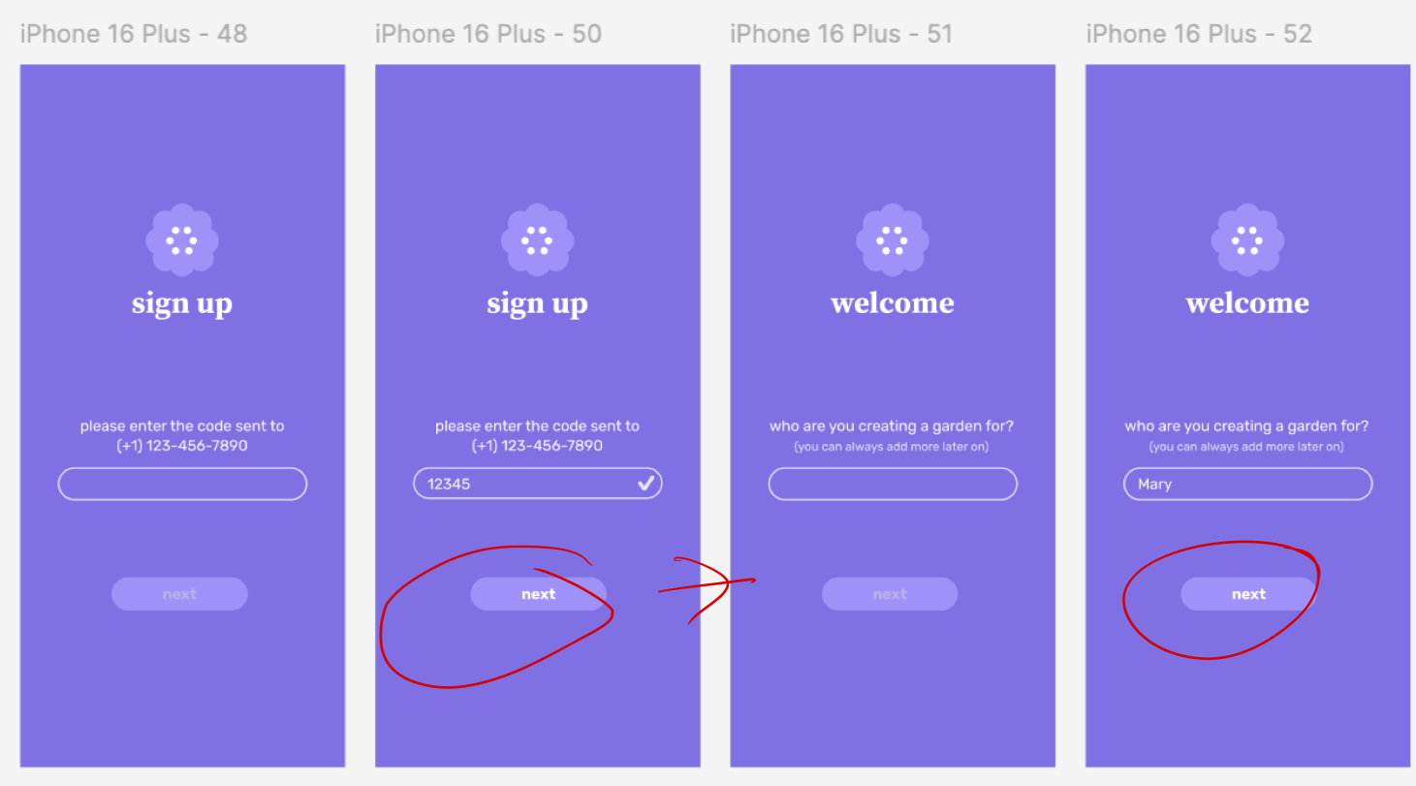
Onboarding task flow

Slide 38
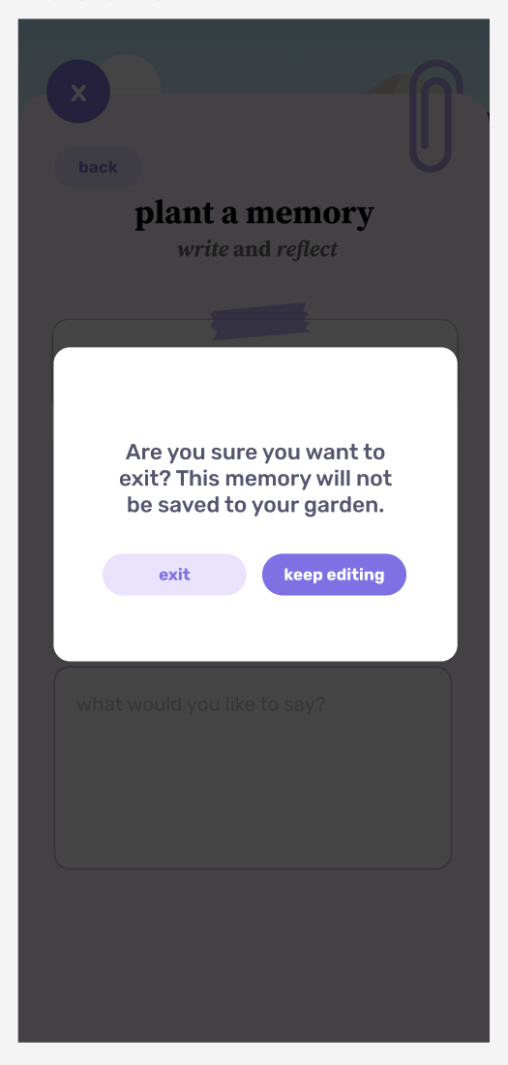
The exit option
Displayed before exiting the page if a memory post is currently in progress

Slide 39
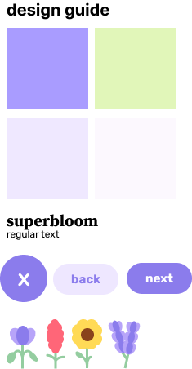
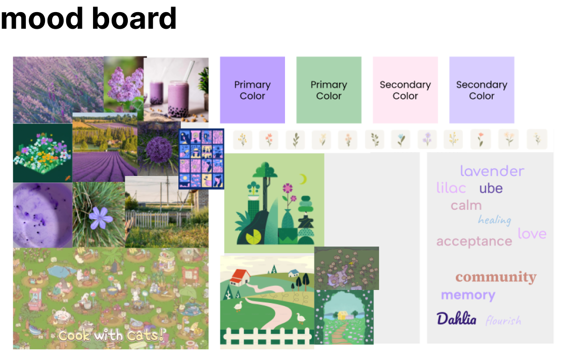
Mood board & design guide

