Slide 1


superbloom
celebrate life
A8: Hi-Fidelity Prototype

Slide 2
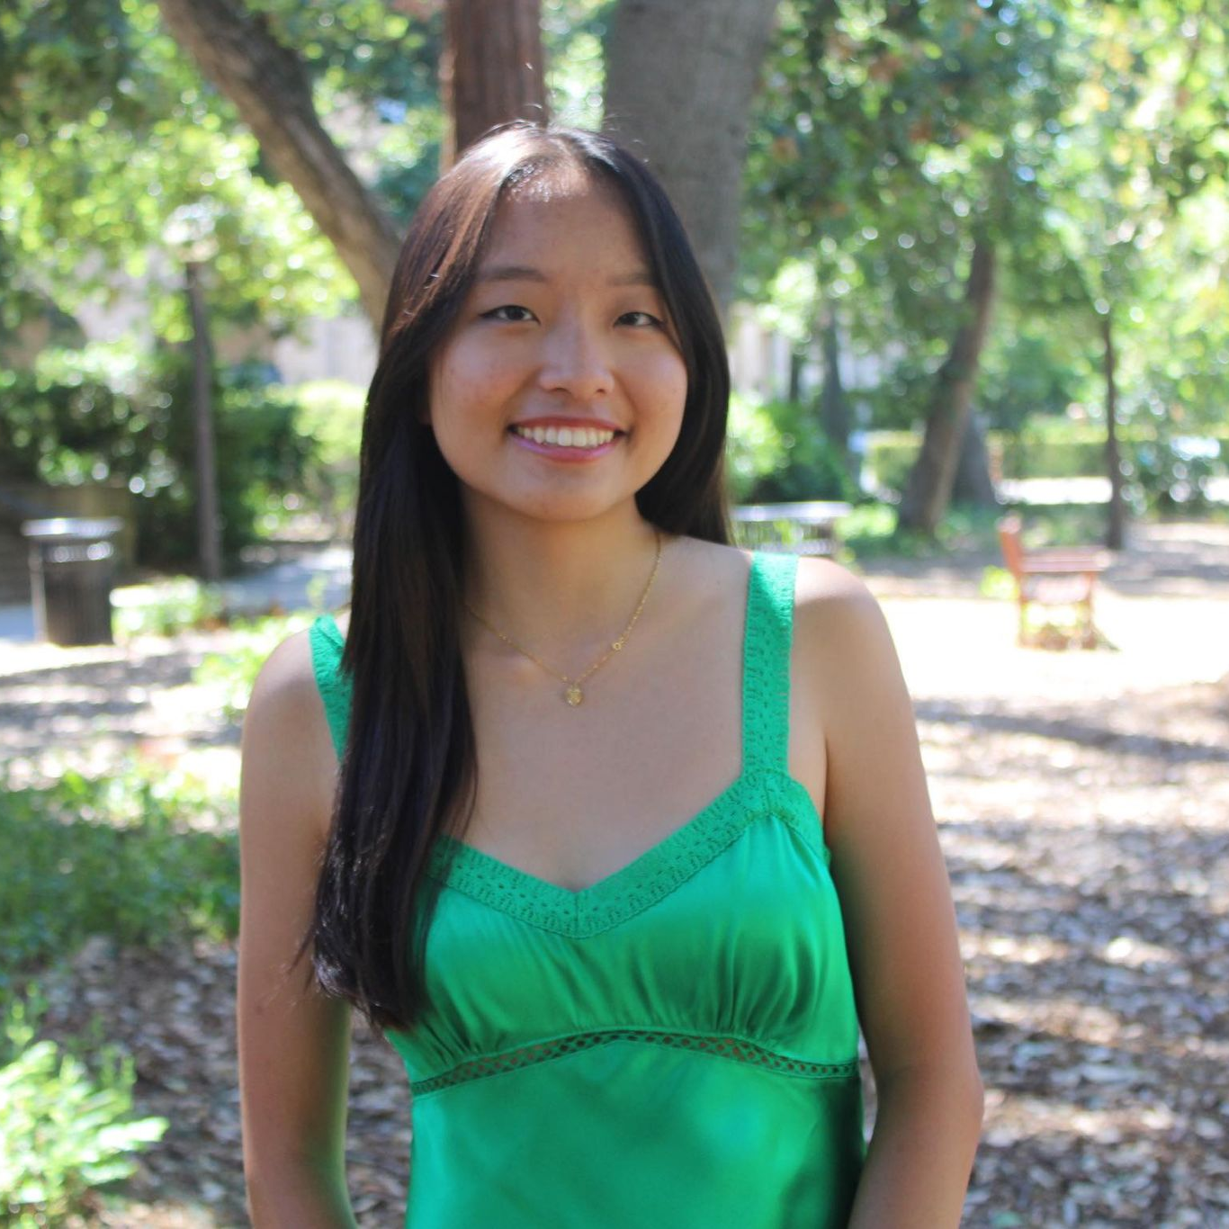
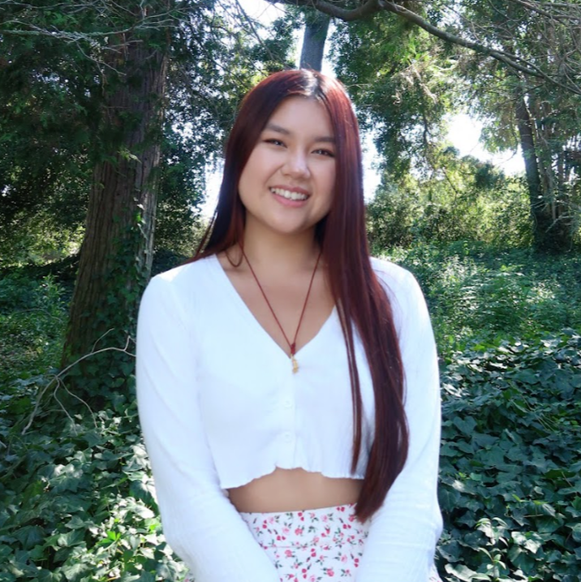

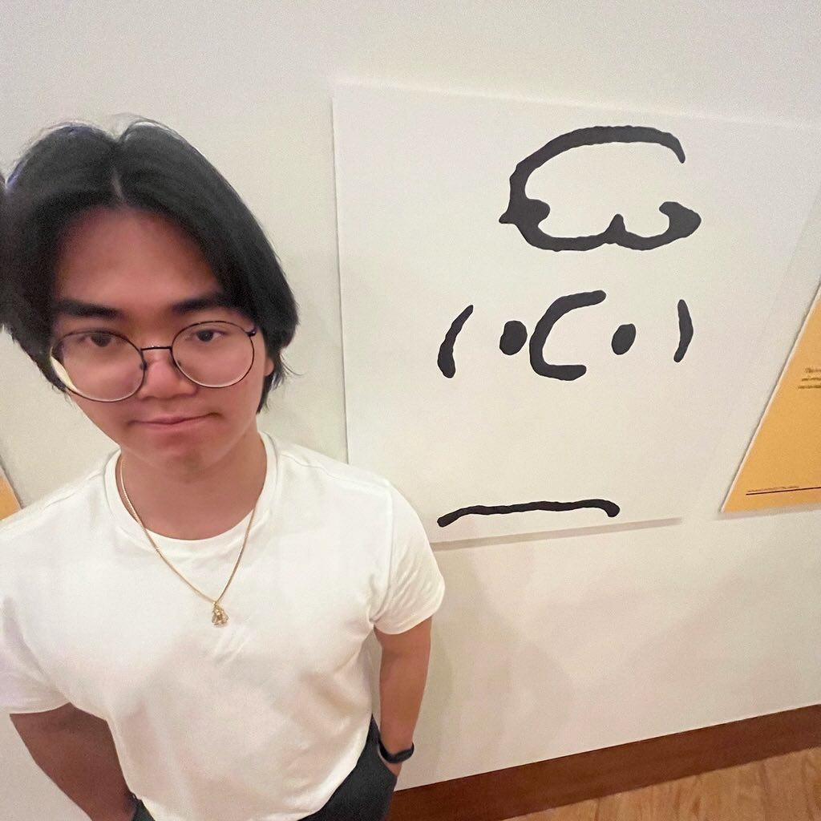
Team Members
Felicia
Myan
Sunny
Thu

Slide 3

Table of Contents
01.
02.
UI Revisions
Heuristic Evaluation Results
03.
04.
Prototype Implementation
High-Fi Prototype

Slide 4

Problem & Solution
Problem
People who have recently lost a loved one often struggle to process their grief and feel isolated.
Solution
superbloom provides a “virtual memorial” space for users to commemorate the loss of loved ones and heal.
Users plant their private and public garden, where each flower is a piece of memory
Users can also see other peoples’ gardens
Users can host superblooms, which are dedicated memorial events that others can collaborate on

Slide 5

Heuristic Evaluation
Heuristic | # Viol. (sev 0) | # Viol. (sev 1) | # Viol. (sev 2) | # Viol. (sev 3) | # Viol. (sev 4) | # Viol. (total)
H1: Visibility of System Status | 0 | 0 | 2 | 3 | 2 | 7
H2: Match b/w System & World | 0 | 4 | 3 | 0 | 0 | 7
H3: User Control & Freedom | 0 | 1 | 3 | 0 | 1 | 5
H4: Consistency & Standards | 0 | 7 | 4 | 3 | 0 | 14
H5: Error Prevention | 0 | 2 | 1 | 3 | 0 | 6
H6: Recognition not Recall | 0 | 4 | 1 | 1 | 1 | 7
H7: Flexibility & Efficiency of Use | 0 | 1 | 9 | 1 | 1 | 12
H8: Aesthetic & Minimalist Design | 0 | 1 | 1 | 1 | 0 | 3
H9: Help Users with Errors | 0 | 0 | 1 | 0 | 0 | 1
H10: Help & Documentation | 0 | 1 | 1 | 0 | 0 | 2
H11: Accessible Design | 0 | 2 | 5 | 1 | 0 | 8
H12. ​​Value Alignment & Inclusion | 0 | 0 | 1 | 0 | 2 | 3
Total Violations | 0 | 23 | 32 | 13 | 7 | 75

Slide 6
Summary of Results
Most-Violated Heuristics
H4: Consistency & Standards
14 violations
Severity 3-4 - 20 violations
Severity 1-2 - 55 violations
H7: Flexibility & Efficiency of Use
12 violations

Slide 7
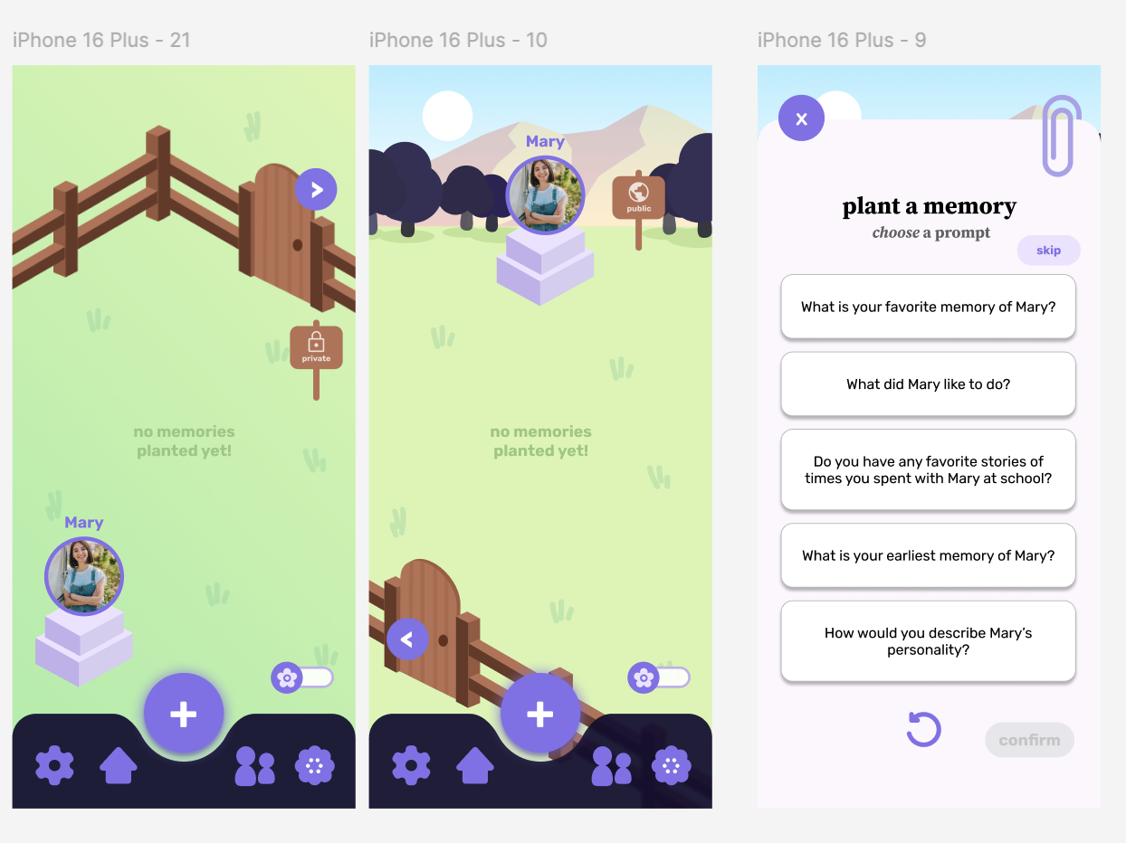
Simple Task (planting memories) Violations
The functions of certain buttons (e.g. toggle) are unclear
inconsistent locations of back buttons
Grayed-out flowers resemble a locked or disabled state, misleading users into thinking they are inaccessible.
Inconsistent button sizes (e.g., "back" and "next" vs. "confirm" and "plant") create visual inconsistency and disrupt the user experience.

Slide 8
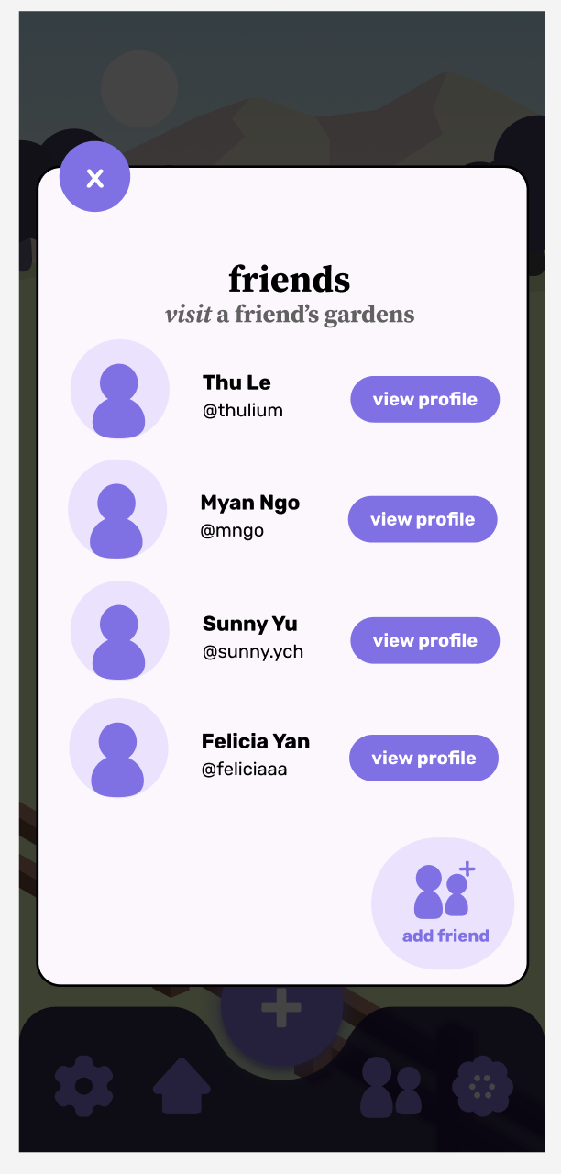
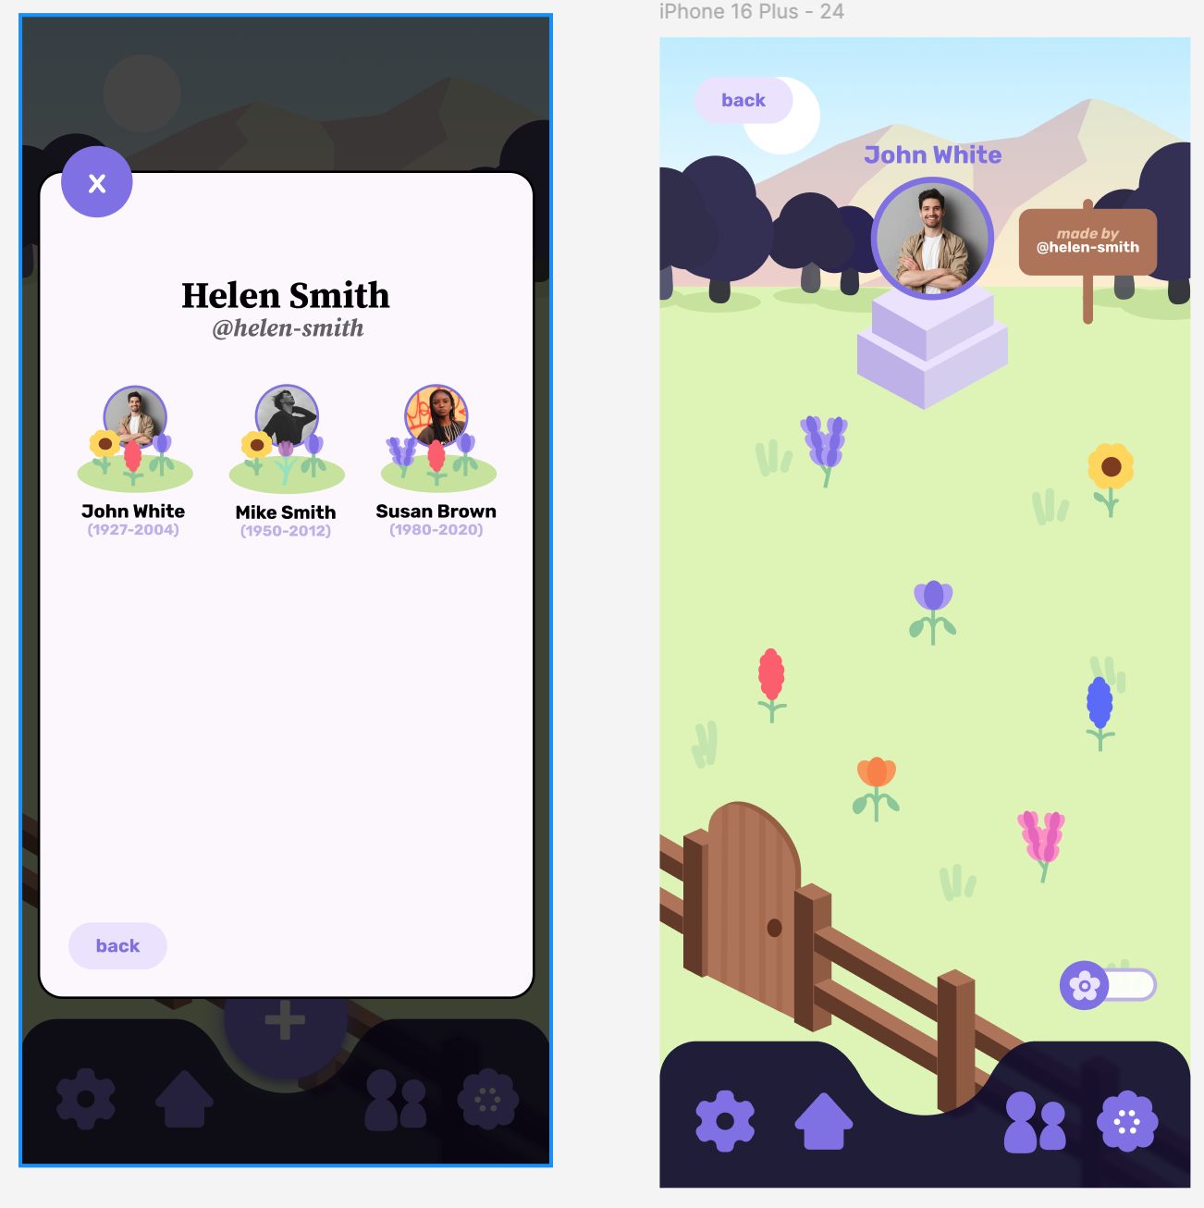
Moderate Task (viewing friends’ gardens) Violations
Color Choice: The purple back button on a blue background lacks contrast
Inconsistent behavior of interactive elements (e.g., clickable doors) across contexts may confuse users
Switching between memorials in a friend's garden requires unnecessary steps, reducing efficiency.
Scrolling through a long list of friends may become time-consuming and difficult to navigate.
Users may struggle to associate flowers with posts in a friend's garden, reducing task efficiency and satisfaction.

Slide 9
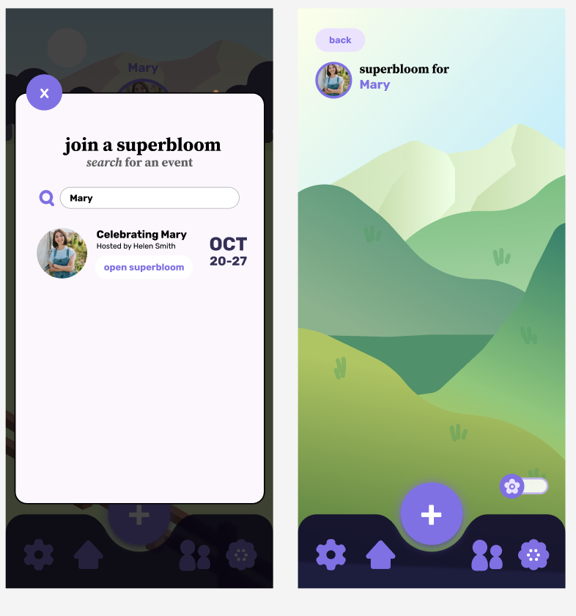
Complex Task (superbloom) Violations
"confirm" and "plant" are inconsistent
Lack of documentation for features like superbloom may confuse users about its purpose or functionality.
Inconsistencies in displayed information (e.g., post dates visible in gardens but not in superblooms) create confusion.
Inability to deselect an image without the back button restricts user control and reduces task flexibility.
Mismatched cues (e.g., associating events with names rather than more intuitive inputs) make tasks harder to complete and increase navigation time.

Slide 10
High Severity Violations
Simple Task: cannot edit or change a post once it is planted as a memory
Complex Task: no page for joined superblooms; no way to create a superbloom; no way to access created superblooms
Other Violations: triggering tombstone display violates values in design; no guard against triggers

Slide 11
UI Design
Revisions

Slide 12
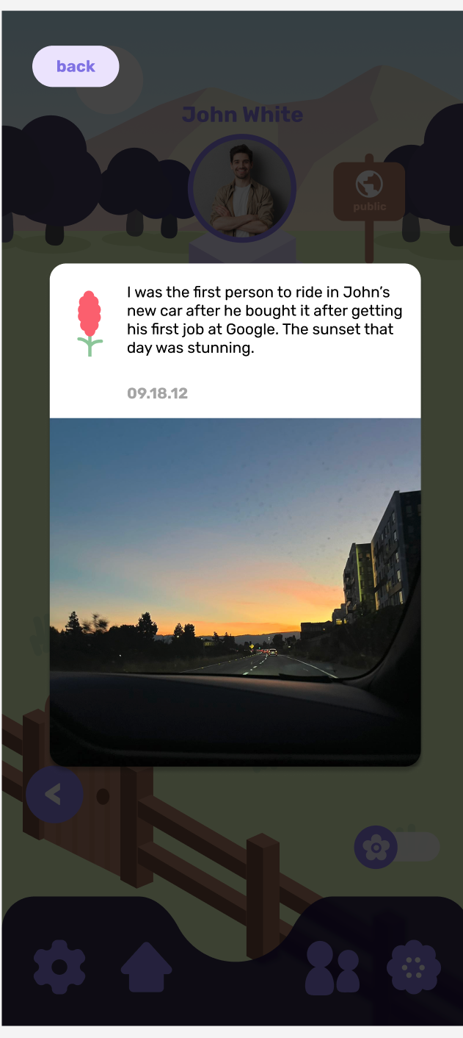
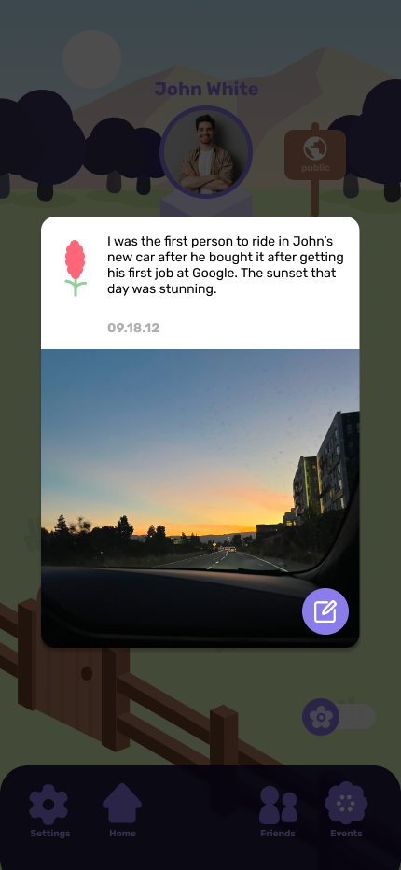
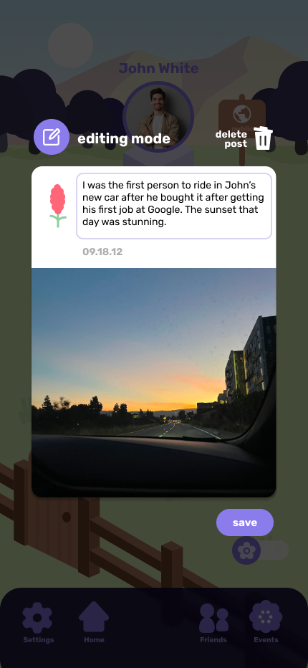
Severity 4 - Editability of posts
H3 (User control and freedom)
Add feature to edit post after it has been made for greater user control
  Allow editing caption or deleting post
before
after

Slide 13
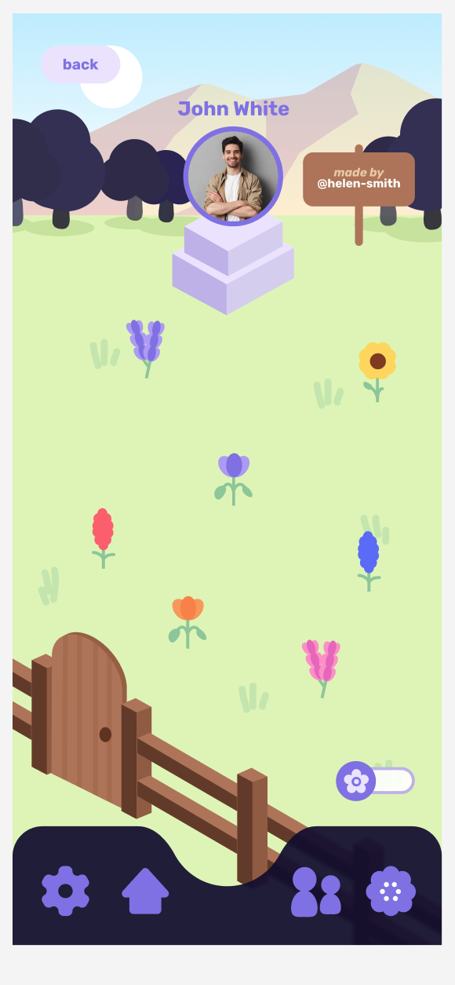
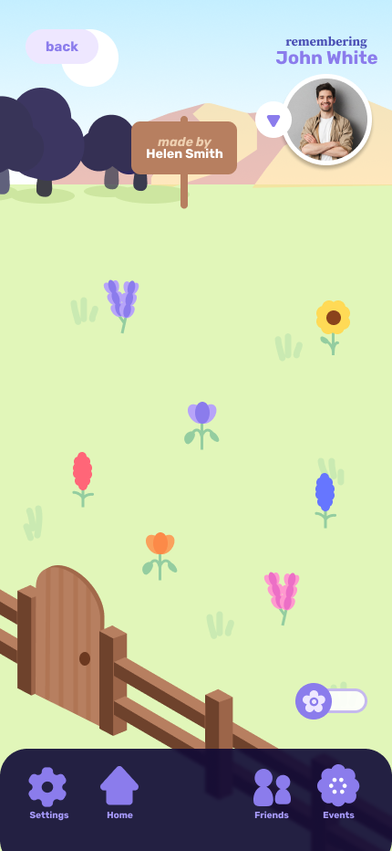
Severity 4 - Design sensitivity
H12 (Value alignment and inclusion)
Removed potentially insensitive or triggering tombstone/cemetery visual, more clearly a garden
before
after

Slide 14
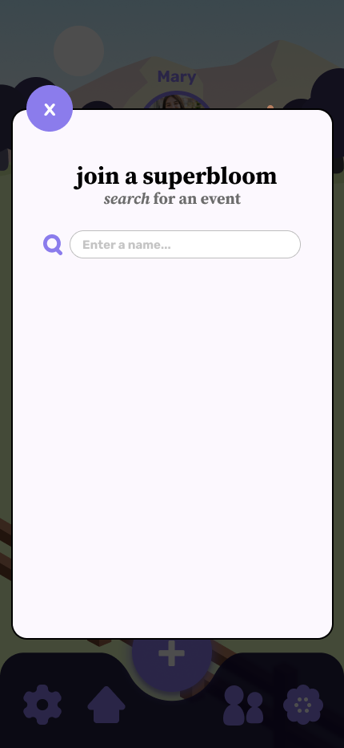
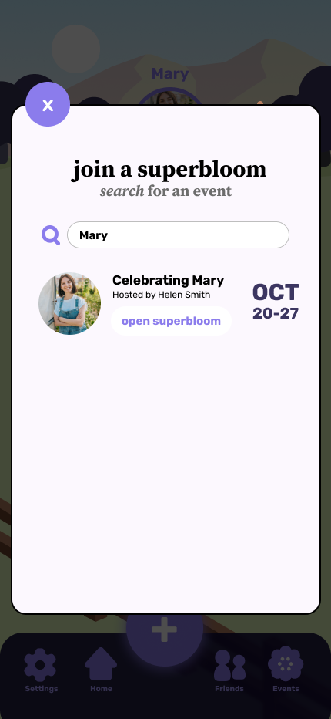
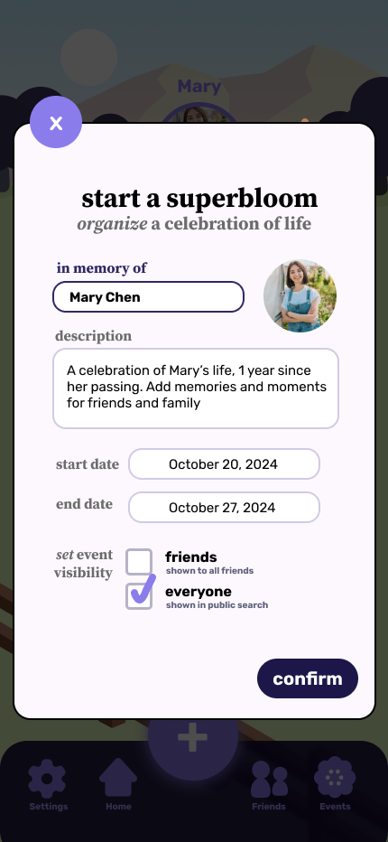

Severity 4 - Starting and managing superblooms
H1 (Visibility of system status), H6 (Recognition not recall), H7 (Flexibility/efficiency of use)
Show superblooms you’ve joined and created in the “Superblooms” page
Added form page for starting a superbloom event
before
after

Slide 15
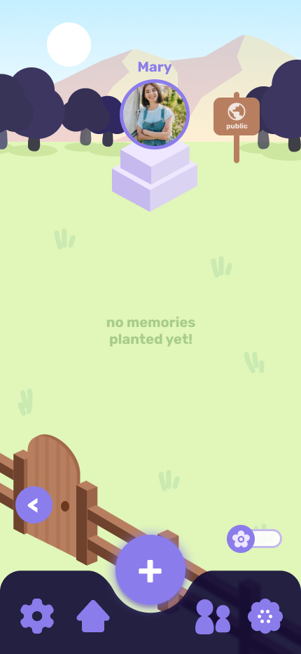
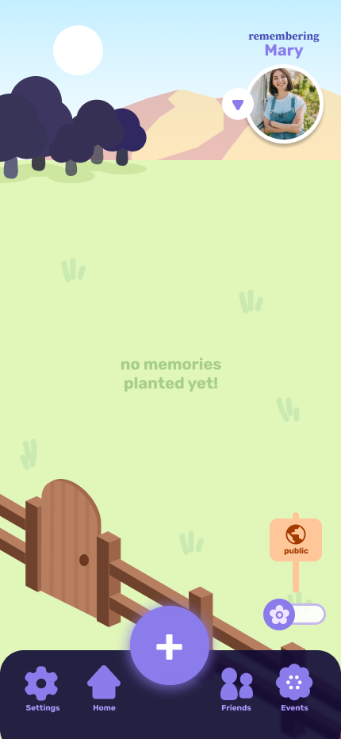
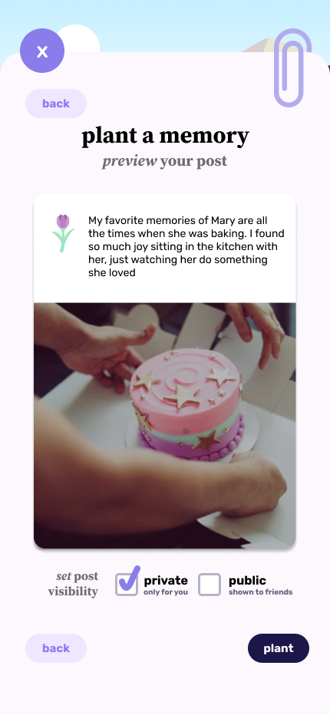
Severity 3 - Managing public vs. private posts
H5 (Error prevention)
Use the wooden sign as the toggle between gardens for clarity and efficiency
  Keep element in place to reduce confusion
Allow user to pick post visibility before posting
before
after

Slide 16
Prototype
Implementation Status

Slide 17





Components
Tools/Frameworks
Wizard of Oz Items
Hard-Coded Aspects
React Native
React Navigation through Expo Router
Supabase (database)
Figma (design)
Github (version control)
Users are magically stored in the backend and can be retrieved through search
Friend-adding process
Each name is linked to the garden
User’s friends
Gardens in Helen Smith’s profile
Items in the garden for John

Slide 18
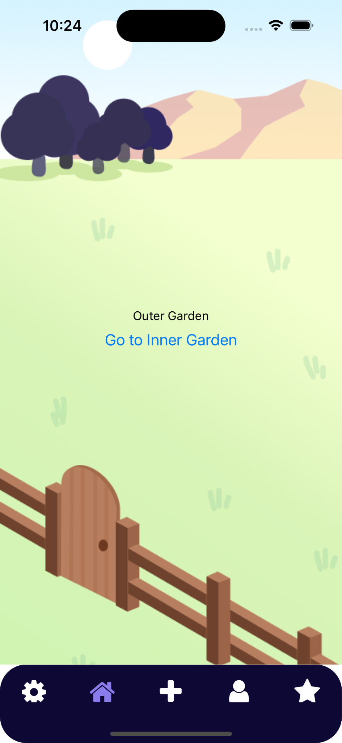
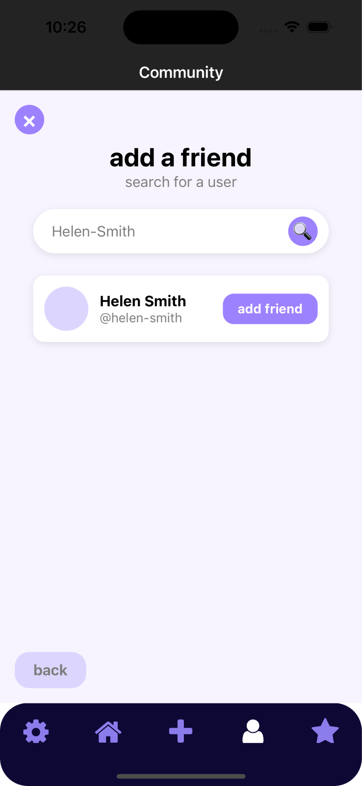
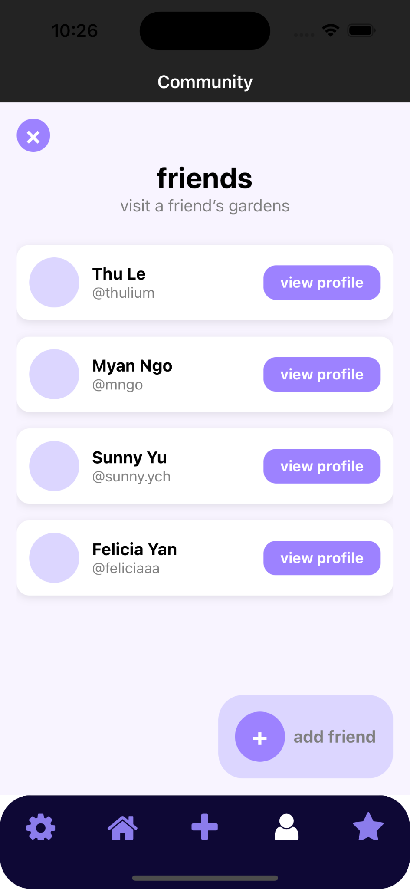
Implemented Features
community page (moderate task)
basic home page
navigation tab bar
internal navigation set up for all pages

Slide 19
Unimplemented Features
Simple Task
SupaBase (Backend)
Complex Task
Search superbloom
Create superbloom
Upload memories to a superbloom and dynamically update the garden UI
Populate SupaBase with some existing posts
Add logic to fetch data from SupaBase and update new data to SupaBase
Populate SupaBase with the user’s friends
For each friend, put the gardens on a SupaBase dataset
Refine the search engine to search from SupaBase
Planting a flower (upload memory)
Save memory to SupaBase
Render memory as a flower in garden and post in collage

Slide 20
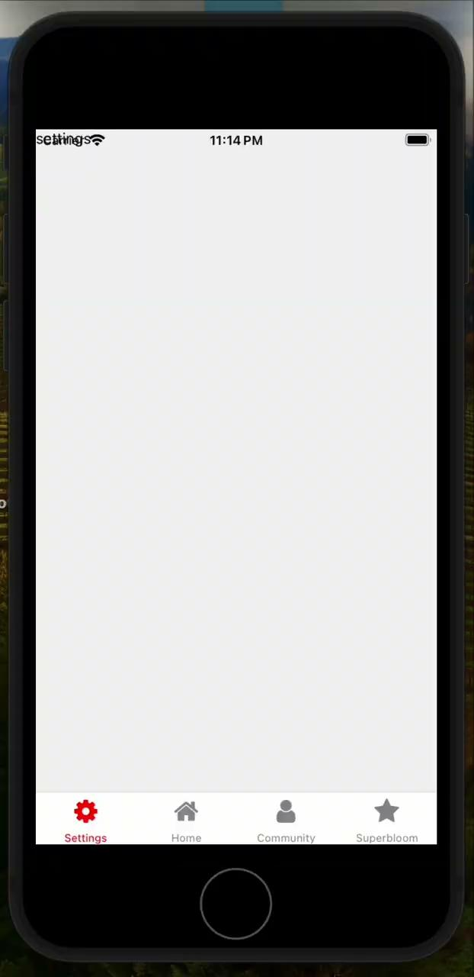
Demo Video

Slide 21
Thank you!
Questions?

Slide 22
Appendix

Slide 23
Rationale for Level 3 + 4 Violations Not Addressed
Including prompt in post - prompts are optional and are intended for generating ideas and thoughts, less so to be part of the memories people upload and write about
Adding friend interactions (likes/comments) - want to reduce social pressure to make posts that will get positive feedback and reactions, promote authenticity and sharing openly without shame

Slide 24
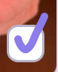

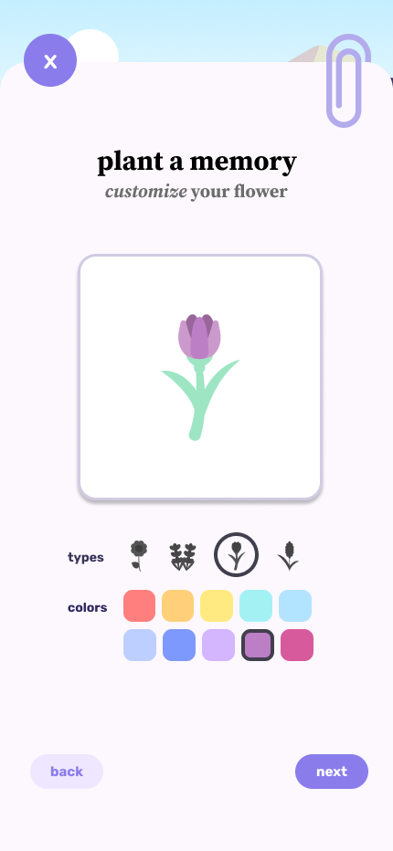
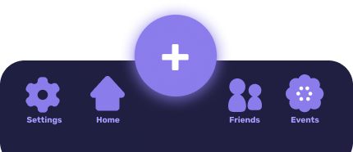
Level 1 + 2 UI Revisions
Check buttons changed from circles to squares to reduce confusion
Show real name instead of username for better recognition
Separate steps to plant a memory into more pages to eliminate need to scroll
New nav bar with less confusing button for adding a memory
  Flower icon looked like a cog
Added descriptive text for more clarity

Slide 25
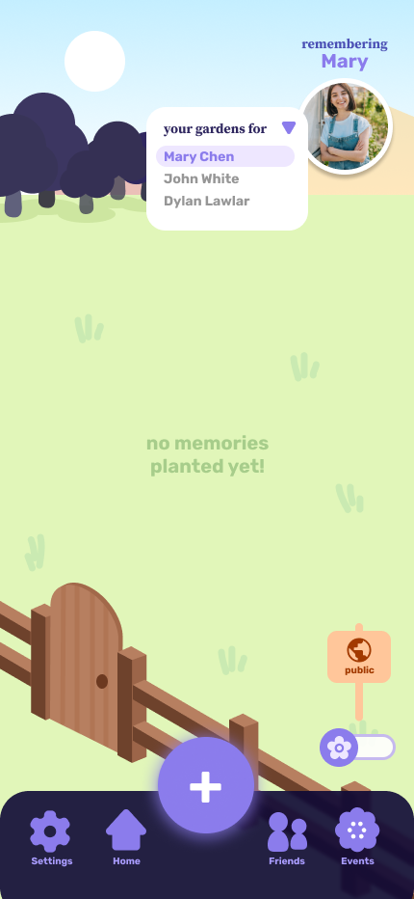
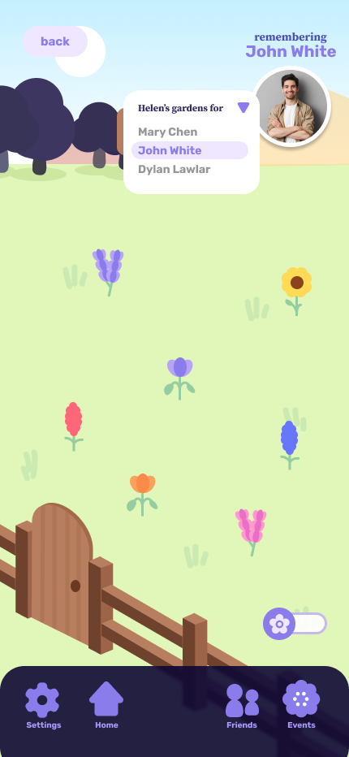
Severity 2 - Moving between gardens of the same user
H7 (Flexibility & Efficiency of Use)
Added dropdown menu to switch between gardens for the same user
  Used for both looking through your own gardens and when you’re visiting the gardens of your friends

Slide 26
Other Minor UI Revisions
Icon redesigns for usability (shuffle)
Dark accent color for final step button for exiting a flow (plant a memory, confirm a memory import, start a superboom)
  Greater distinction from buttons that take you to another step to complete
Increased text sizes for accessibility
Clicking out of pop-ups by clicking outside

