Slide 1




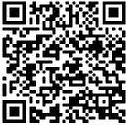


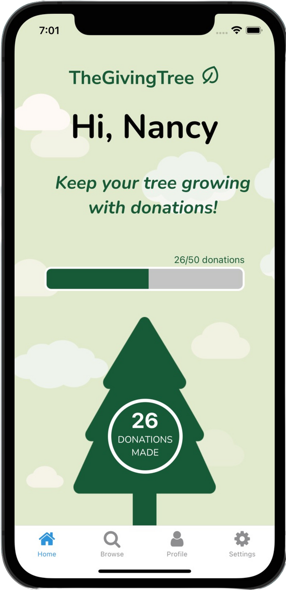
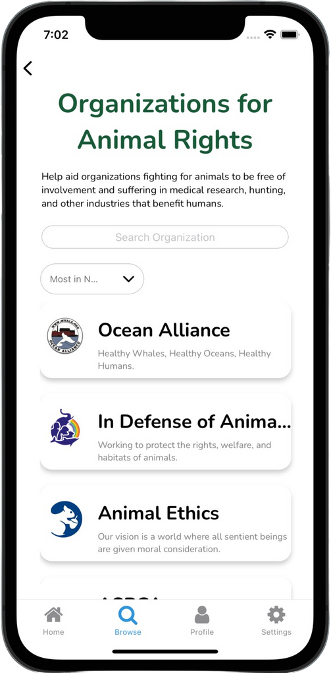
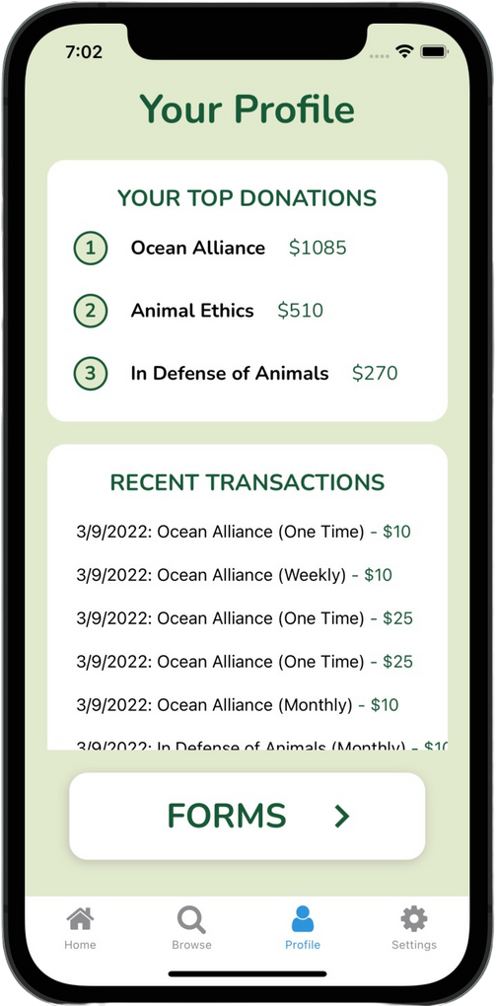










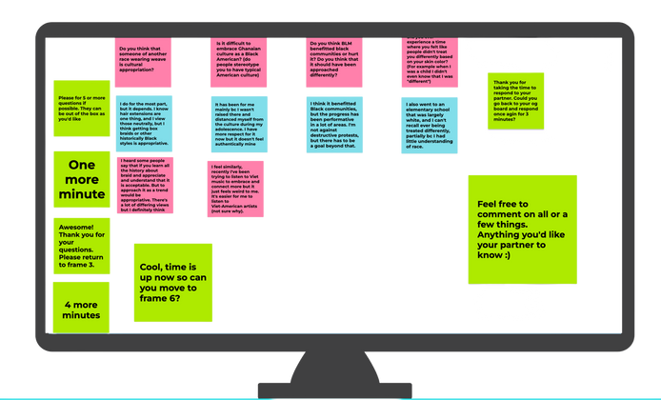
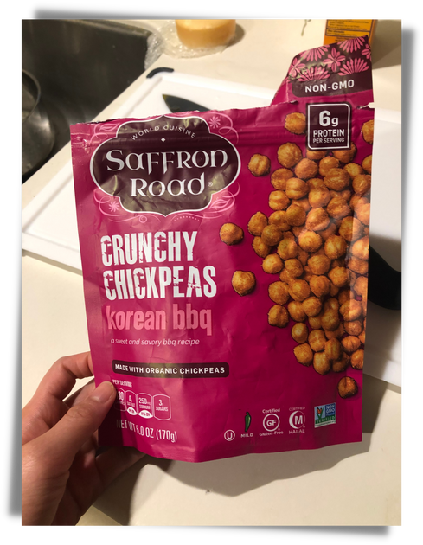
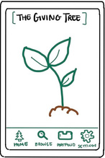
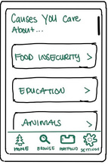
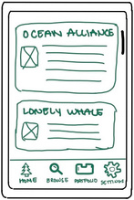
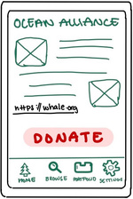
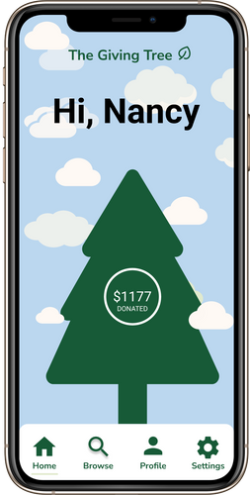
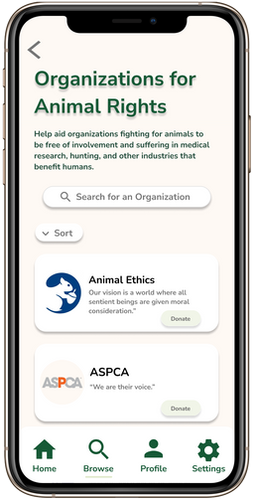
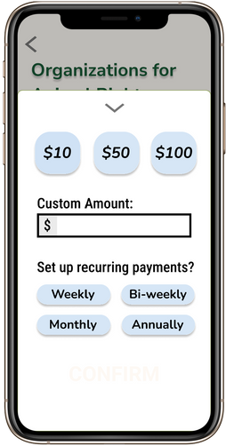
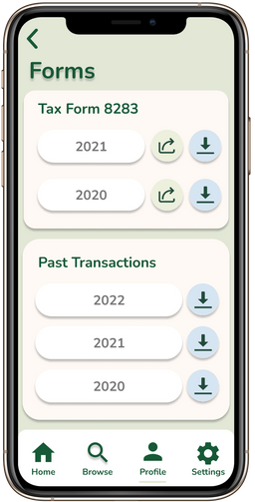




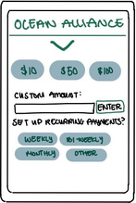
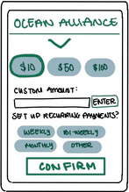
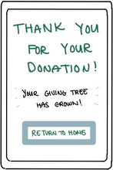
Problem
Learn More:
Finding which what charities are the most in need is extremely difficult for the average donor.
Make your donations go further
Solution
Automatically identifies high-impact nonprofits that users can donate to and helps manage donations long-term.
47
DONATIONS
MADE
Find non-profits
View your progress
Retrieve Forms
The Process:
The Process:
Needfinding
Testing
Low-fi
Medium-fi
Raena
Amber
Susan
36, Equity Team at Facebook
23, Delivery Driver for a Cannabis Dispensary
mid 50s, Software Engineer at Hitachi
Nancy Hoang, Fernanda Kramer, Britney Tran, Lainey Wang | https://hci.stanford.edu/courses/cs147/2022/wi/projects/SystemicJusticeAndEquity/theGivingTree/ | CS147 Winter 2022
Nancy Hoang, Fernanda Kramer, Britney Tran, Lainey Wang | https://web.stanford.edu/class/cs147/projects/SystemicJusticeAndEquity/theGivingTree/ | CS147 Winter 2022

